Slide 1
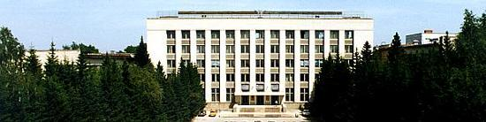
BINP
Cryogenic temperature for SPPC
Alexander Krasnov
Budker Institute of Nuclear Physics (BINP), Novosibirsk, Russia
E-mail address: a.a.krasnov@inp.nsk.su
Workshop on High Energy Circular Electron Positron Collider, November 6-8, IHEP, Beijing

Slide 2

BINP
Contents
Vacuum requirements
Role of surface and radiation
Cold beam pipe. Hydrogen accumulation. PSD
Equations for residual dynamic gas density prediction
CB and BS temperatures
FCC BS new proposal
NEG coating
Solution with NEG application
Activation, surface impedance
Summery

Slide 3
Vacuum requirements
BINP
LHC arc vacuum upper limit:
  Life time limit due to nuclear scattering ~ 100 h
  n ~ 10⁹ H₂/cm³
  ~ 80 mW/m heat load in the cold mass due to proton scattering (two beams!)
  - What is the heat load limit for the 12T (24T) HTS magnets???
Gas | Total cross-section [mb] | Deansity [cm⁻³] for 100h
H₂ | 100 | 1·10⁹
He | 126 | 8·10⁸
CH₄ | 540 | 1.9·10⁸
H₂O | 540 | 1.9·10⁸
CO | 780 | 1.3·10⁸
CO₂ | 1220 | 0.8·10⁸

Slide 4
BINP
Surface
Metallic surface contains 10 ÷ 100 ML (1 ML ≈ 10¹⁵ cm⁻² ) of
Chemically bound: MxOy, Mx(OH)y, Mx(HOC₃)y, carbon clusters
Physically adsorbed: H₂O, organics
Example: Surface of a tube with D=5 cm contains on 10⁷ ÷ 10⁸ times more molecules than ones inside the tube in gas phase at density 10⁹ cm⁻³ !
Radiation can provoke dissociation of the molecules which causes desorption of:
H₂ - most critical for cryogenic beam pipe because H₂ can re-desorb on surface with very low binding energy
CO, CO₂
Saturated hydrocarbons CxHy (due to catalytic reactions on surface)

Slide 5

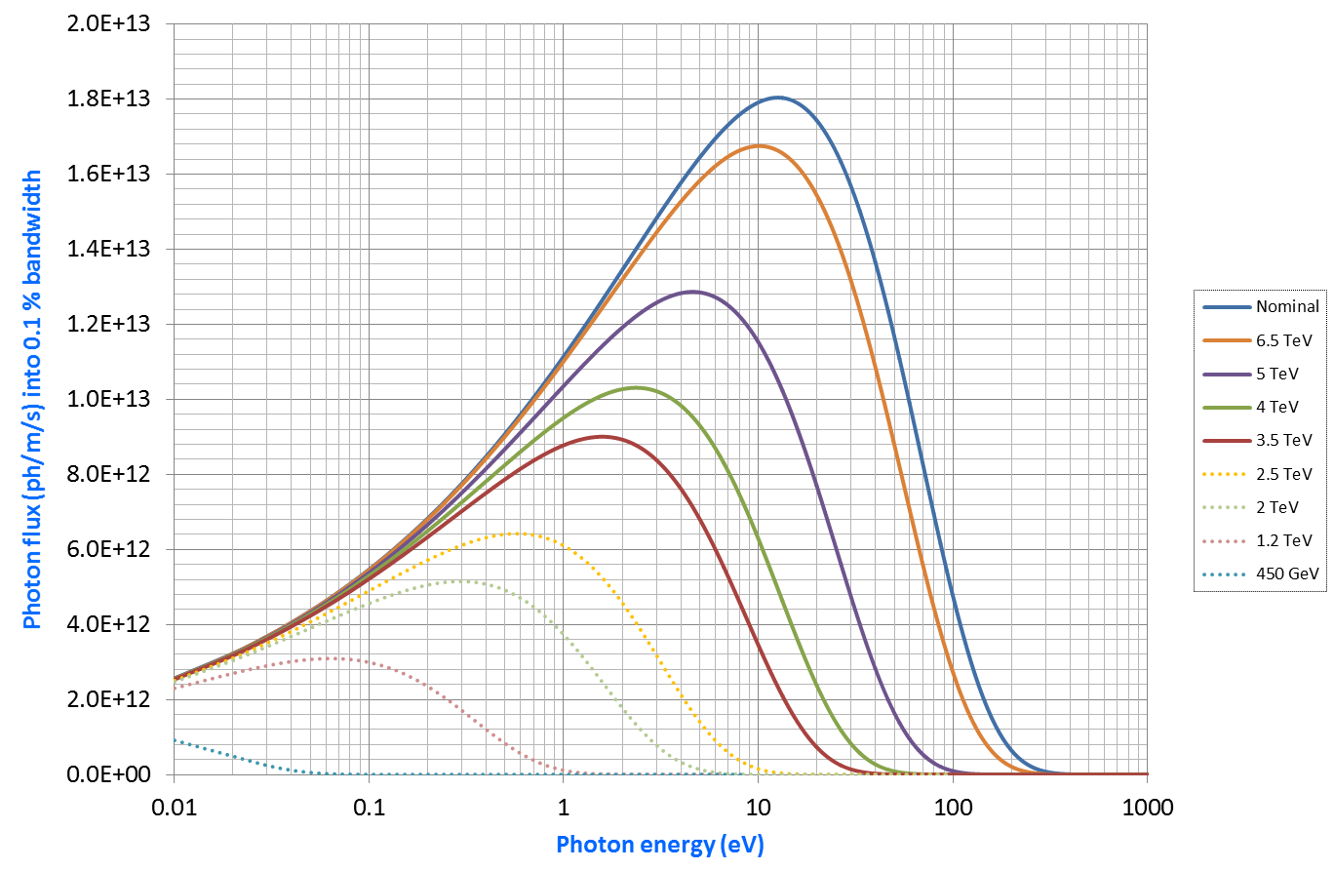
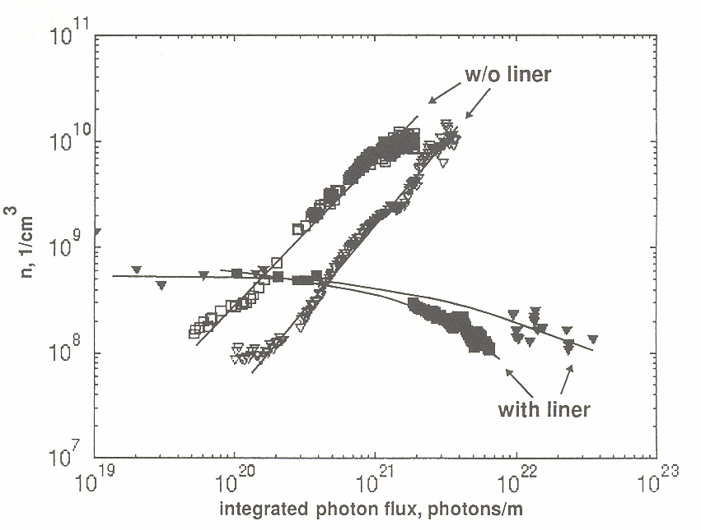
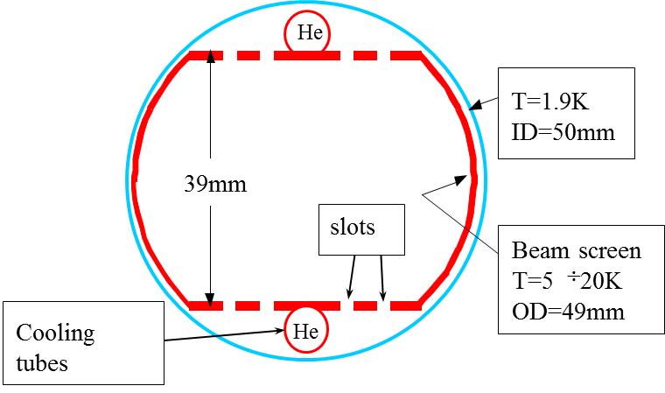
Dynamic density of hydrogen in cold pipe in presence of SR
BINP
LHC SR spectra
Experiments at BINP (25 years ago!) in collaboration with SSC (20 TeV per beam) and CERN vacuum groups
100 h

Slide 6
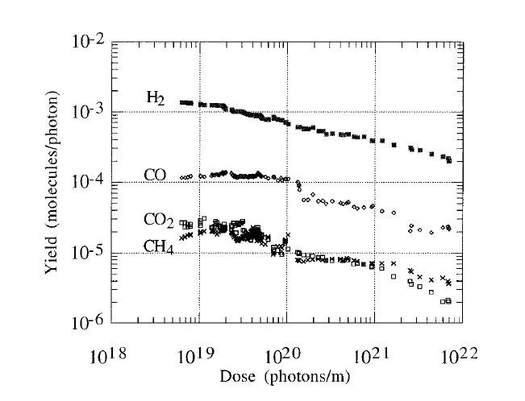
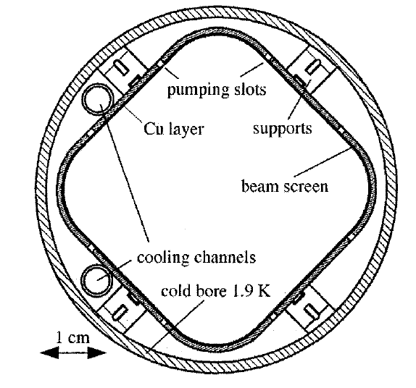
PSD
BINP
Experiments with BS prototype at BINP
(JVSTA-A14-4-1996-p2618)
BS temperature 77K, Ec=45 eV

Slide 7
Phenomena in cold beam pipe
BINP
Cross-section of arc LHC beam pipe in dipoles
Screens against e⁻
Molecular physisorption
onto cryogenic surfaces
(weak binding energy)
re-cycling
Electron Cloud
CB T=1.9K
e⁻
ID=50mm
Saw tooth!
γ
p⁺
γ_{d}
a_{i} - surface density of phisisorbed molecules
l – perimeter of the beam pipe cross-section
γ_{d}
e⁻
e⁻_{ph}
BS T=5 ÷ 20K
- Sticking probability
OD=49mm
Cooling tubes
Slots
-Equilibrium density
- fluxes of photons, electrons and ions correspondingly
- primary desorption yields at irradiation by photons, electrons and ions correspondingly
- secondary desorption yield (re-cycling)
7

Slide 8
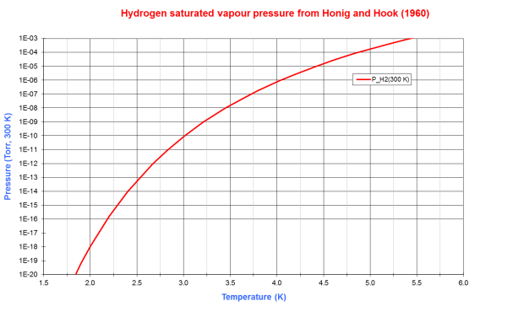
BINP
Increasing temperature of CB
n=1E9 1/cm³
Tmax=3.3K

Slide 9
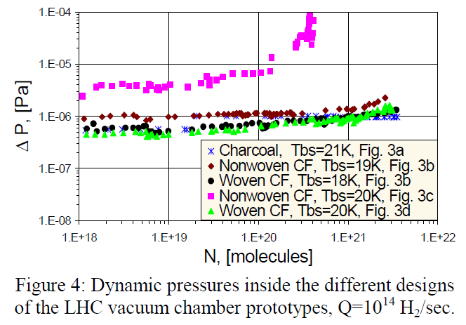
Cryosorber connected to BS in LHC LSS (Tcb=4.5K)
BINP
Possible solution for SPPC: connect a cryosorber to CB!
But how?
During Superconducting Magnet assembly?

Slide 10
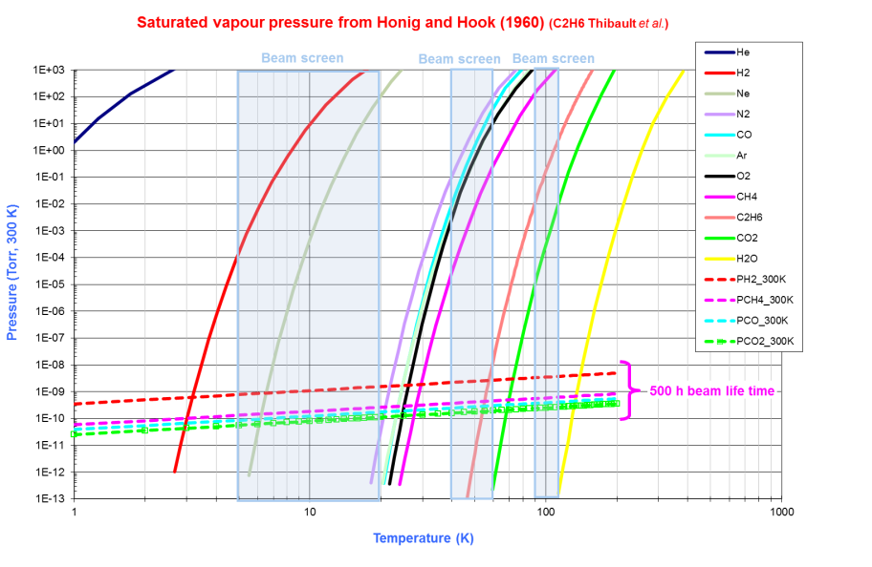
BINP
BS temperature
What about CO, CO2 and CH4 ?
Variation of BS temperature should not provoke a pressure rise!
M. Angelucci, R. Cimino, WP4 EuroCircol meeting, Geneva, 9th October 2017

Slide 11
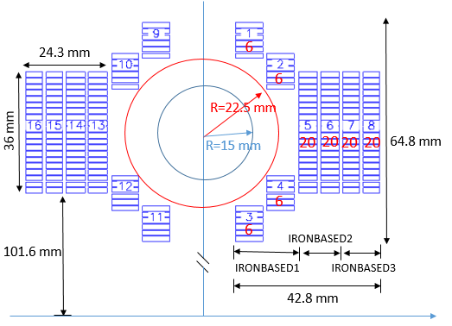
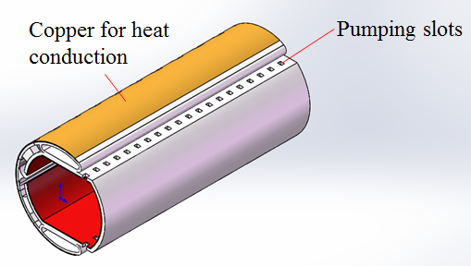
SPPC cold beam pipe
Current approach
BINP
The practically same solution under consideration at CERN.
Disadvantages:
Very complex
Needs large space for cooling and SR absorption

Slide 13
BINP
BS new proposal
WP4 EuroCircol meeting, Geneva, 9th October 2017
simplified design from production point of view
does not need precise beam tuning

Slide 14
BINP
Investigation of TiZrV.
During activation part of molecules evaporate but most part solve (diffuse) in bulk of the material. Rest number of impurities on surface is less than one monolayer.
Effect of activation. Photon flax 4Е16 ph/m/s

Slide 15
Experiment with saturated NEG
BINP
P_{end}
P_{c}
P_{end}
L=150 cm, d=2.5 cm
CO
CO
-L/2
0
L/2
σ=0, s=s_{m}
SR stimulates diffusion of molecules into NEG film!
– prolongation of lifetime!
- No re-cycling!

Slide 16
NEG at low temperature
BINP
H2 dynamic pressure rise at presence of SR flux 4·10¹⁶ ph/s versus temperature
H2 sticking probability versus temperature

Slide 17
SPPC arc beam pipe
Main idea: separation beam pipe from CB of the magnet
BINP
Cooling tubes
Insulating vacuum
Mandatory:
NEG coating for pumping and EC mitigation (activated NEG has low (?) SEY)
Heater and thermo-insulation (needs less than 1mm gap) between beam pipe and CB (to do NEG activation at 220 C)
Cooling: LN₂ (undercooled, 10 atmosphere(?))
Main advantages: no connections between He vessels/pipes and beam vacuum!

Slide 18
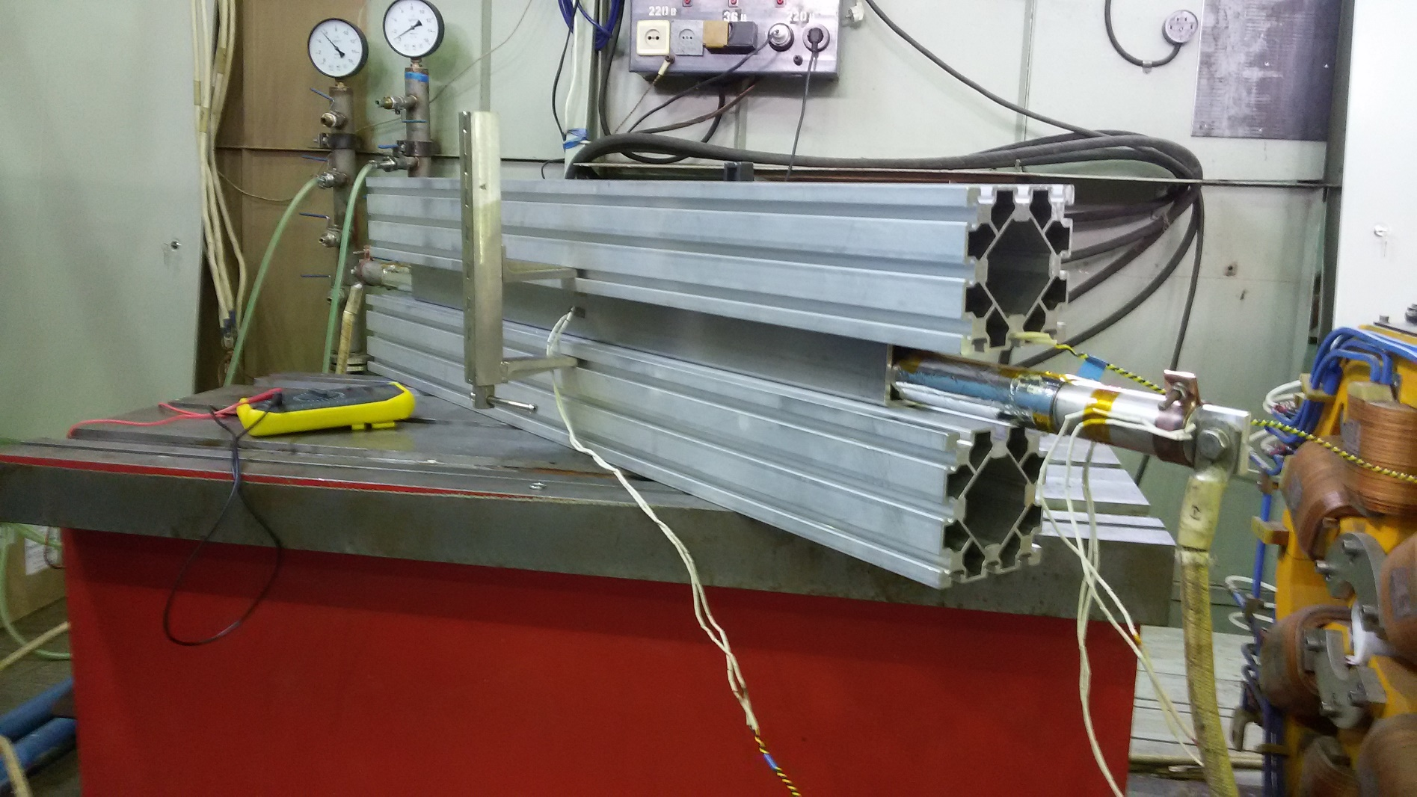
NEG activation inside CB
(CB at RT)
BINP
Simple experiment
Tube OD40. Thermo-insulation 1mm thickness
(6 layers of Kopton and aluminum foil).
Temperature inside 220C reached at P=250 W/m
There are materials with thermal conductivity less than 0,005 W/K/m
P<150 W/m

Slide 19
BINP
NEG surface impedance
Example:
Roughly, NEG specific electrical conductivity 1E-6 Ohm*m
Skin depth at 10 GHz is
It means that 1 micrometer NEG film will not influence on surface impedance at frequencies up to 30 GHz (1cm wavelength)

Slide 20
Summery
There are two solutions
BINP
LHC style
An absorber has to be connected to CB if its temperature > 3,3K
Possible He leak into Beam Vacuum because many weld connections in He system
A coating or laser treatment is needed to suppress EC (or long conditioning)
A conditioning is necessary due to PSD, ESD and recycling
Insulated Beam Vacuum
CB temperature does not matter
The use maximum horizontal aperture!
- There are No direct connection between He cooling system
NEG coating and its activation is needed to get pumping and EC suppress (needs less than 1mm gap between beam pipe and CB to do NEG activation at 220 C)
A conditioning is NOT necessary
Must be thin to avid influence on HF impedance
Laboratory experiments are necessary to check vacuum and emission properties of beam pipe prototypes

Slide 21
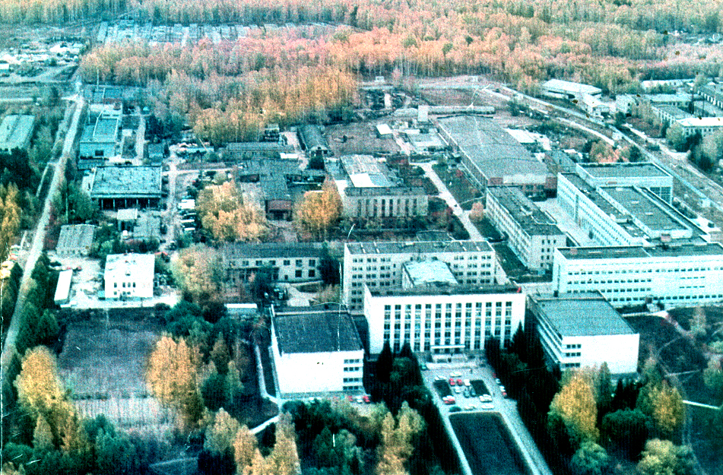
Thanks for your attention

Slide 22
SPPC cold beam pipe
Possible solutions
BINP
SR water cooled absorbers
placed between magnets
A – absorber for hydrogen
BS
A
Mandatory:
Coating for EC mitigation (may be strip-like to keep impedance)
Short bending magnets ( 5 – 7 meters – very preliminary estimation)

Slide 23
BINP
Summery
Vacuum tightness!
Mechanical stability against external pressure or quenching
Low SEY & PEY: Electron Clouds (EC) problems – beam instability
Impedance: LF - resistive instability (LHC, SPPC/FCC), HF: TMI (anti- EC coatings, roughness)
Power absorption: SR, EC, Image Current

Slide 24
BINP
Surface conditioning (SEY must be less 1.3 for LHC arcs)
SEY measurements at CERN for copper samples:
Pure copper: δ = 1.35

Slide 25
BINP
Relation between SEY and ESD during conditioning!
B.Henrist, N.Hilleret, C.Scheuerlein, M.Taborelli, G.Vorlaufer. The variation of the secondary electron yield and of the desorption yield of copper under electron bombardment: origin and impact on the conditioning of the LHC. Proceedings of EPAC 2002, pp. 2553-2555, Paris, France.

Slide 26
Equations for residual dynamic gas density prediction
BINP
z_{p-1}
z_{p}
z_{p+1}
z
S_{p-1}
S_{p}
S_{p+1}
NEG coating!
Limited by u_{i}
100 l/s
10000 l/s
re-cycling
Sorption capacity 1 ML. Lifetime ?
Most popular NEG composition is TiZrV – low activation temperature 180 °C
Advantages: low and low SEY, high pumping speed
Disadvantages: Needs baking, low sorption capacity (lifetime ?)

Slide 27
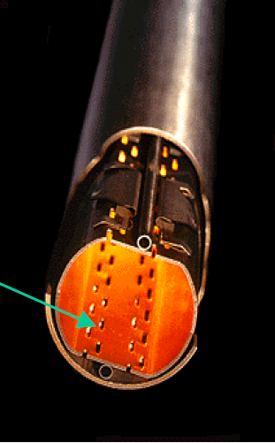
BINP
Important solutions made for LHC arc beam pipe
Beam screen: screening of CB against SR and EC, power absorption
Copper co-lamination: high electrical conductivity at cryogenic temperature
SR
Saw tooth!
0.02÷0.03
0.5
Slots
Decreasing number of diffusely scattered photons
decreasing number of photo-electrons (3 ÷ 5 times!) and increasing of conditioning effectiveness
Open question: conditioning is slow in compare with laboratory experiments (10 times at least!)

