Slide 1
Beam-beam effects in SPPC and future hadron colliders
Lijiao Wang (IHEP), Kazuhito Ohmi (KEK)
International workshop on High Energy Circular Electron Positron Colliders,
Nov 6-8, 2017, IHEP, Beijin, China

Slide 2
Introduction
Weak-strong Beam-beam simulation for SPPC.
HH/HV crossing and without crossing. No long range
2-IP HH crossing with long range (82 locations)
2-IP HV crossing with long range (82 locations)
Tune shift and beam-beam resonances

Slide 3
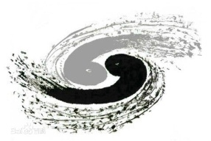
Institute of High Energy Physics
SPPC relative parameter | Value |  | Unit
 | CDR | Ultimate
Circumference | 100 | 100 | km
Beam energy | 37.5 | 62.5-75 | TeV
Number of IPs | 2 | 2
Revolution frequency | 3 | 3 | kHz
Physics performance and beam parameters
Peak luminosity per IP | 1.01×10³⁵ | - | cm⁻²s⁻¹
Beta function at collision | 0.75 | - | m
Circulating beam current | 0.7 | - | A
Nominal beam-beam tune shift limit per IP | 0.0075 | -
Bunch separation | 25 | - | ns
Number of bunches | 10080 | -
Bunch population | 1.5×10¹¹ | -
Normalized rms transverse emittance | 2.4 | - | μm
Turnaround time | 3 | - | hours
inelastic cross section | 105 | - | mb
total cross section | 148 | - | mb
Full crossing angle | 110 | - | urad

Slide 4
Main collision (weak-strong model)
bunch slice, z_{i},i=1,n_{sl}=10.
Collision point between particle (z) and slice(zi), .
Transfer to collision point s_{i} from s*, and slice center in x,y
Collision (round beam)
Inverse transformation to s=s*.
$$x=x+p_{x}s_{i}$$
$$y=y+p_{y}s_{i}$$
$$p_{z}=p_{z}−(p_{x}^{2}+p_{y}^{2})/4$$
$$σ_{r}^{2}(s_{i})=(β_{x}+\frac{s_{i}^{2}}{β_{x}})ε_{x}$$
$$x=x−x_{i}(z_{i})$$
$$x=x−y_{i}(z_{i})$$
repeat n_{sl} times
$$x=x+x_{i}(z_{i})$$
$$y=y+y_{i}(z_{i})$$
$$x=x−p_{x}s_{i}$$
$$y=y−p_{y}s_{i}$$
$$p_{z}=p_{z}+(p_{x}^{2}+p_{y}^{2})/4$$

Slide 5
Transf. for Crossing angle, θ_{c}: half crossing angle
Central position of slices,
Before collision
Main collision (last page)
After collision
Luminosity
$$x_{i}\left(z_{i}\right)=θ_{c}z_{i}$$
$$x=x+θ_{c}z$$
$$p_{z}=p_{z}−θ_{c}p_{x}$$
$$x=x−θ_{c}z$$
$$p_{z}=p_{z}+θ_{c}p_{x}$$
$$L=\frac{N_{p}^{2}}{Nmp}\frac{1}{2πσ_{r}^{2}}\sum_{i=1}^{Nmp}{exp}\left(−\frac{{|r_{i}−r_{s}|}^{2}}{2σ_{r}^{2}}\right)$$

Slide 6
Simulation for
2-IP with HH,HV crossing and without crossing. No long range.
Initialize 131072 particle with random number generator, and track particles in 10⁶ revolutions. Parallel computation using OMP.
Luminosity and beam size are averaged every 100 turns.
Luminosity plot over every 100 turns and fit using f(x)=a+b*x
Luminosity decay rate/day is estimated. f₀=3kHz=2.6x10⁸/day

Slide 7
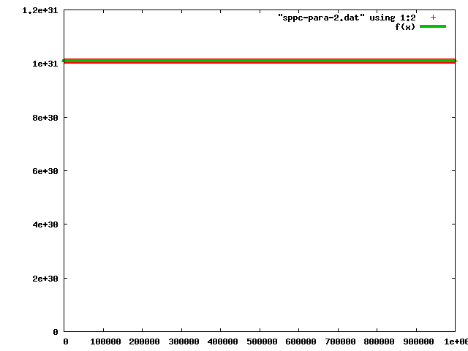
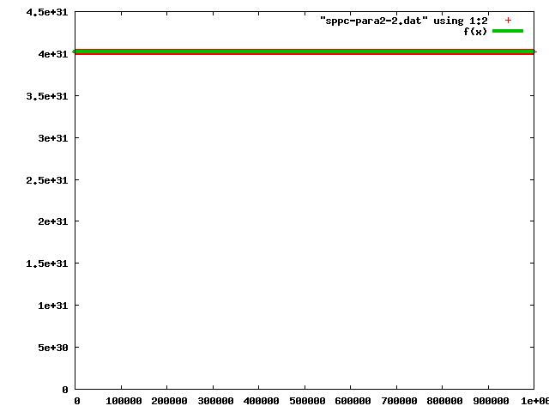
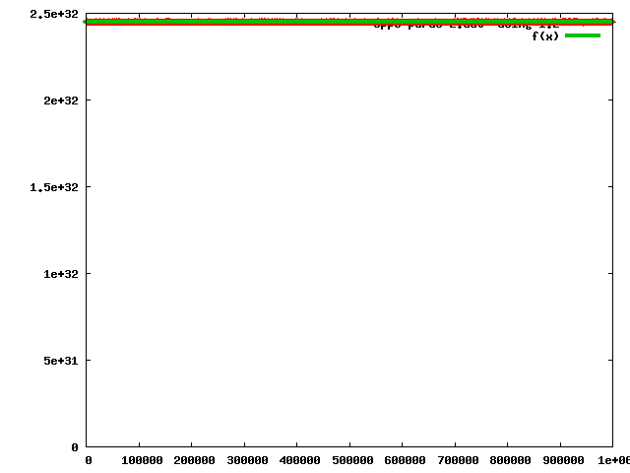
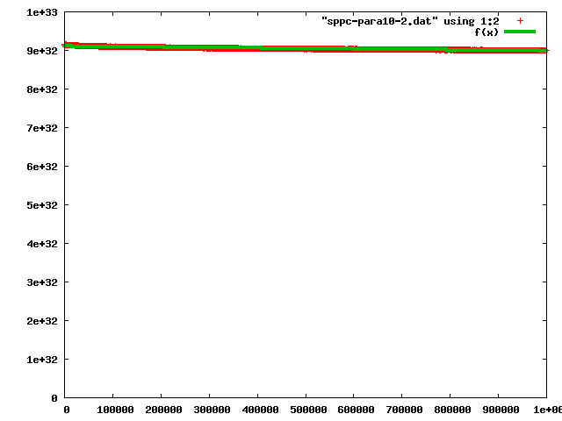
1-IP H with crossing. No long range (tunex=0.655,tuney=0.16)=2IP HH crossing
Design parameter:
Np=1.5e11
a= 1.00958e+31 (0.000467%)
b= 3.29834e+20(2476%)
Np=2*1.5e11
a= 4.0171e+31 (0.0004706%)
b= 5.7786e+22(56.66%)
Np=5*1.5e11
a=2.45031e+32 (0.0005675%)
b= -5.17266e+21(0.5344%)
a= 9.10413e+32 (0.001894%)
b= -1.17056e+27(0.2551%)
Np=10*1.5e11

Slide 8
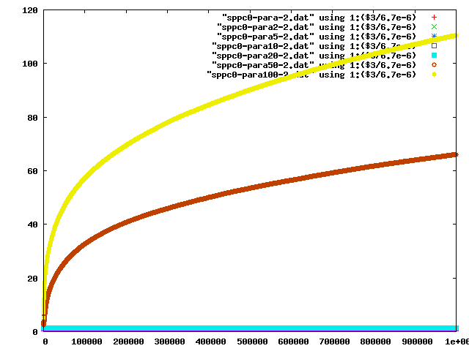
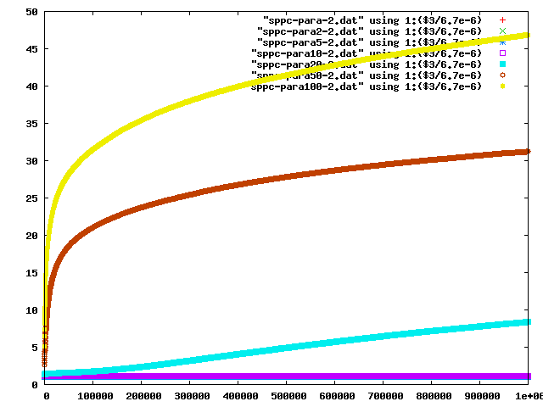
Beam size averaged over every 100 turns in 10⁶ revolutions.
X direction(bsize/σ)

Slide 9
2-IP HH, HV crossing and without crossing. No long range
 |  | θ=0μrad | θ=110μrad | θ=110μrad
Tune/IP | 0.655,0.16 |  | HH | HV
Np | ξ/IP | ΔL/L₀ (per day) | ΔL/L₀ (per day) | ΔL/L₀ (per day)
1.5e11 | 0.007633 | 0 | 0 | 0
2*1.5e11 | 0.015266 | 0 | 0 | 0
5*1.5e11 | 0.038165 | 0 | 0 | -14.5
10*1.5e11 | 0.076330 | -0.26 | -6.66 | -203
20*1.5e11 | 0.152659 | -2.36 | -210 | -309
50*1.5e11 | 0.381649 | -380 | -494 | -231
100*1.5e11 | 0.763297 | -552 | -436 | -215
Tune (LHC) 0.31,1.32->0.155,0.66/IP

Slide 10
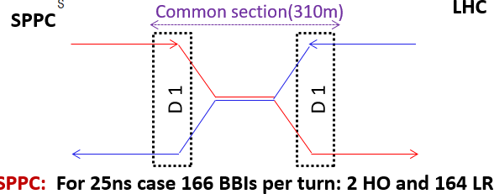
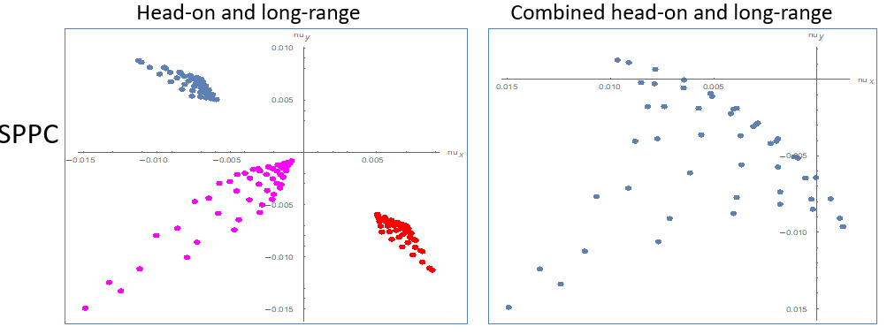
Long range interaction
Δν_{y}
Tune spread
Δν_{x}

Slide 11
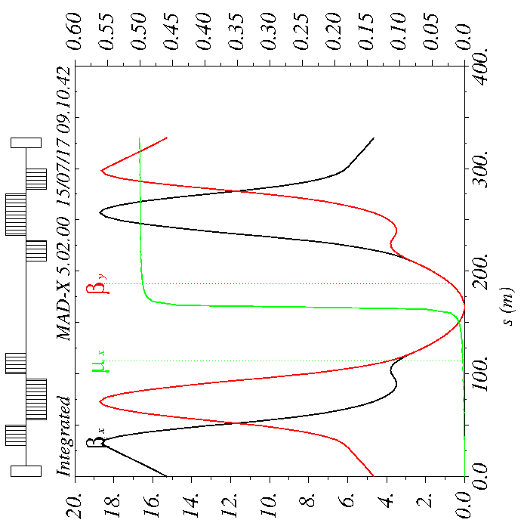
Twiss parameters in IR
Institute of High Energy Physics
IP
SPPC twiss parameters in IR
LHC twiss parameters in IR
Long range interaction: every 3.75m.

Slide 12
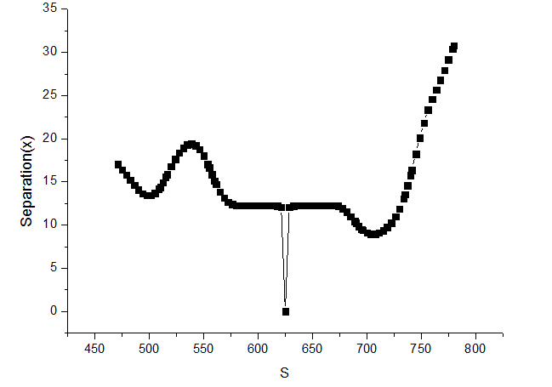
X-separation
Institute of High Energy Physics
Horizontal separation(sigma)

Slide 13
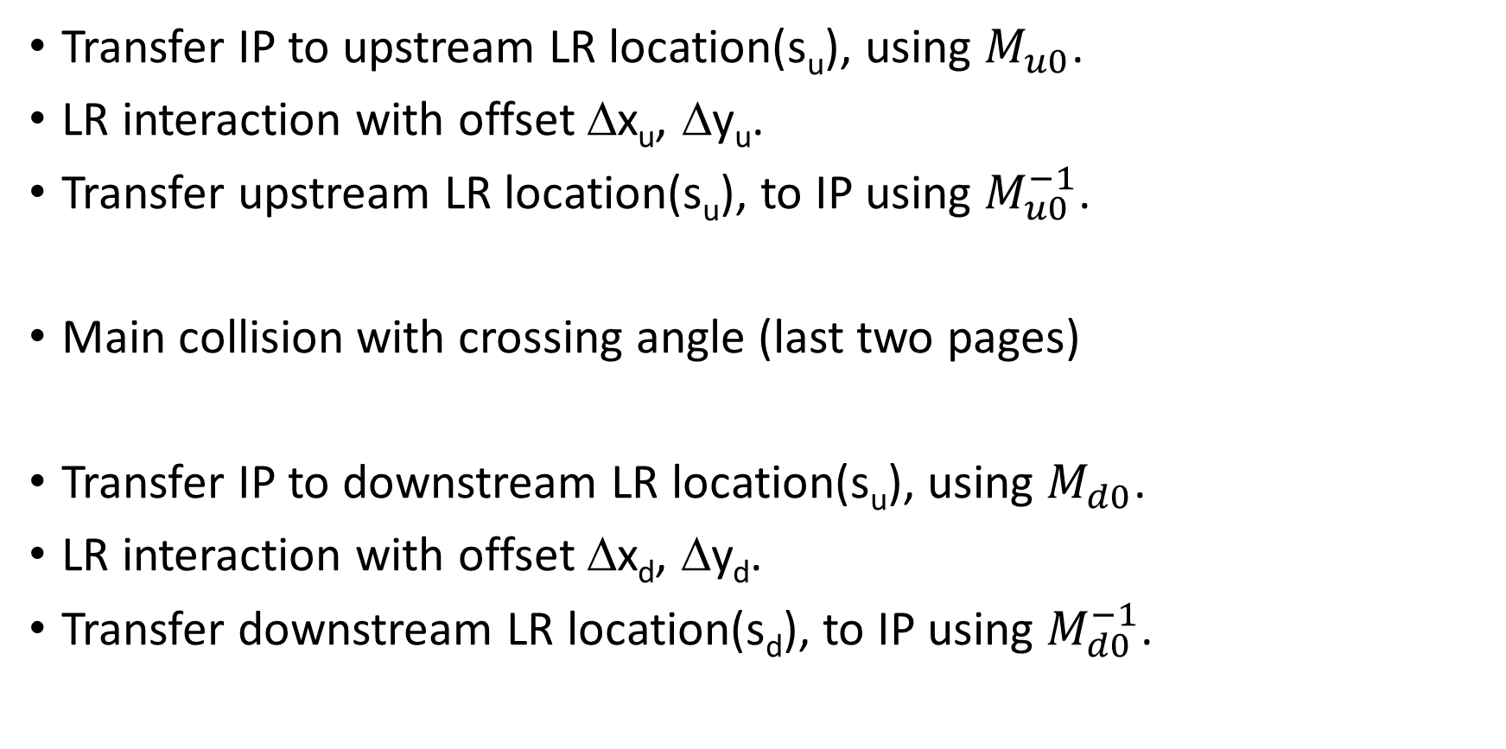
Long range interaction
repeat n_{u}=42 times
Transfer IP to upstream LR location(s_{u}), using $M_{u0}$.
LR interaction with offset Δx_{u}, Δy_{u}.
Transfer upstream LR location(s_{u}), to IP using $M_{u0}^{−1}$.
Main collision with crossing angle (last two pages)
Transfer IP to downstream LR location(s_{u}), using $M_{d0}$.
LR interaction with offset Δx_{d}, Δy_{d}.
Transfer downstream LR location(s_{d}), to IP using $M_{d0}^{−1}$.
repeat n_{d}=42 times

Slide 14
Closed orbit distortion due to long range interaction
Beam deflection due to long range interaction, upstream $∆x_{u}$<0.
Effective momentum, position kick at IP
Downstream, $∆x_{d}>$0. The same formula, u->d.
$${∆p}_{x,u}=−\frac{2N_{p}r_{p}}{γ}\frac{1}{∆x_{u}}$$
$${∆x}_{uIP}=\sum_{u=1}^{nu}{\sqrt{β_{x}^{∗}β_{x,u}}sin{{(φ}_{x}^{∗}−φ_{u}){∆p}_{x,u}}}$$
$${∆p}_{x,uIP}=\sum_{u=1}^{nu}{\sqrt{\frac{β_{x,u}}{β_{x}^{∗}}}cos{{(φ}_{x}^{∗}−φ_{u}){∆p}_{x,u}}}$$
$${∆x}_{uIP}=−3.66 μm$$
$${∆x}_{dIP}=−4.08 μm$$
${∆p}_{x,uIP}=−0.100μ$rad
${∆p}_{x,uIP}=0.125μ$rad

Slide 15
HH crossing with long range bb force
long range (82 locations)/IP
Tune/IP=0.655,0.16 or 0.155,0.66
Initialize 131072 particle with random number generator at a closed orbit with take into account of diffraction due to long range beam-beam. (Initialized at before upstream long range bb. The closed orbit depends on beam intensity and Pacman.)
The particles are tracked in 10⁶ revolutions. Parallel computation using OMP.
We consider long-range interactions using round beam instead of flat beam. Results did not change in several cases.
Beam life time is evaluated for the aperture 5σ or 7σ.
$$\left(\begin{matrix}x_{0} \\ p_{0}\end{matrix}\right)=M_{rev/2}\left[\left(\begin{matrix}x_{0} \\ p_{0}\end{matrix}\right)+\left(\begin{matrix}{∆x}_{d} \\ {∆p}_{d}\end{matrix}\right)+\left(\begin{matrix}{∆x}_{u} \\ {∆p}_{u}\end{matrix}\right)\right]$$

Slide 16
Closed orbit at IP on Main collision
Determine closed orbit using the periodic condition in the half ring.
$$\left(\begin{matrix}x_{0} \\ p_{0}\end{matrix}\right)=\left(\begin{matrix}{∆x}_{u} \\ {∆p}_{u}\end{matrix}\right)+M_{rev/2}\left[\left(\begin{matrix}x_{0} \\ p_{0}\end{matrix}\right)+\left(\begin{matrix}{∆x}_{d} \\ {∆p}_{d}\end{matrix}\right)\right]$$
$${\left(I−M_{rev}\right)}^{−1}=\frac{1}{2}\left(\begin{matrix}1 & β^{∗}\cot{πν} \\ −\frac{1}{β^{∗}}\cot{πν} & 1\end{matrix}\right)$$
$$\left(\begin{matrix}x_{0} \\ p_{0}\end{matrix}\right)={\left(I−M_{rev/2}\right)}^{−1}\left[\left(\begin{matrix}{∆x}_{u} \\ {∆p}_{u}\end{matrix}\right)+M_{rev/2}\left(\begin{matrix}{∆x}_{d} \\ {∆p}_{d}\end{matrix}\right)\right]$$
MDRU | Tunex=0.655 Tuney=0.16
 | X distortion | Px distortion
Design | 2.03053e-07 | -2.844e-06
2 times | 4.06106e-07 | -5.688e-6
3 times | 6.09159e-07 | -1.7064e-5
4 times | 8.12212e-07 | -1.1376e-5
MDRU | Tunex=0.155 Tuney=0.66
 | X distortion | Px distortion
Design | 2.25166e-07 | 9.63179e-06
2 times | 4.50332e-07 | 1.92636e-05
3 times | 6.75498e-07 | 2.88954e-05
4 times | 9.00664e-07 | 3.85272e-05

Slide 17
H/H crossing with long range (82 locations) tune/IP=0.655,0.16
 |  | R=7σ | R=5σ | θ=110μrad
Np | ξ/IP | Beam lifetime | Beam lifetime | Luminosity decay(one day)
1.5e11 | 0.00763 | 275.82h(44 particles lost) | 27.21h(223 particles lost) | 0
2*1.5e11 | 0.01526 | 0.08h(76643 particles lost) | 0.08h(77121 particles lost) | -12.04
3*1.5e11 | 0.02289 | 23.61h(257 particles lost) | 0.08h(82212 particles lost) | -5.1
4*1.5e11 | 0.03052 | 1.48h(4107 particles lost) | 0.13h(53391 particles lost) | -7.16
H/H crossing with long range (82 locations)/IP tune/IP=0.155,0.66
 |  | R=7σ | R=5σ | θ=110μrad
Np | ξ/IP | Beam lifetime | Beam lifetime | Luminosity decay(one day)
1.5e11 | 0.00763 | (no particles lost) | 148h (41 particles lost) | 0
2*1.5e11 | 0.01526 | (no particles lost) | 21.52h(282 particles lost) | -0.114
3*1.5e11 | 0.02289 | 2.14h(2839 particles lost) | 1.35h(4507 particles lost) | -2.26

Slide 18
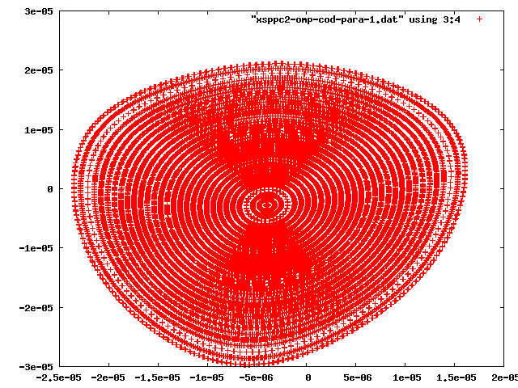
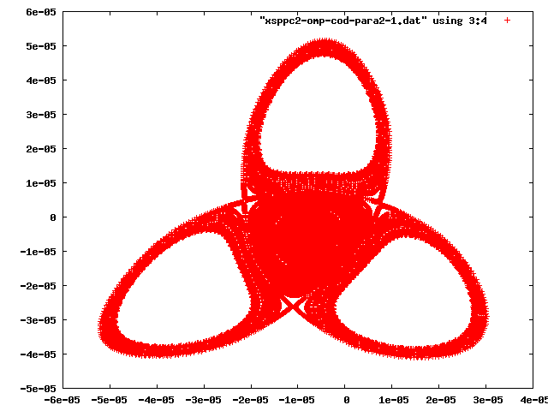
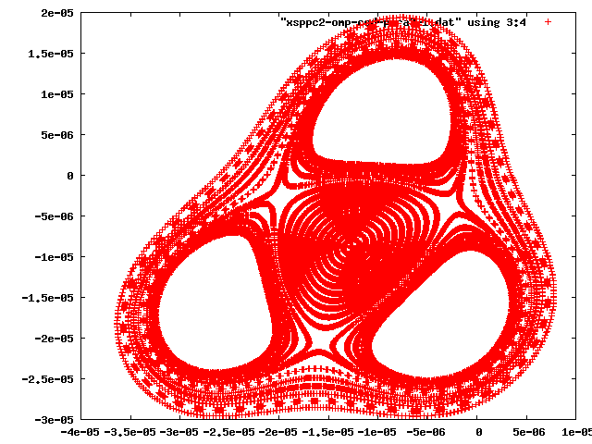
Initialize 30 particles with x=0,0.1,0.2….2.9σ, px=y=py=z=pz=0, and plot x-px in 1000 revolutions.
p_{x}
x
Np=1.5e11
Np=2*1.5e11
Tune/IP=0.655,0.16
Horizontal tune shift is positive for the long range beam-beam force. At 2 times intensity of the design, 3rd order resonance appears and luminosity degradation becomes serious.
Np=3*1.5e11

Slide 19
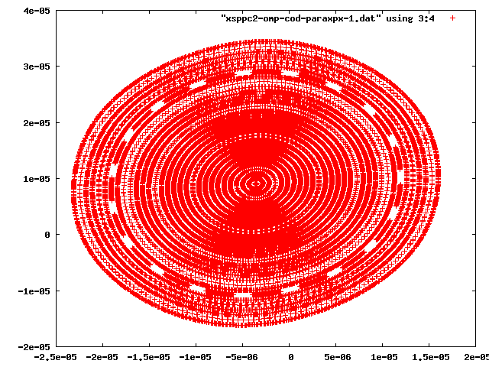
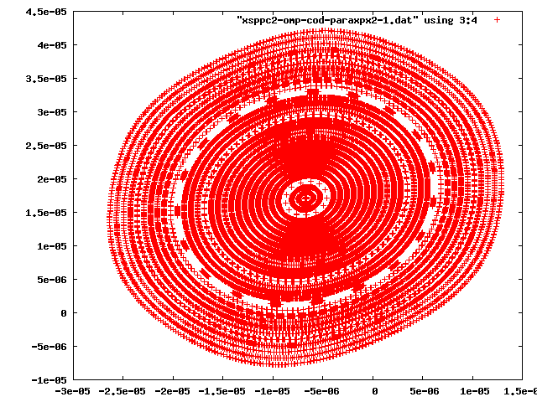
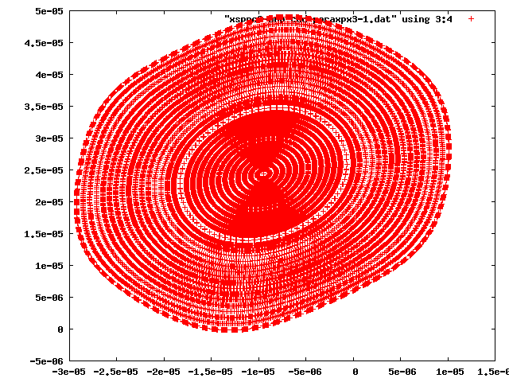
Initialize 30 particles with x=0,0.1,0.2….2.9σ, px=y=py=z=pz=0, and plot x-px in 1000 revolutions.
p_{x}
x
Np=1.5e11
Np=2*1.5e11
Tune/IP=0.155,0.66
No 3rd order resonance. Tune/IP=0.155,0.66 is better than 0.655,0.16
Np=3*1.5e11

Slide 20
Horizontal Vertical crossing
Horizontal orbit at IP-H and vertical orbit at IP-V are obtained each using previous method.
Vertical orbit at IP-H and horizontal orbit at IP-V
The closed orbit depends on the bunch population and on position in the bunch train.
Initialize 131072 particle with random number generator at the closed orbit and tracked in 10⁶ revolutions.

Slide 21

Horizontal Closed orbit at the vertical collision point
$$\left(\begin{matrix}x_{0} \\ p_{0}\end{matrix}\right)=M_{rev}\left(\begin{matrix}x_{0} \\ p_{0}\end{matrix}\right)+M_{rev/2}\left[\left(\begin{matrix}{∆x}_{u} \\ {∆p}_{u}\end{matrix}\right)+\left(\begin{matrix}{∆x}_{d} \\ {∆p}_{d}\end{matrix}\right)\right]$$
$$\left(\begin{matrix}x_{0} \\ p_{0}\end{matrix}\right)={\left(I−M_{rev}\right)}^{−1}M_{rev/2}\left[\left(\begin{matrix}{∆x}_{u} \\ {∆p}_{u}\end{matrix}\right)+\left(\begin{matrix}{∆x}_{d} \\ {∆p}_{d}\end{matrix}\right)\right]$$
RxUxMxDx RyUyMyDy | Tunex=0.31 Tuney=1.32
 | X distortion | Px distortion
Design | 1.10561e-08 | 6.23789e-06
2 times | 2.21122e-08 | 1.24758e-05
3 times | 3.31683e-08 | 1.87137e-05
4 times | 4.42244e-08 | 2.49516e-05
RxUxMxDx RyUyMyDy | Tunex=1.31 Tuney=0.32
 | X distortion | Px distortion
Design | -1.10561e-8 | -6.23789e-6
2 times | -2.21122e-8 | -1.24758e-5
3 times | -3.31683e-8 | -1.87137e-5
4 times | -4.42244e-8 | -2.49516e-5
$$=\frac{1}{2}\left(\begin{matrix}0 & \frac{β^{∗}}{\sin{πν}} \\ −\frac{1}{β^{∗}\sin{πν}} & 0\end{matrix}\right)$$
$${\left(I−M_{rev}\right)}^{−1}M_{rev/2}=\frac{1}{2}\left(\begin{matrix}1 & β^{∗}\cot{πν} \\ −\frac{1}{β^{∗}}\cot{πν} & 1\end{matrix}\right)\left(\begin{matrix}\cos{πν} & β^{∗}\sin{πν} \\ −\frac{1}{β^{∗}}\sin{πν} & \cos{πν}\end{matrix}\right)$$
The orbit distortion should be corrected.

Slide 22
Vertical Closed orbit at the Horizontal collision point
$$\left(\begin{matrix}y_{0} \\ p_{y0}\end{matrix}\right)=M_{rev}\left(\begin{matrix}y_{0} \\ p_{y0}\end{matrix}\right)+M_{rev/2}\left[\left(\begin{matrix}{∆y}_{u} \\ {∆p}_{yu}\end{matrix}\right)+\left(\begin{matrix}{∆y}_{d} \\ {∆p}_{yd}\end{matrix}\right)\right]$$
$$\left(\begin{matrix}x_{0} \\ p_{0}\end{matrix}\right)={\left(I−M_{rev}\right)}^{−1}M_{rev/2}\left[\left(\begin{matrix}{∆x}_{u} \\ {∆p}_{u}\end{matrix}\right)+\left(\begin{matrix}{∆x}_{d} \\ {∆p}_{d}\end{matrix}\right)\right]$$
RxUxMxDx RyUyMyDy | Tunex=1.31 Tuney=0.32
 | Y distortion | Py distortion
Design | -1.08308e-8 | 6.11047e-6
2 times | -2.16616e-8 | 1.22209e-5
3 times | -3.24924e-8 | 1.83314e-5
4 times | -4.33232e-8 | 2.4419e-5
RxUxMxDx RyUyMyDy | Tunex=0.31 Tuney=1.32
 | Y distortion | Py distortion
Design | 1.08308e-08 | -6.11047e-06
2 times | 2.16616e-08 | -1.22209e-05
3 times | 3.24924e-08 | -1.83314e-05
4 times | 4.33232e-08 | -2.44419e-05
$$=\frac{1}{2}\left(\begin{matrix}0 & \frac{β^{∗}}{\sin{πν}} \\ −\frac{1}{β^{∗}\sin{πν}} & 0\end{matrix}\right)$$
$${\left(I−M_{rev}\right)}^{−1}M_{rev/2}=\frac{1}{2}\left(\begin{matrix}1 & β^{∗}\cot{πν} \\ −\frac{1}{β^{∗}}\cot{πν} & 1\end{matrix}\right)\left(\begin{matrix}\cos{πν} & β^{∗}\sin{πν} \\ −\frac{1}{β^{∗}}\sin{πν} & \cos{πν}\end{matrix}\right)$$
The orbit distortion should be corrected.

Slide 23
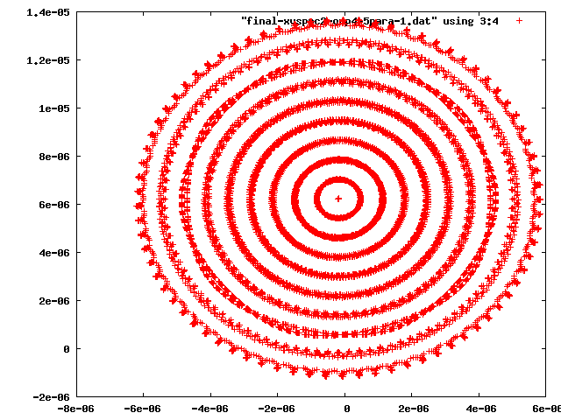
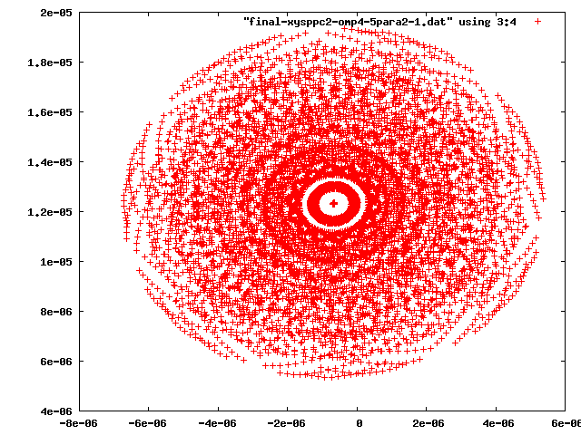
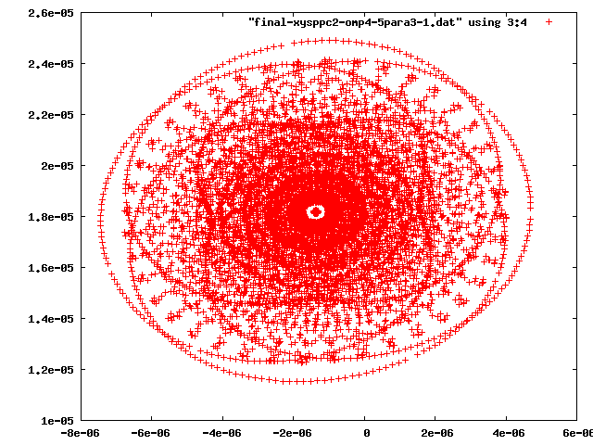
Initialize 10 particles with x=0,0.1,0.2….0.9σ, px=y=py=z=pz=0, and plot x-px in 1000 revolutions.
p_{x}
x
Np=1.5e11
Np=2*1.5e11
Tune/IP=0.155,0.66
Vertical/horizontal closed orbits at IP-H/V are not corrected. Complex chaotic behavior is seen.
p_{x}
Np=3*1.5e11

Slide 24
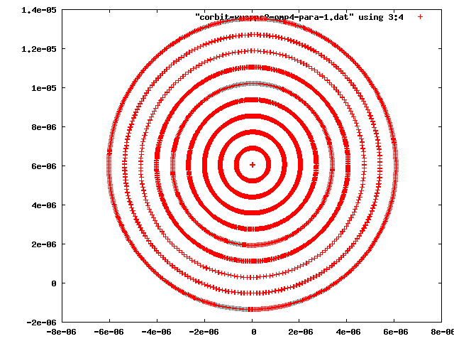
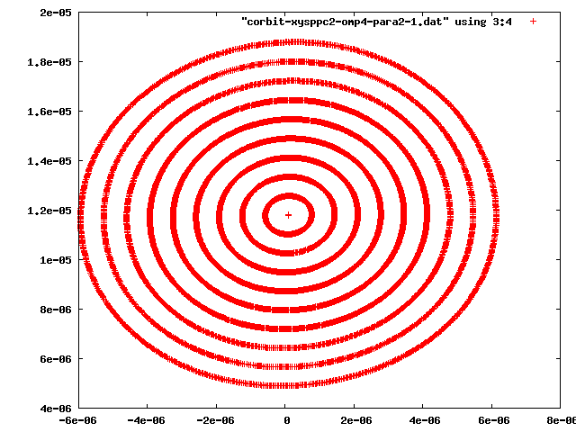
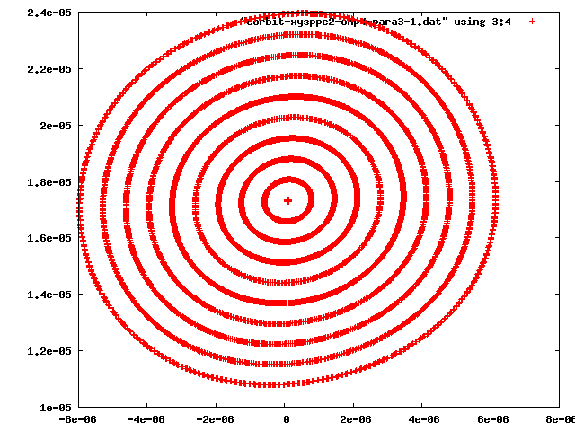
Initialize 10 particles with x=0,0.1,0.2….0.9σ, px=y=py=z=pz=0, and plot x-px in 1000 revolutions.
p_{x}
x
Np=1.5e11
Np=2*1.5e11
Tune/IP=0.155,0.66
Vertical/horizontal closed orbits at IP-H/V are corrected. Regular phase space structure is seen.
Np=3*1.5e11

Slide 25
4. 2-IP HV crossing with long range (164 locations)
 |  | R=7σ | R=5σ | θ=110μrad
Tune/IP |  | 0.655,0.16 | 0.655,0.16 | 0.655,0.16
Np | ξ/IP | Beam lifetime | Beam lifetime | Luminosity decay(one day)
1.5e11 | 0.00763 | (no particles lost) | 216.72h (56 particles lost) | 0
2*1.5e11 | 0.01526 | 58.35h(208 particles lost) | 16.20h(749 particles lost) | -0.13
3*1.5e11 | 0.02289 | 1.03h(11812 particles lost) | 0.92h(13146 particles lost) | -11.56
 |  | R=7σ | R=5σ | θ=110μrad
Tune/IP |  | 0.155,0.66 | 0.155,0.66 | 0.155,0.66
Np | ξ/IP | Beam lifetime | Beam lifetime | Luminosity decay(one day)
1.5e11 | 0.00763 | (no particles lost) | 216.72h (56 particles lost) | 0
2*1.5e11 | 0.01526 | 58.91h (206 particles lost) | 13.95h (772 particles lost) | -0.14
3*1.5e11 | 0.02289 | 1.03h (11744 particles lost) | 0.93h (13054 particles lost) | -11.52

Slide 26
4. 2-IP HV crossing with long range (164 locations) with correcting orbit
 |  | R=7σ | R=5σ | θ=110μrad
Tune/IP |  | 0.155,0.66 | 0.155,0.66 | 0.155,0.66
Np | ξ/IP | Beam lifetime | Beam lifetime | Luminosity decay(one day)
1.5e11 | 0.00763 | (no particles lost) | 220.66h (55 particles lost) | 0
2*1.5e11 | 0.01526 | 263.8(46 particles lost) | 17.46(695 particles lost) | -0.085
3*1.5e11 | 0.02289 | 8.76h (1385 particles lost) | 3.15h (3418 particles lost) | -2.22
Tune/IP=0.155,0.66
The orbit correction of Horizontal/vertical closed orbits at IP-V/H works well. The correction is dependent of beam intensity and PACMAN.
The performance of HV with the orbit correction is similar as HH.

Slide 27
Summary
Weak-strong Beam-beam simulations are performed for SPPC.
HH/HV crossing and without crossing. No long range
HH/HV crossing with long range (82 locations)
Beam-beam limit for collision without crossing ξ/IP=0.15 for luminosity lifetime shorter than 1 day .
ξ/IP=0.076 for HH crossing and 0.038 for HV crossing.
Considering Long range interaction
ξ_{lim}/IP=0.015-0.023 for both of HH and HV crossing.
The design of SPPC, ξ/IP=0.0075, is reasonable.

Slide 28
Thank you for your attention

Slide 29
Packman bunch
For example, first bunch of a train experiences long range interactions only downstream of IP.
Regular bunches
MDRU | Tunex=0.155 Tuney=0.66
 | X distortion | Px distortion
Design | 2.1268e-06 | 5.0716e-06
2 times | 4.2537e-06 | 1.0143e-05
3 times | 6.3804e-06 | 1.5215e-05
Tunex=0.155 Tuney=0.66
X distortion | Px distortion
2.25166e-07 | 9.63179e-06
4.50332e-07 | 1.92636e-05
6.75498e-07 | 2.88954e-05
HH
MDRU | Tunex=0.155 Tuney=0.66
 | X distortion at IP-H | Px distortion | Y distortion | Py distortion
Design | 2.0704e-06 | 1.7850e-06 | 4.447e-08 | 2.891e-06
2 times
3 times
HV
Different orbit from that of the regular bunches.

Slide 30
Tuneshift footprint(long-range )
X-separation
Y-separation

Slide 31
Tuneshift footprint
Head-on and long-range
Combined head-on and long-range
SPPC
LHC

Slide 32
Closed orbit at IP on Main collision
Determine closed orbit using the periodic condition.
$$\left(\begin{matrix}x_{0} \\ p_{0}\end{matrix}\right)=\left(\begin{matrix}{∆x}_{u} \\ {∆p}_{u}\end{matrix}\right)+M_{rev/2}\left[\left(\begin{matrix}x_{0} \\ p_{0}\end{matrix}\right)+\left(\begin{matrix}{∆x}_{d} \\ {∆p}_{d}\end{matrix}\right)\right]$$
$${\left(I−M_{rev}\right)}^{−1}=\frac{1}{2}\left(\begin{matrix}1 & β^{∗}\cot{πν} \\ −\frac{1}{β^{∗}}\cot{πν} & 1\end{matrix}\right)$$
$$\left(\begin{matrix}x_{0} \\ p_{0}\end{matrix}\right)={\left(I−M_{rev/2}\right)}^{−1}\left[\left(\begin{matrix}{∆x}_{u} \\ {∆p}_{u}\end{matrix}\right)+M_{rev}\left(\begin{matrix}{∆x}_{d} \\ {∆p}_{d}\end{matrix}\right)\right]$$
$${∆x}_{uIP}=−3.66 μm$$
$${∆x}_{dIP}=−4.08 μm$$
${∆p}_{x,uIP}=−0.100μ$rad
${∆p}_{x,uIP}=0.125μ$rad
$$\left(\begin{matrix}x_{0} \\ p_{0}\end{matrix}\right)=\left(\begin{matrix}0.214 μm \\ 3.39 μrad\end{matrix}\right)$$

