Slide 1
CEPC Radiation Shielding
Ma Zhongjian, Ding Yadong, Shi haoyu, Yan Mingyang, Zhang Qingjiang, Li Jungang, Wu Qingbiao, Wang Qingbin
2017-11-07

Slide 2
Outline
Characteristics of the project
Shielding design criteria
Shielding calculation methods
Radiation shielding design
Radiation dose monitor system
Personal protection system
R&D
Summary

Slide 3
Characteristics of CEPC
High beam energy and beam power
  CEPC:
    Beam energy and circulating current: 120GeV*17.7mA
    SR power/beam: 30 MW/ per beam
A large-scale accelerator complex
  100 km @ underground about 50-70 m
Parameters | Symbols | Values | Units
Beam energy | E | 120 | GeV
Beam current | I | 17.7 | mA
Bending radius | ρ | 10900 | m
Power per unit length | P | 435 | W/m
Critical energy | E_{c} | 351.6 | keV
Bending angle | θ | 2.844 | mrad
Notes:
1吨TNT相等于4.2千兆焦耳

Slide 4
Radiation shielding tasks
  The thickness of the main tunnel
  Radiation dose induced by synchrotron radiation, shielding for magnets;
  Shielding for straight tunnel, beam dump, collimate station, injection section, maze, duct, shielding doors, RF station, etc;
  Induced radioactivity analysis: cooling water, ventilation air, accelerator component, local shielding concrete, ground water, environmental samples, etc;
On the other hands …
  Shielding methods with high accuracy were strongly required for a detailed design study.

Slide 5
Shielding Design Criteria
Dose limitation in regulations
  The national standard of the People’s Republic of CHINA, “Basic standards for protection against ionizing radiation and for the safety of radiation Source”, GB 18871-2002.
  The national standard of the people’s republic of china, “The rule for radiation protection of particle accelerators”, GB 5172 1985.
  ICRP publication 103, “The 2007 Recommendations of the International Commission on Radiological Protection”.
Radiation dose limit for person in the regulations
 |  | Worker | Public
Effective Dose | Average in 5 years | 20mSv/year | 1mSv/year
 | Max. in single year of the 5 years | 50mSv/year | 5mSv/year
Equivalent Dose | Lens eye | 150mSv/year | 15mSv/year
 | Skin | 500mSv/year | 50mSv/year

Slide 6
Limits for shielding design of CEPC-sPPC
1. Prompt dose rate limit
Area | Design Value | example
Radiation monitored area | < 2.5 μSv/h | registered radiation workers can enter freely any time Such as facilities halls, the surface of concrete shielding
Radiation controlled area | < 25 μSv/h | access this area is limited and permissions and the entering procedures are required. Such as auxiliary tunnel;
Forbidden area | >>1mSv/h | access to this area is in principle forbidden. Such as tunnel while the beam is running.
Site boundary | 0.1 mSv/year
All the areas underground should be clearly classified, and the occupancy factors should be clearly defined after the functional structures are determined.
2. Residual dose rate limit: < 1mSv/h for the workers to get into the tunnel
( 30cm, 4 h down ) (refer SNS)

Slide 7

Concentration limit of induced activity
  Design criteria: According to GB18871-2002: “if there are more than one kind of radionuclide, only if the ratio of activity (or specific activity) to its exempt value of each kind of the radionuclide was less than 1, it is exemptible.”
Convenient method to soil and ground water activation: The prompt dose rate is ~5.5mSv/h in the thickness of 1m soil to ensure it is below the exempt value of above. (refer J-PARC)
$$\sum_{i=1}^{n}{\frac{S_{i_saturation}}{S_{i_exempt}}<1}$$
Shielding design principle
  Shields are basically ordinary concrete and soil, steel, partially lead
  The shielding thickness of the main tunnel was determined by the radiation level (prompt and residual) caused by average beam loss along the tunnel, other hot spots, such as places for IP, injection, collimation and beam dump, have to be locally shielded to the equal radiation level respect to the former situation

Slide 8
Shielding Calculation Methods
For Magnets、bulk shielding、Beam-Dump and Collimators：
CEPC：FLUKA + MCNP + Empirical formula
For streaming：
DUCT-III（Shin’s equation) + FLUKA
For skyshine：
Stapleton’s equation
For activity calculation and residual dose rate :
FLUKA + Empirical formula

Slide 9
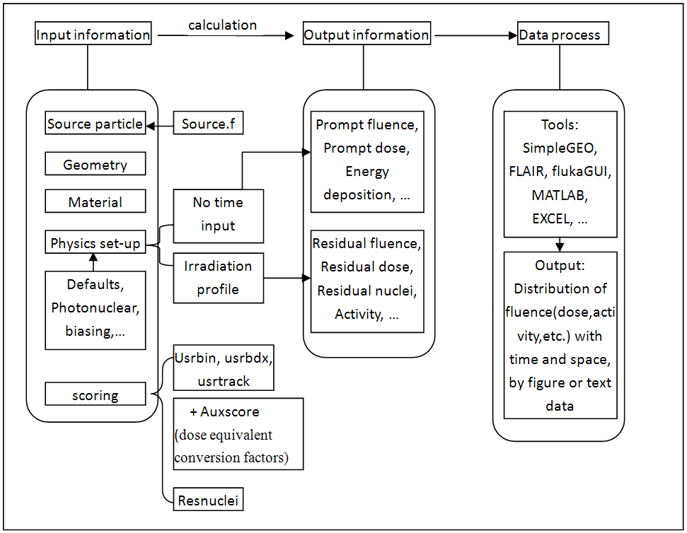
Calculation process of FLUKA in the shielding design
For limitation of prompt dose rate, residual dose rate, and activity need be considered together, we calculate all of them by FLUKA code totally.

Slide 10
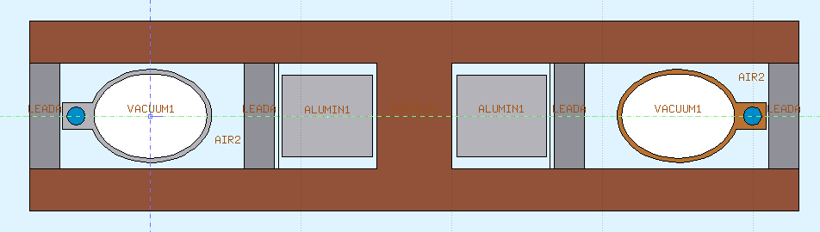
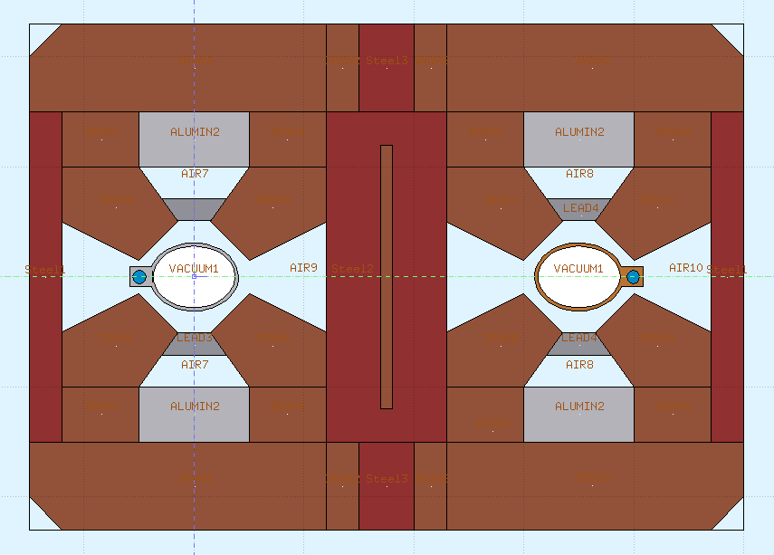
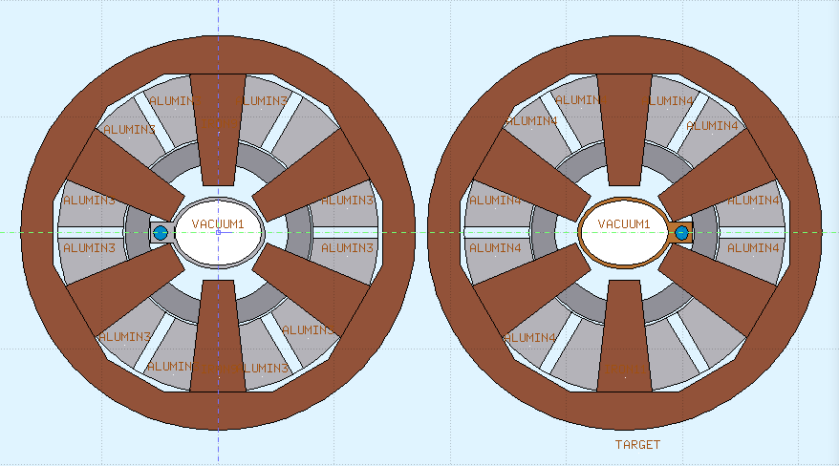
Radiation shielding design
Shielding design for magnets
  Magnet coils are wrapped around by massive organic materials, which are special sensitive to radiation. 20 mm lead is used for protecting the coils of magnets.

Slide 11
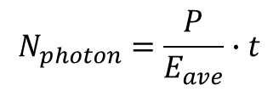
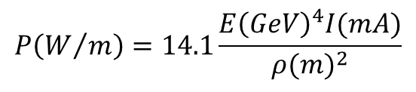
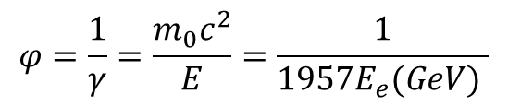
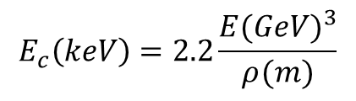

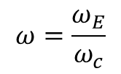
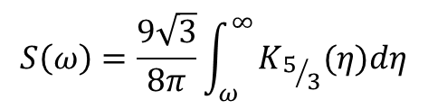
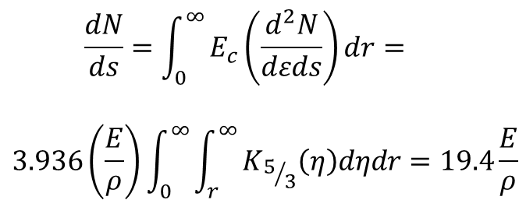
Synchrotron radiation parameters calculation
SR critical energy：
Solid degree $φ$：
$$E_{c}\left(keV\right)=2.2\frac{{E(GeV)}^{3}}{ρ(m)}$$
$$φ=\frac{1}{γ}=\frac{m_{0}c^{2}}{E}=\frac{1}{1957E_{e}(GeV) }$$
~ 351.6 keV
SR Power：
Number of photons (Method 1)：
$$P\left(W/m\right)=14.1\frac{{E\left(GeV\right)}^{4}I(mA)}{{ρ(m)}^{2}}$$
$$N_{photon}=\frac{P}{E_{ave}}∙t$$
~ 435 W/m
Number of photons (Method 2)：
SR spectrum：
$$\frac{dN}{ds}=\int_{0}^{∞}{E_{c}\left(\frac{d^{2}N}{dεds}\right)dr=}$$
$$3.936\left(\frac{E}{ρ}\right)\int_{0}^{∞}{\int_{r}^{∞}{K_{5/3}\left(η\right)dηdr=19.4\frac{E}{ρ}}}$$
$$S\left(ω\right)=\frac{9\sqrt{3}}{8π}\int_{ω}^{∞}{K_{5/3}(η)dη}$$
$$ω=\frac{ω_{E}}{ω_{c}}$$

Slide 12
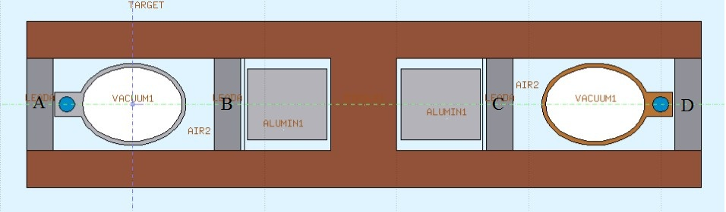
Energy deposition in dipole and vacuum chamber
Total power 870 W/m
Beam direction: left W/m |  | Beam direction: right W/m
Al chamber | 199 | Al chamber | 186
Cu chamber | 308 | Cu chamber | 332
Dipole | 186 | Dipole | 182
Lead A | 60.6 | Lead A | 29.2
Lead B | 33.5 | Lead B | 80.0
Lead C | 46.8 | Lead C | 18.8
Lead D | 14.3 | Lead D | 20.4

Slide 13
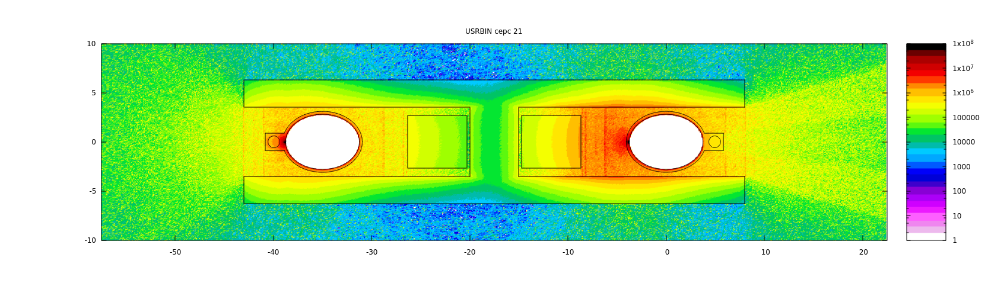
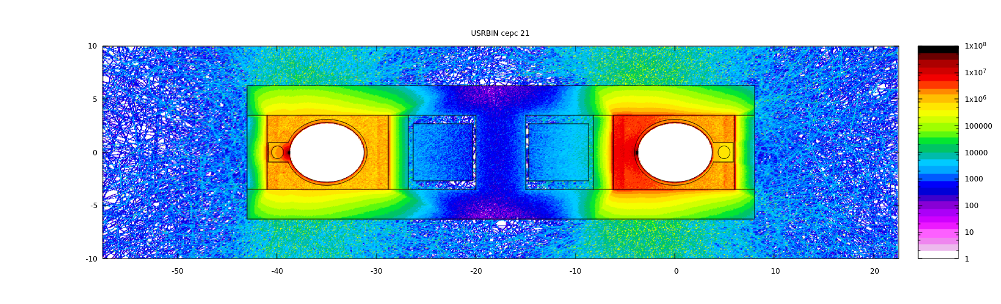
Radiation dose distribution around the coils
Materials | Upper dose limit in Gy | Radiation dose in Gy/Ah | Time in h
Fiberglass | 10⁸ | 1.89×10⁴ | 2.99×10⁵
Semi-organic coating | 10⁸ | 1.89×10⁴ | 2.99×10⁵
Epoxy resin | 2×10⁷ | 1.89×10⁴ | 5.98×10⁴

Slide 14
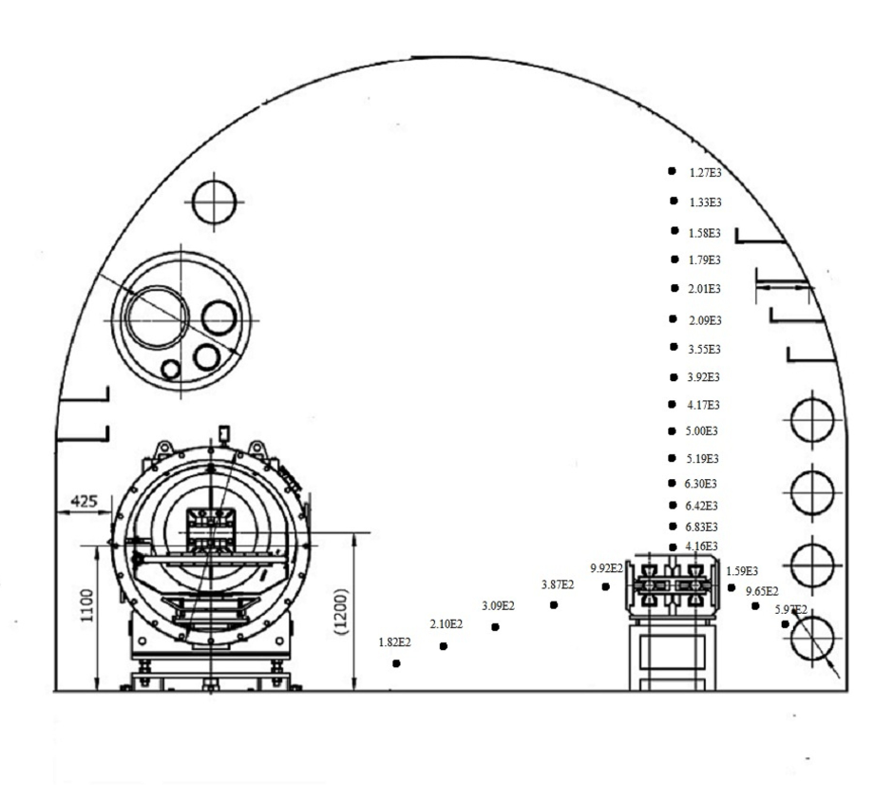
Radiation dose distribution in the tunnel
Dose distribution in Gy/Ah at 120 GeV in a dipole section with shielding
Radiation dose of the other sections are lower than dipole section.

Slide 15
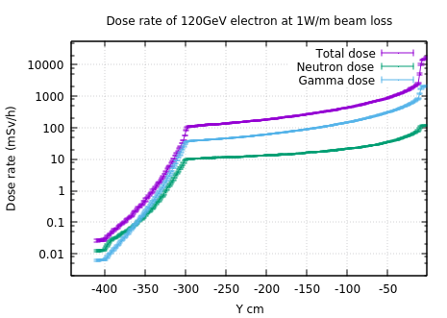
Simulation result for thickness of the main tunnel for CEPC
Beam loss parameter: 1W/m for 120GeV electrons, the material of the beam pipe is Fe and 1 cm thickness
  Radiation levels caused by other beam loss parameters can be deduced through proper conversion coefficient

Slide 16
Average beam loss parameter
  According to the cumulated number of particles and the lifetime of the beam
Beam loss calculation
  Beam energy:120GeV; Lifetime:1h; circumference:100km;
  For CEPC: ~0.004 W/m
So, the dose rate in the arc tunnel is about several hundreds μSv/h

Slide 17
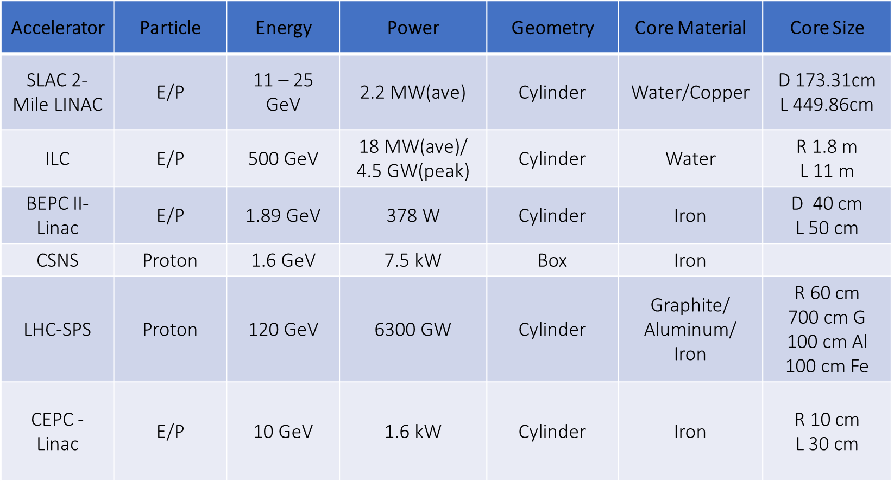
Beam dump design
  Dump for electron energy 120GeV and 10GeV
Material and size of absorber core.
  According to experienced formula and FLUKA simulation
 | LINAC | Collider
Energy(GeV) | 10 | 120
Current(uA) | 0.1 | 17.7mA
No. of E(/s) | 6.25E11 | 1.1E17
Notes:
(collect time is 330us)

Slide 18
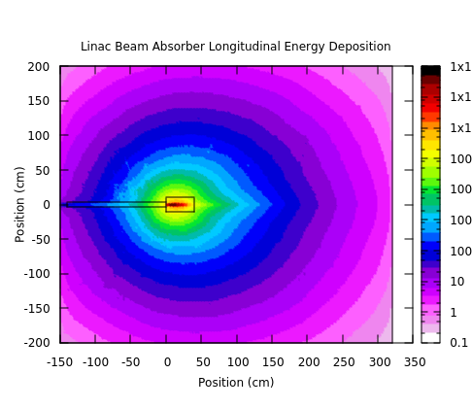
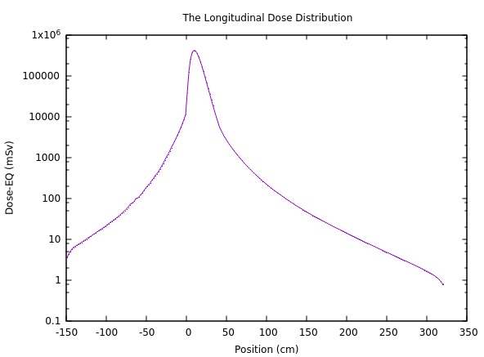
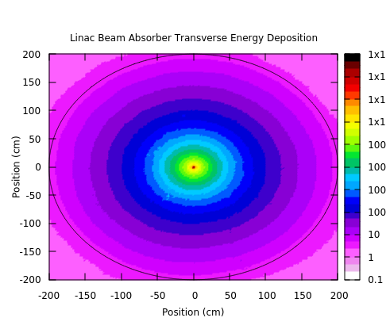
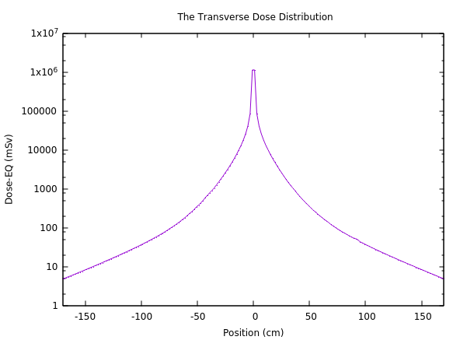
Linac Beam dump
  Longitudinal and transverse Dose distribution and dose attenuation
Beam Absorber:
Material: Iron
Size:10cm(R)*30cm(L)
99% of beam energy would be deposited in the absorber
Shielding :
Material: Concrete
Size:150cm(R)*130cm(L)
Average ambient dose equivalent outside the concrete is below 5.5 mSv/h
Longitudinal (upper) and transverse (down)

Slide 19
Induced radioactivity
  Calculation method:
    Direct calculation of isotope production with FLUKA
    The traditional method, that folding of particle fluence with energy-dependent cross sections for the production of certain isotopes, also be used in some situations
  Main concern of activation yields in different components
    The concrete shielding: ²⁴Na
    Air activation: ¹¹C ,¹³N,¹⁵O,⁴¹Ar
    Cooling water activation: ¹¹C,¹³N,¹⁵O,⁷Be,³H
    Soil activation: ⁷Be,³H
Notes:
Na：sodium
C: carbon
N: nitrogen
O: oxygen
Ar: argon
Be: beryllium
H: hydrogen

Slide 20
Radiation dose monitor system
Goal: guarantee the radiation level of workplace and the environment around complies with relevant regulations.
state of the art system: once radiation level exceeds the set critical value, monitors would sound the alarm.
Main includes:
  Workplace monitoring program
  Environmental monitoring program
  Personal dose monitoring program
  Management of radioactive components

Slide 21
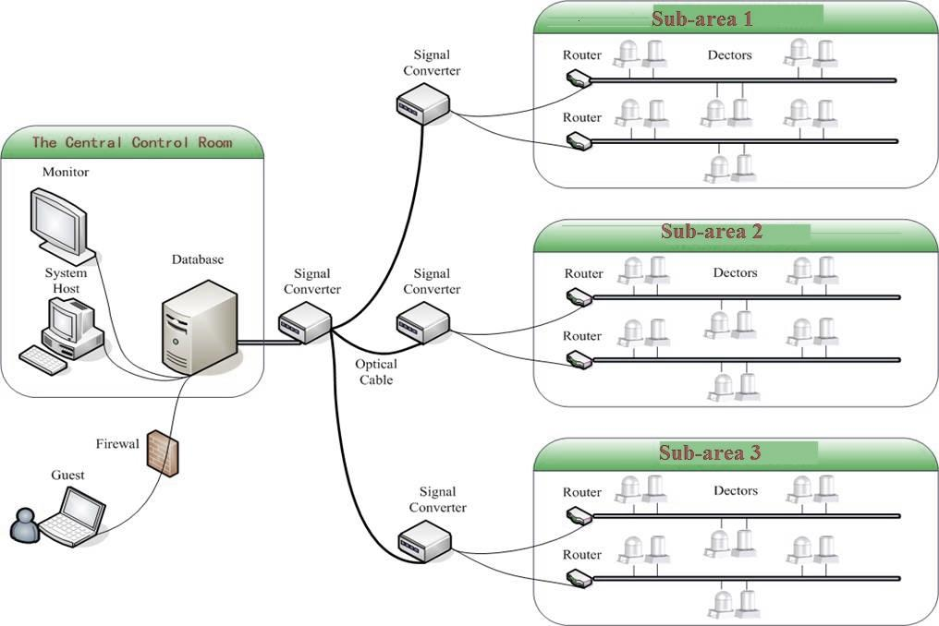
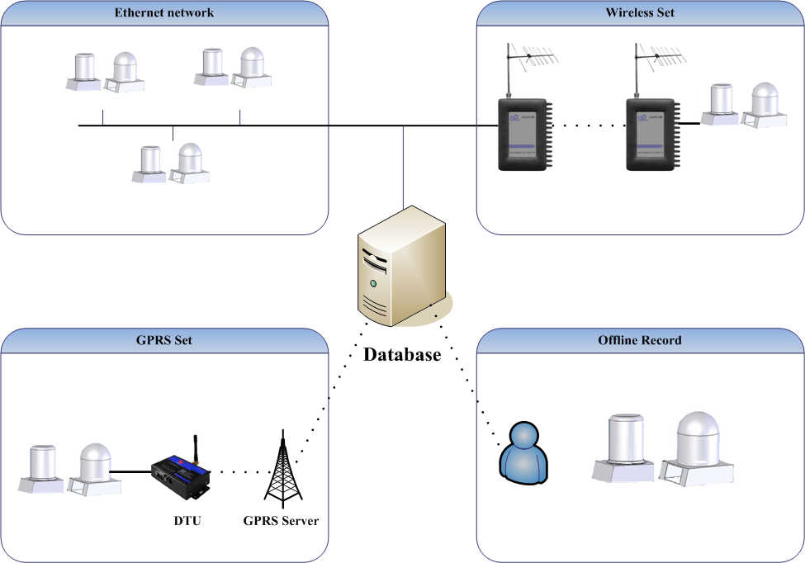
Frame diagram of the radiation monitor system
  provides remote supervision, long term database storage and off-line data analysis
  The monitored areas can divided into different parts
  4 communicating ways: Ethernet network, wireless sets, GPRS sets and offline record.
System framework
Date communication methods

Slide 22
Workplace monitoring program
  Establishing monitoring sites at all the main entrances to high radiation level areas and in the workplaces near the accelerator or radioactive source
  Each site has one gamma detector and one neutron detector
Personal dose monitoring program
  All the radiological staffs are supervised by personal dose monitoring program
  OSL (Optically Stimulated Luminescence) was chosen for γ cumulative dose monitoring, and CR-39 solid track dosimeter was chosen for neutron cumulative dose monitoring
  Electronic personal dose alarm apparatus also be equipped

Slide 23
Environmental monitoring program
  4 contents mainly concerned:
    monitoring dose rate levels in the environment
    monitoring of radioactivity in released outflow (air, water)
    monitoring activity densities in various environmental samples (plants, soil)
    environment radiation background survey
  Environmental radiation monitoring stations consist of a pressurized ionization chamber for gamma monitor and a rem-counter for neutrons
  Outflow monitor station enable on-line and off-line analysis
  Radiation background survey should be started 2 or 3 years before the equipment be constructed, and lasted annually.
  Measurements will be carefully carried out especially after each upgrades of the facility

Slide 24
Management of radioactive components
  Parts of the accelerator structure and its surroundings will become radioactive
  The specific activity depends on the material composition, the location of the material with respect to beam losses, the irradiation history and the elapsed decay time
  All the radioactive components should be firstly measured and classified
  Transferred to the temporary storage, then sent them to the long-term repositories, or reused in machine upgrades, or disposed according the legislation.

Slide 25
Personal Protection System (PPS)
The main function : to prevent personnel from being harmed by exposure to radiation generated by the beam in the shielded enclosures.
Must be designed to provide a very high level of protection.
Design criteria
  Fail-safe operation: Failure mode of any key component lead to the interlock logic to the safe aspect.
  Redundancy: Two or more facilities doing the same task of interlocking.
  Reliable

Slide 26
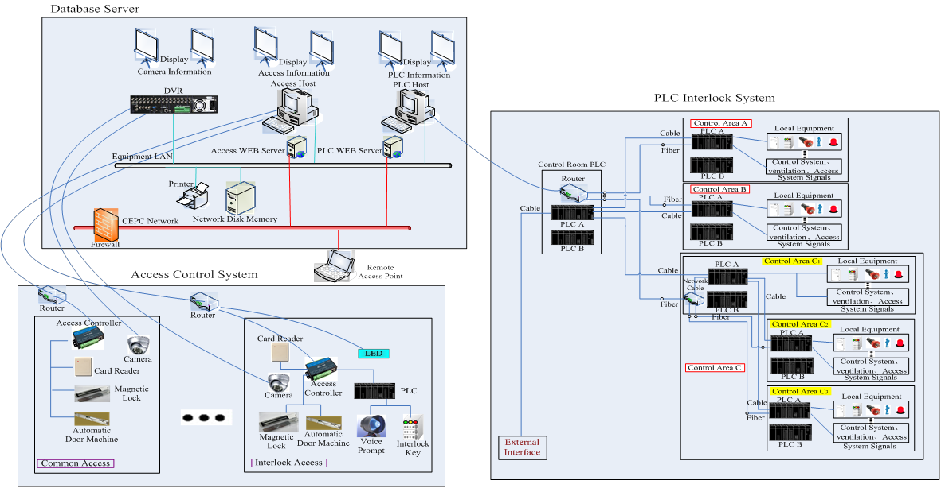
Schematic diagram of the PPS
  Including PLC system, access control system, database server

Slide 27
System Features
  Interlocking key: allowing either access or beam operation but not simultaneously.
  A requirement for secure search prior to operation.
  Door limit-switch : to establish an area interlocked
  Emergency switch : to stop the operation at emergency
  Personal key: ensure no one stays at the interlocked area during operation
Operation flow chart of the PPS

Slide 28
R&D
Radiation shielding methods and comparation between different codes, benchmark experiment on shielding simulation and activation calculation
High performance, real-time dose monitoring system
Pre-research on personal safety interlock system of large-scale accelerator

Slide 29
Summary
  Radiation shielding design must be more careful than for the existing accelerators in China for its big scale and influence.
  The major issues for the shielding design are source term estimation, bulk shielding, duct streaming, skyshine and activation.
  The methodology, benchmarking and data evaluation related to these issues should be verified and further for review
  FLUKA and MCNP are widely used for simulation design and verified each other independently, any other well developed, simple methods for quick estimation should be investigated.

Slide 30
Summary
One thing to be mentioned:
  In order save budget, the tunnel may have no concrete, the current plan is to pouring lime mortar to the rock tunnel in arc section.
  Except the radioactivity caused by total neutron and gamma tally, is there any other issues should be considered from the radiation shielding aspect?
  Radiation dose monitor system should be a state of the art system
  Personal protection system should be established more and more reliable and the access be strictly controlled
  Many radiation-related issues should be researched and clarified clearly to support this project to be approved by the government and interested and safety to the scientists around the world.

Slide 31
Thanks for your attention!

