Slide 1
Power supply and Electrostatic separator for CEPC
2017.11.07
Bin Chen
International Workshop on CEPC

Slide 2
Outline
  Preliminary requirements of the power supplies
  Design and progress for power supplies
  Design and progress for electrostatic separator
  Summary

Slide 3
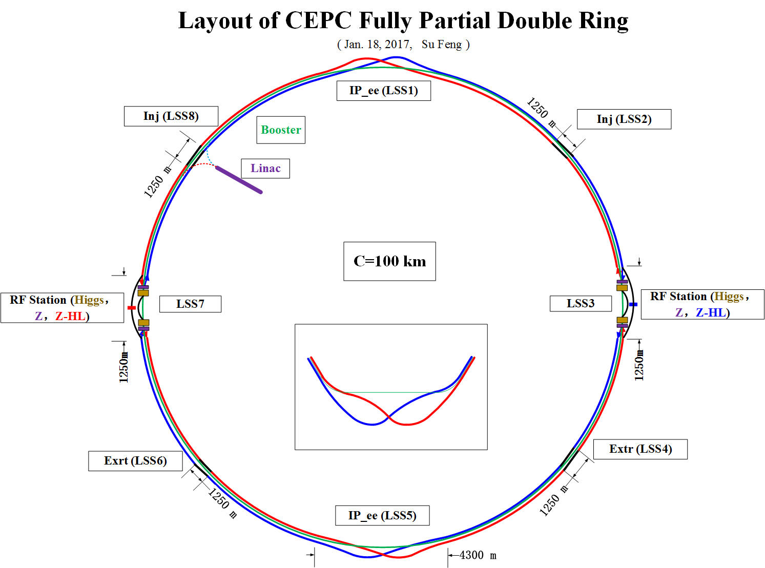
Based on the 8 Arc lattice layout

Slide 4
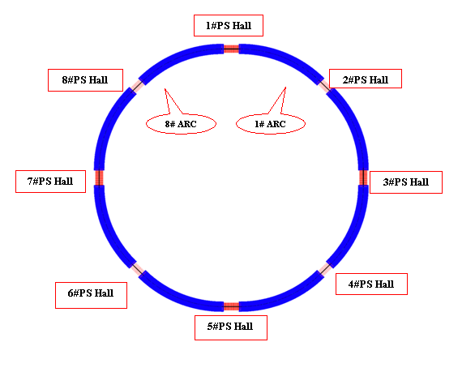
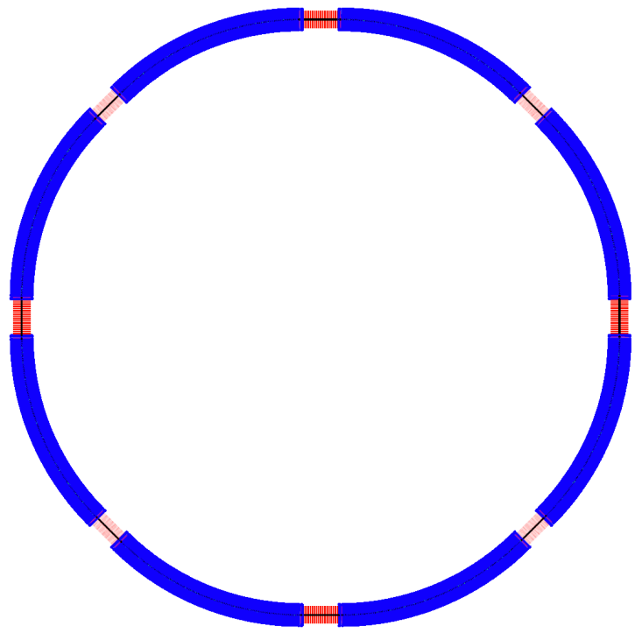
Distribution of the Power Supply
Power supply surface buildings will be located between the two ARC. In order to save the power cables, Same type magnets in two adjacent half-arcs will use one or two or four power supplies.

Slide 5
Distribution of the Power Supply
auxiliary stub tunnel
General Layout of the Underground Areas (from Pre-CDR)
Power supplies for single magnet load (e.g. correctors) will be installed at the auxiliary stub tunnel around the main tunnel, for reduced volume and high efficiency.

Slide 6
Power supply system: Main summary data
Storage Ring
Power Supply | Quantity | Stability /8hours | Output Rating | Total Power
D-aperture Dipole | 8 | 100ppm | 2240A/1170V | 20.96MW
S-aperture Dipole | 66 | 100ppm | ?? | 2.92MW
D-aperture Quadrupole | 32 | 100ppm | 290A/3400V | 31.55MW
S-aperture Quadrupole | 934 | 100ppm | ?? | 24.87MW
Sext.D | 896 | 100ppm | 190A/100V | 17.02MW
Sext.F | 896 | 100ppm | 200A/65V | 11.65MW
Sext | 48 | 100ppm | ?? | 1.40MW
SCQ | 8 | 50ppm | 3000A/10V | 0.24MW
Anti-Solenoid | 4 | 50ppm | 2400A/10V | 0.096MW
Corrector | 5800 | 500ppm | 50A /30V | 8.70MW
Total | 8692 |  |  | 119.4MW

Slide 7
Booster Power Supply System
Design principles of the booster power supplies：
Based on the current waveform requirement of the dipoles, quadrupoles and sextupoles(as shown below, the repetition rate is 0.1Hz); the rating voltage considering the inductive value caused by the magnet inductance.
The magnetic field cycle waveform for CEPC booster

Slide 8
Power supply system: Main summary data
Booster
Total Max power：38.9MW; Total Avg power：15.6MW
Power Supply | Quantity | Stability /tracking error | Output Rating | Total Power
Dipole | 16 | 500ppm / 0.1% | 1000A/1050V | 16.8MW
Quadrupole | 32 | 500ppm / 0.1% | 360A/1700V | 19.6MW
Sext.D | 16 | 1000ppm / 0.1% | 140A/440V | 0.19MW
Sext.F | 16 | 1000ppm / 0.1% | 140A/440V | 0.19MW
Corrector | 360 | 1000ppm | 100A /60V | 2.16MW
Total | 440 |  |  | 38.9MW

Slide 9
Power supply system: Main summary data
Linac
CEPC power supply system basic summary
For 100km fully double ring scheme
Total power supplies quantity：about 9400
Total power： about 160MW
Power Supply | Quantity | Stability /8hours | Output Rating | Total Power
Dipole | 13 | 500ppm | 140A/140V | 0.255MW
Quadrupole | 245 | 500ppm | 220A/24V | 1.294MW
Solenoid-1 | 5 | 500ppm | 400A/480V | 0.960MW
Solenoid-2 | 22 | 500ppm | 10A/50V | 0.011MW
Total | 285 |  |  | 2.52MW

Slide 10
Design principles for the power supply system
The following shows the basic design principles for the power supplies:
According to magnets parameters and connection modes, and considering cables loss, to determine the power supplies current and voltage ratings, which include 10 ~ 15% safety margins.
Water cooling for power supplies with power above 1kW, and air-forced cooling for others
High reliability, better EMC, operational redundancy and convenient structure for maintenance.
Modular design for most power supplies
Fully digital design for all power supplies.
Switching mode as the main topology.

Slide 11
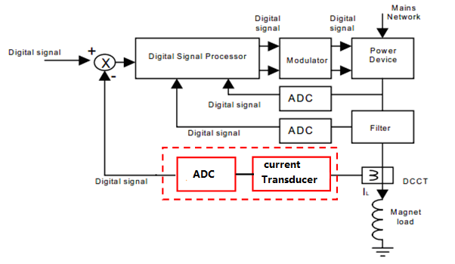
Digital controller
Electronics is one of the important part of a high precision power supply. Digital control technology will be applied to CEPC power supplies. Traditional analog electronics will be replaced by digital electronics . A fully-digital control module will be employed in all power supply. The module will be responsible for the high precision closed-loop feedback within the power supply and the communication with the CEPC control room. The control module principle block diagram is shown below.
Block diagram of the digital control module

Slide 12
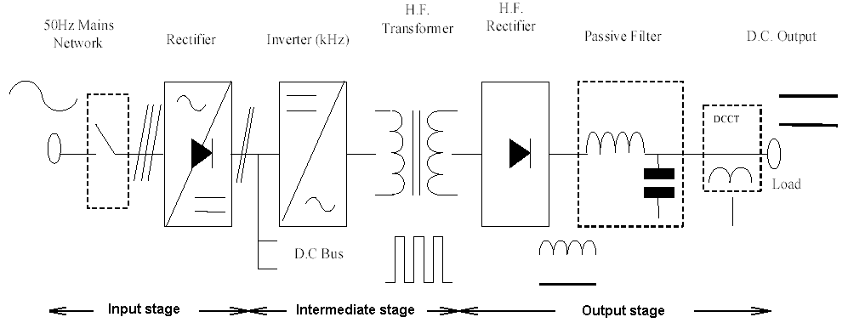
Topology of power supply
Switch-mode technology will be used in most cases.
considerable size reduction (volume and weight) for transformers and filter
improved dynamics
better rejection of the mains perturbations
lower ripple of the output voltage.
Basic structure of a switched-mode power converter
1. Input stage – provides the interface to the mains as well as rectification of the input voltage.
2. Intermediate stage – performs high frequency switching and modulation of an AC voltage that drives the high frequency transformer.
3. Output stage – performs the rectification and filtering of the AC voltage and impedance matching to the load.

Slide 13
R&D Prototype design
  3000A/10V 、2400A/10V High-precision (50ppm) power converter
    For superconducting magnets excitation
  Digital power supply control module

Slide 14
The Specifications of High-precision power converter
DC maximum output current –Imax（A） | 3000/2400
DC output voltage（V） | 10
operating quadrants | 1；(V+，I+)
stability (8 h–10 s) – referred to Imax（ppm） | 50
stability (10 s–0 s) – referred to Imax（ppm） | 20
Reproducibility(1 d) – referred to Imax（ppm） | 100
absolute accuracy – referred to Imax（ppm） | 100
current ripple – referred to Imax（ppm，50Hz and greater） | 20

Slide 15
design for the High-precision power converter
  the power converters are split in three independent parts
    A power part acting as a voltage source, which is suitable for industrial design and production
    Current transducers （Commercial Product or Self-design)
    Self-designed digital electronics control module, which performs the current regulation, diagnostics, monitoring and local/remote service . It’s standardized for all types of power supply.

Slide 16
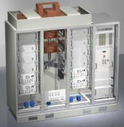
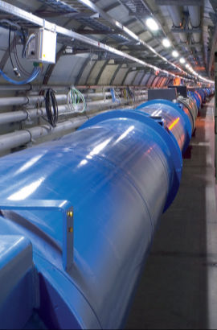
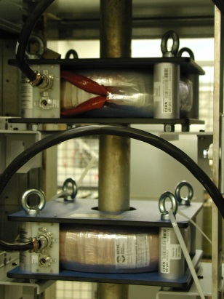
design for the High-precision power converter
Digital Current loop:
promise current with high precision
Voltage loop:
ensuring low voltage ripple
I
B
Iref
Vref
+
e_{I}
Reg.
V
DAC
G(s)
-
e_{V}
F(z)
I_{measured}

Slide 17
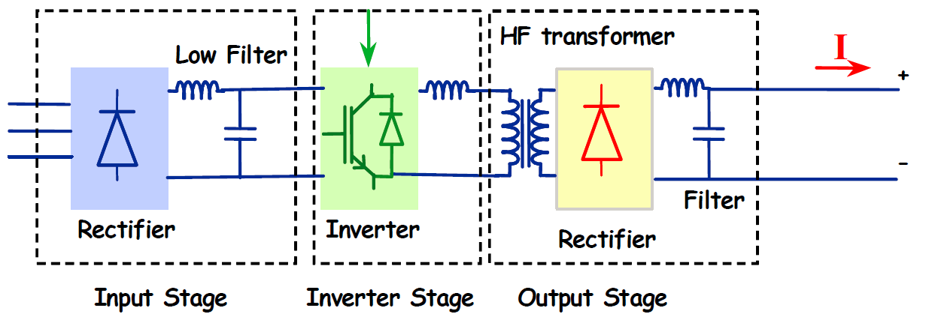
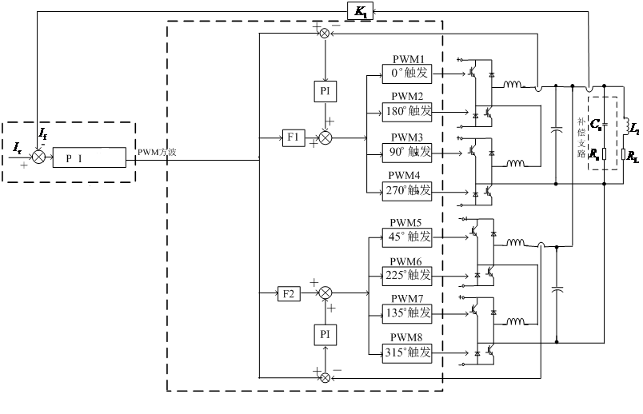
The topology of High-precision power converter
Parallel technology of multiple modules
Pulse width multiple stagger phase technology

Slide 18
Digital Power Supply Control Module
  Digital Power Supply Control Module (DPSCM) : used in the project CSNS, ADS injector-I, and BEPCII
  all algorithms and peripherals control entirely implemented in one FPGA.
  Control cycle achieving less than 1us, it is about several times faster than DSP-based design.

Slide 19
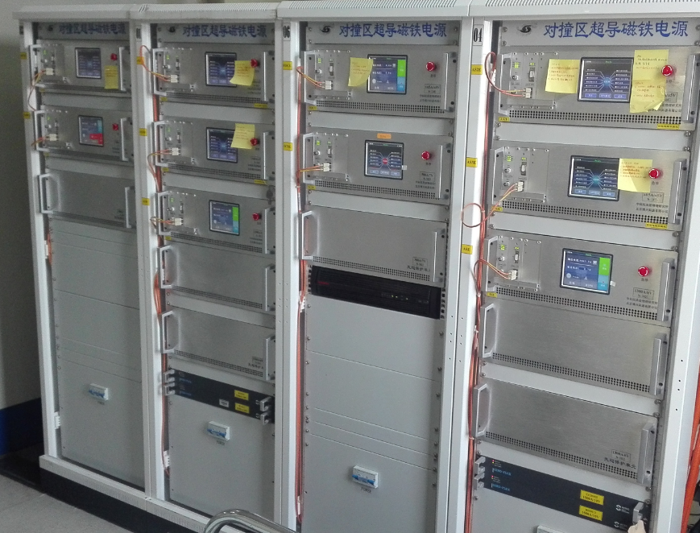
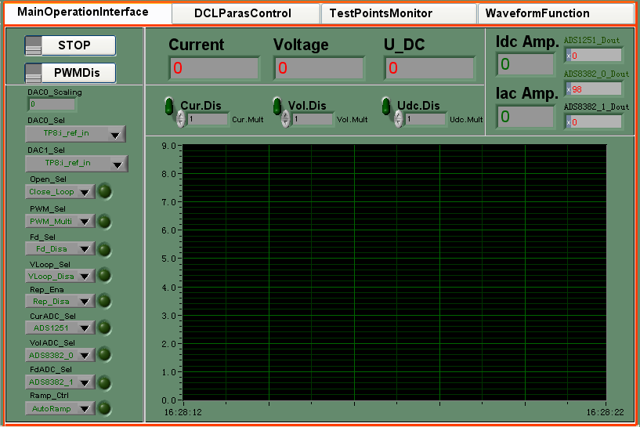
Digital Power Supply Control Module

Slide 20
DPSCM-II for CEPC power supplies
DPSCM-MB: PID + modern
control theory; cost-effective
high precision ADC board DPSCM-AD: temp control
the voltage source interfacing board DPSC-DA
the diagnostic board DPSCM_MDA

Slide 21
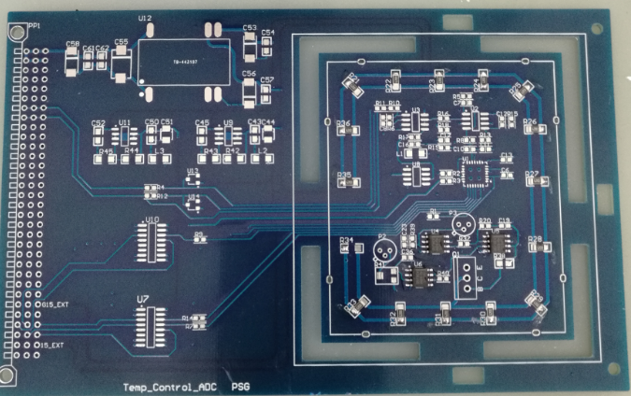
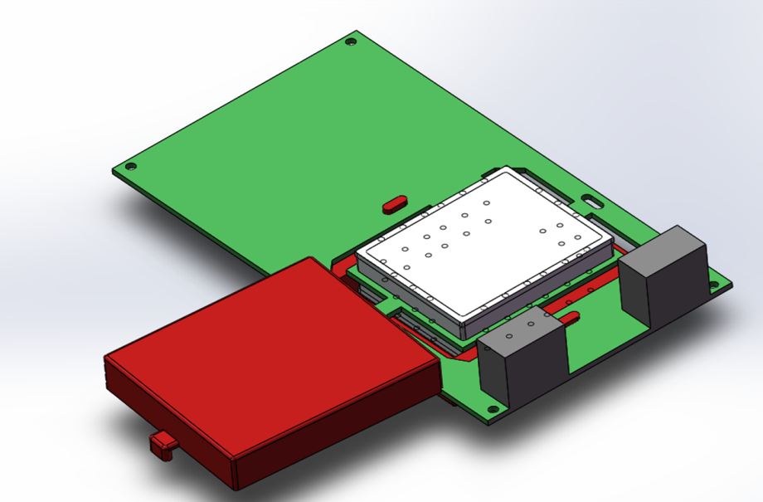
DPSCM-II progress
DPSCM-MB: hardware design is ongoing, PID + modern control theory have been implemented and tested on the FPGA development board.
high precision ADC board DPSCM-AD: finished temp-controller individually; now the test on the ADC board is ongoing
the voltage source interfacing board DPSC-DA: finished
the diagnostic board DPSCM_MDA: finished

Slide 22
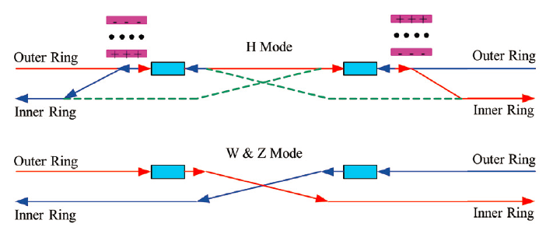
Electrostatic separator for CEPC
  In the RF region, the RF cavities are shared by two ring. A set of electrostatic separators combined with a dipole magnet are used to deflect the outgoing beam and avoid bending of incoming beam. After the combined magnet, there is a drift as long as 75 m to make the two beam distance as large as 10 cm at the entrance of quadrupole.
Layout of RF region

Slide 23
Parameters from physics design on electrostatic separator
Beam energy : 120GeV
Total number of units : 48
Field length per unit : 4m
Gap height : 110mm
Maximum operating field strength : 2MV/m
Maximum deflection per unit : 62.5urad
  Since any HV breakdown between the Electrodes can cause an important reduction in luminosity or even a complete loss of the stored beam, the electrostatic field in the electrode gap is limited to 2MV/m.

Slide 24
Parameters of electrostatic separator
Separator length | 4.5m
Inner diameter of separator tank | 540mm
Electrode length | 4.0m
Electrode width | 260mm
Nominal gap | 110mm
Maximum operating field strength | 2MV/m
Maximum operating voltage | ±110kV
Maximum conditioning voltage | ±160kV
Maximum deflection | 62.5urad
Horizontal good field region (1% limit) | ±80mm
Nominal vacuum pressure | 2.7e-8 Pa

Slide 25
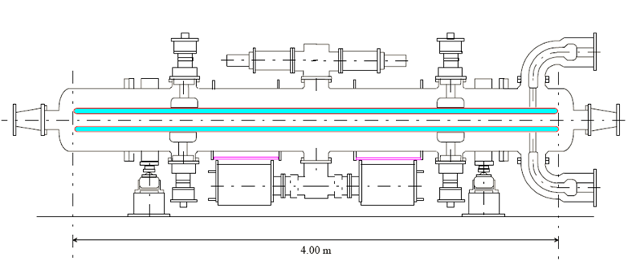
R&D Prototype design
  A separator unit including: a pair of electrodes, UHV tank, metal-ceramic supports, high voltage feedthrough, High voltage circuit, vacuum system.
schematic diagram of separator

Slide 26
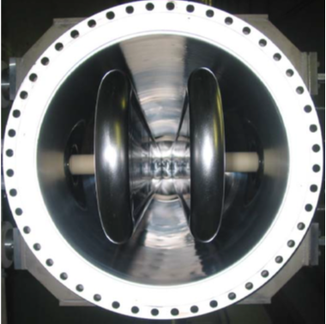
Prototype Design
Electrode (a pair of hollow metal flat plate)
Dimension : 4m long and 260mm wide
Material : Stainless steel
  Separated direction : Horizontal
  Field strength : 2MV/m
– Electrode material
– Surface preparation
  Cooling :
– Parasitic mode losses
– Equip with a simple closed-loop Cooling system

Slide 27
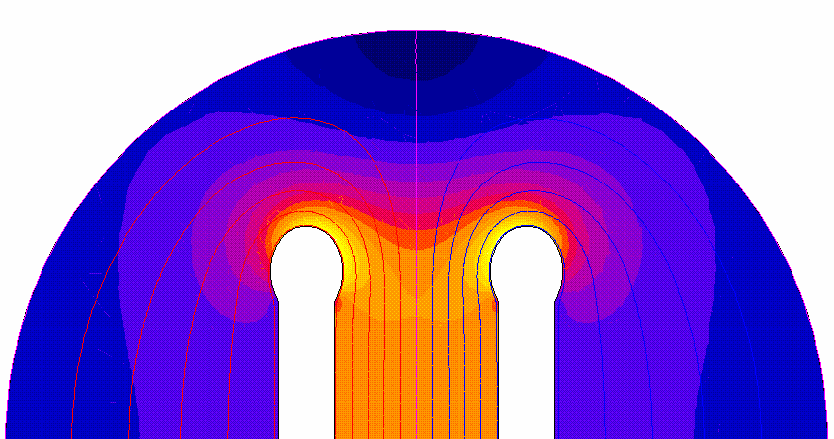
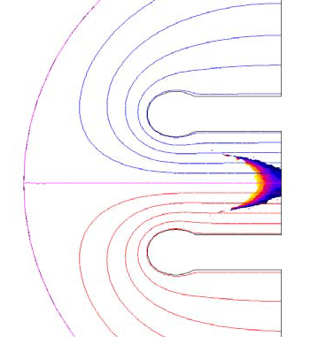
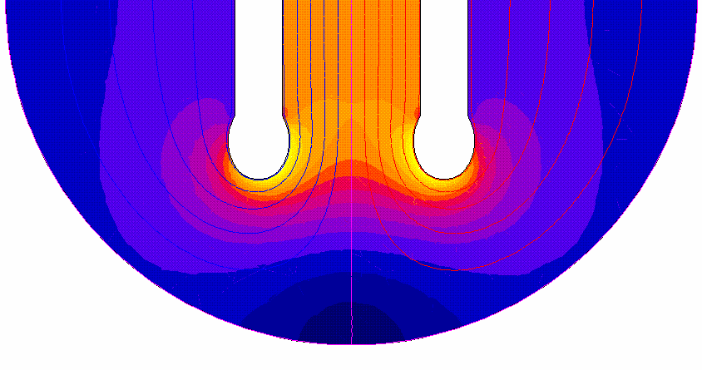
Prototype Design
Electrode
Field homogeneity : 1‰ in 10 x 10 mm²
– Electrode shape
ZL: 1‰ for 25 x 13 mm
Field distribution
Field homogeneity

Slide 28
Prototype Design
Electrode support
Each electrode is supported by two metal-ceramic supports, which insulate the electrode from the vacuum tank
Electrode cooling liquid channel
Insulator material and insulator treatments
HV feedthrough
Each electrode can be charged to its nominal voltage via a high voltage feedthrough
design voltage : up to 160 kV
Modular: can be exchanged in case of failure without removal of separator from beam line

Slide 29
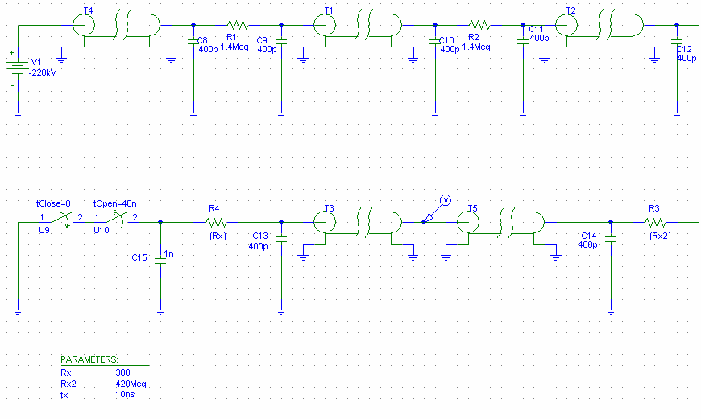
Prototype Design
HV power supplies
Including : two HV supplies of maximum 160kV, 3mA output – one positive and one negative polarity.
– Voltage margin for conditioning, Current margin to cope with dark current / beam loading / recovery after sparking
discharge resistor : 10MΩ
Stability of power supply : 0.5%

Slide 30
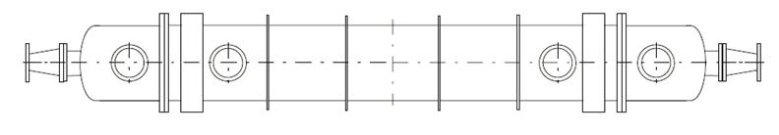
Prototype Design
Vacuum System
To minimize the breakdown rate, the vacuum in all separators will be kept at the low pressure of about 2.7e-8 Pa
Residual gas contents
Including: tow sputter ion pump ( pumping speed 800l/s), and two sublimation pump ( pumping speed 1300l/s).
Bake out at a temperature of up to 300℃.
UHV tank
Dimension : 4.5m long and 540mm inner diameter
Material : stainless-steel

Slide 31
Key issues
  In CEPC, the beam energy and the gap voltage are all quite high. Therefore the following problems must be handled well.
To reduce the impedance
Add ground electrodes into the zero potential planes
To absorb the high order modes (HOMs)
Design outer absorber and inner absorber
  Heats and extraction method
To reduce the sparking rate
HV vacuum feedthroughs and supporters of electrode are arranged under the electrodes to avoid the SR.
To design the masks located at the upstream of separator to obstruct the SR.
To limit the maximum field at end of electrodes.

Slide 32
Summary
The number of power converter types should be optimised.
Power supply is made with modular concept for convenient maintenance and redundancy design.
Switching mode as the main topology for power convertor, and The DPSCM-II will be embedded into it.
Series-parallel connection technology of modular are under study, to provide the load with the needed high voltage and current.
Electrostatic separator’s key issues are under study.

Slide 33
Thank You!

