Slide 1

Status of International Collaboration for CEPC Detectors R&D
Haijun Yang (SJTU)
Contributed from: Hongbo Zhu, Meng Wang, Huirong Qi, Manqi Ruan, Xinchou Lou
CEPC International Workshop
IHEP, Beijing, November 8, 2017

Slide 2
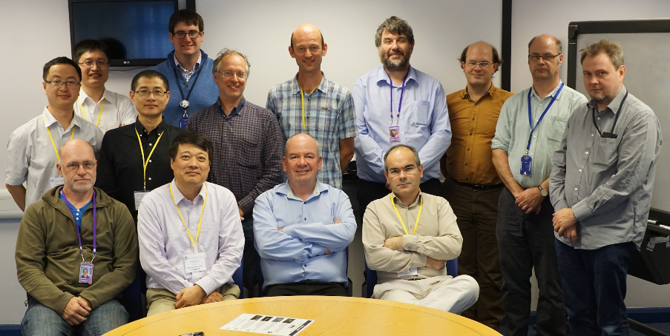
Collaboration on Silicon Strip
IHEP/RAL
Intended contribution of ~1000 barrel strip modules for the ATLAS Phase II ITk upgrade
IHEP established strong collaboration with STFC-RAL
  Have started staff rotation plan (2 FTE) toward the end of module mass production → 500 modules with RAL’s support
  Dedicated training for wirebonding technician
  Financial contribution to international fellowship
Group visit in September 2016 and meeting the UK ATLAS-ITk project management
IHEP-RAL MoU in preparation

Slide 3
Collaboration on Silicon Strip
IHEP/DESY/SLAC
Collaboration with DESY
  Funded CAS-Helmholtz joint research group on advanced silicon detectors for HL-LHC (2015-2017)
  China and Germany Postdoctoral Exchange Program → 2 postdocs as main developers of EUDAQ and EUTelescope and provide technical support of EUDET beam telescopes
  Student exchanges via the DESY summer student program
Collaboration with SLAC
  Joint R&D effort on CHESS 2 (HV-CMOS strip sensor), in particular on sensor characterization
  Joint postdoctoral positions (topics of common interests)

Slide 4
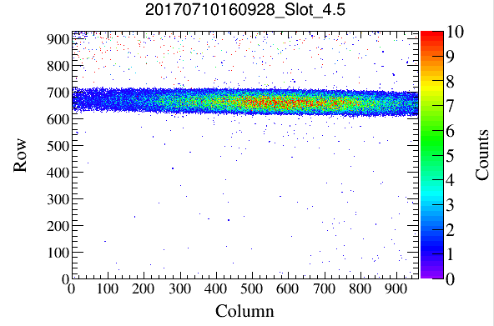
Collaboration with IPHC, Strasbourg
R&D on a pixelated tracker using CMOS pixel sensors (CPS)
  a project originally aimed at the upgrade of BES3 inner drift chamber,
  building a 1/10 prototype
  based on MIMOSA-28, chips used for STAR-PXL
  investigating design of large-dimension pixels
IHEP+CCNU+SDU
IPHC, Strasbourg
pixel response tested with ⁵⁵Fe

Slide 5
Collaboration with IPHC, Strasbourg
Electron collider oriented pixelated CMOS sensor development
  aimed at the future CEPC and ILC colliders
  exploit the potential of CPS technology
    readout < 1 µs
    pixel dimensions small enough to reach a spatial resolution < 3 µm
    power consumption compatible with a low mass cooling system
  tape-out in May 2017 with digital pixels
IHEP+CCNU+SDU
IPHC, Strasbourg
asynchronous
rolling shutter

Slide 6
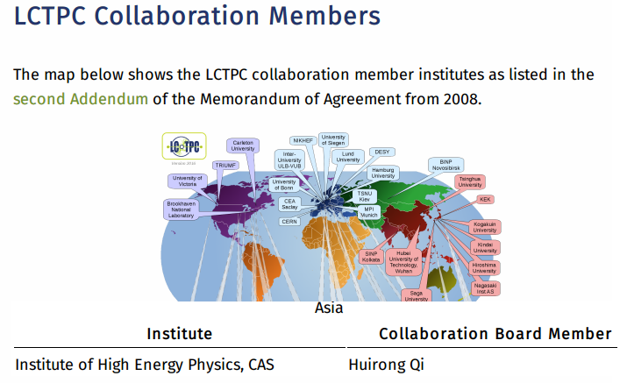
Collaboration of LC-TPC R&D
LC-TPC international collaboration group (LCTPC)
  Singed MOA and joined in LC-TPC collaboration @Dec. 14,2016
  As coordinator in ions test and the new module design work package
  Regular meeting bi-weeks
  Plan to beam test in DESY with our TPC prototype with 266nm laser calibration and the hybrid gaseous detector in 2018
IHEP/LC-TPC
Joint LCTPC international collaboration

Slide 7


Collaboration of LC-TPC R&D
CEA-Saclay IRFU group (FCPPL)
  Three vidyo meetings with Prof. Aleksan Roy/ Prof. Yuanning/ Manqi and some related persons (2016~2017)
  Exchange PhD students: Haiyun Wang participates Saclay’s R&D six months in 2017~2018
  Bulk-Micromegas detector assembled and IBF test
  Optimized designed Micromegas module with more 590 LPI
LC-TPC collaboration Japan group (KEK)
  Joint dE/dx analysis of the beam test data@2016
  Regular meeting every week
  Optimized designed wider hole GEM module with 90-70-90

Slide 8
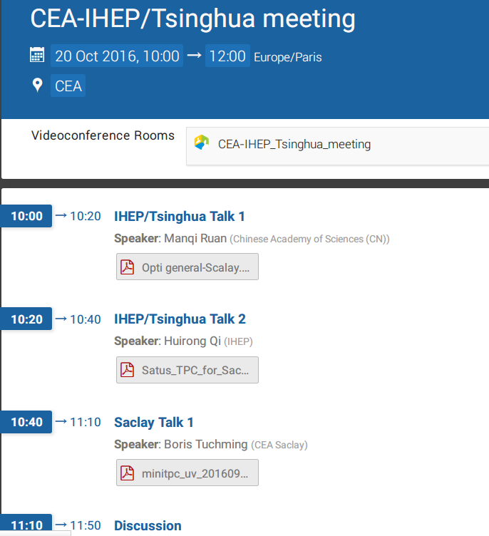
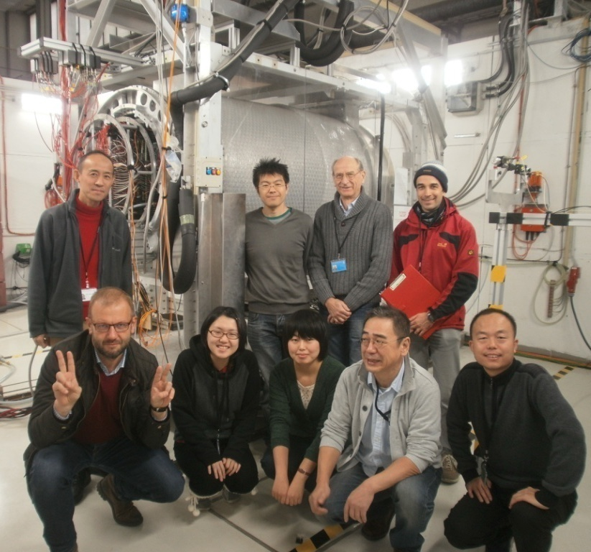
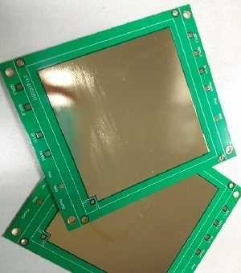
Collaboration of LC-TPC R&D
Collaboration with CEA-Saclay
Collaboration with KEK/DESY
Joint meeting with Saclaty/THU/IHEP
Design the Micromegas PCB boards
Prepare to assemble the R/Micromegas
GEM module with gate GEM in 1.0 Tesla
5.0Gev electron beam test
Join in group and participate in analysis

Slide 9
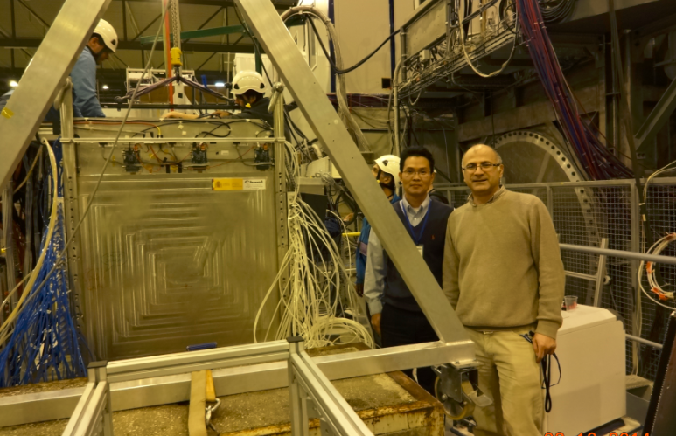
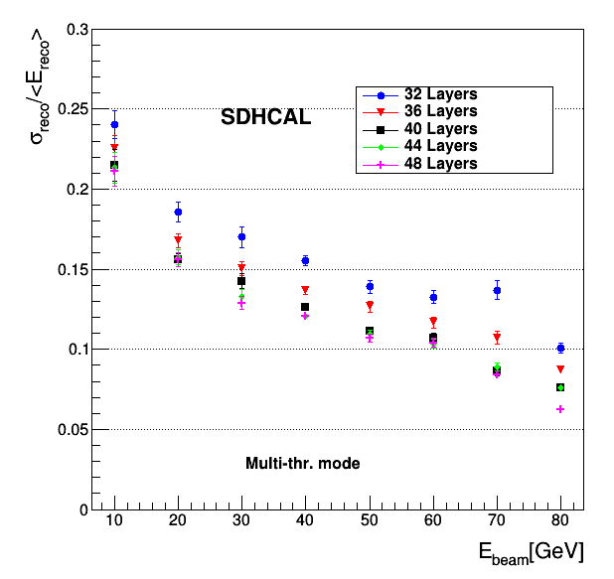
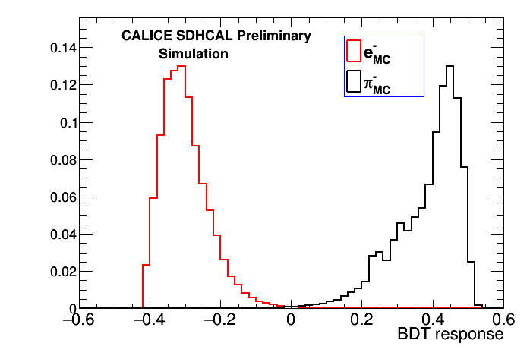
Join the CALICE Collaboration
THU/SJTU/CALICE
THU and SJTU joined the CALICE Collaboration
Collaborating with Imad Laktineh (IPNL) on SDHCAL R&D.
We have a joint Ph.D student via CSC program (2years). CAN-059 about using BDT to improve pi/e/mu separation is under review process.
SJTU will host the CALICE collaboration meeting on Sept. 19-21, 2018. https://agenda.linearcollider.org/event/7799/
e-
pi
➔ IHEP and USTC plan to join the CALICE to work on ScW ECAL and AHCAL

Slide 10
Collaboration on Detector Design & Optimization

Slide 11
Some Suggestions
Fruitful discussions and suggestions:
  join existing workshop groups (eg. ILC, FCC-ee)
  have joint group meetings on specific topics
  invite international colleagues to join CEPC working group
  work closely and be a part of detector R&D
  seek funding via joint proposal (eg. IHEP/USTC - INFN)
  joint Ph.D students via CSC program
  joint postdoc to work on CEPC R&D
  ……

