Slide 1
Mechanical system of CEPC
Haijing Wang, Huamin Qu, Jianli Wang,
Ningchuang Zhou, Minxian Li, Shujin Li
November 7, 2017,IHEP
First international workshop of CEPC

Slide 2
outline
Magnet support system
Tunnel cross section
Study of movable collimator
Summary

Slide 3
Magnet support system
Magnet supports in Collider and Linac
Magnets are supported to the ground.
Dozens of thousands of magnet supports are needed in Collider.
Hundreds of magnet supports are needed in Linac.
Aim: Simple and flexible structure, minimizing the magnet deformation, good stability, low cost...
Supports for dipole magnets (~5,000 mm, twin-aperture):
2 main supports and 2 auxiliary supports.
Main support: Support and 6 DOFs adjustment.
Auxiliary support: Support.
Support for Quadrupole magnet (~2,000 mm, twin-aperture):
2 supports for 1 magnet.
Support for Sextupole magnet (600 mm/1,200 mm, single aperture):
1 support for 2 magnets.

Slide 4
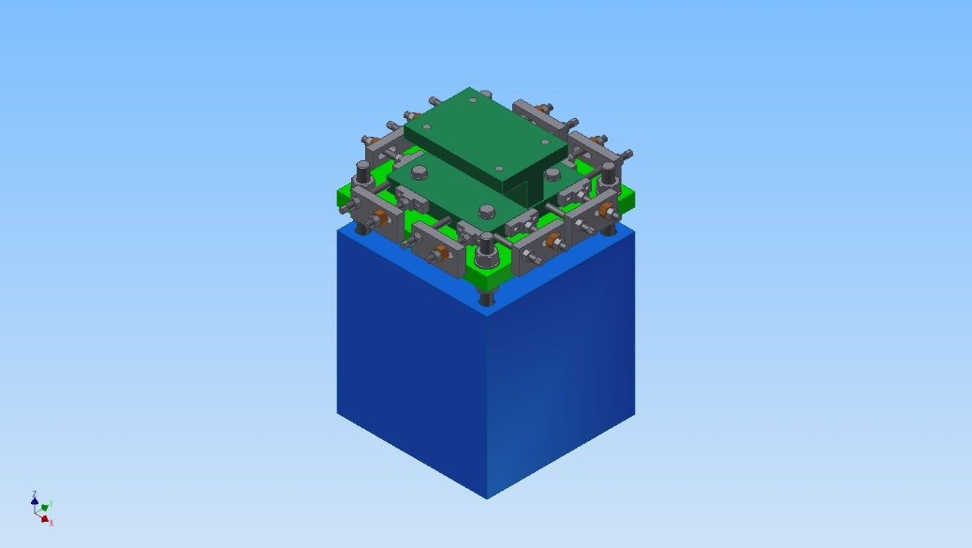
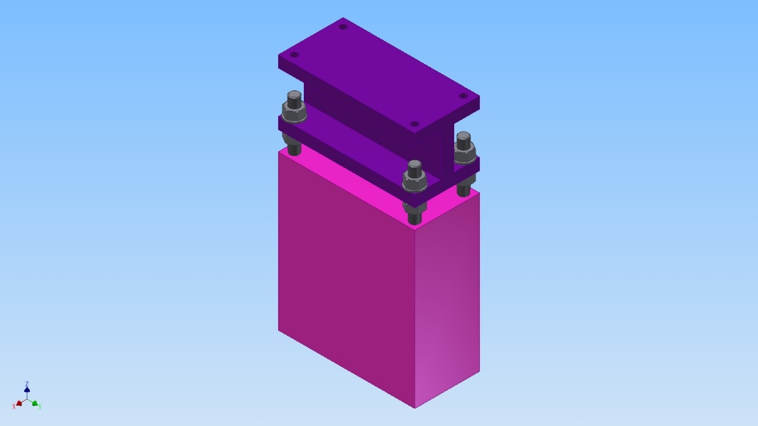
Magnet support system
Magnet supports in Collider
One support concludes pedestal, adjusting mechanism and magnet mounting plate.
Pedestal: concrete.
Adjusting mechanism: adjusting and fixing magnet.
Mounting plate: between magnet and adjusting mechanism.
Mounting plate
Adjusting mechanism
Pedestal
Main support
Auxiliary support

Slide 5
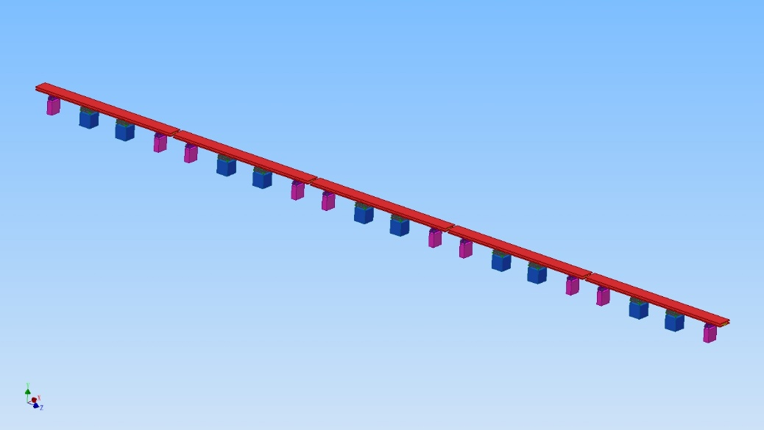
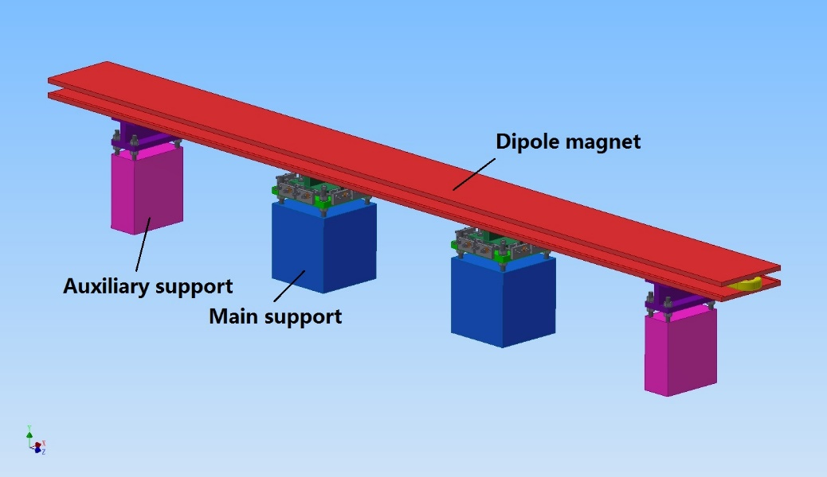
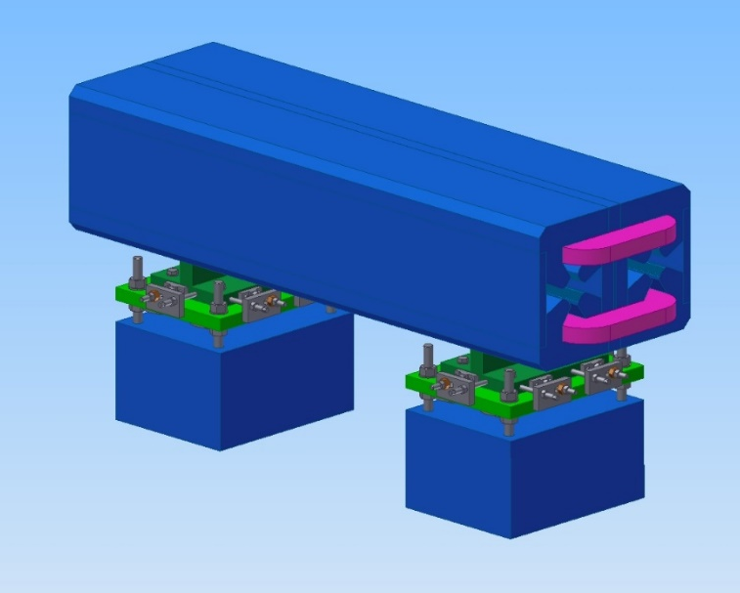
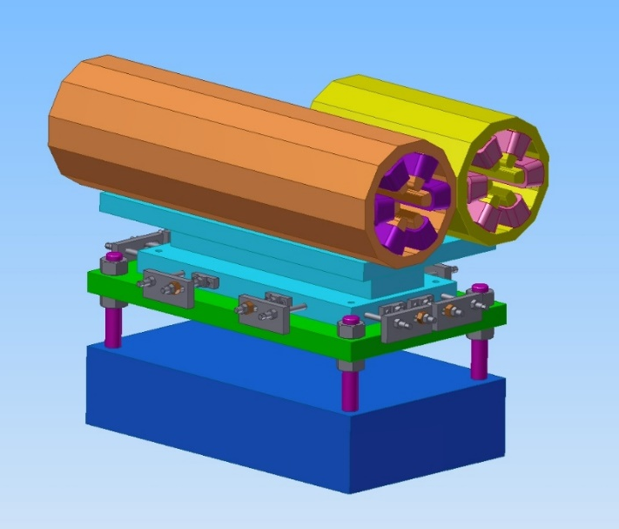
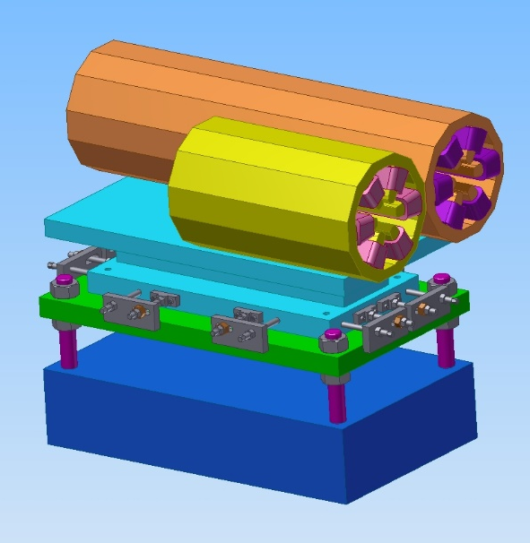
Magnet support system

Slide 6
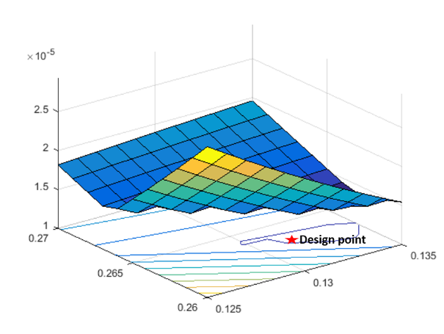
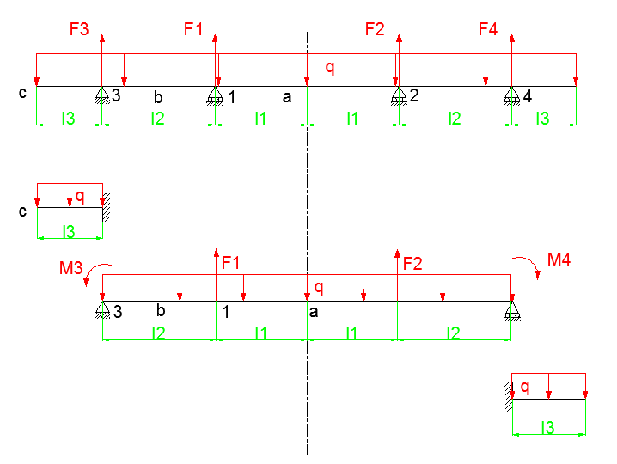
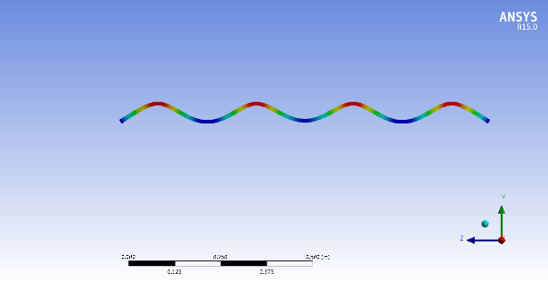
Magnet support system
Distribution of support points for dipole magnets
Supposing the dipole magnet module as a slender beam.
Aim: Minimizing the maximum deformation.
Method: Response Surface design & Theoretical calculation using MATLAB.
Can be used for all kinds of “long” magnets.

Slide 7
Magnet support system
Magnet supports in Booster and Transport Line
Magnets in Booster: 1.5 meters above the Collider, hanged on the wall of the tunnel.
Magnets in BTC (Booster to Collider): Hanged on the wall of the tunnel.
Magnets in LTB (Linac to Booster): Supported on the ground.
Dozens of thousands of magnet supports are needed in Booster and BTC.
Hundreds of magnet supports are needed in LTB.
Aim: Simple and flexible structure, minimizing the magnet deformation, good stability, low cost...
Supports for dipole magnets (~5,500 mm):
2 main supports and 2 auxiliary supports.
Support for other magnets :
1 or 2 supports for 1 magnet.

Slide 8
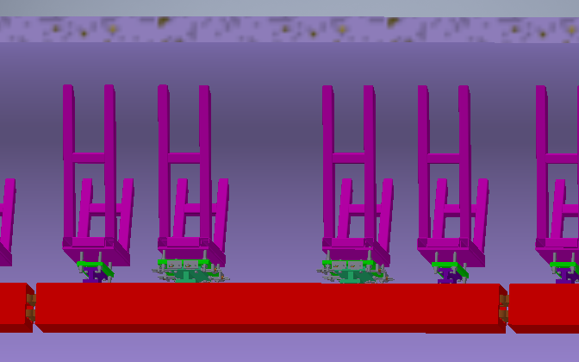
Magnet support system
Magnet supports in Booster and Transport Line
Main support: Support and 6 DOFs adjustment.
Auxiliary support: Support.
Key technologies
The hang-up of the magnet.
Stability.
Water-proof.

Slide 9
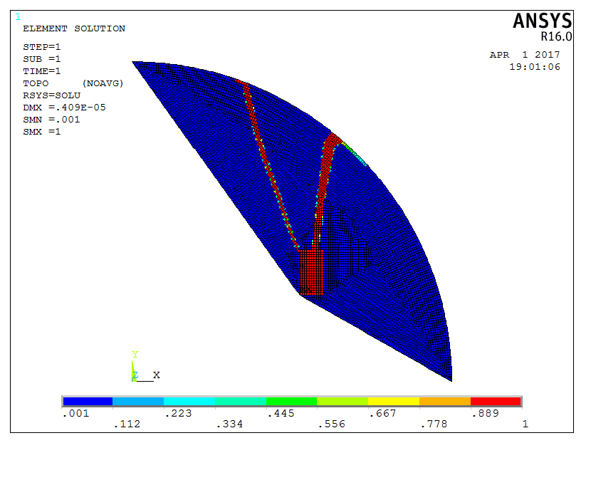
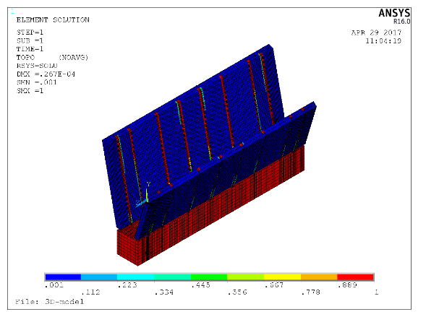
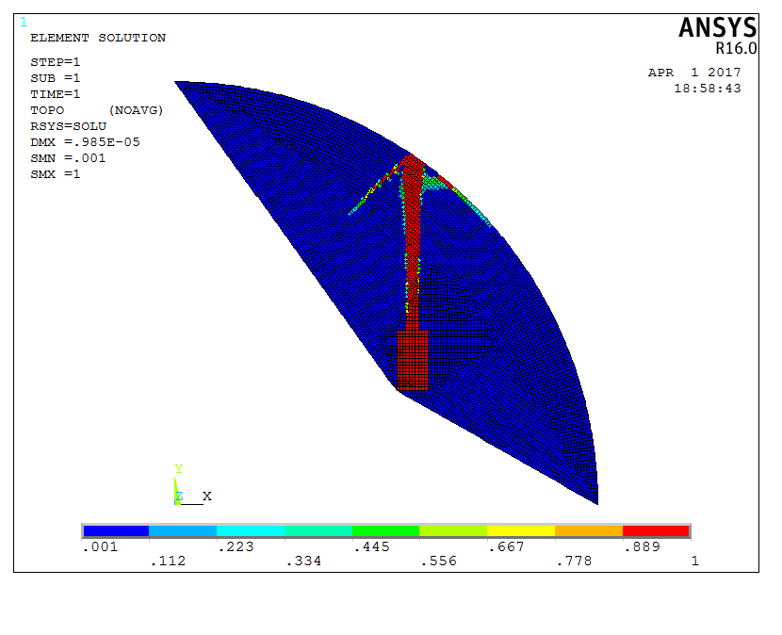
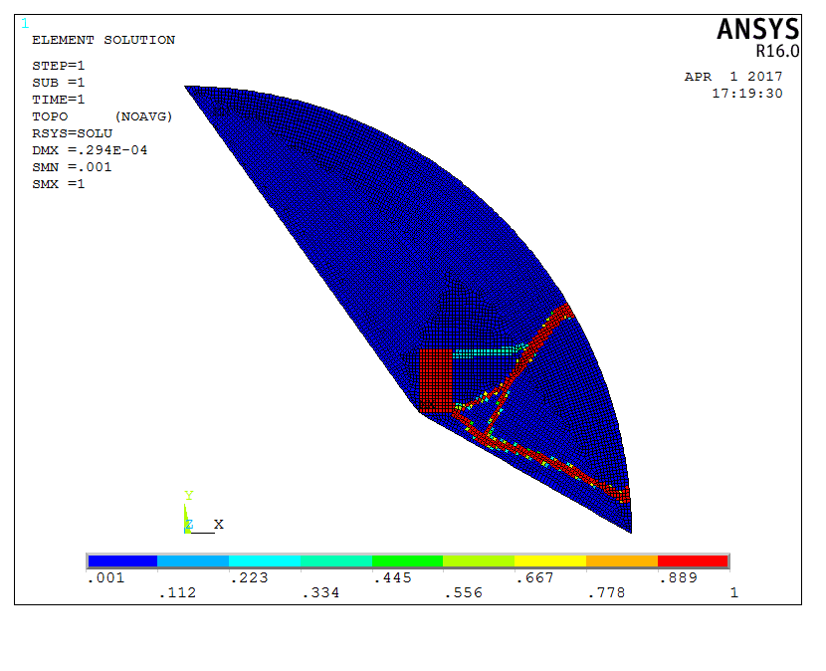
Magnet support system
Topology optimization of magnet supports
Constraint: Volume. Objective function: Structure supple degree .
Can be used for all magnets hanged on the wall of the tunnel.

Slide 10
Magnet support system
Requirements of Magnet supports
Stability with large time constants, avoiding creep and fatigue deformation.
Simple and reliable mechanics for safe mounting and easy alignment.
Good vibration performance.
Good water-proof performance of the tunnel, especially at the mounting locations.
 | Range of adjustment | Accuracy of adjustment
X | ≥±20mm | ≤±0.02mm
Y | ≥±30mm | ≤±0.02mm
Z | ≥±20mm | ≤±0.02mm
Δθx | ≥±10mrad | ≤±0.05mrad
Δθy | ≥±10mrad | ≤±0.05mrad
Δθz | ≥±10mrad | ≤±0.05mrad

Slide 11
Tunnel cross section
In the tunnel of CEPC, there are the double ring Collider, the Booster, the SPPC Ring and corresponding conventional facilities and cables, and lots of transportation, installation and adjustment are to be done in the tunnel.
The computer aided engineering (CAE) software are used for space design.
The cross section of the tunnel will be as compact as possible to lower the cost.

Slide 12
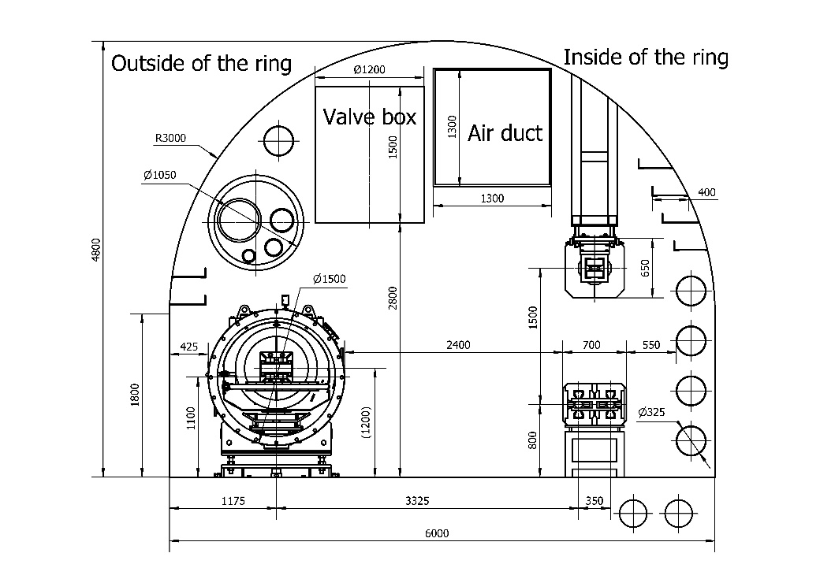
Tunnel cross section
Tunnel cross section at arc-section
Width: 6,000 mm. Height: 4,800 mm.

Slide 13
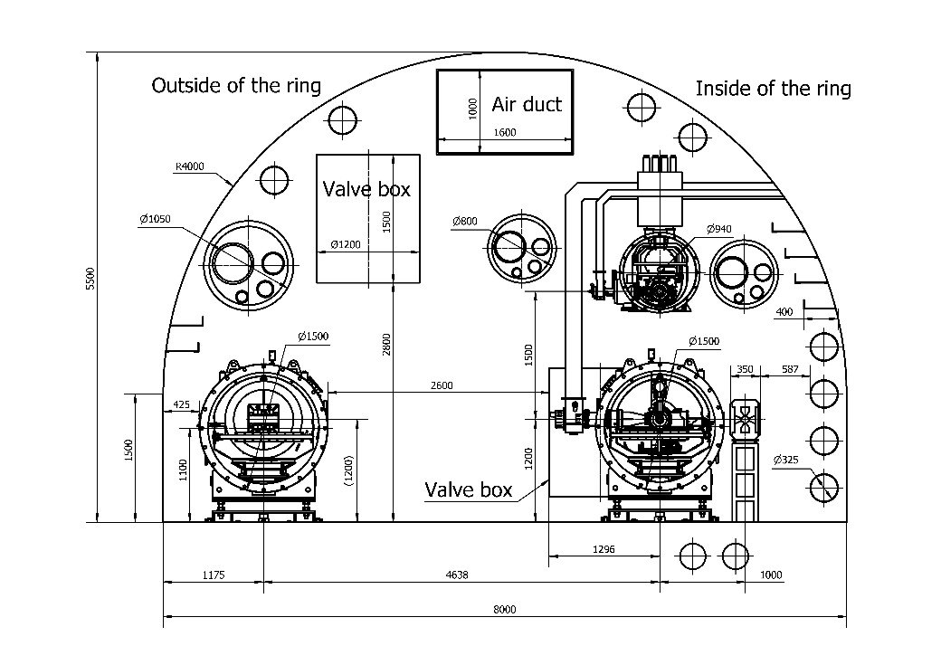
Tunnel cross section
Tunnel cross section at RF-section
Width: 8,000 mm. Height: 5,500 mm.

Slide 14
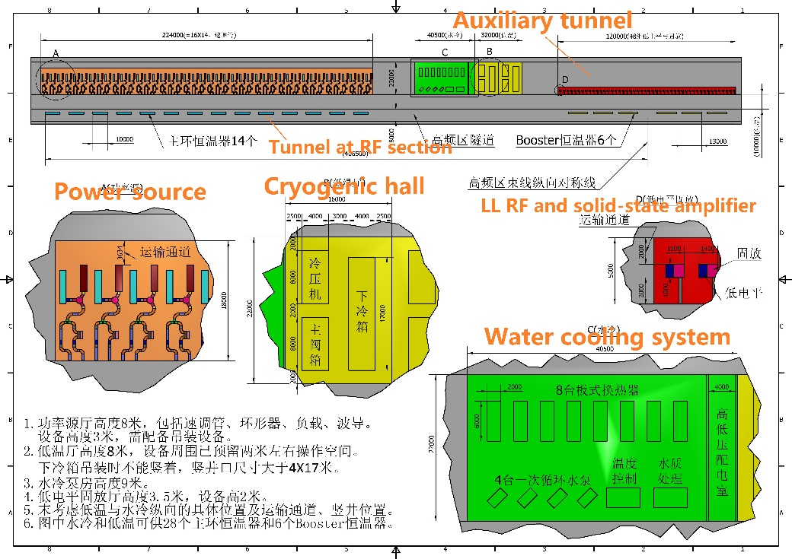
Tunnel cross section
Auxiliary tunnel at RF section
Parallel to the tunnel, 22 meters wide and 813 meters long.

Slide 15
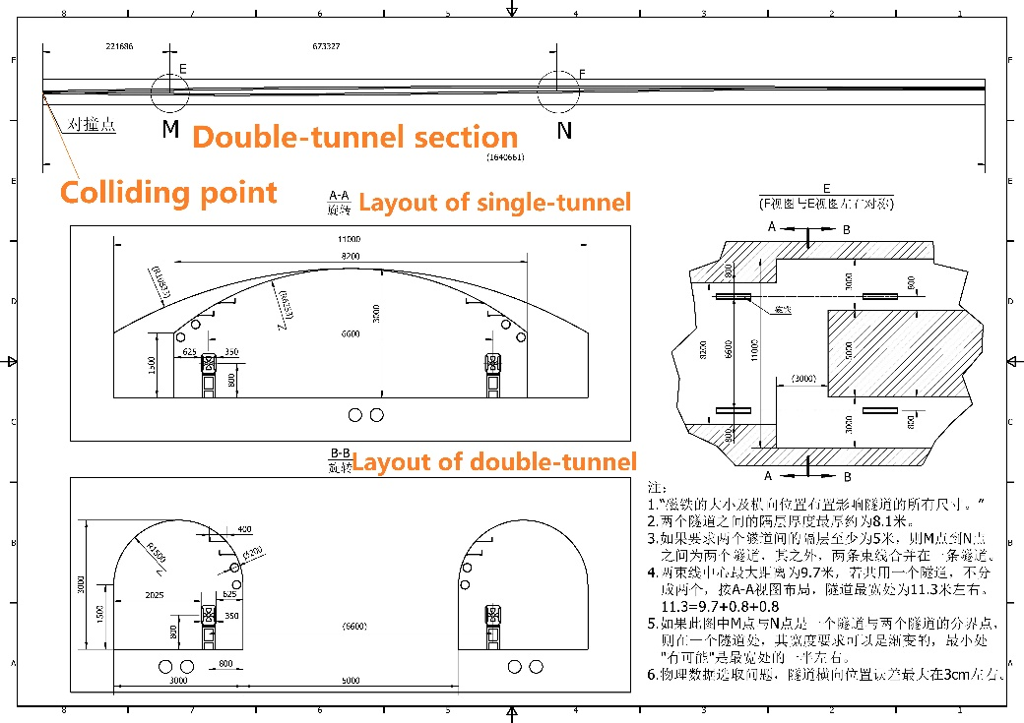
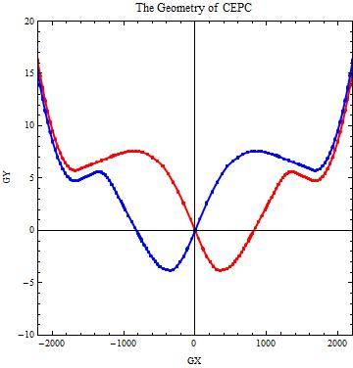
Tunnel cross section
Tunnel at colliding point.
Double-tunnels about 670 meters each, symmetry in the colliding point.

Slide 16
Tunnel cross section
Mockup of the tunnel
We are considering to make a mockup, the arc-section will be chosen because it forms the majority of the tunnel.
To double-check the integration of 3D models of the tunnel layout, to imitate the transportation, installation and alignment of the devices in the tunnel, to provide space to do some test like the magnet vibration and, to give a visual presentation of the tunnel.
Design support system to support all the prototypes needed to be installed in the mockup.
Develop some necessary tools for the mockup.

Slide 17
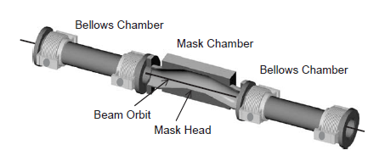
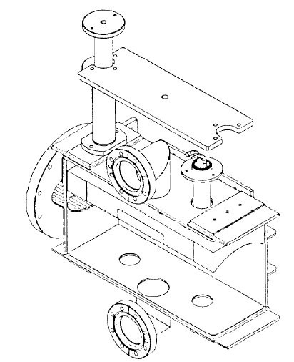
Study of movable collimator
Two types of collimators.
Four for reducing background of the particle detector and dozens for regular beam collimation .
Not designed yet. The technical routes are:
Design the inner profile according to the physical requirements, like low impedance.
Calculate and optimize thermal and mechanical status use FEA.
Design and develop a prototype with simple and flexible structure.
Movable collimator of KEKB
Movable collimator of Super KEKB
Movable collimator of LEP

Slide 18
Summary
Plenty of magnet supports are need for CEPC. Preliminary design of magnet support system is done. The aims are simple and flexible structure, minimizing the magnet deformation, good stability, low cost and so on. Some key technologies like stability and water-proof should be solved in the future.
The computer aided engineering (CAE) software are used for design of tunnel cross section, as compact as possible to lower the cost. A mockup of the tunnel is considered to recheck the design and imitate some necessary operations.
The movable collimators will be designed and developed after the physics makes the requirements.

Slide 19
Thanks for your attention!

