Slide 1
CEPC parameter optimization and lattice design
International Workshop on High Energy Circular Electron Positron Collider
Dou Wang, Yuan Zhang, Yiwei Wang, Chenghui Yu, Na Wang, Huiping Geng, Jiyuan Zhai, Yudong Liu, Sha Bai, Xiaohao Cui, Tianjian Bian, Cai Meng, Weiren Chou, Jie Gao
Many Thanks: K. Oide(KEK), Y. Cai (SLAC), C. Zhang (IHEP), D. Zhou(KEK)
6-8 November 2017, IHEP.

Slide 2
Outline
CEPC CDR parameters
Combined magnet scheme (D+S) based on CDR lattice
Alternative lattice design for collider ring

Slide 3
CEPC layout
CEPC is a double ring collider with two IPs, shared SCRF for Higgs.
SR power/ beam was limited ~ 30 MW due to the power budget.
Z parameters were designed based on the Higgs factory. No cost increase.
C₀=100km

Slide 4
Constraint for CEPC parameter choice
SR beam power
SR power for single beam: ≤ 30 MW
Limit of Beam-beam tune shift
F_{l}: ξy enhancement by crab waist
(F_{l}=1.7@H 2.0@W, 2.6@Z)
Beam lifetime due to beamstrahlung
BS life time: ~30 min
Beamstrahlung energy spread
A=δ₀/δ_{BS} (A≥5)
HOM power per cavity (coaxial coupler)

Slide 5
CEPC CDR parameters
 | Higgs | W | Z
Number of IPs | 2
Energy (GeV) | 120 | 80 | 45.5
Circumference (km) | 100
SR loss/turn (GeV) | 1.68 | 0.33 | 0.035
Half crossing angle (mrad) | 16.5
Piwinski angle | 2.75 | 4.39 | 10.8
N_{e}/bunch (10¹⁰) | 12.9 | 3.6 | 1.6
Bunch number | 286 | 5220 | 10900
Beam current (mA) | 17.7 | 90.3 | 83.8
SR power /beam (MW) | 30 | 30 | 2.9
Bending radius (km) | 10.9
Momentum compaction (10⁻⁵) | 1.14
β_{IP} x/y (m) | 0.36/0.002
Emittance x/y (nm) | 1.21/0.0036 | 0.54/0.0018 | 0.17/0.0029
Transverse σ_{IP} (um) | 20.9/0.086 | 13.9/0.060 | 7.91/0.076
ξ_{x}/ξ_{y}/IP | 0.024/0.094 | 0.009/0.055 | 0.005/0.0165
V_{RF} (GV) | 2.14 | 0.465 | 0.053
f _{RF} (MHz) (harmonic) | 650 (217500)
Nature bunch length σ_{z} (mm) | 2.72 | 2.98 | 3.67
Bunch length σ_{z} (mm) | 3.48 | 3.7 | 5.18
HOM power/cavity (kw) | 0.46 (2cell) | 0.32(2cell) | 0.11(2cell)
Energy spread (%) | 0.098 | 0.066 | 0.037
Energy acceptance requirement (%) | 1.21
Energy acceptance by RF (%) | 2.06 | 1.48 | 0.75
Photon number due to beamstrahlung | 0.25 | 0.11 | 0.08
Lifetime due to beamstrahlung (hour) | 1.0
Lifetime (hour) | 0.33 (20 min) | 3.5 | 7.4
F (hour glass) | 0.93 | 0.96 | 0.986
L_{max}/IP (10³⁴cm⁻²s⁻¹) | 2.0 | 4.1 | 1.0

Slide 6
luminosity
Luminosity of H & W limited by the SR power 30 MW.
-- Luminosity @ H: 2.0×10³⁴ cm⁻²s⁻¹, 286 bunches
-- Luminosity @ W: 4.1×10³⁴ cm⁻²s⁻¹, 5220 bunches
Luminosity of Z limited by TMCI and electron cloud instability.
-- 2.6nC/bunch → TMCI
-- Luminosity @ Z: 1.0×10³⁴ cm⁻²s⁻¹, 10900 bunches
-- The minimum bunch separation for Z due to electron cloud effect is 25 ns.

Slide 7
Beam-beam tune shift
definition
 | H | W | Z
ξ_{x}/ξ_{y}/IP | 0.024/0.094 | 0.009/0.055 | 0.005/0.0165
Why not larger ξ_{y}
-- H: ξ_{y} close to the beam-beam limit
-- W& Z : ξ_{y} limited by the single bunch instability
Why not larger ξ_{x}
-- larger ξ_{x} introduce coherent beam-beam instability (x-z resonance)

Slide 8
Hour glass effect
Effective bunch length: overlap area of colliding bunches
Hour glass factor:

Slide 9
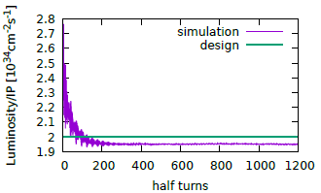
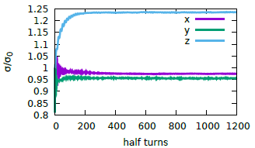
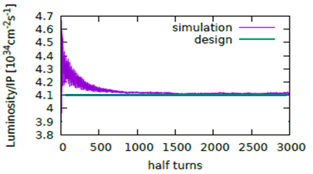
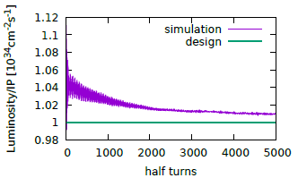
Beam-beam simulations
Beam-beam simulations agree well with the parameter design.
H
H
W
Z

Slide 10
β_{y}* choice – 2mm
Luminosity can be increased by reducing β_{y}*
Why not smaller β_{y}*?
Maximum bata-function in the final focusing quadrupole, β_{y,FFQ}=L^{*2}/β_{y}*, where the L*, defined as the distance from the FFQ to IP, is restricted by the geometry of the detector.
Large β_{y}^{FFQ} requires high strength + large aperture of FFQ;
Large β_{y}^{FFQ} also generates larger chromaticity, linear Δξ_{y}= (βy⋅kl)_{FFQ}/4π and higher order term, reduce the energy acceptance of DA.
Nonlinearity of kinematic effects due to small β_{y}*, cause dynamic aperture problem

Slide 11
Beamstrahlung effect @Higgs
Typical issue for energy-frontier e+e− colliders
During collision, the deflected particles will lose part of its energy due to the synchrotron radiation.
Extra energy spread
Beam loss for large energy deviation → life time reduction
Detector background (photons, hadrons…)
Divergence angle → interfere the detection of small-angle events
Constraint for energy spread
Nature energy spread: 0.098%
Beamstrahlung energy spread: ~0.019%
Total energy spread: 0.1%
Constraint for life time
Large energy acceptance is essential!
Requirement for energy acceptance: ~1.2%

Slide 12
Beam lifetime
(Beamstrahlung & Radiative Bhabha)
Beamstrahlung
-- calculation: ~1 hour @ Higgs
-- simulation: ~40 min @ Higgs (with real lattice)
Radiative Bhabha
-- Higgs: σ_{bb}= 1.6×10⁻²⁵ cm², Bhabha lifetime= ~100 min
-- Z: σ_{bb}= 1.9×10⁻²⁵ cm², Bhabha lifetime= ~13 hour
Total lifetime due to beamstrahlung and Bhabha for Higgs at the level: ~ 20 min
*V.I. Telnov, "Issues with current designs for e+e- and gammagamma colliders“, PoS Photon2013 (2013) 070. https://inspirehep.net/record/1298149/files/Photon%202013_070.pdf

Slide 13
Bunch length choice
A balance of bunch charge and larger Piwinski angle
-- longer bunch accommodate more charge
-- longer bunch → coherent beam-beam instability
-- shorter bunch mitigate luminosity reduction due to large Piwinski angle
 | H | W | Z
Bunch charge (nC) | 20.6 | 5.8 | 2.6
Nature bunch length σ_{z} (mm) | 2.72 | 2.98 | 3.67
Bunch length σ_{z} (mm) | 3.48 | 3.7 | 5.18
The design luminosities include the bunch lengthening effect according to the impedance budget.
Bunch lengthening was calculated by simulations.
-- H: bunch lengthening ~30%
-- W: bunch lengthening ~ 24%
-- Z: bunch lengthening ~ 40%, energy spread increase ~2%

Slide 14
CEPC amplitude-tune dependence
βx=0.22 βy=0.002 | C_{xx} (m⁻¹) | C_{xy} (m⁻¹) | C_{yy} (m⁻¹)
Kinematic effects | 3.7 | 271 | 44762
Fringe field (QD0+QF1) | 2.0+1.4 | 5788+2444 | 21.3+4.0
βx=0.144 βy=0.002 | C_{xx} (m⁻¹) | C_{xy} (m⁻¹) | C_{yy} (m⁻¹)
Kinematic effects | 8.6 | 414 | 44762
Fringe field (QD0+QF1) | 3.0+2.0 | 8558+3450 | 21.3+3.7
Larger βx* give help to on-momentum DA.
* Nonlinear effect of sextupole pairs can be corrected by the attached weak sextupole pairs.

Slide 15
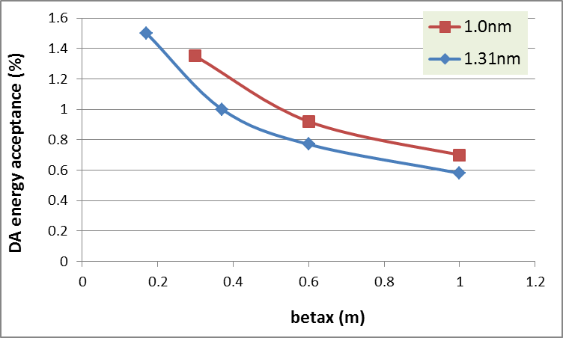
Energy acceptance vs. βx*
Larger βx* reduce the requirement of energy acceptance.

Slide 16

β_{x}* choice – 0.36 m
Parameter modification for β_{x}*: 0.171m→ 0.36m
-- larger β_{x}* reduced the amplitude-tune dependence ⎯ on mumentum DA
-- larger β_{x}* reduced the horizontal chromaticity both for linear and nonlinear term ⎯ off mumentum DA
-- larger β_{x}* reduce the requirement of energy acceptance ⎯ easier DA
Balance between DA and coherent beam-beam instability
-- smaller β_{x}* help suppress the coherent beam-beam instability

Slide 17
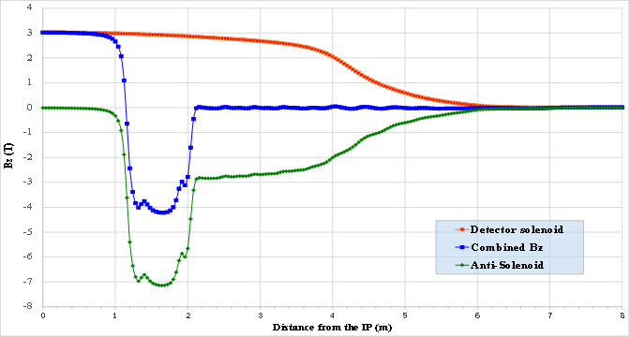
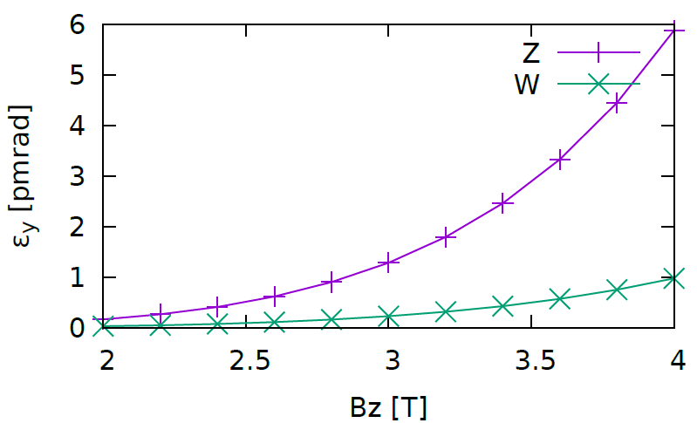
Solenoid coupling effect
Vertical emittance growth at Z pole is most serious!
 | Higgs | W | Z
Vertical emittance due to solenoid[pmrad] | 0.14 | 0.42 | 2.0
ε_{y,solenoid} /ε_{x} (%) | 0.01 | 0.08 | 1.2
Emittance Coupling Budget (%) | 0.3 | 0.3 | 1.7
Larger coupling factor (1.7%) at Z pole
Coupling: 0.3% for Higgs and W
Real model
Detector

Slide 18
Principle of combined D+S scheme
The power consumption of the arc sextupoles are too high.
Sextupole : 16.7 MW (copper coils)
Dipole: 6.5 MW (Al coils)
Reducing the strength of the stand-alone sextupoles can make help.
Combined function magnet: dipole + sextupole
Combined sextupoles: correct part (all) of the linear chromaticity
Stand-alone sextupoles: correct higher order chromaticity

Slide 19
New lattice with combined D+S
Five dipoles between two quadrupoles in the arc
Combined sextupoles are on the first and fifth dipoles (β_{x,y} >>β_{y,x})
-- one dipole is cut into 6 slices
-- 7 thin sextupoles are insert in one dipole
No additional power sources for SF and SD
SF
SD
SD
SF

Slide 20
Primary magnet design for combined D+S
Twin aperture dipole
Separation of two ring: 0.35m
SF
SD

Slide 21
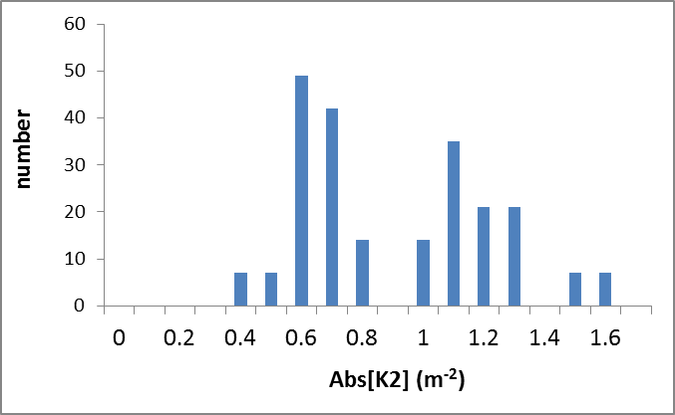
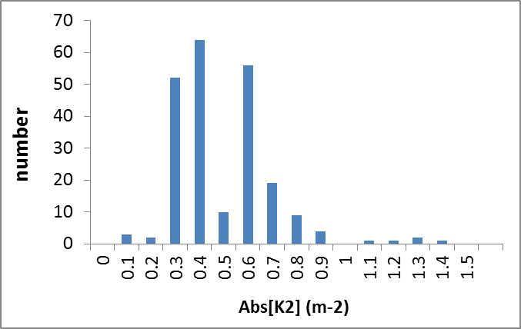
DA with 50% reduction of independent K2
Tracking 200 turns
50 seeds
w/o combined D+S
w combined D+S (50% reduction)

Slide 22
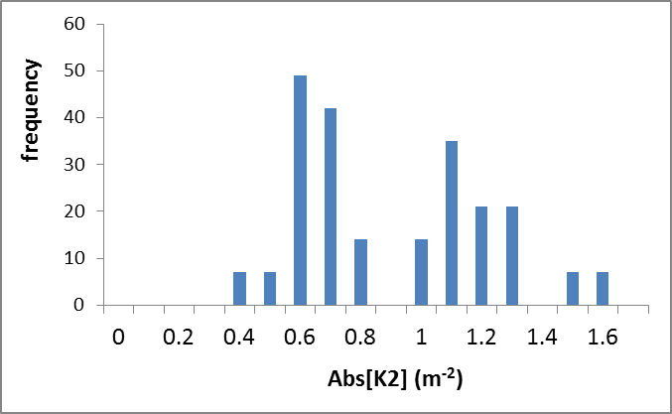
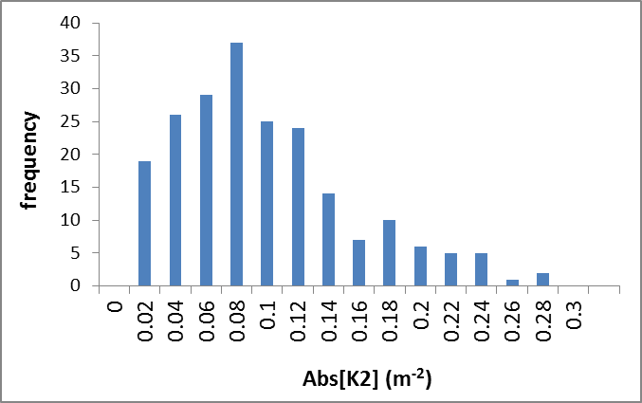
DA with 90% reduction of independent K2
Tracking 200 turns
50 seeds
w/o combined D+S
w combined D+S (90% reduction)

Slide 23
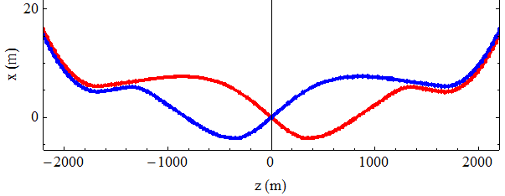
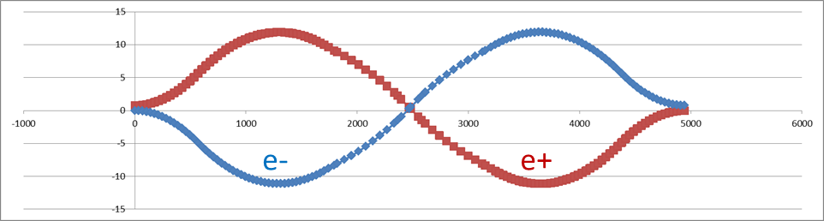
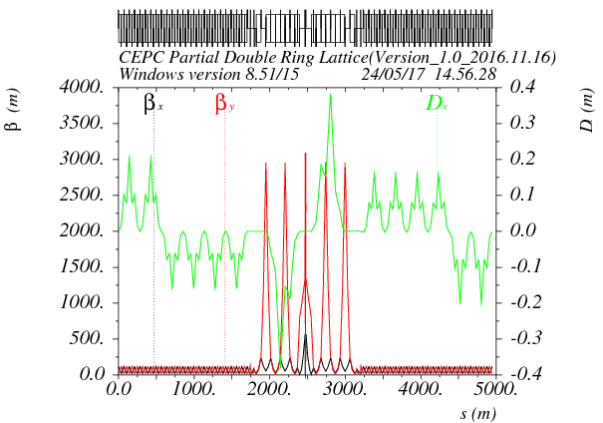
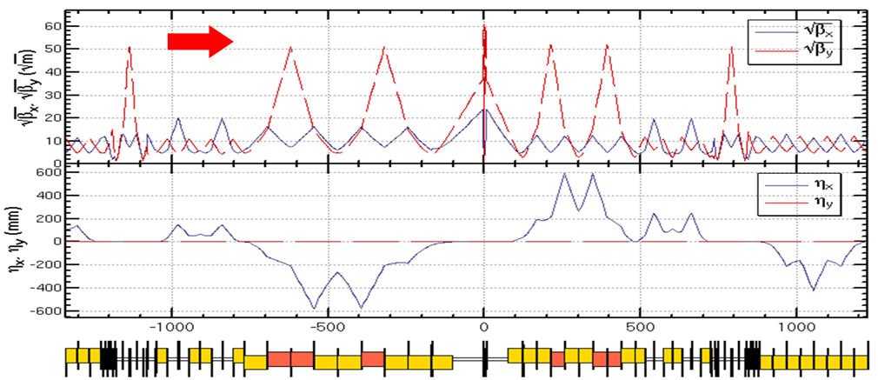
IR lattice and survey
Two kinds of IR design
- left: asymmetrical , right: symmetrical
SPPC need a long straight for collimation at two IR.
Another possibility for IR survey and lattice

Slide 24
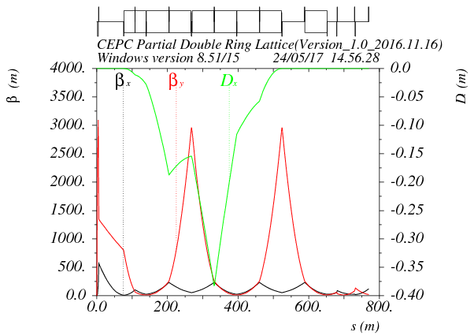
Alternative FFS design
Asymmetric dispersion
Shared sextupole for chromaticity correction and crab waist
1st sextupole correct chromaticity, 2nd sextupole correct the geometric term of 1st sextupole (Oide’s talk on FCCweek17)
Ec < 100 keV within 800m
Crab sextupole
Betax=0.171m
Betay=0.002m
L*=2.2m
K1(QD0)=150T/m

Slide 25
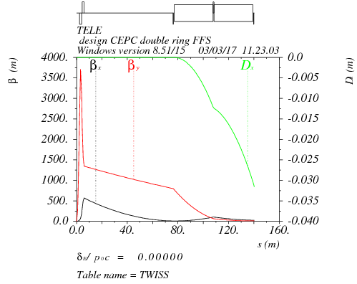
Final doublet + triplet
Betax=0.171m
Betay=0.002m
μx=0.75, μy=0.5
L*=2.2
L(QD0)=1.75m
L(QF1)=1.46m
k(QD0)=-150T/m
k(QF1)=106T/m
L₀=0.5m

Slide 26
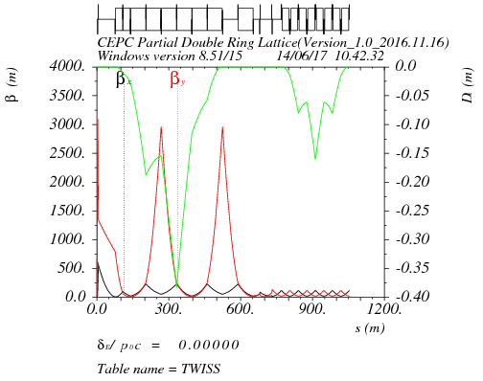
Final doublet + triplet+CCY+matching+CCX
μx=1.5, μy=1.25
μx=2.5, μy=2.375
IP
CCY
CCX
matching

Slide 27
Correction of the sextupole length effect
S1: main sextupole pair
S2: correcting sextupole pair ∼ −0.1*k₂(S1)
*A.Bogomyagkov, S.Glykhov, E.Levichev, P.Piminov

Slide 28
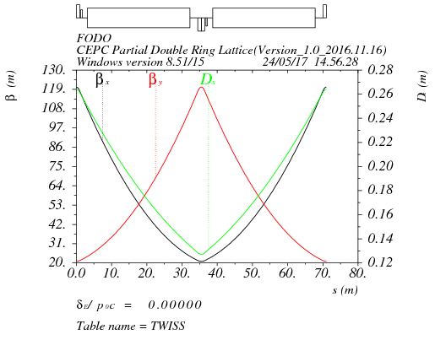
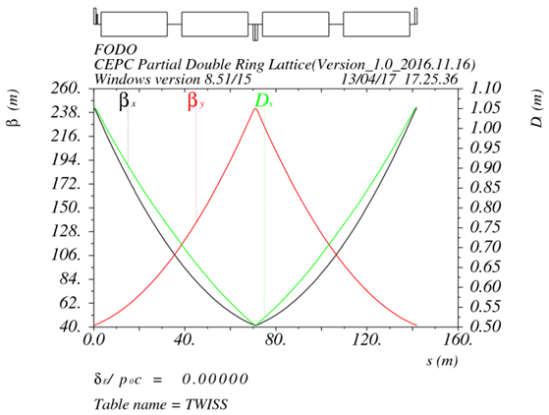
Arc lattice design
Higgs & W
Z
90/90 FODO cell
  Non-interleave sextupoles, period N=5cells
  Emittance
  - Higgs: 1.33nm
  - W: 0.57nm
  Two FODO cells combined into one FODO cell
Geometry of Z compatible with Higgs lattice
Emittance: 1.5nm

Slide 29
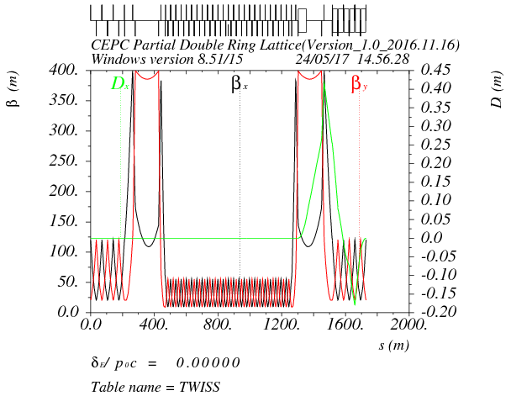
Shared RF section
Shared RF cavities for e- and e+ ring (Higgs)
Separator bending cancel that of dipoles for the beam of opposite direction (Oide’s talk on FCCweek17)
Smaller beta in RF section to suppress the multi-bunch instability (βmax: 55.5 m/βmin: 9.8 m)
separator combined with a dipoles
beam
-- Δx=26cm at first quadrupole
-- Seperation at the end of seperator section: 0.77m
RF
RF

Slide 30
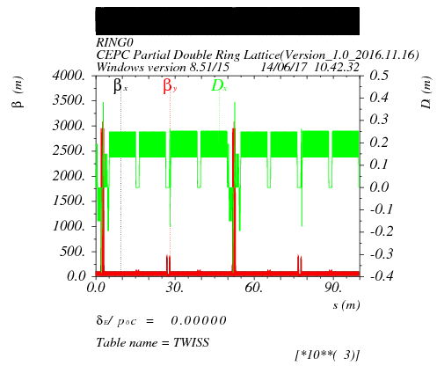
Whole ring lattice
Working point : Qx = 353.10 Qy = 354.22
Circumference：99685m
Emittance from the real lattice：1.33nm

Slide 31
DA
DA optimization with 234 sex knobs.
Open: Sync oscillation/ Damping/ Sawtooth/tampering/fluctation
Tracking 100 turns
50 seeds
Crab=0
phase=0
phase=π/2
phase= π
phase=3π/2
Emittance: 1.33 nm
Coupling: 0.3%

Slide 32
Summary
A consistent analytical method for CEPC parameter design with carb waist scheme has been created. Crosscheck luminosity with beam-beam simulations
Luminosity of Higgs is limited by power budget and luminosity of Z is limited by bunch charge due to TMCI.
First taste of combined magnet (D+S) looks good.
-- Power for sextupoles → ¼, 50% reduction of independent K2
Alternative lattice for collider ring was explored. DA is comparable with CDR lattice. Far from maturity.

