Slide 1
Concept Design for CEPC Booster
Tianjian Bian¹ , Jie Gao, Xiaohao Cui, Daheng Ji, Chuang Zhang
Institute of High Energy Physics, Beijing, China
Mail to: biantj@ihep.ac.cn

Slide 2
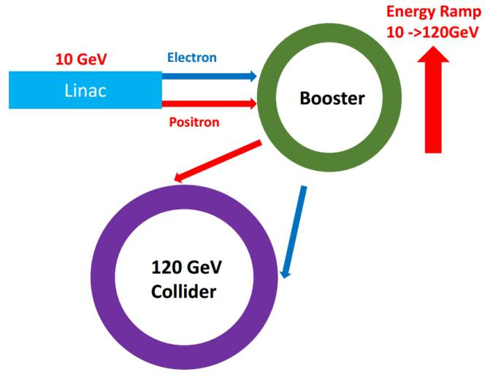
CEPC Booster
CEPC layout
10 GeV linac provides electron and positron beams.
The CEPC booster is in the same tunnel as CEPC collider, placed above the collider ring and has the same circumference.
CEPC booster should have two bypass sections to avoid conflict with two detectors and also match the geometry of collider.

Slide 3
CEPC Booster
Main parameters for CEPC collider
parameters | H | W | Z
Energy (GeV) | 120 | 80 | 45.5
Ne/bunch (10¹⁰) | 12.9 | 3.6 | 1.6
Bunch number | 286 | 5220 | 10900
Beam current (mA) | 17.7 | 90.3 | 83.8
Emittance x/y (nm) | 1.21/0.0036 | 0.54/0.0018 | 0.17/0.0029
Lifetime due to beamstrahlung (hour) | 1.0 | 2 | 4

Slide 4
CEPC Booster
Requirements for booster
Parameters | Design goals
Beam current (mA) | <0.8
Emittance in x (nm rad) | <3.6
Dynamic aperture (σ, normalized by linac beam size) | >3
Energy acceptance | >1%
Timing | Meet the top-up injection requirements

Slide 5
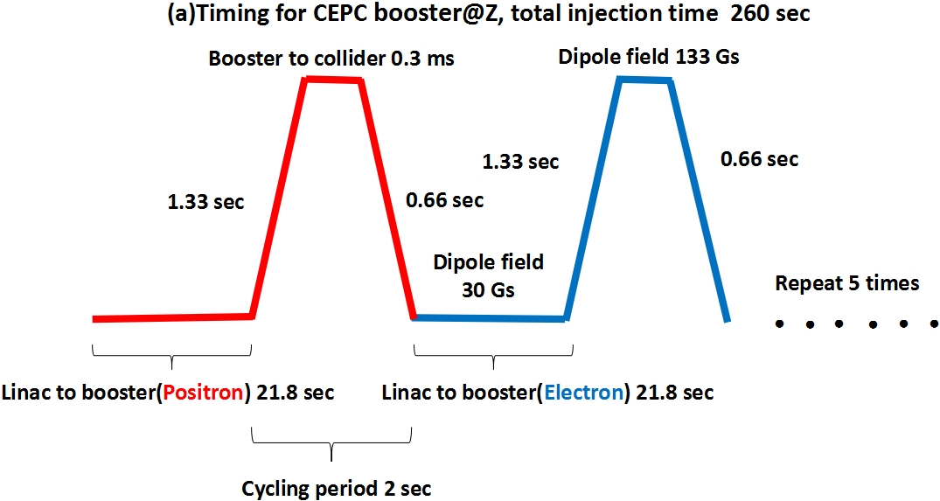
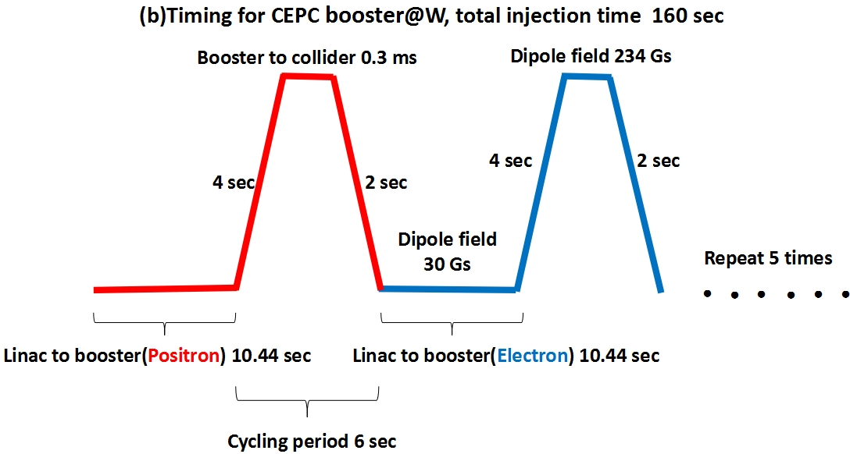
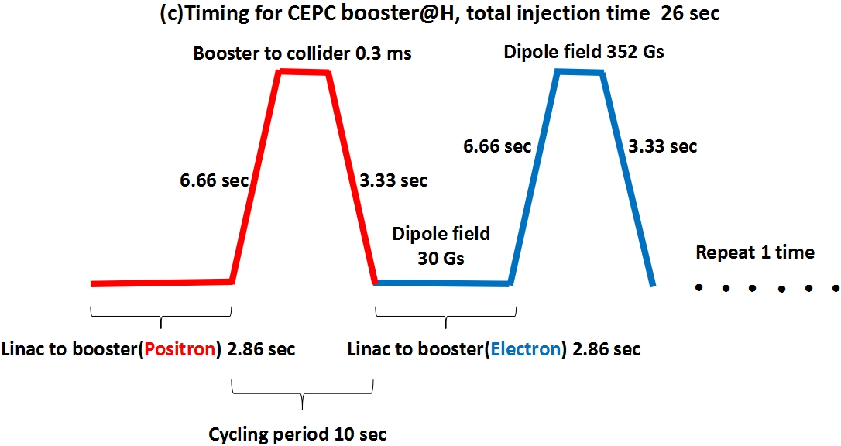
CEPC Booster
Timing
 |  | H | W | Z
Injection times |  | 1 | 5 | 5
Revolution frequency | Hz | 2997.92 | 2997.92 | 2997.92
Bunch number |  | 286 | 1044 | 2180
Transmission efficiency | % | 95 | 95 | 95
Bunch charge | nC | 0.62 | 0.17 | 0.078
Beam current | mA | 0.53 | 0.54 | 0.51
Linac repetition rate | Hz | 100 | 100 | 100
From linac to booster | sec | 2.86 | 10.44 | 21.80
From booster to collider | us | 333.56 | 333.56 | 333.56
Ramp cycling period | sec | 25.72 | 32.88 | 47.60
Total injection time | sec | 25.72 | 164.40 | 238.00

Slide 6
CEPC Booster
Booster parameters
Injection Energy |  | H | W | Z
Bunch number |  | 286 | 1044 | 2180
Transmission efficiency | % | 0.95 | 0.95 | 0.95
Bunch population |  | 3.86×10⁹ | 1.08×10⁹ | 4.87×10⁹
Bunch charge | nC | 0.618 | 0.17 | 0.078
Beam current | mA | 0.53 | 0.542 | 0.51
Ramping time | s | 5 | 3 | 1
Energy spread | % | 0.2
SR loss/turn | GeV | 0.000077
Momentum compaction factor | 10⁻⁵ | 2.09
Emittance in x | nm rad | 200
RF voltage | GV | 0.09
Longitudinal fractional tune |  | 0.12
RF energy acceptance | % | 2.51
Damping time | s | 86.94
Bunch length(rms) | mm | 1
Extraction Energy |  | H | W | Z
Bunch number |  | 286 | 1044 | 2180
Transmission efficiency | % | 0.95 | 0.95 | 0.95
Bunch population |  | 3.86×10⁹ | 1.08×10⁹ | 4.87×10⁹
Bunch charge | nC | 0.618 | 0.17 | 0.078
Beam current | mA | 0.53 | 0.542 | 0.51
Ramping time | s | 5 | 3 | 1
Energy spread | % | 0.0966 | 0.00805 | 0.037
SR loss/turn | GeV | 1.59 | 0.314 | 0.033
Momentum compaction factor | 10⁻⁵ | 1.93 | 2.09 | 2.12
Emittance in x | nm rad | 3.1 | 1.56 | 0.51
RF voltage | GV | 1.83 | 0.7 | 0.36
Longitudinal fractional tune |  | 0.11 | 0.12 | 0.11
RF energy acceptance | % | 0.71 | 1.56 | 2.18
Damping time | ms | 50.06 | 169.73 | 922.94
Bunch length | mm | 3.22 | 2.1 | 1.19

Slide 7
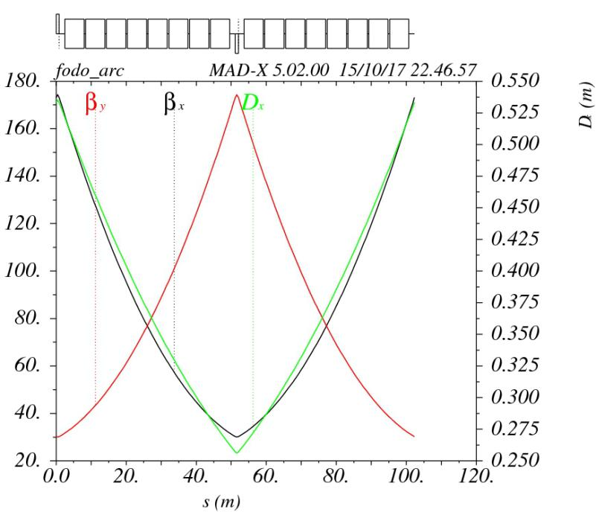
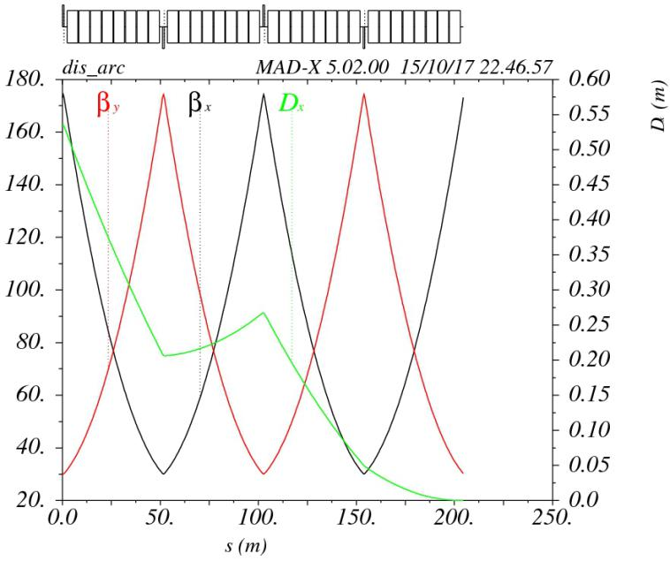
CEPC Booster
CEPC booster linear lattice in ARC
FODO cells with 90 degrees phase shift in transverse plane.
The length of bend is 5.5 meters long. 0.43 meter gap between two bending magnet.
The length of each quadrupole is 0.9 m
Total length of each FODO structure is 102.29 m.
The twiss function of a FODO cell
The twiss function of a dispersion suppressor

Slide 8
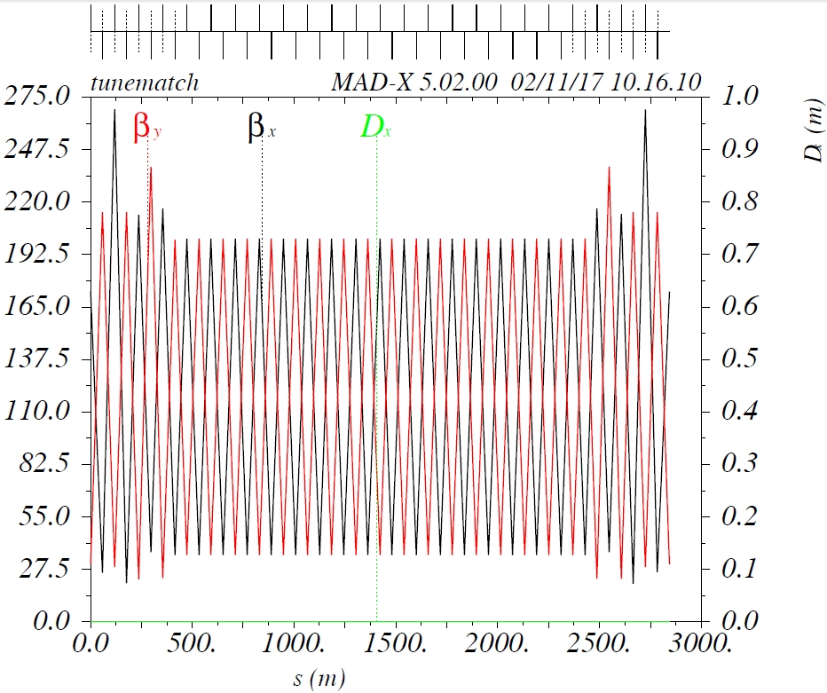
CEPC Booster
CEPC booster linear lattice in RF region
RF region is made up by 24 FODO structures.
Length of each FODO structure is 118.49 m.
The twiss function in RF region

Slide 9
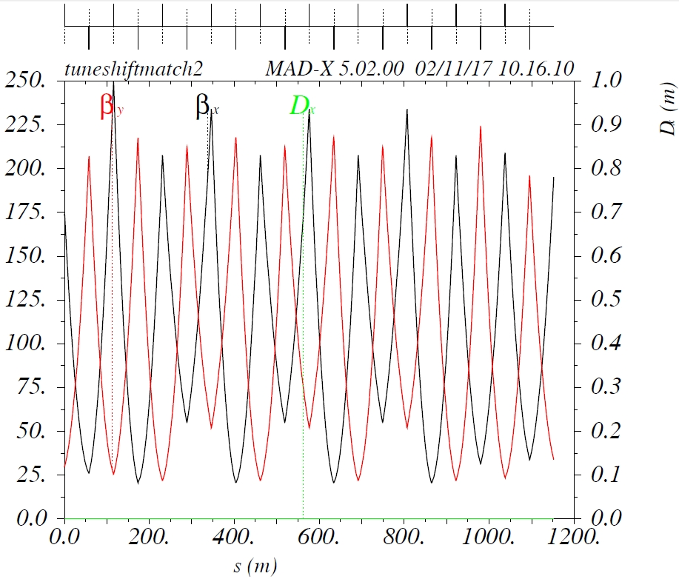
CEPC Booster
CEPC booster linear lattice in straight section region
Straight section region is made up by 10 FODO structures.
Length of each FODO structure is 112.62 m.
The twiss function in straight section region

Slide 10
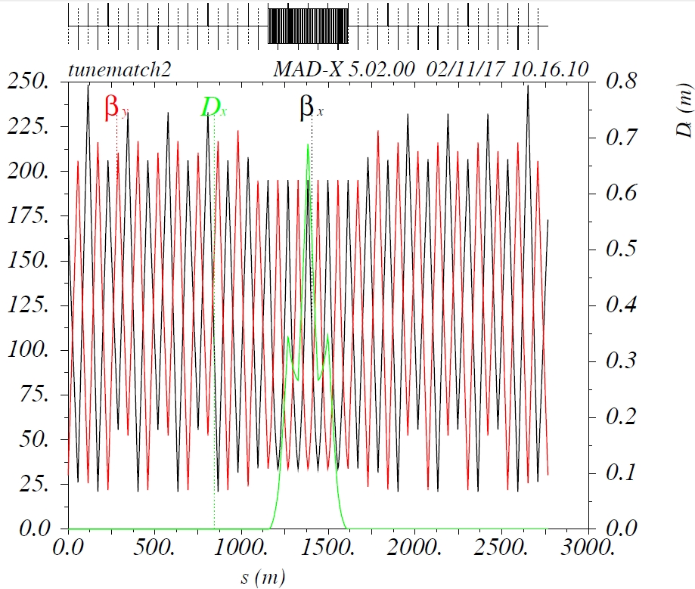
CEPC Booster
CEPC booster linear lattice in bypass region
Bypass region is made up by 24 FODO structures.
Length of each FODO structure is 115.23 m.
The distance between interaction point and bypass is 21 m.
The twiss function in straight bypass region

Slide 11
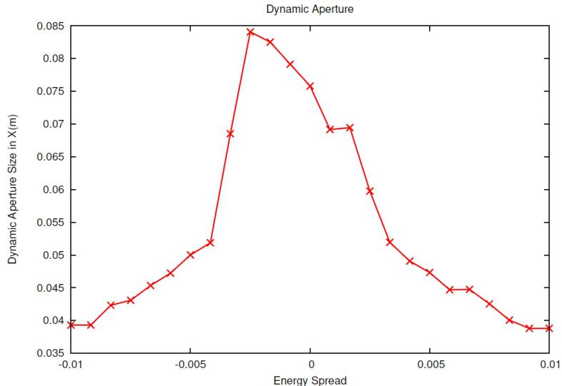
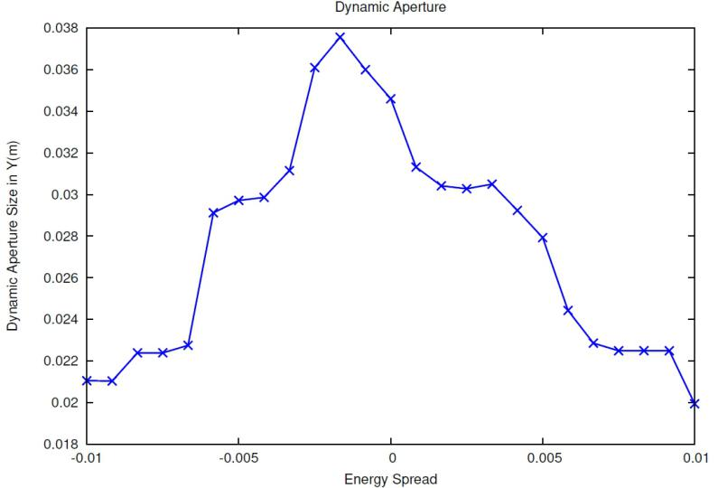
CEPC Booster
CEPC booster nonlinear dynamics
CEPC booster adopt 2 sextupole families and phase shifts between arcs are optimized carefully.Bian, T., Gao, J., Cui, X. et al. Radiat Detect Technol Methods (2017) 1: 22.
Dynamic aperture as a function of energy spread in X direction
Dynamic aperture as a function of energy spread in Y direction

Slide 12
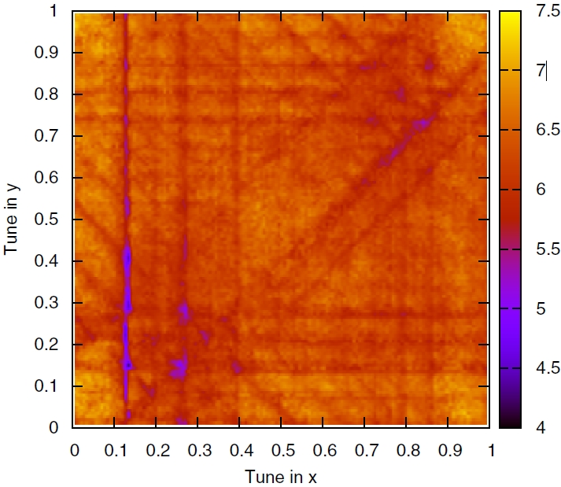
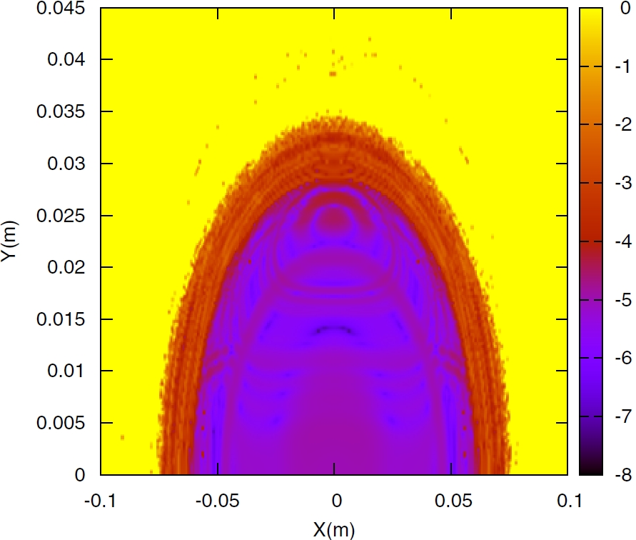
CEPC Booster
CEPC booster nonlinear dynamics
Use tune (0.3237,0.7626) as an example and normalize the dynamic aperture by 300 nm rad
x direction dynamic aperture is 12.8σ, y direction dynamic aperture is 11.5σ @0%(Goal: 3σ)
x direction dynamic aperture is 8.3σ, y direction dynamic aperture is 9.1σ @0.5%
Tune scan for CEPC booster lattice
Frequency map analysis for on-momentum particles

Slide 13
CEPC Booster
CEPC booster error analysis
Gaussian distribution and cut-off at 3σ
Parameters | Dipole | Quadrupole | Sextupole | Corrector | Parameters | BPM
Transverse shiftX/Y (μm) | 100 | 100 | 100 | 100 | Accuracy (m) | 10⁻⁵
Longitudinal shiftZ (μm) | 150 | 150 | 150 | 150 | Tilt (mrad) | 10
Tilt about X/Y (mrad) | 0.1 | 0.2 | 0.2 | 0.2 | Gain | 5%
Tilt about Z (mrad) | 0.05 | 0.2 | 0.2 | 0.2 | Offset after BBA(mm) | 10⁻³
Nominal field | 10⁻³ | 10⁻³ | 10⁻³ | 10⁻²

Slide 14
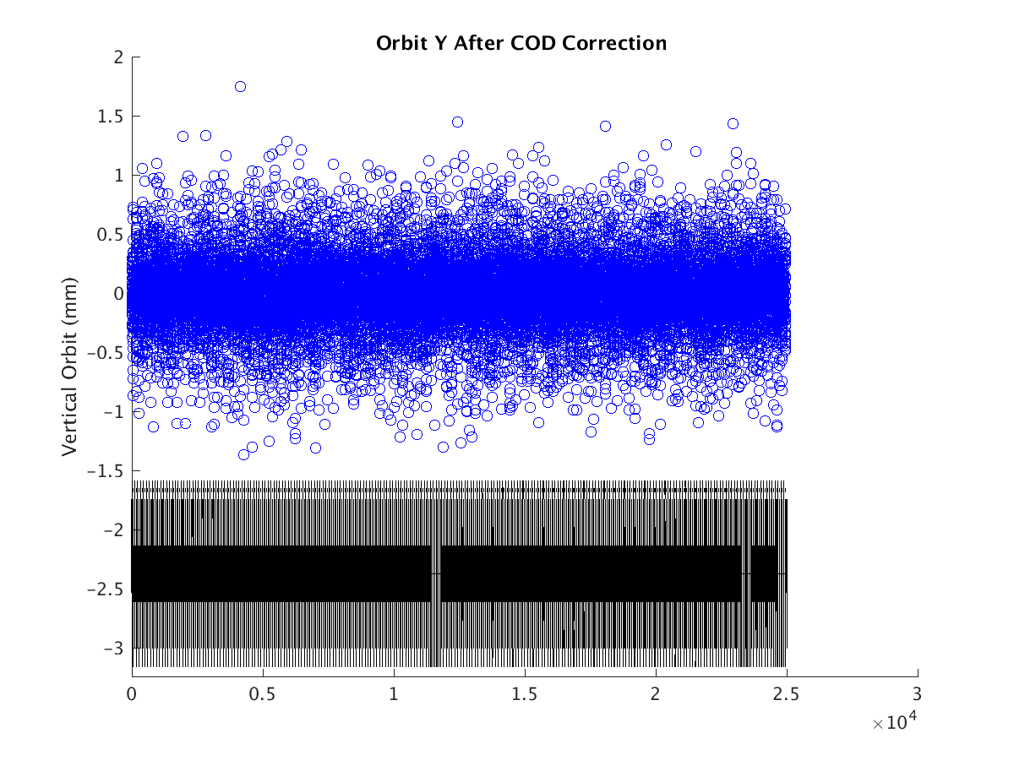
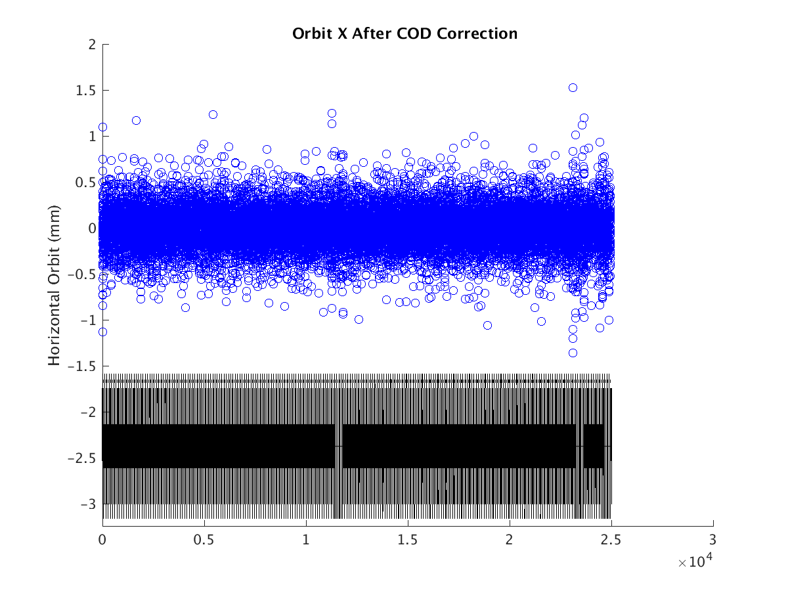
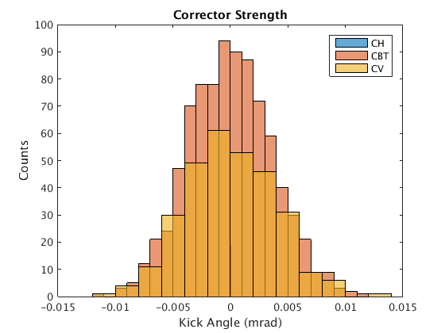
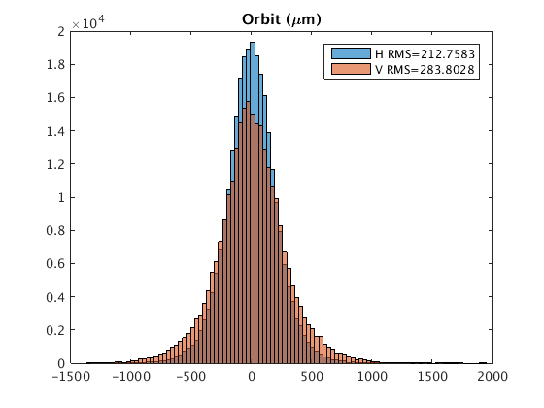
CEPC Booster
CEPC booster error analysis
Gaussian distribution and cut-off at 3σ
R.M.S orbit is: 213 um in x and 284 um in y.

Slide 15
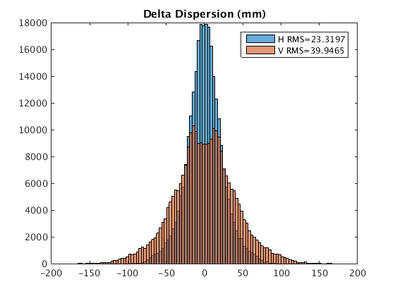
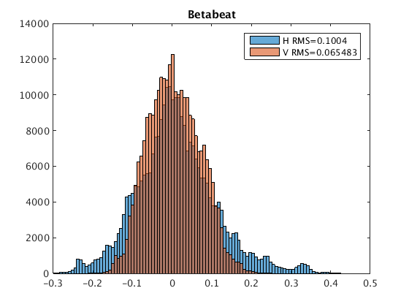
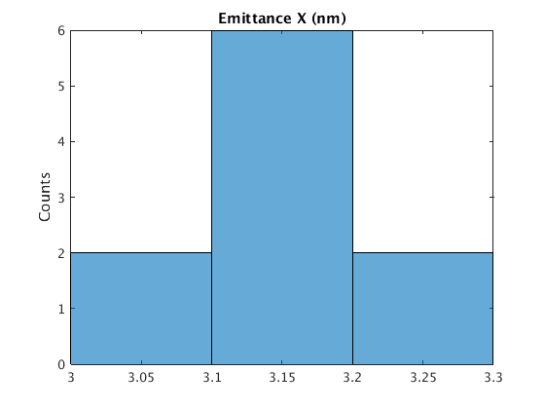
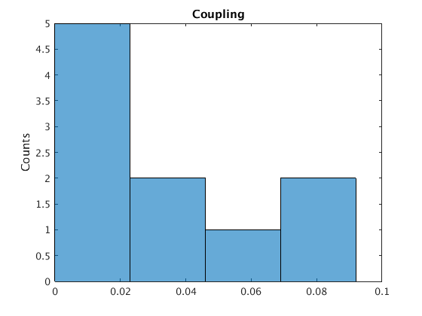
CEPC Booster
CEPC booster error analysis
R.M.S dispersion is: 23 mm in x and 40 mm in y.
Relative beta-beating: 10% in x and 6.5% in y.

Slide 16
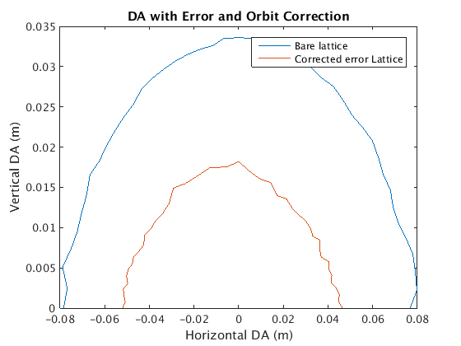
CEPC Booster
CEPC booster error analysis
Red line is the aperture of booster pipe.
With error and orbit correction, on-momentun aperture is about :
0.05 m(8.3σ) in x and 0.018 m(5.5σ) in y

Slide 17
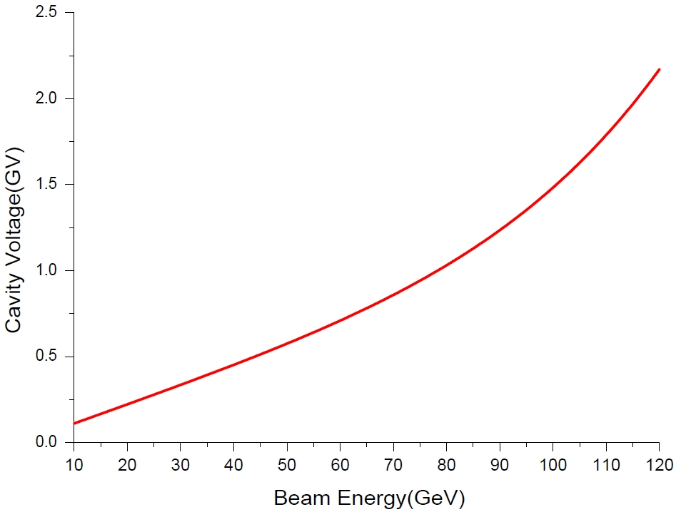
CEPC Booster
 | H | W | Z
Injection beam energy [GeV] | 10
Extraction beam energy [GeV] | 120 | 80 | 45.5
RF frequency [MHz] | 1300
Beam current [mA] | 0.53 | 0.53 | 0.51
Bunch charge [nC] | 0.62 | 0.17 | 0.078
Injection RF voltage [GeV] | 0.09
Extraction RF voltage [GV] | 1.83 | 0.7 | 0.36
Injection synchrotron phase from crest [deg] | 89.95
Extraction synchrotron phase from crest [deg] | 29.8 | 63.4 | 84.8
Bunch length injected from linac [mm] | 4
Extraction equilibrium bunch length [mm] | 2.9 | 2 | 1.1
Cavity number | 96 | 64 | 32
Cell number / cavity | 9
Cryomodule number | 12 | 8 | 4
Extraction cavity gradient [MV/m] | 18.4 | 10.5 | 10.8
Q0 at operating gradient for long term | 1.00E+10
Total cavity wall loss (average) @ 2 K [kW] | 0.6 | 0.1 | 0.02
Cavity bandwidth [Hz] | 130
Input power (peak) / cavity [kW] | 14.1 | 4.4 | 3.4
Input power (average) / cavity [kW] | 2.1 | 0.4 | 0.1
SSA power (peak) [kW] | 25
SSA number | 96 | 64 | 32
HOM power (average) / cavity [W] | 0.5 | 0.25 | 0.19
RF parameters
RF voltage ramping curve of CEPC booster

Slide 18
CEPC Booster
Beam stay clear region is defined as:
2*(3×σ+5 mm) =55 mm
5 mm is the margin for the close orbit correction.
The aperture of magnets should be 63 mm.
Quantum lifetime at 10 GeV is about 14 min.
CEPC booster magnet requirements
Specifications of quadrupole magnets@120 GeV
Magnet name | QFARC | QDARC | QFM | QDM
Quantity | 832 | 824 | 72 | 96
Aperture [mm] | 63 | 63 | 63 | 63
Max. Field Gradient [T/m] | 12.3706 | 12.3706 | 13.2091 | 13.2091
Operation Field Gradient [T/m] | 12.3706 | 12.3706 | 13.2091 | 13.2091
Effective Magnetic Length [mm] | 900 | 900 | 900 | 900
Good Field Region (radius) [mm] | 27.5 | 27.5 | 27.5 | 27.5
Harmonic errors | 1/1000 | 1/1000 | 1/1000 | 1/1000
Specifications of sextupole magnets@120 GeV
Specifications of dipole magnets@120 GeV
Magnet name | SF | SD
Quantity | 256 | 256
Aperture [mm] | 63 | 63
Max. Sextupole Field [T/m^2] | 104.3221 | 226.9971
Operation Sextupole Field [T/m] | 104.3221 | 226.9971
Effective Magnetic Length [mm] | 700 | 700
Good Field Region (radius) [mm] | 27.5 | 27.5
Harmonic errors | 1/1000 | 1/1000
Magnet name | BDISARC | BARC | BBP
Quantity | 512 | 12672 | 128
Gap [mm] | 63 | 63 | 63
Max. Field [T] | 0.0358 | 0.0352 | 0.0370
Operation Field [T] | 0.0358 | 0.0352 | 0.0370
Effective Magnetic Length [mm] | 2700 | 5500 | 3000
Good Field Region [mm] | 55 | 55 | 55
Field Uniformity | 1/1000 | 1/1000 | 1/1000

Slide 19
CEPC Booster
Beam stay clear region is defined as:
2*(3×σ+5 mm) =55 mm
5 mm is the margin for the close orbit correction.
The aperture of magnets should be 63 mm.
Quantum lifetime at 10 GeV is about 14 min.
CEPC booster magnet requirements
Specifications of quadrupole magnets@10 GeV
Magnet name | QFARC | QDARC | QFM | QDM
Quantity | 832 | 824 | 72 | 96
Aperture [mm] | 63 | 63 | 63 | 63
Max. Field Gradient [T/m] | 1.0309 | 1.0309 | 1.1008 | 1.1008
Operation Field Gradient [T/m] | 1.0309 | 1.0309 | 1.1008 | 1.1008
Effective Magnetic Length [mm] | 900 | 900 | 900 | 900
Good Field Region (radius) [mm] | 27.5 | 27.5 | 27.5 | 27.5
Harmonic errors | 1/1000 | 1/1000 | 1/1000 | 1/1000
Specifications of sextupole magnets@10 GeV
Specifications of dipole magnets@10 GeV
Magnet name | SF | SD
Quantity | 256 | 256
Aperture [mm] | 63 | 63
Max. Sextupole Field [T/m^2] | 8.6935 | 18.9164
Operation Sextupole Field [T/m] | 8.6935 | 18.9164
Effective Magnetic Length [mm] | 700 | 700
Good Field Region (radius) [mm] | 27.5 | 27.5
Harmonic errors | 1/1000 | 1/1000
Magnet name | BDISARC | BARC | BBP
Quantity | 512 | 12672 | 128
Gap [mm] | 63 | 63 | 63
Max. Field [T] | 0.00298 | 0.00293 | 0.00308
Operation Field [T] | 0.00298 | 0.00293 | 0.00308
Effective Magnetic Length [mm] | 2700 | 5500 | 3000
Good Field Region [mm] | 55 | 55 | 55
Field Uniformity | 1/1000 | 1/1000 | 1/1000

Slide 20
CEPC Booster
CEPC booster pipe
Booster pipe material: aluminum
Internal diameter is 55 mm, limited by instability.
During ramping, parasitic sextupole strength caused by eddy current in dipole: K2=0.00038
Chromaticity in x: 0.3→102.2
Chromaticity in y: 0.3→-84.5
To correct the chromaticity: SF: 0.42→0.31 SD: -0.85→-1.02

Slide 21
CEPC Booster
Summary
Table below is the contrast between design goals and design results. From the booster design results, we can say that the booster design is reasonable and meet the requirements.
Parameters | Design goals | Design results
Beam current (mA) | <0.8 | 0.54
Emittance in x (nm rad) | <3.6 | 3.1
Dynamic aperture(σ, normalized by linac beam size) | >3 | 8.3/5.5
Energy acceptance | >1% | √
Timing | Meet the top-up injection requirements | √

Slide 22
Thanks

Slide 23
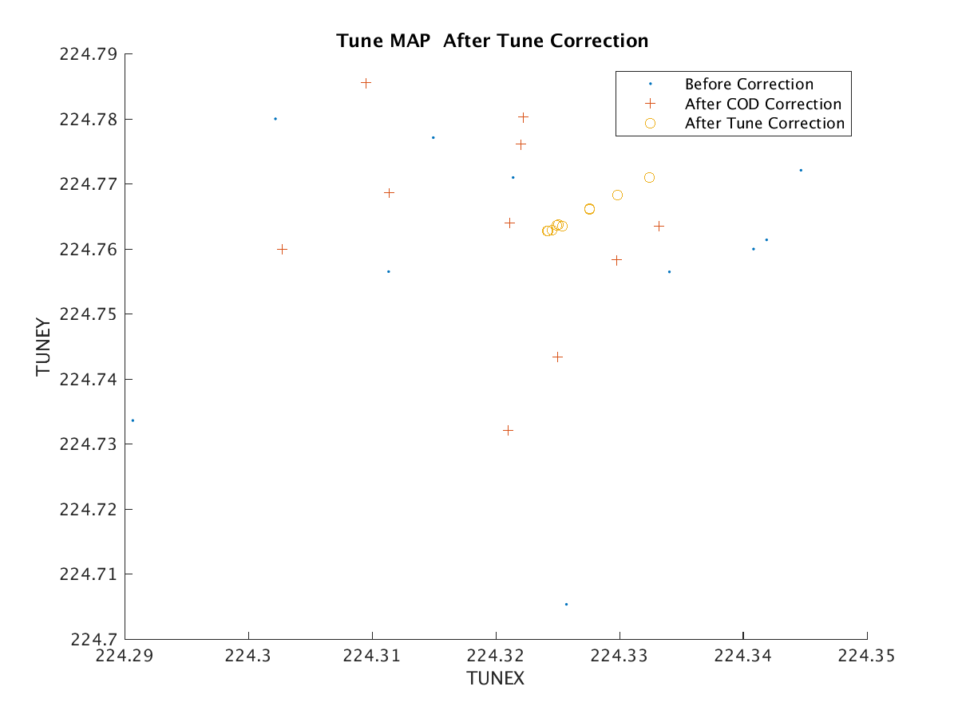
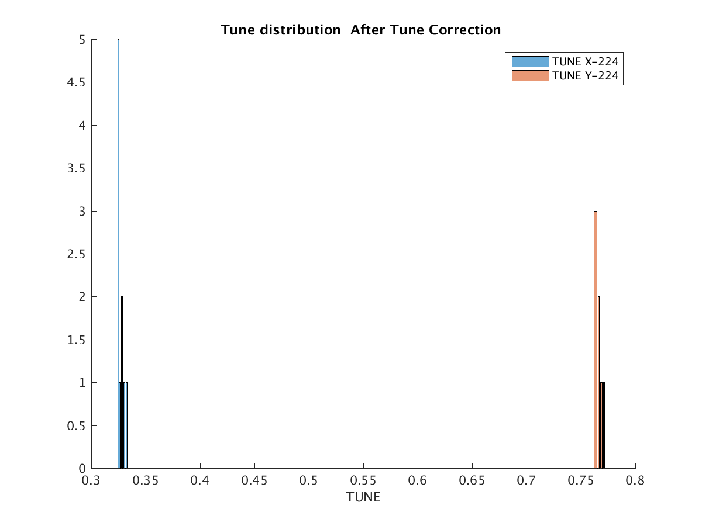
CEPC Booster
CEPC booster error analysis
After orbit correction, tune corrected with two group quadrupoles

Slide 24
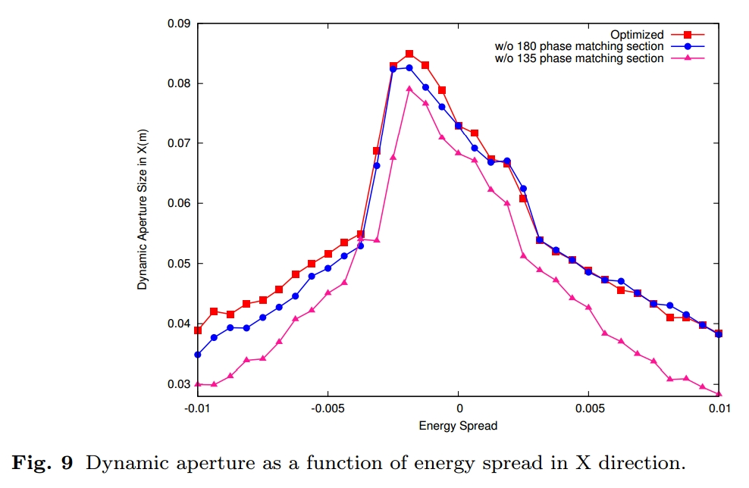
CEPC Booster

Slide 25
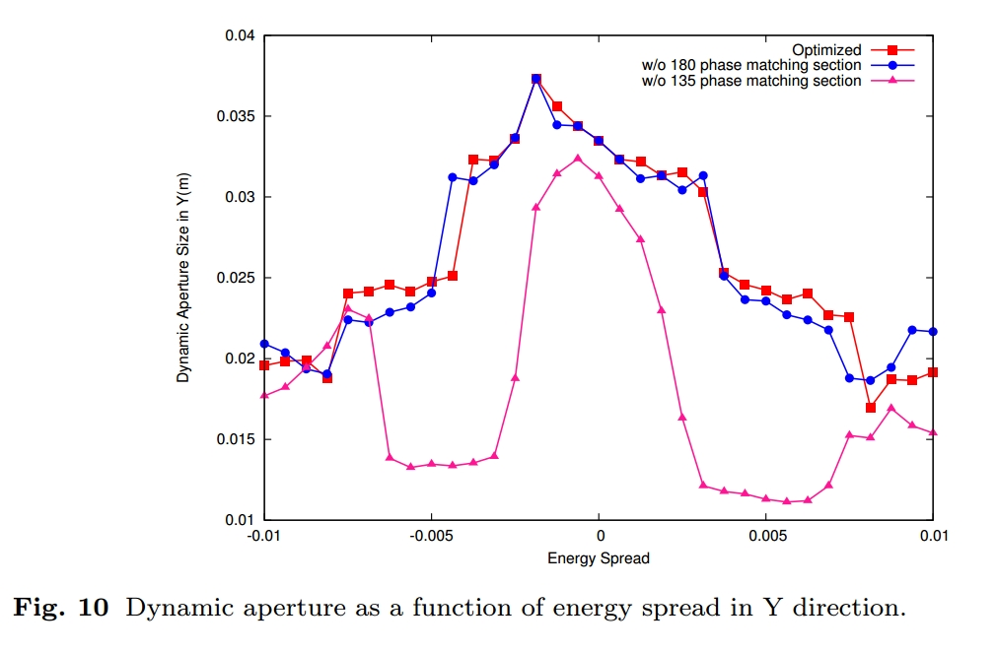
CEPC Booster

Slide 26
CEPC Booster
Specifications of dipole magnet | 二极磁铁设计指标 | 增强器磁铁
Magnet name | 磁铁名称 | B
Quantity | 磁铁数量 | 1616
Gap [mm] | 磁铁气隙[mm]
Max. Field [T] | 最大磁场[T]
Operation Field [T] | 工作磁场[T] | 0
Field Waveform (for Booster) | 磁场波形（增强器）
Reptitive Frenquency [Hz] (for Booster) | 磁场重复频率[Hz]（增强器）
Effective Magnetic Length [mm] | 磁有效长度[mm] | 51109.73451
Good Field Region [mm] | 好场区宽度[mm] | 50
Field Uniformity | 积分磁场均匀性 | 3e-4
Excitation linearity | 励磁线性度
Other Limits | 其它要求

Slide 27
CEPC Booster
Specifications of quadrupole magnet | 四极磁铁设计指标
Magnet name | 磁铁名称 | QD
Quatanty | 磁铁数量 | 856
Aperture [mm] | 孔径直径[mm] | 40*40
Max. Field Gradient [T/m] | 最大梯度[T/m]
Operation Field Gradient [T/m] | 工作梯度[T/m] | 10.28981167
Field Waveform (for Booster) | 磁场波形（增强器）
Reptitive Frenquency [Hz] (for Booster) | 磁场重复频率[Hz]（增强器）
Effective Magnetic Length [mm] | 磁有效长度[mm] | 1000
Excitation linearity | 励磁线性度
Good Field Region (radius) [mm] | 好场区半径[mm]
Harmonic errors | 高阶场误差
Other Limits | 其它要求
Harmonic errors | 高阶场误差
Other Limits | 其它要求

Slide 28
CEPC Booster
Specifications of sextupole magnet | 六极磁铁设计指标
Magnet name | 磁铁名称 | SF1cell1
Quatanty | 磁铁数量 | 32
Aperture [mm] | 孔径直径[mm] | 40*40
Max. Sextupole Field [T/m^2] | 最大六极场强[T/m^2]
Operation Sextupole Field [T/m] | 工作六极场强[T/m^2] | 168.8738181
Field Waveform (for Booster) | 磁场波形（增强器）
Reptitive Frenquency [Hz] (for Booster) | 磁场重复频率[Hz]（增强器）
Effective Magnetic Length [mm] | 磁有效长度[mm] | 400
Excitation linearity | 励磁线性度
Good Field Region (radius) [mm] | 好场区半径[mm]
Harmonic errors | 高阶场误差
Other Limits | 其它要求

Slide 29
CEPC Booster
End

Slide 30
CEPC Mainring Design
Achromatic module
Sextupole pair for the 3rd order, but it can't be used in the mainring. So 2nd and 3rd order chromaticity can only cancelled by appropriate sextupole families.
Octupole pair for the 4rd order

Slide 31
Plan
There are 6 months left, our plan is:
Optimization code 2 month
Lattice redesign, with injection and ejection. 2 month
The process of ramping. 1 month
Design goal of CDR
For injection, emit of booster@120Gev should be about 3.5E-9 m*rad.
1 percent energy acceptance for enough quantum lifetime.
DA_x and DA_y should bigger than 7~8 sigma for injection for both on-momentum and off-momentum.

