Slide 1

CEPC Cryogenic System
Jianqin Zhang, Shaopeng Li
Accelerator center, IHEP
CEPC workshop
2017.11.07

Slide 2
Outline
Introduction
Heat load
Refrigeration
Cooling scheme
Cryomodules
R&D
Summary

Slide 3
Introduction
The Cryogenic system will cool all the cavities in a liquid-helium bath at a temperature of 2 K to achieve a good cavity quality factor.
The Cryogenic system lies besides the RF station, which provides helium for the collider ring and the booster ring.
The Cryogenic system mainly includes the refrigerators, distribution boxes, compressor group, helium storage tanks and cryomodules.

Slide 4
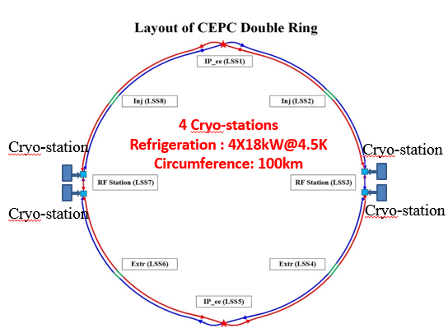
Introduction
Booster ring:
  1.3 GHz 9-cell cavities, 96 cavities
  12 cryomodules
  3 cryomodules/each station
  Working temperature: 2K/31mbar
  Collider ring:
  650MHz 2-cell cavities, 336 cavities
  56 cryomodules
  14 cryomodules/each station
  Working temperature: 2K/31mbar

Slide 5
Flowchart of one Cryo-station
Each Cryo-station mainly includes Compressor, Cold box, helium gas storage tanks, cryomudules and purification system.
The cryomodules have two shields, a 40K~80K shield and a 5K~8K shield.
A 2.2K, 1.2bar helium is supplied for the cryomodules and the 2K, 31mbar helium gas return to the cold box with the cold compressors.

Slide 6
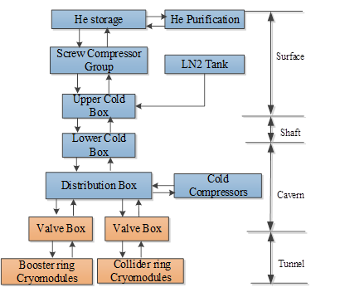
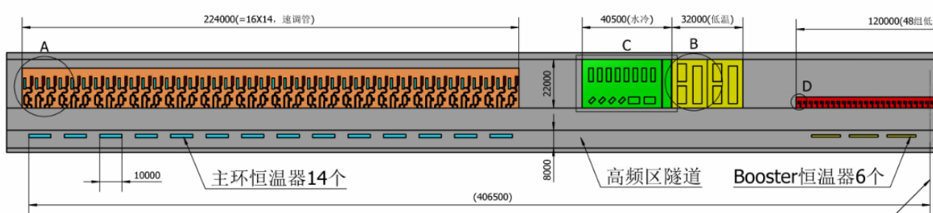
Infrastructure
Equipment:
T>80K, on the surface
T<80K, in the tunnel
Each cryo-station has an underground plant in the cavern, the size is 16m * 22m.

Slide 7
Parameters of SC cavities related for Cryogenic system
100km RF parameters( From ZJY20171022) | Collider |  |  | Booster
mode | H | W | Z | H | W | Z
Frequency(MHz) | 650 | 650 | 650 | 1300 | 1300 | 1300
Cavity operating voltage (MV) | 6.37 | 2.15 | 2.21 | 19.06 | 10.94 | 11.25
Duty factor | CW | CW | CW | 0.17 | 0.10 | 0.04
Total number of cavities | 336 | 192 | 24 | 96 | 64 | 32
Total number of modules | 56 | 32 | 4 | 12 | 8 | 4
Eacc (MV/m) | 13.8 | 9.4 | 9.6 | 18.4 | 10.5 | 10.8
R/Q | 213 | 213 | 213 | 1036 | 1036 | 1036
Q0 | 1E+10 | 1E+10 | 1E+10 | 1E+10 | 1E+10 | 1E+10
Operation temperature (K) | 2 | 2 | 2 | 2 | 2 | 2
Cavity dynamic heat load@ 2K (W/cavity) | 19 | 8.7 | 9.2 | 6 | 1.2 | 0.5
Total dynamic heat load @ 2K(kW) | 6.52 | 1.96 | 0.22 | 0.59 | 0.08 | 0.02

Slide 8
Heat load
H mode | Collider |  |  | Booster
 | 40-80K | 5-8K | 2K | 40-80K | 5-8K | 2K
Module static heat load (W) | 140 | 20 | 3 | 300 | 60 | 12
Module dynamic heat load (W) | 300.00 | 60.00 | 113.51 | 140 | 10 | 48
HOM loss per module (W) | 86.4 | 8.64 | 2.88 | 2 | 1 | 1
Connection boxes (W) | 50 | 10 | 10 | 50 | 10 | 10
Total heat load (kW) | 41.24 | 7.76 | 7.75 | 3.98 | 0.49 | 0.74
Total predicted mass flow (g/s) | 197.62 | 242.24 | 365.76 | 19.1 | 15.4 | 35.1
Overall net cryogenic capacity multiplier | 1.54 | 1.54 | 1.54 | 1.54 | 1.54 | 1.54
4.5K equiv. heat load with multiplier (kW) | 4.77 | 10.81 | 38.18 | 0.46 | 0.69 | 3.67
Total 4.5K equiv. heat load with multiplier (kW) | 53.77 |  |  | 4.81
Total 4.5K equiv. heat load of booster and collider (kW) | 58.58

Slide 9
Installed power requirement
 | 40-80 K | 5-8 K | 2 K
Booster heat load（kW） | 6.14 | 0.76 | 1.15
Collider heat load（kW） | 63.51 | 11.96 | 11.94
CEPC TOTAL（kW） | 69.64 | 12.71 | 13.08
COP（W/W) | 16.4 | 197.9 | 700.2
Install power（MW） | 1.14 | 2.52 | 9.16
Total installed power（MW） | 12.82
The required total 4.5K equiv. heat load is 58.58kW and total installed power is 12.82MW.
Four individual 18kW@4.5K refrigerators will be employed for the CEPC cryogenic system.
Referred to LHC 18kW refrigerator, the corresponding installed power is 16.6MW.

Slide 10
Helium Inventory
The volume of one 1.3GHz and 650MHz module is about 320 liters and 346 liters, respectively.
The total liquid helium volume in the system will be 33,166 liters.
To safely operate the cryogenic system, a coefficient factor 60% is added, so CEPC needs a standard 4.5E4 m³ helium inventory system.

Slide 11
Refrigeration
With a 20% margin, four individual 18kW@4.5K refrigerators will be employed.
The total cryogenic capacities are equivalent to 72kW at 4.5K.

Slide 12
Cooling scheme for Collider

Slide 13
Cooling scheme for Booster

Slide 14
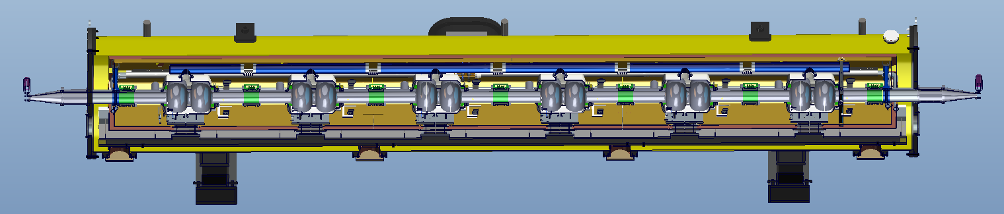
Cryomodule for 650MHz 2-cell cavities
From Ruixiong Han
Including six 2-cell 650 MHz superconducting cavities, six high power couplers, six mechanical tuners and two HOM absorbers
Fast Cool-down is introduced, means 10K/minute below 45K.
The static heat load of whole cryomodule is 5W at 2K.

Slide 15
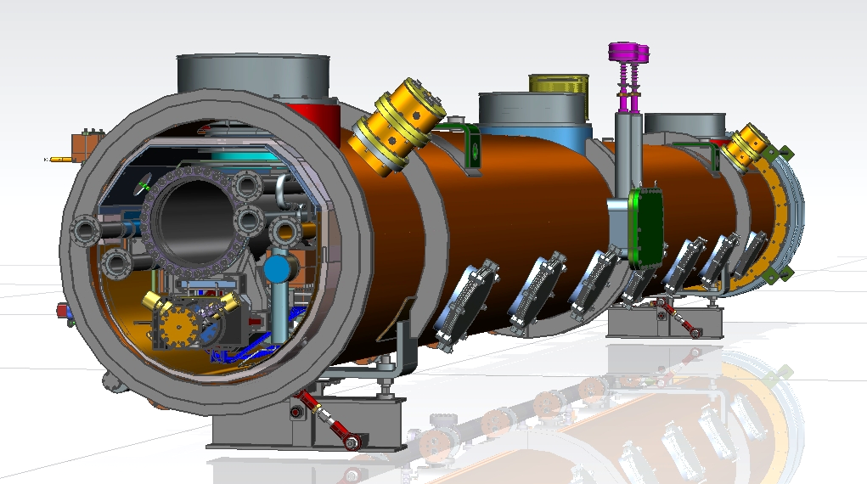
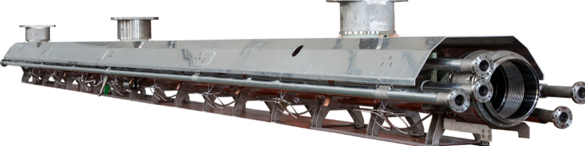
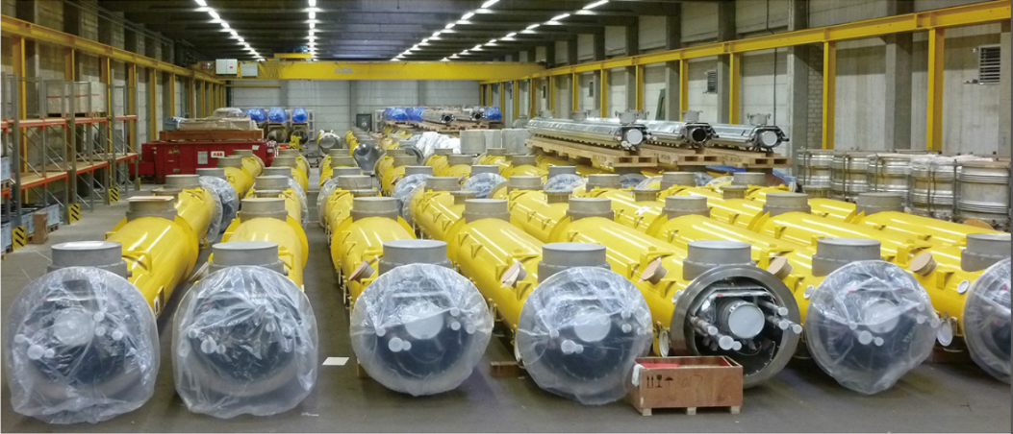
Cryomodule for 1.3GHz 9-cell cavities
Design Goals:
Low heat loss
Fast cool down
XFEL / LCLS-II type Cryomodule for High Q Cavity
Cryogenic Group in IHEP has manufactured 58 1.3GHz 9-cell Cryomodules for EXFEL cooperated with domestic companies.
It’s a good foundation for the optimization design for the CEPC cryomodules.

Slide 16
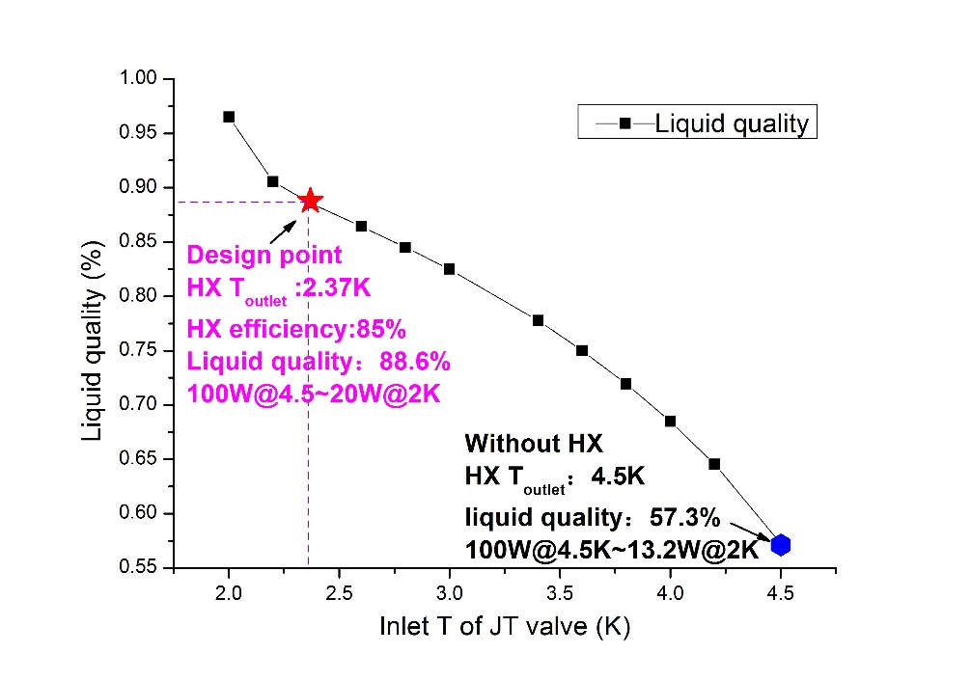
R&D
2K JT heat exchanger
JT HX can increase the liquid quality by 30% at 2K！
Key points：
efficiency ≥85%
Pressure drop ≤100Pa
Low heat loss
The 2K JT heat exchangers(HXs) were designed, the flow is 2g/s , 5g/s and 10g/s.
2K JT HX test stand will be built in PAPS in 2018.
The 2K JT HX with high efficiency will be used in the CEPC cryogenic system.

Slide 17
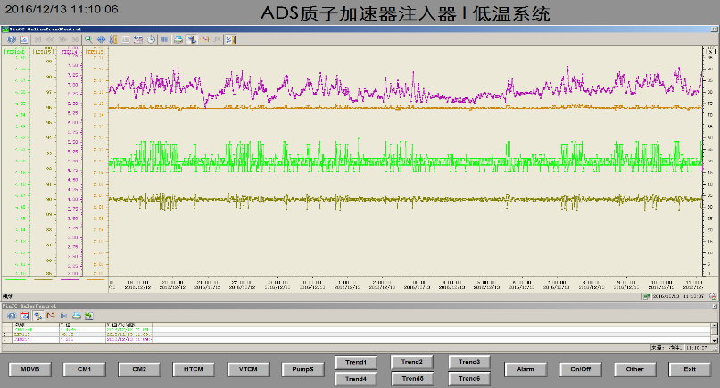
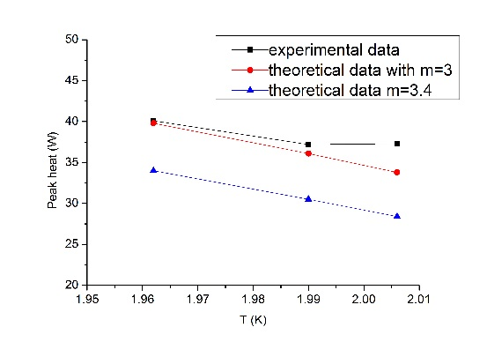
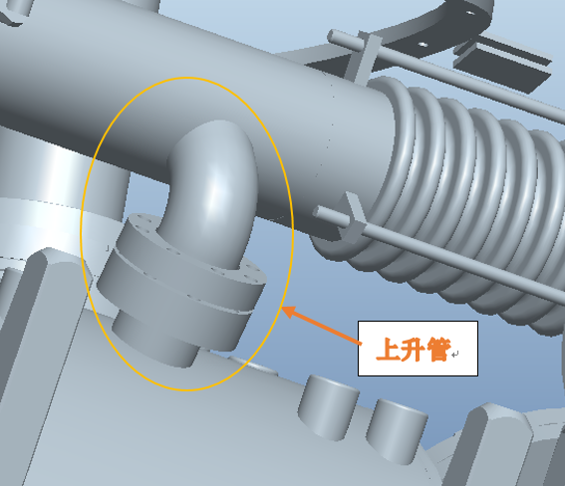
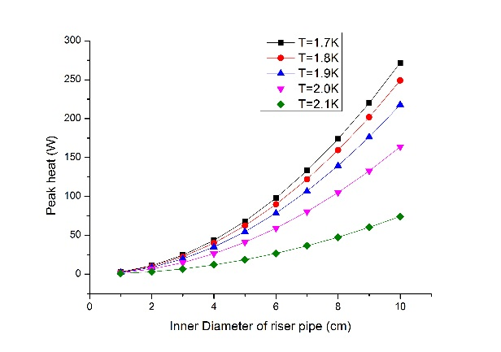
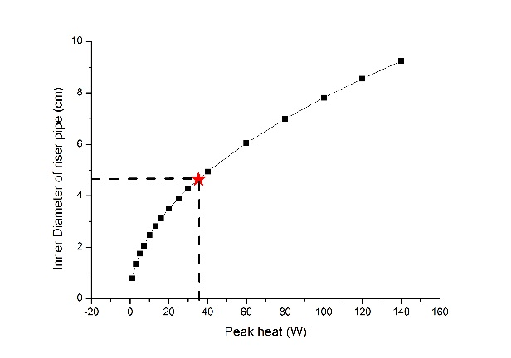
R&D
2K superfluid helium
The 2K superfluid helium has a peak heat for the specific superconducting facility.
In ADS 2K cryogenic system, the peak heat versus the diameter of the riser pipe in the cryostat is analyzed.
The design method of the riser pipe of the cryostat is proposed.
m=3, the difference between experiment data and the theoretical data is less than10%！
Pressure fluctuation < ±10Pa
For ADS cryostat, the peak heat is 37.3W@2K
Riser pipe

Slide 18
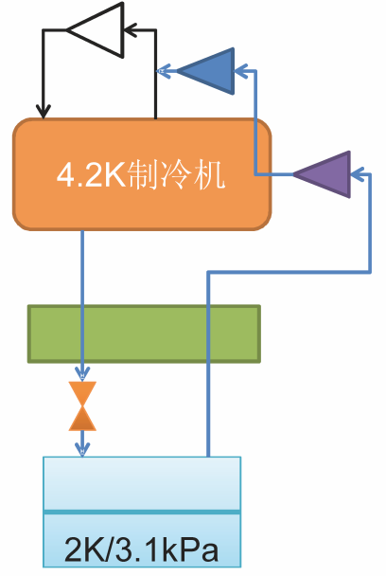
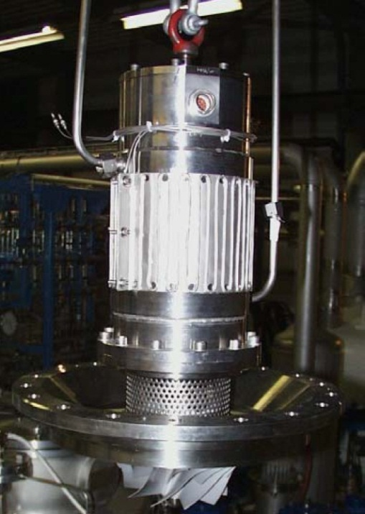
R&D
Cold compressor
From Zhuo Zhang
Cold compressor is the key equipment for large 2K cryogenic system (mass flow> 10g/s).
Only a few core manufacturers abroad have the design and manufacturing capacity.
The research of cold compressor is ongoing and supported by Key independent deployment project of Particle Accelerator Physics and Technology Key Laboratory .
4.2K Refrigerator
Technical parameters:
adiabatic efficiency: ≥60%
Compression ratio: ≥2
Leakage rate: 10-9 Pa•m3/s
A high-speed motor output power: ≥1 kW
High speed motor speed: ≥36krpm
Cold compressor
JT HX

Slide 19
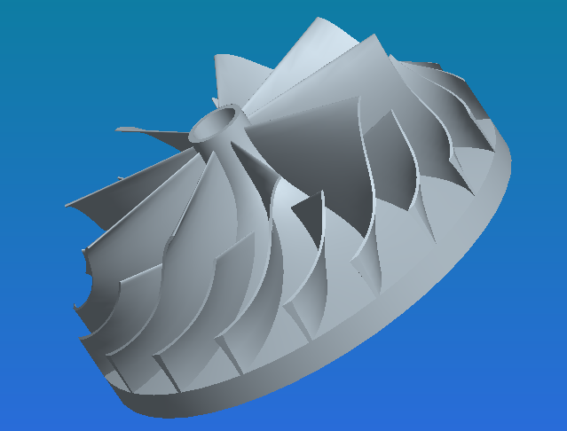
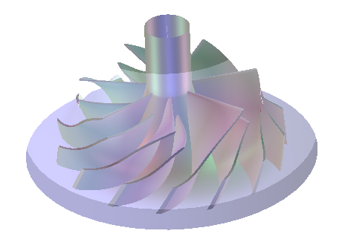
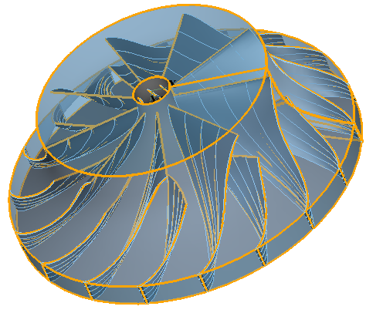
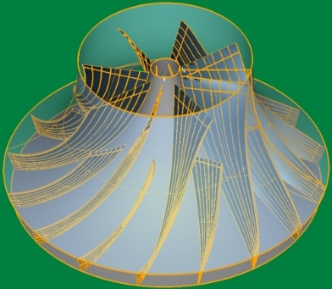
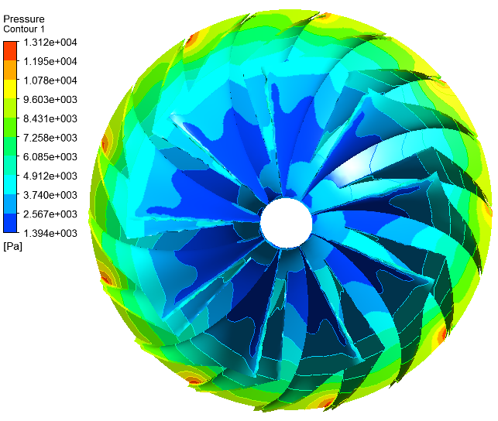
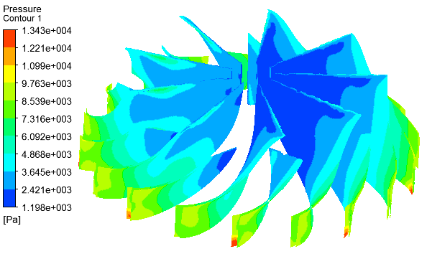
R&D
Cold compressor
From Zhuo Zhang
Impeller is the key part of the cold compressor.
Four types of impellers have been designed and numerically simulated with 3D software. Manufacturing and test is under way.
CC-IHEP01
CC-IHEP02
CC-IHEP03
CC-IHEP04
CC-IHEP01
Simulation results：
Compression ratio：2.87
Mass flow：30g/s
Inlet Temperature：3.15K
Outlet Temperature：6.04K
P distribution on blade and hub
P distribution of blade surface

Slide 20
Summary
The heat load is evaluated, the required total 4.5K equiv. heat load is 58.58kW and total installed power is 12.82MW.
There are four cryo-stations and each station has an individual 18kW@4.5K refrigerator.
The R&D of 2K JT heat exchanger, 2K superfluid helium and cold compressor is under way.

