Slide 1
CEPC Magnet System
CHEN, Fusan
KANG, Wen
November 5, 2017

Slide 2
Outline
CEPC collider magnet
  Overview
  Design of the dual aperture dipole
  Design of the dual aperture quadrupole
  Design of the sextupole
CEPC booster magnet (provided by KANG, Wen)
  Overview
  Design of the low field dipole
  Test of the low field dipole prototype

Slide 3
Collider magnet overview
The magnets cover almost 80% of the 100km ring.
The most concern issues for collider magnet
  Manufacturing cost
  Power consumption
  Radiation shielding (Zhongjian will give a detailed report)
  Field quality
 | Dipole | Quad. | Sext. | Corrector | Total
Dual aperture | 2368 | 2232 | - | - | 9360
Single aperture | 33*2 | 467*2 | 920*2 | 2480
Total length [km] | 71.4 | 5.2 | 0.8 | 1.7 | 79.1
Power [MW] | 6.5 | 36 | 1.5 | 2 | 46

Slide 4
Basic design consideration
To reduce the manufacturing cost
  Make coil with aluminum instead of copper.
  Decrease the filling factor of core to reduce the steel.
    E.g. steel-concrete combined core referring to LEP.
To reduce the power consumption
  Choose the gap/aperture as small as possible.
  Use dual aperture dipole and dual aperture quadrupole.
    Dual aperture magnet save about 50% power.
  Use dipole/sextupole combined function magnet.
    Reduce the sextupole strength.
  Increase the cross section of the magnet coils.
  High-voltage low-current design to reduce the cable loss.
  Possibility of using permanent magnet.

Slide 5
Design of dual aperture dipole
The magnetic length of the dipole is 30m
  The core is divided into 5 segments for easy fabrication
Different polarity sextupoles combined in the first and the last segments
of one dipole
To reduce the
difficulty and power
consumption of
individual sextupoles
No additional ps
is needed.
SF
SD
SD
SF

Slide 6
Design of dual aperture dipole
Two types dual aperture dipole segments
  The first and the last segments: sextupole combined
  The three middle segments: dipole only
Beam center separation:
  350mm
Trim coils:
  For strength tapering
  ±1.5% adjustability
Radiation shielding:
  30mm thickness

Slide 7
Design of dual aperture dipole.
Field optimization
  For the dipole only segments
    Pole shimming on the outer side
    to improve the uniformity
    Better than 3×10⁻⁴@10mm
  For sextupole combined
  segments
    Tuning the pole surface
    profiles of each aperture
    Further optimization is
    needed to make the dipole
    strength of two sides equal.
    The sext. difference can be compensated by individual sext.
  Adjusting the trim coil current in one aperture has no obvious effect to the field in the other aperture
 | Left aperture | Right aperture
Dipole | 0.0360 T | 0.0362 T
Quad. | 0.0002 T/m | -0.0001 T/m
Sext. | 4.9483 T/m² | -8.6429 T/m²

Slide 8
Design of dual aperture dipole.
Design parameters
Magnetic length [m] |  | 29.565
Magntetic strength [T] |  | 0.036
Aperture [mm] |  | 70
Main coil | Turns | 1
 | Material | Aluminum
 | Conductor specs. [mm] | 60×54, φ10
 | Current [A] | 2120
 | Current density [A/mm²] | 0.67
 | Voltage [V] | 1.31
 | Power consumption [kW] | 2.8
Trim coil | Turns | 1×4
 | Material | Aluminum
 | Conductor specs. [mm] | 60×3
 | Current [A] | 16.7
 | Current density [A/mm²] | 0.093
 | Voltage [V] | 0.36
 | Power consumption [kW] | 0.006
Cooling water | loop number | 1
 | pressure [kg/cm²] | 6
 | Velocity [m/s] | 1.75
 | Flux [l/s] | 0.138
 | Temperature rise [°C] | 4.8
Overall size (H×V×L) [mm] |  | 530×200×30500

Slide 9
Design of dual aperture quad.
Polarity: F/D
Center separation:
  350mm
Trim coils:
  ±1.5% adjustability
Gap between cores:
  50mm
Magnetic shielding:
  11.24mm
Radiation shielding:
  30mm

Slide 10
Design of dual aperture quad.
Purpose of the magnetic shielding
  Compensate the odd order harmonics.
  No effect on the even order harmonics.
  The variation is proportional to the shielding thickness.
  The variations of all odd order harmonics have the same scale, so the shielding can compensate them at one time.
B_{n}/B₂ | Before shielding | After shielding
1 | -2132.6 | -1.3
3 | -169.9 | -0.1
4 | 0.4 | 0.5
5 | -2.3 | 0.0
6 | -0.1 | 0.0
7 | 0.2 | 0.0
10 | 0.0 | 0.0
14 | 0.0 | 0.0

Slide 11
Design of dual aperture quad.
Effect of the trim coils
  Adjusting the gradient in one aperture with trim coils will effect the odd order harmonics in both apertures.
  The gap between two cores which is filled with stainless steel can weaken the coupling of the two apertures.
  Harmonics induced by 1.5% of field adjustment with 50mm core gap are acceptable for beam optics.
B_{n}/B₂ | No variation | +1.5% | -1.5%
1 | -1.3 | -51.4 | 52.3
3 | -0.1 | -4.1 | 4.1
4 | 0.5 | 0.5 | 0.5
5 | 0.0 | 0.0 | 0.0
6 | 0.0 | 0.0 | 0.0
7 | 0.0 | 0.0 | 0.0
10 | 0.0 | 0.0 | 0.0
14 | 0.0 | 0.0 | 0.0

Slide 12
Design of dual aperture quad.
Design parameters
Magnetic length [m] |  | 2
Gradient [T/m] |  | 8.21
Aperture [mm] |  | 76
Main coil | Turns | 36×2
 | Material | Aluminum
 | Conductor specs. [mm] | 10×10, φ6, R1
 | Current [A] | 265
 | Current density [A/mm²] | 3.74
 | Voltage [V] | 38
 | Power consumption [kW] | 10.1
Trim coil | Turns | 20×4
 | Material | copper
 | Conductor specs. [mm] | 4×2, R0.2
 | Current [A] | 7.2
 | Current density [A/mm²] | 0.9
 | Voltage [V] | 5.4
 | Power consumption [kW] | 0.04
Cooling water | loop number | 4
 | pressure [kg/cm²] | 6
 | Velocity [m/s] | 1.62
 | Flux [l/s] | 0.184
 | Temperature rise [°C] | 13
Overall size (H×V×L) [mm] |  | 700×500×2000

Slide 13
Design of sextupole
The sextupoles of the two rings are single aperture magnets installed side by side.
  The core size is limited by the 350mm beam separation.
  The space between two sextupoles is only 10mm.
  Copper coils to reduce the power consumption.
Wedge shaped pole
Powered with
independent ps.
  No trim coil
Radiation shielding
  20mm

Slide 14
Design of sextupole
Design parameters
  The original gradient required is 574T/m². With the help of the combined function dipoles, this requirement is halved and the power consumption is reduced to a quarter.
Type |  | SF | SD
Magnetic length [m] |  | 0.6 | 1.2
Gradient [T/m²] |  | 287*
Aperture [mm] |  | 80
Coil | Turns | 26×6
 | Material | Copper
 | Conductor specs. [mm] | 7×7, φ3.5, R0.5
 | Current [A] | 96
 | Current density [A/mm²] | 2.5
 | Voltage [V] | 10.3 | 18.5
 | Power consumption [kW] | 1.0 | 1.8
Cooling water | loop number | 6
 | pressure [kg/cm²] | 6
 | Velocity [m/s] | 1.74 | 1.24
 | Flux [l/s] | 0.100 | 0.072
 | Temperature rise [°C] | 2.4 | 6.0
Overall size (H×V×L) [mm] |  | 350×350×600 | 350×350×1200

Slide 15
The main parameters of the CEPCB magnets
Compared to the quadrupole and sextupole magnets, design of the dipole magnets has much more technology challenges due to large number and low field.

Slide 16
CEPCB low field dipole magnets
 | BST-74B
Quantity | 13312
Minimum field (Gs) | 29
Maximum field (Gs) | 352
Gap (mm) | 63
Magnetic Length (mm) | 5500
Good field region (mm) | 55
Field uniformity | 0.1%
Field reproducibility | 0.05%
Challenges
Total length of the dipoles ~70km how to reduce cost
Field error <29Gs*0.1%=0.029Gs how to design
Field reproducibility<29Gs*0.05%=0.015Gs how to measure
Magnet length ~5500mm how to fabricate

Slide 17
CEPCB low field dipole magnets
Thanks to the low field, the core of the magnet can be made of magnetic material of iron as little as possible so that the weight and cost of the magnet could be reduced.
There are two directions to dilute the iron of the core, one is longitudinal direction, another is transversal direction.
The technology of core dilution has the additional advantage that can increase the min. field in the core and decrease the influence of the remnant field.
For LEP’s and LHeC’s low field dipole magnets, the cores were diluted in longitudinal direction by filling concrete or plastic into the steel laminations.
For CEPCB’s low field dipole magnets, both the longitudinal and transversal dilution of the cores will be tried.

Slide 18
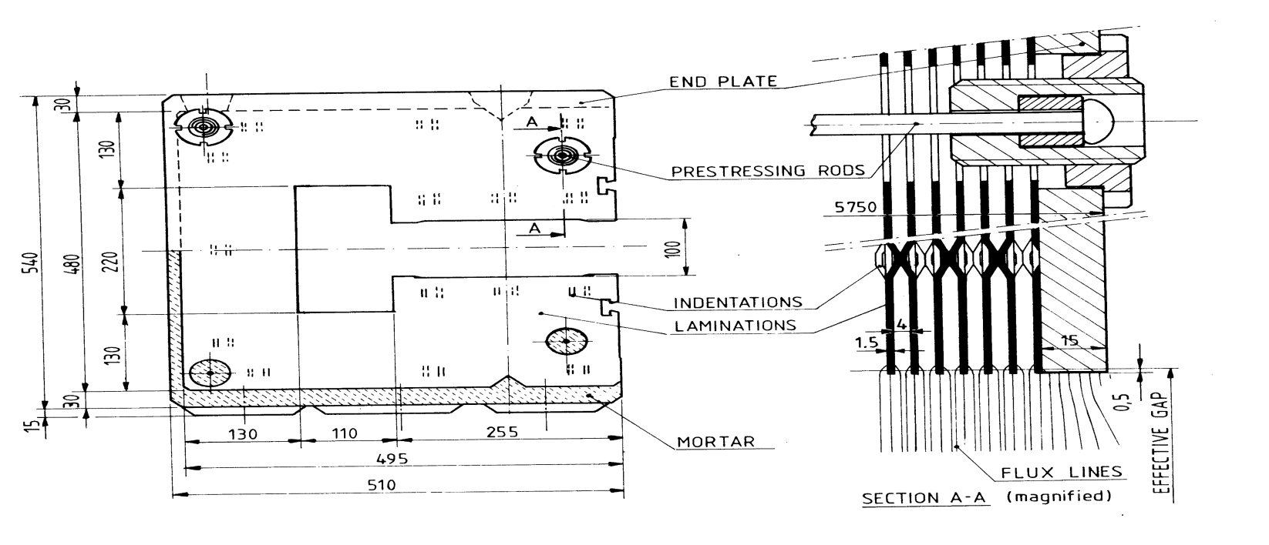
CEPCB low field dipole magnets
The core dilution technology of the LEP’s low field dipole magnet.
In longitudinal direction, the cores were made by 20% steel laminations and 80% concrete.
The magnets had got a low field of 127Gs with good quality.

Slide 19
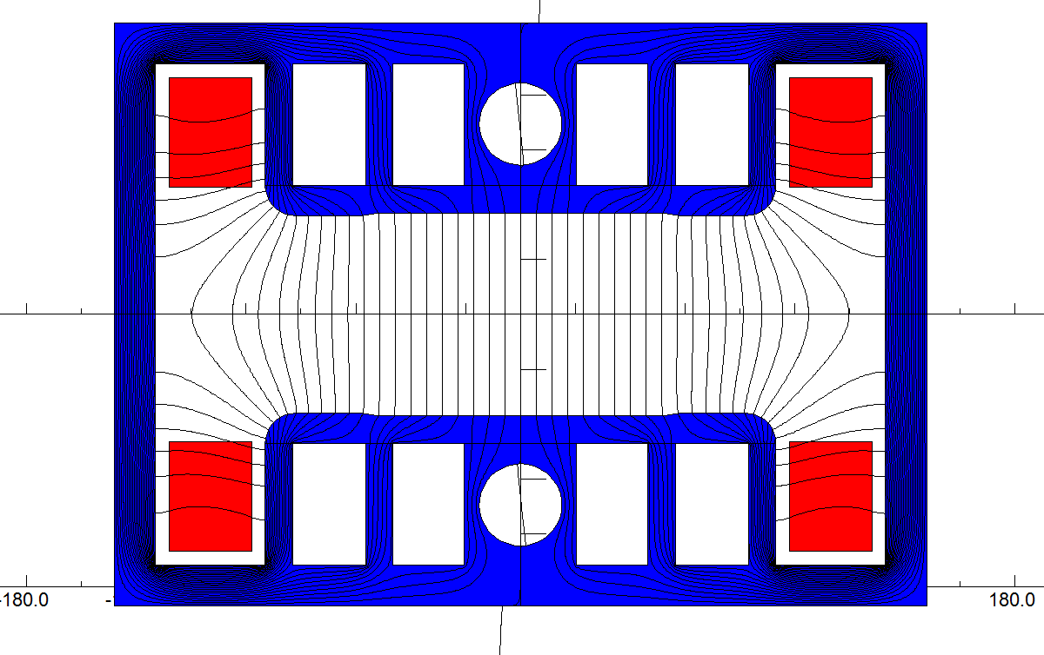
CEPCB low field dipole magnets
The core dilution technology of the CEPCB’s dipole magnet.
In transversal direction, by making the return yokes of the cores as thin as possible and by stamping holes in the pole areas, the weight of the cores can be reduced dramatically.
In longitudinal direction, the cores were made by 40% steel laminations and 60% aluminium laminations. The weight of the cores can be reduced further.

Slide 20
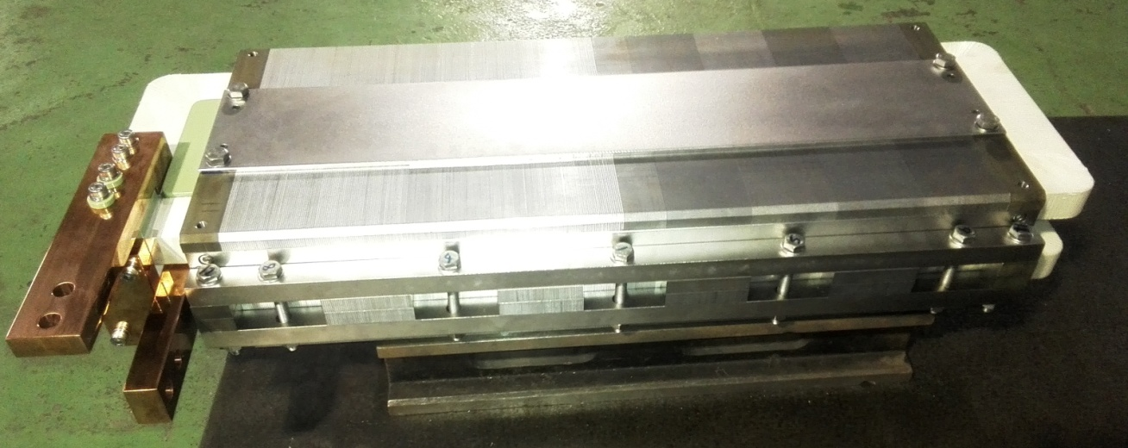
CEPCB low field dipole magnets
In order to verify the design of the CEPC low field dipole magnet, a subscale prototype dipole magnet was produced.
The core of the magnet is about 1m long. One half is stacked by the steel laminations, another half is stacked by the steel laminations interleaved with the aluminum laminations.
The coils of the magnet have only one turn per pole, which is made by solid aluminum bars without water cooling.

Slide 21
CEPCB low field dipole magnets
The field of the prototype magnet were measured by Hall probe measurement system.
The field reproducibility is about 4E-4 at low field of 33Gs whereas 1E-5 at high field of 558Gs.
However, the measurement precision of the Hall probe system at 33Gs is about 3E-4.

Slide 22
CEPCB low field dipole magnets
Due to remnant field, the excitation non-linearity at low field is about 10%.
Due to saturation of the core, the excitation linearity of the half magnet with the combined laminations at high field also becomes bad. It means that the longitudinal dilution should be adjusted.

Slide 23
CEPCB low field dipole magnets
Due to remnant field, the field errors at low field becomes 10 time larger than that at high field.
To meet the field uniformity of 5E-4, the minimum field of the magnet should be higher than 100Gs.
The measured remnant field in the magnet gap is about 4-6Gs, which is 13%-20% of the low field of 30Gs.

Slide 24
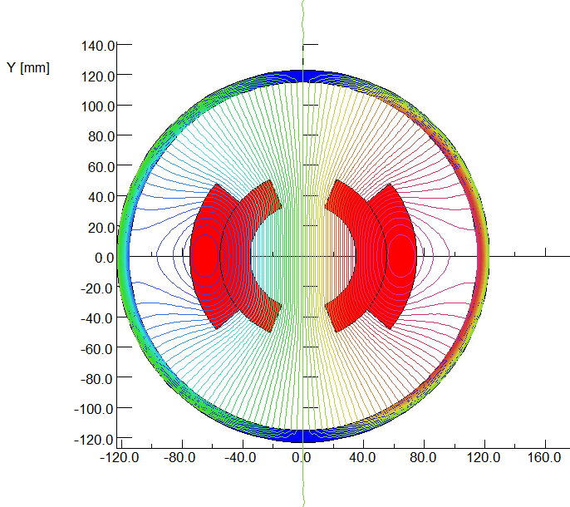
CEPCB low field dipole magnets
The ways to improve the field qualities of the low field magnets
To increase the injection energy of the Booster so that the minimum field of the magnet is increased from 30Gs to 100Gs.
To develop high quality silicon steel laminations with very low remnant field.
To design and develop the low field magnet without magnetic core like superconductor dipole magnets.

