Slide 1
American Activities on Future Colliders
Charles Young (SLAC)

Slide 2
What Is A Future Collider?
Arbitrarily take it to mean a time scale beyond LHC Phase-I upgrade. Please forgive me when I violate my own definition…
Hadron Colliders
HL-LHC
HE-LHC
FCC-hh
SppC
e⁺e⁻ Colliders
ILC
CLIC
FCC-ee
CEPC

Slide 3
What Activities?
Activities in HEP are international in nature.
No uniquely American activities.
Very wide range of activities, e.g.
Physics studies
Accelerator R&D
Detector development from individual sensors to systems
Simulation and computing
Impossible to discuss everything even if I knew them all.
Some topics already covered by others in this workshop.
Apologies for personal biases in the selection of topics.

Slide 4
Challenges for Future Colliders
Hadron Colliders
High field magnets
Pile-up
Radiation
e⁺e⁻ Colliders
Acceleration gradient
Power
Machine detector interface
Experiments
Detectors with high granularity, high speed, low power and high radiation tolerance
Preferably constructed with no material

Slide 5
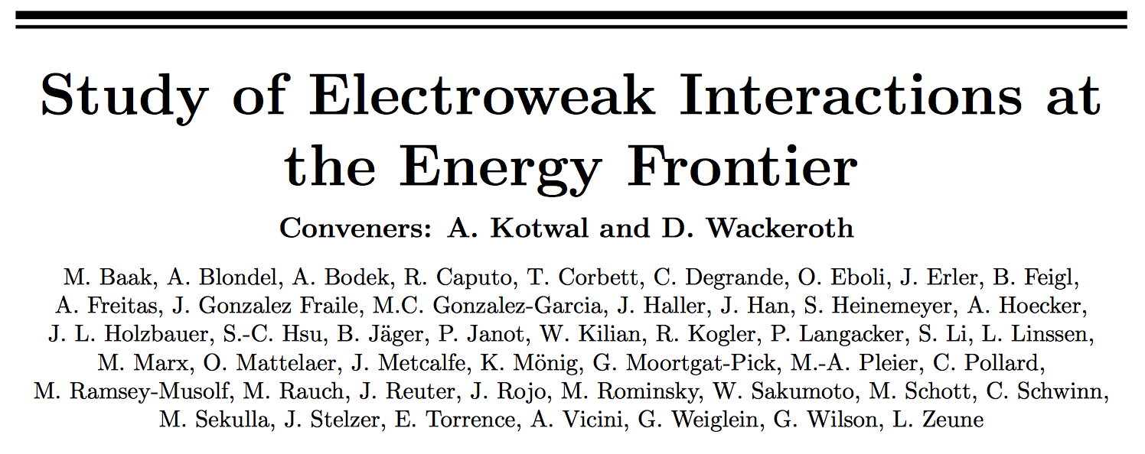
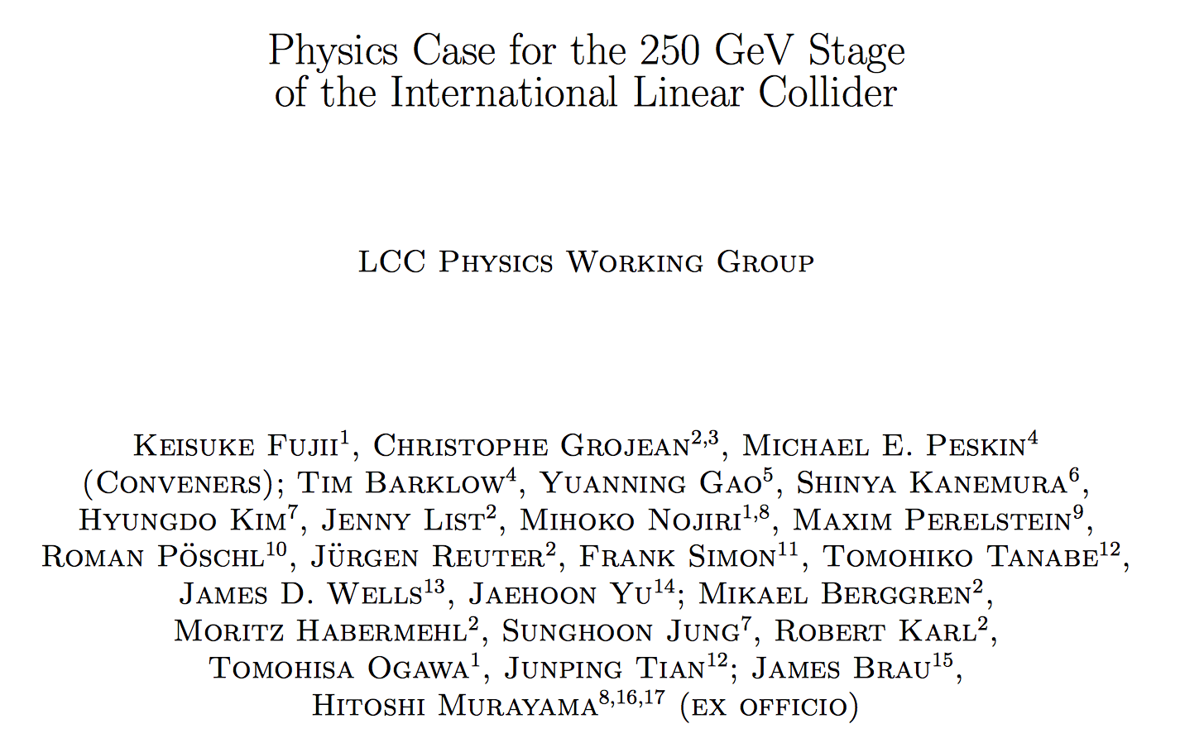
Physics Studies
Many studies by individuals and groups, such as those cited in LTW’s talk this morning
Electroweak
PDG chapter (http://pdg.lbl.gov/2017/reviews/rpp2016-rev-standard-model.pdf)
Snowmass Study (1310.6708)
Gfitter (1407.3792)
ILC250 physics case (1710.07621)
Directly applicable to CEPC
See A. Yamamoto’s ILC talk earlier.
Notes:
Note international nature of authors.
We investigate the thresholds of precision that need to be achieved in order to be sensitive to new physics. We study the precision that can be achieved at various facilities on these observables. We discuss the calculational tools needed to predict SM rates and distributions in order to perform these measurements at the required precision.

Slide 6
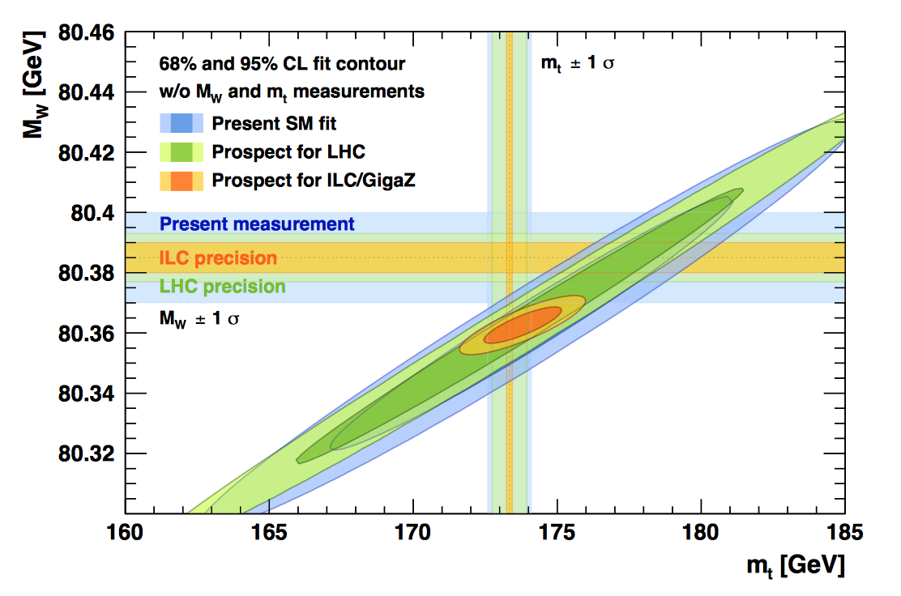
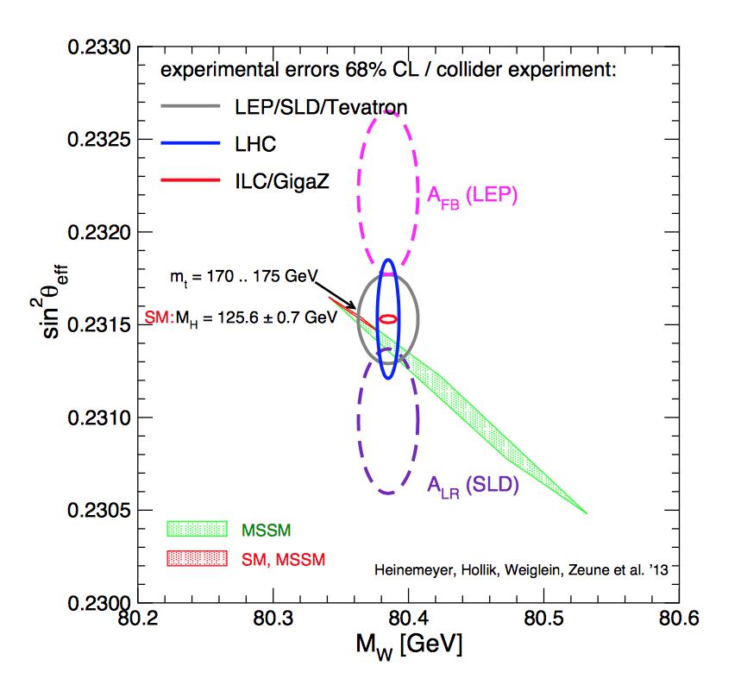
Electroweak
Gfitter
PDG
Snowmass study
Snowmass study and Gfitter’s use of ILC/GigaZ predate CEPC. Nevertheless, they illustrate the importance of finishing the CEPC CDR and of vigorous engagement in international activities.

Slide 7
Electroweak
What is the appropriate luminosity goal for CEPC at the Z pole (and at WW threshold)?
Next generation of circular e⁺e⁻ colliders will define our experimental reach for many decades.
Theoretical improvements beyond current state-of-the-art are expected but major effort is unlikely without a vigorous case from experimental side.

Slide 8
Electroweak
What is the appropriate luminosity goal for CEPC at the Z pole (and at WW threshold)?
Next generation of circular e⁺e⁻ colliders will define our experimental reach for many decades.
Theoretical improvements beyond current state-of-the-art are expected but major effort is unlikely without a vigorous case from experimental side.
Theory improvements that come later can still be useful but significant upgrade in luminosity may be harder to achieve.
Look forward to in-depth discussions later this week! http://indico.ihep.ac.cn/event/7104/overview

Slide 9
Electroweak
What is the appropriate luminosity goal for CEPC at the Z pole (and at WW threshold)?
Next generation of circular e⁺e⁻ colliders will define our experimental reach for many decades.
Theoretical improvements beyond current state-of-the-art are expected but major effort is unlikely without a vigorous case from experimental side.
Theory improvements that come later can still be useful but significant upgrade in luminosity may be harder to achieve.
See S. Heinemeyer’s talk tomorrow morning on theoretical considerations of Z-pole fits.

Slide 10
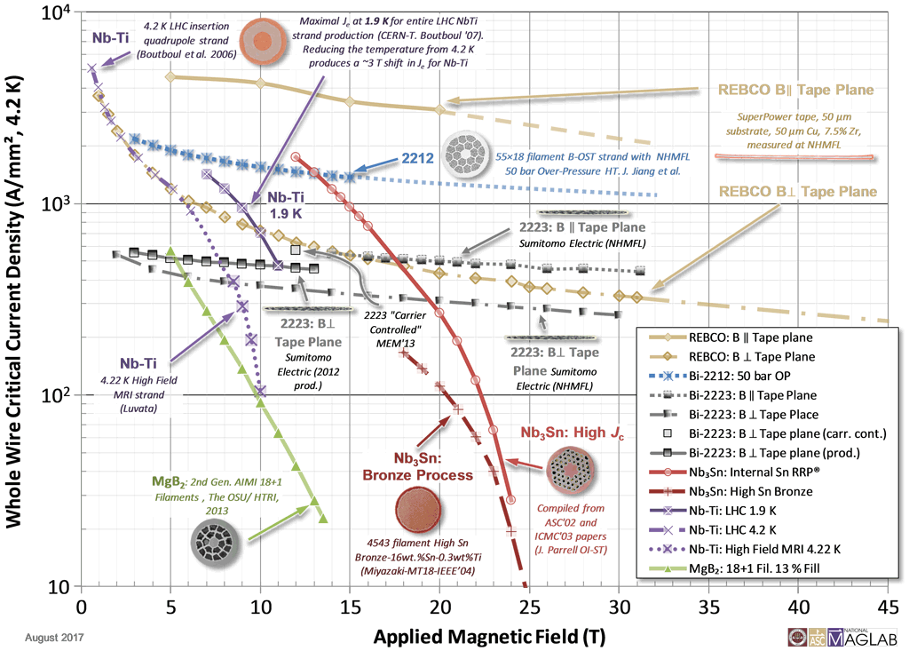
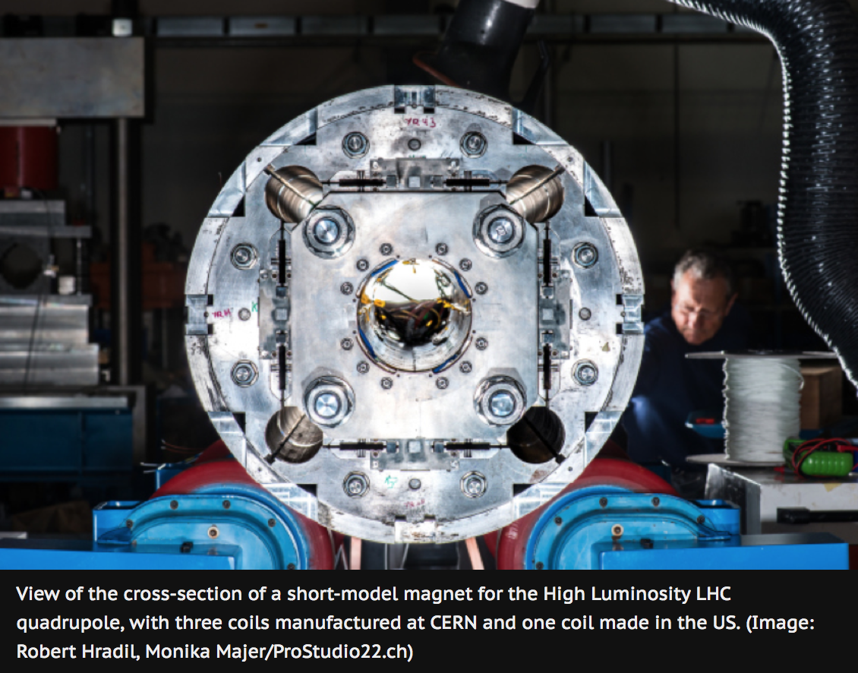
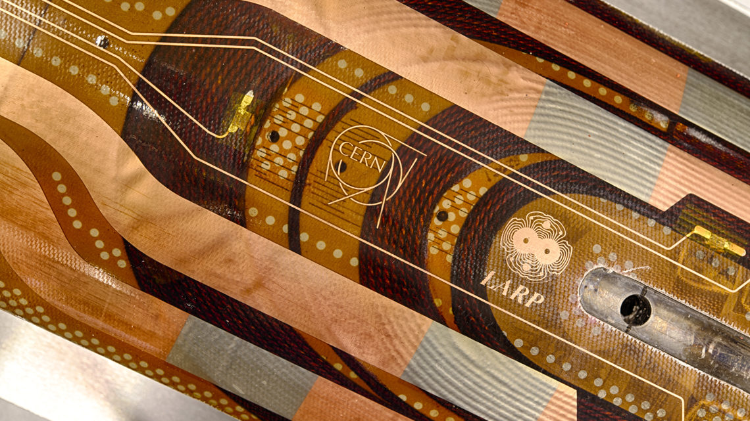
High Field Magnet
From National High Magnetic Field Laboratory
Superconducting materials
Magnet R&D
Nb₃Sn magnets for HL-LHC final focus.
See S. Prestemon and R. Gupta’s talks tomorrow morning

Slide 11
LARP to AUP
LHC Accelerator Research Program (LARP) is a DOE funded R&D program for future upgrades to the LHC.
HL-LHC Accelerator Upgrade Project (HL-LHC AUP) is a construction project to contribute to the HL-LHC upgrade.
Young accelerator scientists supported
by a Fellowship set up to honor
Tim Toohig.
Physicist Tim Toohig
Father Timothy Toohig, S.J.

Slide 12
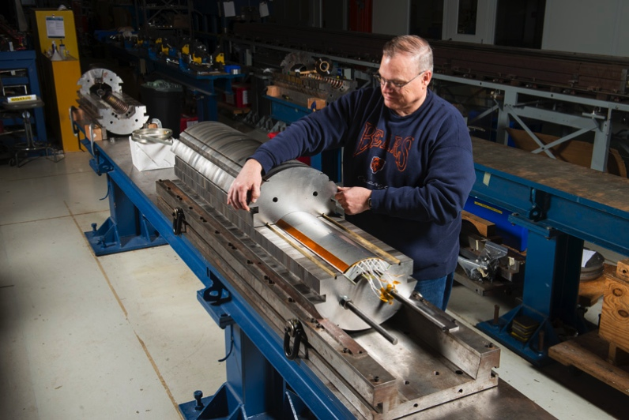
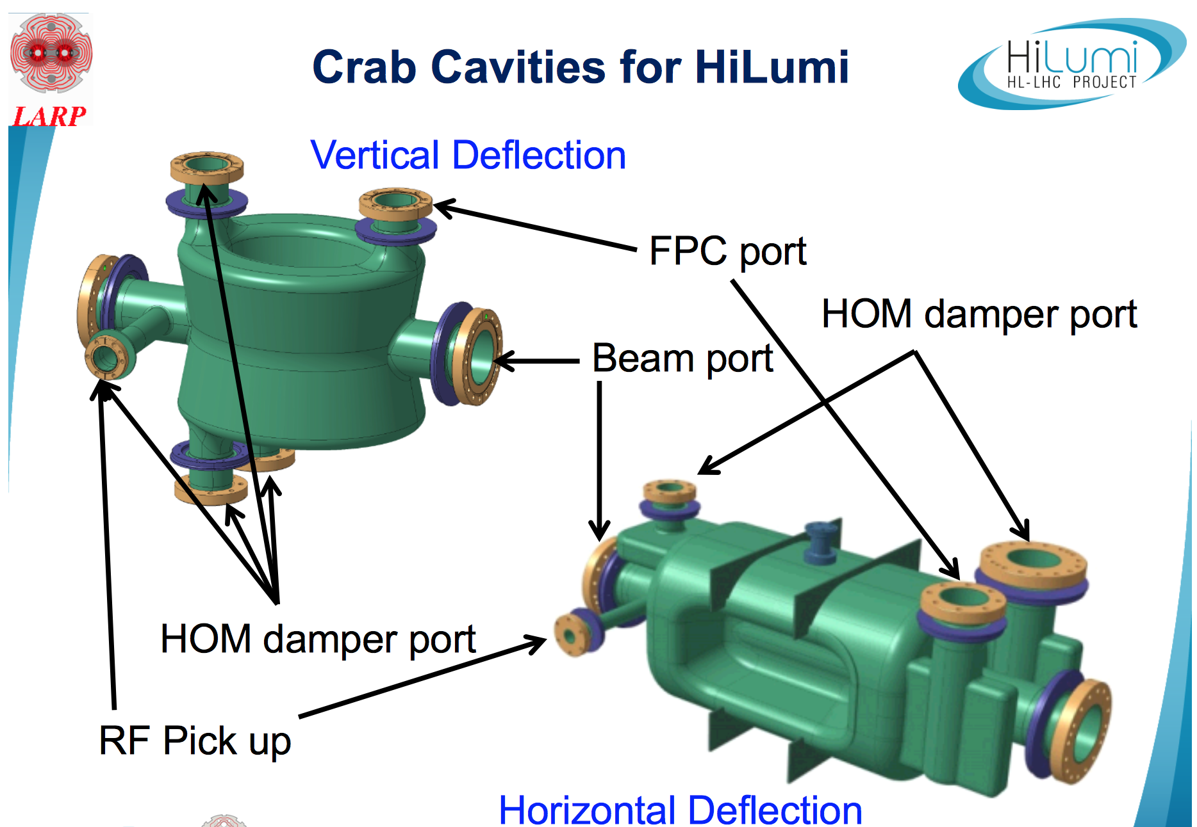
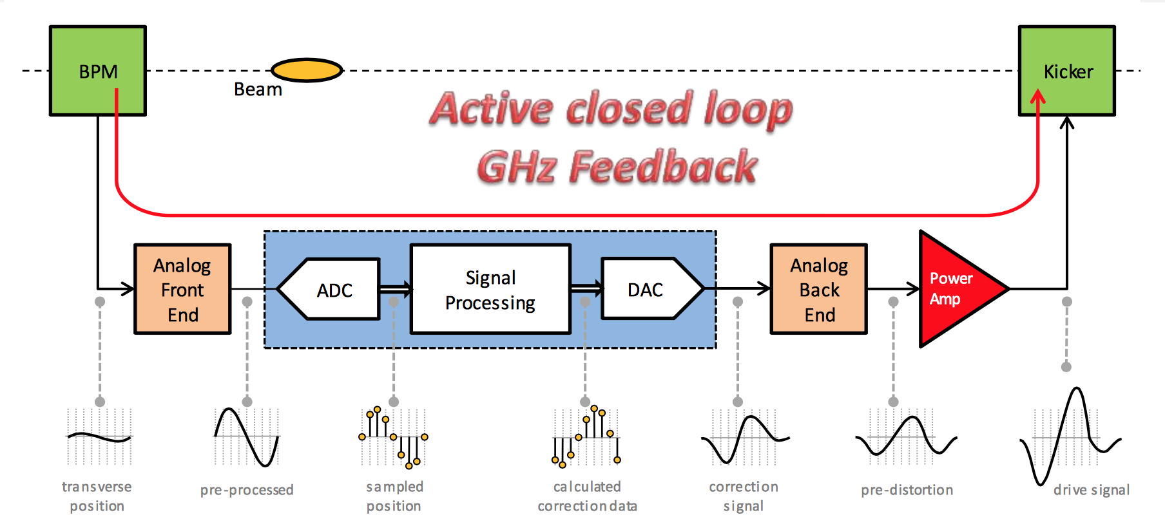
LARP and AUP
Nb₃Sn magnets
Crab cavities
Rotatable collimators
Beam dynamics
Wideband feedback in LIU
First short QXF mirror coil (2015)

Slide 13
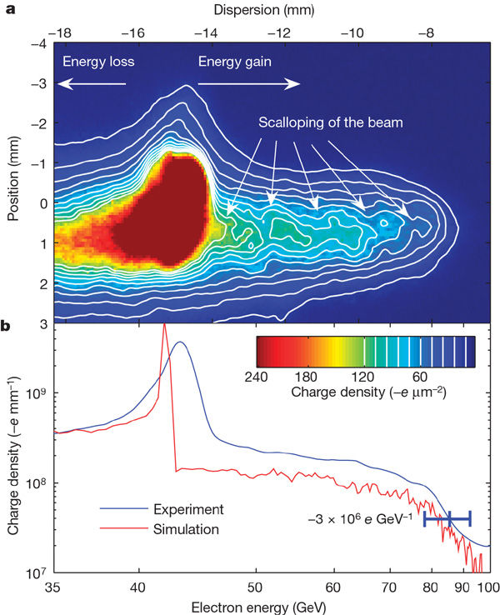
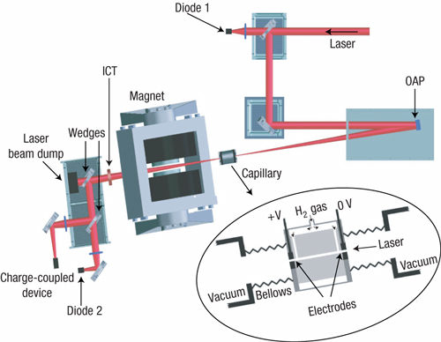
Wakefield Acceleration
Plasma wakefield
Laser wakefield
Also see W. Lu’s talk on plasma based injector for CEPC tomorrow morning..

Slide 14
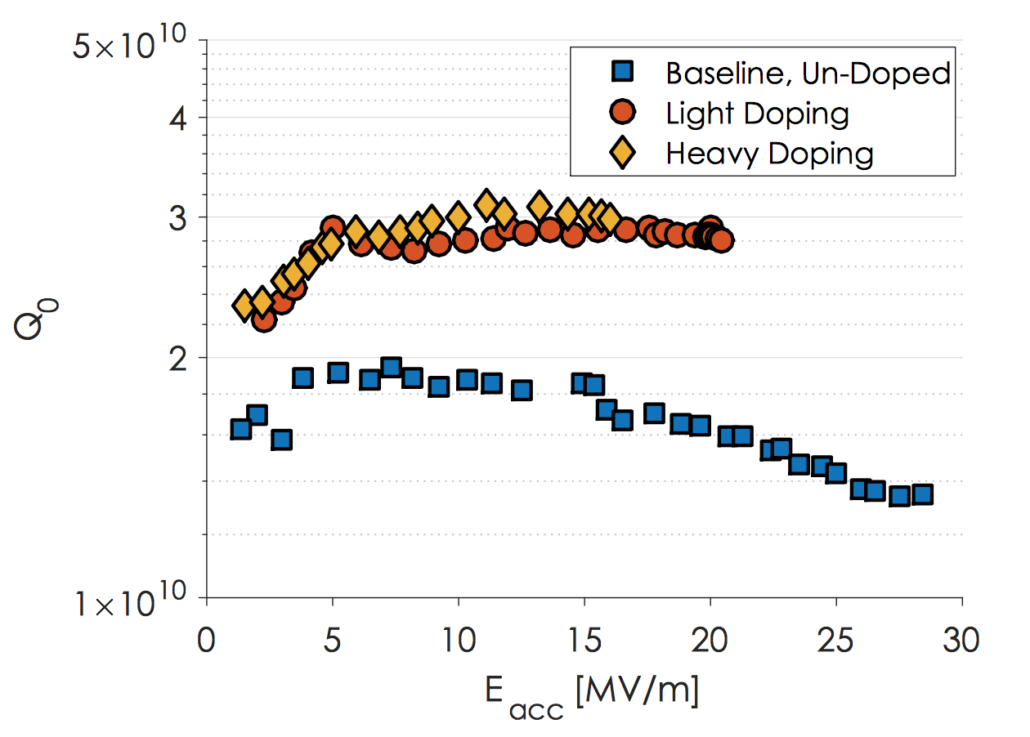
Nitrogen Doping of Niobium SC RF Cavities
A. Grassellino et al, Superconductor Science and technology, Volume 26, Number 10 (2013)
Intrinsic quality factor Q₀ higher than previously achievable.
Simple preparation steps now widely adopted.
from thesis by Daniel Gonnella, Cornell (2016)
improvement in quality factor Q₀

Slide 15
Machine Detector Interface
Complicated and congested area
Close-in quadrupoles for luminosity
Forward detectors for acceptance
High-radiation environment
Additional considerations for trickle injection
Built on experience at a number of American colliders.
See S. Bai talk Tuesday morning, MDI session tomorrow afternoon, and MDI session in last week’s CDR mini-review.

Slide 16
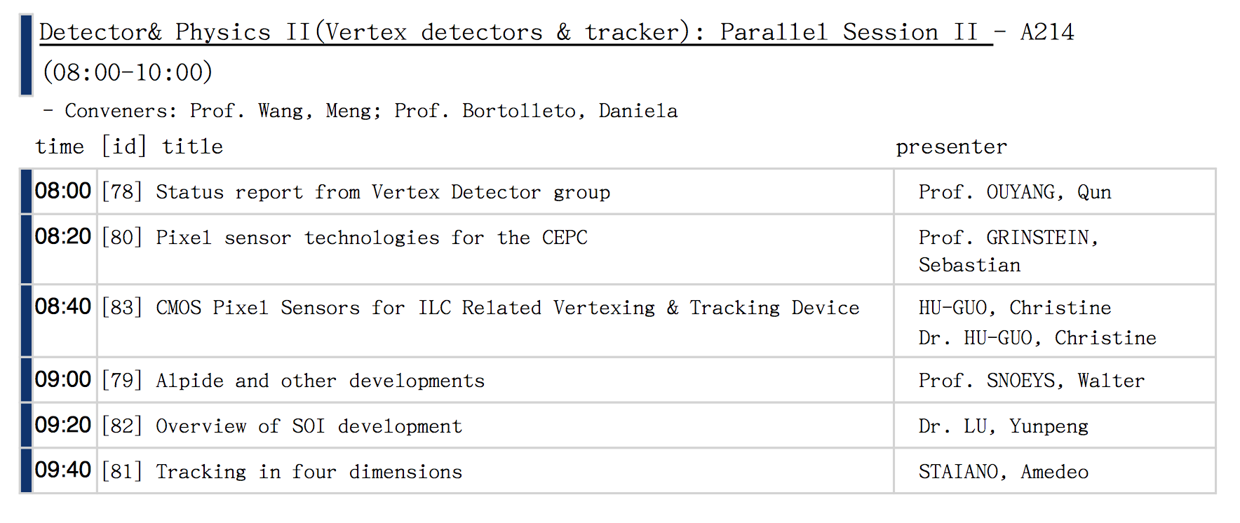
Detector Development
Silicon sensor technologies.
Calorimetry
Some activities directed towards CEPC
Many current activities related to HL-LHC.
See session tomorrow morning.
See M. Yao talk on full silicon detector this afternoon.

Slide 17
Pile-up Challenge
Calorimeters have high occupancy.
Jets from different p-p collisions are merged, and energy resolution is degraded.
Good news: pile-up mitigation in analysis has performed better than originally anticipated for LHC.
Trigger remains difficult.
Track information has helped, usually in software trigger.
What about HL-LHC, FCC-hh and SppC?
Computing difficulties unresolved.

Slide 18
CMS Endcap Calorimeter
Good depth segmentation:
EE: 28 sampling layers; 25X₀, 1.3 λ
FH: 12 sampling layers; 3.5 λ
BH: 11 layers; 5.5 λ
High-granularity silicon readout (in EE and FH)
Typically ~1 cm²
~0.5 cm² for small radius region
Precision timing of O(50 psec) would assist pile-up rejection
See A. Belloni talk on CMS HGCAL this afternoon.

Slide 19
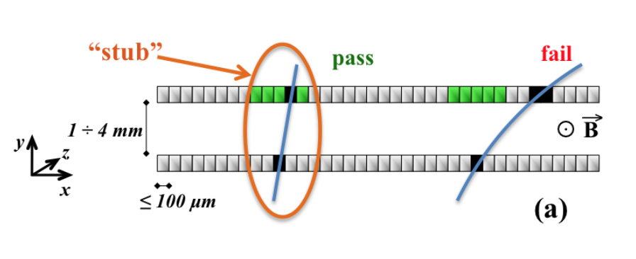
Track p_{T} for Hardware Trigger
CMS
Closely spaced pair of silicon sensors.
“Stub” provides p_{T} information for trigger.
ATLAS pursuing several different options with equivalent trigger-level capability

Slide 20
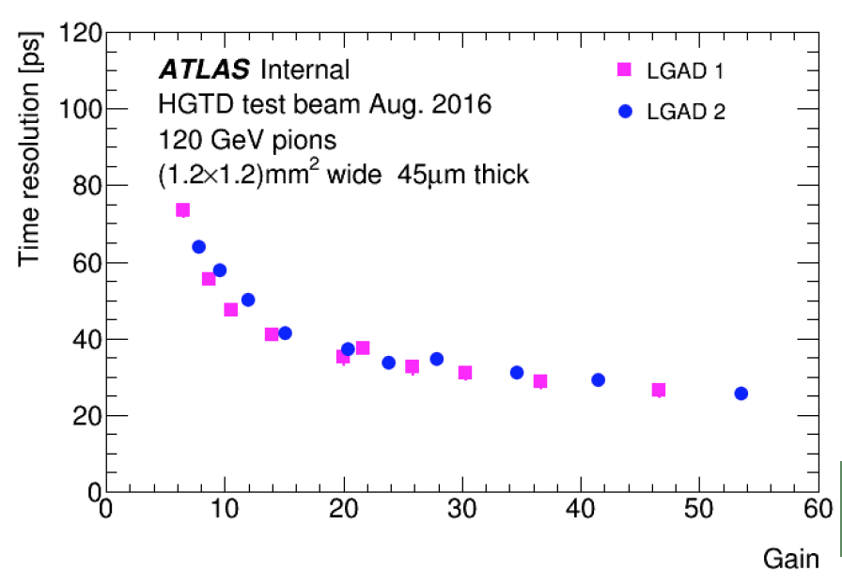
Combining Good Spatial and Time Resolution - LGAD
LGAD = Low Gain Avalanche Diode
Excellent timing
From U. Mallik, CPAD 2016
Also see A. Staiano talk on tracking in four dimensions tomorrow morning.

Slide 21
Detector Trends
Combination of functions
Sensor and front-end electronics (Pixel CMOS)
Timing in calorimeter (CMS calorimeter)
Timing in tracker (LGAD)
Direction in tracker (CMS tracker but recall earlier jet chamber)
Why not further integration, e.g.
Micro-channel cooling for silicon sensors
Combine position, direction and time information

Slide 22
Computing
Physics exploitation heavily reliant on computing.
Track finding is a combinatorial problem and scales poorly with increasing pile-up.
Simulation currently uses more resources than reconstruction and analysis.
Developments on many fronts
Use of supercomputers for simulation
Rewrite simulation for greater CPU and memory efficiency
Refactor code for use on GPU (and possibly FPGA)
New algorithmic approaches

Slide 23
Machine Learning
There is a lot of hype…
There is also some substance, e.g.
MicroBooNE had a “conventional” reconstruction program.
Convolutional Neural Network (CNN) based approach to find and classify tracks was developed quickly and performs well.
Possible benefits of ML.
Faster development
Better performance
Generally scales well and adaptable to modern hardware
See F. Yang talk on Machine Learning in CEPC tomorrow afternoon .

Slide 24
Summary
Activities in HEP are international in nature.
No uniquely American activities.
North, Central and South American physicists are deeply embedded in many of the activities for future colliders
Physics studies
Machine development
Experiments

