Slide 1
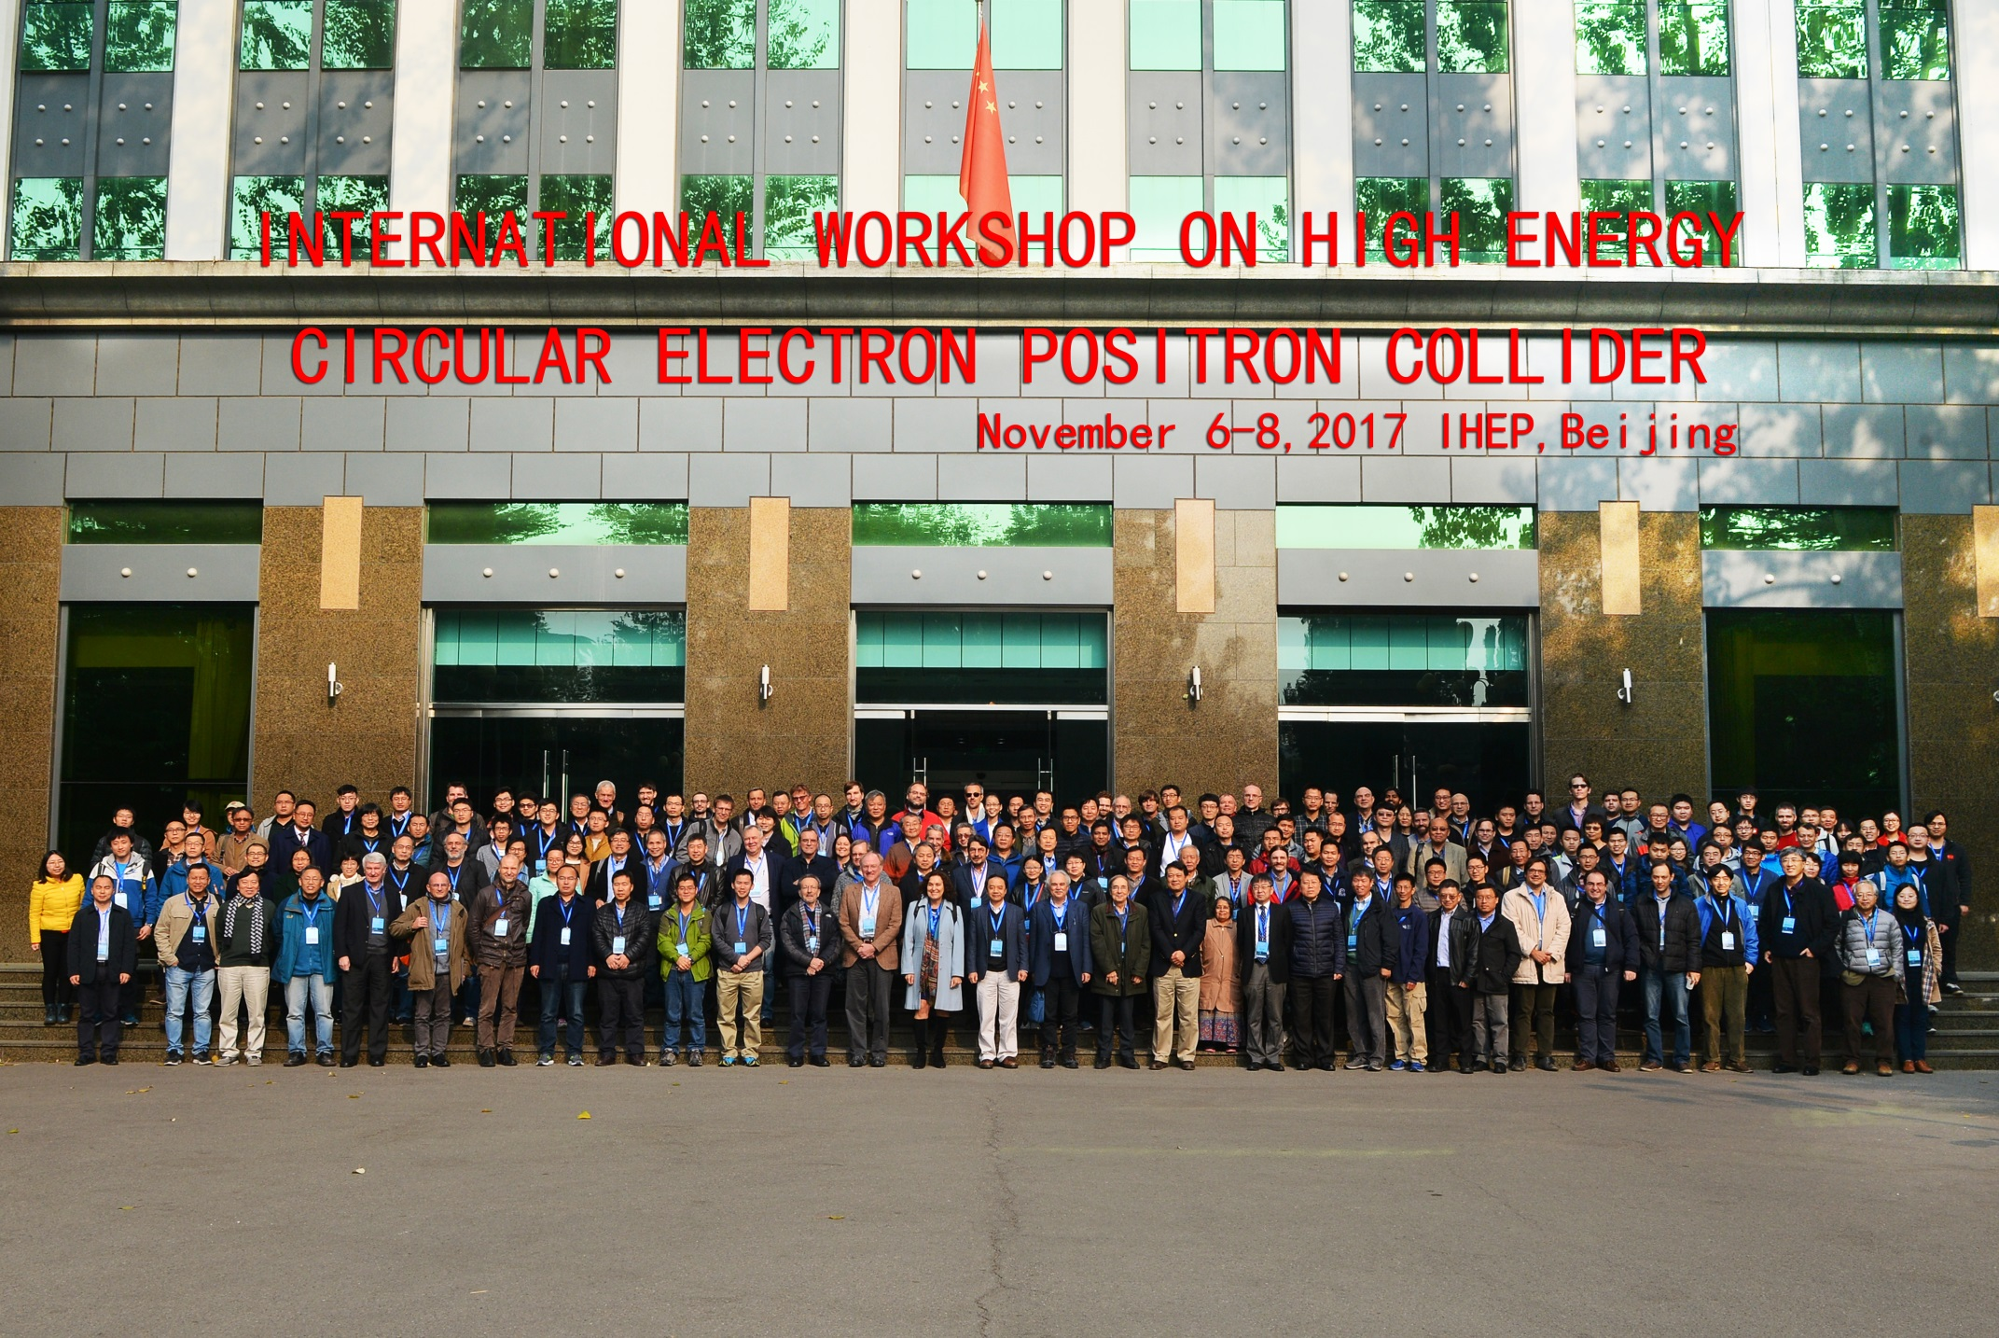

Slide 2
International Workshop on CEPC
CDR
Input to CDR, please contact
Theory Liantao Wang
Detector-simulation Joao Guimaraes da Costa
CEPC-SppC Accelerator Weiren Chou
  Please help review the CDR drafts when they are available

Slide 3
International Workshop on CEPC
International collaboration
exchange scholars and visitors
joint R&D
join in the detector R&D collaborations
Working in China
    Many staff- faculty positions available in China- IHEP, Universities
    International postdocs, short term visitors

Slide 4
International Workshop on CEPC
International Advisory Committee
Young-Kee Kim, U. Chicago (Chair)
Barry Barish, Caltech
Hesheng Chen, IHEP
Michael Davier, LAL
Brian Foster, Oxford
Rohini Godbole, CHEP, Indian Institute of Science
David Gross, UC Santa Barbara
George Hou, Taiwan U.
Peter Jenni, CERN
Eugene Levichev, BINP
Lucie Linssen, CERN
Joe Lykken, Fermilab
Luciano Maiani, Sapienza University of Rome
Michelangelo Mangano, CERN
Hitoshi Murayama, UC Berkeley/IPMU
Katsunobu Oide, KEK
Robert Palmer, BNL
John Seeman, SLAC
Ian Shipsey, Oxford
Steinar Stapnes, CERN
Geoffrey Taylor, U. Melbourne
Henry Tye, IAS, HKUST
Yifang Wang, IHEP
Harry Weerts, ANL
Theory
•Qing-Hong Cao (PKU)
•Nathaniel Craig (UCSB)
•Hongjian He (SJTU)
•XiaoGang He (SJTU)
•JianPing Ma (ITP)
•Maxim Perelstein (Cornell U.)
•Tilman Plehn (Heidelberg U.)
•Matthew Reece (Harvard U.)
•German Valencia (Monash U,)
•Liantao Wang (Chicago U.)
Detector
•Patrizia Azzi (INFN Padova)
•Daniela Bortoletto (Oxford)
•Massimo Caccia (INFN)
•Joao Guimaraes da Costa (IHEP)
•Yaquan Fang (IHEP)
•Roberto Ferrari (INFN)
•Yuanning Gao (THU)
•Sasha Glazov (DESY)
•Imad Laktineh (IPNL)
•Jianbei Liu (USTC)
•Wang Meng (SDU)
•Soeren Prell (Iowa State U.)
•Manqi Ruan (IHEP)
•Charlie Young (SLAC)
Scientific Committee
CEPC accelerator
•Philip Bambade (LAL)
•Anton Bogomyagkov (BINP)
•Yunlong CHI (IHEP)
•Jie GAO (IHEP)
•Sergei Nikitin (BINP)
•Carlo Pagani (Milano U. & INFN-LASA)
•Guoxi Pei (IHEP)
•Chenhui YU (IHEP)
SppC accelerator
•Kazuhito Ohmi (KEK)
•Robert Palmer (BNL)
•Jingyu Tang (IHEP)
•Davide Tommasini (CERN)
•Qingjin Xu (IHEP)
Thank you for everything

Slide 5
International Workshop on CEPC
The Local Organization Committee
Xinchou Lou, IHEP (Chair)
Qinghong Cao, PKU, Joao Guimaraes Costa, IHEP
Jie Gao, IHEP ,Yuanning Gao, THU
Hongjian He, SJTU, Xiaogang He, SJTU
Shan Jin, NJU, Jianbei Liu, USTC
Yajun Mao, PKU, Qing Qin, IHEP
Manqi Ruan, IHEP, Jingyu Tang, IHEP
Liantao Wang, UCHICAGO, Meng Wang, SDU
Nu Xu, CCNU, Haijun Yang, SJTU
Hongbo Zhu, IHEP
Thank you for the effort, the talks and organizations, ….

Slide 6
International Workshop on CEPC
Conveners and session chairs,
speakers, participants,
helpers, …
The secretarial support
Dr. Gang Li (scientific secretary)
Miss Yaru Wu, Miss Huan Xing,
Ms. Tianhong Xing, Mz. Yeliu Mo, Miss Juan Ren
Postdocs and students
Yu Zhang, Xin Mo, ….
Thank you!

Slide 7
International Workshop on CEPC
Have a safe trip home
See you next year

