Slide 1
Progress of SPPC lattice design
(100 Km - 12 T – 75 TeV)
Chen Yukai
International workshop on High Energy Circular Electron Positron Collider
Nov. 6-8, 2017, IHEP

Slide 2
Outline
Background
Lattice design(ARC, DS, LSS)
DA consideration
Summary

Slide 3
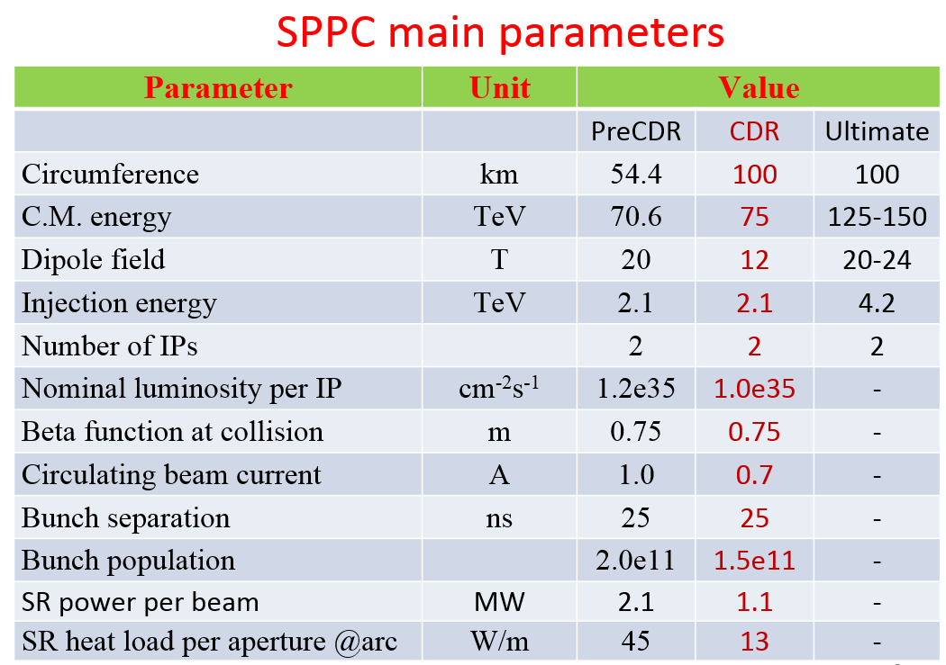

Slide 4
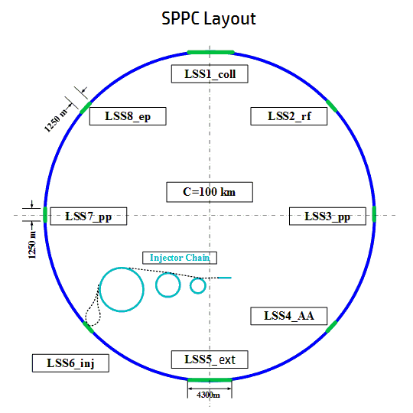
General layout of SPPC
Use the same CEPC tunnel to build SPPC
Maximize the beam energy to 37.5 TeV by using ~12T Iron-based SC magnets
8 arcs, total length 83900 m
2 IPs for pp, 1250 m each
2 IRs for injection or RF, 1250 m each
2 IRs for ep or AA, 1250 m each
2 IRs for collimation( ee for CEPC ）, 4300 m each
C = 100 km
Dipole length needed: 65.45 Km (12 T Dipole, Ep=37.5 TeV)
Dipole filling factor: 0.79
ARC length( including DS ): 65.45 Km/0.79=82.9 Km
Considering some reserved length, ARC length is chosen as 83.9 Km, left 16.1 Km for long straight section

Slide 5
Consideration of geometry
Calculation base on:
Parameters | Beam energy | Strength of Dipole | Length of quadrupole | Space between Q and B | Space between B and B | ARC numbers of the ring | Number of DS each ARC
value | 37.5 TeV | ~12 T | 6 m | 3.5 m | 1.4 m | 8 | 2
Parameter should be determined:
Parameters | Number of Dipoles each FODO cell ( N_dipole ) | Number of FODO cell each ARC ( N_fodo ) | Length of dipole | Length of FODO cell | Total length of ARC | Filling factor
value | 10 or 12 or 14 ? | ? | 14 -15 m ? | ? | ? | ?
N_fodo each ARC
LSS
N_fodo each ARC
LSS
……
DS
DS
DS
DS
8 ARCs

Slide 6
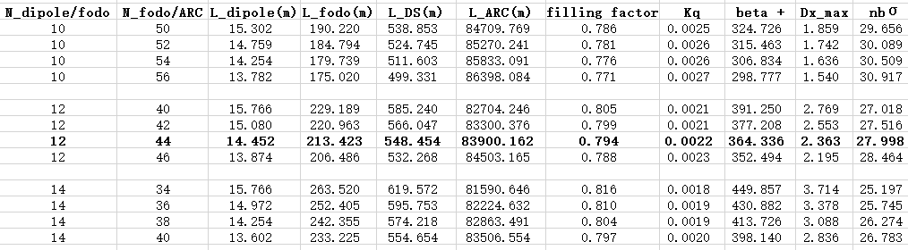
B = 11.8 T

Slide 7
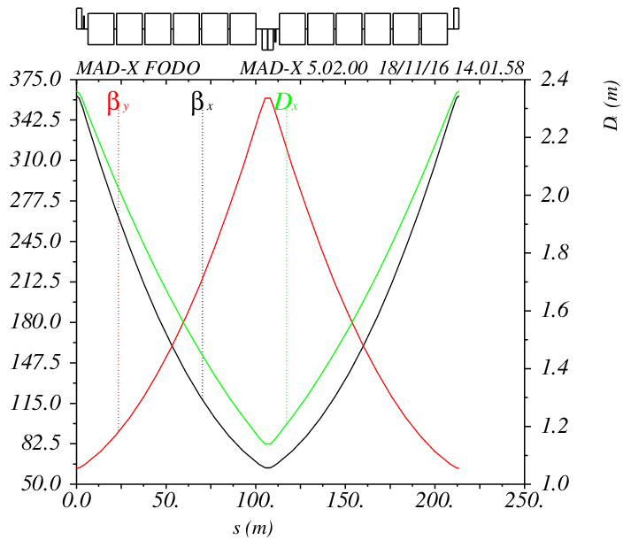
ARC FODO cell of SPPC
Parameters | Value
Dipole length | 14.452 m
Quadruple length | 6 m
Sextuple length | 0.5
Space between dipoles | 1.4 m
Space between dipole and quadruple | 3.5 m
Cell length | 213.42 m
Phase advance | 90 degree
β+ | 363 m
Β- | 62 m
Dx_max | 2.4 m
Beam stay clear at FOCO cell( When aperture is 1.75 cm) | 28 σ
β(m)
FODO cell structure

Slide 8
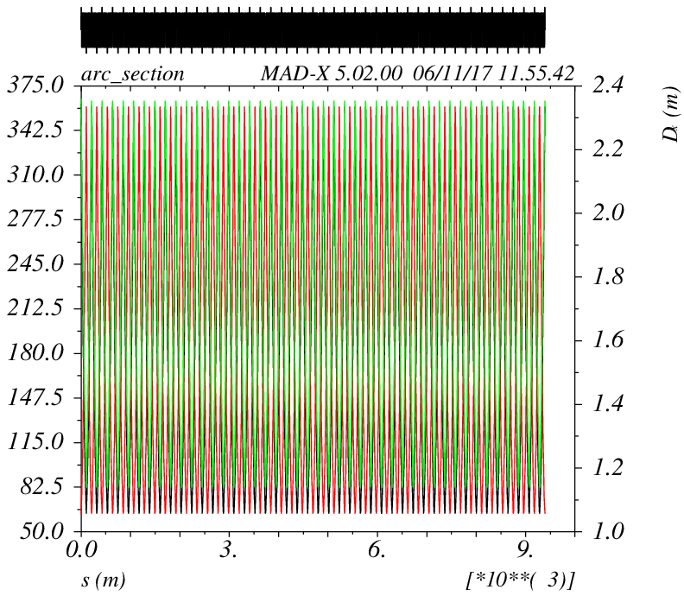
β(m)
Optics of one ARC section
44 FODO cells
ARC length:9390.6 m
ARC length with two Dispersion Suppressor: (548.454 m each): 10487.5 m

Slide 9
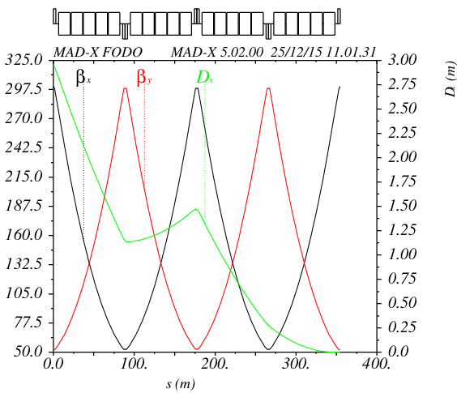
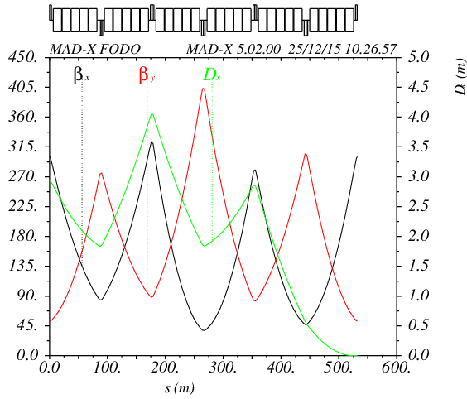
Dispersion Suppressor
β(m)
β(m)
Half bend DS
Full bend DS
Half dipole strength (compare to that of ARC)
Quadruple is the same as that of ARC
Simple, but not flexible
May reduce dipole filling factor
Full dipole strength
Simple
Optics functions bump
Layout is fixed

Slide 10
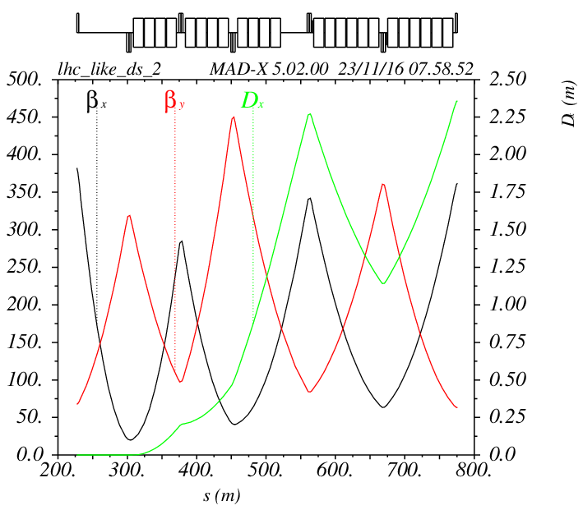
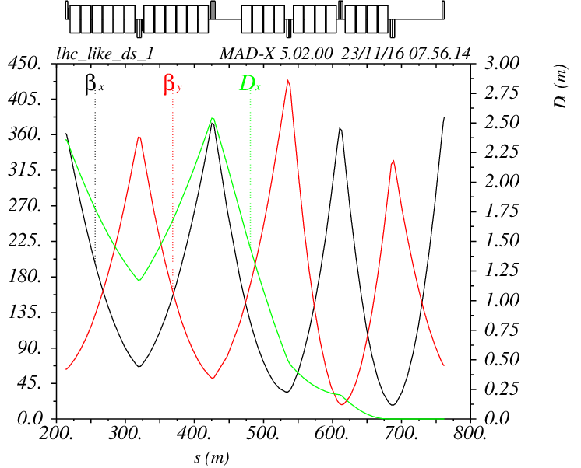
DS design of SPPC
Length can be changed help to adopt the layout
β(m)
β(m)
Left part of DS
Right part of DS
Like full bend DS, but flexible in layout
Irregular structure FODO
Length: 548.454 m ( can be adjusted slightly)
7 quadruples can be use to match optics functions
Maximum beta function bigger than that of ARC slightly

Slide 11
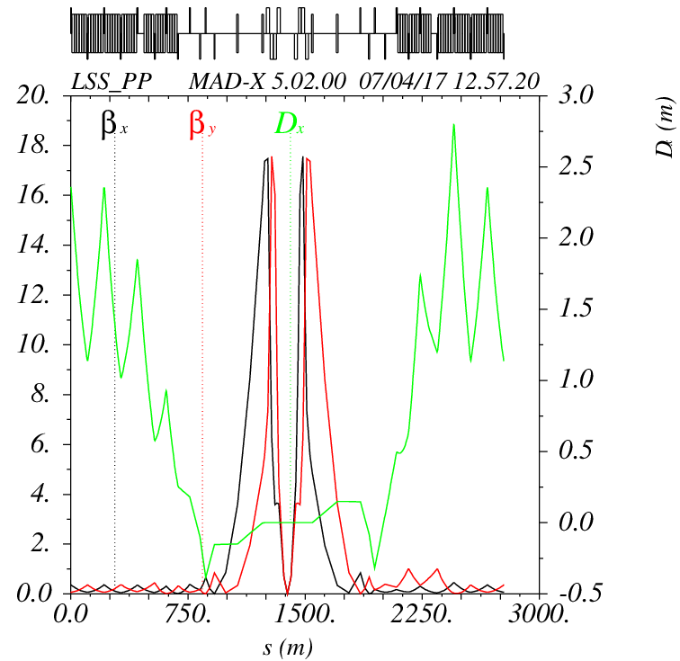
Beam separation and combination
LSS of IP-pp
Final focus triplet
Separation dipoles
Outer triplet
Beam 1
β(m)
30 cm
Beam 2
LSS_PP( beta*=0.75 m )

Slide 12
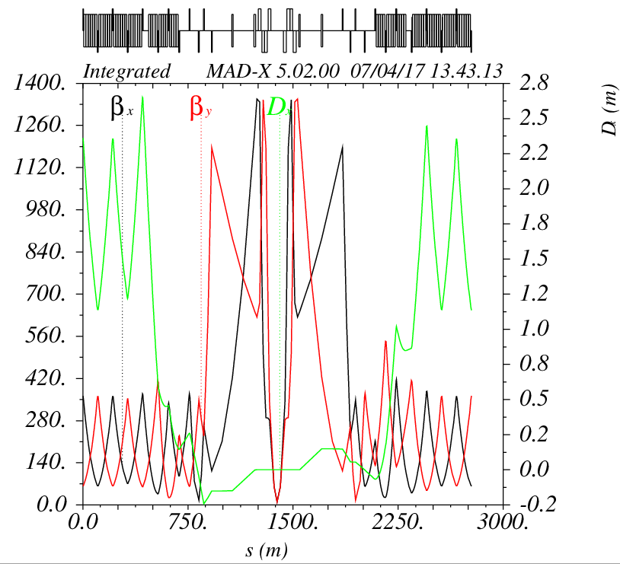


β(m)
β(m)
LSS_PP at collision ( beta*=0.75 m )
LSS_PP at injection ( beta*=10 m )
ε_{n}=2.4 μm
β_{max}=18 km
Ep=37.5 TeV
ε_{n}=2.4 μm
β_{max}=1.3 km
Ep=2.1 TeV
$σ_{max}=\sqrt{\frac{ε_{n}}{γ}∙β_{max}}$=1.04 mm
$σ_{max}=\sqrt{\frac{ε_{n}}{γ}∙β_{max}}$=1.18 mm

Slide 13
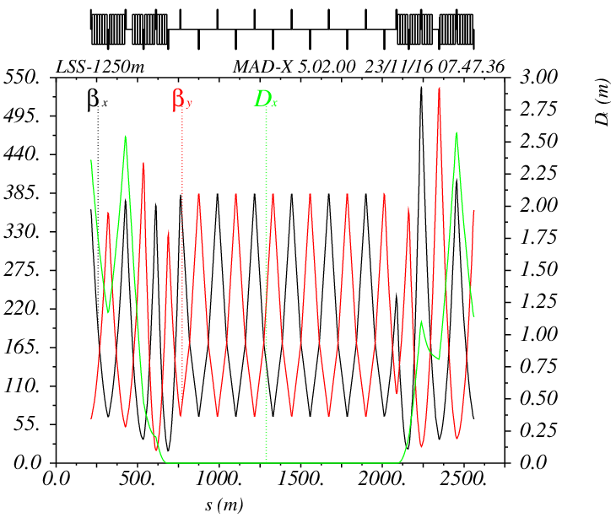
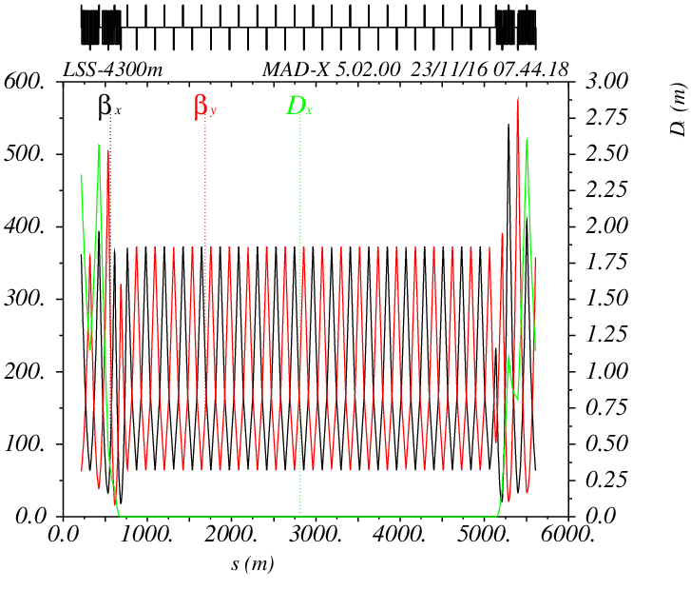
Temporary Lattice of other LSSs
β(m)
β(m)
1250 m length LSS
4300 m length LSS

Slide 14
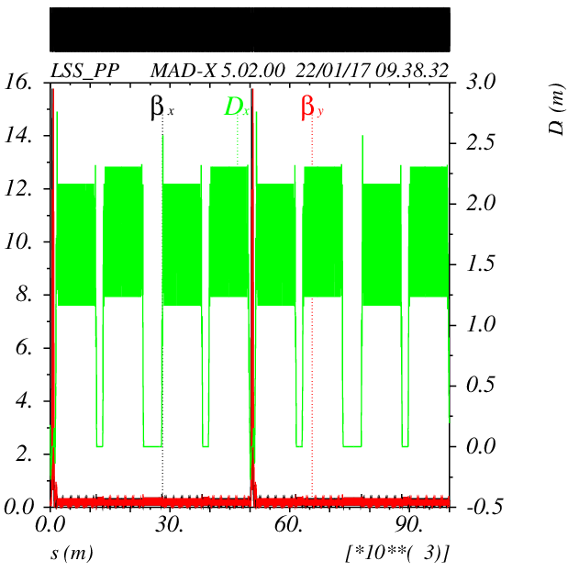
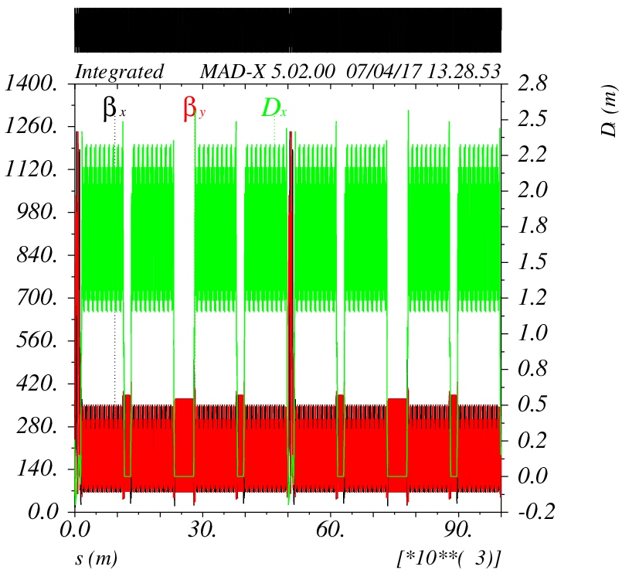
Integrated lattice
β(m)
β(m)
Integrated Lattice at collision
(beta*=0.75m Qx =121.28, Qy=118.31)
Integrated Lattice at injection
(beta*=10 m Qx =119.28, Qy=118.31)

Slide 15
Dynamics Aperture consideration

Slide 16
Source of nonlinear force:
Sextuple magnets( for chromaticity correction)
Magnet multiple error
- ARC bending magnets error (more than 4400 ARC dipoles in total)
- Separation dipoles error ( large aperture)
- Final focus quadrupoles error( large aperture)
- ARC Quadrupoles error
Misalignment
Beam-beam
……

Slide 17
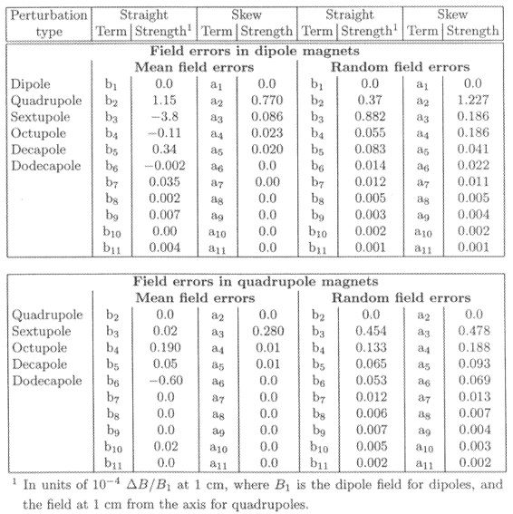

Dipole error table
Systematic
From LHC
From FCC
There isn’t a dipole error table for SPPC, we cite the data of FCC to give the first estimation of DA.

Slide 18
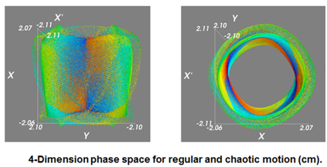
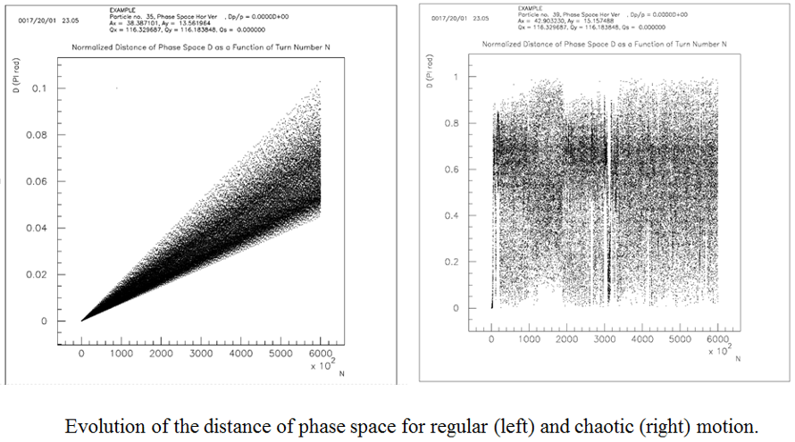
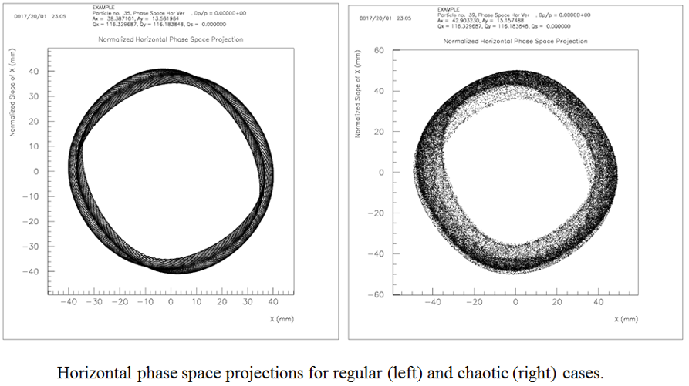
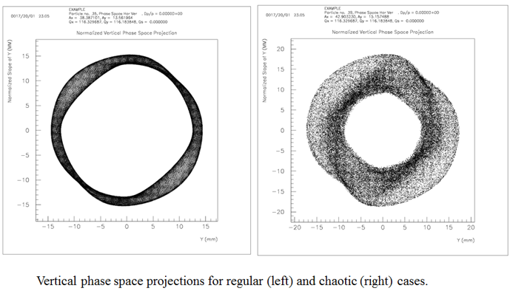
DA study with SixTrack

Slide 19
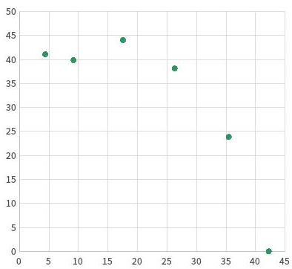
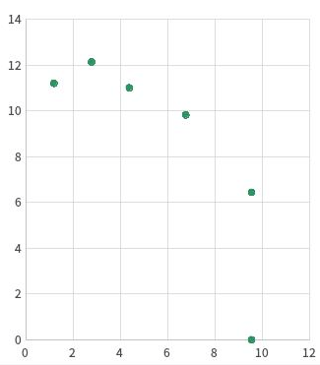
DA at injection
σy
σy
σx
σx
Adding sextuple without dipole error
(chromaticity corrected)
Adding sextuple and dipole error
(chromaticity corrected)
Qx =119.28, Qy=118.31
Normalized rms transverse emittance: 2.4 μm
Proton energy: 2.1 TeV
σx=0.627 mm, σy=0.250 mm
Track 1000 turns

Slide 20
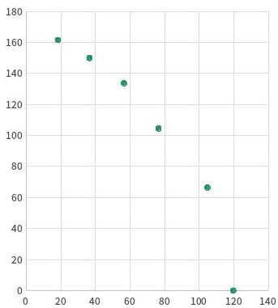
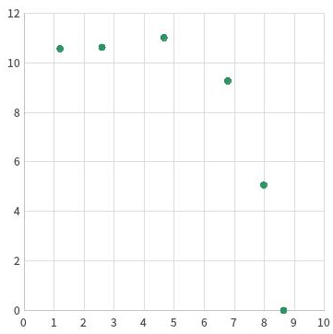
DA at collision
σy
σy
σx
σx
Adding sextuple without dipole error
(chromaticity corrected)
Adding sextuple and dipole error
(chromaticity corrected)
Qx =121.28, Qy=118.31
Normalized rms transverse emittance: 2.4 μm
Proton energy: 37.5 TeV
σx=0.15 mm, σy=0.065 mm
Track 1000 turns

Slide 21
Lots of work need to be done
Tune scan
Frequency map
Resonance analysis
Errors and correction
……
Tools are under construction: Sixdesk running environment for SixTrack; powerful clusters, and so on.

Slide 22
Summary
Preliminary lattice design of the new design scope 100km - 12 T - 75 TeV collider has been done.
Integrated Lattice is available for collimation effect study and DA study.
DA study has been started. Preliminary DA result is about 8-10 σ (considering ARC dipole error and sextuple).
Next to do
Optimize the Lattice design
- Detail collision section design
- Matching section design
Make further study of DA.
- Massive simulation jobs are needed to do under the Sixdesk platform
- Tune scan and resonance analysis.

Slide 23
Thank you for your attention！

