Slide 1

Machine-Detecter Interface of CEPC double ring
Sha Bai
On behalf of the MDI group and Accelerator Physics group
International Workshop on High Energy Circular Electron Positron Collider
2017-11-07

Slide 2
Outline
MDI layout
IR superconducting magnets
Solenoid compensation
Beam pipe
Mechanical and Assembly
Synchrotron radiation
Beam loss backgrounds
Collimator
Summary

Slide 3
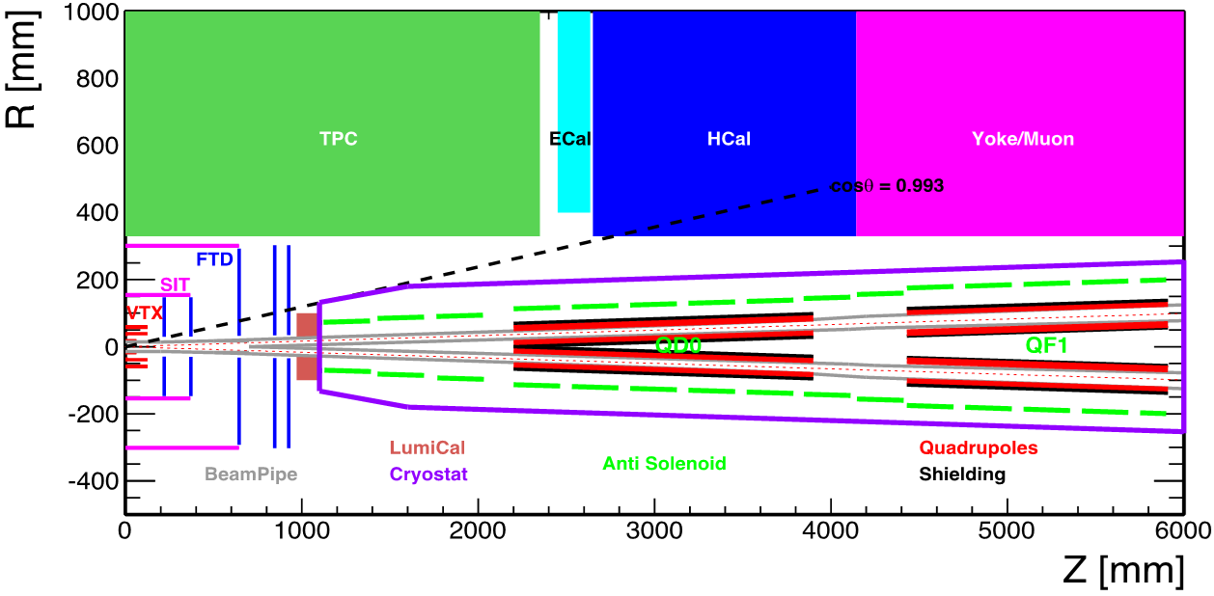
MDI layout
The Machine Detector Interface of CEPC double ring scheme is about ±7m long from the IP.
The CEPC detector superconducting solenoid with 3 T magnetic field and the length of 7.6m.
The accelerator components inside the detector without shielding are within a conical space with an opening angle of cosθ=0.993.
The e+e- beams collide at the IP with a horizontal angle of 33mrad and the final focusing length is 2.2m
Lumical will be installed in longitudinal 0.95~1.11m, with inner radius 28.5mm and outer radius 100mm.

Slide 4
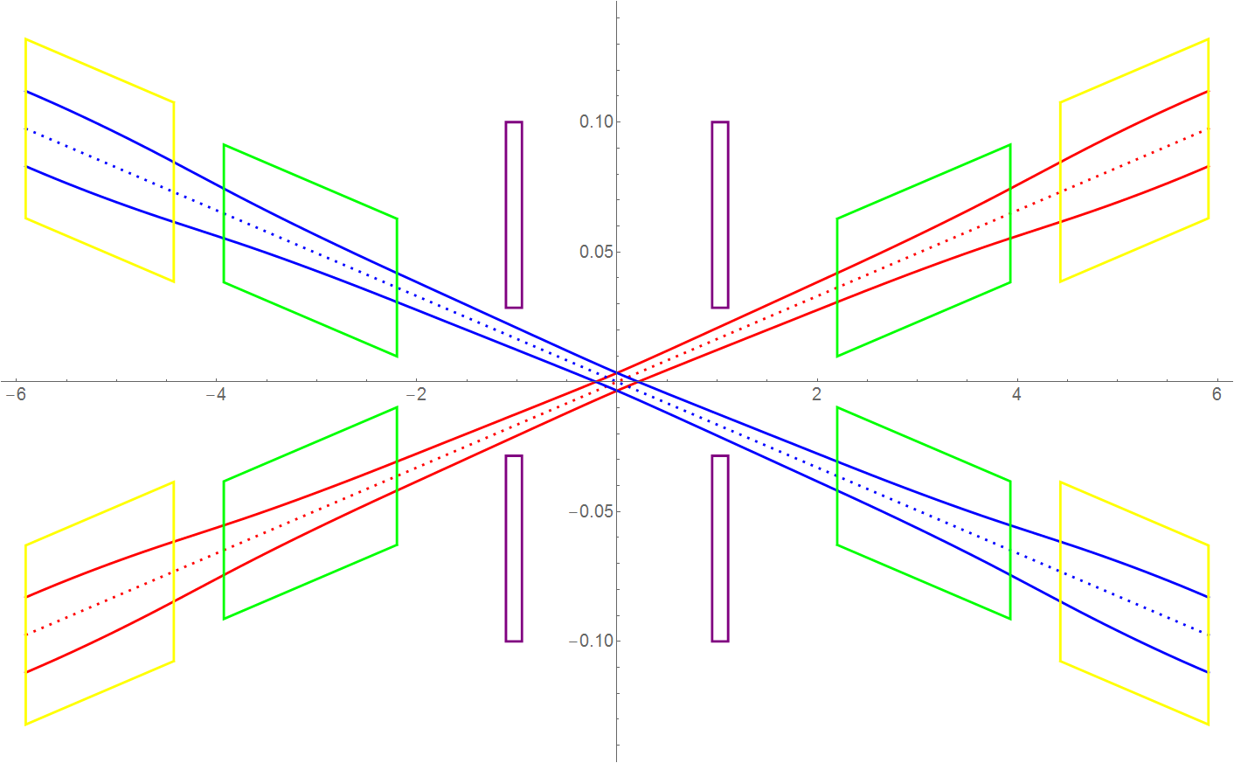
Beam stay clear region
QF1
Lumical
According to the considerations of injection and beam tail effect after collision, CEPC IR beam stay clear region are defined as:
BSC_x = ±(20σ_{x}+3mm)
BSC_y = ±(30σ_{y}+3mm)
QD0

Slide 5
QD0/QF1 physics design parameters
QD0 | Horizontal BSC 2（20σ_{x}+3） | Vertical BSC 2（30σ_{y}+3） | e+e- beam center distance
Entrance | 11.17mm | 16.27mm | 72.61mm
Middle | 14.02mm | 18.70mm | 101.32mm
Exit | 19.15mm | 17.63mm | 129.70mm
Good field region | Horizontal 19.15 mm; Vertical 18.77 mm
Effective length | 1.73 m
Distance from IP | 2.2 m
Gradient | 151 T/m
QF1 | Horizontal BSC 2（20σ_{x}+3） | Vertical BSC 2（30σ_{y}+3） | e+e- beam center distance
Entrance | 23.04 mm | 16.01 mm | 146.20 mm
Middle | 27.49 mm | 14.26 mm | 170.63 mm
Exit | 28.96 mm | 13.68 mm | 195.05 mm
Good field region | Horizontal 28.96 mm; Vertical 16.01 mm
Effective length | 1.48 m
Distance from IP | 4.43 m
Gradient | 102 T/m

Slide 6
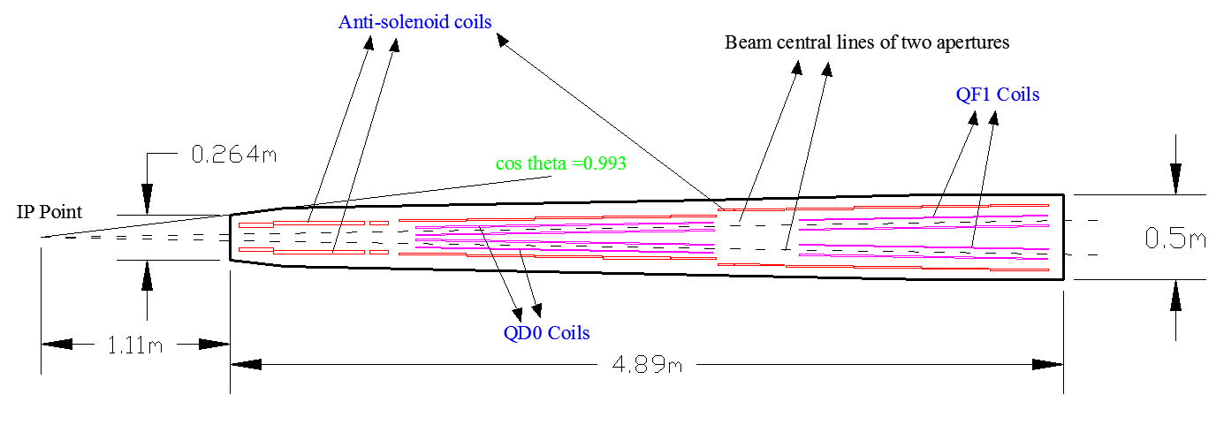
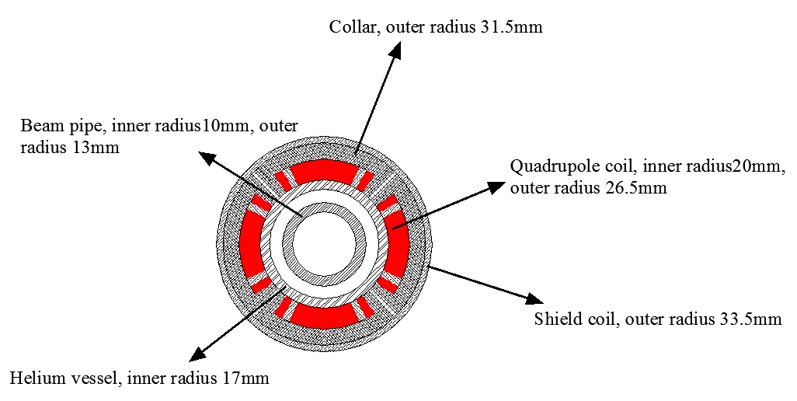
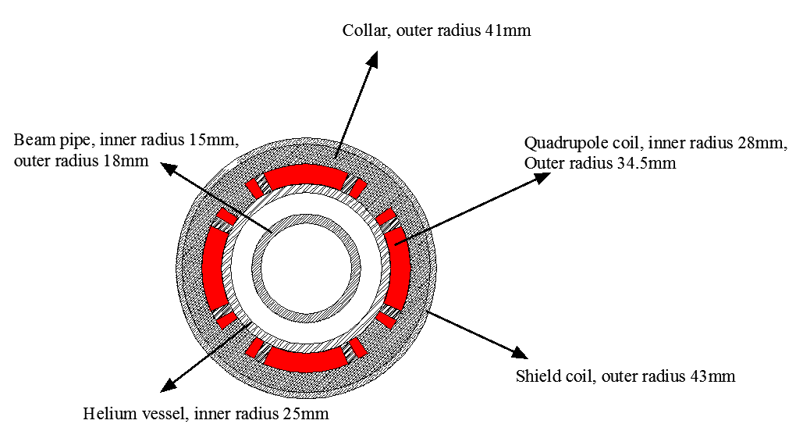
IR superconducting magnets
Both of QD0 and QF1 are double aperture superconducting magnets.
QD0/QF1 and anti-solenoid are all in a cryogenics system.
QD0/QF1 peak field in coil 3.5T/3.7T.
Peak field in coil of Anti-solenoid is 7.4T before QD0, 2.9T within QD0 and 1.9T after QD0.

Slide 7
Solenoid compensation
Anti-solenoids are designed to compensate the solenoid field from the detector.
The integral longitudinal field ∫B_{z}ds within 0~2.12m is 0 and Bz is less than 460Gauss after 2.12m away from the IP.
The skew quadrupole coils are designed to make fine tuning of Bz over the QF1 and QD0 region instead of the mechanical rotation.

Slide 8
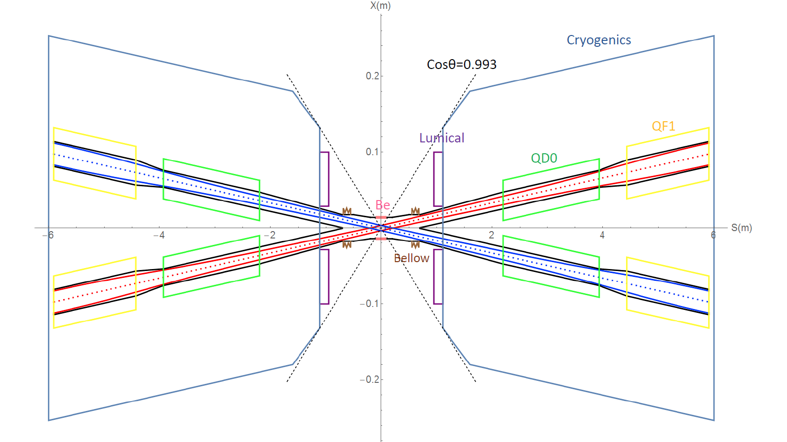
IR beam pipe
The inner diameter of the beryllium pipe ~ 28mm. Length ~14cm in longitudinal.
Due to bremsstrahlung incoherent pairs, the shape of beam pipe between 0.2~0.5m is selected as cone.
Bellows for the requirements of installation in the crotch region where is located about 0.7m away from the IP.
Water cooling structure is considered due to heating problem of HOM.
Room temperature beam pipe has been adopted within final doublet quadrupoles.

Slide 9

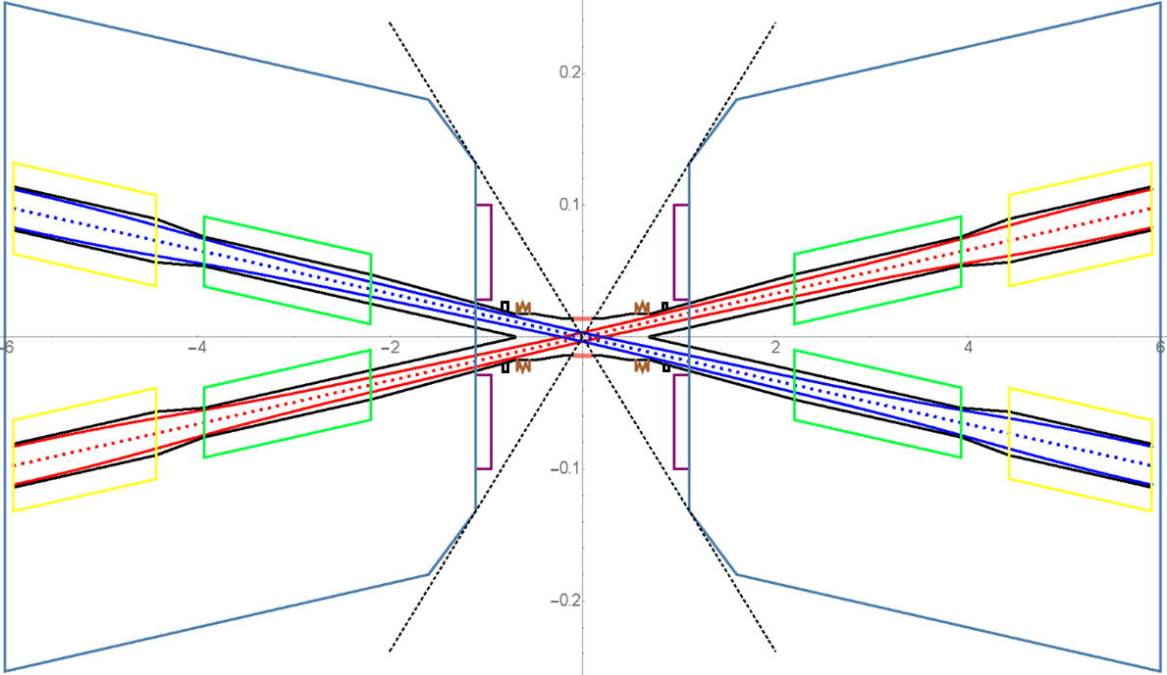
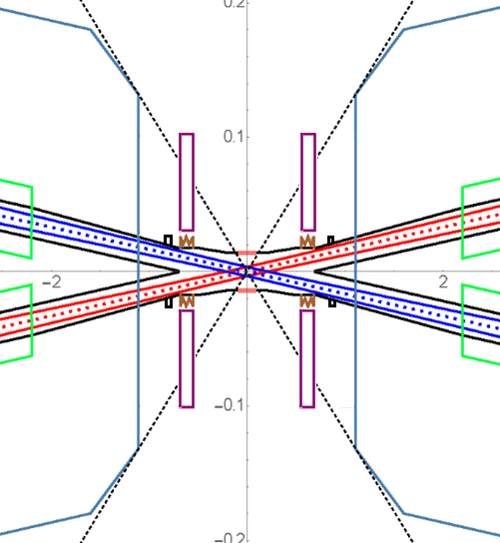
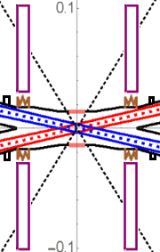
Mechanical and Assembly (Preliminary)
1, IP Chamber
3, SC Magnet and Vacuum chamber (remotely)
4, Move Lumical back and attach to the cover of cryostat with alignment holes (remotely)
2, Bellows and Lumical (remotely)

Slide 10
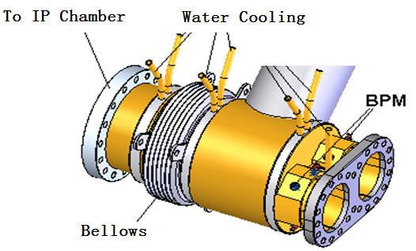
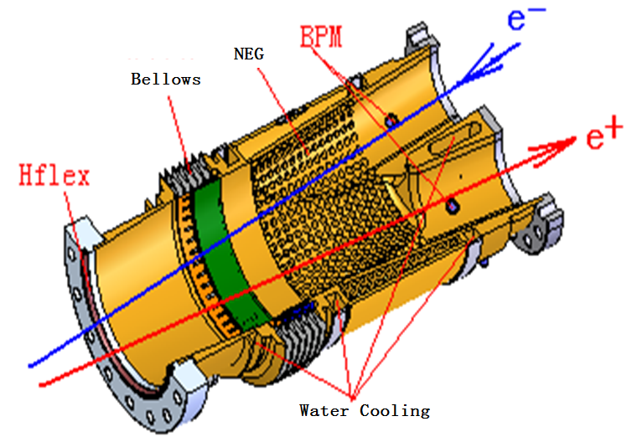
Crotch region design (Preliminary)
Helicoflex

Slide 11
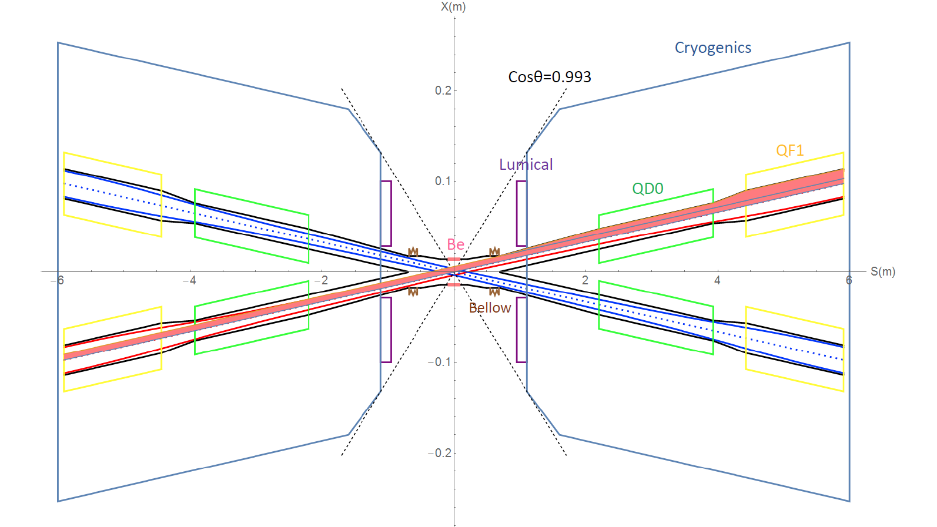
SR from last B magnet upstream
Asymmetric lattice adopted to allow softer bends in the upstream of IP.
Reverse bending direction of last bends is applied to avoid synchrotron radiation hitting IP vacuum chamber.
Upstream of IP, critical energy of SR <47keV within 66m and 100keV within 400 m.
Downstream of IP, critical energy < 95keV within 120 m and 300keV within 250 m.

Slide 12
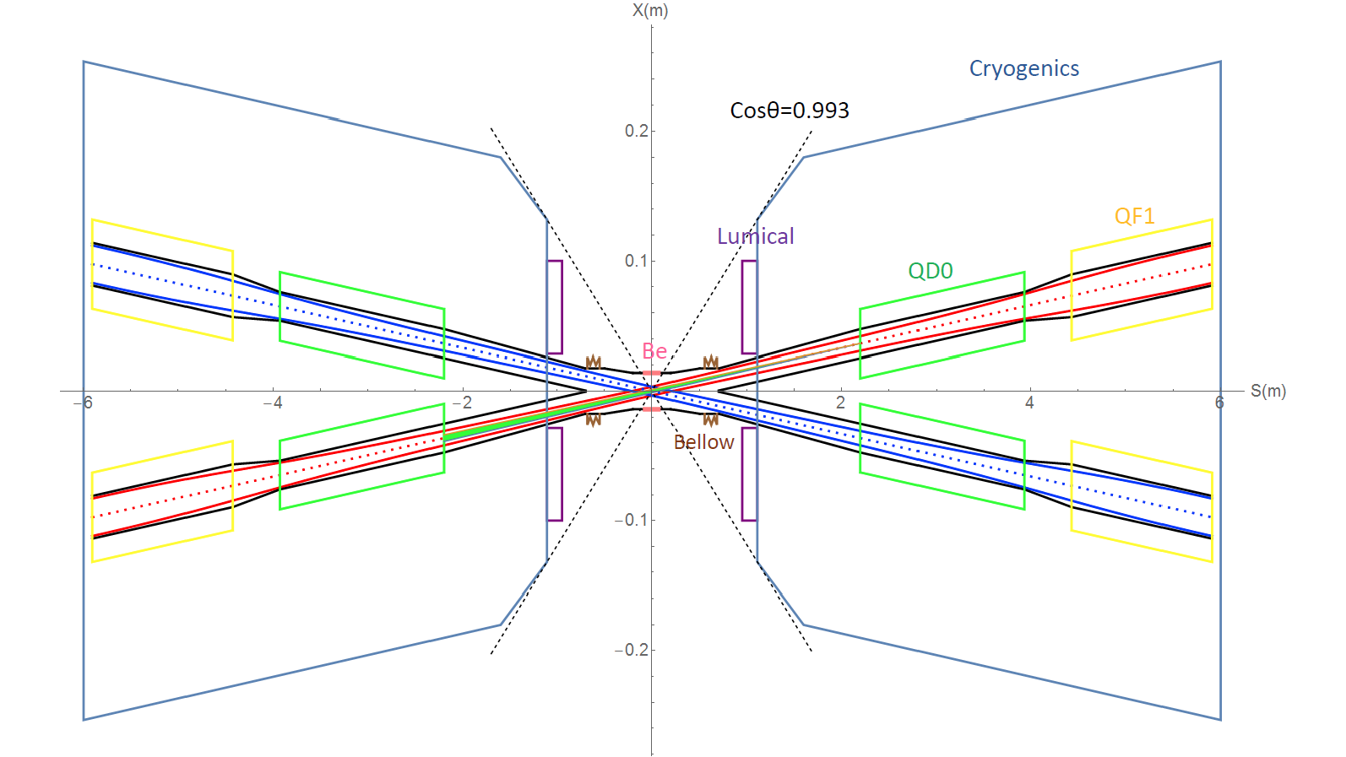
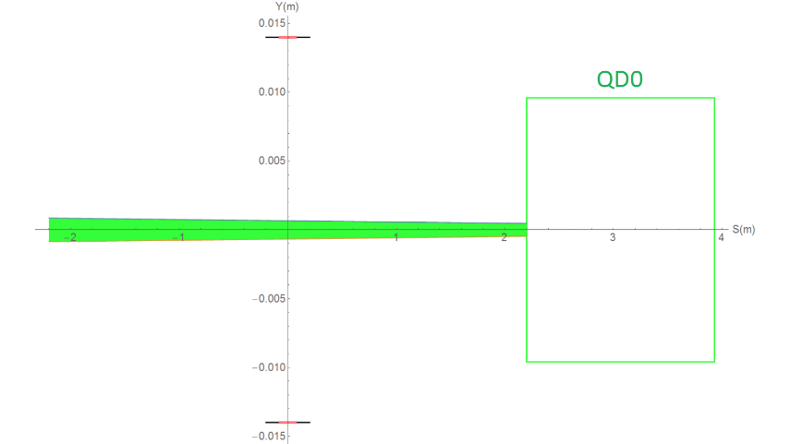
SR from QD0 in horizontal and vertical plane
SR fans generated by QD0 of particles in 3σ.
The total SR power generated by the QD0 is 603W in horizontal and 157W in vertical.
The critical energy of photons is about 1.3MeV in horizontal and 423keV in vertical.

Slide 13
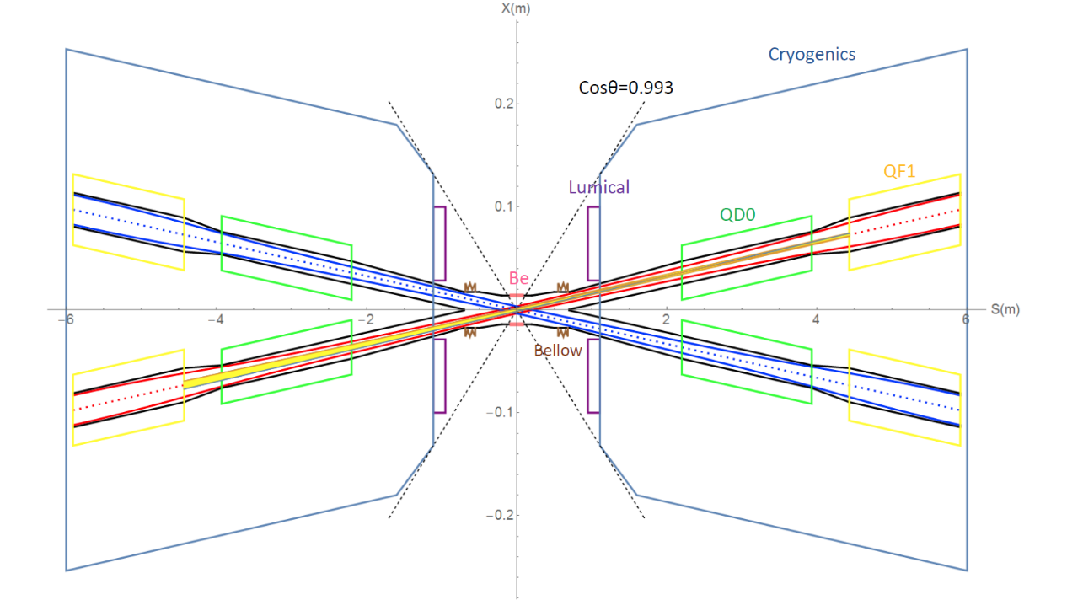
SR from QF1 in horizontal plane
The total SR power generated by the QF1 magnet is 1387W in horizontal and 30W in vertical.
The critical energy of photons is about 1546keV in Horizontal and 189keV in vertical.
There is no SR photons within 6$σ_{x}$ directly hitting or once-scattering to the detector beam pipe.

Slide 14
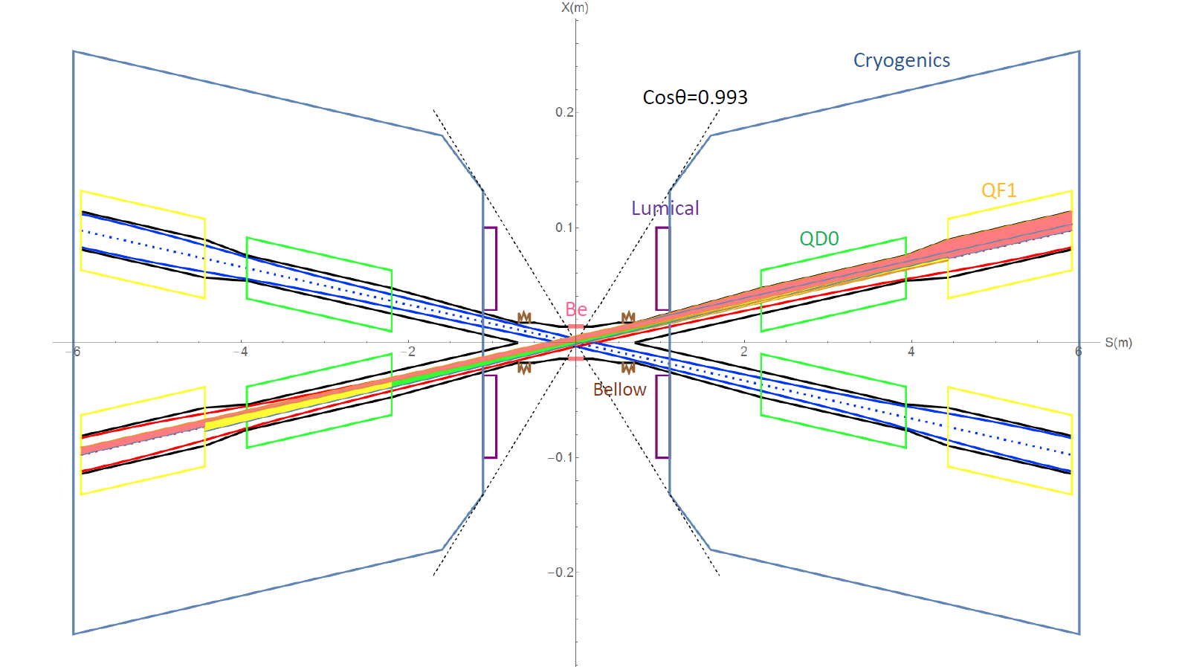
SR from B, FD in horizontal plane
~ last bending magnet upstream of IP and final doublet

Slide 15

SR from QD0/QF1 with beam tails
QF1
QF1
QD0
QD0
Beyond 10$σ_{x}$the SR photons will hit on the IP beam pipe.
Beyond 20$σ_{x}$ the SR photons will hit on the beryllium pipe directly.
QF1
QF1
QD0
QD0
10σ
20σ

Slide 16
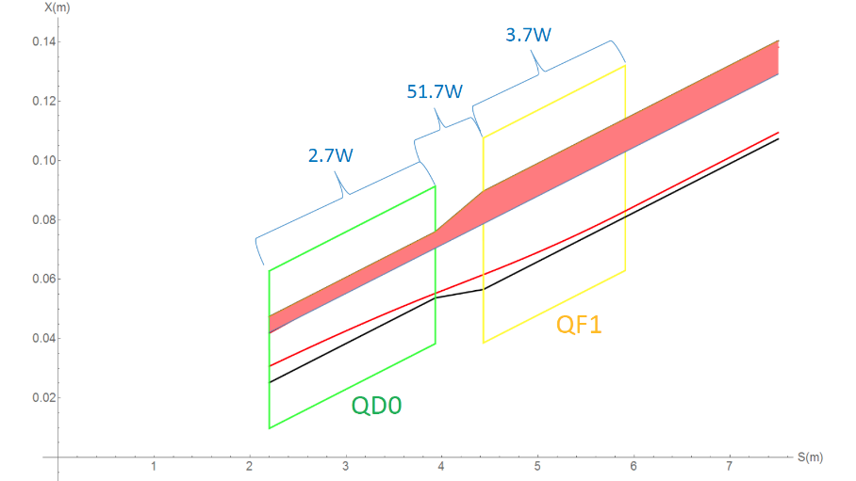
Synchrotron radiation in the IR
“Room temperature” beam pipe and conduction cooled superconducting magnet has to be adopted.
The synchrotron radiation power within QD0 is 2.7W along 1.73m, on QF1 is 3.7W along 1.48m. The region between QD0 and QF1 is 51.7 W (0.5m).

Slide 17
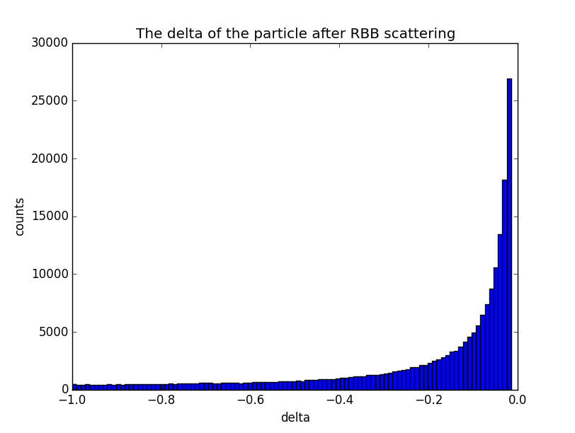
Radiative Bhabha scattering events
According to the off-momentum dynamic aperture after optimizing the CEPC lattice, and considering the beam-beam effect and errors, the energy acceptance of CEPC is about 1.5%.
Radiative Bhabha scattering is simulated by BBBrem or Py_RBB.
Generate 2e+5 particles.

Slide 18
RBB lost particles statistic
~first two turns
Set aperture according to beam pipe
RBB generated at IP1, tracking in SAD
The position and coordinate in phase space of lost particles near the IP are recorded.
Most the events lost in the detector immediately. A few particles with high energy will lost near the IP after one revolution for a small energy loss.
Although pretty large fraction of events lost in the downstream region, the radiation damage for detector component is tolerable.

Slide 19
Loss particles due to RBB in turns
Compared to the one turn’s tracking, more particles get lost in the upstream region of the IR.
The events lost in the upstream region are more dangerous for they are likely permeate into the detector components, even with the small flying angle respect to the longitudinal direction considered.
Collimators are needed.

Slide 20
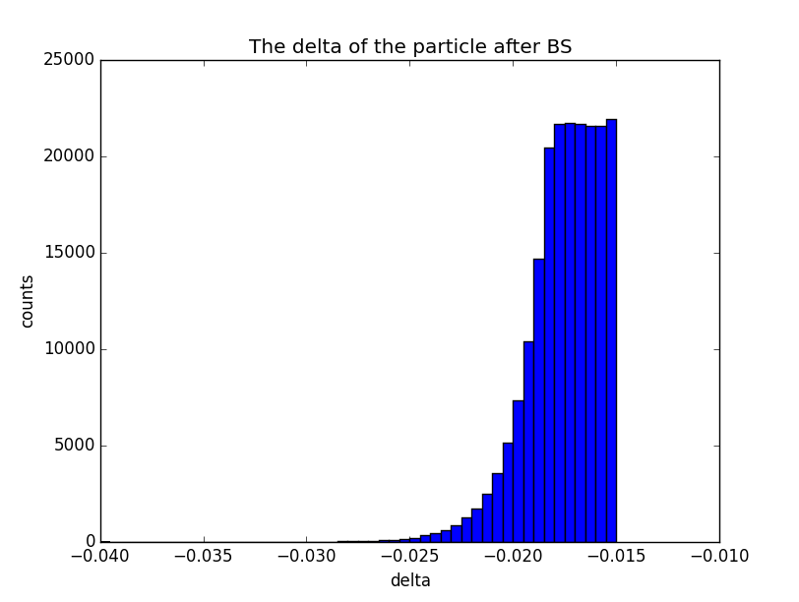
Beamstrahlung events
Compared with the energy spread of RBB, beamstrahlung effect is increased in exponential growth with energy spread, so most of particles energy spread are distributed in a region close to 1.5%.
Beamstrahlung events have been generated with Guinea-Pig++ or Py_BS.
Generate 200000 particles.

Slide 21
BS lost particles statistic
~first two turns
Set aperture according to beampipe
BS generated at IP1, tracking in SAD
The position and coordinate in phase space of lost particles near the IP are recorded.
Energy spread distribution close to the energy acceptance, the beam loss particles not appeared in the downstream of first turn.

Slide 22
Loss particles due to BS in turns
Compared to the one turn’s tracking, more particles get lost in the upstream region of the IR.
The events lost in the upstream region are more dangerous for they are likely permeate into the detector components, even with the small flying angle respect to the longitudinal direction considered.
Collimators are needed.

Slide 23
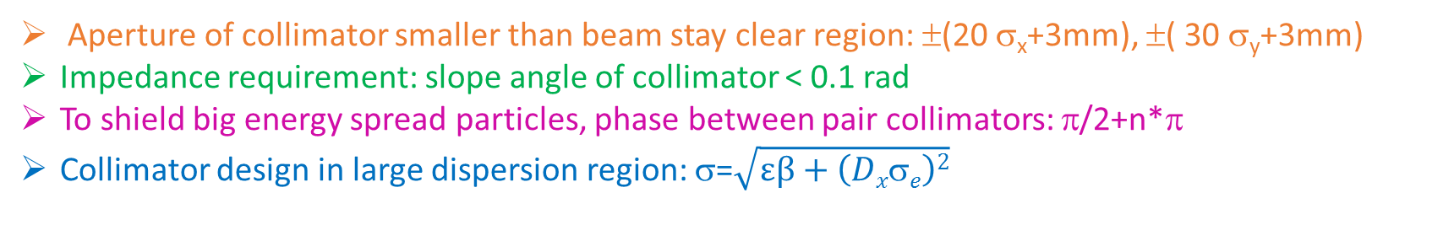
Collimator design in ARC
Aperture of collimator smaller than beam stay clear region: ±(20 σ_{x}+3mm), ±( 30 σ_{y}+3mm)
Impedance requirement: slope angle of collimator < 0.1 rad
To shield big energy spread particles, phase between pair collimators: π/2+n*π
Collimator design in large dispersion region: σ=$\sqrt{εβ+\left(Dxσe\right)2}$
name | Position | Distance to IP/m | Beta function/m | Horizontal Dispersion/m | Phase | BSC/2/m | Range of half width allowed/mm
APTX1 | D1I.1884 | 2206.08 | 108.35 | 0.24 | 348.62 | 0.010242 | 1~10
APTX2 | D1I.1909 | 1713.85 | 104.60 | 0.24 | 350.37 | 0.010115 | 1~10
APTY1 | D1I.1897 | 1956.16 | 116.81 | 0.12 | 349.32 | 0.004128 | 1~4.1
APTY2 | D1I.1908 | 1745.21 | 125.22 | 0.16 | 350.07 | 0.004168 | 1~4.1

Slide 24
Beam loss with collimators
Different apertures of the collimators are used to study the stop efficiency of the collimator.
The results show that the number of particles lost in IR will be significantly suppressed when the aperture of the collimator are reduced.

Slide 25
RBB and BS loss with collimators for Higgs
horizontal collimator half width 5mm(13σ_{x}), vertical collimator half width 2mm(51σ_{y}).
The collimators will not have effect on the beam quantum lifetime.
The lost particles has been reduced to a very low level with the system of collimators, especially in the upstream of the IP.
Although the beam loss in the downstream of the IP is still pretty large in the first turn tracking, the radiation damage and the detector background are not as serious as the loss rate for the relative small flying angle to the ideal orbit.

Slide 26
RBB and BS loss with collimators for Z
horizontal collimator half width 5mm(37σ_{x}), vertical collimator half width 2mm(137σ_{y}). Emittance of Z is much smaller than Higgs.
The collimators will not have effect on the beam quantum lifetime.
Although the energy acceptance ~0.75% is fifty percent lower than in higgs factory (1.5%), collimators still work well in Z.

Slide 27
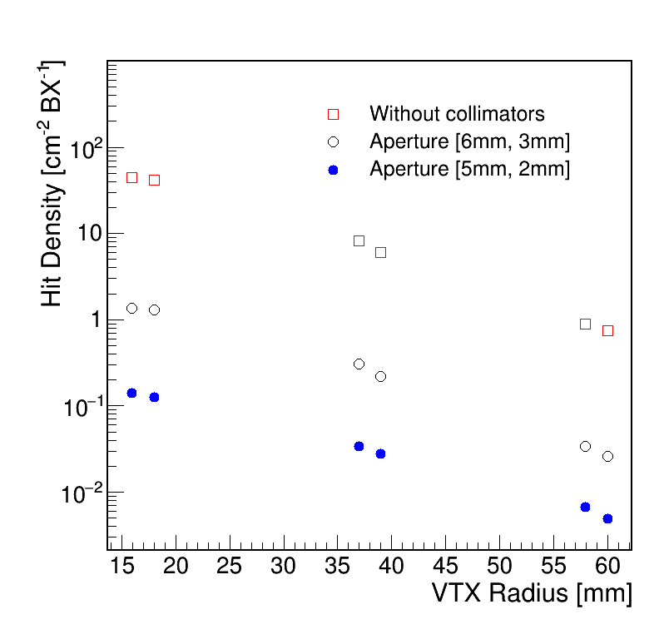
Hit Density at VTX
The level of the beam induced backgrounds are evaluated by the hit density at the vertex detector. ~ 1e+7 events input.
The event rate with collimators is acceptable for the CEPC detector for beam loss particles.
Requirement from detector: hit density should be smaller than a few hits/cm²/BX.

Slide 28
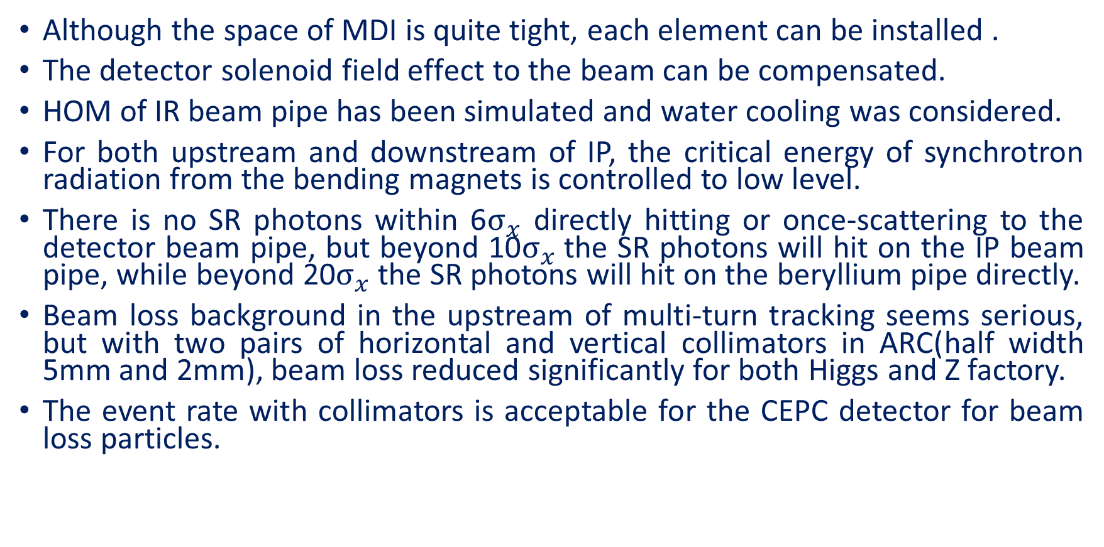
Summary
Although the space of MDI is quite tight, each element can be installed .
The detector solenoid field effect to the beam can be compensated.
HOM of IR beam pipe has been simulated and water cooling was considered.
For both upstream and downstream of IP, the critical energy of synchrotron radiation from the bending magnets is controlled to low level.
There is no SR photons within 6$σ_{x}$ directly hitting or once-scattering to the detector beam pipe, but beyond 10$σ_{x}$the SR photons will hit on the IP beam pipe, while beyond 20$σ_{x}$ the SR photons will hit on the beryllium pipe directly.
Beam loss background in the upstream of multi-turn tracking seems serious, but with two pairs of horizontal and vertical collimators in ARC(half width 5mm and 2mm), beam loss reduced significantly for both Higgs and Z factory.
The event rate with collimators is acceptable for the CEPC detector for beam loss particles.

Slide 29
Thanks

