Slide 1


ATLAS FCPPL Projects session
Introduction
Shan JIN (IHEP) / Emmanuel MONNIER (CPPM)
FCPPL 10th workshop
Beijing 27th March 2017

Slide 2
First LHC Run2 2016 beam splashes in ATLAS
FCPPL 2016 message
ATLAS ready to go for 2016 Run2 !

Slide 3
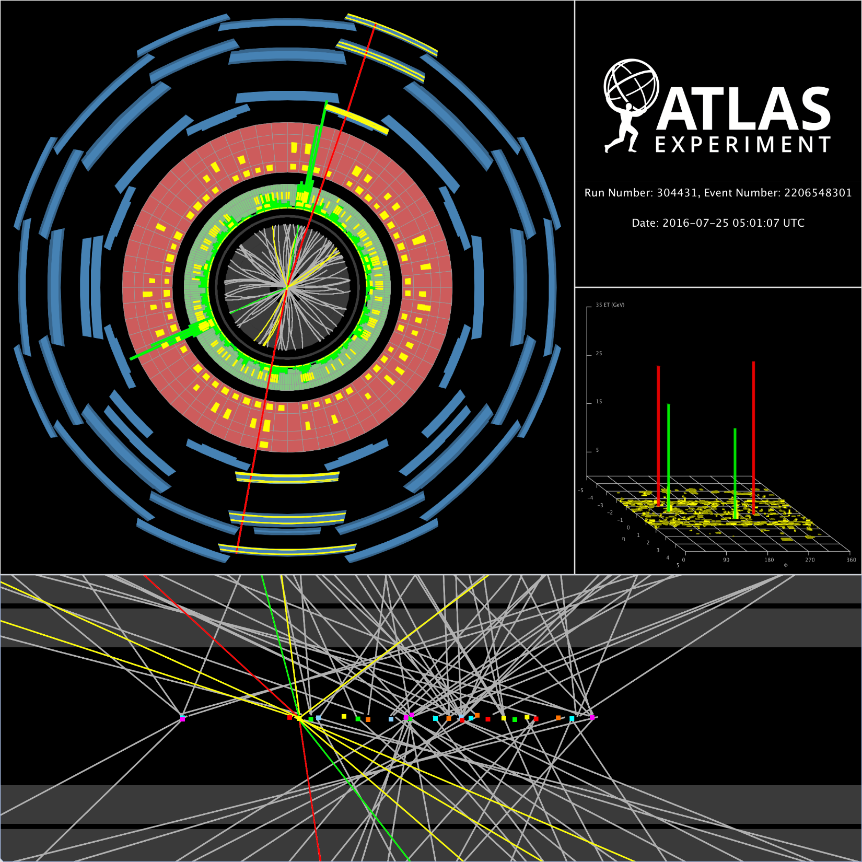
First LHC Run2 2016 beam splashes in ATLAS
FCPPL 2016 message
ATLAS ready to go for 2016 Run2 !
Lot of Higgs candidates !
And others…

Slide 4
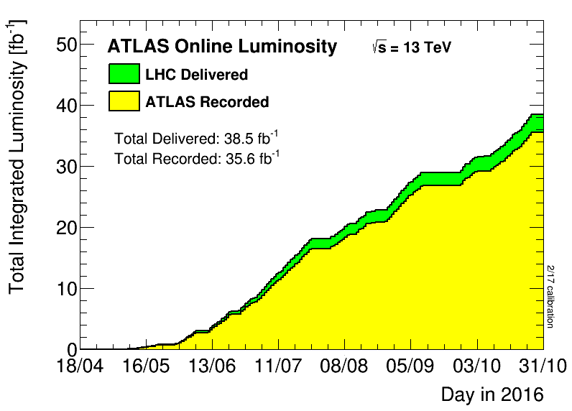
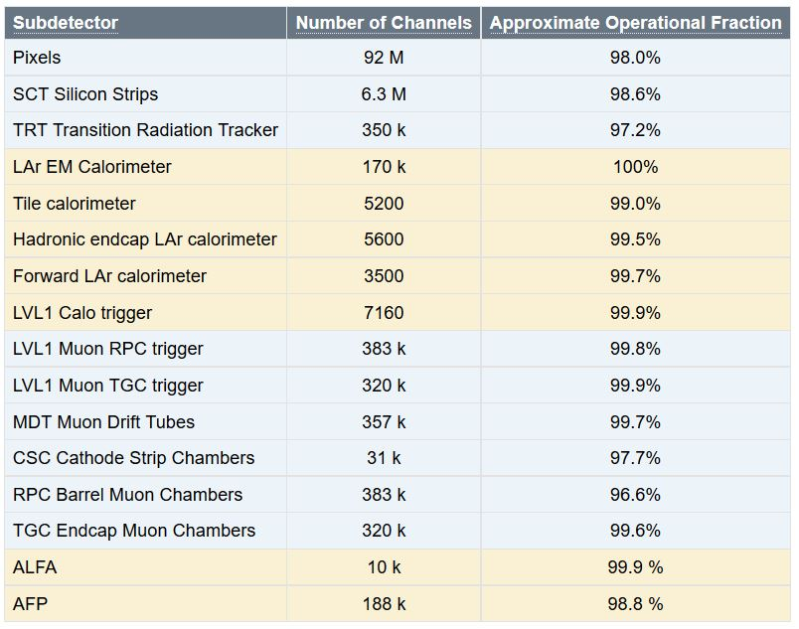
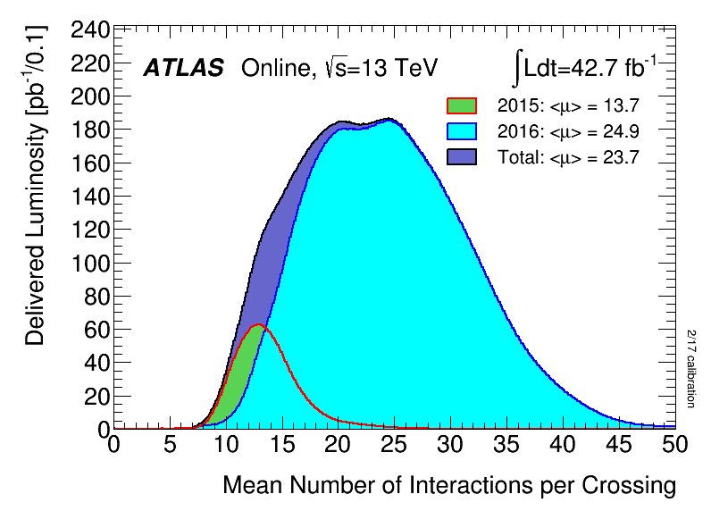
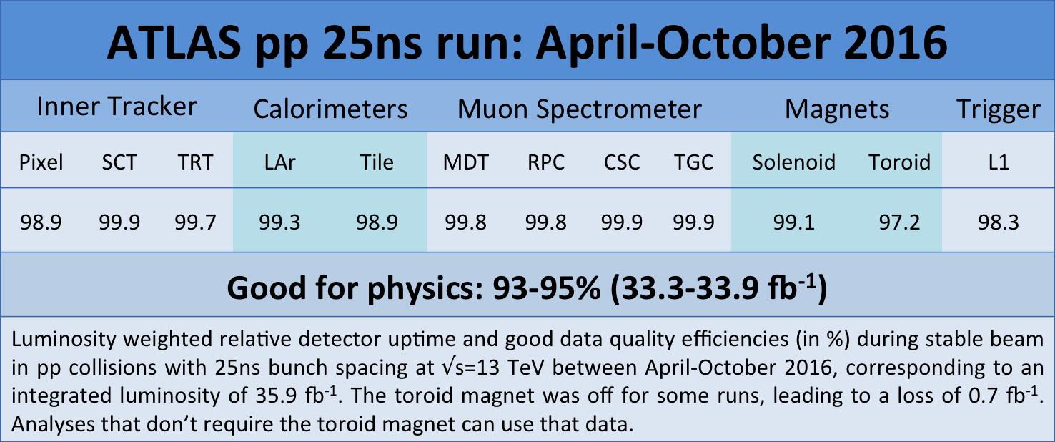
(And 3.2 fb-1 for 2015)
Excellent Year 2016 !

Slide 5
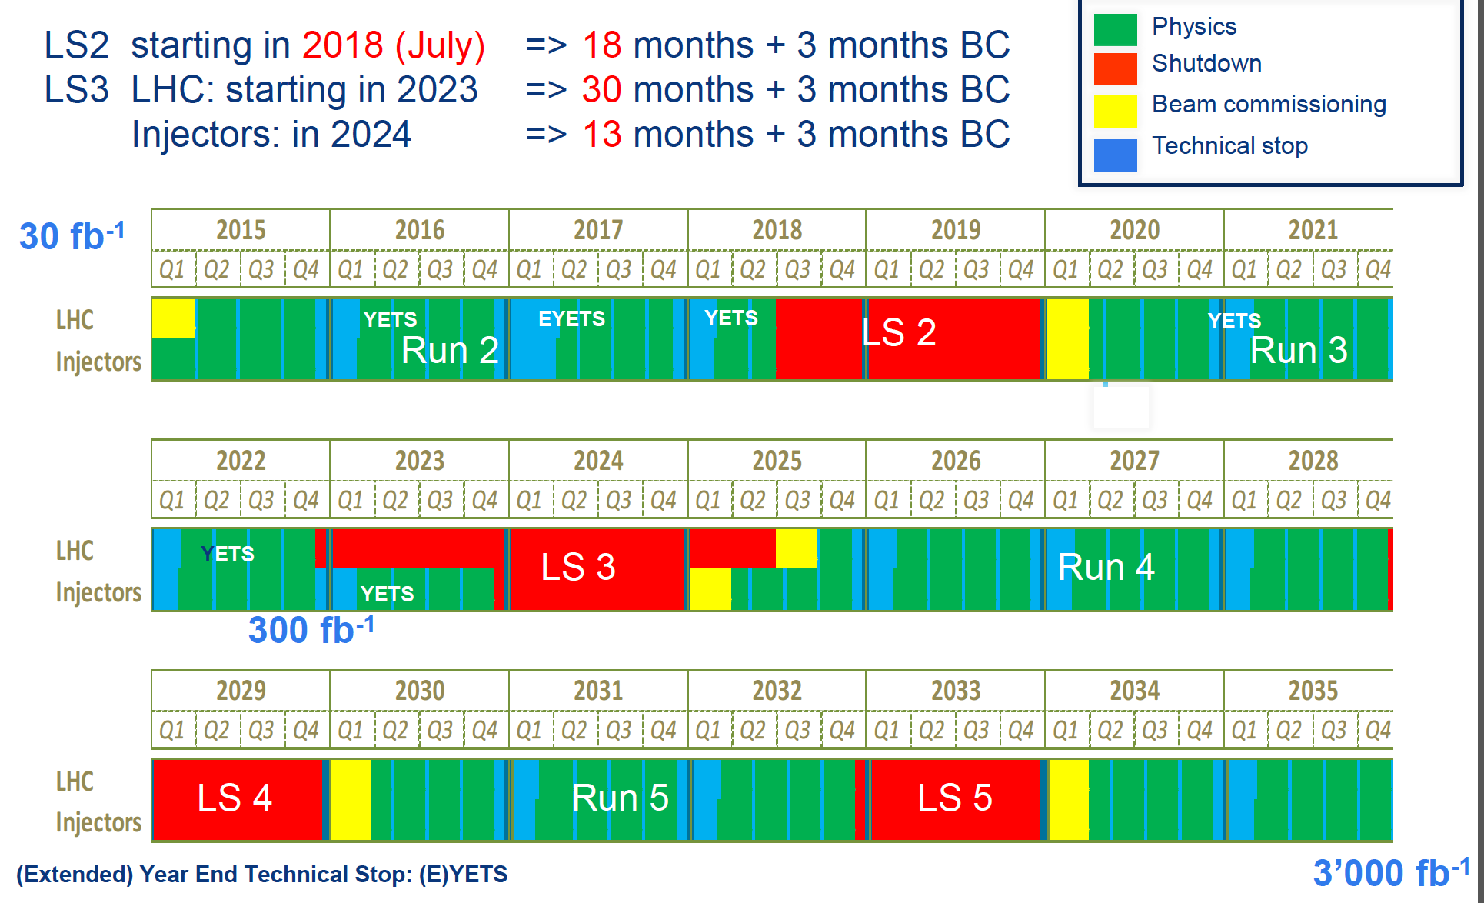
2019
24
30 fb⁻¹
300 fb⁻¹
3000 fb⁻¹

Slide 6
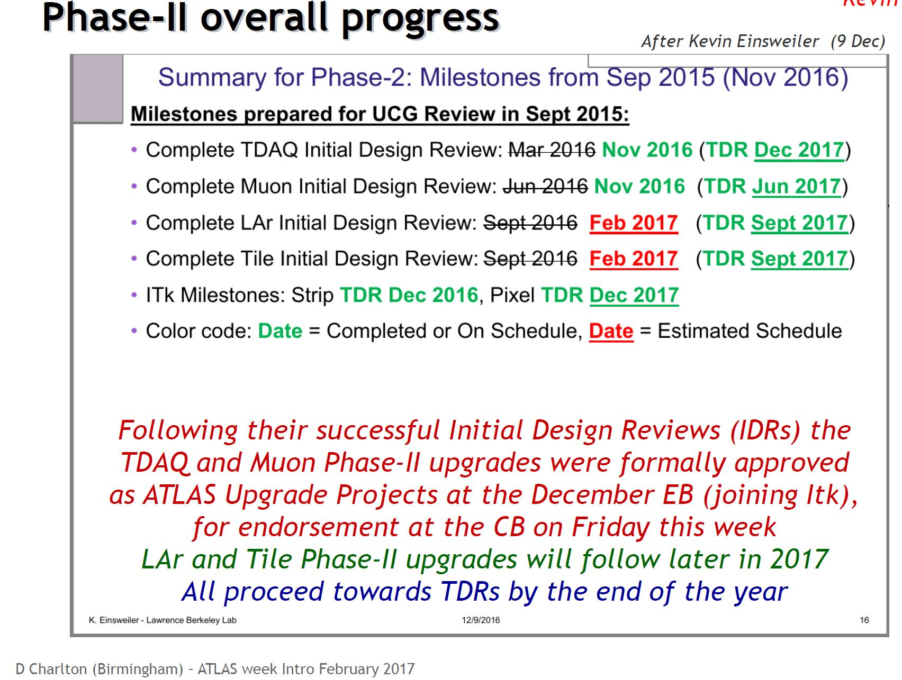

Slide 7
FCPPL ATLAS should think on common interest for Upgrade Phase II

Slide 8
LHC schedule 2017 (draft)
ATLAS start of run schedule
Expect Lumi up to 2x10³⁴ !

Slide 9
LHC schedule 2017 (draft)
ATLAS start of run schedule
Expect Lumi up to 2x10³⁴ !
FCPPL in 2016-2017: 2015+2016 data analysis
(cf X. Chen Atlas highlight talk and see following ones…)
and a bit of upgrade (see talks in R&D session thursday)
Many “Run 2” data (Higgs, Susy, SM analysis…) in which FCPPL cooperation is strongly contributing.
See today’s talks as well as winter conference slides and related conf notes for details of ATLAS new results.
ATLAS Upgrade ramp up now in full swing. ATLAS FCPPL need to think on opportunities to further cooperate

Slide 10
ACC(IHEP/NJU/SDU/USTC…)-IN2P3(CPPM/LAL/LPNHE/CC)-CEA
Very strong cooperation program between the Atlas Chinese Cluster and CPPM, LAL, LPNHE since several years:
  Higgs, Susy studies (through γ γ, WW final states and also lepton/jet/bjet/top final states such as in ttH)
    (C. Diaconu, Y. Liu, H. Ren, C. Wang, W. Song talks)
  Multi-boson studies
  Top properties
  Performance studies (E/gamma, B tag, Trigger, Calorimeter)
  Silicon detector R&D (J. Liu, P. Pangaud, Thursday R&D session)
  Numerous presentation in Atlas meetings, conferences as well as in internal, public/conf notes and publications.
  Many senior physicists visits (France and China) with continuous cooperation work between ACC physicist and IN2P3 physicists
  Several co-PhD thesis defended in 2016, J. Liu, and more to come in 2017: H. Ren… (Co-PhDs are an important strengthing force fo the LIA)
Strong cooperation on WLCG, IHEP/IN2P3/CEA (C. Gang talk)

Slide 11
ATLAS ACC-IN2P3 heavily involved in Run2 data analyses & performance studies in 2016-2017 aiming at 2015+2016 publications.
Co-PhD :
  Y. Zhao (LAL/SDU) SDU/LAL/Eiffel funded (started 09/14)
  H. Zhang (LAL/Nanjing) CSC funded (started 09/15)
  Y. Ma (LAL/SDU) SDU/CSC funded (started 09/15)
  C. Li (LPNHE/USTC) USTC funded (started 09/15)
  R. Zhang (CPPM/USTC) CSC/USTC/FCPPL funded (09/14)
  C. Wang (CPPM/SDU) CSC Cai Yuanpei funded (09/14)
  H. Ren (CPPM/IHEP) CAS/IHEP/FCPPL funded (09/14)
  No start of Co-Phd in fall 2016, stat fluct. But need to act !
K. Liu former PhD (USTC/LPNHE) Postdoc at CPPM
Many former Co-PhD students now postdoc or permanent positions
Strong SLHC Silicon detector R&D cooperation program ongoing,
J. Liu (SDU/CPPM), SDU/FCPPL/Eiffel funded, defended May 2016, But need new PhD students & short stay scientists to strengthen it !
Need to strengthen manpower/funds for strong ATLAS Run 2 analysis and R&D for ATLAS upgrade and future detectors.

Slide 12
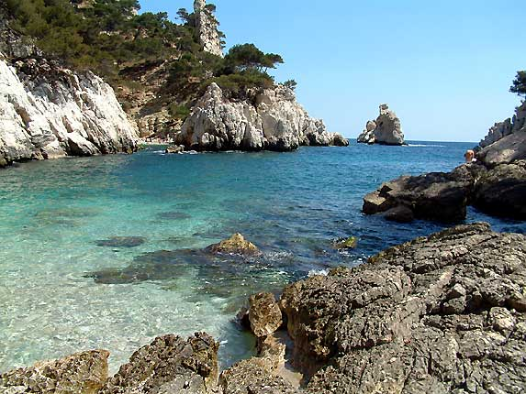
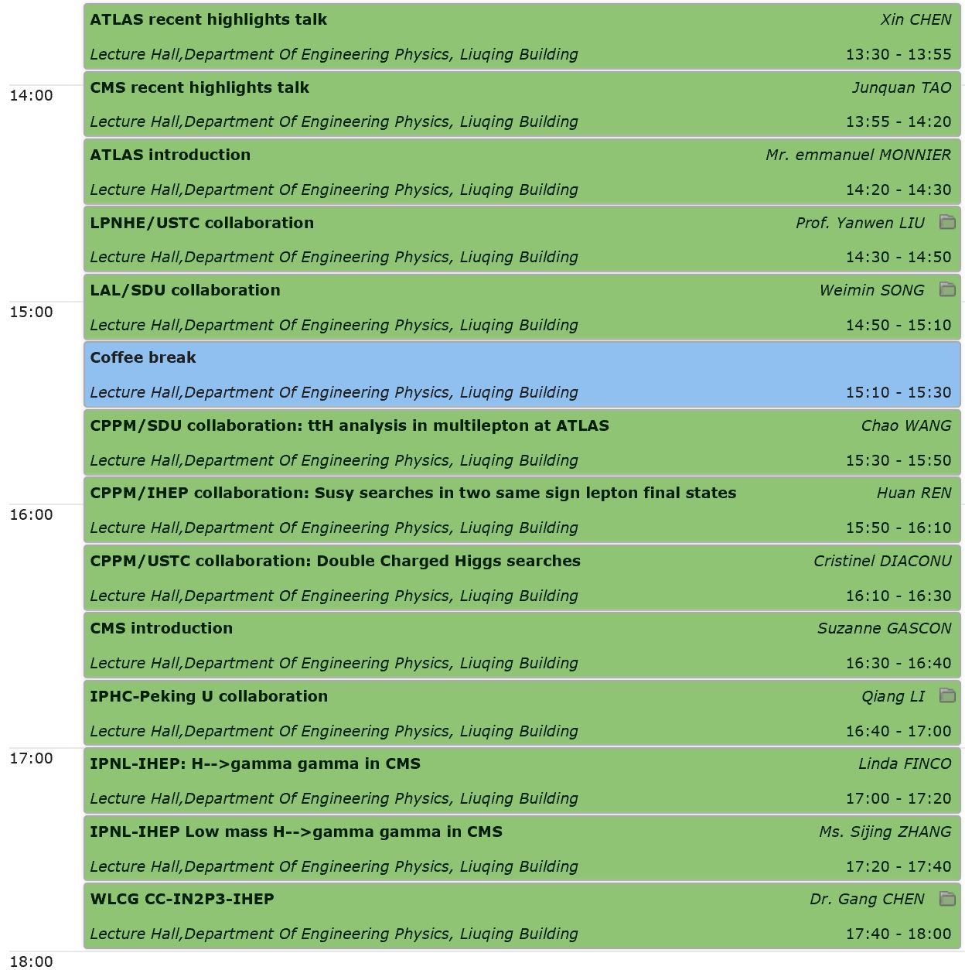
谢谢！
Merci !
Thank You !
Highlights
ATLAS
CMS
LCG
12

