Slide 1








CMS in FCPPL: 10 years!
Guoming CHEN (1), Suzanne GASCON-SHOTKIN (2)
(1)IHEP/CAS Beijing , (2) IPN Lyon (IN2P3-CNRS)/Université Claude Bernard Lyon 1
Qiang LI(3), Nicolas CHANON (4),
(3) IPHC Strasbourg, (4) Peking University Beijing
FCPPL 2017
Tsinghua University, Beijing, China
March 27 , 2017
Notes:
Universite,

Slide 2
10 years of exchanging people and ideas
IHEP-IPNL: Collaboration started in 2007
  6 IHEP doctoral students have visited IPNL for stays of between 2-6 months: TAO Junquan (2007), ZHANG Zhen (2007-2008), XIAO Hong (2010,2011), FAN Jiawei (2011, 2012, 2014), SHEN Yuqiao (2013), ZHANG Sijing (2015, 2016)
  1 IHEP postdoc ,TAO Junquan, has visited IPNL for 4 months (2009)
  4 IPNL doctoral students have visited IHEP for stays of 2 months : Nicolas CHANON (2009), Hugues BRUN (2010), Olivier BONDU (2011), Louis SGANDURRA (2012)
  2 IPNL postdocs (will) have visited IHEP for stays of 1 month: Camillo CARRILLO (2014), Linda FINCO (2017, starting now)
  2 IHEP/UCAS doctoral students have been (are) co-PhD students with IPNL/Universite Claude Bernard Lyon 1 under prestigious scholarships: Fan Jiawei (CAS, defended 2015) and Sijing ZHANG (Eiffel, defense forseen for June 2018)
PKU-IPHC: Collaboration started in 2015, 1 PKU student (Jing LI) has visited/is visiting IPHC for 2 stays of 3 months each (2016, 2017)
IHEP, IPNL and IPHC have all hosted the FCPPL workshop once and contribute members of the scientific committee on a regular basis

Slide 3
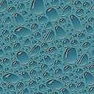
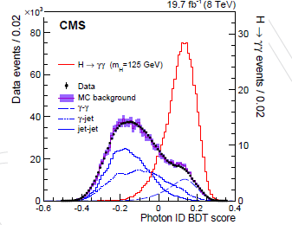
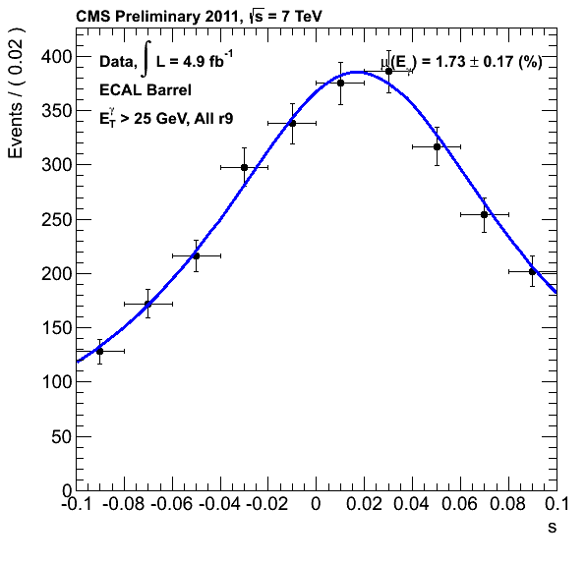
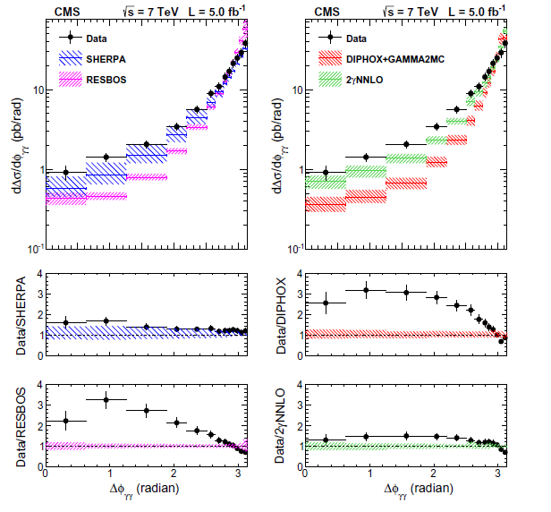
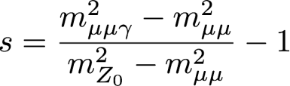
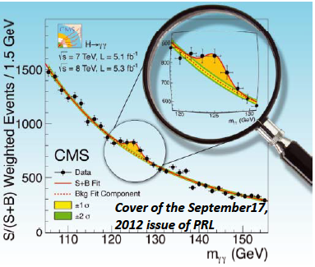
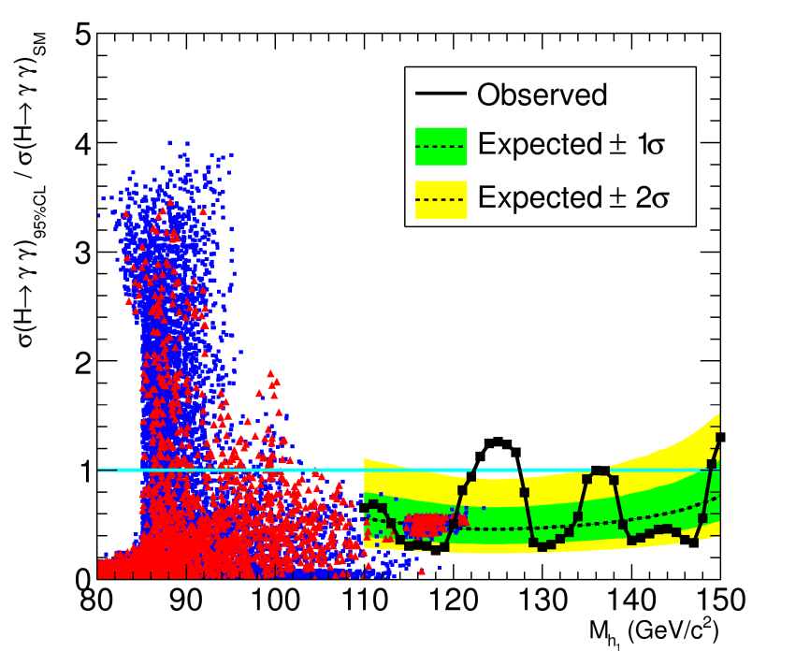
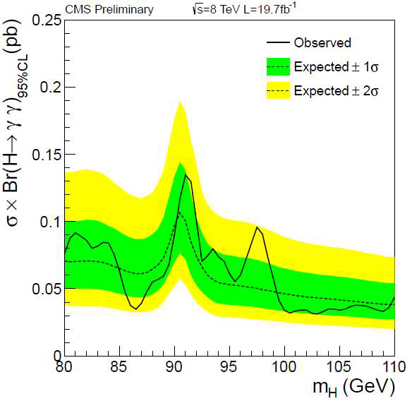
10 years of important results on photons and Higgs bosons (up to 2015)
Photon energy scale extraction with Z→μμγ (2007-…) .
γγ + X differential cross section measurement (2010-…)
.
γ/π⁰ discrimination for photon ID (2008-…)
.
Cluster/Photon commissioning, Runs 1&2 (2008-…)
.
Eur.Phys.J. C74 (2014) 11
CMS-PAS-HIG-13-001
CMS-PAS-EGM-10-005
σ_{ϕ}/σ_{η}
CMS-DP-2012/024
J. Fan et al,
Chinese Phys. C 38 073101
Discovery and measurement of a Higgs boson (2012-…)
.
Feasibility study for a 2nd lighter Higgs boson (2013-…)
.
CMS-PAS-HIG-14-037
Search for a 2nd lighter Higgs boson in 8 TeV data (2013-...…) .
Notes:
Vignettes + pubs, correct animation and add pubs

Slide 4

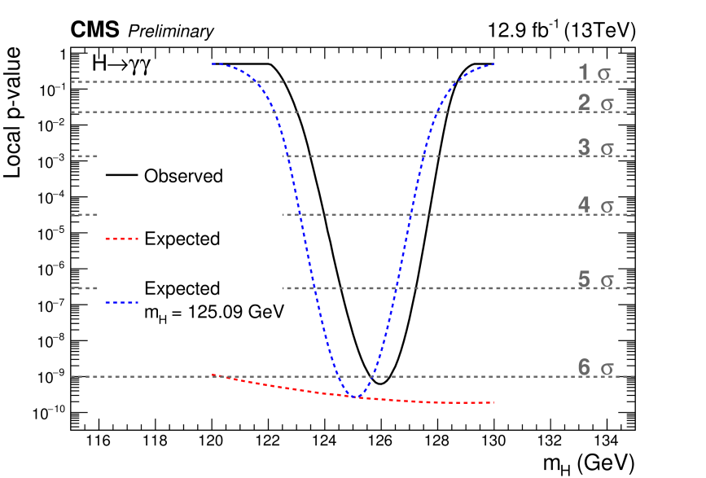
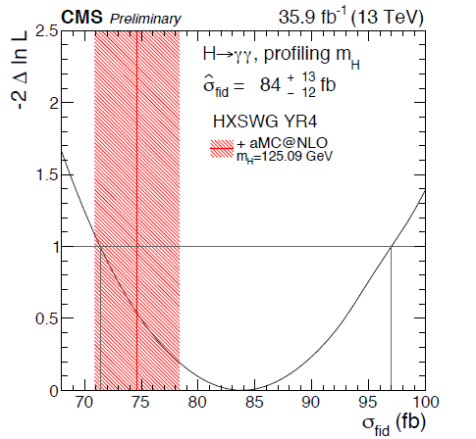
IHEP-IPNL 2016-2017: Run2 H→γγ measurements
CMS PAS HIG-16-020 (ICHEP16 )
IPN Lyon : Camilo CARRILLO, Benoit COURBON, Linda FINCO, Suzanne GASCON-SHOTKIN, Morgan LETHUILLIER, Bernardo MARQUES IHEP-Beijing : Guoming CHEN, Mingshui CHEN, Yuqiao SHEN, Junquan TAO, Sijing ZHANG
Major contributions since discovery analysis: photon ID MVA development, photon energy corrections, electron veto efficiency, Z→μμγ validation (see dedicated talk by Linda FINCO)
Contribution to public results: HIG-15-005 (Moriond16) , HIG-16-020 (ICHEP16), HIG-17-015 (Moriond17)
CMS PAS HIG-17-015 (Moriond2017)
Future plans:
  Take over development and maintenance responsibility for high-level trigger (Linda FINCO)
  Re-investigate gg→γγ/gg→H→γγ interference
Notes:
See talk by Linda FINCO, L FINCO Hgg trigger responsibilities

Slide 5
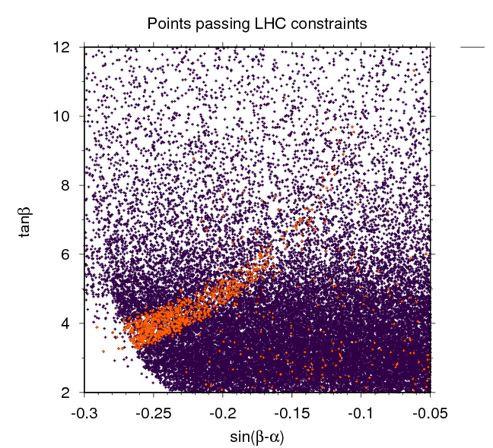
IHEP-IPNL 2016-2017: Run 1 low-mass H→γγ search interpretation and Run 2 low-mass H→γγ search
IPN Lyon : Camilo CARRILLO, Benoit COURBON, Linda FINCO, Suzanne GASCON-SHOTKIN, Morgan LETHUILLIER, Bernardo MARQUES IHEP-Beijing : Guoming CHEN, Mingshui CHEN, Yuqiao SHEN, Junquan TAO, Sijing ZHANG
Hold responsibility for this search
Interpretation of Run 1 public result (HIG-14-037) within 2HDM in paper with IPNL theorists A. Deandrea, G. Cacciapaglia, S. Le Corre (JHEP12 (2016) 068) (see dedicated talk by Sijing ZHANG) First such collaboration.
Future plans:
  Run 2/2016 results coming soon, plan for more interpretations
  Prepare analysis of 2017 data
CMS PAS HIG-14-037
JHEP12 (2016) 068
Requesting financing for airfare for Linda FINCO for a 1-month stay at IHEP starting now, and for 1 month of a 2-month stay at IPNL in Autumn 2017 for Sijing ZHANG who are key contributors to these topics

Slide 6

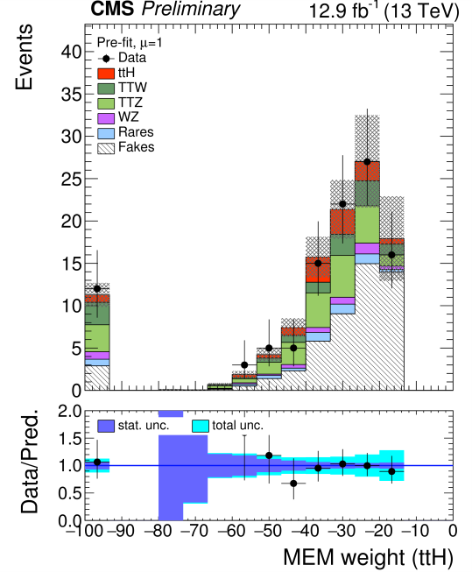
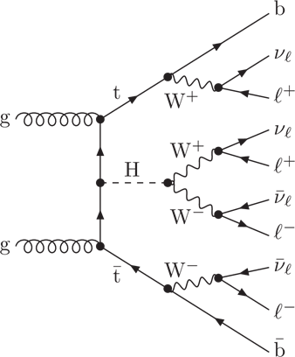
PKU-IPHC 2016-2017: ttbarH→multilepton measurements
IPHC Strasbourg: Daniel BLOCH, Nicolas CHANON, Anne-Catherine LE BIHAN, Xavier COUBEZ PKU-Beijing: Zhenwei CUI, Jing LI, Qiang LI, Yajun MAO
ttbarH multilepton channel can provide the first direct measurement of the top-Higgs coupling
Matrix Element Method (MEM) is complementary to usual multivariate methods (see dedicated talk by Qiang LI)
Contribution to public results: HIG-16-022 (ICHEP16) and HIG-17-004 (Moriond 2017). Paper in preparation.
Future plans: Extension to more involved multivariate methods for improved signal/background discrimination: MEM with Neural Networks, Deep learning
CMS PAS HIG-17-004
Requesting financing for a 3-month stay in Autumn 2017 for Jing LI who is a key contributor to these topics

Slide 7
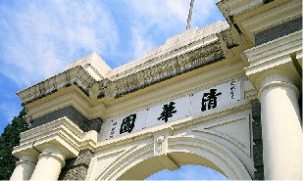

Acknowledgements
THANKS to the FCPPL
We are looking forward to your continued support!
For the next 10 yrs!
Notes:
Thanks for your continued support!

