Slide 1
Status of WLCG FCPPL project
Status of Beijing site
Activities over last year
Ongoing work and prospects for next year
POGGIOLI Luc & CHEN Gang

Slide 2
Last year activities on one page
Grid Operation and development
Participation of Chinese & French colleagues to monthly ATLAS and technical computing French meetings + vidyo/Skype/…
Sharing of expertise and tools : grid middleware and experiment specific (Xiaofei YAN (闫晓飞)
Network monitoring (Fazhi QI/齐法制)
HPCs for ATLAS simulation
Collaboration between IHEP, CNIC and European partners
IHEP Wenjing WU (伍 文静), (Xiaofei YAN (闫晓飞)
ATLAS@home: Volunteer computing project Wenjing WU (伍 文静)

Slide 3
Beijing Tier-2 - status
From 2016/03-2017/03
Site reliability: 99.00%, ranked at 29th of 144 ATLAS sites.
Site availability: Excellent over last year (98.00%)

Slide 4
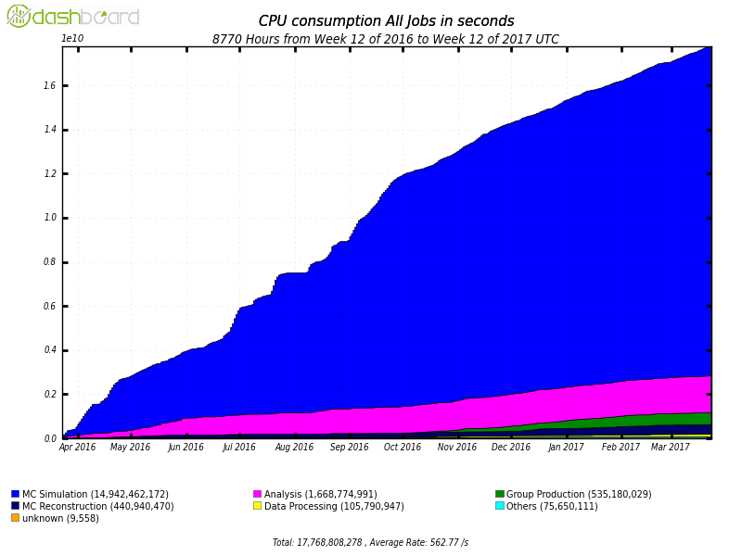
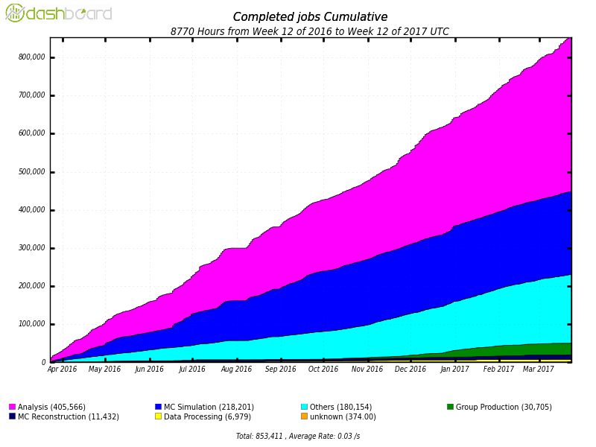
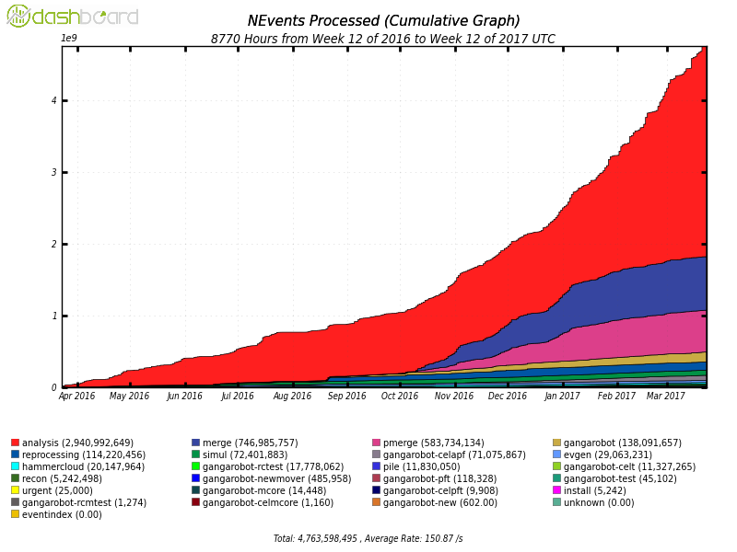
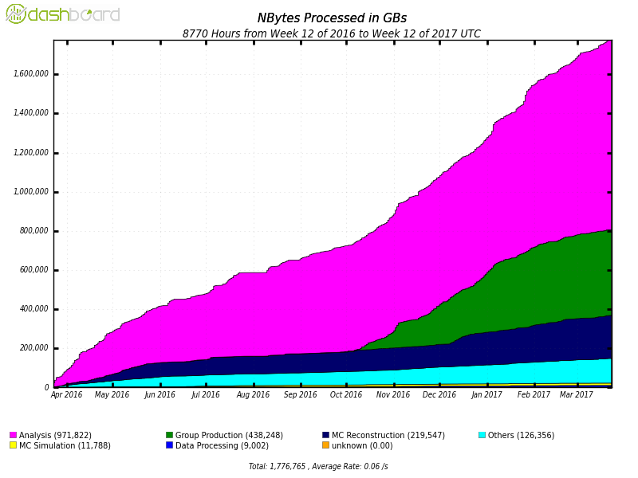
Data Processed at Beijing Site
5.0Million CPU hours.
0.83 Million jobs completed
1.7PB data, 4.6Billion events processed .

Slide 5
http://atlasphysathome.web.cern.ch/
Contributed paper at CHEP2016

Slide 6
What is volunteer computing?
Use of personal computer spare cycles (when computer sleeps) to run jobs for a community
Initial project SETI (Search for Extra-Terrestrial Intelligence) launched in 1999
Standard interfaces provided by BOINC project (Berkeley Open Infrastructure for Network Computing)
Pioneer project in Asia : CAS@home

Slide 7
Volunteer growth since March 2015
Currently 120k volunteers:
12500 ran at least one job
4000 currently active
Einstein@Home: 300k volunteers, 47k active
Seti@Home: 5 million volunteers, 150k active
Users
Hosts

Slide 8
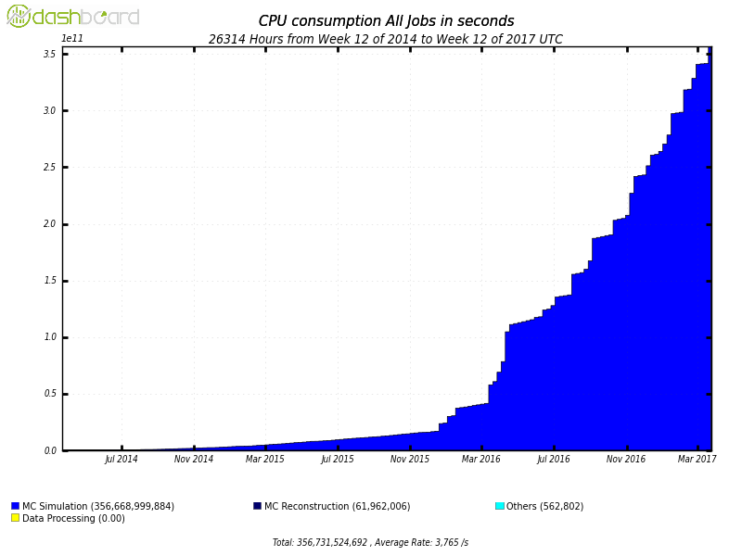
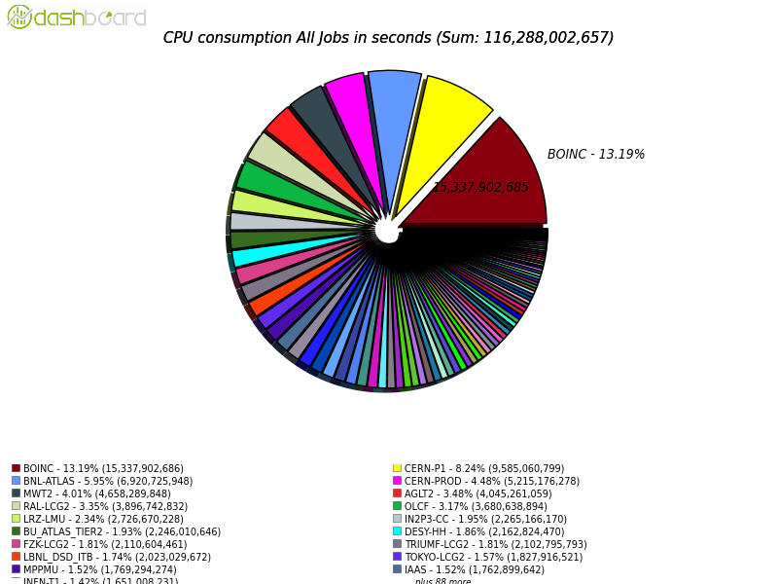
Job statistics since May 2014
Continuous increase in running jobs
Now 11k parallel running jobs, peak at 20k
7.3M completed jobs
100M CPU hours, 158M events processed
MC Simulation on all Grid sites [Mar. 2016, Mar. 2017]
ATLAS@home (BOINC): 1st site

Slide 9
Long… ATLAS@home work-plan
Multi-core: run dynamically multi-core jobs on volunteer machines based on no cores assigned to ATLAS
Run ATLAS@home on T3 clusters
Event Service: integration with event service for continuous upload of events as they are produced
New task types: start running event generation and other low I/O workloads
Scalability: investigate how infrastructure could scale with a 10 or 100-fold increase in volunteers
Outreach: Challenger, web design, “screensaver”, volunteer recruitment, …
Acknowledge user contribution http://boincai04.cern.ch/Atlas-test/graphics/

Slide 10
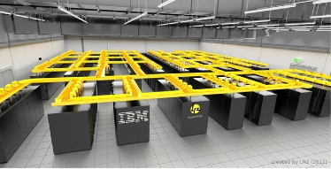
HPC (High-Performance Computing) resources
PRACE, the Partnership for Advanced Computing in Europe
Large investments in many countries : from Peta to Exa scales initiatives^{[1]}
Latest competitive supercomputers are familiar Linux clusters
Large number of spare CPU cycles are available at HPCs which are not used by ‘standard’ HPC applications
China host some of the largest HPC facilities worldwide
SuperMUC a PRACE Tier-0 centre :
155,000 Sandy Bridge cores 2.8M HS06
WLCG 2013 T0/1/2 pledges ~2.0M HS06

Slide 11
Interface of HPCs from CAS
Collaboration between European collaborators, IHEP and CNIC (Computer Network Information Center)
HPC centres from CAS inter-connected through ScGrid !
Unique in the world!
Jan. 2015 workshop at CNIC to define the interface between WLCG and ScGrid
Fall 2015, the interface is installed in IHEP
Event simulation on HPCs
Storage at IHEP
Spring 2016 ERA-II in test

Slide 12
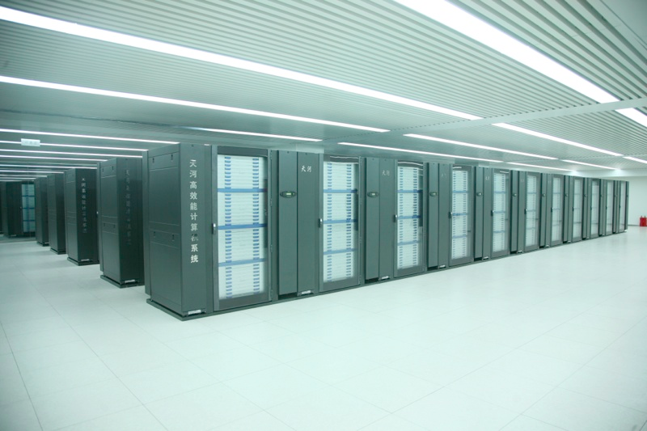
Huairou campus of CNIC
Tianhe-1A :TOP500 2nd, June 2011

Slide 13
IHEP (ATLAS) HPC architecture
3 HPCs being used:
ERA : 20 core jobs (BEIJING-ERA_MCORE)
ERA-II: 24 core jobs (BEIJING-ERAII_MCORE)
Tiianhe 1: 12 core jobs (BEIJING-TIANJIN-TH-1A_MCORE)
About 2k cores used after ERA-II was put in production (Spring 2016)

Slide 14
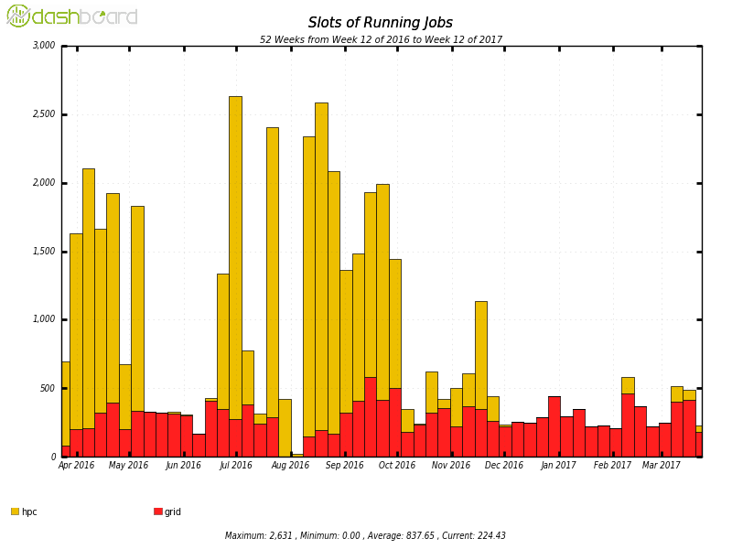
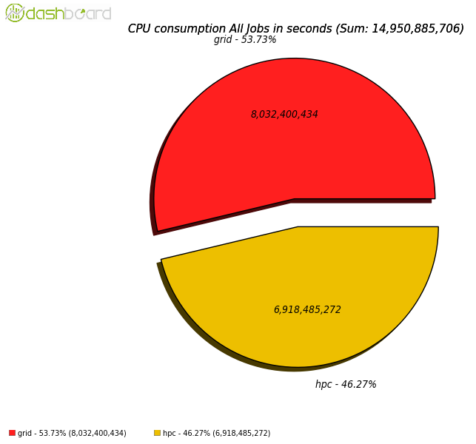
IHEP (ATLAS) Tier 2 site simulation activity since March 2016
Grid
HPC
Grid
HPC
Slots of running jobs
CPU consumption

Slide 15
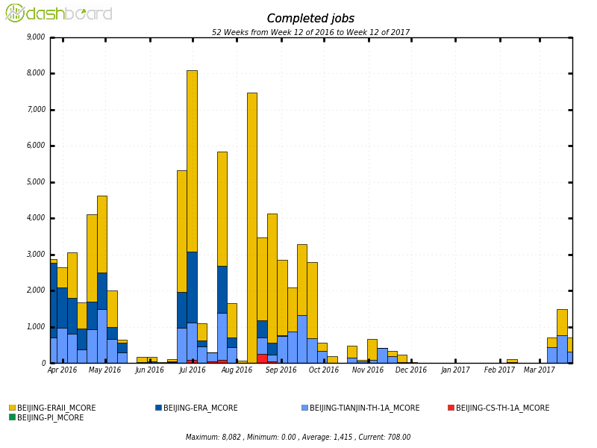
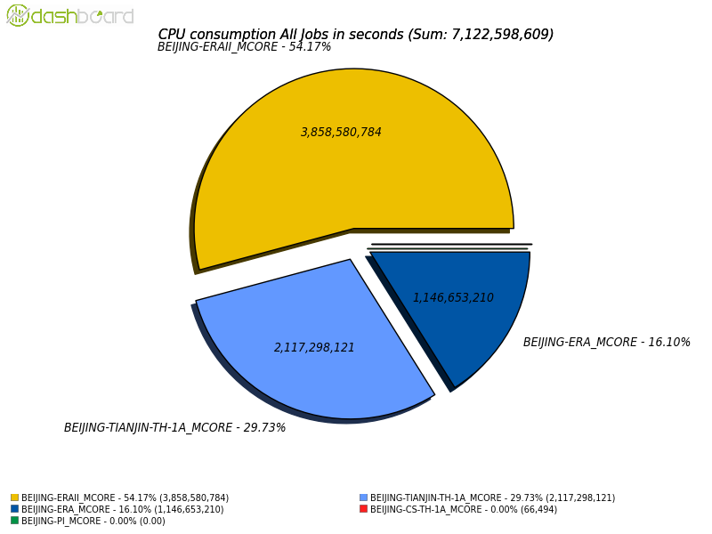
IHEP (ATLAS) HPC production activity since March 2016
Slots of running jobs
CPU consumption

Slide 16
2017 work-plan on HPCs
Can we get more HPCs to participate?
Can we demonstrate the scalability for a limited amount of time (eg one or few days) at thelevel of few 10k cores?
Large scale test would bring extremely good publicity in HEP, WLCG community and elsewhere
ARC-CE needs to be more powerful for this, probably 2 or 3 required
Network effort to sustain 200MB/s (2Gb/s) to store output files to IHEP

Slide 17
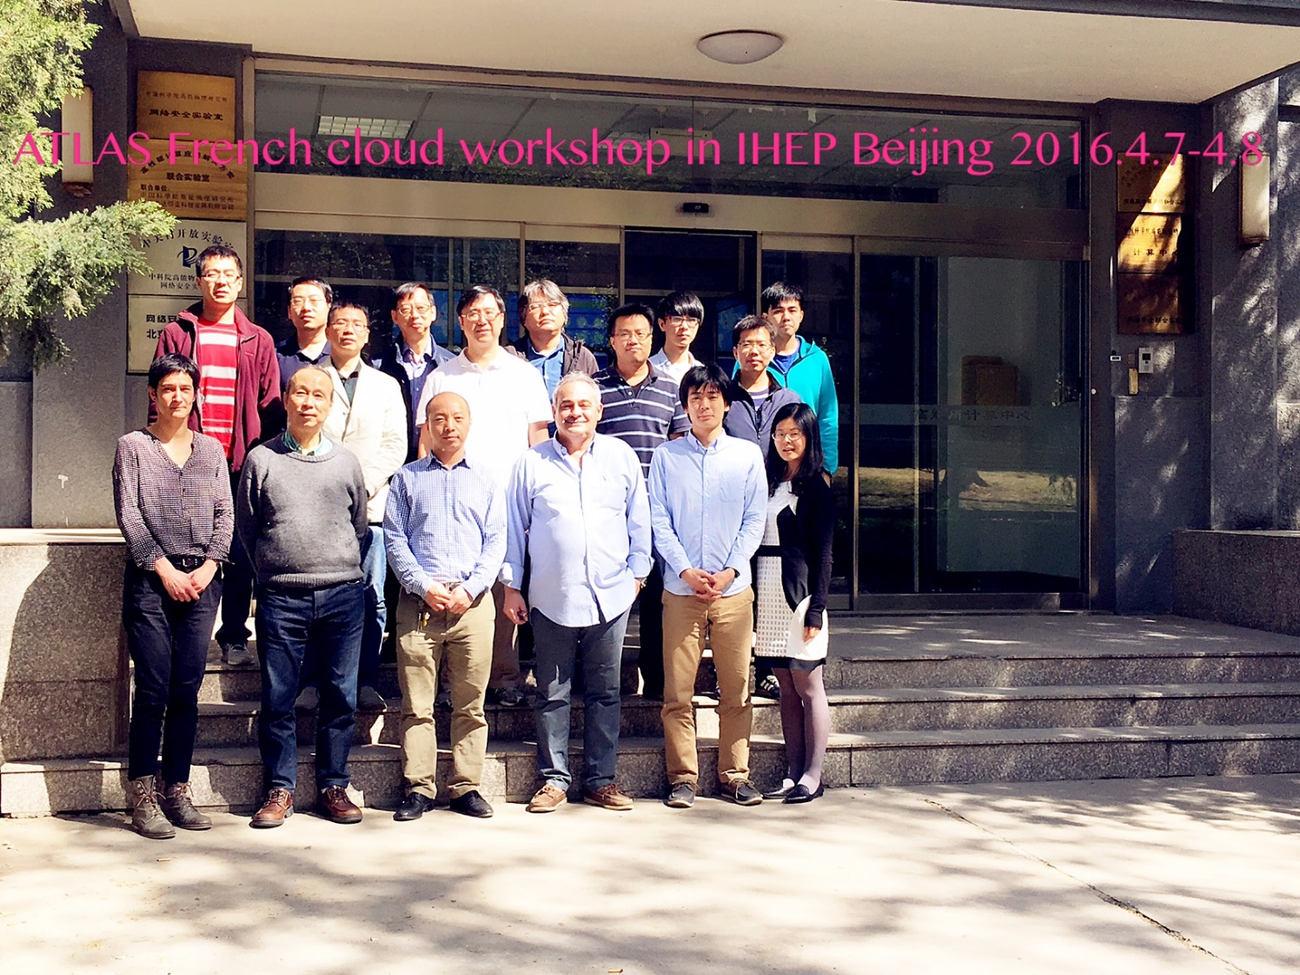
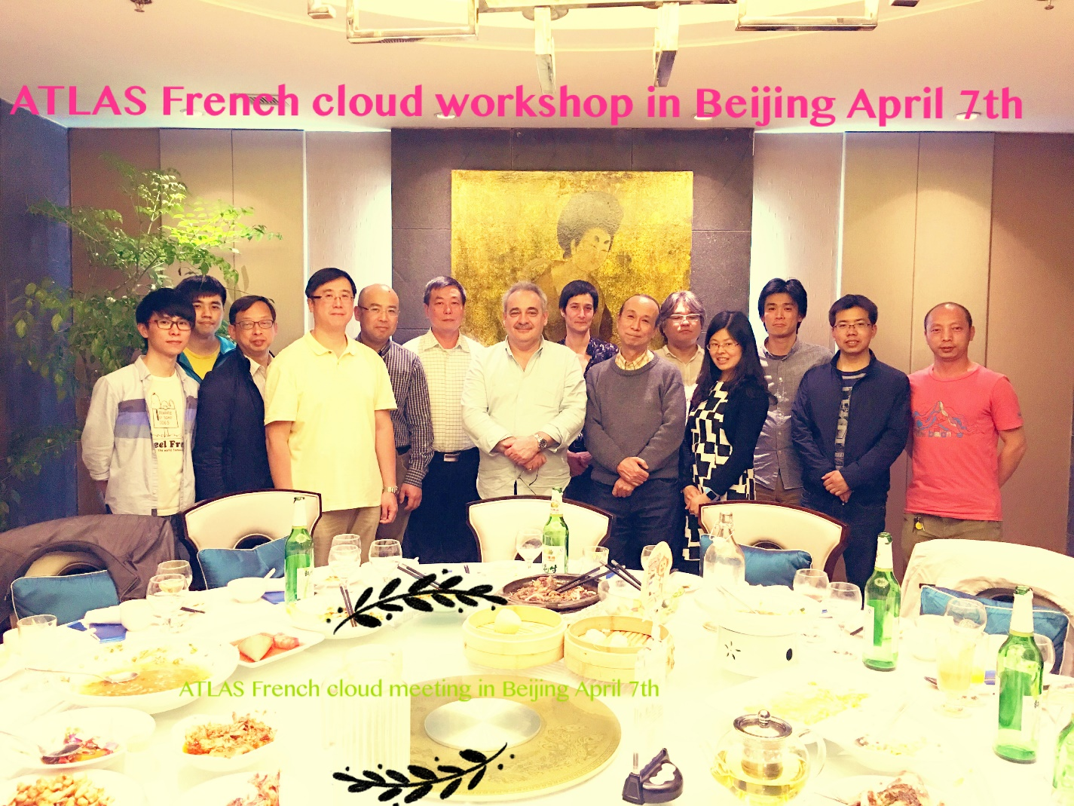
Meetings and workshops
Annual workshop of the French-cloud in IHEP, April 2016
Participants from : Beijing, Honk-kong, Tokyo, France

