Slide 1
Luminosity and beam loss monitoring at SuperKEKB
Philip Bambade
LAL-Orsay
On behalf of LAL group
Cécile Rimbault, P. B., Didier Jehanno (engineer), Yann Peinaud (engineer)
Dima El Khechen (PhD student → CERN/FCC-ee), Pang Chengguo* (PhD student)
Viacheslav Kubytskyi (postdoc → October 2017), N.N. (new postdoc opening in 2017)
*Chinese Scholarship Council
10th FCPPL workshop Tsinghua - China 27-30 March 2017

Slide 2
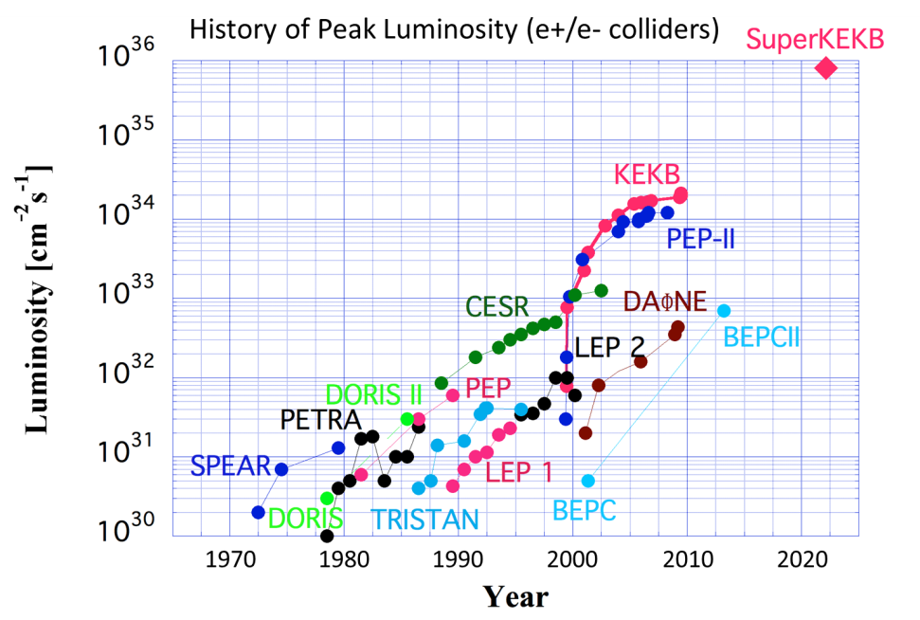
Luminosity Frontier
1km diameter
KEKB
2×10³⁴/cm²/s
SuperKEKB
80×10³⁴/cm²/s
All future e+e− circular colliders use novel “nanobeam” collision scheme, which will be tried for 1st time at SuperKEKB in 2018
➔ essential validation + training for CEPC / FCC-ee

Slide 3
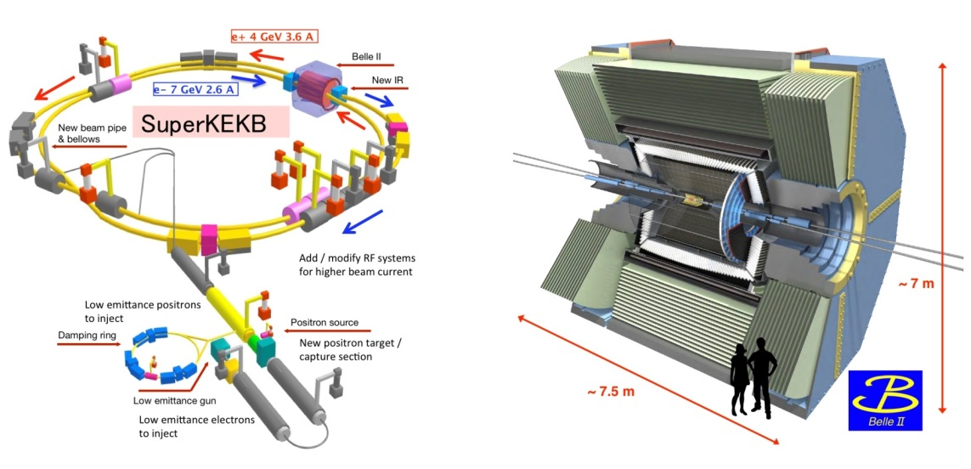
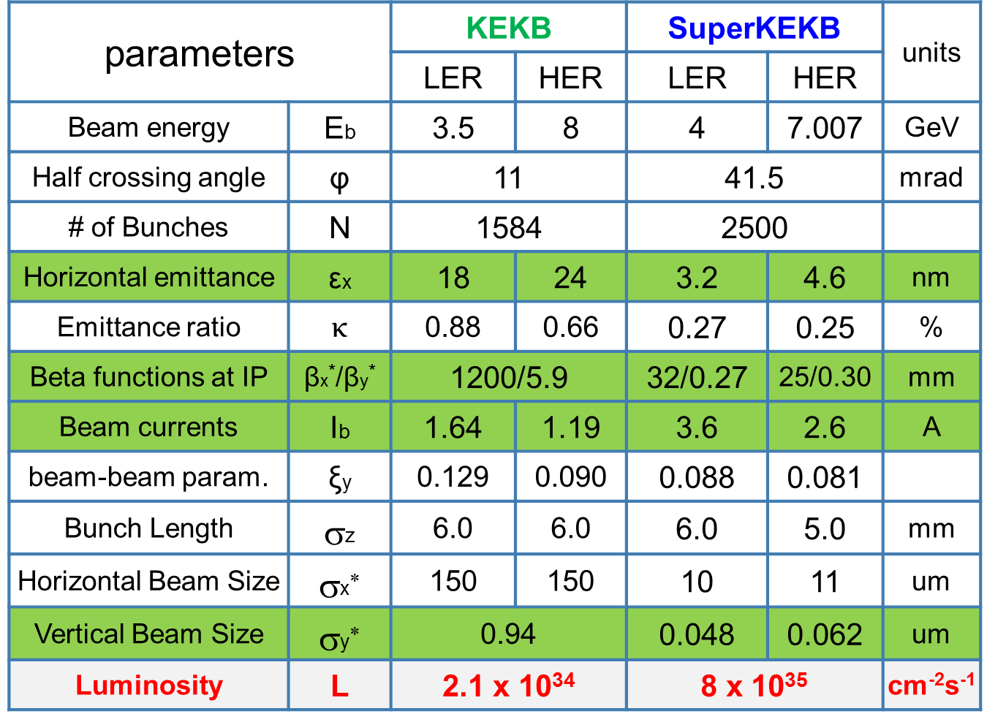
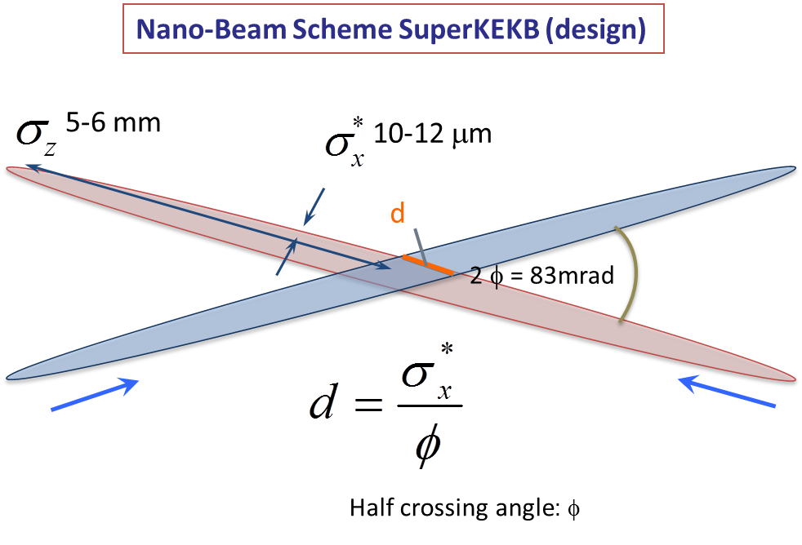
SuperKEKB / Belle-II & “Machine-Detector Interface”
Control beam induced backgrounds
Luminosity monitoring & tuning
1) Phase 1 : 2016/Feb. → Jun.
- single beam commissioning, vacuum scrubbing
- no luminosity (no final focus), no detector
2) Phase 2 : 2018/Feb. → 2018/Jul.
- colliding beam commissioning, no vertex detector
3) Phase 3 : from end of 2018…
- towards full luminosity for physics running
→
→
→
β_{y} = 300 μm
d ∼ 300 μm
→ mitigates beam-beam and hour-glass effects
→ Luminosity × 40

Slide 4
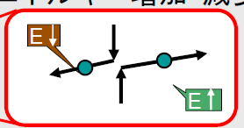
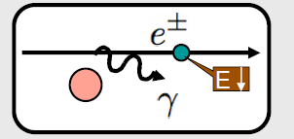
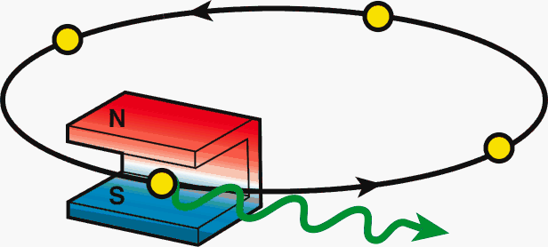
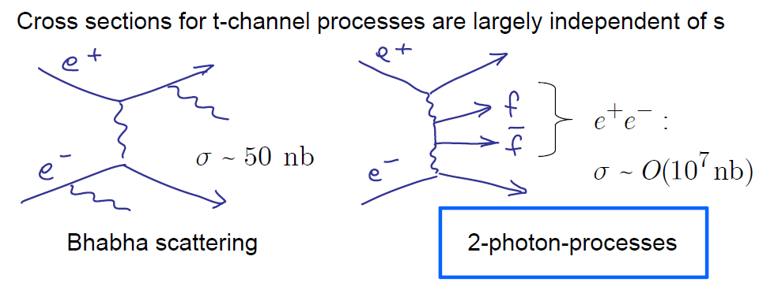
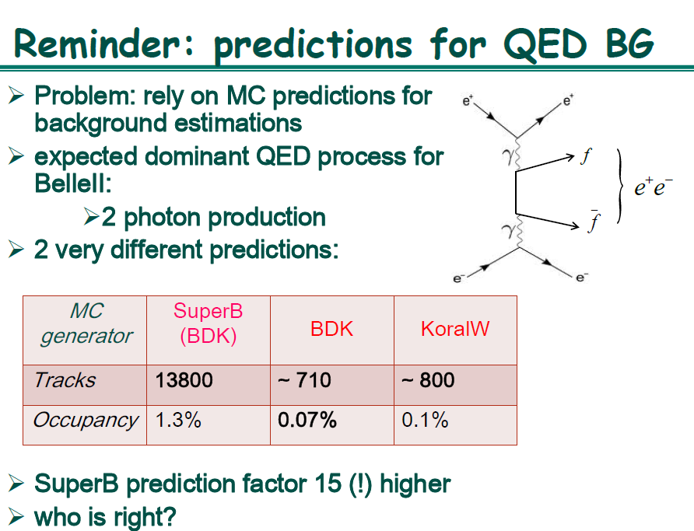
Beam backgrounds at SuperKEKB
At SuperKEKB with x 40 larger luminosity, beam background will also increase drastically
  Touschek scattering
  Beam-gas scattering
  Synchrotron radiation
  Radiative Bhabha event: emitted γ
  Radiative Bhabha event: spent e+/e-
  2-photon process event: e+e-→e+e-e+e-
  etc…
Beam-origin
Luminosity dependent
e⁺
e⁻
e⁻
Notes:
In this slide, I have listed up variety of possible beam background sources at SuperKEKB.
Among these background sources, so-called “Touschek scattering” will be the most difficult one to cope with, which I will explain in more detail in the following slides.

Slide 5
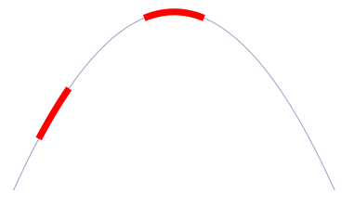
Luminosity
Fast & slow variations at IP require feedback corrections
Beam-beam deflection (SLC, KEKB) for fast vertical motion
Luminosity feedback by “dithering” (PEP-II) for slower horiz. motion
Luminosity tuning with optical knobs (SLC, FFTB, ATF2) to maintain small spot sizes ( time scales of ∼ hours ? )
Δy at IP=
∼ 5nm ∼ 1/10σ_{y}*
BPM
Δy at BPM= ∼ 1.3μm
Vertical vibration ∼ 25-100 Hz
Sampling (BPMs) ∼ 32 kHz
IP
BPM
↔
2×f₀
Horizontal motion ∼ few Hz
Modulation freq. f₀ ∼ 77 Hz
Sampling (lumi. meas.) ∼ 1 kHz
→ minimize f₀ output component
Luminosity
↔
f₀
x

Slide 6
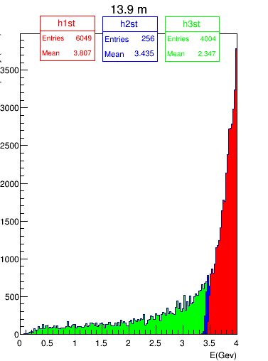
Radiative Bhabha at vanishing scattering angle
σ ∼ 250 mbarn (E_{γ} > 1% E_{beam} )
major background source from induced particle losses after IP
luminosity monitoring
Positron
energy
LAL & KEK
Luminosity monitoring specs
Relative measurements
10⁻³ in 1 ms over all bunches (“dithering”)
10⁻³ in ∼ 1 s for each 2500 bunch → 4ns
(for nominal luminosity)
Non luminosity scaling contamination < 1% (e.g. beam gas bremstrahlung and Touschek losses)
Should also work for initial luminosity
Macroscopic QED effect…
Y. Funakoshi (KEK), background workshop, Feb. 2012

Slide 7
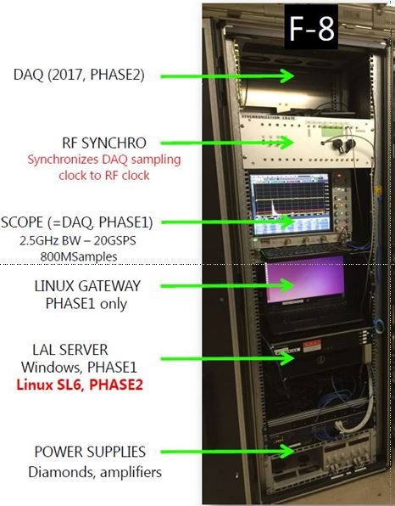
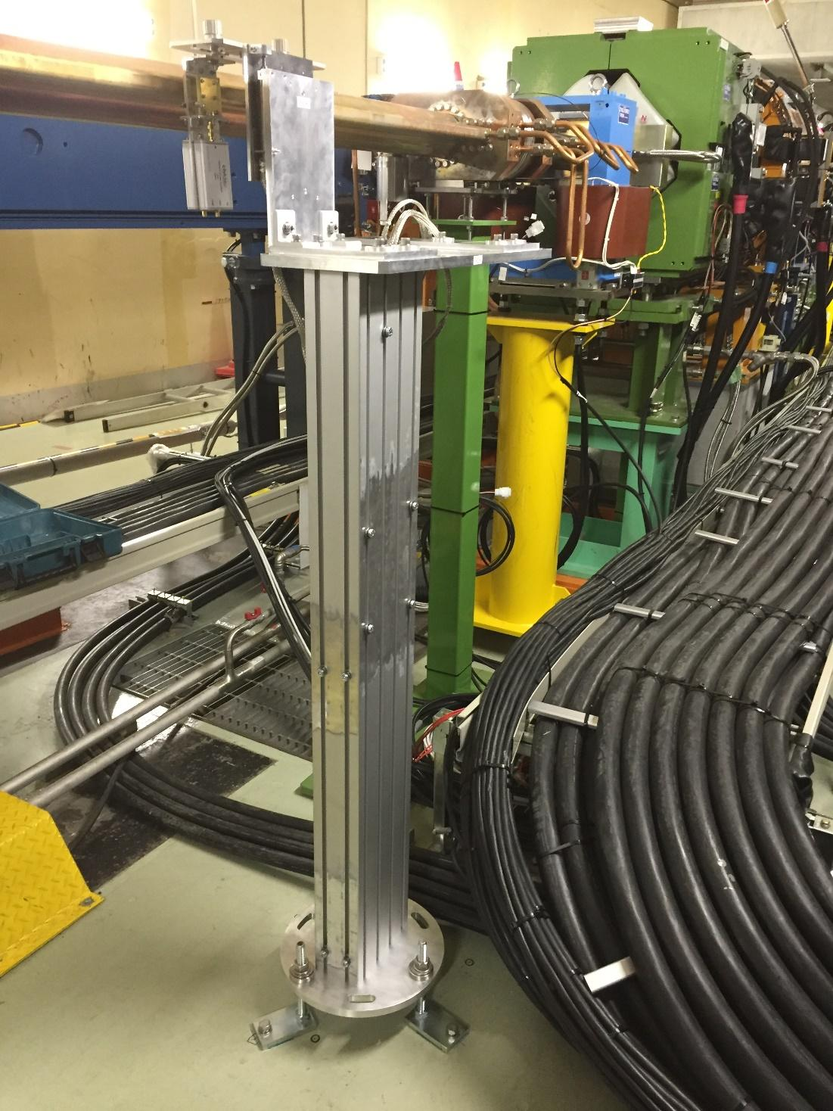
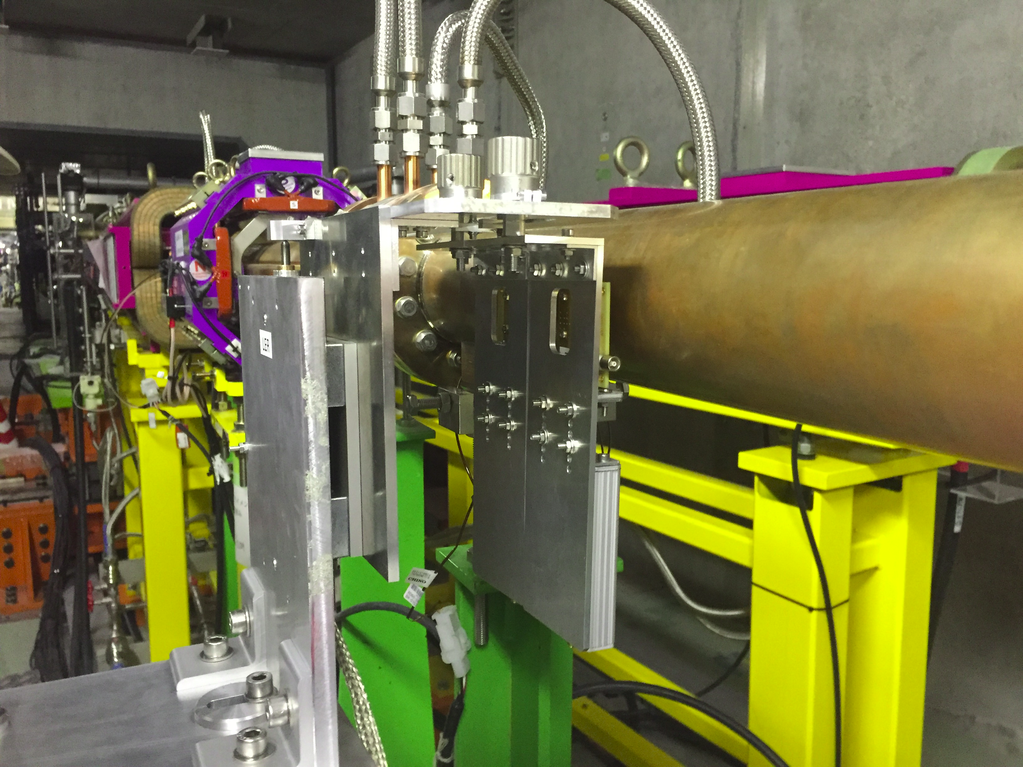
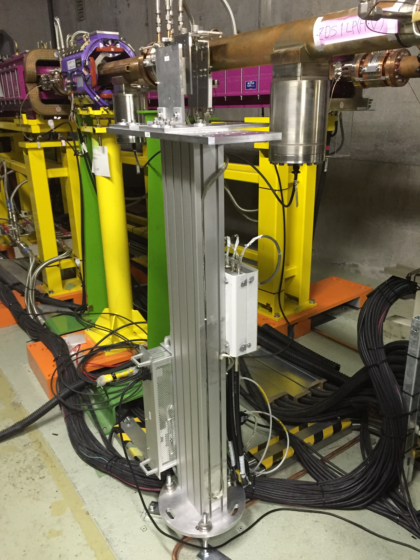
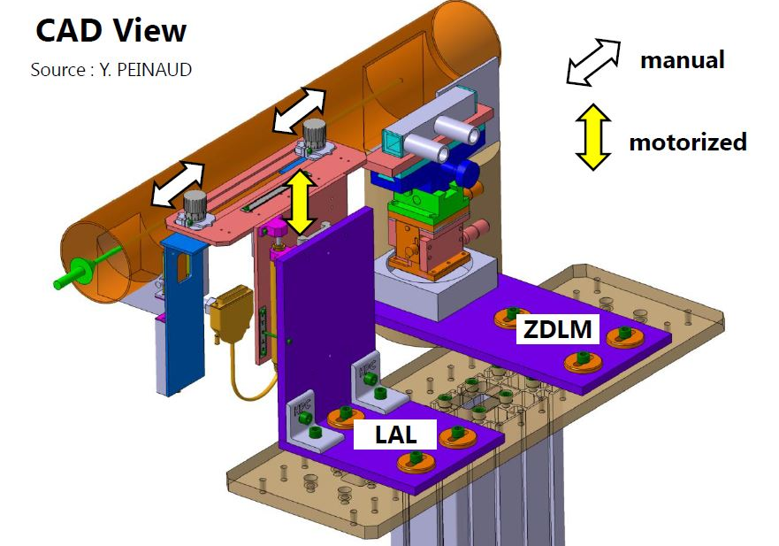
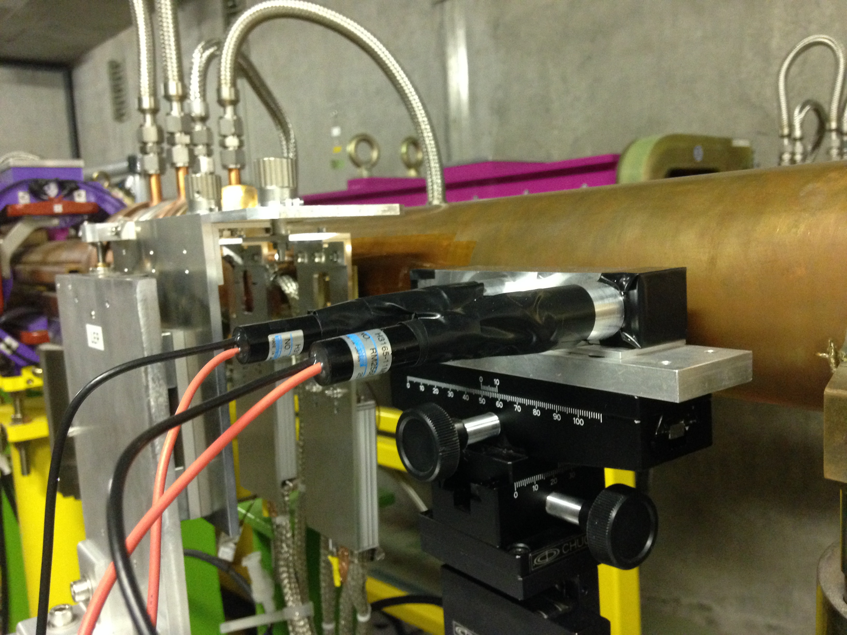
LAL Luminosity monitor : test setup for Phase 1 commissioning
HER ~ 30 m → photon
500 μm diamond sensors
LER ~ 11.9 m → positron

Slide 8
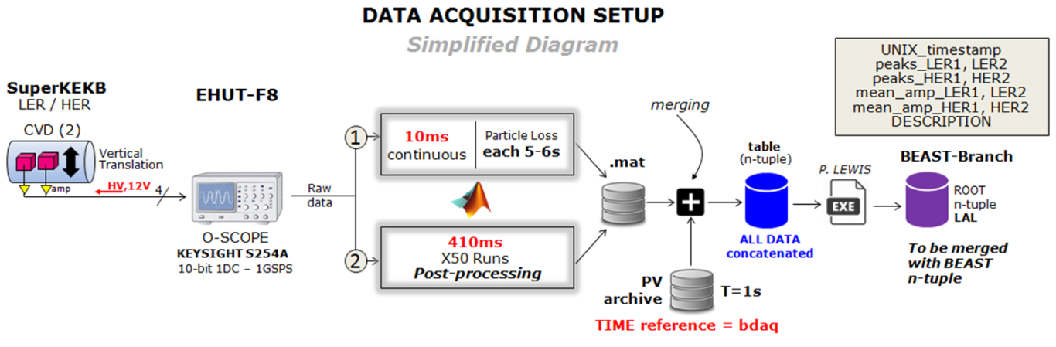
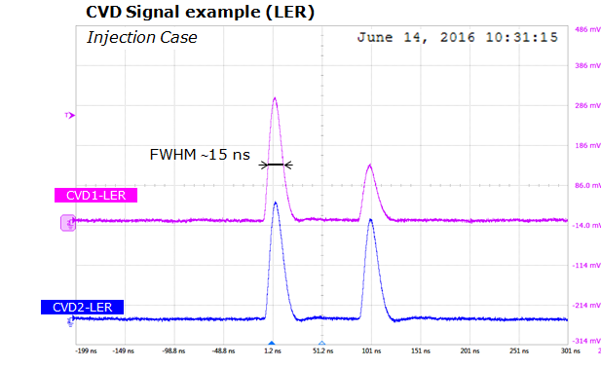
Data acquisition for Phase 1 commissioning
beam background measurement → validation
Data processing
→ Define waveforms and save them
→ Extract maximum of signal (total
integrated charge)
→ Position in time
→ FWHM
→ Save in .mat files
→ Merge them to EPICS

Slide 9
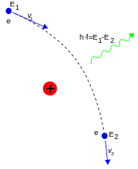
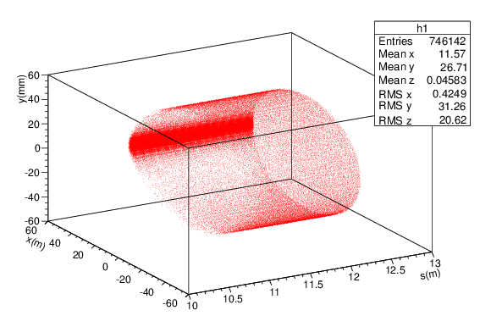
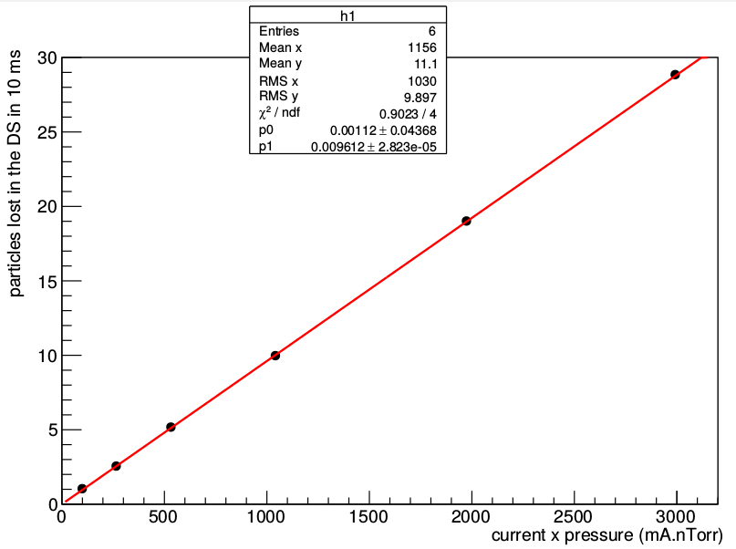
Beam gas Bremsstrahlung
→ Inelastic Coulomb scattering
→ Beam particles pass by EM of nucleus of molecules of residual gas
→ Emission of photon → particle loses energy
→ Particle is lost downstream of emission point
Loss vs (current x pressure)
→ Scattering and loss rates are proportional to beam current and vacuum pressure

Slide 10
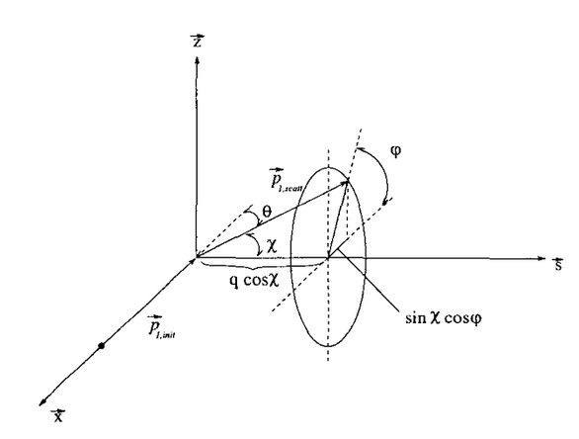
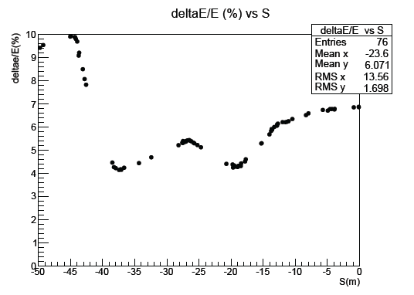
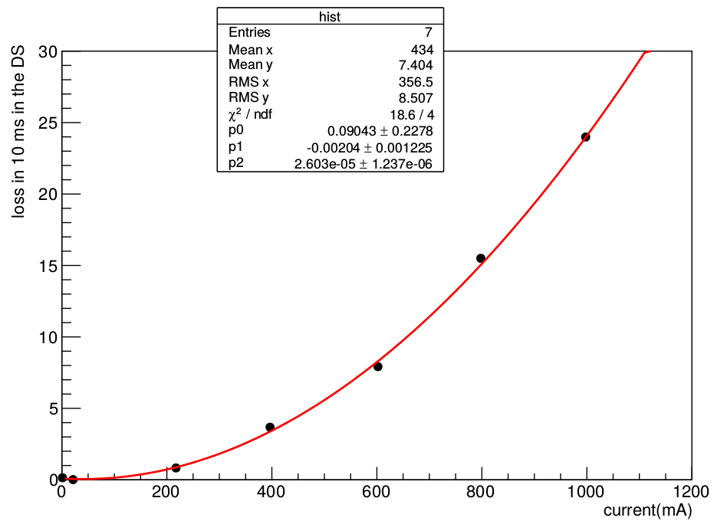
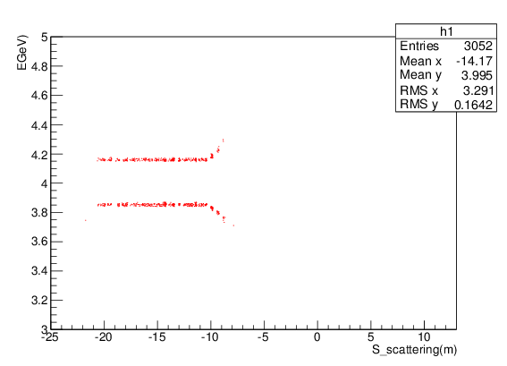

Touschek scattering
→ Scattering of beam particles upon each other
→In CM; p_{init1, 2} = (±p_{x},0,0)
p_{scat1, 2} = (±p_{x} sinχ cosφ, ±p_{x}cosχ, ±p_{x} sinχ sinφ)
→ In Lab frame: maximum momentum transfer : ΔE= γ x p_{x}
→ One particle loses energy and the other gain energy
→ Scattering and loss rates are proportional to I² and inversely proportional to the beam size
$$\frac{p_{x}}{p}=\sqrt{\frac{ϵ_{x}}{β_{x}}}$$
Energy vs emission position
3.7%
analytic calculation

Slide 11
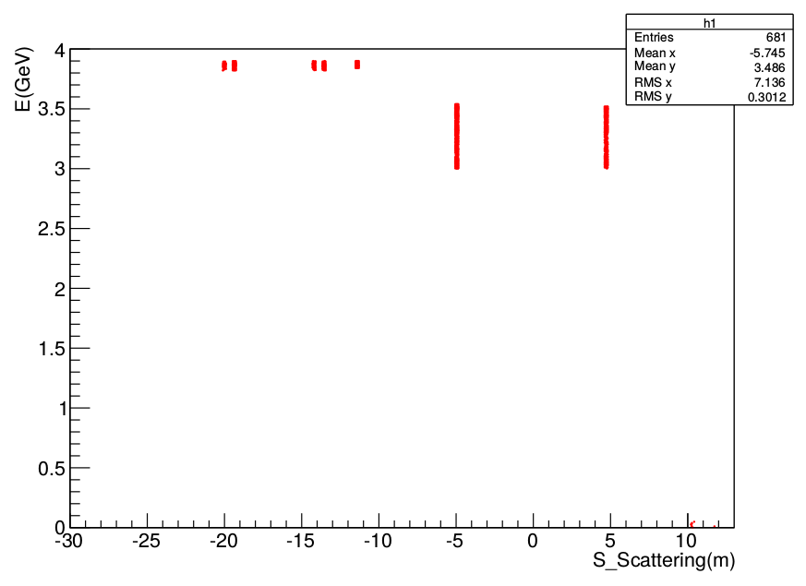
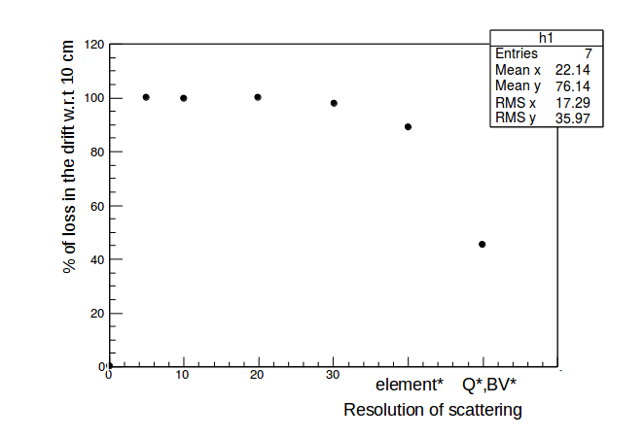
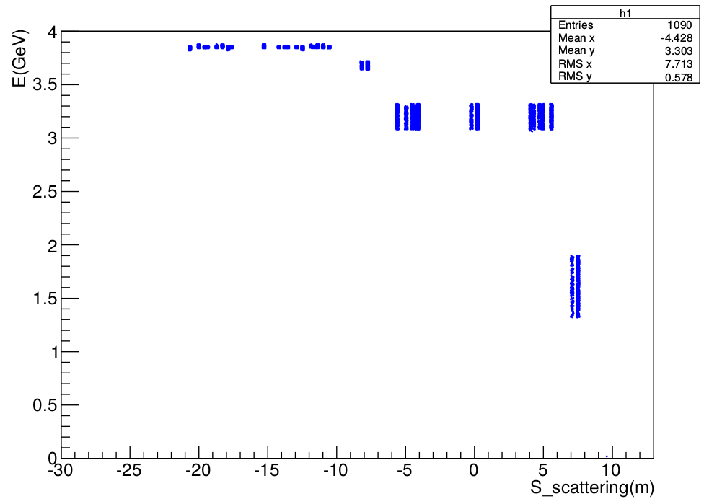
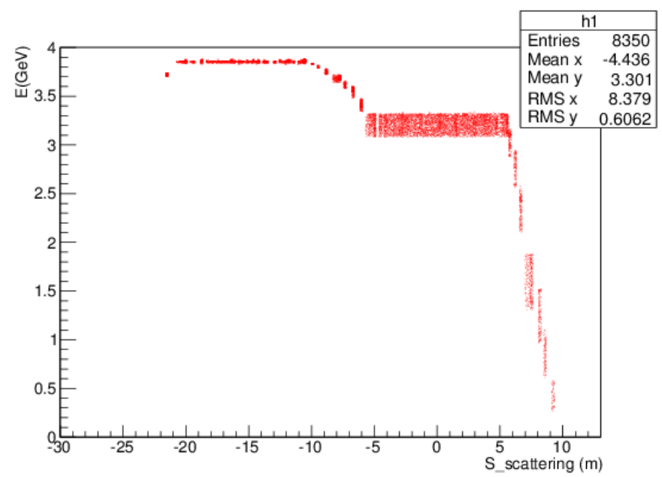
Simulation improvement: scattering resolution
Physical processes interfaced in SAD tracking code by Y. Ohnishi to simulate overall beam loss in SuperKEKB rings
Default code
Scattering @ quad
Energy
vs emission point
Scattering @ all elements
Slicing drifts (10 cm) and bends (15 cm)

Slide 12

Vacuum bumps in LER
→ Vacuum bumps were performed upstream of the IP
→ Fraction of losses in the sCVD from scattering regions were calculated and compared to data
→
is the loss in the sCVD at the maximum of the bump
$$f=\frac{{loss}_{bump}}{{loss}_{all−sections}}$$
total loss simulated in the sCVD, when pressure everywhere in the
ring is equal to that of the maximum of the bump at the given section
Pressure profile
Loss profile
17~35 m
4~12 m
17-35 m
4-12 m
4-12 m
17-35 m

Slide 13
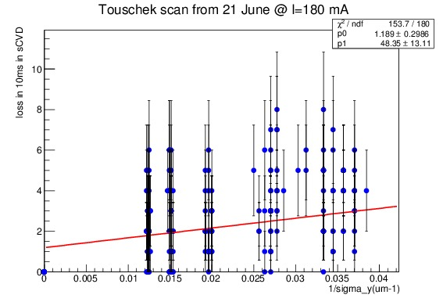
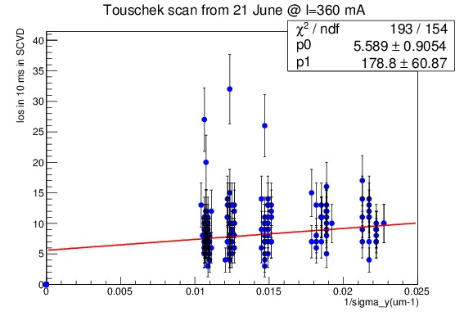
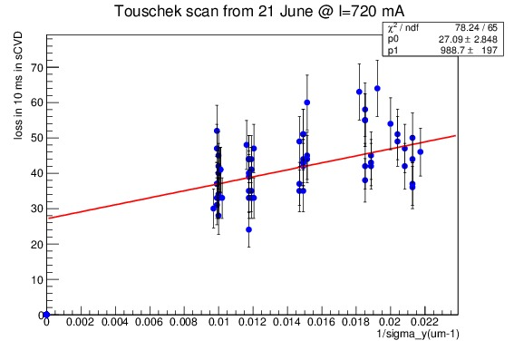
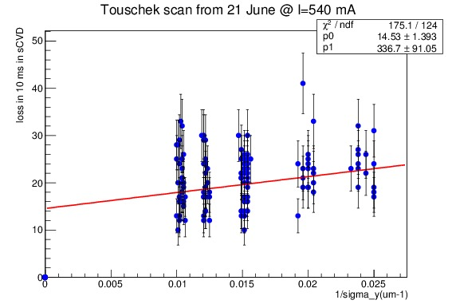
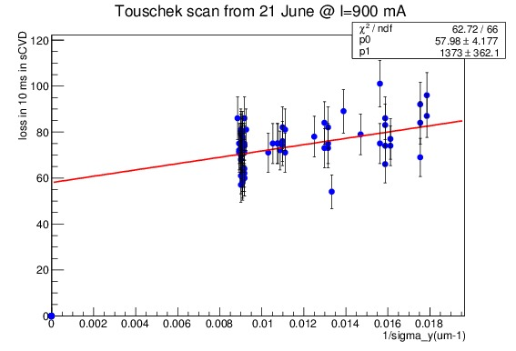
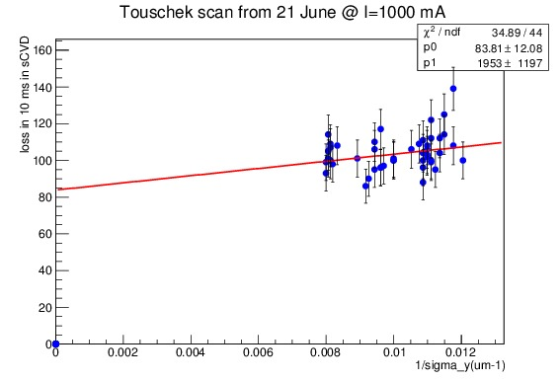
Vertical beam size scans
→ The vertical beam size σ_{y} was varied adjusting
the x-y coupling (“Emittance Control Knob”)
→ Losses in the sCVD were fitted as a function of
the inverse vertical beam size (σ_{y}⁻¹)
→ Loss = Bremsstrahlung + Touschek × σ⁻¹_{y}
180 mA
360 mA
(constant term) (slope)
720 mA
540 mA
900 mA
1000 mA

Slide 14
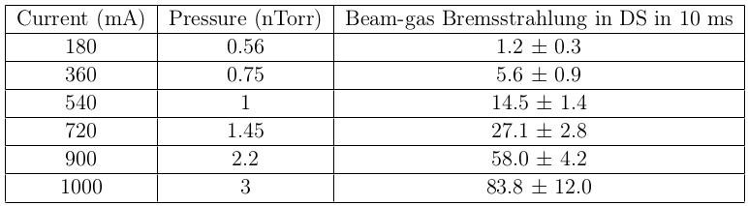
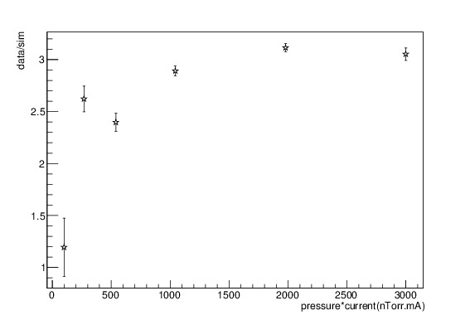
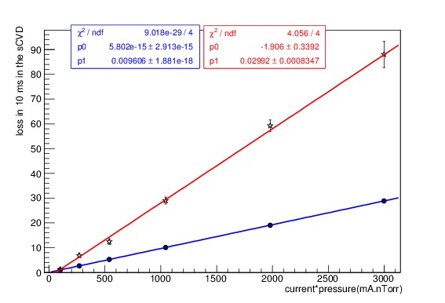
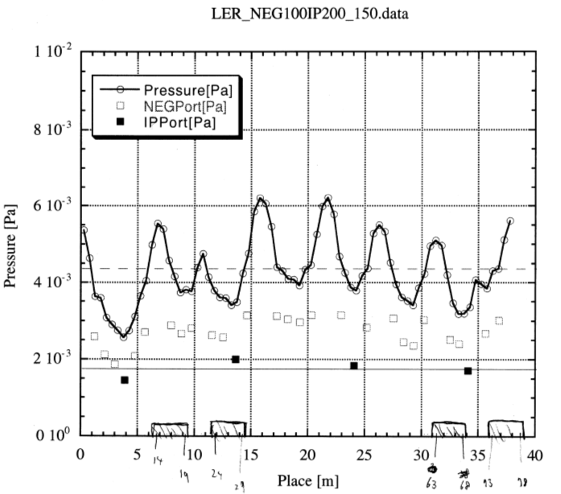
Bremsstrahlung losses (from constant terms of vertical beam size scans)
→ Data is larger than simulation by factor about 3
data
simulation
→ Factor 3 ± 1.5 was estimated by simulation for KEKB
by vacuum group
→ The pressure measured at Gauges should be multiplied
by ∼ 3 to represent the pressure at center of beam pipes

Slide 15
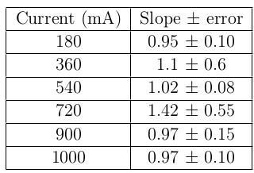
Touschek losses (from slopes of vertical beam size scans)
Measured slopes combined after quadratic extrapolation to I = 1 A to compare with simulation
→ simulation / data = 1.7 ± 0.74
(preliminary)
Uncertainties
(for future improved comparison)
Statistics (both data and simulation)
Beam size measurement considered reliable in vertical but not in horizontal
Emittance growth with beam current due to intra-beam scattering was neglected

Slide 16
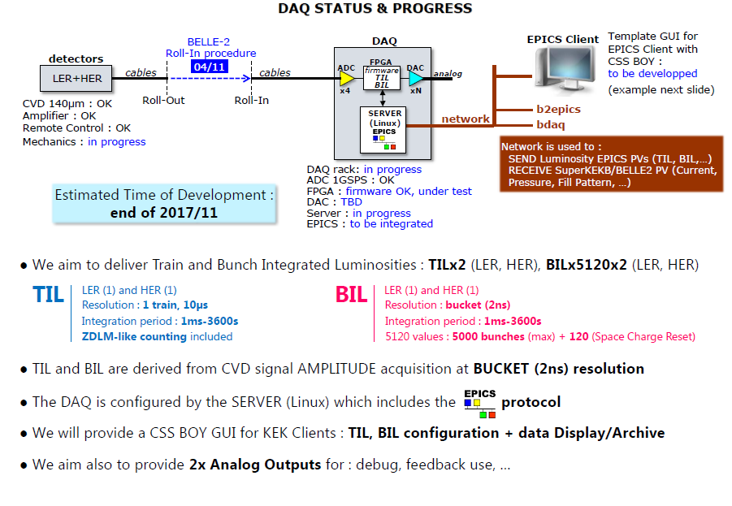
DAQ status and progress for Phase 2/3

Slide 17
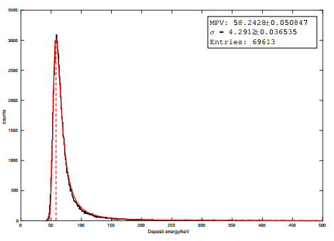
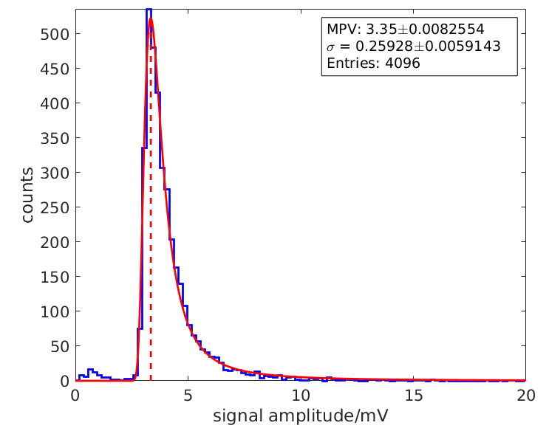
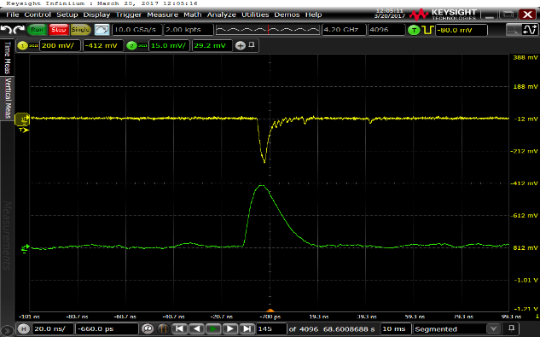
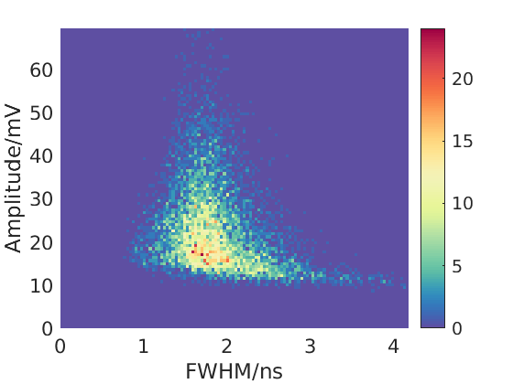
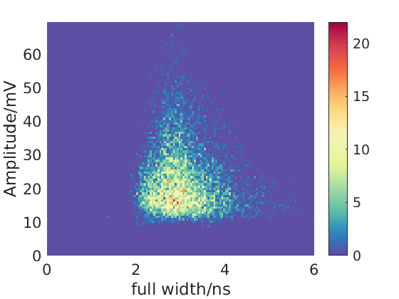
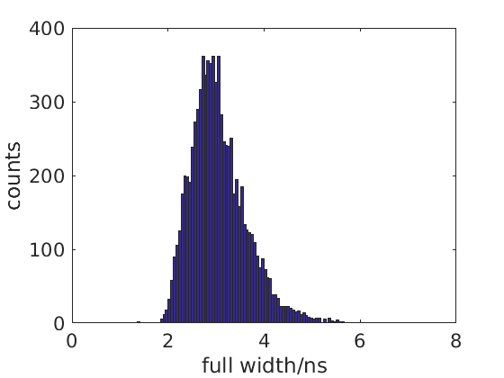
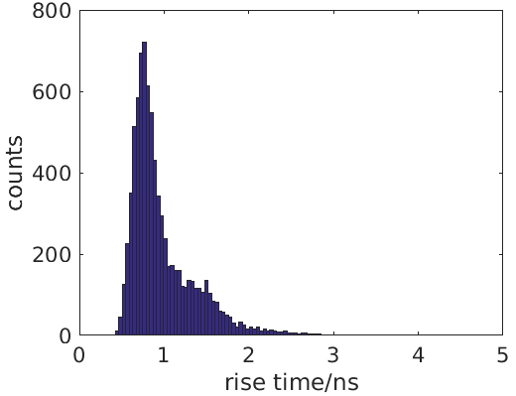
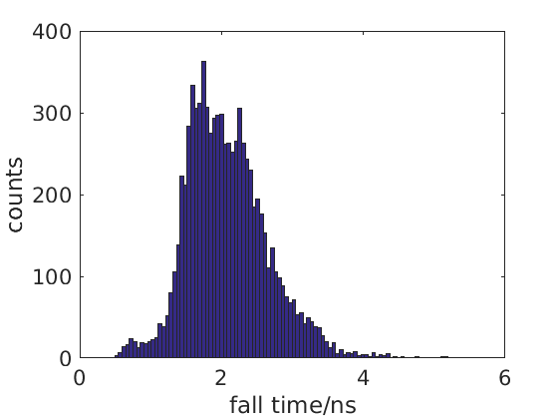


140$μm$ diamond test for Phase 2/3
G4 simulation: 58.2KeV
$\frac{58.2×{10}^{3}eV}{13eV}×(1.6×{10}^{−4}fC)×4mV/fC=2.87mV$
Experiment: 3.35mV
G4 simulation
Test with Sr-90
scintillator
diamond
Landau distribution of energy deposited and signal amplitude- 140$μm$ DS
May lead to pile up

Slide 18














Geant4 simulation for Phase 2/3
According to the energy deposited in DS per Bhabha, relative precision with different luminosity can be calculated.
Energy spectra of
Bhabhas-LER
$$N_{Bhabha}=ℒ∗σ∗τ∗f$$
$$ν_{p}=\frac{1}{\sqrt{N_{Bhabha}}}$$
${45}^{。}$window G4 model
Target luminosity
$$ℒ=8×{10}^{35}{cm}^{−2}s^{−1}$$
$$λ=ℒ∗σ∗τ∗f$$
Simulated signal sequence to test FPGA algorithm
Phase 2:
$$ℒ=1×{10}^{34}{cm}^{−2}s^{−1}$$

Slide 19
Conclusions & Prospects
SuperKEKB: 1st trial in 2018 of new “nanobeam” collision scheme which promises a breakthrough in luminosity (× 40 increase)
Challenge for the controls of the beams + significantly enhances beam related backgrounds
Successful test of LAL and KEK fast luminosity monitor hardware during 2016 single beam commissioning
Measurement of background conditions; validation of simulation to enable extrapolating in the successive luminosity conditions
Preparing on-line train-integrated and bunch-integrated luminosity monitoring for 2018
Background modeling and assessment will need to continue during luminosity operation
➔ Large impact on future circular e+e− collider design work
➔ Rare “real life” training chance for early stage scientists
+ great fun in great atmosphere !

Slide 20
Backup slides

Slide 21
LER & HER measurement stations
LER
e⁺
HER
e⁻
Recoil electron
Outside
γ from positron
γ from electron @ ∼ 30 m
Recoil positron @ ∼11 m
2 diamonds + 1 Cherenkov + 1 Scintillator
2 diamonds + 1 Cherenkov + 1 Scintillator

Slide 22


Slide 23
Overall schedule
Calendar year
2016
2017
2018
2019
…
Japan FY
JFY2016
JFY2017
JFY2018
JFY2019
Summer shutdown
(power saving)
Summer shutdown
(power saving)
Power saving
after mid July 2018
Summer shutdown
(power saving)
(mid Feb. – mid Jul. 2018)
phase 1
w/o QCS
w/o Belle II
phase 2 (MR)
phase 3
MR renovation for phase 2, including
installation of QCS and Belle II
w/ QCS
w/ Belle II (no VXD)
w/ full Belle II
MR startup
HER start
VXD installation
LER start
phase 3 operation
9 months / year
DR installation & startup
DR commissioning

Slide 24


Slide 25



Coulomb scattering
→ Elastic scattering of particle beams on the nucleus of residual gas molecules
→ Particle receives a transverse kick and is lost downstream the emission point
→ Transverse offset of particle lost at position B and emitted at A depends on
$$\sqrt{β_{A}×β_{B}}$$

Slide 26
Calibration
→ Maximum of signal of Data were fit by “Landau”
→ A cut at 6 mV separates signal from noise
→ In simulation: minimum of 50 KeV ( > 3σ of noise )
→ MPV= 11.6 mV in data
→ MPV= 9.2 mV in simulations
→ 11.6/9.2 = 1.3 ➔ threshold is at ~ 4.7 mV for simulations
11.6 mV
9.2 mV
data
simulation

