Slide 1
highlights & news
Philip Bambade
LAL-Orsay
10th FCPPL workshop Tsinghua - China 27-30 March 2017

Slide 2
Main topics (2016)
Energy frontier physics (5)
Flavour physics (2)
Neutrino and non-accelerators physics (4)
Hadron Physics (1)
Astroparticle physics (2)
Instrumentation R&D for high energy experiments (3)
Accelerator R&D for high energy physics (8)
Computing (2)
Application of subatomic physics methods (2)
Coordination team in 2014-2017
Japan: J. HABA (KEK), codirector, R. OTA (KEK), secretariat
France: P. BAMBADE (LAL) and M. BESANÇON (IRFU), codirectors, G. GILBERT (LAL), secretariat
Steering committee:
Japan: Masanori YAMAUCHI/Katsuo TOKUSHUKU, Yasuhiro OKADA/Takashi KOBAYASHI, Shoji HASHIMOTO, Satoshi MIHARA, Mitsuhiro YOSHIDA (KEK), Mashiro KUZE (Tokyo Institute of Technology)
France: Reynald PAIN/Ursula BASSLER/Patrice VERDIER, Guy WORMSER, Marc WINTER (IN2P3), Anne-Isabelle ETIENVRE/Gautier HAMEL DE MONTCHENAULT, Marco ZITO, Olivier NAPOLY (IRFU)

Slide 3
Main features and information (1) http://fjppl.in2p3.fr/cgi-bin/twiki.source/bin/view/FJPPL/WebHome
Founded in 2006 by IN2P3, IRFU and KEK to promote French-Japanese cooperation in high energy physics and related areas
Renamed Toshiko Yuasa* Laboratory in 2009 special ceremony
Supports ∼ 25 joint projects (topical workshops, visits, transport)
GOALS: - exchanges of personnel, including technical staff
- seed money / promotion for new initiatives & ideas
- joint training for junior staff and students
Does not support costs of research programs themselves, only additional costs of collaborating with French/Japanese partner
Mainly bottom-up + considerations for coordination and coherence
* Toshiko Yuasa (1909-1980) studied at College de France with F. Joliot-Curie and worked for 30 years at IPN-Orsay. She was the first ever Japanese female physicist and played a pioneering and decisive role in building up French-Japanese relations in subatomic physics

Slide 4
Main features and information (2) http://fjppl.in2p3.fr/cgi-bin/twiki.source/bin/view/FJPPL/WebHome
Yearly project evaluations and workshop (France ↔ Japan ↔ Korea)
→ 2014 Bordeaux → 2015 Okinawa → 2016 Seoul →10-12 May 2017 Strasbourg
Allows genuine knowledge of partner’s environment, conditions and methods → close collaborative relations
Modest but dedicated centrally allocated budgets act as incentive, providing useful context, still within an official (but light) framework
Benefits: “coo-petition”, added visibility and credibility, improved facility access, springboard for other funding,…
Brief project summaries on “public” twiki as showcase for “external” visibility (see: http://fjppl.in2p3.fr/cgi-bin/twiki.source/bin/view/FJPPL/FJPPLprojects)
Special emphasis on supporting and promoting:
1) Young researchers in TYL-FJPPL activity
(see: http://fjppl.in2p3.fr/cgi-bin/twiki.source/bin/view/FJPPL/FJPPLStudents)
2) Actions towards gender balance (→ mainly KEK)

Slide 5
Annual call to fund staff exchanges on joint activities http://fjppl.in2p3.fr/cgi-bin/twiki.source/bin/view/FJPPL/FJPPLStaffExchange
Staff from CNRS, CEA, KEK + universities; participation of junior staff and students encouraged
Emerging activity or new initiative in existing activity; within research program at IN2P2, IRFU and KEK
Maximum four years → evolution of scope / leaders after that…
Request budgets reasonable for planned exchanges; funding only for visits, joint workshops, transport of equipment
Evaluation based on yearly written report + presentation at workshop
Scientific and technical quality of the foreseen research program. In case of re-application, progress made in the elapsed year, including publications, reports, communication to conferences,...
Quality of the collaboration in terms of scientific and technical exchanges between the French and Japanese partners, task definition and assignments, complementarity, joint publications and reports, joint training of junior staff and students,...
Expected impact of the TYL-FJPPL framework for the described activity. Justification for the funds requested to support the proposed exchanges between French and Japanese teams
→ 19 (IN2P3) – 5 (IN2P3 + IRFU) – 4 (IRFU) – 1 (INP)
→ 10 (KEK) – 15 (KEK + University/other) – 4 (University/other)
→ 6 new projects: 3 genuinely + 3 with evolved scope/leader
2016 applications

Slide 6
TYL-FJPPL Student or Early Stage Researcher Secondment http://fjppl.in2p3.fr/cgi-bin/twiki.source/bin/view/FJPPL/FJPPLStudents
Master/doctoral students + postdocs in approved TYL-FJPPL projects
TYL-FJPPL funding for most cases based on cost sharing :
- sending group → travel
- receiving group → accommodation and meals
Application briefly describe :
- context / purpose of visit, concrete project to be pursued
- proposed duration
- supervision arrangements
Limited to 28 days / year
Can combine with other funding for in/out-going international mobility
KEK → LAL S. Kazama 1 month (A_RD_08)
Tsukuba → CERN M. Hirano + B. Chul Kim 1 month (HAD_01)
LAL → KEK R. Yang 1 month (A_RD_10)
Subatech → KEK L. Gallego Manzano + S. Diglio 2 weeks (D_RD_11)
2015
Tohoku → LAL Y. Sato 1 month (HEP_01)
Tsukuba → IPHC T. Sakamoto 2 weeks (HAD_01)
LAL → KEK R. Yang 1 month (A_RD_10)
LAL → KEK S. Bilokin 1 month (HEP_01)
2016

Slide 7
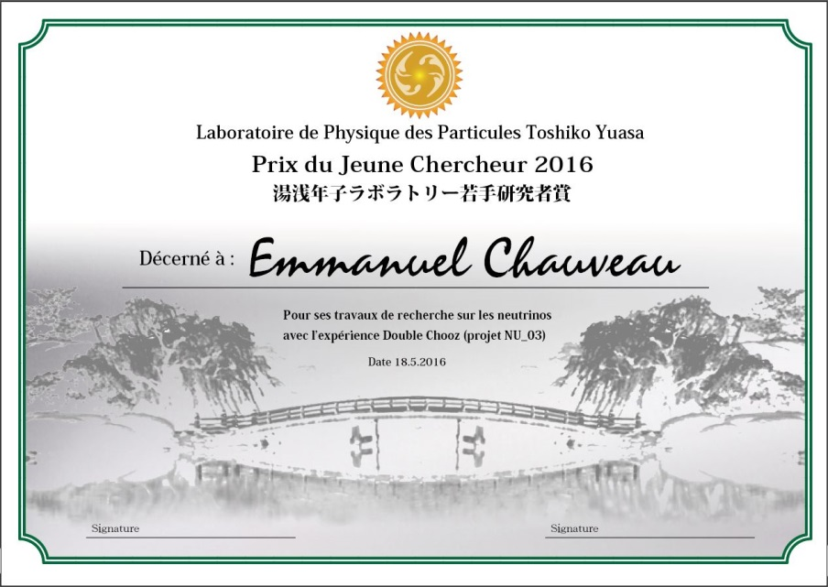
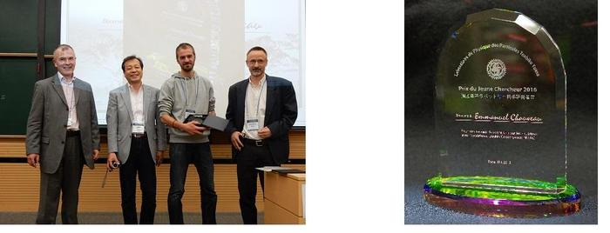
TYL-FJPPL Young Investigator Award http://fjppl.in2p3.fr/cgi-bin/twiki.source/bin/view/FJPPL/FJPPLStudents
Highlight / promote individual work of junior scientists within TYL-FJPPL teams
PhD student / postdoc contribution to TYL-FJPPL supported projects
Criteria:
- Importance and originality of specific contribution to one of the TYL-FJPPL projects
- Level of recognition in both partner teams
- Scientific / technical excellence (e.g. papers, talks, others,...) + any special consideration
2017 winner : Hiroki YOKOYAMA (ALICE at LHC), Uni. Tsukuba & Grenoble
2016 winner : Dr. Emmanuel Chauveau (Double Chooz), Uni. Tohoku & CENBG

Slide 8
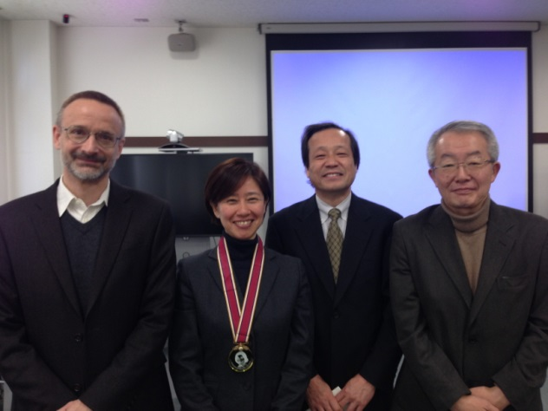
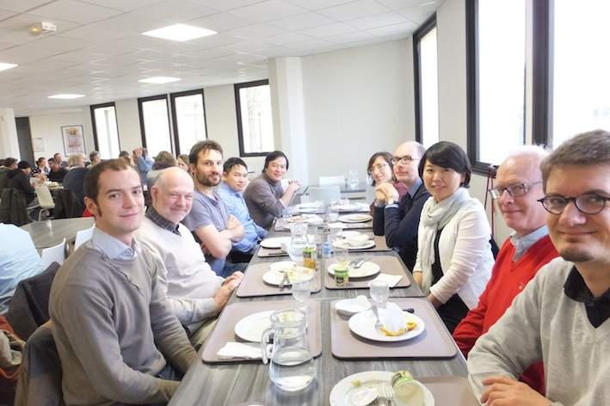
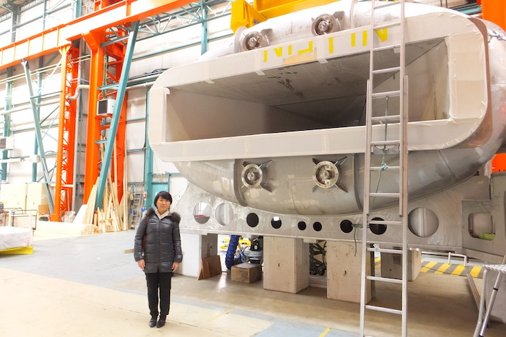
TYL-FJPPL supports two KEK actions promoting the participation of female researchers in Japan
Rikeijoshi Female High School Student Camp at KEK
- under the patronage of the Toshiko Yuasa Laboratory
- 30 selected Japanese high school students for 2 days of activities
- participation of French TYL-FJPPL + includes French keynote speakers:
2017 Marie-Emmanuelle Couprie 2016 Ursula Bassler 2015 Catherine Césarsky…
Toshiko Yuasa Awards for outstanding Japanese female scientist achievements
- awarded by Ochanomizu Women’s University with assistance of TYL-FJPPL
- all fields of science + science outreach + actions towards gender balance
2016 Y. Mitarai (Gold) 2015 M. Bando (Gold) & K. Sekiguchi (Silver)…
Mitarai-san honoured at Ochanomizu Uni.
Sekiguchi-san’s visit at GANIL & Saclay…

Slide 9
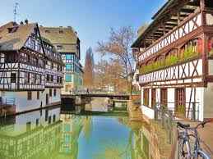
TYL-FJPPL / FKPPL Annual Workshop
10-12 May 2017 Strasbourg
Presentation of French-Japanese and French-Korean joint projects
Award ceremony for winning TYL-FJPPL and FKPPL young investigators
Keynote speakers:
P. Ko (KIAS) “Theory developments fundamental physics”
F. Bordry (CERN) "R&D Challenges for Future Accelerators"
M. Winter (IPHC) "R&D Challenges for Future Detectors“
M. Matsuoka (Mitsubishi) "Academia-Industry Collaboration"
Brainstorming discussion sessions:
Physics/theory/phenomenology Computing Accelerator R&D Detector R&D
Talks on future vision of bilateral collaboration by IN2P3, IRFU, KEK and Korea
Participation of a few officials (general sessions, a few nice social events…)
Academia-Industry Collaboration (discussion with French & Japanese leaders)
Welcome !

