Slide 1
100km CEPC parameters and lattice design
10th workshop of the France China Particle Physics Laboratory
Dou Wang, Jie Gao, Chenghui Yu, Yuan Zhang, Yiwei Wang, Feng Su, Bai Sha, Jiyuan Zhai, Huiping Geng, Cai Meng, Tianjian Bian, Na Wang, Xiaohao Cui
27-30 March 2017, Tsinghua University, Beijing.

Slide 2
Advantage:
Avoid pretzel orbit, more bunches
Correct sawtooth effect
Reduce beam power with crab waist

Slide 3
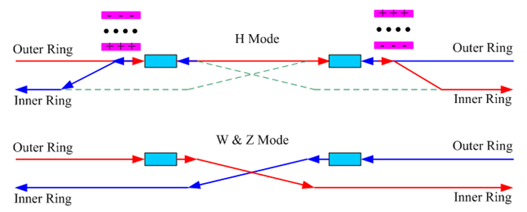
CEPC RF distribution

Slide 4

CEPC bunch distribution
W & Z
Higgs
C₀=100km
C₀=100km

Slide 5
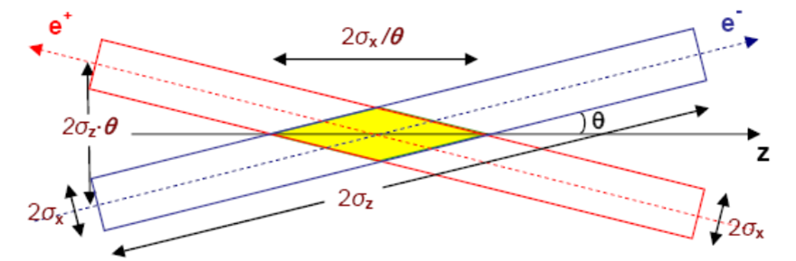
Machine constraints / given parameters
Energy E₀
Circumference C₀
N_{IP}
Beam power P₀
β_{y}*
Emittance coupling factor κ_{ε}
Bending radius ρ
Piwinski angle Φ
ξy enhancement by crab waist F_{l} ~1.5 (2.6)
Energy acceptance requirement (DA)
Phase advance per cell (FODO)

Slide 6
Constraints for parameter choice
Limit of Beam-beam tune shift
F_{l}: ξy enhancement by crab waist
Beam lifetime due to beamstrahlung
BS life time: 30 min
V.I. Telnov
Beamstrahlung energy spread
A=δ₀/δ_{BS} (A≥3)
HOM power per cavity (coaxial coupler)
*J. Gao, emittance growth and beam lifetime limitations due to beam-beam effects in e+e- storage rings, Nucl. Instr. and methods A533（2004）p. 270-274.

Slide 7
parameters for CEPC double ring
（wangdou20161219-100km_1mmβy）
 | Pre-CDR | H-high lumi. | H-low power |  | W | Z
Number of IPs | 2 | 2 | 2 | 2 | 2 | 2 | 2
Energy (GeV) | 120 | 120 | 120 | 120 | 80 | 45.5 | 45.5
Circumference (km) | 54 | 100 | 100 | 100 | 100 | 100 | 100
SR loss/turn (GeV) | 3.1 | 1.67 | 1.67 | 1.67 | 0.33 | 0.034 | 0.034
Half crossing angle (mrad) | 0 | 15 | 15 | 15 | 15 | 15 | 15
Piwinski angle | 0 | 2.5 | 2.5 | 2.5 | 3.57 | 5.69 | 5.69
N_{e}/bunch (10¹¹) | 3.79 | 1.12 | 1.12 | 1.12 | 1.05 | 0.46 | 0.46
Bunch number | 50 | 555 | 333 | 211 | 1000 | 16666 | 65716
Beam current (mA) | 16.6 | 29.97 | 17.98 | 11.4 | 50.6 | 367.7 | 1449.7
SR power /beam (MW) | 51.7 | 50 | 30 | 19 | 16.7 | 12.7 | 50
Bending radius (km) | 6.1 | 11 | 11 | 11 | 11 | 11 | 11
Momentum compaction (10⁻⁵) | 3.4 | 0.96 | 0.96 | 0.96 | 3.1 | 3.3 | 3.3
β_{IP} x/y (m) | 0.8/0.0012 | 0.3/0.001 | 0.3/0.001 | 0.3 /0.001 | 0.1 /0.001 | 0.12/0.001 | 0.12/0.001
Emittance x/y (nm) | 6.12/0.018 | 1.01/0.0031 | 1.01/0.0031 | 1.01/0.0031 | 2.68/0.008 | 0.93/0.0049 | 0.93/0.0049
Transverse σ_{IP} (um) | 69.97/0.15 | 17.4/0.055 | 17.4/0.055 | 17.4/0.055 | 16.4/0.09 | 10.5/0.07 | 10.5/0.07
ξ_{x}/ξ_{y}/IP | 0.118/0.083 | 0.029/0.083 | 0.029/0.083 | 0.029/0.083 | 0.0082/0.055 | 0.0075/0.054 | 0.0075/0.054
RF Phase (degree) | 153.0 | 123.3 | 123.3 | 123.3 | 149 | 160.8 | 160.8
V_{RF} (GV) | 6.87 | 2.0 | 2.0 | 2.0 | 0.63 | 0.11 | 0.11
f _{RF} (MHz) (harmonic) | 650 | 650 | 650 | 650 | 650 (217800) | 650 (217800)
Nature σ_{z} (mm) | 2.14 | 2.72 | 2.72 | 2.72 | 3.8 | 3.93 | 3.93
Total σ_{z} (mm) | 2.65 | 2.9 | 2.9 | 2.9 | 3.9 | 4.0 | 4.0
HOM power/cavity (kw) | 3.6 (5cell) | 0.75(2cell) | 0.45(2cell) | 0.28(2cell) | 1.0 (2cell) | 1.6(1cell) | 6.25(1cell)
Energy spread (%) | 0.13 | 0.098 | 0.098 | 0.098 | 0.065 | 0.037 | 0.037
Energy acceptance (%) | 2 | 1.5 | 1.5 | 1.5
Energy acceptance by RF (%) | 6 | 1.8 | 1.8 | 1.8 | 1.5 | 1.1 | 1.1
n_{γ} | 0.23 | 0.26 | 0.26 | 0.26 | 0.26 | 0.18 | 0.18
Life time due to beamstrahlung_cal (minute) | 47 | 52 | 52 | 52
F (hour glass) | 0.68 | 0.83 | 0.83 | 0.83 | 0.84 | 0.91 | 0.91
L_{max}/IP (10³⁴cm⁻²s⁻¹) | 2.04 | 5.42 | 3.25 | 2.06 | 4.08 | 18.0 | 70.97

Slide 8
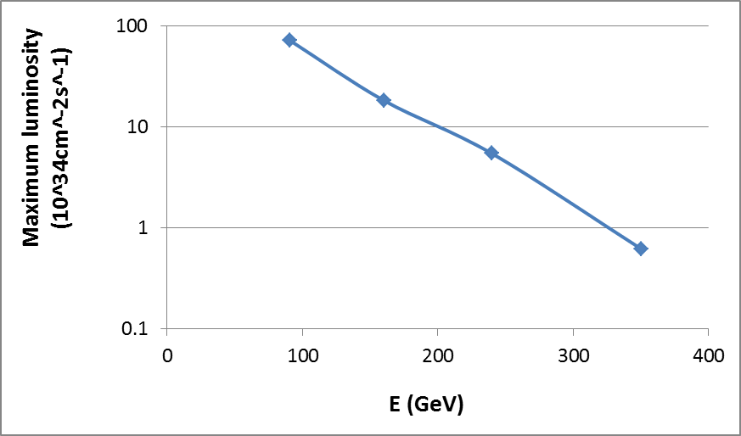
100km CEPC luminosity potential
(1mmβy+50MW/beam)
z
W
H
tt

Slide 9
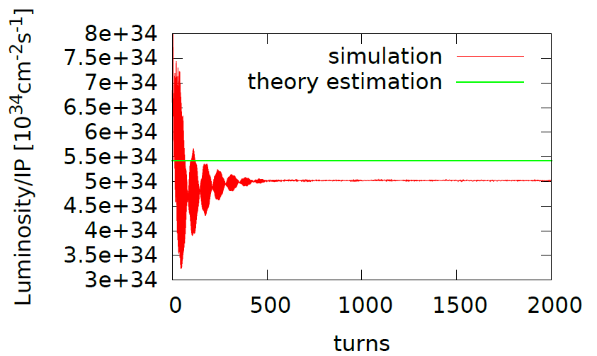
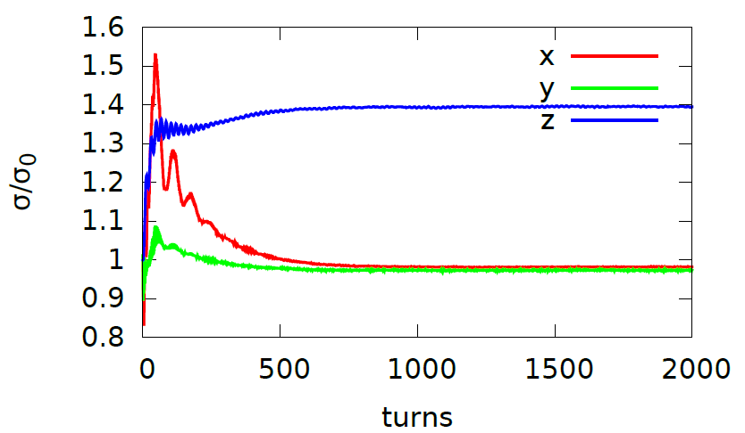
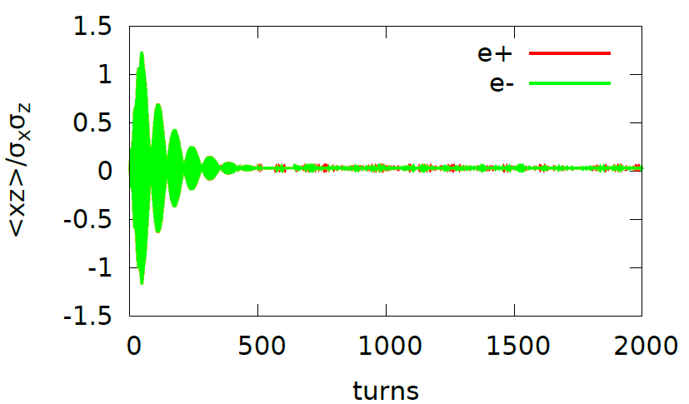
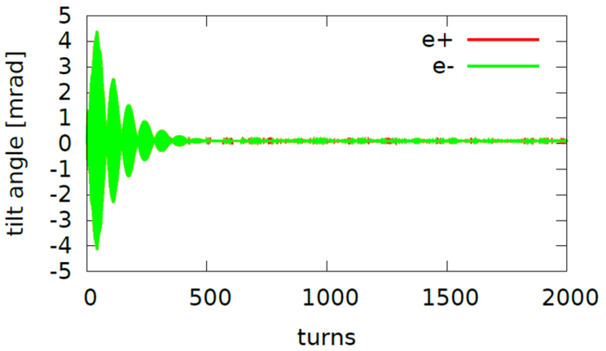
Strong-strong simulation – 100km
wangdou20161219-100km_1mmβy with full crab waist, Higgs
Working point: (0.54, 0.61) with ν_{s} = 0.0272
Lifetime: 400min
In Phase <xz> oscillation in the first few hundred collisions

Slide 10
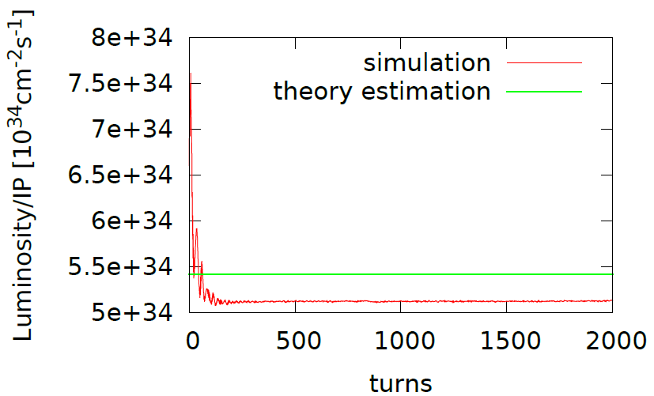
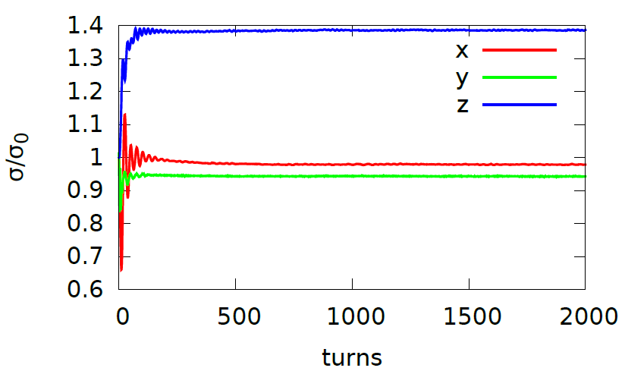
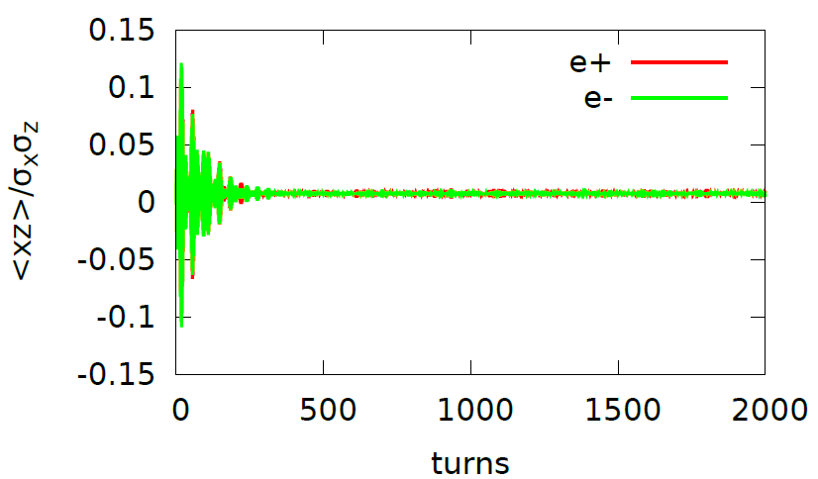
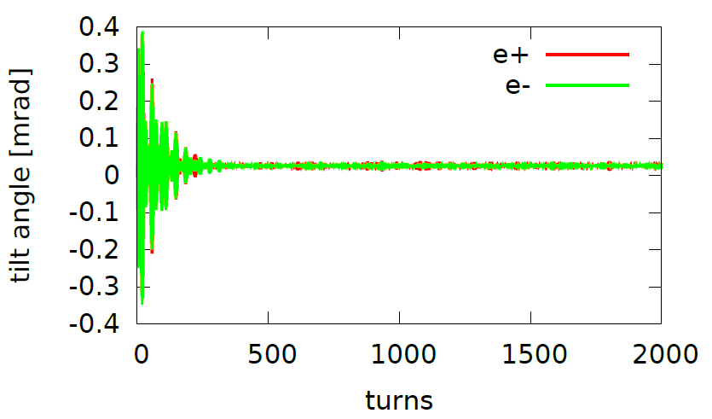
Strong-strong simulation-100km
wangdou20161219-100km_1mmβy with full crab waist, Higgs
(0.51,0.55) with ν_{s} =0.0272 could help suppress the <xz> oscillation

Slide 11
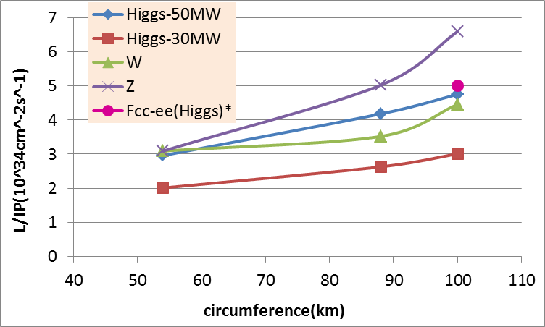
CEPC Luminosity vs circumference
* Fabiola Gianotti, Future Circular ColliderDesign Study, ICFA meeting, J-PARC, 25-2-2016.

Slide 12
Parameter for single ring-100km
（wangdou20161122）
 | Pre-CDR | New-100km
Number of IPs | 2 | 2 | 2
Energy (GeV) | 120 | 120 | 120
Circumference (km) | 54 | 100 | 100
SR loss/turn (GeV) | 3.1 | 1.67 | 1.67
N_{e}/bunch (10¹¹) | 3.79 | 1.79 | 1.79
Bunch number | 50 | 350 | 100
Beam current (mA) | 16.6 | 30.0 | 8.6
SR power /beam (MW) | 51.7 | 50 | 14.3
Bending radius (km) | 6.1 | 11 | 11
Momentum compaction (10⁻⁵) | 3.4 | 3.15 | 3.15
β_{IP} x/y (m) | 0.8/0.0012 | 0.4/0.0012 | 0.4/0.0012
Emittance x/y (nm) | 6.12/0.018 | 6.18/0.019 | 6.18/0.019
Transverse σ_{IP} (um) | 69.97/0.15 | 49.5/0.15 | 49.5/0.15
ξ_{x}/IP | 0.118 | 0.055 | 0.055
ξ_{y}/IP | 0.083 | 0.055 | 0.055
V_{RF} (GV) | 6.87 | 4.88 | 4.88
f _{RF} (MHz) | 650 | 650 | 650
Nature σ_{z} (mm) | 2.14 | 2.41 | 2.41
Total σ_{z} (mm) | 2.65 | 2.47 | 2.47
HOM power/cavity (kw) | 3.6 | 3.2 | 0.92
Energy spread (%) | 0.13 | 0.098 | 0.098
Energy acceptance (%) | 2 | 0.94 | 0.94
Energy acceptance by RF (%) | 6 | 4.5 | 4.5
n_{γ} | 0.23 | 0.15 | 0.15
Life time due to beamstrahlung_cal (minute) | 47 | 54 | 54
F (hour glass) | 0.68 | 0.7 | 0.7
L_{max}/IP (10³⁴cm⁻²s⁻¹) | 2.04 | 2.5 | 0.72

Slide 13
New modifications
βy*=2mm (1mm)
L*=2.2m (1.5m)
Crossing angle： 33mrad (30mrad)
Strength of QD0: 150T/m (200T/m)
Strength of detector solinoid: 3T (3.5T)
Strength of anti-solinoid: 7.0T (13T)

Slide 14
parameters for CEPC double ring
（wangdou20170306-100km_2mmβy）
 | Pre-CDR | Higgs | W | Z
Number of IPs | 2 | 2 | 2 | 2
Energy (GeV) | 120 | 120 | 80 | 45.5
Circumference (km) | 54 | 100 | 100 | 100
SR loss/turn (GeV) | 3.1 | 1.67 | 0.33 | 0.034
Half crossing angle (mrad) | 0 | 16.5 | 16.5 | 16.5
Piwinski angle | 0 | 3.19 | 5.69 | 4.29
N_{e}/bunch (10¹¹) | 3.79 | 0.968 | 0.365 | 0.455
Bunch number | 50 | 412 | 5534 | 21300
Beam current (mA) | 16.6 | 19.2 | 97.1 | 465.8
SR power /beam (MW) | 51.7 | 32 | 32 | 16.1
Bending radius (km) | 6.1 | 11 | 11 | 11
Momentum compaction (10⁻⁵) | 3.4 | 1.14 | 1.14 | 4.49
β_{IP} x/y (m) | 0.8/0.0012 | 0.171/0.002 | 0.171 /0.002 | 0.16/0.002
Emittance x/y (nm) | 6.12/0.018 | 1.31/0.004 | 0.57/0.0017 | 1.48/0.0078
Transverse σ_{IP} (um) | 69.97/0.15 | 15.0/0.089 | 9.9/0.059 | 15.4/0.125
ξ_{x}/ξ_{y}/IP | 0.118/0.083 | 0.013/0.083 | 0.0055/0.062 | 0.008/0.054
RF Phase (degree) | 153.0 | 128 | 126.9 | 165.3
V_{RF} (GV) | 6.87 | 2.1 | 0.41 | 0.14
f _{RF} (MHz) (harmonic) | 650 | 650 | 650 (217800) | 650 (217800)
Nature σ_{z} (mm) | 2.14 | 2.72 | 3.37 | 3.97
Total σ_{z} (mm) | 2.65 | 2.9 | 3.4 | 4.0
HOM power/cavity (kw) | 3.6 (5cell) | 0.41(2cell) | 0.36(2cell) | 1.99(2cell)
Energy spread (%) | 0.13 | 0.098 | 0.065 | 0.037
Energy acceptance (%) | 2 | 1.5
Energy acceptance by RF (%) | 6 | 2.1 | 1.1 | 1.1
n_{γ} | 0.23 | 0.26 | 0.15 | 0.12
Life time due to beamstrahlung_cal (minute) | 47 | 52
F (hour glass) | 0.68 | 0.96 | 0.98 | 0.96
L_{max}/IP (10³⁴cm⁻²s⁻¹) | 2.04 | 2.0 | 5.15 | 11.9

Slide 15
Higgs mode and W mode will use the same lattice.
For Z pole, Considering the constraint of 10 ns bunch separation from detector, the maximum bunch number can be increased by only 40% with dedicated RF cavities. So the luminosity of Z is limited by detector speed.
Z mode use different lattice rather than Higgs/W, because Z needs larger emittance which can be realized by closing half quadrupoles in Higgs lattice.

Slide 16
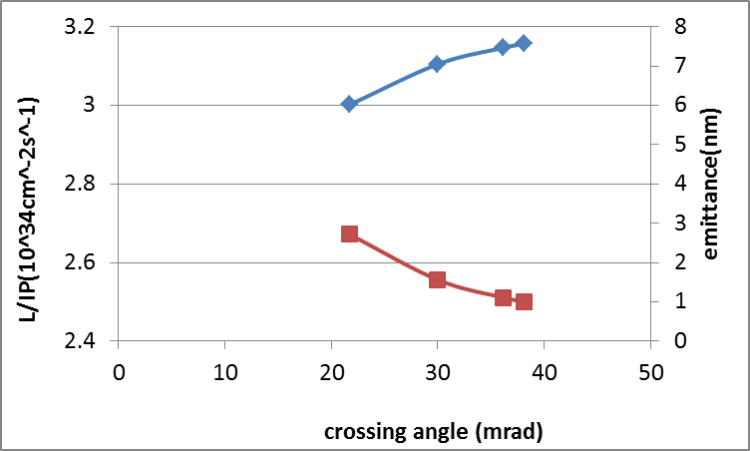
Higgs Luminosity vs. crossing angle
Keep beamstrahlung life time constant (52min)
100km
luminosity
emittance

Slide 17
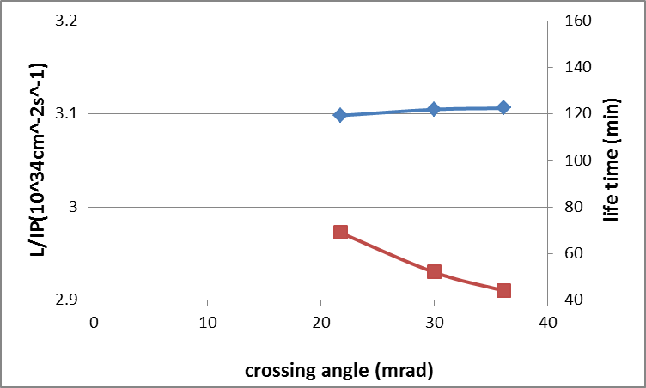
Higgs Luminosity vs. crossing angle
Keep emittance constant (1.56nm)
100km
luminosity
Life time

Slide 18
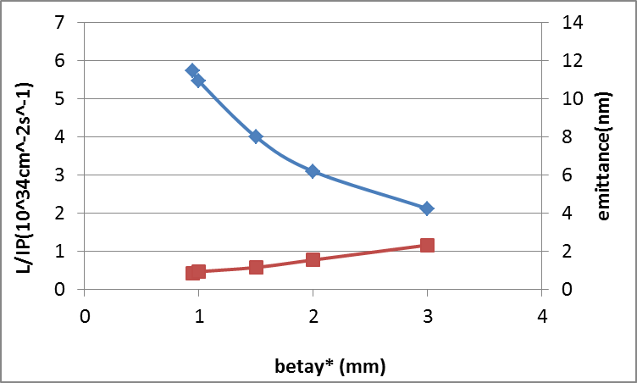
Higgs Luminosity vs. βy*
Keep beamstrahlung life time constant (52min)
100km
luminosity
emittance

Slide 19
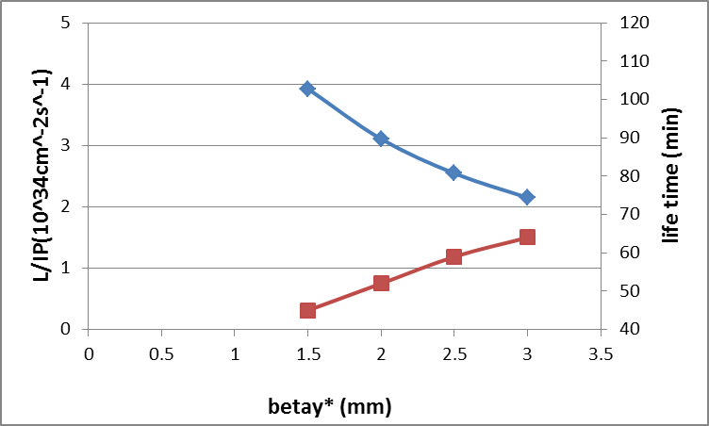
Higgs Luminosity vs. βy*
Keep emittance constant (1.56nm)
100km
luminosity
Life time

Slide 20
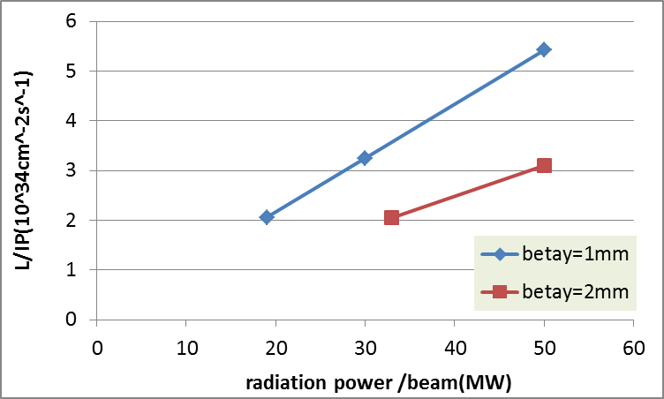
Higgs Luminosity vs. SR power
100km
goal

Slide 21
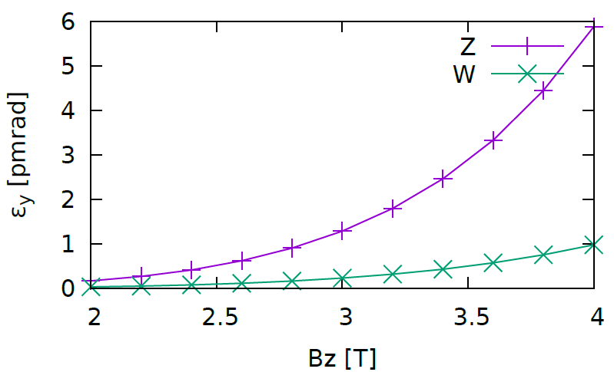
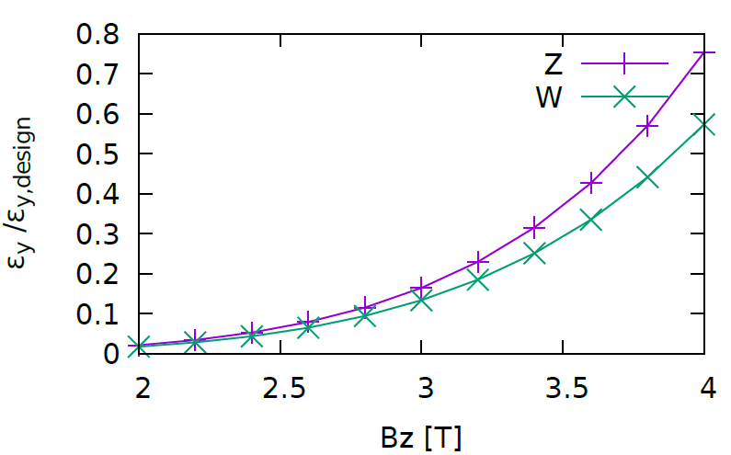
Vertical emittance induced by solenoid
Design emittance
Higgs: 1.31/0.004 nm
W: 0.57/0.0017 nm
Z: 1.48/0.0078 nm
Vertical emittance at Z pole is most dangerous with solenoid!
Detector
Detector

Slide 22
Z parameters with different coupling
 | Z-0.303% | Z-0.527% | Z-0.714% | Z-1%
Number of IPs | 2
Energy (GeV) | 45.5
Circumference (km) | 100
SR loss/turn (GeV) | 0.034
Half crossing angle (mrad) | 16.5
Piwinski angle | 4.29
N_{e}/bunch (10¹¹) | 0.346 | 0.455 | 0.532 | 0.63
Bunch number | 30870 | 21300 | 15580 | 11120
Beam current (mA) | 513.3 | 465.8 | 398.3 | 336.7
SR power /beam (MW) | 17.7 | 16.1 | 13.7 | 11.6
Bending radius (km) | 11
Momentum compaction (10⁻⁵) | 4.49
β_{IP} x/y (m) | 0.16/0.002 | 0.16/0.002 | 0.16/0.002 | 0.16/0.002
Emittance x/y (nm) | 1.48/0.0045 | 1.48/0.0078 | 1.48/0.0106 | 1.48/0.015
Transverse σ_{IP} (um) | 15.4/0.095 | 15.4/0.125 | 15.4/0.145 | 15.4/0.172
ξ_{x}/ξ_{y}/IP | 0.006/0.054 | 0.008/0.054 | 0.009/0.054 | 0.011/0.054
RF Phase (degree) | 165.2 | 165.3 | 165.4 | 165.6
V_{RF} (GV) | 0.13 | 0.14 | 0.14 | 0.14
f _{RF} (MHz) (harmonic) | 650 (217800)
Nature σ_{z} (mm) | 3.99 | 3.97 | 3.96 | 3.93
Total σ_{z} (mm) | 4.0
HOM power/cavity (kw) | 1.67(2cell) | 1.99(2cell) | 1.99(2cell) | 1.99
Energy spread (%) | 0.037
Energy acceptance by RF (%) | 1.1 | 1.1 | 1.1 | 1.1
n_{γ} | 0.09 | 0.12 | 0.14 | 0.17
F (hour glass) | 0.96 | 0.96 | 0.96 | 0.96
L_{max}/IP (10³⁴cm⁻²s⁻¹) | 13.1 | 11.9 | 10.2 | 8.62

Slide 23
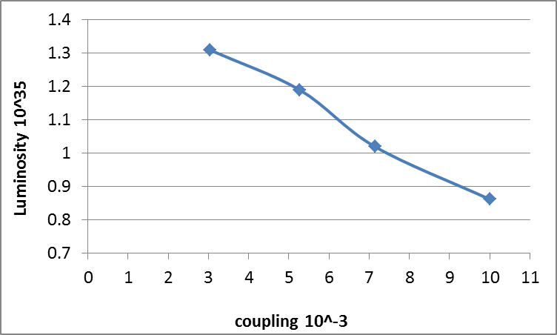
Z luminosity vs. coupling

Slide 24
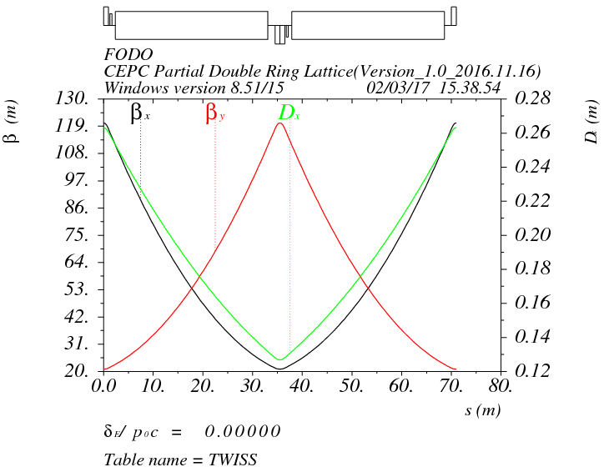
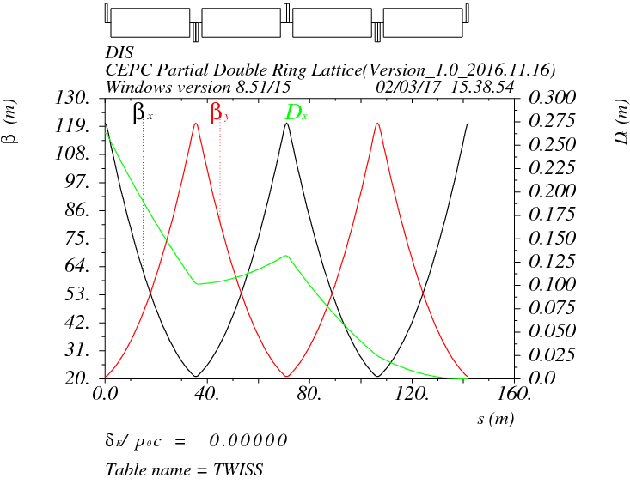
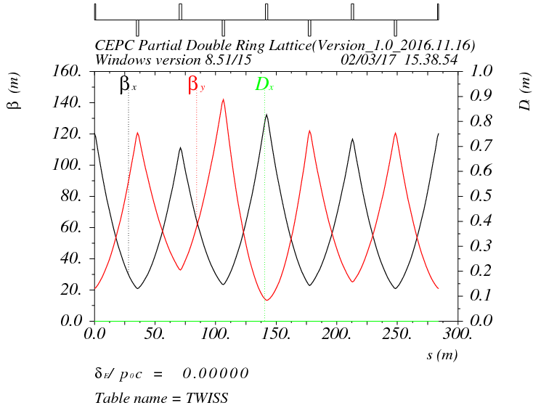
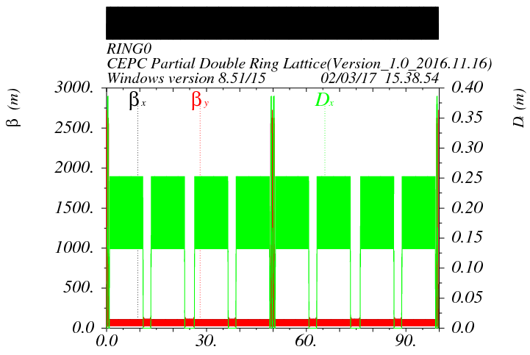
Arc design for 100km CEPC

Slide 25
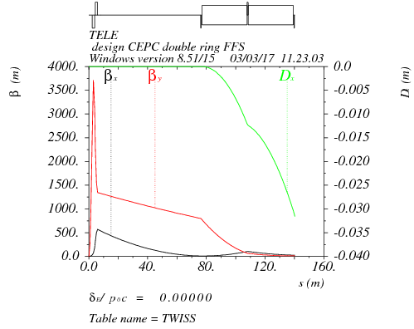
Final doublet + triplet
Betax=0.171m
Betay=0.002m
μx=0.75, μy=0.5
L*=2.2
L(QD0)=1.75m
L(QF1)=1.46m
k(QD0)=-150T/m
k(QF1)=106T/m
L₀=0.5m

Slide 26
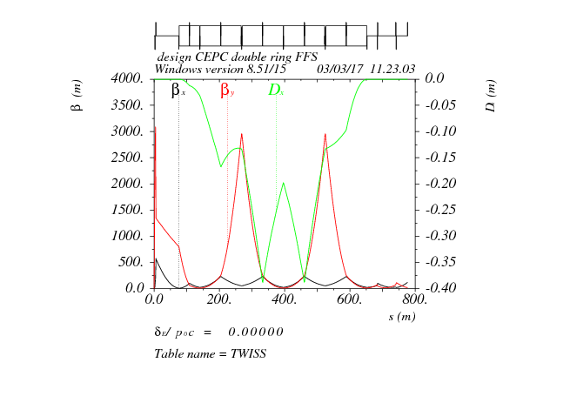
FFS optics
μx=1.5, μy=1.25
crab sextupole
μx=1.0, μy=0.75
Both FFS sextupoles of the CCS-Y section can work as the crab sextupoles.

Slide 27
Correction of the sextupole length effect
S1: main sextupole pair
S2: correcting sextupole pair ∼ −0.1*k₂(S1)
*A.Bogomyagkov, S.Glykhov, E.Levichev, P.Piminov

Slide 28
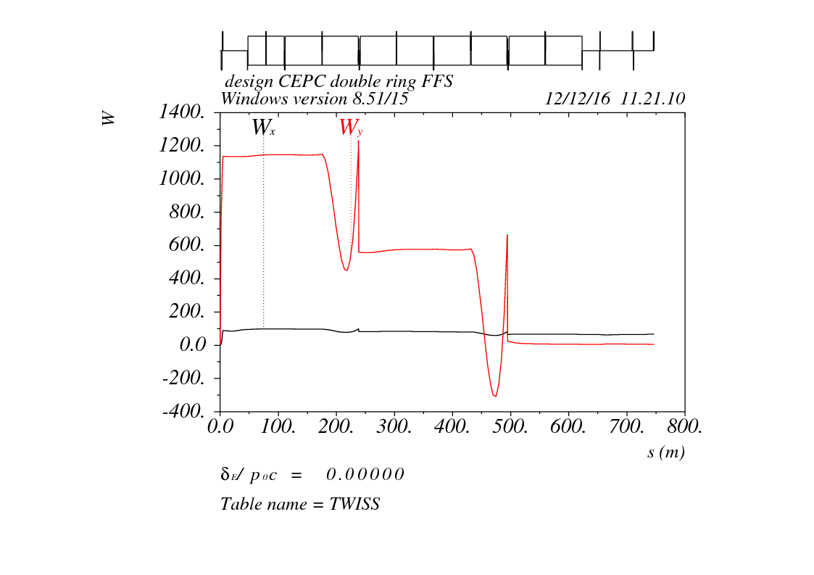
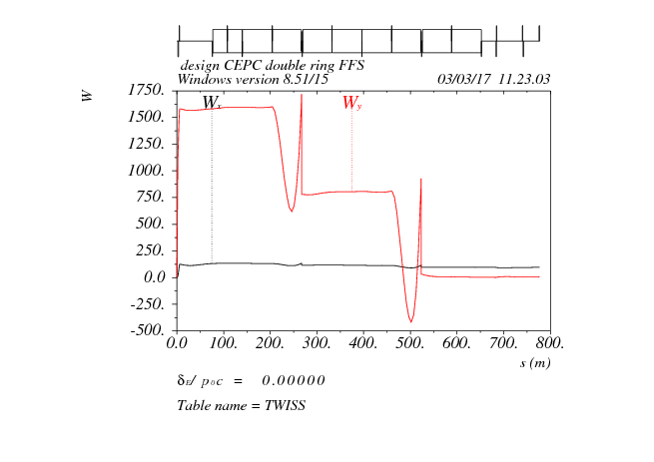
W function of FFS
98
98
98
98
98
184
98
28
98
-37
Critical energy Ec < 100 keV within 560m, Ec < 200 keV within 800m.
Horizontal chromaticity leak Wx=90

Slide 29
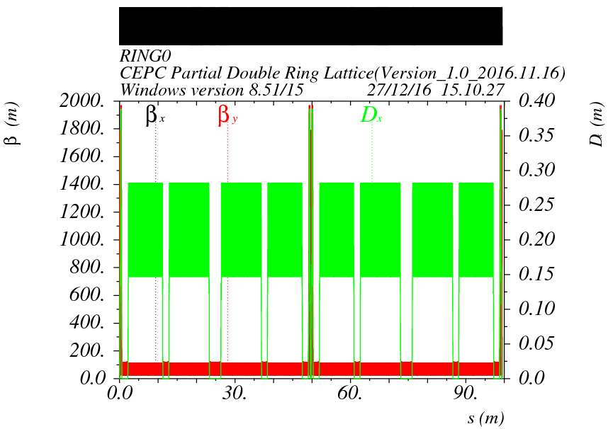
Arc + FFS
（L*=2.2m,Betax=0.171m,Betay=0.002m）

Slide 30
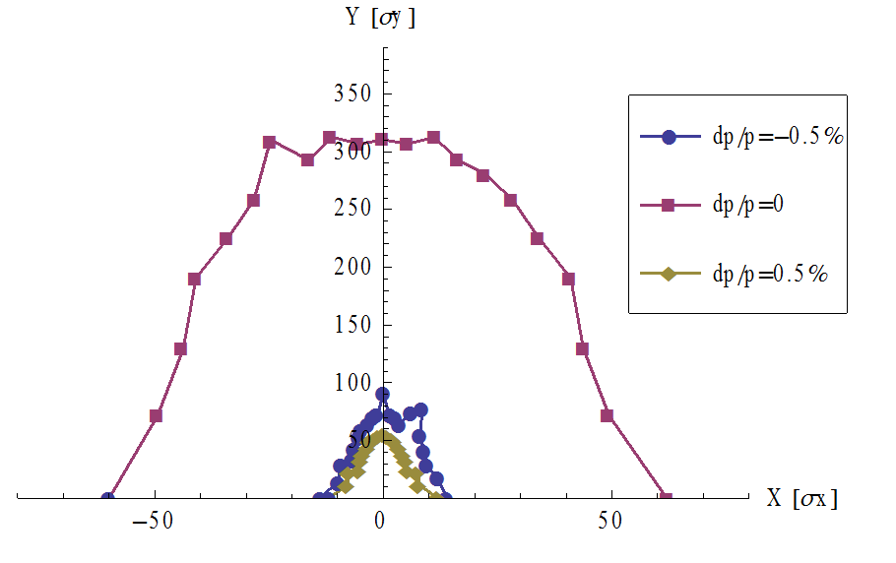
Arc + FFS (2 fam)
（L*=2.2m,Betax=0.171m,Betay=0.002m）
2 families sextupole in arc
No damping
Tracking 200 turns
Energy acceptance： 0.5%
DA: 60σ_{x}×310 σ_{y}

Slide 31
Arc + FFS (112 fam)
（L*=2.2m,Betax=0.171m,Betay=0.002m）
Without damping
With damping
Energy acceptance： 1.2%

Slide 32
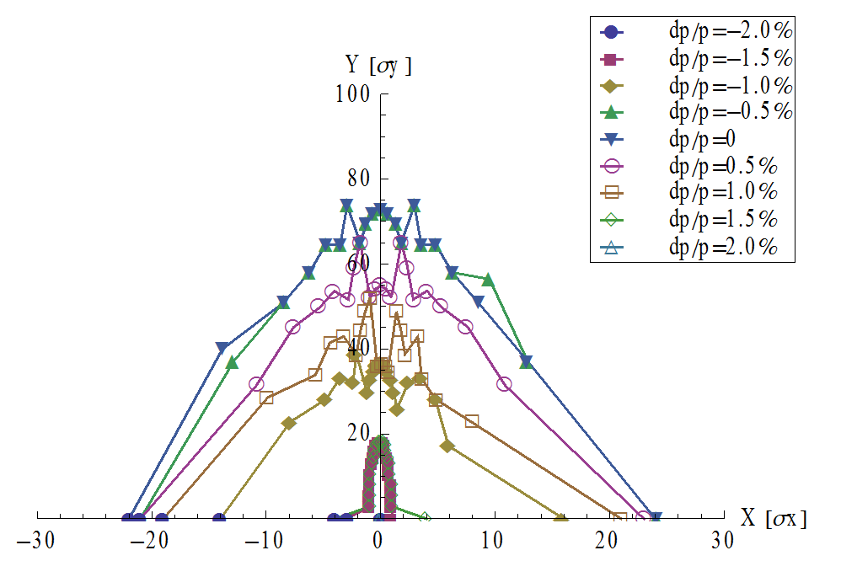
DA after optimization (Arc + FFS)
With damping, crab sextupoles: close
Tracking 200 turns
L*=1.5m
Betax=0.22m,Betay=0.002m
k(QD0)=-200T/m
L*=2.2m
Betax=0.171m,Betay=0.002m
k(QD0)=-150T/m
Energy acceptance： 1.5%
Energy acceptance： 1.2%

Slide 33
summary
A consistent calculation method for CEPC parameter choice with carb waist scheme has been created. Crosscheck luminosity with beam-beam simulations
Based on double ring scheme with 100 km circumference, we can get higher Higgs luminosity (+170%) keeping Pre-CDR beam power or to reduce the beam power (19 MW) keeping same luminosity. Luminosity for Z: ~10³⁵cm⁻²s⁻¹
Requirement for energy acceptance reduced to 1.5% enlarging the ring.
New IP parameters made the FFS design and DA more difficult.
have got 1.5% energy acceptance without crab sextupoles. Further studies of DA with new L* are going on.

Slide 34
Thanks！

Slide 35
Back up

Slide 36
parameter for CEPC partial double ring
（wangdou20160325-54km）
 | Pre-CDR | H-high lumi. | H-low power | W | Z
Number of IPs | 2 | 2 | 2 | 2 | 2
Energy (GeV) | 120 | 120 | 120 | 80 | 45.5
Circumference (km) | 54 | 54 | 54 | 54 | 54
SR loss/turn (GeV) | 3.1 | 2.96 | 2.96 | 0.59 | 0.062
Half crossing angle (mrad) | 0 | 15 | 15 | 15 | 15
Piwinski angle | 0 | 2.5 | 2.6 | 5 | 8.5/7.6
N_{e}/bunch (10¹¹) | 3.79 | 2.85 | 2.67 | 0.74 | 0.46
Bunch number | 50 | 67 | 44 | 400 | 1100
Beam current (mA) | 16.6 | 16.9 | 10.5 | 26.2 | 45.4
SR power /beam (MW) | 51.7 | 50 | 31.2 | 15.6 | 2.8
Bending radius (km) | 6.1 | 6.2 | 6.2 | 6.1 | 6.1
Momentum compaction (10⁻⁵) | 3.4 | 2.5 | 2.2 | 2.4 | 3.5
β_{IP} x/y (m) | 0.8/0.0012 | 0.25/0.00136 | 0.268 /0.00124 | 0.1/0.001 | 0.1/0.001
Emittance x/y (nm) | 6.12/0.018 | 2.45/0.0074 | 2.06 /0.0062 | 1.02/0.003 | 0.62/0.0028
Transverse σ_{IP} (um) | 69.97/0.15 | 24.8/0.1 | 23.5/0.088 | 10.1/0.056 | 7.9/0.053
ξ_{x}/IP | 0.118 | 0.03 | 0.032 | 0.008 | 0.005/0.006
ξ_{y}/IP | 0.083 | 0.11 | 0.11 | 0.074 | 0.084/0.073
V_{RF} (GV) | 6.87 | 3.62 | 3.53 | 0.81 | 0.12
f _{RF} (MHz) | 650 | 650 | 650 | 650 | 650
Nature σ_{z} (mm) | 2.14 | 3.1 | 3.0 | 3.25 | 3.9
Total σ_{z} (mm) | 2.65 | 4.1 | 4.0 | 3.35 | 4.0
HOM power/cavity (kw) | 3.6 | 2.2 | 1.3 | 0.99 | 0.99
Energy spread (%) | 0.13 | 0.13 | 0.13 | 0.09 | 0.05
Energy acceptance (%) | 2 | 2 | 2
Energy acceptance by RF (%) | 6 | 2.2 | 2.1 | 1.7 | 1.1
n_{γ} | 0.23 | 0.47 | 0.47 | 0.3 | 0.27/0.24
Life time due to beamstrahlung_cal (minute) | 47 | 36 | 32
F (hour glass) | 0.68 | 0.82 | 0.81 | 0.92 | 0.95
L_{max}/IP (10³⁴cm⁻²s⁻¹) | 2.04 | 2.96 | 2.01 | 3.09 | 3.61/3.09

Slide 37
parameter for CEPC partial double ring
（wangdou20161109-61km）
 | Pre-CDR | H-high lumi. | H-low power | W | Z | Z-5cell
Number of IPs | 2 | 2 | 2 | 2 | 2 | 2
Energy (GeV) | 120 | 120 | 120 | 80 | 45.5 | 45.5
Circumference (km) | 54 | 61 | 61 | 61 | 61 | 61
SR loss/turn (GeV) | 3.1 | 2.96 | 2.96 | 0.58 | 0.061 | 0.061
Half crossing angle (mrad) | 0 | 15 | 15 | 15 | 15 | 15
Piwinski angle | 0 | 1.88 | 1.84 | 4.11 | 5.86 | 5.87
N_{e}/bunch (10¹¹) | 3.79 | 2.0 | 1.98 | 0.85 | 0.6 | 0.6
Bunch number | 50 | 107 | 70 | 400 | 1100 | 700
Beam current (mA) | 16.6 | 16.9 | 11.0 | 26.8 | 52.0 | 33.1
SR power /beam (MW) | 51.7 | 50 | 32.5 | 15.7 | 3.2 | 2.0
Bending radius (km) | 6.1 | 6.2 | 6.2 | 6.2 | 6.2 | 6.2
Momentum compaction (10⁻⁵) | 3.4 | 1.48 | 1.48 | 1.48 | 3.1 | 3.1
β_{IP} x/y (m) | 0.8/0.0012 | 0.272/0.0013 | 0.275 /0.0013 | 0.16/0.001 | 0.12/0.001 | 0.12/0.001
Emittance x/y (nm) | 6.12/0.018 | 2.05/0.0062 | 2.05 /0.0062 | 0.93/0.003 | 0.87/0.0046 | 0.87/0.0046
Transverse σ_{IP} (um) | 69.97/0.15 | 23.7/0.09 | 23.7/0.09 | 12.2/0.056 | 10.2/0.068 | 10.2/0.068
ξ_{x}/IP | 0.118 | 0.041 | 0.042 | 0.0145 | 0.0098 | 0.0098
ξ_{y}/IP | 0.083 | 0.11 | 0.11 | 0.084 | 0.073 | 0.073
V_{RF} (GV) | 6.87 | 3.48 | 3.51 | 0.7 | 0.12 | 0.12
f _{RF} (MHz) | 650 | 650 | 650 | 650 | 650 | 650
Nature σ_{z} (mm) | 2.14 | 2.7 | 2.7 | 3.23 | 3.9 | 3.9
Total σ_{z} (mm) | 2.65 | 2.95 | 2.9 | 3.35 | 4.0 | 4.0
HOM power/cavity (kw) | 3.6 | 0.74 | 0.48 | 0.47 | 0.59 | 0.93
Energy spread (%) | 0.13 | 0.13 | 0.13 | 0.087 | 0.05 | 0.05
Energy acceptance (%) | 2 | 2 | 2
Energy acceptance by RF (%) | 6 | 2.3 | 2.4 | 1.3 | 1.1 | 1.1
n_{γ} | 0.23 | 0.35 | 0.34 | 0.28 | 0.24 | 0.24
Life time due to beamstrahlung_cal (minute) | 47 | 37 | 37
F (hour glass) | 0.68 | 0.82 | 0.82 | 0.89 | 0.92 | 0.92
L_{max}/IP (10³⁴cm⁻²s⁻¹) | 2.04 | 3.1 | 2.01 | 3.5 | 3.44 | 2.2

Slide 38
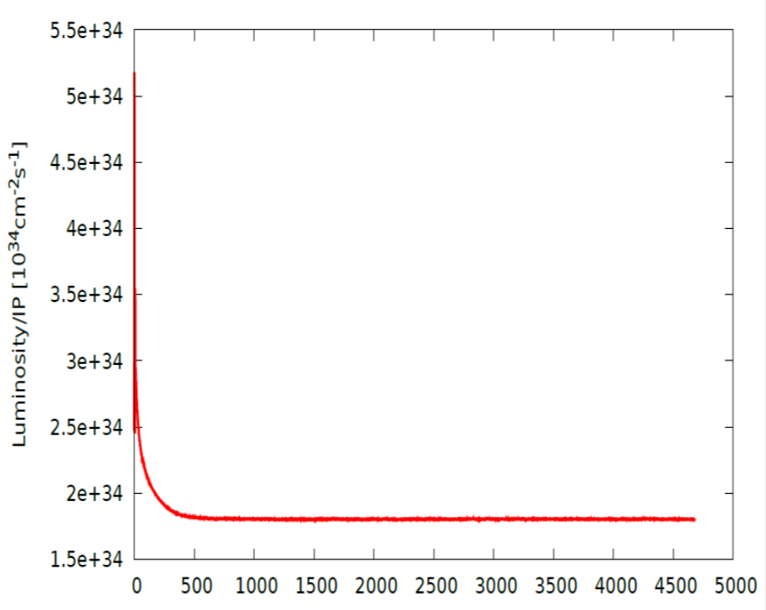
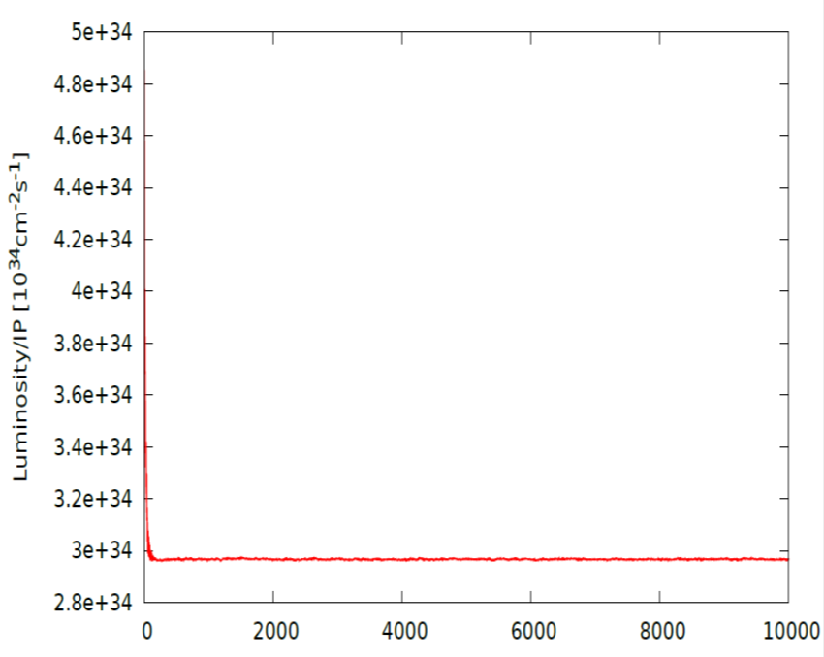
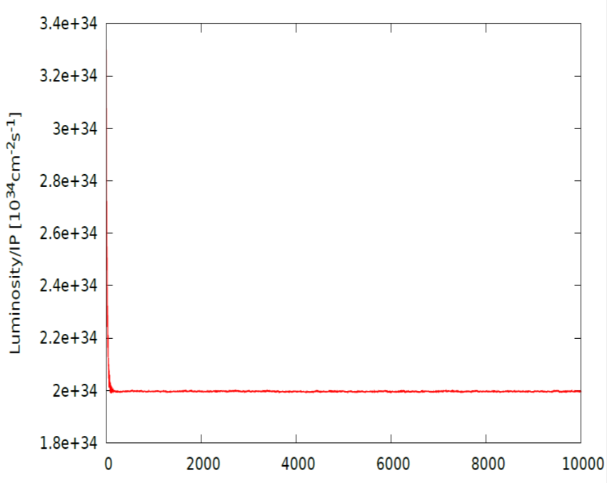
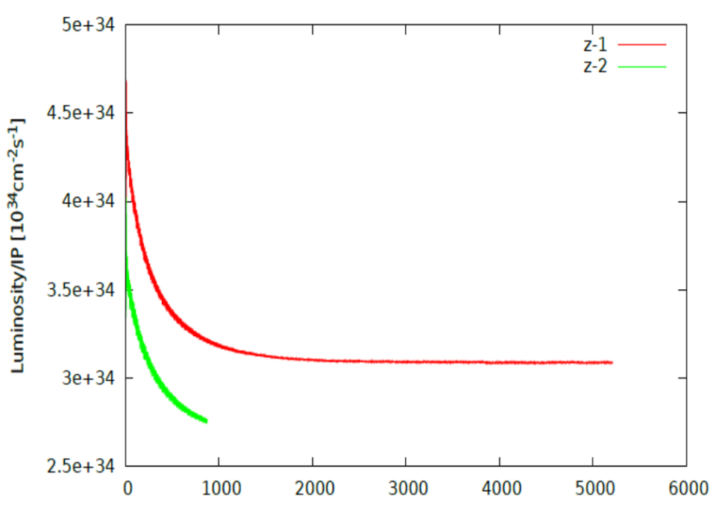



Beam-beam simulation-54km
IBB: Strong-Strong Beam-Beam Code with Beamstrahlung effect
Developed by Y. Zhang@IHEP
Case: Pre-CDR
Case: H-high lum
Lifetime: 108 min(16$σ_{p}$)
Lifetime: 118 min(16$σ_{p}$)
Case: H-low power
Case Z
Lifetime: 97 min(16$σ_{p}$)

Slide 39
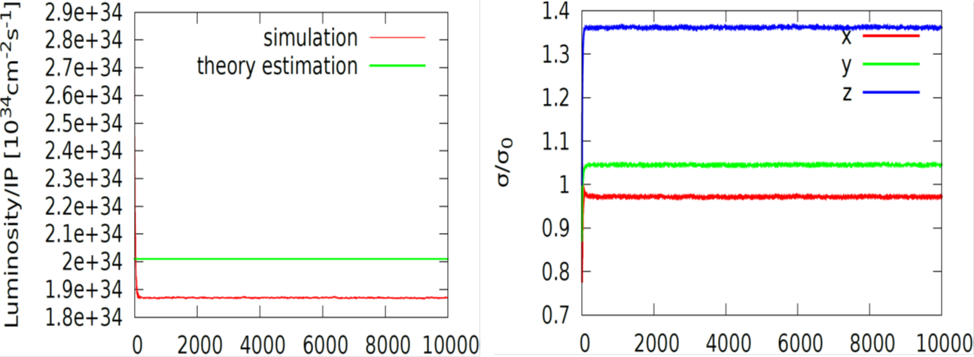
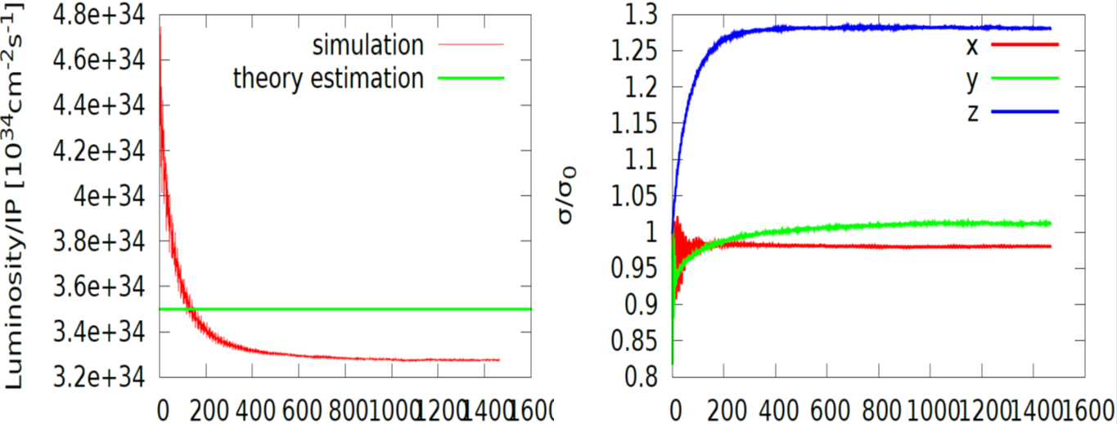
Beam-beam simulation-61km
IBB: Strong-Strong Beam-Beam Code with Beamstrahlung effect
Developed by Y. Zhang@IHEP
Case: H-low power
Lifetime: 260 min
Case: w

