Slide 1
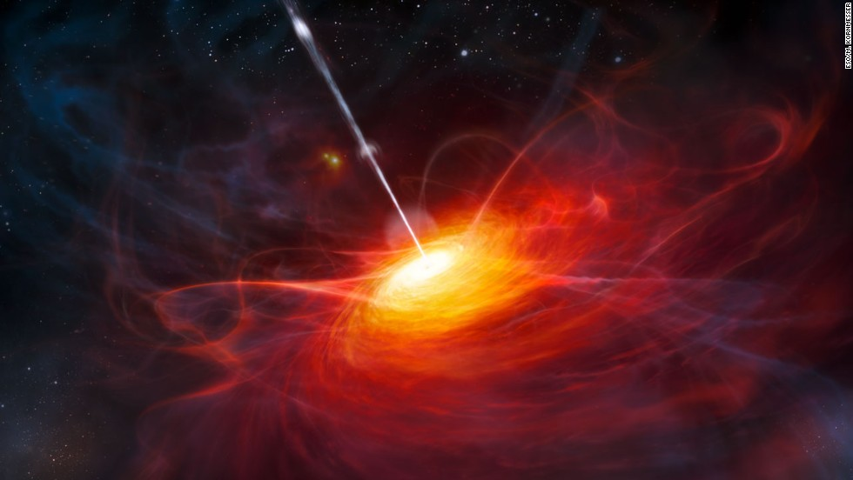
Black Hole Candles for Expansion History of High-z Universe
Jian-Min Wang
Institute of High Energy Physics
2017/03/28

Slide 2
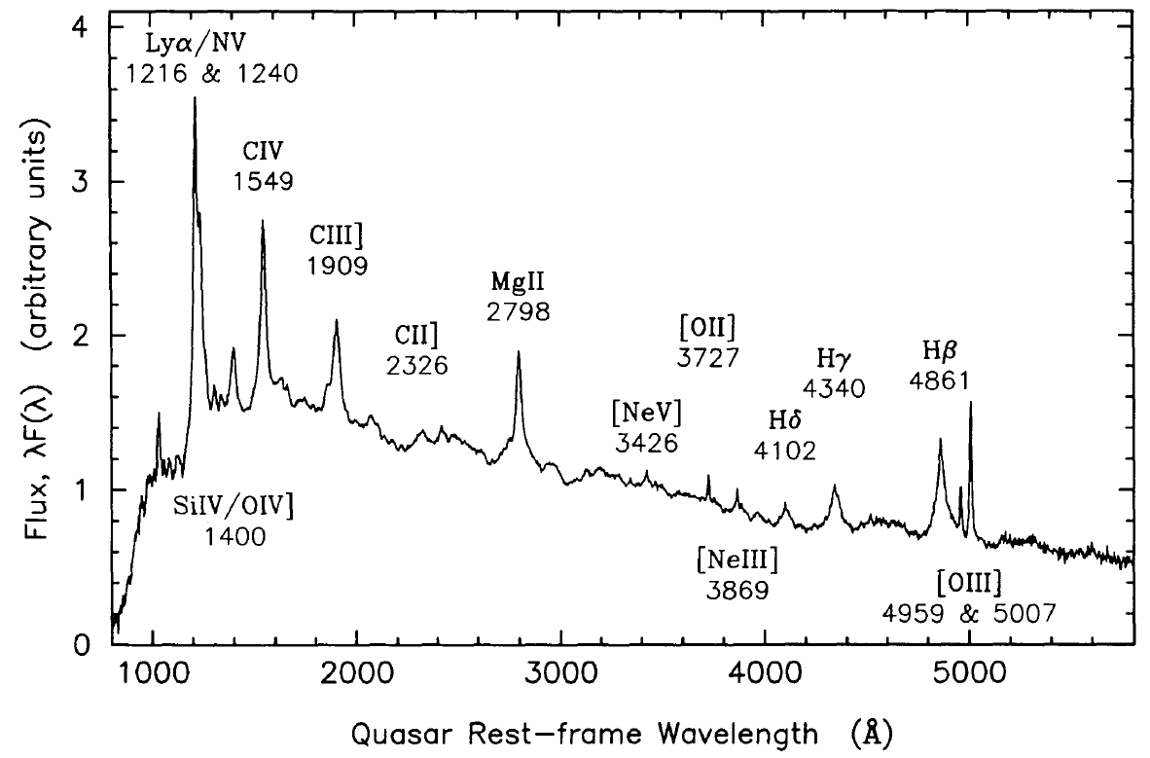

Slide 3
Quasar Cosmology
Methodology: Observables – Luminosity Relation
Baldwin effects: EW(CIV)-L_{UV}
R-L relation (Watson et al. 2012)
Super-Eddington BHs (Wang et al. 2013)
L=L_{Edd} (Marziani & Sulentic 2014)
σ – L_{X} relation (La Franca et al. 2014)
α_{OX}-L_{X} relation (Risaliti & Lusso 2015)

Slide 4
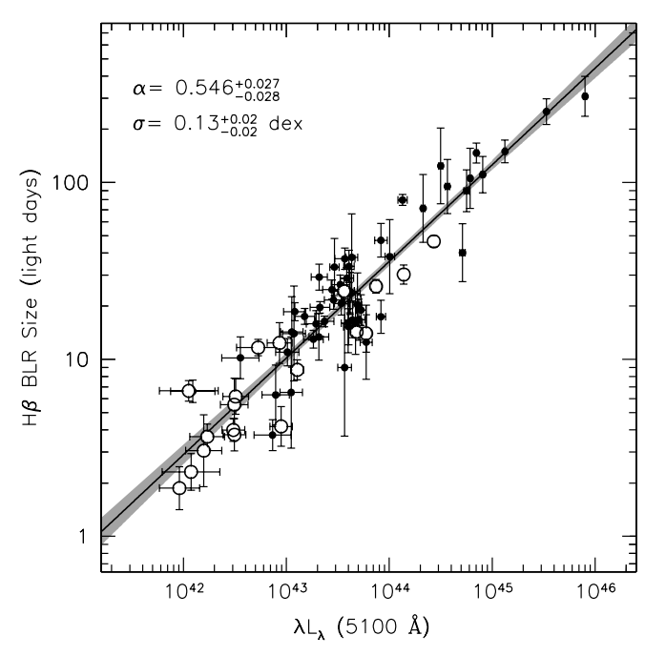
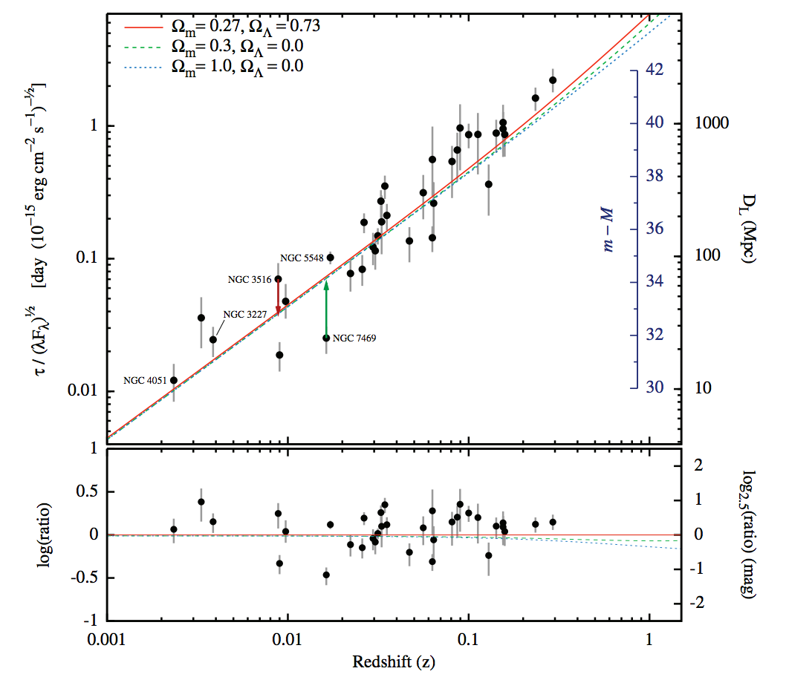
R-L Relation
(Kaspi et al. 2000; Bentz et al. 2013)
Watson et al. (2012)
Diffcultties: 1) (1+z); 2) small amplitude of variations

Slide 5
Ongoing Project: SEAMBH
New results
Future 5-year Plan

Slide 6
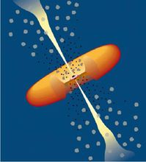
Urry & Padovani (1995)
Should be revised
what?
how?

Slide 7
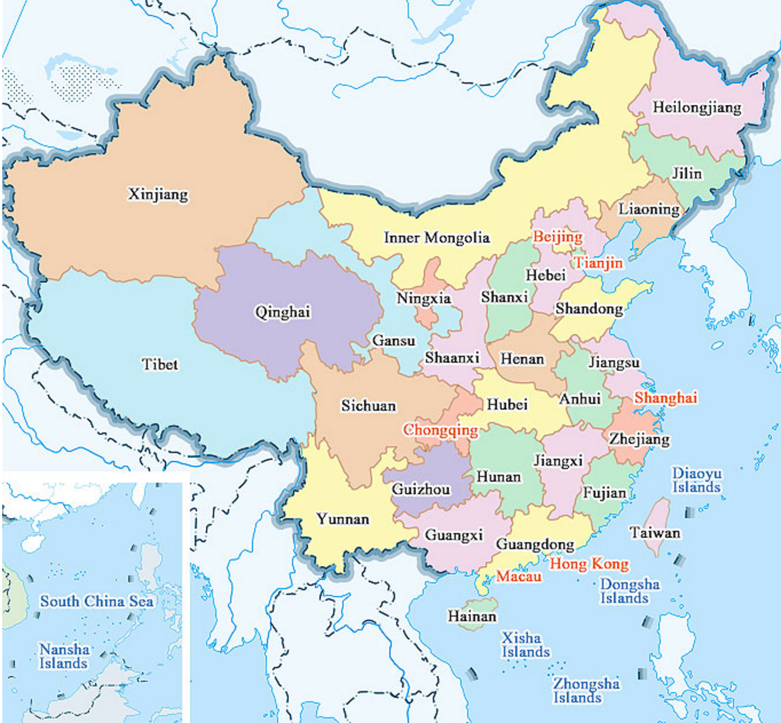
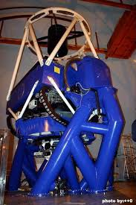
The Lijiang 2.4m telescope: YFOSC since 2012
Yunnan Observatories, CAS
Myanmar

Slide 8
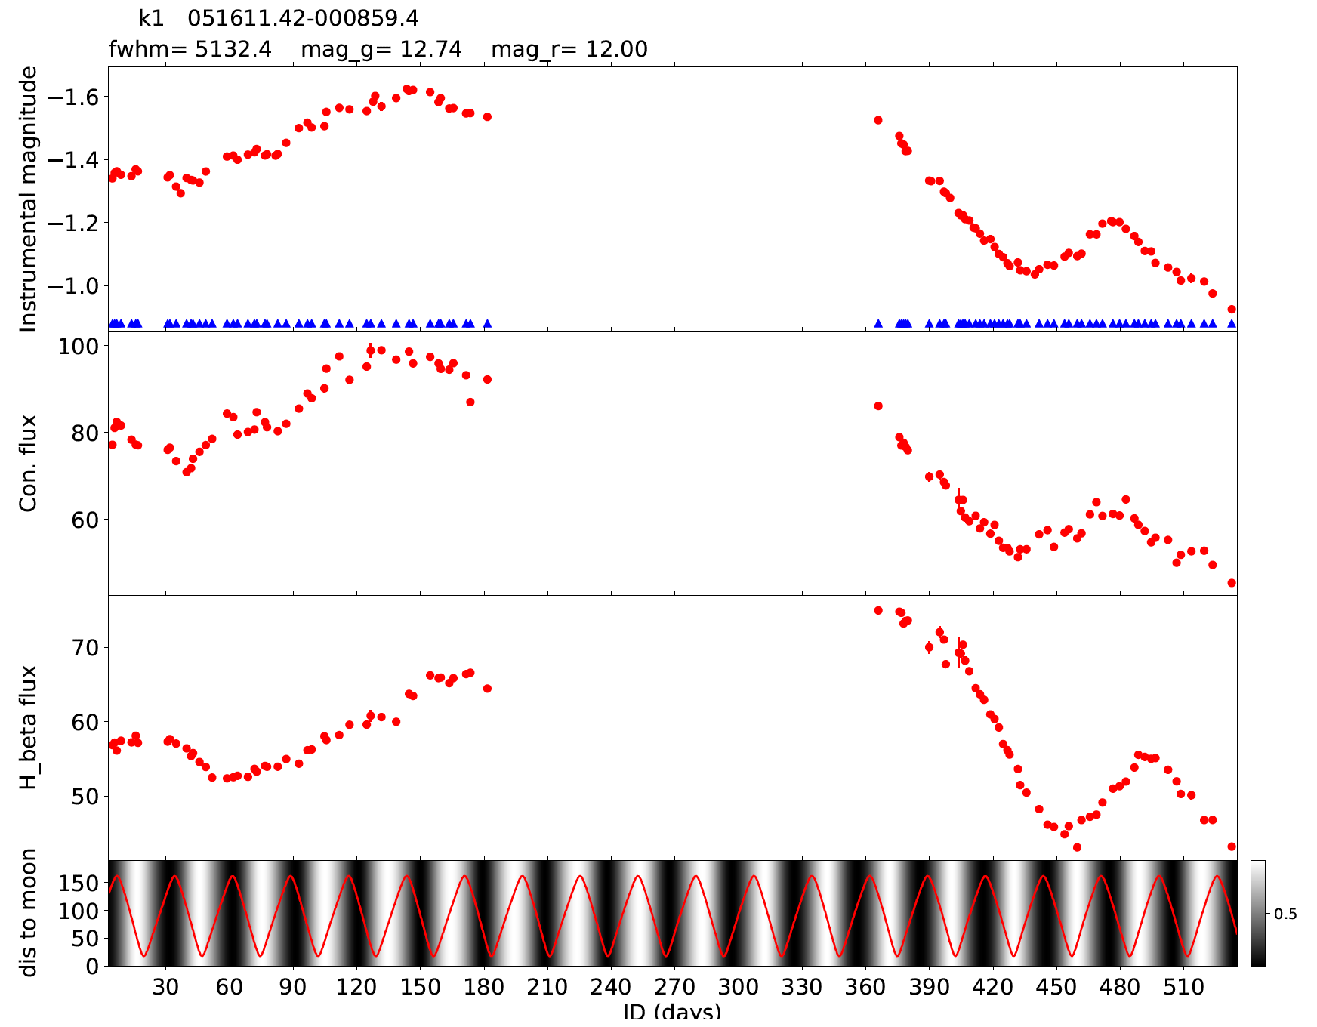
Reverberation mapping: BH mass

Slide 9
Purposes of RM-Project
AGN physics: BLR
Origin? Structure? Radiation?
Accretion physics: anisotropic radiation
Super-Eddington accretion (2012)?
BH fundamental parameters: mass and spin
Virial mass? RM-mass?
SMBH formation: ultrafast growth
Black hole candles
Saturated luminosity? Scatters?
Coevolution of BH and host
For cosmology

Slide 10
Developing project
Phase I (2012-2016): NSFC + CAS
Lijiang 2.4m telescope: SEAMBHs
IHEP + YNAO + Tel Aviv + PKU
APO 3.5m telescope campaign: not successful
Phase II (2016- 2020): BHOLE + CAS + NSFC
Lijiang 2.4m + CAHA 2.2m + WIRO2.3m: various AGNs
Phase III (2019-2023?): BHOLE + CAS + NSFC
4m-class telescope: high-z quasars (Mg II, C IV)
mini-AGNs for fast growth of SMBHs

Slide 11
Current Sciences

Slide 12
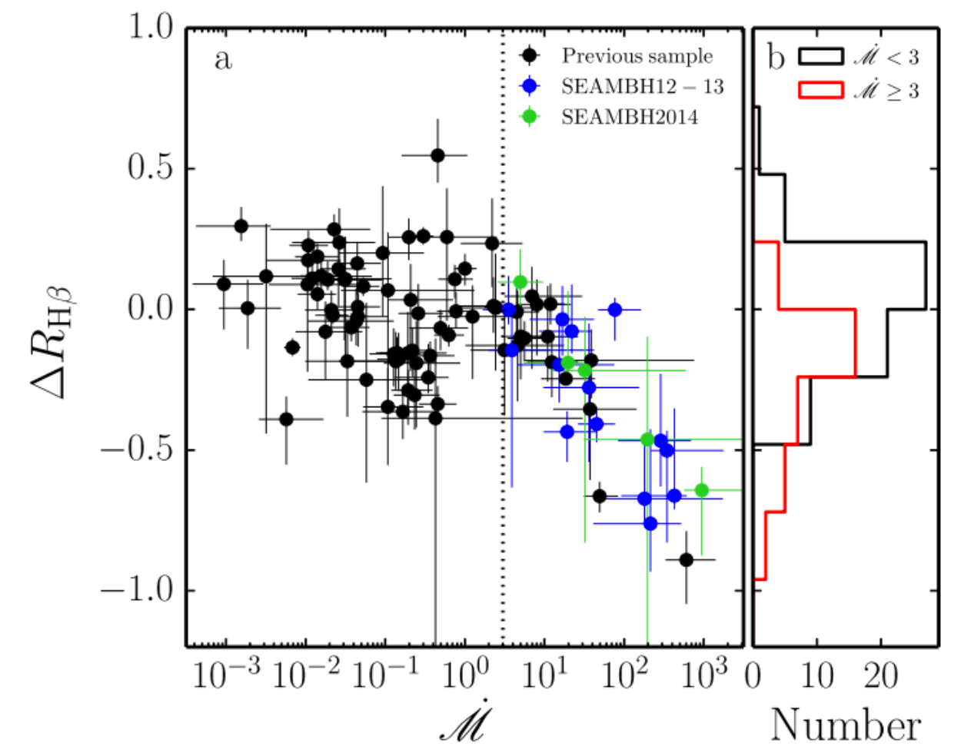
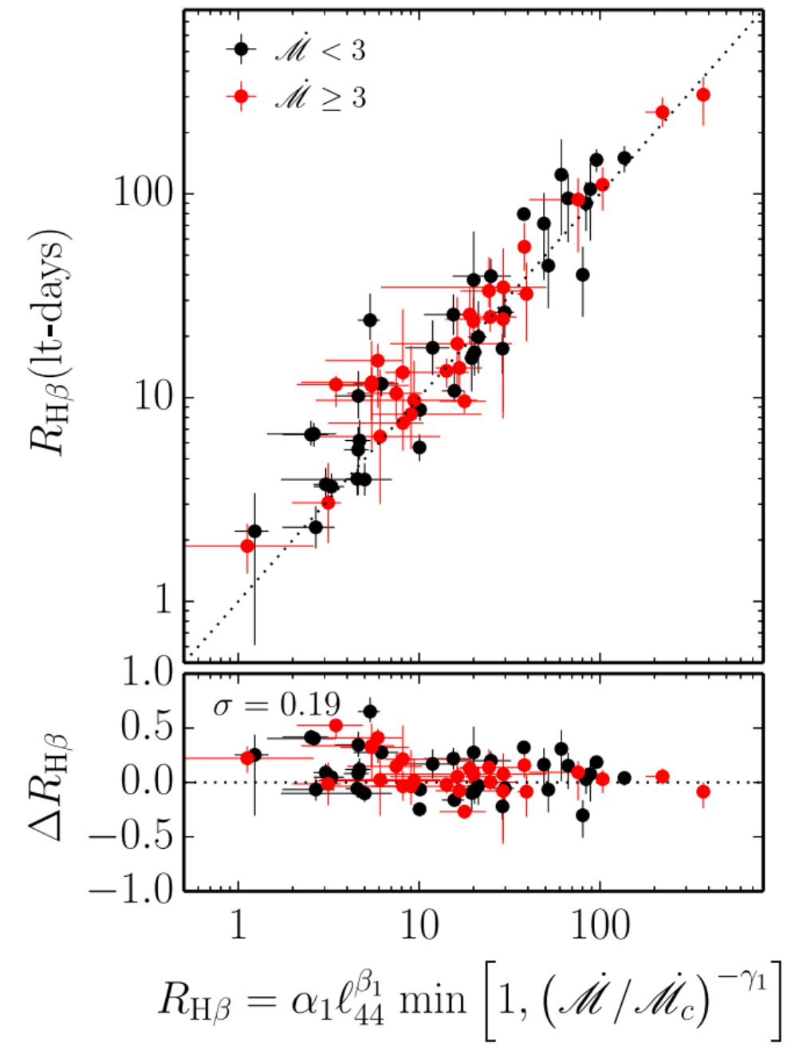
New scaling relation: two-parameters
A new scaling relation is obtained
(Du et al. 2016a,b)

Slide 13
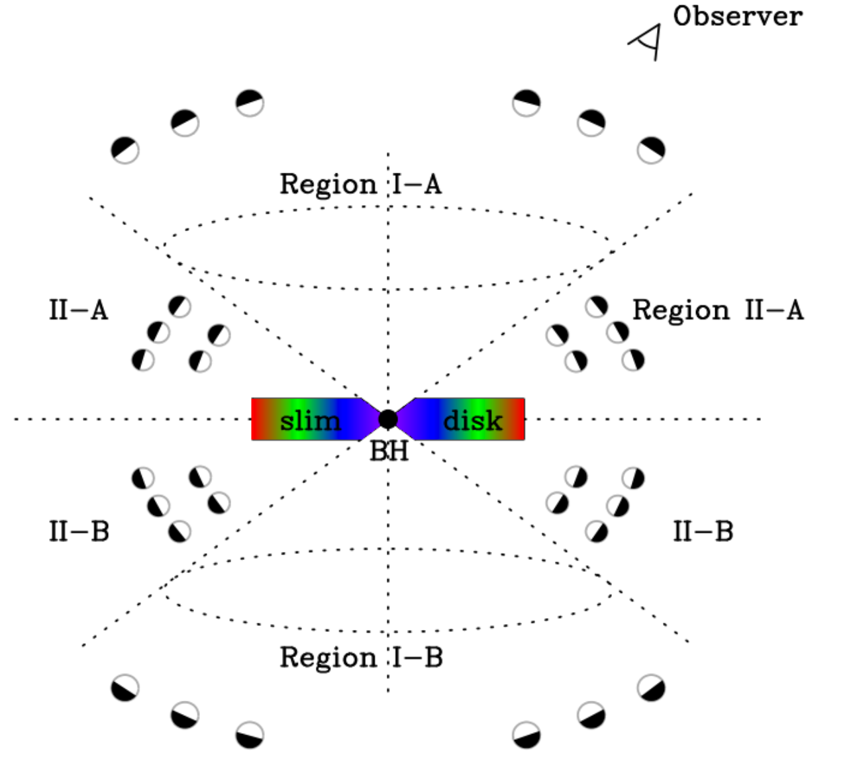
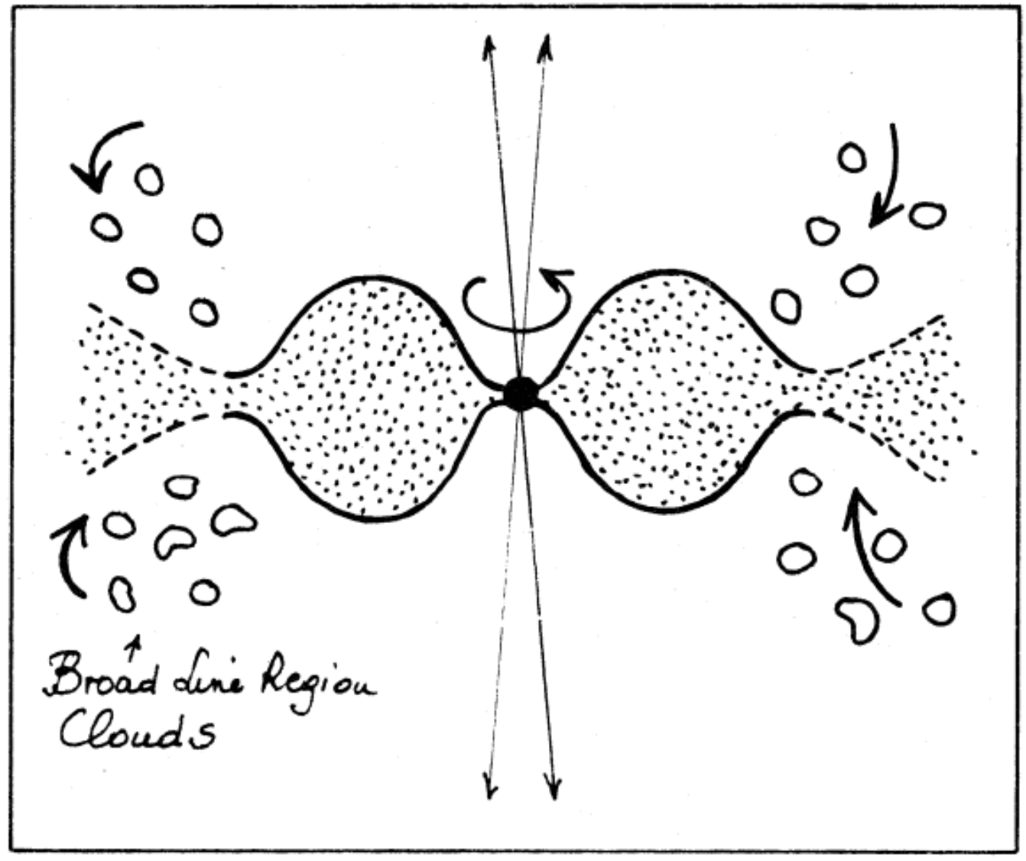
High- disks: self-shadowing effects
Alloin (1990)
(Wang et al. 2014)
Shadowed BLR: shrinks and shorter lags
longer lags? (longer campaign to monitor)
Consequence: weak line quasars

Slide 14
Observed Hβ lags: physical meanings? BLR: structure? R-L relation? BH Virial-mass: accuracy? Many things are to be answered

Slide 15
Accretion physics?

Slide 16
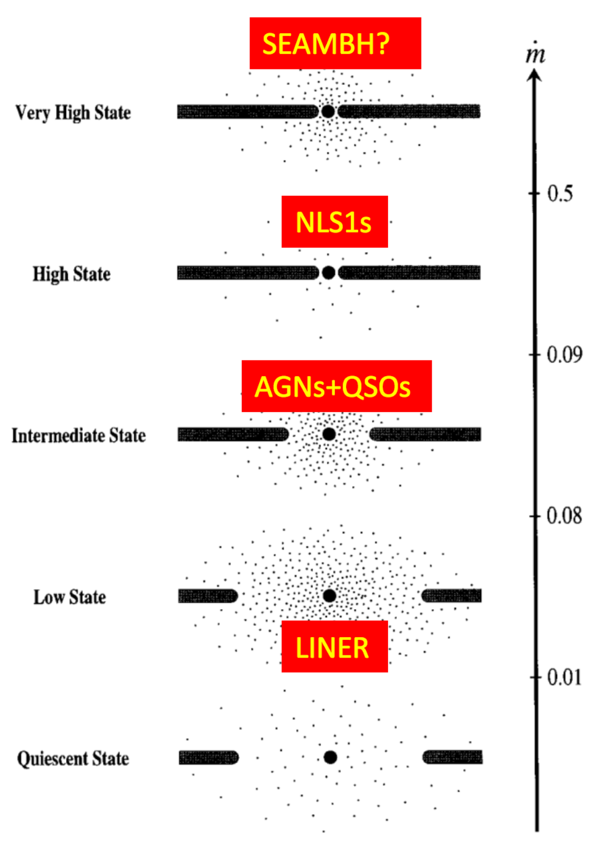
Accretion Physics
Low accretion disks
(ADAF; ADIOs)
Shakura-Sunyaev disks
(intermediate rates)

Slide 17
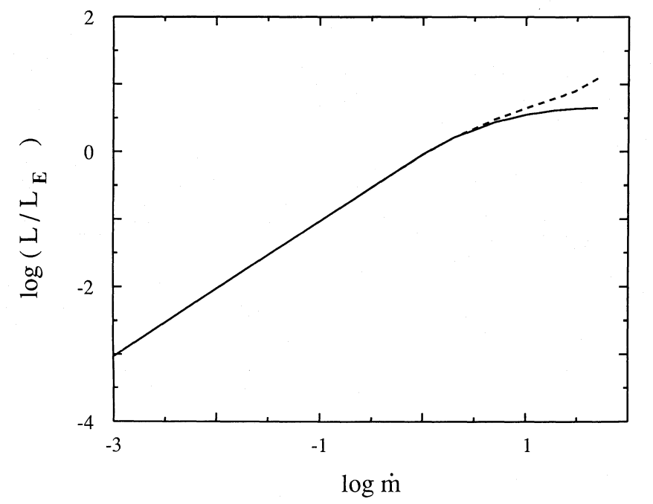
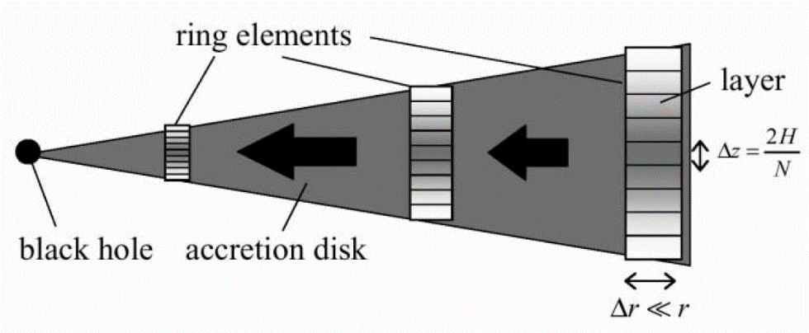
Transonic flow
Sub-Keplerian rotation
Photon trapping effects
Wang & Zhou (1999): self-similar solution
Mineshige+(2000)
Sadowski et al. (2013)

Slide 18
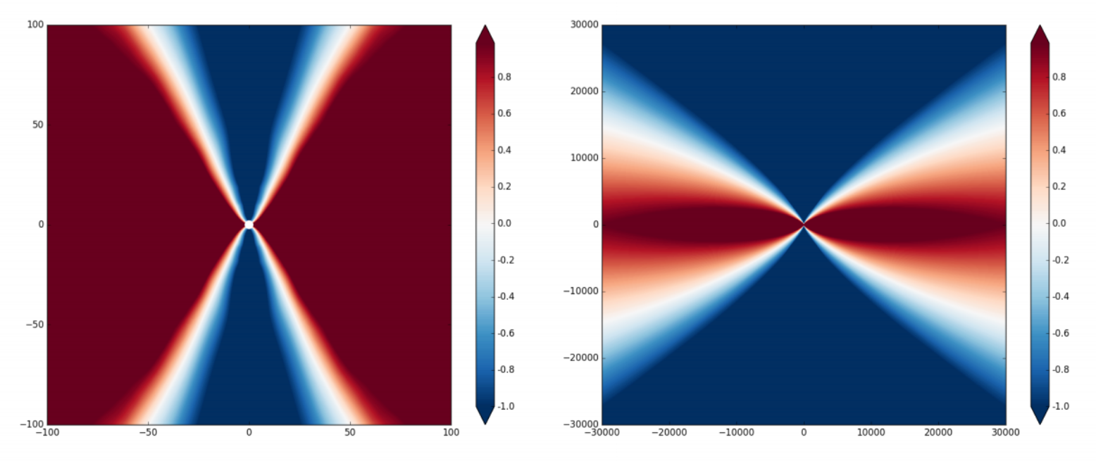
Narayan, Sadowski & Sori (2017)

Slide 19
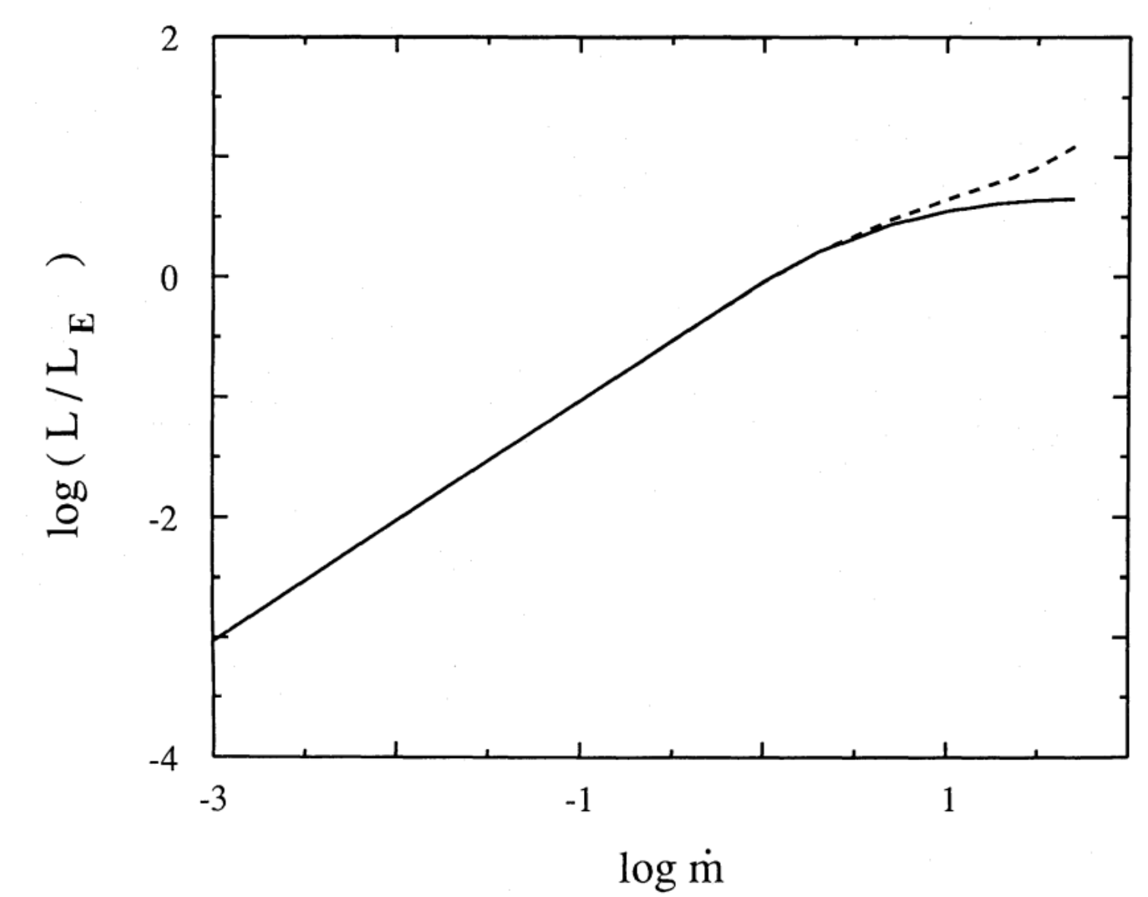
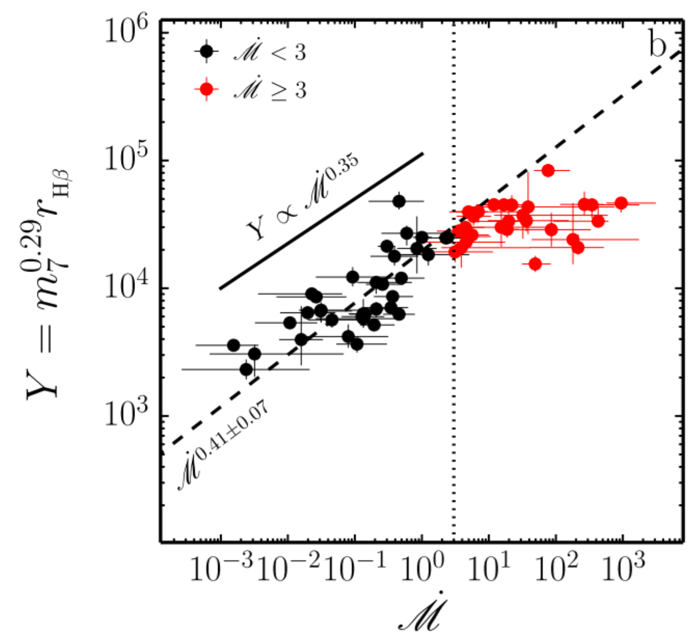
Evidence for saturated luminosity
Slim accretion disks
(Abramowicz et al. 1988)
SEAMBH collaboration
(Du et al. 2016a)
Dissipated lum.
Radiated lum.
Photon trapping effects: (theory)
Saturated luminosity --> cosmological candles (Obs.)

Slide 20
SMBH formation: ultrafast growth

Slide 21
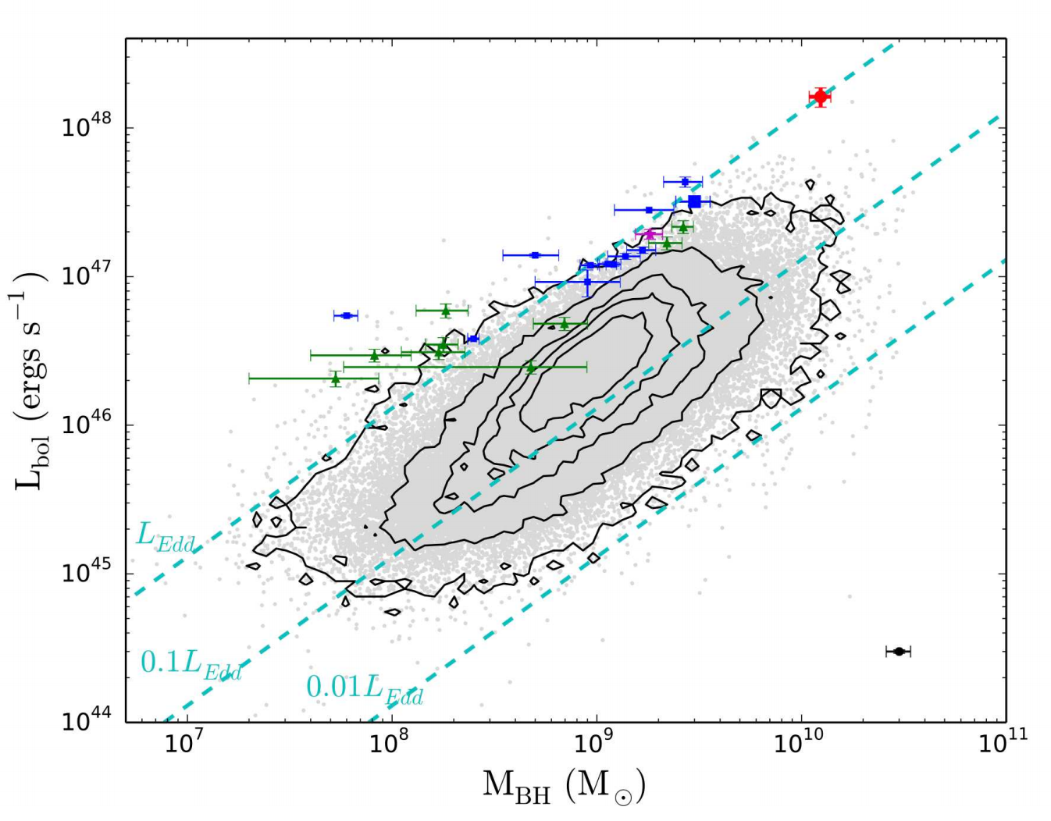

Slide 22
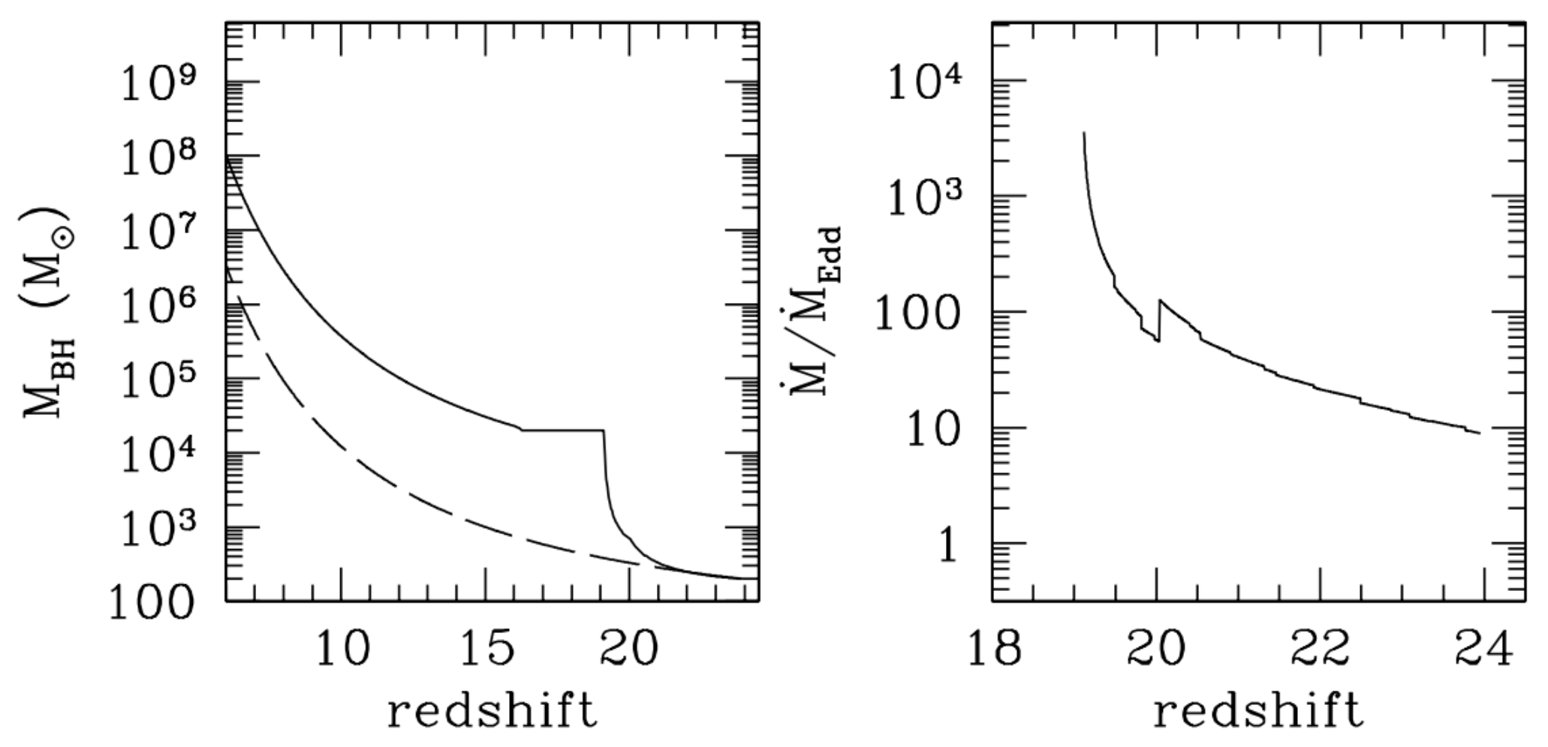
Ultrafast growth of BHs (Volonteri & Rees 2005)

Slide 23
SEAMBHs exist
Accretion rates: ~ 10³Eddington rate
In local, we are witnessing:
10³→10¹⁰M
fast growth of seed BH in high-z Universe.

Slide 24
Evidence for saturated luminosity
Slim accretion disks
(Abramowicz et al. 1988)
SEAMBH collaboration
(Du et al. 2016a)
Dissipated lum.
Radiated lum.
Photon trapping effects: (theory)
Saturated luminosity --> cosmological candles (Obs.)

Slide 25
Main Goal: Intrinsic scatters of the candles

Slide 26
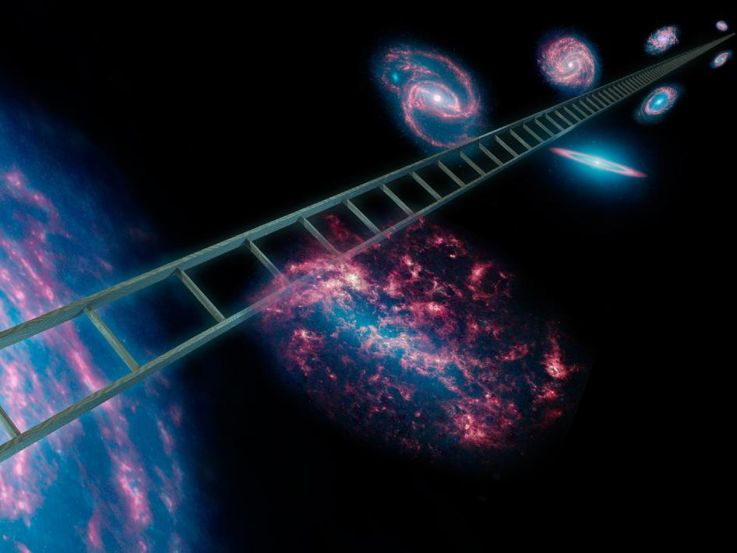
SEAMBHs for Cosmology?
Notes:
Why do we hope to monitor such a kind of objects. We have two motivations. The first one is AGN physics, and the second one is cosmology.

Slide 27
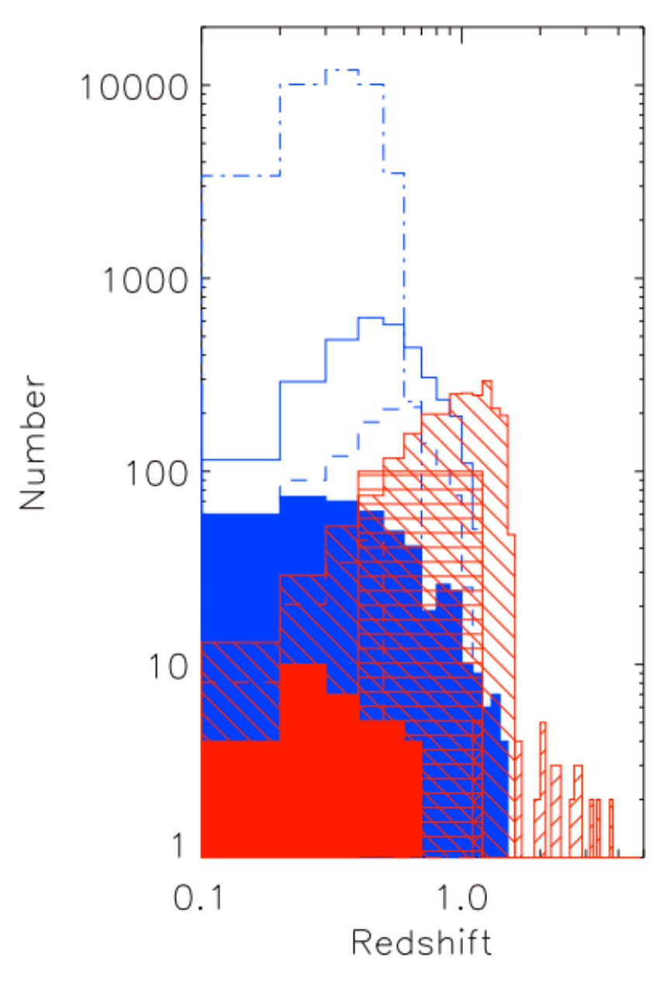
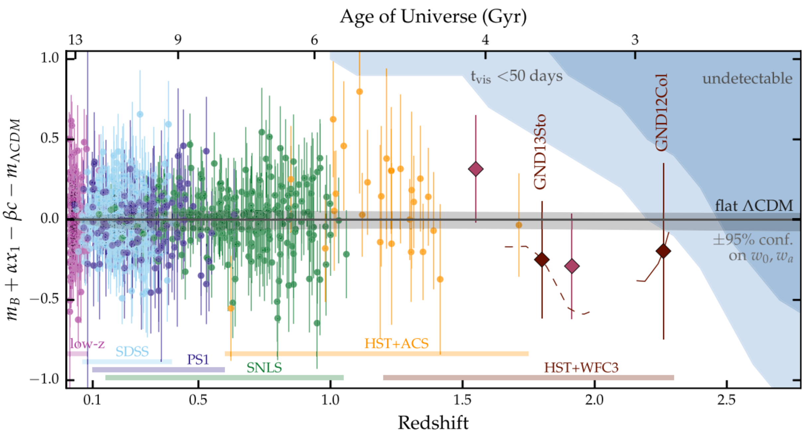
SNIa for cosmology: z<1.5
Hook (2013)
Rodney, Riess et al. (2015)

Slide 28
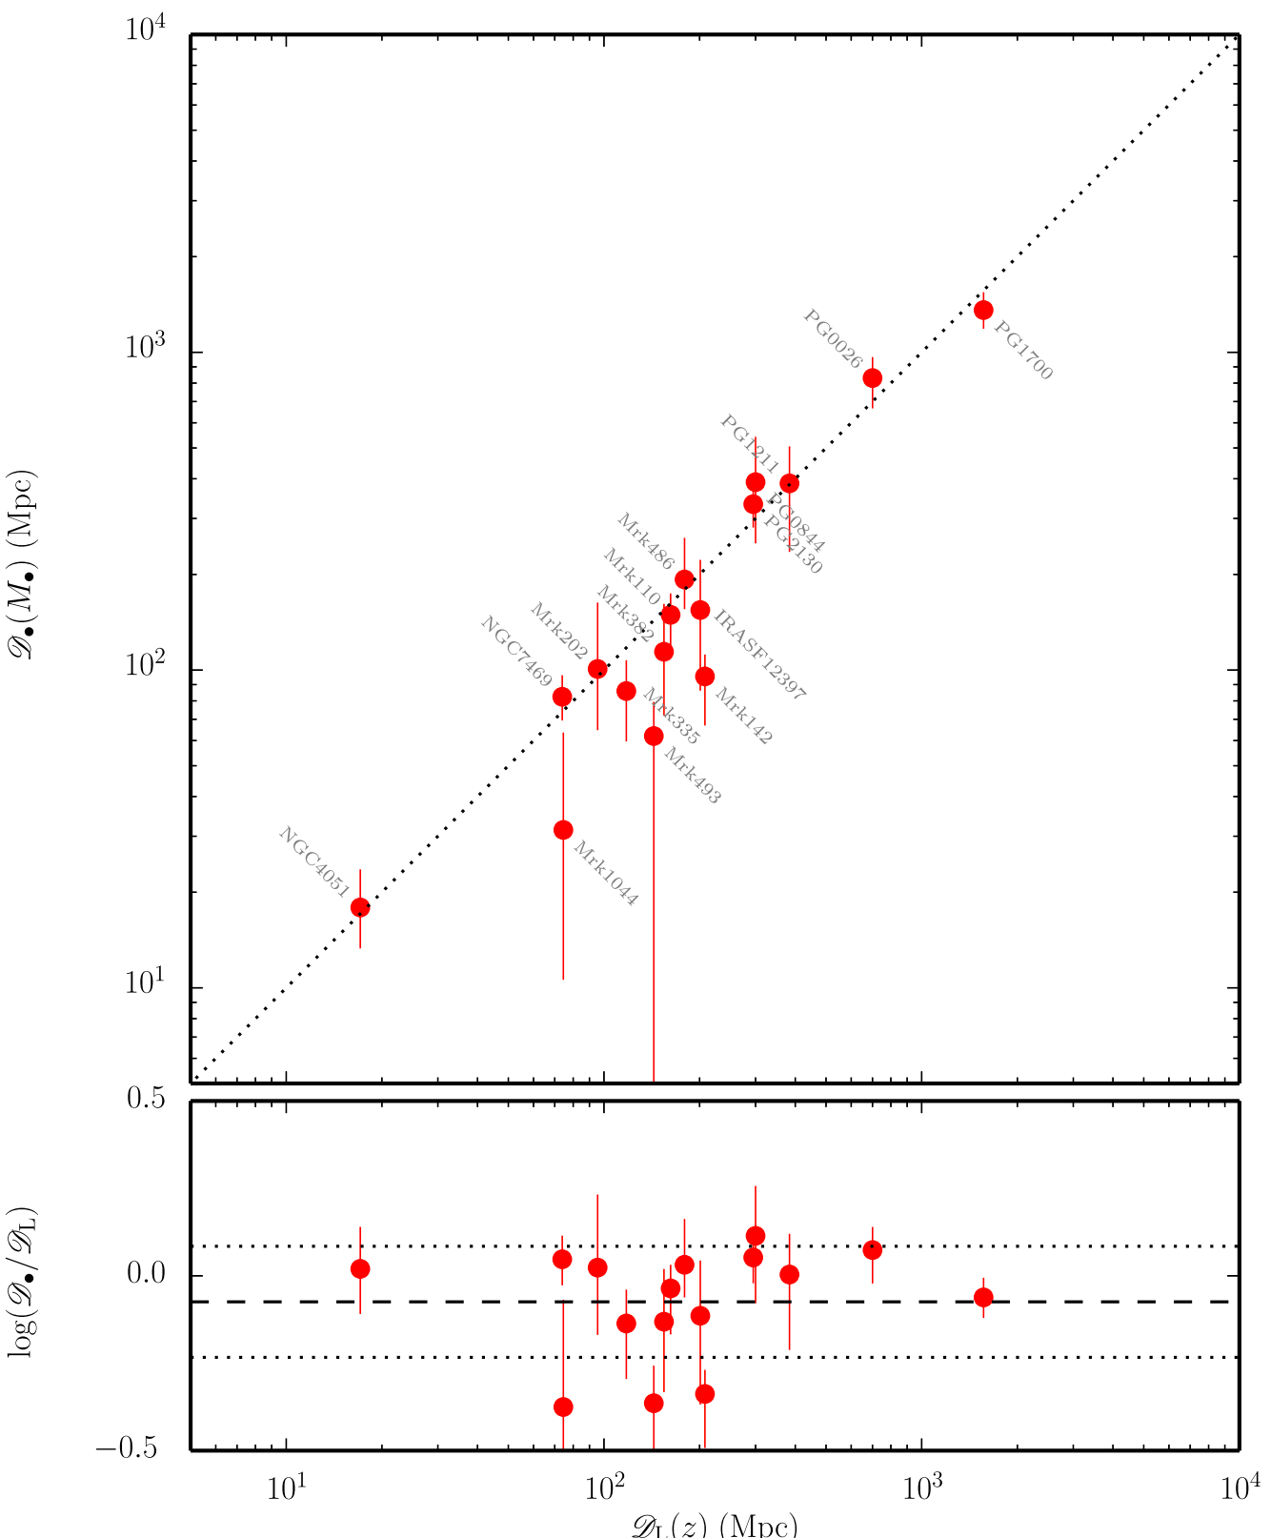
SEAMBH for cosmology (Wang et al. 2013; 2014)
Saturated luminosity:
standard candles
Intrinsic scatter: 0.15 dex

Slide 29
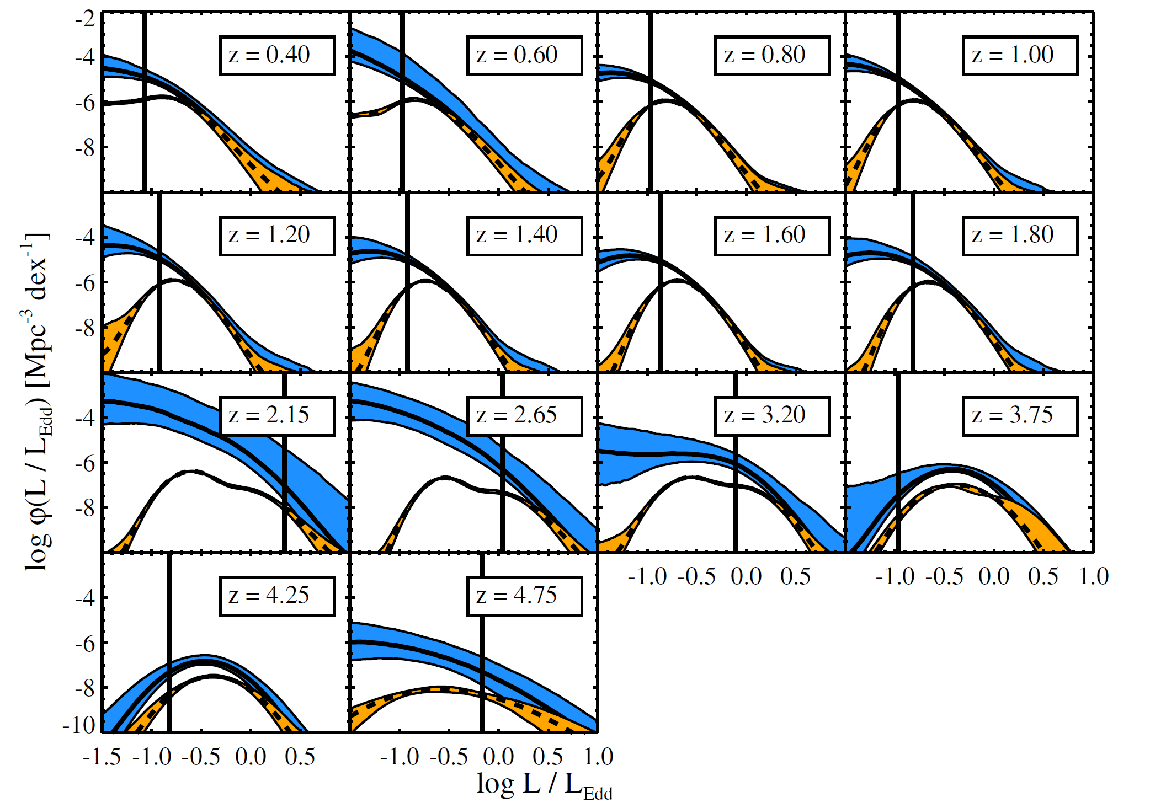
Eddington ratio function (Kelly & Shen 2013)
SDSS sample：
SEAMBH fractions evolve

Slide 30
Lyα Forest BAO measurement (Aubourg et al. 2015)

Slide 31
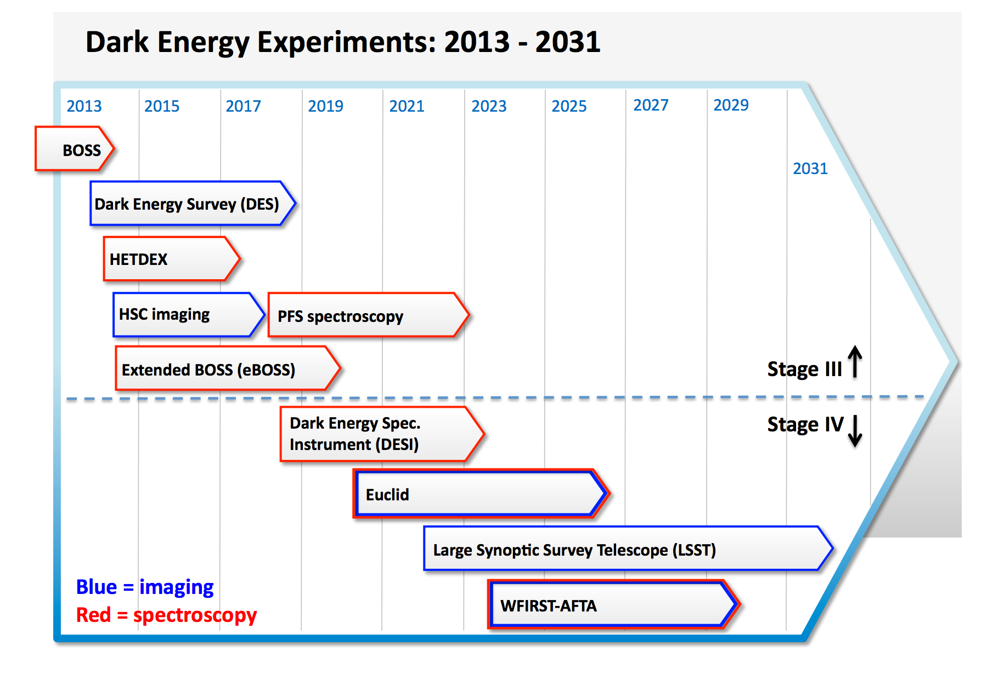
SEAMBH project

Slide 32
Future 5-year Plans

Slide 33
SEAMBH properties:
- saturated luminosity
scatters? black hole candles?
- shortened lags
physics behind: BLR+accretion
- reverberation of multiwavelength continuum from
radio, IR, optical to X-rays
accretion physics

Slide 34
Is R-L relation biased?
an homogeneous Hβ sample with
A large campaign in China: 200AGNs
8 Institutions: spectroscopic and photometric RM
IHEP, YANO, PKU, NAOC, NJU, USTC, XAO, PMO

Slide 35
Thanks!

