Slide 1
Institute of High Energy Physics
Theoretical collaboration on hadron physics
Collaborators:
J.-M. Richard (Lyon University)
Qian Wang (Bonn University)
Qiang Zhao (IHEP, CAS)
Subjects:
Hadron spectroscopy, Exotic hadrons, Charmed baryons, Hypernuclei
Methods:
Quark model, Nonrelativistic EFT
10th Workshop of the FCPPL , March 27-30, 2017, Tsinghua University

Slide 2
The lifetime puzzle of hypertriton ${}_{☹}^{3}H$
About Λ hyperon
Lifetime of free Λ
Lifetime of ${}_{☹}^{3}H$
Explanation for the shortened lifetime of ${}_{☹}^{3}H$
Brief summary
In collaboration with J.-M. Richard and Q. Wang, arXiv:1604.04208v1 [nucl-th]

Slide 3
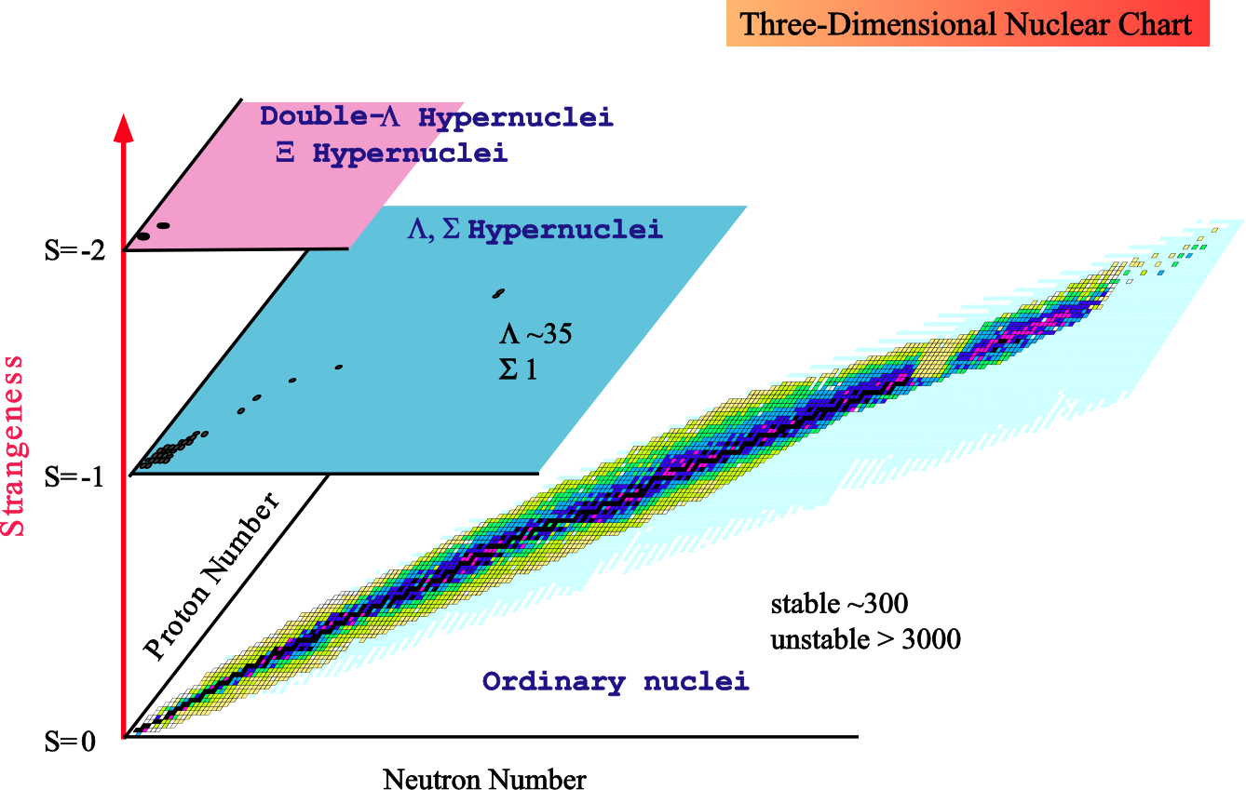
Nuclear chart with strangeness
What’s the role played by the Λ-N interaction in the formation of hypernucleus?
What can we learn from their decays?
_{ΛΛ}⁴n ?
Extending drip-line!
Λ
_{Λ}⁵He
J.-M. Richard, Q. Wang and Q. Zhao, PRC91, 014003 (2015); arXiv:1404.3473 [nucl-th].
A. Gal and H. Garcilazo, PLB736, 93 (2014), arXiv:1404.5855 [nucl-th].
E. Hiyama, S. Ohnishi, B.F. Gibson and T.A. Rijken, PRC89, 061302 (2014), arXiv:1405.2365 [nucl-th]
⁵He
Nuclear chart from E. Hiyama
Notes:
Outline

Slide 4
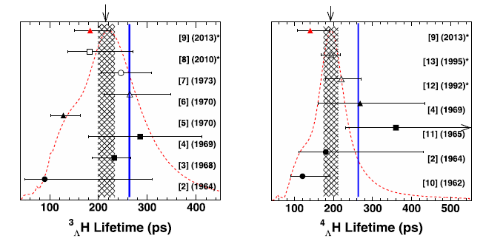
Lifetime measurement of ${}_{☹}^{3}H$ and ${}_{☹}^{4}H$
Free Λ: (263.2±2.0) ps
The lifetimes of both ${}_{☹}^{3}H$ and ${}_{☹}^{4}H$ are shorter than that of the free Λ!
C. Rappold et al., Physics Letters B 728 (2014) 543–548

Slide 5
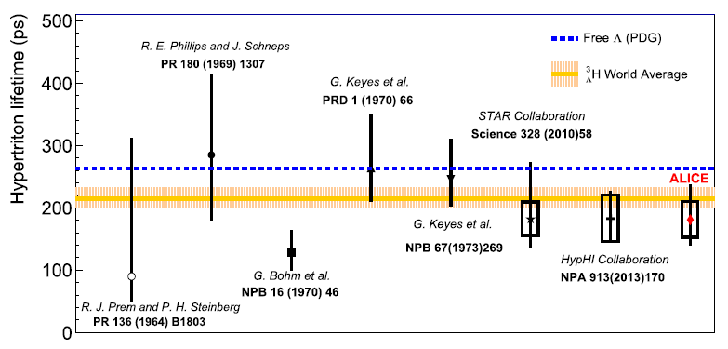
ALICE Collaboration, Physics Letters B 754 (2016) 360–372

Slide 6
Lifetime of Λ: (263.2±2.0) ps = 2.63×10⁻¹⁰ s.
Λ → p + π⁻ , n + π⁰
V(r)
Λ
nucleons
r
Mp= 938 MeV
Mπ= 139 MeV
MΛ= 1115 MeV
MΛ −(Mp+ Mπ)
= 38 MeV
Nuclear binding
Hyper-nucleus
Excess energy
For a “weakly-bound” “light” hyper-nucleus, its lifetime should not be much different from that of a free Λ.

Slide 7
Why surprising?
For the weakly bound system, the non-mesonic weak decay will be suppressed by the pion propagator. Hence, one would expect that the lifetime of ${}_{☹}^{3}H$ is more or less the same as the free Λ.
Non-mesonic weak decay, e.g. ${}_{☹}^{3}H$ → p + 2n, d + n
deuteron
$${}_{☹}^{3}H$$
Λ
p
π⁻
Mesonic decay is dominant via
${}_{☹}^{3}H$ → π⁻ + ${}_{}^{3}{He}$, π⁻ + ${}_{}^{3}H$, π⁻ + d + p, π⁻ + 2p + n, π⁰ + d + n, π⁰ + p + 2n
p
n
n
n

Slide 8
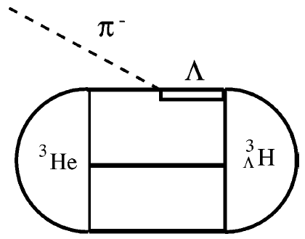
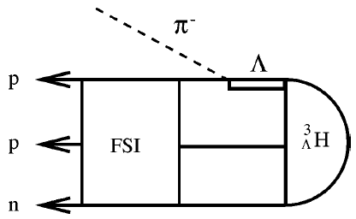
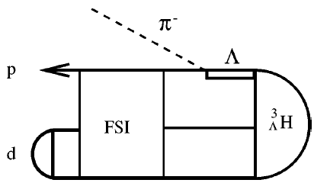
H. Kamada, J. Golak, K. Miyagawa, H. Witała, and W. Glockle, Phys. Rev. C 57, 1595 (1998)
Pionic weak transition operator has been parametrized out:

Slide 9
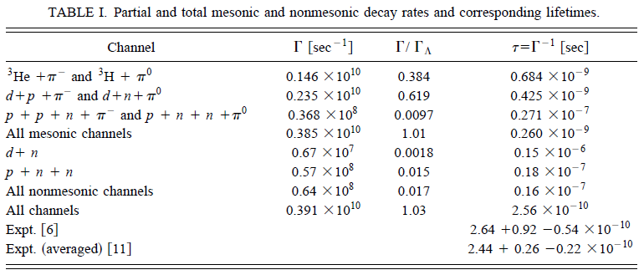

Slide 10
The Λ weak decay
I) Direct pion emission
π⁻
π⁻
‾u
d
Λ
p
W
s
u
Λ
u
u
p
d
d
Highly suppressed for nπ⁰!
PDG:
BR(Λ→ pπ⁻) = (63.9±0.5)%
BR(Λ→ nπ⁰) = (35.8±0.5)%
Direct pion emission CANNOT be dominant!

Slide 11
The Λ weak decay
π⁻
Λ
p
II) Pole contribution via baryon internal conversion
d
π⁻
d
π⁻
‾u
‾u
u
d
Λ
s
u
+
Λ
u
u
p
s
d
u
p
d
d
n
d
Σ⁺
π⁻
π⁻
Λ
p
+
Λ
p
n
Σ⁺

Slide 12
In the quark model the transition amplitude can be expressed as:
π⁻
π⁻
Λ
p
+
Λ
p
n
Σ⁺

Slide 13
Explicit calculation of the strong and weak transition matrix elements in the quark model:
π
π
N_{i}
N_{f}
N_{i}
N_{f}
The non-relativistic expansion gives
Goldberger-Treiman relation:

Slide 14
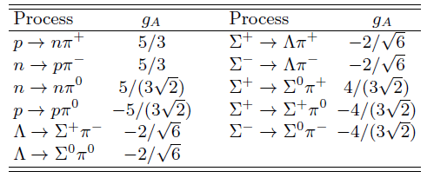
The transition amplitude becomes:
indicates the SU(3) flavor symmetry breaking.
Explicit cancellation between the pole terms.
is determined by the free Λ and Σ decays and will be fixed.

Slide 15
All involve cancellations among the pole terms due to SU(3) flavor symm.
I) Λ → n π⁰
π⁰
π⁰
Λ
n
+
Λ
n
n
Σ⁰
PDG:
BR(Λ→ pπ⁻) = (63.9±0.5)%
BR(Λ→ nπ⁰) = (35.8±0.5)%

Slide 16
All involve cancellations among the pole terms due to SU(3) flavor symm.
II) Σ⁺ → n π⁺
π⁺
π⁺
π⁺
Σ⁺
n
+
Σ⁺
n
+
Σ⁺
n
p
Λ
Σ⁰
Sign difference arising from signs of the propagators!

Slide 17
III) Σ⁺ → p π⁰
π⁰
π⁰
Σ⁺
p
+
Σ⁺
p
p
Σ⁺
IV) Σ⁻ → n π⁻
π⁻
π⁻
Σ⁻
n
+
Σ⁻
n
Λ
Σ⁰

Slide 18
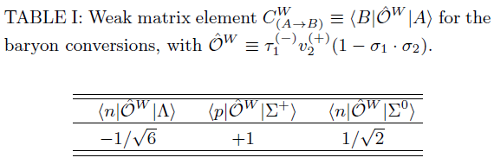
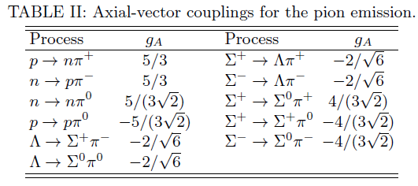

Slide 19
The SU(3) flavor symmetry parameters are strongly correlated indicating an intrinsic dynamic connection.

Slide 20
Some general features:
The Λ and Σ hadronic weak decays involve significant cancelations among the pole terms which is determined by the SU(3) flavor symmetry.
However, the cancellations are sensitive to the SU(3) flavor symmetry breaking, which means a coherent study of the free Λ and Σ hadronic weak decay is necessary.
Information about the short-distance behavior of the wavefunction is also crucial, but only contributes to the overall factor.
The dominance of pole contributions in the Λ and Σ hadronic weak decays has important consequence for the lifetime of light hyper-nuclei.

Slide 21
Hadronic weak decay of ${}_{☹}^{3}H$
J=1/2
p
π⁻
π⁻
Λ
p
+
Λ
p
Λ
n
Σ⁺
n
π⁻
π⁻
n
Λ
p
Λ
p
$${}_{☹}^{3}H$$
p
p
$${}_{}^{3}{He}$$
+
Σ⁺
n
n
Pauli principle will forbid the intermediate (nn) to stay in the same state, which will make these two pole terms different in hyper-nucleus decays.

Slide 22
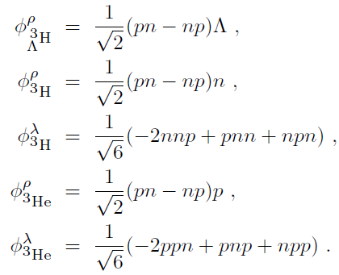
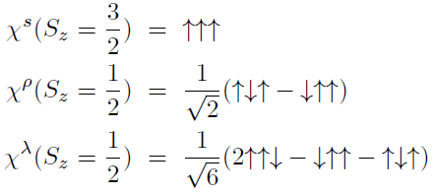
Wavefunctions for the light nuclei, -- anti-symmetrized in the isospin space
The spin and isospin wavefunctions are:

Slide 23
Spacial wavefunction:
Wavefunction in momentum space:

Slide 24
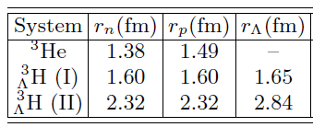
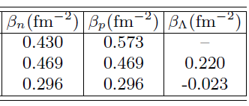
Mean square radius:
The r.m.s are from Juelich model and Nijmegen model, with which the HO parameters are fixed.
H. Polinder, J. Haidenbauer and U.-G. Meisner, Phys. Lett. B 653, 29 (2007)
J. Haidenbauer, S. Petschauer, N. Kaiser, U.-G. Meisner, A. Nogga and W. Weise, Nucl. Phys. A 915, 24 (2013)
T. A. Rijken, M. M. Nagels and Y. Yamamoto, Few Body Syst. 54, 801 (2013)

Slide 25
Transition matrix element for

Slide 26
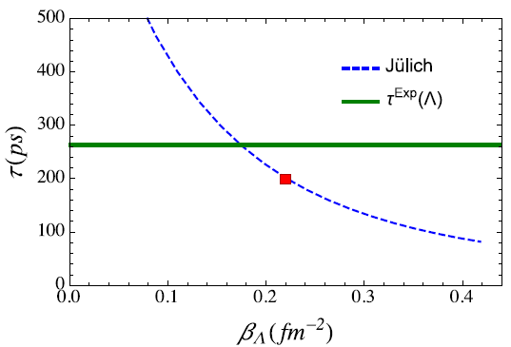
Partial width:
“Lifetime” in comparison with the exp. data:
Sensitivity of the pole term cancellation mechanism to the nuclear model:
Other channels, e.g. ${}_{☹}^{3}H$ → π⁻ + d + p, π⁻ + 2p + n, π⁰ + d + n, π⁰ + p + 2n, will further contribute to the partial width and further shorten the lifetime.

Slide 27
Brief summary
The presence of Pauli blocking plays a unique role in light hypernucleus weak decays and can explain the fastened lifetime of ${}_{☹}^{3}H$.
More realistic nuclear wavefunctions are needed for quantitative calculations in the future.
Thanks for your attention!

Slide 29
Lifetime of neutron: 880 sec.
Mp= 938.27 MeV
Mn= 939.56 MeV
Mp+Mn= 1877.83 MeV
Mp+Mp= 1876.54 MeV
Md= 1875.61 MeV
n → p + e⁻ +‾ν_{e}
V(r)
p
n
r
~ −1.29 MeV
~ −2.22 MeV
p
p
deuteron
Neutron becomes stable inside the deuteron since the binding energy is larger than the excess energy.

