Slide 1
Cosmic ray detection with LHAASO
L. L. Ma, S.S.Zhang, B.Y. Bi, L.Q.Yin, Z.Z. Zong
For LHAASO collaboration
Institute of High Energy Physics, Beijing, China

Slide 2
Outline
LHAASO introduction
Prospects for cosmic ray spectra bellow 100 PeV
Summary

Slide 3
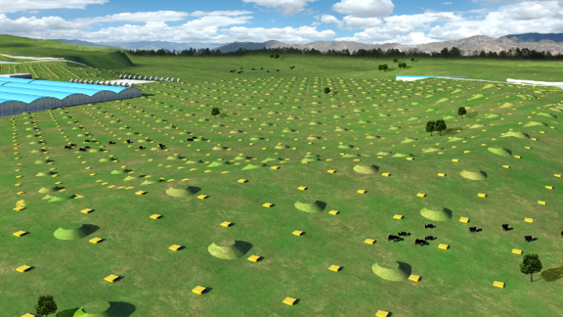
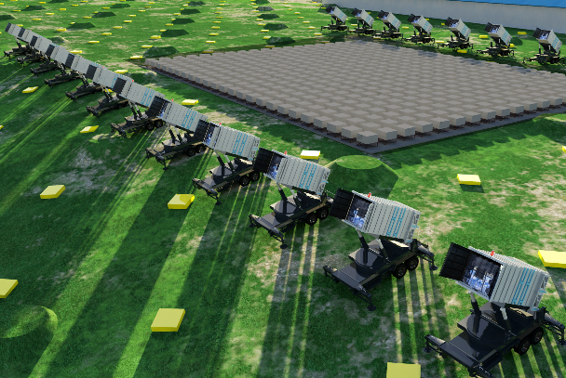
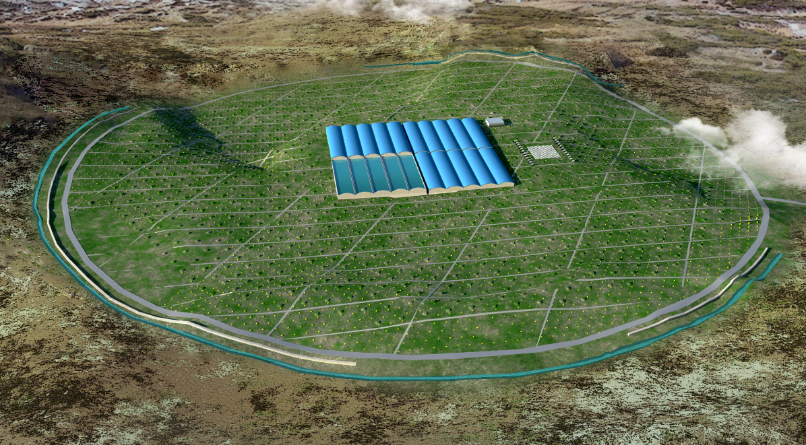
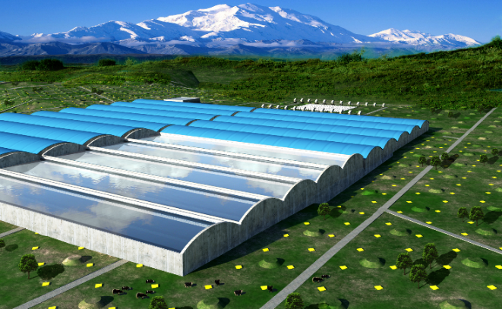
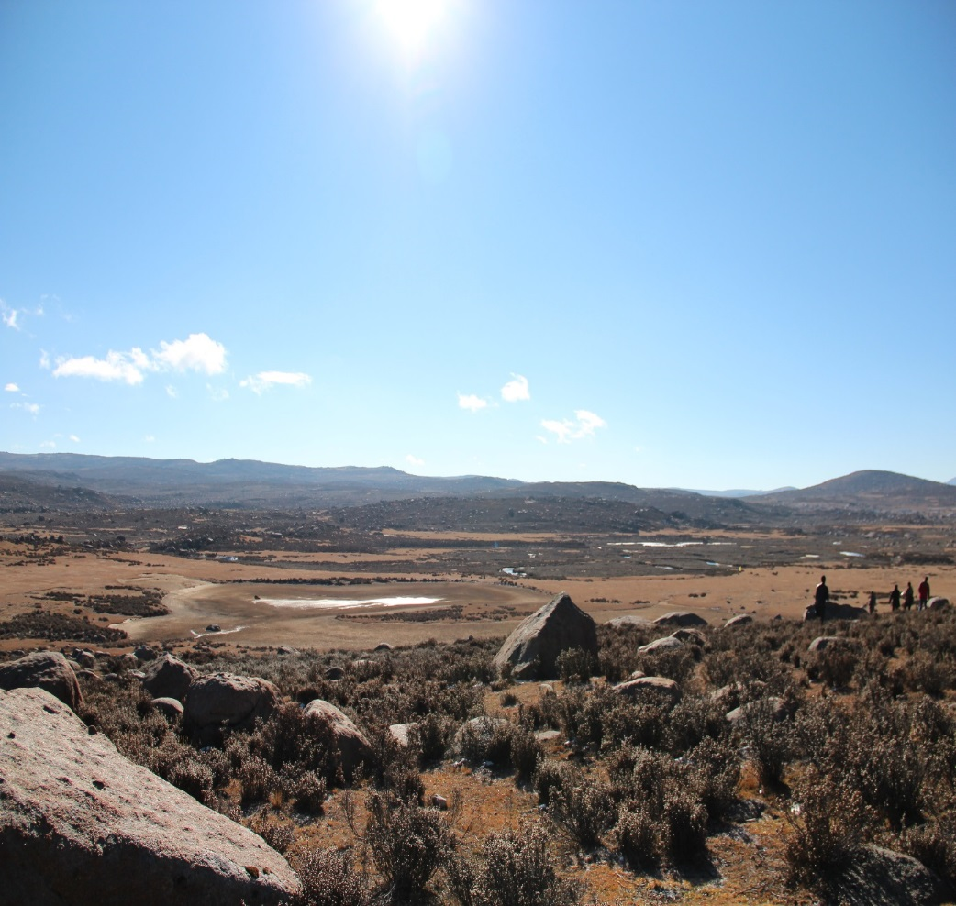
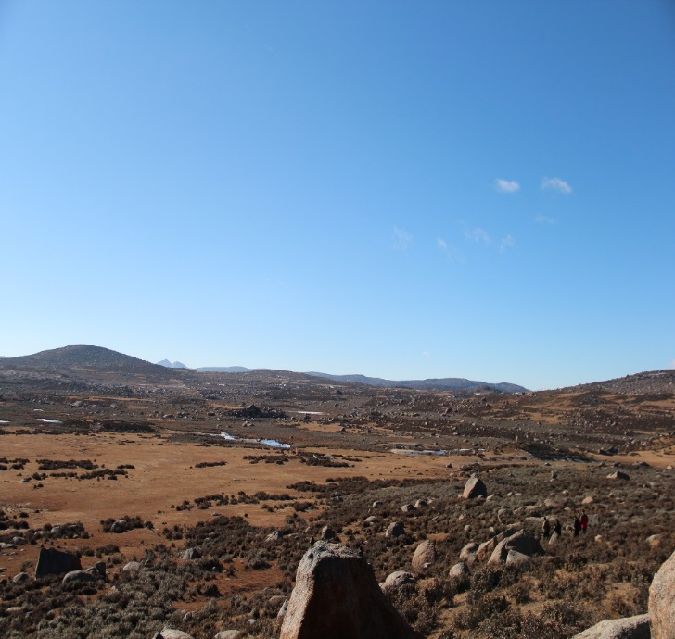
Large High Altitude Air Shower Observatory
KM2A:
5195 Eds: 1 m² each, 15m spacing
1171 MDs: 1146 MDs, 36 m² each, 30m spacing
WFCTA:
18 Cherenkov telescopes (1024 pixels/telescope)
WCDA:
3000 cells (25m²/cell)
Daocheng, Sichuan (29º21’ 31” N, 100º08’15” E, 4410 m a.s.l., 600 g/cm²)

Slide 4
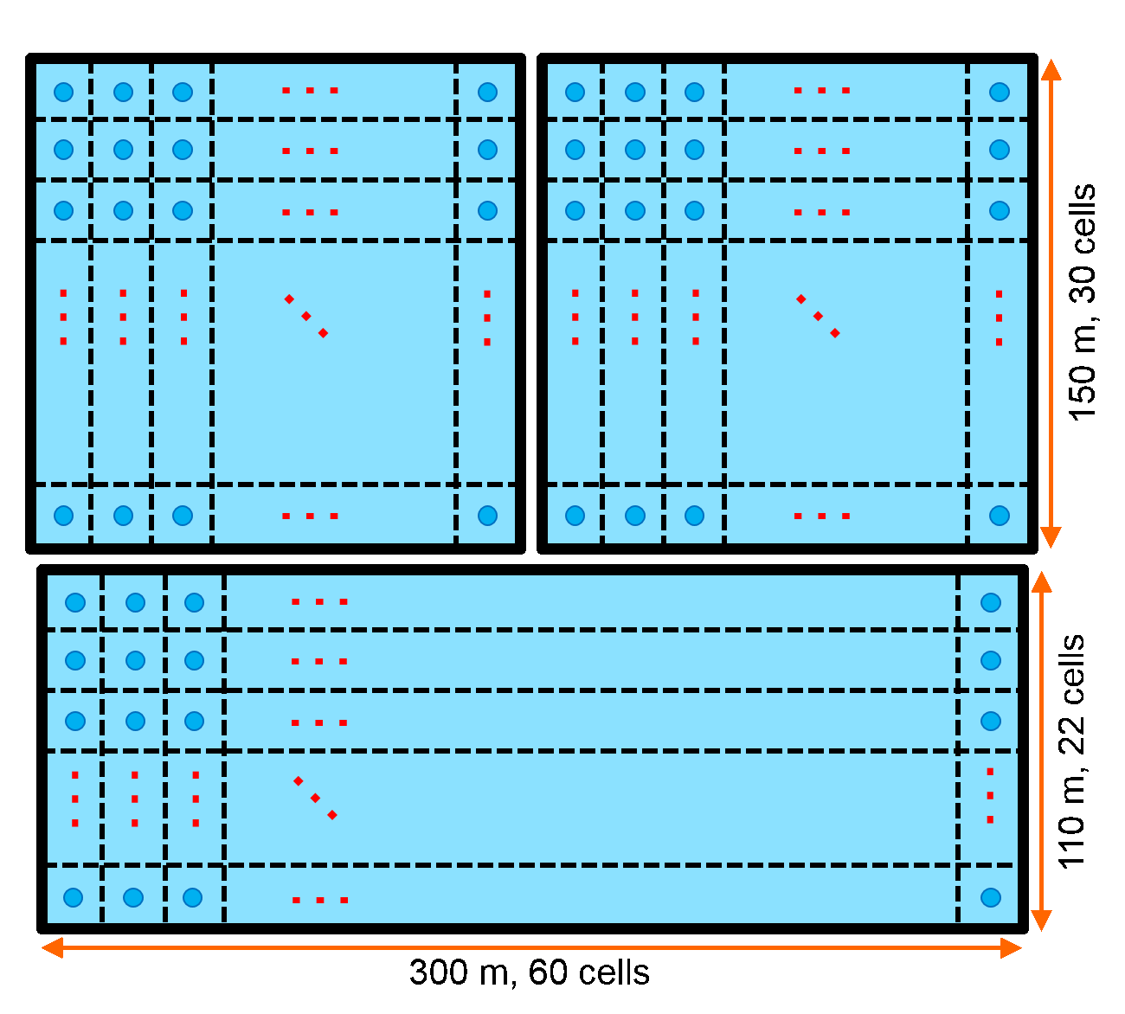
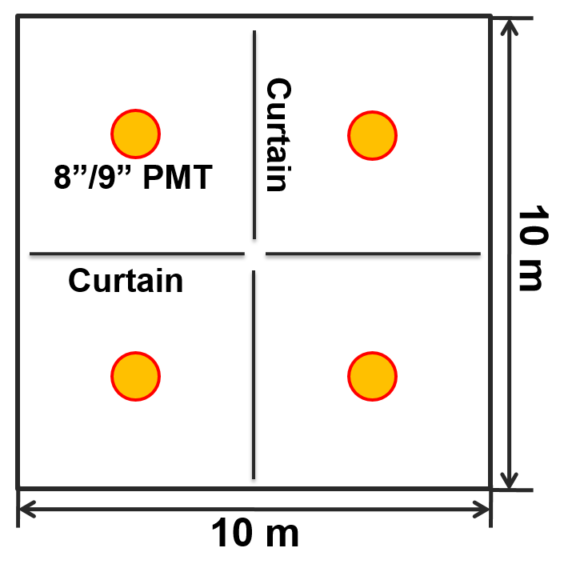
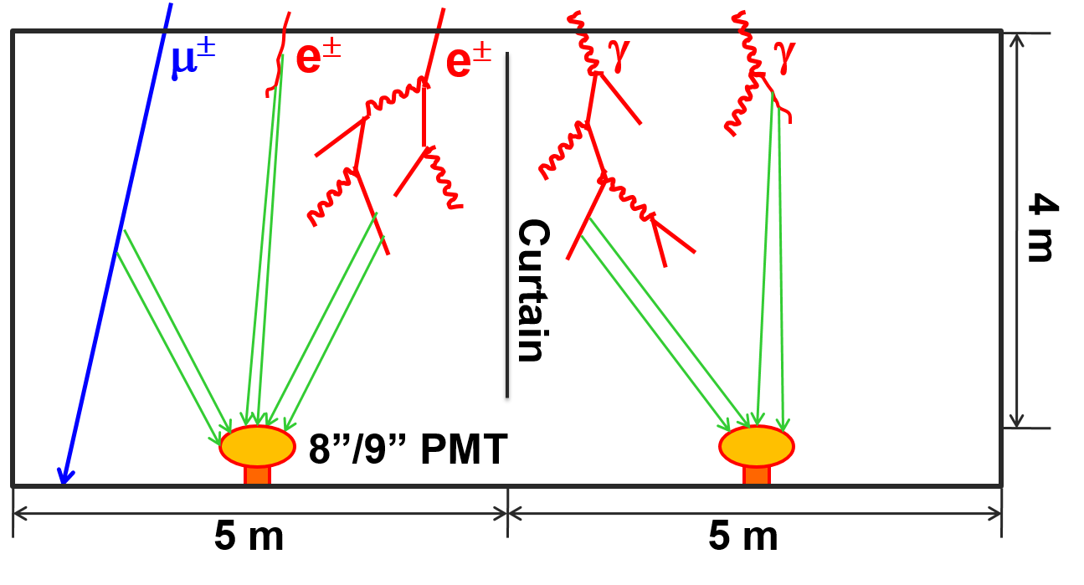
Water Cherenkov
Detector Array
3 water ponds:
  78,000 m² in total;
  4 m effective depth;
  3120 cells, with an 8”/9” PMT in each cell;
  Cells are partitioned with black curtains.
WCDA++: 1”PMTs enhance Dynamic Range

Slide 5
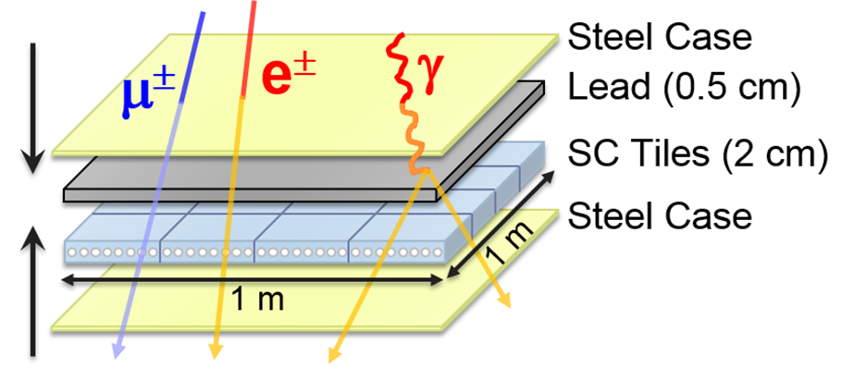
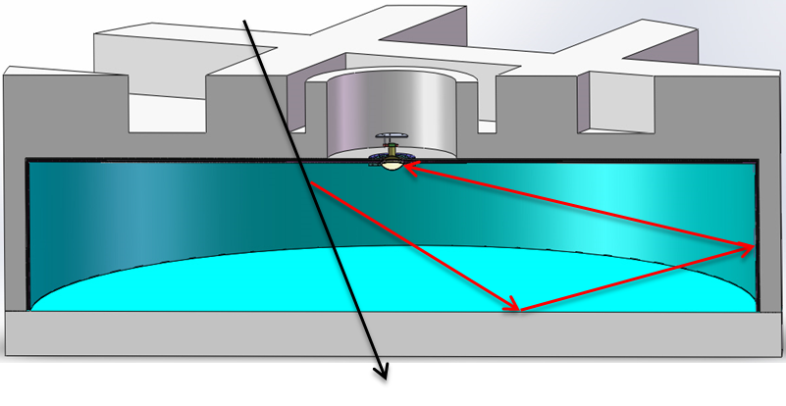
KM² Array (KM2A)
2.8m
1.2m
ED
MD
 | ED | MD
Effective area | 1m² | 36m²
Spacing | 15m | 30m
Total NO. of detectors | 5195 | 1171
Time resolution | 2ns | 10ns

Slide 6
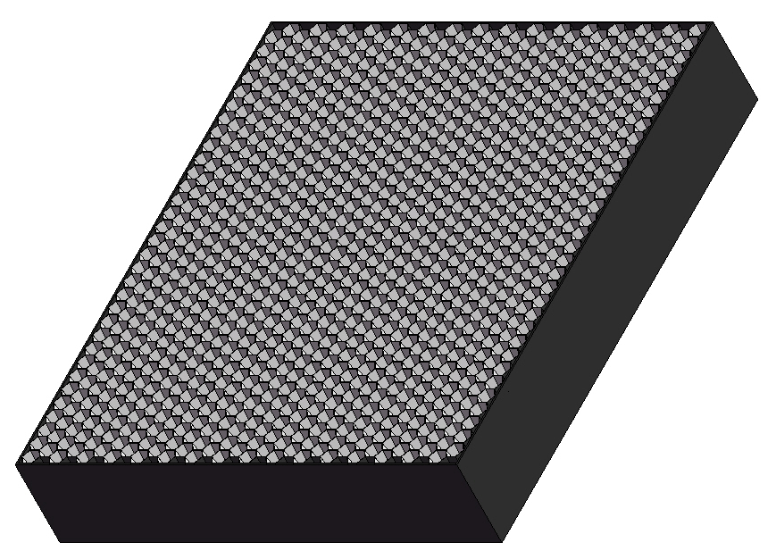
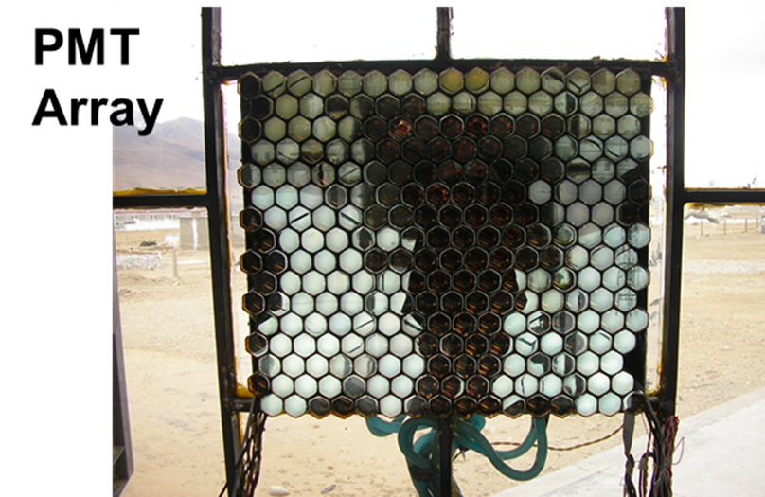
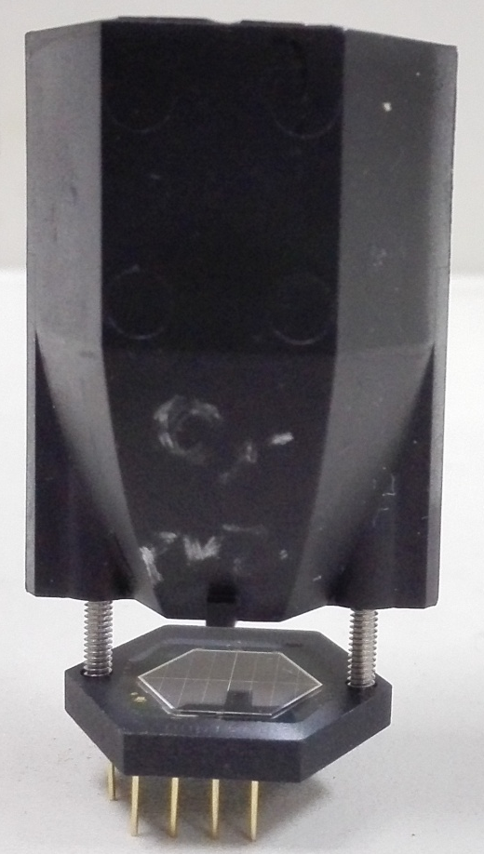
Wide Field of View Cherenkov Telescope (WFCTA)
18 Telescopes
5m² spherical mirror；
32×32 SiPMs array
Pixel size 0.5°；
FOV: 14°× 16°.
Duty cycle: 30%
Duty cycle: 10%
instead of
SiPM camera
A prototype of WFCTA

Slide 7
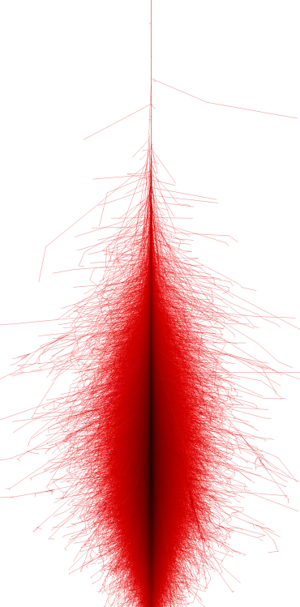
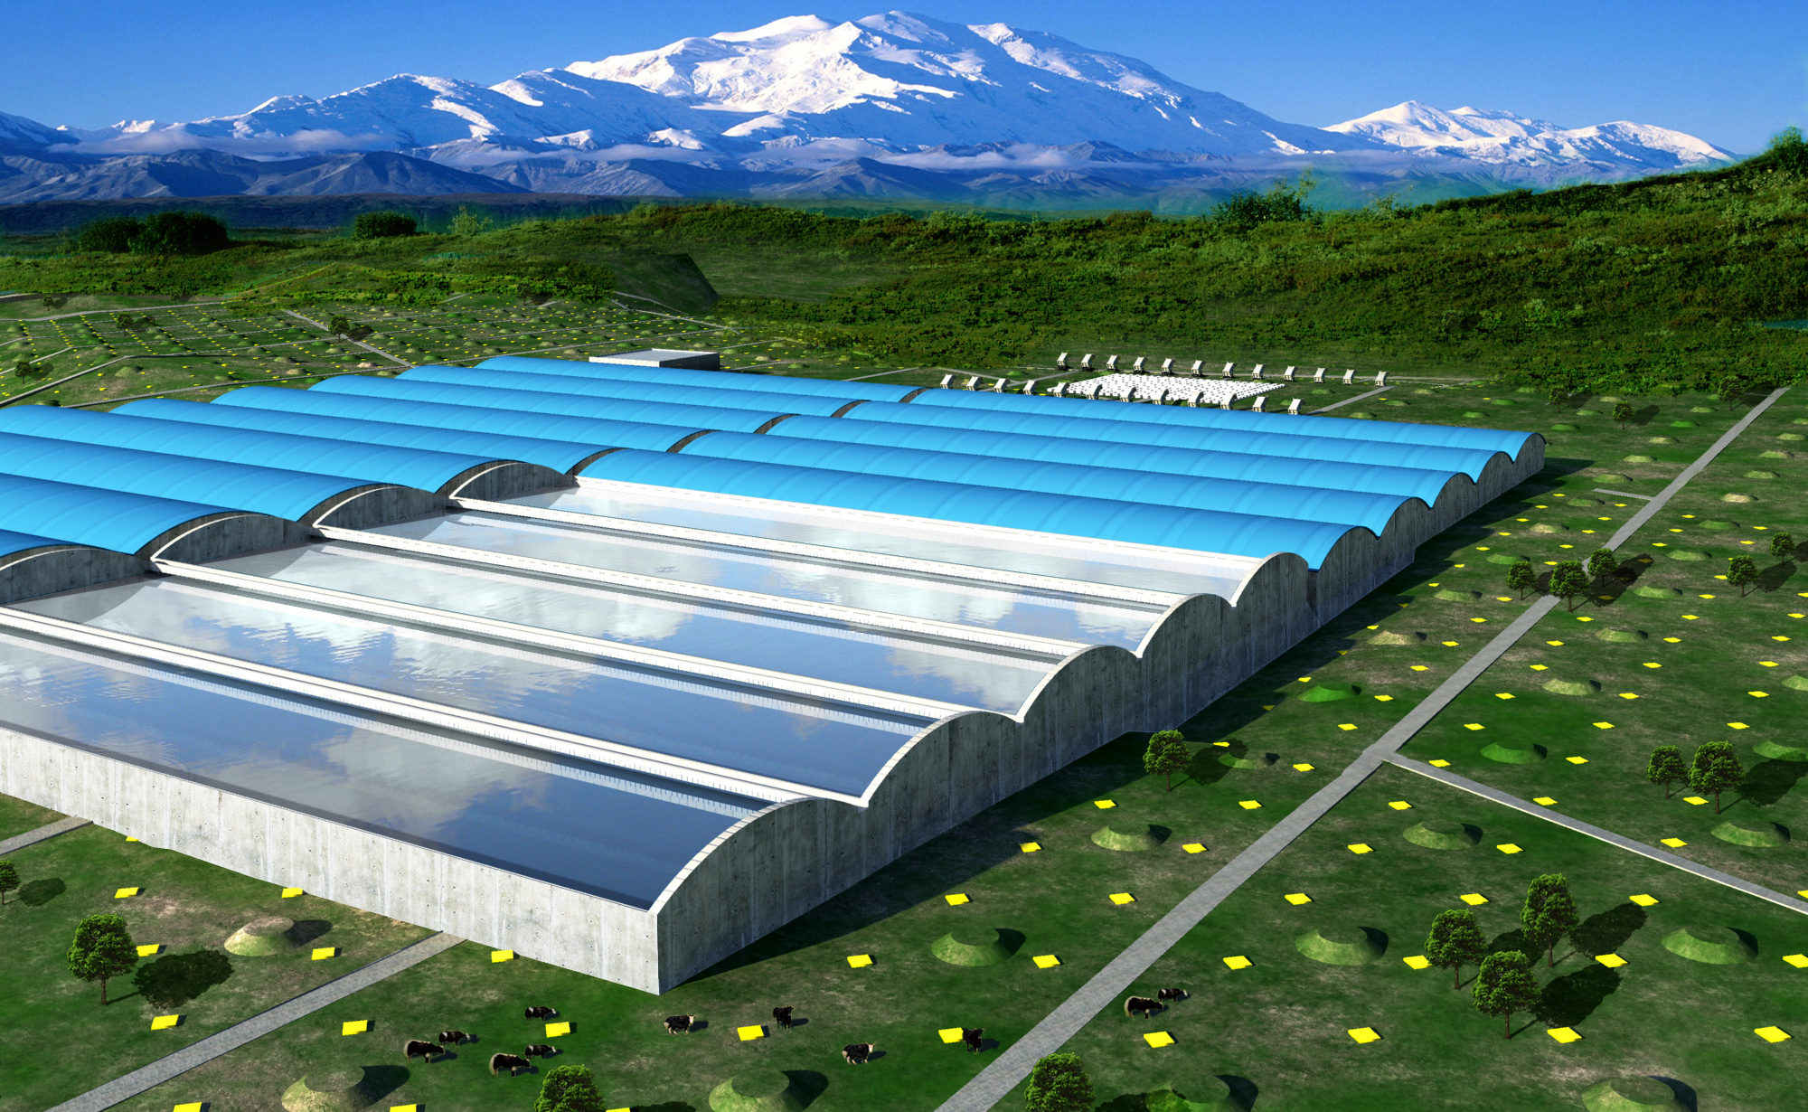
>10TeV

Slide 8
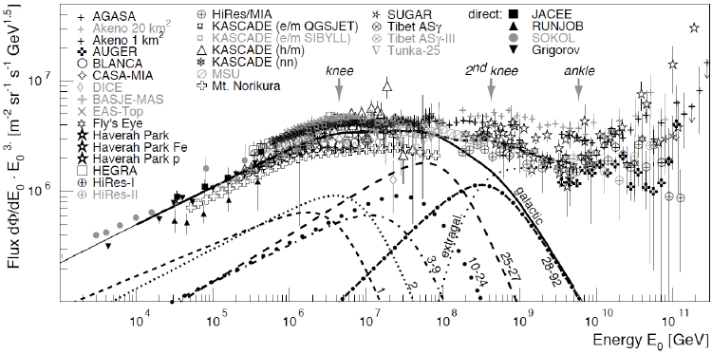
LHAASO prospects of CR Physics
  10TeV-100TeV
  Energy Scale
100TeV-10PeV
  Knees for H,He,…
10PeV-100PeV
  knee of Fe
100PeV-2EeV
  2nd knee & composition changing
  Transition from galactic to extra-galactic
  Energy Scale
J.R. Horandel, MPL A, 22, 1533 (2007)

Slide 9
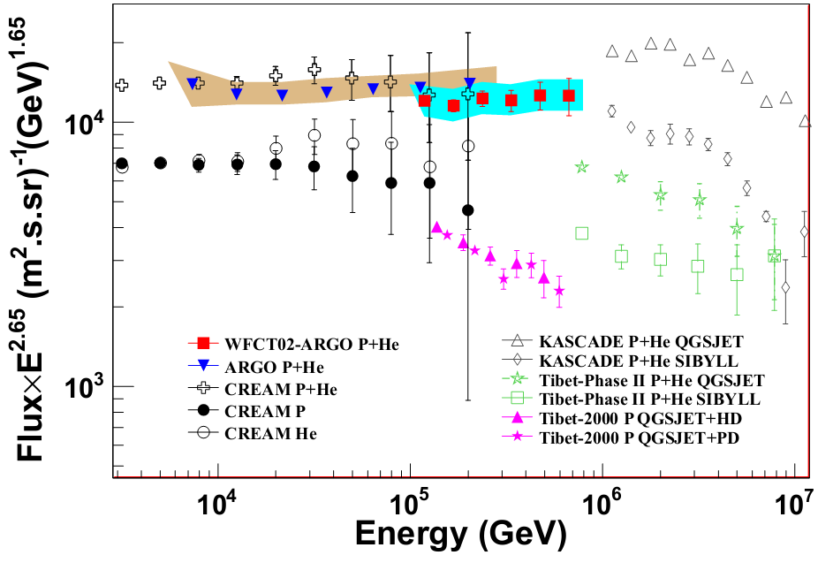
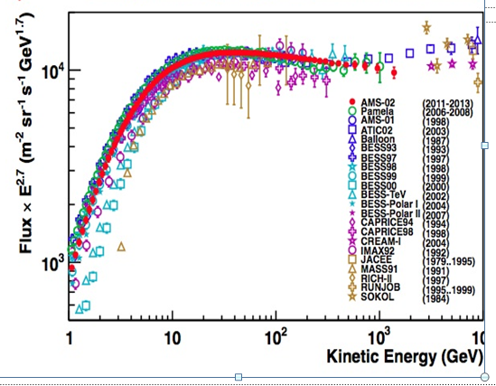
CREAM: 1.09x1.95x10⁻¹¹(E/400TeV)^{-2.62}
ARGO-YBJ: 1.95x10⁻¹¹(E/400TeV)^{-2.61}
LHAASO Prototype: 0.94x1.95x10⁻¹¹(E/400TeV)^{-2.62}
ISS-CREAM
B. Bartoli et al, Chinese Physics C, Vol. 38, No. 4, 045001 (2014)

Slide 10
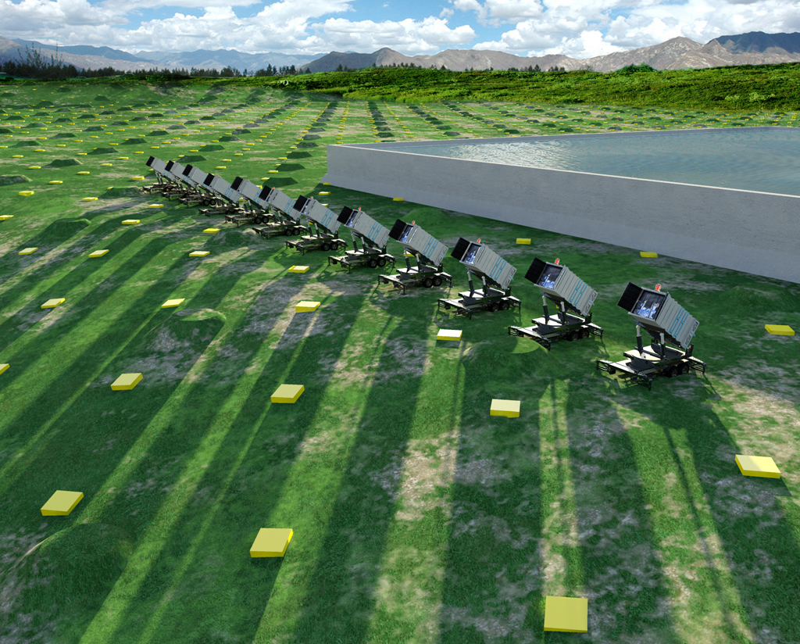
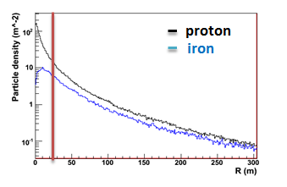
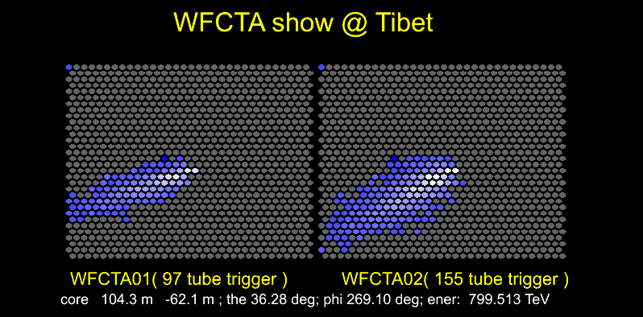
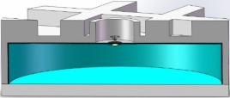
Prospects of P, He knees from 100TeV to 10PeV
WCDA
  Core reconstruction: 3m
  Arrival direction reconstruction: 0.3°
  No. of particles near the core
WFCTA
  SIZE (total PE in image)
  Width, Length
  Distance between arrival directions to the image center
KM2A
  Total Muon number
a
b

Slide 11
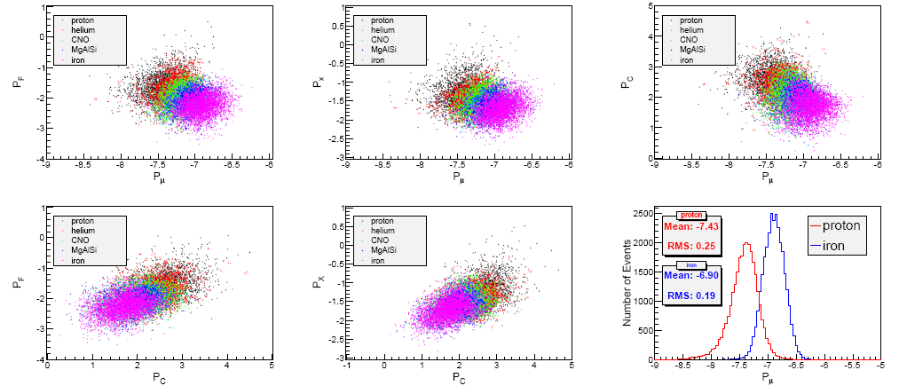

Slide 12

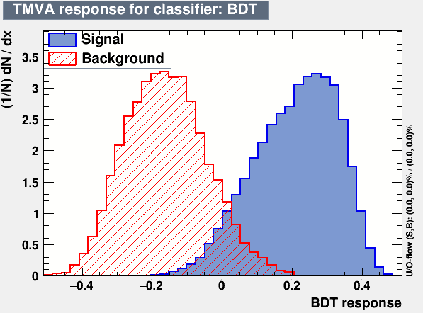
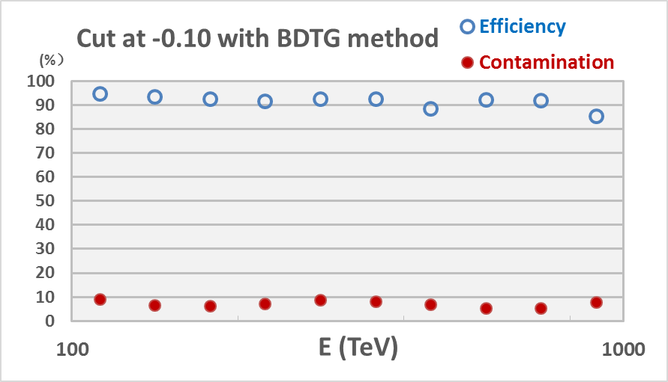


MVA method for p,He / heavy separation
With the Multi-Variate Analysis methods (e.g. neural networks and boosted decision trees), good separations for p/iron and p+He/heavy nuclides identification can be obtained.
Efficiency $\sim 90\%$
p, He
CNO,
MgAlSi,
iron
Contamination $<10\%$
Separation of light (p+He) and heavy nuclei by the BDT (Boost Decision Trees) method.
The contamination is calculated based on the Hörandel model.

Slide 13
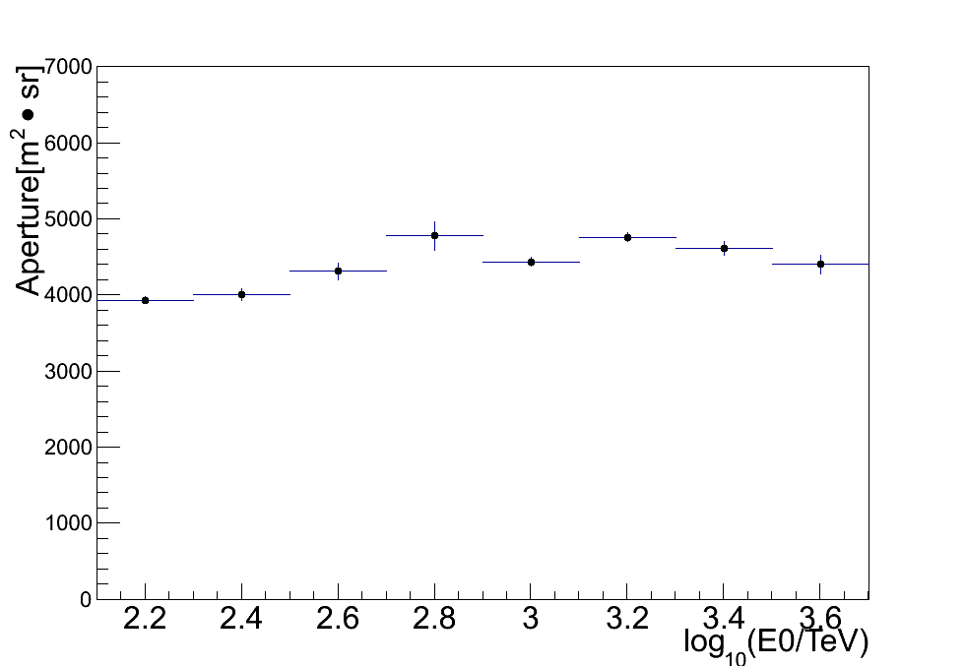
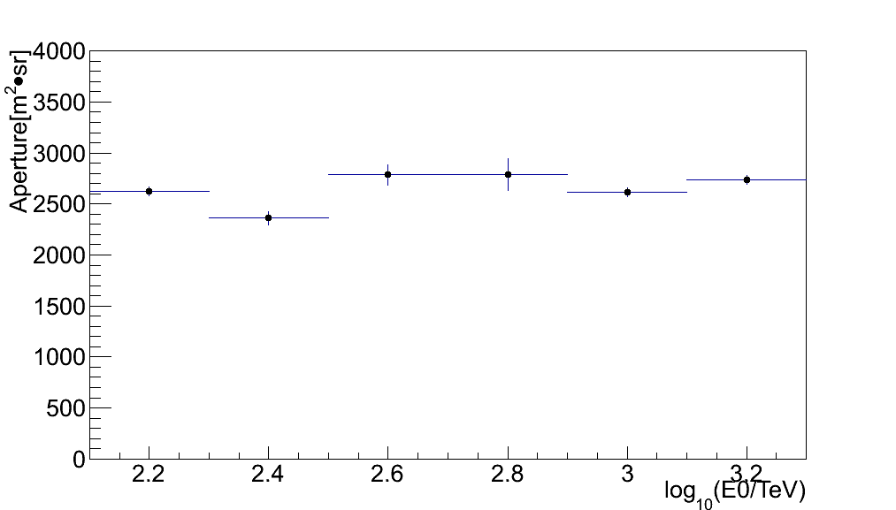
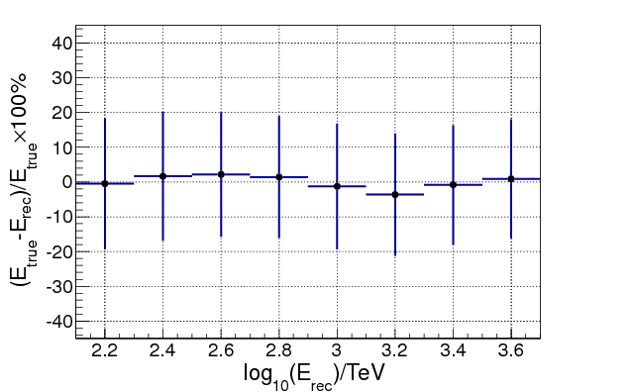
Aperture: ~4000 m².sr
Aperture: ~2500 m².sr
P+He
P
Energy resolution 20%

Slide 14
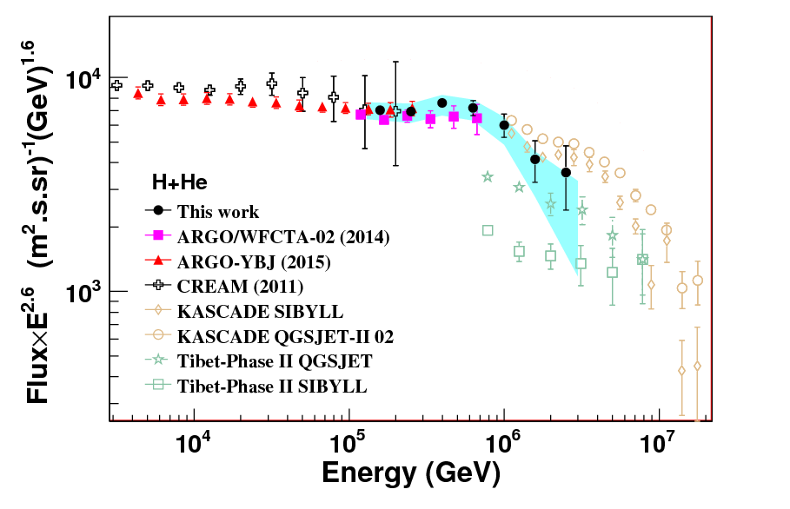
Proton + Helium energy spectrum measured by the ARGO-YBJ detector and a prototype telescope of LHAASO.
    The knee of (700±230_{stat.}±70_{sys.}) TeV is found
PHYSICAL REVIEW D 92, 092005 (2015)

Slide 15
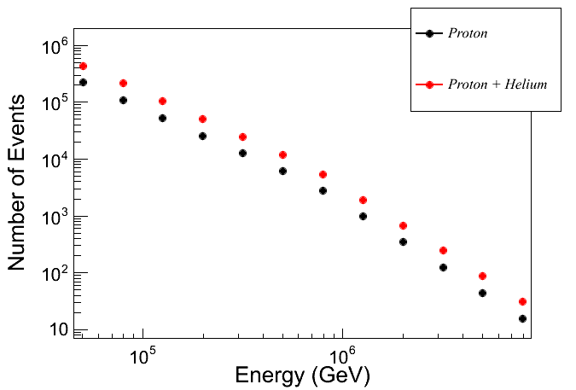
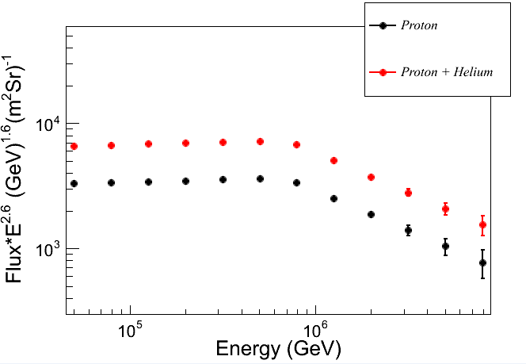
Proton and helium energy spectrum expectation in one year with 15% duty cycle

Slide 16
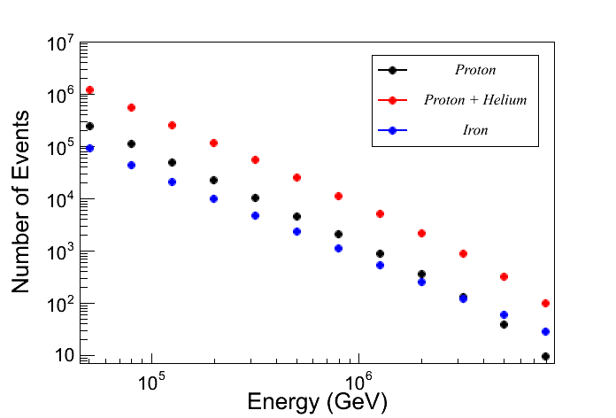
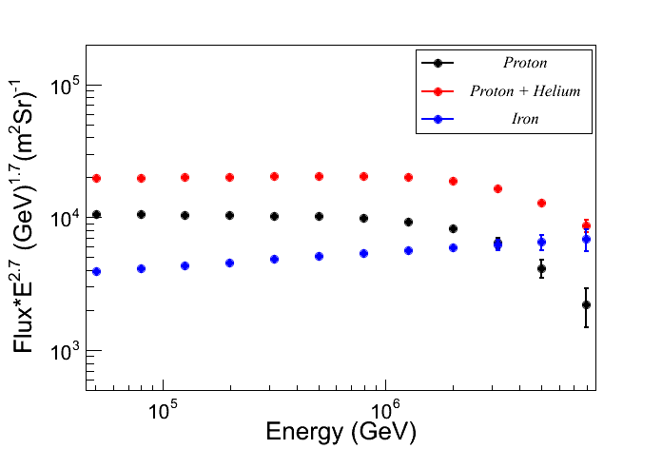
Horandel Model

Slide 17
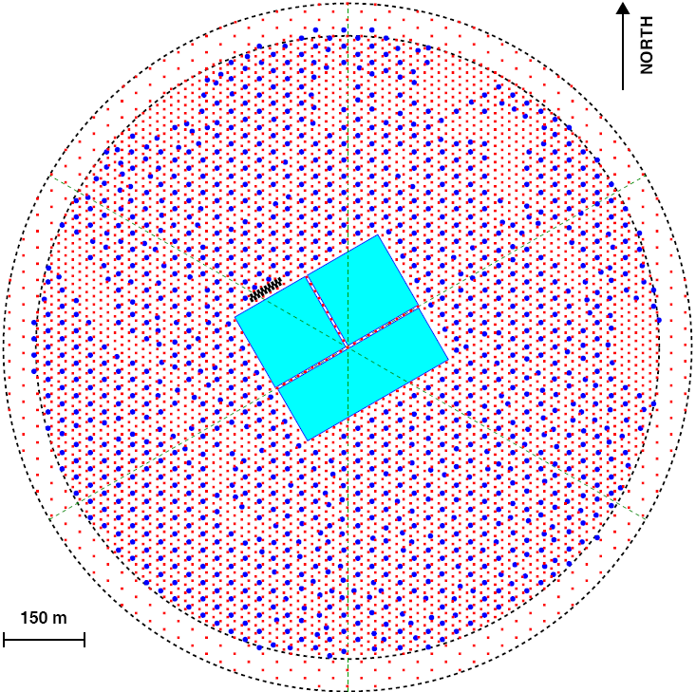
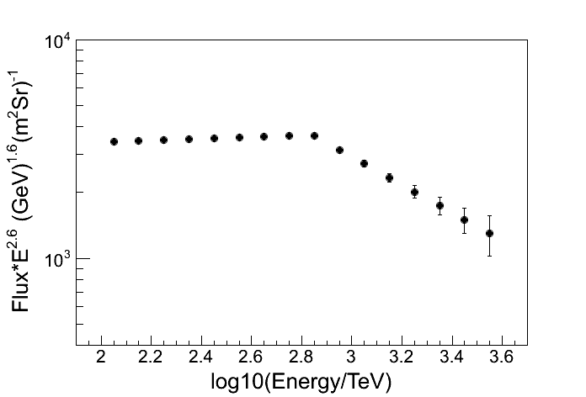
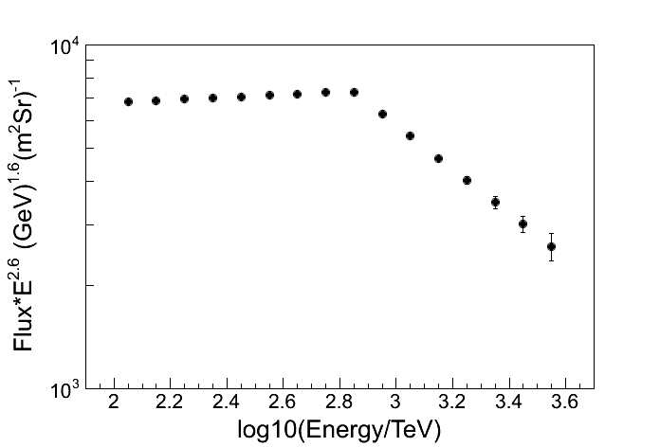
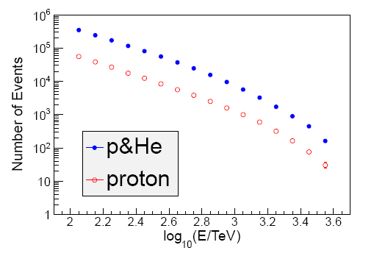
Performance of 1./4 LHAASO array
  6 WFCT telescopes
  A water Cherenkov detector pool
  10,000 m² muon detectors covering 250,000 m²
570m
Proton
P+He

Slide 18
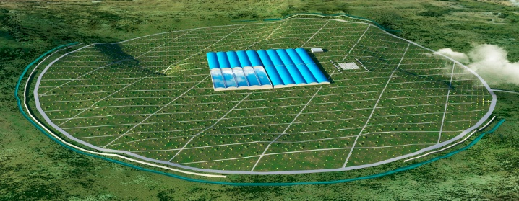
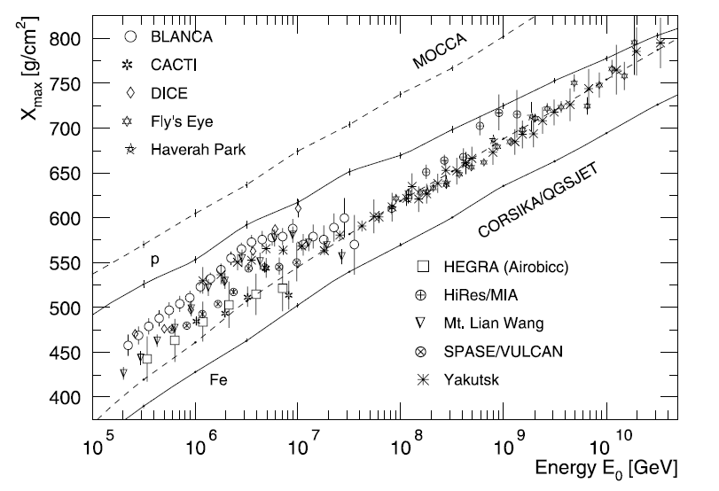
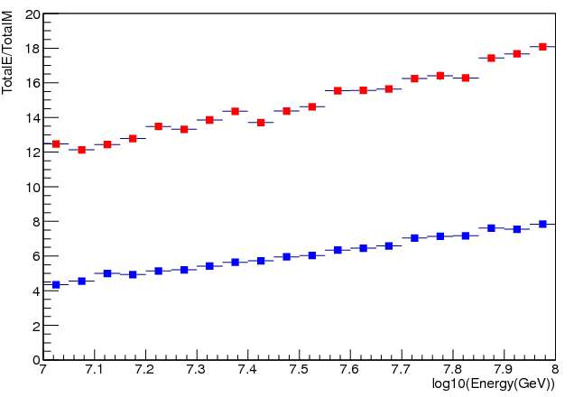
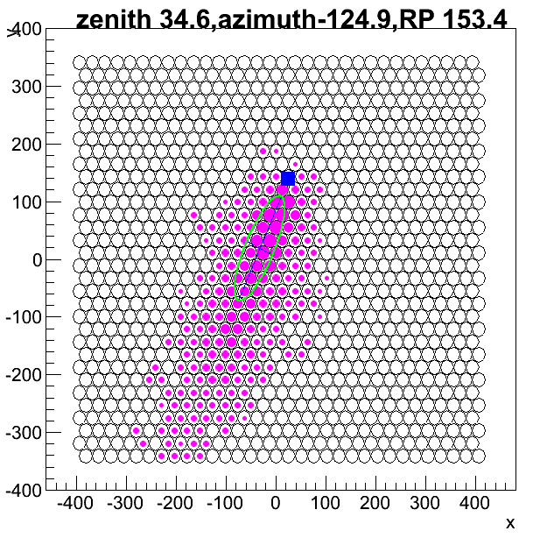
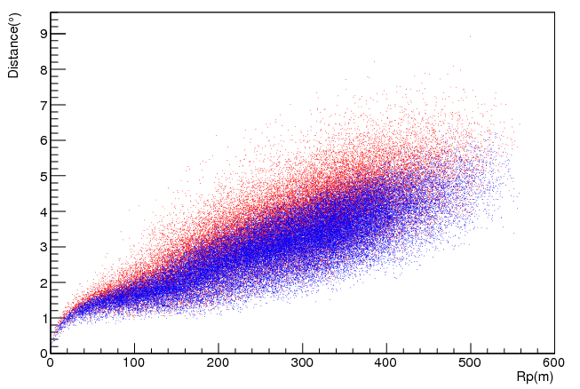
Prospects of iron knees from 10PeV to 100PeV
KM2A:
  Geometry reconstruction:
    core resolution: <3 m
    arrival direction resolution: ≤0.2°
  No. of Muons
  No. of electromagnetic particles
WFCTA:
  SIZE (total PE in image)
  Distance between arrival directions to the image center
Telescope point to zenith 45º
Zenith angle range：from 38º to 52º Atmosphere depth: >770g/cm²
proton
proton
iron
iron

Slide 19
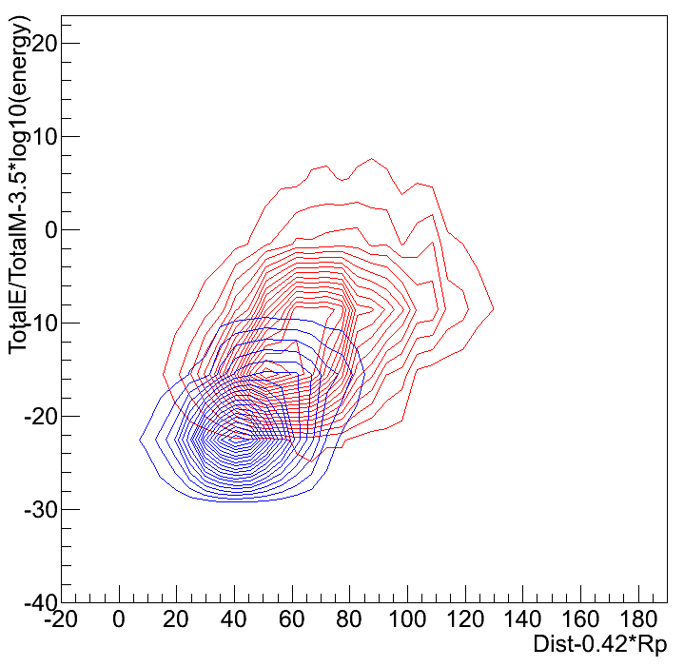
Hybrid observation of KM2A and WFCTA
Blue: iron
Red: proton
Purity:
Iron 87%
Iron + MgAlSi 94%
Parameters by KM2A
Parameters by WFCTA

Slide 20
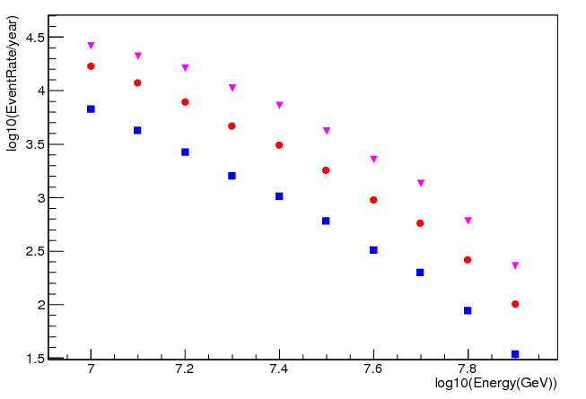
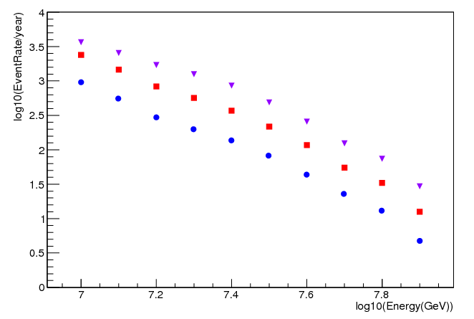
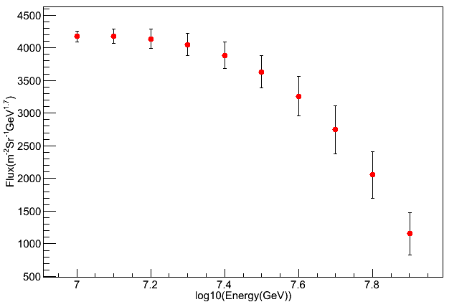
Event rate per year with 15% duty cycle
Pink: Rp <300m
Red: Rp<250m
Blue: Rp<200m
Iron events with 87% purity
All events
Expectation of iron spectrum with Rp less than 250m and 87% purity

Slide 21
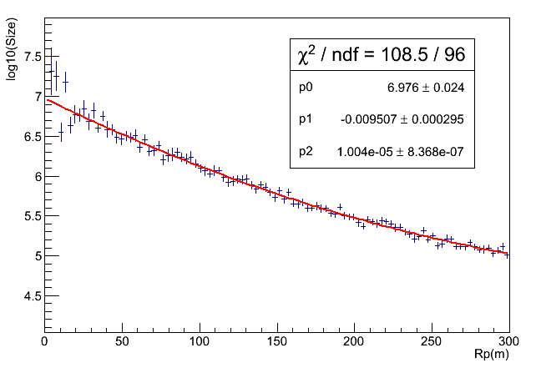
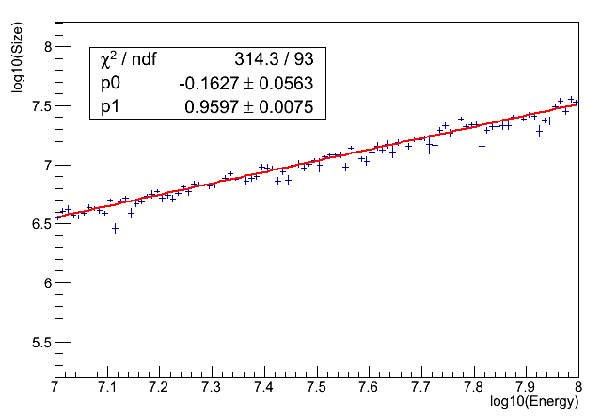
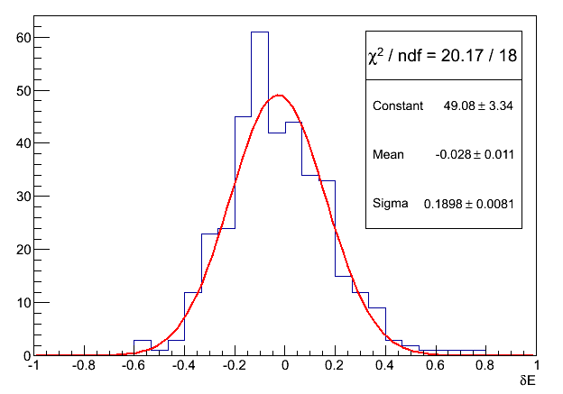


Energy reconstruction
The reconstructed energy is a function total Npe recorded by WFCTA and Rp
Energy resolution
  <20% (Rp<100m)
  <25%(Rp<200m)
  ~30%(Rp<300m)
Rp<100m
Rp<200m
Rp<300m

Slide 22
Summary
Due to the low energy threshold of LHAASO detectors, energy scales of the detectors can be obtained by crossing calibration with direct measurements
Proton or proton + helium spectra can be obtained by WCDA, KM2A, WFCTA with high statistics and high purity 90%
Iron spectra can be obtained by KM2A, WFCTA with 30 gold events at 100PeV and 87% purity
With multiple detectors LHAASO can measure individual spectra of cosmic rays in a broad energy range

