Slide 1
FCPPL2017
Status and Prospects of the LHAASO Experiment
Huihai He, IHEP, CAS
on behalf of the LHAASO collaboration
2017-3-28

Slide 2
Outline
Introduction
Gamma ray astronomy @ LHAASO
Project approval progress
Preparation for detector deployment
Early stage construction
Conclusion

Slide 3
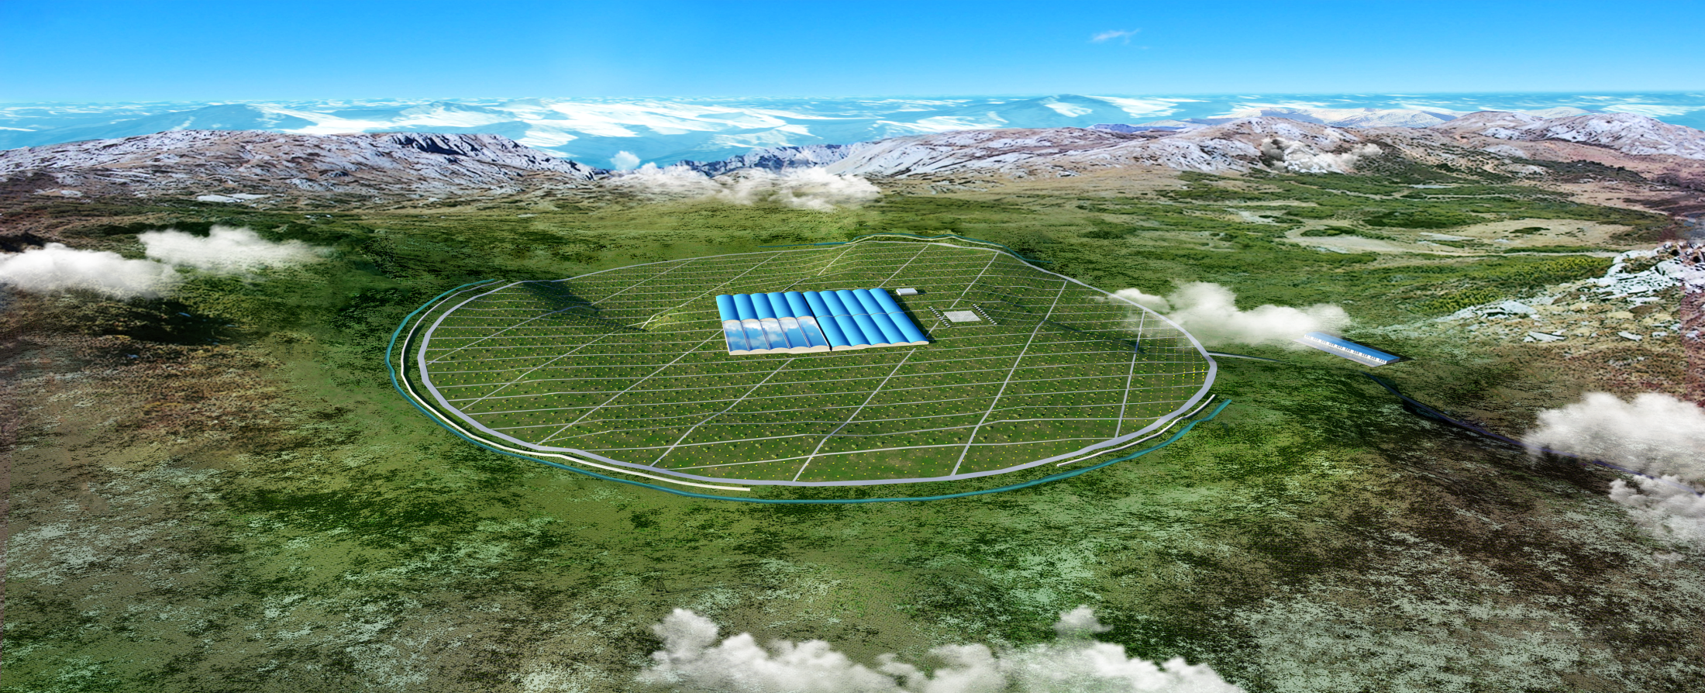
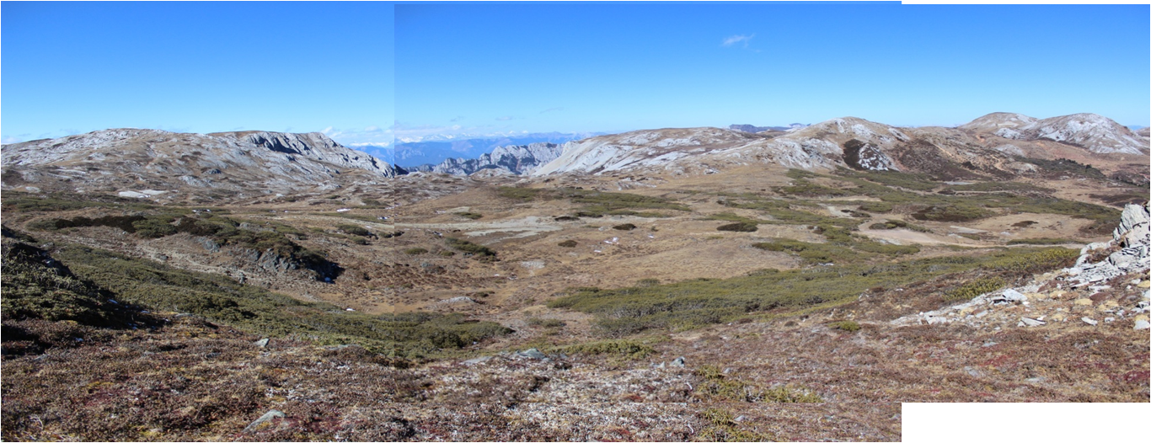
LHAASO: Large High Altitude Air Shower Observatory

Slide 4
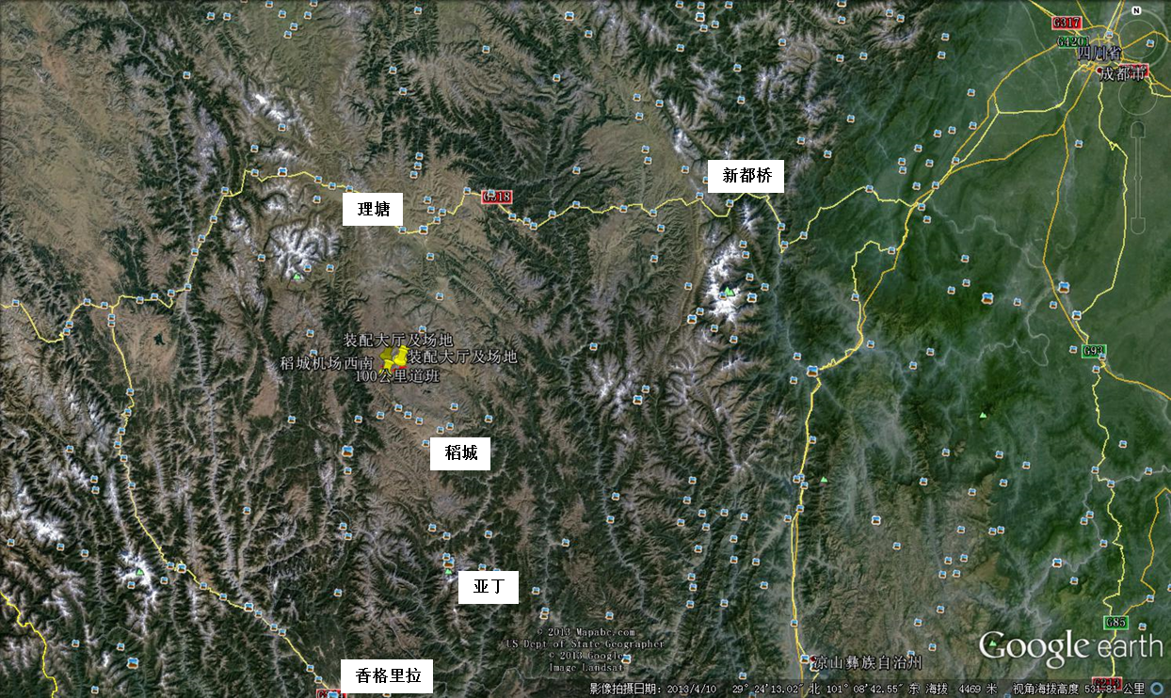
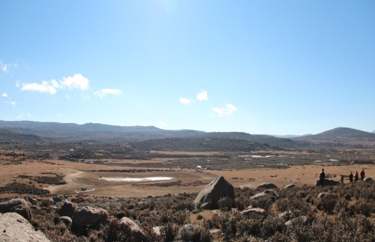
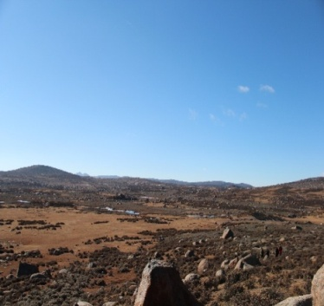
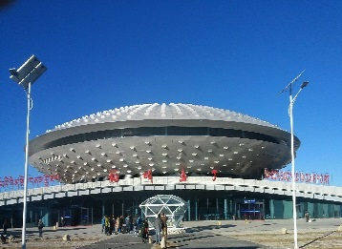
Mt. Haizi (4410 m a.s.l., 29º21’ 27.6” N, 100º08’19.6” E), Sichuan, China
Yading Airport 4410m
LHAASO 4410m

Slide 5
Major Scientific Goals
Origin of GCRs
  Searching for GCR sources by measuring SED with an unprecedented sensitivity of 1% Crab unit at 50 TeV
  Energy spectra for individual compositions with energy from 10 TeV to 1 EeV, where the spectrum knees are located
Gamma ray astronomy
  Searching for TeV gamma sources, especially extended and transient ones, with an unprecedented survey sensitivity of 1% Crab unit at 3TeV.
New physics frontier:
  dark matter, Lorentz invariance, new physics beyond LHC energy, etc
(Lingling Ma’s talk)

Slide 6
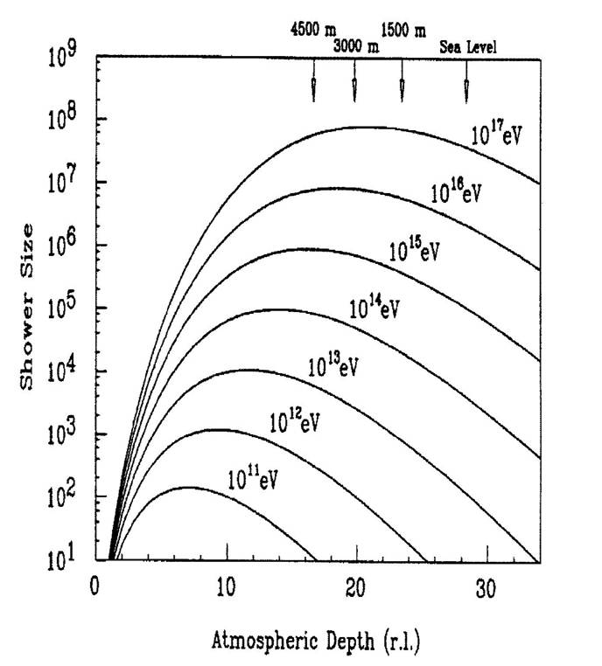
Measurement of air showers at high altitude
HE: near Xmax →lower fluctuation, better σ_{E}
LHAASO
Lower E_{th} →deeper, more sources

Slide 7
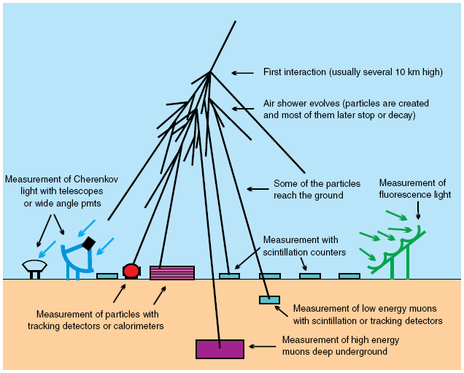
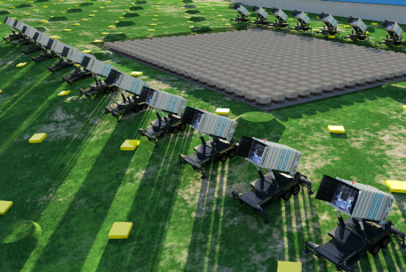
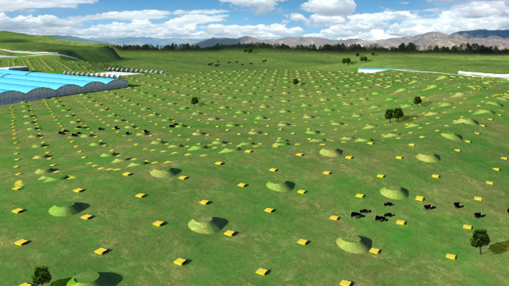
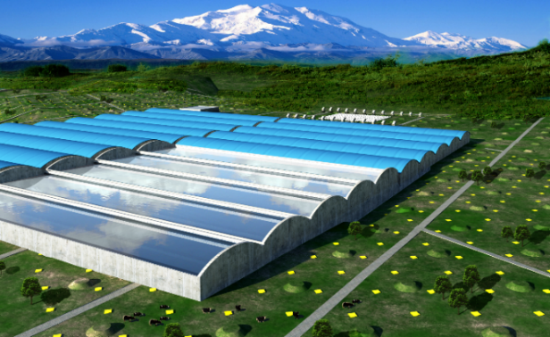
Hybrid Detection of Extensive Air Showers by LHAASO
WCDA:
3000 cells
WFCTA:
12 telescopes
1024 pixels each
KM2A:
5195 EDs
1171 MDs

Slide 8
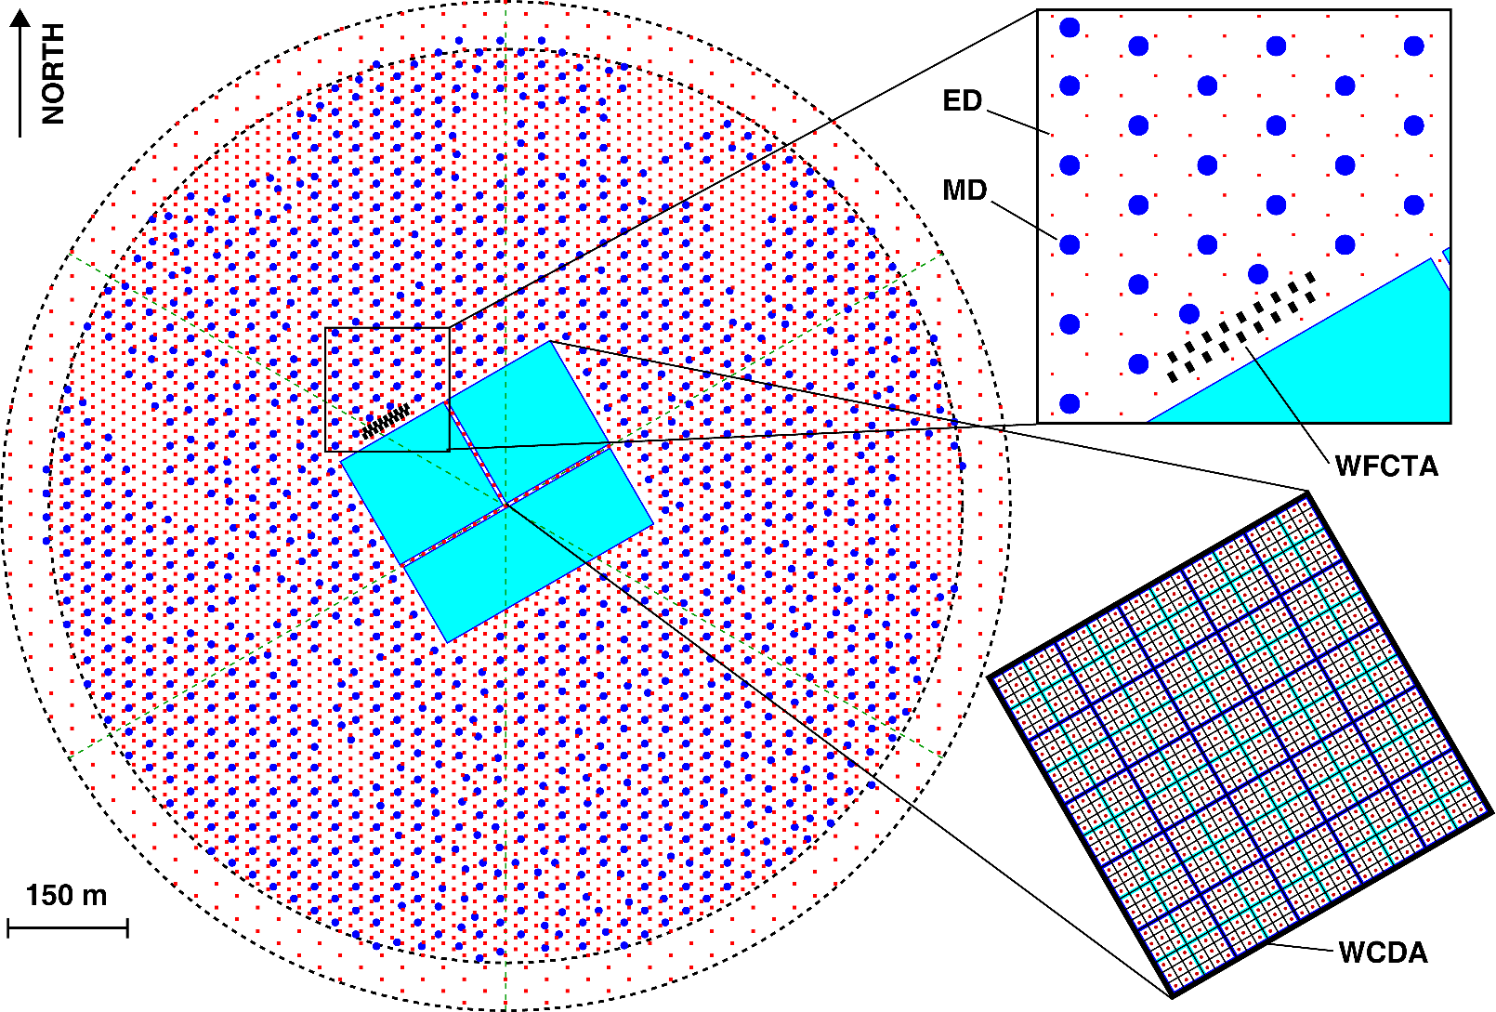
LHAASO layout
5195 EDs
  1 m² each
  15 m spacing
1171 MDs
  36 m² each
  30 m spacing
3000 WCDs
  25 m² each
12 WFCTs

Slide 9
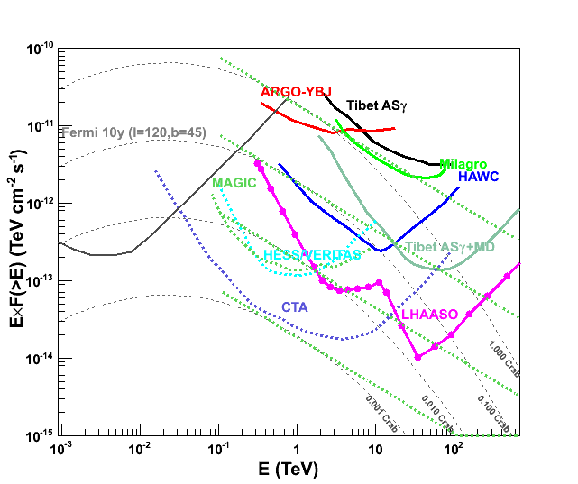
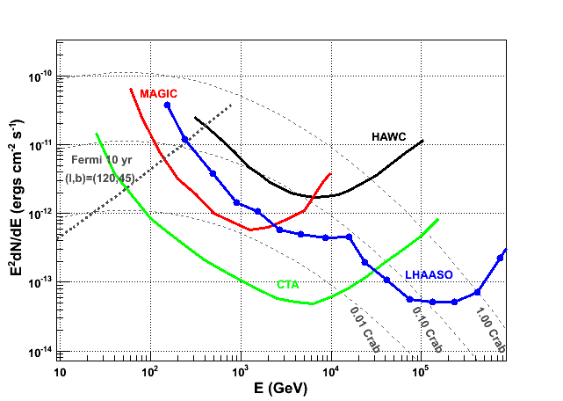
Sensitivity to gamma ray sources
Integral: 1% Crab unit @3TeV & 50TeV
Integral differential

Slide 10
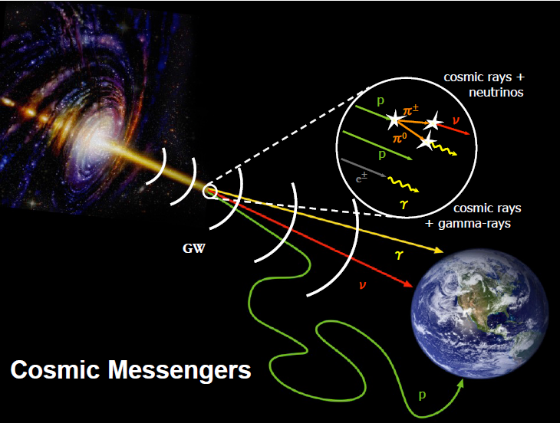
Origin of GCRs
1 ev/cm³
  Where→ Source
  How → Acceleration
  What → Propagation
  Global vs. local

Slide 11
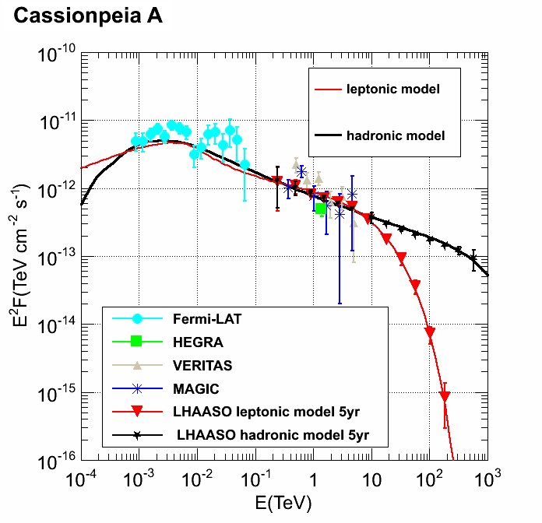
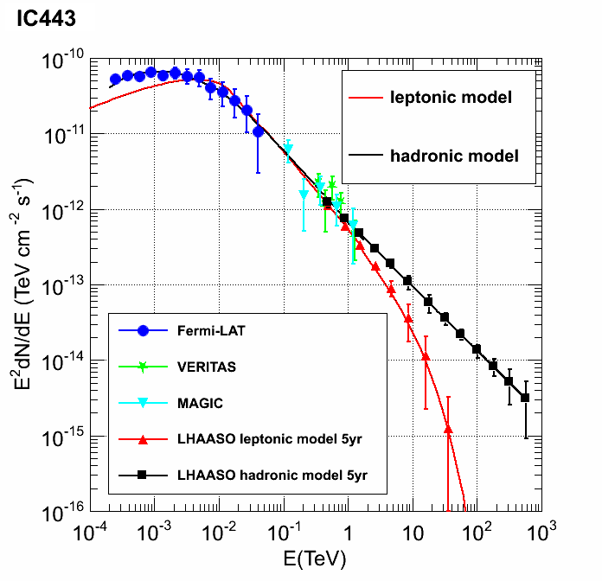
Hadronic vs. Leptonic
Characteristic signatures of π⁰ decay:
  at highest energy by LHAASO
10.1126/science.1231160
Historical SNRs
interacting with molecular clouds

Slide 12
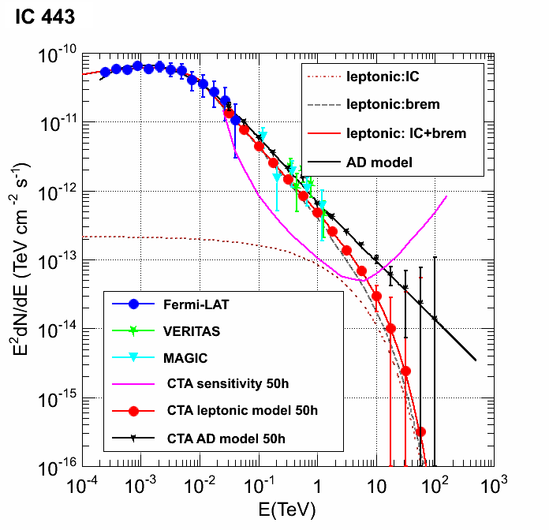
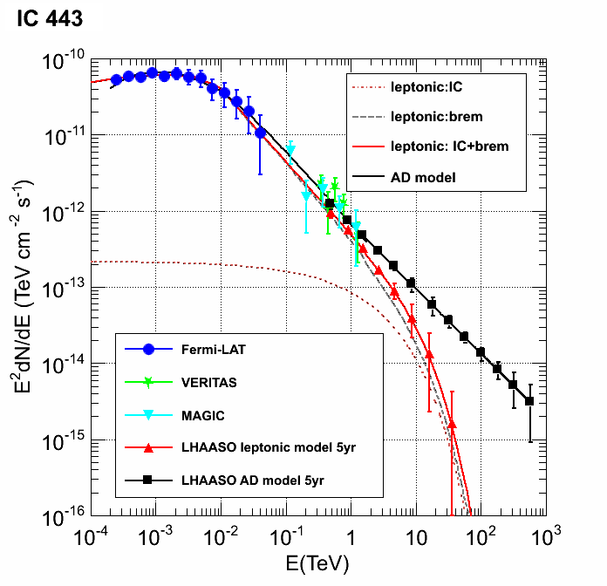
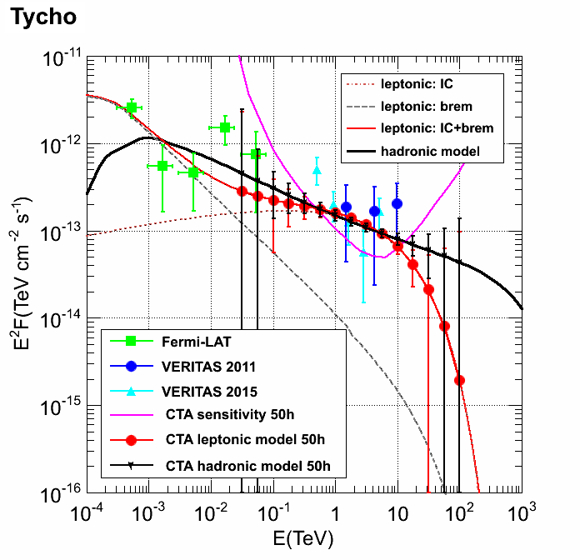
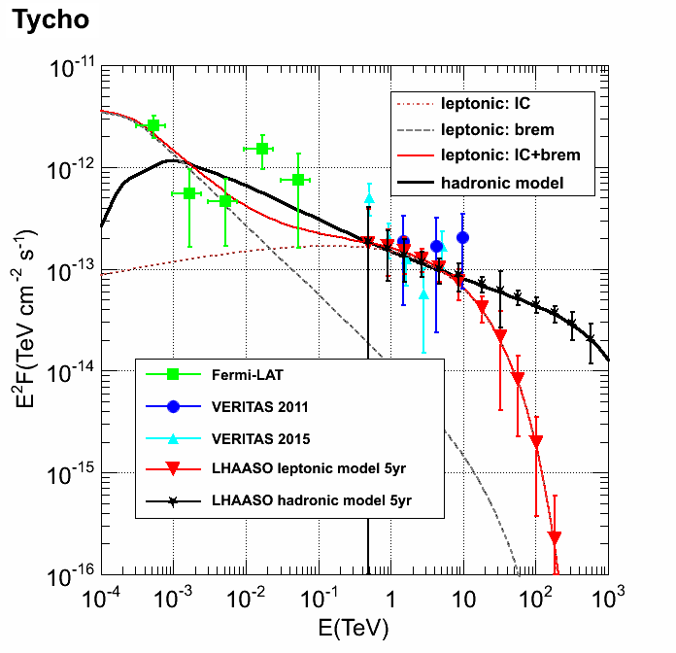
GCR signature @ the highest energies
A LHAASO-like sensitivity is mandatory
@CTA
@LHAASO

Slide 13
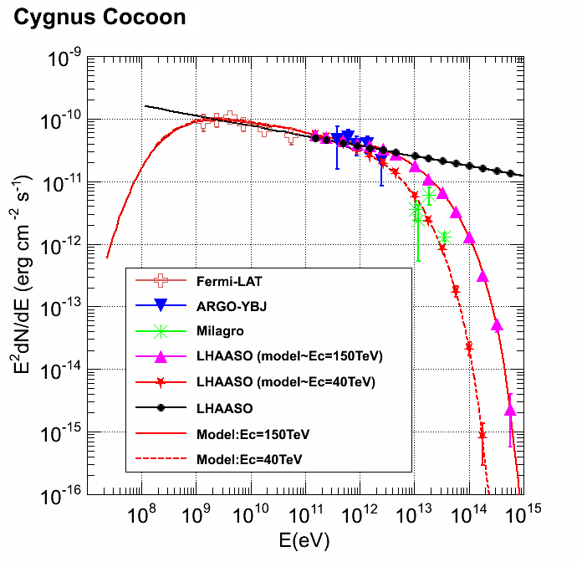
Acceleration limit of GCR sources
An effective probe to the cut-off energy of GCRs (knee)

Slide 14
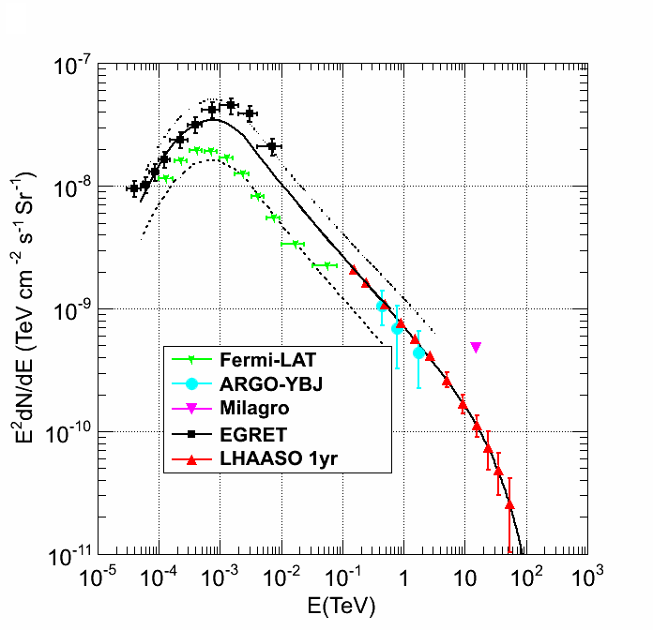
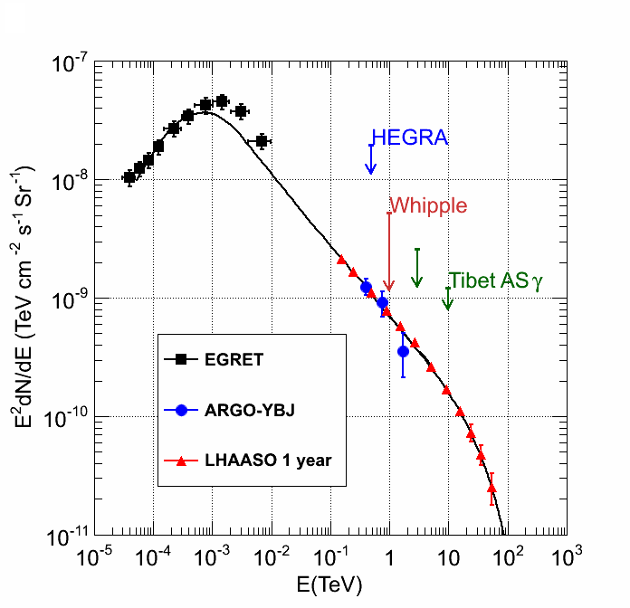
GCR spectrum and density:
global vs. local, diffuse emission as a probe
wide FOV is mandatory
Ec=50TeV
25° < l < 100°, |b|< 5°
Cygnus region

Slide 15
Gamma ray astronomy

Slide 16
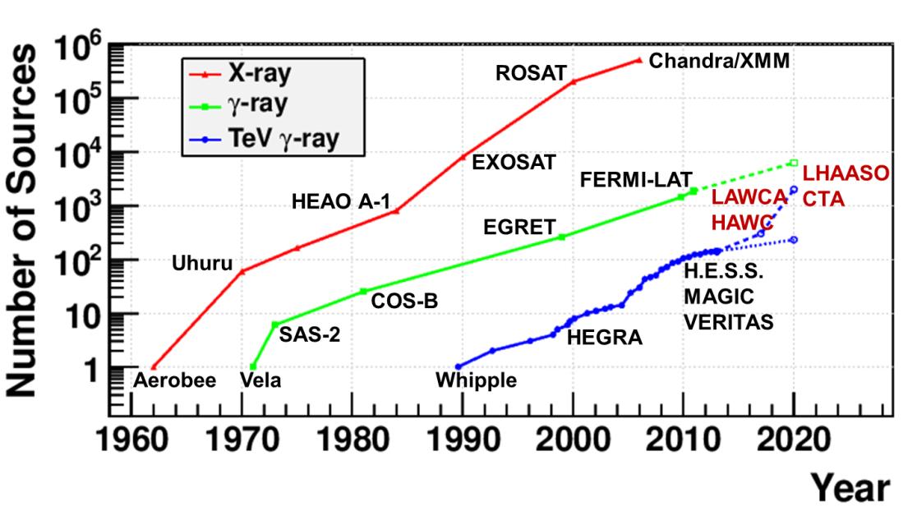
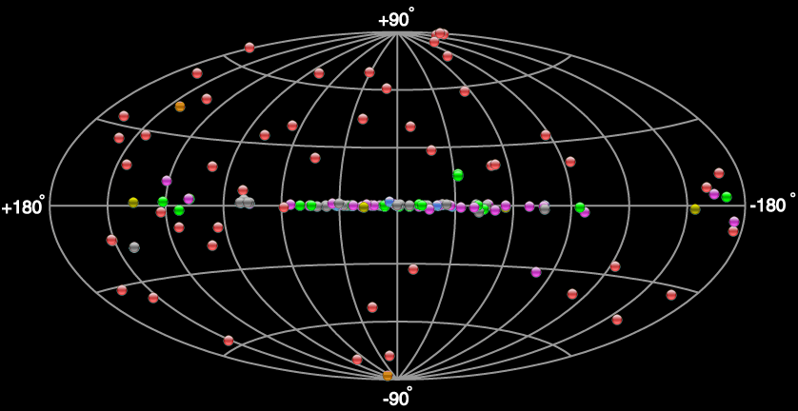
Survey of the γ sky
LHAASO FOV: 60% of the whole sky
Full duty cycle

Slide 17
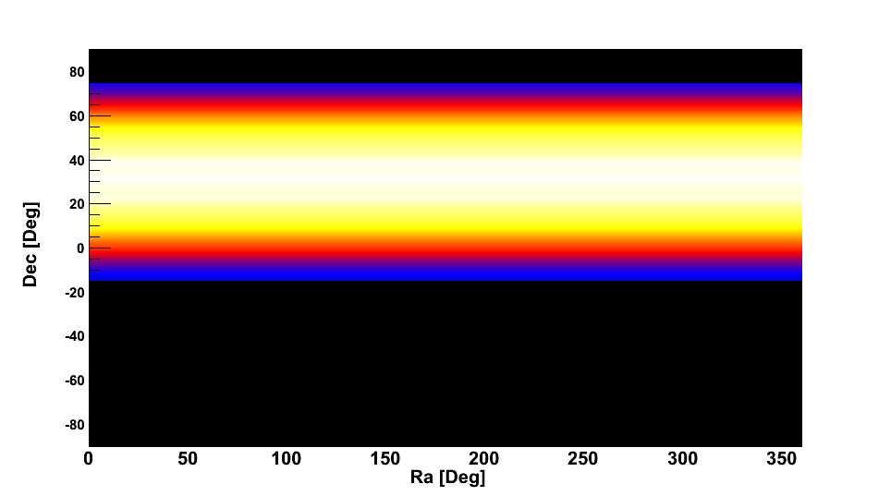
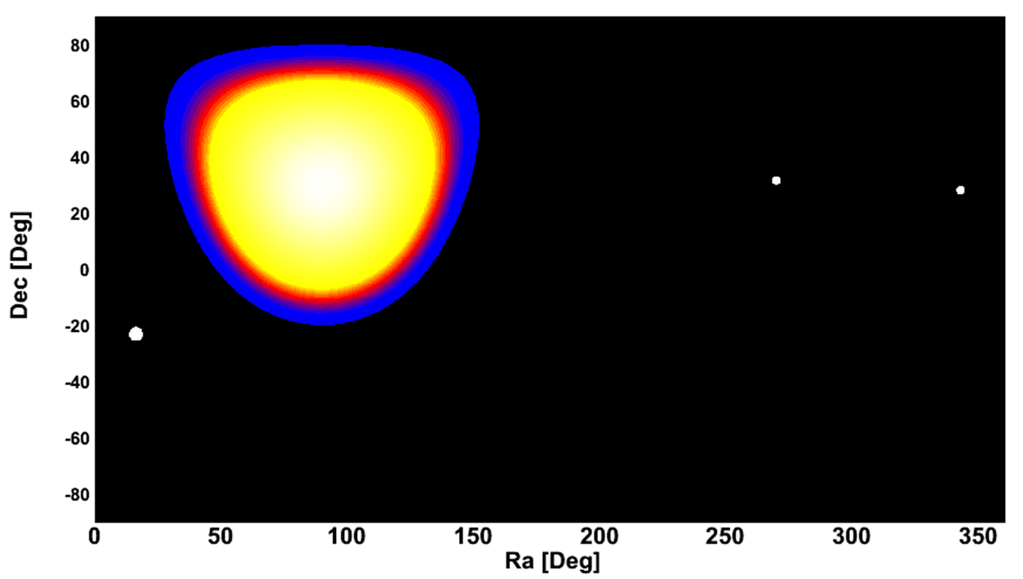
Wide FOV
1/7 of the sky at each moment
60% of the sky every day
LHAASO
MAGIC
VERITAS
HESS
Diurnal FOV

Slide 18
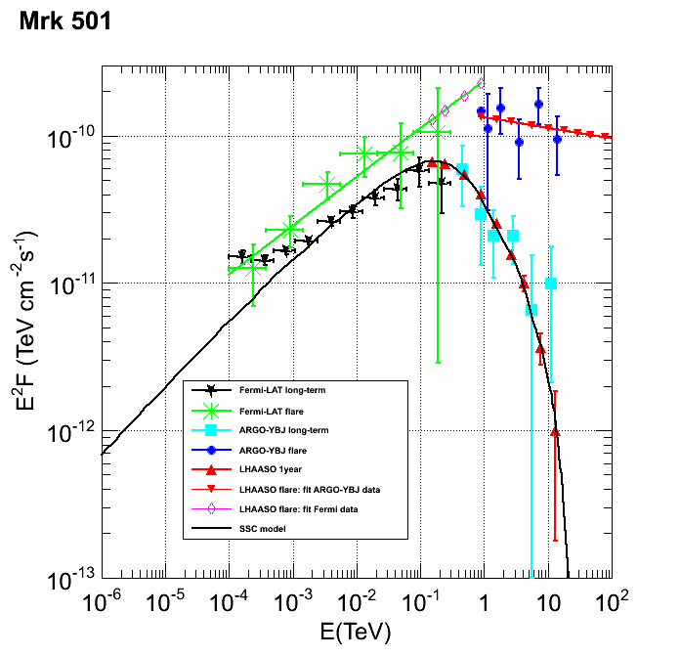
Transient Phenomena: multi-wavelength study
Duration | Sensitivity (Crab Unit)
1 year | 0.013
6 months | 0.019
3 months | 0.026
1 month | 0.078
10 days | 0.20
3 days | 0.72
1 day | 2.0
2 hours | 7.0
1 hour | 10.8

Slide 19
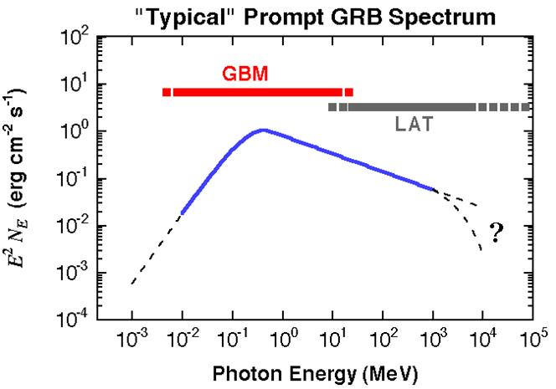
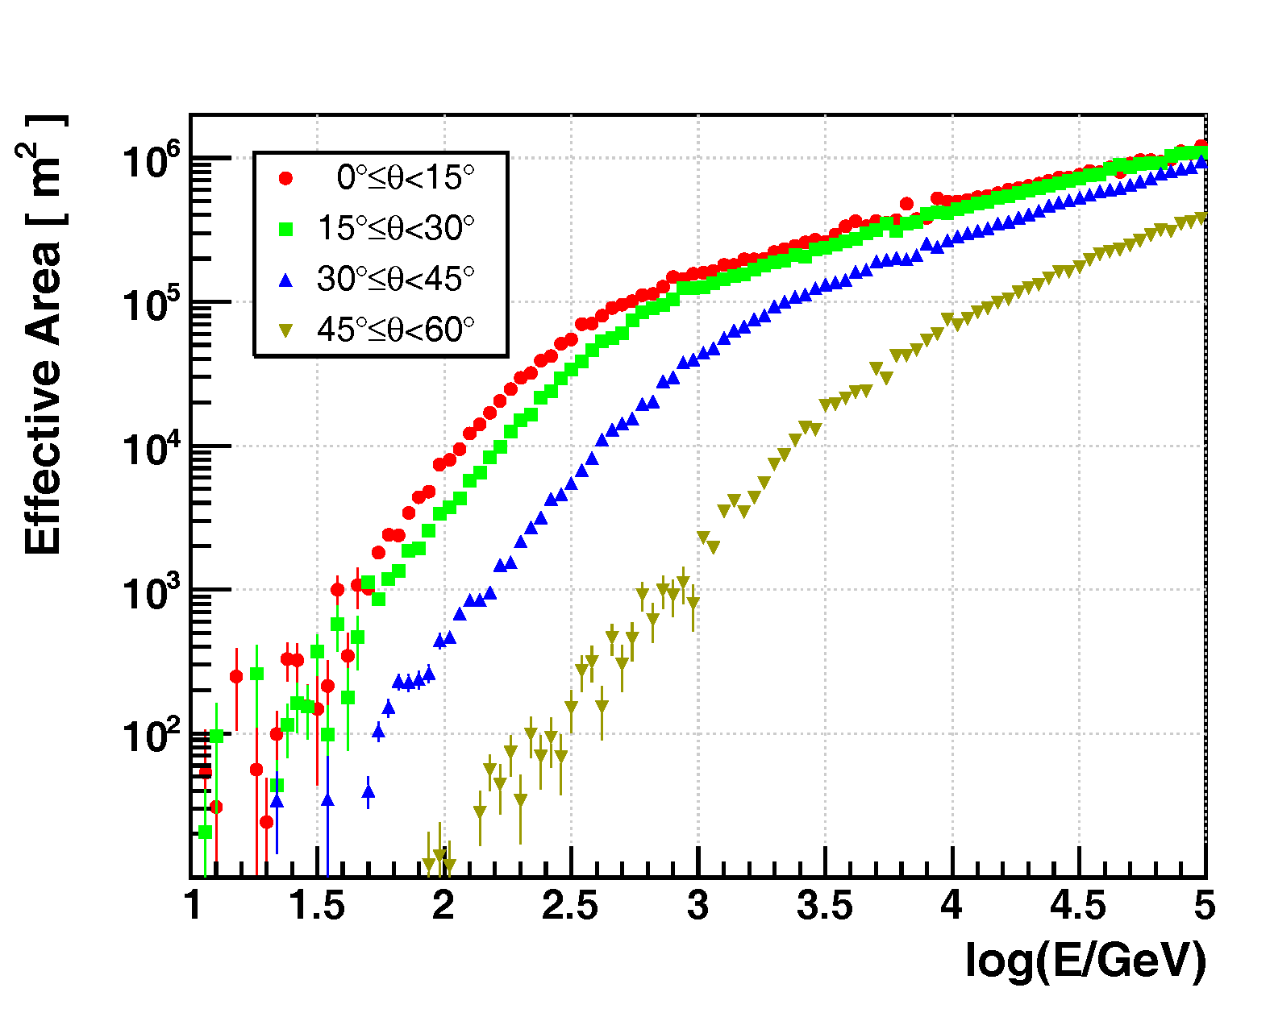
Gamma ray bursts
LHAASO

Slide 20
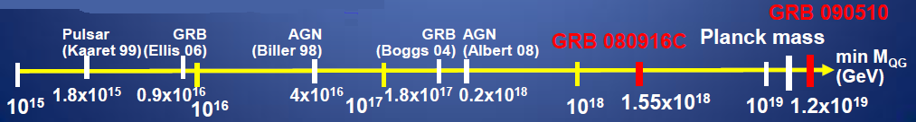
LHAASO @ LIV
GRB/AGN
LHAASO vs. Fermi-LAT
  Aeff@100GeV ×5000
Mass scale ×10
Fermi-LAT: one 31-GeV γ，delay<1s
X.F. Feng

Slide 21
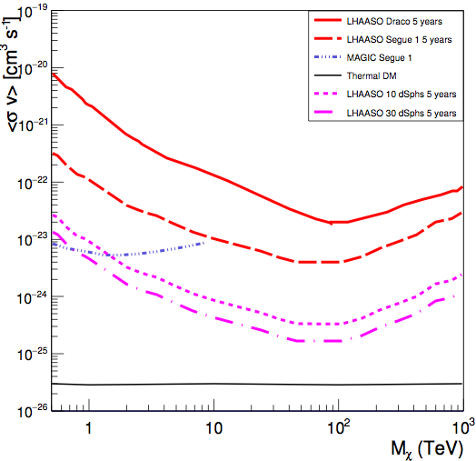
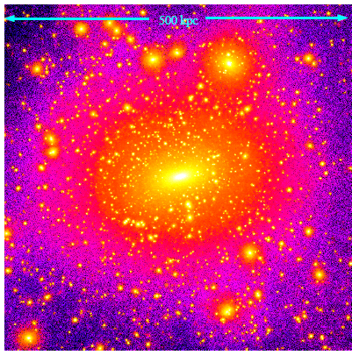
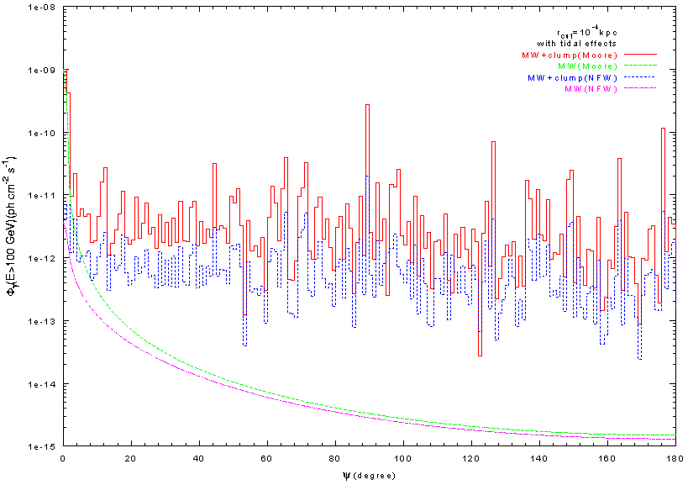
LHAASO @ Dark Matter
Decay/annihilation
  dwarf spheroidal galaxies
  clustering
Large FOV、High sensitivity
PRELIMINARY !
ARGO sensitivity
LHAASO sensitivity
Reed et al, MNRAS357,82(2004)
γ-rays from smooth bkg

Slide 22
Progress of Project Approval
Proposal approved on Dec. 31, 2015
EIA, ESA, …… approved
FSR approved
Expectations:
  TDR review & approval: Apr. 2017
  Detector construction: Apr. 2017

Slide 23
LHAASO Construction Schedule
project | LHAASO Construction period （month）
Capital construction | 24
Detector production | 36
Setup and test |  | 36
Testing run |  |  | 28
Full run |  |  |  |  |  | 2
Duration: 4 years
Different detectors will go parallel
¼ will be finished and start to take data by the end of the 2nd year (i.e. 2018)

Slide 24
Total Budget: ￥1,200 M
Project: 900 M (NDRC)
  Detector and assembly，test，partial operation，etc.
Local Matching: 300 M (Sichuan Province)
  Land, power, road, civil construction, etc.
Local funding:
  100 M (2015)
  150 M (2016)
  50 M (2017)
Operation money:
  1.2 M (2018)
  4.8 M (2019)
  6 M (2020)

Slide 25
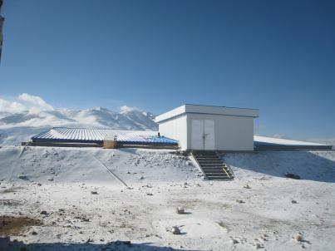
LHAASO R&D
2008-2016, 8 years
Engineering array ~1% of LHAASO @ YBJ
  42 EDs, 2 MDs, 9-unit WCDA, 2 telescopes …
  Fully implementing the LHAASO designs, including WR-based clock distribution, “triggerless” DAQ, etc
  Operated for years
See published papers for details

Slide 26
Preparation for detector deployment

Slide 27
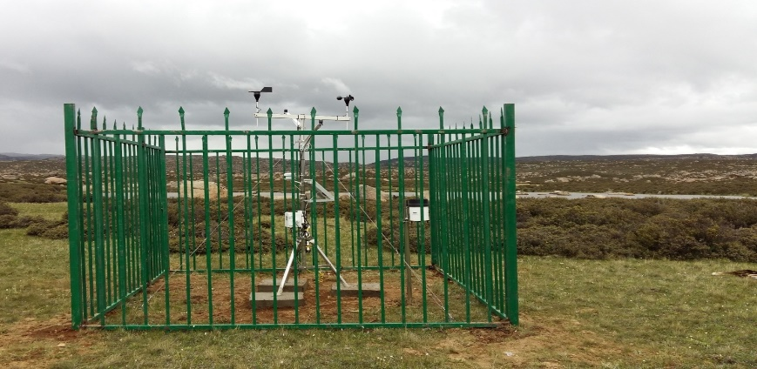
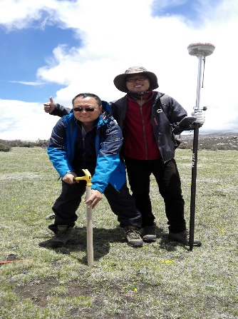
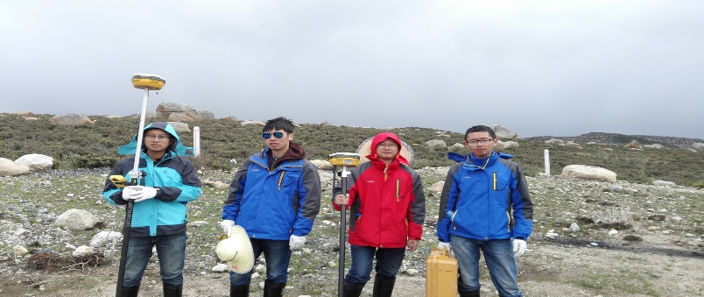
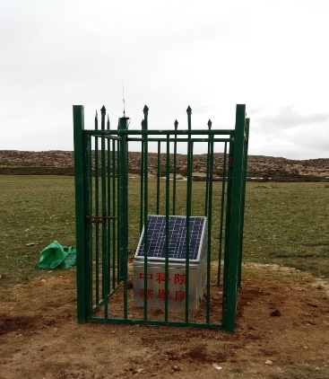
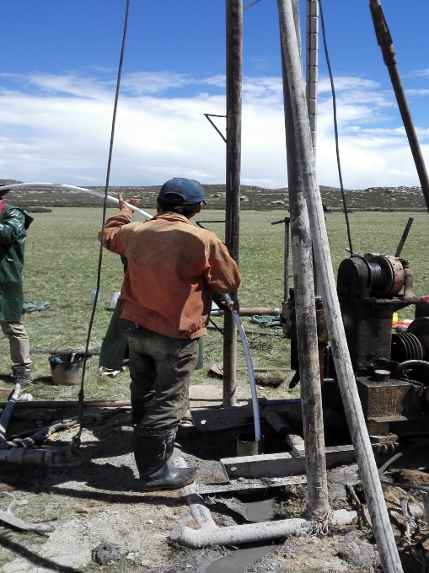
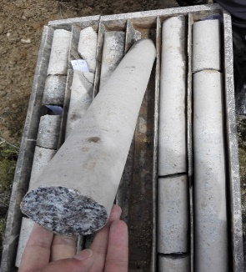
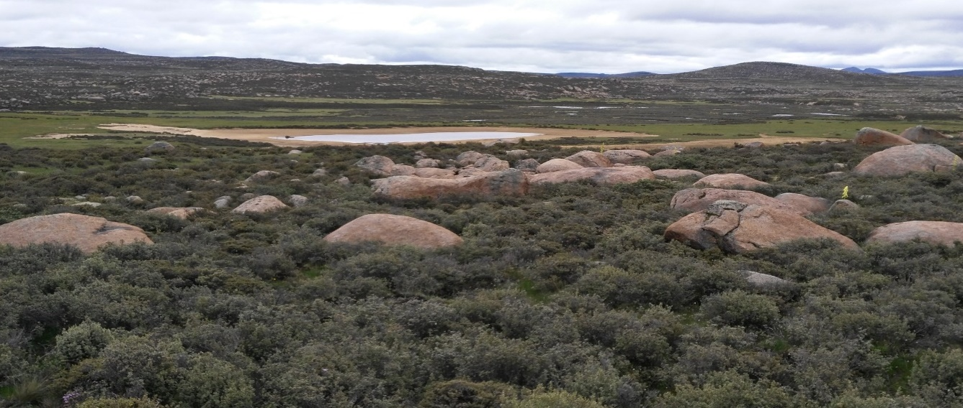
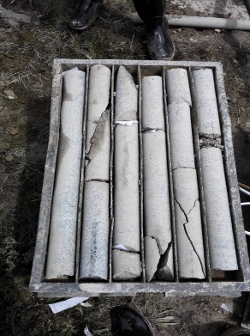
Activities @LHAASO site
Meteo-station
Soil-temperature measurement
MD sites
Site boundary survey
Mt. Haizi (4410 m a.s.l.), Sichuan, China, July 2015
Deep geo-survey, July 2015

Slide 28
LHAASO layout
5195 EDs
  1 m² each
  15 m spacing
1171 MDs
  36 m² each
  30 m spacing
3000 WCDs
  25 m² each
12 WFCTs

Slide 29
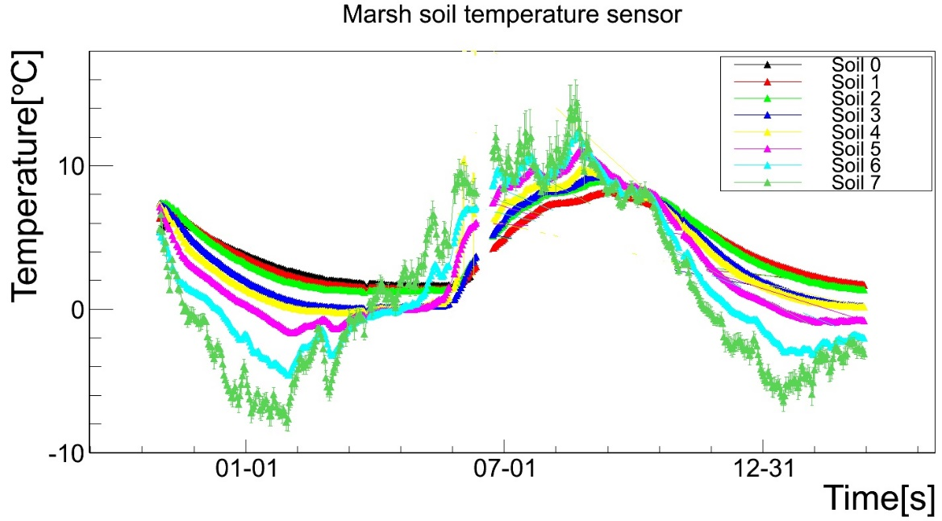
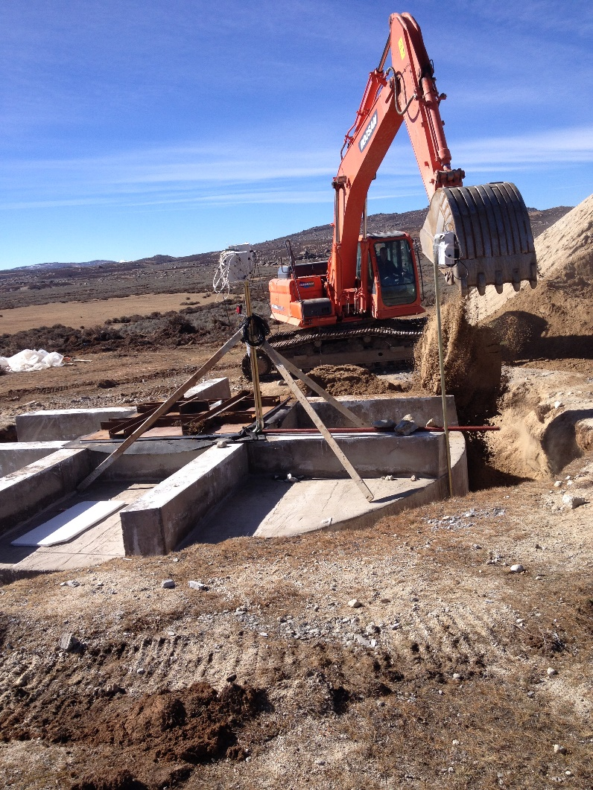
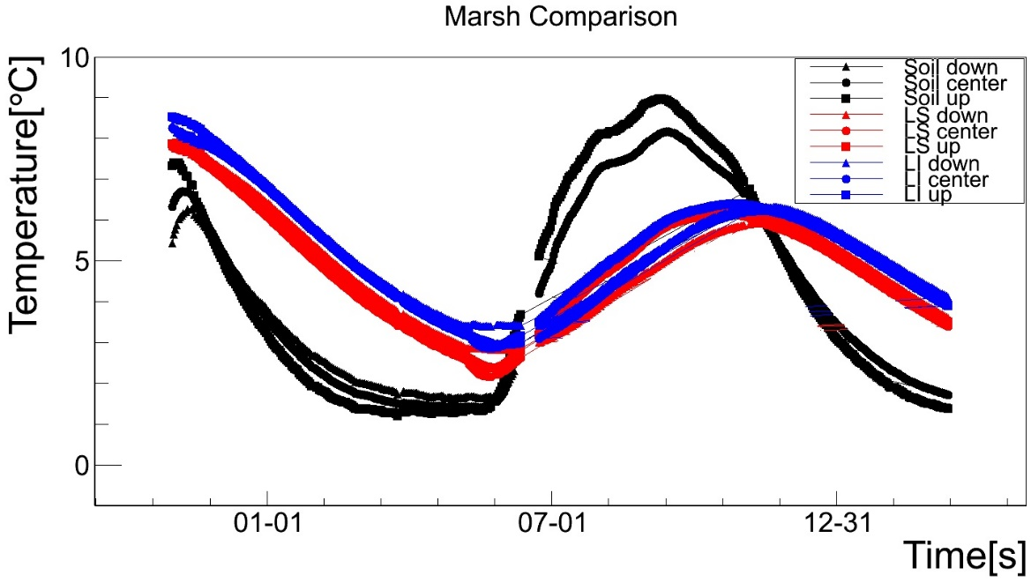
MD anti-freezing
3 prototypes @ LHAASO site.

Slide 30
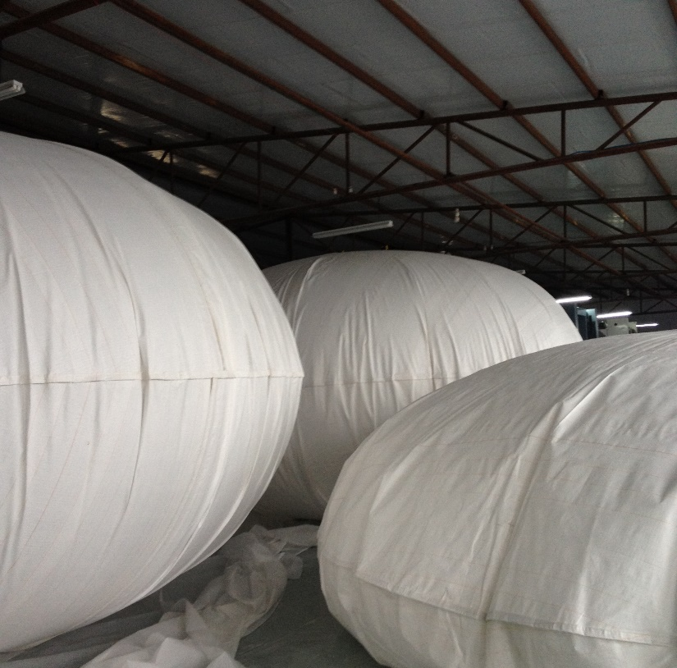
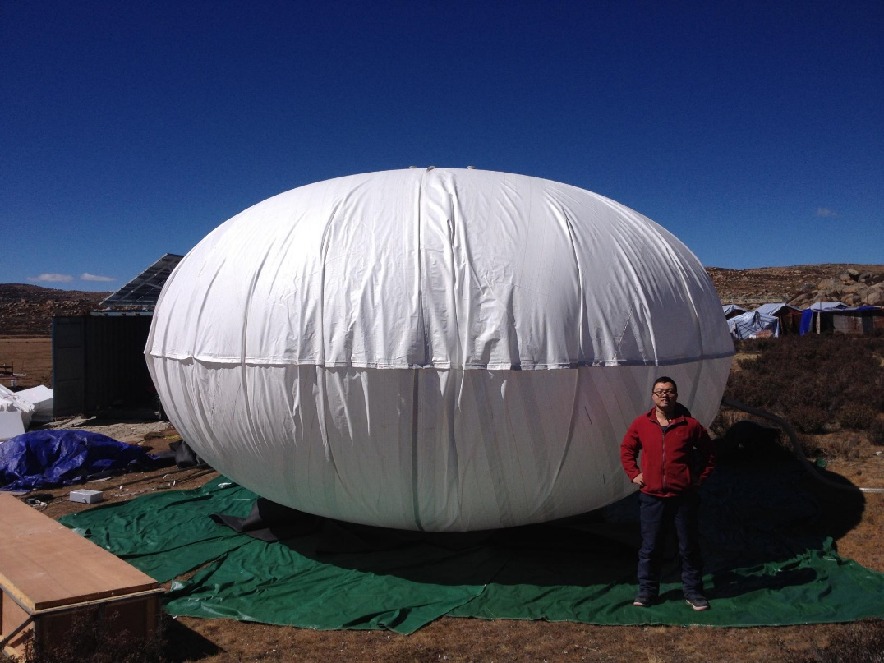
MD water bag: production & test

Slide 31
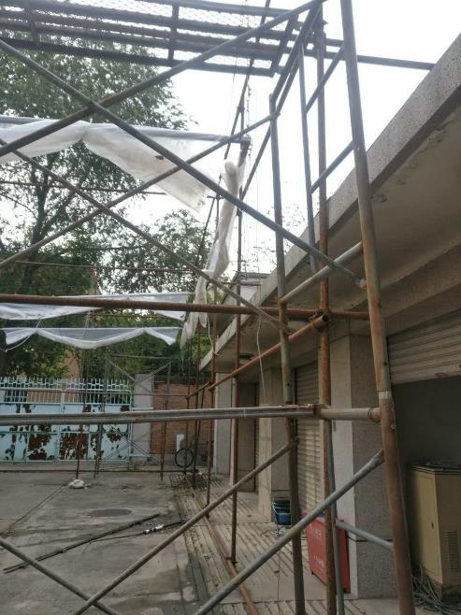



WCDA: curtain & PMT installation

Slide 32



WFCTA: mirror installation

Slide 33
Early Stage Construction
Living base in the downtown
35 KV transmission line
Site preparation

Slide 34




Living Base (3750 m a.s.l.)
North region of the downtown
N
We are here
We are here

Slide 35




Started in Aug. ,2016, will be completed in May, 2017

Slide 36




35KV Transmission Line
29 km Sangdui village → LHAASO site, 92 towers
3800 m → 4410 m a.s.l.
Notes:
Switch station
Transformer substation

Slide 37






Site Preparation
Notes:
Canal, flood gate
Vegetation restoration, Humus layer, Plant seed

Slide 38
Everything will be ready by the end of May, 2017, and then, detector deployment will start.
See you at the LHAASO site!

