Slide 1
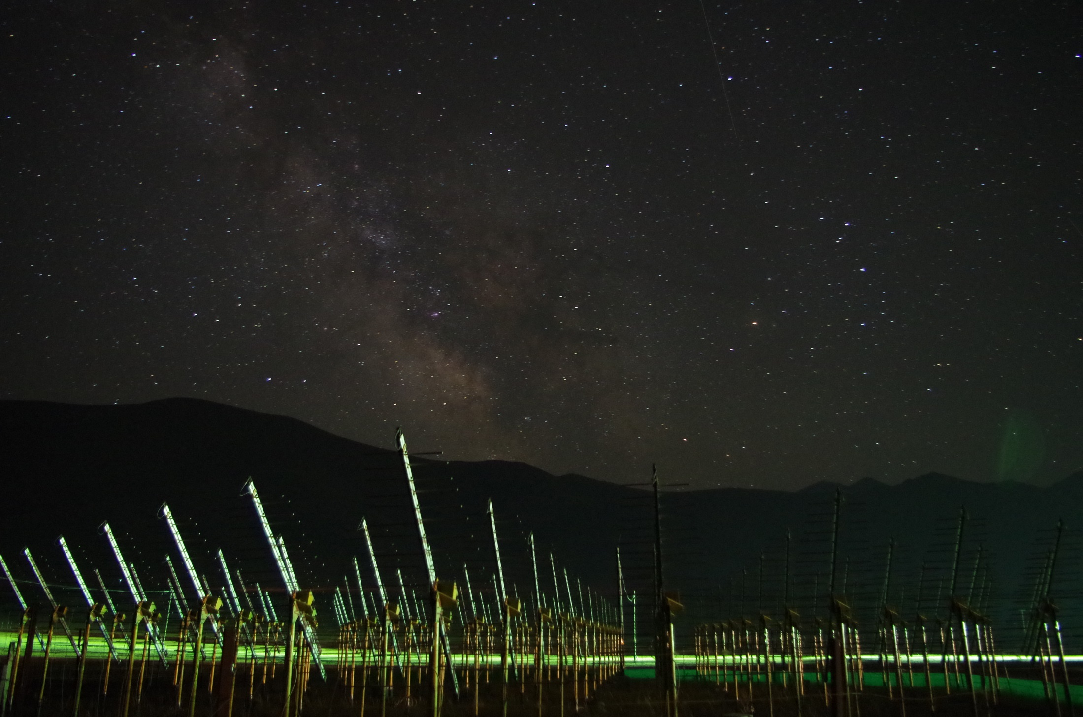
Milky Way over the 21CM array (Gu Junhua)
The Giant
Radio
Array for
Neutrino
Detection
Why VHE neutrino astronomy?
Proposal for a Giant Radio Array for Neutrino Detection
Steps towards GRAND completion
Olivier Martineau
FCPPL workshop, March 28, 2017

Slide 2
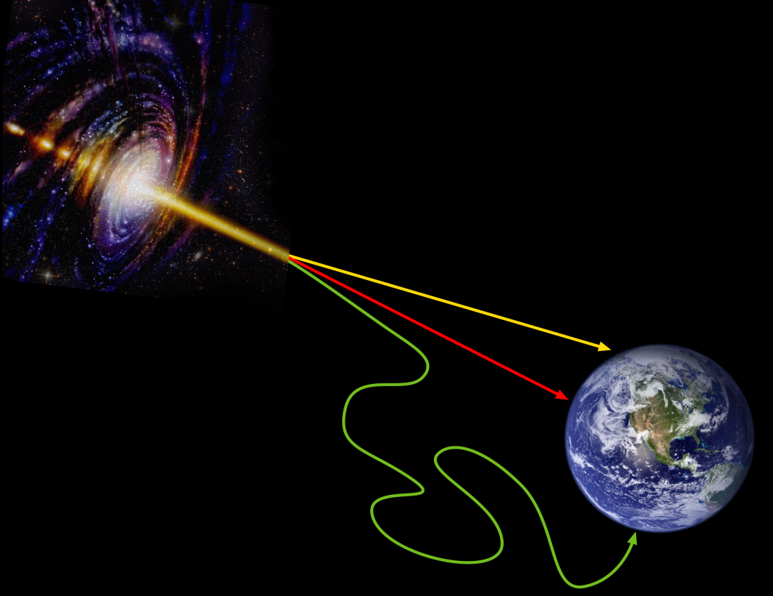
GRAND: primarly
a telescope for EeV neutrinos
of astrophysical origin
ν
γ
cosmic
rays
Neutrino mean free path ~ 10Gpc

Slide 3
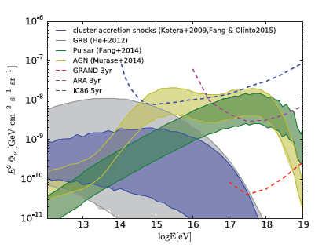
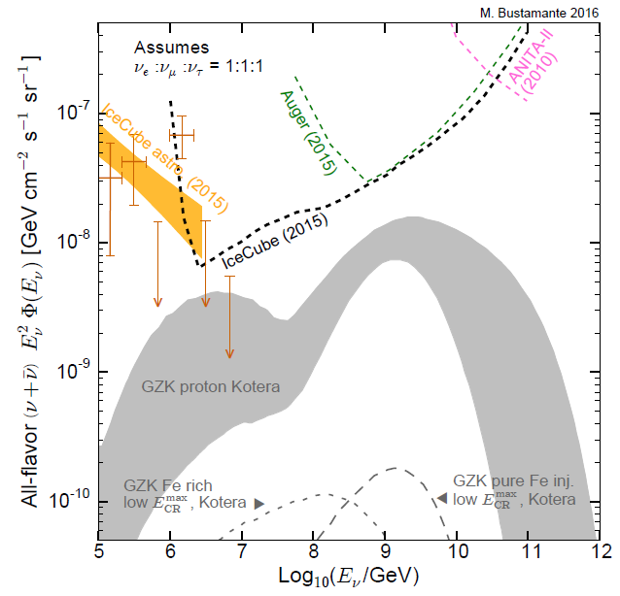
EeV neutrinos sources
$$\text{Cosmogenic} \text{neutrinos}\text{:} UHECR_{E>{10}^{19.5}eV}+γ_{CMB}→ … →ν_{μ}+{\overline{ν}}_{μ}+ν_{e}+…$$
$$\text{P}\text{robing} \text{UHECRs} \text{composition}\text{ \& }\text{sources} \text{evolution}$$
M. Bustamante
Target sensitivity: guaranted detection & 100s of evts/year if large flux
Ε²φ = 10⁻¹⁰ GeV.cm⁻².sr⁻¹.s⁻¹ sensitivity
would make detectors able to detect neutrinos @ source (AGNs, pulsars, …) and perform neutrino astronomy!

Slide 4
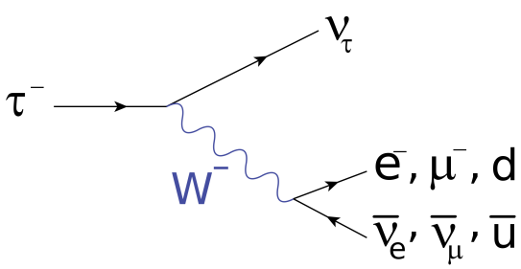
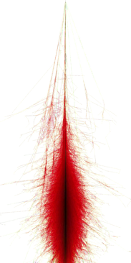
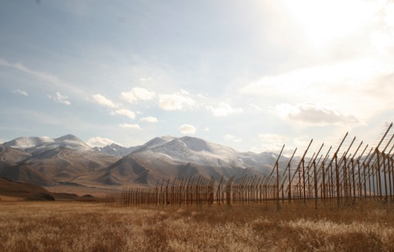
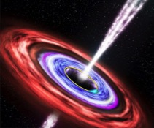
EeV neutrino detection
τ
ν_{τ}
Rock target:
Principle:
ν-induced tau decays in atmosphere generate ~horizontal extensive air showers.
[Fargion astro-ph/99066450, Bertou astro-ph/0104452]
Issues:
Earth-skimming trajectories
VERY seldom events → requires HUGE detectors

Slide 5
~Horizontal EAS radio emission
max (Efield)
[µV/m]
ZHAireS Efield computation
W. Carvalho
30-80MHz
2 10¹⁷eV tau decay @ origin
Subsequent shower:
E = 1.4 10¹⁷ eV
θ = 89.5°
Tau
decay
Typical sky
noise level: 15µV/m
[30-80MHz]
Shower axis
Longitudinal distance [km]
Lateral distance [km]

Slide 6
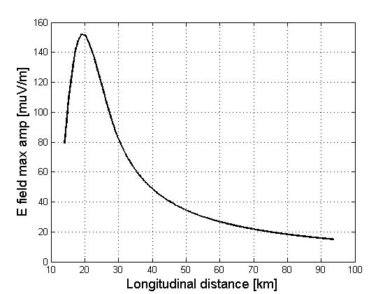
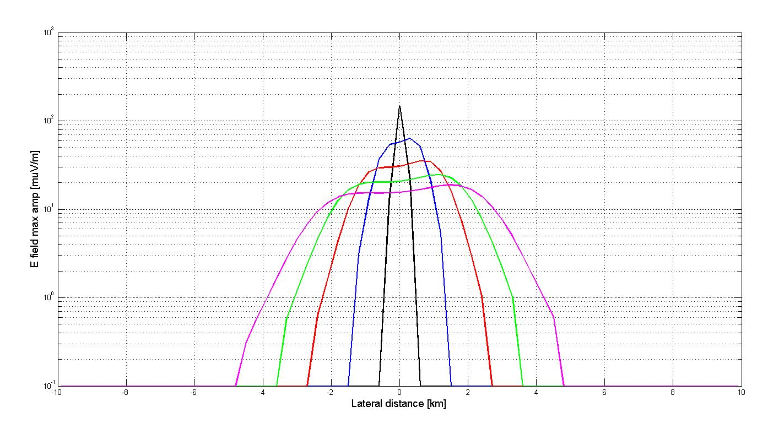
(Very) inclined EAS radio emission
2 10¹⁷eV shower
d_{decay} = 18km
36km
54km
73km
91km
2 10¹⁷eV shower
Sky noise level
Sky noise level
Shower viewed from the side
Strongly beamed radio emission certainly an asset for horizontal shower detection. Radio antennas facing the shower (e.g. on mountain slopes) could be very efficient detectors!

Slide 7
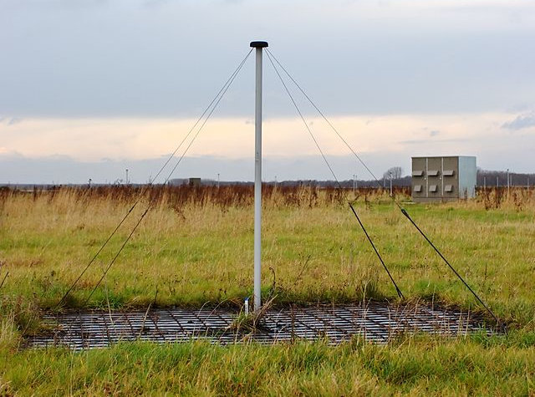
A cheap EAS radio detection unit?
a LOFAR antenna
Basic ⬄ cheap
P. Lautridou (2011)

Slide 8
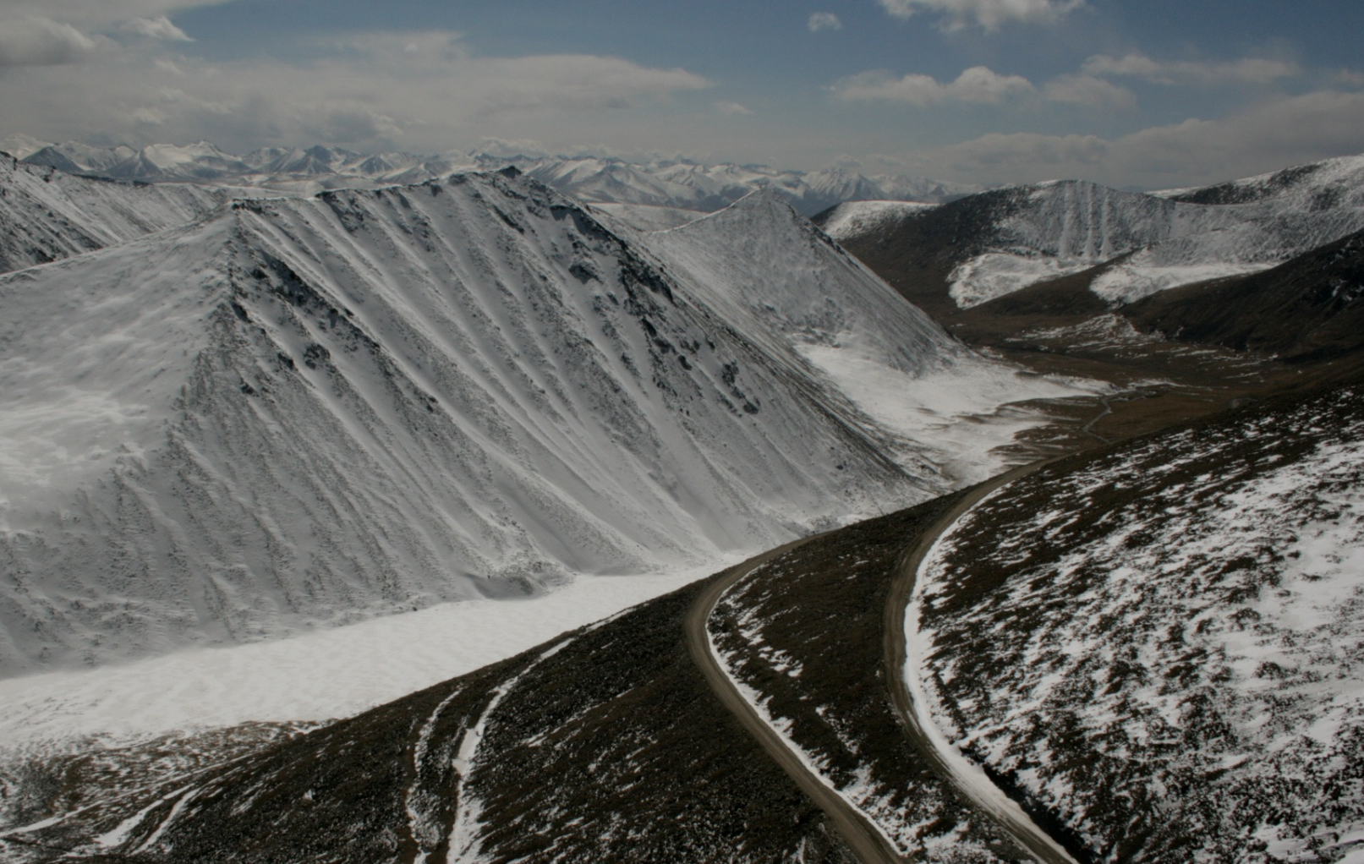
Size of the neutrino detector is a key parameter.
>10000 km²?
- technical capacity?
- topology?
Ulastai
a GIANT array may be technically & financialy feasable!
… How well would it perform?

Slide 9
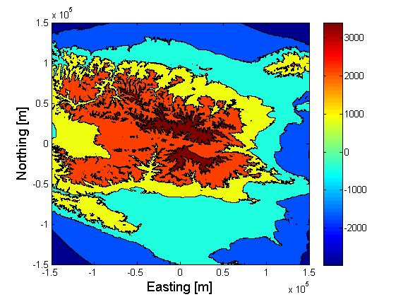
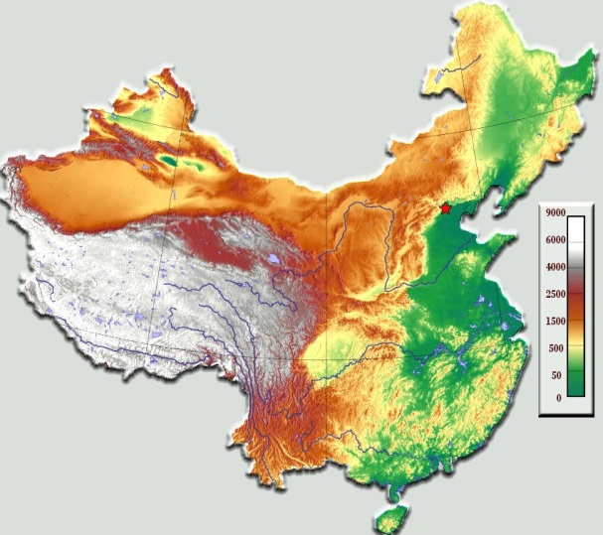
GRAND ν sensitivity study - Setup
Simulation layout of 90’000 antennas over 60’000km² (800m step size square grid)
MC down to τ decay (E_{ν} in 10¹⁷ - 10²¹ eV, θ in [85-95°])
Shower radio emission:
Not yet validated for
very inclined showers
(Very) time consuming
Preliminar study with
radio signal parametrization
(trigger volume = cone with
shape = f(E) determined through
ZHAireS simulations) .
Northing [km]
+150
+100
+50
0
-50
-100
-150
Urumqi
Ulastai
-150 -100 -50 0 +50 +100 +150
Easting [km]

Slide 10
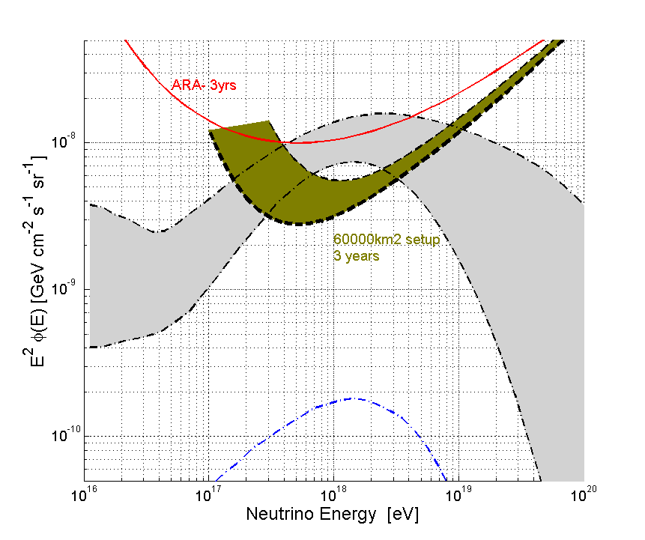
GRAND ν sensitivity study - Results
Sensitivities > 0 for zenith values = ±4° around horizontal ⇨ Earth-skimming trajectories only.
Mountains are sizable targets (~40% of total).
Earth becomes opaque at highest energies
3.10²⁰eV
3.10¹⁹eV
3.10¹⁸ eV
3.10¹⁷ eV
Upward
Going
(Earth)
Downward
Going
(mountains)
- 60’000km² simulation setup
- single flavor flux φ(E)= φ₀E⁻²
- no candidate in 3 years
⇨ 90% CL integral limit:
Ε²φ < 2 10⁻⁹ GeV.cm⁻².sr⁻¹.s⁻¹
Not good enough!
Not quite there!
All flavors

Slide 11
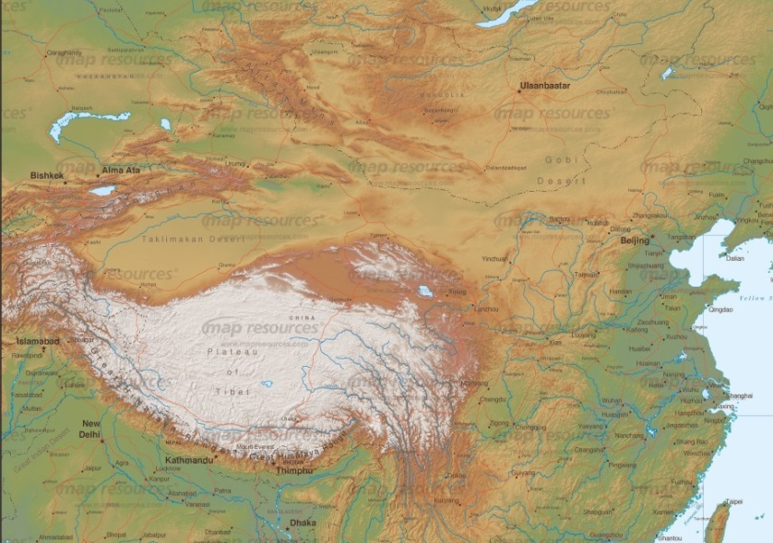
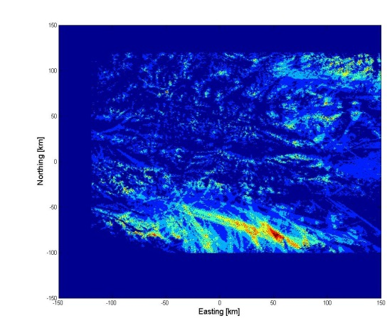
GRAND ν sensitivity study
Target sensitivity: E²φ = few 10⁻¹⁰ GeV.cm⁻².sr⁻¹.s⁻¹ range
(~10 times better than 60000km² simu result)
Driver: hotspot with favorable topography corresponds to factor >3 increase in sensitivity!
Giant simulation area (1’000’000 antennas over 1’000’000 km²?) to identify hotspots (using « generic » showers)
Huge simulation requests ➔requires clever +clean parametrization of shower radop-emission .
On-going work (W. Carvalho , K. De Vries, S. Le Coz, OM, C. Medina, V. Niess, M. Tueros & A. Zilles)

Slide 12
GRAND performances
Hotspot with favorable topology
enhanced detection rate!
x 10 in sensitivity for x 3 in surface
200’000km² could be enough to reach 1.5 10⁻¹⁰ GeV.cm⁻².sr⁻¹.s⁻¹ sensitivity.
Still to be confirmed.
Atop of that: great angular resolution thanks to mountains.
Median = 0.02°
Mean = 0.05°
f(Δθ>1°) = 0.2%
Ultimate resolution
assuming σ_{t} = 3ns
All flavors

Slide 13
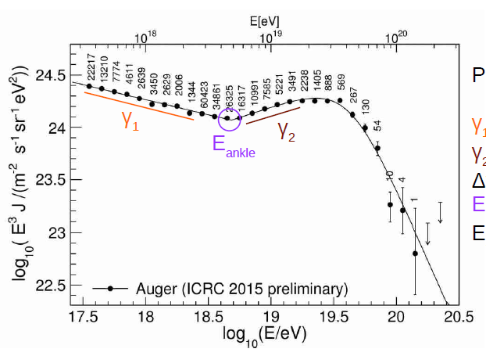
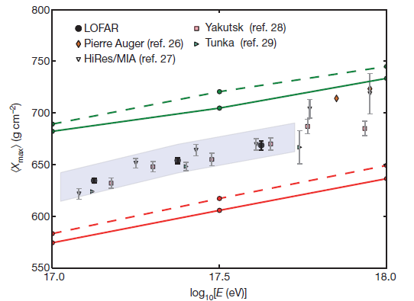
Physics with GRAND
Trans-GZK UHECRs:
significant stat achievable above 10¹⁹eV thanks to huge effective area (~AUGER x 15)…
Would be tremendous if good resolution achievable on X_{max}
➔ on-going study.
Fast Radio Bursts (?)
Epoch of Reionization (?)
Extreme atmosphere events (?)
Buitink et al., Nature
AUGER 2005-2015:
5 events above 10²⁰eV…

Slide 14
GRAND challenges
Autonomous radiodetection of ~horizontal showers?
Background rejection / event identification
Technological challenges: trigger, data collection, maintenance, …

Slide 15
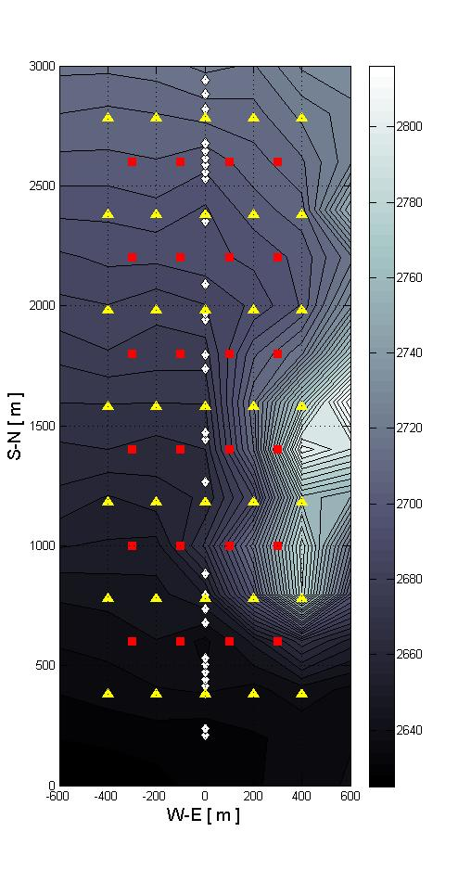
GRANDproto35 (2018-2020)
Antennas
Scintillators
TREND demonstrated that identification of EAS from radio data only is doable with high efficiency [see talk by S. Le Coz].
But results affected by poor setup reliability.
Build GRANDproto35 with
reliable antennas: 35 units with 3 arms ➔ polarization measurement
fast DAQ system: 100% duty cycle up to 1kHz trigger rate (developped @ LPNHE).
EAS nature cross-check: array of 24 scintillators on the radio array site, running independently. Allowing quantitative determination of radio detection efficiency and background rejection performances (project led by IHEP).

Slide 16
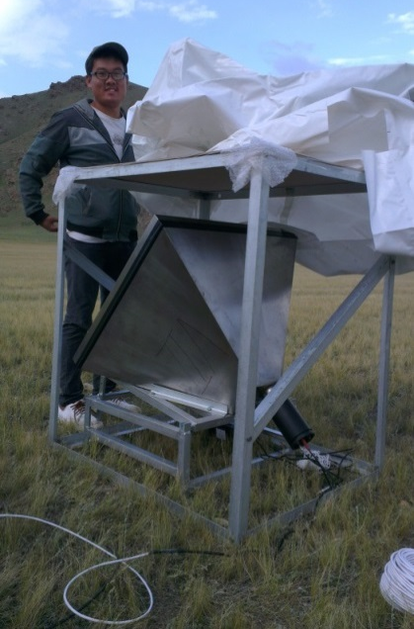
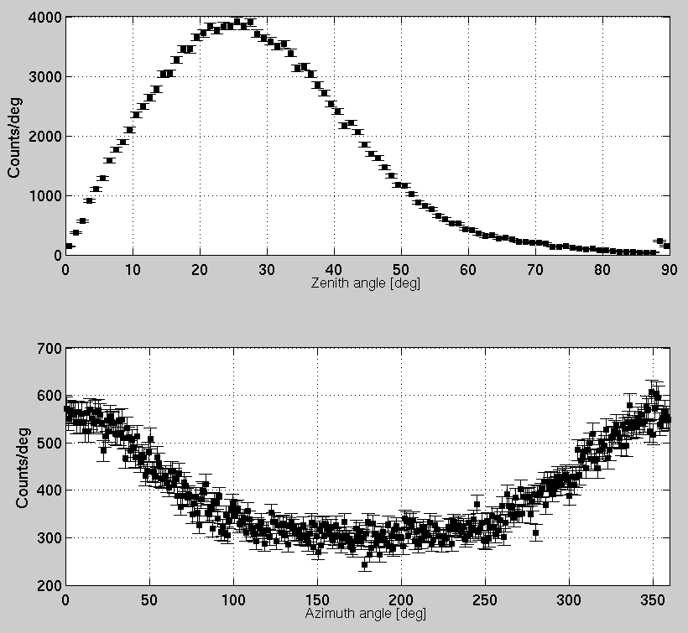
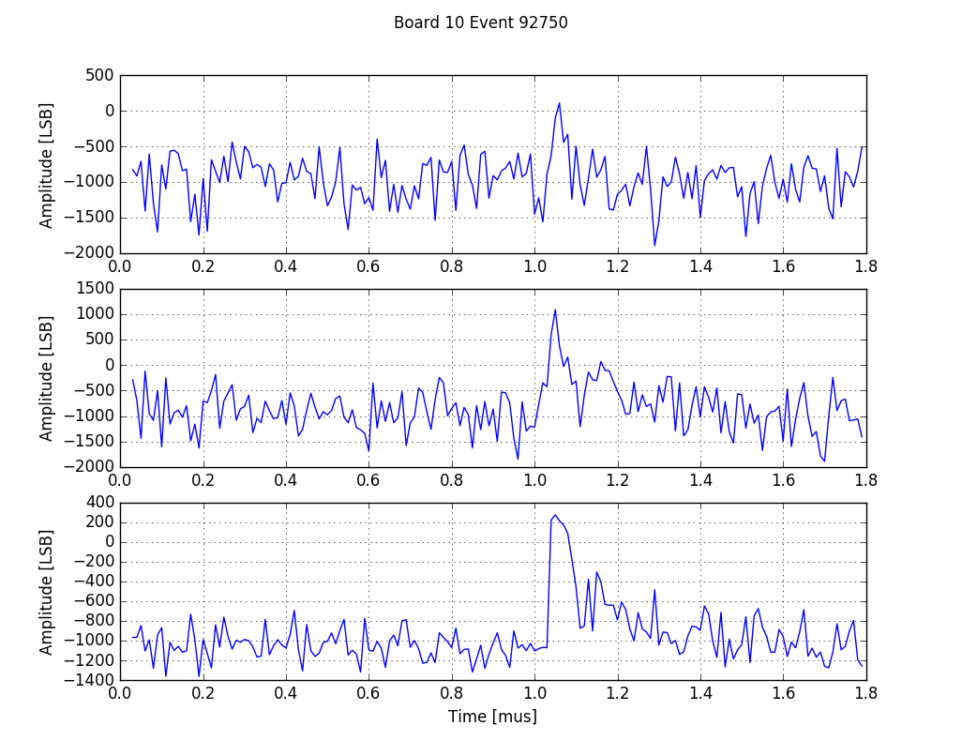
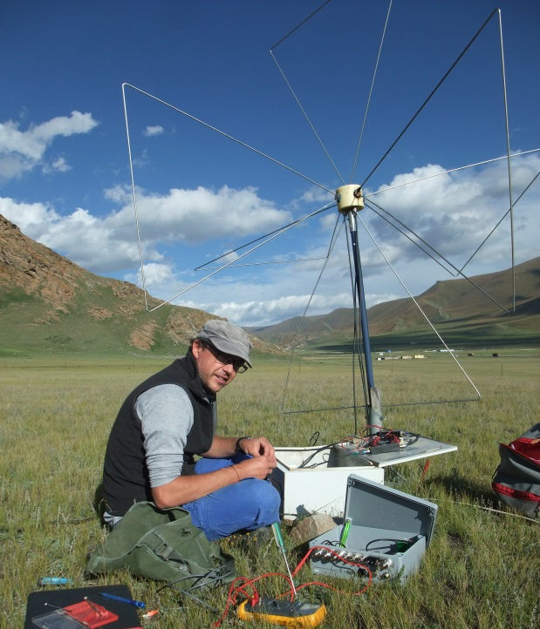
GRANDproto status
Zenith distrib
6 antennas + 6 scintillators deployed summer 2015 for hardware tests ➔ OK.
Radio DAQ system validated on site in Dec. 2016: >95% live time @ 2kHz rig rate. 35 units to be produced before this summer.
3 units of AUGER-AERA DAQ deployed summer 2016 for cross-checks (collaboration initiated with Nijmegen, the Netherlands).
Azim distrib
GRANDproto on-site tests, 10/12/2016
EW-channel
NS-channel
AUGER-AERA
DAQ on
GRANDproto
Vert-channel

Slide 17
Timeline & budget
Timeline hard to define today. LONG road requiring several validation steps:
GRANDproto35 (2018-2020):
Validate efficient automous radio detection
R&D: autonomous stations with optimized sensitivity to inclined showers.
Physics: precise polarization info of EAS radio emission
GRANDproto300 (starting ~2020):
300 antennas.
Validate very inclined CR shower detection
R&D: GRAND trigger & data transfer.
Physics: CRs composition between 2nd knee (?) and ankle [See Liu Wei ‘s talk].
First GRAND hotspot (during 2020s’):
Full scale deployment (~10000km²) on one hotspot
Validate setup design
Physics: neutrino discovery instrument.
Full setup (200’000km²) (2030?):
Could very well be splitted on different sites in the world.
Detection unit target price: <500$/unit ➔ ~100M$ project budget range
Provided funding is on time!

Slide 18
GRAND people
White paper workshop
at IAP, Paris, May 2017
GRAND study initiated (2012-2014) with very limited ressources (V. Niess + OM for ν sensitivity study, K. Kotera for science case)
Seminal GRAND workshop @ LPNHE (February 2015)
38 participants (AUGER, IceCube, ANITA, ARA, …) ➔ ICRC paper
No institutionnal involvement yet beyond China, but 35 physicists working on a GRAND white paper.
France: OM, V. Niess, D. Charrier, F. Hernandez, K. Kotera, C. Medina, A. Zech, A. Zilles, N. Renault-Tinnaci, V. Decoane, C. Tasse, I. Cognard, P. Zarka & F. Mottez
China: Hu Hongbo, Gou Quanbu, Zhang Yi, Qian Zheng, Gu Junhua, XiangPing Wu, S. Le Coz, Yi Mao
Netherlands: S. de Jong, C. Timmermans
USA: M. Bustamante, K. Fang, K. Murase, F. Oikonomou, J. Hanson, M. Mostafa
Spain: J. Alvarez-Muniz
Germany: F. Schröder
Belgium: K. de Vries
Argentina: M. Tueros
Brazil: W. Carvalho
Denmark: C. Finley
Joined in 2016-2017

Slide 20
Young extragalctic pulsars
Very possible source for UHECRs:
[K. Fang et al., arXiv:1311.2044]
Matches AUGER spectrum
UHE heavy nuclei emmited
Production of neutrinos through nuclei interaction with supernova ejecta. Then
π⁺ l + ν_{l} (= UHE neutrinos)
10s of events/year expected in GRAND!

Slide 21
ICECUBE
Fermi
Blazars
G. Emery & M. Cerrutti (LPNHE)
Work in progress.
HESS
GRAND60000
G. Emery – LPNHE – 25/05/2016

Slide 22
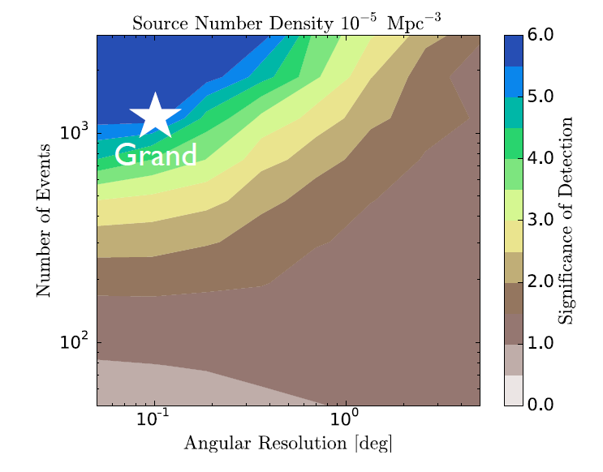
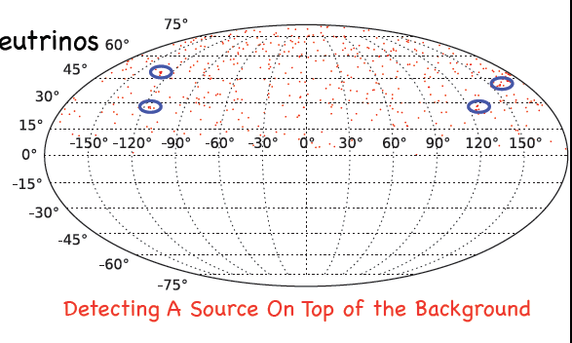
Multiplet analysis
Identifying individual sources from diffuse background…
…may be possible thanks to optimal angular resolution & large stats.

Slide 23
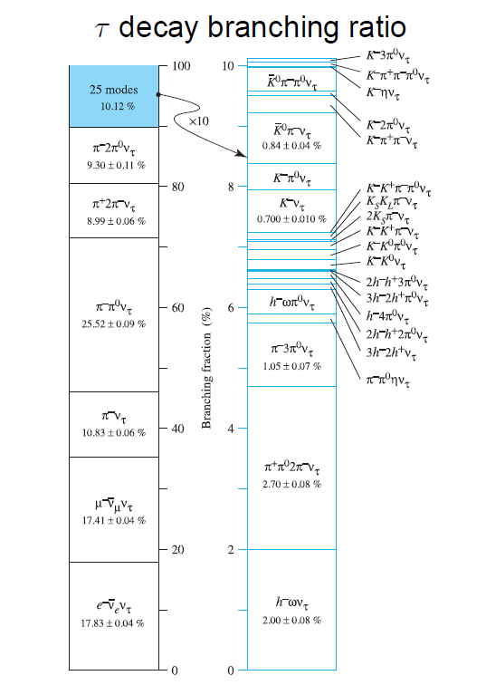

Slide 24
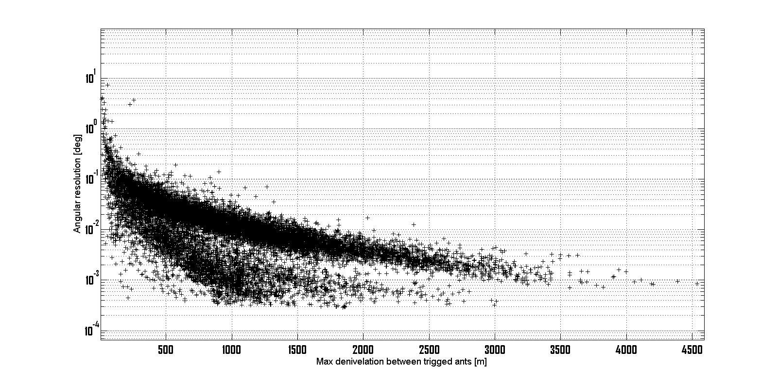
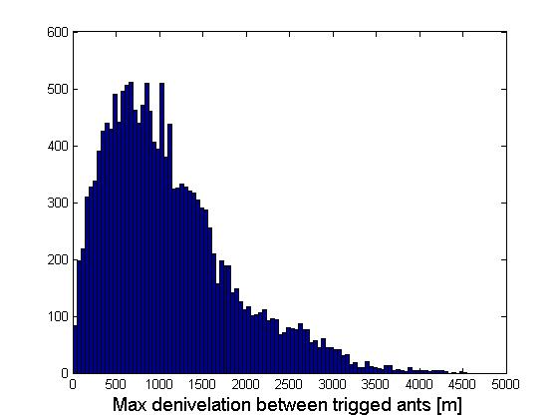
GRAND expected resolution
Cut out events with max deniv<100m
(2% of events)
num: 16424
mean: 0.0524
median: 0.0228

Slide 25
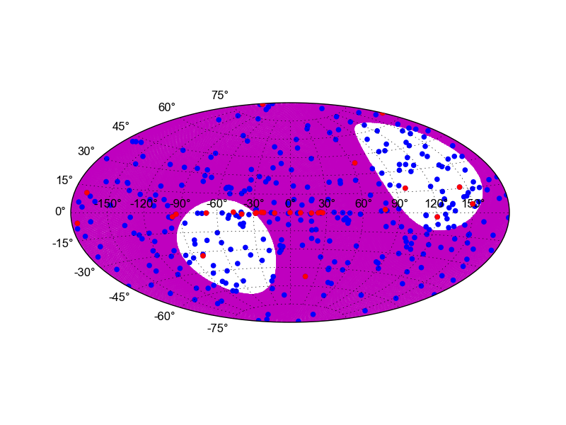
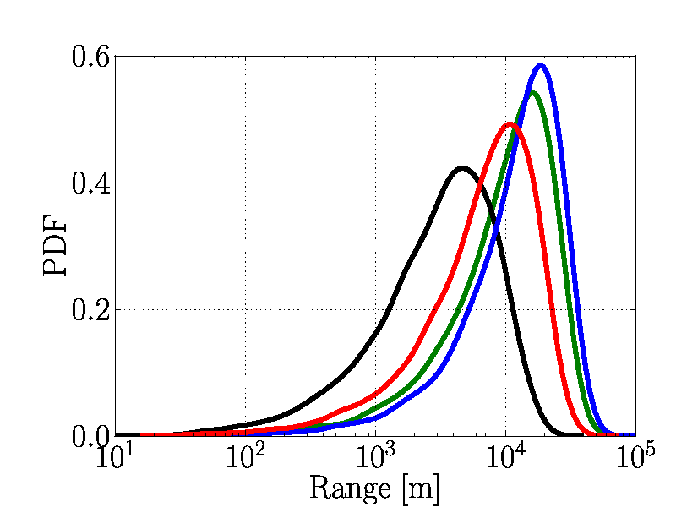
GRAND ν sensitivity study - Results
Field of view
(JP Lenain)
Energy reconstruction
… is not possible
But at least we know E_{ν}>E_{sh}
Do better thanks to E_{ν} correlation with τ time of flight (?)
1h visibility
24h visibility
Angular resolution
Analytical computation
assuming 3ns trigger timing precision (no noise).
Mean = 0.05°: full benefit of extended trigger zone & denivelation.
10^{17.5} eV
10^{18.5} eV
10^{19.5} eV
10^{20.5} eV
Median = 0.02°
Mean = 0.05°
f(Δθ>1°) = 0.2%
… thanks to mountains!
Tau flight distance [m]

Slide 26
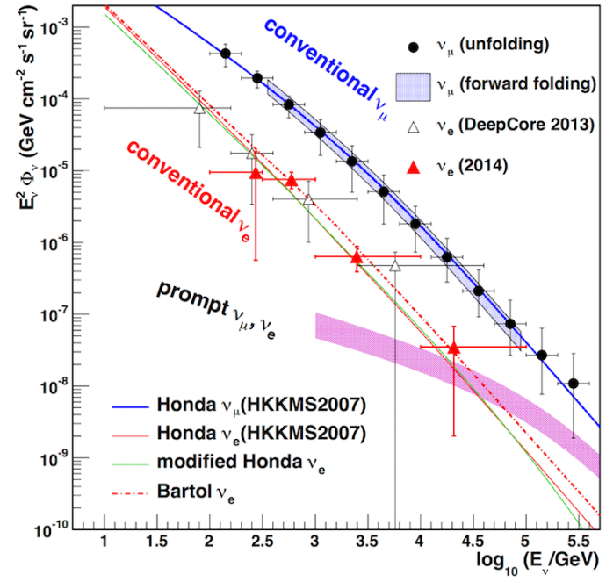
Neutrino cosmic background
Sensitivity limit for 0 candidates within 3 years…
=> Background rejection is a major challenge.
«Cosmic» background sources:
Atmospheric ν and µ fluxes negligeable beyond 10¹⁶eV.
UHECRs wrongly reconstructed below the horizon
«Old» showers
⇨ larger X_{max}
⇨ wider footprint at ground
Cut on reconstructed zenith angle θ> horizon - 1° kills large fraction of background thanks to angular resolution.
UHECR
E>30µV/m @ 400km for
E>2 10¹⁸eV only.
Radio signal lateral extension is then 2xtan(2°)x400 = 32km
UHECR EAS radio emission
d>400km for θ>89°

Slide 27
Neutrino cosmic background
Sensitivity limit for 0 candidates within 3 years…
=> Background rejection is a major challenge.
«Cosmic» background sources:
Atmospheric ν and µ fluxes negligeable beyond 10¹⁶eV.
UHECRs wrongly reconstructed below the horizon
«Old» showers
⇨ larger X_{max}
⇨ larger footprint at ground
Cut on reconstructed zenith angle θ> horizon - 1° kills large fraction of background thanks to angular resolution.
UHECR
Cut on θ>horizon-1°
UHECR EAS radio emission
ν
ν EAS radio emission

Slide 28
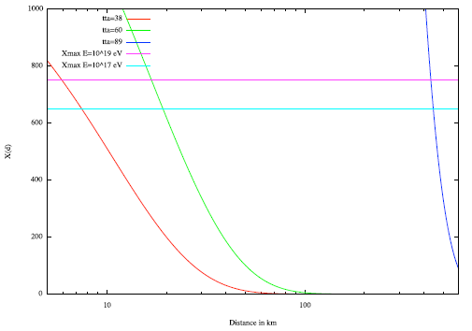

Slide 29
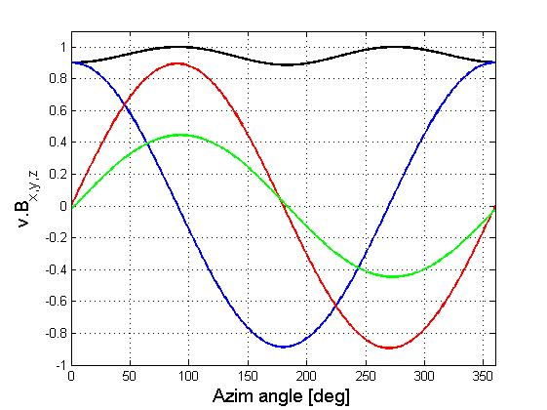
θ = 89°
θ = 60°
V_{tot}
V_{x}
V_{y}
V_{z}
V_{tot}
V_{x}
V_{y}
V_{z}

Slide 30
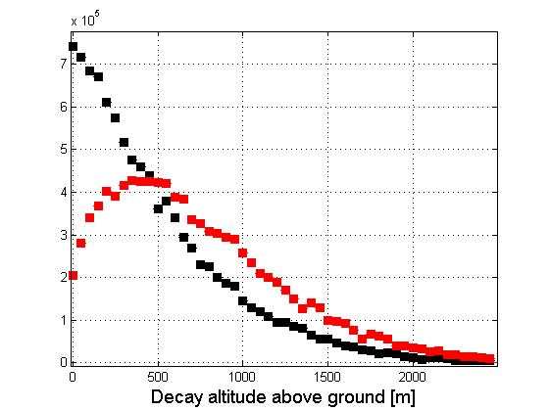
Very inclined shower propagation
Wave interference & diffraction relevant for d ~ λ (<10m)
AND
Signal produced >100m of meters above ground in 90%+ of cases.
Horizontal traj + beamed emission) → signal remains high above ground (or crashes into mountain slope).
➔
Signal reflected far away from antenna simply cannot reach it.
Safe margin of 50m above ground will be included in shadowing effects in the simulation.
Altitude @ decay
Altitude @ decay+14km

Slide 31
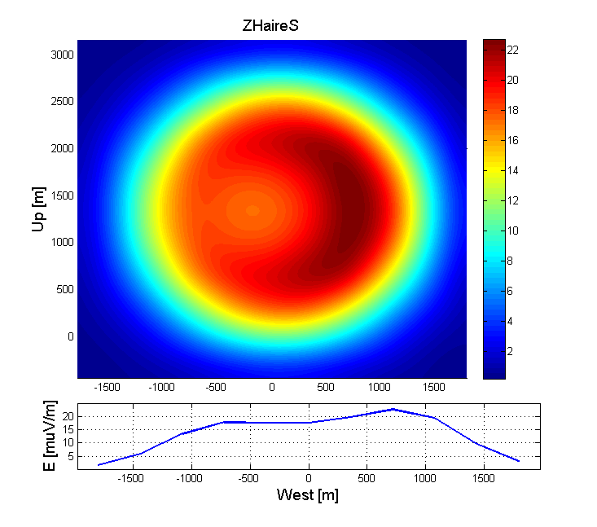
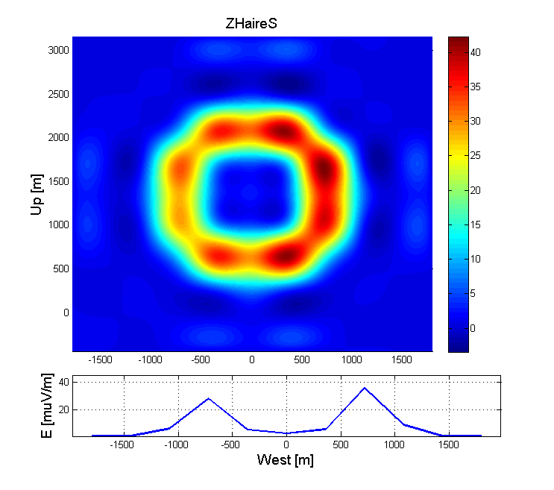
Cerenkov ring
Very clean signature of shower geometry (core position). Could be a great tool for reconstruction & Xmax measurement. To be confirmed through detailed simulations (2017).
Station design then an open issue: one large bandwidth antenna [30-200MHz] or 2 dedicated antennes: LF [30-80MHz] + HF [200-300MHz]?
E = 9.6 10¹⁶eV shower, θ = 90.5°
Plane perpendicular to shower axis
d = 34km away from Xmax
E = 9.6 10¹⁶eV shower, θ = 90.5°
Plane perpendicular to shower axis
d = 34km away from Xmax
30-80MHz
200-300MHz

Slide 32
GRAND project pricing
GRAND station cost
Baseline design:
3 "active butterfly" antennas, h = 4, 6 & 8m
2 horizontal arms for h = 6 & 8m, 3D for h = 4m
1 electronic box for the 7 channels
Componant | Unit price ($) | Nb units/station | Price/station ($) | Total nb of units | Total price (M$) | Comment
Pole | 10 | 1 | 10 | 200000 | 2 | 150$/m3
Antenna mechanics | 50 | 3 | 150 | 200000 | 30
Antenna LNA (ASIC) | 2.5 | 7 | 17.5 | 200000 | 3.5 | Consumption: 100mW/channel
Analog filters | 10 | 7 | 70 | 200000 | 14 | Probably not necessary (digital filtering). GRANDproto: 40$/unit for 100 units
Electronics (ASIC) | 16.66666667 | 3 | 50 | 200000 | 10 | Price estimate to be confirmed. Consumption ~1W/station
GPS | 20 | 1 | 20 | 200000 | 4 | Most parts included in main ASICS
Communication | 20 | 1 | 20 | 200000 | 4 | Most parts included in main ASICS
Electronic box | 50 | 1 | 50 | 200000 | 10
Cables | 0.2 | 20 | 4 | 200000 | 0.8 | Belden9116 (GRANDproto): 30$/100m
Connectors, analog components, etc |  |  | 50 | 200000 | 10
Solar pannel+regulator |  |  | 100 | 200000 | 20 | Total power <5W
Total: |  |  | 531.5 |  | 106.3
Deployment + infrastructure cost: |  |  |  |  | 20
Total cost for GRAND200k | 125M$
Very very preliminary

Slide 33
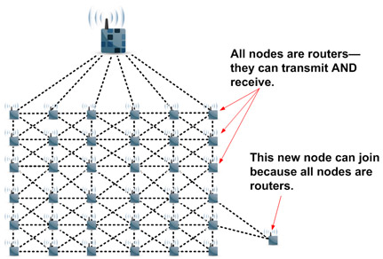
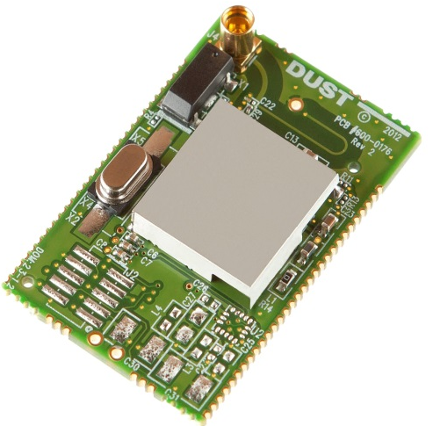
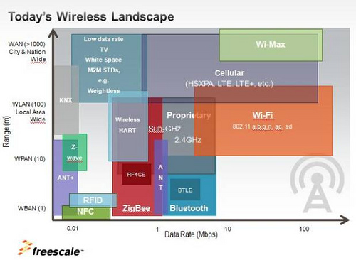
GRAND data format & transfer
SmartMesh (DustTechnologies)
2.4GHz band.
36 packets/s
90bits/packet -> 900 in 2016
OK for ~250 antennas/concentrator (15x15 km²)
IF we save minimal info: 5x16 = 80 bits per trigger
Trig time (32bits <-> 4s)
Amplitude (16 bits)
Polarization info
(2 angles: 2x8 bits)
Others (ID, monitoring…)
Assuming trig rate = 100Hz
800bytes/antenna/s ⇨ 200MBy/s data rate for full array
Solution for data transfer? Many development in recent years for commercial applications may be useball/usefull.
Smart Mesh + Wireless HART
Wifi (802.11xx), WiMax
GSM
…
~10$/unit
C. Timmermans @ GRAND workshop

Slide 34
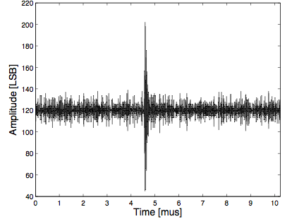
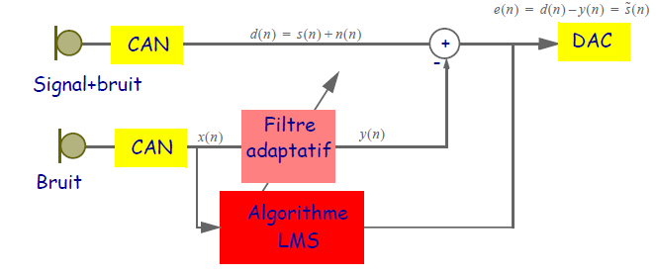
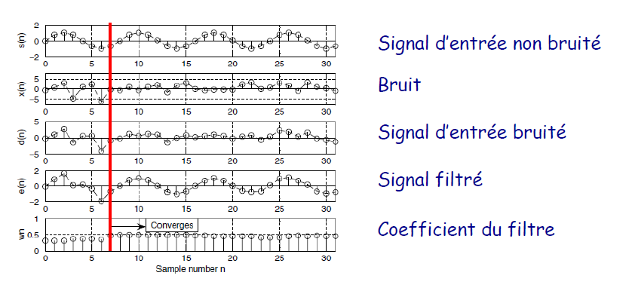
GRAND trigger
Investigate online enhanced signal processing @ FPGA level:
Very little done on the topic so far… Could be improved because we KNOW expected signal (simulations) AND background (data).
Adaptative filter
Signal correlation
2nd level trigger @ FPGA level
better threshold, better background rejection
TREND trigger
Nxσ_{noise} (N=8-10)
σ_{noise}
(~10µV @ antenna level)

Slide 35
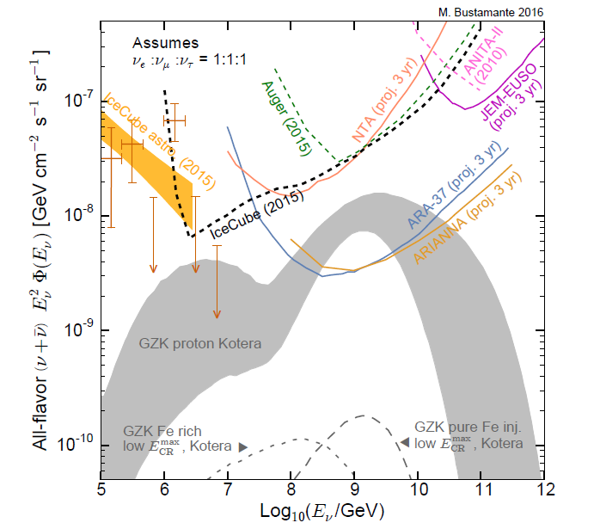
EeV neutrino detection
Challenge: how to gain order(s) of magnitude in sensitivity?
Go for a BIG detector. One (popular) option: radio in Antarctica (ANITA, ARA & ARIANA)
Principle: in-ice interaction → shower → Askaryan radio emission
☺ Antarctica: large target volume + ice transparency + low background
☹ Antarctica: complicated access & environment, expensive.
☹ Detection technique limits the angular resolution to ~1° range.
Kael HANSON – AERA 2016

Slide 36
EAS radio signal
Small θ
X_{max}
Larger zenith angle:
more distant X_{max} (+larger geometric projection)
larger radio footprint
Radio footprint:
Radio emission cone
Earth
Large θ
X_{max}
Radio footprint:
Radio emission cone
Earth

Slide 37
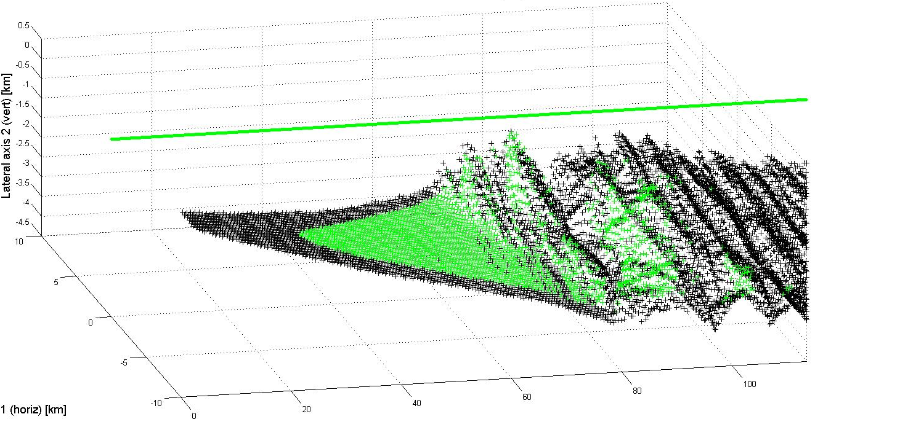
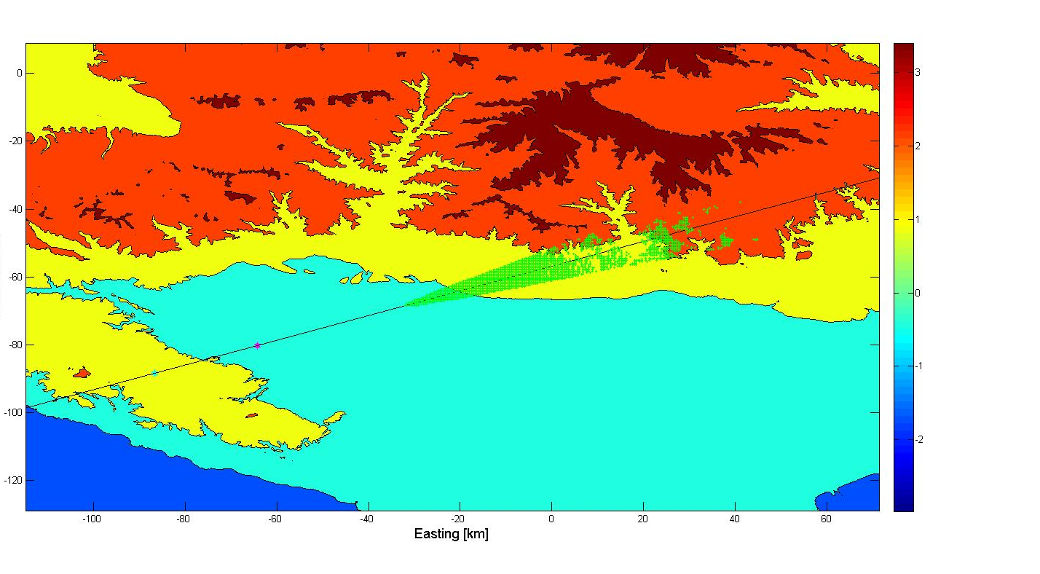
3 10²⁰eV neutrino
2.4 10²⁰eV shower
θ = 88°
2114 antennas
triggered
Cut view (Earth referential)
Tau decay
Shower axis
Neutrino interaction
3D view (shower referential)
Radio emission cone
(4.5° for E>30µV/m @ E_{sh} = 2.4 10²⁰ eV)
Shower axis
Vertical axis (km)
Antenna field
(trig’d antennas)
Lateral axis (km)
Longitudinal axis (km)
Top view (Earth referential)
Shower tagged as « detected » if a cluster of 8+ antennas is inside the radio detection cone.
Shower radio track
Northing [km]
Tau decay
Neutrino interaction
Easting [km]

Slide 38
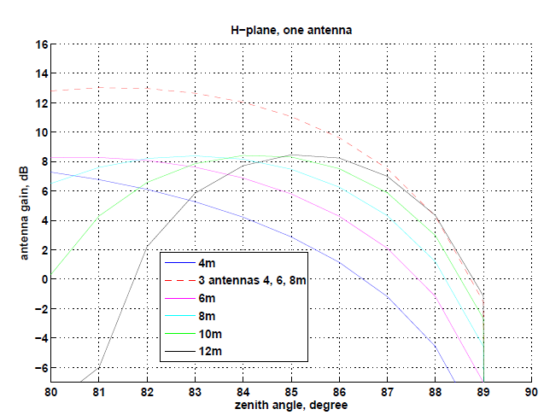
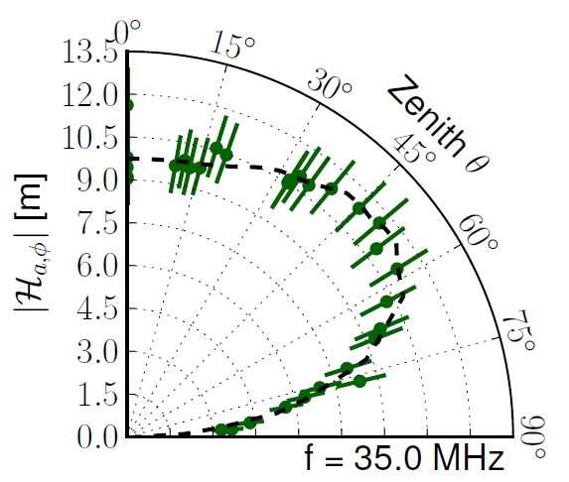
Very inclined showers detection
8m
Perfectly conducting ground: σ = +∞
➔ E_{plane} = 0 for θ = 90°
For h = 2m:
G_{max} = max(P_{rad})/(P_{in} /4π)= 7.6dB
G(87°)=-6.9dB
For h = 4+6+8m (phased antennas):
G(87°)=7.5dB
Noise /sqrt(3)
Still to be tested!
➔ GRAND300: 300 antennas over 300km² dedicated to the detection of inclined showers (running in 2021?)
GRANDproto300
Aab, astro-ph/1209.3840

Slide 39
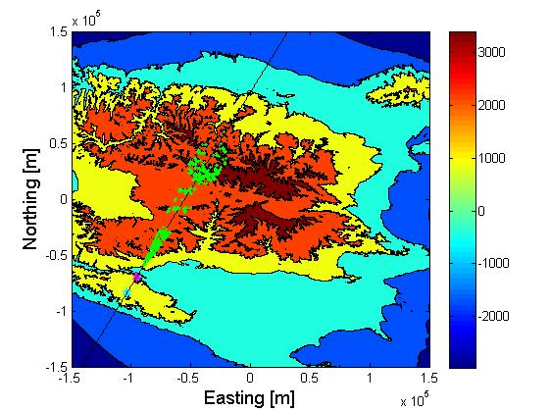
GRAND background discrimination
GRAND estimation (scalled TREND event rate): ~10⁷ background event/year.
Trigger pattern @ ground + wavefront + direction reconstruction provide VERY POWEFULL means of discrimination
Clustering analysis in ANITA: 5 candidates survive out of 270000 reconstructed events…

Slide 40
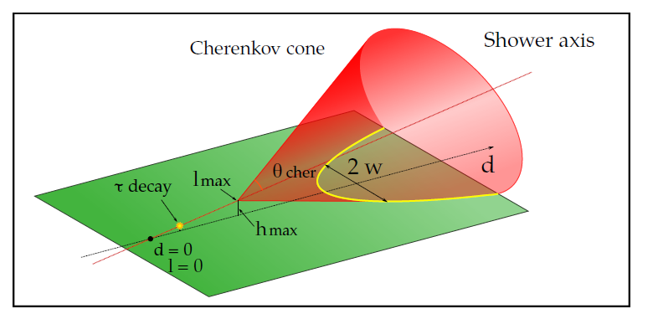
Terrestrial background rejection
W Carvalho @ GRAND workshop
z
β
EAS signatures
Trigger pattern at ground
(beamed emission with flat wavefront & lateral drop)
Cerenkov cone
Polarization : ┴B_{geo} & ┴v at 1st order on all antennas
P
x (EW)
η
y (NS)
η = atan(max|E_{y}|/max|E_{x}|)
β = atan(max|E_{plane}|/max|E_{z}|)
30-80MHz Efield computation
ZHAireS simulation code
Polarization angles on all trigged antennas
Tau decay @ origin
Subsequent shower:
E = 1.4 10¹⁷ eV
θ = 89.5°
Shower axis
Longitudinal distance [km]
Lateral distance [km]

Slide 41
Physics at industrial scale
GRANDproto digital board
ASIC
(Application-specific integrated circuit)
Cost ~ 10M$ ➔ few 10$ /board
Consomption < 1W
Reliability ☺
PCB + discrete componants: amplifier, ADC, FPGA, comm.
cost~1000 € /board
consomption~ 5W
Reliability?

Slide 42
Take-home message
GRAND proposes a next-generation detector of EeV cosmic particles. Would in particular be a EeV neutrino discovery instrument (worst case scenario) and a precision* instrument (best case scenario).
*: large stat & fraction of degree resolution.
Probably takes 200’000 km² & 200’000 antennas to reach that goal. Aiming at 1st hotspot in 2020’s.
Loads of exciting work ahead:
White paper to define science case & achievable perfs (based on simulations+experimental status).
Optimise air shower autonomous radiodetection efficiency.
Design & test antennas sensitive to horizontal showers
Design & test valid+cheap+robust station & DAQ.
Show that background can be rejected (>10⁻⁷ level)

Slide 43
The TREND project (2009-2014)
(tiny) Sino-French project (5 physicists)
Goal: autonomous radio detection of air showers
Site: Ulastai, XinJiang province, China (site of the 21CMA radio-interferometer)
50 monopolar antennas deployed over 1.5km²
DAQ nominal trig rate at ~200Hz/antenna
D. Ardouin et al., Astropart Phys 34, (2011)
TREND: ~500 EAS candidates selected in 317 live days from offline analysis of radio data. Distribution as expected for EAS ⇨ TREND goal reached: it showed that
autonomous EAS detection & identification with radio arrays is possible.
But TREND detection efficiency is ~20% only (preliminary). Mostly due to hardware & DAQ limitations ➔ new setup with optimized hardware +DAQ system: GRANDproto35.
Azimuthal distribution
Data
Simu
(no envir cuts +
only West hemisphere)
Zenithal distribution
90°
60°
Data
Simu EAS
(full array)
30°
dN/dθ (Normalized)
dN/dϕ (Normalized)

