Slide 1
Measurement of inclusive branching fraction for ψ(3686)→φX
J.Y. Zhao and G. Rong
2017/03/22
Charmonium Group Meeting

Slide 2
Outline
Introduction
Data and Monte Carlo samples
Data analysis
Detection efficiency
Cross section analysis
Systematic uncertainties
Summary

Slide 3
Introduction
The decay of ψ(3686) provide a place to test predictions based on quantum chromodynamics (QCD). Its property has been studied for more than 40 years.
Comparison of inclusive and exclusive branching fractions would provide us information of the unmeasured exclusive decay final states, which would guide us to study more exclusive channels and search for intermediate states in those decay channels.
However, no inclusive branching fractions have been reported in PDG. Based on the data sample taken with BES-III, this analysis reports the first measurement of the inclusive decays of the ψ(3686)→φX (X=anything).

Slide 4
Data and Monte Carlo
Boss Version:
6.6.4.p01.
Data:
Data taken in the energy range of 3.64∼3.71 GeV in 2010;
Monte Carlo:
Kinds of Monte Carlo events are generated with KKMC + BesEventGen, 500000 MC samples are generated for every process at 7 energy points (3.64, 3.65, 3.66, 3.67, 3.68, 3.69, 3.70 GeV).
(1) γ_{ISR}ψ’ (2) γ_{ISR}J/ψ (3) qqbar
To estimate QED background, we use the large IncMC samples generated at 3.773 GeV.
(1) Bhabha (2) Dimu (3) Ditau

Slide 5
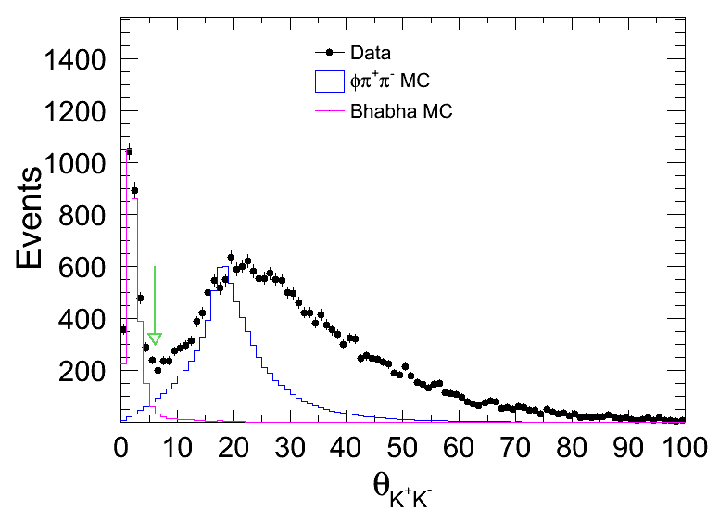
Event Selection
Charged track selection:
|R_{xy}| < 1.0 cm;
|R_{z}| < 10.0 cm;
|cosθ| < 0.93;
Number of charged tracks satisfy:
N_{good charge} ≥ 2;
Particle identification:
K: CL(K)>CL(π);
To reject Bhabha background:
The angle between K⁺K⁻ is required to be larger than 6.

Slide 6
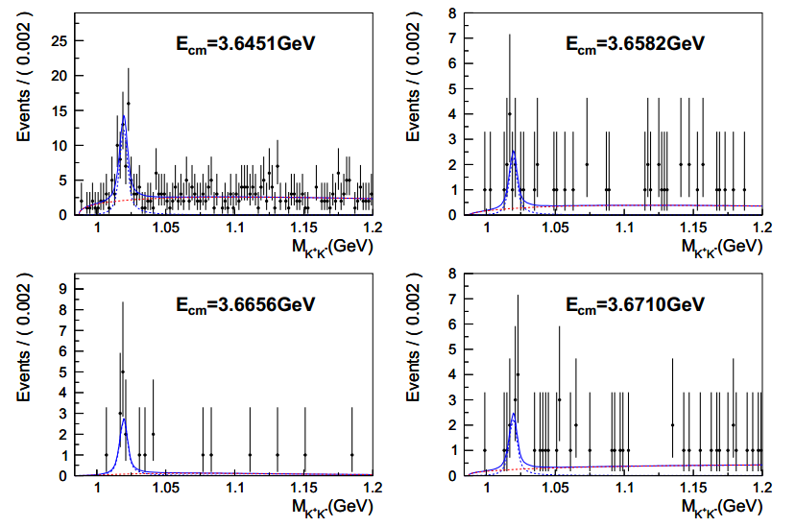
K⁺K⁻ Invariant Mass Spectrum
The invariant mass distribution of Κ⁺Κ⁻ is fitted to obtain the number of signal events.
Signal shape:
Monte Carlo Shape convolved by a Gaussian
Background shape:
Argus function

Slide 7
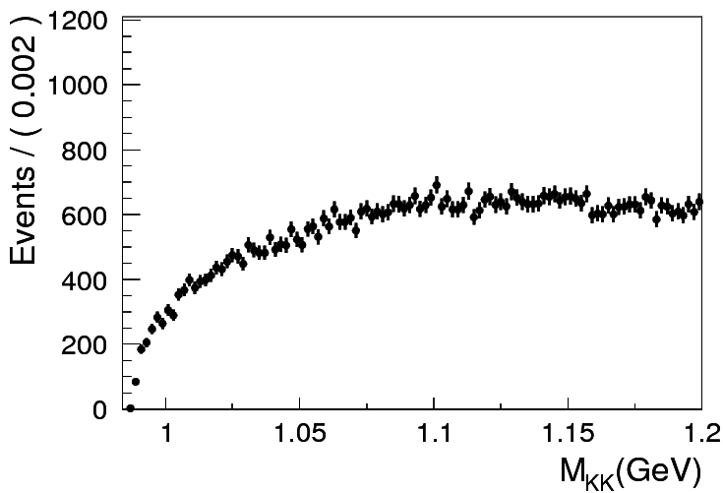
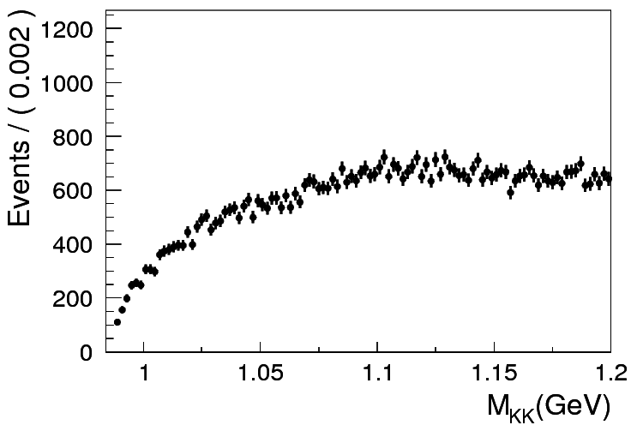
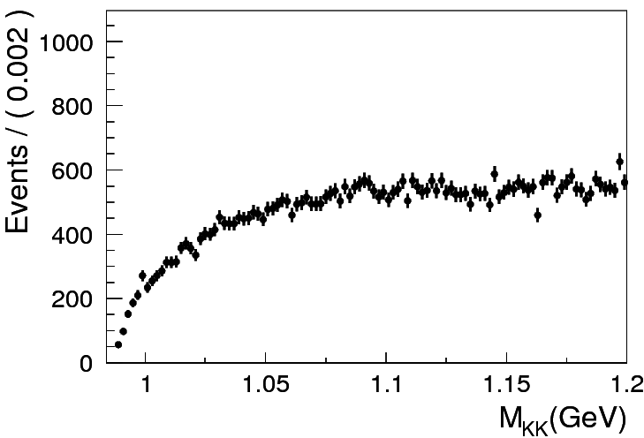
Backgrounds
When analyzing backgrounds, the signal events are excluded.
J/ψ (φX excluded)
ψ(3686) (φX excluded)
No Peaking Backgrounds!!
qqbar (φX excluded)

Slide 8
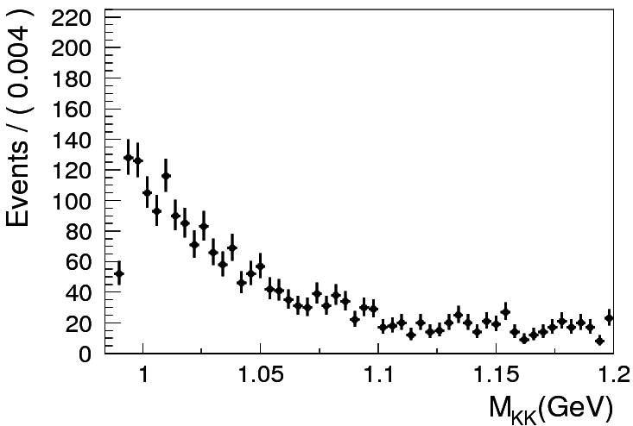
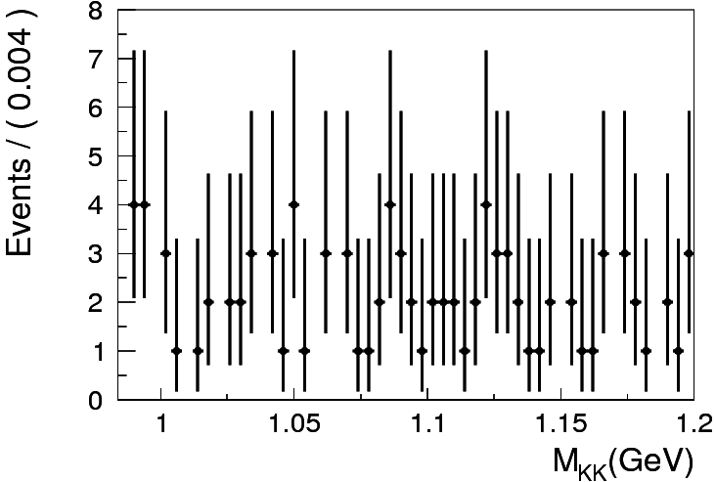
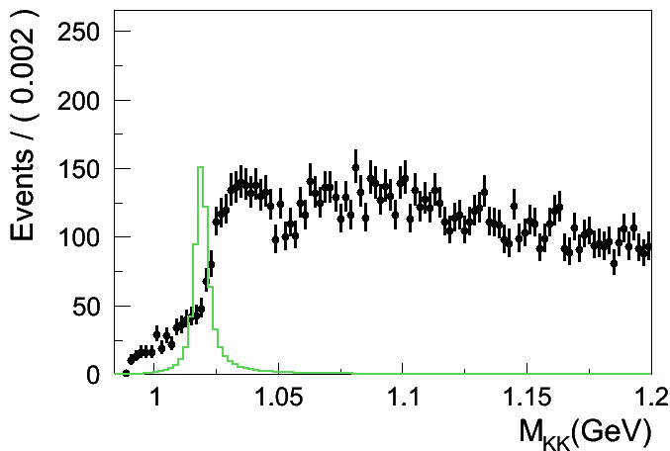
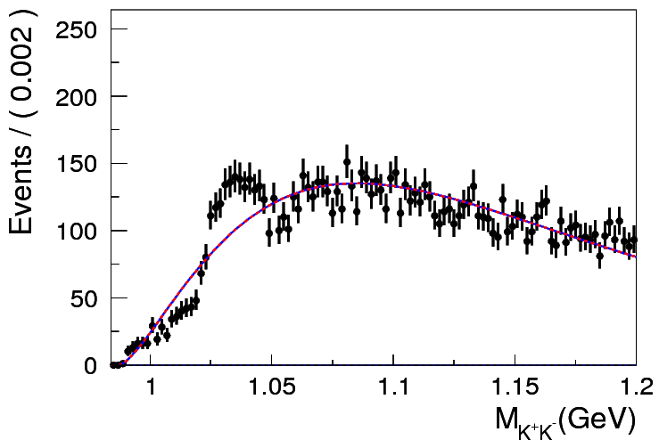
Backgrounds
Based on 3773 IncMC
Bhabha
Dimu
No Peaking Backgrounds!!
Ditau

Slide 9
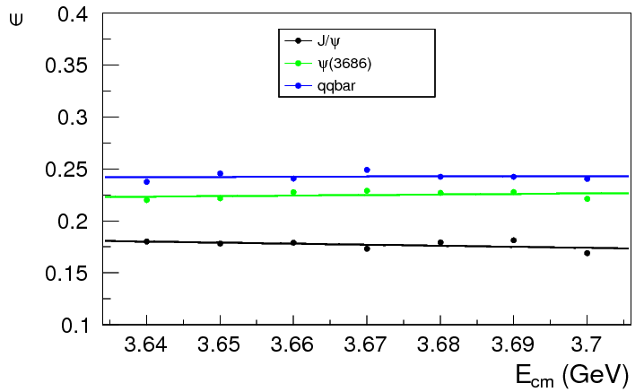
Detection Efficiency
Efficiencies of every components are considered separately before obtaining the average efficiency.
500000 J/ψ, ψ(3686) and qqbar Monte Carlo are generated at 7 points. From those samples, we selected the φX events and calculated efficiencies.

Slide 10
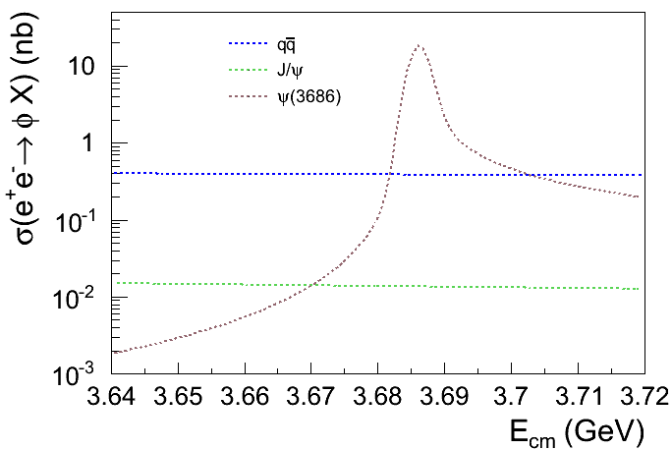
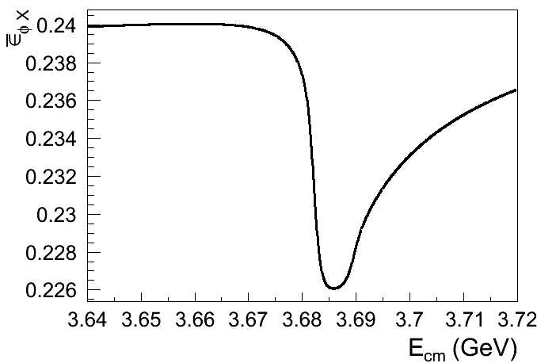
Detection Efficiency
The average efficiency is obtained using the cross sections of those components .

Slide 11
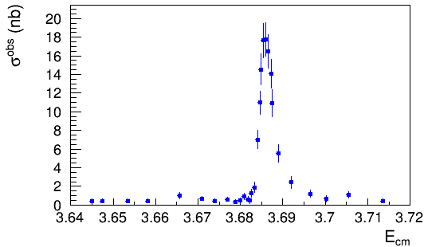
Observed Cross Section
Observed cross section :

Slide 12
Analysis of Observed Cross Section
A maximum likelihood fit is performed to the observed cross sections.
Expected number of signal events:
Likelihood:
Sampling function
Yad. Fiz. 41 (1985) 733.
Gaussian function
Breit-Wigner function
Gaussian function, if n ≥ 12
Poisson function, if n < 12

Slide 13
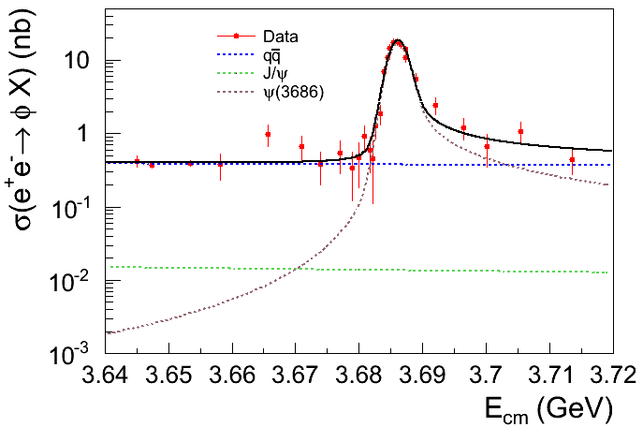
Analysis of Observed Cross Section
Br[ψ’→φX]=(2.77±0.12±0.11)%
The branching fraction in PDG(including ψ(3686)→φπ⁺π⁻, φΚ⁺Κ⁻, φη, φη’, φf’₂(1525), ψ(3686)→J/ψX→φX, and ψ(3686)→J/ψX→φX):
Br[ψ’→φX]=(9.89±0.39)×10⁻³

Slide 14
Systematic Uncertainties – Cross Section
Sources
Uncertainty in angle θ_{K+K−} cut;
Uncertainty in fitting mass spectrum;
Uncertainty in MDC tracking for the kaons;
Uncertainty in PID for the kaons;
Uncertainty in branching fraction for φ→K⁺K⁻;
Uncertainty in the luminosity.

Slide 15
Systematic Uncertainties – Cross Section
θ_{K+K−} cut
The cross section is also determined with the θ_{K+K−} selection requirements ranging from θ_{K+K−} >4°to θ_{K+K−} >8°;
The differences from the standard selection of θ_{K+K−} >6°are all less than 0.15%;
To be conservative, we take 0.2% as the systematic error due to the θ_{K+K−} selection in this work.

Slide 16
Systematic Uncertainties – Cross Section
Fitting mass spectrum
To estimate the uncertainties due to fits to the M_{KK} distributions, we refit the distribution by varying:
Background shape
4th order polynomial — 0.29%
Fit region — 1.31%
Bin width — 1.37%
Total systematic uncertainty from fit to mass spectrum:

Slide 17
Systematic Uncertainties – Cross Section
Quoted systematic uncertainties
MDC tracking
1.0% per kaon; (PLB 753 (2016) 103-109)
K PID
1.0% per kaon; (PLB 753 (2016) 103-109)
Branching Fraction
Br[φ→K⁺K⁻]=(48.9±0.5)%(PDG2016)
1.0%.
Luminosity
1.0%. (Chin. Phys. C 37,123001 (2013))

Slide 18
Systematic Uncertainties – Cross Section
Summary
Source | Systematic uncertainty(%)
θ_{K+K−} >6° | 0.20
Fit to M_{K+K−} spectrum | 1.92
MDC tracking | 2.00
K PID | 2.00
Br[φ→K⁺K⁻] | 1.00
Luminosity | 1.00
Total | 3.70

Slide 19
Systematic Uncertainties – Br[ψ(3686)→ φX]
To obtain the systematic uncertainty of branching fraction, we change the values of the observed cross sections by ±1σ of systematic uncertainty and refit the cross sections. The absolute differences in branching fraction is less than 0.11%, which is taken as the systematic uncertainty of Br[ψ(3686)→ φX].

Slide 20
Summary
The observed cross section of e⁺e⁻→φX in the energy range from 3.64 to 3.71 GeV have been measured.
By analyzing the observed cross section measured at those energy points, the branching fraction of Br[ψ(3686)→φX] is determined to be:
Br[ψ(3686) →φX] =(2.77±0.12±0.11)%
The branching fraction of Br[ψ(3686)→φX] measured in this work is much larger than that in PDG, which means many exclusive channels should be searched for.

Slide 21
Thank You!

