Slide 1
Update of $e^{+}e^{−}$→ $ωχ_{c0}$ using new XYZ data
Junhao Yin, Jingzhi Zhang, Changzheng Yuan

Slide 2
Event selection
4 good charged tracks
2 soft tracks (p<0.6 GeV)
2 hard tracks (p>1.0 GeV)
At least 2 good photons.
A pi0 list is created by requiring $M_{γγ}$ in [1.1, 1.6] GeV/c^2.
Soft charged tracks are regarded as pion, hard charged tracks are regarded as pion or Kaon.
Loop every pi0list and two kinds of particle identification of tracks to perform 5C kinematic fit.
The one with smallest $χ_{5C}^{2}$ is chosen.

Slide 3
Datasets
The new taken XYZ data
4190, 4200, 4210, 4220
100,000 signal MC for $e^{+}e^{−}$→ $ωχ_{c0}$, $χ_{c0}→KK/ππ$
Boss version: 702p01

Slide 4
The $χ_{5C}^{2}$ is required less than 60.

Slide 5
Require $χ_{5C}^{2}$<60.
Clearly that there is very little events in the $ω$’s sideband.

Slide 6
Require $χ_{5C}^{2}$<60 and a very loose $χ_{c0}$ cut M($χ_{c0}$)>3.25.

Slide 7
Require $χ_{5C}^{2}$<60.
For 4190 and 4200, require $M_{3π}$ in [0.72, 0.81] since there is a tail in omega due to the threshold;
For 4210 and 4220, require $M_{3π}$ in [0.75, 0.81].

Slide 8
Require $χ_{5C}^{2}$<60.
For 4190 and 4200, require $M_{3π}$ in [0.72, 0.81]; for 4210 and 4220, require $M_{3π}$ in [0.75, 0.81].
Clearer than KK mode.

Slide 9
Data 4190
Using MC shape to describe the signal and Argus function to describe the background.
The branching fractions of $χ_{c0}→KK/ππ$ and the corresponding efficiencies are fixed in the simultaneous fit.

Slide 10
Data 4200

Slide 11
Data 4210

Slide 12
Data 4220

Slide 13
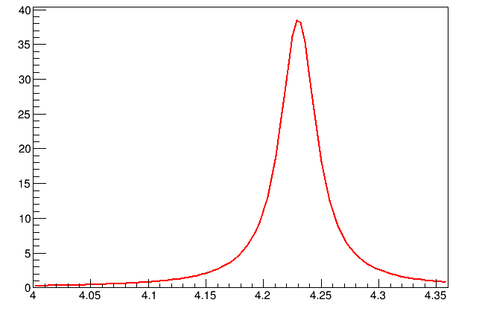
Assuming the procedure is from Y(4230).
Using lineshpe from previous work:
M=4.230 GeV
$Γ$=38 MeV
E_cms | luminosity | efficiency (%) | $${\left(1+δ\right)}_{rad}$$ | $${\left(1+δ\right)}_{vac}$$ | Nsig(cor) | $σ^{dressed}$(pb) | $σ^{Born}$(pb)
4190 | 517.5 | 25.39/25.16 | 0.578558 | 1.056 | (0.0+-5.99)e3 | 0.0+-22.43 | 0.0+-21.24
4200 | 519.4 | 26.46/26.39 | 0.678281 | 1.056 | (6.91+-2.00)e3 | 22.49+-6.51 | 21.30+-6.16
4210 | 509.0 | 25.42/25.62 | 0.692907 | 1.057 | (11.40+-2.40)e3 | 36.23+-7.63 | 34.28+-7.22
4220 | ~500 | 25.31/25.25 | 0.703638 | 1.057 | (27.08+-3.42)e3 | 86.3+-10.91 | 81.65+-10.32

Slide 14
Using $BW×f_{PHSP}$ to fit the cross section:
$$BW×f_{PHSP}=\frac{12πΓ_{ee}∙ℬ(ωχ_{c0})∙Γ∙{(ℏc)}^{2}}{{(s−M^{2})}^{2}+M^{2}Γ^{2}}×\frac{p}{\sqrt{s}}$$
The fitted mass and width are 4222.1 $±$2.1 MeV/c^2 and 32.1 $±9.5$ MeV. Compared with Yuping’s result: M=${4218.4}_{−4.5}^{+5.5}±0.9$ MeV/c^2, $Γ={66.0}_{−8.3}^{+12.3}±0.4$ MeV (PRL 118, 092002).

Slide 15
Summary
It looks like a narrow state as Y4220 but much narrower than that from $ππh_{c}$mode. More XYZ data points are needed. Waiting for the data taking finished this year.
The efficiency obtained from MC simulation is not very accuracy by now.
Systematic uncertainties need to be done.

