Slide 1
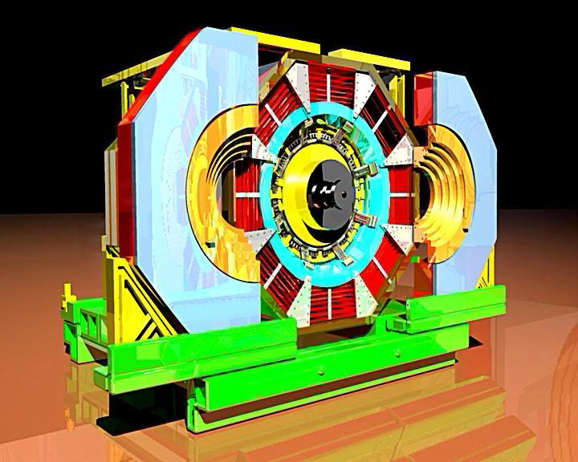
^{Baryons strike back in BESIII}
Evidence for a new 2g1γvirtual charmonium decay ?
K.Zhuª, J.Bian^{b}, P.Wangª, F.Harris^{c}
R.BaldiniFerroli^{d}, M.Destefanis^{e}, M.Maggiora^{e}, G.Mezzadri^{f}, S.Pacetti^{g}, L.Yan^{e}
Institute of High Energy Physics, IHEP, Beijing, China
University of Minnesota, USA
Haway University, Manoa Honolulu, USA
INFN, LNF, Frascati, Italy and Institute of High Energy Physics, Beijing, China
INFN and University Torino, Italy
INFN and University Ferrara, Italy
g. INFN and University Perugia, Italy

Slide 2
Why to understand Baryons is important
Visible mass in the Universe is due essentially to the strong force
binding quarks inside the Nucleon
Many Meson features come from QED->QCD, once α -> α_{S}
Baryons: no analogue in QED and unique QCD feature
But why Baryon Skyrme model (no q, π’s soliton) so successful ?
Baryons really fully understood ?
Vector charmonium,³S₁, and BB_{bar} linked: 3 gluons -> 3 qq_{bar} pairs
³S₁ -> BBbar fully understood ?
Not the angular distributions 1+ α cos²θ :
why α change sign in J/ψ or ψ(3686)-> ΛΛ/ ΣΣ ?
why α_{p} ≠ α_{n} , while B_{p} ~ B_{n} , in ψ (3686) -> NN_{bar} ?

Slide 3
Ψ(3686) -> NN_{bar} Branching Ratios
~ 23400 pp_{bar} and 2650 nn_{bar} events have been selected, obtaining
B[ψ(3686)->pp_{bar}] = (3.06±0.02±0.13)·10⁻⁴ ,
B[ψ(3686)->nn_{bar}] = (3.09±0.06±0.14)·10⁻⁴ .
The close B values, within small errors, would suggest
interference between strong and em decay is small
(positive in the pp_{bar} and negative in the nn_{bar} decay),
i.e. their relative phase φ ~ 90⁰ .
In the case of J/ψ -> NN_{bar}, close B values were also achieved :
B[J/ψ ->pp_{bar}] = (2.112±0.004±0.031)·10⁻³ ,
B[J/ψ ->nn_{bar}] = (2.07 ± 0.01 ±0.17 )·10⁻³ .
So far, so good. Up to a certain point.

Slide 4
Ψ(3686) -> N N_{bar} Angular Distributions
Fitting ψ(3686) -> NN_{bar} with 1+α cos² θ:
α_{p} = 1.03±0.06±0.03 , α_{n} = 0.47±0.15±0.15
i.e. pp_{bar} and nn_{bar} angular distribution are quite different,
in spite of similar B.
Furthermore α_{p} is close to the limit |α_{p}| ≤ 1.
No evidence of a cos θ term, i.e. no forward/backward asymmetry.
Conversely, in the case of J/ψ -> NN_{bar} it was obtained:
α_{p} = 0.595±0.012±0.015 , α_{n} = 0.50±0.04±0.21
consistent with a phase, between strong and em decay, φ ~ 90⁰ .

Slide 5
Ψ(3686) ->pp_{bar} Angular Distribution

Slide 6
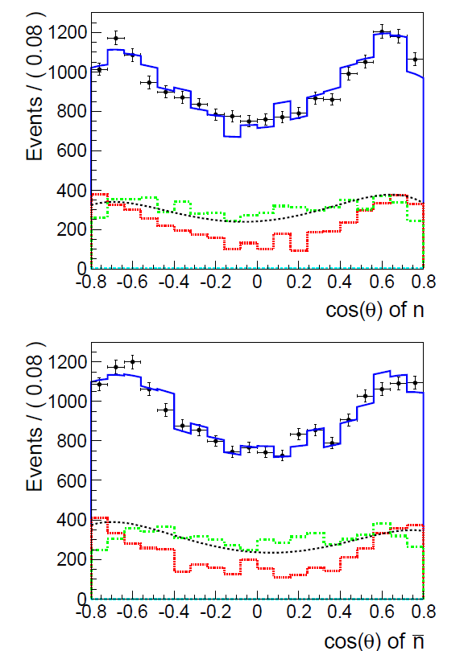
Ψ(3686) ->nn_{bar} Angular Distribution

Slide 7
Magnetic B_{M} and Electric B_{E} Branching Ratios
In e⁺e⁻ annihilation the FF squared |G_{M}|² and |G_{E}|² are defined:
dσ (e⁺e⁻->BB_{bar})/dcosθ ~ [|G_{M}|² (1+cos²θ)+4 (M_{B}/W)²|G_{E}|²sin²θ]
σ (e⁺e⁻->BB_{bar}) ~ [|G_{M}|²+2 (M_{B}/W)²|G_{E}|²]
Accordingly, in a Vector Meson V decay B_{M} and B_{E} can be defined:
B(V->Bb_{bar}) = B_{M} + τ·B_{E} , τ = 2·[M_{N}/Mψ`]² ~ 0.13
dσ (V->BB_{bar})/dcosθ ~ B·[1+ α· cos²θ]
α = [B_{M} - 2·τ·B_{E}]/[B_{M} + 2·τ·B_{E}] (by def. |α| ≤ 1).
τ small -> B_{E} small effect on B
B and α -> B_{M} and B_{E}

Slide 8
Magnetic B_{M} and Electric B_{E} Branching Ratios
Toy MC to evaluate B_{M} and B_{E} errors from B and α:
Statistical and systematic errors added in quadrature
B_{M}[ψ(3686)->nn_{bar}] = (2.60±0.26)·10⁻⁴ ,
B_{E} [ψ(3686)->nn_{bar}] = (3.77±1.74)·10⁻⁴ .
In the pp_{bar} case, to avoid unphysical values, toy MC gaussian error simulation rejected any time |α_{p}| > 1 :
B_{M}[ψ(3686)->pp_{bar}] = (3.02±0.13)·10⁻⁴ ,
B_{E} [ψ(3686)->pp_{bar}] = (0.28±0.23)·10⁻⁴ .
Or, even better, simulating 0.95 ≤ α_{p} ≤ 1 with 68% probability,
according to a Bayes approach:
B_{M}[ψ(3686)->pp_{bar}] = (3.02±0.13)·10⁻⁴ ,
B_{E} [ψ(3686)->pp_{bar}] = (0.24±0.18)·10⁻⁴ .

Slide 9
Phases between Strong and EM decays
PQCD: asymptotically B_{E}/B_{M} -> 0, due to helicity conservation.
But it cannot be the explanation of ψ(3686) B_{E} behaviour,
since it should be the same for pp_{bar} and nn_{bar} .
Let exploit a possible interference between strong and em decay,
assuming it is not the same for pp_{bar} and nn_{bar} .
Unfortunately the continuum e⁺e⁻ -> pp_{bar} is poorly measured at
W ~ 3.68 GeV and there are poor information on |G_{E}/G_{M}|.
BaBar and BESIII: σ(e⁺e⁻ -> pp_{bar})~(1.6±0.5) pb at W~3.68 GeV
B_{E}/B_{M}~1 within a large uncertainty
(arXiv:1302.0055[hep-ex]1Feb2013 , X.Zhu thesis)
Lacking any information, assume the same for e⁺e⁻ -> nn_{bar}
Therefore B_{em} = B[ψ(3686)->μμ]/σ(e⁺e⁻ -> μμ )·σ(e⁺e⁻ ->NN_{bar}) ~ 2·10⁻⁶
For pp_{bar} and nn_{bar} assume: B_{M} ~ B_{E} ~ B_{em}

Slide 10
Phases between Strong and EM decays
Connecting pp_{bar} and nn_{bar} , it is assumed:
B_{M}^{p} = |S_{M}·e^{iφ} + E_{M}^{p}|² = |S_{M}|² + |E_{M}^{p}|² + 2·|S_{M}|·|E_{m}^{p}|·cosφ
B_{M}^{n} = |S_{M}·e^{iφ} + E_{M}^{n}|² = |S_{M}|² + |E_{M}^{n}| ² - 2·|S_{M}|·|E_{m}^{n}|·cosφ
Opposite sign in the interference term comes from opposite E_{M} sign
The two equations with two unknown (S_{M} and cosφ) can be solved.
Fluctuating B_{M} and E_{M} within the quoted errors, it is found:
S_{M}² = 2.79±0.15 , φ_{M} = 63⁰±19⁰
S_{M}² >0, |cosφ|<1 : 94% C.L.
Results consistent with the expectation.
A better φ measurement requires a better continuum knowledge that is a scan below and at ψ(3686) !

Slide 11
A G parity violating Amplitude in ψ(3686)->pp_{bar} ?
No chance to find a solution for pp_{bar} Electric decay, B_{E}^{p} :
0.2% C.L. to have S_{E}² >0 , |cosφ|< 1.
Therefore, additional to the strong amplitude S, it is assumed
a G parity Violating Amplitude T in B_{E}[ψ(3686)->pp_{bar}] ,
that is added to S negatively, to explain vanishing B_{E} in pp_{bar} ,
while there will be S only in B_{E} in nn_{bar} .
In the following this assumption will be exploited,
trying to determine T and the consistency of this approach

Slide 12
A G parity violating Amplitude in ψ(3686)->pp_{bar} ?
Still assuming E^{n} and E^{p} have opposite signs,
em decays may interfere negatively too
or don’t, as in the B_{M} case
however T values achieved are the same, within the errors
φ = 180⁰
√B_{E}^{n} = S^{n} + |E^{n}| , √B_{E}^{p} = S^{p} + |E^{p}|,
S^{p} = S^{n} + T
T = √B_{E}^{p} - √B_{E}^{n} - (|E^{p}| – |E^{n}|) (< 0)
or
φ = 90⁰
B_{E}^{n} = |S^{n}|² + |E^{n}|² , B_{E}^{p} = |S^{p}|² + |E^{p}|²,
S^{p} = S^{n} + T
T = √(B_{E}^{p} -|E^{p}|²) - √ (B_{E}^{n} -|E^{n}|²) (< 0)

Slide 13
A G parity violating Amplitude in ψ(3686)->pp_{bar} ?
Systematic errors in B^{p} and in B^{n} are partially correlated,
so in the following statistical errors only are considered,
extracting T from B_{E}^{p} and B_{E}^{n} :
B_{E} [ψ(3686)->nn_{bar}] = (3.69±1.20)·10⁻⁴ ,
B_{E} [ψ(3686)->pp_{bar}] = (0.22±0.16)·10⁻⁴
Therefore
|τT²| ~ ( 2.7 ± 1.0) · 10⁻⁵ at the ψ(3686)
99.9 % C.L. that τT² < 0
90. % C.L. that τT² > 0.8·10⁻⁵ (in comparison B^{p} ~ 3·10⁻⁴)

Slide 14
A further Strong Amplitude in J/ψ->pp_{bar} too ?
τ = 2·[M_{N}/M_{J/ψ} ]^{2~} 0.18
Statistical and systematic errors still added in quadrature
B_{M}[J/ψ−>nn_{bar}] = (17.6±2.0)·10⁻⁴ ,
B_{E} [J/ψ−>nn_{bar}] = (16.7±7.8)·10⁻⁴ .
B_{M}[J/ψ−>pp_{bar}] = (18.7±0.3)·10⁻⁴ ,
B_{E} [J/ψ−>pp_{bar}] = (13.0±0.7)·10⁻⁴ .
S_{M}² = 17.6±1.0 , φ_{M} = 84.7⁰ ± 9.5⁰,
S_{E}² = 14.2±3.9 , φ_{E} = 100.8⁰ ± 32.2⁰
|τT²| ~ ( 0.9 ± 3.4) · 10⁻⁵ at the J/ψ
S_{E} too big to extract the G parity Violating Amplitude, if any

Slide 15
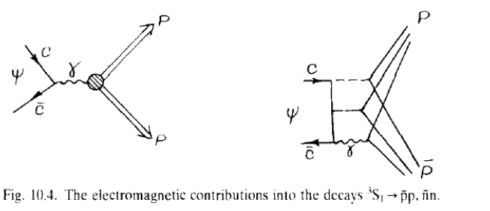
ψ(3686)->pp_{bar} decay via 2g1γ_{virtual}
A contribution from ψ(3686)-> 2g1γ_{virt} ->NN_{bar} is expected.

Slide 16
ψ(3686)->pp_{bar} decay via 2g1γ_{virtual}
There will be 3 amplitudes, where the virtual γ will produce alternatively one of the 3 possible qq_{bar} pairs, inside NN_{bar.}
Each amplitude will be proportional to the charge of the corresponding q, so that, adding the 3 amplitudes, the total will be proportional to the Baryon charge.
Therefore the contribution to nn_{bar} will vanish.
While the contribution to pp_{bar} should be negative.
Conversely in the case of a negative Baryon, like Σ⁻, 2g1γ_{virt} contribution should interferes positively, increasing B_{E} in pp_{bar} with respect to nn_{bar} . It has to be evaluated.
Since the 2g1γ_{virt} amplitude is small, it is difficult to check if contributes to B_{M} too

Slide 17
ψ(3686)->pp_{bar} decay via 2g1γ_{virtual}
S. Pacetti (BESIII 2015 Coll. Meeting, Shanghai Jiao Tong Un, June) has already discussed the 2g1γ_{virtual} contribution, showing the experimental evidence, according the present data on J/ψ -> ππ decay and e⁺e⁻ -> ππ, close to J/ψ :
B(J/ψ->2g1γ_{virt}-> ππ) ~ 10⁻⁴,
B(ψ(3686)->2g1γ_{virt}-> ππ) ~ 0.5·10⁻⁵,
and a quantitative successful model: γ_{virt} <− η’−> ππ .
The order of magnitude of the present result is close:
B(ψ`->2g1γ_{virt}->NN_{bar}) ~ ( 2.7 ± 1.0) · 10⁻⁵
B(ψ`->2g1γ_{virt}->NN_{bar})/B(ψ`->3g->NN_{bar}) ~ 0.09±0.03

Slide 18
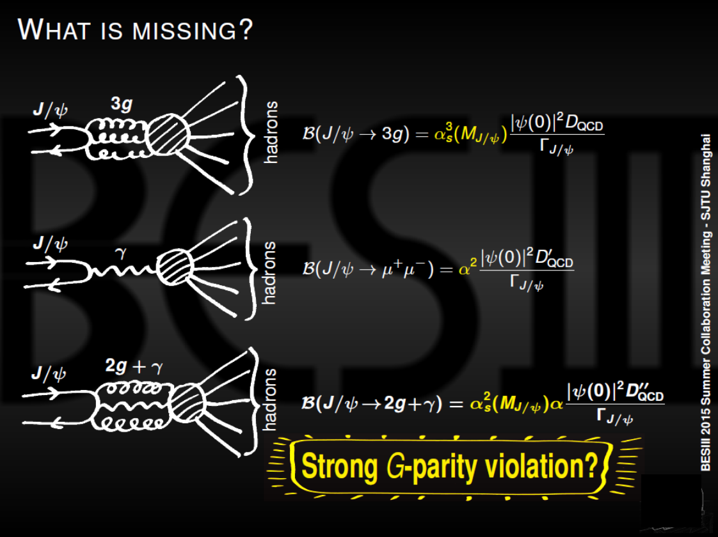
Simone Pacetti
(BESIII 2015 Coll. Meeting, Shanghai Jiao Tong Un, June)

Slide 19
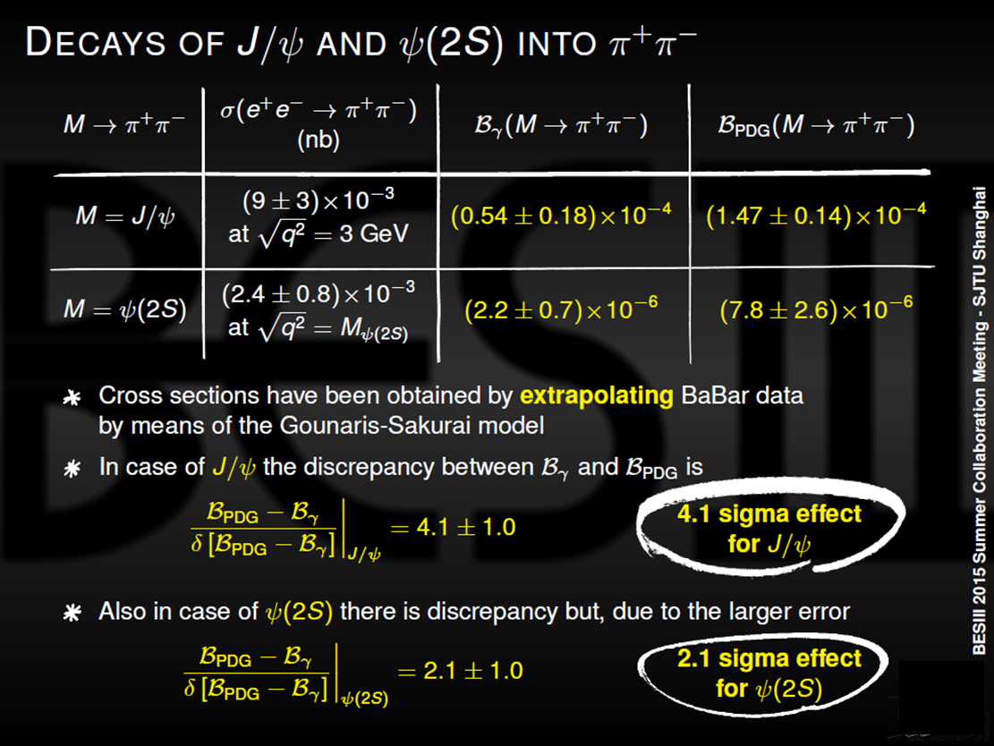
Simone Pacetti
(BESIII 2015 Coll. Meeting, Shanghai Jiao Tong Un, June)

Slide 20
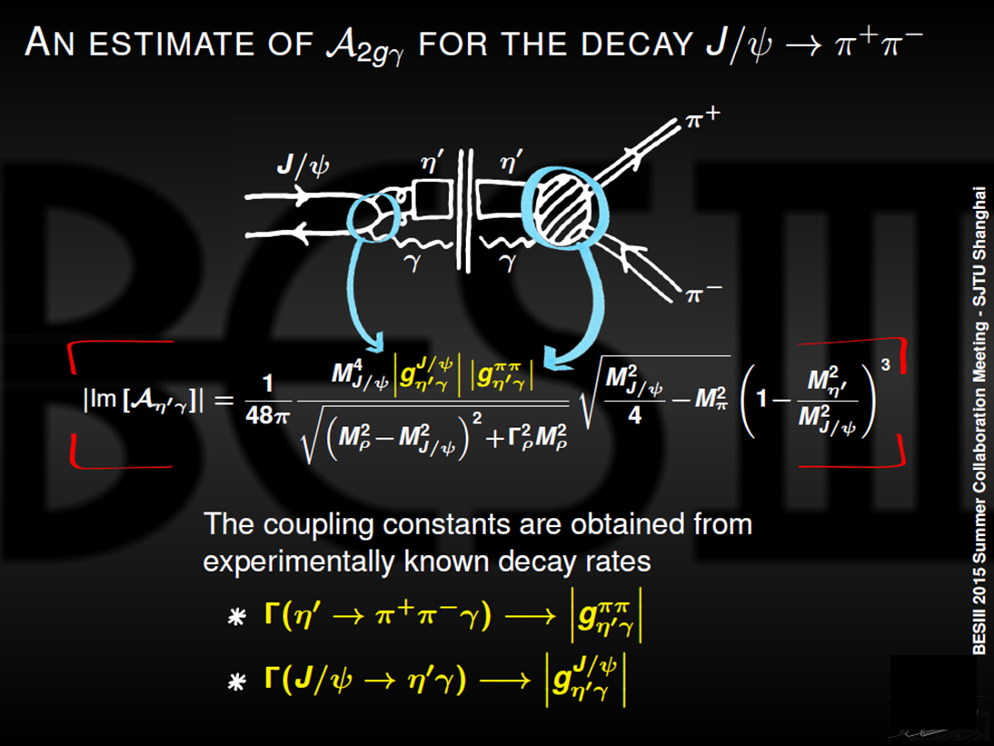
Simone Pacetti
(BESIII 2015 Coll. Meeting, Shanghai Jiao Tong Un, June)

Slide 21
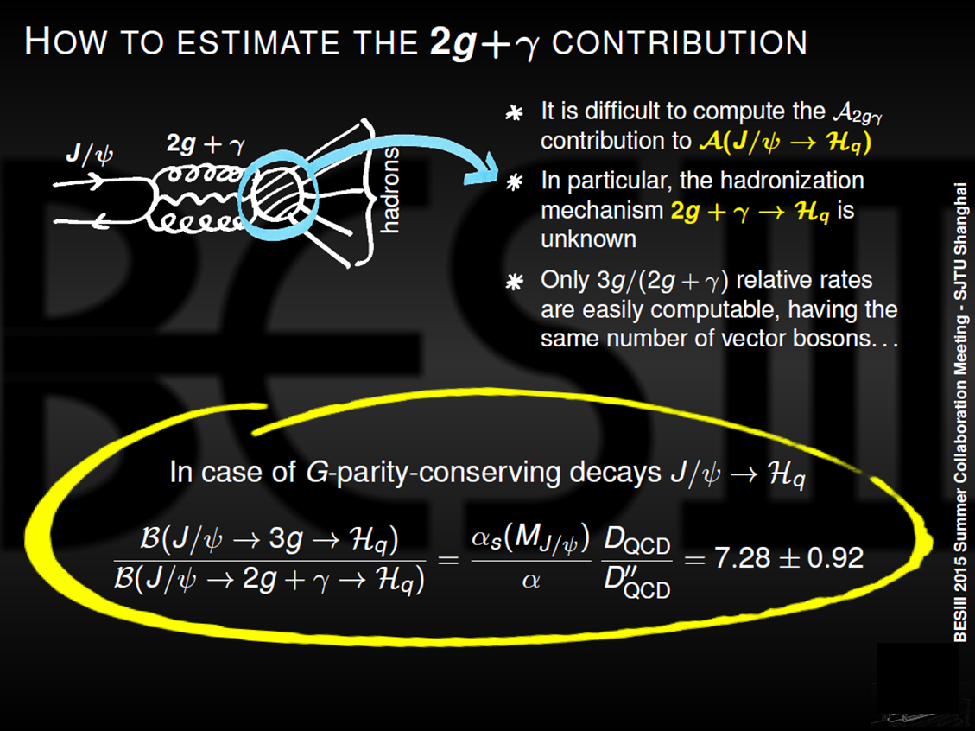
Simone Pacetti
(BESIII 2015 Coll. Meeting, Shanghai Jiao Tong Un, June)

Slide 22

ψ(3686)->pp_{bar} decay via 2g1γ_{virtual}
M.S.Chanowitz (P.R. D12 (1975) 918) also considered 1 γ_{virt}
and made an estimation, assuming α_{S} ~ 0.3 at the ψ(3686):
B(J/ψ->2g1γ_{virt}->H)/ B(J/ψ->3g->H)~16/5 α/α_{S} P~ 0.08 P,
P is a factor to take into account “the effective coupling of the
photon to qq_{bar} in the cc_{bar} decay volume”, ranging from α to 1.
According the present results P should be close to 1.

Slide 23
ψ(3686)->pp_{bar} decay via 2g1γ_{virtual}
V.L.Cherniak and A.R.Zitniski (Phys.Rep. 112, 3 (1984) 173)
also considered 1 γ_{virt} , and made an estimation,
on the basis of PQCD, applied on both 1 γ_{virt} vertices
(generation and hadronization), assuming α_{S} ~ 0.3:
A(J/ψ->2g1γ_{virt}->H)/ A(J/ψ->3g->H)~ - 4/5 α/α_{S}
B(J/ψ->2g1γ_{virt}->H)/ B(J/ψ->3g->H)~ 0.4·10⁻³
Chanowitz questioned the factor 4/5 and the validity of PQCD
in the hadronization regime.
Actually, according V.L.Cherniak and A.R.Zitniski,
by the same token : A(J/ψ->2g1γ_{virt}-> ππ ) ~ 0
in contradiction with present data, as shown by Simone.

Slide 24
Temporary Conclusions
A contribution from ψ(3686)-> 2g1γ_{virt} ->NN_{bar} is expected and likely found in the vanishing Electric Proton Branching Ratio B_{E} ^{p}, with respect to the Electric Neutron Branching Ratio B_{E} ^{n}.
It turns out:
B(ψ(3686)-> 2g1γ_{virt} ->NN_{bar} ) ~ (2.8 ± 1.9) · 10⁻⁵
(99.4% CL that B >0, 90% CL that B > 3·10⁻⁶ )
and there is a negative interference between 3g and 2g1γ_{virt}
The evidence of this G parity violation is good, according the achieved CL. Unfortunately statistics is not enough to get also good accuracy
Present theoretical predictions are affected by lack of knowledge concerning the hadronization

Slide 25
Temporary Conclusions
Opposite behaviour is expected in the Σ⁻ and Σ⁺ branching ratios, to be evaluated
A better determination would shed light on the hadronization mechanism (validity of PQCD)
B_{M} phase, between strong and em decay, φ_{M} = 63⁰ ± 19⁰ , but present continuum knowledge has large uncertainties-> scan below and at ψ(3686) !
Work in progress,
however, once more……

Slide 26

BARYONS STRIKE BACK IN BESIII

