Slide 1
The fitting method of center-of-mass energy and ISR J/psi
Changzheng Yuan
Longzhou Liao

Slide 2
Introduction
Using two different methods to fit the ISR J/psi to do the momentum calibration to show that our fitting methods is OK
Giving a criterion of the fitting range when we fit the M($μ^{+}μ^{−}$) peak with a Gauss fuction

Slide 3
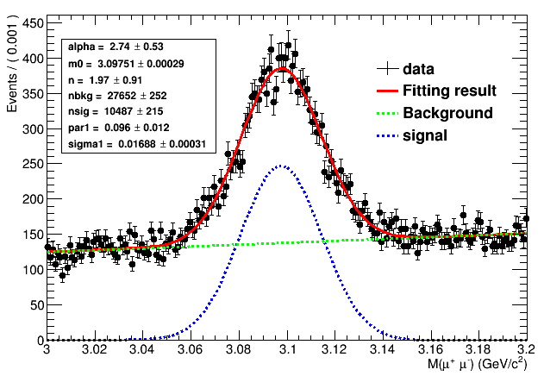
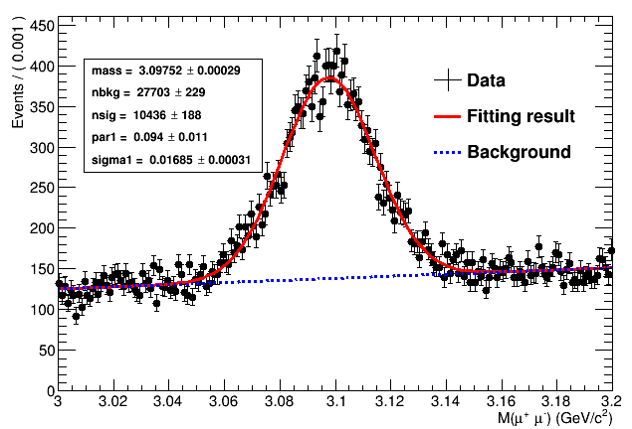
Fitting the ISR J/psi peak with different methods
Crystal_ball + 1st-order polynomial Fit chi2/ndf: 1.10506
Mmp = 3097.51 +/- 0.292723MeV
Gauss + 1st-order polynomial Mmp=3097.52+/-0.29MeV
The fitting results showing the consistency of the two methods and our fitting methods is OK

Slide 4
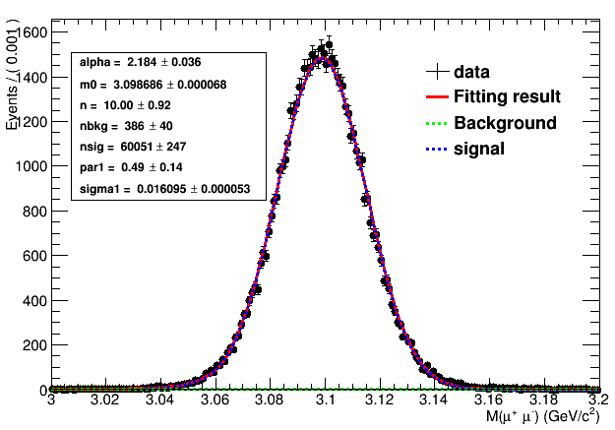
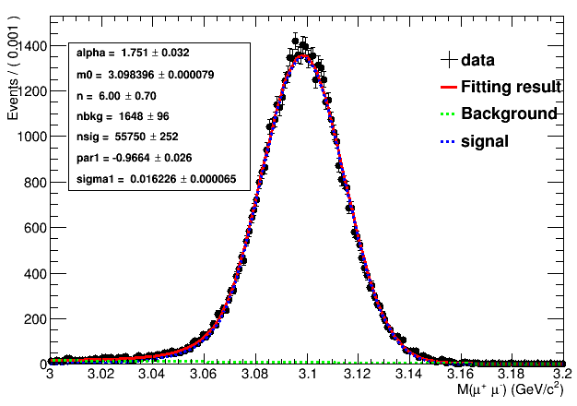
Using MC simulate ISR J/psi process to get the FSR correction
Crystal_ball + 1st-order polynomial
Fit chi2/n: 1.24888
Mmp= 3098.686 +/- 6.79475e-02MeV
Fit chi2/n: 1.13748
Mmp= 3098.396 +/- 7.86597e-02MeV
FSR = 0.29 +/- 0.10 MeV

Slide 5
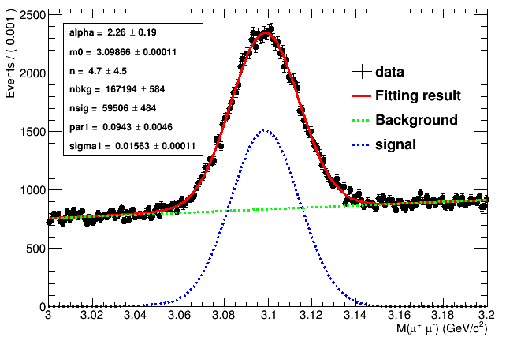
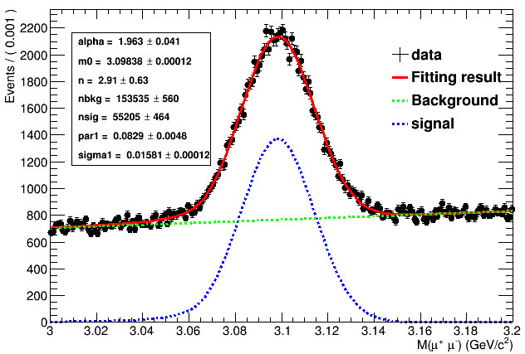
Using the background of data as the MC background to get the FSR correction
Fit chi2/ndf: 1.17615
Mmp(isr)= 3098.66 +/- 0.11MeV
Fit chi2/ndf: 1.13289
Mmp(ifsr) = 3098.38 +/- 0.12MeV
FSR=0.28+/-0.16MeV
Consider the fitting error ,the results is reliable

Slide 6
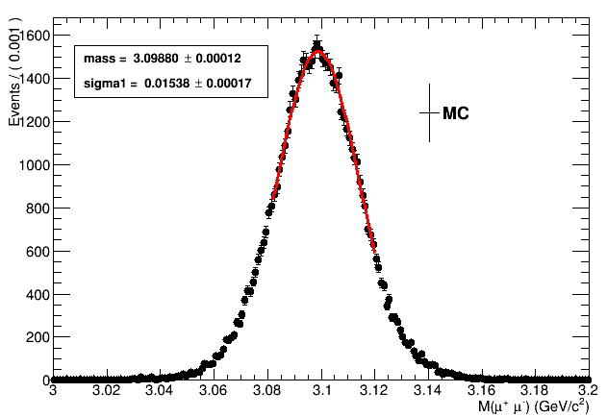
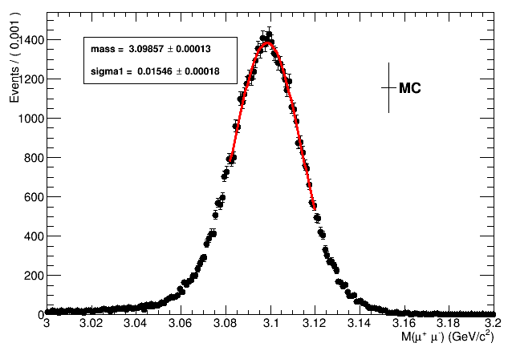
Gauss
Fit chi2/ndf: 1.02629
Mmp= 3098.80+/- 0.12MeV
Fit chi2/ndf: 1.14954
Mmp= 3098.57 +/- 0.13MeV
FSR=0.23+/-0.17MeV

Slide 7
After FSR correction the result is :
ISR J/psi = 3097.51+ 0.29=3097.80 +/- 0.31MeV
And the PDG value : 3096.916 +/- 0.011MeV
∆m = 0.884+/- 0.310MeV
The ∆m will be as the momentum calibration value

Slide 8
Fitting the Dimu peak
When we fitting the dimu peak with a Gauss function ,we give a criterion to confirm the fitting range .
First ,we fitting all the data with a reasonable range to get the fitting sigma and chisquare over number of freedom degree(chis/ndf) ,also we need the peak value(pv) approximately .
Than we changed the fitting range to compare the difference of the fitting result . We found when the chis/ndf <2 ,the difference is less than 0.1MeV and we decided to use (pv-1.0sigma,pv+1.5sigma) as the fitting range and as the criterion finally .
And the difference of fitting (0.1MeV) because of fitting range change will consider as a system error .

Slide 9
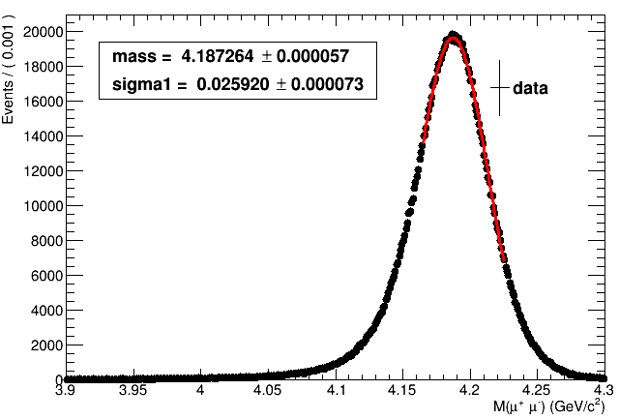
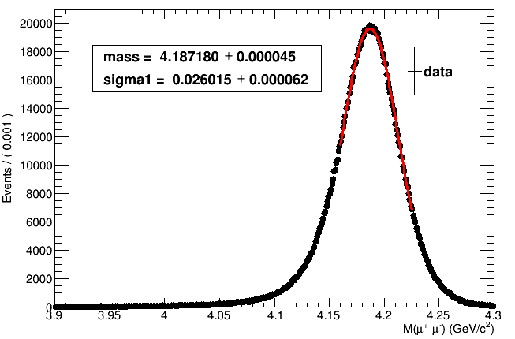
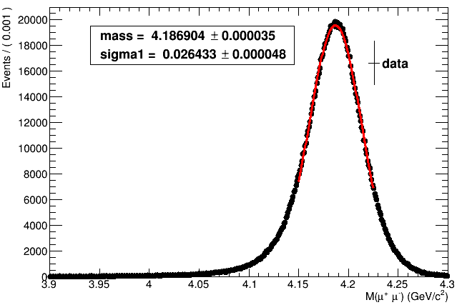
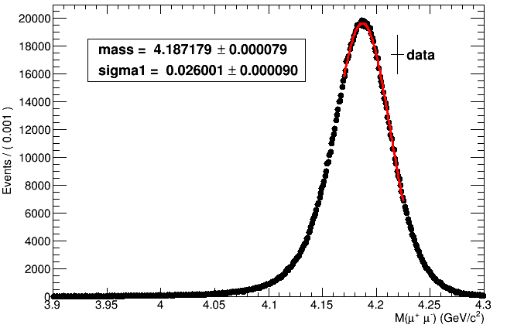
Dimu fitting method
Fit chi2/ndf: 1.85028
Mmp= 4.18718 +/- 4.49092e-05
Range(4.16,4.225)
-1.2sigma+1.5sigma
Fit chi2/ndf: 1.90207
Mmp = 4.18726 +/- 5.68024e-05
Range(4.165,4.225)
-1sigma +1.5sigma
Fit chi2/ndf : 3.26676
Mmp = 4.1869 +/- 3.54429e-05
Range(4.15,4.225)
-1.6sigma+1.5sigma
Fit chi2/ndf : 1.86152
Mmp= 4.18718 +/- 7.87849e-05
Range(4.15,4.225)
-0.8sigma+1.5sigma

Slide 10
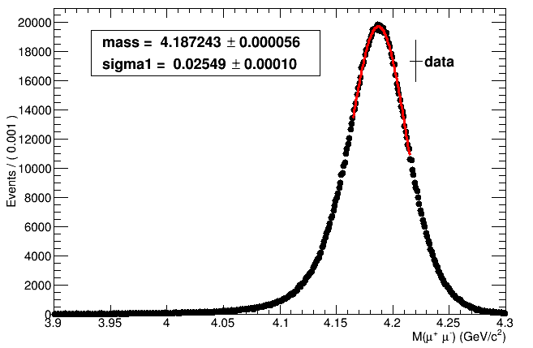
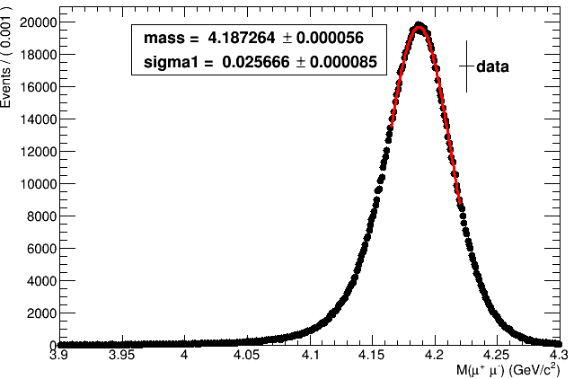
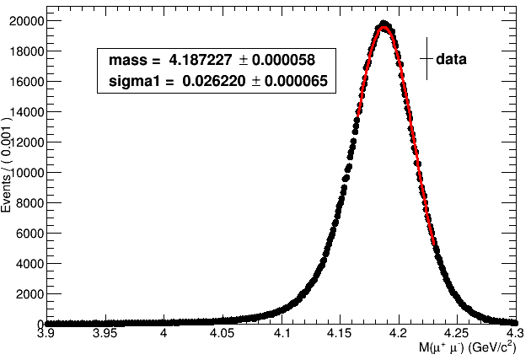
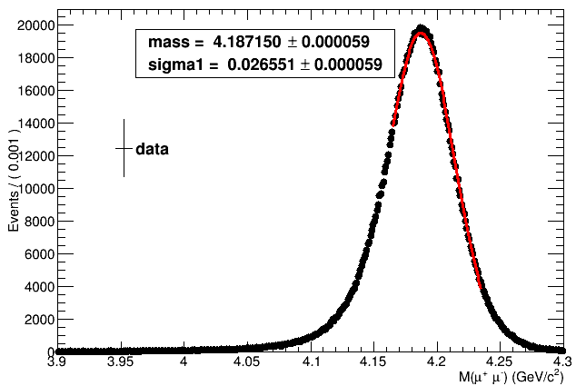
Fit chi2/ndf: 1.32265
Mmp= 4.18724 +/- 5.56823e-05
Range(4.165,4.215)
-1sigma+1.1sigma
Fit chi2/ndf: 1.47981
Mmp= 4.18726 +/- 5.57824e-05
Range(4.165,4.220)
-1sigma+1.3sigma
Fit chi2/ndf: 2.7764
Mmp = 4.18723 +/- 5.80177e-05
Range(4.165,4.230)
-1sigma +1.7sigma
Fit chi2/ndf : 4.1634
Mmp= 4.18715 +/- 5.92089e-05
Range(4.165,4.235)
-1sigma +1.9sigma

Slide 11
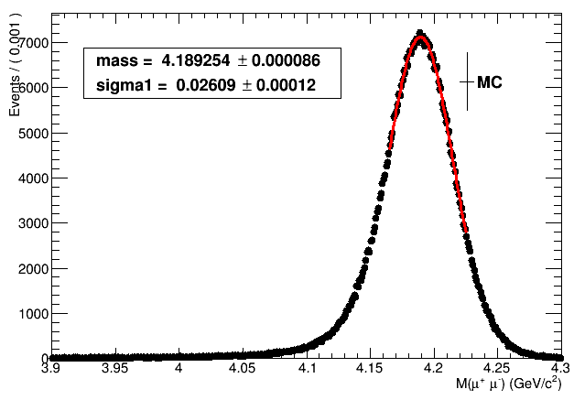
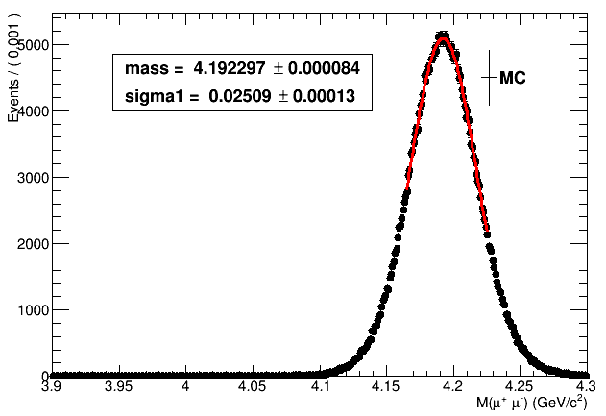
ISR correction (∆M ) by MC sample
We use the same range to fitting the MC samples to get the ISR correction
Mmp =4.189254+/-0.000086GeV
Mmp =4.192297+/-0.000084GeV
ISR=3.043+/-0.120MeV

Slide 12
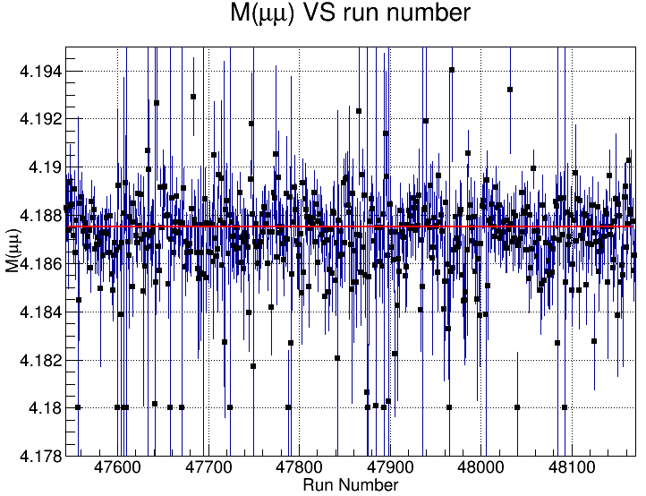
Run by run
Value: 4.18751e+00
Err :5.54951e-05

Slide 13
Thank you !!!

