Slide 1


Tunable Electron Bunch Train Generation at Tsinghua University
Zhen Zhang
On Behalf of the Accelerator Laboratory of Tsinghua University
08/29/2017
SAP17, Jishou

Slide 2
Outline
Introduction and application of electron bunch train
Methods to generate electron bunch train
Two methods used in Tsinghua University
  Nonlinear longitudinal space charge oscillation
  Slice energy spread modulation
Summary

Slide 3






Electron Bunch Train
Bunch train consists of a large number of equally spacing electron microbunches.
$$N_{b}$$
…
…
$$T_{0}$$
$$σ_{b}/I_{p}$$
$$b\left(k_{0}\right)=\frac{1}{N_{e}ec}∫I\left(z\right)e^{−ik_{0}z}dz$$
$$k_{0}=\frac{2π}{cT_{0}}$$

Slide 4




Application of Bunch Train
Narrow-band high-intensity THz radiation
Form factor
Single bunch
Bunch train

Slide 5
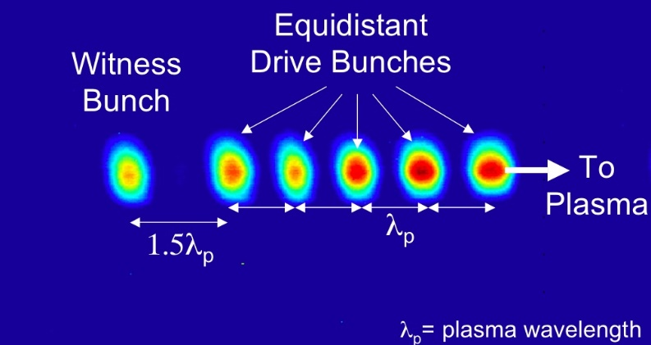
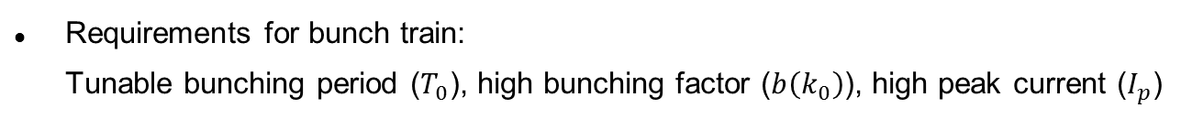
Application of Bunch Train
Resonant excitation of plasma/dielectric wakefields.
The plasma density is matched to the bunch train period for maximum wakefields acceleration or maximum transformer ratio in plasma wakefield acceleration.
P. Muggli et al., PRL 101, 054801 (2008)
C. Jing et al., PRL 98, 144801 (2007)
Requirements for bunch train:
Tunable bunching period ($T_{0}$), high bunching factor ($b\left(k_{0}\right)$), high peak current ($I_{p}$)

Slide 6
Outline
Introduction and application of electron bunch train
Methods to generate electron bunch train
Two methods used in Tsinghua University
  Nonlinear longitudinal space charge oscillation
  Slice energy spread modulation
Summary and acknowledgments

Slide 7
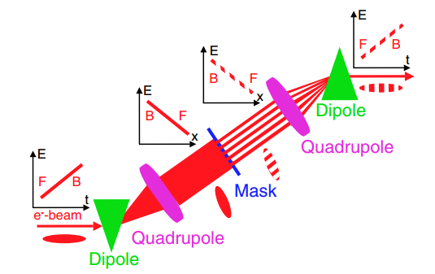
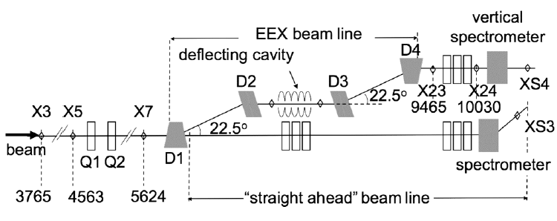
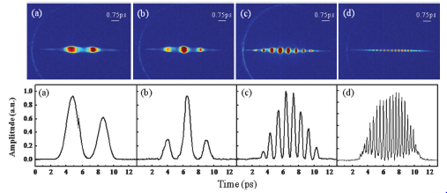
Bunch Train Generation
Exchange transverse modulation to longitudinal distribution
P. Muggli et al., PRL 101, 054801 (2008)
Y. E. Sun et al., PRL 105, 234801 (2010)
Generate the beam modulation directly at the cathode with drive laser shaping
Y. Shen et al., PRL 107, 204801 (2011)
M. Boscolo et al., NIMA 577, 409 (2007)
Y. Li et al., APL 92, 014101 (2008)
J. G. Neumann et al., JAP 105, 053304 (2009)
L. X. Yan, et al., IPAC 1st, Kyoto, Japan(2010)

Slide 8
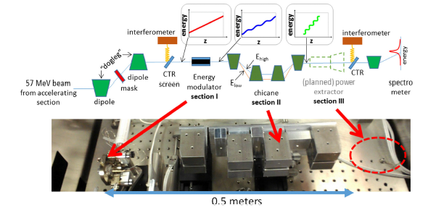
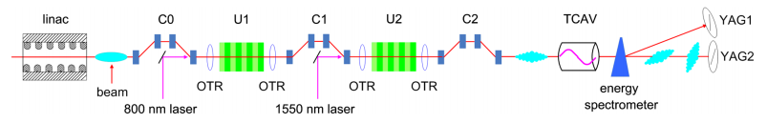
Bunch Train Generation
Exchange wake-induced energy modulation to density bunching
S. Antipov et al., PRL 108, 144801 (2012)
S. Antipov et al., PRL 111, 134802 (2013)
Frequency beating or difference of the laser-induced density bunching
D. Xiang et al., PRST-AB 12, 080701 (2009)
M. Dunning et al., PRL 109, 074801 (2009)

Slide 9
Outline
Introduction and application of electron bunch train
Methods to generate electron bunch train
Two methods used in Tsinghua University
  Nonlinear longitudinal space charge oscillation
  Slice energy spread modulation
Summary and acknowledgments

Slide 10

Longitudinal space charge oscillation
Space charge force dominants the evolution of the beam with initial modulation.
Plasma oscillation predicts the periodic evolution between density and energy modulation.
$$E_{z}$$
density
energy
density
energy
density
energy
Move direction
To maintain the initial modulation, the oscillation should be close to zero or half oscillation period.

Slide 11
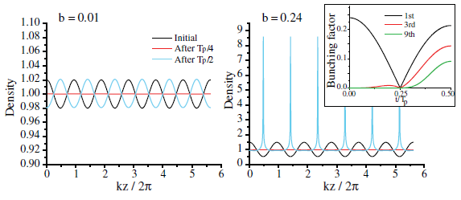



Longitudinal space charge oscillation
Linear and Non-linear regime?
Use 1D fluid model to solve the longitudinal space charge oscillation
P. Musumeci et al., PRL 106, 184801 (2011)
$$n=n_{0}\left(1+2bcos\left(kz\right)\right)$$
Wave breaking happens at the nonlinear space charge oscillation.
The method is proposed to generate high-intensity electron bunch train.
P. Musumeci et al., PRST-AB 16, 100701 (2013)

Slide 12
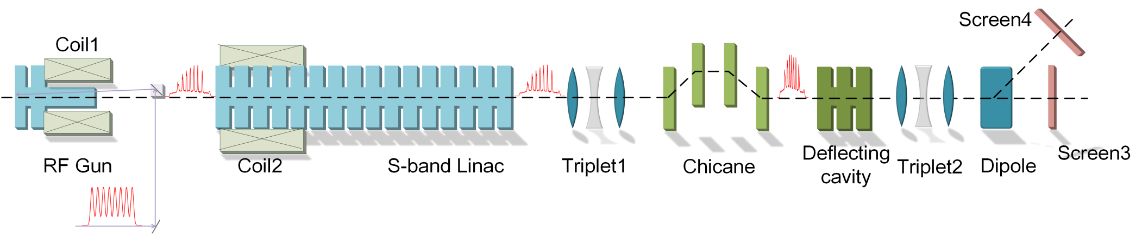
Experiment beam line at Tsinghua
The experiment was carried out at Tsinghua Thomson scattering X-ray source.
Key parameters: Initial density modulation and oscillation phase advance
Initial density modulation is generated by laser pulse stacking with 3 $α$-BBO crystals with fixed separation 1ps.
Oscillation phase advance is controlled by beam charge, laser spot size at the cathode and solenoid focusing.

Slide 13
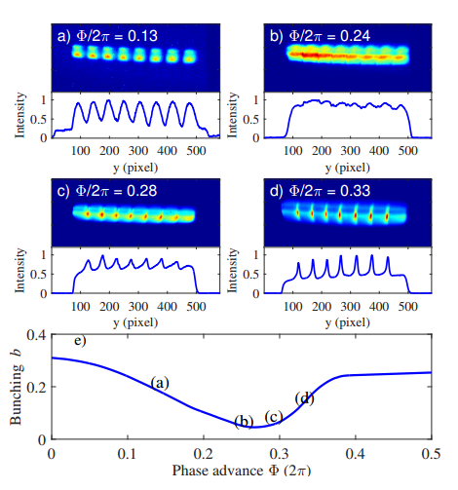
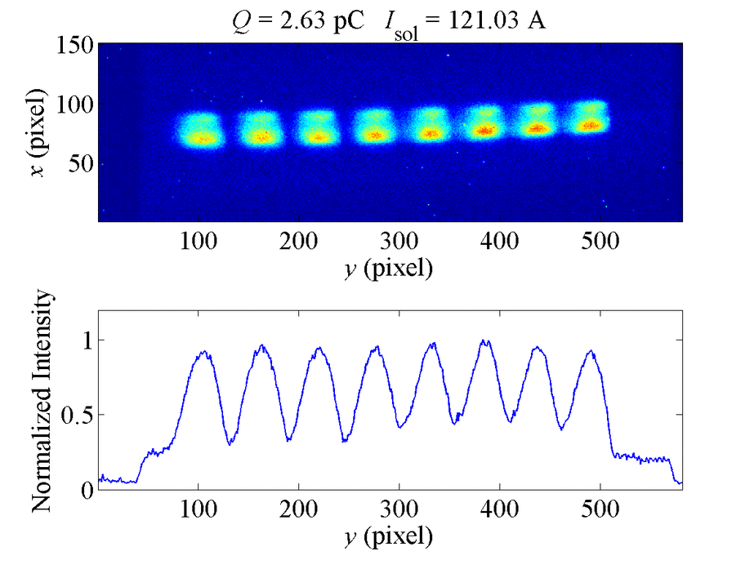
Oscillation evolution
Start from low charge and weak solenoid focus
From GPT simulation

Slide 14
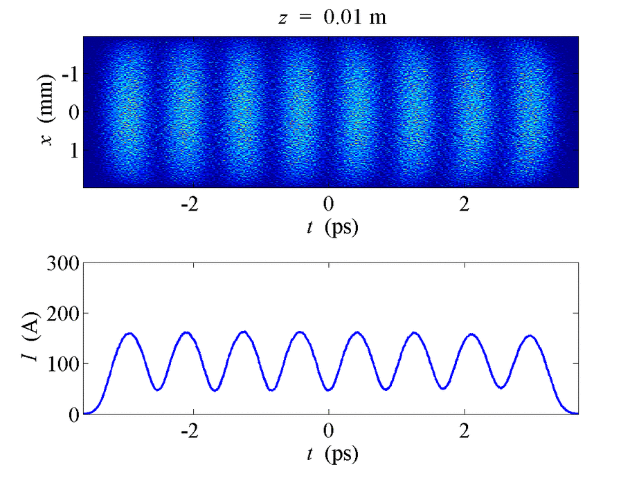
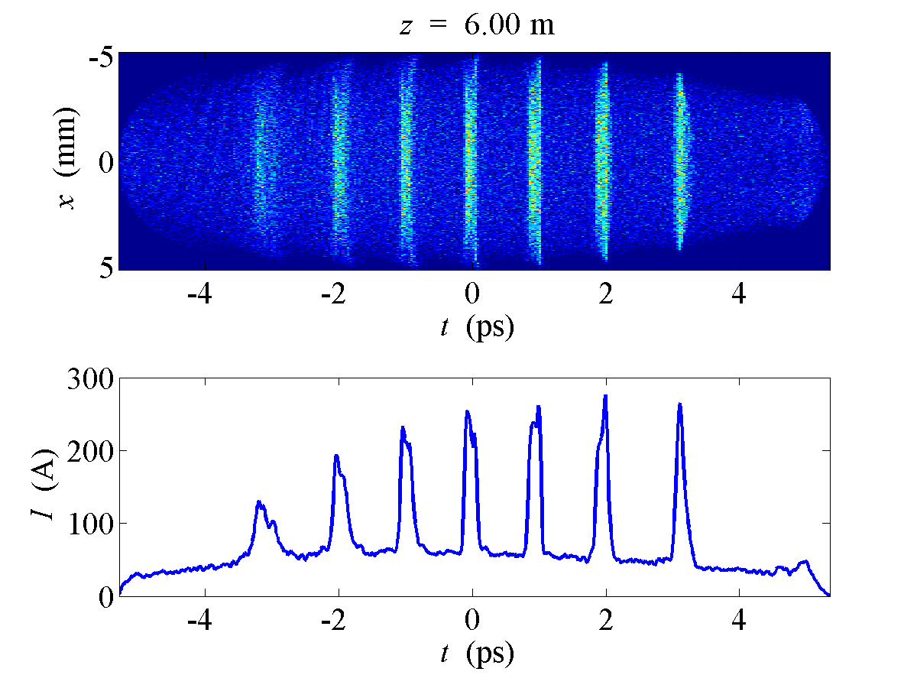
Oscillation evolution
Measurements of high-intensity electron bunch train
Experiment measurement
GPT simulation

Slide 15

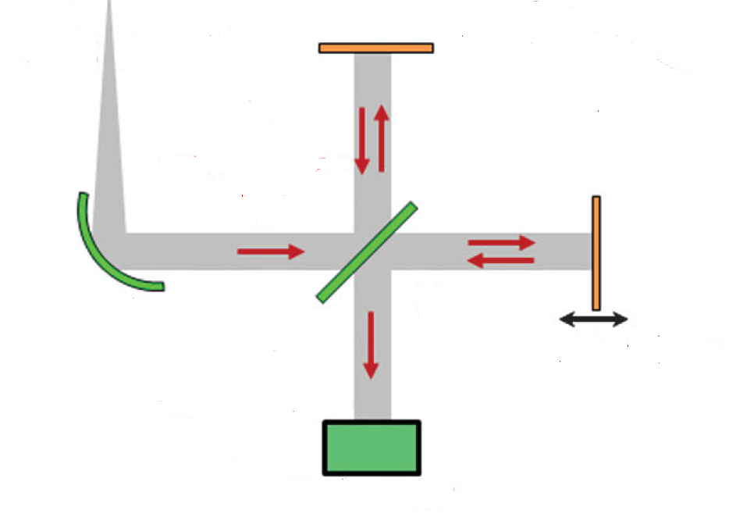
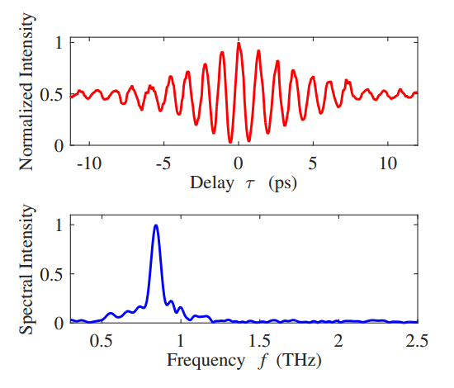

THz autocorrelation measurement
The electron bunch trains are used to generate THz radiation by CTR, and the spectra are solved through the autocorrelation by the interferometer.
CTR
Mirror
Autocorrelation
13 peaks → 7 bunches
Splitter
Paraboloid
Movable mirror
Detector
(Golay Cell)
THz Spectra
$$FWHM≈\frac{0.08 THz}{0.85 THz}≈9\%$$
Michelson interferometer

Slide 16
Tunable bunch train spacing
The bunch train spacing can be controlled by the velocity bunching of the RF gun and the accelerator, or by the magnetic compression.
Velocity bunching
Gun
Magnetic compression
Chicane
Gun max. gradient ~106MV/m
Accelerator phase 0 (max. acceleration)
Chicane off
Change the launching phase
Gun max. gradient ~106 MV/m
Gun phase 45 degreeS
Accelerator phase -37 degreeS
Change the Chicane current

Slide 17
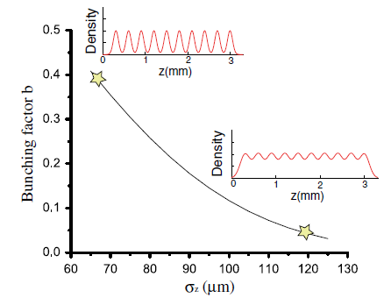
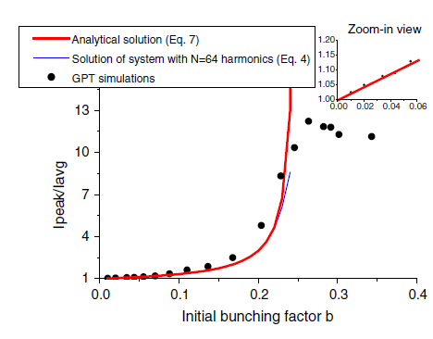
Optimization of THz radiation energy
Simulation studies have shown that there is a optimal initial bunching factor that can yield largest peak current and largest THz energy.
For a fixed 1-ps initial spacing, the initial bunching factor can be controlled by the single UV pulse width.
P. Musumeci et al., PRST-AB 16, 100701 (2013)
The UV pulse length was varied by tuning the IR compression grating before third-harmonics generation process and measured by cross-correlation technique with an IR laser.

Slide 18
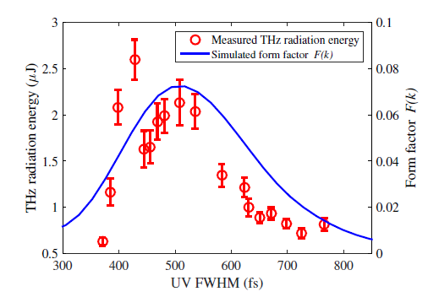
THz radiation energy
THz radiation energy with different initial UV pulse length (initial density modulation).

Slide 19
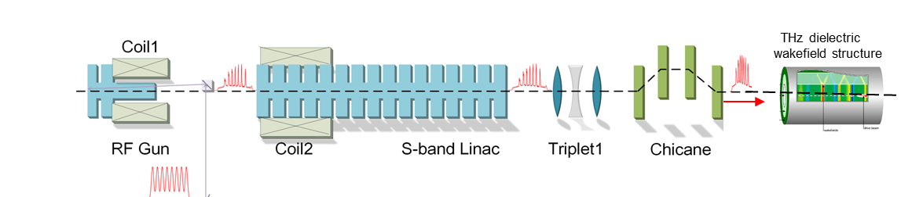
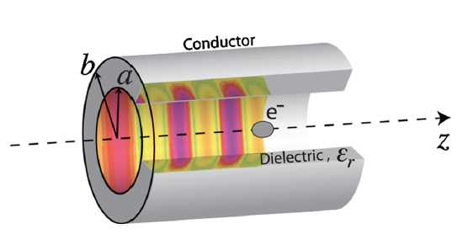
THz from dielectric wakefield structures
mJ level THz radiation can be produced by the electron bunch train based on dielectric wakefield tubes.

Slide 20
Outline
Introduction and application of electron bunch train
Methods to generate electron bunch train
Two methods used in Tsinghua University
  Nonlinear longitudinal space charge oscillation
  Slice energy spread modulation
Summary and acknowledgments

Slide 21
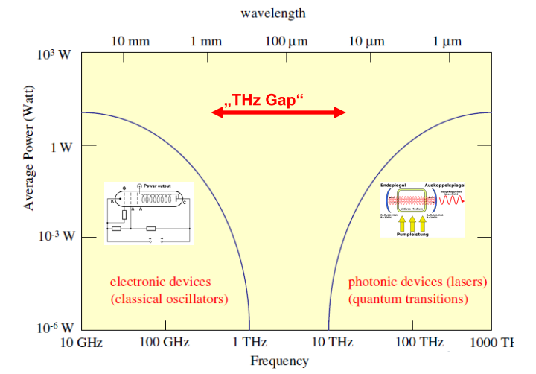
Generate electron bunch train
The methods based on the self-field (space charge or wakefield) of electron beam have disadvantages:
  NOT available for high frequency (~>5THz)
  Hard to control the other parameters of the beam (beam size, current)
We need more powerful tool!

Slide 22
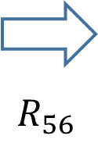





Generate electron bunch train
Laser-based modulation for high-brightness electron beam
$$E$$
$$E$$
$$t$$
$$t$$
Energy modulation
Density modulation (bunching)
However, when we use laser modulation to generate THz bunching …
IR: $800nm \sim 375THz≫1∼10THz$
difference-frequency method, but with low efficiency

Slide 23
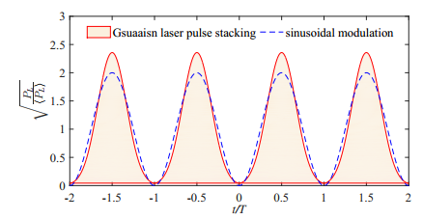
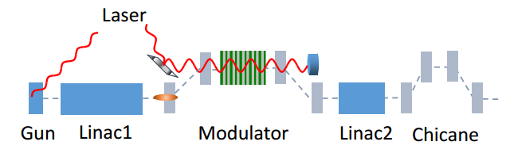

Generate electron bunch train
We propose a method based on slice energy spread modulation.
Modulated laser pulse
$$R_{56}$$

Slide 24
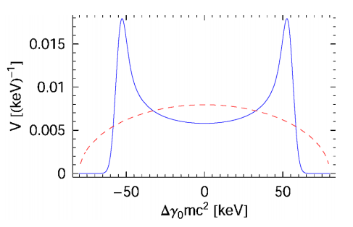



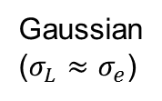

Theoretical analysis
The final optimal bunching factor depends on the distribution of energy spread.
$$R_{56}$$
Gaussian
($σ_{L}≈σ_{e}$)
$$b_{1}≈0.27$$
$$σ_{L}≫σ_{e}$$
$$σ_{L}≈σ_{e}$$
Z. Huang et al., PRST-AB 7, 074401 (2004)

Slide 25
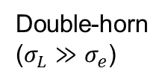


Theoretical analysis
The final optimal bunching factor depends on the distribution of energy spread.
$$R_{56}$$
Gaussian
($σ_{L}≈σ_{e}$)
$$b_{1}≈0.27$$
$$R_{56}$$
Double-horn
($σ_{L}≫σ_{e}$)
$$b_{1}≈0.4$$

Slide 26

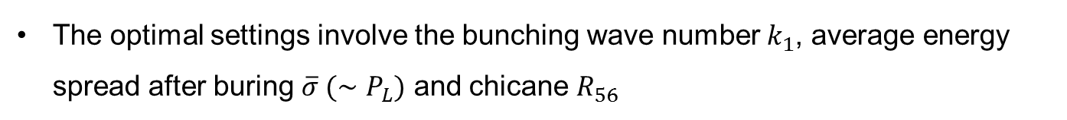
Theoretical analysis
The optimal settings involve the bunching wave number $k_{1}$, average energy spread after buring $\overline{σ} (∼P_{L})$ and chicane $R_{56}$

Slide 27
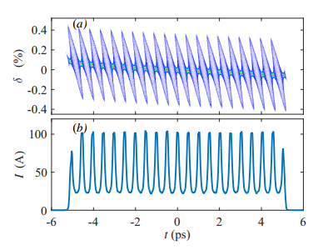
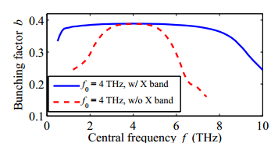
Simulations and frequency tunability
LCLS injector parameters: 135MeV, 800nm, 2(or 4) THz modulation
X-band linearizer

Slide 28
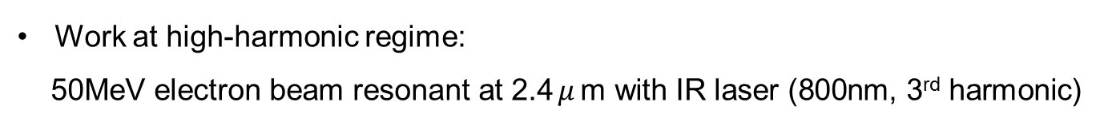

Generate electron bunch train
135MeV just for THz radiation? How about low energy?
$$R_{56}$$
Work at high-harmonic regime:
50MeV electron beam resonant at 2.4$μ$m with IR laser (800nm, 3rd harmonic)
Produce narrow-band mJ-level THz radiation ranging up to ~20THz with kHz repetition rate in undulator radiation (see Z. Huang’s talk in FEL2017)

Slide 29
Generate electron bunch train
135MeV just for THz radiation? How about low energy?
$$R_{56}$$
Work at high-harmonic regime:
50MeV electron beam resonant at 2.4$μ$m with IR laser (800nm, 3rd harmonic)
Produce narrow-band mJ-level THz radiation ranging up to ~20THz with kHz repetition rate in undulator radiation (see Z. Huang’s talk in FEL2017)

Slide 30
Summary
Electron beam train production is an interesting topic including longitudinal beam dynamics, beam manipulation, radiation and wakefield effect.
We talked about two methods to generate electron beam train at Tsinghua
  Nonlinear space charge oscillation
  Slice energy spread modulation
The method based on slice energy spread modulation is of great potentials to be applied in modern free-electron laser facilities.
For detailed information, please refer to our two papers
PRL 116, 184801 (2016) and PRAB 20, 050701 (2017)

Slide 31
Thanks !

