Slide 1
Beam Commissioning of the CSNS Sheng Wang Yong Li for CSNS Accelerator Team Institute of High Energy Physics, CAS Aug. 29, 2017 g
SAP2017, Jishou, 28-30 August 2017

Slide 2
Outline
Project Overview
Linac Commissioning
RCS Commissioning
Summary
2
2

Slide 3
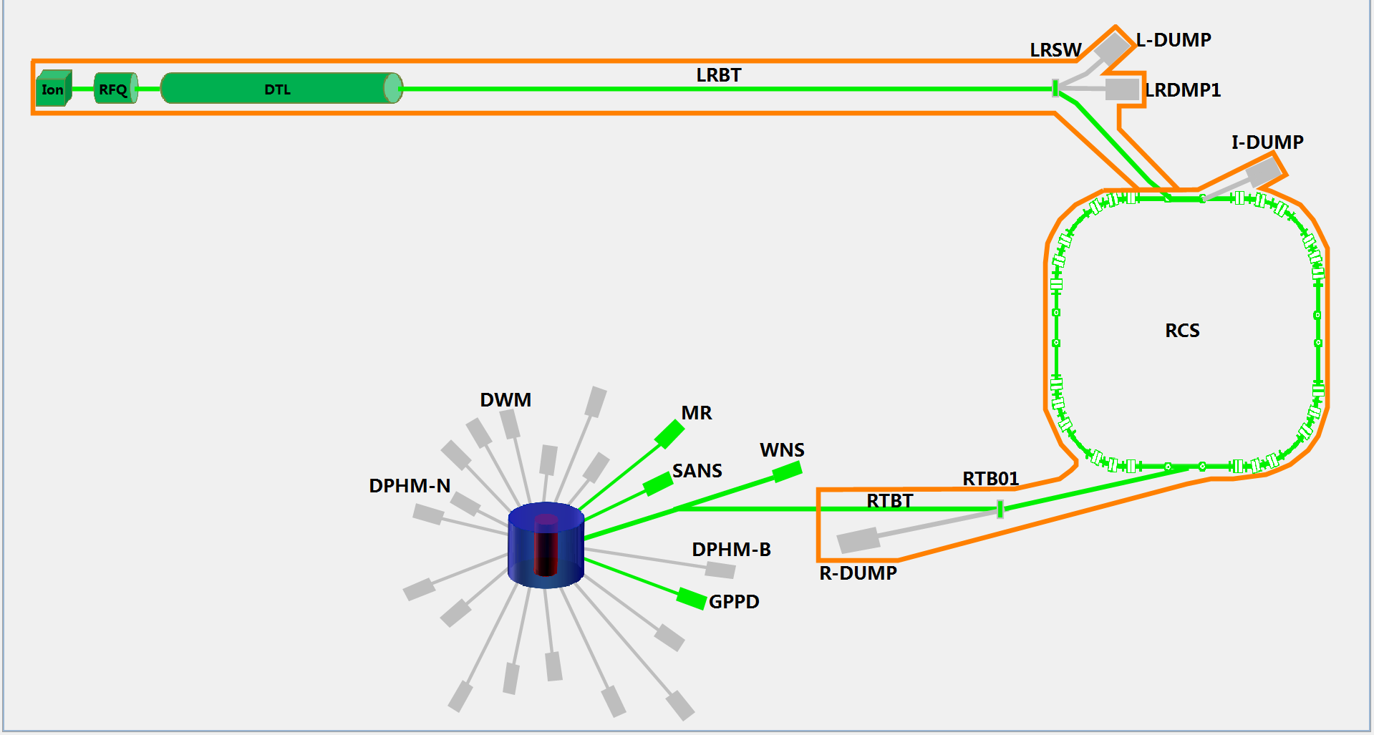
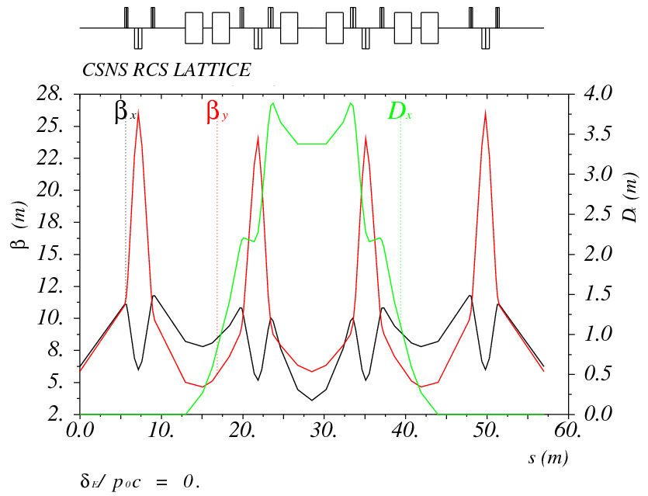
Project Overview
The phase-I CSNS facility consists of an 80-MeV H⁻ linac, a 1.6-GeV RCS, beam transport lines, a target station, and 3 instruments.

Slide 4
Key Milestones
Front end | Oct.18,2013-Apr.10, 2014 | 125 days
RFQ,MEBT,DTL1 | Jun.5,2014-Aug.27, 2014 | 60 days
DTL2-4 | Jun.30, 2015-Nov.3, 2015 | 90 days
LRBT+Linac | Nov.4,2015-Jan.6, 2016 | 46 days
RCS | May13,2016-Mar.2, 2017 | 210 days
RTBT | Mar.3,2017-May 25, 2017 | 60 days
First beam on target | Aug.24, 2017
Beam power to 10kW | Aug.25,2017-Mar.3,2018 | 6 months
Beam power to 100kW | Mar.3,2018-Mar.3,2021 | 3 years
Feb. 2001 | idea of CSNS discussed
June 2005 | proposal approved in principle by the central government (CD0)
Jan. 2006 | prototyping R&D started
Sept. 2008 | proposal approved
Oct. 2009 | feasibility study report reviewed
April 2010 | site preparation start
Feb. 2011 | feasibility study report approved (CD-1)
May 2011 | preliminary design report approved (CD-2)
Sept. 2011 | construction started (CD-3), component fabrication started
May 2012 | civil construction started
Oct. 2014 | Frontend and LRBT started installation in Linac tunnel
April 2015 | the RCS magnets started installation in RCS tunnel
May 2015 | the Helium Vessel of the target station installed
Jan. 2016 Apr. 2017 | DTL-1 Beam commissioning Linac beam commissioning
May. 2017 | RCS commissioning start
Sept. 2017 | first beam on target
Mar. 2018 | project complete/operation start (6.5 years from start)
4
Notes:
Conventional facility @ infrastructure completed
Key technology R&D

Slide 5
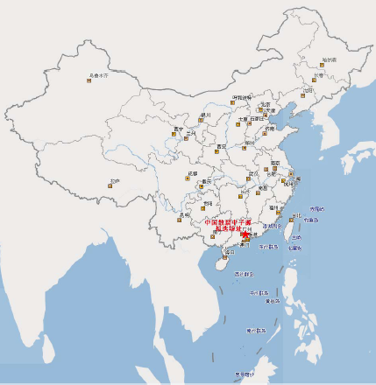
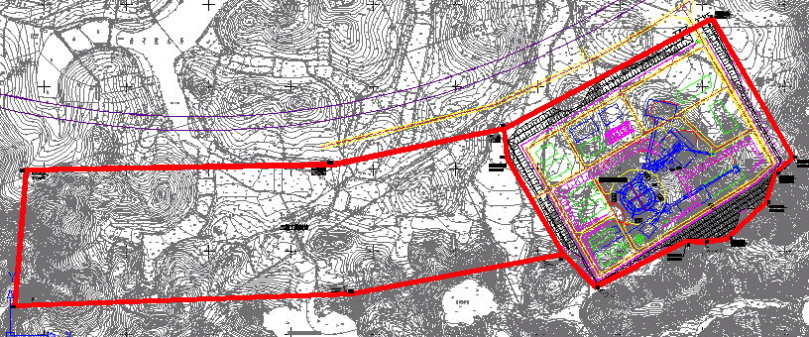
Site Area
The site of CSNS locates at Dongguan, Guangdong Province.
The Dongguan local government provided a land of about 0.67km² for CSNS campus. 0.27-km² is used for the phase-I construction.

Slide 6
May 2009: before land breaking
Aug 2011: land is prepared

Slide 7
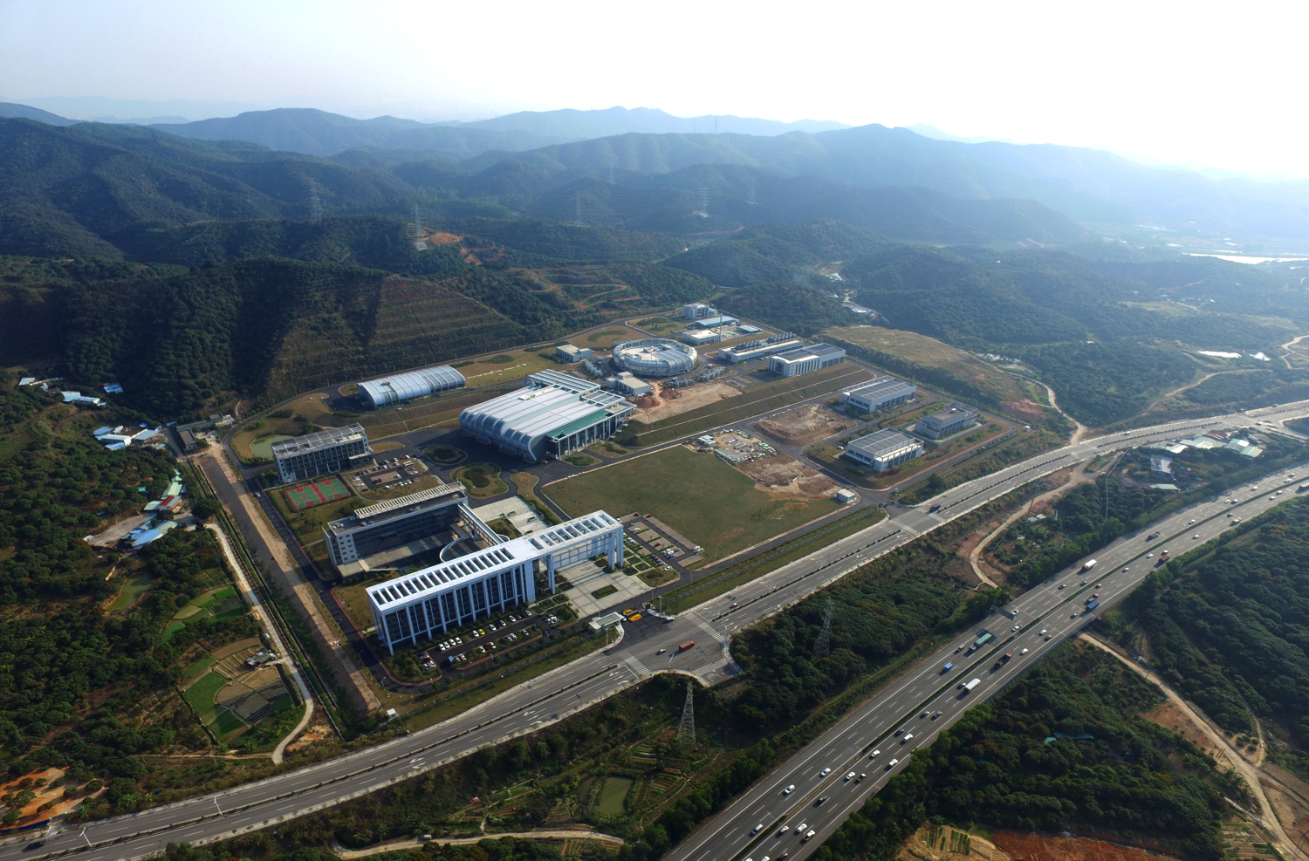
CSNS site

Slide 8
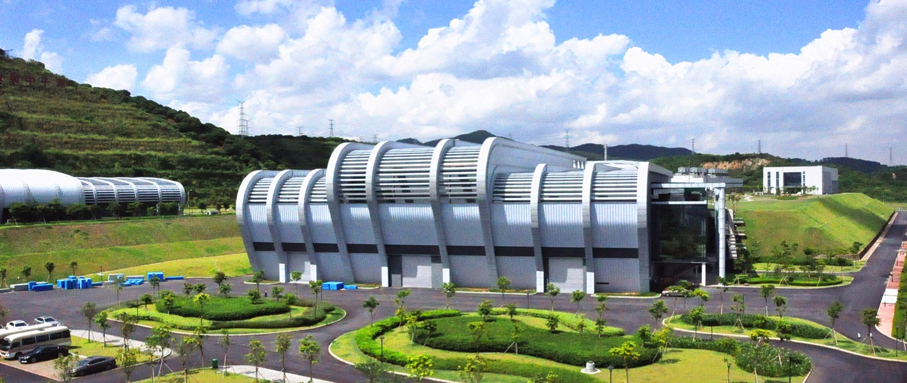
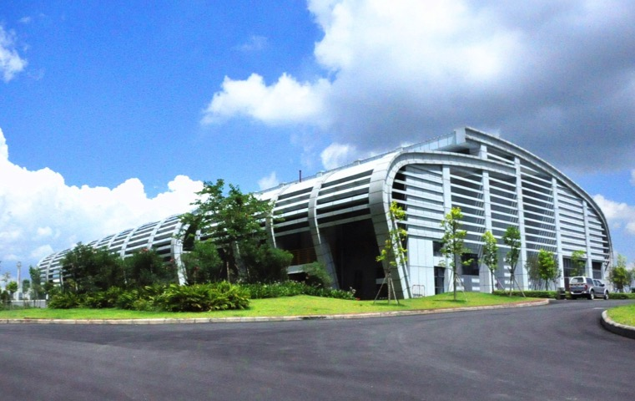
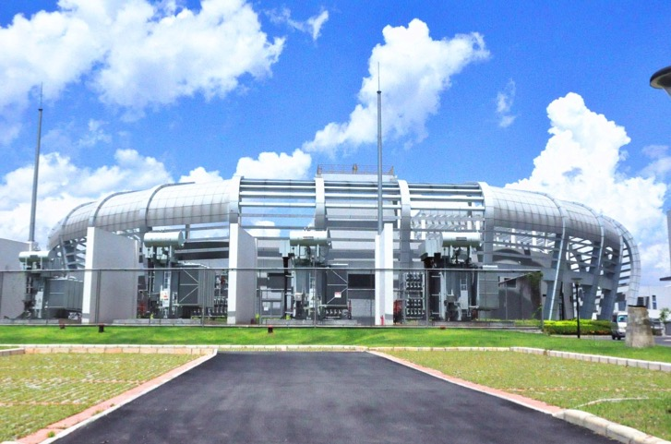
Target and experiment Hall
Linac service building
RCS service building

Slide 9
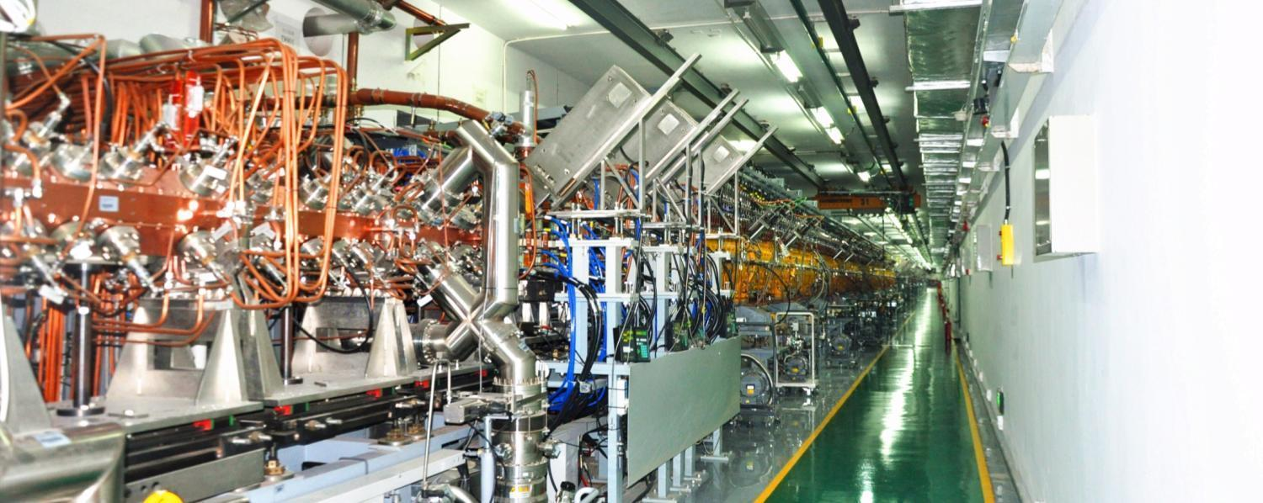
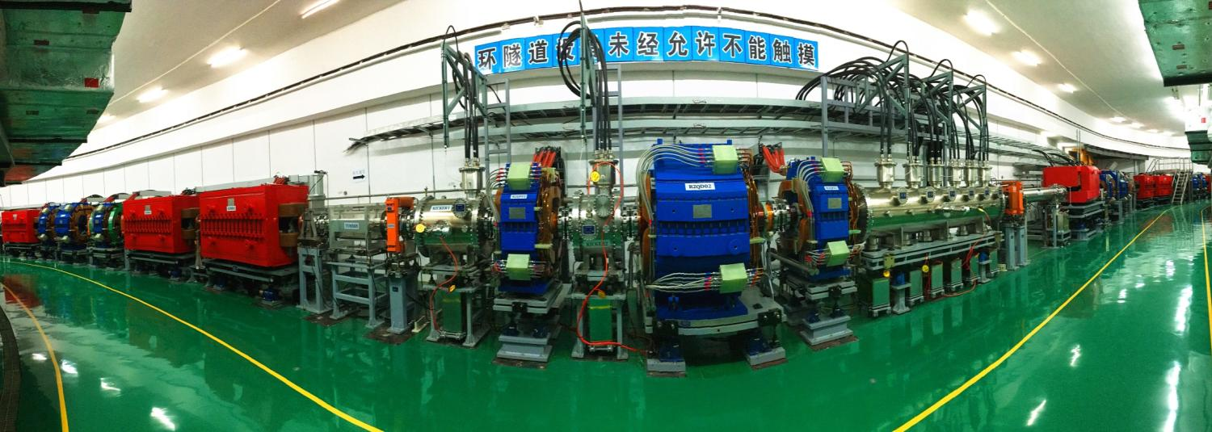
Linac tunnel
RCS tunnel

Slide 10
Linac Commissioning
10

Slide 11
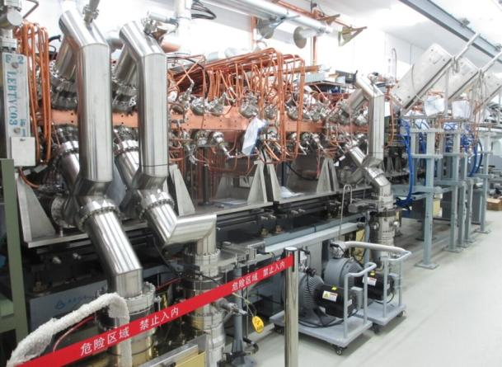
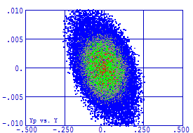
LEBT, RFQ and MEBT (beam commissioning at June 2015)
 | Design | Achieved
Peak current [mA] | 15 | 17
Beam energy[MeV] | 3.025 | 3.02±0.015
Chopping rate [%] | 50 | 50
Pulse width [μs] | 420 | 500
Pulse repetition rate [Hz] | 25 | 25
Simulated Emittance=0.22 PI mm-mrad Measured Emittance=0.27 PI mm-mrad

Slide 12
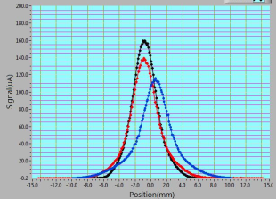
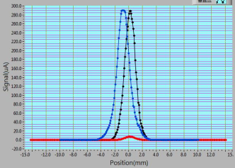
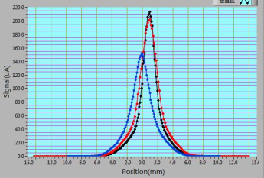
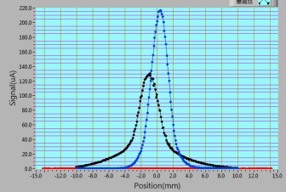
Transverse emittance measurement:1
Wire scanner
Beam RMS size along the MEBT
Wireanalysis
XAL
 | α | β[mm/mrad] | Emittance [πmm mrad]
Horizontal Measured / Simulated | -1.716 /-1.773 | 0.256 / 0.233 | 0.215 / 0.215
Vertical Measured / Simulated | 1.944 / 0.639 | 0.173 / 0.074 | 0.211 / 0.212

Slide 13
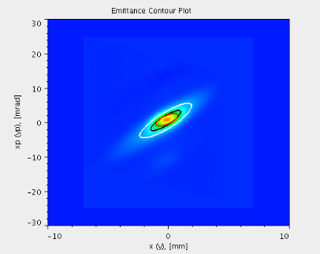
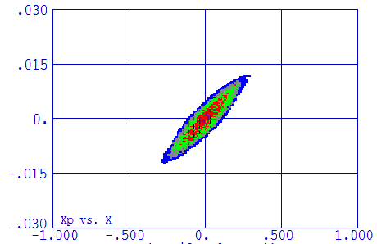
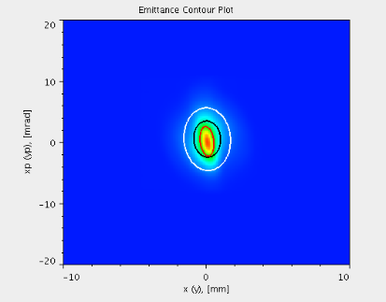
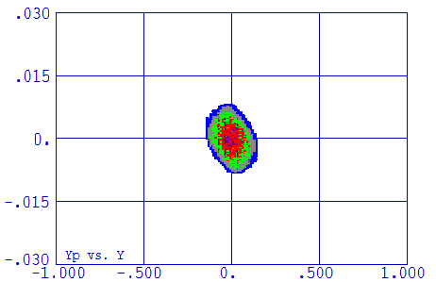
Transverse emittance measurement:2
(a) X(mm)-X’(rad)
(b) Y(mm)-Y’(rad)

Slide 14
DTL commissioning
CT
FCT
CT
FCT
CT
FCT
Tank1
Tank2
Tank3
Tank4
Temporal Beam Diagnostic system:
1BPM,1CT,2FCT,1 QEM,1 x-y steering magnet,1EM,1WS
1 Energy degrader /Faraday cup,1 Beam dump(0.163kW)
Tank number | 1 | 2 | 3 | 4 | total
Output energy (MeV) | 21.67 | 41.41 | 61.07 | 80.09 | 80.09
Number of cell | 64 | 37 | 30 | 26 | 157
RF driving power (MW) | 1.35 | 1.32 | 1.32 | 1.34 | 5.33
Total RF power (MW) (I=15mA) | 1.62 | 1.62 | 1.62 | 1.63 | 6.49
Accelerating field (MV/m) | 2.86 | 2.96 | 2.96 | 3.0
Synchronous phase (degree) | -35 to -25 | -25 | -25 | -25

Slide 15
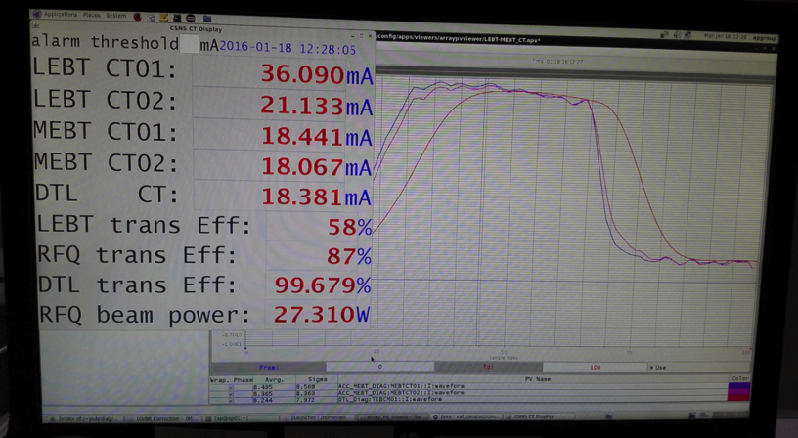
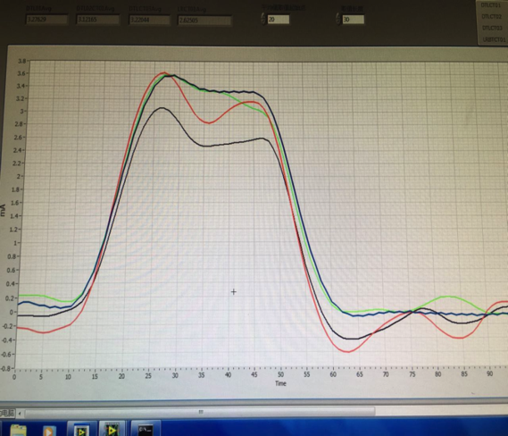
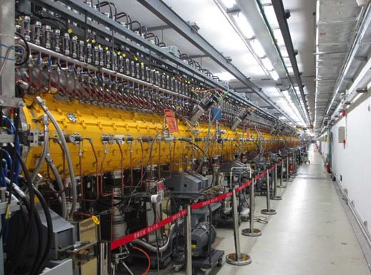
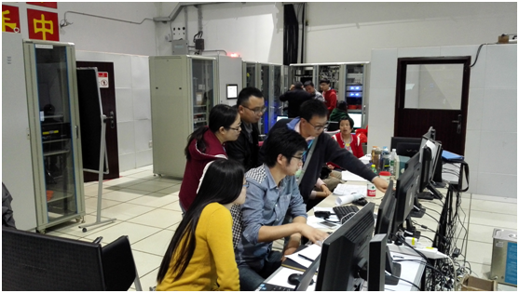
DTL beam commissioning
DTL-1: In 2016, 18mA/21.67MeV/50us/1Hz beam was obtained, which exceeds the design goal of beam current of 15mA. the beam reached the end of the first DTL tank with peak current of 18mA at 21.67 MeV, with transmission rate ～ 100%.
DTL-2,3: In April 2017, beam from DTL-3 about 15mA @ 60MeV.
Beam current measurement from CTs for beam commissioning of DTL-1 and DTL-3.

Slide 16
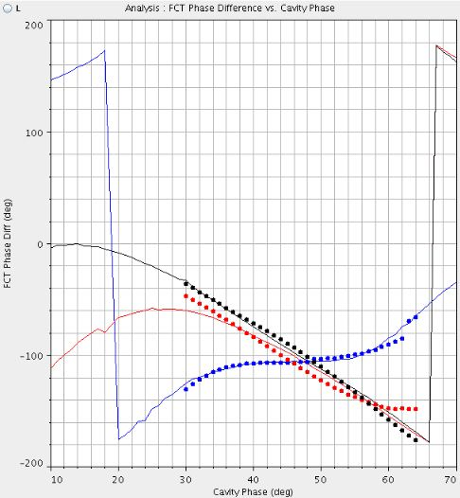
Setting DTL RF amplitude and phase
XAL, Pasta (an RF phase scan and tuning application)
 | DTL1 | Design
Φ_{cavity}（degree） | 41 | -35
Amp | 6333 | 2.86MV/m
W_{RFQ}(MeV) | 3.029 | 3.0258
W_{DTL1}(MeV) | 21.802 | 21.67
 | Design [MeV] | Phase scan [MeV] | TOF [MeV]
RFQ | 3.026 | 3.029 | 3.027 ±0.01
DTL1 | 21.669 | 21.802 | 21.685±0.01
DTL2 | 41.415 | 41.52 | 41.566±0.14
DTL3 | 61.072 | 60.917 | 61.09±0.34
Signature matching
All the energy deviation are < 1%

Slide 17
LRBT matching
Simulation data
Measurement data
Before
matching
After
matching

Slide 18
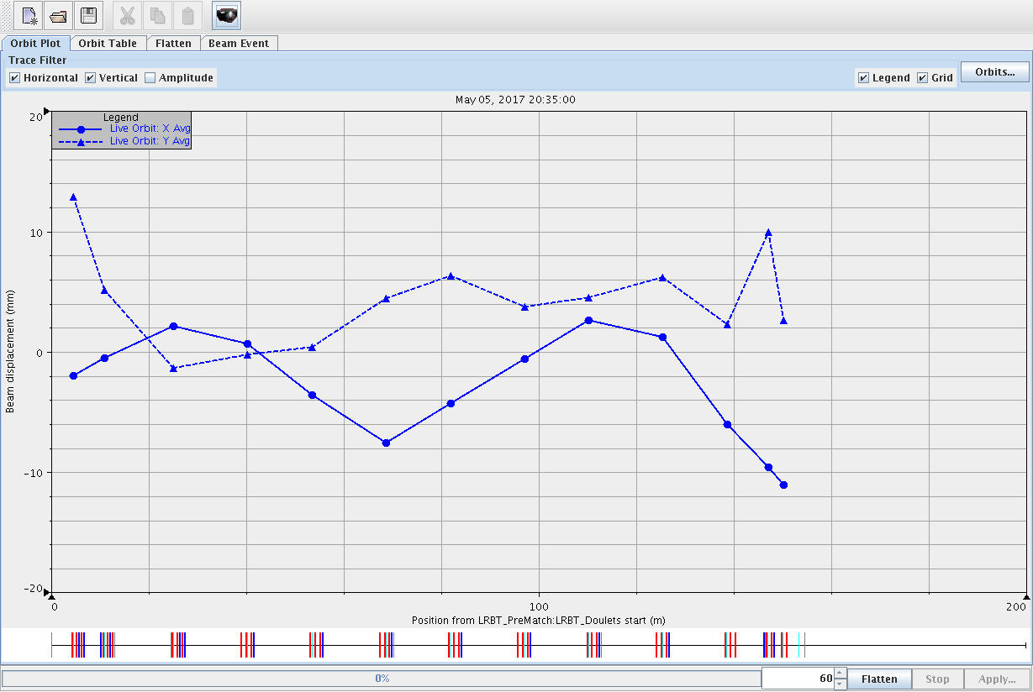
LRBT Orbit correction
before correction
± 13mm
after correction
± 2mm

Slide 19
RCS Commissioning

Slide 20
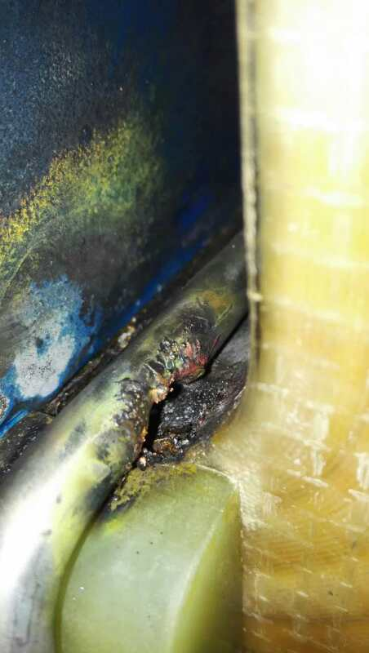
RCS Dry Running
A week per time, 2 times
Problem found:
Water leakage was found in one cavity.
Cooling tubes of two AC magnets were burned through.
17 chokes had strong vibration and had been returned to the manufacture to repair.
Ceramic vacuum chamber Broken
Arc of extraction kicker
……

Slide 21
Beam Commissioning to Inj. Dump

Slide 22
RCS Beam Commissioning-DC mode
To control the beam loss during the beam commissioning, the single shot beam mode is adopted. In the first step, the beam commissioning was started in DC mode without acceleration.
In May 31st, the first beam was injected into the RCS, and successfully accumulated in the RCS. The maximum accumulated particle number is about 1/3 of the design goal.
In June 5th, the first beam was extracted to RCS dump.

Slide 23
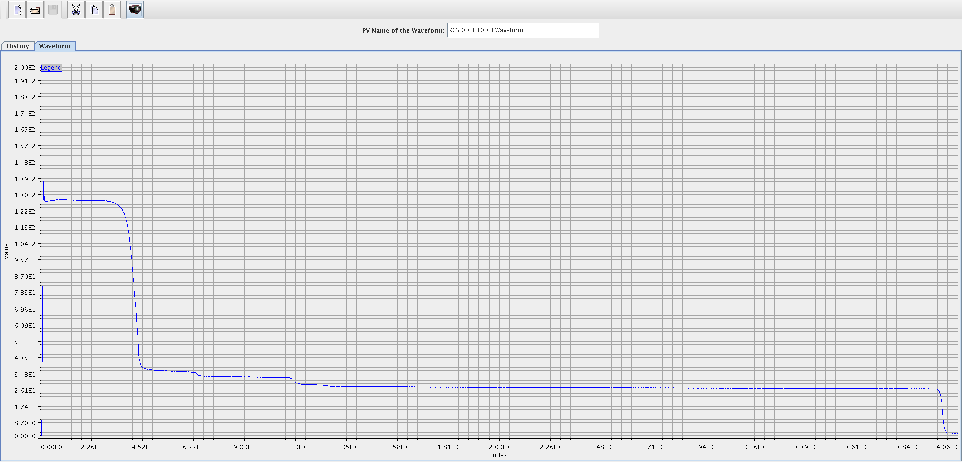
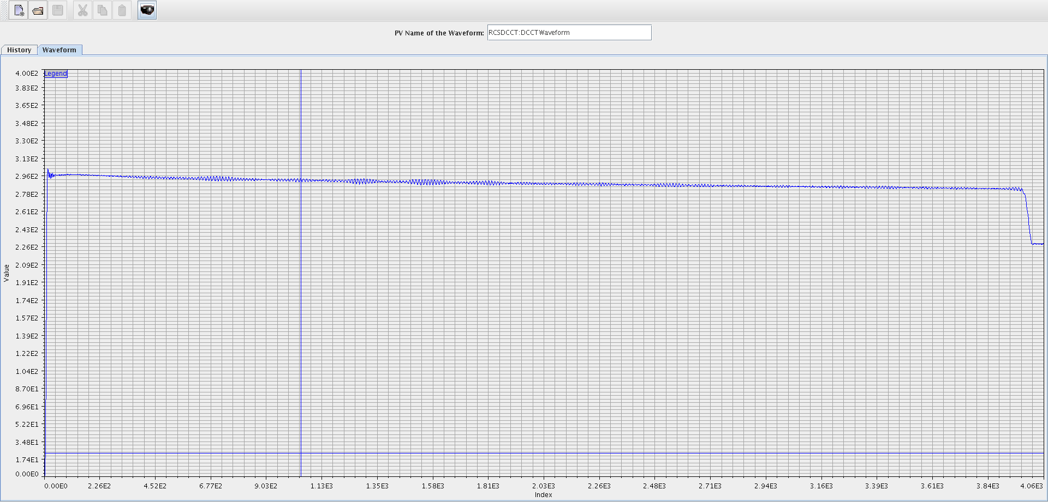
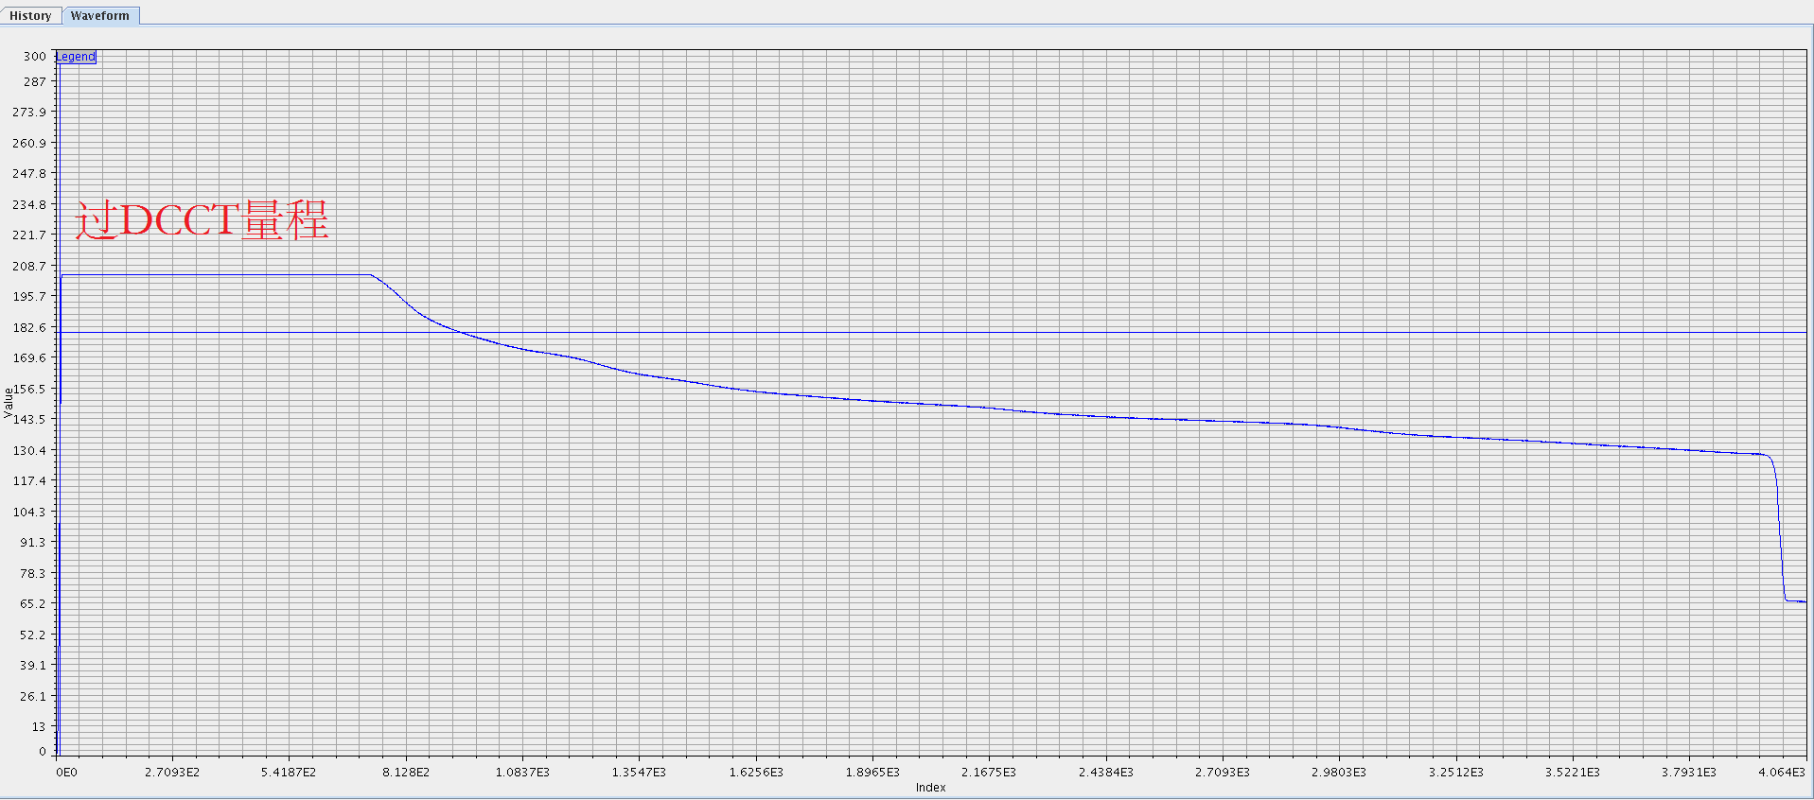
Optimization of the accumulation
1：Optimization of RF pattern
2：Optimization of the B field
3：Injection painting
One day later, beam transmission was more than 98%

Slide 24
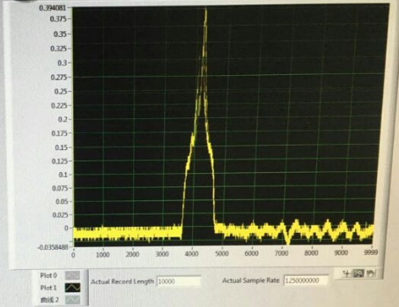
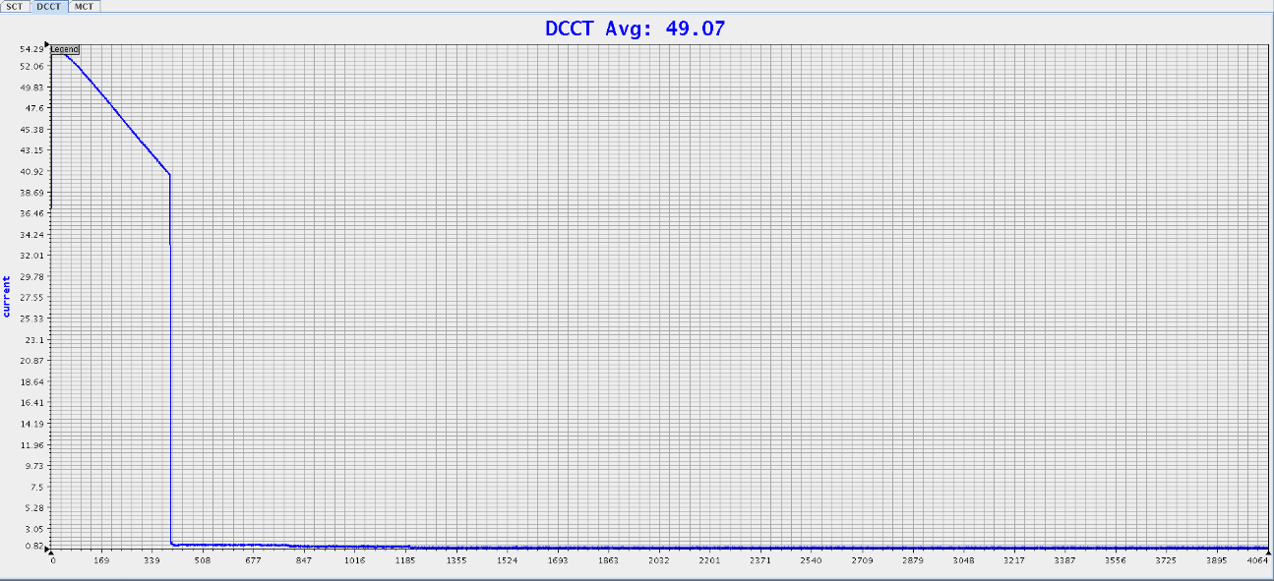
60 MeV Beam Extraction to R-Dump

Slide 25
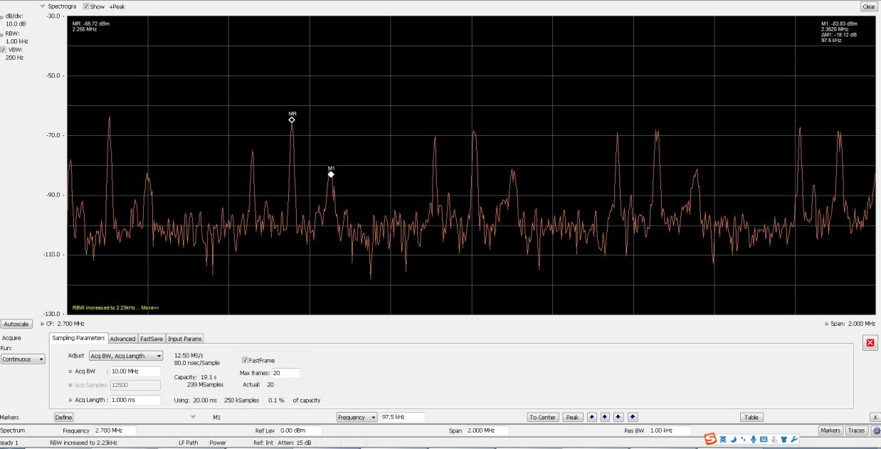
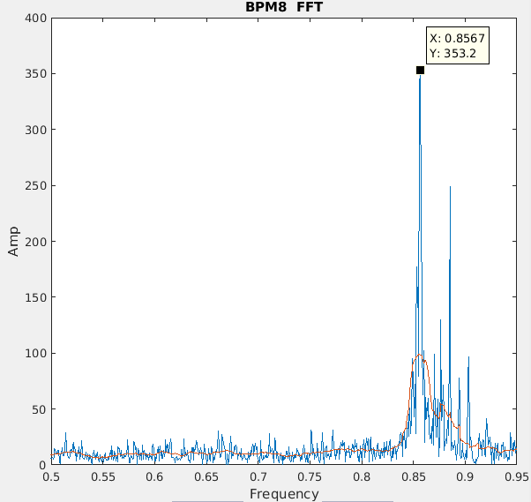
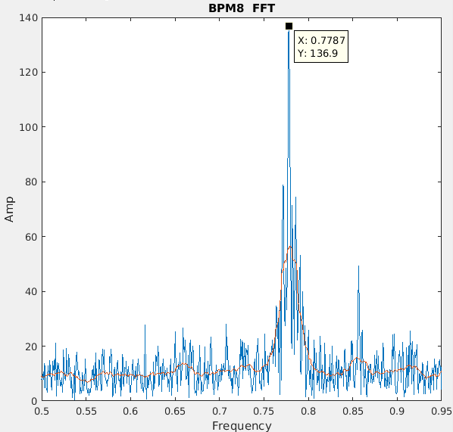
Tune measurement
Measured Tune：4.857/4.779 Design Tune：4.86/4.78

Slide 26
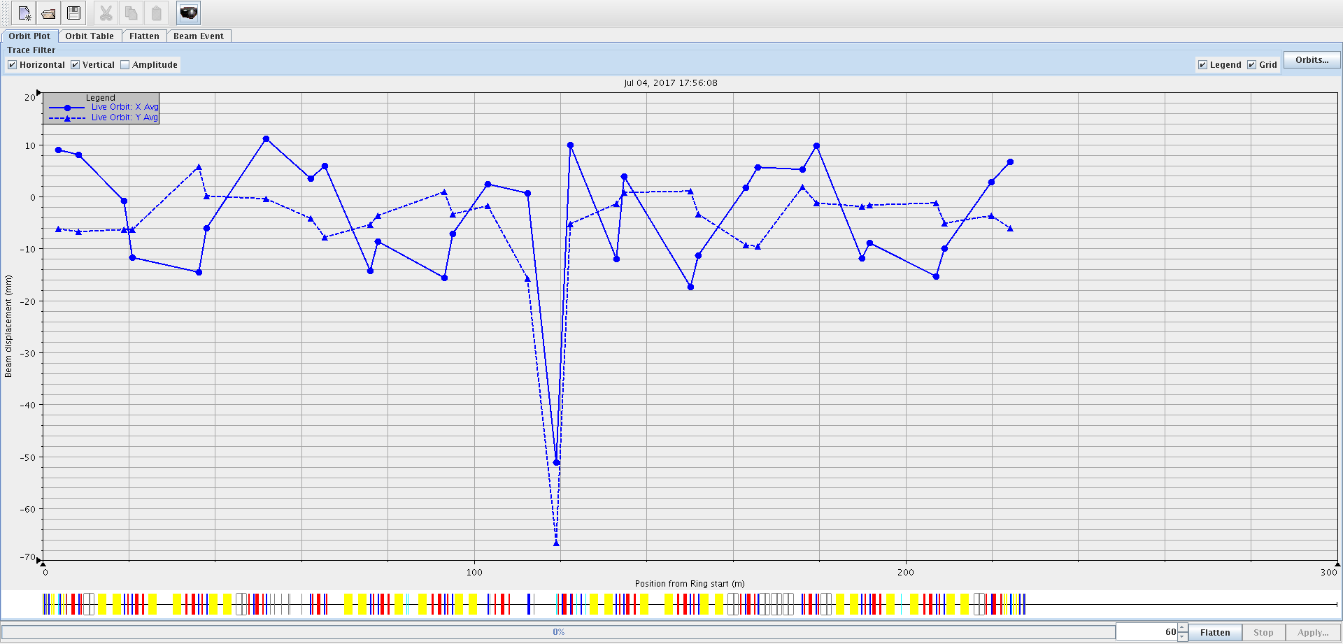
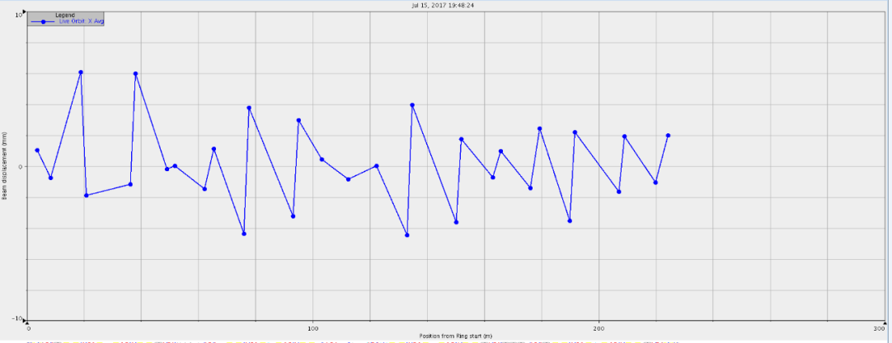
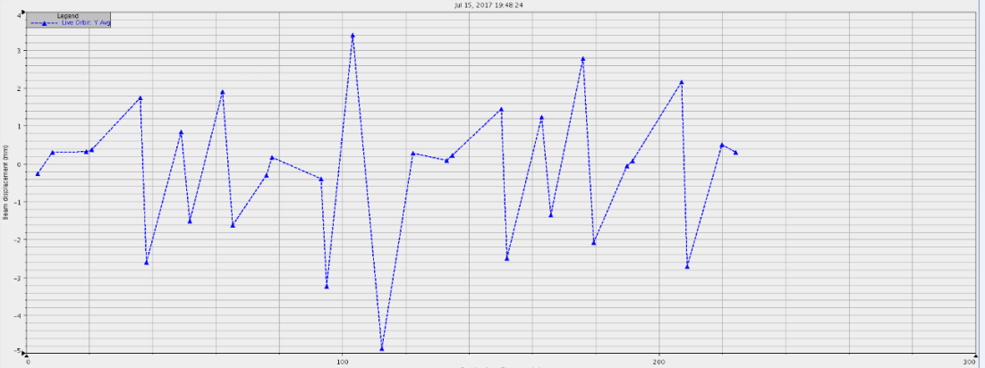
Orbit correction
before correction
± 10mm
X
after correction
± 5mm
after correction
Y
± 5mm

Slide 27
Online Model
Response matrix
Fringe field is added to the online model of OPEN XAL.
Field interference is also included.
 | Tunex | Tuney
Design model | 4.86 | 4.78
Without fringe field in Openxal | 4.946 | 4.979
With fringe field in OpenXAL | 4.863 | 4.785
Measured Tune | 4.857 | 4.779

Slide 28
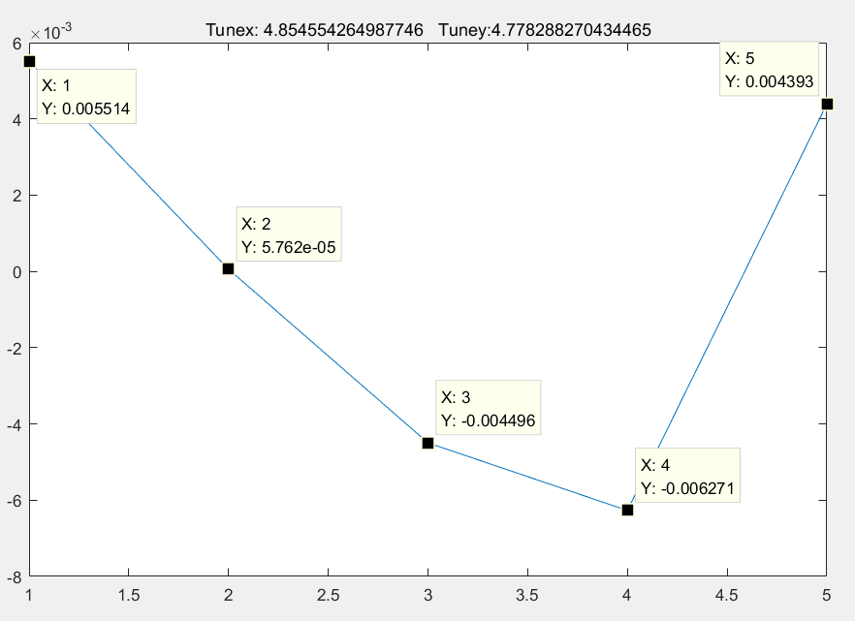
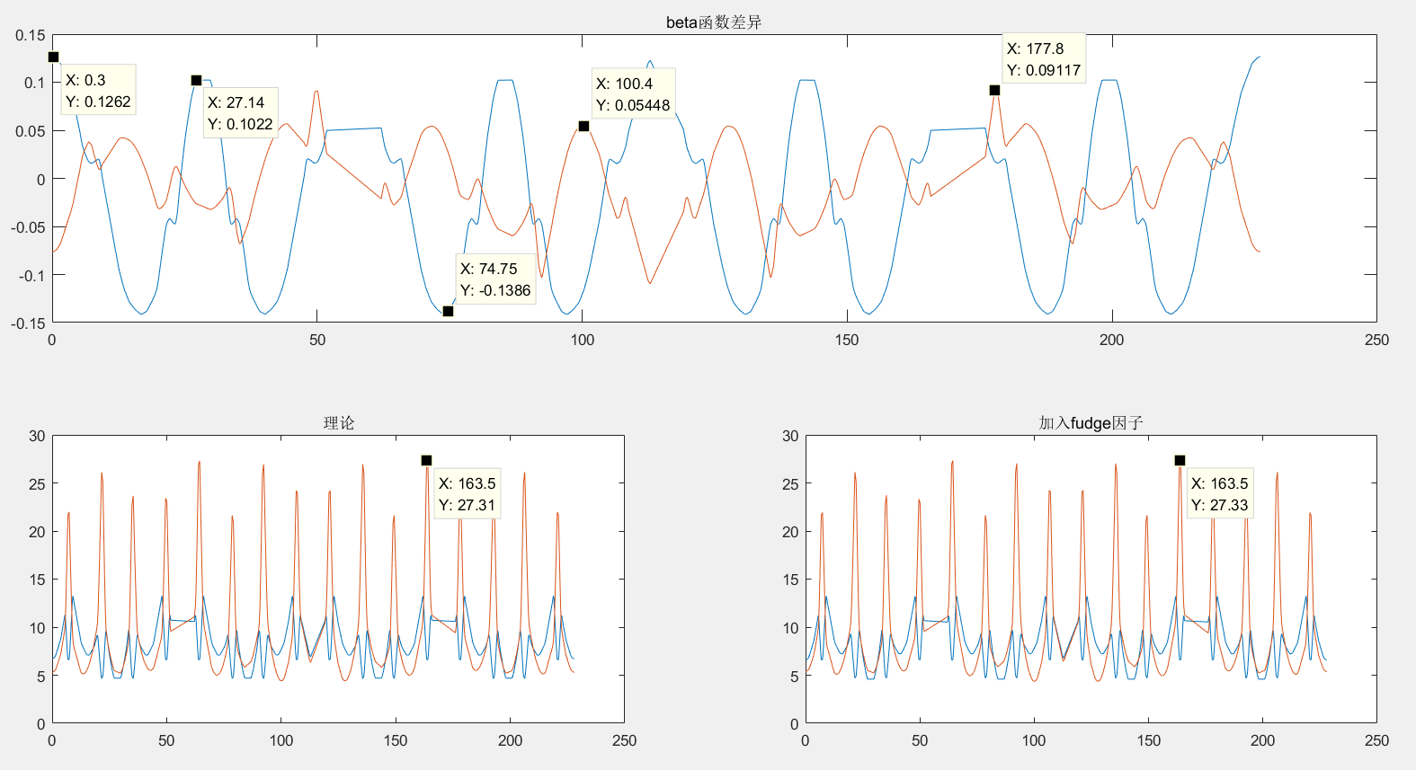
Fudge factor by response matrix
Nominal tune: Tunex/tuney: 4.8532/ 4.7816
Measured tune: Tunex/tuney: 4.8568/ 4.7765
After correction: Tunex/tuney: 4.854/ 4.778
Max. beta-beating :0.12

Slide 29
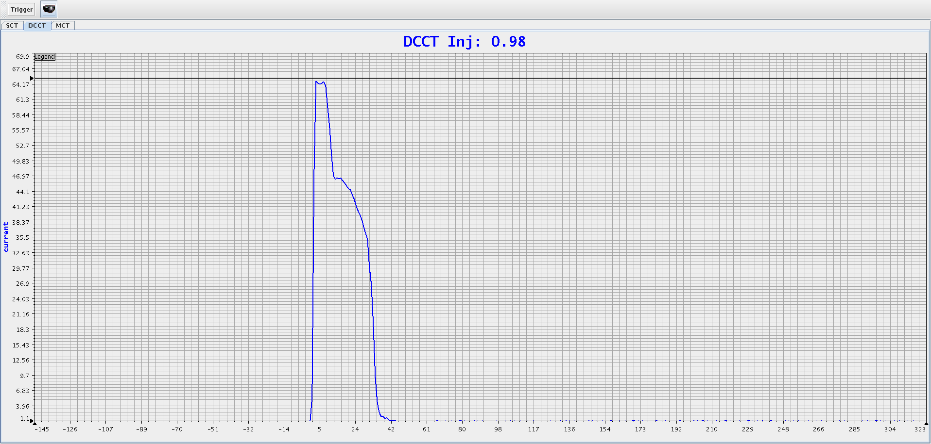
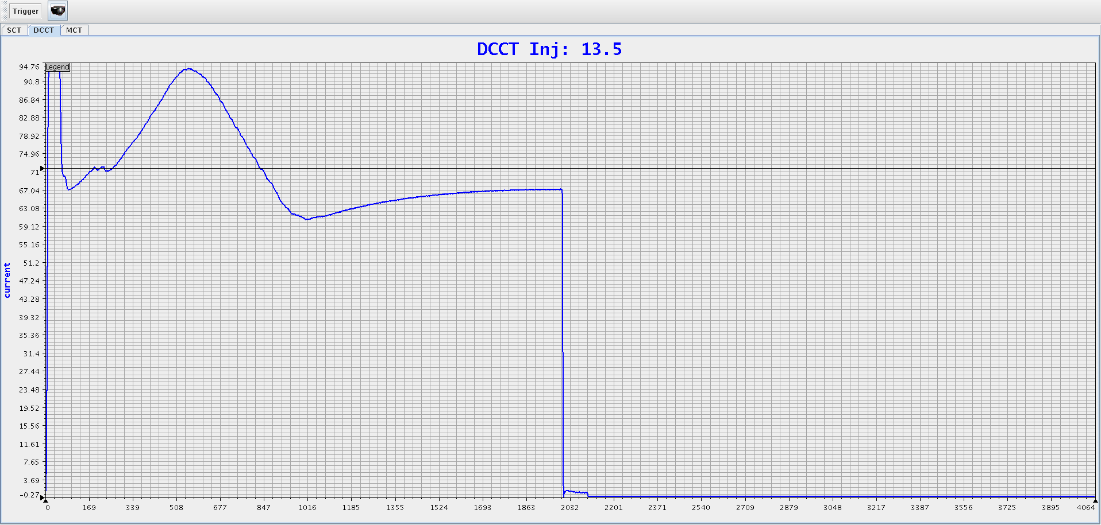
RCS Beam Commissioning-AC mode
Beam life time is 4ms in the first shot.
Shift timing between RF and B field, then major part of beam was accelerated to 1.6GeV and extracted.
Beam accelerated to 1.6GeV
July 7
July 7, the first beam was accelerated from 60MeV to 1.6 GeV

Slide 30
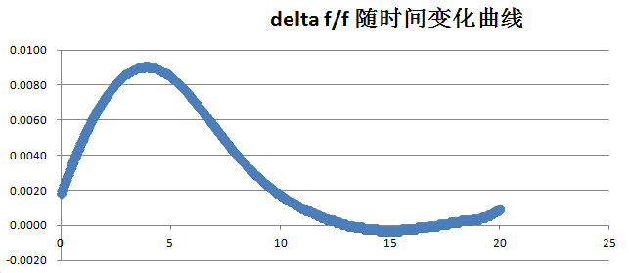
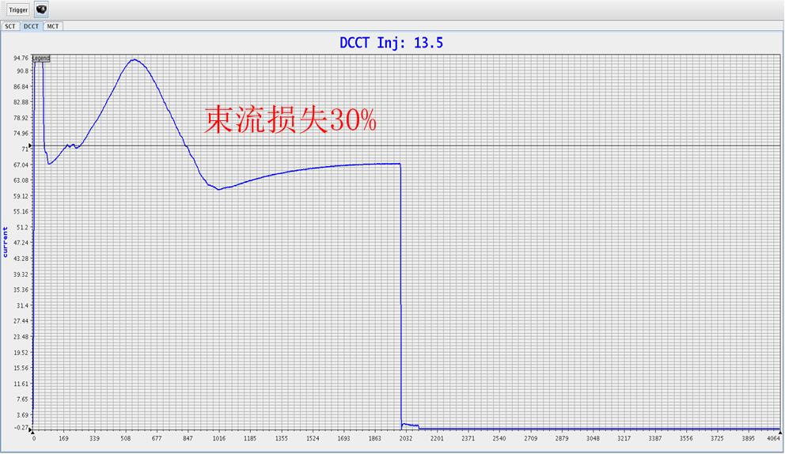
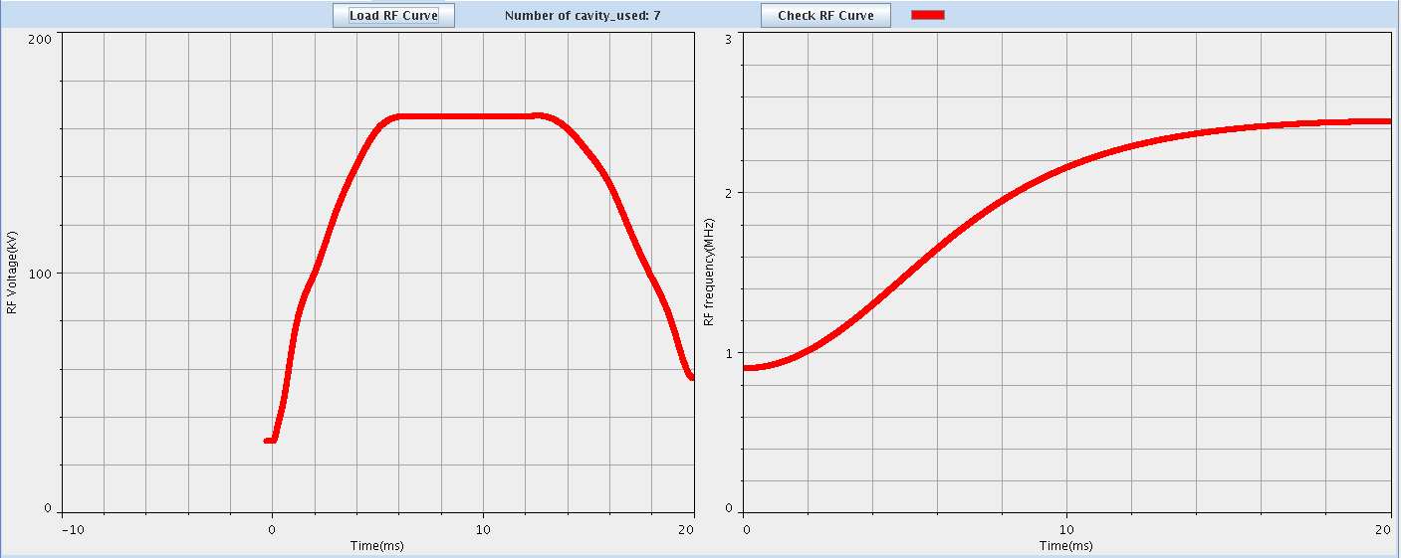
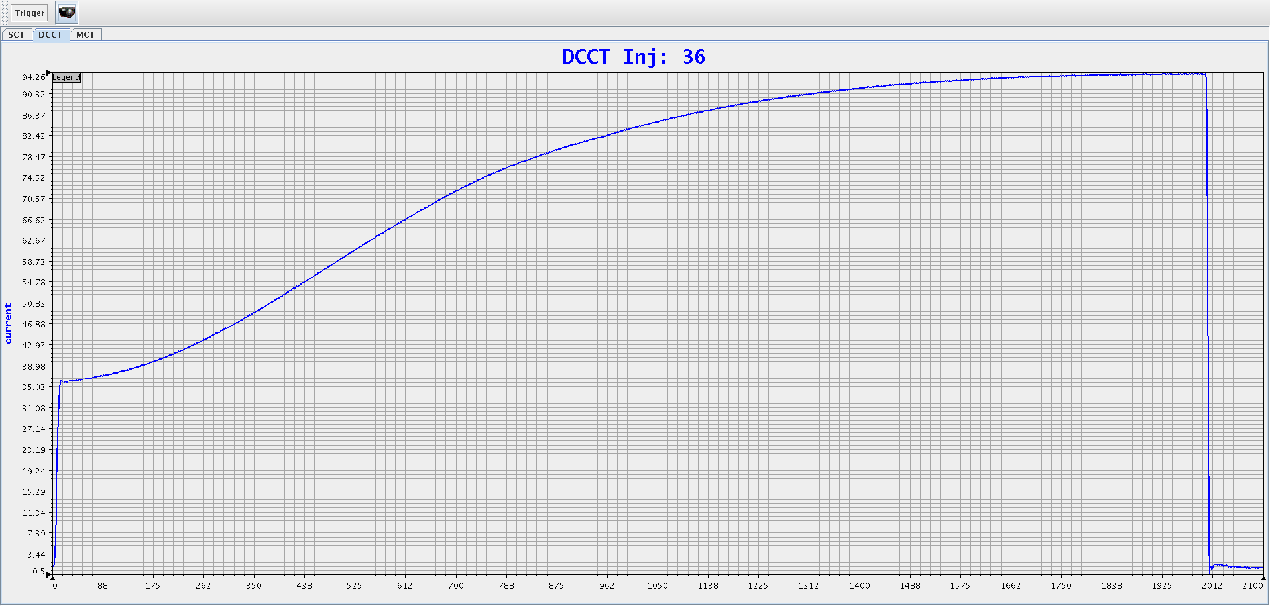
Finally reached about 99% beam transmission rate at RF frequency (0.9018, 2.444MHz）
RF parameter optimization
Tuning RF amplitude 、frequency curve
July 9

Slide 31
Modify tune with one cycle
△Qx=0.12
△Qy=0.06

Slide 32
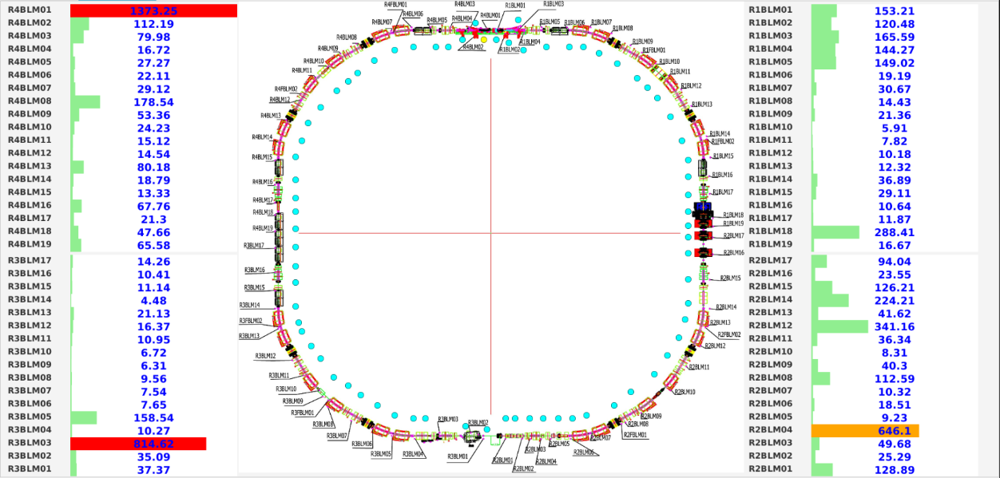
Beam loss distribution around RCS
Before optimization
After
optimization

Slide 33
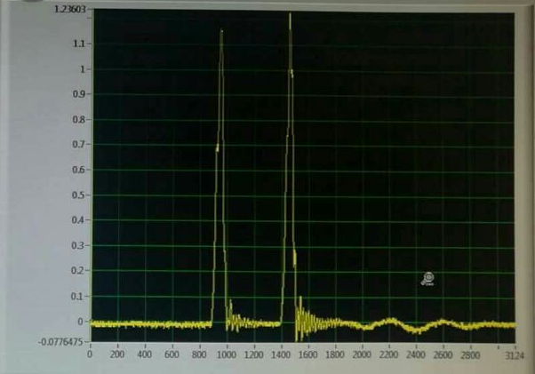
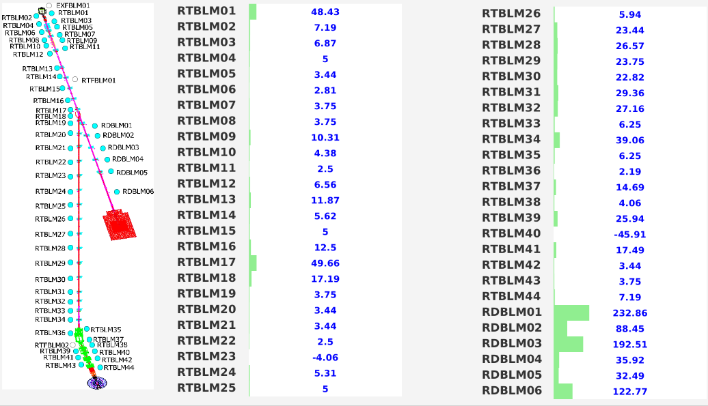
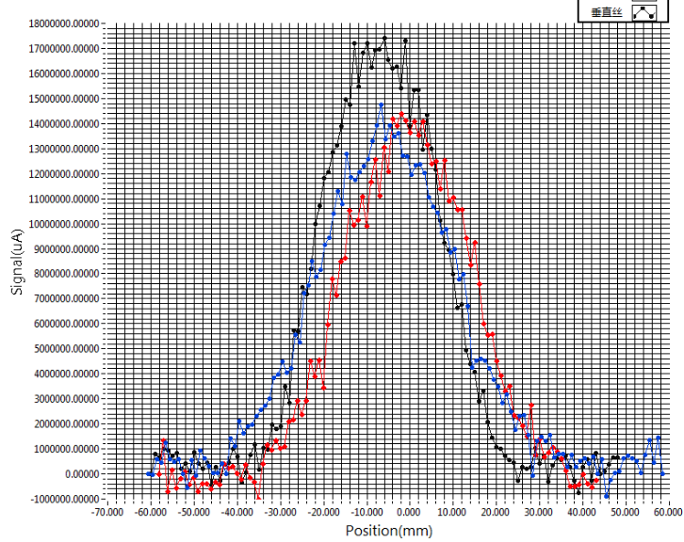
1.6 GeV Extraction
1.6GeV Proton beam was extracted from RCS with low beam loss along the beam line.

Slide 34
COD correction
20 orbits at 20 different energy points were chosen to display and correction.

Slide 35
Live orbit
before correction
Predicted orbit
After correction

Slide 36
Fixed bump injection and painting injection
Compared to the painting injection, there is more beam loss during the injection process for the fixed bump injection.
Fixed bump injection
Painting injection

Slide 37
The first beam on the target
Aug. 28, 2017

Slide 38
Application software development based on XAL
Early preparation:
Optics files in XAL format was created.
EPICS soft IOC for the conversion between power supply and magnet field is created.
Testing the communication(PV) with hardware.
Software platform is created in new control room.
A GIT server was set up for software version control.
Applications development
Directly used \little modification\ self developed
JAVA\MATLAB\JAVAFX/Python
Database creation
Database: PVlogger\score\model-lattice\magnet
OPENXAL contribution
Add fringe filed to online model and created machinesimulator app.
App *
App *
App *
App *
App *
Matlab
Python
GUI
XAL
EPICS
Hardware

Slide 39
Summary
CSNS project comes its final stage after 6-year construction.
With 60 MeV injection beam, beam commissioning have been doing with a good performance of 1.6GeV beam extraction.
We plan to commission linac beam at 80MeV with 4 klystrons in November.
The official acceptance will be done in the Mar. of 2018, as promised.

Slide 40
Thank you!

