Slide 1


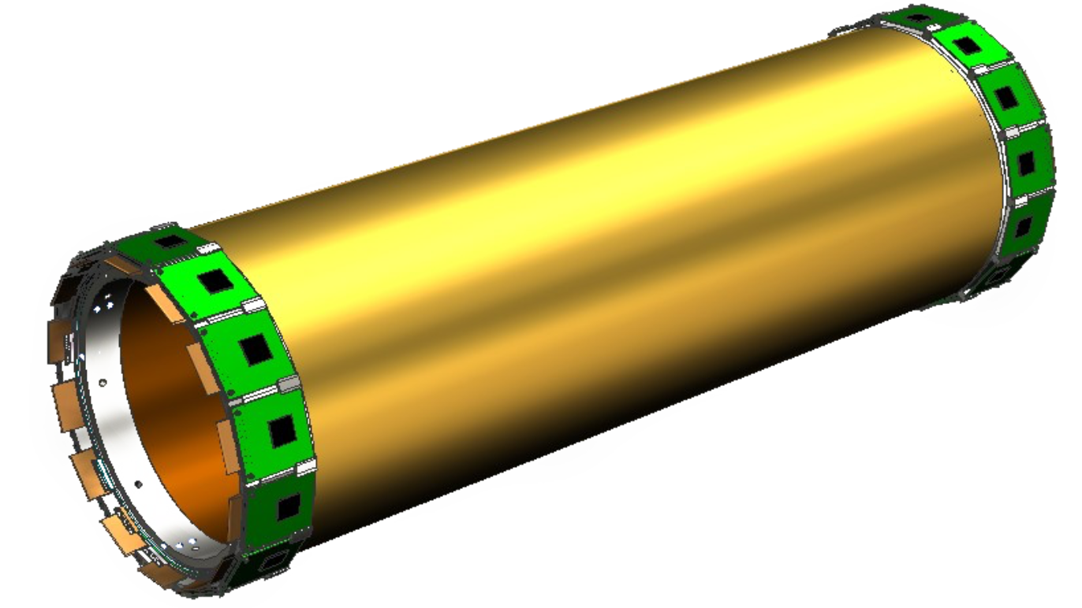
Status of CGEM offline software
王亮亮 (IHEP, Beijing)
On behalf of CGEM-IT software working group
2017.06.05
2017 高能物理计算与软件会议 成都

Slide 2
Outline
Introduction
Simulation of CGEM-IT
Track reconstruction with CGEM-IT and ODC
  CGEM-IT cluster reconstruction
  CGEM-IT track segment finding
  Track matching
  Global tracking with Hough transformation
  Track fitting with Kalman Filter
Release of CgemBoss
(first workable version: CgemBoss665b)
Summary

Slide 3
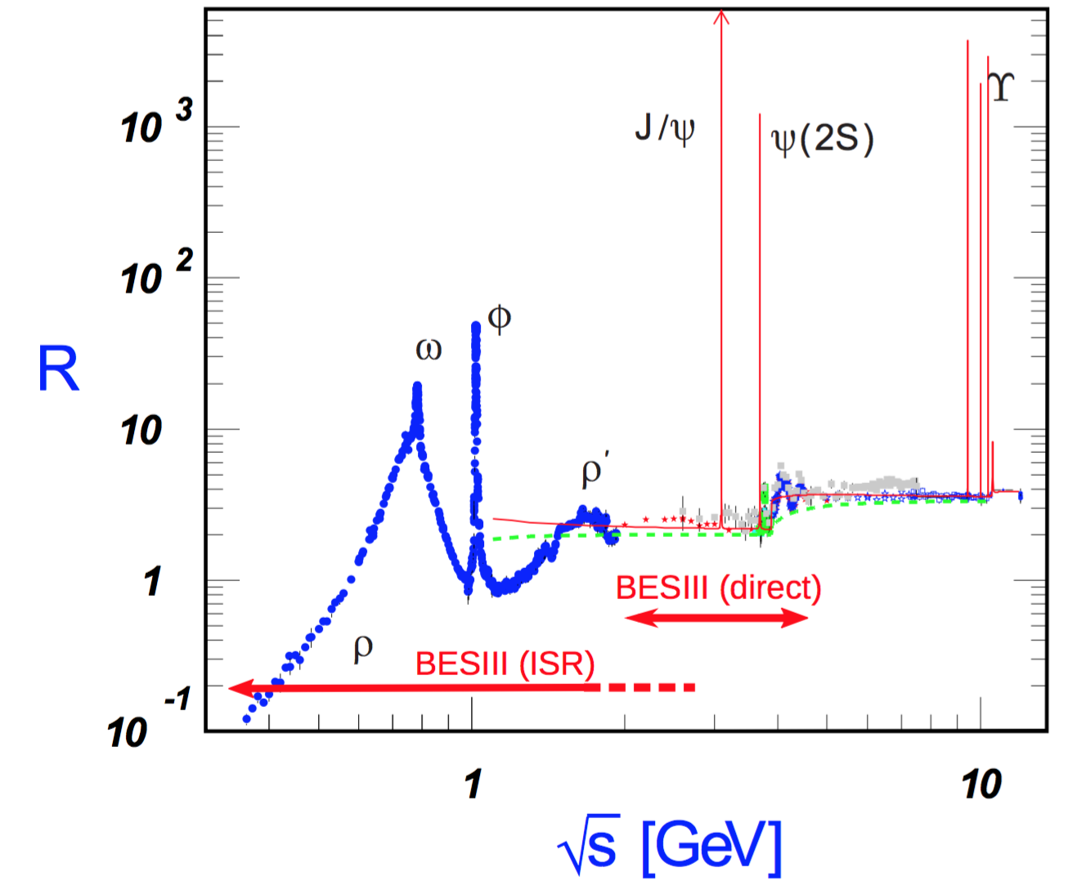
BESIII experiment: physics
ττ threshold
R and QCD
τ physics
Light hadron physics
Charmonium physics
Charm Physics
XYZ meson physics

Slide 4
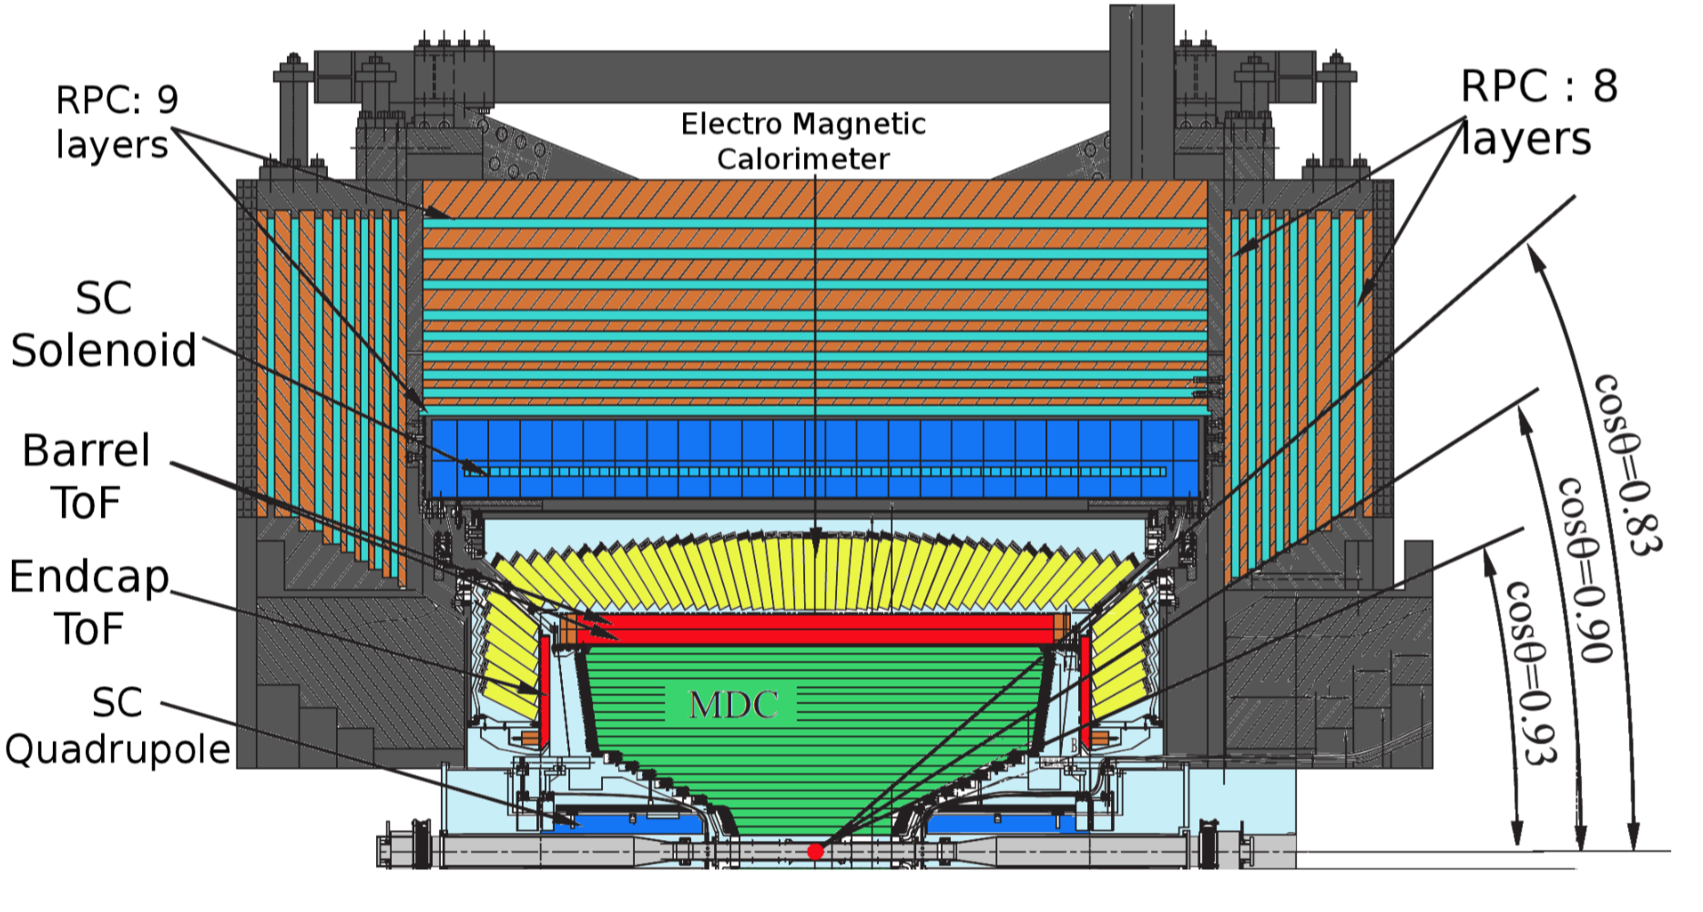
BESIII experiment: detector

Slide 5
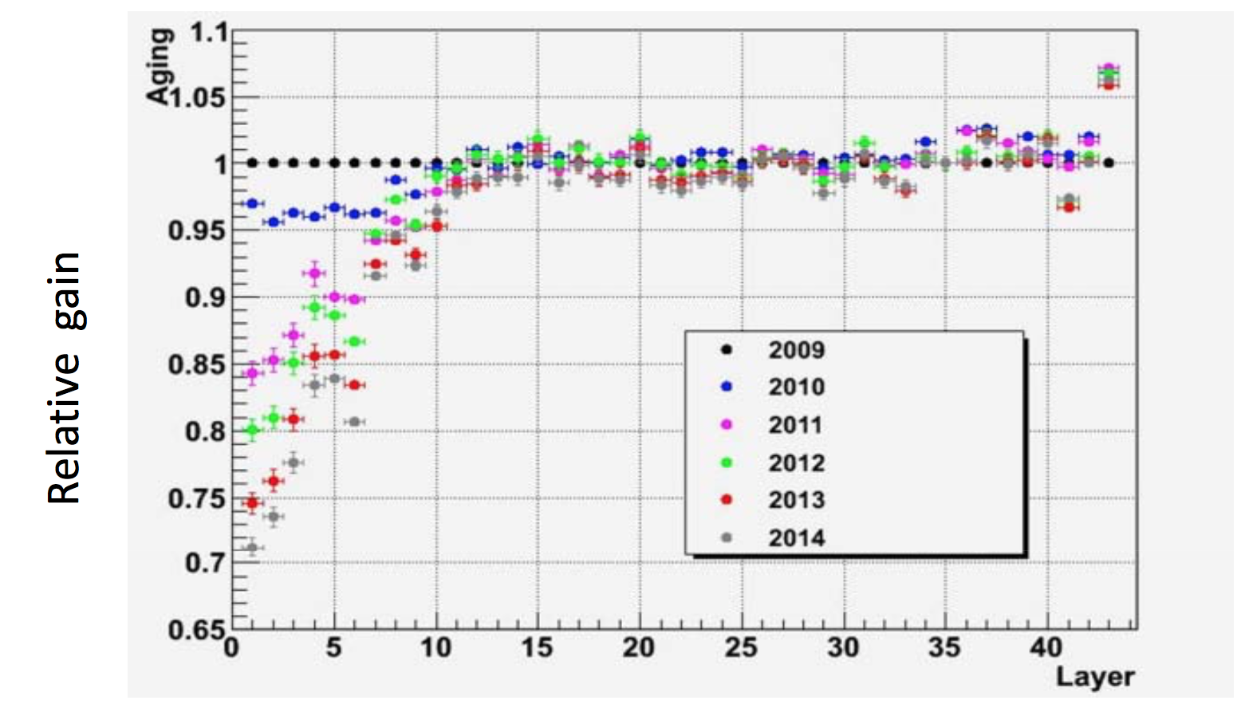
Aging of MDC
inner-DC
outer-DC

Slide 6
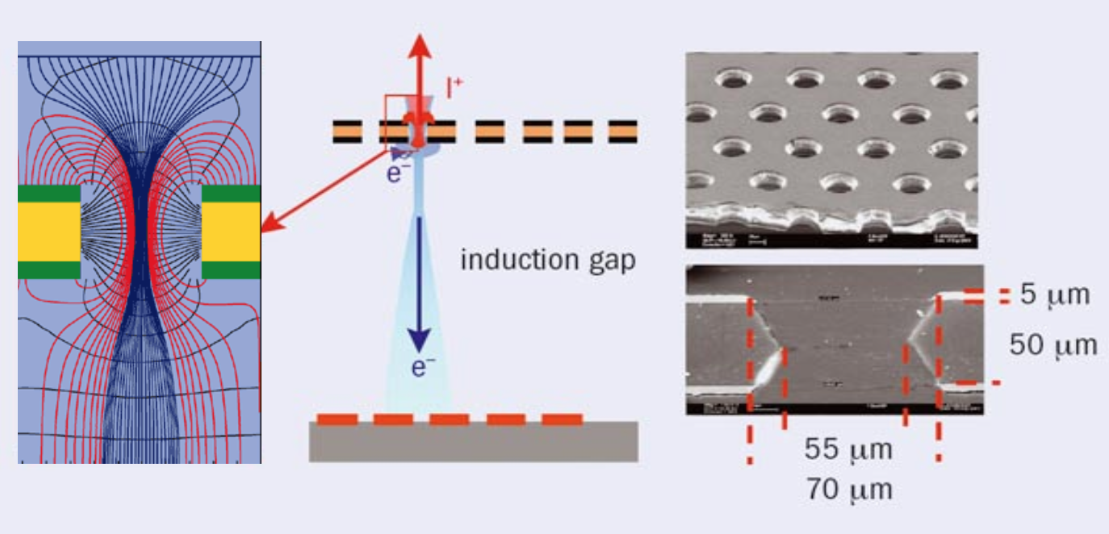
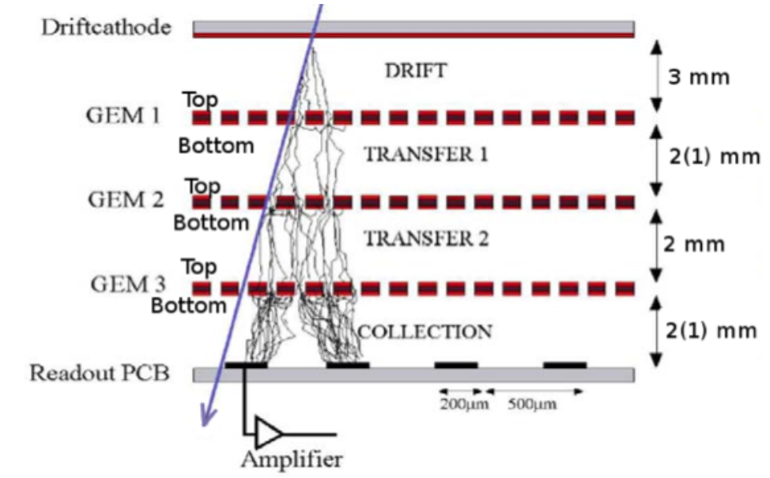
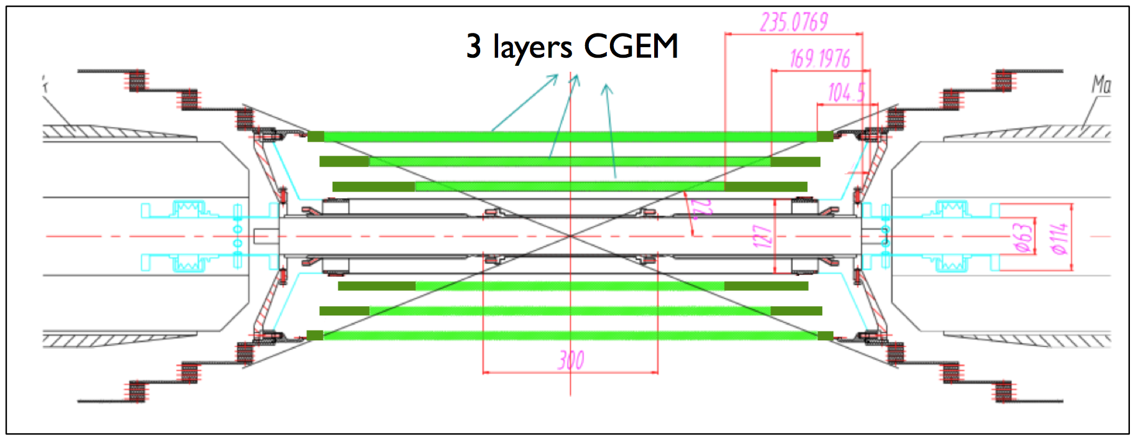
Proposal of CGEM-IT (Inner Tracker)

Slide 7
CGEM offline software
part of the BESIII Offline Software System (BOSS)
Simulation
Detector description (Geometry/material)
Digitization
Raw data
MC
Cluster reconstruction
Track segment finding with CGEM
Track matching
Global track finding with
Hough transformation
Track fitting
Reconstruction
Calibration & alignment
DST
Resolution
Geometry correction
Physics analysis
This talk focuses on software for simulation and reconstruction

Slide 8
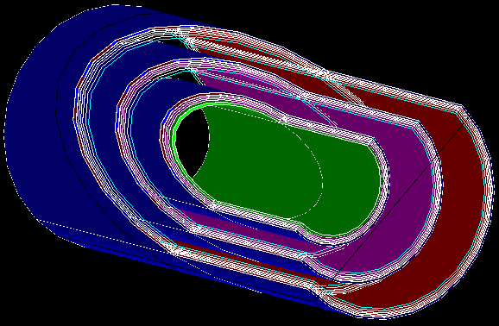
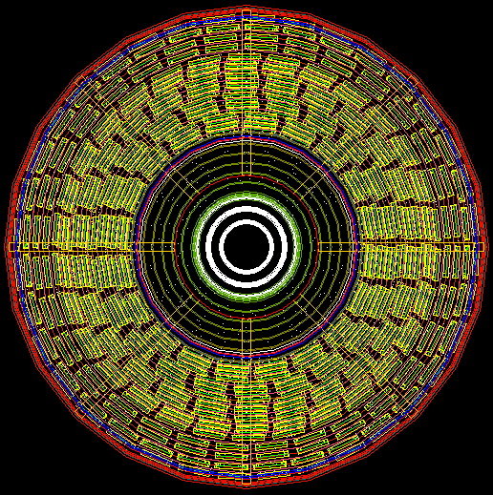
Virtual CGEM detector constructed with Geant4
CGEM-IT
Outer-DC
tracking system
1st version by Qinglei XIU & Xudong JU (2014~2015)

Slide 9
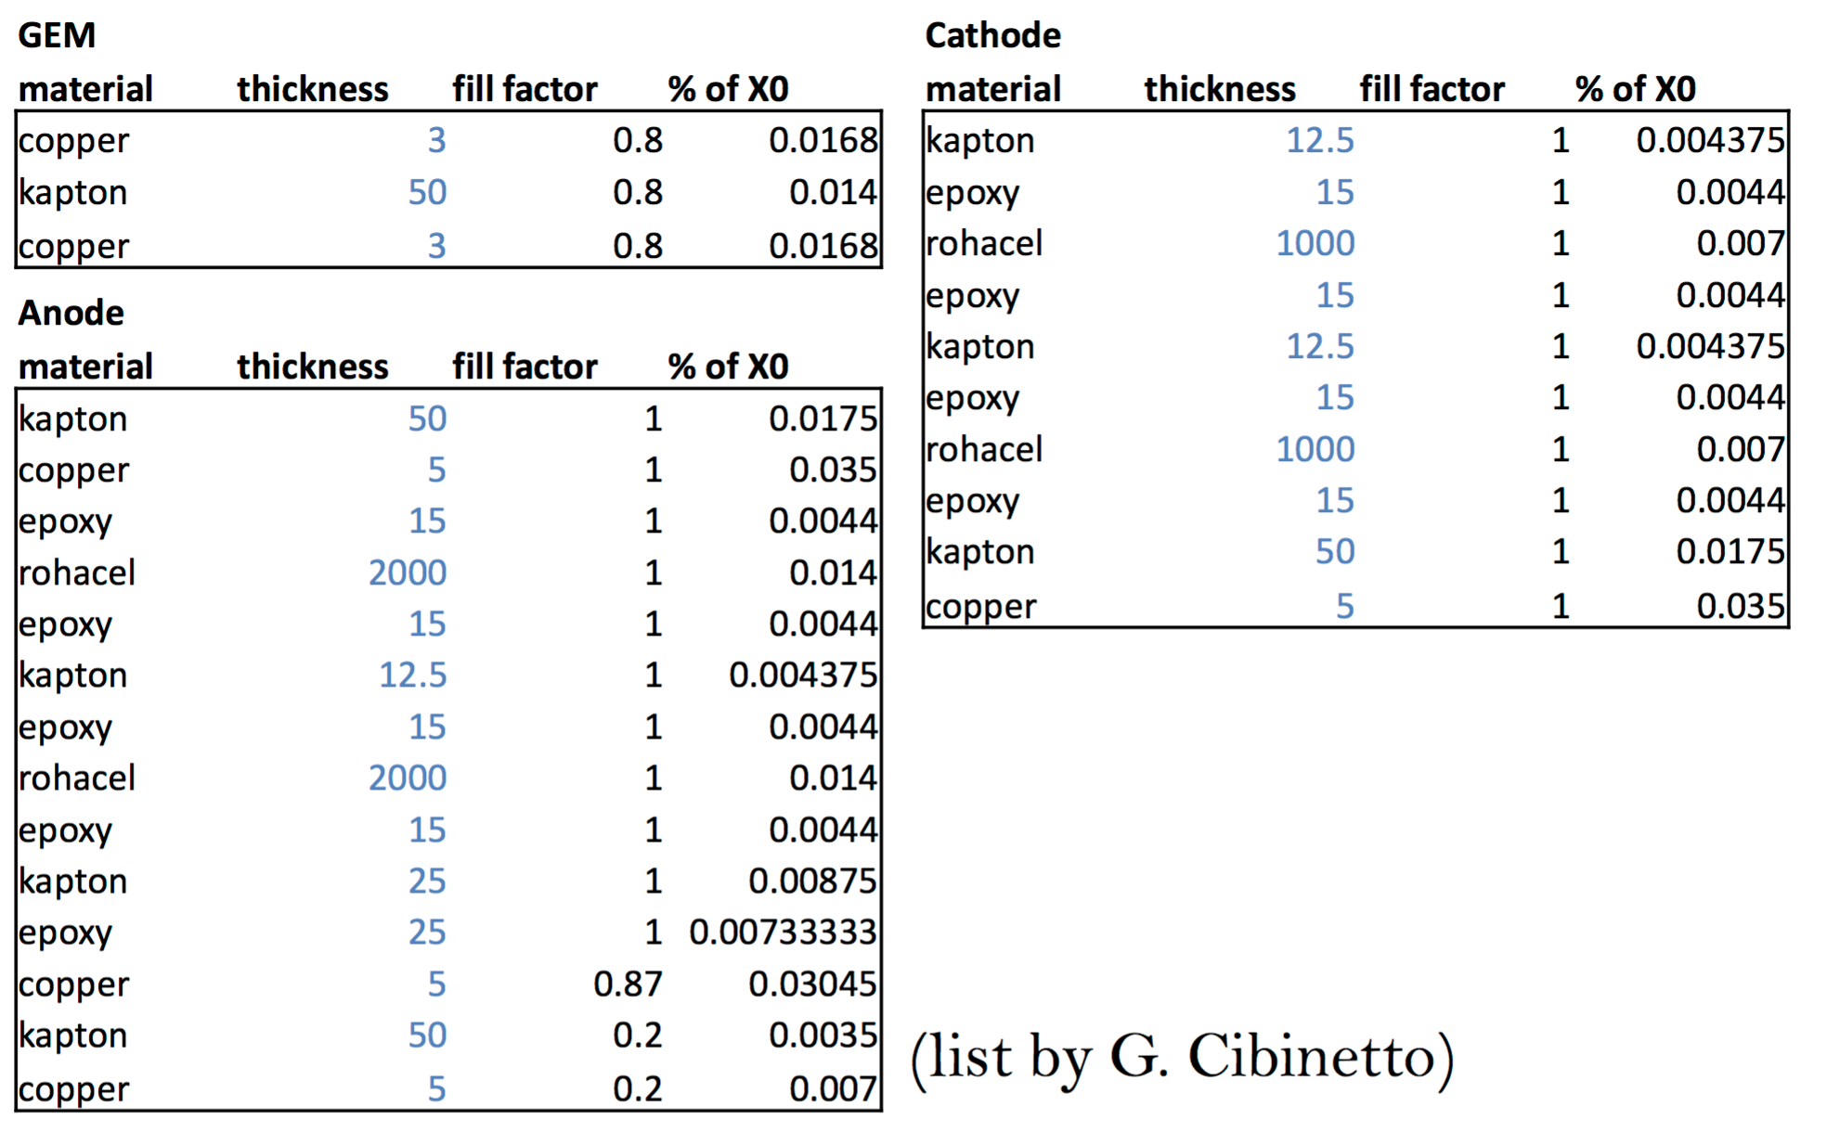
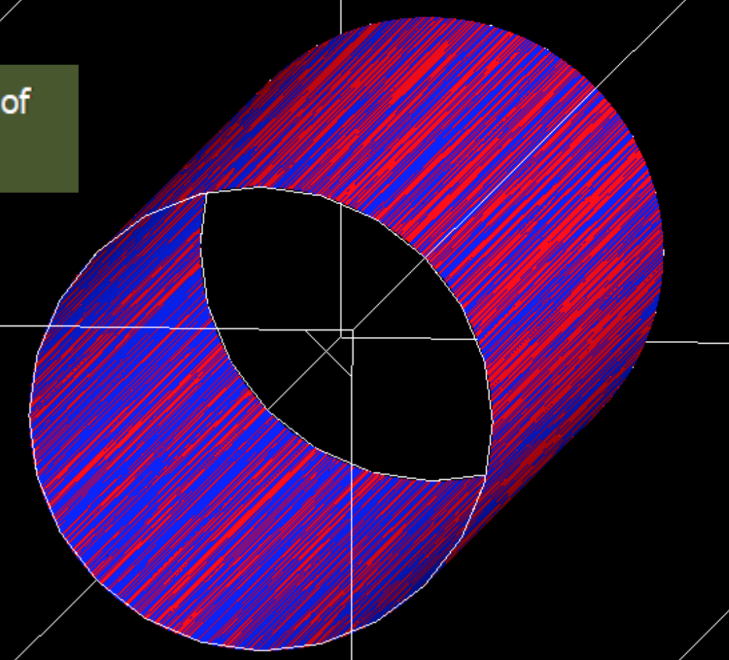
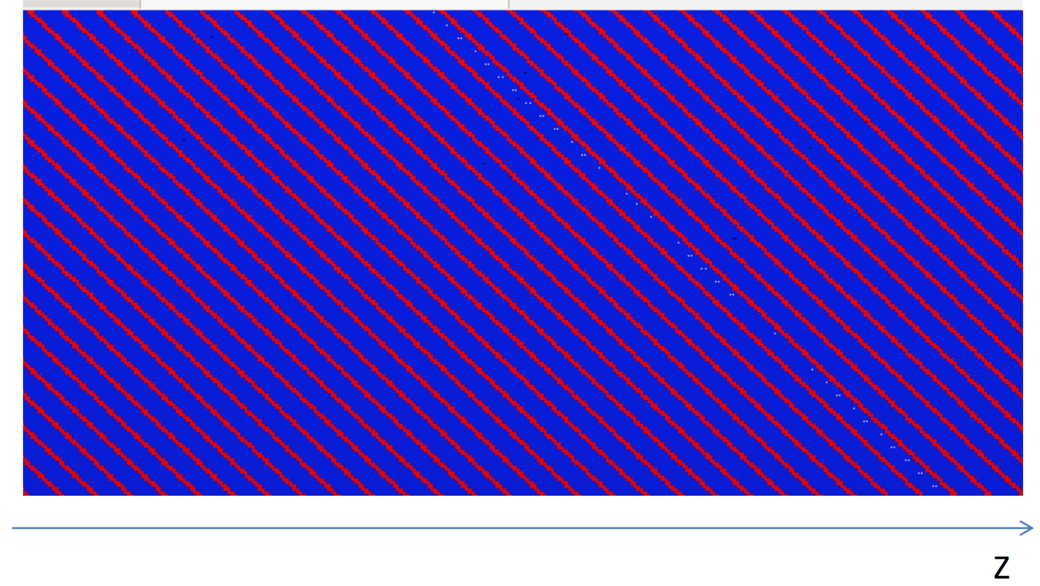

Geometry updates according to the final design
by Lia LAVEZZI (2016)
included in CgemBoss665b
Strips construction (optional)
V-strips
X-strips

Slide 10
CGEM geometry service package and gdml file
(geometry and material information provider)
Simulation
CgemGeomSvc
Lia LAVEZZI, Linghui Wu, Liangliang Wang (2016~2017)
Raw data
MC
Unique package for CGEM geometry description/function to guarantee consistency between simulation/reconstruction/analysis
Parameters changeable for a certain
layout/structure (controlled by a text input file)
Reconstruction
Calibration & alignment
DST
gdml
by Zhen Huang (2017)
Physics analysis
Contains geometry/material description
Can be used in CGEM construction
used in Kalman Filter

Slide 11
CGEM digitization
simulate the signal recorded
by CGEM for each CGEM hit
Simulation with Geant4
CGEM hit (MC truth)
Digitization
CGEM firing strips
Trajectory
and energy loss
in CGEM
CGEM clusters
Cluster reconstruction
Track reconstruction

Slide 12



CGEM digitization (I)
digi_v1
A’
B’
A
B
B’
A’
A simplified model was implemented (by Yue GUO & Liangliang WANG in 2015):
projection of the track segment in the drift region onto the readout plane with a 0 Lorentz angle (non-0 angle is optional) and non-diffusion
=> a model considers the geometric effects and gives a resolution reasonable in magnitude
=> allows a rapid move to the subsequent software development

Slide 13
CGEM digitization (II)
digi_v2
used by CgemBoss665b
A simple direct cluster-sampling module is prepared recently:
to control the resolution/efficiency directly (e.g. to reflect the results obtained by the beam tests)
to start the study of benchmark channels with CGEM-IT
Simulation with Geant4
CGEM hit (MC truth)
Digitization
CGEM firing strips
Direct cluster sampling
CGEM clusters
Cluster reconstruction
(toy cluster)
Efficiency, resolution
can be predefined here
(default 100% and 130 μm)
basic elements from CGEM in track rec.
Track reconstruction

Slide 14
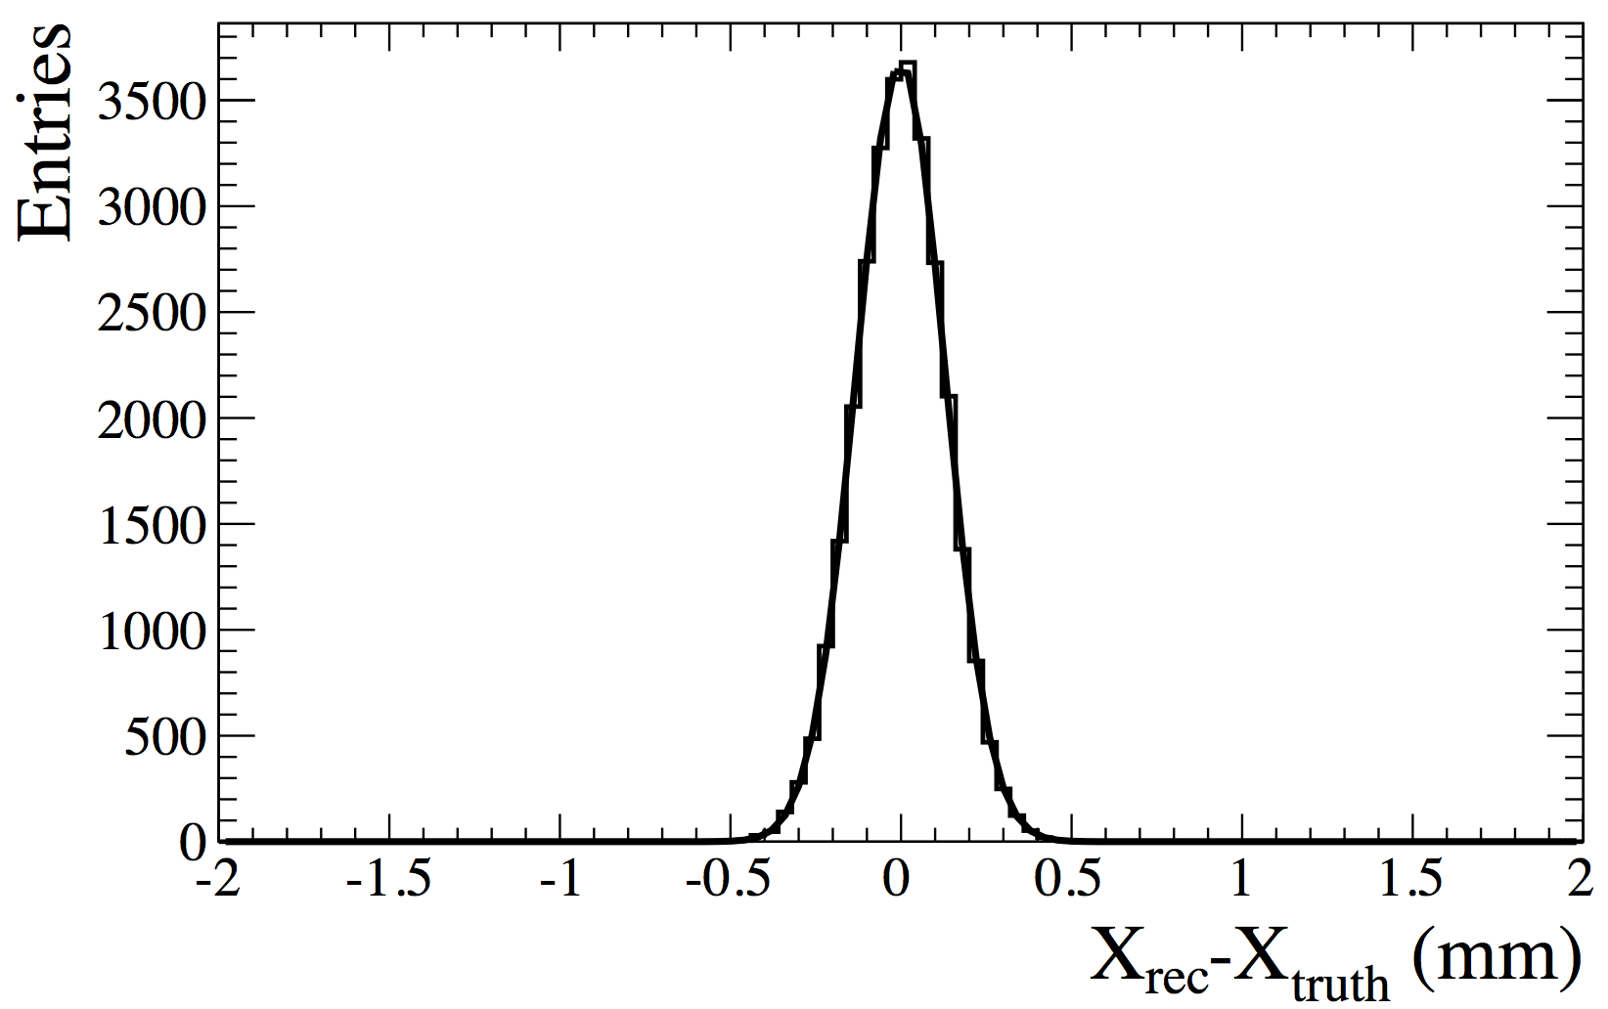

CGEM digitization (II)
digi_v2
used by CgemBoss665b
σ=130μm
σ=130μm

Slide 15
CGEM digitization (III)
digi_v3
(in progress)
(by Lia Lavezzi, Riccardo Farinelli & LiangLiang Wang)
A more delicate digitization model is in preparation
estimate the detailed responds (performance) of CGEM
achieve a detailed consistency between MC and data after a careful tuning
trajectory and energy loss in CGEM
Primary (secondary) ionizations
step 1
Simulation with Geant4
electrons along the trajectory
Firing strips
Induction
Drift & multiplication
(loop all ionized electrons)
step 2
simulate the signal
obtained by electronics
Sampling models can be built from Garfield simulation
step 3

Slide 16
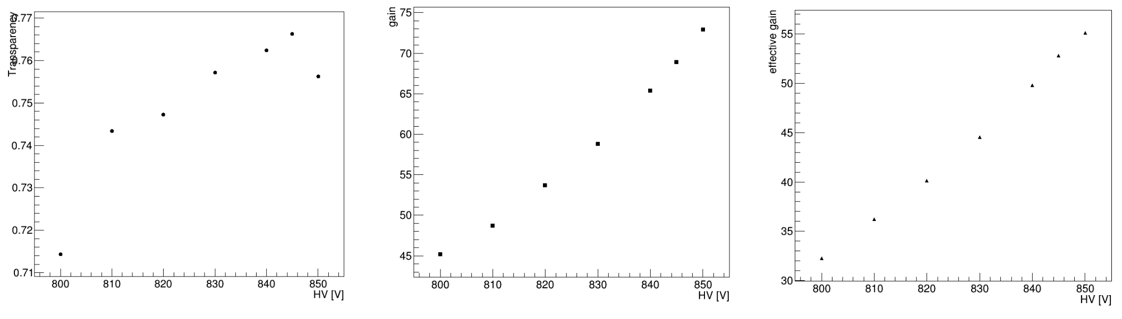
CGEM digitization (III) - Garfield simulation
Garfield simulation are done for GEM foils and gaps separately (to get position, charge, time)
much time saved (2~3 magnitudes)
easy to parameterize models separately
final signal is obtained by a sampling chain with these models
induction
transfer
transfer
e⁻
d
GEM foils
Transparency
Gain
Effective Gain
one GEM foil
one GEM foil
one GEM foil
HV (V)
HV (V)
HV (V)

Slide 17
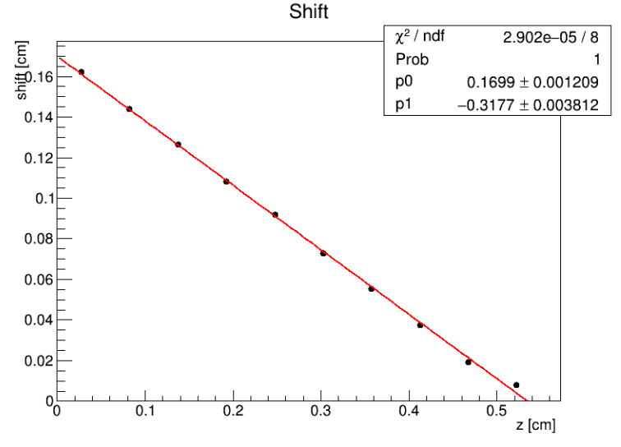
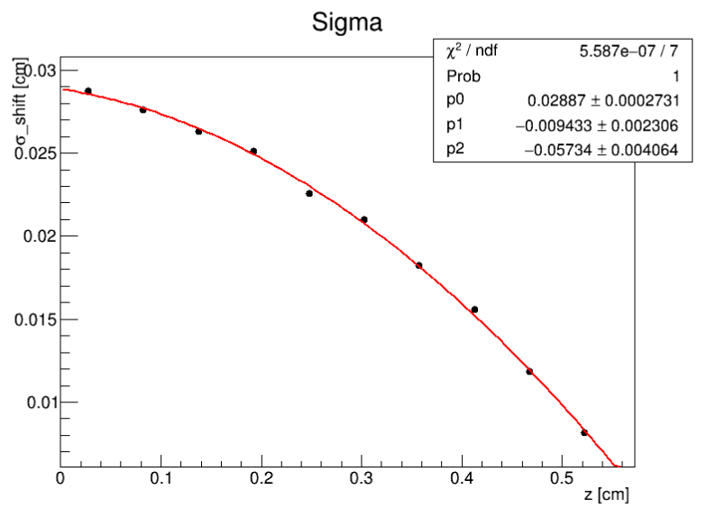
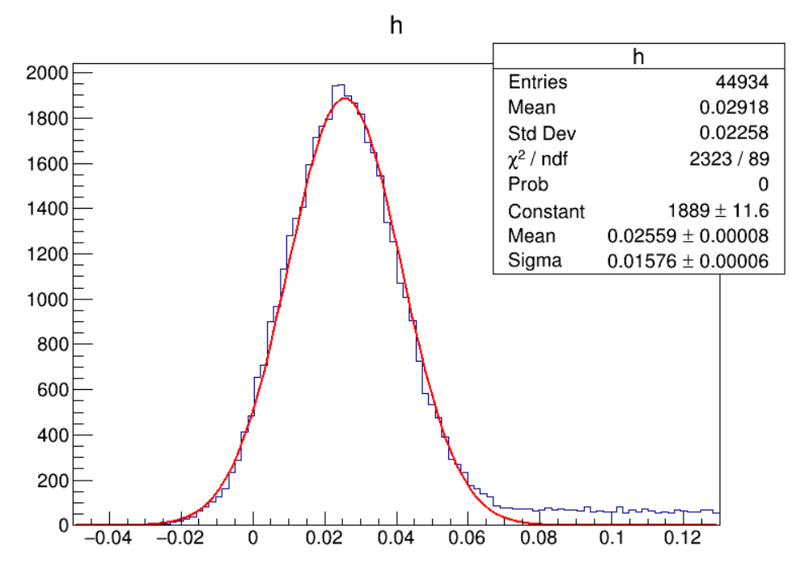
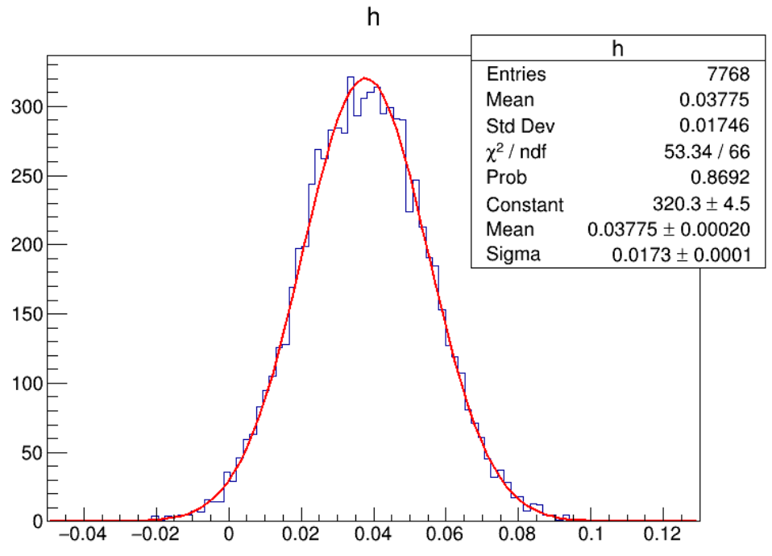
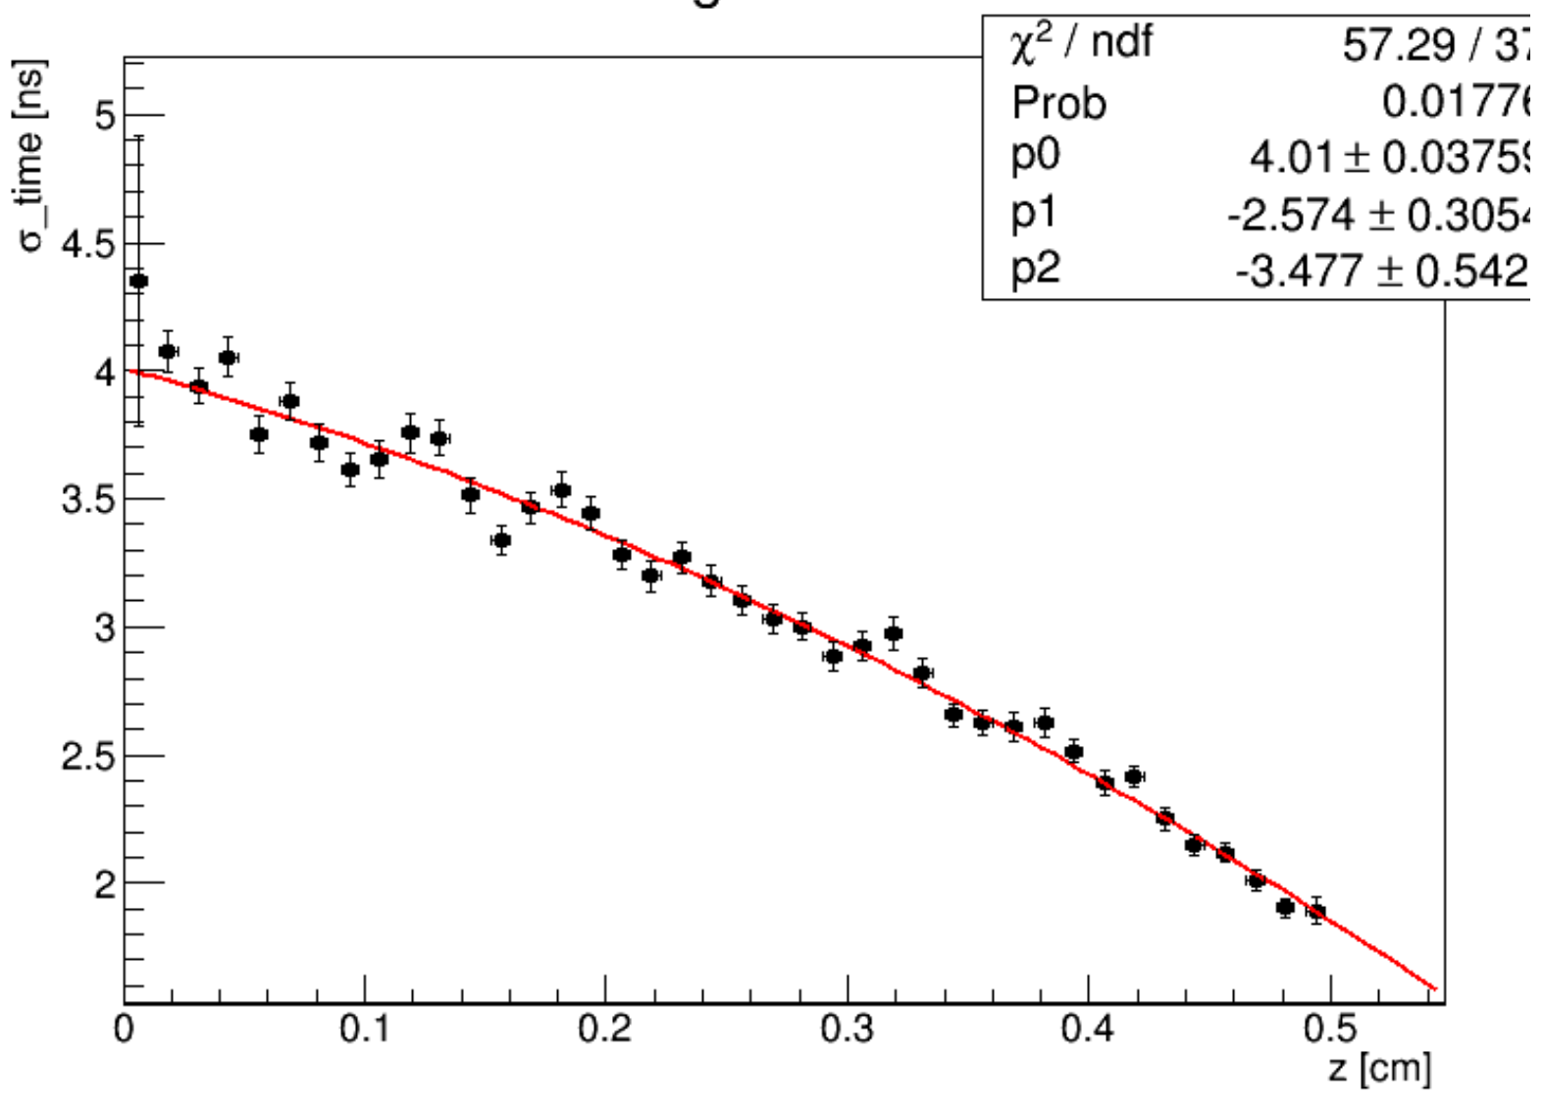
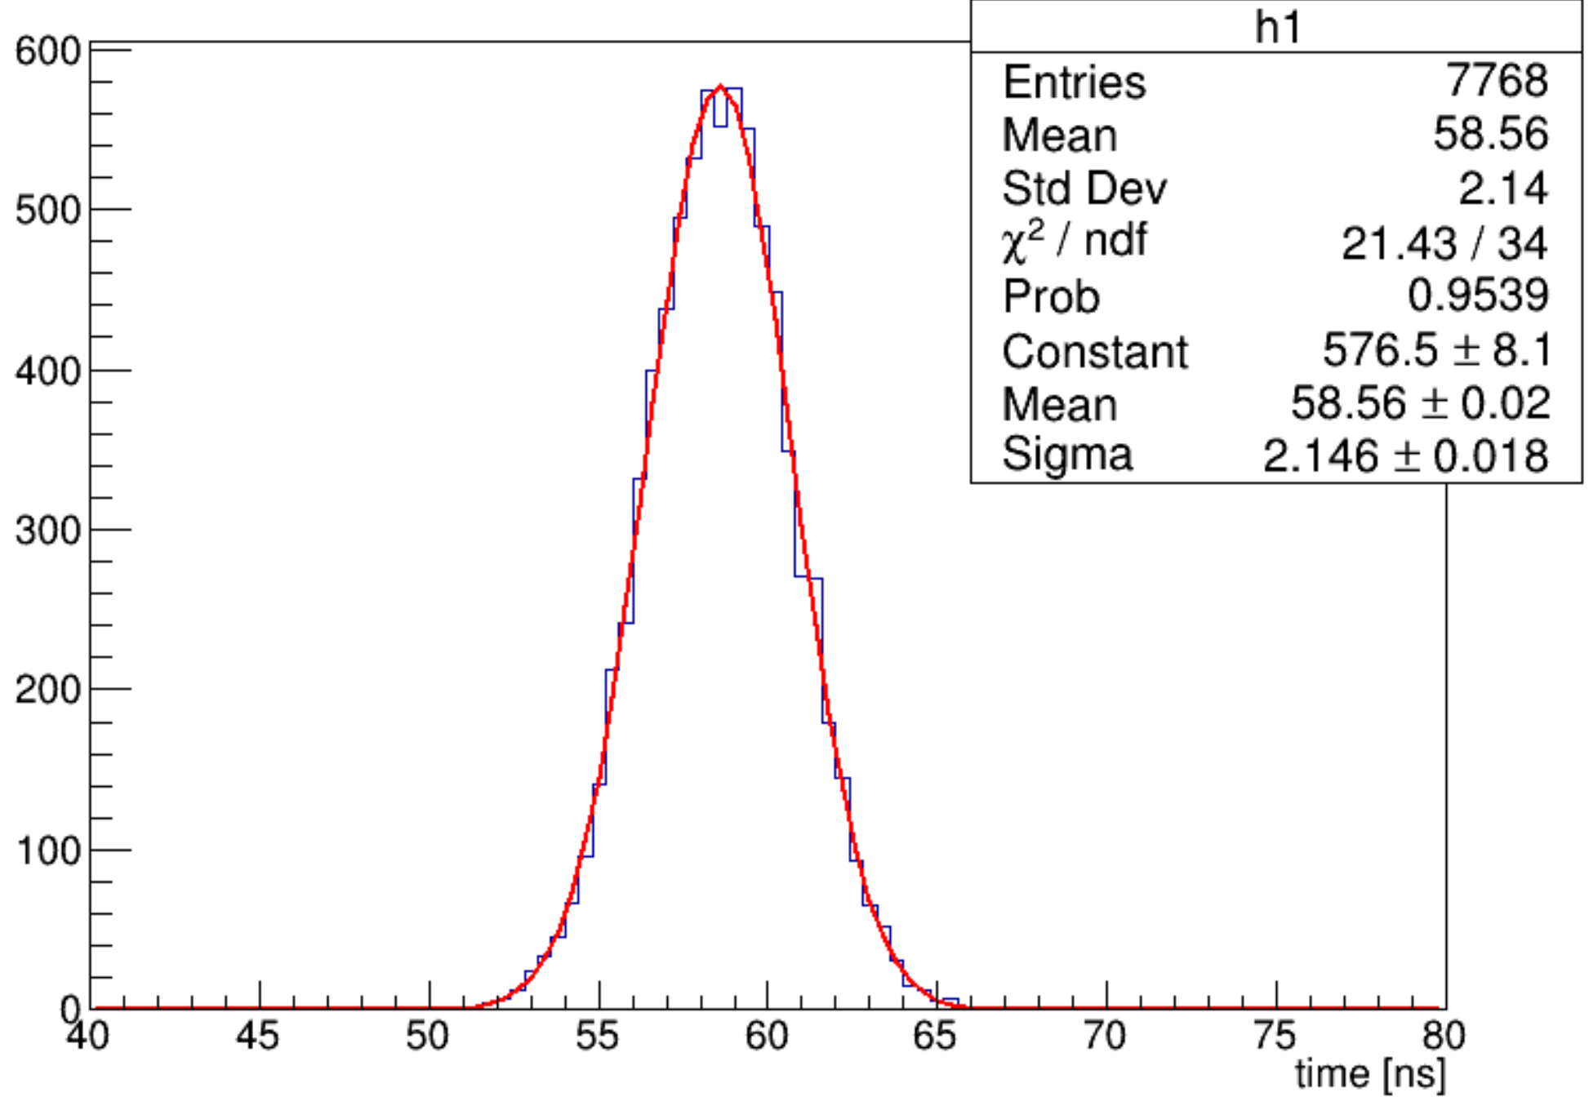
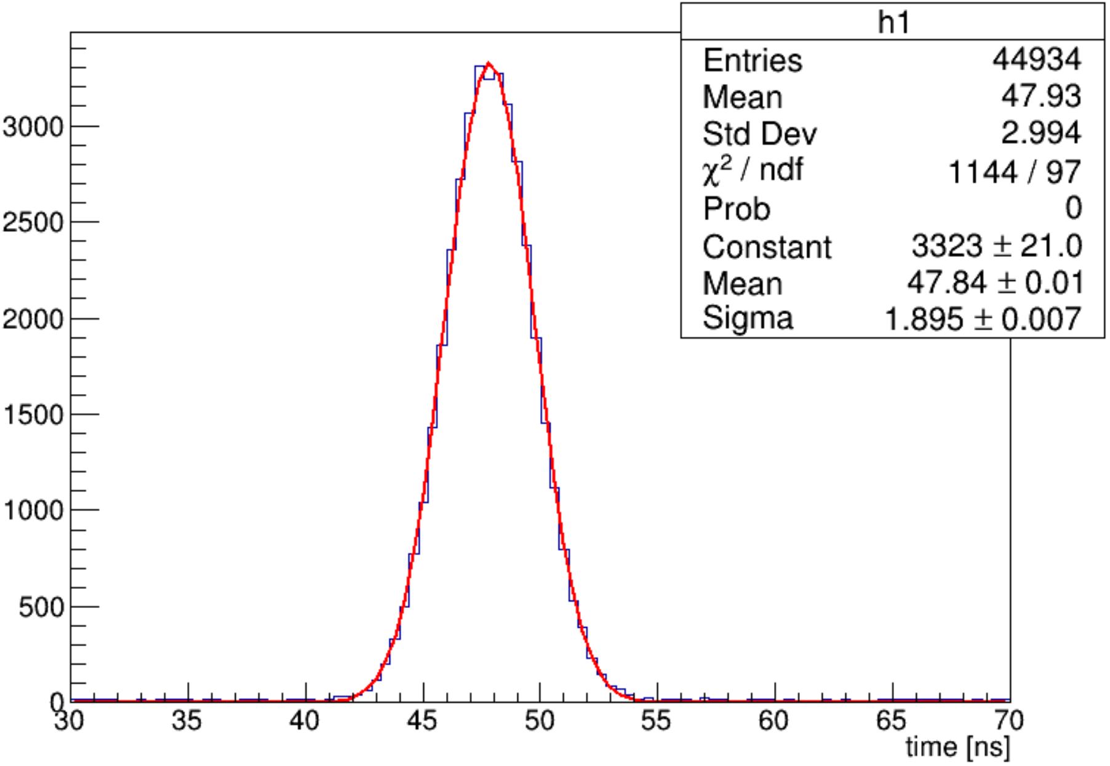
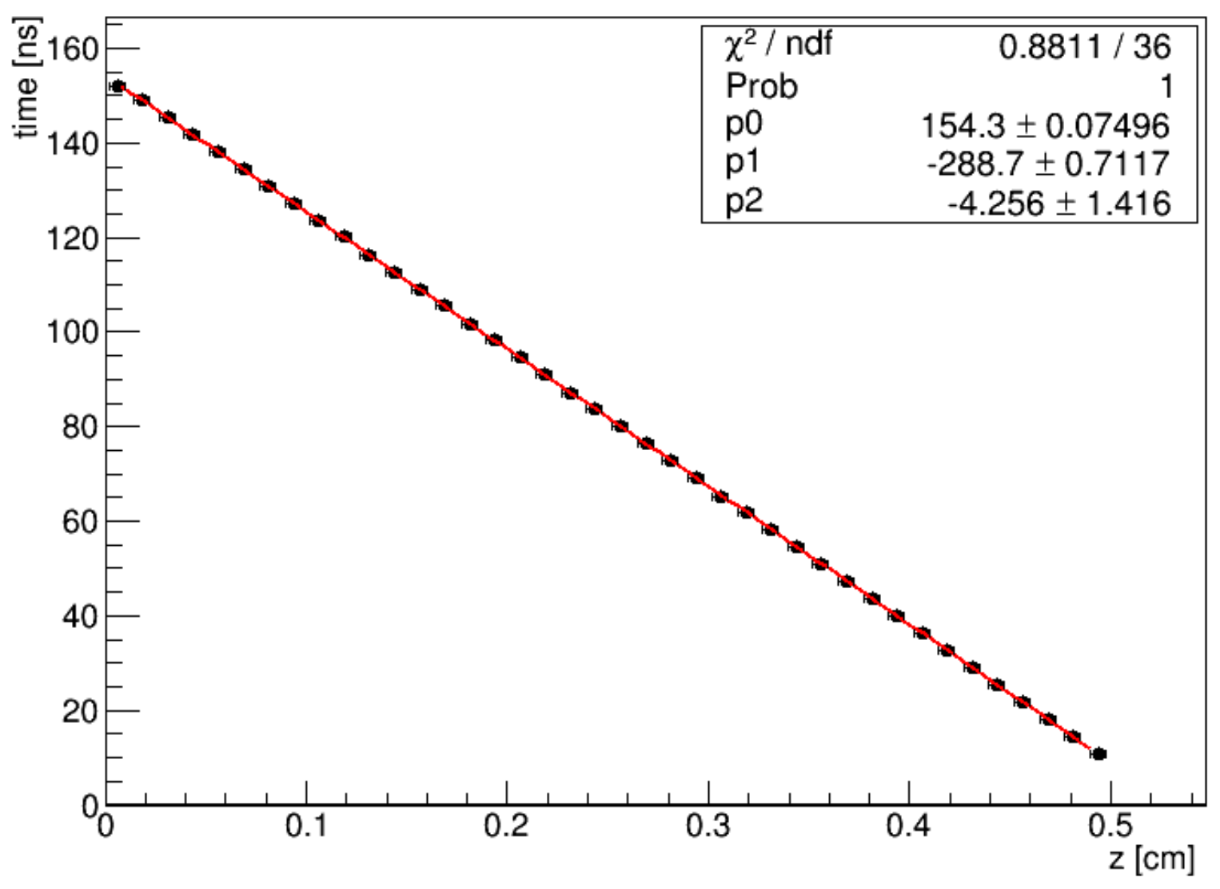
CGEM digitization (III) - Garfield simulation
Mean shift
σ
Transfer region
Induction region
Drift region
Drift region
d (cm)
d (cm)
Shift (cm)
Shift (cm)
Mean time
σ
Transfer region
Induction region
Drift region
Drift region
d (cm)
d (cm)
time (ns)
time (ns)

Slide 18
Track Reconstruction with CGEM-IT + ODC
CGEM cluster
reconstruction
Outer-DC hits
CGEM track segment finding
Tracking in outer-DC
(In progress)
Global tracking with Hough transformation
Track segments matching
Complete tracks
Adopted algorithm for MDC
But need optimization (Yao ZHANG, Jin ZHANG, Nannan Miao)
Track fitting with Kalman Filter method

Slide 19
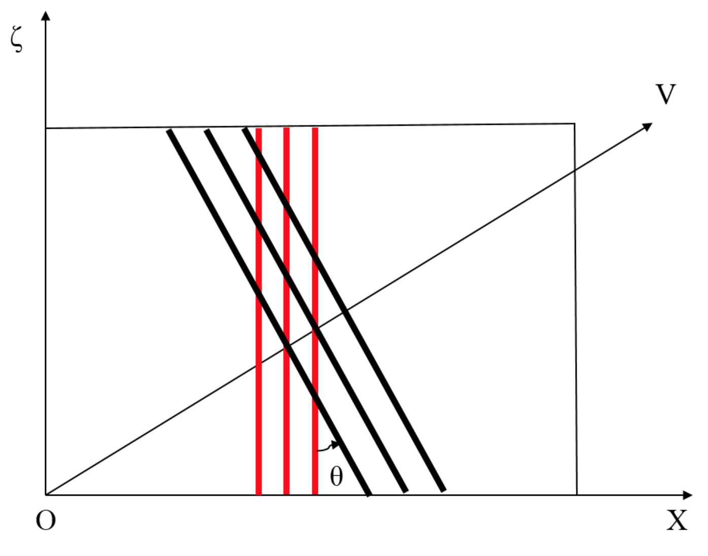
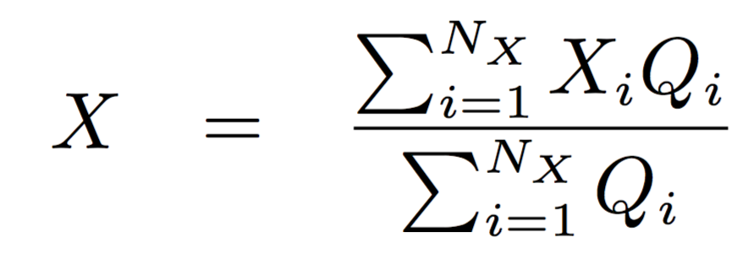
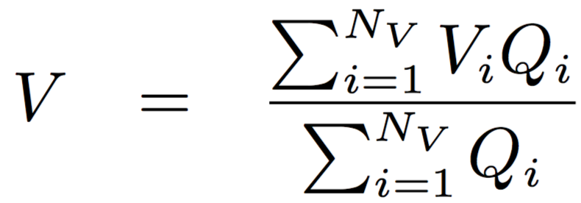
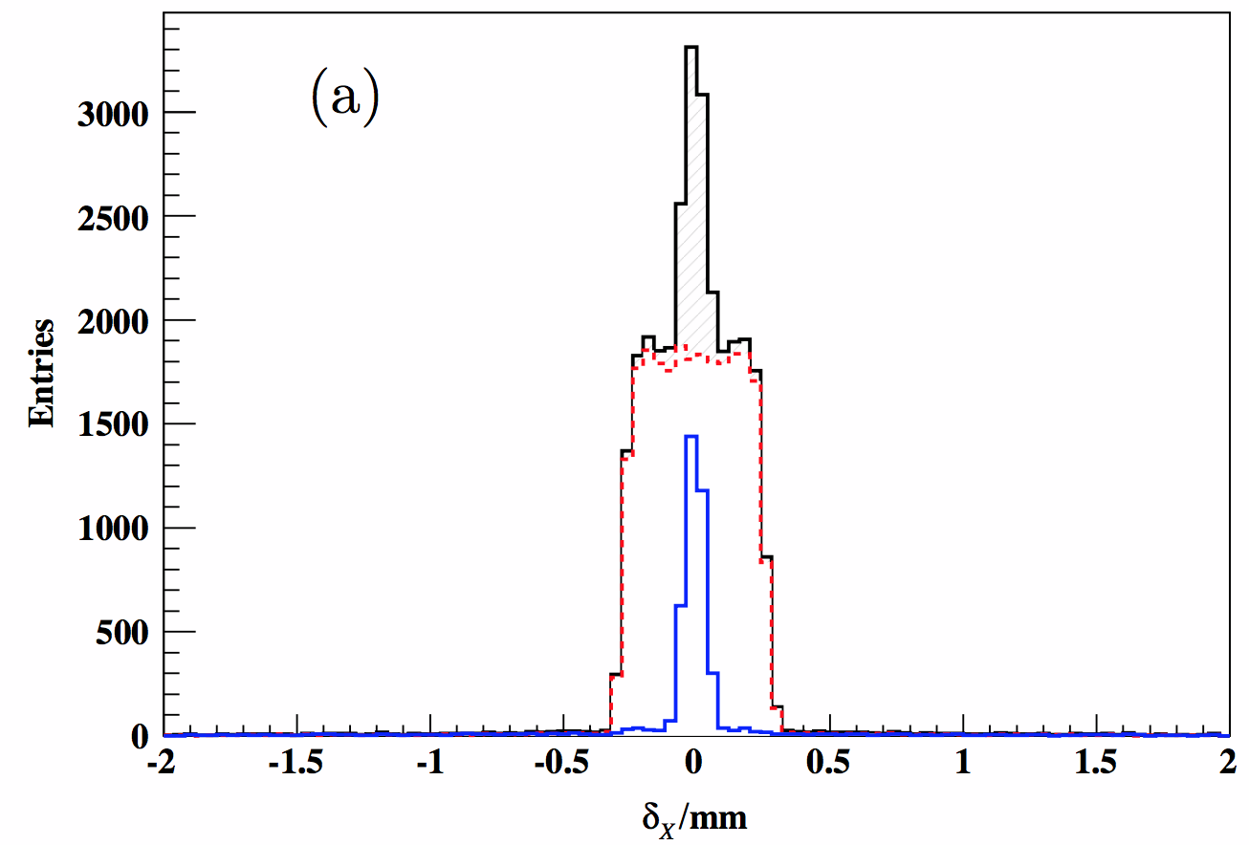
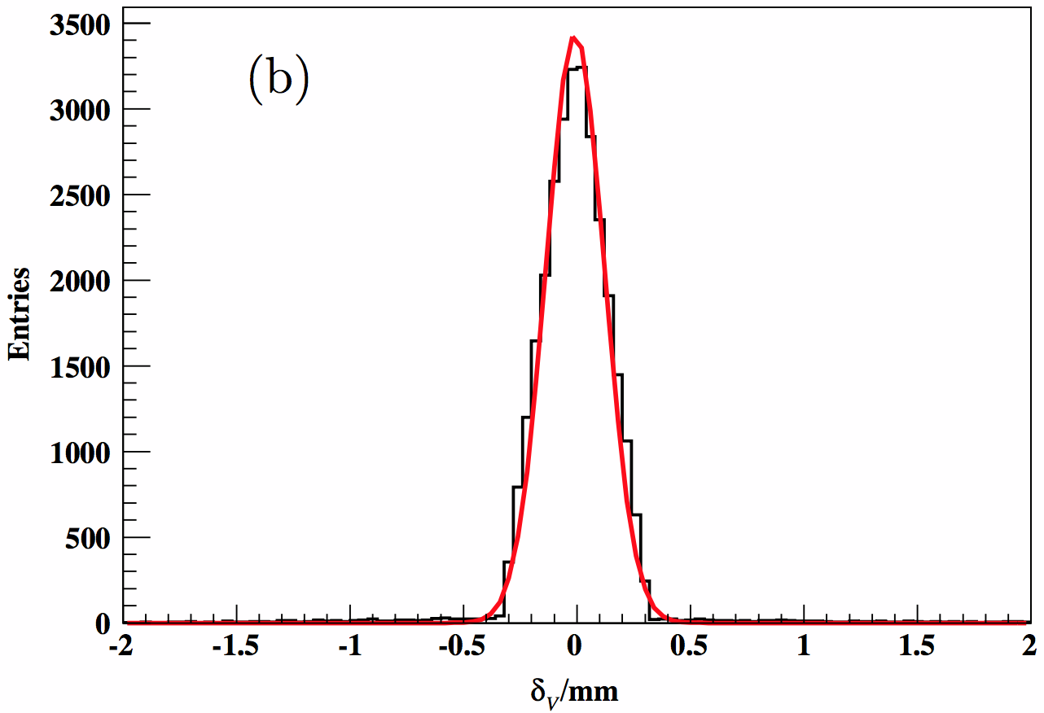
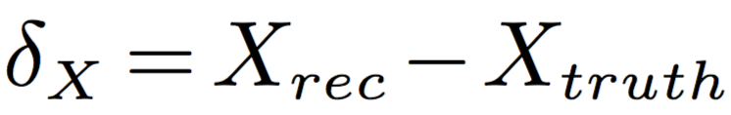

CGEM cluster reconstruction by Yue Guo, Liangliang WANG & Linghui WU (2015)
Continuous firing strips in X (or V):
X-cluster (or V-cluster)
Intersection between X and V clusters:
XV-cluster
Charge centroid of a XV-cluster:
RMS~217μm
σ~130μm
1 GeV/c muon
old geometry
digi_v1
1 GeV/c muon
old geometry
digi_v1
(mm)
(mm)

Slide 20
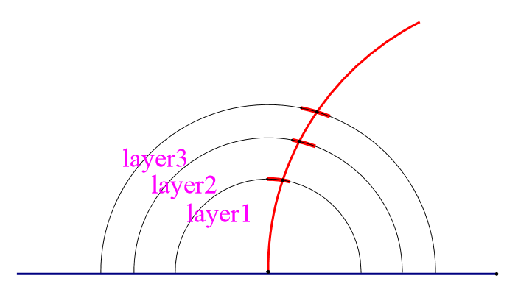
Track segment finding in CGEM-IT
By Xinhua SUN, Liangliang WANG & Linghui WU (Sep 2015~Mar 2016)
One charged track
An explicit method by parameterization:
find patterns for the 3 clusters from individual charged tracks
Track segment
CGEM
clusters
IP
Steps:
Introduce two kinds of variables: δφ and δZ
Study the patterns of the distributions
Parameterization of the distributions using mu track
Define the selection criteria for track segments
Segment selection with the predefined criteria

Slide 21
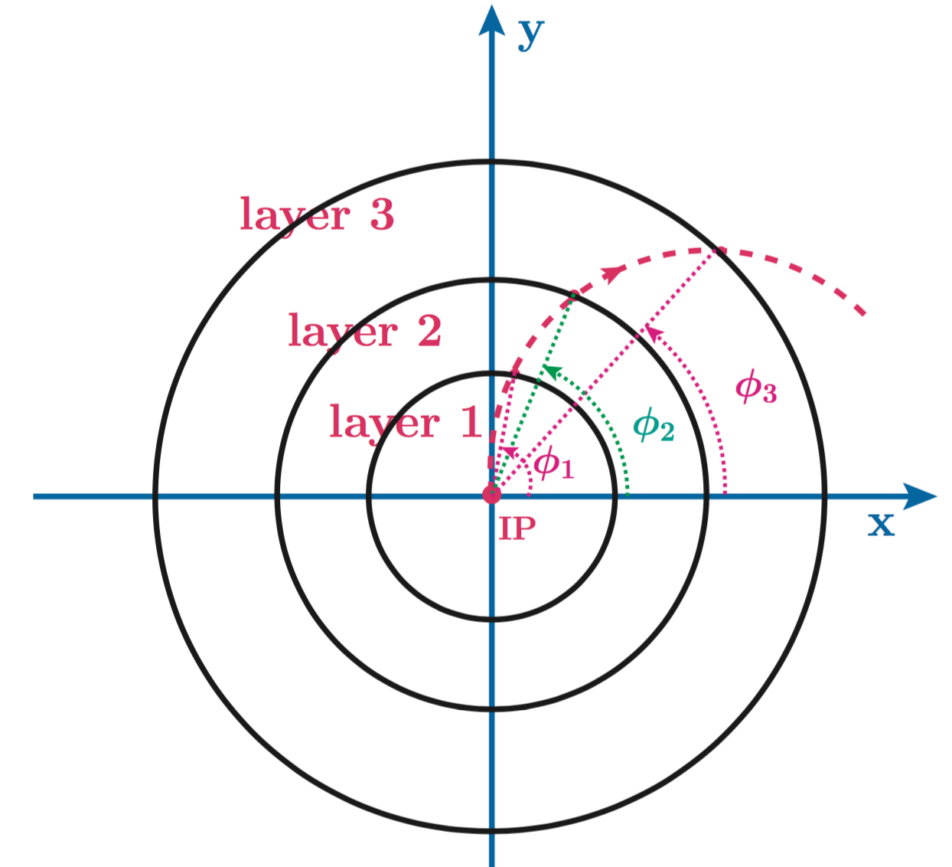
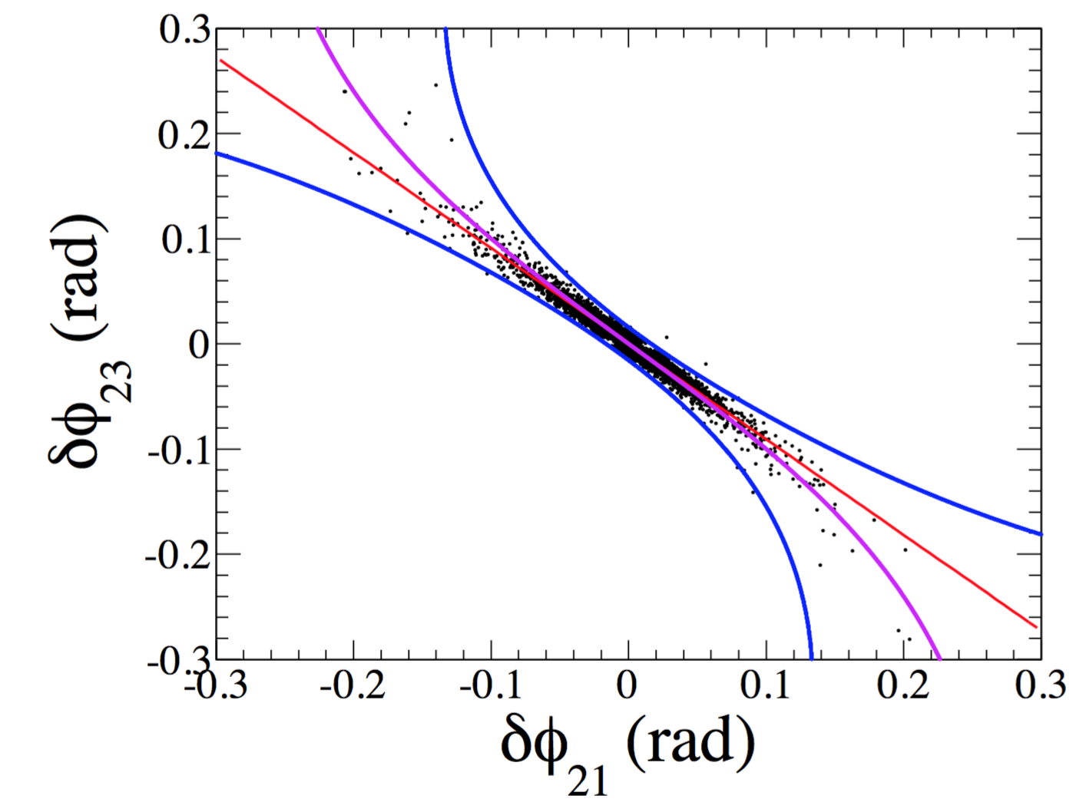
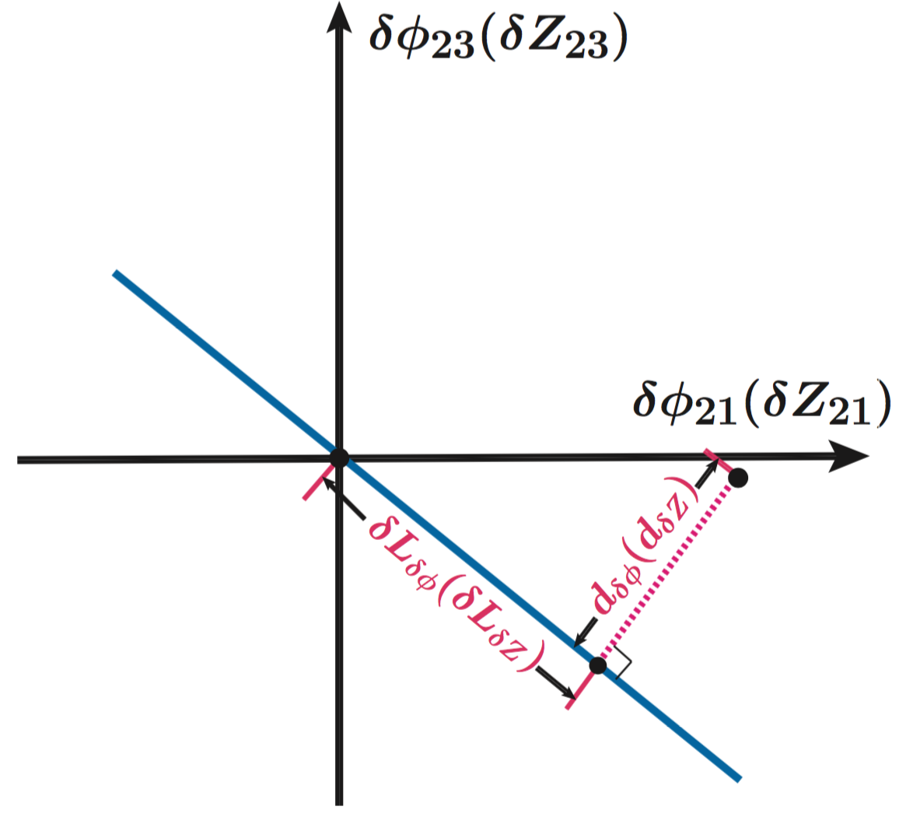
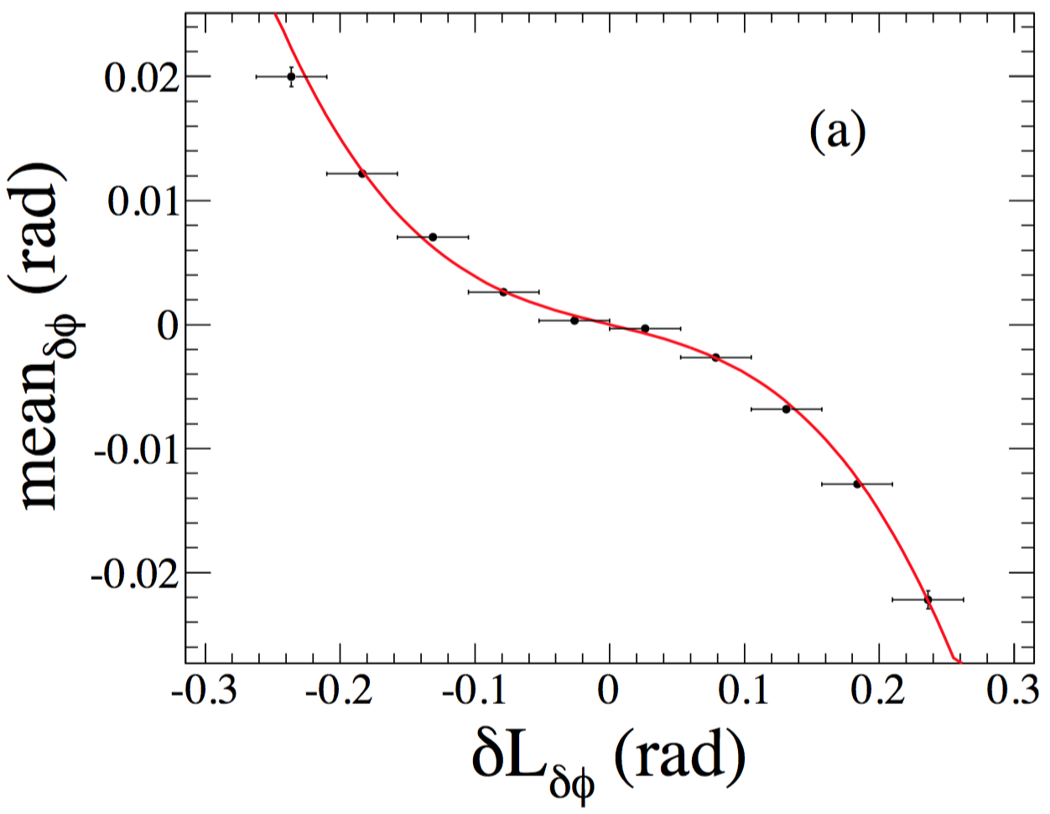
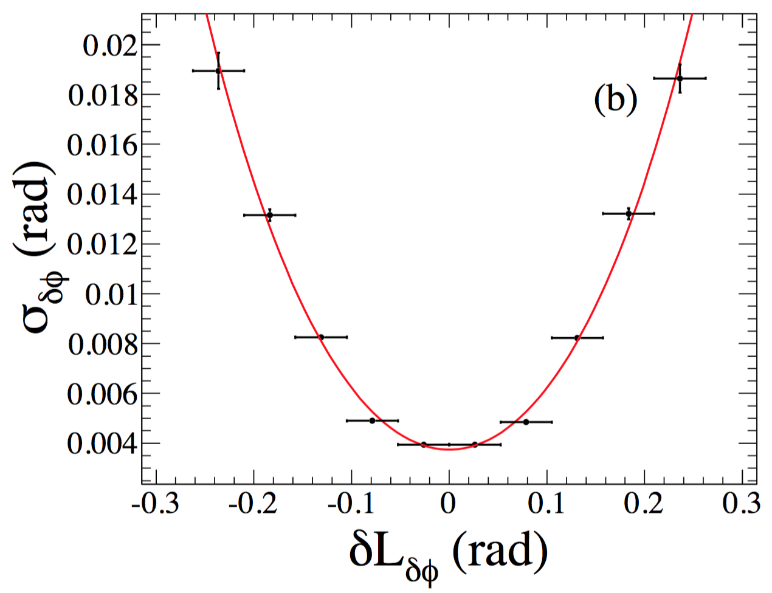
δφ pattern and parameterization
μ− with p_{t}=
0.05~1 GeV/c
δφ₂₁=φ₁−φ₂
δφ₂₃=φ₃−φ₂
Linear reference line
+3σ
−3σ
mean
σ
Fit to
c₀+c₂*(δL)²+c₄*(δL)⁴
Fit to
c₁*δL+c₃*(δL)³

Slide 22
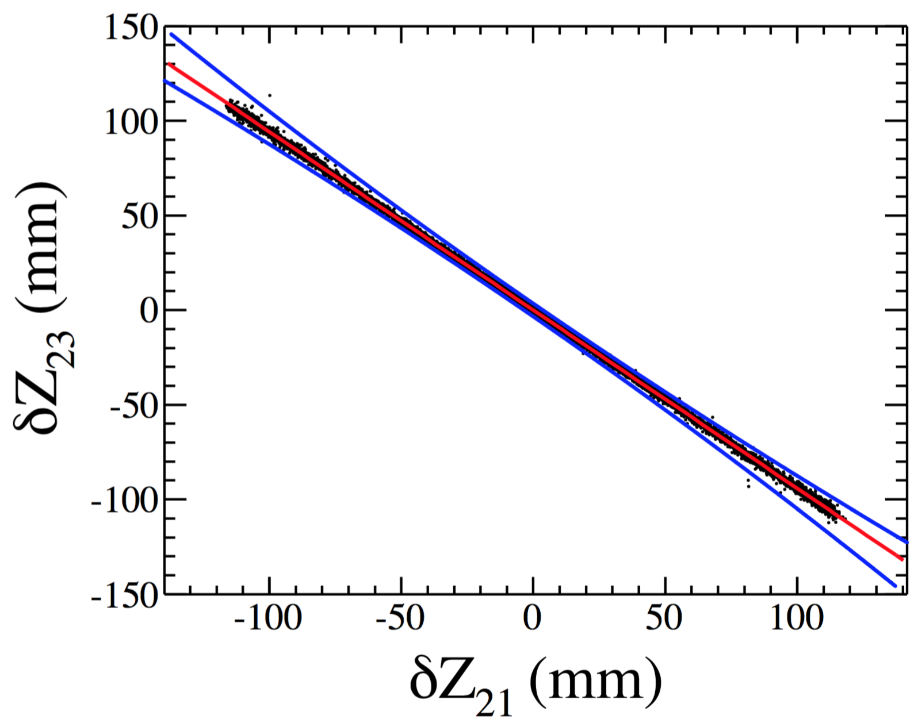
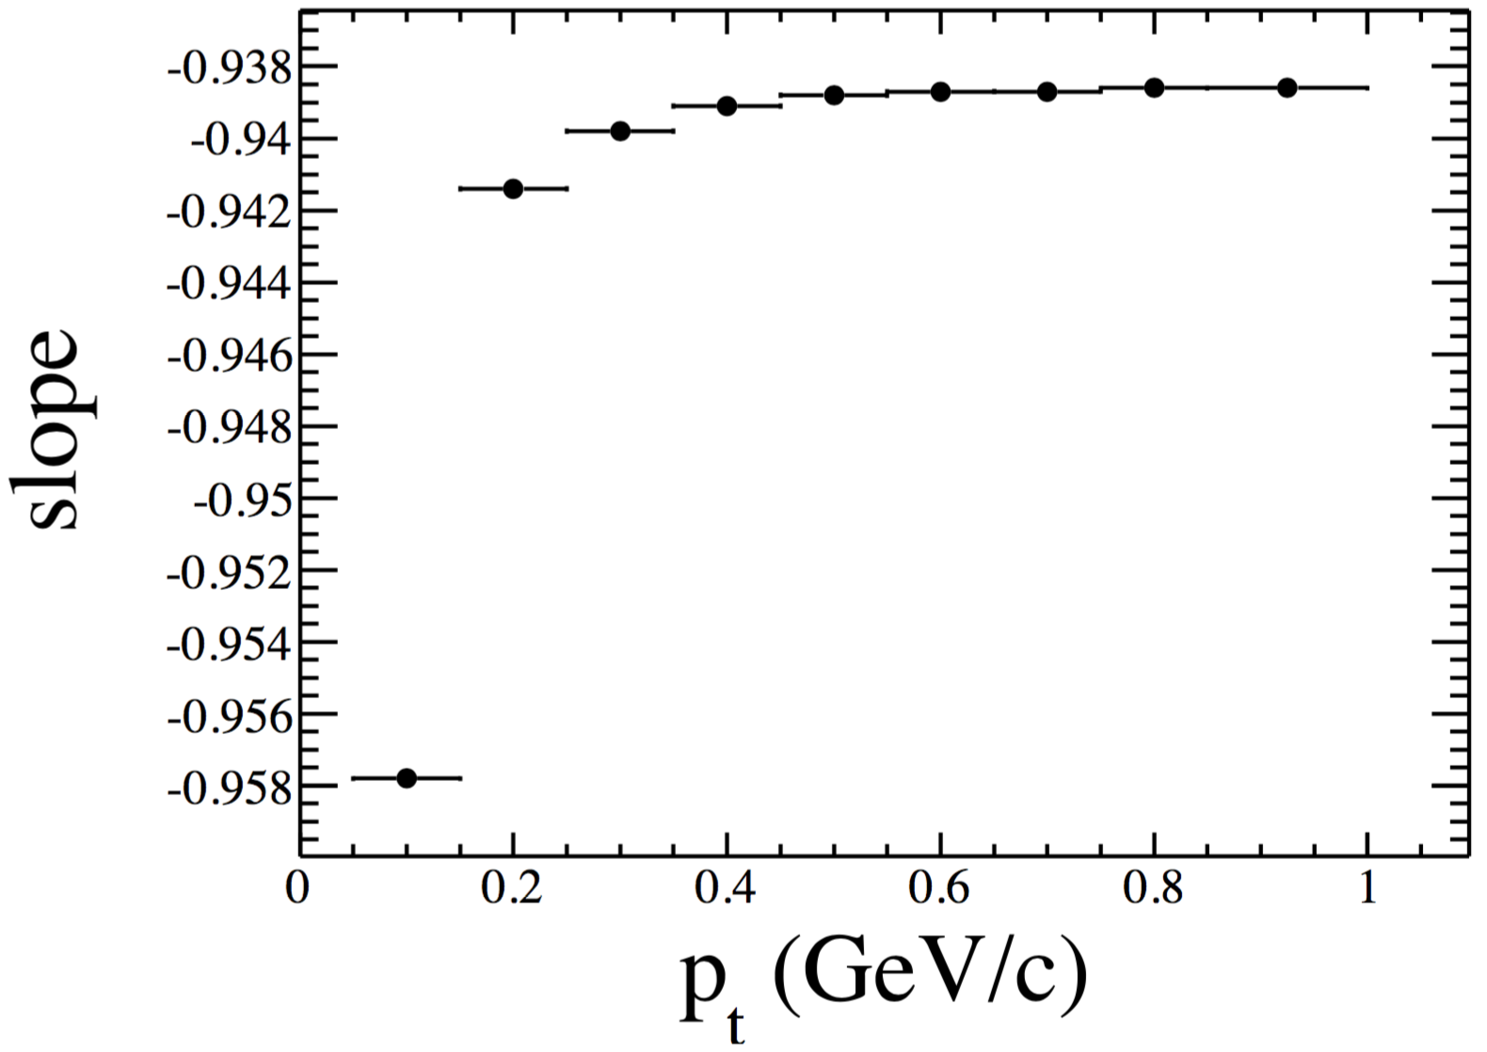
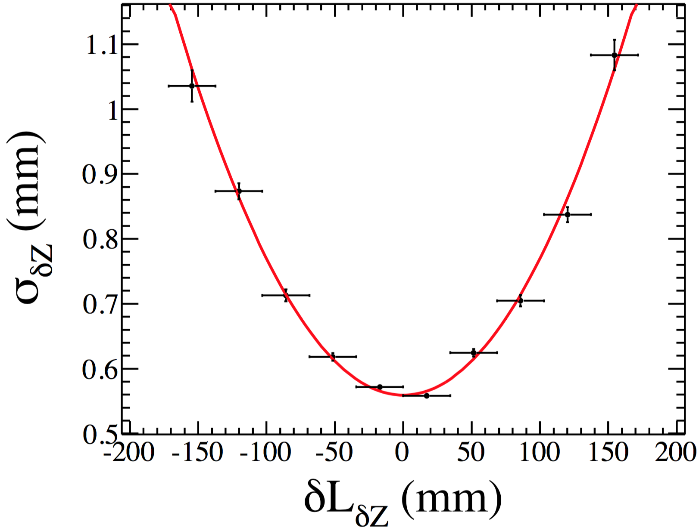
δΖ pattern and parameterization
Fit to a linear line
Weak p_{t} dependence
μ− with p_{t}~0.2 GeV/c
+3σ
μ− with p_{t}~0.2 GeV/c
−3σ
σ
Slope is studied as a function of p_{t}
Mean (consistent with 0) and resolution are studied as a function of both δL_{δZ} and p_{t}
A merged area covering ±3σ of track segments with p_{t}=0.05~1 GeV/c
Fit to
c₀+c₂*(δL)²

Slide 23
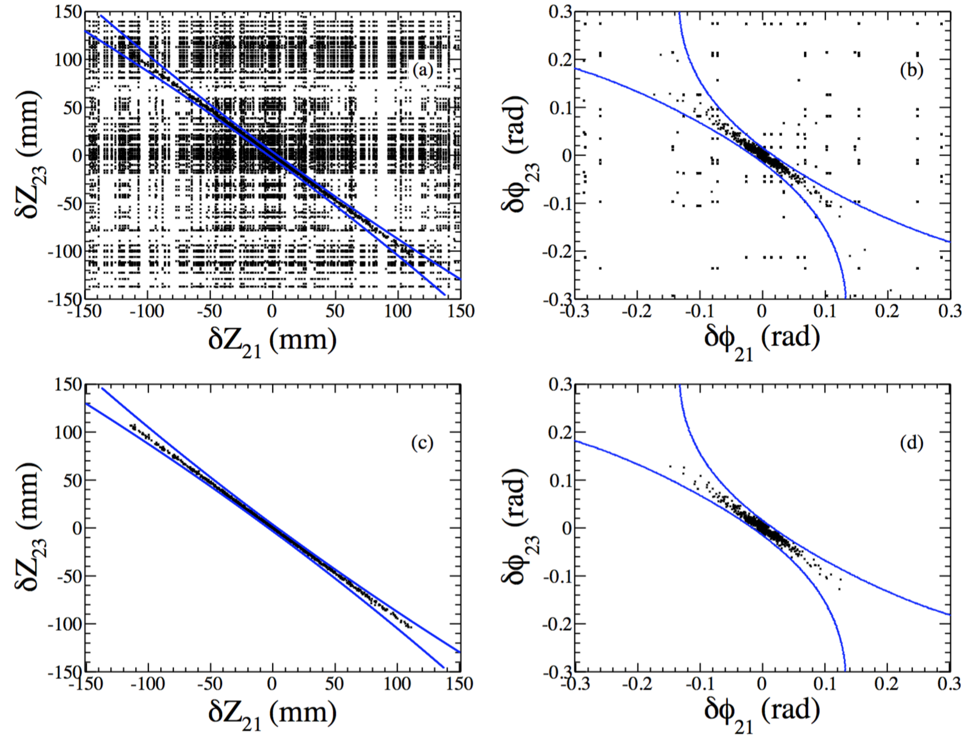
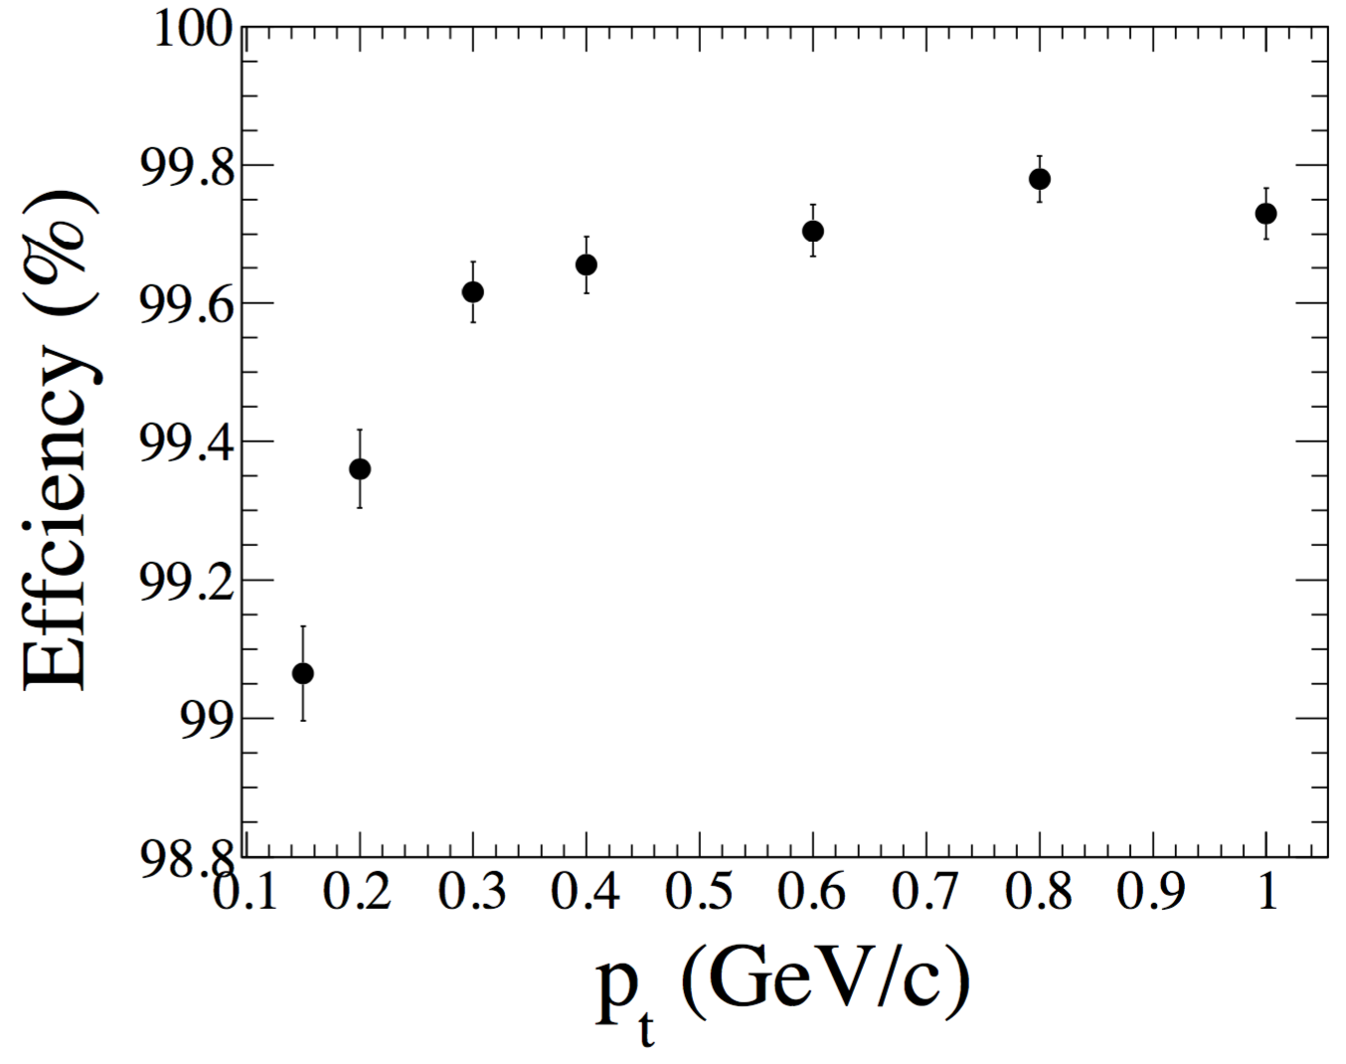
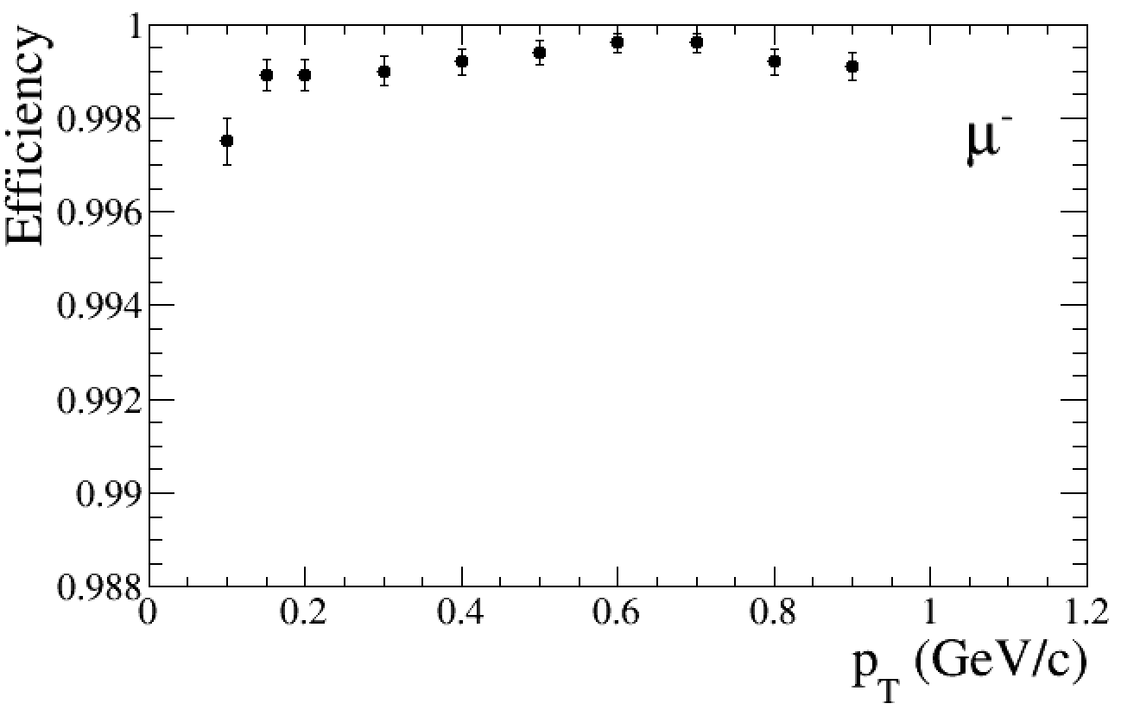
Track segment selection in CGEM-IT
Before selection:
After selection:
Efficiency >99%:
μ^{+/−}
old geometry
digi_v1
new geometry
digi_v2

Slide 24
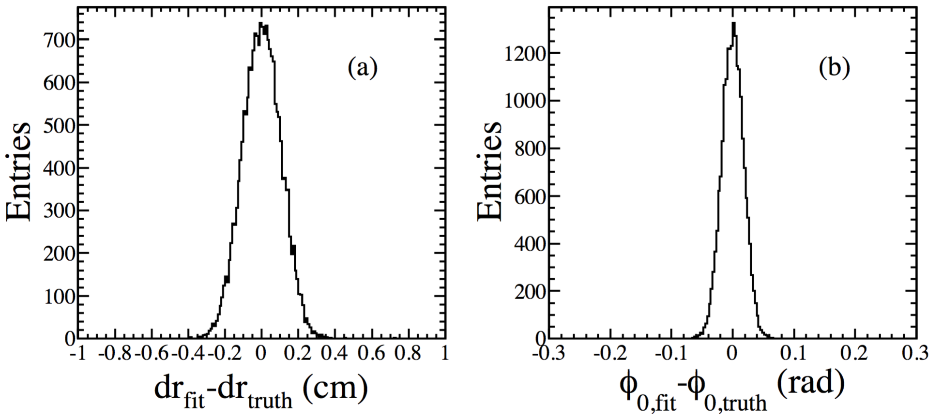
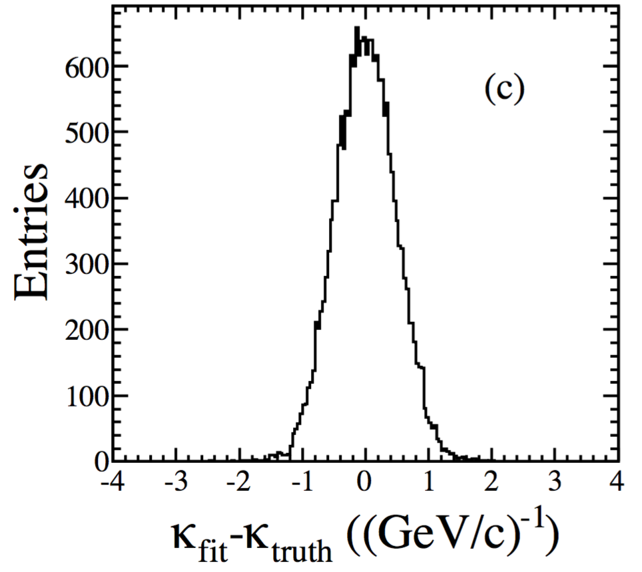
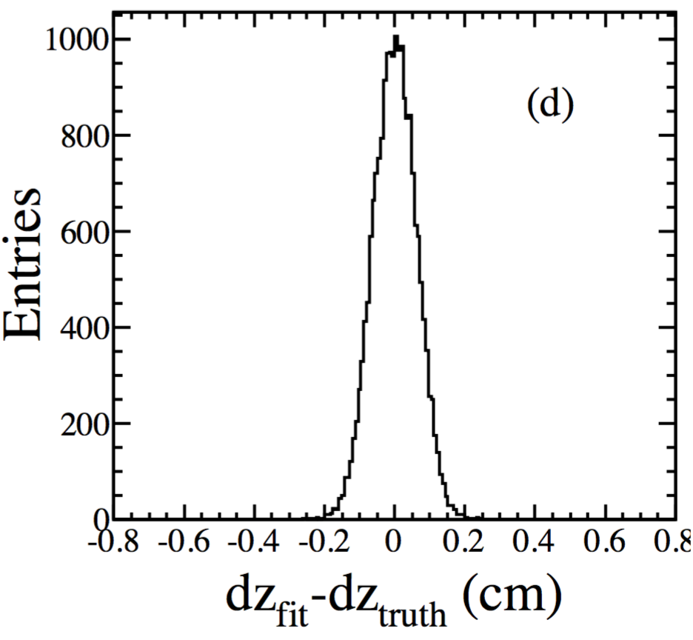
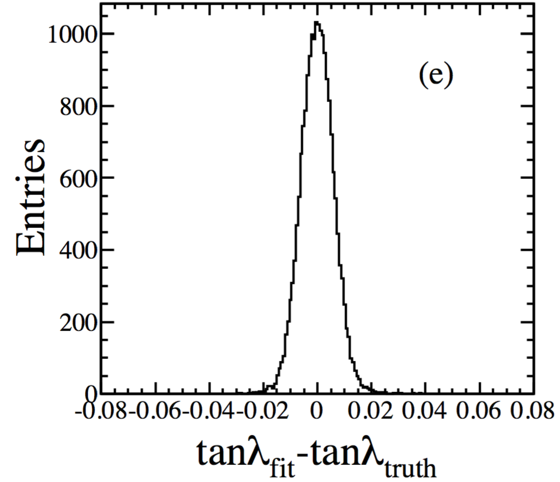
CGEM track segment fitting
Track segment in CGEM-IT is fitted to a helix model with 5 parameters
Least Square Method (MINUIT)
Residual distributions of the five parameters (μ with pt~0.8GeV/c as an example)
Results are reasonable and unbiased

Slide 25
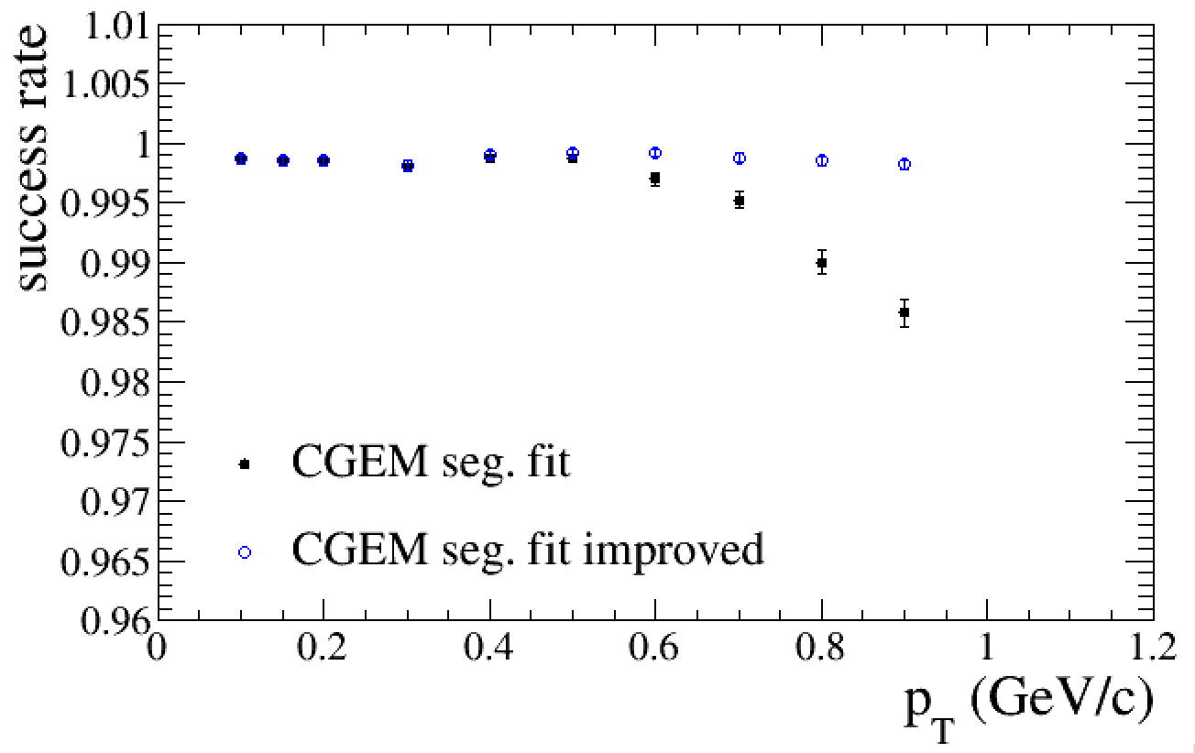
CGEM track segment fitting
improvements in success rate @ high p_{T} by attempts with different initial track parameters
included in CgemBoss665b
μ−

Slide 26
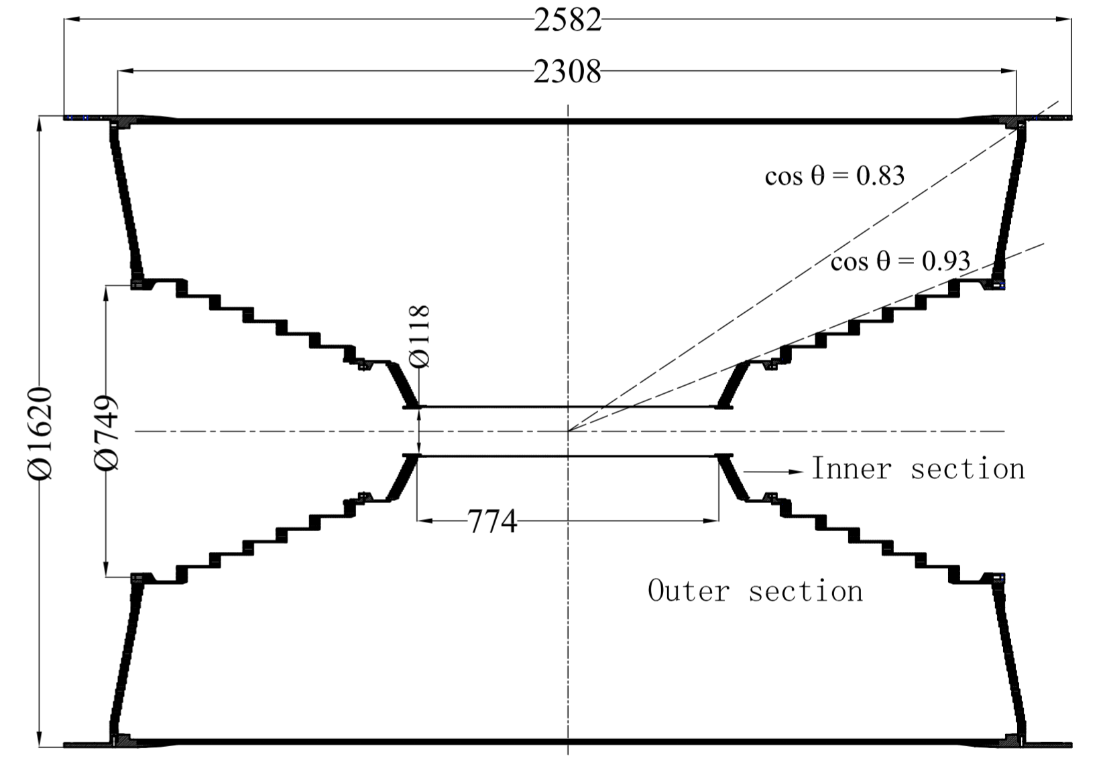
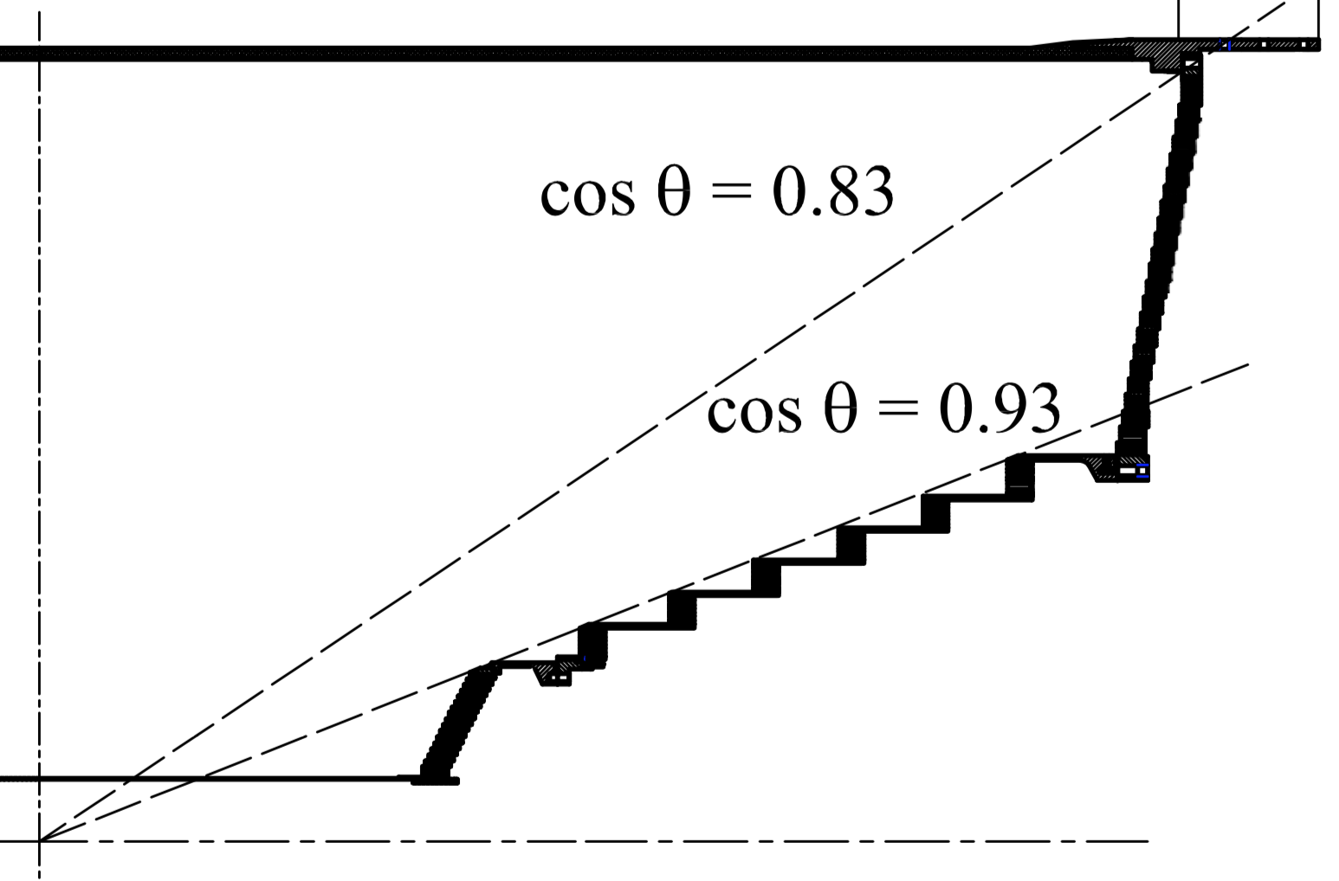
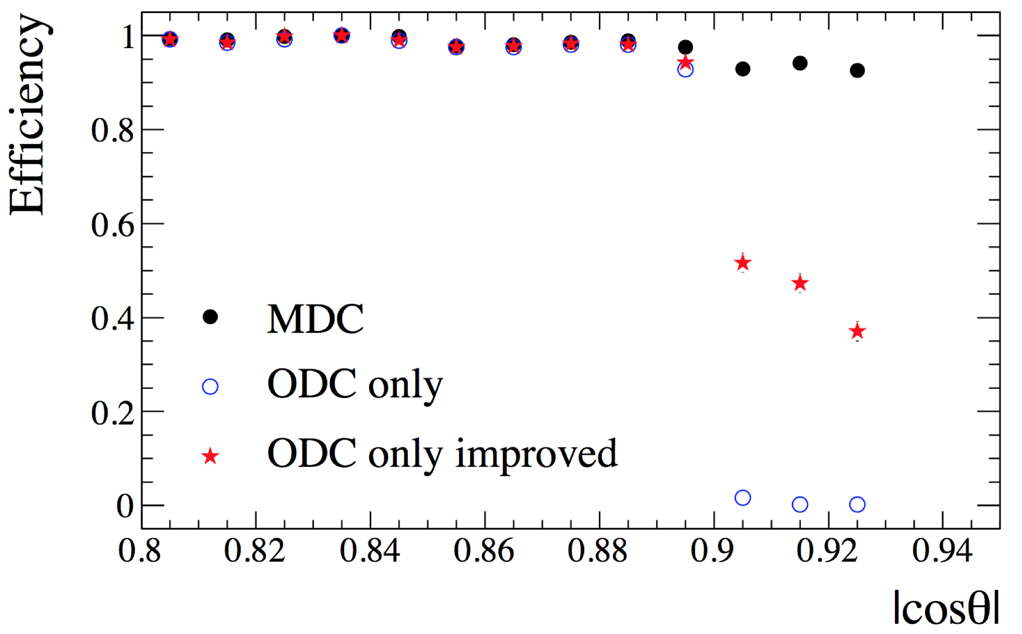
Tracking efficiency with Outer-DC only
studied by Nannan Miao, Yao Zhang (2017)
axial wires
cosθ=0.83
stereo wires
cosθ=0.9
Outer-DC
cosθ=0.93
axial wires
MDC
Inner-DC
Tracking efficiency loss at large |cosθ| with ODC only
Reason: close to the acceptance boundary of stereo wires of ODC
The improvement of the tracking codes with ODC only progressed
included in CgemBoss665b

Slide 27
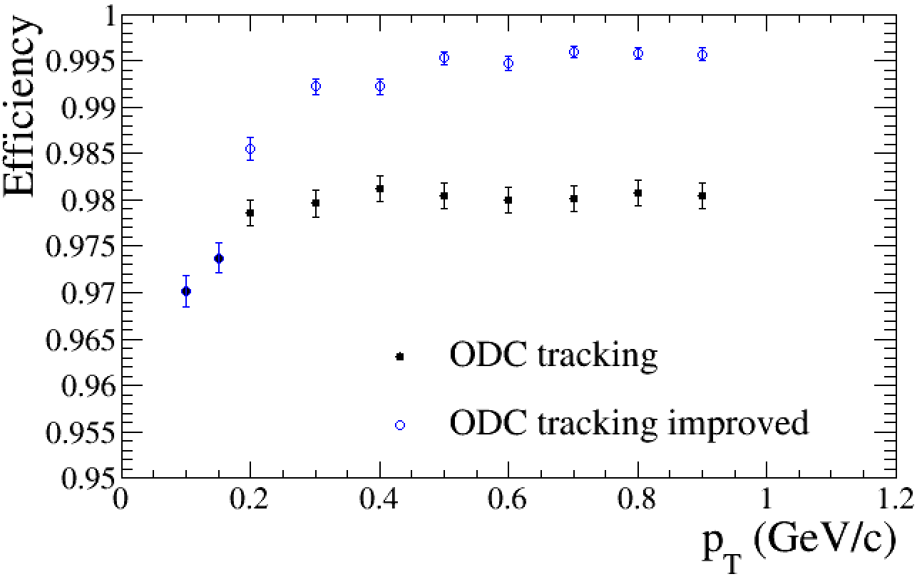
Tracking efficiency with Outer-DC only
studied by Nannan Miao, Yao Zhang (2017)
axial wires
cosθ=0.83
stereo wires
cosθ=0.9
Outer-DC
cosθ=0.93
axial wires
MDC
Inner-DC
included in CgemBoss665b
Tracking efficiency loss at large |cosθ| with ODC only
Reason: close to the acceptance boundary of stereo wires of ODC
The improvement of the tracking codes with ODC only progressed

Slide 28
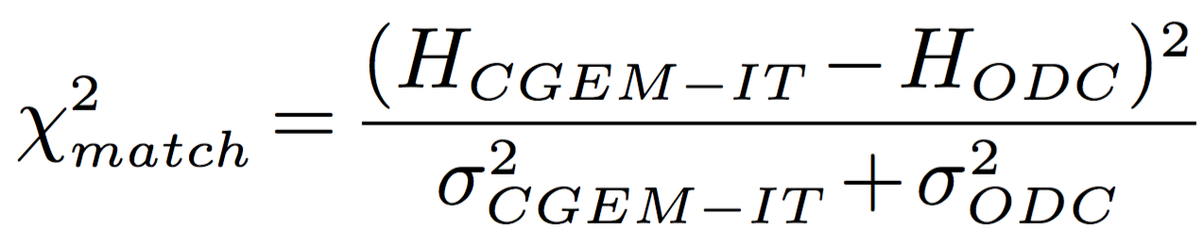


Matching of the tracks between CGEM-IT and Outer-DC v1
is calculated between track segments in
CGEM-IT and Outer-DC to valuate the consistency quantitatively
Examples for μ±
with p_{t}=0.8 GeV/c

Slide 29


Matching of the tracks between CGEM-IT and Outer-DC v1
Proper requirements are chosen for different parameters and momenta
Efficiency ~ 99%

Slide 30






Matching of the tracks between CGEM-IT and Outer-DC v2
improvement included in CgemBoss665b
New geometry + digi_v2 => need new optimization
Matching criteria on χ² is not standard
Improvement:
  Calibrate the resolution of the residual between CGEM & ODC track parameters
σ_{c}_dr
σ_{c}_φ₀
σ_{c}_κ
σ_{c}_dz
σ_{c}_tanλ
More meaningful criteria
χ²=(H_{CGEM}-H_{ODC})²/σ_{c}² <30~100
Distinguish with φ₀, κ, tanλ
if multiple combinations
μ−

Slide 31


Efficiency for track segment finding and matching
old geometry, digi_v1
new geometry, digi_v2
CgemBoss665b
Efficiency for track segment finding/fitting with CGEM-IT >99%
Tracking efficiency with Outer-DC improved by 1~2%
Relative efficiency for track matching >99% (~100% @ high p_{T})

Slide 32




Global tracking with Hough transformation
Isabella GARZIA & Giulio MEZZADRI (started in 2015)
Yao ZHANG, Zhen HUAN (joined in 2017)
in progress
Complementary tracking module: in the case of no good track (segment) candidate
found in either CGEM-IT or Outer-DC (especially for low momentum track)
Transformation procedure in practice tracking:
y
Y
ρ
x
X
θ
Circle
(image space)
X=2x/(x²+y²)
Line
(image space)
ρ=Xcosθ+Ysinθ
Point
(parameter space)
Y=2y/(x²+y²)
Hough
transformation
Tracking => Peak (point) finding
ρ
Define a matrix (ρ, θ)
If line passes through a cell
→ add one vote
Search for maximum values
(technique details are ignored here)

Slide 33
Track fitting with Kalman Filter
by Yue GUO & Liangliang WANG (Sep 2014~Mar 2015), updated by Zhen Huang (2017)
Kalman filter (linear quadratic estimation) estimates information using a series of measurements over time with random noise.
The Kalman-Filter-based track fitting package for MDC is extended to be able to process CGEM clusters and MDC hits
  Geometry and material description of CGEM
  Calculation of the CGEM cluster predictions
  Update of the track parameter with CGEM clusters
Track-parameters extrapolation in B field with E loss
Measurement m_{i}
Prediction of the measurement
a_{ini}
a’_{i+1}=F(a_{i}), w_{i}
m’_{i+1}=H(a’_{i})
Update a’_{i+1}→a_{i+1}
Estimation of uncertainties from E loss and multiple scattering
yes
Next hit (cluster)?
No more
Extrapolate a_{n}@IP

Slide 34






Track fitting with Kalman Filter
by Yue GUO & Liangliang WANG (Sep 2014~Mar 2015), updated by Zhen Huang (2017)
old geometry/material & digitization v1
Approaching point resolution
Momentum resolution
σ_{ρ}
(old)
σ_{z}
(old)
(old)
σ_{p}
New geometry and material description of CGEM implemented according to the final design recently (by Zhen Huang 2017)
σ_{ρ}
new
σ_{z}
σ_{p}
new
new
new: new geometry/material & digitization v2

Slide 35
Releases of CgemBoss
By Linghui Wu, Yao Zhang, Liangliang Wang (2015~present)
CgemBoss: a special BESIII Offline Software System for CGEM
CgemBossCVS: archive the developments of CGEM related software packages
http://docbes3.ihep.ac.cn/viewvc/cgi-bin/viewvc.cgi/BESIII/CgemBossCvs/
Different CgemBOSS versions are released to provide the environments for the test/validation and further development
The other updates in standard BOSS releases are traced and incorporated in CgemBOSS releases to test/keep the compatibility of CGEM packages.
First workable CgemBOSS version released on 6 April, 2017: CgemBoss665b

Slide 36




Performance check with CgemBoss665b
Efficiency for good reconstructed tracks (dr<1cm, |dz|<10cm)

Slide 37



Performance check with CgemBoss665b
ψ(3686)→π+π−J/ψ→π+π−e+e-
4 good tracks with total charge = 0
one pair of oppositely charged tracks with lower momentum (<0.8GeV/c): π+π−
one pair of oppositely charged tracks with higher momentum (>0.8GeV/c): e+e- from J/ψ
4C kinematic fit
Comparable resolution
similar χ²_{4C} distribution,
but efficiency is lower
( χ²_{4C}<60:
30% CgemBoss665b vs
39% Boss665p01)

Slide 38
Summary and plan
Basic status
Simulation and reconstruction software is in a good shape
First workable CgemBoss released: CgemBoss665b
(includes recent improvements)
Performance reasonable
Efficiency for low momentum tracks is to be improved by global tracking with Hough Transformation
Activities in progress:
The full digitization modeling
Progress on Global tracking with Hough transformation
Global track fitting with CGEM and ODC hits
In plan: Calibration and alignment
Thanks for your attention!

