Slide 1
Reconsideration of the $B→K^{∗}$ transition form factors within
the QCD light-cone sum rules
Wei Cheng
Department of Physics, Chongqing University, Chongqing 401331, P.R. China
Institute of Theoretical Physics, Chongqing University, Chongqing 401331, P.R. China
Background | $B→K^{∗}$ TFFs Within The LCSR | Numerical Analysis | Summary | 16 October 2017

Slide 2
Outline
Background
$B→K^{∗}$ TFFs Within The LCSR
Numerical Analysis
Summary
Basic inputs
Properties of the LCSRs
An extrapolation of the TFFs and the correlation
coefficient $ρ_{XY}$ for the two LCSRs
The branching fraction of $B→K^{∗}{\text{μ}}^{\text{+}}{\text{μ}}^{\text{−}}$
Background | $B→K^{∗}$ TFFs Within The LCSR | Numerical Analysis | Summary | 16 October 2017

Slide 3
B-meson decay
CDF collaboration
BABAR collaboration Belle collaboration
LHCb collaboration ATLAS collaboration
CMS collaboration
……
Purterbative
Nonpurterbative
QCD Factorization
Lattice QCD
AdS/QCD
QCD sum rule
……
Experiment
Theory
B-meson decay
Testing the CP-violation phenomena
Testing the Standard Model
Seeking new physics beyond the Standard Model (SM)
……
Background | $B→K^{∗}$ TFFs Within The LCSR | Numerical Analysis | Summary | 16 October 2017

Slide 4
QCD sum rule
SVZ-SR (1979)
LCSR (1989)
Improved LCSR (2000)
Background | $B→K^{∗}$ TFFs Within The LCSR | Numerical Analysis | Summary | 16 October 2017

Slide 5
QCD sum rule
SVZ-SR (1979)
LCSR (1989)
Improved LCSR (2000)
The Shifman-Vainshtein-Zakharov (SVZ) sum rules
Nucl.Phys. B 147, 385 (1979).
Nucl.Phys. B 147, 448 (1979).
Application
Quark mass
Hadronic state mass
Decay constant
Transition form factors
…
Problem
the breaking of power-counting at large $q^{2}$-region
the contamination of sum rules by “non-diagonal” transitions
…
Background | $B→K^{∗}$ TFFs Within The LCSR | Numerical Analysis | Summary | 16 October 2017

Slide 6
QCD sum rule
SVZ-SR (1979)
LCSR (1989)
Improved LCSR (2000)
I.Balitsky and V.M.Braun and A.V.Kolesnichenko,
“Radiative Decay in Quantum Chromodynamics,”
Nucl.Phys.B312,509 (1989).
$$σ^{\text{+}}→p γ$$
Differences with SVZ sum rule
1. The correlator is the matrix element between vacuum and hadronic final state: $〈H(p)|T\{J_{1}(x)J_{2}(0)\}|0〉$
2. The OPE is around the light cone x²→0 instead of x→0
3. The corresponding non-perturbative part are expressed as distribution ampliutdes (DAs) of hadrons instead of vacuum condensate
4. The DAs can be expanded from its twist (the difference between dimension (l) and spin (s) twist = |l – s| )
Background | $B→K^{∗}$ TFFs Within The LCSR | Numerical Analysis | Summary | 16 October 2017

Slide 7
QCD sum rule
SVZ-SR (1979)
LCSR (1989)
Improved LCSR (2000)
I.Balitsky and V.M.Braun and A.V.Kolesnichenko,
Nucl.Phys.B 312,509 (1989).
Application
CKM matrix element $|V_{ub}|$ and $|V_{cb}|$
Differential decay branching ratio
Decay width $Γ$and differential with $dΓ/dq^{2}$
Asymmetry of semi-leptonic $B→K^{∗}μ^{+}μ^{−}$
…
Problem
Contain all twist contributions DA
Large uncertainty from high twist DA
Mixture of different twist DA
…
Background | $B→K^{∗}$ TFFs Within The LCSR | Numerical Analysis | Summary | 16 October 2017

Slide 8
QCD sum rule
SVZ-SR (1979)
LCSR (1989)
Improved LCSR (2000)
Huang Tao and Li ZuoHong and Wu XiangYao
Phys.Rev.D.63.094001
Differences with LCSR
The new current is Chiral Current instead of usual
current
Advance
1. Suppress the uncertainty from high twist
Background | $B→K^{∗}$ TFFs Within The LCSR | Numerical Analysis | Summary | 16 October 2017

Slide 9
QCD sum rule
SVZ-SR (1979)
LCSR (1989)
Improved LCSR (2000)
By Suppressing the value of threshold $S_{0}$, the contribution from the added scalar can be highly reduced or eliminated.
LCSR and Improved LCSR are both effective!!!
Background | $B→K^{∗}$ TFFs Within The LCSR | Numerical Analysis | Summary | 16 October 2017

Slide 10
The parametrized hadronic matrix element
$$\tilde{T }$$
Background | $B→K^{∗}$ TFFs Within The LCSR | Numerical Analysis | Summary | 16 October 2017

Slide 11
The basic calculation step of the TFFs
1.Choose the current
Traditional current | The chiral current
2.Write down the correlator
3.Deal with the correlator
The hadronic expression | The OPE
4.Work out the TFFs
Equating the two results of the correlator to work out the TFFs with the help of correlatior’s analytic property in the complex plane
Background | $B→K^{∗}$ TFFs Within The LCSR | Numerical Analysis | Summary | 16 October 2017

Slide 12
An example: $B→K^{∗}$ TFFs
1. the current for $B→K^{∗}$
The usual current${ j}_{B}^{†}\left(x\right):$ | The chiral current
 | The left current$j_{B}^{†}\left(x\right):$ | The rigtht Current${ j}_{B}^{†}\left(x\right):$
2. Write down the correlator
$$im_{b}\overline{b}\left(x\right)\left(1−γ_{5}\right)q\left(x\right)$$
$$\begin{matrix}Π_{μ}^{I}\left(p,q\right)=−i\int{d^{4}}xe^{iq⋅x}〈K^{∗}\left(p,λ\right)|T\{\overline{s}\left(x\right)γ_{μ}\left(1−γ_{5}\right)b\left(x\right),j_{B}^{†}\left(0\right)\}|0〉, \\ Π_{μ}^{II}\left(p,q\right)=−i\int{d^{4}}xe^{iq⋅x}〈K^{∗}\left(p,λ\right)|T\{\overline{s}\left(x\right)σ_{μν}q^{ν}\left(1+γ_{5}\right)b\left(x\right),j_{B}^{†}\left(0\right)\}|0〉.\end{matrix}$$
Background | $B→K^{∗}$ TFFs Within The LCSR | Numerical Analysis | Summary | 16 October 2017

Slide 13
An example: $B→K^{∗}$ TFFs
3.Deal with the correlator with usual current
The hadronic expression | The OPE
$$V$$
$$V$$
$$V$$
$$V$$
Background | $B→K^{∗}$ TFFs Within The LCSR | Numerical Analysis | Summary | 16 October 2017

Slide 14
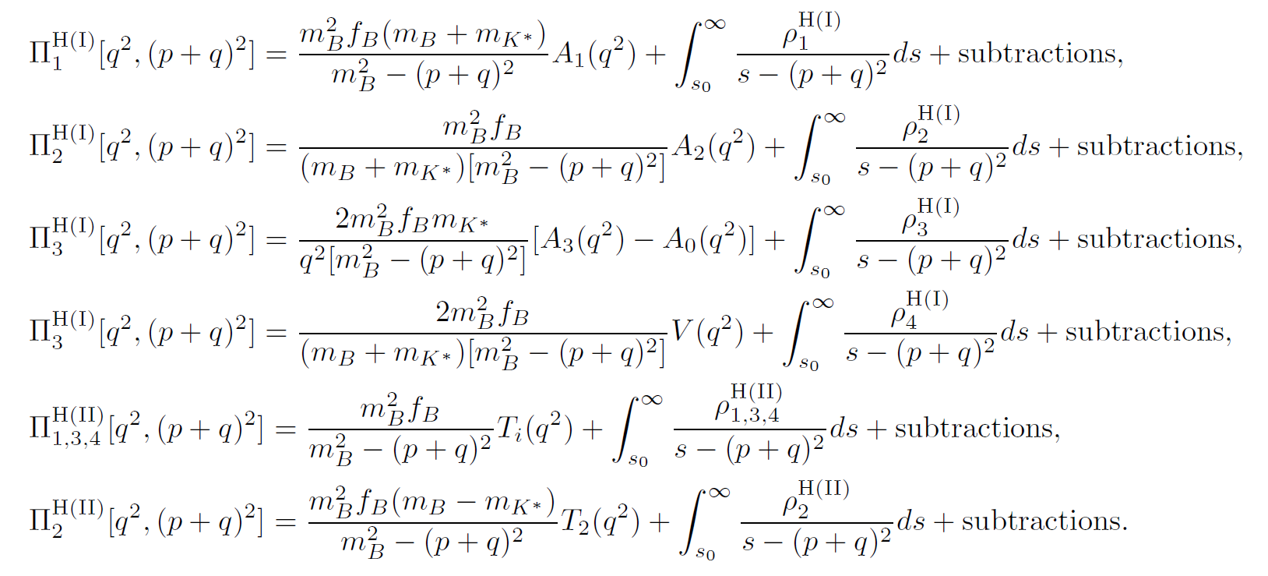
An example: $B→K^{∗}$ TFFs
3.Deal with the correlator with usual current
The hadronic expression | The OPE
Background | $B→K^{∗}$ TFFs Within The LCSR | Numerical Analysis | Summary | 16 October 2017

Slide 15
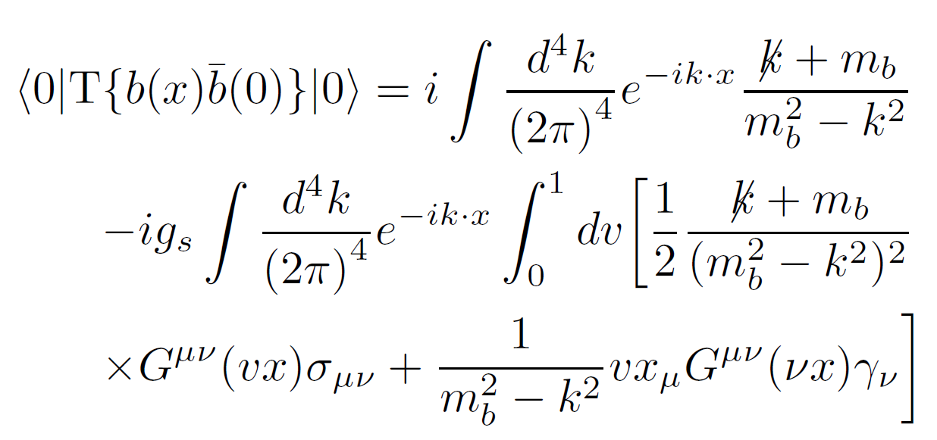
An example: $B→K^{∗}$ TFFs
3.Deal with the correlator with usual current
The hadronic expression | The OPE
Background | $B→K^{∗}$ TFFs Within The LCSR | Numerical Analysis | Summary | 16 October 2017

Slide 16
An example: $B→K^{∗}$ TFFs
3.Deal with the correlator with usual current
The hadronic expression | The OPE
Background | $B→K^{∗}$ TFFs Within The LCSR | Numerical Analysis | Summary | 16 October 2017

Slide 17
An example: $B→K^{∗}$ TFFs
4.Work out the TFFs
Equating the two results of the correlator to work out the TFFs with the help of correlatior’s analytic property in the complex plane
Background | $B→K^{∗}$ TFFs Within The LCSR | Numerical Analysis | Summary | 16 October 2017

Slide 18
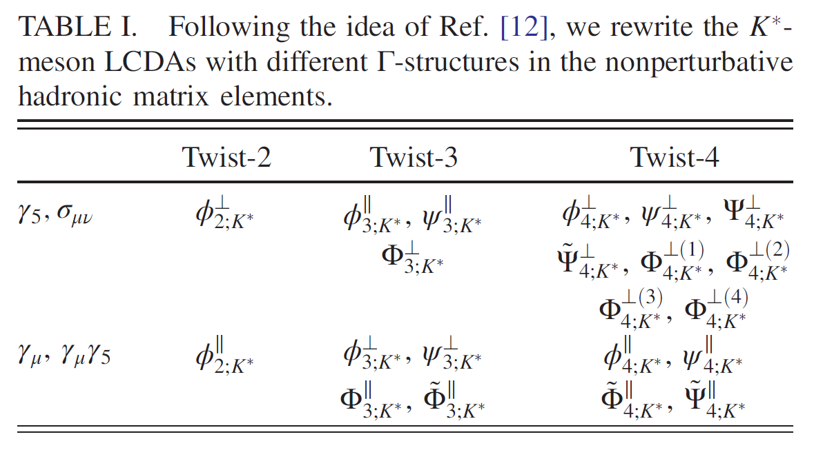
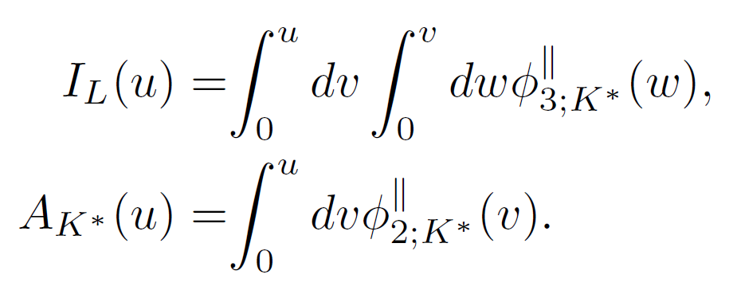
An example: $B→K^{∗}$ TFFs
4.Work out the TFFs
Equate the two results of the correlator to work out the TFFs with the help of the Borel transformation
Background | $B→K^{∗}$ TFFs Within The LCSR | Numerical Analysis | Summary | 16 October 2017

Slide 19
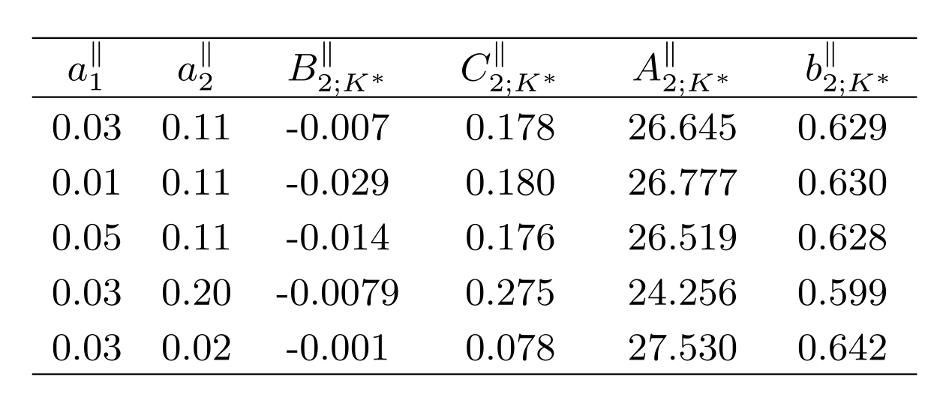
Basic input
Distribution amplitude(WH-model)
Four Criteria
the normalization condition:
the average value of the squared transverse momentum:
the Gegenbauer moments:
Background | $B→K^{∗}$ TFFs Within The LCSR | Numerical Analysis | Summary | 16 October 2017

Slide 20
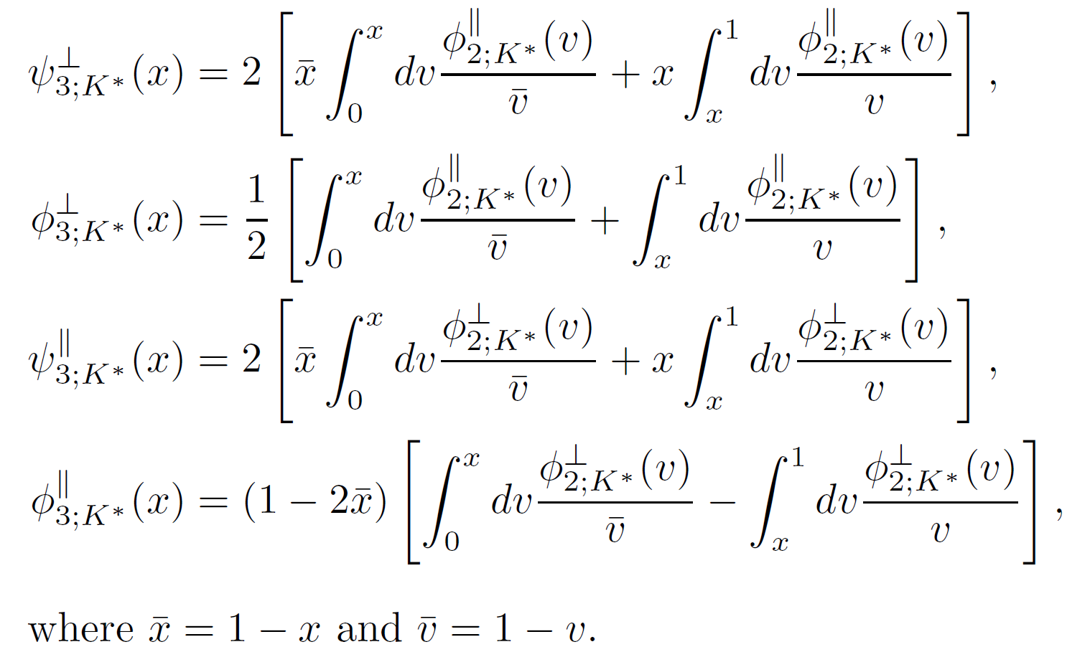
Basic input
Distribution amplitude Twist-3
Background | $B→K^{∗}$ TFFs Within The LCSR | Numerical Analysis | Summary | 16 October 2017

Slide 21
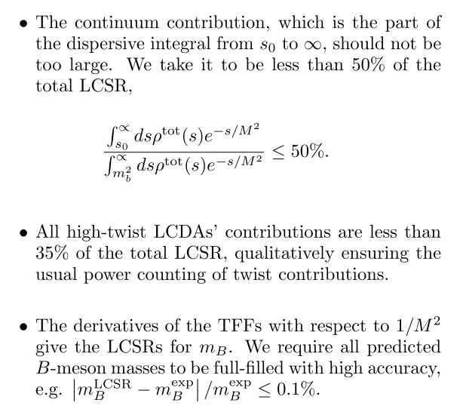
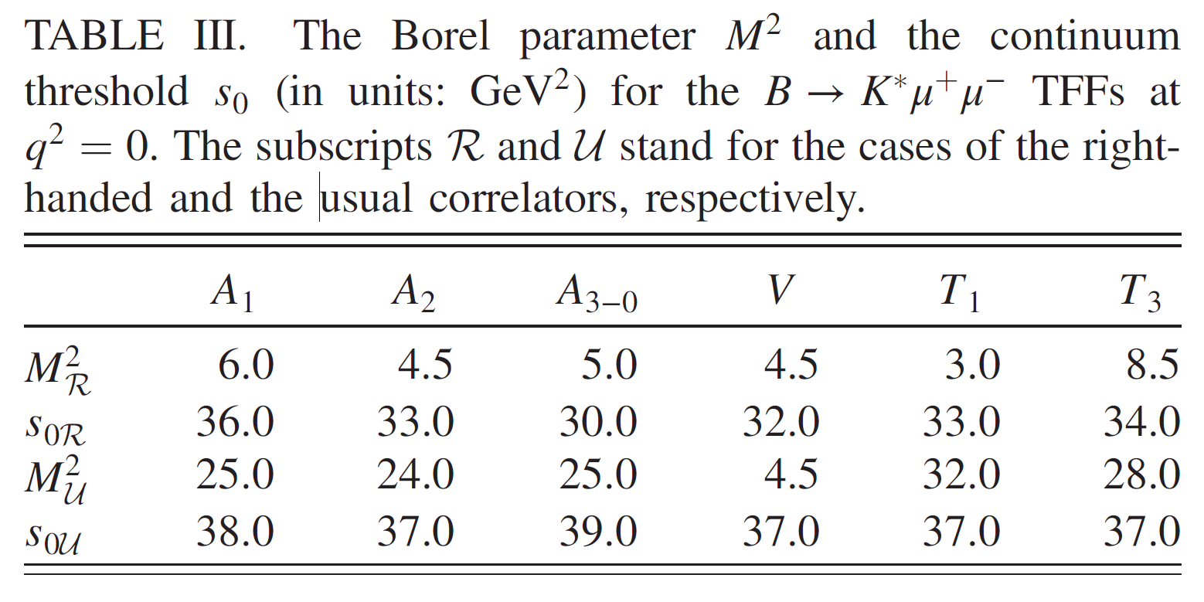
Basic input
The Borel parameter $M^{2}$ and the continuum threshold $S_{0}$
The Criteria | Results
Background | $B→K^{∗}$ TFFs Within The LCSR | Numerical Analysis | Summary | 16 October 2017

Slide 22
Results
The B → $K^{∗}$TFFs at core region
Background | $B→K^{∗}$ TFFs Within The LCSR | Numerical Analysis | Summary | 16 October 2017

Slide 23
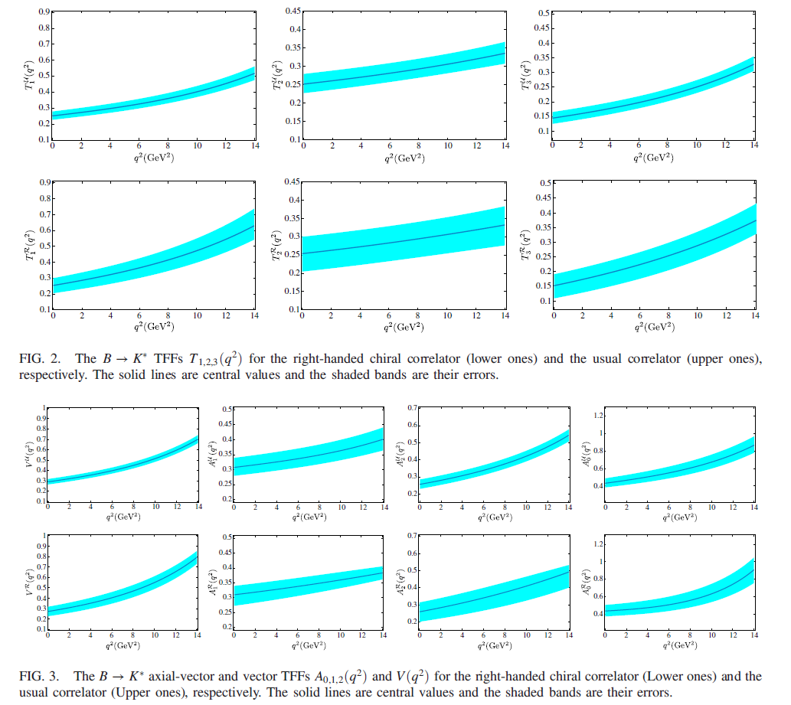
Results
The B → $K^{∗}$TFFs
at$0≤q^{2}≤14{GeV}^{2}$
The TFFs for the two methods
are consistency in errors！
Background | $B→K^{∗}$ TFFs Within The LCSR | Numerical Analysis | Summary | 16 October 2017

Slide 24
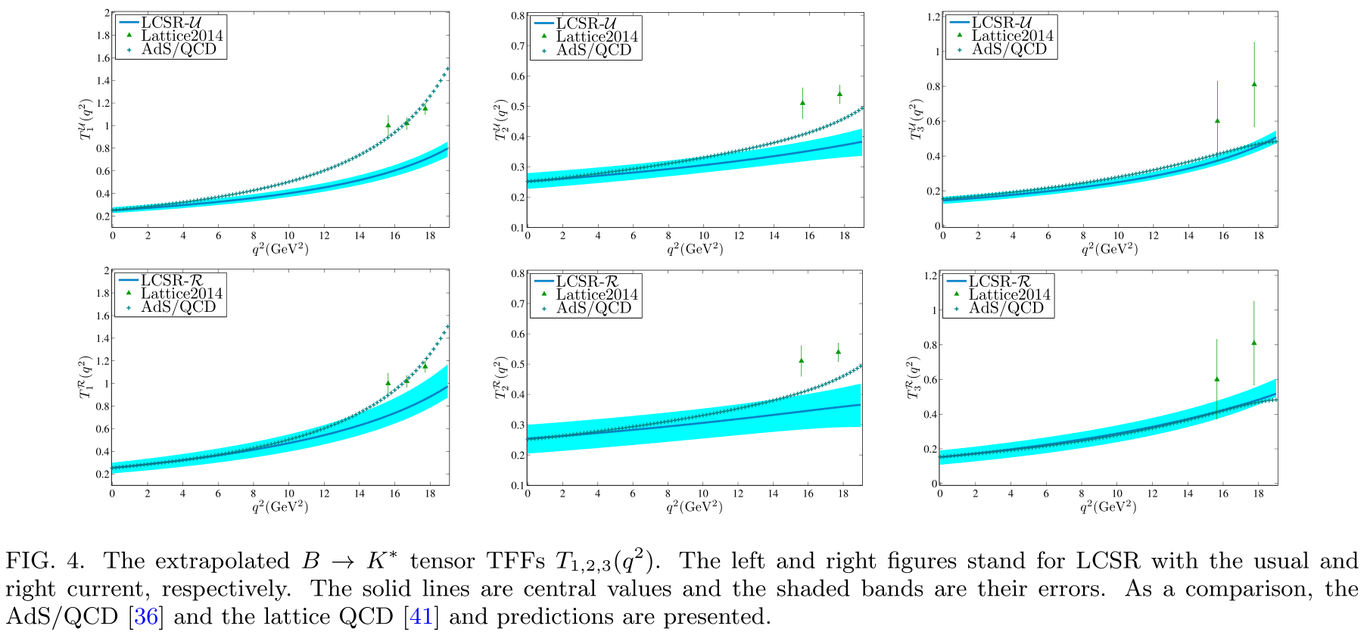
Results
The B → $K^{∗}$TFFs at all allowable region
The simplified series expansion(SSE) formular:
Where
Background | $B→K^{∗}$ TFFs Within The LCSR | Numerical Analysis | Summary | 16 October 2017

Slide 25
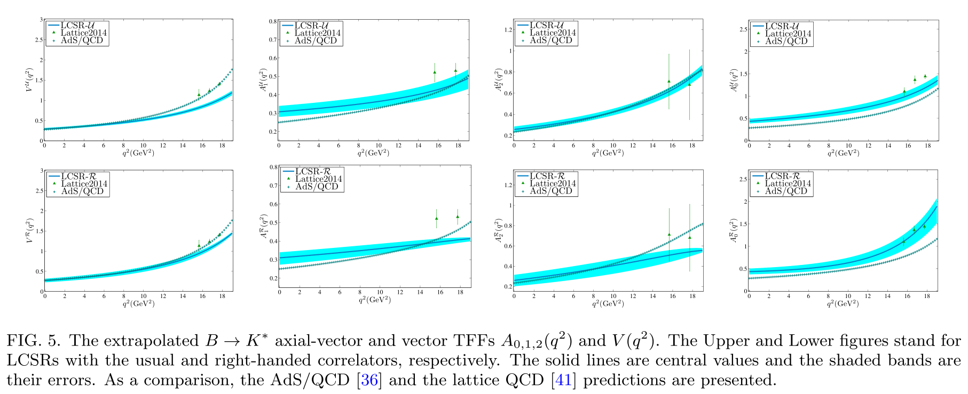
Results
The B → $K^{∗}$TFFs at all allowable region
The simplified series expansion(SSE) formular:
Where
Background | $B→K^{∗}$ TFFs Within The LCSR | Numerical Analysis | Summary | 16 October 2017

Slide 26
Results
The B → $K^{∗}$TFFs at all allowable region
The simplified series expansion(SSE) formular:
Where
The TFFs for two methods are consistency in errors!!!
Background | $B→K^{∗}$ TFFs Within The LCSR | Numerical Analysis | Summary | 16 October 2017

Slide 27
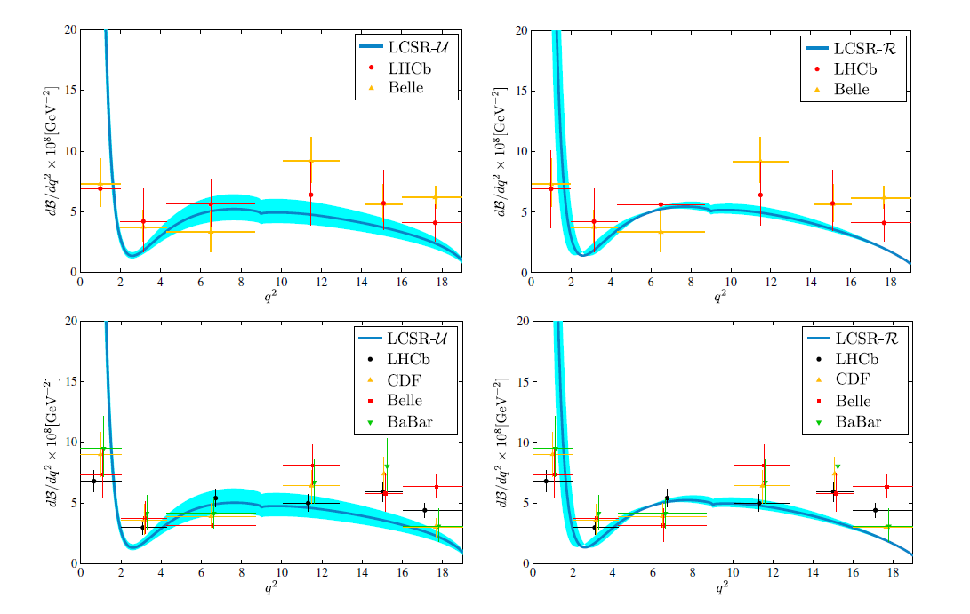
Results
An application: differential branching fraction ${dB}/{dq^{2}}$
$${ B}^{+ }$$
Type
$${ B}^{0 }$$
Type
The application for two methods are consistency in errors!!!
Background | $B→K^{∗}$ TFFs Within The LCSR | Numerical Analysis | Summary | 16 October 2017

Slide 28
Summary
By the $B→K^{∗}$ decay, we in detail discuss the equivalency for the two kinds of LCSRs.
Calculation the $B→K^{∗}$ TFFs under various LCSRs.
To ensure the consistency, The same DAs are adopted for the two methods, more specifically, ,the Twist-2 and 3 are the WH-DA and WW approximate, respectively.
By Suppressing the value of threshold $S_{0}$, the contribution from the added scalar can be highly reduced or eliminated.
The result of TFFs and the application for the two kinds of LCSRs are both consistency in errors.
Background | $B→K^{∗}$ TFFs Within The LCSR | Numerical Analysis | Summary | 16 October 2017

