Slide 1


The Origin of the Chinese Continental Shelf Beneath East China Sea & South China Sea
[The origin of the Yellow Sea]
Yaoling Niu
Notes:
Thank you all the members of the organization for giving me this opportunity, for which I have already learnt a lot since yesterday. I am excited to be involved in such a research, so I thought it is better that I let you know what my expertise is and what I have been working on

Slide 2
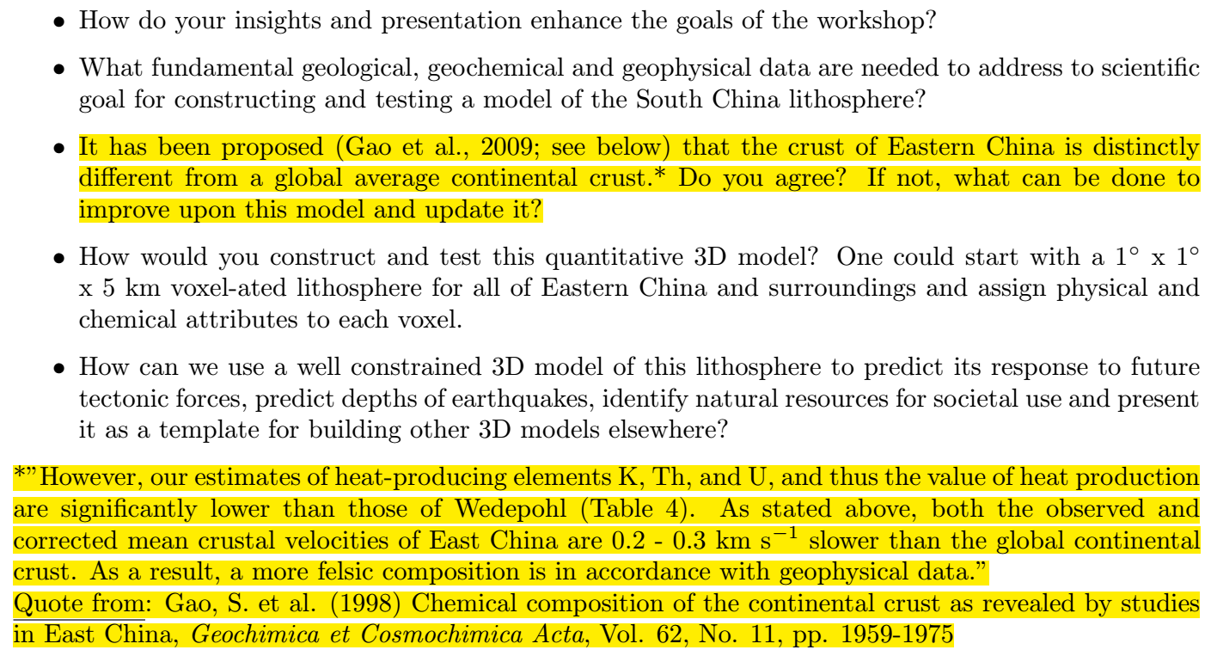
The task by Bill McDonough

Slide 3
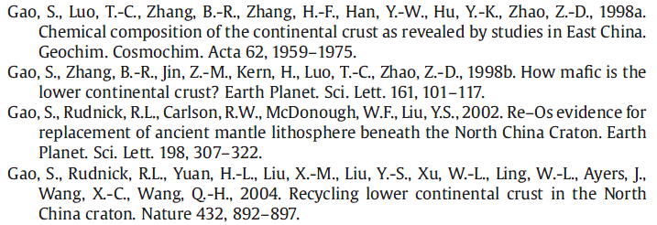
6 slides extracted from Yaoling Niu (2012.12.21, IGG-CAS, Beijing)
Impotrtant problmes to consider (Brief)
1、 Search for geological/geophysical records on the ~ 110 Ma event;
2、 Locate the eastern China-western Pacific suture；
3、 Explain why eastern continental China has thin crust and lacks mafic lower mafic component relative to the global average

Slide 4
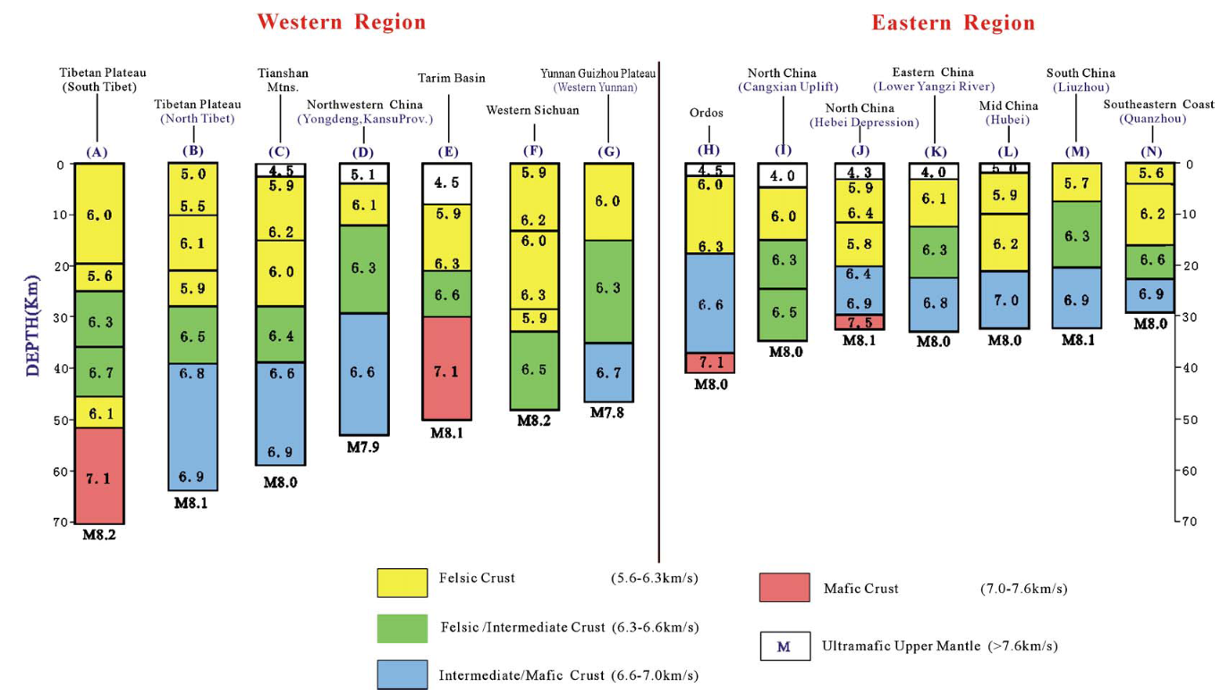
Why?

Slide 5
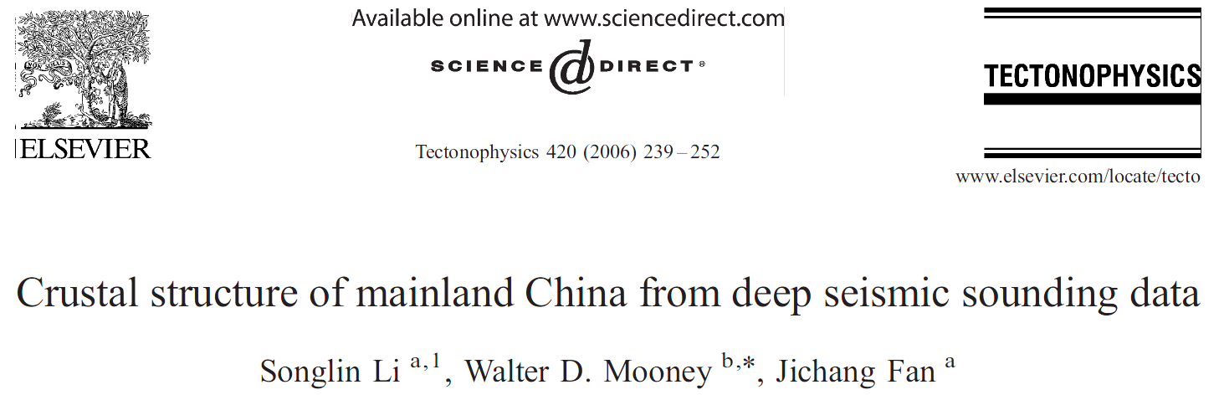
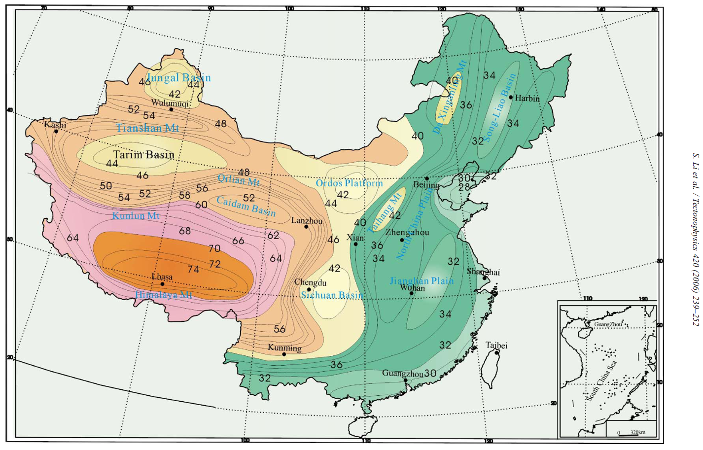

Slide 6
Niu, Y. L. (2005)
East-West
Great Gradient Line
(GGL)
东-西梯度界 (GGL):
Sharp changes in:
1. altitude;
2. gravity anomaly;
3. crustal thickness;
4. mantle seismic velocity
That is:
Thick lithosphere plateau
west
Thin lithosphere hilly/lowland east
0 10 20 30 40 50 60
Latitude (°N)
Surface Expression
ISOSTACY
70 80 90 100 110 120 130 140 150 160
Longitude (°E)

Slide 7
What I have been working on
… …
Notes:
I am a geologist and studying rocks using chemistry, physics, geology and advanced instrumentation

Slide 8
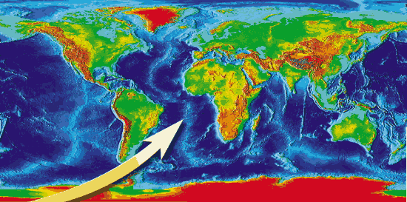
The global ocean ridge basalts (MORB)
Map adapted from NOAA
Niu, Y.L., O'Hara, M.J., 2008. Global correlations of ocean ridge basalt chemistry with axial depth: A new perspective. Journal of Petrology, 49, 633-664
Notes:
Over the last 15 years I have been studying global seafloor rocks and their geodynamic significance.

Slide 9
The global ocean island basalts (OIB) of “mantle plume origin”
Niu, Y.L., Wilson, M., Humphreys, E.R., O’Hara, M.J., 2011. The origin of intra-plate ocean island basalts (OIB): The lid effect and its geodynamic implications. Journal of Petrology, 52, 1443-1468.
Notes:
I have also been studying global ocean island basalts of mantle plume origin

Slide 10
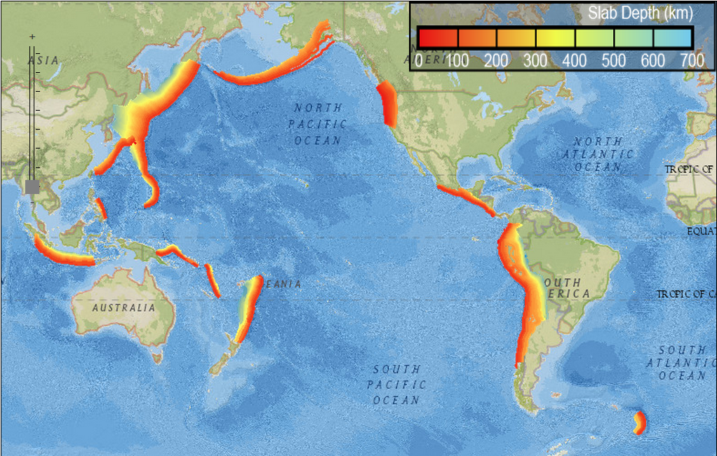
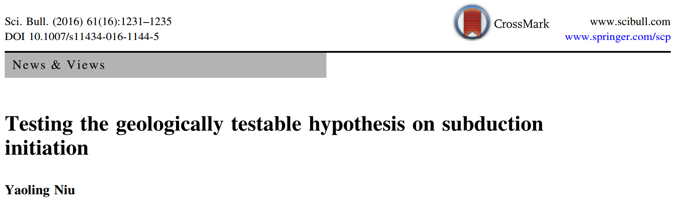
Global distribution of trenches and subduction zones
http://earthquake.usgs.gov/data/slab/map/
Notes:
I have also been studying subduction zone processes, including testing a geologically testable hypothesis on subduction initiation, which is one of the unresolved big problems in Earth Science

Slide 11
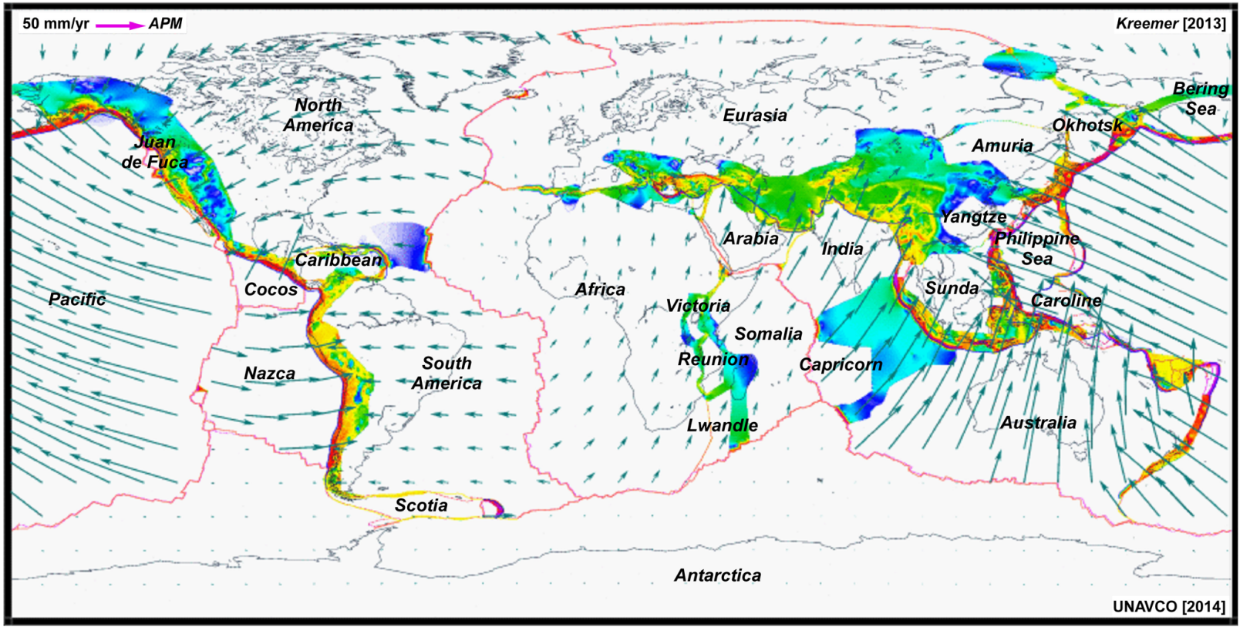
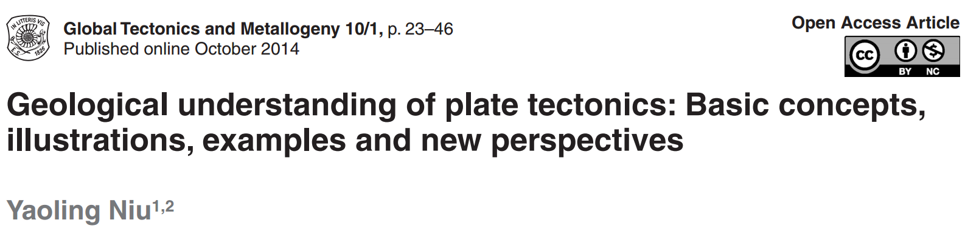
Notes:
Some of my new perspectives on plate tectonics have been summarized in this paper in terms of plain geological language.

Slide 12
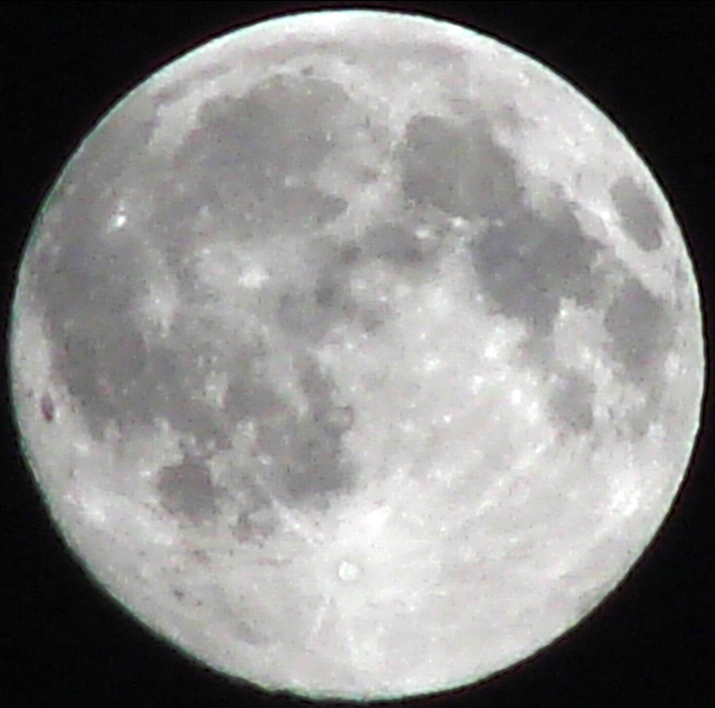
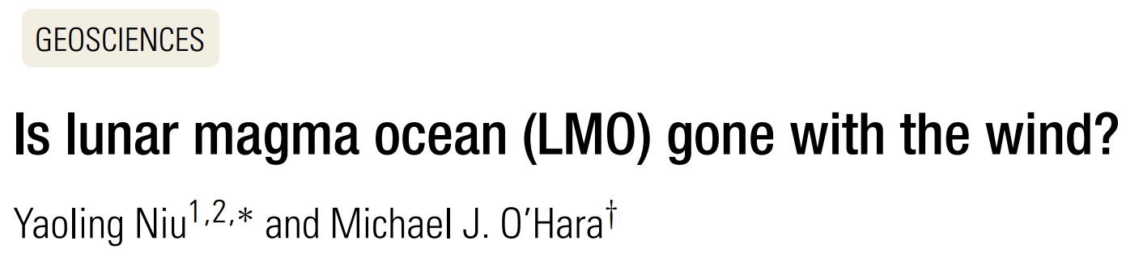
Durhamanian Moon
Taken by
Yaoling Niu
2009.10.03
Durham, UK
Notes:
Against the main stream, I feel the popular view on Lunar process may be incorrect, so I used this title.

Slide 13
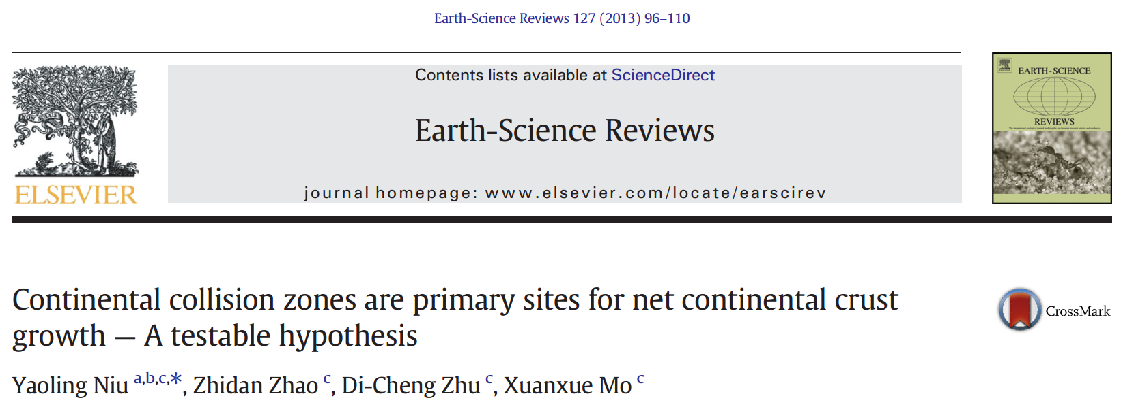
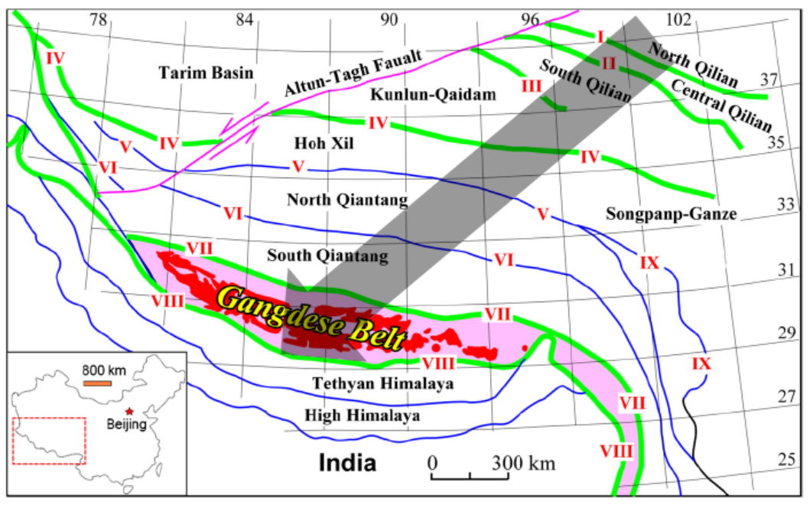
Notes:
Again, against the main streams view, I think the continental crust growth is not through active seafloor subduction, but through continental collisional magmatism, started from studying rockd in southern Tibet.

Slide 14
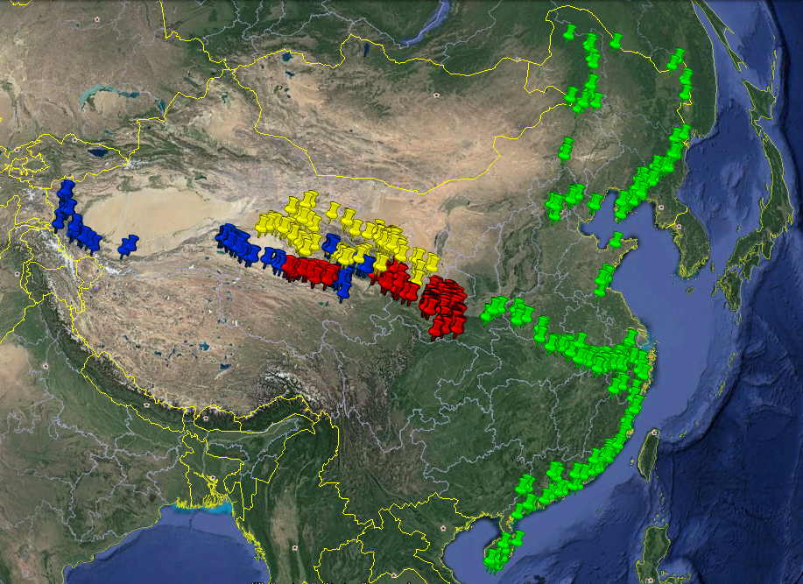
Qilian
Kunlun
Qinling
East China
Notes:
So far, the research by my students and myself, has shown support of my hypothesis through sampling and studying these syncollisional granitoids from Kunlun, Qilian, Qinling as well as southern Tibet, sampled the total length in excess of 6000 km. Out of the curiosity, we have also sampled and studies granitoids from eastern China, which led to the conclusion about the origin of the Chinese continental shelf.

Slide 15
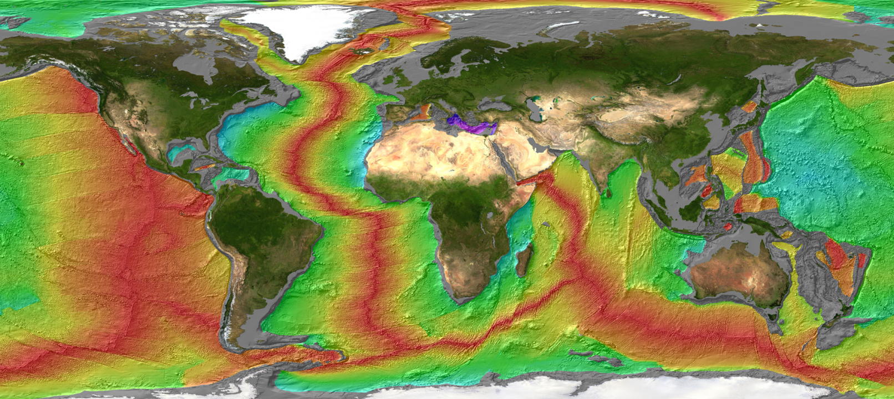

Using stable Ti, Fe, Zr, Hf, U isotopes on seafloor basalts, gabbros and abyssal peridotites to test some hypotheses
Notes:
I am also using these stable isotopes on seafloor rocks to test some important hypotheses. In this lab,

Slide 16



Slide 17

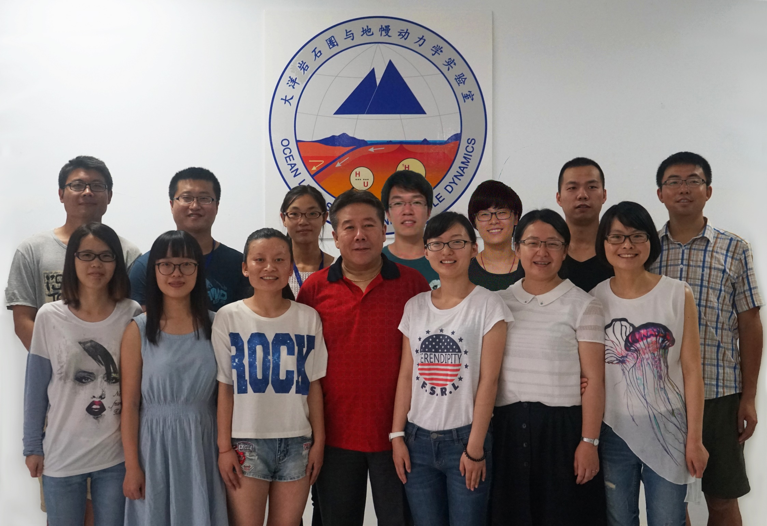
大洋岩石圈与地幔动力学实验室科研队伍成员

Slide 18
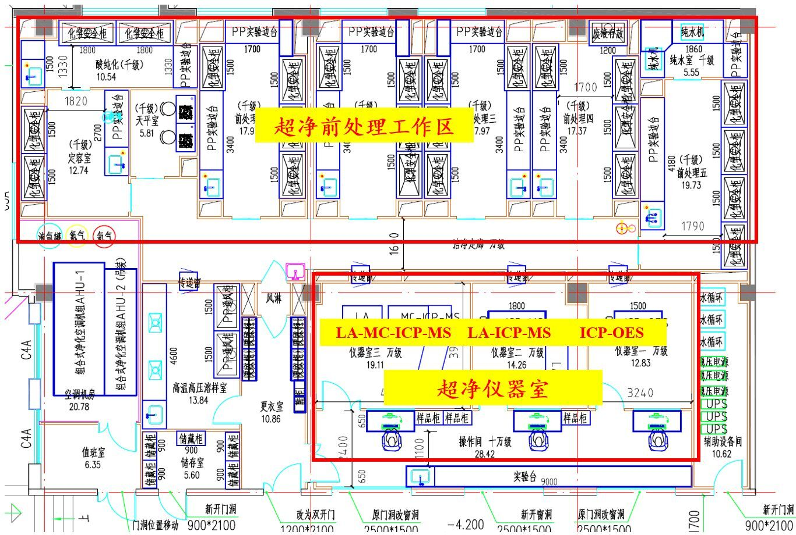
In-building Space：340 m²

Slide 19
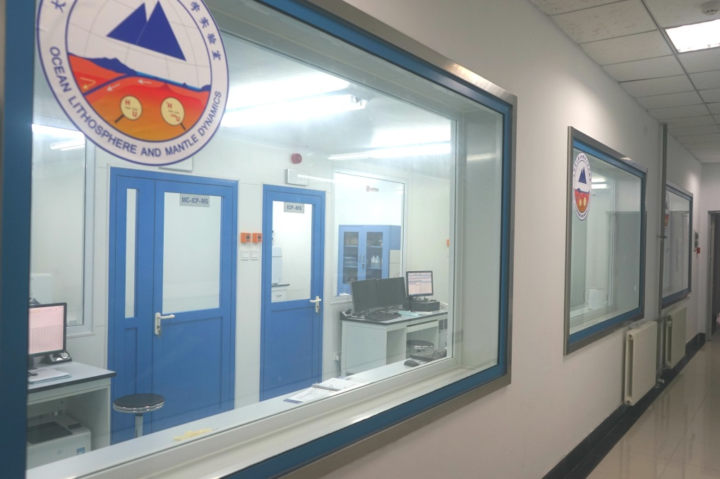
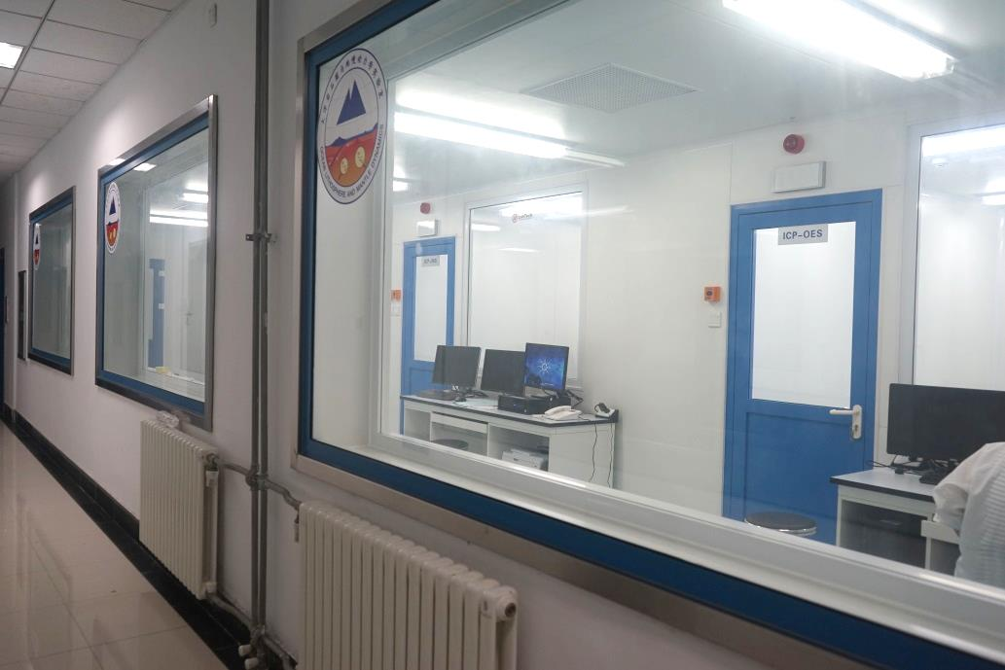
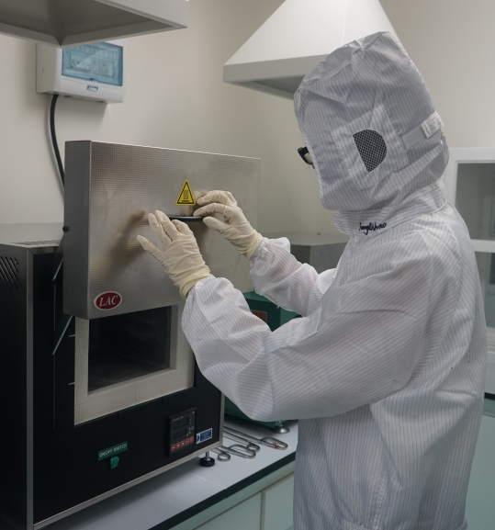
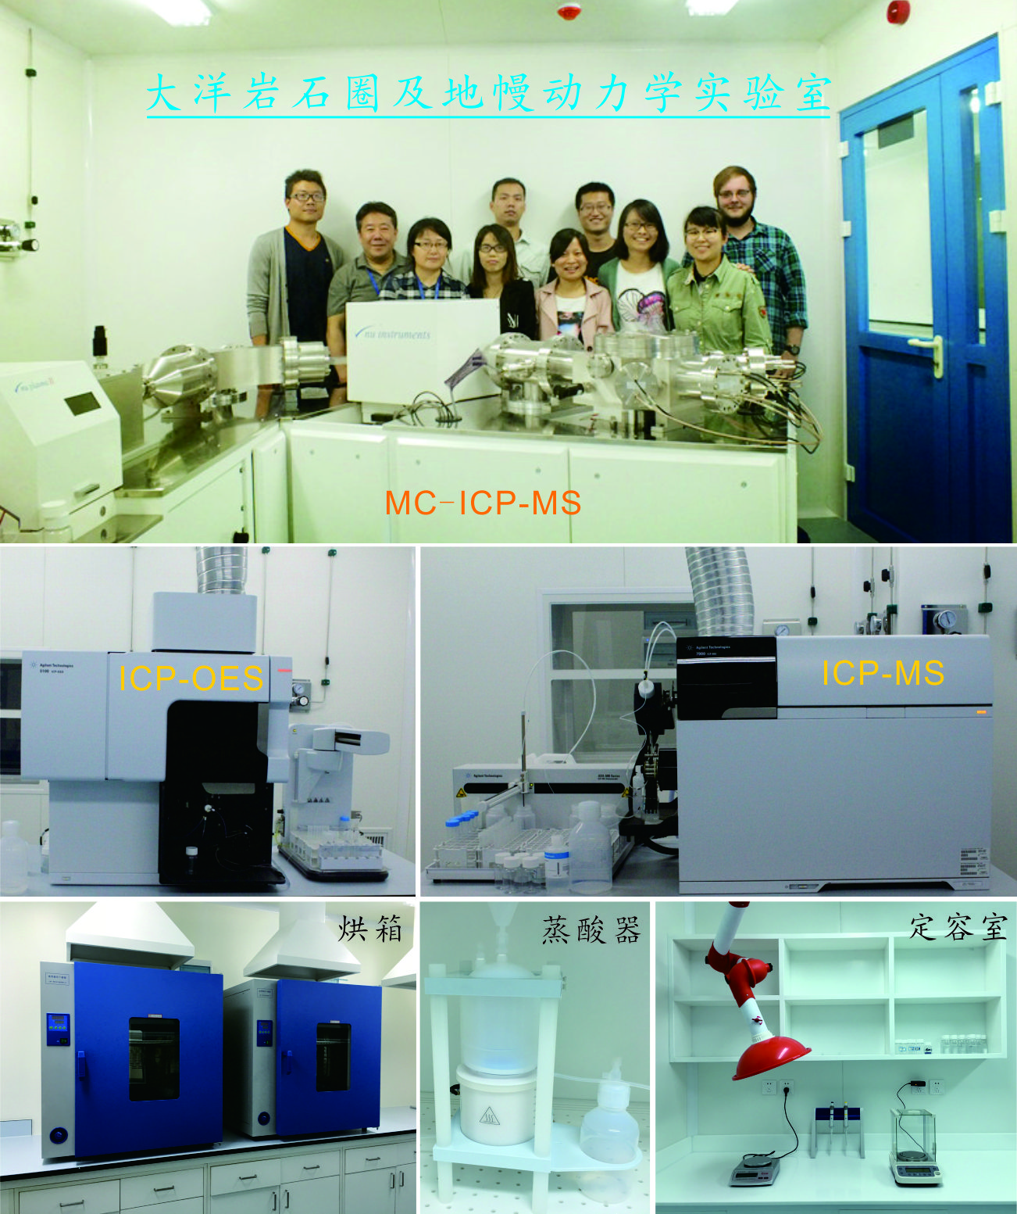

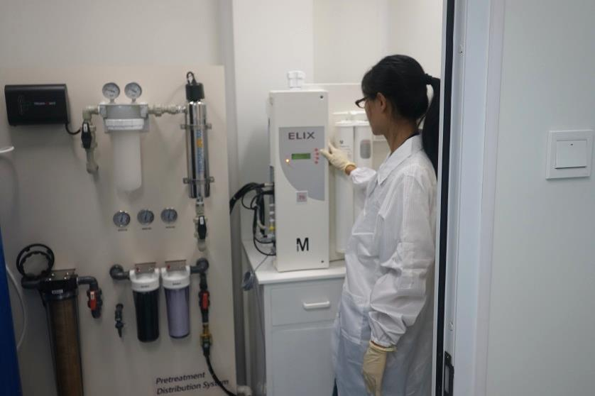



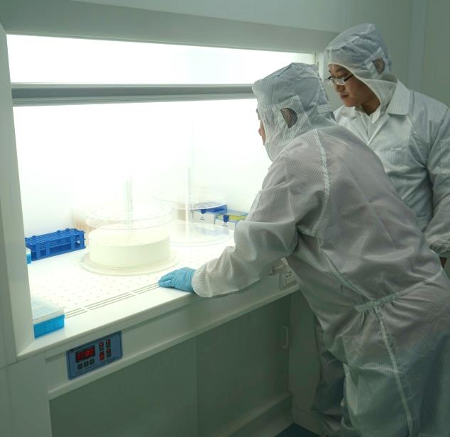

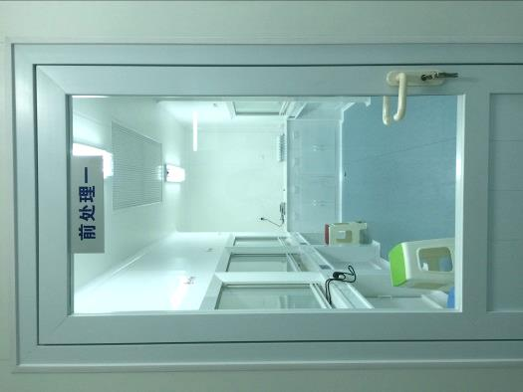
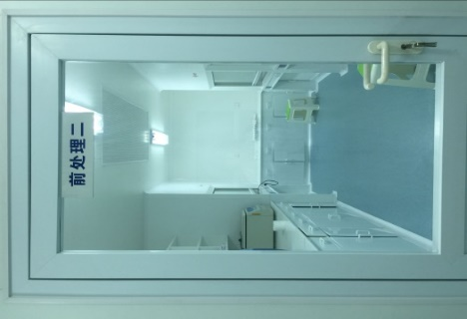
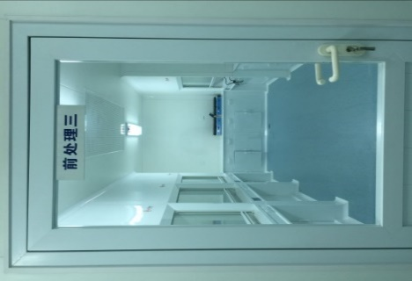

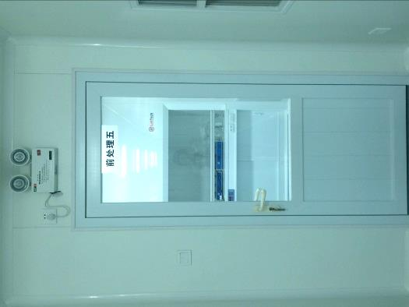

Slide 20
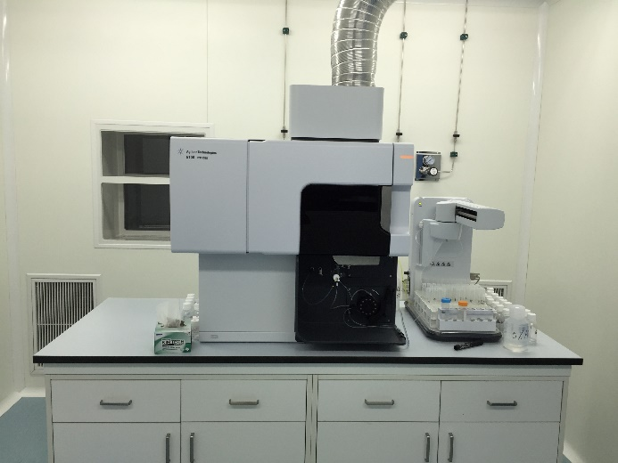
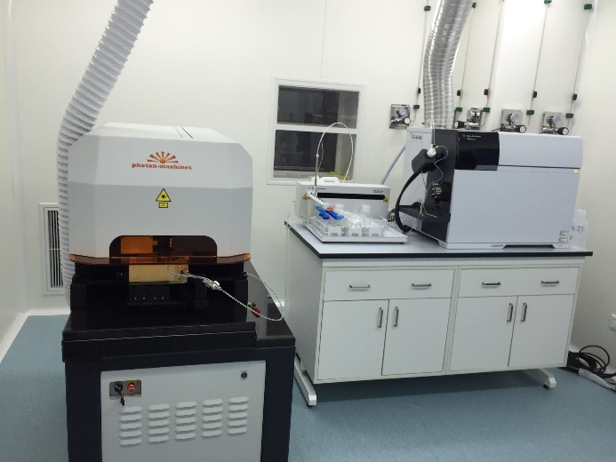
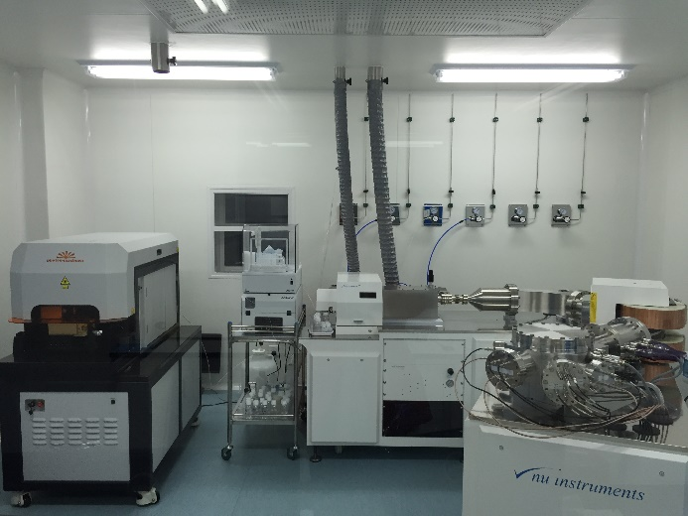
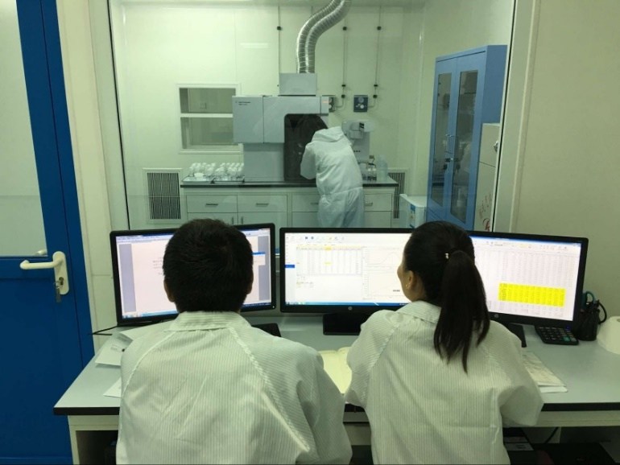
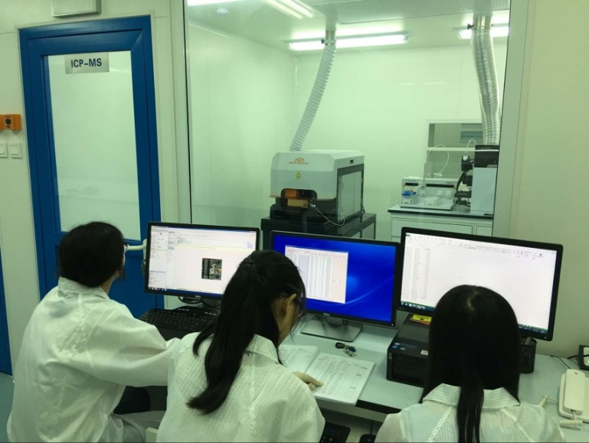
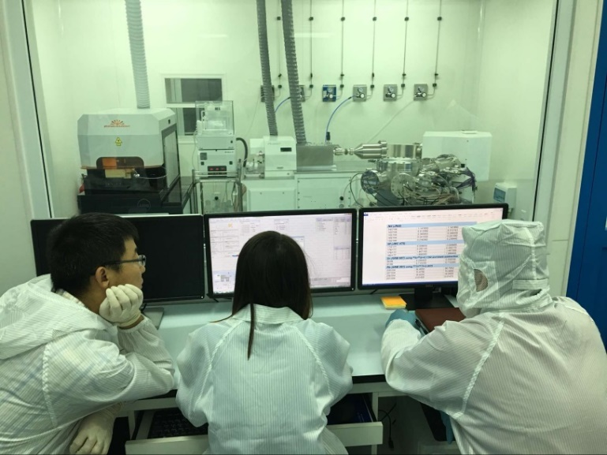
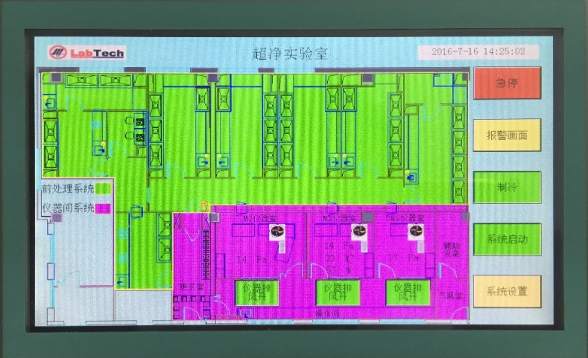
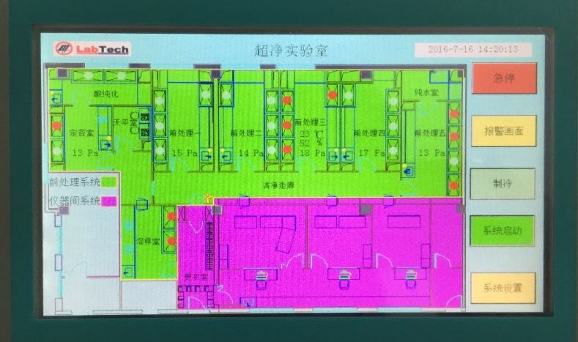

Slide 21
The Origin of the Chinese Continental Shelf Beneath East China Sea & South China Sea
[The origin of the Yellow Sea]
Yaoling Niu
Notes:
各位专家，各位领导，各位朋友，大家好！

Slide 22
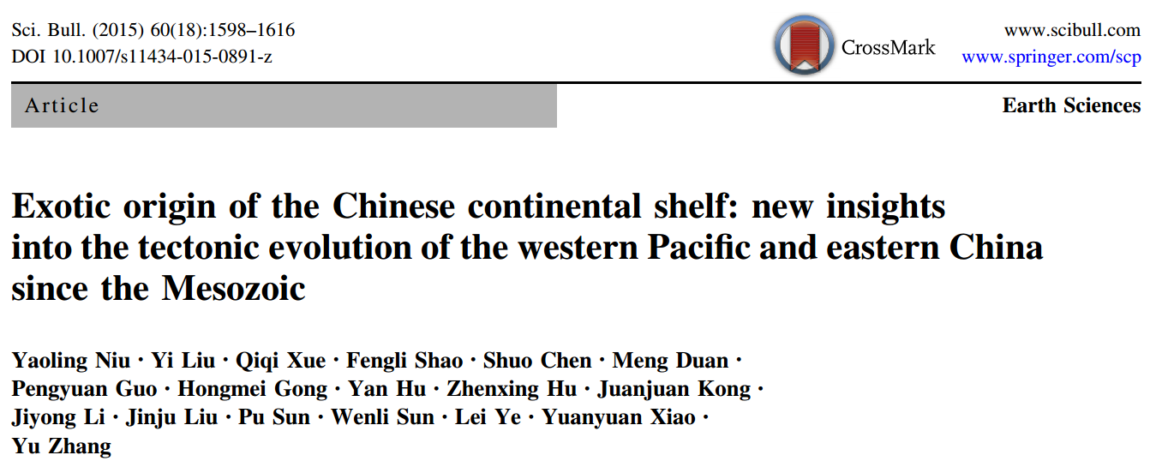

Origin of the Chinese Continental Shelf
《Science Bulletin》

Slide 23
Chinese continental shelf of exotic origin collided with continental China 100 million years ago
It has been axiomatically accepted that the basement of a continental shelf is the offshore extension and geologically part of the same continental lithosphere. While this notion may hold true in places, our analysis of the distribution of Jurassic-Cretaceous granitoids throughout the entire eastern continental China in space and time led us to the conclusion that the basement of the Chinese continental shelf (beneath East China Sea and South China Sea) is of exotic origin geologically unrelated to the continental lithosphere of eastern China. This exotic terrane of a sizeable mass with large compositional buoyancy could be either an oceanic plateau or a micro continent, which was transported by, or along with, the paleo-Pacific plate moving in the course of NW direction and subducting beneath the eastern margin of the continental China in the Mesozoic, responsible for the granitoids with emplacement ages of ~ 190 Ma to ~ 90 Ma. The arc-shaped southeast coastal line of continental China marks the arc-shaped trench.

Slide 24
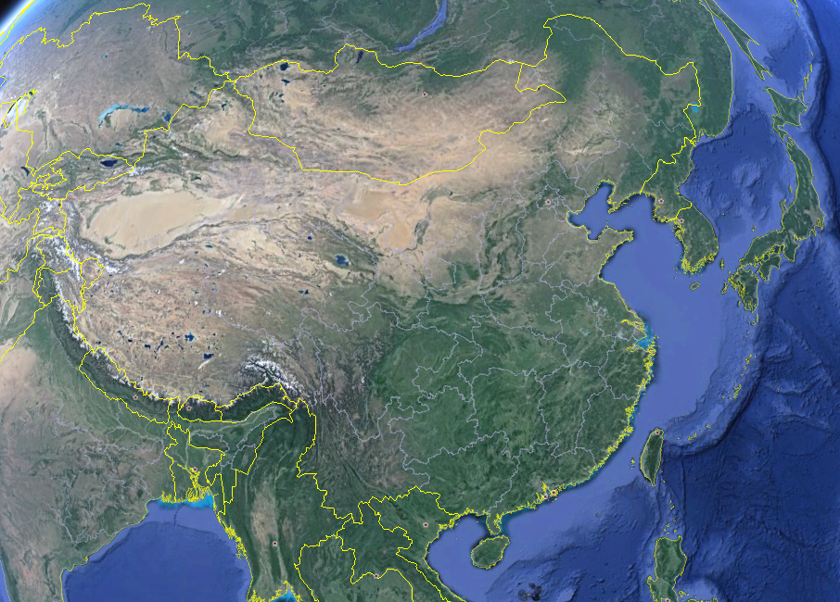
Yellow Sea
Tibetan Plateau
East
China
Sea
South China
Sea

Slide 25
Qilian
Kunlun
Qinling
East China
Granitoids in eastern continental China < 190Ma

Slide 26
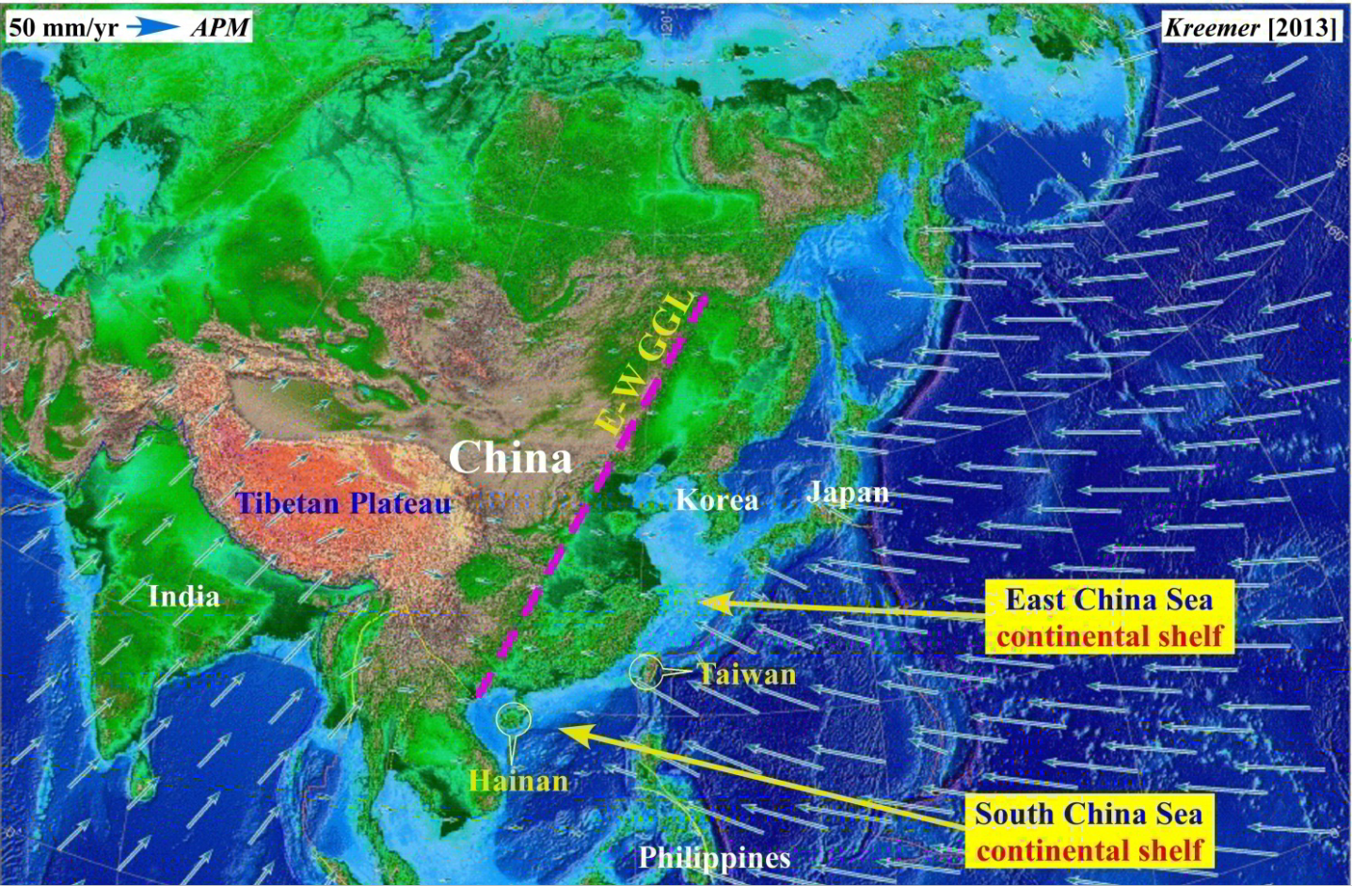

Slide 27
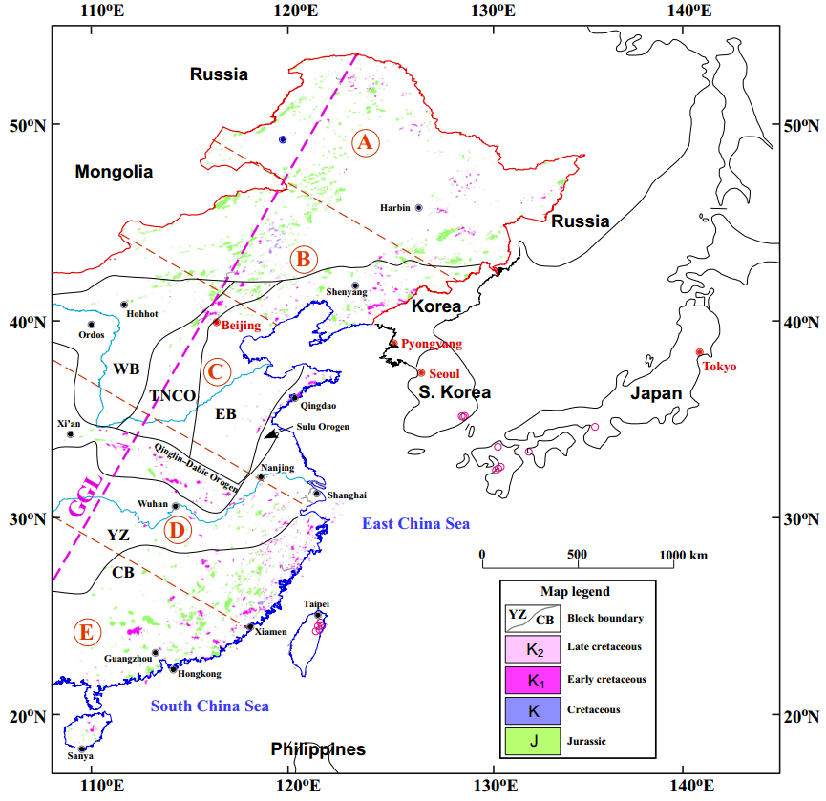
For convenience, we divided into 5 sections:
A、B、C、D、E

Slide 28
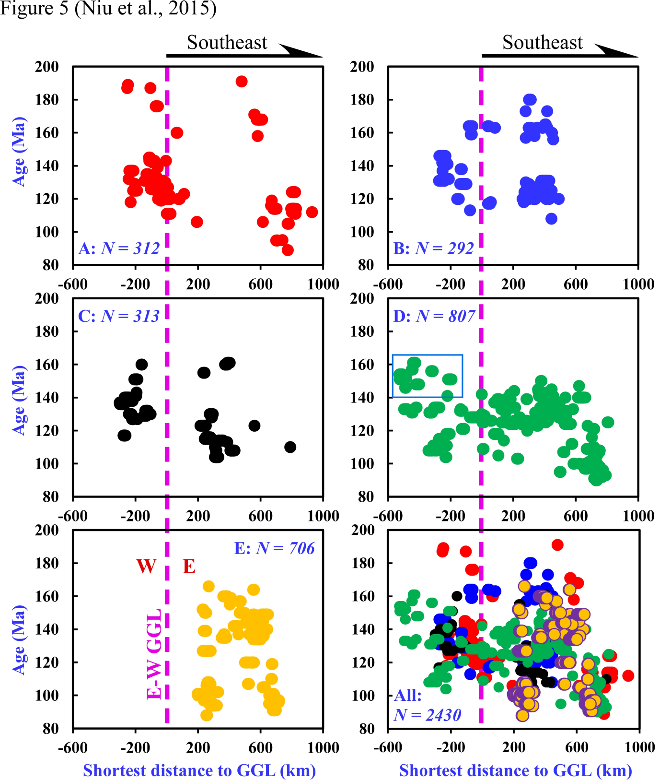
Age distribution of J-K granitoids in eastern China
(paleo-Pacific plate subduction related)
In J-K, eastern China was an active continental margin
But NOT
an Andean-Type margin
Andean-Type margin:
< 200 km magmatic arc
But such arc did not exist in eastern China
J-K granitoids in eastern China:
[1]varying ages at a given location
[2]same ages in all locations
(E-W, > 1000 km)
Areal distribution in space and time！

Slide 29
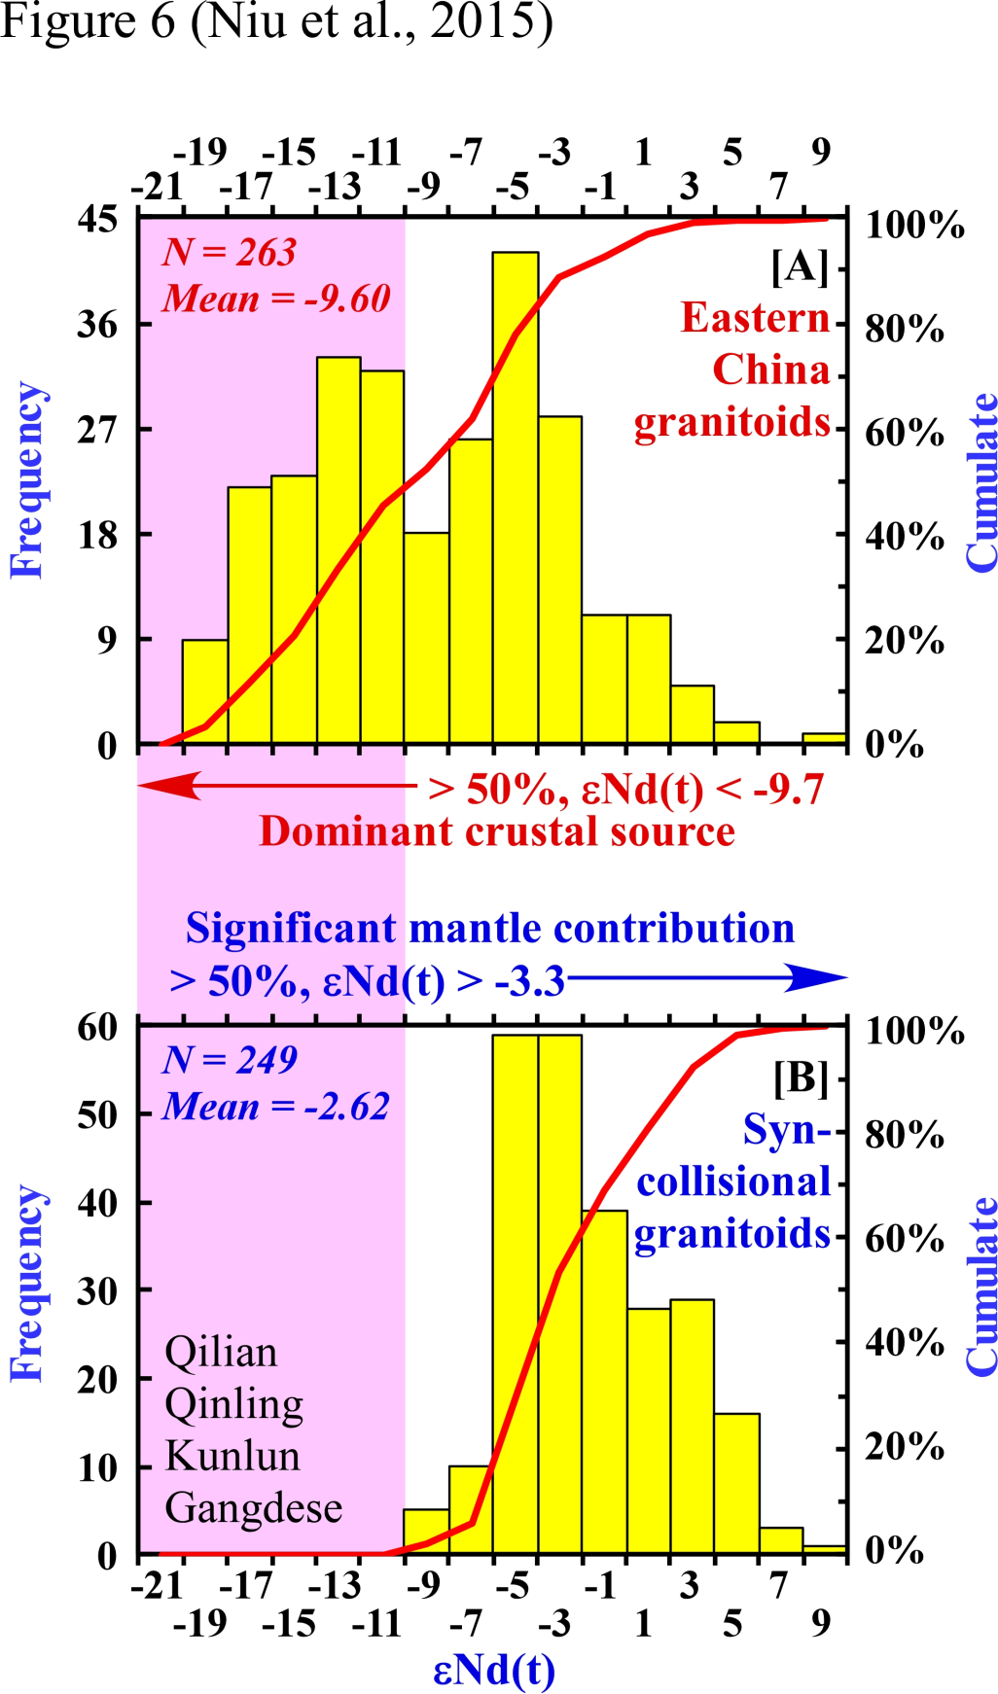
Compare ε_{Nd(t)} of granitoids
between
Eastern continental China J-K granitoids
and
Syncollisional (in a broad sense) granitoids from Qilian, Qinling, Kunlun and Gangdese

Slide 30
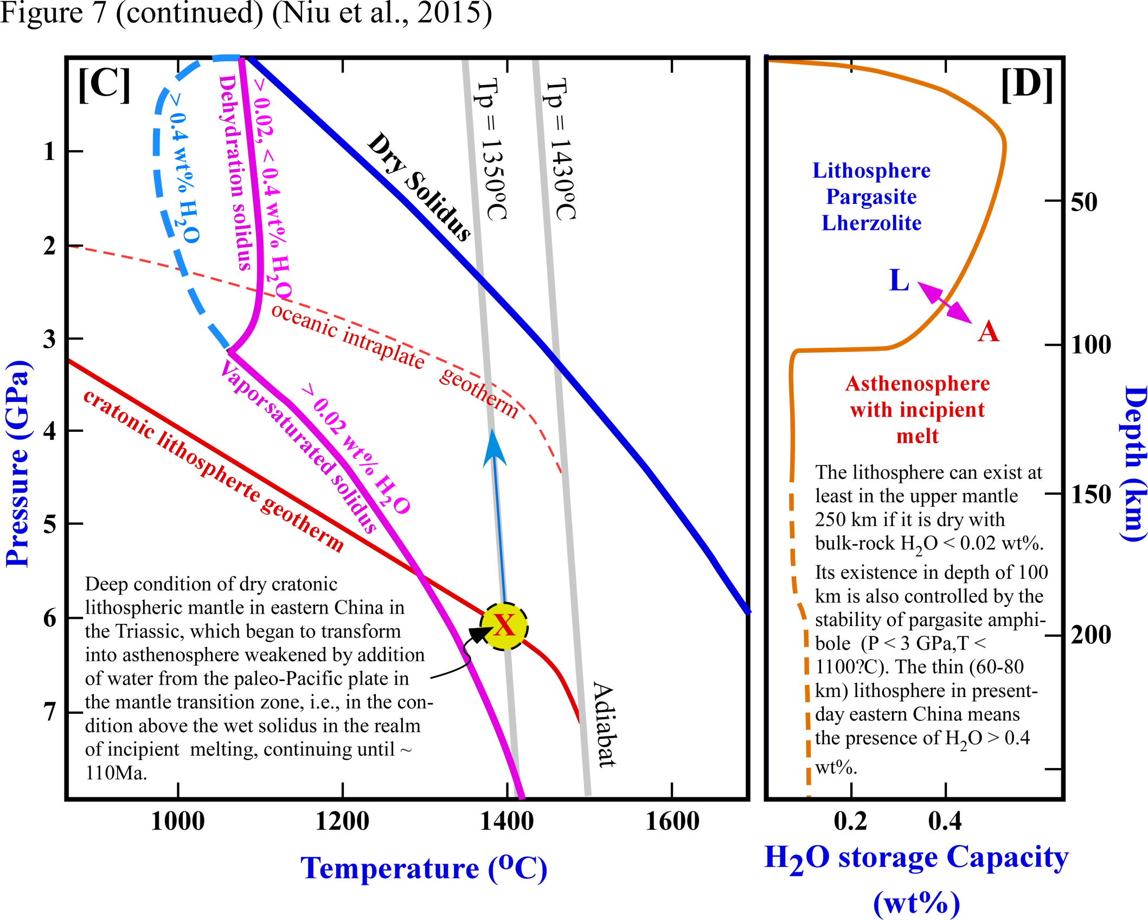

Slide 31
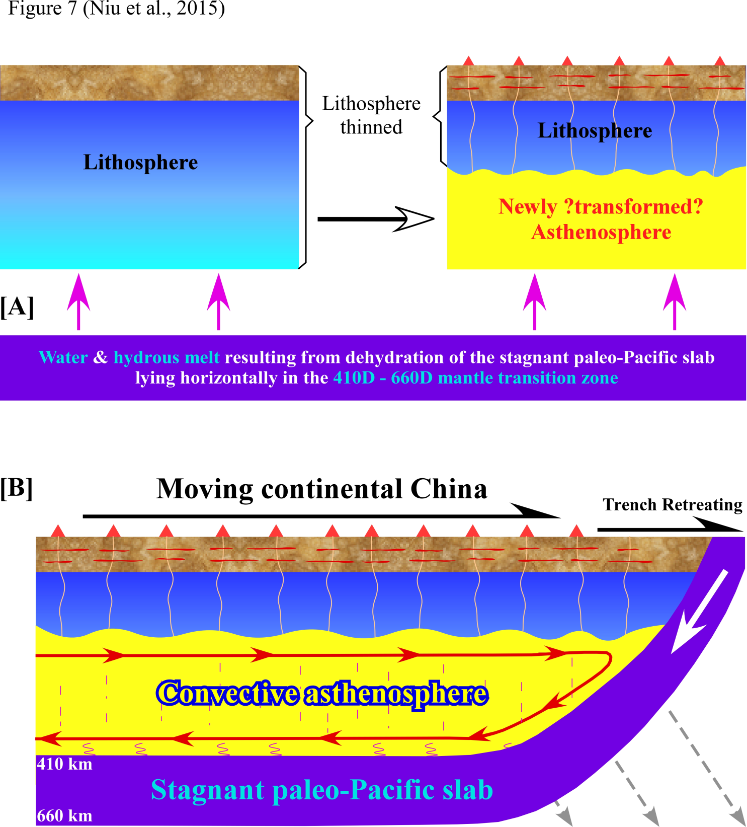
Crustal granitoid magmatism -determined by transition-zone slab dehydration!
where there is slab dehydration atop the transition zone there will be overlaying crustal melting.
the slab is stagnant but the lithosphere with crust is moving, crustal melting occurs whenever and wherever it moves over the dehydrating slab in the transition zone.
Time-space random granitoid magmatism
continental drift is passive response to trench retreat - position of the “volcanic arc” immediately above the subduction zone will not change throughout of the life time of the subduction.
Niu, Y.L., 2014. Geological understanding of plate tectonics: Basic concepts, illustrations, examples and new perspectives, Global Tectonics and Metallogeny, 10, 23-46.
Notes:
Modified from Ref. [22] to elaborate the crustal melting illustrated in (A) and to explain why the granitoids show no systematic variation in space and time (Figs. 2, 3, 4, 5). Fast trench retreat under gravity resulted in the three-layered structure: the paleo-Pacific slab left behind stagnantly in the mantle transition zone, the continental China lithosphere passively drifting eastward (the origin of continental drift as described in Ref. [22]) and the wedgesuction [18] induced asthenosphere convection. The slab-derived water in the form of incipient hydrous melt percolates upwards, metasomatizes the upper mantle, and weakens/converts the basal lithosphere into asthenosphere accompanied by melting of the beingconverted lithosphere/asthenosphere to produce basaltic melts. These melts rise and underplate/intrude the crust, causing crustal melting for the granitoids. That is, the crustal granitoid magmatism is ultimately determined by the transition-zone slab dehydration, i.e., where there is slab dehydration atop the transition zone there will be overlaying crustal melting. Because the slab is stagnant but the lithosphere with crust is moving, crustal melting occurs whenever and wherever it moves over the dehydrating slab in the transition zone. Hence, the age and location of a granitoid pluton is a surface/crustal expression of the dehydrating transition-zone slab at that time and in that location, thus giving no systematic granitoid distribution in time and space (Figs. 2, 3, 4, 5). "Note that because continental drift is passive response to trench retreat [22], the relative position of the “volcanic arc” immediately above the subduction zone will not change throughout of the life time of the subduction."

Slide 32
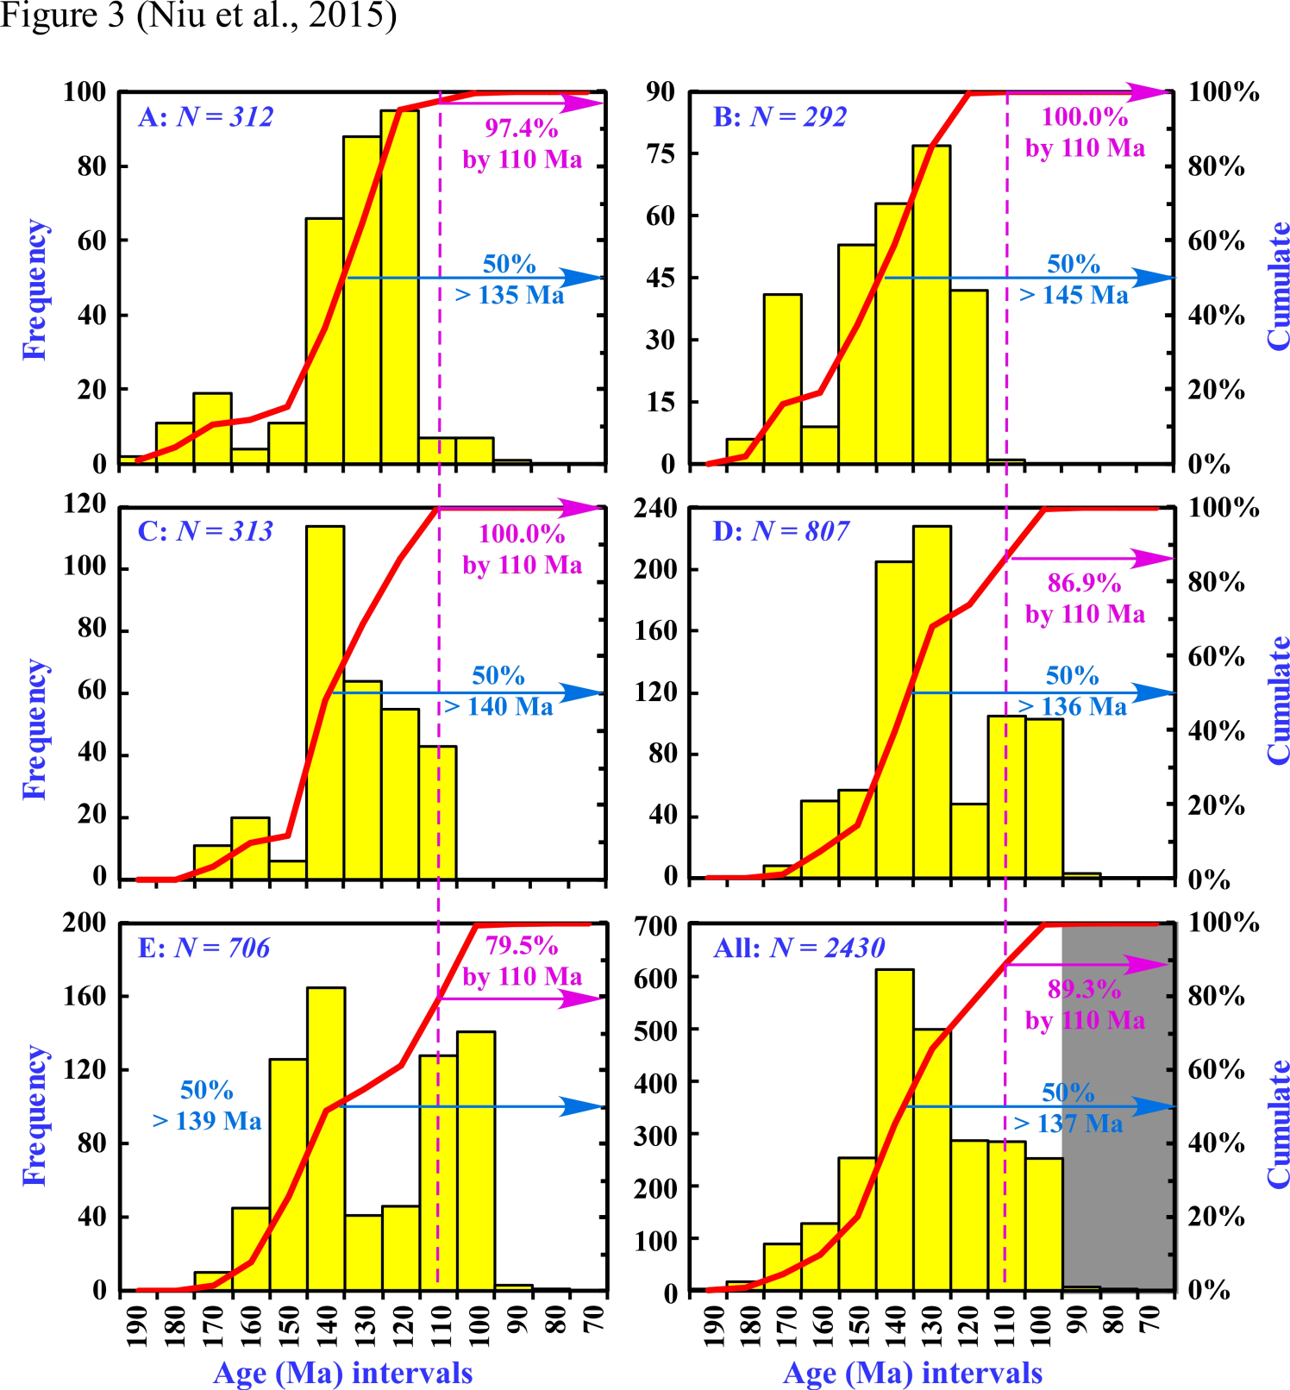
Age distribution of granitoid outcrop areas of eastern China J-K granitoids
(paleo-Pacific subduction related)

Slide 33
Age distribution of granitoid outcrop areas of eastern China J-K granitoids
(paleo-Pacific subduction related)
~ 110Ma
Peak J-K granitoid magmatism
~140Ma
~ 90% granitoid emplaced before ~110Ma
Inference: lithosphere thinning largely completed by ~110Ma

Slide 34
Age distribution of granitoid outcrop areas of eastern China J-K granitoids
(paleo-Pacific subduction related)
~ 90 Ma
Eastern China J-K granitoid magmatism ended at ~ 90 Ma
Best interpretation：
Paleo-Pacific plate subduction ended at ~ 90 Ma or shortly beforehand ~ 100 Ma

Slide 35
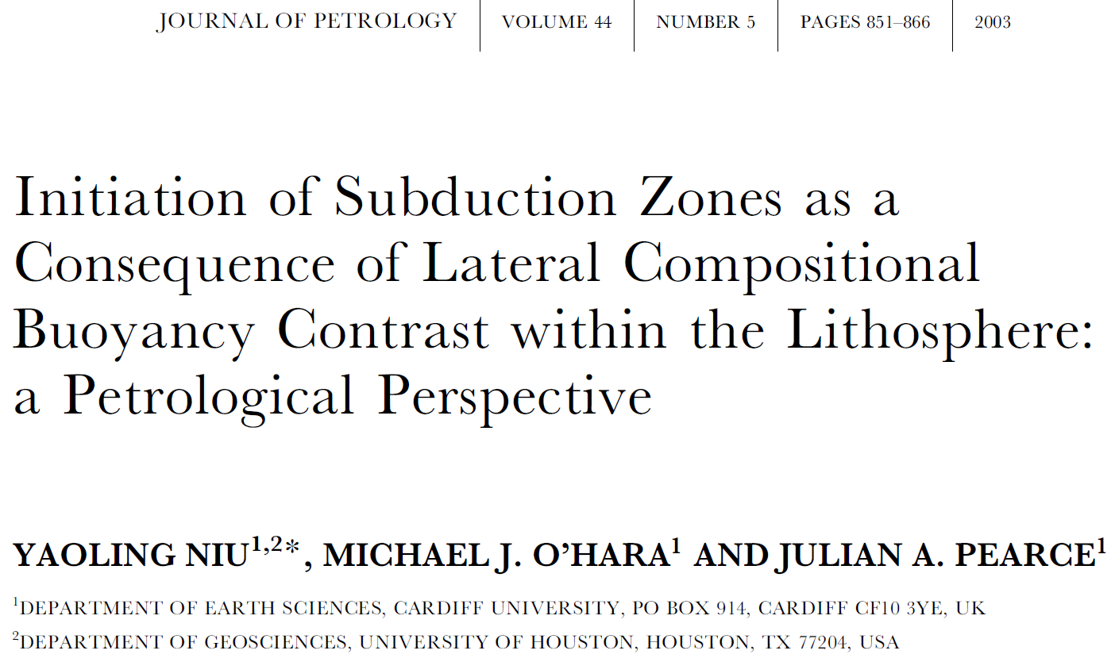
We have shown that subduction stops only if the trench is jammed!

Slide 36
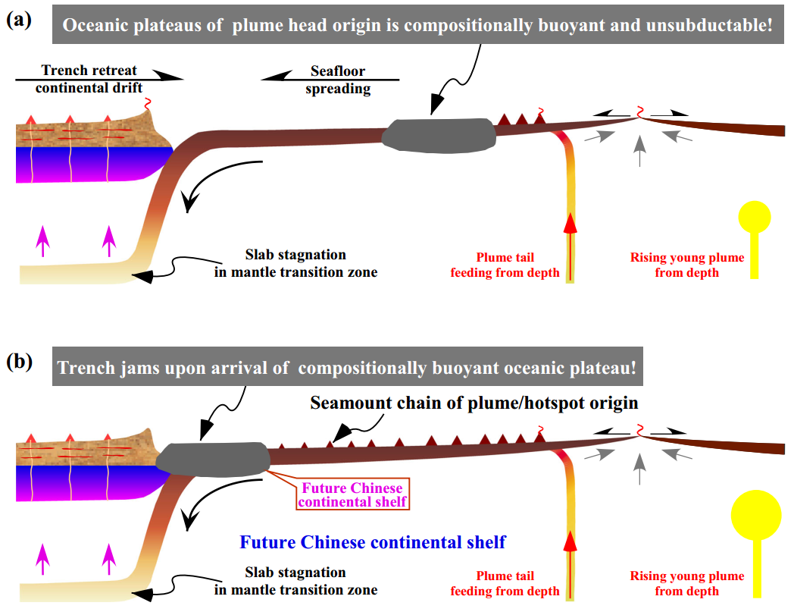
The cause of trench jam!
Trench jams only if less dense, buoyant and volemetrically large masses come to collide with the arc. They are too big and too buoyant to subduct (unsubductable), hence
Trench jams
Subduction stops
Best candidates:
（1）Oceanic Plateaus
（2）Micro continents

Slide 37
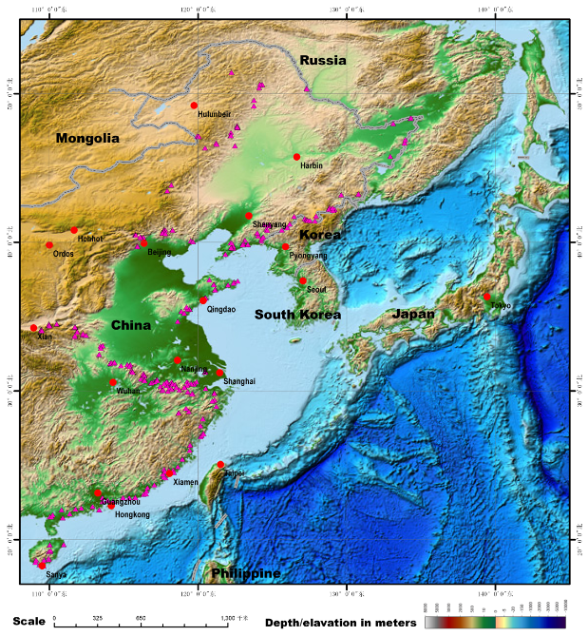
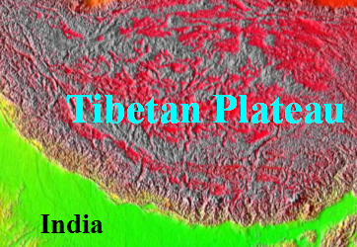
Eastern China J-K granitoid magmatism ended ~ 90 Ma
Ryukyu Arc, Ryukyu Trench/Okinawa Trough,
Young < 15 Ma
That is, paleo-Pacific plate subduction
stopped ~ 100 Ma
Western Pacific subduction zones
~ 50 Ma
Subduction stops because of trench jam by large less dense, buoyant oceanic plateaus or microcontinents
Chinese continental shelf basement is such a large, buoyant exotic terrane: Oceanic Plateau?
Micro-continent?

Slide 38
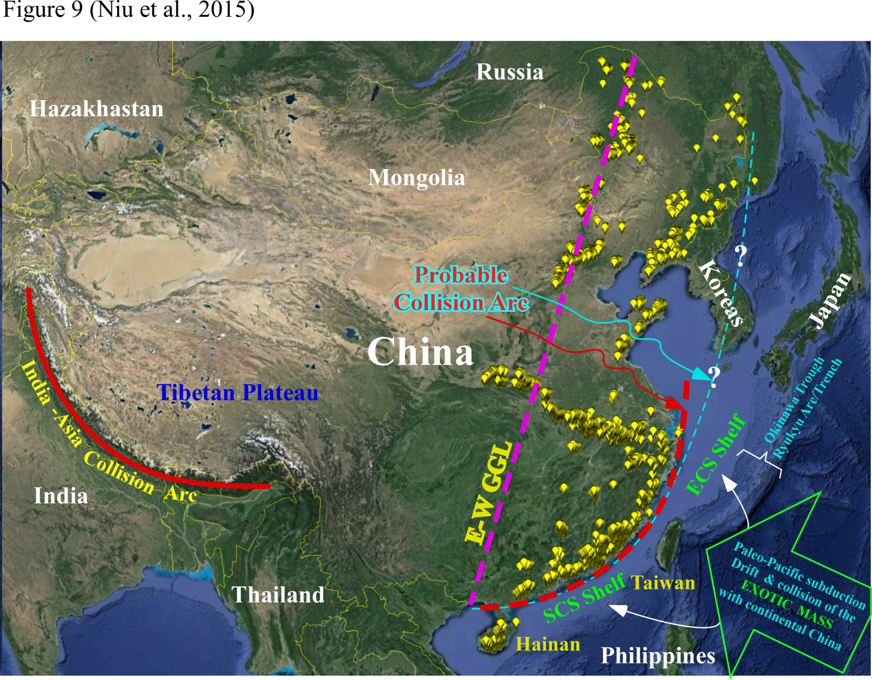
~ 100 Ma

Slide 39


Note: Subduction ended ~ 100 Ma, granitoid magmatism ended ~ 90 Ma
Present-day western Pacific subduction zones, ~ 50Ma
~ 40 Myrs gap of subduction-related granitoid magmatism?
> ~ 100Ma subduction, ~ < 100 Ma “welded”
Continental shelf of exotic origin
Transform, subduction reborn！

Slide 40
JOIDES
Resolution
Drilling, drilling!
at ideal sites

Slide 41

CN-1
CN-2
CN-3

Slide 42
~ 100 Ma

Slide 43

“Transpressional”?
Inherited “transpressional transform”
100 Ma - 43 Ma
> 100 Ma, < 43 Ma
Sea of Okhotsk
(< 43 Ma?)
Sea of Japan
(< 25 Ma?)
South China Sea (< 32 Ma?)

Slide 44

Possible origin of the Yellow Sea?
Most granitoids in South Korea, SW Japan, Russian Far East > > 90 Ma，but some are younger!
South Korea, SW Japan, 88-71 Ma!
Russia Far East> ~ 56 Ma的！
Tang et al (2016); Niu & Tang (2016)

Slide 45

Possible origin of the Yellow Sea?
Hypothesis:
~ 100 Ma ~ 55 Ma?
Present
> 56 Ma，Korean Peninsula & SW Japan = Part of continental China
Pacific- “new” eastern Asia: S → N, transform to oblique subduction！
Yellow Sea：rifted from Continental China
Yellow Sea：must be ocean crust？
Testing:
Petrology, stratigraphy, geochronology
Yellow Sea geophysics
Drilling st ideal sites!
Tang et al (2016); Niu & Tang (2016)

Slide 46

Yellow Sea:
Continental rifted basin: rifting & seafloor spreading; a “back-arc” basin, together with the opening of the Sea of Japan, a response to Pacific plate subduction at ~ 30 Ma (?)
Arrival of the Philippine plate →SW Japan migration towards SE; Seafloor spreading ceased ~ 16 Ma (?)
There must be basaltic ocean crust (?)
Pre-Cenozoic fragments may be trapped, but unlikely to be significant！

Slide 47

Possible origin of the Yellow Sea?
Niu & Tang (2016)《Science Bulletin》
Notes:
初步成果以可检验假说的形式投稿。

Slide 48
Qilian
Kunlun
Qinling
East China
Granitoids in eastern continental China < 190Ma

Slide 49

An example, eastern China “Intra-plate” granitoids

Slide 50


The significance of isotopic systematics of “Intraplate”granitoids
Hf & Nd-Pbisotope corrrelations are unexpected！
But consistent with basal hydration weakening for lithosphere thinning！

Slide 51

“Basal hydration weakening”- lithosphere thinning and the granitoid petrogenesis
Transition-zone stagnant slab dehydration, leads to prior lithosphere meting for basaltic magmatism, whose underplating/intruding the deep crust resulting in crustal melting and granitoids!

Slide 53
Gravity “anomalies” in mGal
Thickened
Lithosphere
Thinned Lithosphere
Consequences of Plate Tectonics！

Slide 54
Li, Mooney, Fan, Tectonophysics 420, 239-252

Slide 55

JUNO: [1] Thinned lithosphere;
[2] Paleo-subduction zone;
[3] Terrane boundary between Cathaysia and western Australia
CJPL: [1] Stacked or doubled lithosphere；
Tibetan crust
Tibetan mantle lithosphere
Indian crust (partial)
Indian mantle lithosphere
Yellow Sea
Tibetan Plateau
East
China
Sea
South China
Sea

Slide 56




Slide 57
Thank you all!
Especially Yufei Xi, Yufeng Li, Ran Han and Bill McDonough!
Yellow Sea
Tibetan Plateau
East
China
Sea
South China
Sea

Slide 58
6 4 2 0 -2 -4%
100 km
Lithosphere thinning =
LVZ formation
=
basal hydration weakening
=
plate tectonics
150 km
Harvard tomography (1998)
0 45 90 135 180 225 270 315 360
Longitude (°E)
Niu, Y. L. (2005)
Notes:
这是全球在100和150公里深度的地震波速异常图。显然中国东部上地幔结构与典型大陆上地幔结构不同，但与大洋上地幔结构相同， 在减薄的岩石圈之下是地震波低速带（LVZ）。

Slide 59




Slide 60


Slide 61

Basal hydration weakening!
Niu, Y. L.,（2005）
Notes:
这是“底部加水弱化导致岩石圈减薄”机制假说的基本思想

Slide 62


Slide 63


Slide 64
六、拟解决的关键问题（扼要）
1、 找到110Ma 的地质、地球物理记录/证据；
2、 找到，并确认古太平洋俯冲带动缝合线的置；
3、 查明为什么中国东部地壳薄且缺乏相当于模型下地壳的基性组分？
更仔细的大陆地质工作
有部署的海洋地质、地球物理工作：中国大陆架（Okinawa Trough/Ryukyu Island Arc以西）！

Slide 65

On the Origin of the Yellow Sea — An insight
Yaoling Niu ^{1,2,3}，Jie Tang ^{1,4}
Department of Earth Sciences, Durham University, Durham DH1 3LE, UK
Institute of Oceanology, Chinese Academy of Sciences, Qingdao 266071, China
Qingdao National Laboratory for Marine Science and Technology (Marine Geology), Qingdao 266061, China
College of Earth Sciences, Jilin University, Changchun 130061, China
Notes:
今天我讲讲对黄海成因的认识。

Slide 66

Possible origin of the Yellow Sea?
~ 100 Ma

Slide 67
谢谢！

Slide 68
六、拟解决的关键问题（扼要）
1、 找到110Ma 的地质、地球物理记录/证据；
2、 找到，并确认古太平洋俯冲带动缝合线的置；
3、 查明为什么中国东部地壳薄且缺乏相当于模型下地壳的基性组分？

Slide 69
六、拟解决的关键问题（扼要）
1、 找到110Ma 的地质、地球物理记录/证据；
2、 找到，并确认古太平洋俯冲带动缝合线的置；
3、 查明为什么中国东部地壳薄且缺乏相当于模型下地壳的基性组分？
更仔细的大陆地质工作
有部署的海洋地质、地球物理工作：中国大陆架（Okinawa Trough/Ryukyu Island Arc以西）！

Slide 70

Xu, Y.G., Physics and Chemistry of the Earth, 26, 747-757, 2001.

Slide 71
0 10 20 30 40 50 60
Latitude (°N)
70 80 90 100 110 120 130 140 150 160
Longitude (°E)

Slide 72
East-West
Great Gradient Line
(GGL)
GGL:
Sharp changes in:
1. altitude;
2. gravity anomaly;
3. crustal thickness;
4. mantle seismic velocity
That is:
Thick lithosphere plateau
west
Thin lithosphere hilly/lowland east
0 10 20 30 40 50 60
Latitude (°N)
Surface Expression
ISOSTACY
70 80 90 100 110 120 130 140 150 160
Longitude (°E)

Slide 73

郝天珧等（地学前缘，2004）

Slide 74
Mature crustal melting and granitoid magmatism
⇑
Heating by mantle derived basaltic magmas
⇑
Inference: paleo-Pacific plate stagnation in mantel transition zone dehydration → lithosphere basal hydration weakening, melting, thinning→Mesozoic “basaltic magmatism”!
Areal distribution of paleo-Pacific plate in the mantle transition zone ⇒ Areal dehydration⇒Areal lithosphere thinning/basaltic magmatism⇒Areal crustal melting/granitoids
Paleo-Pacific slab stagnation! Eurasian continent drifted eastward in response to western Pacific trench retreat!
Hence, random and areal granitoids in space and time!
Niu, Y.L., 2014. Geological understanding of plate tectonics: Basic concepts, illustrations, examples and new perspectives, Global Tectonics and Metallogeny, 10, 23-46.

