Slide 1
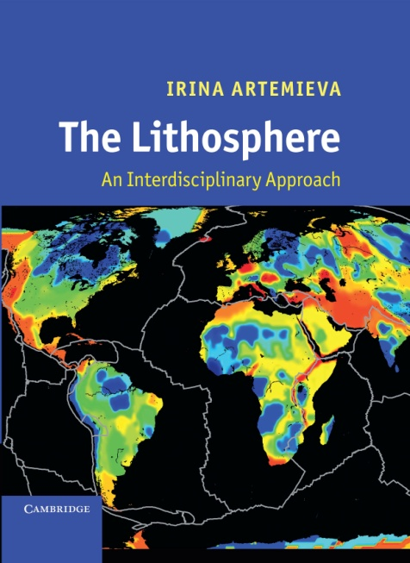
Thermo-chemical heterogeneity of the continental lithosphere
Irina Artemieva
University of Copenhagen, Denmark
Irina@ign.ku.dk
Cambridge University Press,
2011, 794 pp.

Slide 2
Lithosphere =
crust + upper (lithospheric) mantle
Conts
Oceans
7 km
10-
150
km
CRUST
30-70
km
50-350
km
Lithosphere
(conduction
dominates)
Lithospheric mantle
(conductive)
Upper Mantle
(~ the same compo-sition)
LAB
Upper mantle
(+Asthenosphere)
(convective)
  LAB (lithosphere-asthenosphere boundary):
Cannot be deeper than the top of the transition zone (410 km)
Depth extent – debated (~10 km to ~350 km, depends on tectonic setting)

Slide 3
Major points
1. Secular thermal evolution
2. Crustal structure: how well do we know?
3. Lithosphere as thermal boundary layer
4. Lithosphere as chemical boundary layer
Examples:
Global;
East European craton,
West Siberia and Siberian craton,
cratons of southern Africa,
North China craton

Slide 4
3 types of time-dependent processes
Irreversible:
  Secular cooling of the interior;
Periodic/episodic:
  Supercontinental cycles;
Unique:
  Related to mantle-scale convective instabilities;
  Related to large-scale meteorite impacts (e.g. formation of the Moon)
Except [may be] for meteorite impacts, all of them reflect (or are controlled by) internal heat in the Earth

Slide 5
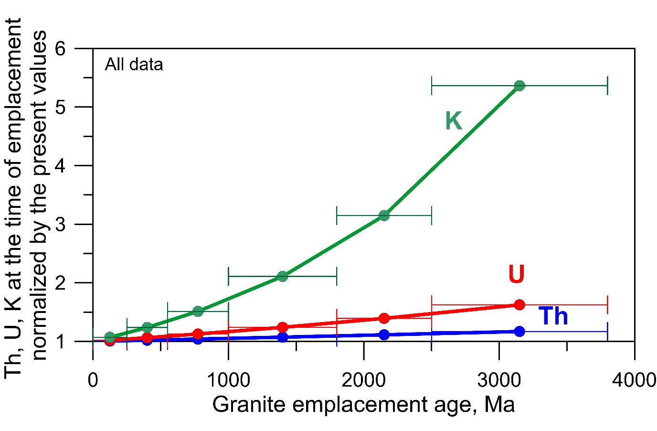
Secular decrease in radioactive decay: irreversible process
Concentrations of U, Th, K in granitic rocks emplaced at different times
(based on new GRANITE2017 dbase)
Implications:
1. Different vigor of mantle convection through time
Oldest
crust
Present
Artemieva et al., 2017, Earth Science Reviews

Slide 6
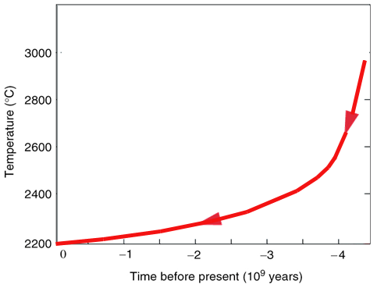
Secular cooling of the mantle: irreversible process
Average mantle T
Earth
formation
Implications:
1. Different vigor of mantle convection through time
2. Crust and lithosphere mantle are formed by mantle melting (will discuss later)
-> different types of crust and lithosphere mantle are produced at different times
Oldest
crust
Present

Slide 7
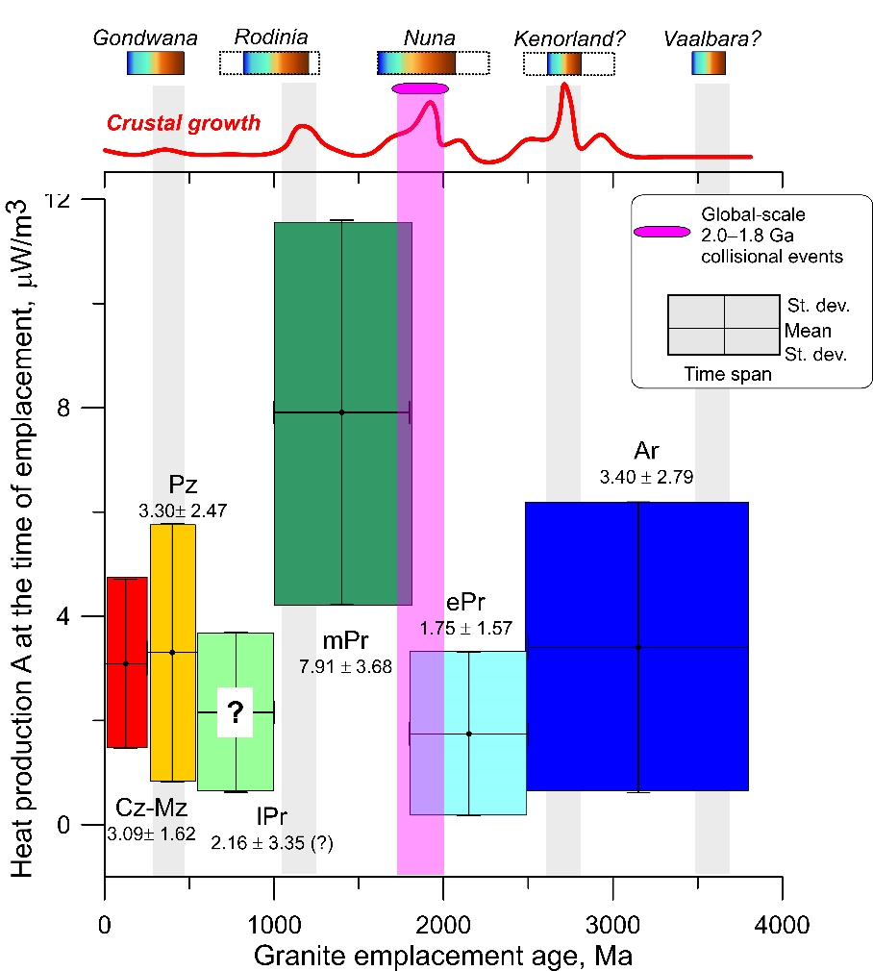
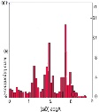
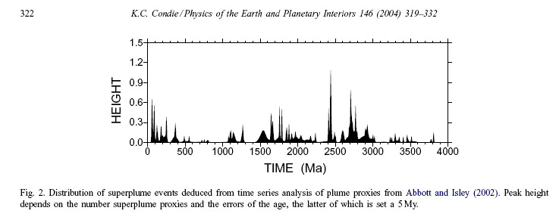
Periodic processes related to supercontinent cycles
~800 Ma
~800 Ma
~800 Ma
~800 Ma
Super-
continents
Peaks in crustal growth
Oldest
crust
Condie, 1998
Present
Superplumes (mantle convective instabilities)
Condie, 2004

Slide 8
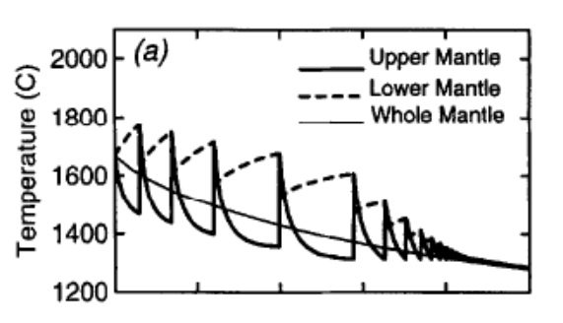
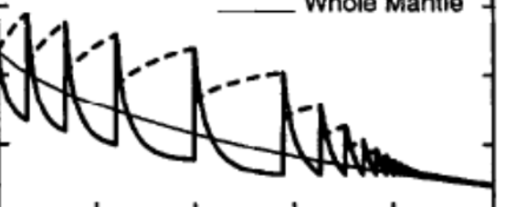
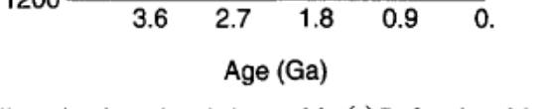

Thermal evolution of the mantle: secular cooling + episodic superplumes
Whole mantle
Present
Davies 1995

Slide 9
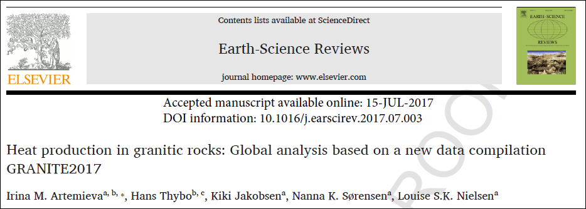
Unique events ? Radiogenic heat production in granitic rocks formed at different times
?
A unique peak in HPE at ca. 1.8 Ga?
Anomaly in the Urey ratio?
Present

Slide 10
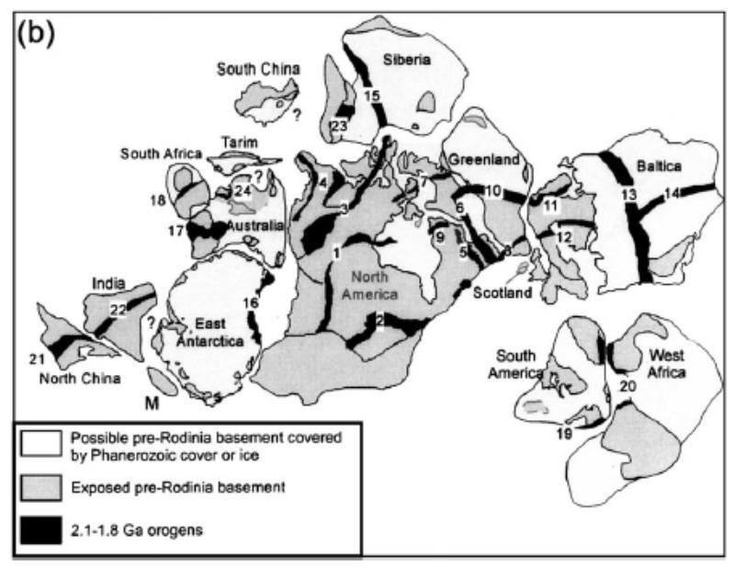
Global-scale orogenic event at 1.8-2.1 Ga
Is a unique peak in HPE at ca. 1.8 Ga related to a global orogenic event ?
Zhao et al, 2004

Slide 11
The crust
How well do we know the crustal structure?

Slide 12
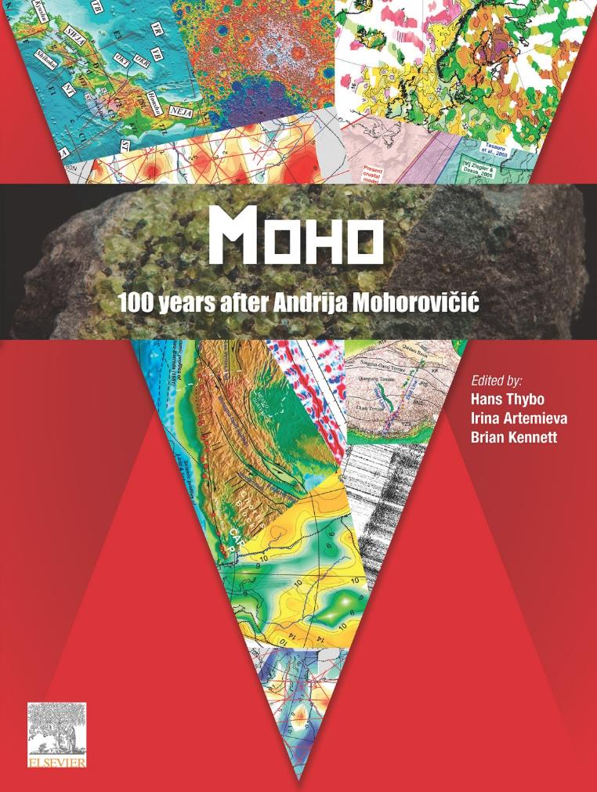
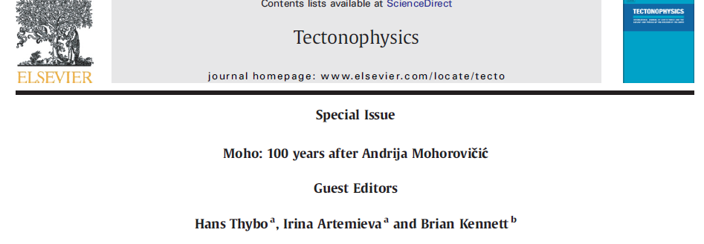
How well do we know the crustal structure?
Book-on-demand, 2013, 740 pages,
can be ordered on Elsevier web-site,
also published as
Tectonophysics Sp. Issue
2013

Slide 13
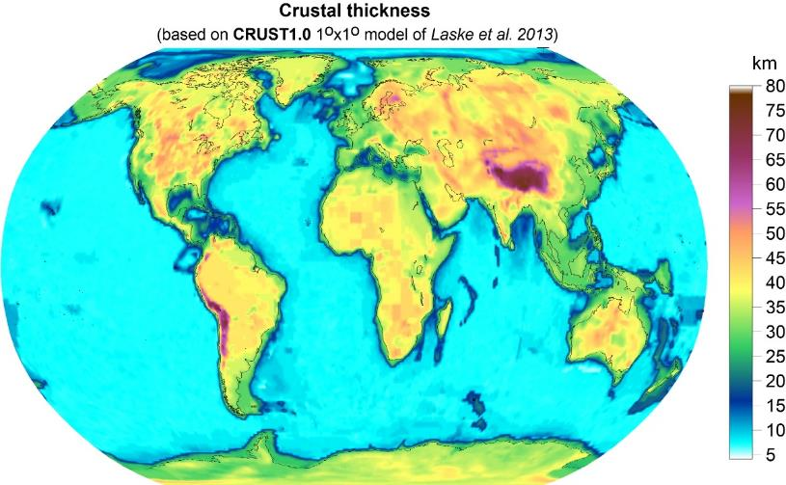
How well do we know the crustal structure?
3 new regional crustal models based on seismic data only
EUNAseis
Artemieva & Thybo,
Tectonoph., 2013
SibCrust
Cherepanova et al,
Tectonoph., 2013
NCcrust
Xia et al.
JGR 2017
Significant differences between regional crustal models based on regional seismic data
and global crustal models
in ALL parameters

Slide 14
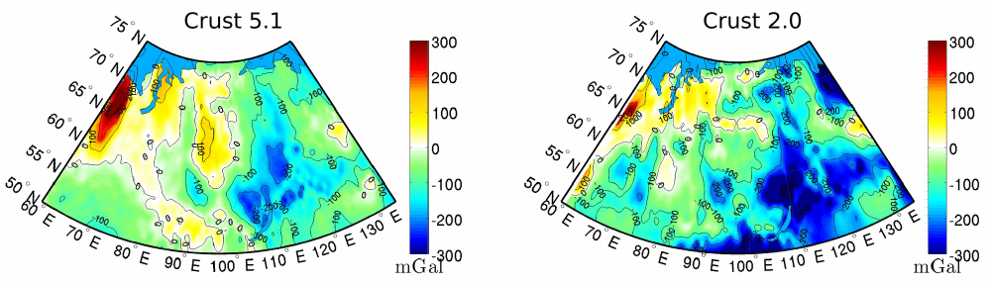
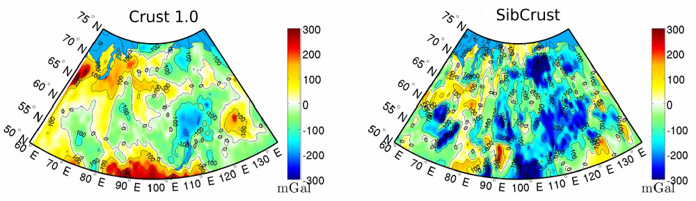
Why do we need reliable crustal models ?
Need crustal correction to different geophysical modeling
Upper mantle residual gravity anomalies in Siberia
(=reflect density heterogeneity below Moho)
calculated by subtracting the crustal gravity effect
will discuss these results in few minutes
Herceg, Artemieva, Thybo,
Geophys. J. Int., 2016
The worst
For SibCrust regional crustal model

Slide 15
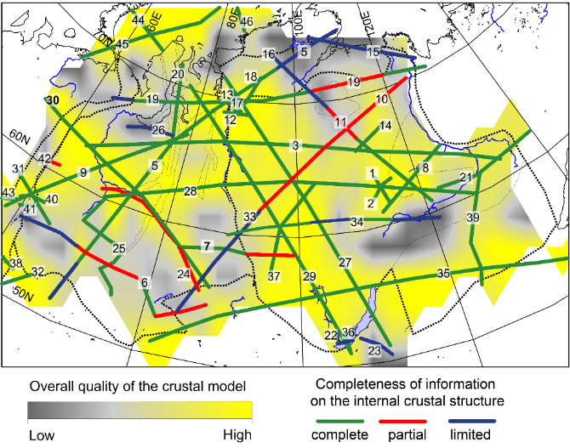
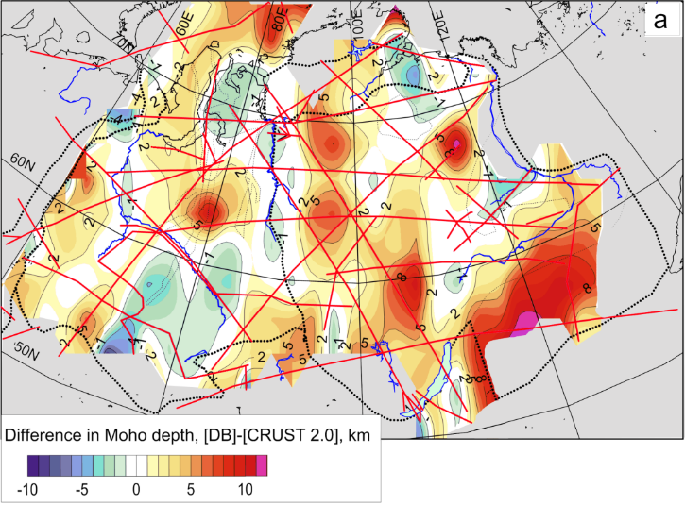
Crustal thickness, comparison
SibCrust = Siberia
(West Siberian Basin + Siberian Craton) Seismic model for the crust
Data coverage
Moho: SibCRUST minus CRUST2.0
Cherepanova, Artemieva, Thybo, Chemia, Tectonoph., 2013

Slide 16
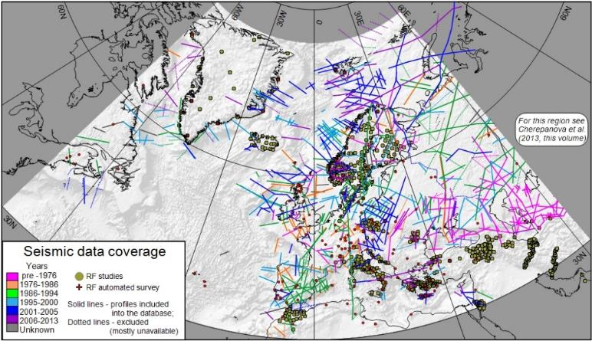
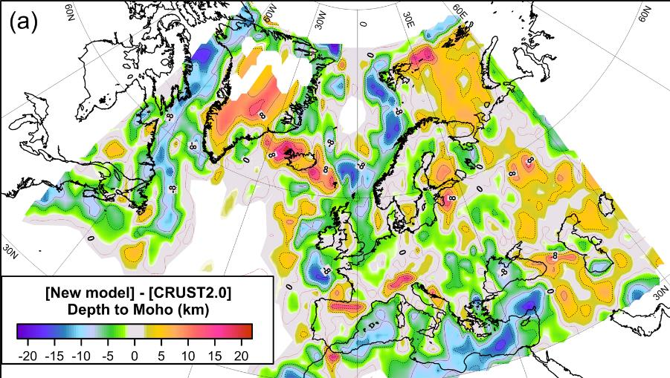
Data coverage
EuNAseis =
Europe + North Atlantic Seismic model for the crust
Difference in Moho depth: EuNAseis minus CRUST2.0
Artemieva & Thybo, Tectonoph., 2013

Slide 17
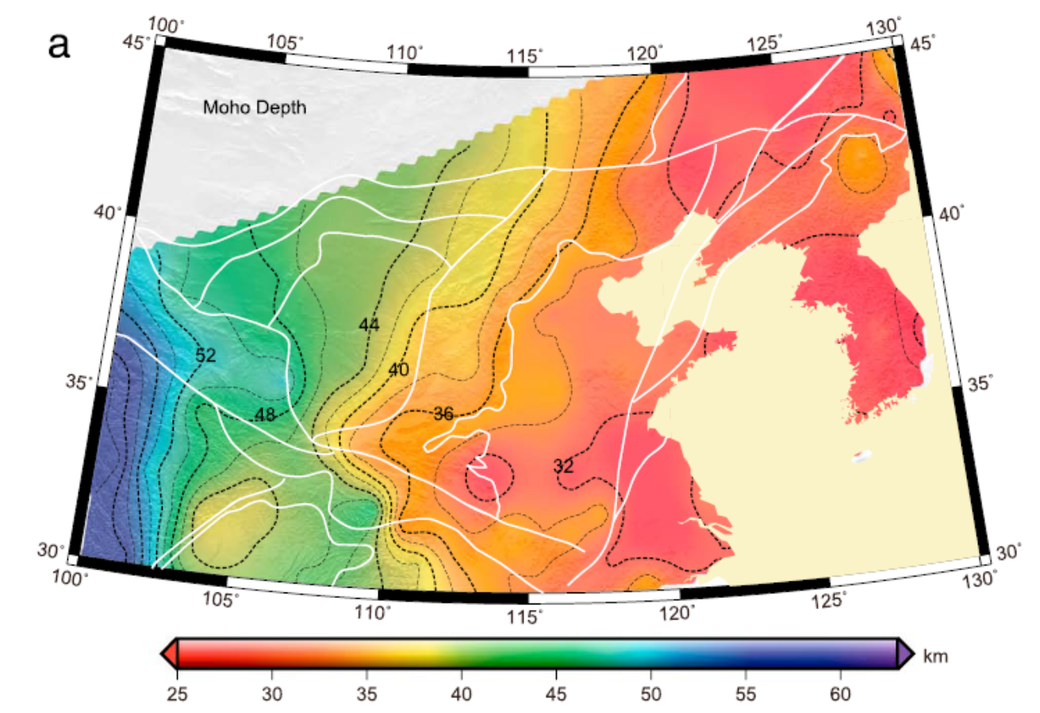
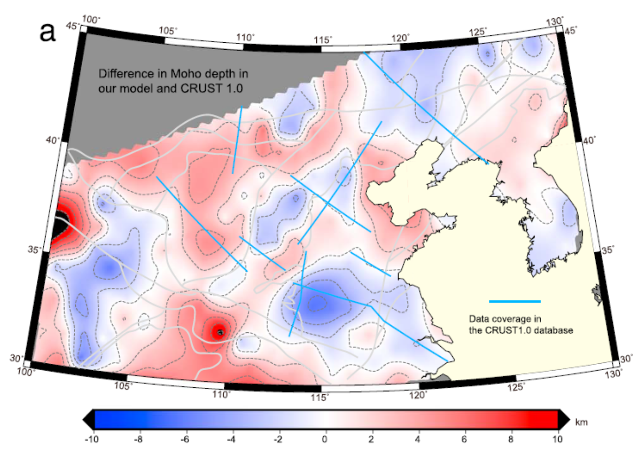
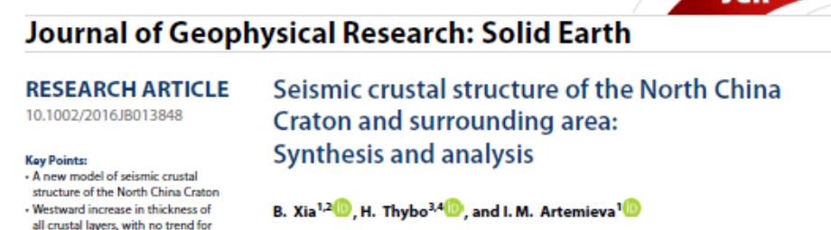
Crustal thickness, comparison
NCcrust =
North China Craton seismic model for the crust
Crustal thickness
NCcrust
NCcrust – CRUST1.0
2017

Slide 18
Crustal thickness, comparison
NCcrust =
North China Craton seismic model for the crust
Crustal thickness
NCcrust
NCcrust – CRUST1.0
Regional crustal model based on regional seismic data provides most reliable basis for modelling.
Global models are not good for many regions,
Errors for Moho depth upto ±10 km
2017

Slide 19
The lithospheric mantle
How well do we know its structure?

Slide 20
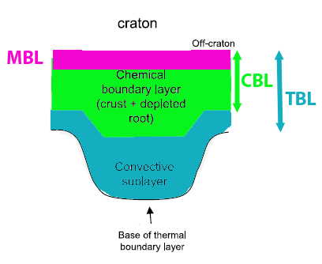
Role of the lithosphere
Lithosphere plates
take part in plate tectonics processes
Makes
Mechanical boundary layer (MBL)
on the top of the convecting mantle

Slide 21
Role of the lithosphere
2) Lithosphere = has conductive heat transfer
(by definition, with local advection)
Makes
Thermal boundary layer (TBL)
on the top of the convecting mantle
Simple in oceans – TBL thickness ~sqrt (age) as any TBL,
Complex in continents due to additional heat source - HPE

Slide 22
Role of the lithosphere
3) Lithosphere = residue of mantle melting
Makes
Chemical boundary layer (CBL)
on the top of the convecting mantle
Particularly important for continents

Slide 23
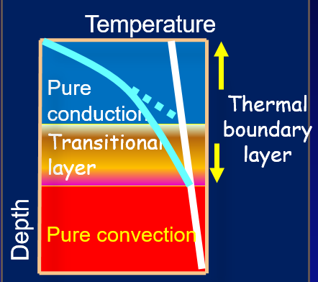
Lithosphere as thermal boundary layer

Slide 24
Thermal structure of the lithosphere:
From surface heat flow
  Problem: only near-surface data with uneven coverage;
  Can be complemented by geochemical data;
  Assumptions based on observation-based correlations are used to narrow the parameter-space
By converting velocity anomalies to temperature anomalies;
  Problem: velocity anomalies are caused by a large spectrum of factors, and are poorly correlated in the upper mantle
From P-T equilibrium of mineral phases of mantle rocks brought to the surface by magmas (xenolith geotherms)
  Problem: P-T crucially depend on geothermobarometer choice;
  Spatially restricted - “Nature’s” sampling

Slide 25
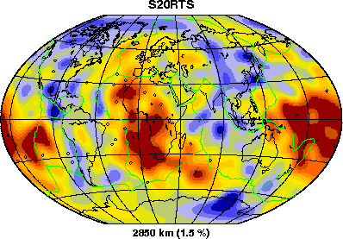
Seismic and thermal anomalies are not well-correlated globally
Origin of seismic anomalies in the mantle:
Thermal
Non-thermal
cratons
Interpretations of V
anomalies in terms of T
Hot
Cold
Composition
Melts
Fluids
Anisotropy
Grain size var.
Black – all continents;
red – stable conts.
Artemieva et al., GJI, 2004

Slide 26
Seismic and thermal anomalies are not well-correlated globally
Origin of seismic anomalies in the mantle:
Thermal
Non-thermal
cratons
Cannot be used to calculate mantle temperatures from seismic tomography:
Requires too many assumptions on composition, melts, fluids, anisotropy etc
Interpretations of V
anomalies in terms of T
Hot
Cold
Composition
Melts
Fluids
Anisotropy
Grain size var.
Black – all continents;
red – stable conts.
Artemieva et al., GJI, 2004

Slide 27
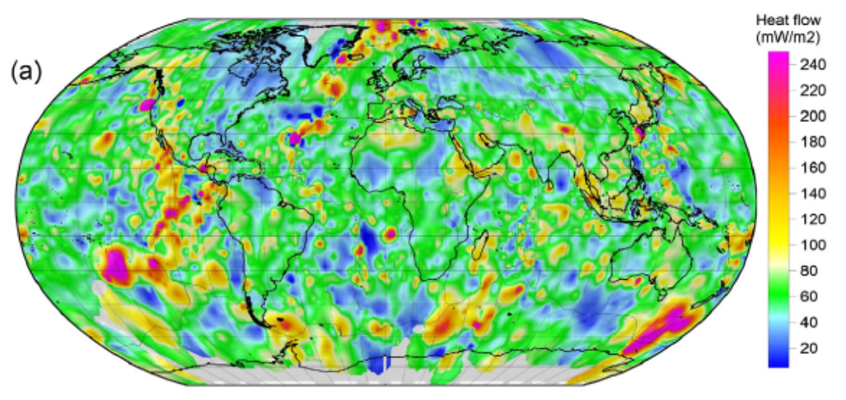
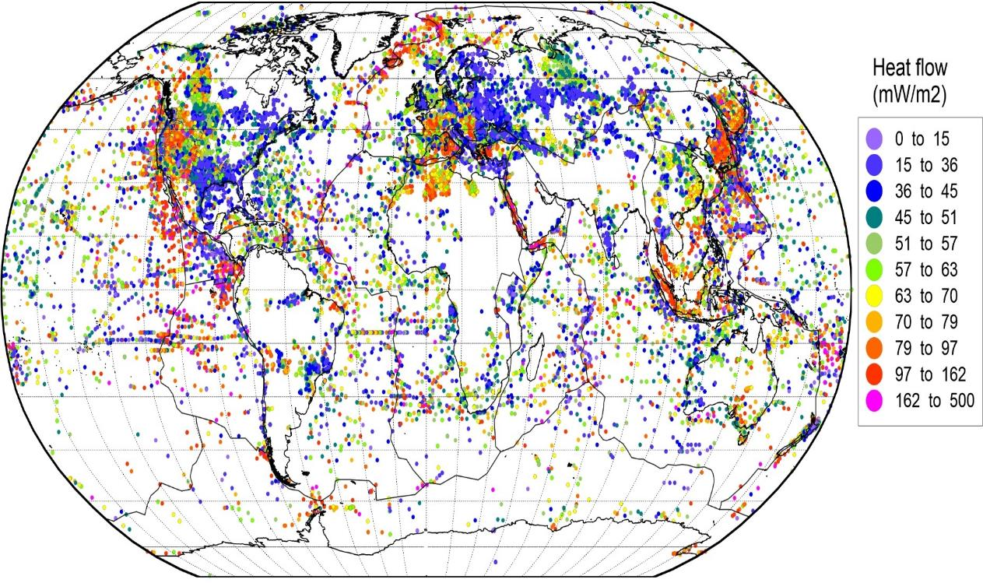
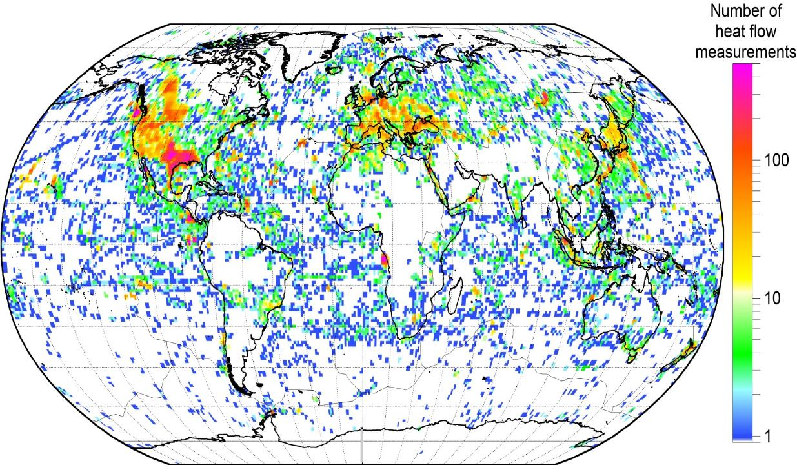
Global
heat flow
red colors – high values,
blue colors – low values
Cannot be used as reported.
Requires paleoclimate corrections, up to 30-40%
Density of
data coverage
Artemieva, Thybo, Shulgin, 2015, GR

Slide 28
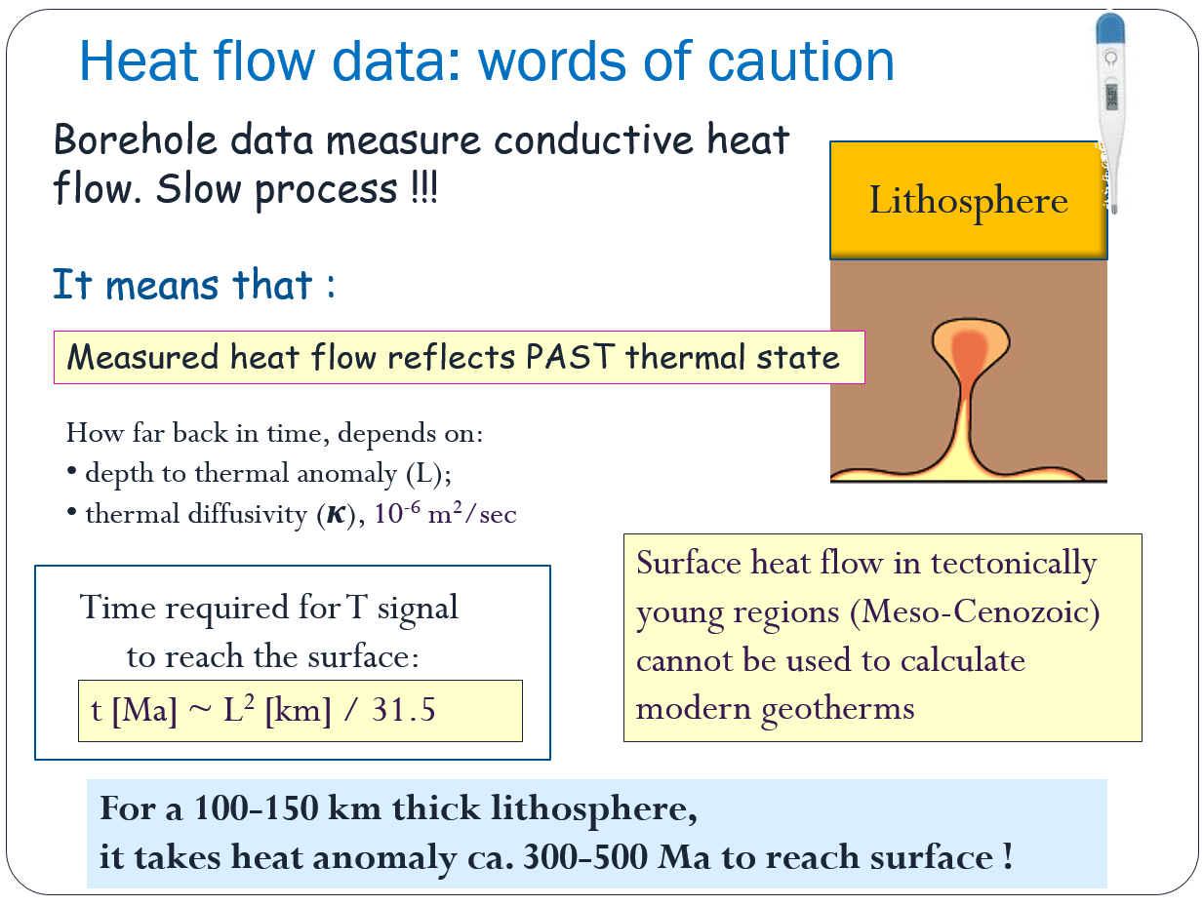

Slide 29
Surface heat flow will probably tell nothing about the PRESENT thermal regime of the lithosphere around JUNO
Thermal anomaly related to
the Phanerozoic subduction may be
far too young to reach the surface yet

Slide 30
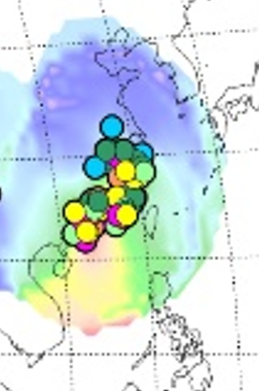
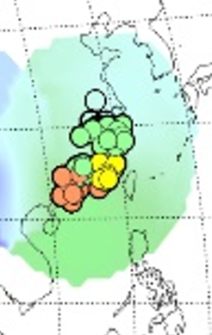
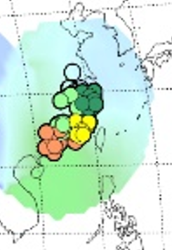
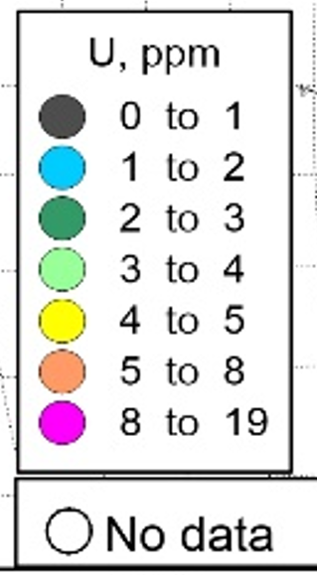
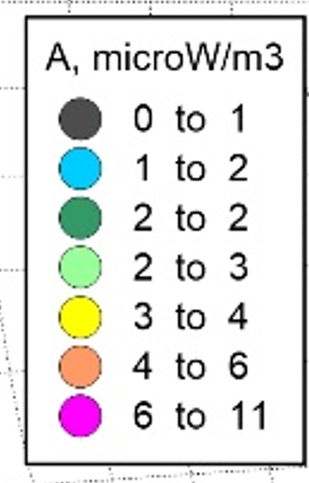
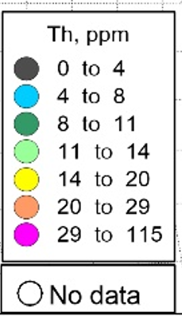
Surface heat flow can be used in stable regions (cratons) to calculate lithospheric geotherms, if heat production is known
Near-surface HPE in granites, southern China
Artemieva et al., 2017, Earth Science Reviews
GRANITE2017 database

Slide 31
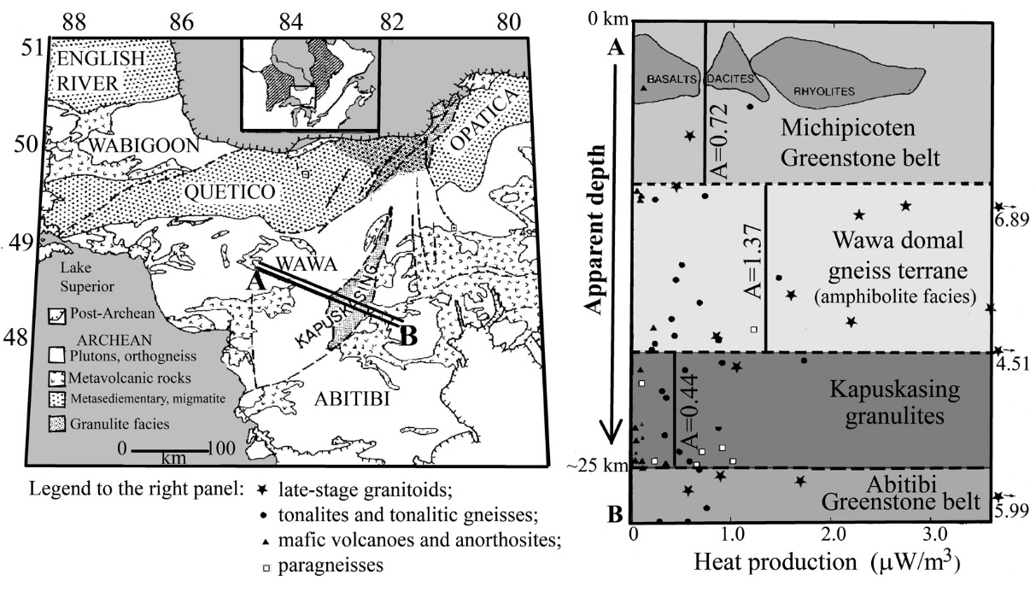
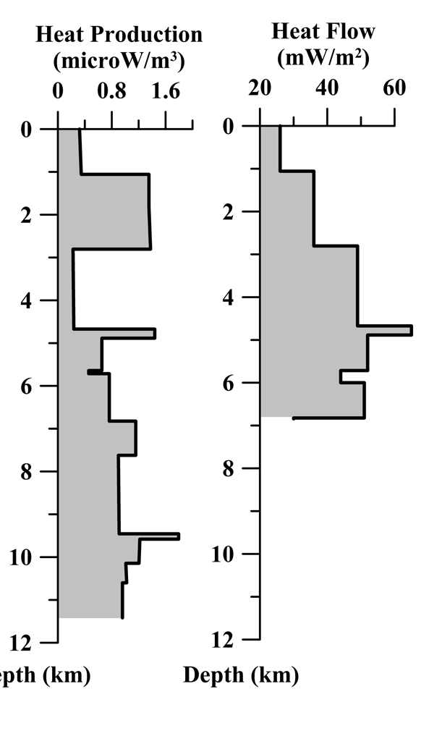
Constraints on crustal HP vs depth
Commonly is assumed to decrease with depth;
~exp(-z) is the most convenient mathematical form;
not supported by many regional observations
Kola Superdeep borehole
(12.4 km deep, Russia)
Exposed 25 km of the crust in the Canadian shield

Slide 32
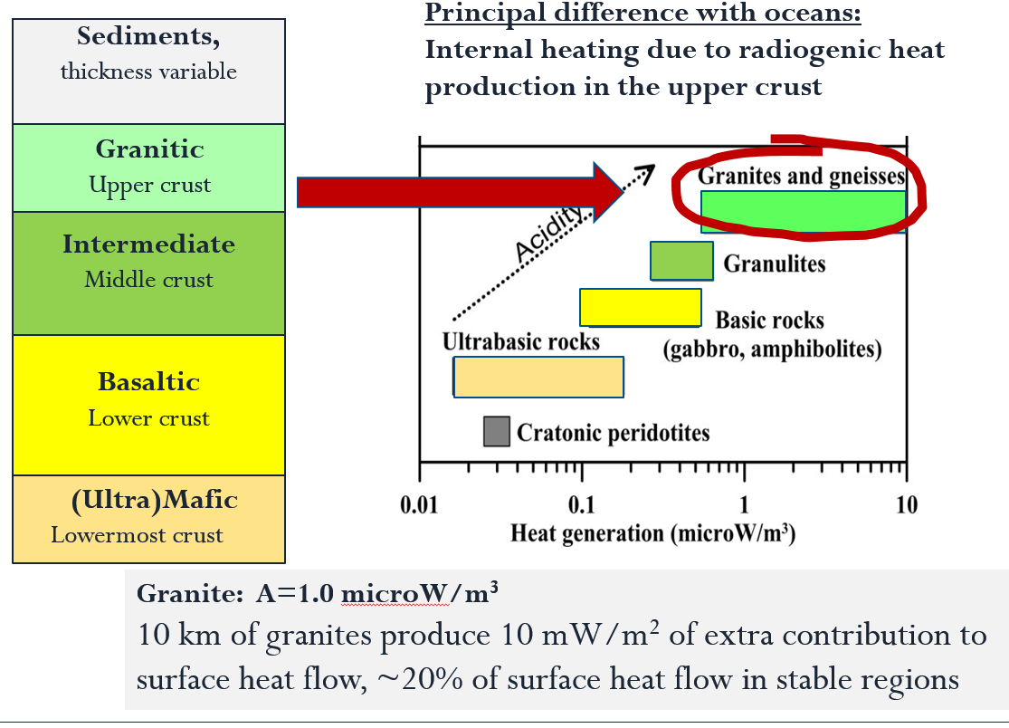
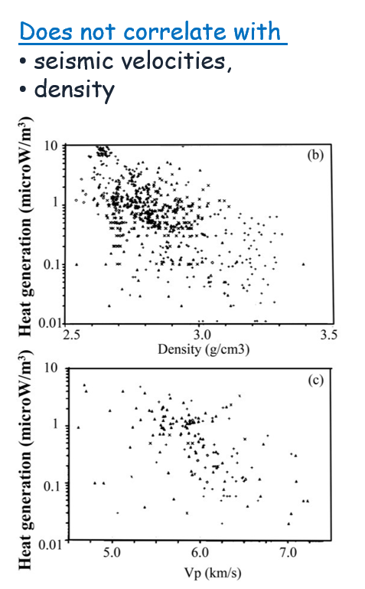
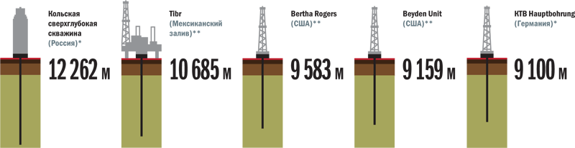
Constraints on crustal HP vs depth
Most of heat production is in the upper crust
Lab data: poor correlation with
+ several in China and Russia

Slide 33
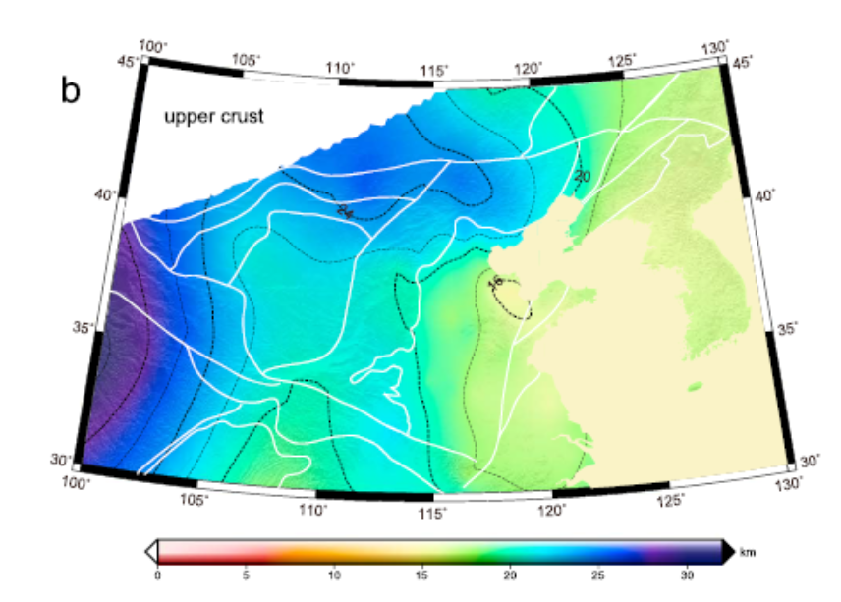
How much heat generates granitic crust?….
A 5 km error in upper crust thickness (20 km u.c) produces an error of 15-20% of its contribution to heat flux
20 mW/m2
30-50% of heat flux
20 mW/m2
30-50% of heat flux
1 µW/m³
4 µW/m³
(mPr peak)
1 µW/m³
(mPr peak)
Hi-res crustal models are needed
5 km
±2.5 km
North China craton
thickness of upper crust
20 km
Typical continental heat flux:
40-70 mW/m2
0
10
20
30

Slide 34
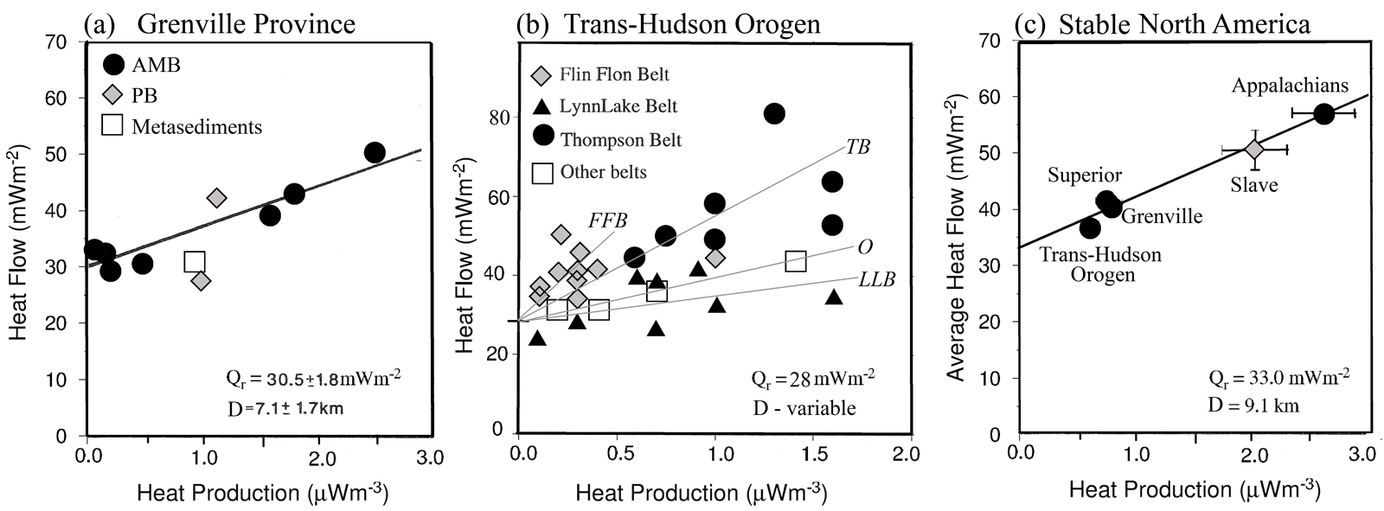
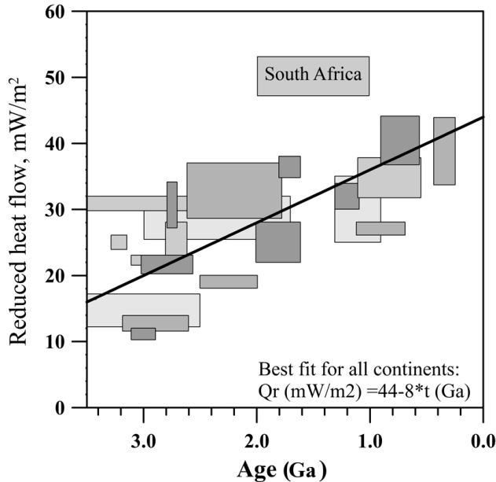
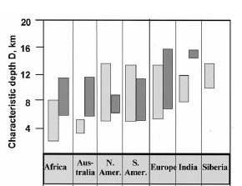
HP(depth) and
“Mantle” heat flow
Qo = Qr + DA
D – slope, thickness of HPE-rich layer
Qr – intersect, reduced heat flow generated in HPE-rich layer D
Reduced heat flow
Thickness of HPE-enriched layer D
Thinner than granitic layer !
Artemieva & Mooney, 2001

Slide 35
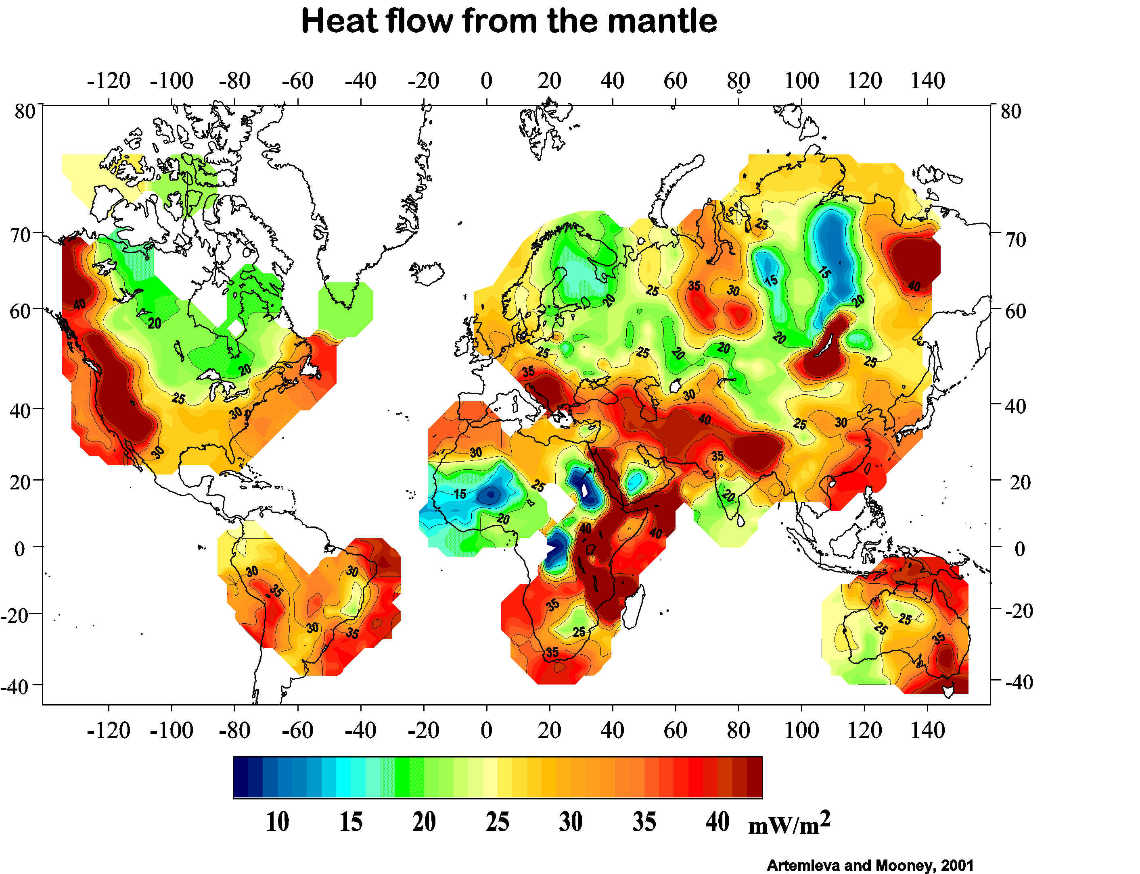
Mantle heat flow (at LAB)
Artemieva & Mooney, 2001

Slide 36
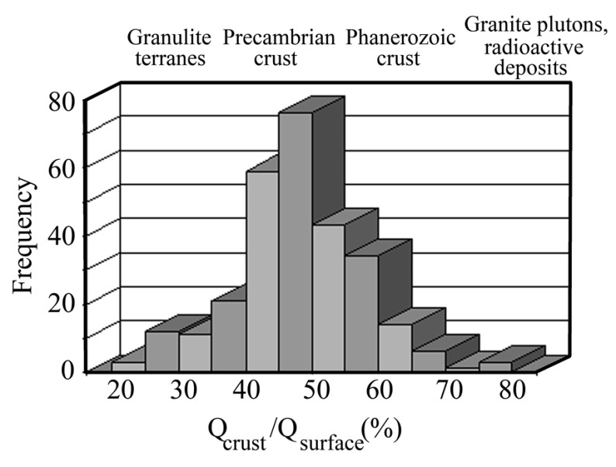
Crustal contribution to surface heat flow
Estimates of heat production are based on:
Experimental data from boreholes and outcrops
Concept of heat flow provinces
Wavelength of heat flow variations
Global geochemical constraints on total crustal radioactivity
Artemieva & Mooney, 2001

Slide 37
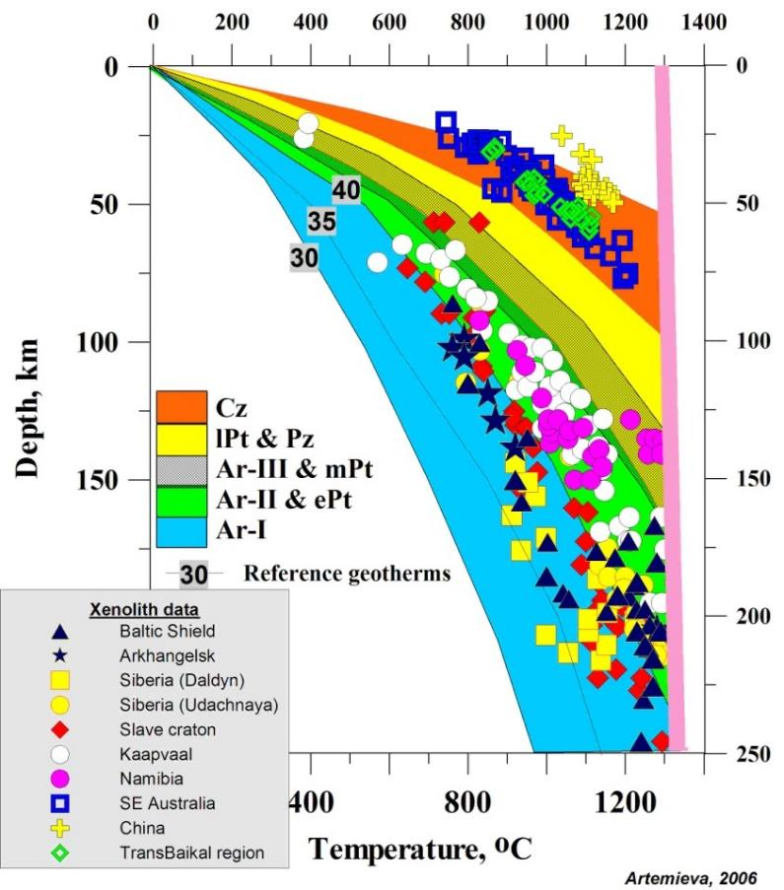
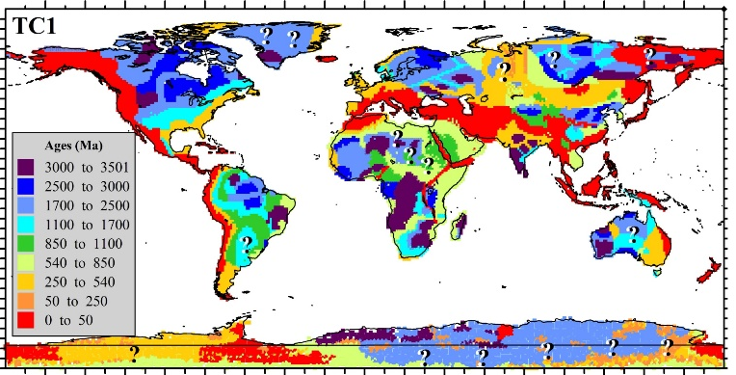
Continental geotherms from heat flow
versus xenolith P-T arrays
Old
Young
At 100 km depth, mantle temperature may differ by ca. 700 deg C
Artemieva, 2006

Slide 38
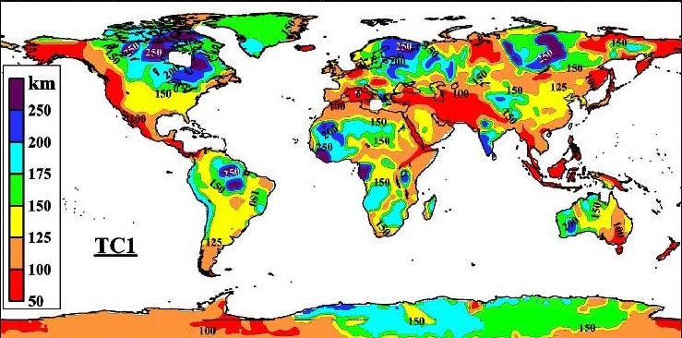
Thickness of thermal lithosphere
Lithosphere thickness is method-dependent
Uncertainty
ca. +/- 25 km
Artemieva, 2006;
Artemieva & Mooney, 2001;

Slide 39
Lithosphere as chemical boundary layer

Slide 40



Strongly heterogeneous crust
Artemieva & Thybo, Tectonoph., 2013
….. and homogeneous mantle ?!
Is it possible?
Common image in all textbooks

Slide 41

Xenolith data show that
mantle lithosphere is heterogeneous
Petrologic profile across the Siberian kimberlites
Distance 1000 km
50 km
Strong heterogeneity, both vertically and laterally
Large-scale features should be seen by geophysical methods
Depth
250 km
50 km
Depth
250 km
Griffin et al., 1999

Slide 42

Lithosphere = residue of mantle melting (CBL)
(chemical boundary layer)
Earth
formation
Secular cooling of the mantle
Higher T in Archean ->
unique thickness;
unique composition
of cratonic lith. mantle (LM)
Oldest
crust
Present
Global petrologic observations
O”Reilly & Griffin, 1998

Slide 43
Lithosphere = residue of mantle melting (CBL)
(chemical boundary layer)
Mg# = Mg/[Mg+Fe]
[or Fo-content]
characterizes mantle composition
which depends on degree of melting
problem:
refers only to 60-75% of mantle material (olivine)
Global petrologic observations
O”Reilly & Griffin, 1998

Slide 44


Melt-depletion (characterized by Mg#) causes
Vs increase and density decrease in mantle
ln (DENSITY)
Vs (km/s)
r=0.87
Lee, 2003
88 94
Mg# bulk
Lee, 2003
Anomalies in mantle composition should be seen in large-scale geophysical models

Slide 45
Effect of temperature ?
Lithosphere T is higher in younger structures (at the same depth)
with T decrease, Vs & Vp increase
with T decrease, Rho increases
Interpretations of dVp, dVs
in terms of hot vs cold
dT masks density variations.
Neutral buoyancy of Ar cratons (isopycnicity)
Young Cratonic
Young Cratonic
ln (DENSITY)
Vs (km/s)
r=0.87
Lee, 2003
88 94
modified after Lee, 2003

Slide 46
Thermo-chemical heterogeneity of mantle from geophysical data
Remote sampling
(seismic, gravity,
MT, etc…)
Thermal heterogeneity
Chemical heterogeneity
Enhances VS anomalies
Hides density anomalies
-> need to remove

Slide 47
Compositional heterogeneity of lithospheric mantle from seismic data
Start with a seismic tomography model
Remove effect of regional temperature variations from seismic Vs
3. Result: mantle compositional anomalies

Slide 48


Compositional Vs variations in the mantle
East Eur. Craton
Depth
Craton edge
Slow and
heavy
non-cratonic mantle
Fast and
light (depleted)
cratonic mantle
Cratonic margin:
its surface expression corresponds
to the compositional transition in the mantle
Artemieva, Lithos, 2009

Slide 49


Compositional Vs variations in the mantle
East Eur. Craton
Depth
This profile is ca. 600 km to the east and crosses the kimberlite region in Karelia
Slower than
typical cratonic
mantle beneath the Karelian kimberlite fields
Depth
Seismic LAB, 2% dVs
Artemieva, Lithos, 2009

Slide 50

Compositional heterogeneity: Asia
Siberian
craton
West
Siberia
Baikal
Sino-
Korean
craton

Slide 51

Compositional Vs variations in the mantle
Mantle plume north of Baikal?
Anabar
shield
West
Siberia
Baikal
Major
Kimberlite
province
of Siberia
Reworked Sino-Korean craton
Sino-Korean
craton
Artemieva, 2009, Lithos

Slide 52

Compositional heterogeneity: 150 km depth
Strong contrast with the Siberian craton
Mosaic pattern in the North China and Yangtze cratons,
with no depleted lithospheric root
Blue- depleted,
cratonic
Yellow – fertile,
cratonic
Red – possible
fluids and/or
melts
Siberian craton
Baikal rift
Tibet
z=150 km
India
Artemieva, 2009, Lithos

Slide 53
Density heterogeneity of lithospheric mantle from gravity modeling
Remove gravity effect of the crust
(need to know crustal structure in detail!)
Remove effect of temperature variations
Result: mantle compositional density

Slide 54

Mantle density anomalies in the Siberian craton
Khatanga rift
Blue – depleted Archean mantle
Siberian traps
Viluy rift
Green – reworked cratonic mantle
Yellow – fertile
non-cratonic mantle
Cherepanova and Artemieva, 2015

Slide 55
Mantle density anomalies in the cratons of southern Africa
SPT
Petrologic range for kimberlite-hosted xenoliths
Artemieva and Vinnik, 2016

Slide 56

Blocks with low mantle density have sharp seismic Moho and thin crust
Density (in situ)
Moho sharpness
(seismic velocity contrast at Moho)
Youssof et al, 2013
Limpopo
Belt
Artemieva and Vinnik, 2016

Slide 57

LM density,
Moho sharpness, and magmatic reworking
Artemieva and Vinnik, 2016
Magmatism modifies composition of cratonic lithosphere mantle,
Adds underplated material to the crust -> transitional Moho,
Or leads to lower crustal removal -> sharp Moho

Slide 58
Thermal structure and HPE in southern China: to-do list
Need regional data on near-surface heat production
  New measurements on representative rocks
  Talk to SINOPROBE – data from deep drilling
  Detailed regional geology and ages
  Comparative study with other similar settings
2. Need regional-scale heat flow measurements
  May be non-representative of present deep structure
  Need regional geodynamic models, with age-constraints
3. Need reliable high-resolution crustal models
  Global models are not good enough
4. Need lithosphere-scale regional models
  Lithosphere thickness from different methods
  Mantle transition zone -> mantle T anomalies
  Compositional anomalies and Phanerozoic magmatism

