Slide 1
Science of Neutrinos
Yifang Wang
Institute of High Energy Physics

Slide 2
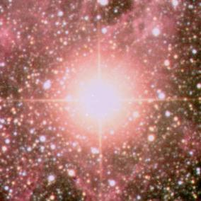
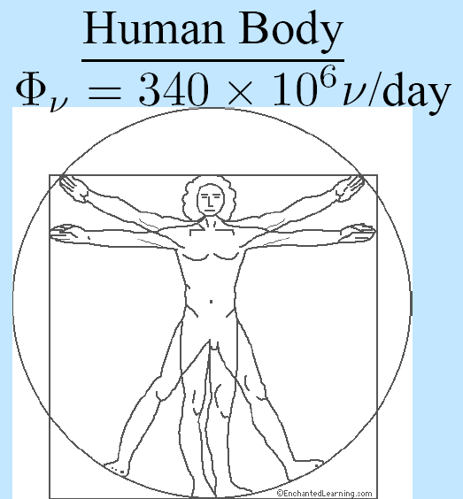
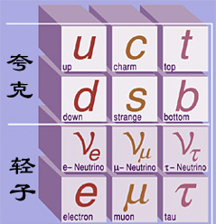
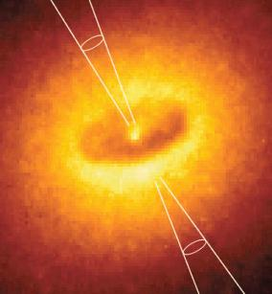
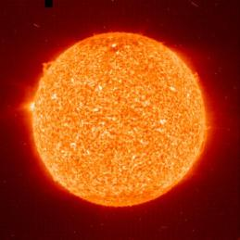
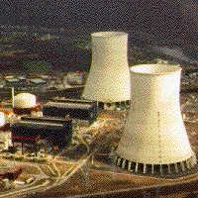

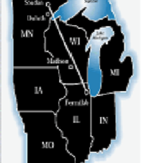
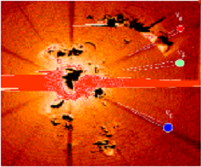
Neutrinos Around Us
Particle physics
Astrophysics
Supernova
Quarks
人体
Cosmology
Leptons
Nuclear Physics
Geology
Galaxy
accelerator
Big bang
Sun
reactor
Earth

Slide 3
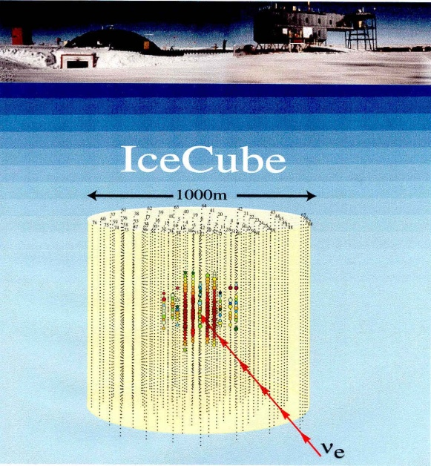
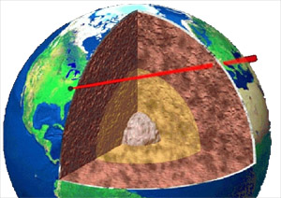
Neutrinos are useful
Neutrino astronomy
  Proved the solar model
  Supernovae study
  Neutrinos from deep Universe
  Cosmic-rays
Neutrino geology
  Earth thermal emission
  U/Th ratio in earth
  Neutrino beams through earth: CT ?
Rector monitoring

Slide 4
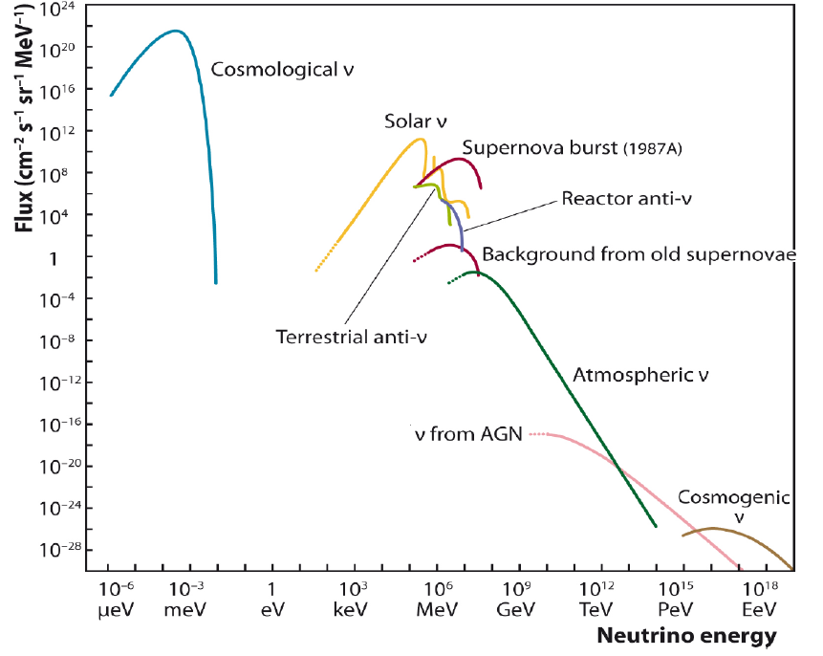
Neutrino Spectrum
arXiv: 1207.4952

Slide 5
Neutrino properties
Neutral
Almost massless, Σ_{i} m_{νi} < 0.7 eV
Extremely abundant in the Universe, ~ 300/cm³ ➔ mass is a crucial issue
Many unknowns:
  Absolute mass
  Magnetic moments
  Dirac or Majorana
Important in particle physics, astrophysics and cosmology:
  Only evidence beyond Standard Model
  Through Leptogenesis ➔ matter-antimatter asymmetry
  Universe structure
  Dark matter, although not a significant amount

Slide 6



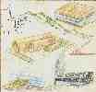
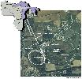








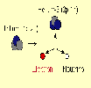











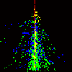








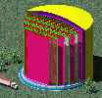
Neutrino industry

Slide 7
Neutrino physics：problems and methods
Dirac/
Majorana
Magnetic moments
mass
oscillation
astronomy
cosmology
geology
Radioactive sources
Atmos-pheric
solar
Astro-objects
Relic-neutrino
reactor
accelerator
earth
Semiconductor/crystals/gaseous/
scintillator
Liquid scintillator
Liquid Argon
Water
Cerenkov
Nuclear chemistry
calorimeter
emulsion

Slide 8


Neutrino Oscillation
If the neutrino mass eigenstate is different from that of the weak interaction, neutrinos can oscillate: from one type to another during the flight:
ν_{e}
ν_{μ}
ν_{e}
ν_{μ}
Oscillation probability：
P(ν_{e}−>ν_{μ}) = sin²(2θ) sin²(1.27Δm²L/E)
Oscillation
amplitude
Oscillation
frequency
ν₁
ν₂
ν₃
Bruno Pontecorvo
The most sensitive method to know if neutrino is massless
ν₁
ν₂
ν₃

Slide 9


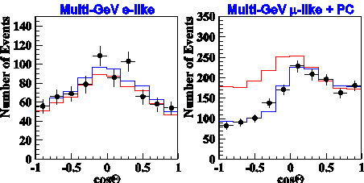
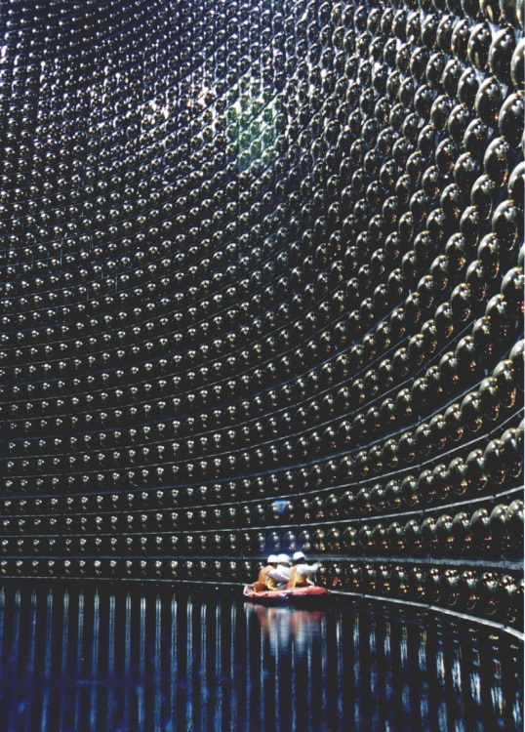
Discovery of Neutrino Oscillation
Muon neutrinos from sky to the SuperK detector , through the earth, oscillate into tau neutrinos
2015
Up
Down
Up
Down
Physical Review Letters 1998

Slide 10

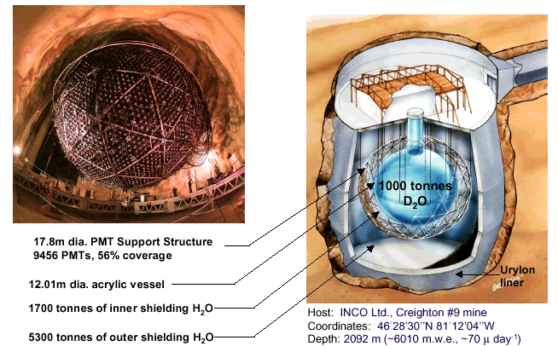
Confirmation of Neutrino Oscillation
Disappeared solar neutrinos becomes muon/tau neutrinos ➔ neutrino oscillation
Physical Review Letters 2002
2015

Slide 11
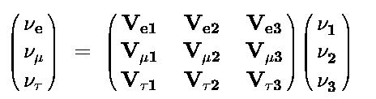
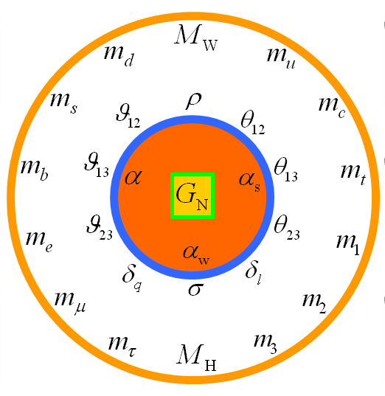
Neutrino Oscillation
Oscillation matrix for 3 generations：
Solar ν Oscillation
sin²2θ₁₂ ~ 0.9
ν₁
ν₂
ν₃
θ₁₃ ?
Atm. ν Oscillation
Sin²2θ₂₃ ~ 1
Known parameters： θ₂₃，θ₁₂，|ΔΜ²₂₃|， ΔΜ²₁₂，
Recent progress: θ₁₃
Unknown parameters: mass hierarchy(ΔΜ²₂₃), CP phase δ
11

Slide 12
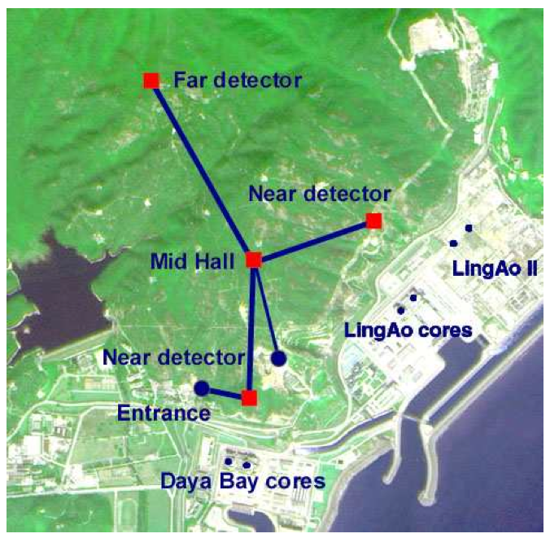
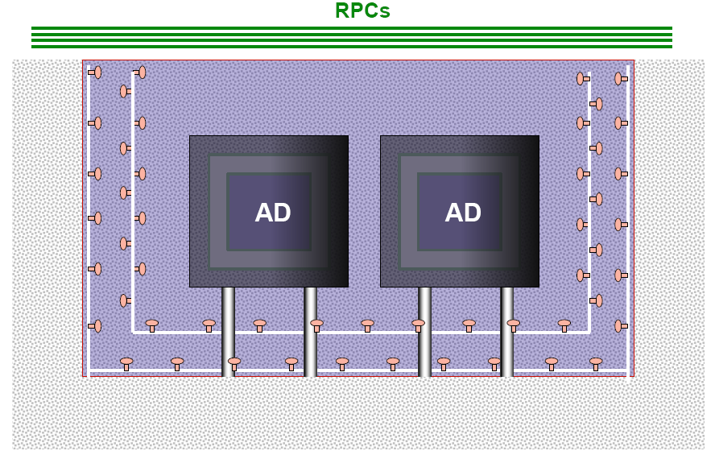
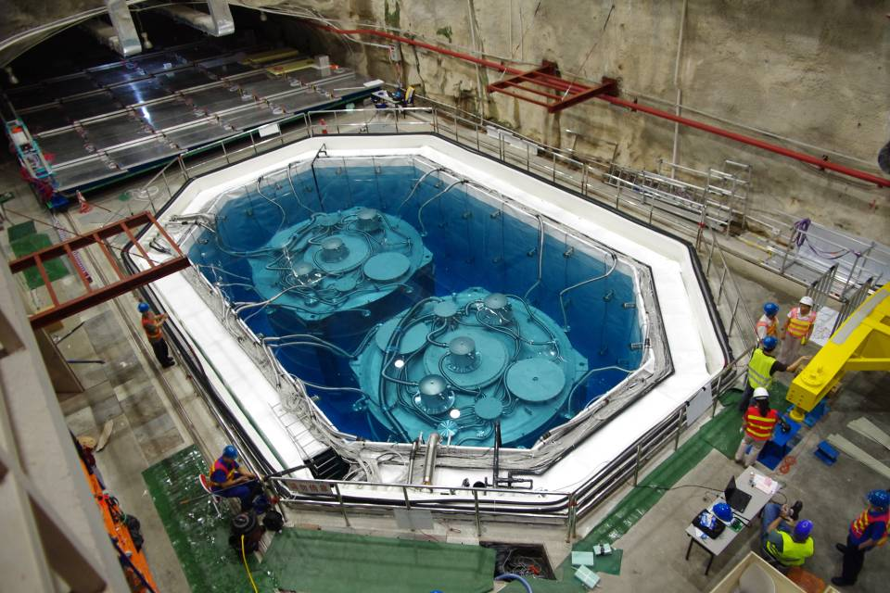
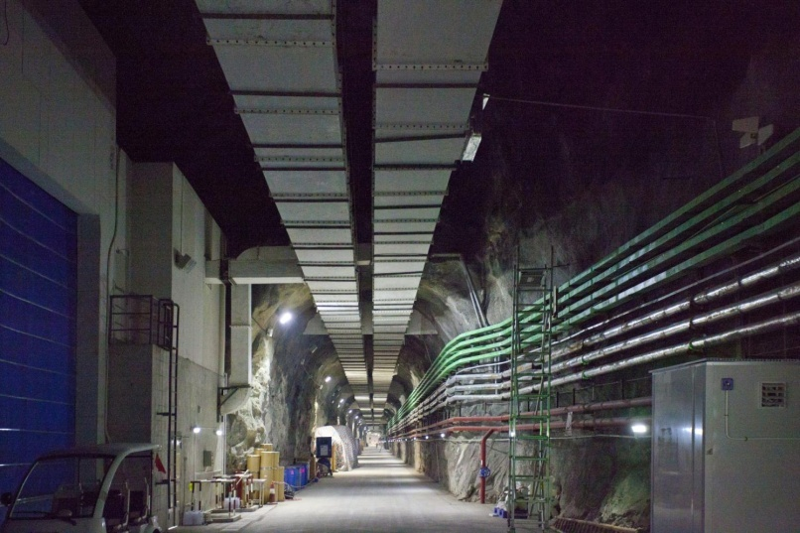
Daya Bay Experiment
Redundancy !

Slide 13
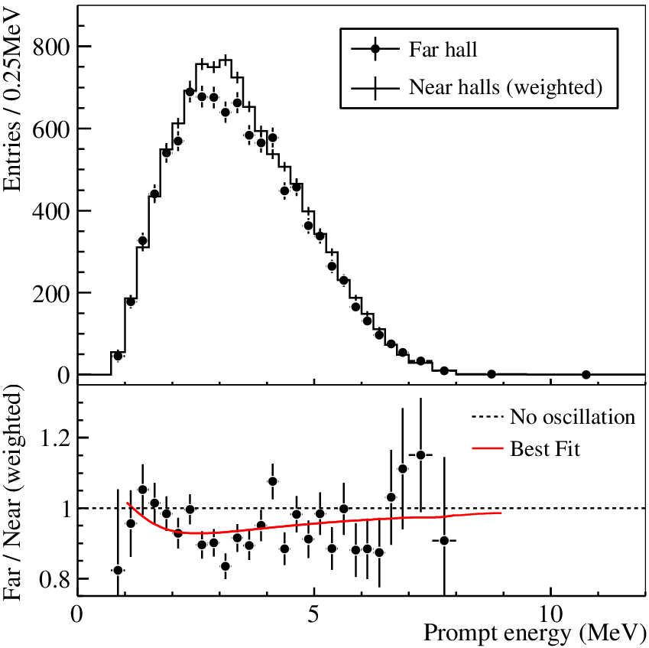
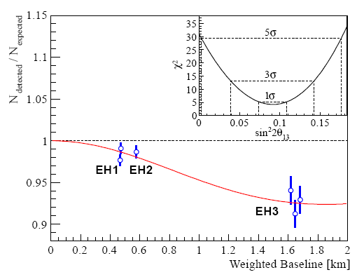
A New Type of Oscillation Discovered
Observation of electron anti-neutrino disappearance:
R = 0.940 ±0.011 (stat) ±0.004 (syst)
announced on Mar. 8, 2012
Sin²2θ₁₃ = 0.092 ± 0.016(stat) ± 0.005(syst)
χ²/NDF = 4.26/4, 5.2 σ for non-zero θ₁₃
F.P. An et al., NIM. A 685(2012)78
F.P. An et al., Phys. Rev. Lett. 108, (2012) 171803

Slide 14
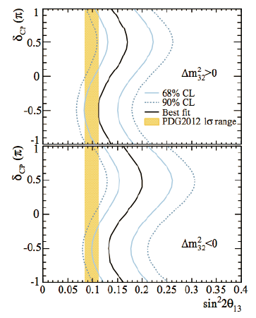
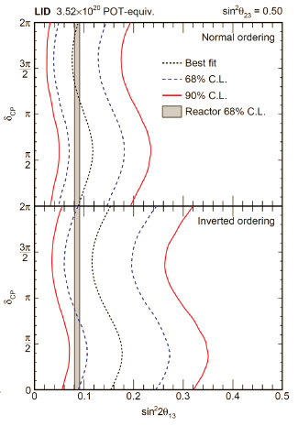
T2K and Nova: CP is known？
C. Water@neutrino2014

Slide 15
Future Experiments
Octant
Mass hierarchy
CP phase
JUNO
LBNF/DUNE
T2HK
Neutrino factory
Beta beams
MOMENT

Slide 16
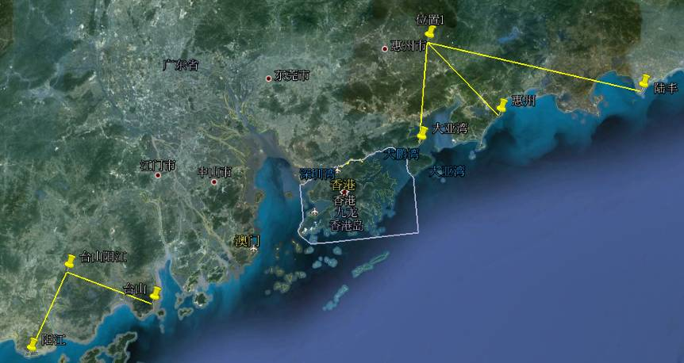
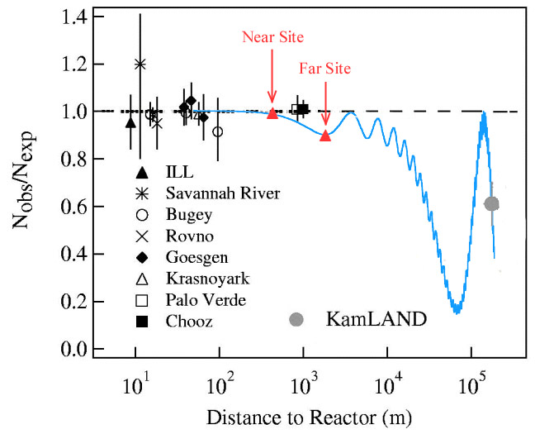
Next Step: Mass Hierarchy
 | Daya Bay | Huizhou | Lufeng | Yangjiang | Taishan
Status | running | planned | approved | Construction | construction
power/GW | 17.4 | 17.4 | 17.4 | 17.4 | 18.4
Daya Bay
60 km JUNO
Previous site
Lufeng
Huizhou
Daya Bay
Current site
Hong Kong
Taishan
JUNO Physics Book: arXiv: 1507.05613
Yangjiang

Slide 17
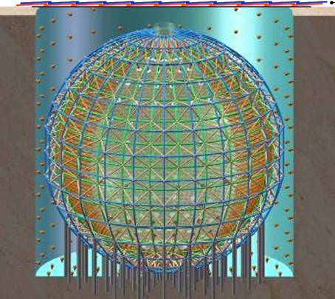
JUNO
Mass hierarchy
Precision measurement of mixing parameters
Supernova neutrinos
Geoneutrinos
Sterile neutrinos
……
LS volume:× 20 ➔ for statistics (40 events/day)
light(PE) × 5 ➔ for resolution (ΔM²₁₂/ ΔM²₂₃ ~ 3%)
Muon detector
Stainless Steel Structure
Φ35m Acrylic tank
20 kt LS(A_{L}> 25 m)
40kt pure water(A_{L}> 50 m)
~18000 20” PMTs
coverage: ~75%
2000 20” VETO PMTs

Slide 18
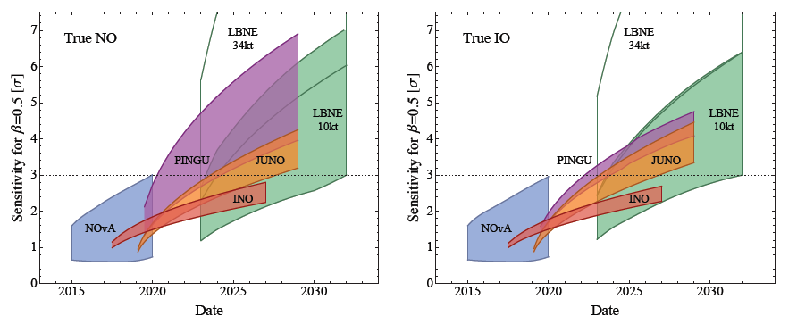
Race for the Mass Hierarchy
M. Blennow et al., JHEP 1403 (2014) 028
NOvA, LBNE: δ
PINGU, INO: θ₂₃=40-50°
JUNO: 3%-3.5%
JUNO is competitive for measuring MH using reactor neutrinos
  Independent of the yet-unknown CP phase, matter effects and θ₂₃
Many other science goals:
    Precision measurement of Δm₃₁², θ₁₂, Δm₂₁²
    Geo-, solar, supernova, …, neutrinos

Slide 19
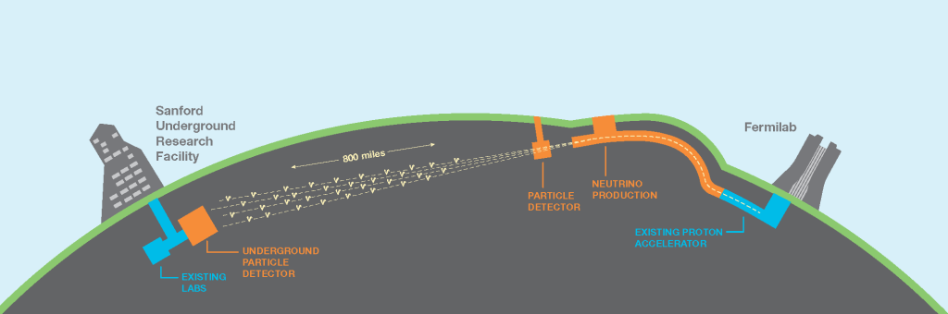
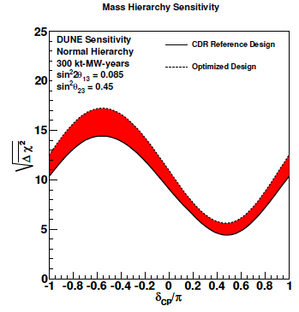
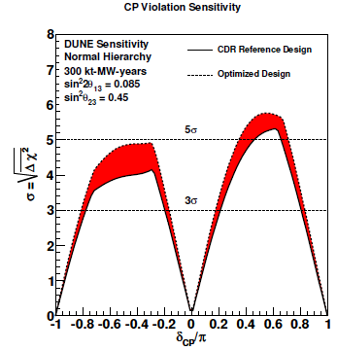
LBNF/DUNE

Slide 20
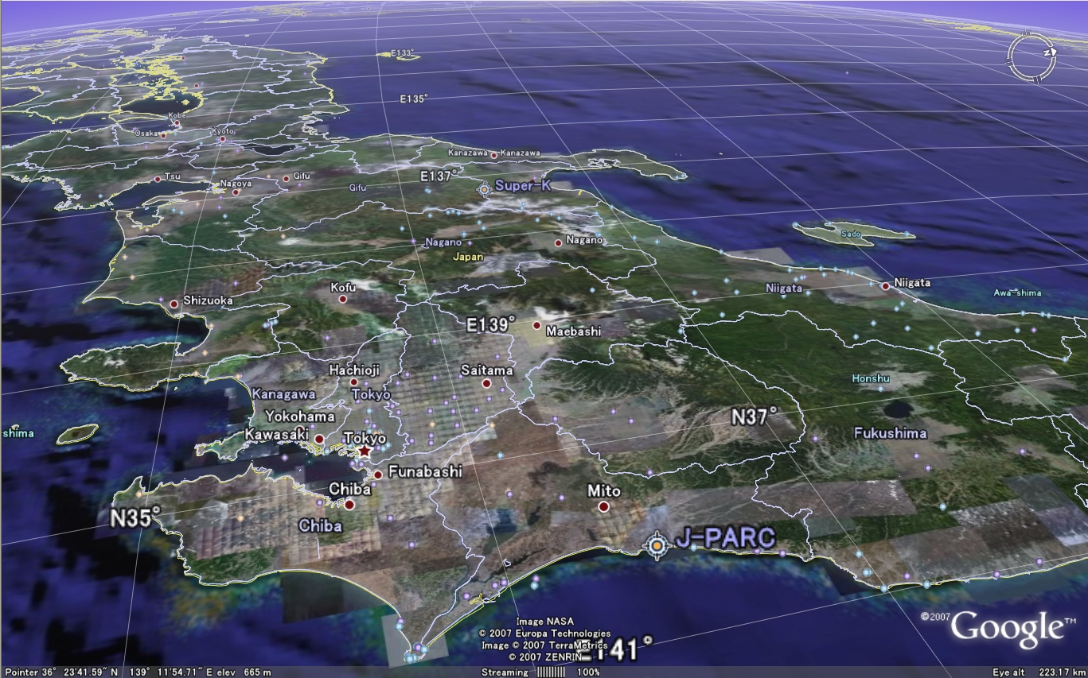
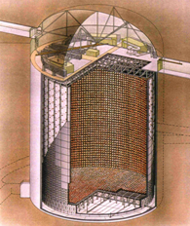
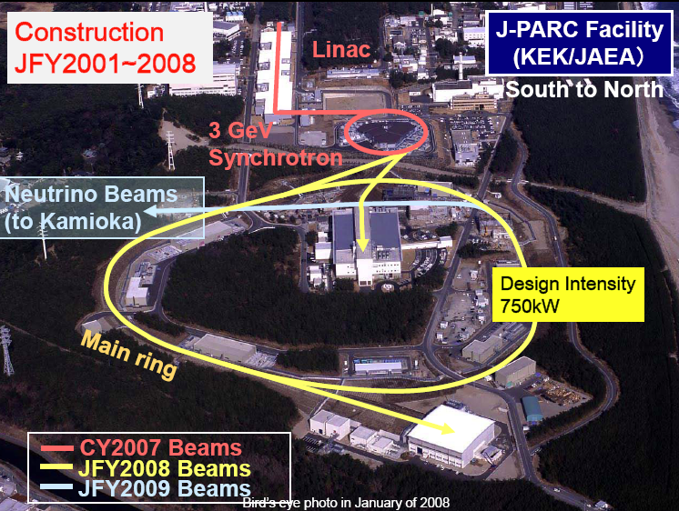
#
T2K & T2HK

Slide 21
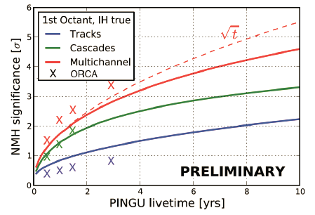
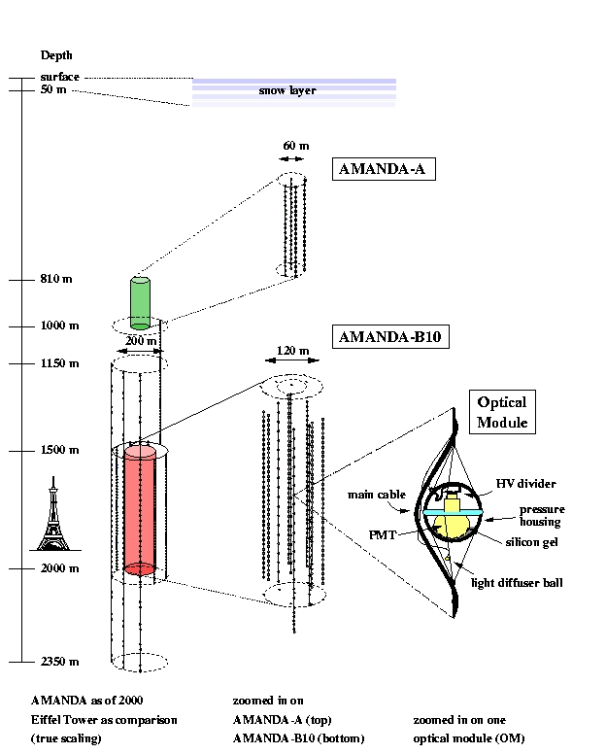
PINGU (& ORCA)
PINGU: determine MH at ~ 3σ level with ~3 years of data
ORCA: similar

Slide 22
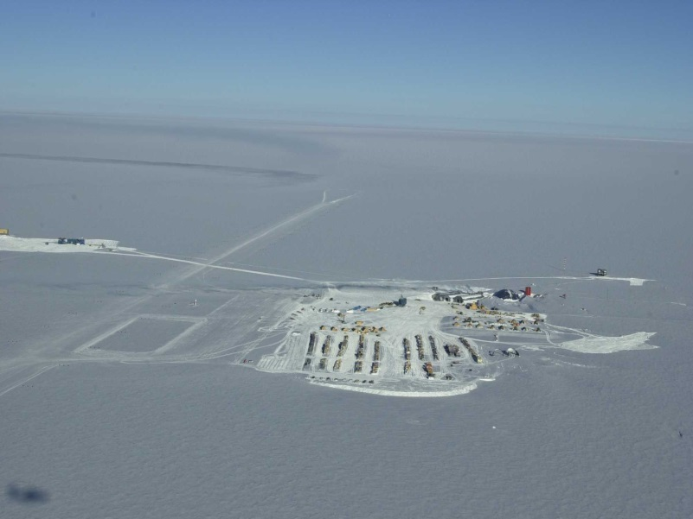

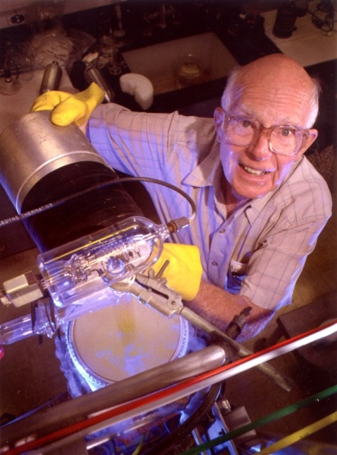
Neutrinos as a probe
A probe to the universe
A probe to the earth: only way to see deep underground and the core
Supernova Neutrinos
Solar Neutrinos
Cosmic neutrinos
2002
Far Universe: ~ similar to photons, not affected by magnetic fields
M. Koshiba
R. Davis

Slide 23

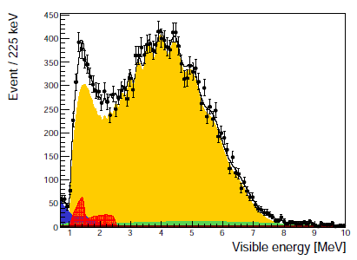
Geoneutrinos
Seen by KamLAND for the first time
Current results:
KamLAND: 30±7 TNU(PRD 88(2013)033001)
Borexino: 38.8±12.0 TNU(PLB 722(2013)295)
JUNO:
  ~ 10% precision for 3 years
  ~ 6% precision for 10 years
Possible to determine U/Th ratio
What JUNO can measure about geoneutrinos ?
How to get a better measurement with the help of geologists ?
What geoneutrino can tell us about geology ?

Slide 24
Other(crazy) ideas about neutrinos in geology
---- an incomplete list
Earth structure
  J.M. Herndon, Proc. Natl. Acad. Sci. 93(1996) 646
Earth tomography
  M. Lindner et al., Hep-ph/0207238
  L.Y. Shan at al., Phys.Rev.D 68(2003)013002
Earthquake detection
  B. Wang et al., Chin. Phys. C 35(2011)325
Oil exploration
  A.N. Ioannisian and A.Y. Smirnov, hep-ph/0201012
  T. Ohlsson et al., Europhys. Lett., 60(2001)34
Earth Core reactor ?
  D.F. Hollenbach and J.M. Herndon, Proc. Natl. Acad. Sci. 98(2001)11085
  R.S. Raghavan, hep-ex/0208038

Slide 25
Conclusions
Neutrinos are fundamental building blocks of our universe ➔ still a lot of unknowns
Large neutrino experiments lead to the observation of geo-neutrinos, which should be interesting for geologists
JUNO can give us much more geo-neutrinos
Geology + particle physics = ?

