Slide 1
Optics design with dynamic aperture considerations for CEPC collider ring
Yiwei Wang, Yuan Zhang, Sha Bai, Dou Wang,
Huiping Geng, Chenghui Yu, Jie Gao
IHEP, Beijing
ICFA Min-Workshop on Dynamic Apertures of Circular Accelerators,
IHEP, 1-3 NOV 2017

Slide 2
Outline
Introduction
Optics of Collider ring (linear optics, geometry, nonlinearity correction)
Interaction region
Arc region
RF region
Straight section region
Dynamic aperture

Slide 3
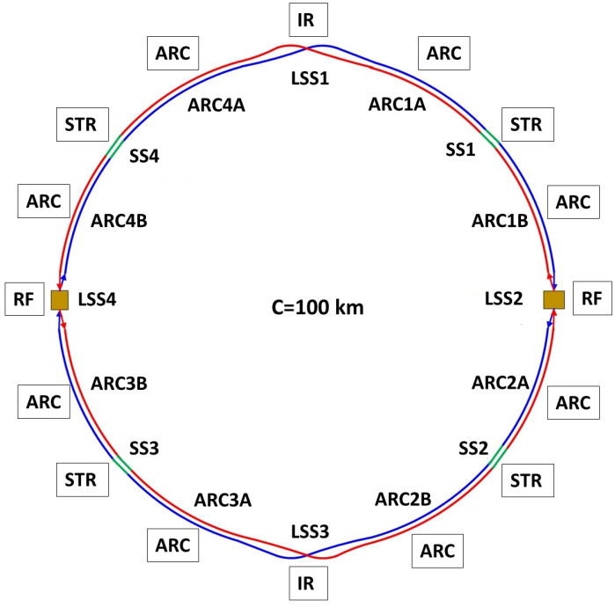
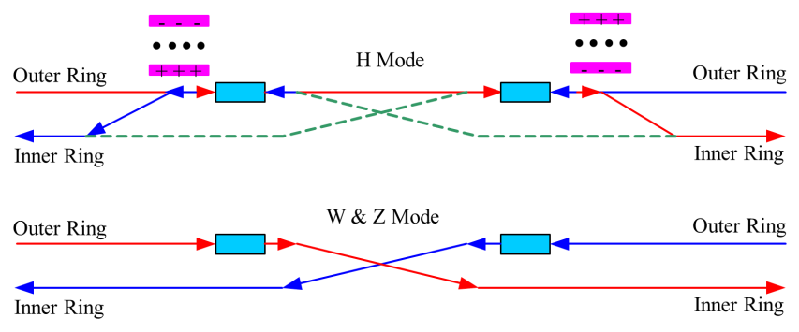
Introduction
The circumference of CEPC collider ring is 100 km.
In the RF region, the RF cavities are shared by two ring for H mode.
Twin-aperture of dipoles and quadrupoles is adopt in the arc region to reduce the their power. The distance between two beams is 0.35m.
Compatible optics for H, W and Z modes
For the W and Z mode, the optics except RF region is got by scaling down the magnet strength with energy.
For H mode, all the cavities will be used and bunches will be filled in half ring.
For W & Z modes, half number of cavities will be used and bunches can be filled in full ring.

Slide 4
Parameters of CEPC collider ring
 | Higgs | W | Z
Number of IPs | 2
Energy (GeV) | 120 | 80 | 45.5
Circumference (km) | 100
SR loss/turn (GeV) | 1.68 | 0.33 | 0.035
Half crossing angle (mrad) | 16.5
Piwinski angle | 2.75 | 4.39 | 10.8
N_{e}/bunch (10¹⁰) | 12.9 | 3.6 | 1.6
Bunch number | 286 | 5220 | 10900
Beam current (mA) | 17.7 | 90.3 | 83.8
SR power /beam (MW) | 30 | 30 | 2.9
Bending radius (km) | 10.9
Momentum compaction (10⁻⁵) | 1.14
β_{IP} x/y (m) | 0.36/0.002
Emittance x/y (nm) | 1.21/0.0036 | 0.54/0.0018 | 0.17/0.0029
Transverse σ_{IP} (um) | 20.9/0.086 | 13.9/0.060 | 7.91/0.076
ξ_{x}/ξ_{y}/IP | 0.024/0.094 | 0.009/0.055 | 0.005/0.0165
RF Phase (degree) | 128 | 134.4 | 138.6
V_{RF} (GV) | 2.14 | 0.465 | 0.053
f _{RF} (MHz) (harmonic) | 650
Nature bunch length σ_{z} (mm) | 2.72 | 2.98 | 3.67
Bunch length σ_{z} (mm) | 3.48 | 3.7 | 5.18
HOM power/cavity (kw) | 0.46 (2cell) | 0.32(2cell) | 0.11(2cell)
Energy spread (%) | 0.098 | 0.066 | 0.037
Energy acceptance requirement (%) | 1.21
Energy acceptance by RF (%) | 2.06 | 1.48 | 0.75
Photon number due to beamstrahlung | 0.25 | 0.11 | 0.08
Lifetime due to beamstrahlung (hour) | 1.0
F (hour glass) | 0.93 | 0.96 | 0.986
L_{max}/IP (10³⁴cm⁻²s⁻¹) | 2.0 | 4.1 | 1.0
D. Wang

Slide 5
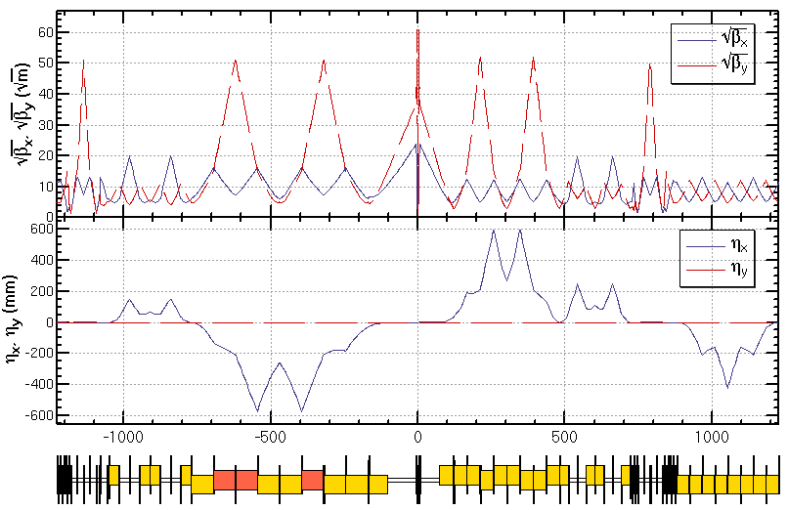
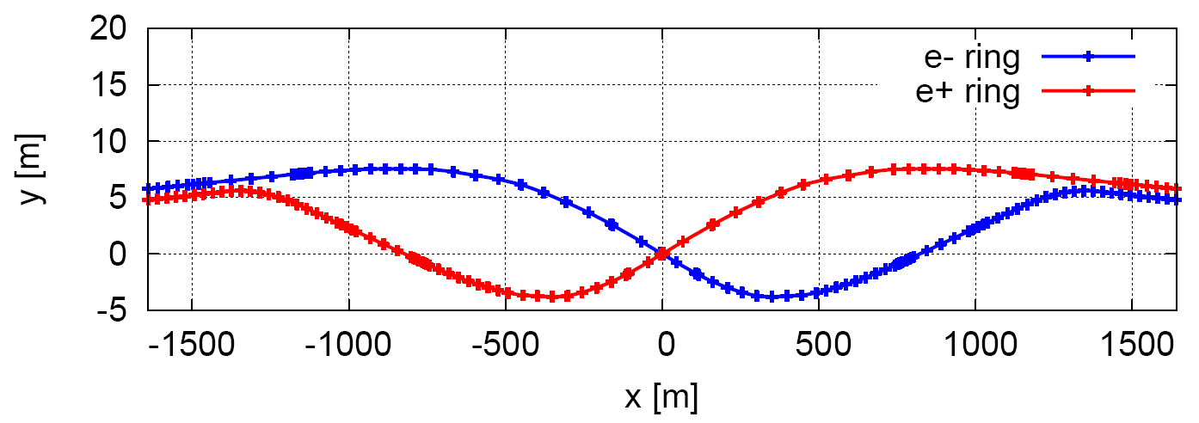
Linear optics of Interaction region
Provide local chromaticity correction of both plane
L*=2.2m, θc=33mrad, GQD0=150T/m, GQF1=100T/m
IP upstream of IR: Ec < 100 keV within 400m, last bend Ec = 47 keV
IP downstream of IR: Ec < 300 keV within 250m, last bend Ec = 95 keV
The vertical emittance growth due to solenoid coupling is less than 4%.
CW
CCX
CCY
FT
L*= 2.2m
βx*= 0.36mm
βy*= 2mm
GQD0≅-150T/m
GQF1≅100T/m
LQD0=1.73m
LQF1=1.48m
Notes:
New IR bends

Slide 6
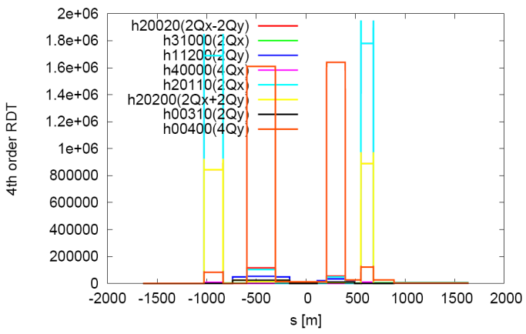
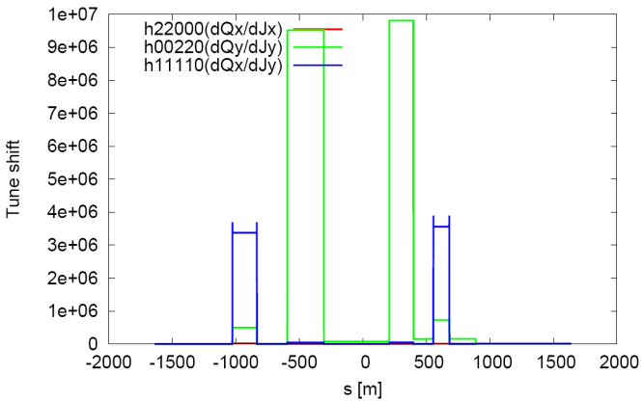
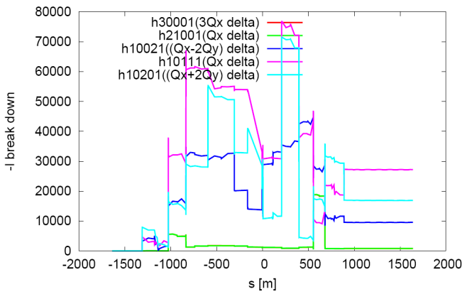
Nonlinearity correction of Interaction region
Local chromaticity correction with sextupoles pairs separated by –I transportation
all 3rd and 4th RDT due to sextupoles almost cancelled 1)
up to 3rd order chromaticity corrected with main sextupoles, phase tuning and additional sextupole pair 2,3)
tune shift dQ(Jx, Jy) due to finite length of main sextupoles corrected with additional weak sextupoles 3,4)
Break down of –I could be optimized with odd dispersion scheme 5), Brinkmann sextupoles 2) or pair of decapoles 3)
Ref:
1) K. Brown
2) Brinkmann
3) Y. Cai
4) Anton
5) K. Oide
J. Bengttson’s formular used in the calculation

Slide 7
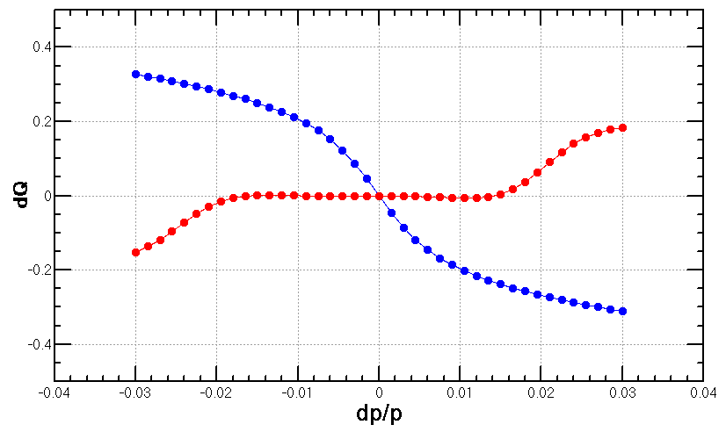
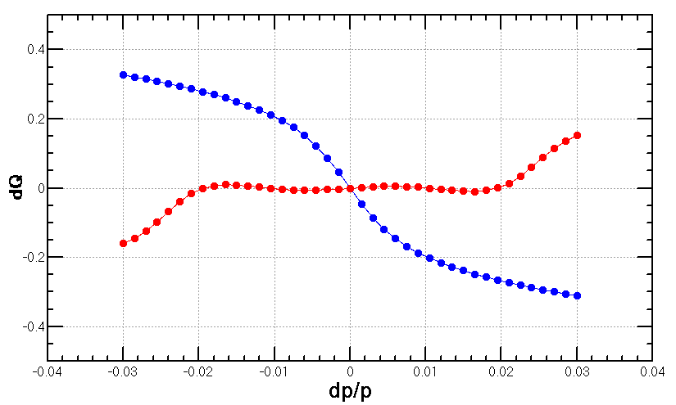
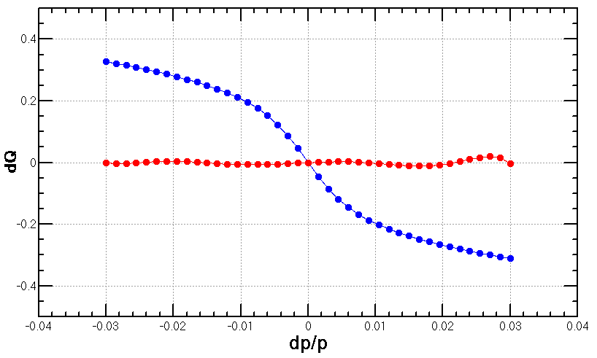
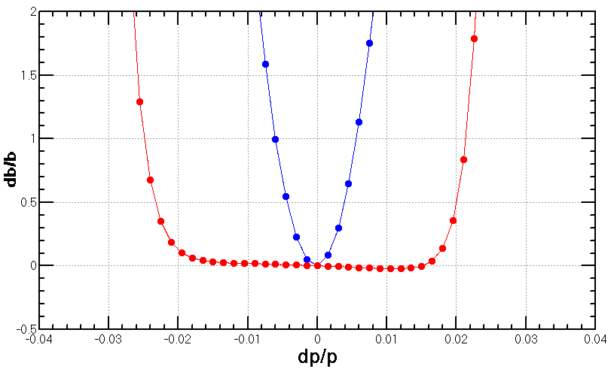
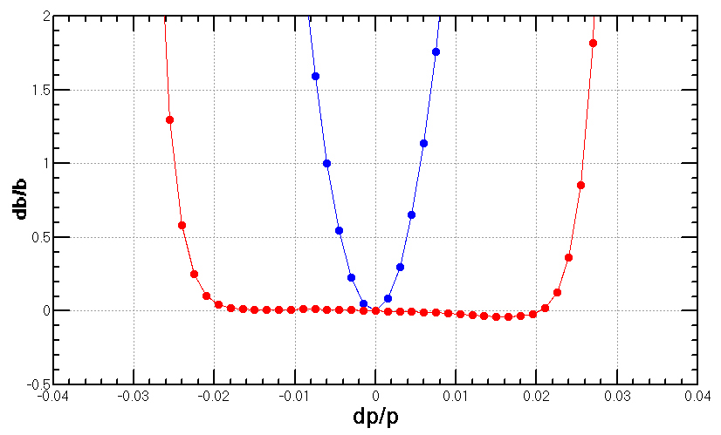
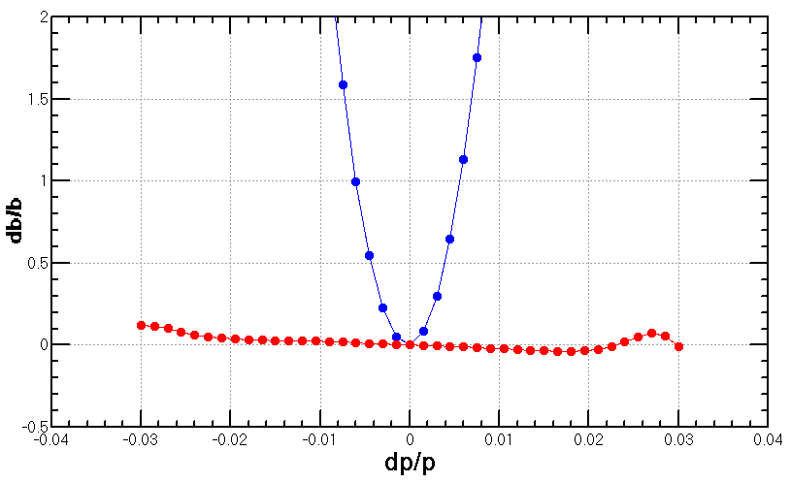
Correction of up to 5th order chromaticity*
w/ 3rd order corr.
w/ 4th order corr.
w/ 5th order corr.
* ref: Y. Cai

Slide 8
Optics choice of ARC region
For the Arc region, the FODO cell structure is chosen to provide a large filling factor.
 | Interleave sextupoles | Non-interleaved sextupoles
60 ° /60° | n=6 All 3rd RDT due to sextupoles cancelled All 4th RDT except 2Qx-2Qy due to sextupoles cancelled dQ(Jx,Jy): accumalte to be large dQ(δ): small even with 2 families DA on momentum: limited by tune shift dQ(Jx,Jy) DA off momentum: easy to optim. | -
90 ° /60 ° | n=12 All 3rd RDT due to sextupoles cancelled All 4th RDT except 4Qx due to sextupoles cancelled dQ(Jx,Jy): accumalte to be large dQ(δ): small even with 2 families DA on momentum: limited by tune shift dQ(Jx,Jy) DA off momentum: easy to optim. | -
90 ° /90 ° | n=4 All 3rd RDT due to sextupoles cancelled 4th RDT except 4Qx, 2Qx+2Qy, 4Qy, 2Qx-2Qy due to sextupoles cancelled dQ(Jx,Jy): accumalte to be large dQ(δ): small even with 2 families DA on momentum: limited by tune shift dQ(Jx,Jy) DA off momentum: easy to optim. | n=5 All 3rd RDT due to sextupoles cancelled 4th RDT except small 4Qx, 2Qx+2Qy, 4Qy, 2Qx-2Qy due to sextupoles cancelled dQ(Jx,Jy): small dQ(δ): correct with many families DA on momentum: large as small tune shift dQ(Jx,Jy) DA off momentum: with many families to correct dQ(δ) and –I break down

Slide 9
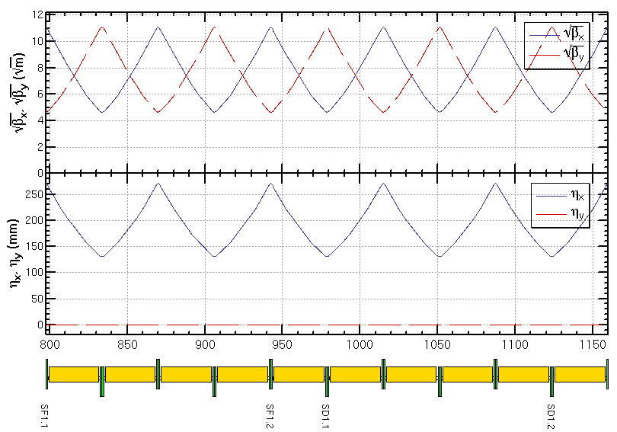
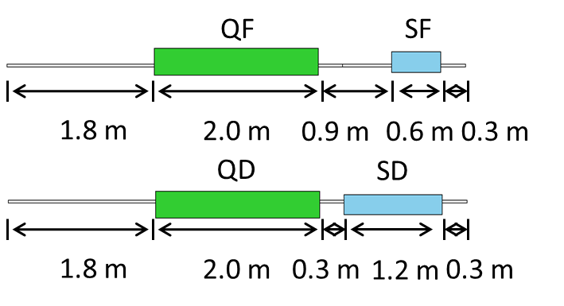
Optics design of ARC region
-I
-I
Notes:
Should be 5 cells

Slide 10
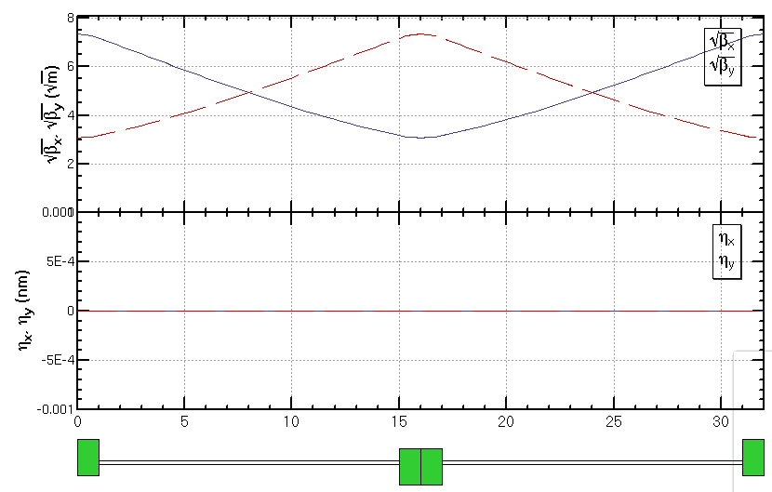
FODO cell for cryo-module
336 / 6 / 2RF stations / 2 sections / 2= 7 cells in each section
get a smallest average beta function to reduce the multi-bunch instability caused by RF cavities
90/90 degree phase advance
as short as possible distance between quadrupoles, but should be larger than a module length (12m)
90/90 deg
Half cell: 14m+2m
βmax: 53.8 m
βmin: 9.5 m
cryo-module
quadrupole

Slide 11
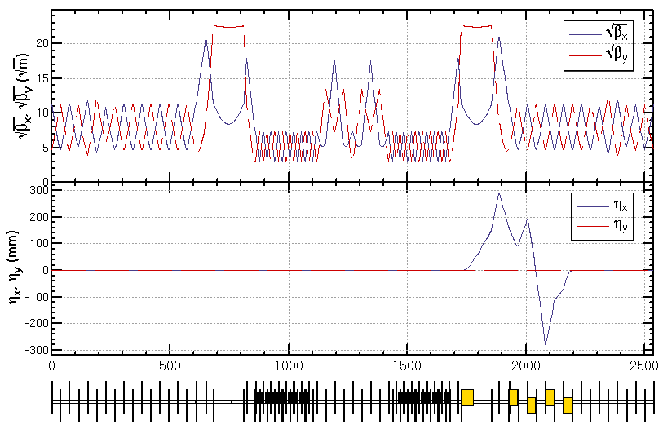
Optics design of RF region
Common RF cavities for e- and e+ ring (Higgs)
An electrostatic separator combined with a dipole magnet to avoid bending of incoming beam (ref: Oide, ICHEP16)
RF region divided into two sections for bypassing half numbers of cavities in Z mode
Phase tuning
Phase tuning
common RF cavities
combined magnet
Esep=1.8 MV/m
Lsep=50m
Ldrift=75m
Δx=10cm at entrance of quad

Slide 12
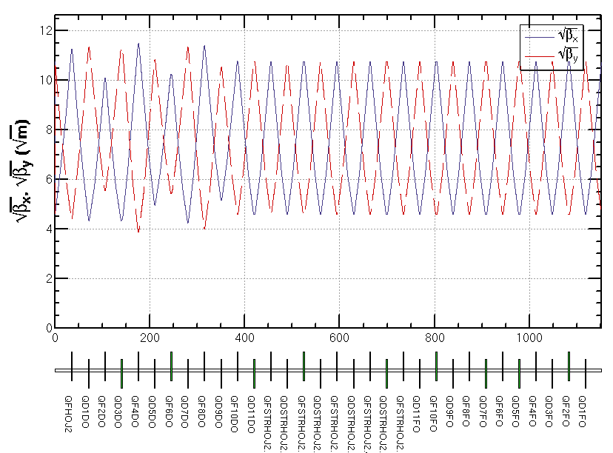
Optics design of Straight section region
The function of the straight section is phase advance tuning and injection.
Independent magnets for two rings
0.3m between two quadrupoles of two rings allows a larger size of quadrupoles
Phase tuning
Injection
Phase tuning

Slide 13
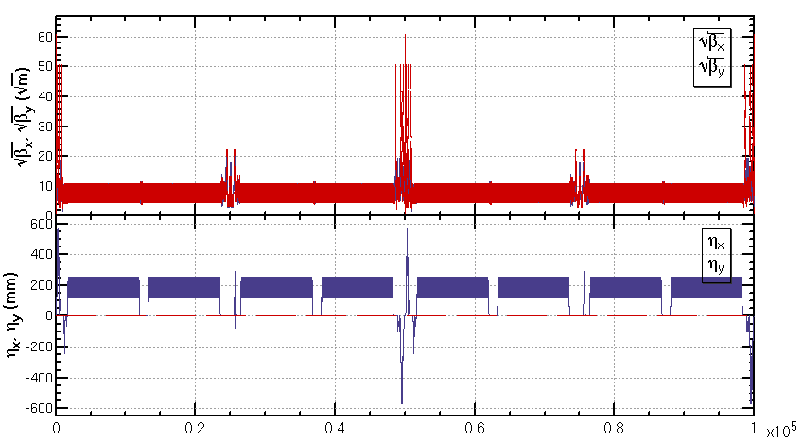
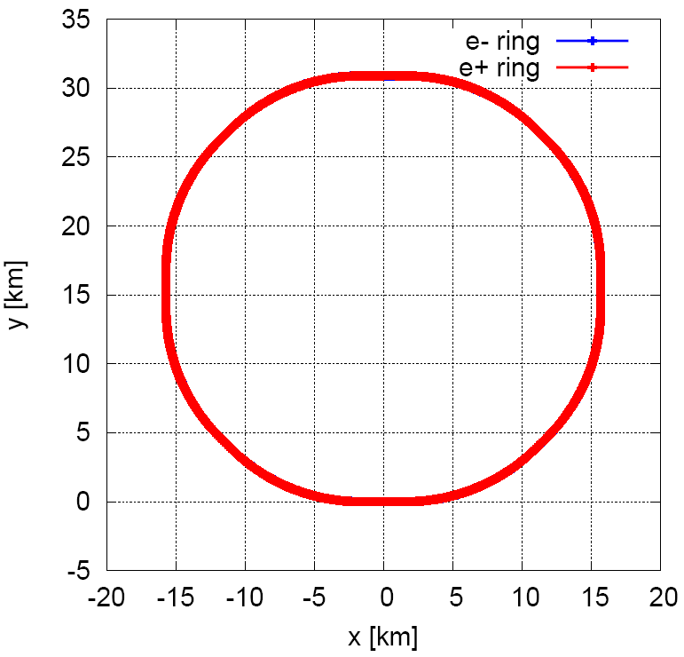
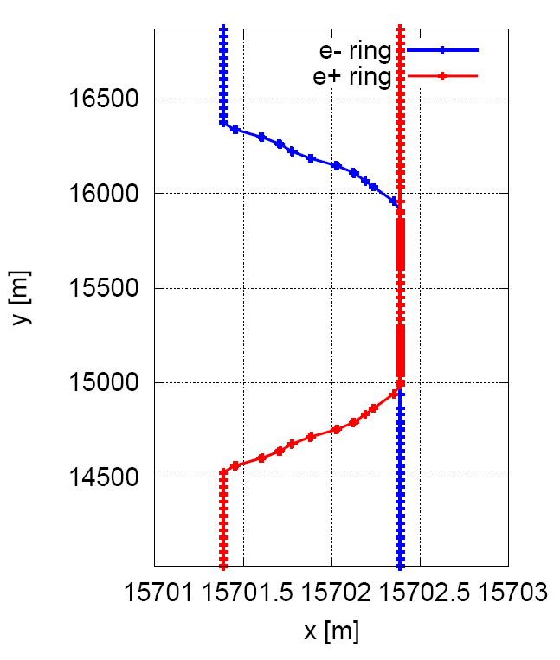
Linear optics of the collider ring
An optics fulfilling requirements of the parameters list, geometry, photon background and key hardware.

Slide 14
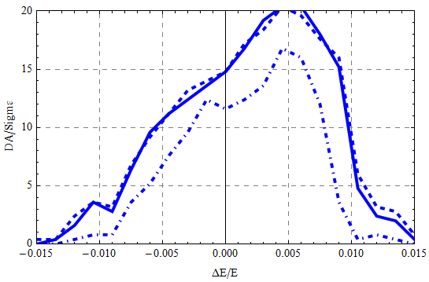
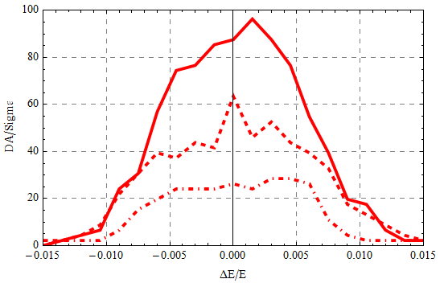
Dynamic aperture
8 families of sextupoles in IR and 4 families of sextupoles in ARC
x
y
Hard line: w/ damping only
Dashed line: w/ damping and fluctuation (20 samples, maximum)
Dot-dashed line: w/ damping and fluctuation (20 samples, minimum)

Slide 15
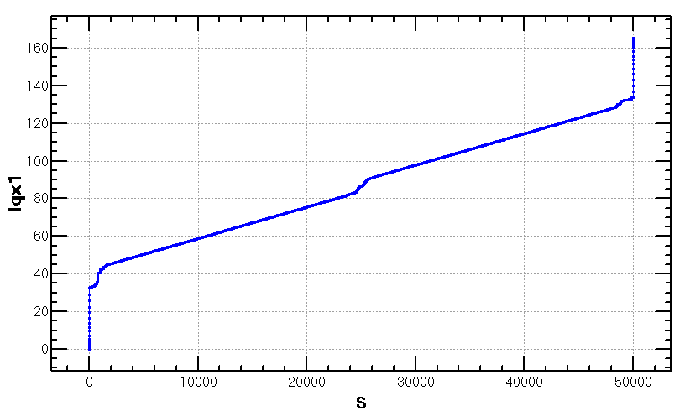
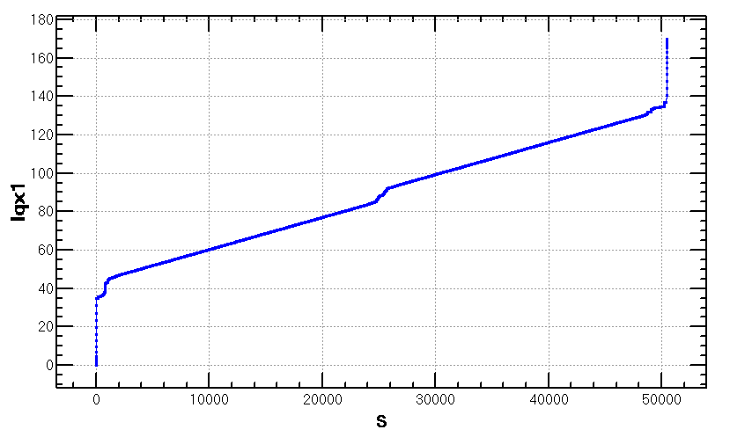
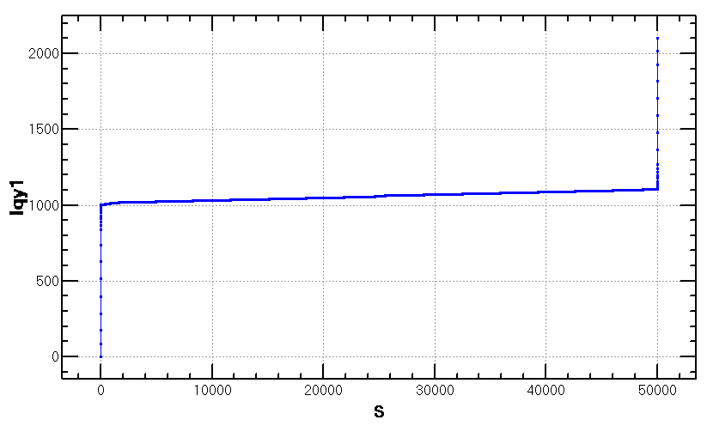
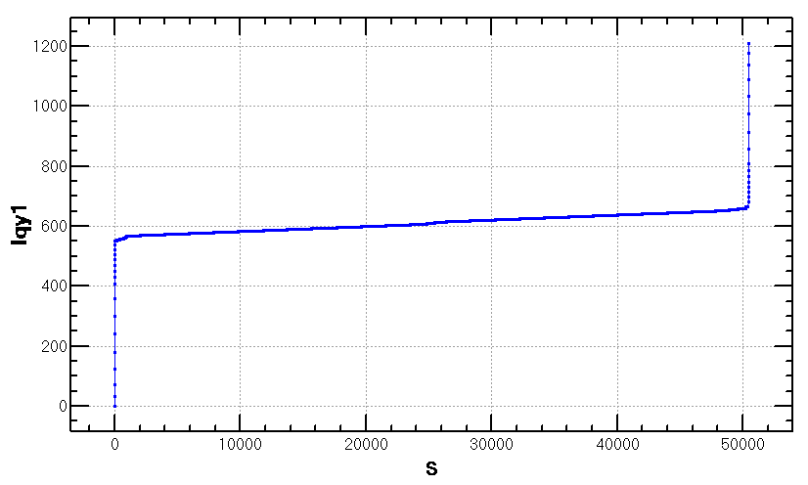
Damping vs damping+fluctuation
Radiation power due to quadrupoles:
$P∝\int{B^{2}ds}∝$ $\int{{K_{1}^{}}^{2}βds≅\sum{{(K_{1}^{}l)}^{2}β/l}}$
LQF=LQD=2.0 m
LQD0=1.73 m, LQF1=1.48m
LQF=LQD=2.0 m
LQD0=1.73 m × 2.0, LQF1=1.48m
small
contribution of QF1 and ARC
quadrupole comparative
lager
contribution of QD0 dominant

Slide 16
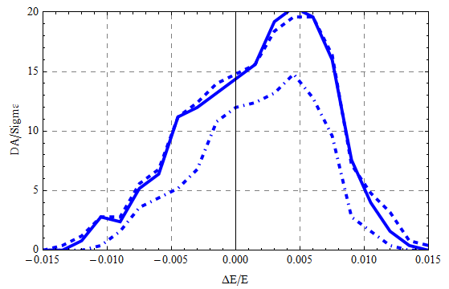
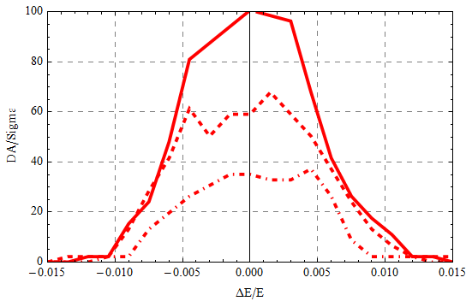
Damping vs damping+fluctuation
LQF=LQD=2.0 m
LQD0=1.73 m, LQF1=1.48m
LQF=LQD=2.0 m
LQD0=1.73 m × 2.0, LQF1=1.48m
x
y
Hard line: w/ damping only
Dashed line: w/ damping and fluctuation (20 samples, maximum)
Dot-dashed line: w/ damping and fluctuation (20 samples, minimum)
Further optimization with longer QD0
by MODE is undergoing.

Slide 17
Summary
Optics of the CEPC collider ring designed fulfilling requirements of the parameters list, geometry, photon background and key hardware.
Efforts made to give a good start point of DA optimization.
Reducing the synchrotron radiation from QD0 significantly increase the vertical dynamic aperture for on-momentum particle.
Study with errors and correction is undergoing.

Slide 18
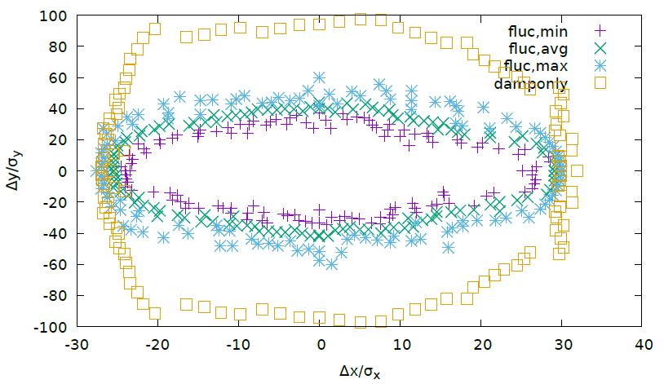
Backup

