Slide 1
DA studies in CEPC by downhill method
ICFA Mini-Workshop on Dynamic Apertures of Circular Accelerators
Dou Wang, Yuan Zhang, Yiwei Wang, Huiping Geng, Chenghui Yu, Weiren Chou, Jie Gao
Many Thanks: K. Oide(KEK), Y. Cai (SLAC), D. Zhou(KEK)
1-3 November 2017, IHEP.

Slide 2
Outline
Introduction Downhill method & modifications
Application on CDR lattice
Application on new lattice with combined magnets (dipole + sextupole) in arcs

Slide 3
Dynamic aperture study in CEPC
DA requirement for Higgs (with errors, crab sextupoles and beam-beam)
On-momentum: 20σx × 30σy
Energy acceptance: 1.5%
Multi-sextupole optimization
Two methods:
- Downhill Simplex, K. Oide@KEK
MODE (Multi-Objective optimization by Differential Evolution), Y. Zhang@IHEP
Effects included in DA tracking
- Synchrotron oscillation
- SR Damping
- Sawtooth + tampering
- Quantum fluctation
Difference of two methods
Downhill: local search, quick convergence, need less cpu.
MODE: global search, time consuming, need strong computers.
Both methods were used on CEPC to complement each other.

Slide 4
Principle of downhill optimization
Scan the strength of sextupoles;
DA tracking for the energy list
Calculate the objective function (DA)
Find the minimum of the objective function by the downhill simplex method
Go to 1.
Optimization stop when
(fmax-fmin)/(abs(fmax)+abs(fmin)) < Tolerance

Slide 5
Objective function for DA optimization
Case I: wth ≥ 0, optimize the energy bandwidth
-- t: Touschek lifetime
-- Bandwith(n): DA bandwidth according to n*σ DA reference
-- w & w1: weight for the DA bandwidth
Case II: wth < 0, optimize the total DA value
-- DA_{j}(i): DA for i*σ_{δ} energy deviation with the j^{th} initial phase (totally 6 phases)
-- w(i) : DA weight for i*σ_{δ} energy deviation

Slide 6
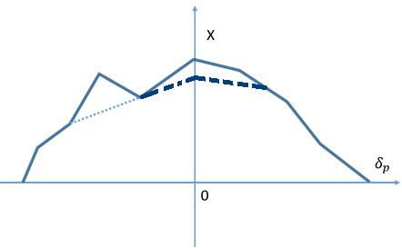
Downhill Simplex modification
DA results not stable while opening fluctuation
Cancel the noise due to fluctuation
Two methods：
Scan whole DA list (5 seeds) → Minimum
Scan DA at center energy (10 seeds) → Minimum → Clip
So far, we used method 2 to save computer time.

Slide 7
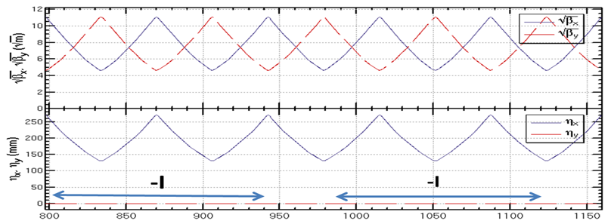
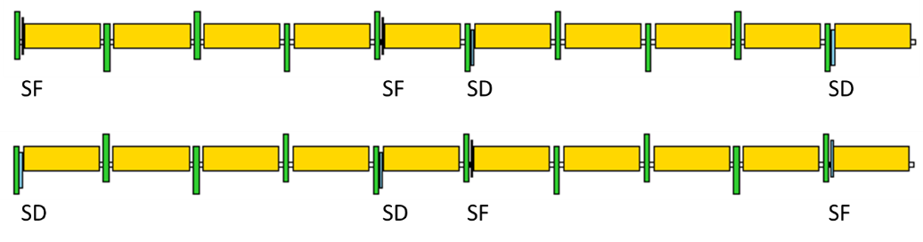
CEPC CDR lattice - arc
  FODO cell, 90°/90°, non-interleaved sextupole scheme
  224 sextupole pairs in the half ring

Slide 8
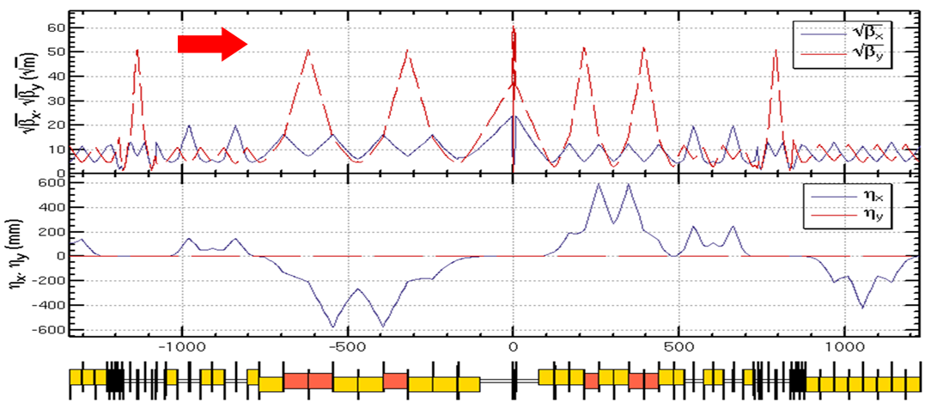
CEPC CDR lattice - IR
  Final Telescope + CCY + CCX + Matching + crab section
  10 sextupole pairs in the half ring
CCY: 4 pairs → linear chromaticity + sextupole length effect
CCX: 4 pairs → linear chromaticity + sextupole length effect
Image points: 2 pairs → third order chromaticity (vertical)
- Ι
- Ι
- Ι
- Ι

Slide 9
Sawtooth effect
With only two RF station, the sawtooth orbit : ~1mm
~5% distortion of beam optics and DA reduction
sawtooth orbit after tapering: ~1um
DA study always include sawtooth + tampering

Slide 10
Initial DA
Crab=1
100 turns tracking
50 seeds
Ax(0): 14 σx
Ay(0): 36 σy
DA bandwith: 1.2%

Slide 11
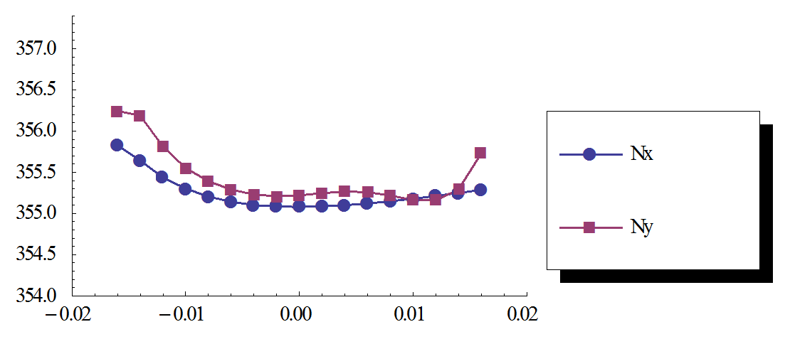
DA-after optimization
− 234 sextupole knobs (no check for variable redundancy)
100 turns tracking
50 seeds
Crab=1
Ax(0): 14 σx
Ay(0): 33 σy
DA bandwith: 1.6%

Slide 12
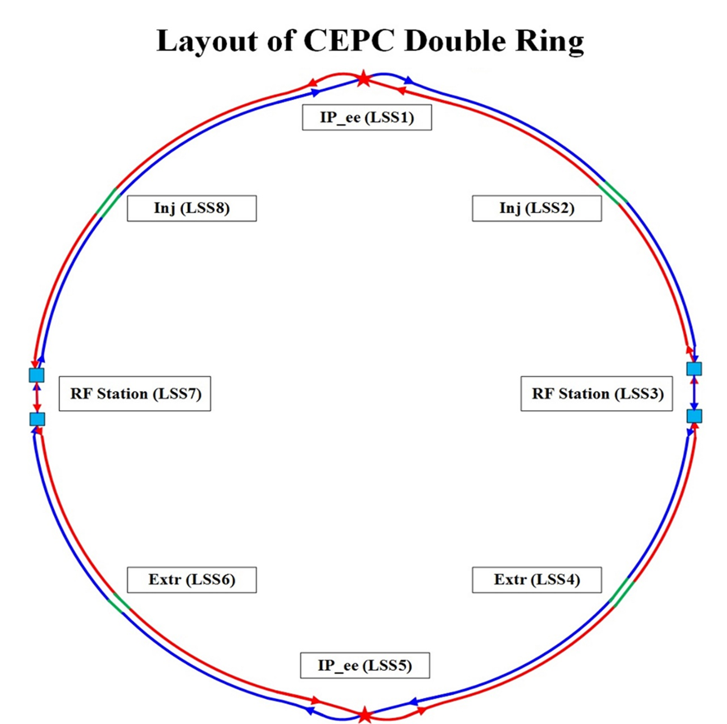
Quadrupoles optimization in MODE
12*6 quadrupoles are varied for phase advance tuning
Working points are locked.
Phase tuning sections
Phase tuning sections

Slide 13
DA optimization with MODE’s K1
Optimization with additional K1 knobs give ~20% DA enlargement.
234 K2 knobs
K1 values from MODE
234 K2 knobs
Crab=1
Crab=1
100 turns tracking
50 seeds

Slide 14
Principle of combined D+S scheme
The power consumption of the arc sextupoles are too high.
Sextupole : 16.7 MW (copper coils)
Dipole: 6.5 MW (Al coils)
Reducing the strength of the stand-alone sextupoles can make help.
Combined function magnet: dipole + sextupole
Combined sextupoles: correct part (all) of the linear chromaticity
Stand-alone sextupoles: correct higher order chromaticity

Slide 15
New lattice with combined D+S
Five dipoles between two quadrupoles in the arc
Combined sextupoles are on the first and fifth dipoles (β_{x,y} >>β_{y,x})
-- one dipole is cut into 6 slices
-- 7 thin sextupoles are insert in one dipole
No additional power sources for SF and SD
SF
SD
SD
SF

Slide 16
Primary magnet design for combined D+S
Twin aperture dipole
Separation of two ring: 0.35m
SF
SD

Slide 17
Case I: 50% K2 reduction
Chromaticity correction with SF & SD
SF =0 m⁻²
SD =0 m⁻²
SF =30.4 T/m
SD =-51.2 T/m

Slide 18
DA before multi-sextupole optimization
Crab=1
50% reduction
Tracking 100 turns
20 seeds
phase=0
phase=π/2
phase= π
phase=3π/2

Slide 19
DA after multi-sextupole optimization
Crab=1
50% reduction
Optimization knobs: 234 K2s
Tracking 100 turns
20 seeds
phase=0
phase=π/2
phase= π
phase=3π/2

Slide 20
DA comparison
Tracking 200 turns
50 seeds
w/o combined D+S
w combined D+S (50% reduction)

Slide 21
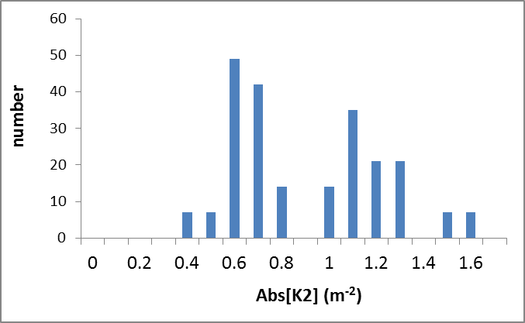
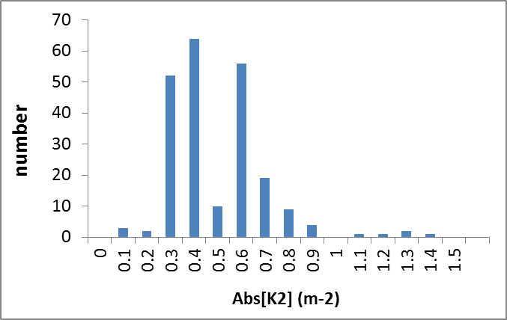
Strength of independent sextupoles
w/o combined D+S
w combined D+S (Case I)

Slide 22
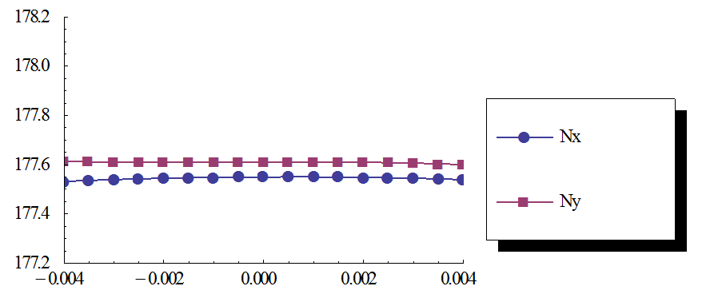
Case II: 90% K2 reduction
Chromaticity correction with SF & SD
SF =0 m⁻²
SD =0 m⁻²
SF =55.6 T/m
SD =-94.4 T/m

Slide 23
DA before multi-sextupole optimization
Crab=1
90% reduction
Tracking 100 turns
20 seeds
phase=0
phase=π/2
phase= π
phase=3π/2

Slide 24
DA after multi-sextupole optimization
Crab=1
90% reduction
Optimization knobs: 234 K2s
Tracking 100 turns
20 seeds
phase=0
phase=π/2
phase= π
phase=3π/2

Slide 25
DA comparison
Tracking 200 turns
50 seeds
w/o combined D+S
w combined D+S (90% reduction)

Slide 26
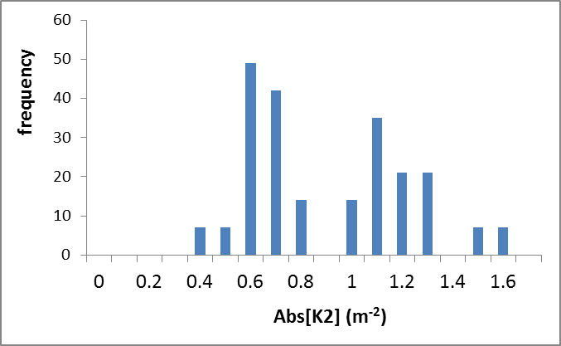
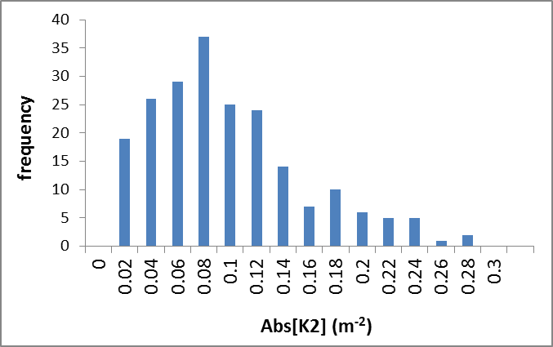
Strength of independent sextupoles
w/o combined D+S
w combined D+S (Case II)

Slide 27
Summary
Both Downhill and MODE were used to complement each other.
Downhill can give almost same results as MODE.
-- Plan to introduce K1 knobs in Downhill
First taste of combined magnet (D+S) looks good.
-- Power for sextupoles → ¼, 50% reduction of independent K2
-- Still need careful check for the DA results

