Slide 1
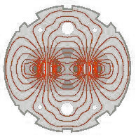
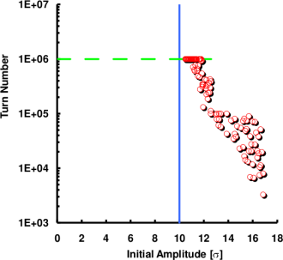
Review talk on Dynamic Aperture
Numerical Challenges and modern Solutions in Single Partical Non-Linear Dynamics
Challenges & Solutions
What is the Dynamic Aperture (DA)?
Definition & Chaos Criteria
Measurement (Classic Kick Technique)
Simulation & Computing
DA experiments since the late `80s
SPS
Tevatron
Hera
LHC DA Experiment (E.H. Maclean, R. Tomàs, F. Schmidt, and T.H.B. Persson)
1

Slide 2
Challenges & Solutions 1/2
In 1994 we got the green light to construct the LHC at CERN.
R&D had started long before but in earnest after the approval.
Roughly 14 years of construction but also optics work.
Continuous collaboration between magnet designer and optics specialist to optimize the magnet field quality (main dipoles & triplet magnets).
Superconducting magnets need to tweaked to optimize the higher order field components ( <= b11 ).
By all means avoid systematic (low order) resonances (LHC integer tune 69).
Power supplies
Traditional Systems: Watch out to reduce multiples of 50HZ➔Tune Ripple ➔ Experiments&Simulations indicate large reduction of DA!
Switch Mode: Make sure the higher frequency do not coincide with the betatron freqency or other system frequencies.

Slide 3
Challenges & Solutions 2/2
Dipole Coil Aperture enlarged from 50 to 56 mm.
LHC Switch Mode PS should avoid tune ripple. Very low noise level in general!
Tune split 59/64 to avoid linear coupling without bad systematic resonances.
All Multipole Components are either measured cold (10%) or induced by the warm-cold correlation ➔ The CERN Fidel database holds all that information including misalignments & tilts. Additionally, these data are manipulated via Wise to be read in by MAD-X.
15 years of intense Simulation Campaign
Use or Develop various Non-Linear Analysis Tools: NormalForm, Chaos Detection, Survival Plots, Driving Term Measurement, Frequency Maps, Chaos Maps*.
Speed Optimization of Symplectic Tracking Code (SixTrack), Rounding Errors checked to be sufficiently small.
Simulation Engine for massive simulation Runs ( <= 10k jobs ).
Very systematic parameter scans with and without BB and always over 60 seeds to evaluate the effect of the Random Part of the Multipole Components.

Slide 4
Tracking Engine for massive LHC Tracking Studies 1/2
Many Thanks to Eric McIntosh
For LHC tracking we are using SixTrack which is kept rigorously bug-free while continuously optimizing the code for speed.
The lattice is transferred from MAD-X. MAD-X, SixTrack & PTC are benchmarked against each other.
Great care has been taken to sample the 6D phase space appropriately!
We have prepared a SixTrack run environment which allows to automatically launch up to 10k of jobs at a time and storing all output data in a elaborate directory structure. After all jobs have been finished, automatic post-processing procedure are being launched for a full analysis of the simulation data.

Slide 5
Tracking Engine for massive LHC Tracking Studies 2/2
Jobs can be sent to various batch systems, e.g. a local CERN batch cluster with 400 nodes is at our disposal.
Moreover, we at CERN have created LHC@Home. Presently about >150’000 volunteers have sign up to contribute world-wide. The so-called BOINC system organizes the flow of jobs to the contributors and sends back the results into our directory structure, E.G. 2005 a Tunescan was done with BB: 10⁶ runs, each over 10⁶ turns using 6 months continuously using 75’000 boxes.
Special care has been taken by Eric McIntosh to guarantee bit-by-bit accuracy on any computer platform. A checkpoint-restart mechanism is implemented as well.

Slide 6
Definition of Dynamic Aperture
W. Fischer, F. Schmidt, Y. Luo
Real World Dynamic Aperture (RW-DA) Definition ➔ W. Fischer:
Largest Amplitude at which particles remain in the accelerator over a time range of interest.
Potential Dynamic Aperture (PO-DA) = Onset of global Chaos
Largest Amplitude with mainly regular motion.
Insignificant chaotic layers within the regular regime will be ignored.
However considerable wide “chaotic spikes” have to be taken into account ➔ F. Schmidt, Y. Luo
➔ It turns out that the PO-DA is typically too small as RW-DA estimate

Slide 7
Chaos Criteri
F. Schmidt, thesis 1988
PO-DA Detection ➔ find amplitude with non-zero Lyapunov Exponent:
In practice, the Lyapunov exponent is rarely evaluated directly.
Instead, one follows the evolution of the distance in phase space. Most effectively by using the angular distance that is extremely sensitive to find even weakly chaotic motion.

Slide 8
Dynamic Aperture Scheme
F. Schmidt, thesis 1988
Rapid amplitude growth and loss
Stable Islands in chaotic sea
Fine chaotic layers in stable regime
Mostly stable particle motion
RW-DA
PO-DA

Slide 9
DA in 1D
F. Schmidt, thesis 1988

Slide 10
1D close-up
F. Schmidt, thesis 1988

Slide 11
2D Stable and Chaos
F. Schmidt, thesis 1988

Slide 12
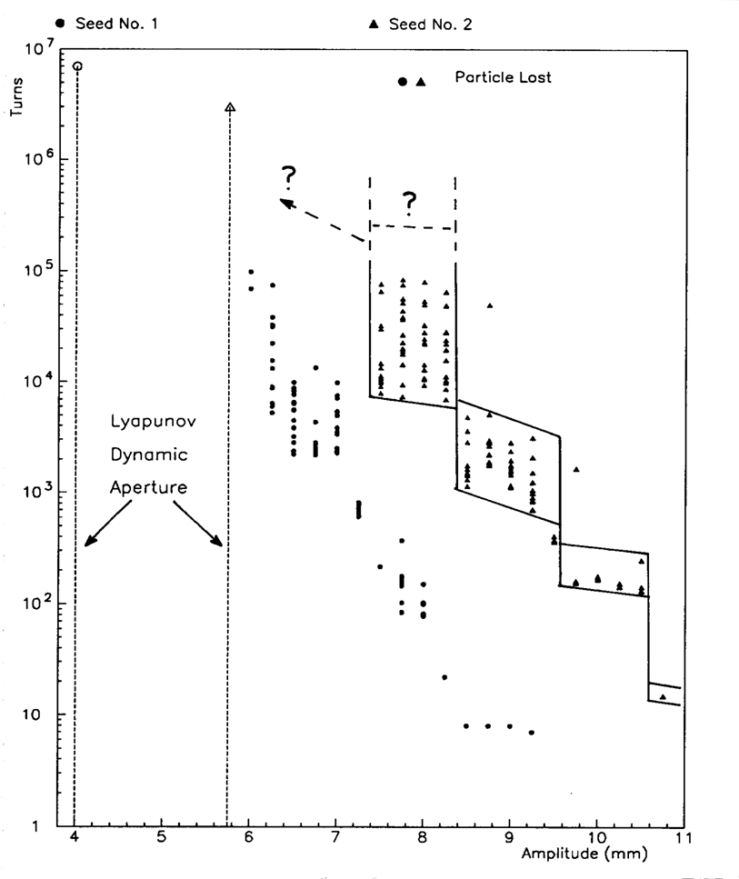
Survival Plots and Resonance Wandering F. Galluccio, F. Schmidt
The survival plots depict the number of turns particles stay in the machine for a given amplitude. In this particular example we tracked an ensemble of particles started in a tiny volume of phase space. The width of the survival times tends to grow inverse proportionally with amplitude since the chaotic motion becomes weaker. There is no known method that could predict the evolution to smaller amplitudes toward the onset of global chaos.

Slide 13
Survival Plots and Resonance Wandering
F. Galluccio, F. Schmidt

Slide 14
3Q_{y}=16 – uncorrected
Drivingterm Measurement & Correction 1/2,
CERN Thesis: 1988, “LEAR Ring”, J. Bengtsson, 2004, “PS Booster”, P. Urschütz
Beam intensity
Vertical beam position
Normalised phase space
resonance strength and phase:
(0, 3) Resonance Line
Phase and amplitude data obtained from Fourier spectra
Fourier spectrum

Slide 15
3Q_{y}=16 – compensated
Drivingterm Measurement & Correction 2/2,
CERN Thesis: 1988, “LEAR Ring”, J. Bengtsson, 2004, “PS Booster”, P. Urschütz
Beam intensity
Vertical beam position
Normalised phase space
Results from the measurements:
|h₀₀₃₀| = 9.0±0.6*10⁻³ mm^{-1/2}
ψ₀₀₃₀ = -21º±14º
Calculated compensation currents (for two independent skew sextupoles):
I_{XSK2L4} = -29.3 A, I_{XSK9L1} = +15.3A
Fourier spectrum

Slide 16
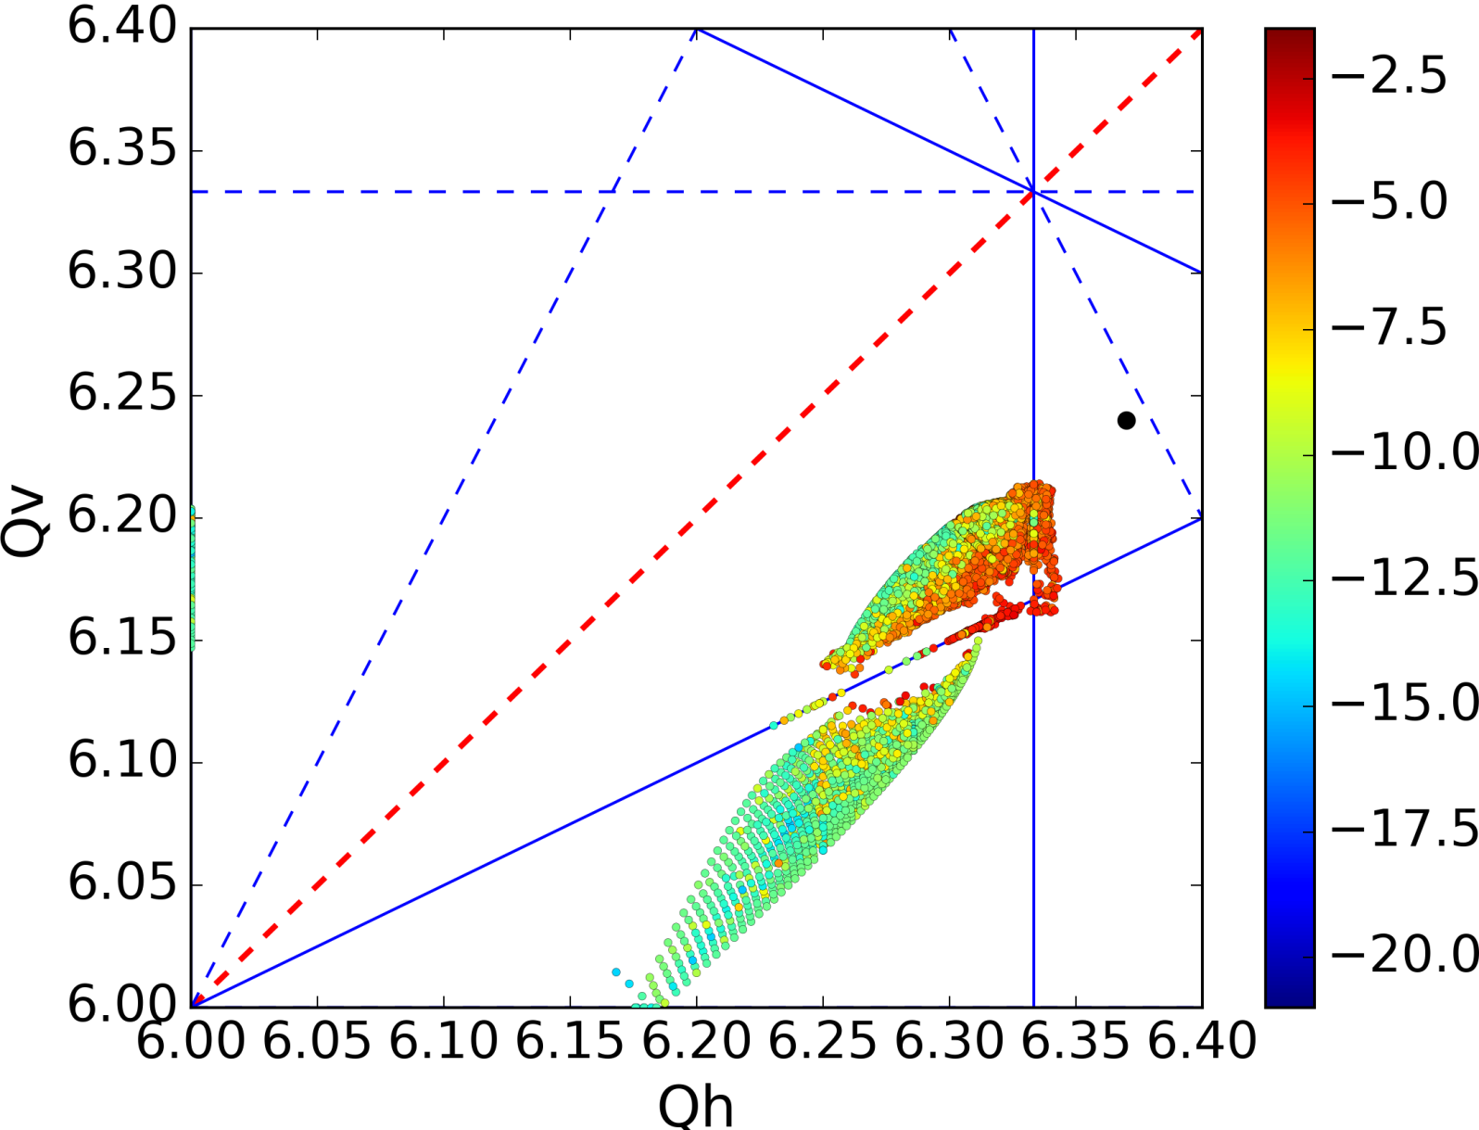
Frequency Map Analysis
J. Laskar, Physica D 67, 257 (1993), J. Laskar and D. Robin, Part. Acc. 54, 183 (1996)
Foteini Asvesta CERN
2017, PS with strong sextupoles for Chromaticity Correction,
Strong Space Charge
(1, -2) Resonance Line

Slide 17
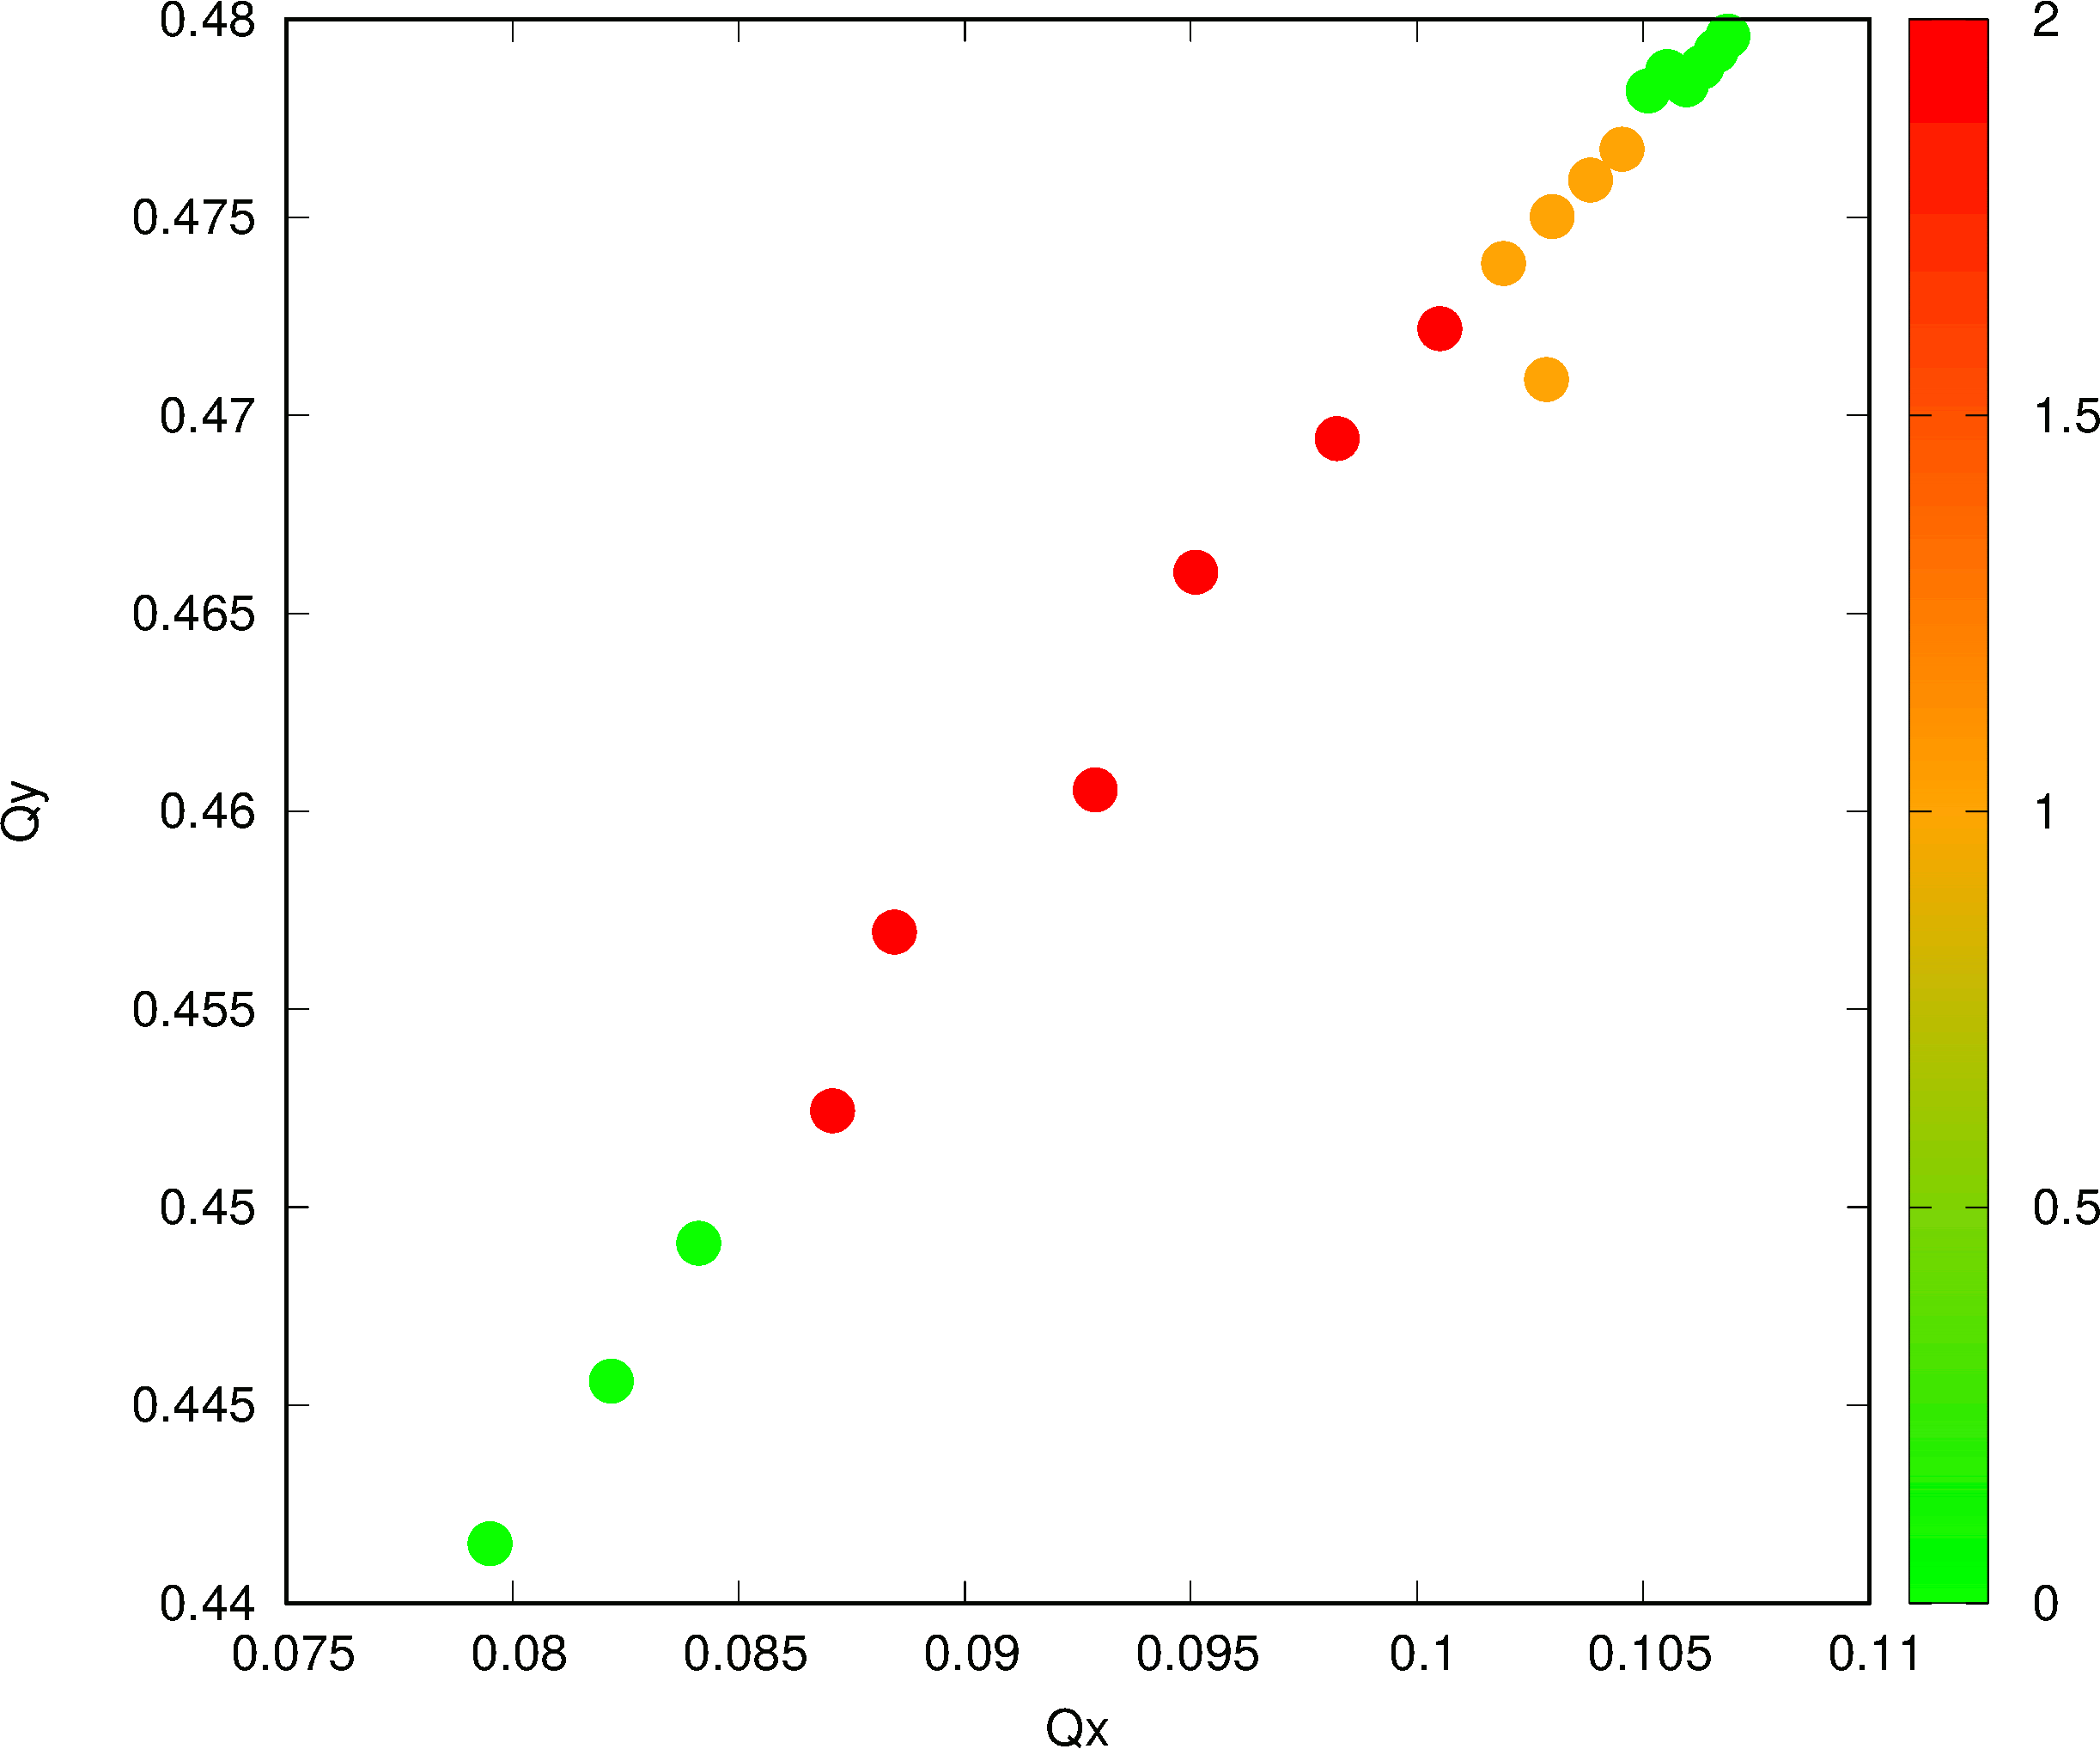
Chaos Map Analysis
Michail Zampetakis & Frank Schmidt
Chaos Map Analysis
2017, PS Study with weak space charge and a strong sextupole. Under development
and with refinement to the Frequency Map Analysis
(1, 2) Resonance Line

Slide 18
DA Experiments 1988 - 1994
In view of the proposed 2 competing projects the SSC and LHC, experiments have been conducted both at SPS and Fermilab
SPS (1988 - 1996)
E778 (1989) at Tevatron
With the following agenda:
DA measurements to compare with simulation code:
SPS: the machine is too linear, therefore 8 strong sextupoles have been powered with self-compensation of the low order resonances.
Tevatron: Non-linear but there has never been a complete model of Tevatron including non-linearities
Effect of Resonances
Influence of Tune Modulation
Diffusion speed at large amplitudes
2004 Hera DA experiment

Slide 19
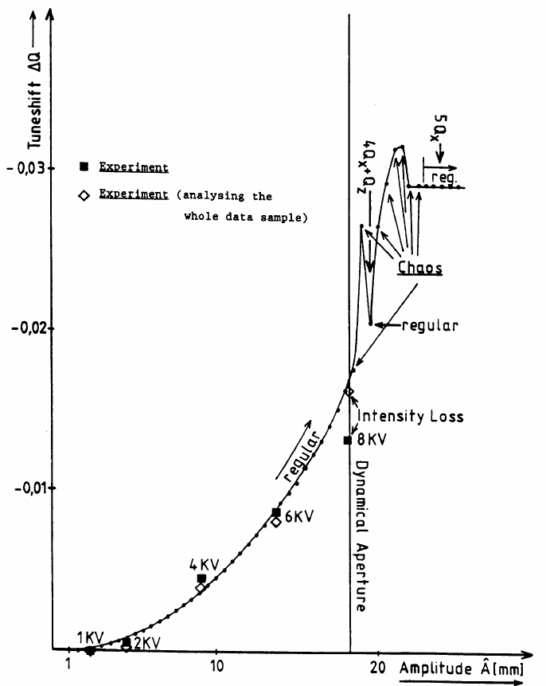
SPS DA Experiment 1988 J. Gareyte, A. Hilaire, F. Schmidt
Dynamic Aperture

Slide 20
DA Experiment (HERA)
Wolfram Fischer’s PhD thesis

Slide 21
Conjecture: Factor of 2 LHC Safety Margin 1/2 M. Böge and F. Schmidt
Following the rather sobering experimental results we decided to apply a certain safety factor to insure stable motion at 6 σ, i.e. the projected positions of the collimators. Obviously, this isn’t really hard science but lacking convincing experimental evidence we hoped to be on a safe path to a LHC machine not limited by dynamic aperture. We follow here the original version (slightly modified):
“TRACKING STUDIES FOR THE LHC OPTICS VERSION 4 AT INJECTION ENERGY“,
M. Böge and F. Schmidt,
LHC Project Report 103, (PAC, Vancouver 1997).

Slide 22
Conjecture: Factor of 2 LHC Safety Margin 2/2
We consider always the minimum DA which is pessimistic but on the other hand tracking with 60 seeds underestimates the DA by 5%. We figured that this will cancel out.
Here the individual reduction factors:
Finite 6D mesh: 8%
Additional DA loss scaling from 10⁵ ➔ 4x10⁷ turns: 7%
Linear Imperfections: 7%
Ripple & Time varying fields: 7%
Unknown Effects: 20%
➔ Additing all up linearly (pessimistic!) we get 49% or a factor of 2 of reduction of the simulated DA.
This means that we will need about 12 σ DA in the simulations to insure stability at 6 s. Effectively before the commissioning of the LHC we found 11.3 σ.

Slide 23
DA Experiments LHC 2012
At the LHC in 2011 and 2012 we had 1 shot each to do this DA experiments. We have been fortunate enough to do independent experiments on Beam1 and Beam2
Beam1: This was dedicate to a new technique to probe the dynamic aperture according to the inverse logarithm scaling law for the dynamic aperture. This scaling law, derived from tracking data, has been recently used to derive a possible relation between the intensity evolution and dynamic aperture. This has been performed by Massimo Giovannozzi and analzed by E.H. Maclean.
Beam2: This part of the experiment determines the DA with the classical kick technique and will be reported here. Rogelio Tomàs and Frank Schmidt have been leading this effort and the (former) PhD student Ewen Maclean and also T.H.B Perssson doing all the work! It goes without saying that we are indebted to the machine protection group that allowed us to use the powerful MKA kicker and also the BI experts and the LHC operation team. A report has been published:
E.H. Maclean, R. Tomàs, F. Schmidt, and T.H.B. Persson, “Measurement of LHC non-linear observables using kicked beams.”, Phys. Rev. ST Accel. Beams 17, 081002 – Published 18 August 2014.

Slide 24
Kick Experiment and Simulation Conditions
Experiment
LHC Injection Energy 450 GeV
Aperture kicker (MKA) up to ~14 beam sigma
collimators set to 11.7 beam sigma to protect the triplets
BPM system calibrated before the experiment
Wire scanners scale enlarged to cover 12 sigma kicks
DA Measurement via Loss monitors
Simulation
Latest LHC lattice
Multipole of machine as build
Seeds needed for cold-warm variations. The usual 60 seeds tracked.
Misalignment measurement of all magnets (offsets and tilts)
For the corrected machine the first order detuning has been matched to the measured ones.

Slide 25
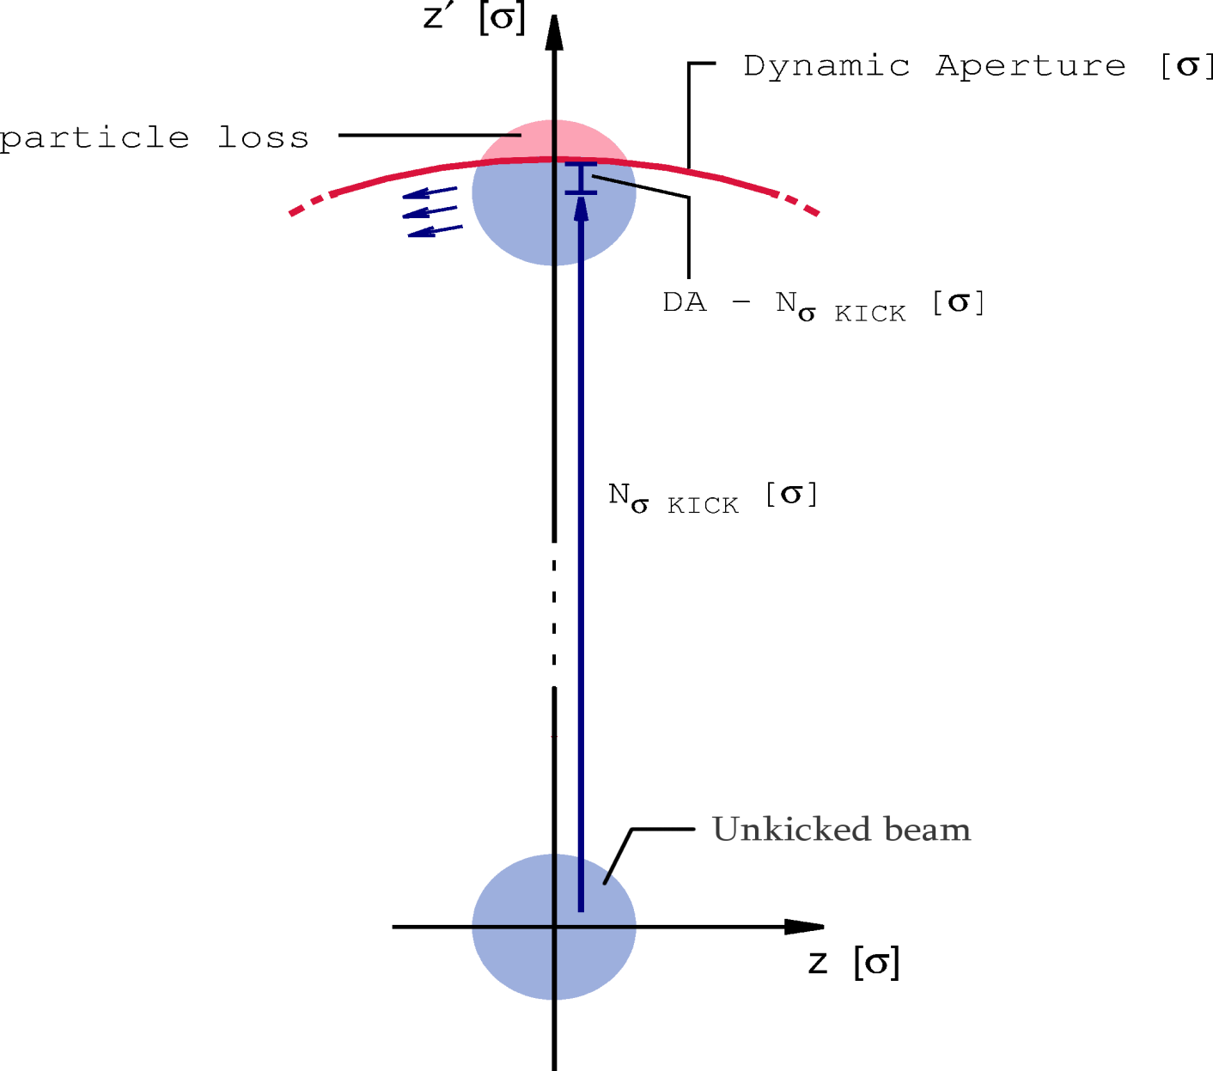
Classic Kick Technique 1/6 E.H. Maclean, R. Tomàs, F. Schmidt, and T.H.B. Persson

Slide 26
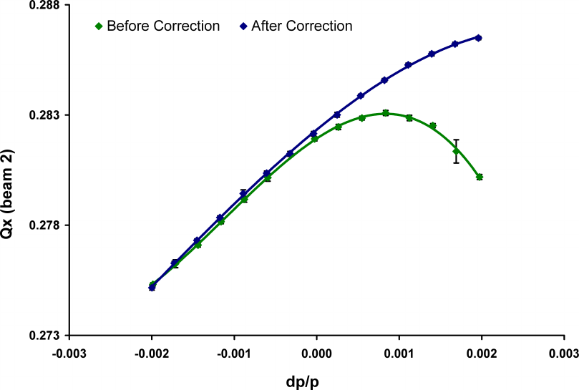
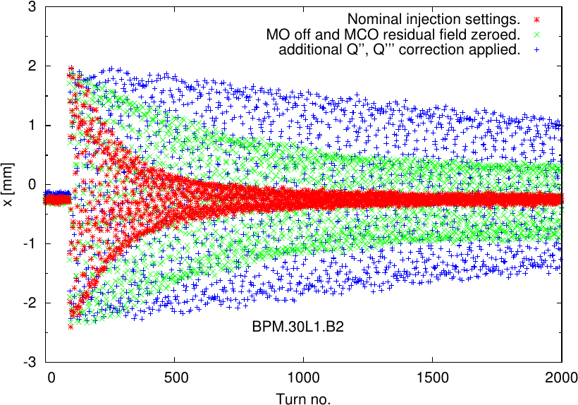
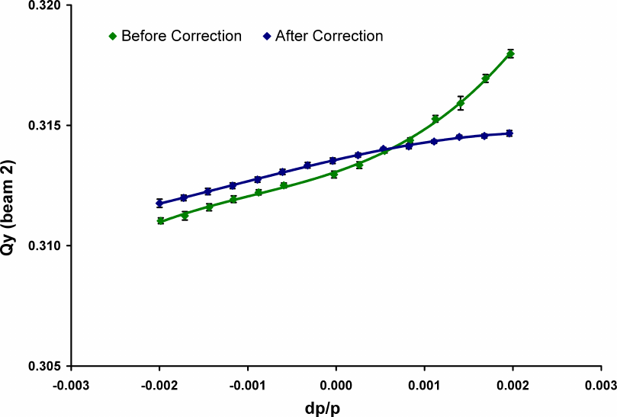
Q’’ & Q’’’ Correction - LHC 2/5 E.H. Maclean, R. Tomàs, F. Schmidt, and T.H.B. Persson
2012
2011
Horizontal
Nominal Machine
Vertical

Slide 27
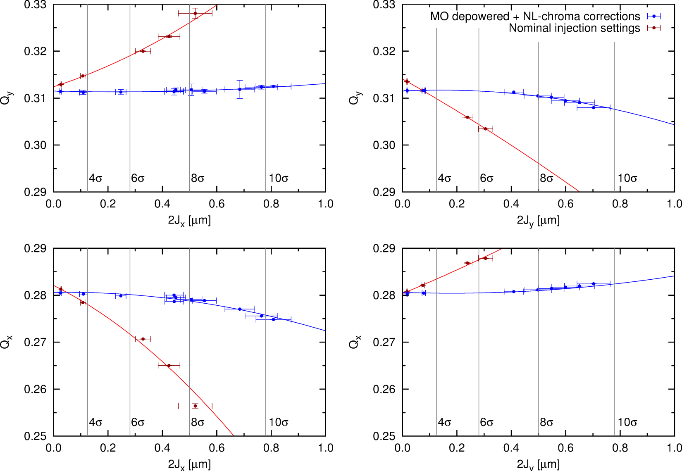
Detuning with Amplitude - LHC 3/6 E.H. Maclean, R. Tomàs, F. Schmidt, and T.H.B. Persson
Corrected Machine
Nominal Machine

Slide 28
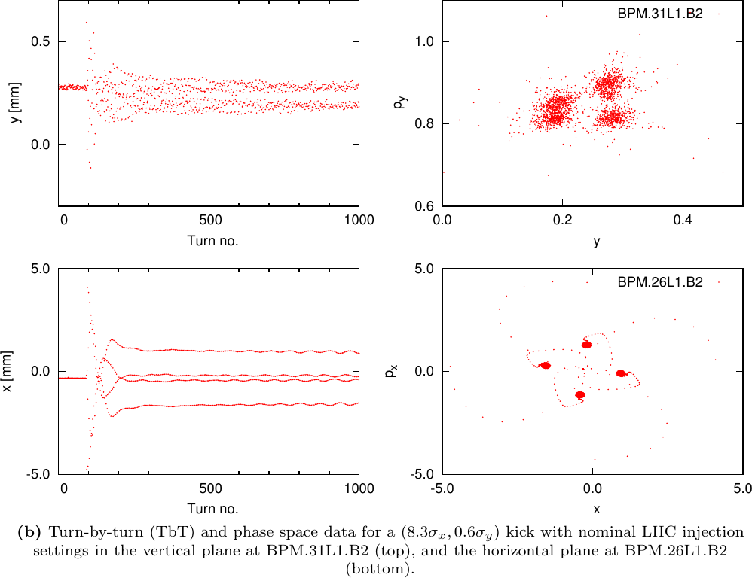
H&V Resonances - LHC 4/6
E.H. Maclean, R. Tomàs, F. Schmidt, and T.H.B. Persson
Nominal Machine

Slide 29
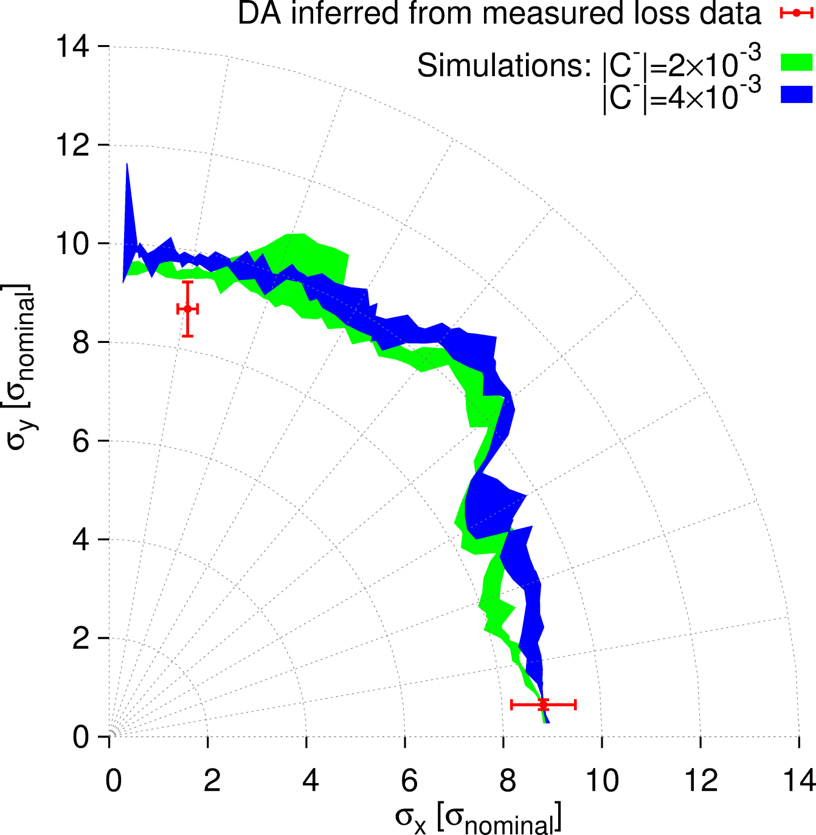
DA Nominal Machine - LHC 5/6 E.H. Maclean, R. Tomàs, F. Schmidt, and T.H.B. Persson

Slide 30
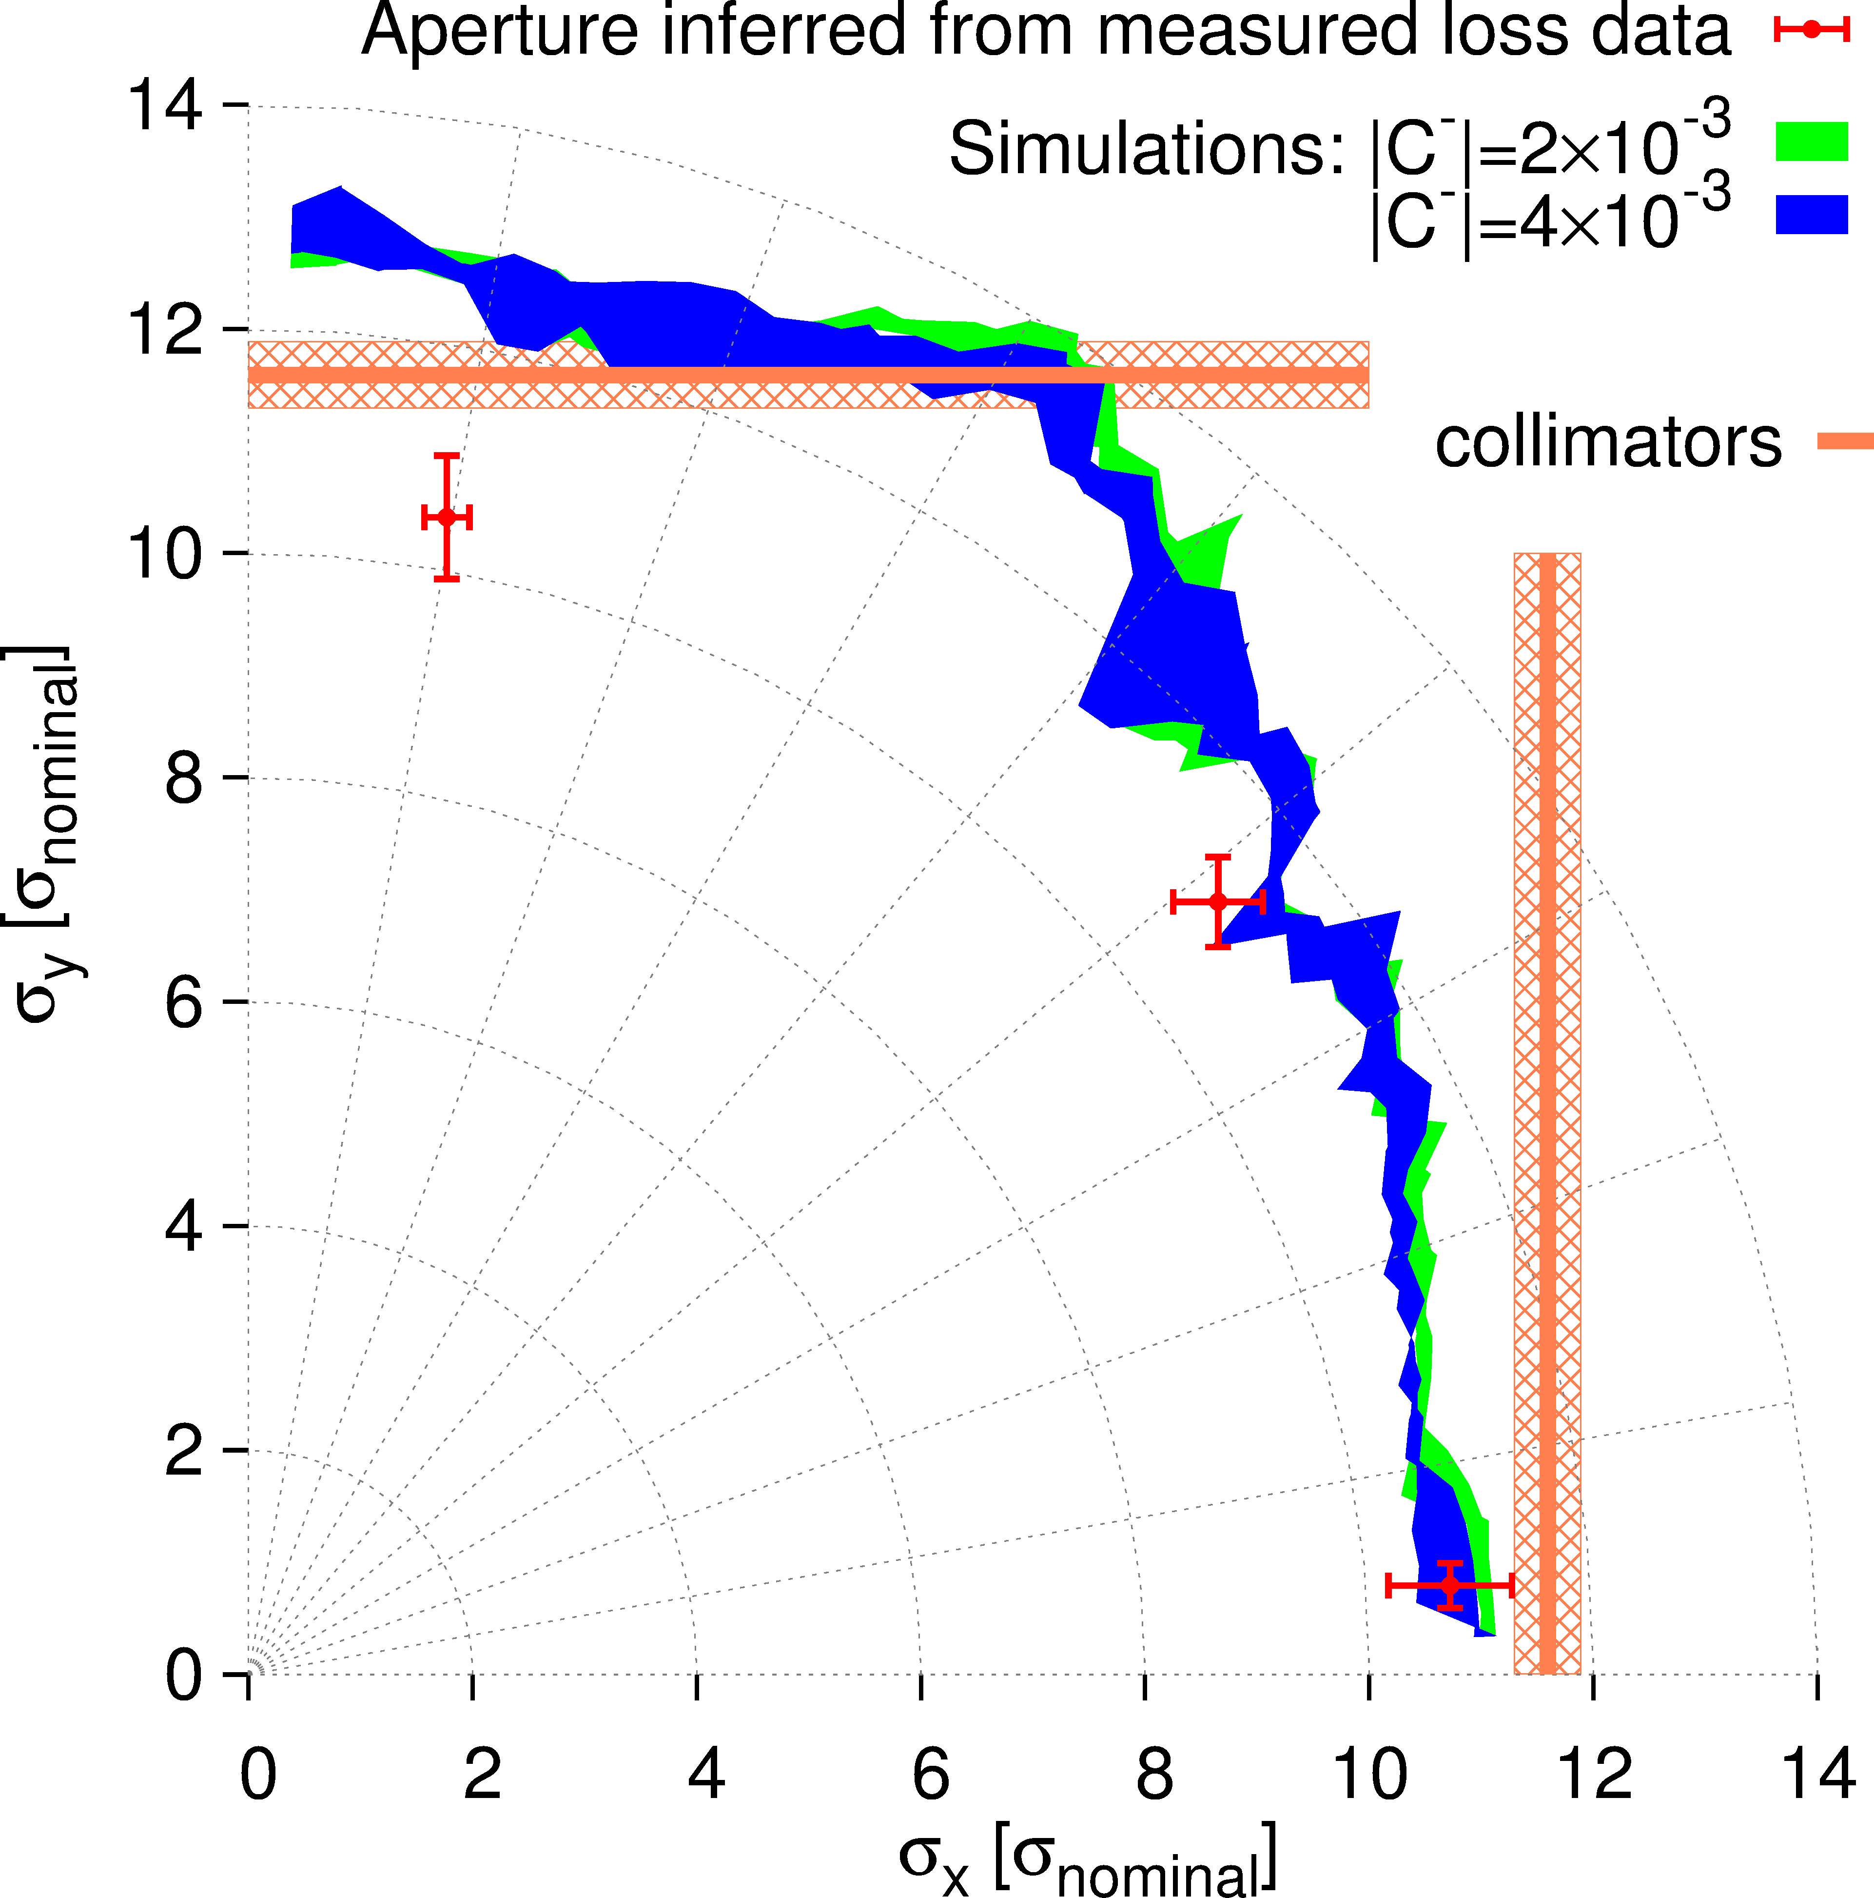
DA Corrected Machine - LHC 6/6 E.H. Maclean, R. Tomàs, F. Schmidt, and T.H.B. Persson

Slide 31
Conclusion 1/2
After 30 years of simulations from HERA, SPS, Tevatron, RHIC to LHC we can conclude that our simulation tools are reliable.
In particular, we can perform any kind of massive simulation studies via distributed and scalable computing facilities.
The theoretical understanding is advanced enough to understand the non-linear dynamics caused by multipolar components. In particular, we understand single particle loss due to deterministic chaos.

Slide 32
Conclusion 2/2
The 2012 LHC DA experiment using the classic kick technique allows to say that we can predict the DA to about 10% rather than the expected factor 2. Reasons are:
Excellent knowledge of multipolar components, magnet by magnet, including misalignments (CERN Fidel & Wise)
Apparently the power supply ripple is under control
➔ This does increase our confidence in simulation studies for the HL-LHC, FCC.

Slide 33
Reserve

Slide 34
Acknowledgements
MPP: Rüdiger Schmidt and Markus Zerlauth
MKA hardware: Jan Uythoven, Alain Antoine, Rodolphe Rosol
CCC MKA software: Verena Kain
Operation: Stefano Redaelli, Alick Macpherson
Additional Experimenter: Glenn Vanbavinckhove
Wirescanner (12 σ): Ana Guerrero
BPM rephasing: Eva Calvo Giraldo
34

Slide 35
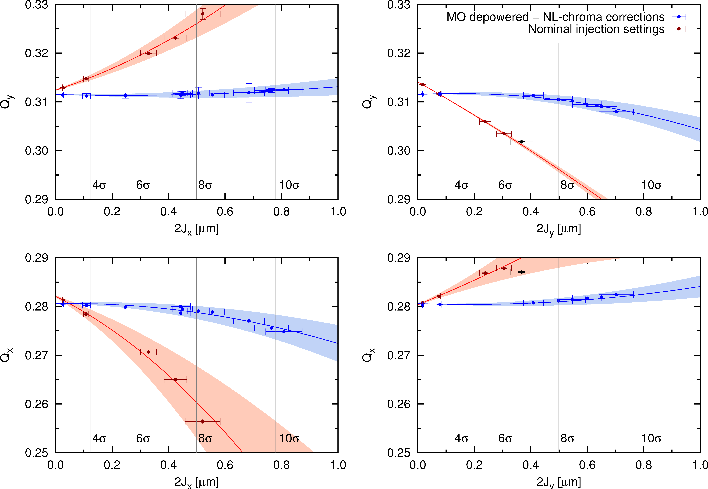
Detuning with Amplitude - LHC 2/6
Corrected Machine
Nominal Machine
E.H. Maclean, R. Tomàs, F. Schmidt, and T.H.B. Persson.

Slide 36
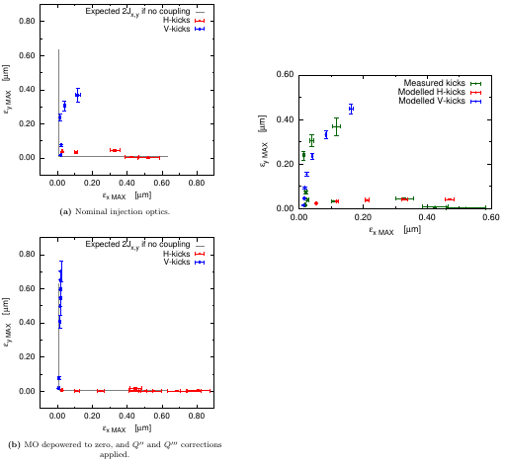
Non-Linear Coupling LHC 4/6
Non-Linear Effect
Nominal
Machine
Corrected Machine
Non-Linear Coupling
reproduced in Simulations:
Red/Blue: H & V Model
Green: Measurement
Lines Linear Expectation

