Slide 1
Dynamic Aperture Optimization of storage ring based colliders with Multi-Objective Algorithm
ZHANG, Yuan WANG, Yiwei WANG, Dou GENG, Huiping
ICFA Mini-Workshop on Dynamic Aperture of Circular Accelerator, 1-3 November 2017, IHEP, Beijing, China
Many Thanks: J. Qiang(LBNL), K. Oide(KEK), D. Zhou(KEK)

Slide 2
Outline
Introduction
Algorithm
Application
Summary

Slide 3
Multi-objective genetic algorithm (MOGA)
Application in storage ring based light source is very popular and successful
  APS/DLS, ELEGANT, M. Borland, in 48th ICFA Beam Dynamics Workshop on Future Light Sources
  NSLSII，L. Yang, Y. Li, W. Guo and S. Krinsky, PRST-AB, 14, 054001 （2011）
  SLS, BMAD, M. Ehrlichman , arXiv: 1603.02459
  HEPS, Accelerator Toolbox, Y. Jiao and G. Xu,
  …

Slide 4
Different Algorithm
Particle Swarm, SPEAR3, X. Huang, J. Safranek, NIMA 757, 48, 2014
Differential Evolution, J. Qiang et al., IPAC’13
Downhill Simplex, SuperKEKB, FCC, K. Oide et al.
…….

Slide 5
Excitation
K. Oide, “A design of beam optics for FCC-ee”, Sep. 2015 @IHEP
255 sextupole pairs per half ring.
Resulting dynamic aperture alomost satisfies the requirements

Slide 6
Why we did the job?
We need to optimize the DA of CEPC
We want to try the direct DA optimization in collider, just as the community has done in light source
Different optimization algorithm is worth to be tried
SAD(http://acc-physics.kek.jp/sad/) is used for the DA determination. It is a parallel code, but the scalability is not very good. A MPI-based parallel code to call SAD will be much more efficient.

Slide 7
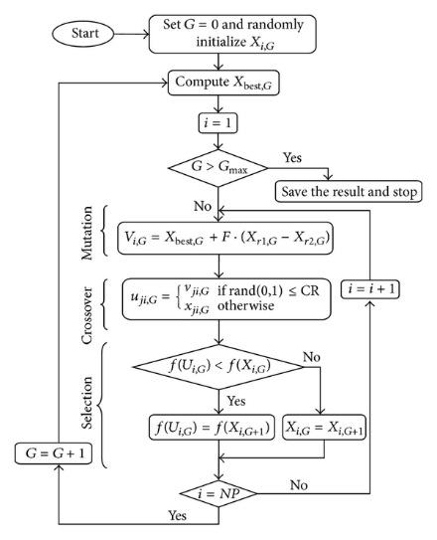
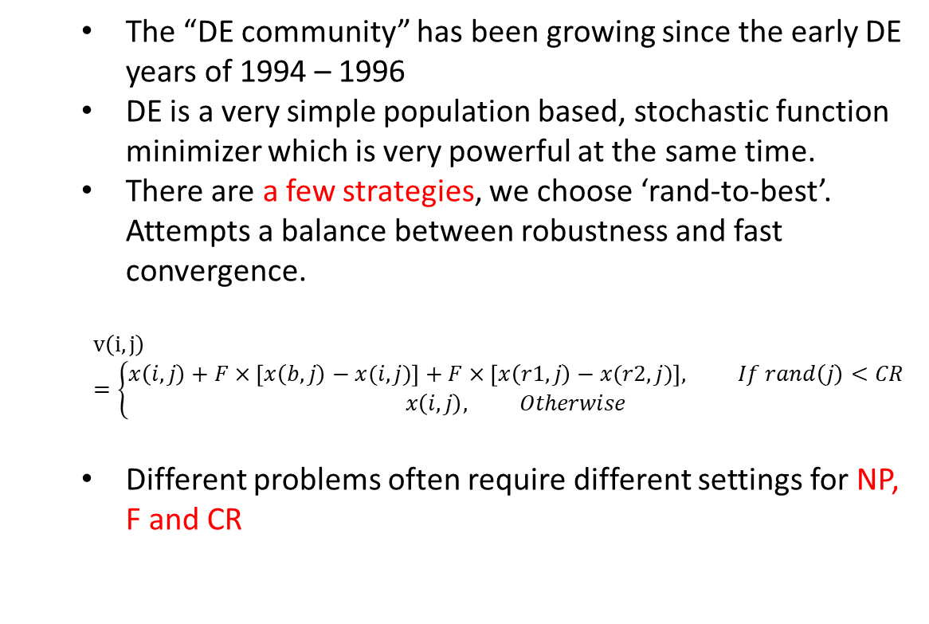
Differential Evolution Algorithm (single objective)
The “DE community” has been growing since the early DE years of 1994 – 1996
DE is a very simple population based, stochastic function minimizer which is very powerful at the same time.
There are a few strategies, we choose ‘rand-to-best’. Attempts a balance between robustness and fast convergence.
$$v\left(i,j\right)=\left\{\begin{matrix}x\left(i,j\right)+F×\left[x\left(b,j\right)−x(i,j)\right]+F×\left[x\left(r1,j\right)−x(r2,j)\right], If rand\left(j\right)<CR \\ x\left(i,j\right), Otherwise\end{matrix}\right.$$
Different problems often require different settings for NP, F and CR
http://www.hindawi.com/journals/ijap/2013/713680.fig.003.jpg

Slide 8
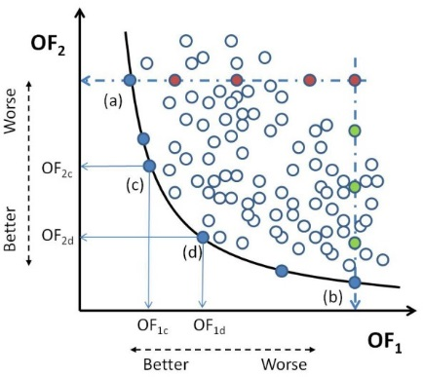
Multi-objective Optimization
Most problems in nature have several (possibly conflicting) objectives to be satisfied.
Many of these problems are frequently treated as single-objective optimization problems by transforming all but one objective into constraints.
The term optimize means finding such a solution which would give the values of all the objective functions acceptable to the decision maker.
Kung et al., J. ACM 22, 4 (Oct. 1975), 469-476
Giuseppe Narzisi, “Multi-Objective Optimization”, 2008

Slide 9
MODE:
Multi-Objective optimization by Differential Evolution
The parallel algorithm is referencing to J. Qiang(IPAC’13)
Initialize the population of parameter vectors
Generate the offspring population using the above differential evolution algorithm
Find the non-dominated population, which are treated as the best solutions in DE to generate offspring
Sorting all the population, select the best NP solution as the parents
Return to step 2, if stopping condition not met

Slide 10
MODE: Scalable Enough at 1000-nodes farm?
Courtesy of Yongjun Li(BNL)

Slide 11
New Parallel Paradigm
High Parallel + High Scalability
Even the time taken by different task is different
Even some node is very busy

Slide 12
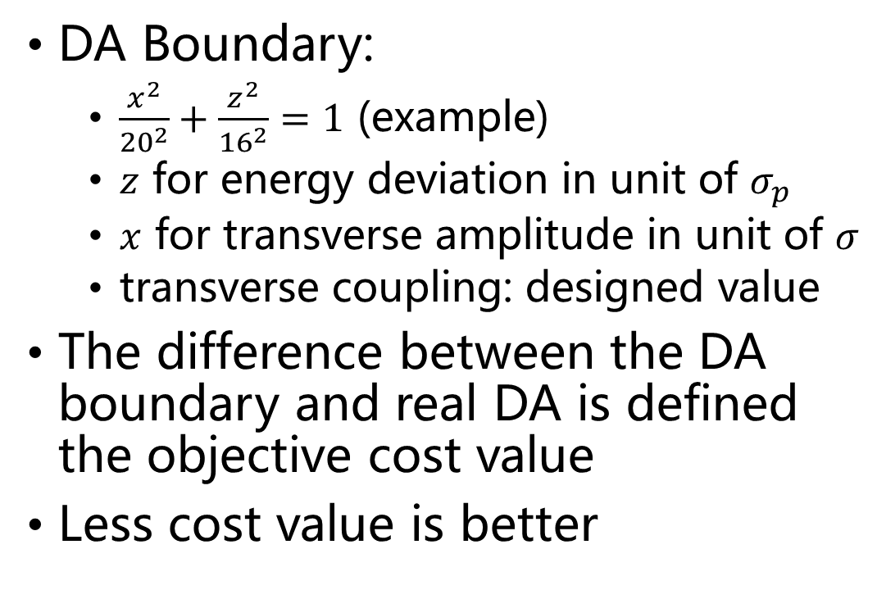
Definition of Objective Cost Value
DA Boundary:
  $\frac{x^{2}}{{20}^{2}}+\frac{z^{2}}{{16}^{2}}=1$ (example)
  $z$ for energy deviation in unit of $σ_{p}$
  $x$ for transverse amplitude in unit of $σ$
  transverse coupling: designed value
The difference between the DA boundary and real DA is defined the objective cost value
Less cost value is better

Slide 13
SuperKEKB: dynamic aperture is a serious issue
Y. Ohnishi, “Optics Issues”, 18th KEKB Review, March 3-5, 2014

Slide 14
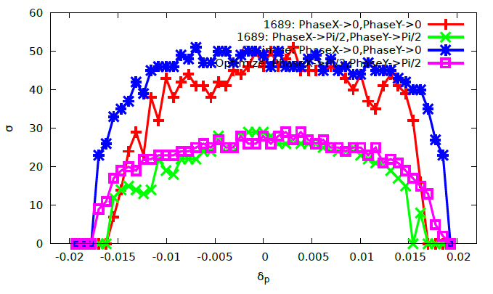

DA Optimization of LER（SuperKEKB）
Objectives:
  $ν_{x}∈\left(0.53,0.66\right), ν_{y}∈\left(0.55,0.66\right),$
  for $δ_{p}∈\left(−0.019,0.019\right)$
  $\frac{x^{2}}{{50}^{2}}+\frac{z^{2}}{{26}^{2}}=1$, for z=Range[-24,24,3],
  $ε_{x,0}=1.89$nmrad, $δ_{p,0}$=7.7e-4
Variables: 68
  2 Octupoles
  54 sextupole pairs
  12 skew sextupole pairs

Slide 15
CEPC DA Optimization Knobs
50 knobs in total
IR sextupoles: (10)
Arc Sextupole (32)
Phase advance (8)

Slide 16
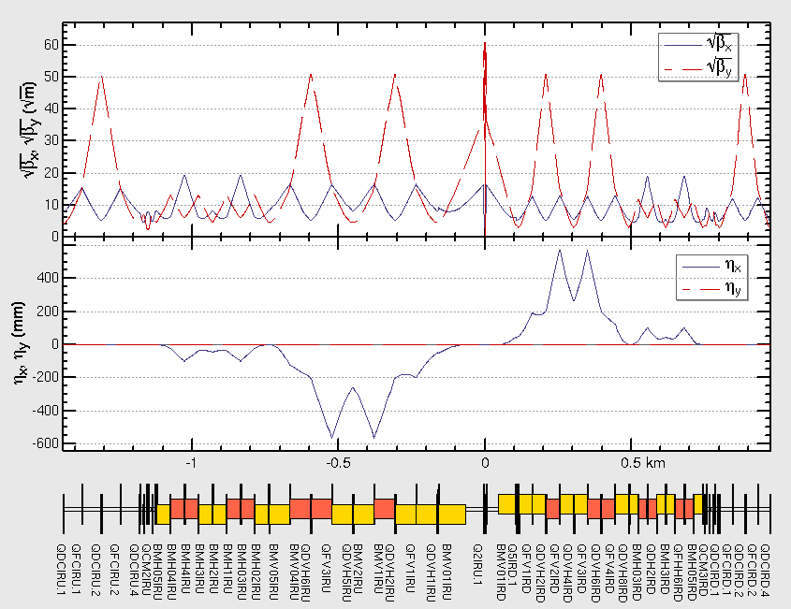
IR knobs
Main Chromaticity Sextupoles (2)
Neighbor weaker sextupole to correct finite length effect
(2)
A. Bogomyagkov, ArXiv:0909.4872
Sextupole to correct higher order chromaticity in vertical direction (1)
Y. Cai, PRAB.19.111006
Different strength between Upstream and Downstream of IP.
10 knobs in IR.

Slide 17
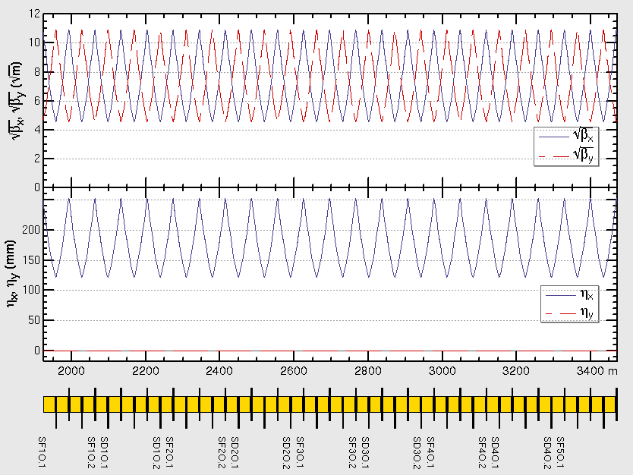
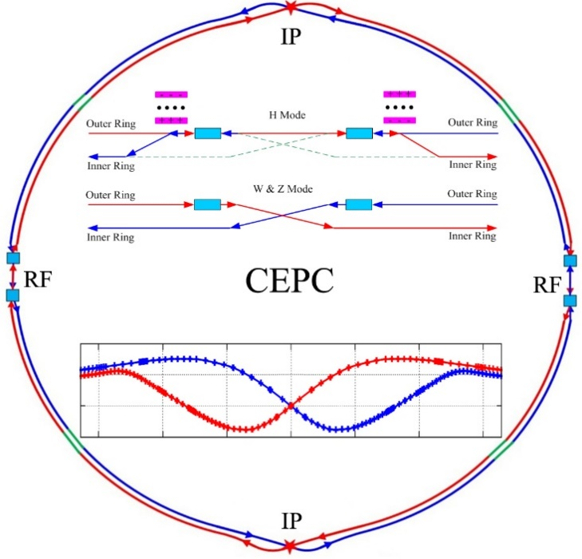

Arc sextupole
90/90 FODO
Non-interleave sextupole scheme
4 SF + 4 SD sextupole configurations in one arc section
7 sub-period in in one arc section，
4 arc section in half ring
Total knobs: 32
$$φ_{x}=10π$$
$$φ_{y}=10π$$
1
1
2
3
4
5
6
7
8
1
2
3
4

Slide 18

Phase Advance Tuning
1
Phase tuning section
2
10 knobs in x/y direction
Keep tune fixed
Only 8 free knobs
3
4
Phase tuning section
5

Slide 19
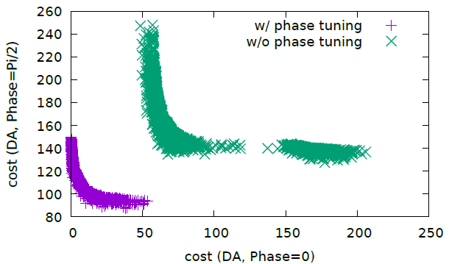
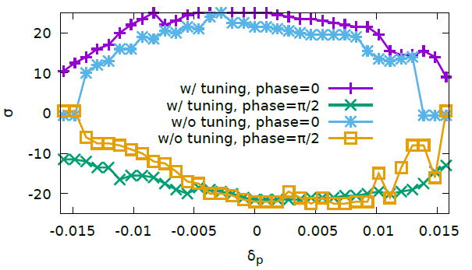
Contribution from phase advance
Notes:
Pcmst-3-cont-slurm

Slide 20
Some Try of Speed-up/Optimization Method
Brute-force dynamic aperture tracking is very time consuming
More strategy of DE algorithm are randomly selected used
The objective is first eased, for example only track 50 turns instead of 100 or 200 turns.
The time consuming cost function is calculated only when the necessary constraints be satisfied. [arXiv: 1603.02459]
First try to optimize with less variables, then more variables.
Iteration with non-dominated solution

Slide 21
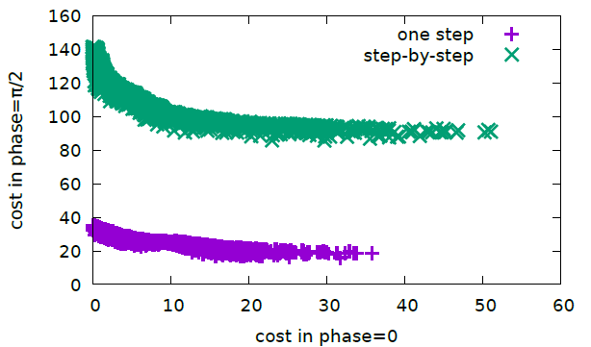
Optimization in one-step vs multiple steps
(32 arc sextupole familiy)
STEP-BY-STEP:
4 Arc Sextupoles:
SFO/SDO/SFI/SDI
If computing resources are enough, It’s better optimize all the variables in one step
16 Arc Sextupoles:
4*(SFO/SDO)+4*(SFI/SDI)
32 Arc Sextupoles:
8*(SFO/SDO)+8*(SFI/SDI)
Notes:
wyw-170410-pcmst-3-one，使用原始的one.x，即不是 pcmst-3 优化得到的。

Slide 22
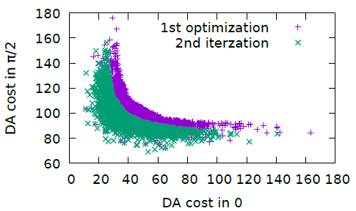
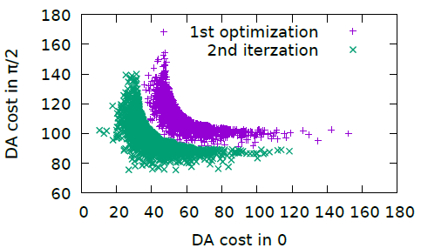
Iteration with Pareto Front Solution
Non-dominated solution achieved + Other initialized solutions are randomly generated
No very clear further optimization
We usually do the iteration if time permits
Bx= 0.37m
Bx= 0.50m

Slide 23
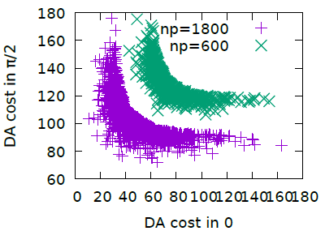
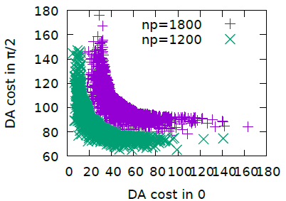
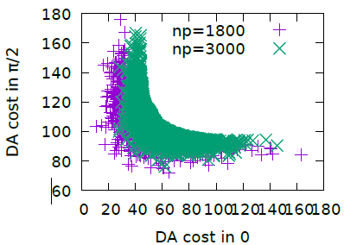
Optimize with different population size
Np=1200~1800 (20-30 times variable number) is good enough

Slide 24
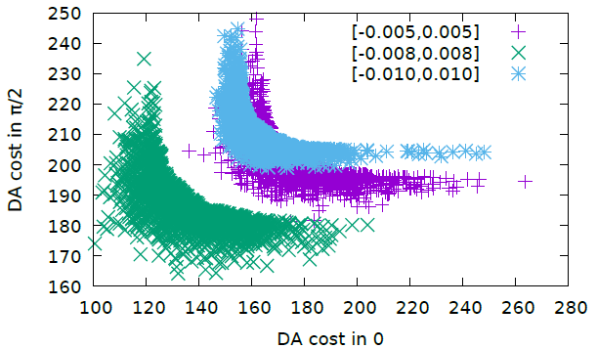
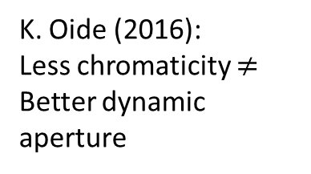
Different Chromaticity Constraint
Half ring tune control:
Qx in (0.52, 0.58)
Qy in (0.58, 0.64)
In our normal optimization, we prefer to control the tune in the maximum momentum offset (0.006~0.008)
The final optimum momentum acceptance is about 0.016.
K. Oide (2016):
Less chromaticity $≠$ Better dynamic aperture

Slide 25

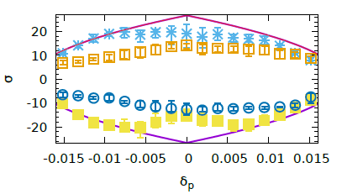
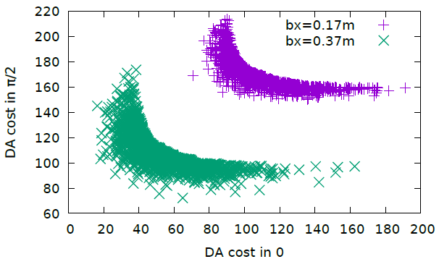
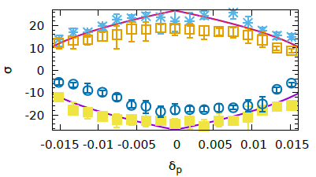
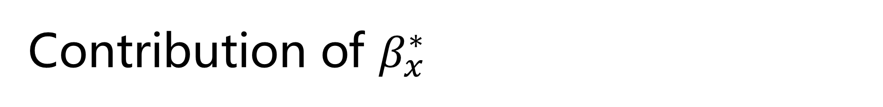
Contribution of $β_{x}^{∗}$
Bx=0.17m
Bx=0.37m

Slide 26
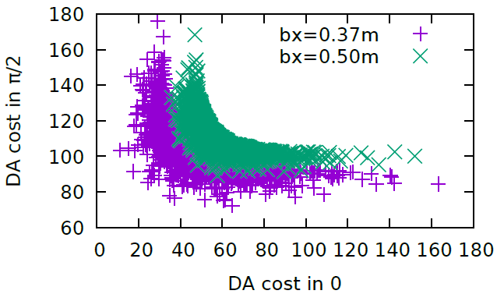
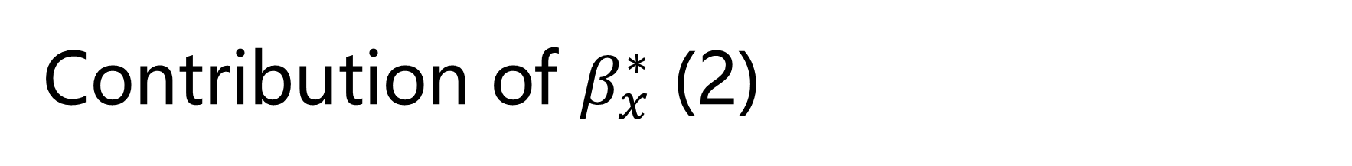
Contribution of $β_{x}^{∗}$ (2)

Slide 27
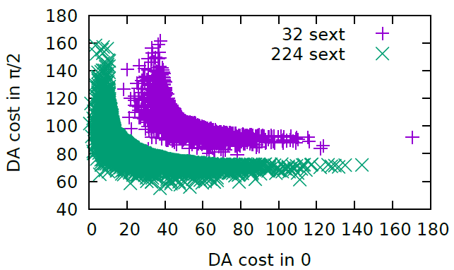

More sextupole configurations
Enlarge the DA about 1-$σ$ on average

Slide 28
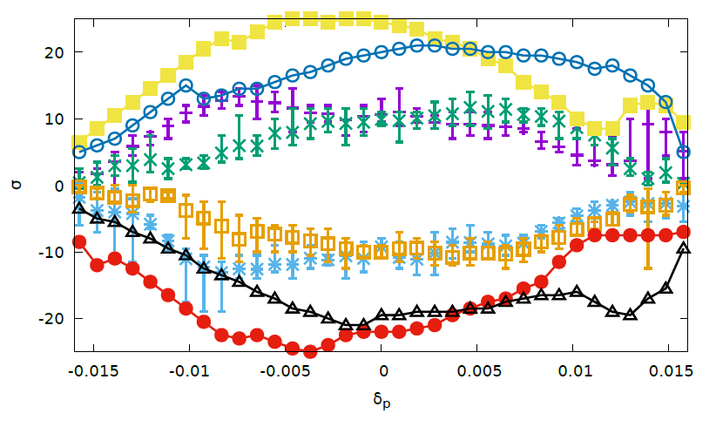
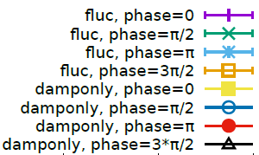
Optimize with DAMPONLY model
Damp at each element:
No diffusion coming from synchrotron radiation.
200 turns,
10 samples

Slide 29
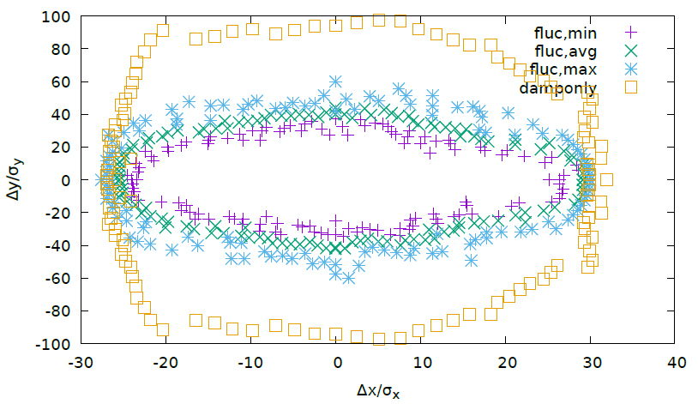
Fluctuation Effect on the vertical dynamic aperture
Only serious DA loss in vertical direction.
On-Momentum DA with damping at each element and radiation fluctuation at each element.

Slide 30
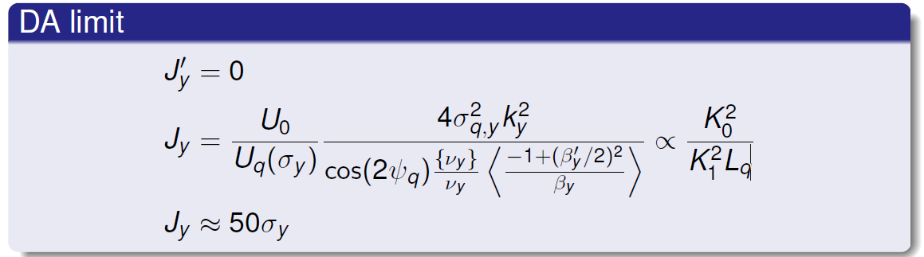
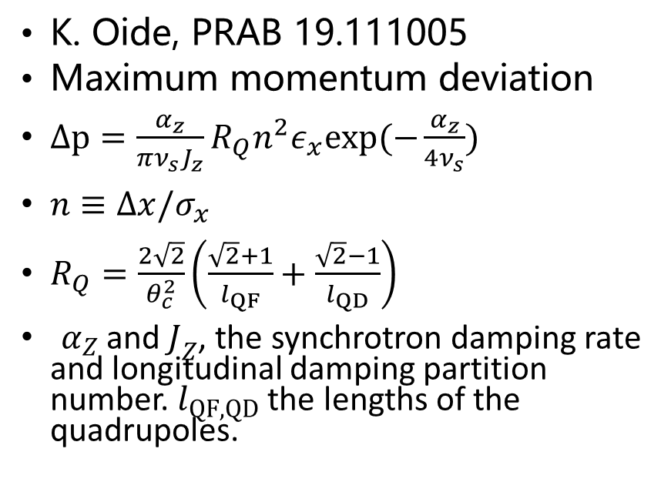
Effect of Synchrotron Radiation in Quadrupoles
FODO Arc - Horizontal
IR QD0 – Vertical
K. Oide, PRAB 19.111005
Maximum momentum deviation
$Δp=\frac{α_{z}}{πν_{s}J_{z}}R_{Q}n^{2}ε_{x}exp(−\frac{α_{z}}{4ν_{s}})$
$n≡Δx/σ_{x}$
$R_{Q}=\frac{2\sqrt{2}}{θ_{c}^{2}}\left(\frac{\sqrt{2}+1}{l_{QF}}+\frac{\sqrt{2}−1}{l_{QD}}\right)$
$α_{Z}$ and $J_{Z}$, the synchrotron damping rate and longitudinal damping partition number. $l_{QF,QD}$ the lengths of the quadrupoles.
A. Bogomyagkov (BINP), FCC-ee, Z

Slide 31
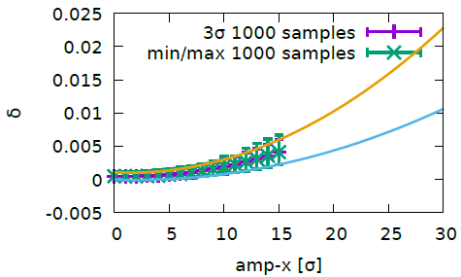
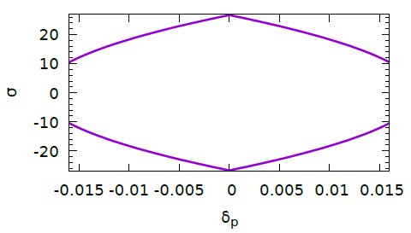

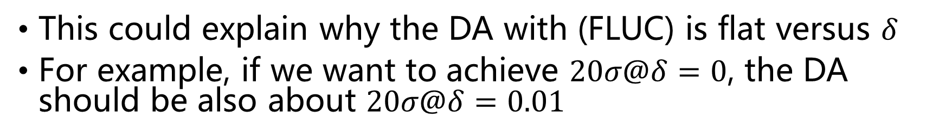
Momentum deviation versus amplitude
DA Objective:
$$\left|δ\right|+Ax^{2}+B=η_{rf}$$
This could explain why the DA with (FLUC) is flat versus $δ$
For example, if we want to achieve $20σ@δ=0$, the DA should be also about $20σ@δ=0.01$
Notes:
Cmst-3-clip1-400t

Slide 32
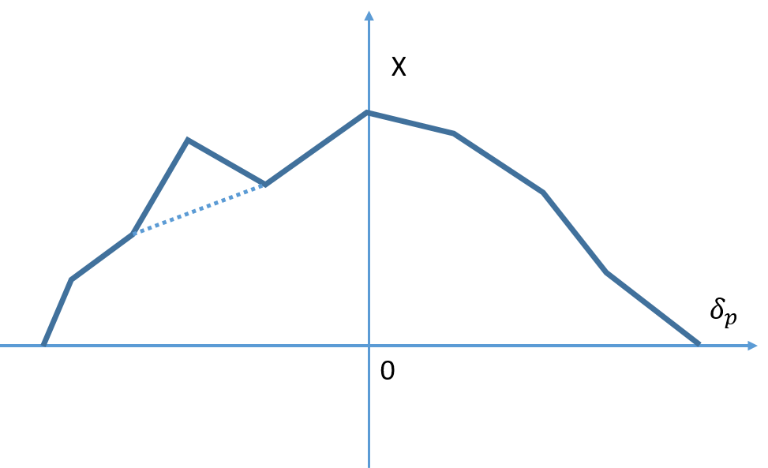
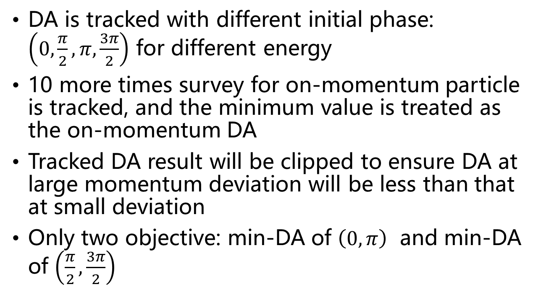
Suppress noise of DA result with radiation fluctuation
DA is tracked with different initial phase: $\left(0,\frac{π}{2},π,\frac{3π}{2}\right)$ for different energy
10 more times survey for on-momentum particle is tracked, and the minimum value is treated as the on-momentum DA
Tracked DA result will be clipped to ensure DA at large momentum deviation will be less than that at small deviation
Only two objective: min-DA of $\left(0,π\right)$ and min-DA of $\left(\frac{π}{2},\frac{3π}{2}\right)$

Slide 33

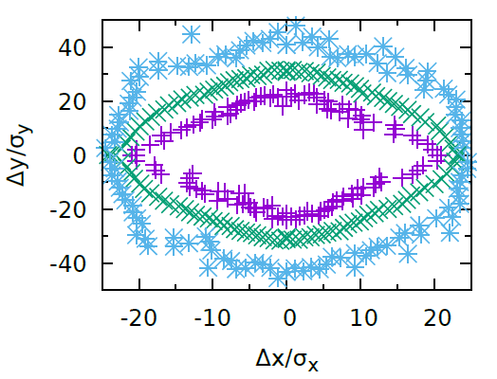
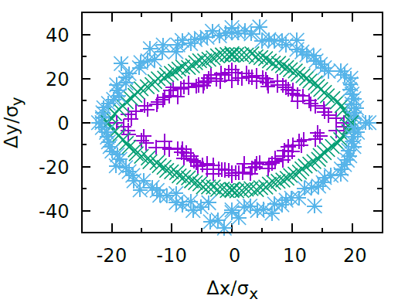
On Momentum Dynamic Aperture (CEPC-Higgs)
Initial Phase: 0
Initial Phase: Pi/2
100 samples are tracked. 200 turns are tracked.
Synchrotron motion, synchtron radiation in dipoles, quads and sextupoles, tapering, Maxwellian fringes, kinematical terms, crab waist are included.

Slide 34
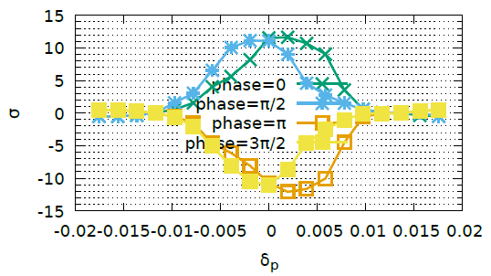
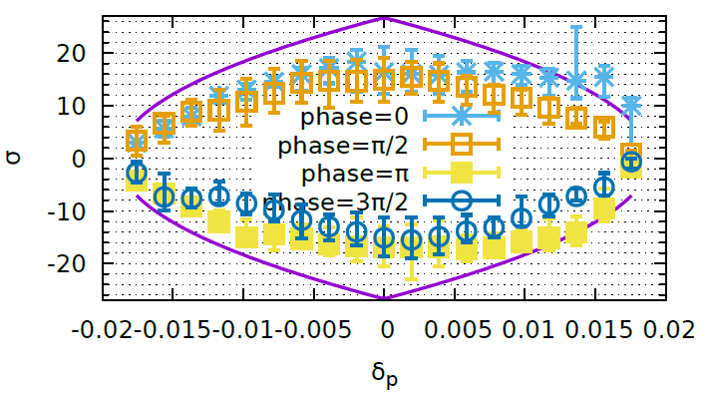
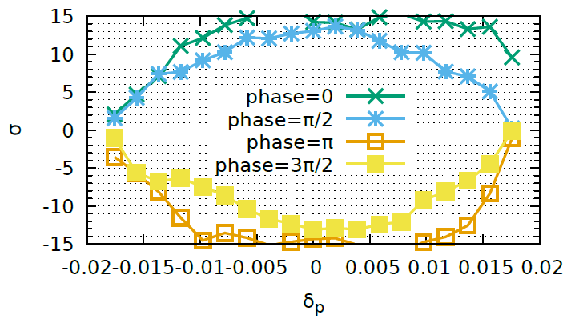
Off momentum Dynamic Aperture
W/O Optimization
Momentum Acceptance: 0.017
Error bar means min and max
90% survival
100 samples. Radiation fluctuation is included. 0.3% emittance coupling. 200 turns are tracked.

Slide 35
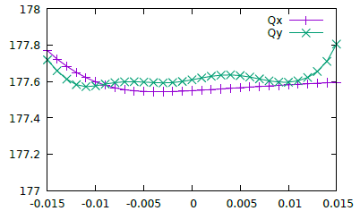
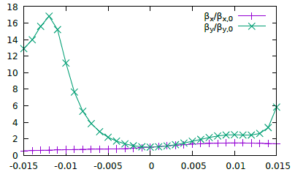
Chromaticity

Slide 36

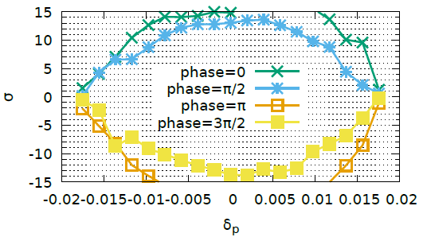
Crab Waist
IP Downstream: K2 = 0.69 m⁻²
IP Upstream: K2 =-0.69 m⁻²
90% survival
CW=0
CW=1.0

Slide 37
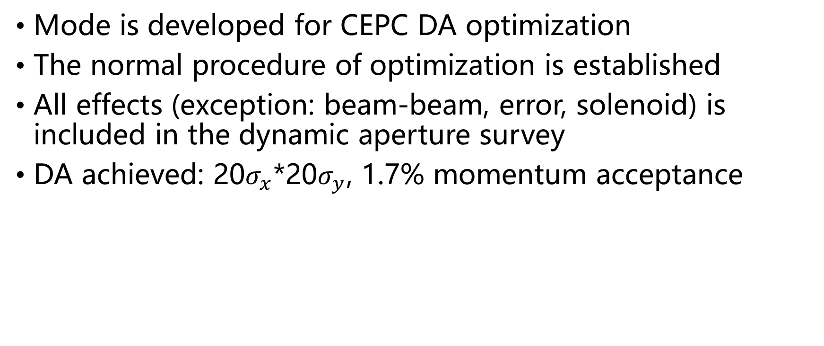
Summary
Mode is developed for CEPC DA optimization
The normal procedure of optimization is established
All effects (exception: beam-beam, error, solenoid) is included in the dynamic aperture survey
DA achieved: 20$σ_{x}$*20$σ_{y}$, 1.7% momentum acceptance

Slide 38
backup

Slide 39
CEPC Parameters
 | Higgs | W | Z
Number of IPs | 2
Energy (GeV) | 120 | 80 | 45.5
Circumference (km) | 100
SR loss/turn (GeV) | 1.68 | 0.33 | 0.035
Half crossing angle (mrad) | 16.5
Piwinski angle | 2.75 | 4.39 | 10.8
N_{e}/bunch (10¹⁰) | 12.9 | 3.6 | 1.6
Bunch number | 286 | 5220 | 10900
Beam current (mA) | 17.7 | 90.3 | 83.8
SR power /beam (MW) | 30 | 30 | 2.9
Bending radius (km) | 10.9
Momentum compaction (10⁻⁵) | 1.14
β_{IP} x/y (m) | 0.36/0.002
Emittance x/y (nm) | 1.21/0.0036 | 0.54/0.0018 | 0.17/0.0029
Transverse σ_{IP} (um) | 20.9/0.086 | 13.9/0.060 | 7.91/0.076
ξ_{x}/ξ_{y}/IP | 0.024/0.094 | 0.009/0.055 | 0.005/0.0165
RF Phase (degree) | 128 | 134.4 | 138.6
V_{RF} (GV) | 2.14 | 0.465 | 0.053
f _{RF} (MHz) (harmonic) | 650
Nature bunch length σ_{z} (mm) | 2.72 | 2.98 | 3.67
Bunch length σ_{z} (mm) | 3.48 | 3.7 | 5.18
HOM power/cavity (kw) | 0.46 (2cell) | 0.32(2cell) | 0.11(2cell)
Energy spread (%) | 0.098 | 0.066 | 0.037
Energy acceptance requirement (%) | 1.21
Energy acceptance by RF (%) | 2.06 | 1.48 | 0.75
Photon number due to beamstrahlung | 0.25 | 0.11 | 0.08
Lifetime due to beamstrahlung (hour) | 1.0
F (hour glass) | 0.93 | 0.96 | 0.986
L_{max}/IP (10³⁴cm⁻²s⁻¹) | 2.0 | 4.1 | 1.0

