Slide 1
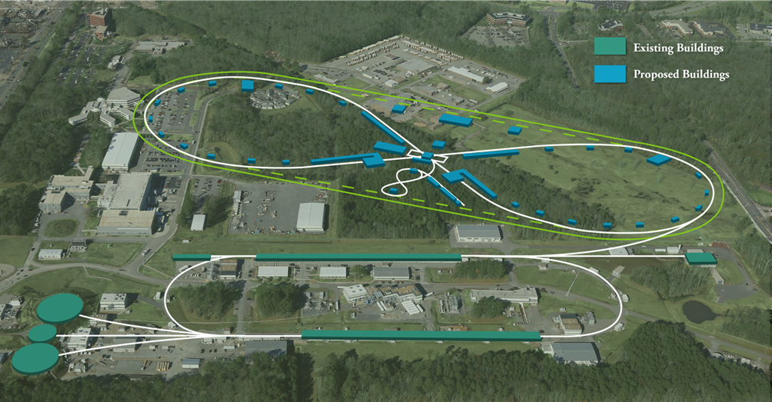
Emittance Control and Nonlinear Beam Dynamics in JLEIC Electron Collider Ring
Fanglei Lin
on behalf of Jefferson Lab Electron Ion Collider (JLEIC) study team

Slide 2
Outline
Introduction of Jefferson Lab Electron Ion Collider (JLEIC) design
Electron collider ring design
Requirements
Options for low-emittance optics
Baseline design
Non-linear chromaticity compensation
Sextupole schemes and performance
Dynamic aperture study
Energy dependence
Errors and corrections
Non-linear field tolerance
Betatron tunes
Summary

Slide 3
Electron Ion Collider (EIC)
Recommendations in NSAC LRP 2015:
Continue existing projects: CEBAF, FRIB, RHIC.
“…a U.S.-led ton-scale neutrinoless double beta decay experiment”
“…a high-energy high-luminosity polarized EIC as the highest priority for new facility construction following the completion of FRIB”
“…small-scale and mid-scale projects and initiatives that enable forefront research at universities and laboratories”
EIC Community White Paper arXiv:1212.1701

Slide 4
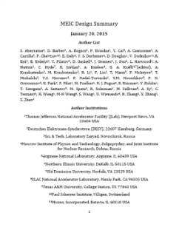
Jefferson Lab Electron Ion Collider (JLEIC)
Electron complex
CEBAF
Collider ring
Ion complex
Ion source / Linac
Booster
Collider ring
IP/detectors
Optimum detector location for minimizing background
Hori. Crab crossing
Polarization
Figure-8 shape rings
8-100(400) GeV
3-12 GeV
8 GeV
& SRF Linac
2012
2015
arXiv: 1209.0757
arXiv: 1504.07961
May 17 update:
https://eic.jlab.org/wiki/index.php/Main_Page

Slide 5
Electron Collider Design Requirements
Provide the necessary beam parameters
3-10 GeV electron
3A beam current up to 6-7 GeV, small emittance, short bunch length ~1cm, focusing at the IP ( to support luminosity above 10³³ cm⁻²s⁻¹)
Sufficient beam and luminosity lifetime
Less than 10MW total synchrotron radiation power
Capability of operating multiple detectors
One full-acceptance detector (small angle detection) incorporated
Space for a second detector reserved
Maintain high polarization above 70%
Longitudinal polarization at the IP
Sufficient polarization lifetime
Incorporate provisions for non-linear dynamics correction
Proper chromatic correction scheme using sextupole families
No emittance growth

Slide 6
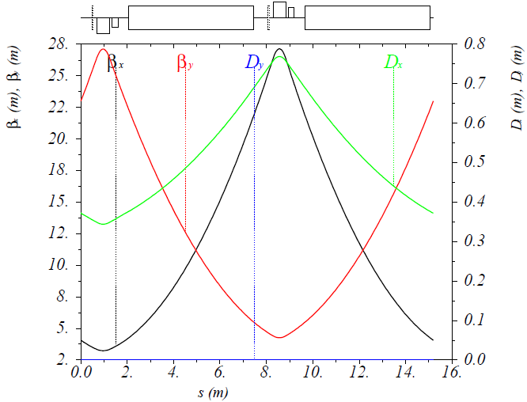
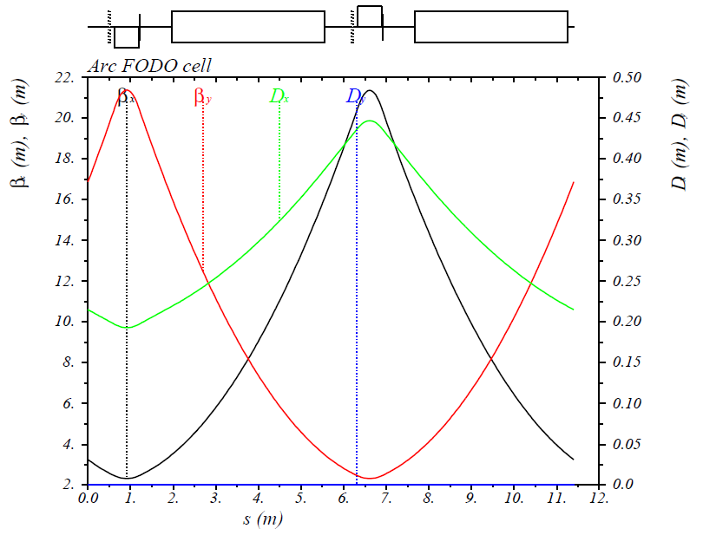
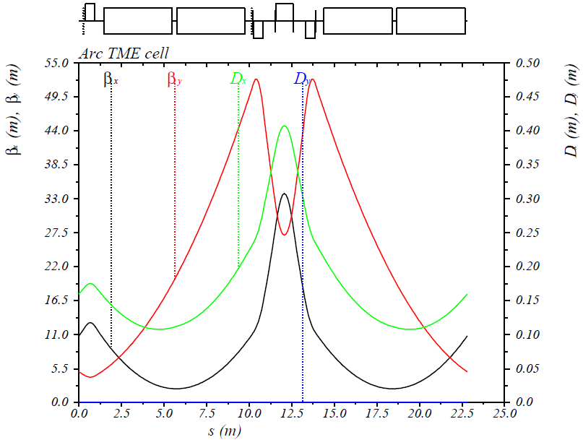
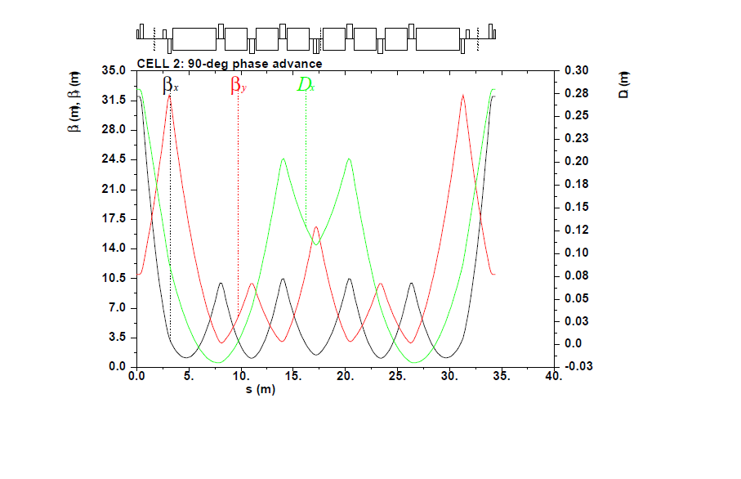
Arc Cell Optics Options
FODO cell w/ PEP-II magnets
FODO cell w/ new magnets (baseline)
TME cell w/ new magnets
HMBA cell w/ new magnets

Slide 7
Arc Optics Options for Low Emittance
 |  | FODO arc cell w/ PEP-II magnets | FODO arc cell w/ new magnets (baseline) | TME arc cell w/ new magnets | HMBA arc cell w/ new magnets
Ring circumference | m | 2282 | 2336 | 2277 | 2395
Bending angle per arc / figure-8 crossing angle | deg | 261.7 / 81.7 | 261.7 / 81.7 | 261.7 / 81.7 | 259.74 / 79.74
Beta stars at IP β*_{x,y} | cm | 10 / 2 | 10 / 2 | 10 / 2 | 10 /2
Hor. / ver. chromaticities ξ_{x,y} |  | -113 / -120 | -127 / -140 | -152 / -150
Momentum compaction factor α | 10⁻³ | 1.9 | 0.95 | 0.5 | ~0.2
Energy spread @ 5 and 10 GeV | 10⁻⁴ | 4.5 / 9.0 | 4.6 / 9.3 | 4.5 / 9.1 | 4.3 / 8.6
Normalized emittance @ 5 and 10 GeV | μrad | 93 / 740 | 54 / 433 | 31 / 247 | 10.4 / 83.4
Hori. beam sizes at IP @ 5 and 10 GeV | μm | 31 / 62 | 24 / 47 | 18 / 36 | 10 / 21
Energy loss per turn @ 5 and 10 GeV | MeV | 0.82 / 13.1 | 0.89 / 14.4 | 0.89 / 13.4 | 0.67 / 10.7
Total SR power @ 5 and 10 GeV | MW | 2.5 / 9.2 | 2.7 / 10.2 | 2.5 / 9.5 | 2.0 / 7.5
Arc cell length | m | 15.2 | 11.4 | 22.8 | 34.4
Arc dipole length / sagitta | m / cm | 5.4 / 3.3 | 3.6 / 1.65 | 4.0 / 1.83 | 4.2 (2.1) / 2.2 (0.6)
Arc dipole bending angle / radius | deg / m | 2.8 / 110.5 | 2.1 / 98.2 | 2.1 / 109.1 | 2.4 (1.2) / 100
quad length/strength @ 10 &12 GeV | m / T/m | 0.56 / 13 / 15.6 | 0.56 / 17.5 / 21 | 0.56, 1.0 / 20 / 24 | 0.3, 0.5 / 40 / 48

Slide 8
Summary of Arc Optics Options
Optics with FODO arc cells using PEP-II magnets
Pros: existing magnets, decent dynamic aperture
Cons: large emittance, large momentum compaction factor, large sagitta
Optics with FODO arc cells using new magnets (baseline)
Pros: decent emittance, decent momentum compaction factor, small sagitta, decent magnet strengths, decent dynamic aperture
Con: new magnets
Optics with theoretical-minimum-emittance (TME) arc cells using new magnets
Pros: small emittance, small momentum compaction factor, small sagitta
Cons: new magnets, strong quadrupoles, not-large-enough dynamic aperture
Optics with hybrid-multi-bend-achromat (HMBA) arc cells using new magnets
Pros: very small emittance, very small momentum compaction factor, small sagitta
Cons: new magnets, strong quadrupoles, strong sextupoles for chromaticity compensation, need study of chromaticity compensation

Slide 9
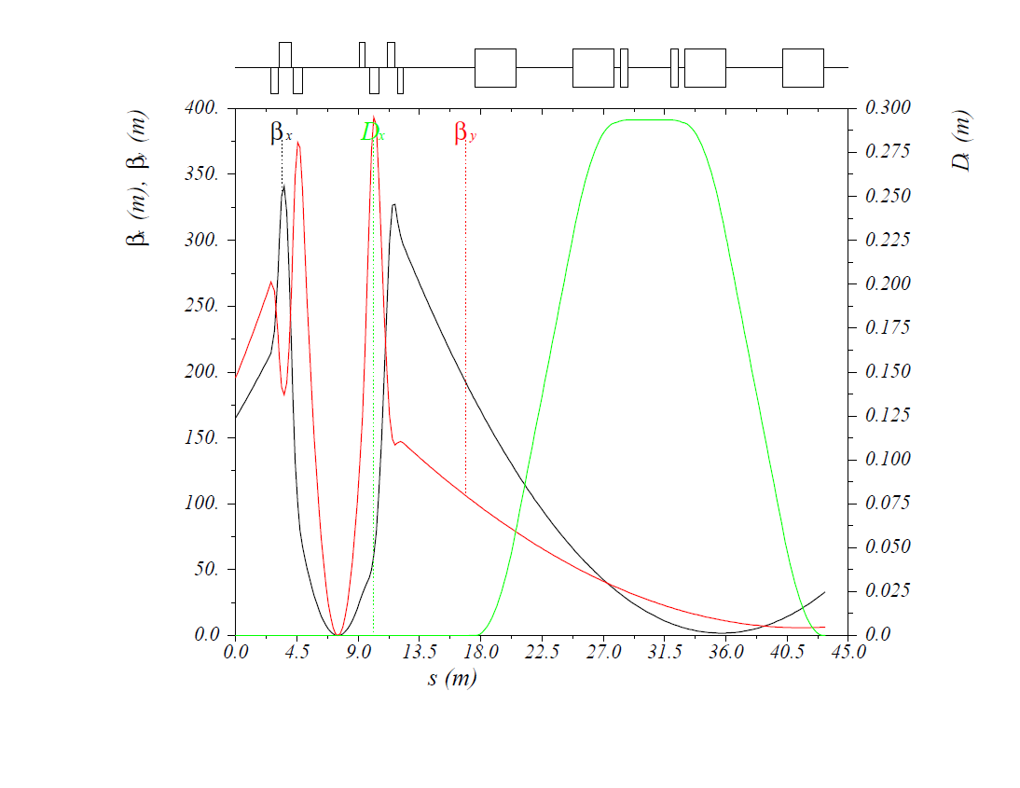
Detector Region Design
Detector region layout
50 mrad crossing angle
Fast beam separation, no parasitic collisions
Improved momentum resolution of the detector solenoid
Electron beam in a straight line
Downstream chicane use for spectrometry and polarimetry
50 mrad up- and downstream bends in ion beam
Downstream beam lines used for spectrometry, dispersion control and geometry matching
Electron ring detector region optics
Chicane dipoles
forward e⁻
detection region
Compton / far-forward e⁻ detection region
e⁻
FFQs
FFQs
IP

Slide 10
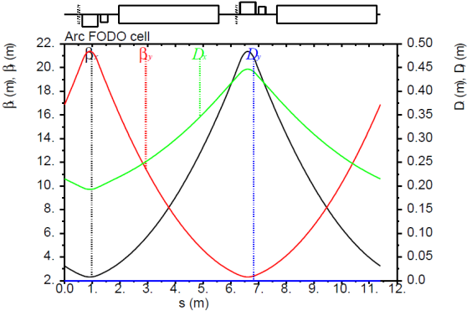
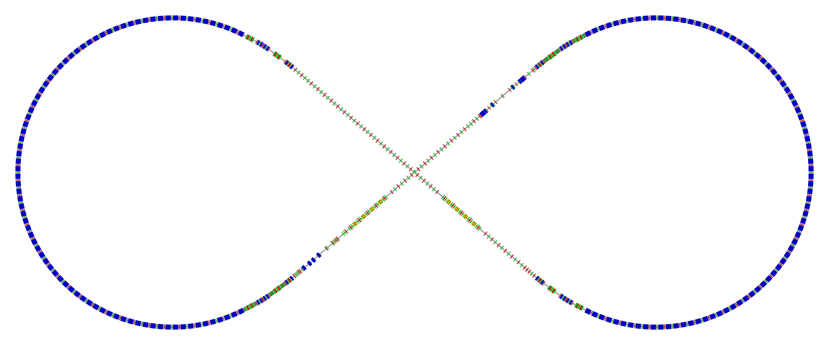
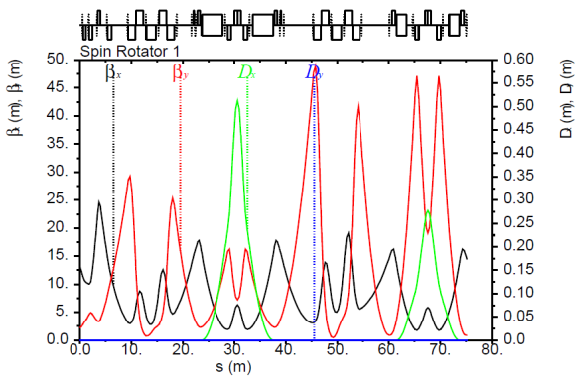
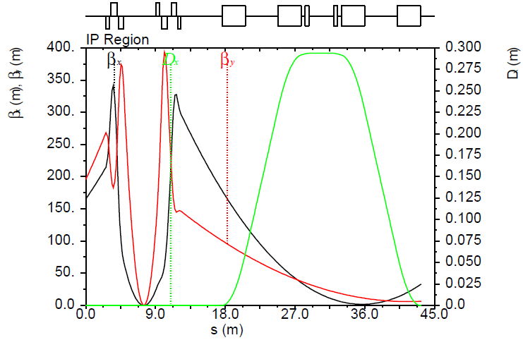
Electron Collider Ring Layout
Spin rotator
Spin rotator
Tune trombone & Straight FODOs
R=155m
81.7°
e⁻
Arc, 261.7°
Future 2nd IP
RF
RF
Spin rotator
IP
Spin rotator
Forward e⁻ detection and polarimetry

Slide 11
Non-linear Chromaticity and Compensation
Non-linear chromaticity from final focusing quads
Final focus is a large single source of non-linear chromaticity due to very large β and strong focusing
Left and right FF quads act in the same phase to excite very large Δβ(δ)/β perturbation, Δβ(δ) gives rise to large 2nd and higher order tune shift ΔQ(δ) and creates chromatic beam smear at IP
These effects enlarge the tune footprint, thus exposing beam to more resonances, resulting in reduced energy range and beam lifetime, and increase the IP beam size σ∗(δ), limiting luminosity
Chromaticity compensation block (CCB)
The correction strategy is to create another large source of non-linear chromaticity – a local chromaticity correction block (CCB) using dedicated sextupoles – placed in phase with and as close as possible to the FF for local correction
To compensate residual Δβ(δ) at IP and outside of IR, two CCBs are required, independently correcting the FF on each side of IP

Slide 12
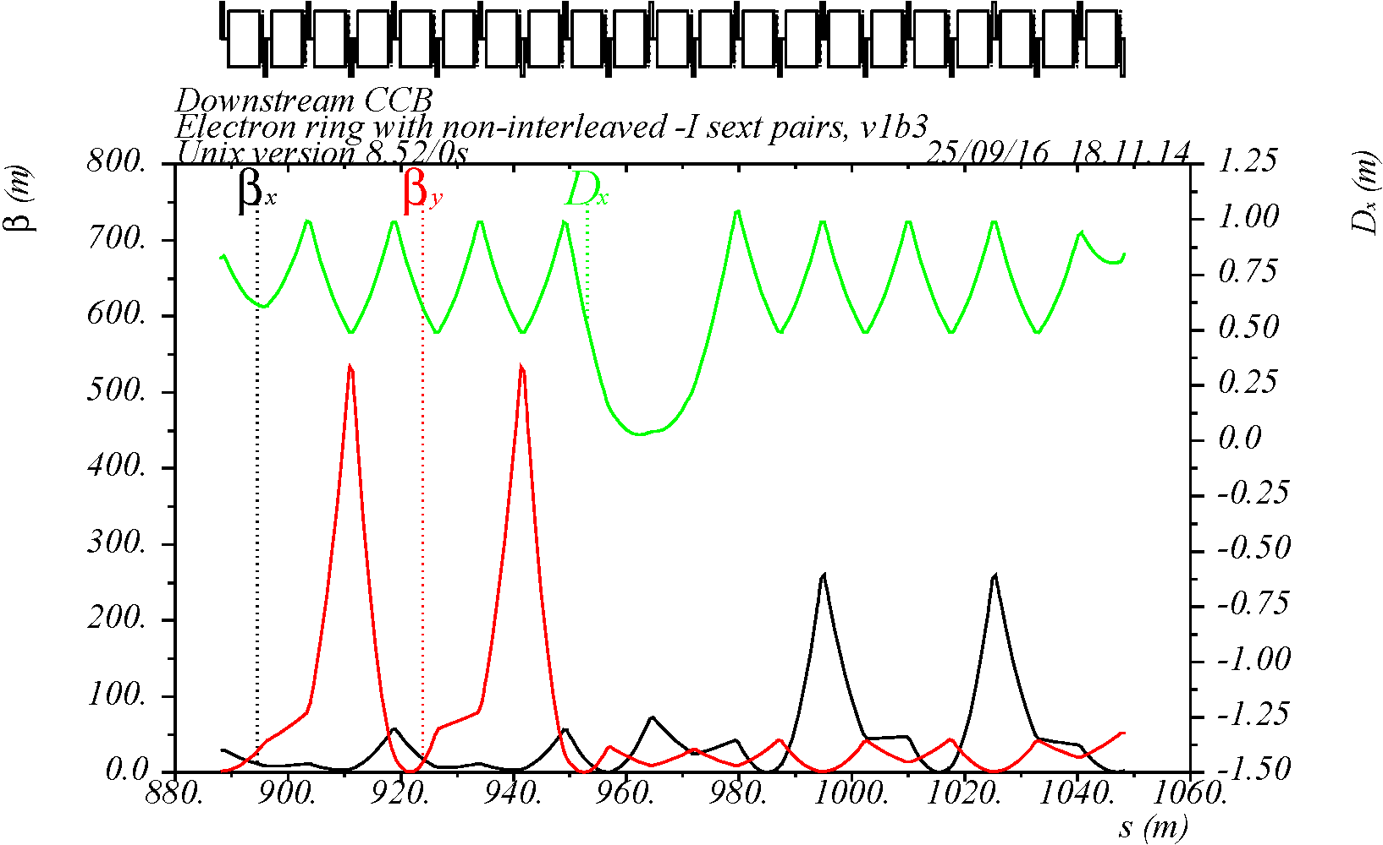
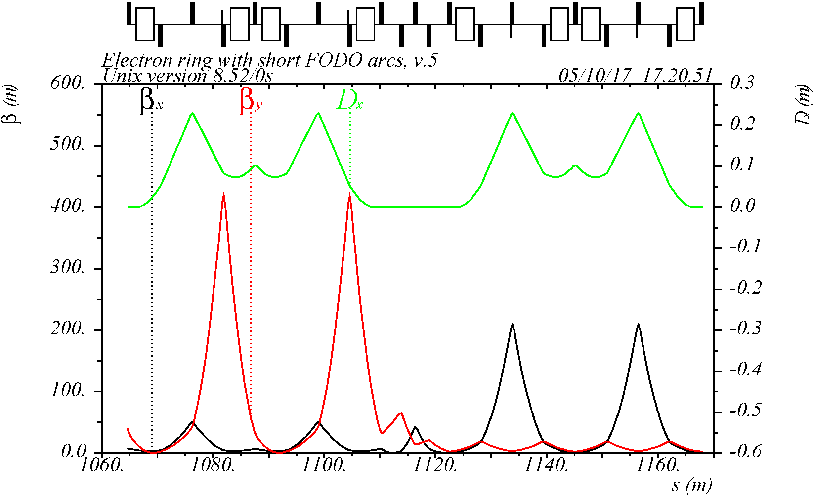
Low Emittance SuperB-like CCB (SBCC)
Normal CCB based on regular arc cells creates a large emittance in the electron ring due to some of the dipoles located near high peaks of horizontal β
Solution: Super-B type chromaticity correction (SBCC) scheme with
dipoles removed from high β_{x} locations
non-interleaved –I pair sextupoles locating at high β-functions
dipole bending angles are adjusted for low emittance
CCB based on regular arc cells
SBCC based on cells with missing bends
S2
S2
-I
-I
S1
S1
-I
-I

Slide 13
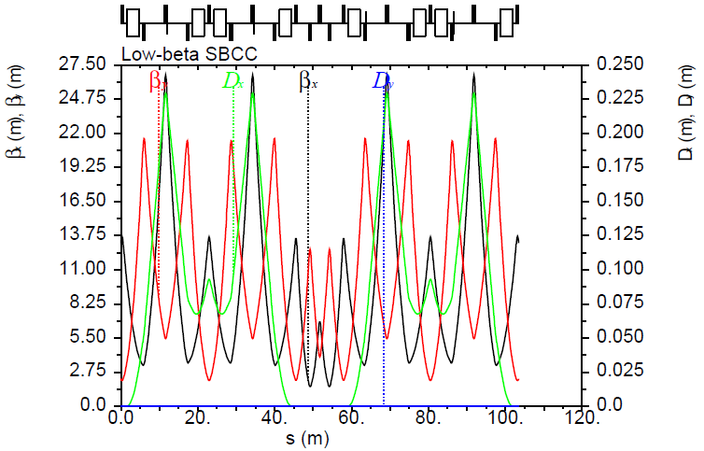
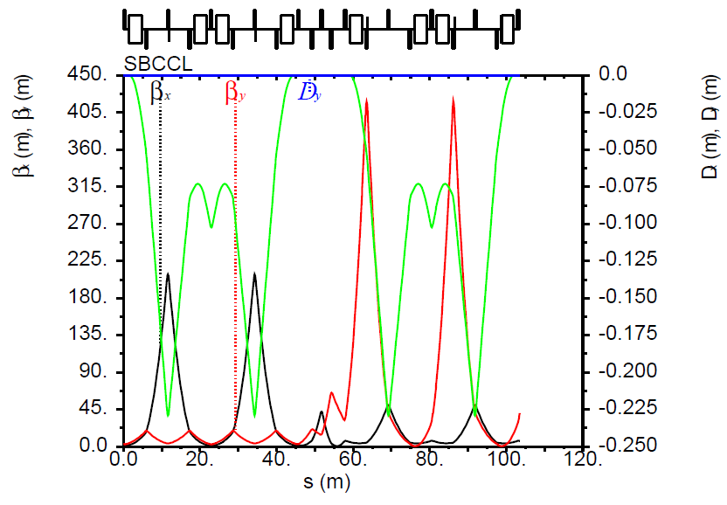
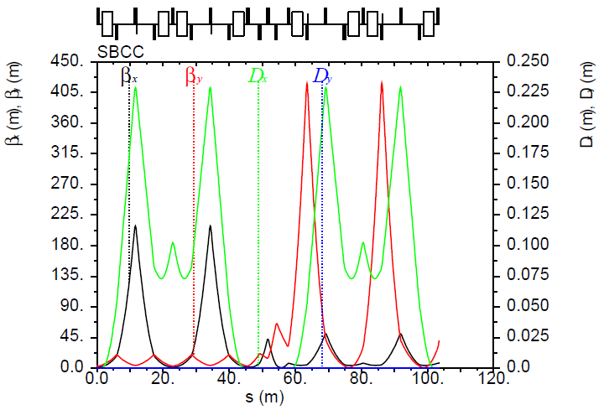
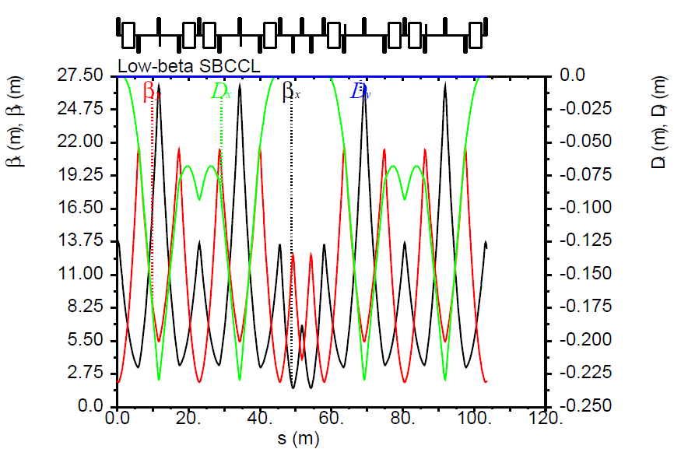
Electron Collider Ring Layout
Spin rotator
Spin rotator
Tune trombone & Straight FODOs
R=155m
81.7°
e⁻
Arc, 261.7°
Future 2nd IP
RF
RF
Spin rotator
IP
Spin rotator
Forward e⁻ detection and polarimetry

Slide 14
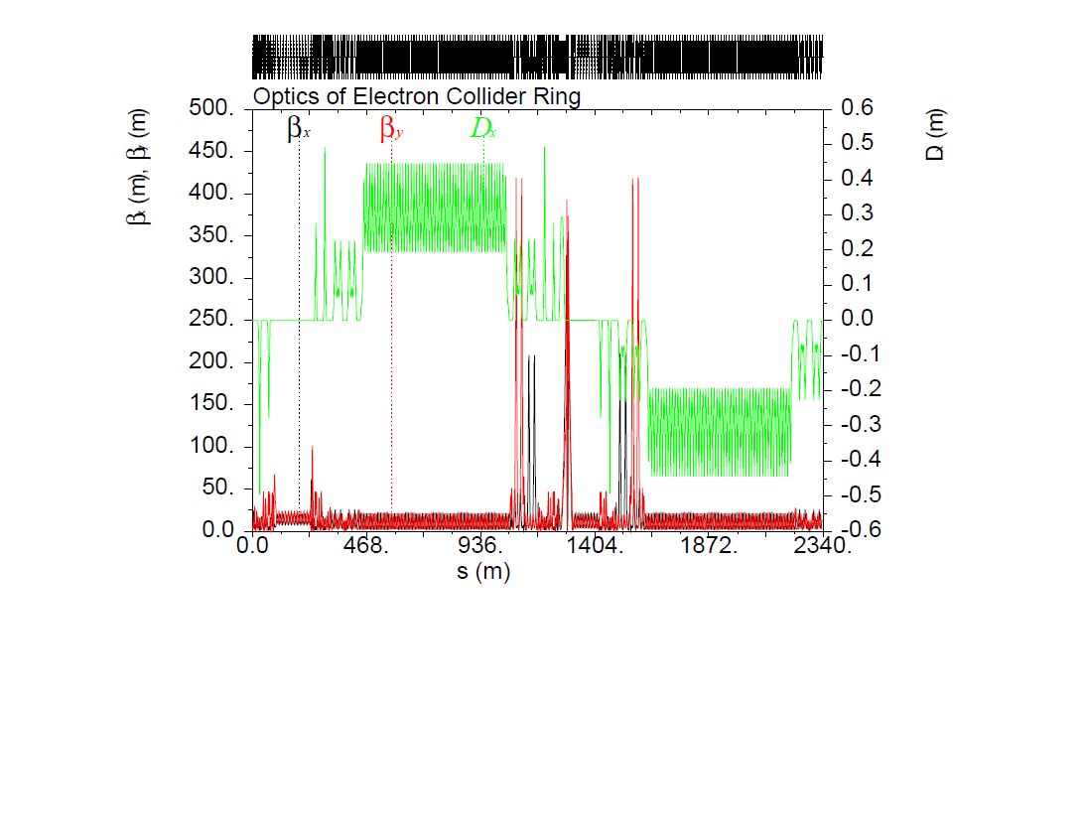
Electron Collider Ring Optics
Betatron tunes ν_{x} = 59.22, ν_{y} = 59.16
Δϕ_{y1}
Δϕ_{y2}
Δϕ_{x1}
Δϕ_{x2}
Chromaticity compensation block

Slide 15
Electron Collider Ring Parameters
Electron beam momentum | GeV/c | 5
Circumference | m | 2336.18
Straights’ crossing angle | deg | 81.7
Beta stars at IP β*_{x,y} | cm | 10/2
Maximum horizontal / vertical β functions β_{x,y} | m | 327 / 420
Maximum horizontal dispersion D_{x} | m | 0.51
Horizontal / vertical betatron tunes ν_{x,y} |  | 59.22 / 59.16
Horizontal / vertical chromaticities ξ_{x,y} |  | -124 / -166
Momentum compaction factor α |  | 9.5 × 10⁻⁴
Transition energy γ_{tr} |  | 32.39
Normalized horizontal /vertical emittance ε_{x,y} (un-normalized) | µm rad (nm rad) | 54 / 11 (5.5 / 1.1)
Horizontal / vertical rms beam size at IP σ*_{x,y} | µm | 24 / 4.8
Maximum horizontal / vertical rms beam size σ_{x,y} | mm | 1.3 / 0.26

Slide 16
Baseline Beam Parameters
Beam energy | GeV | 3 | 5 | 6.95 | 9.3 | 10
Beam current | A | 3 | 3 | 3 | 0.95 | 0.71
Total SR power | MW | 0.34 | 2.63 | 10 | 10 | 10
Energy loss per turn | MeV | 0.12 | 0.88 | 3.3 | 10.5 | 14.0
Energy spread | 10⁻⁴ | 2.8 | 4.6 | 6.7 | 8.6 | 9.1
Transverse damping time | ms | 385 | 83 | 31 | 13 | 10
Longitudinal damping time | ms | 192 | 41 | 15 | 7 | 5
Normalized Emittance | um | 12 | 54 | 168 | 348 | 433

Slide 17
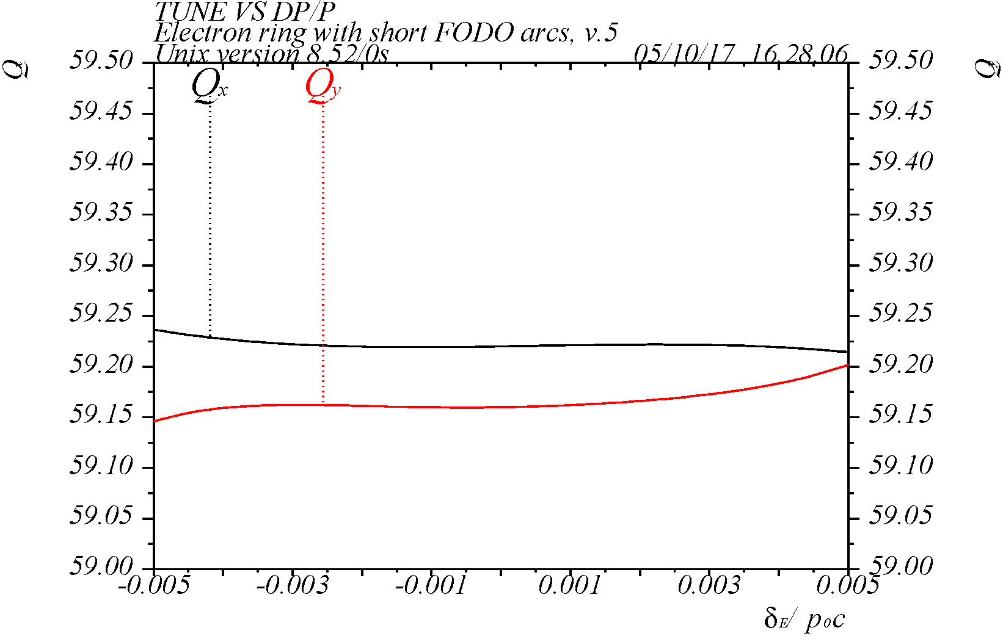
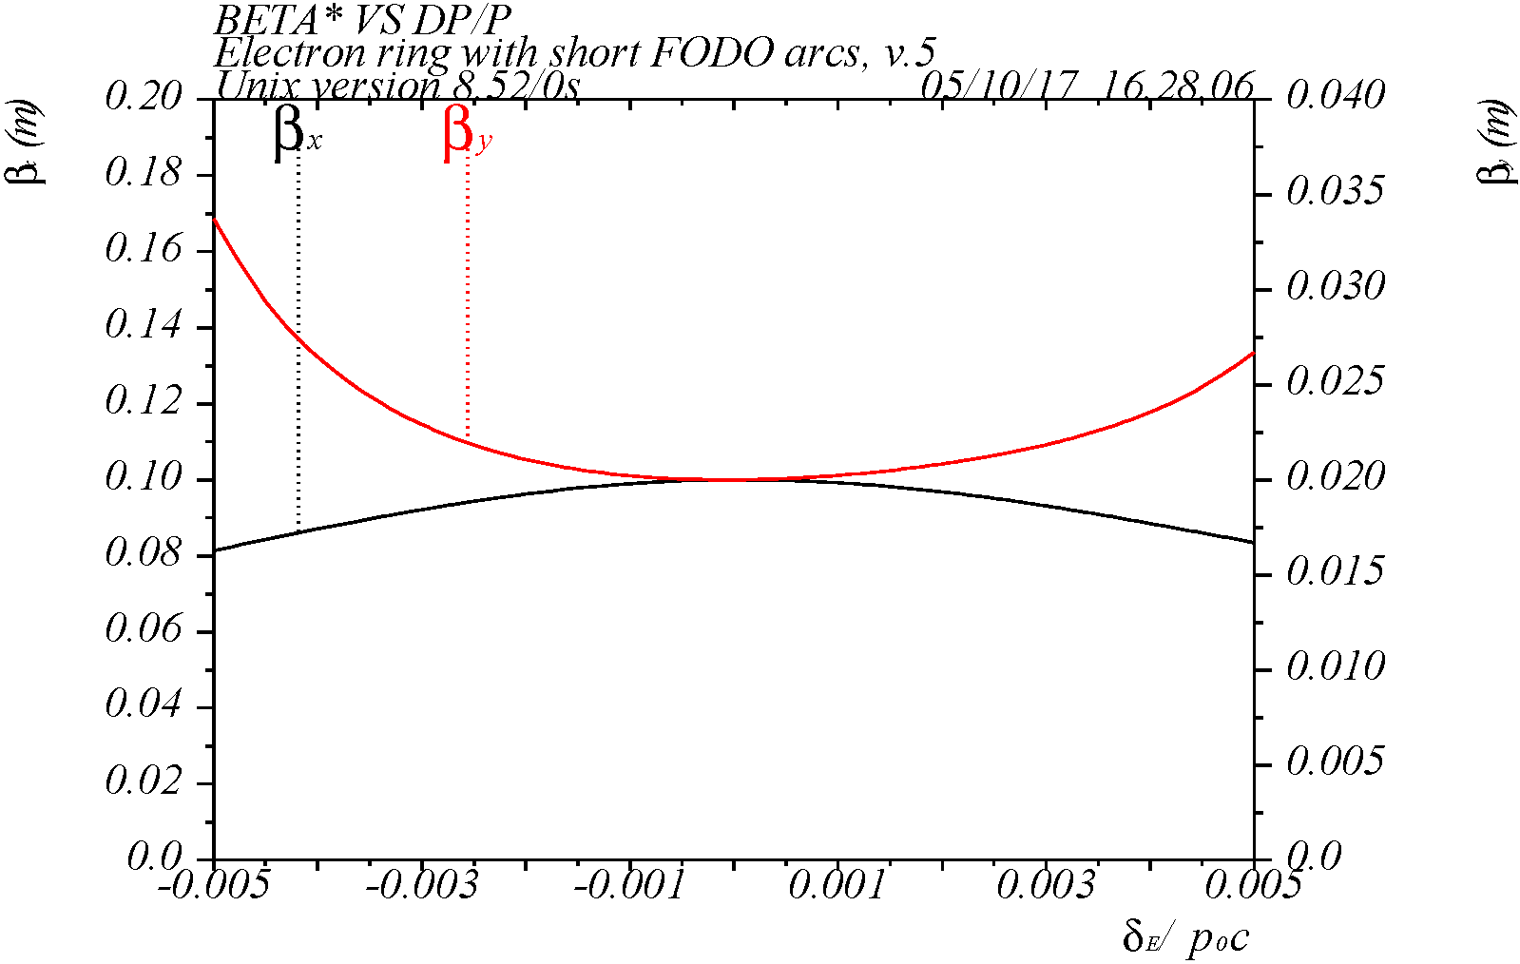
Chromatic Tune and β*
Betatron tunes are 59.22 and 59.16, β* are 10 and 2 cm
Phase advance from SBCC sextupoles to IP is optimized near π/2+nπ for minimum chromatic tune shift over large energy range
40 x 108 degree cells in each arc for linear chromaticity sextupoles
W-function at IP is cancelled for minimum variation of β∗(δ)
Adequate chromatic compensation over 11σ_{p} range
±11σ
17

Slide 18
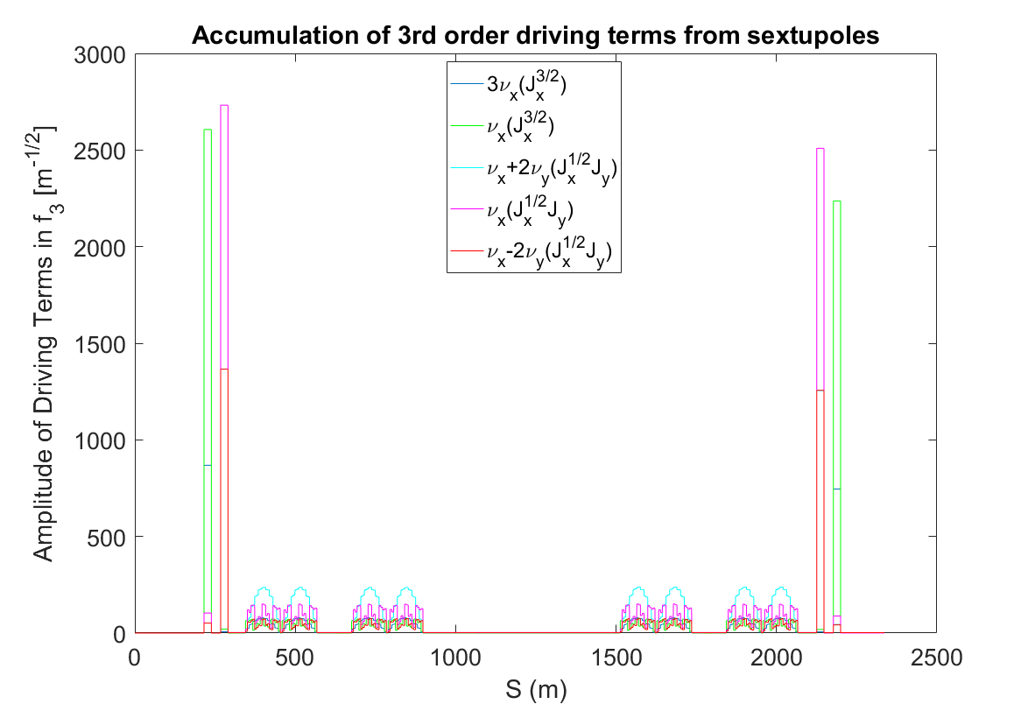
Sextupole Non-linear Geometric Effects
The SBCC –I sextupole pairs and the arc sextupole schemes provide compensation of some of the non-linear resonance effects from sextupoles
The choice of arc cell phase advance and number of arc cells N_{c} with sextupoles such that N_{c}μ_{c} = 2π*integer
μ_{c} = 108 deg → N_{c} =10k in the electron ring
yields cancellation of some of the non-linear resonance driving terms due to systematic non-linear field (A. Verdier, PAC’99; Y. Cai, NIM, A645:168–174, 2011)
Potential improvement of dynamic aperture
Cancellation of 3rd order resonance driving terms
SBCC
SBCC
Arc
Arc
IP

Slide 19
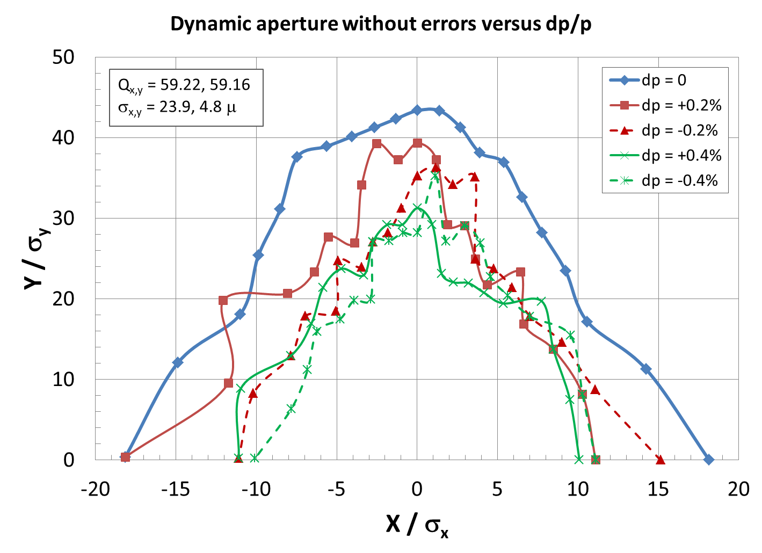
Dynamic Aperture w/ Energy Dependence
DA without errors (shown at IP)
LEGO tracking with 1024 turns, x = +1, e_{x} = 5.7 nm @ 5 GeV (agree with elegant results)
Fractional tune = (.22, .16)
DA ~ 18s for on-momentum
Energy range exceeds
±11σ_{p} at 5 GeV

Slide 20
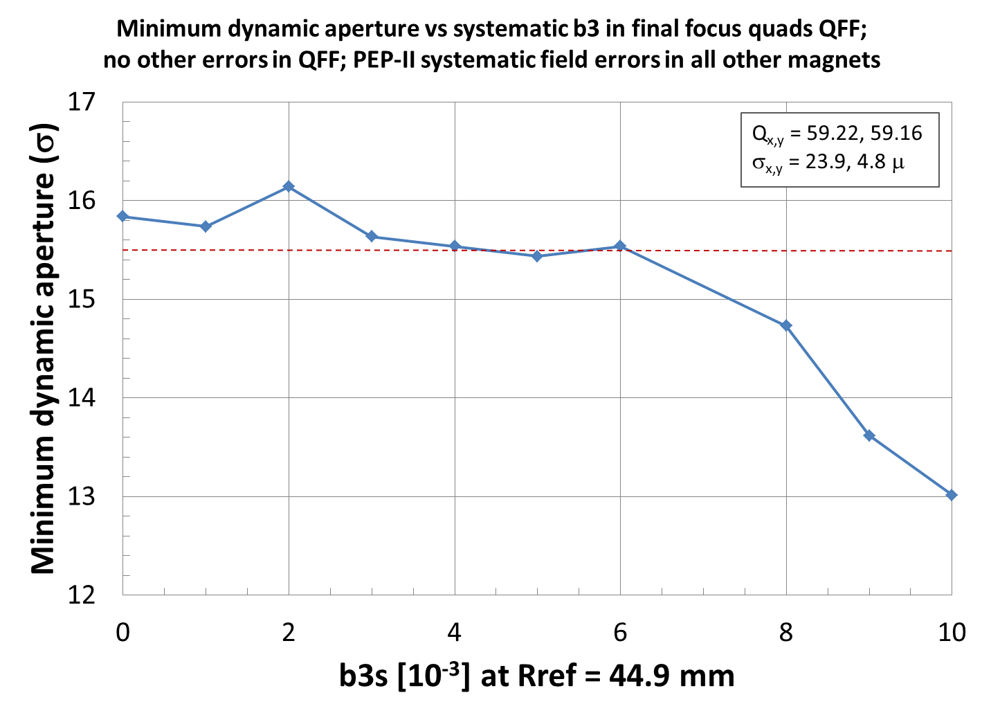
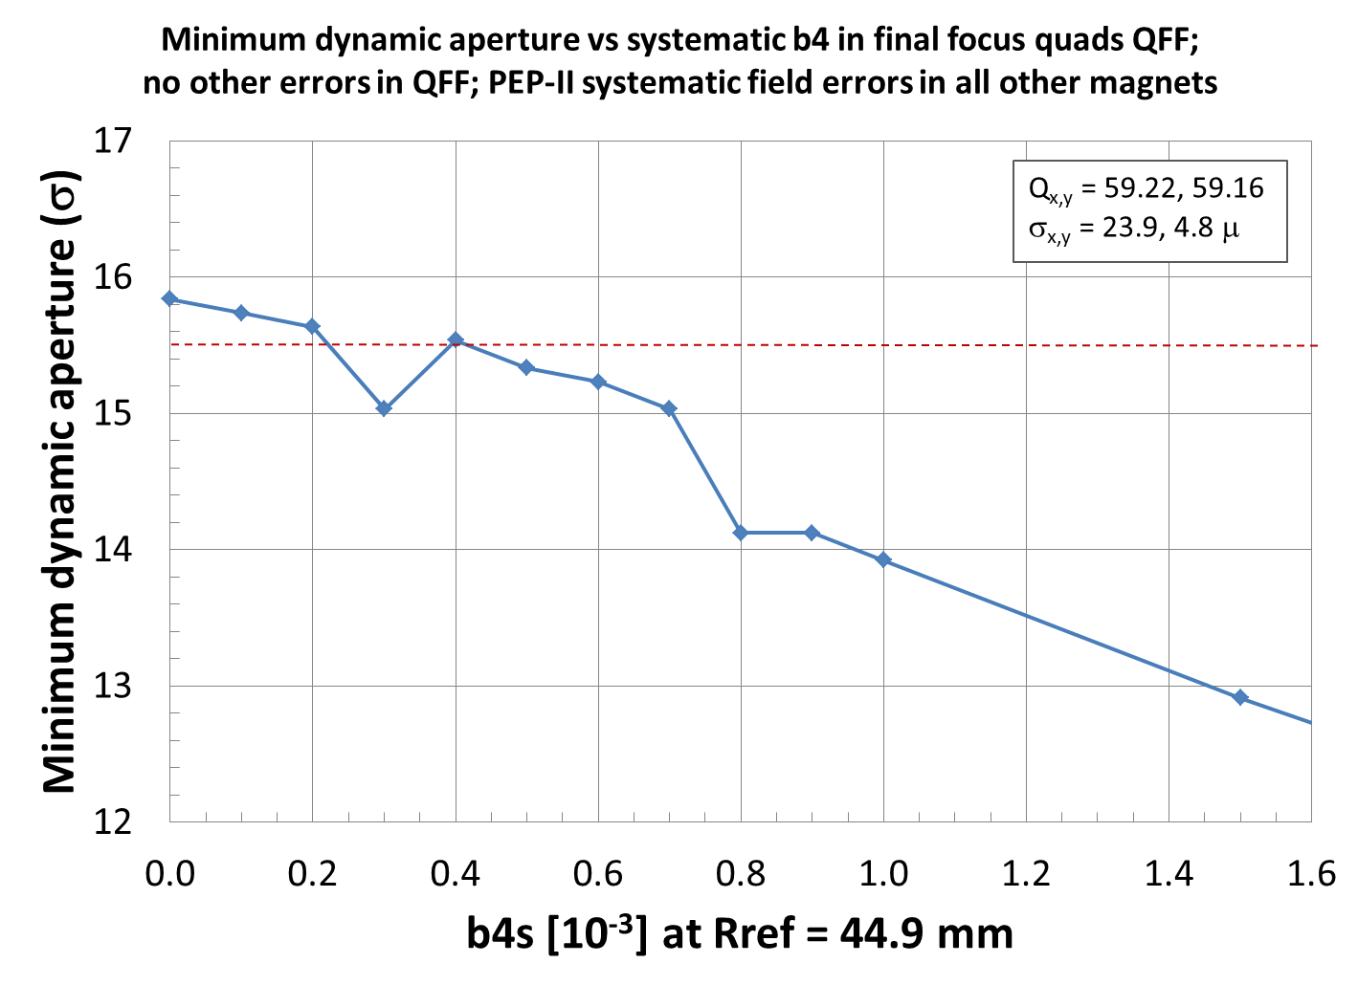
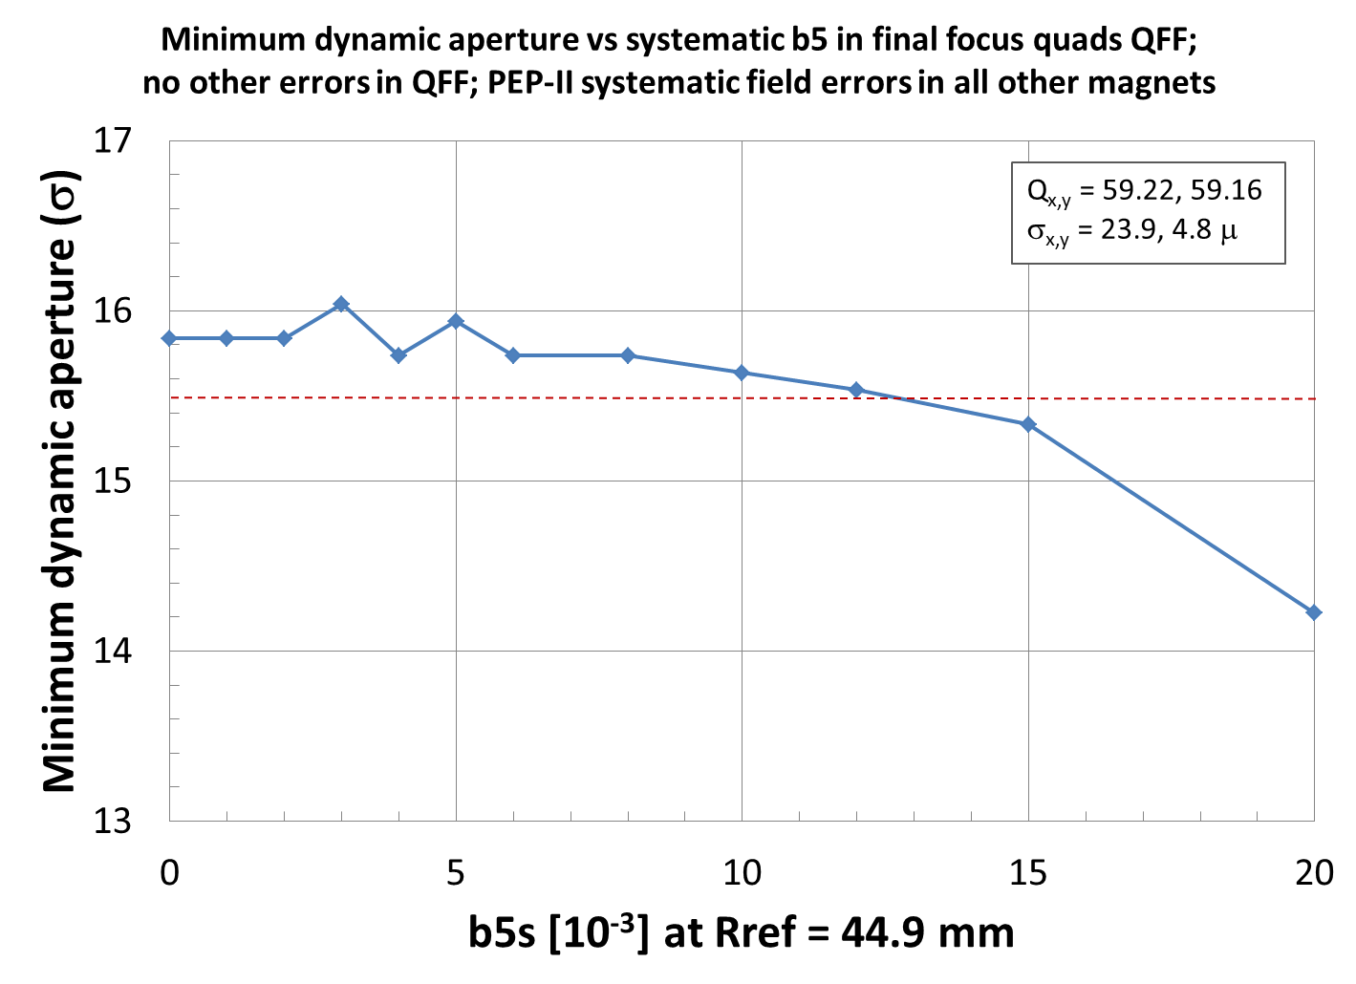
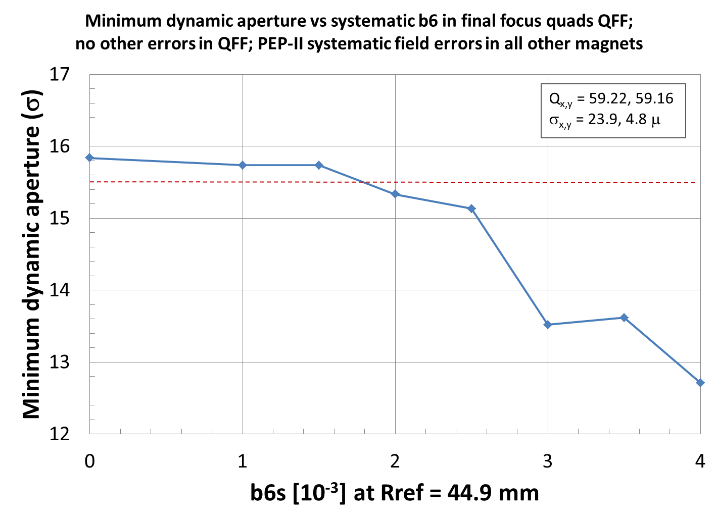
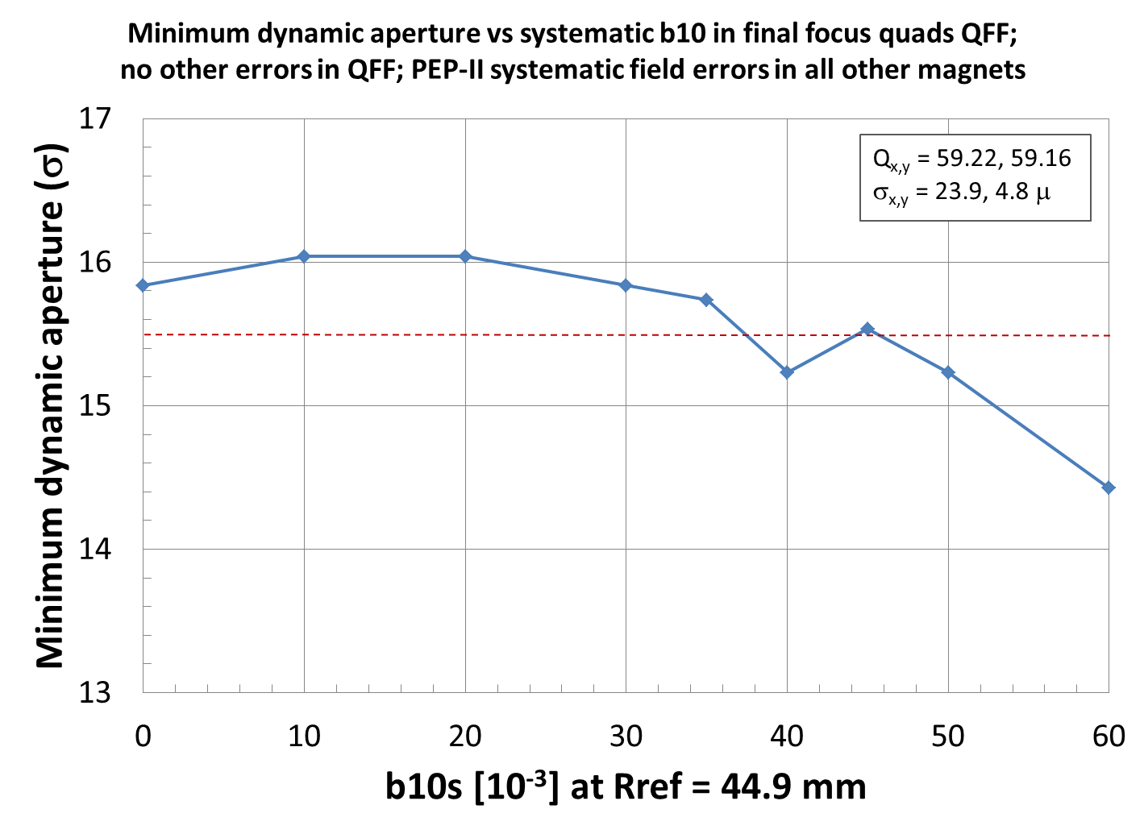
DA w/ Non-linear Field Errors in FF Quads
DA vs systematic non-linear field components (b_{n}) in FF quads is evaluated
Each QFF b_{n} is scanned, one at a time, while other QFF terms are turned off
PEP-II measured systematic b_{n} in other ring magnets
Relatively strong sensitivity to b4, possibly due to the horizontal tune (59.22) near the 4th order resonance
Assuming the same DA reduction (red line in plots), a set of b_{n} “tolerance” values is obtained
b3
b4
b5
b6
b10

Slide 21
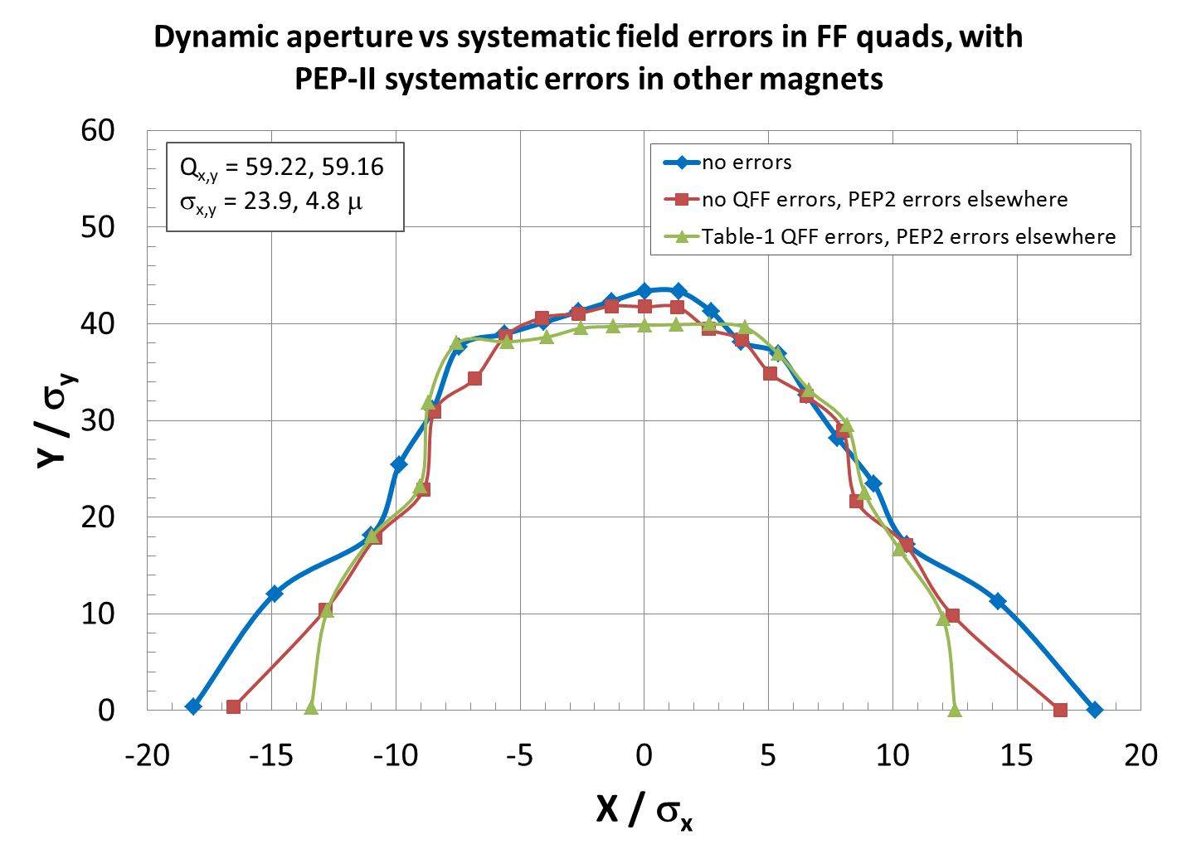
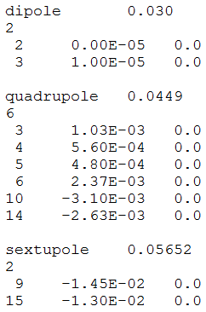
DA with Evaluated Systematic Errors in FF Quads
Without any errors (blue)
Without errors in FF quads, and with PEP-II systematic b_{n} errors in all other magnets (red)
With evaluated errors in FF quads, based on scan, and with PEP-II systematic errors in all other magnets (green)
DA reduction of a few σ_{x} due to the evaluated QFF errors
b3, b5, b10 values appear too generous, compared to PEP-II table → optimization (reduction) of these terms may improve the DA → to be studied
PEP-II systematic bn
QFF evaluated b_{n}
R = 44.9 mm
n | bn [10⁻³]
3 | 4
4 | 0.2
5 | 10
6 | 1.5
10 | 35

Slide 22
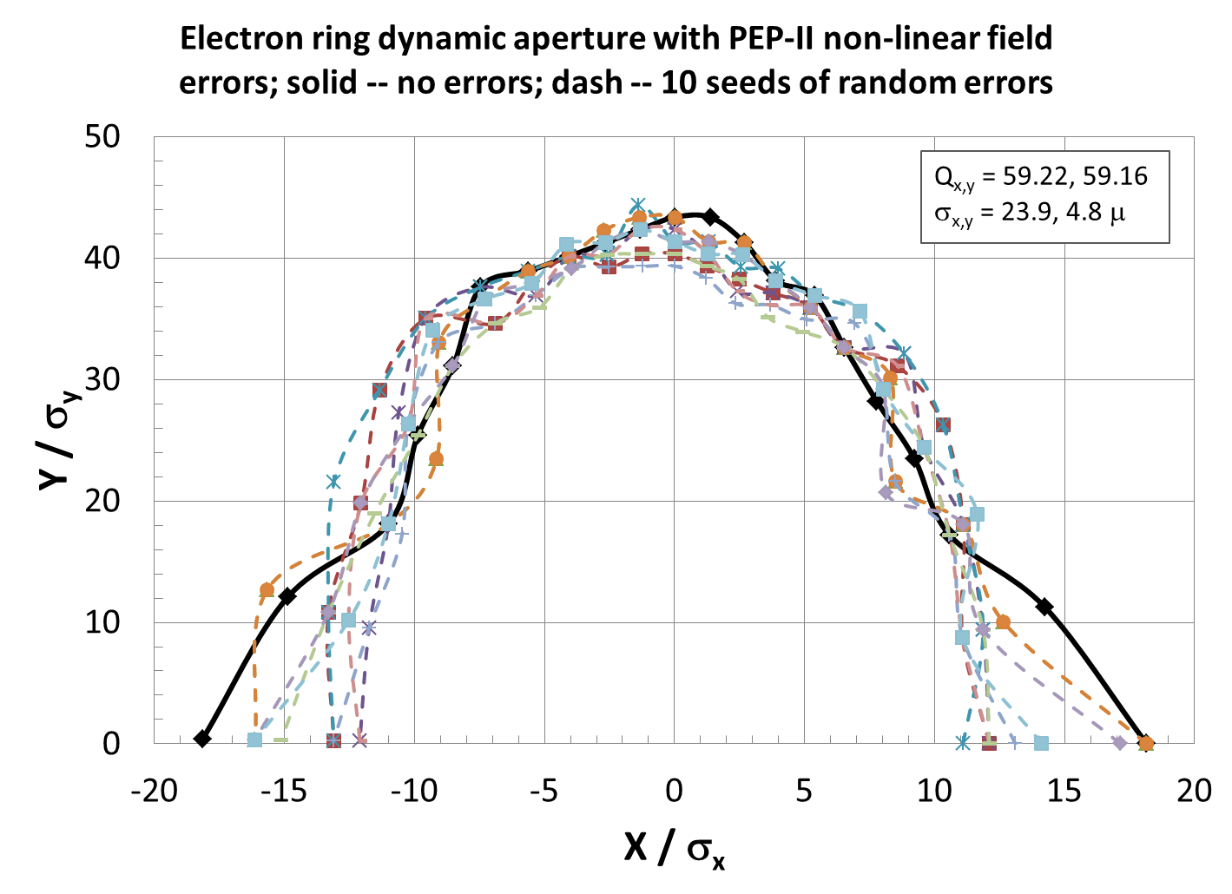
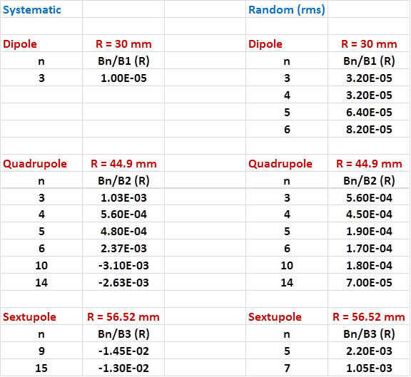
DA with PEP-II Measured Field Errors
PEP-II HER measured systematic and random field errors in all magnets (including FF quads)
10 random seeds, 1024 turns
Minimum DA among all seeds and angles is >11σ with the average minimum DA of about 13σ
Sufficient DA, but other errors (orbit, main field, coupling) and corrections are not yet included → to be studied
PEP-II systematic and random bn

Slide 23
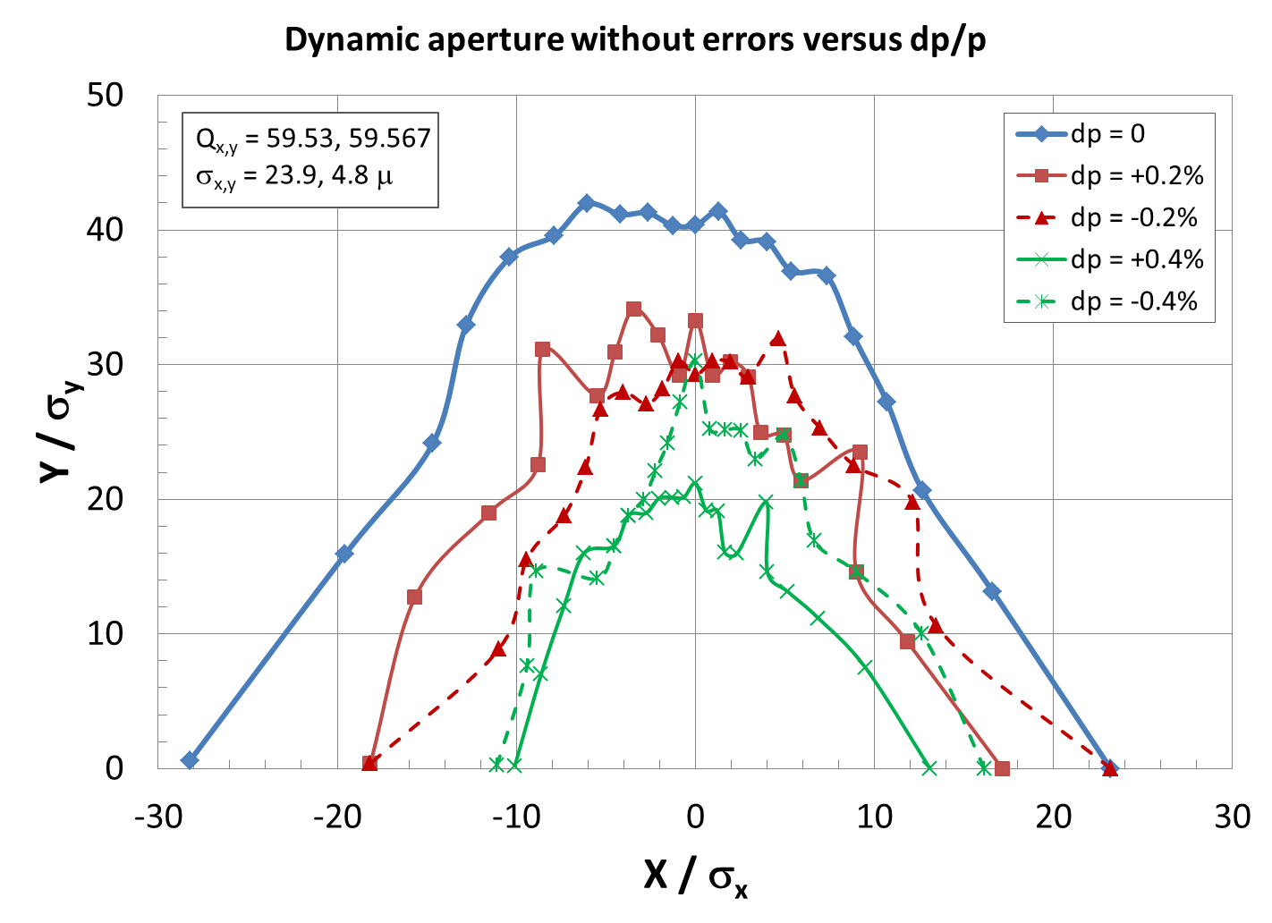
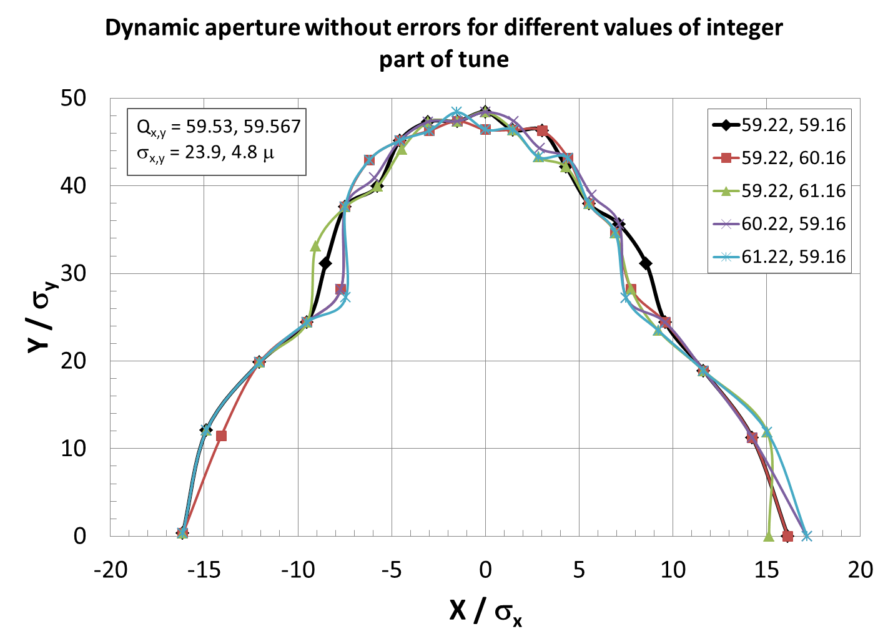
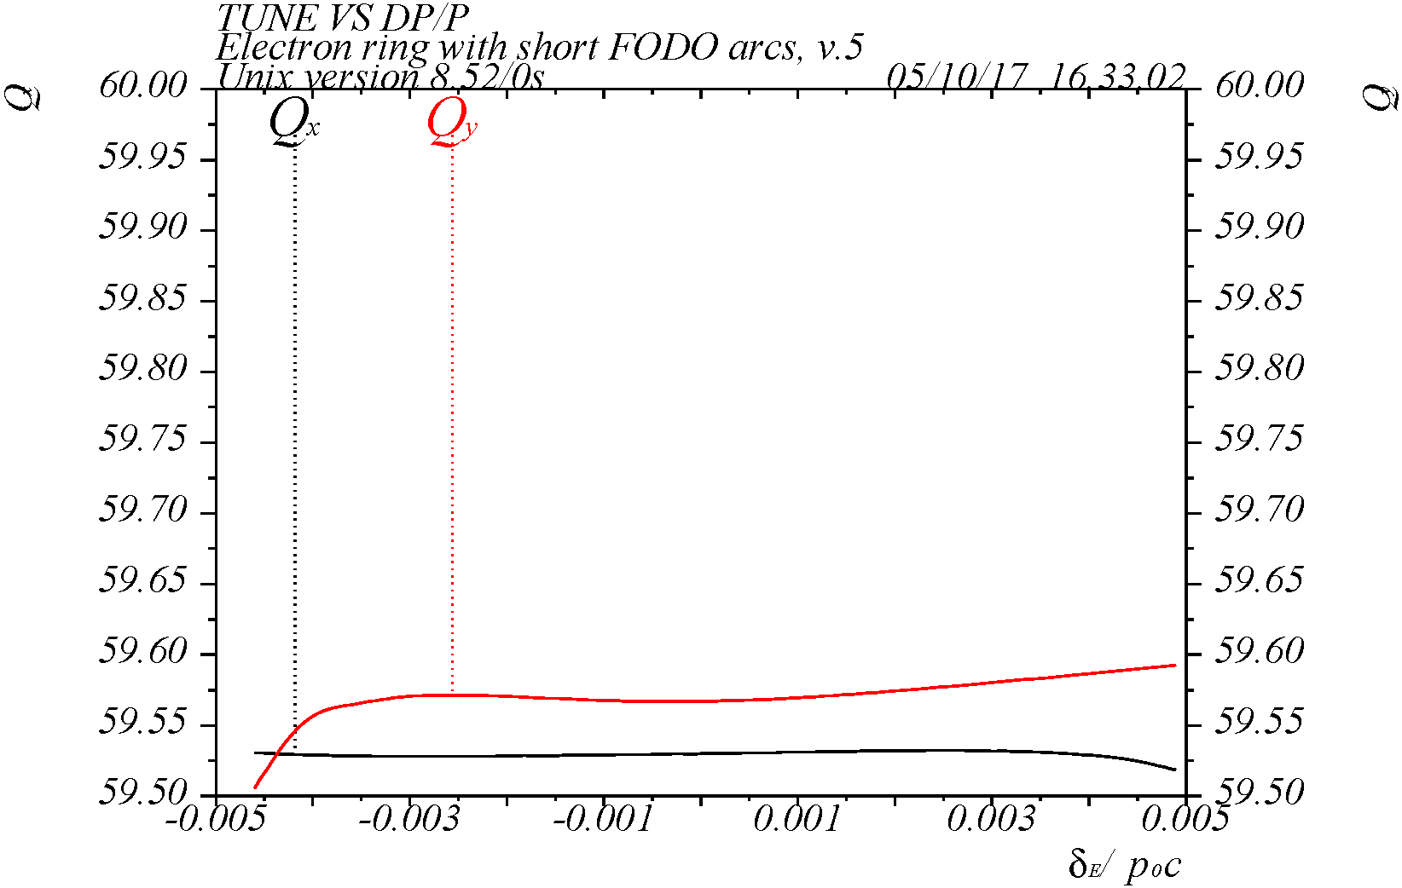
DA w/ Tune Options
Q = 59.22, 59.16
Q = 59.53, 59.567
DA vs integer part of tune
(59/59, 59/60, 59/61, 60/59, 61/59)
No significant sensitivity to integer part of tune
To do → tune scan
On-energy DA near half-integer tune (.53, .567) is larger than at (.22, .16), but energy range is smaller

Slide 24
Summary
The baseline design of JLEIC electron collider ring has been completed
meeting all requirements on the beam parameters, in particular on the emittance
incorporating provisions for correction of beam nonlinearity without introducing emittance growth
incorporating dedicated electron polarization and forward detection design
accommodating up to two detectors
considering optics design for special elements, such as spin rotator, RF, etc.
To do list for DA study
perform tune scan to find optimal tunes for maximum DA
perform tracking with a full set of errors and corrections
perform tracking with beam-beam and crabbing effects

Slide 25
Acknowledgment
Thanks to Yuhai Cai and Yuri Nosochkov (SLAC) for help on the detail of study of compensation schemes and tracking simulations
Thanks to Vasiliy Morozov and Yuhong Zhang (JLAB) for discussion
Thank you for your attention !
谢谢 !

