Slide 1

中国科学院高能物理研究所
INSTITUTE OF HIGH ENERGY PHYSICS
Clean room and Cryomodule assembly area
Jin Dai
2017.07.14

Slide 2
Outline
Clean room layout
Equipment in clean room
Cryomodule assembly area

Slide 3
Hall #2 map

Slide 4
Coupler clean room
Reception
Leak check
Storage
Cleaning processing
Clean assembly
Assembly leak check
Baking
Conditioning
Dismounting and packing
Delivery

Slide 5
Cavity assembly clean room
Water cleaning
Ultrasonic cleaning
High pressure rinsing
Clean room assembly
Cavity string assembly
To cryomodule area

Slide 6
Cavity string assembly
 | CAVITY STRING #1 |  |  |  |  |  |  |  |  | CAVITY STRING #2
 | Cavity1 | Cavity2 | Cavity3 | Cavity4 | Cavity5 | Cavity6 | Cavity7 | Cavity8 |  | Cavity1 | Cavity2 | Cavity3 | Cavity4 | Cavity5 | Cavity6 | Cavity7 | Cavity8
Day1 | cleaning, flange check, gasket preparation
Day2 | 1st HPR+dry | 1st HPR+dry
Day3 | assembly+leak check | assembly+leak check | 1st HPR+dry | 1st HPR+dry
Day4 | 2nd HPR+dry | 2nd HPR+dry | assembly+leak check | assembly+leak check
Day5 | assembly+leak check+baking | assembly+leak check+baking | 2nd HPR+dry | 2nd HPR+dry
Day6 | baking | baking | assembly+leak check+baking | assembly+leak check+baking | 1st HPR+dry | 1st HPR+dry
Day7 | mount to dewar | mount to dewar | baking | baking | assembly+leak check+baking | assembly+leak check+baking | 1st HPR+dry | 1st HPR+dry
Day8 | waiting | waiting | mount to dewar | mount to dewar | 2nd HPR+dry | 2nd HPR+dry | assembly+leak check | assembly+leak check
Day9 | cooling | cooling | cooling | cooling | assembly+leak check+baking | assembly+leak check+baking | 2nd HPR+dry | 2nd HPR+dry
Day10 | VT | VT | VT | VT | baking | baking | assembly+leak check+baking | assembly+leak check+baking
Day11 | rewarming | rewarming | rewarming | rewarming | mount to dewar | mount to dewar | baking | baking |  | cleaning, flange check, gasket preparation
Day12 | out of dewar | out of dewar | out of dewar | out of dewar | waiting | waiting | mount to dewar | mount to dewar |  | 1st HPR+dry | 1st HPR+dry
Day13 | disassembly | disassembly | disassembly | disassembly | cooling | cooling | cooling | cooling |  | assembly+leak check | assembly+leak check | 1st HPR+dry | 1st HPR+dry
Day14 | string assembly | string assembly |  |  | VT | VT | VT | VT |  | 2nd HPR+dry | 2nd HPR+dry | assembly+leak check | assembly+leak check
Day15 |  |  | string assembly | string assembly | rewarming | rewarming | rewarming | rewarming |  | assembly+leak check+baking | assembly+leak check+baking | 2nd HPR+dry | 2nd HPR+dry
Day16 |  |  |  |  | out of dewar | out of dewar | out of dewar | out of dewar |  | baking | baking | assembly+leak check+baking | assembly+leak check+baking | 1st HPR+dry | 1st HPR+dry
Day17 |  |  |  |  | disassembly | disassembly | disassembly | disassembly |  | mount to dewar | mount to dewar | baking | baking | assembly+leak check+baking | assembly+leak check+baking | 1st HPR+dry | 1st HPR+dry
Day18 |  |  |  |  | string assembly | string assembly |  |  |  | waiting | waiting | mount to dewar | mount to dewar | 2nd HPR+dry | 2nd HPR+dry | assembly+leak check | assembly+leak check
Day19 |  |  |  |  |  |  | string assembly | string assembly |  | cooling | cooling | cooling | cooling | assembly+leak check+baking | assembly+leak check+baking | 2nd HPR+dry | 2nd HPR+dry
Day20 | leak check, out of cleanroom |  |  |  |  |  |  |  |  | VT | VT | VT | VT | baking | baking | assembly+leak check+baking | assembly+leak check+baking
Day21 |  |  |  |  |  |  |  |  |  | rewarming | rewarming | rewarming | rewarming | mount to dewar | mount to dewar | baking | baking
Day22 |  |  |  |  |  |  |  |  |  | out of dewar | out of dewar | out of dewar | out of dewar | waiting | waiting | mount to dewar | mount to dewar
Day23 |  |  |  |  |  |  |  |  |  | disassembly | disassembly | disassembly | disassembly | cooling | cooling | cooling | cooling
Day24 |  |  |  |  |  |  |  |  |  | string assembly | string assembly |  |  | VT | VT | VT | VT
Day25 |  |  |  |  |  |  |  |  |  |  |  | string assembly | string assembly | rewarming | rewarming | rewarming | rewarming
Day26 |  |  |  |  |  |  |  |  |  |  |  |  |  | out of dewar | out of dewar | out of dewar | out of dewar
Day27 |  |  |  |  |  |  |  |  |  |  |  |  |  | disassembly | disassembly | disassembly | disassembly
Day28 |  |  |  |  |  |  |  |  |  |  |  |  |  | string assembly | string assembly
Day29 |  |  |  |  |  |  |  |  |  |  |  |  |  |  |  | string assembly | string assembly
Day30 |  |  |  |  |  |  |  |  |  | leak check, out of cleanroom
Manpower of string #1 is released
Shift to string #2
10 days period of one cavity string assembly

Slide 7
Equipment in clean room
Vacuum system
Leakage meter
Dry pump
TP
Pneumatic valve
⑤
②
④
① Slow pumping valve
② Fast pumping valve
③ Inflation valve
④ Dry pumping valve
⑤ Leak check valve
①
1atm inflation valve
MFC
③
Slow pumping：close 2，3，5 , open 1，4
Fast pumping ：close 1，3，5, open 2，4
Leak check：open 5，close 1, 2, 3, 4
Inflation：open 3，close 1, 2, 4, 5

Slide 8
Equipment in clean room

Slide 9
Equipment in clean room

Slide 10
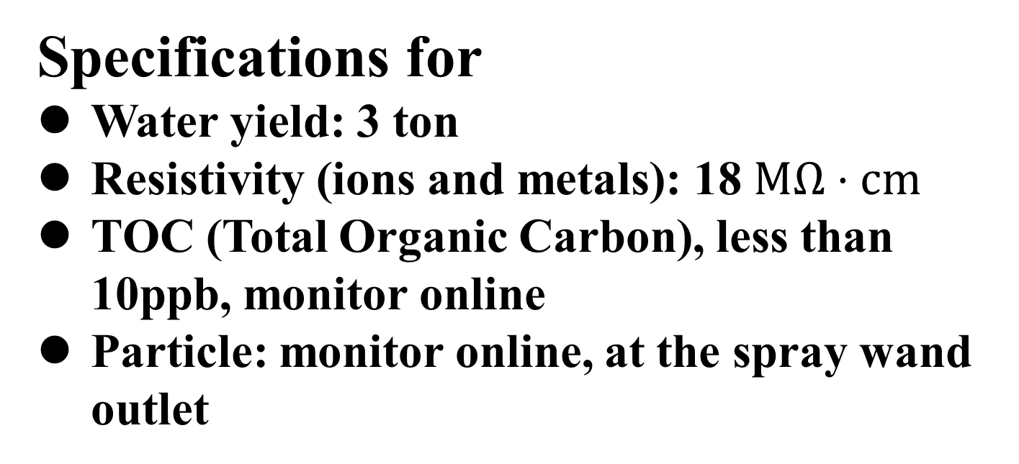
Equipment in clean room
Specifications for
Water yield: 3 ton
Resistivity (ions and metals): 18$ΜΩ⋅cm$
TOC (Total Organic Carbon), less than 10ppb, monitor online
Particle: monitor online, at the spray wand outlet

Slide 11
Equipment in clean room

Slide 12
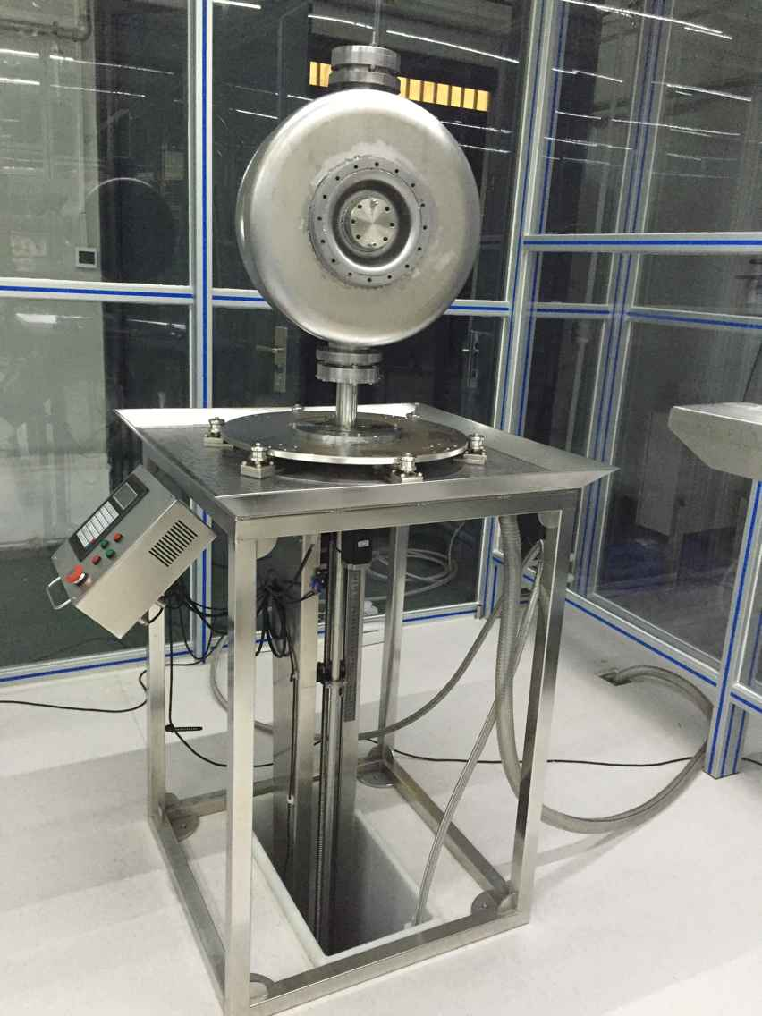
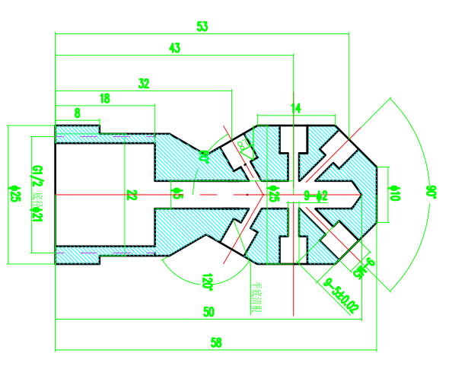
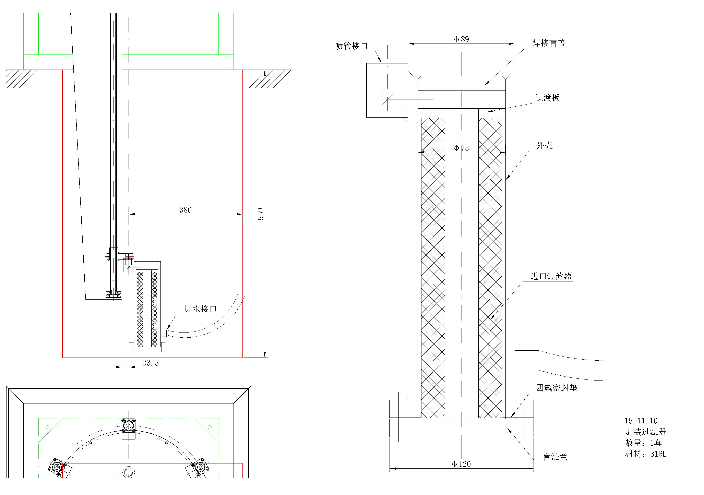
Equipment in clean room
High pressure rinsing system
Set-up
HPR stand in ISO 4
Nozzles: sapphire nozzles
Wanner pump G15X: nitrile rubber for diaphragm and gasket, 316L SS for pump head
Trickle flow all time to reduce bacteria risk
Pall 40nm filter
PTFE gasket
Water flow: 16L/min
Pressure: 100 bar
Cleaning hole：650x800mm

Slide 13
Equipment in clean room
Liquefied nitrogen, no risk of “dirty” bottles
Purity: 1 ppm

Slide 14
Equipment in clean room

Slide 15
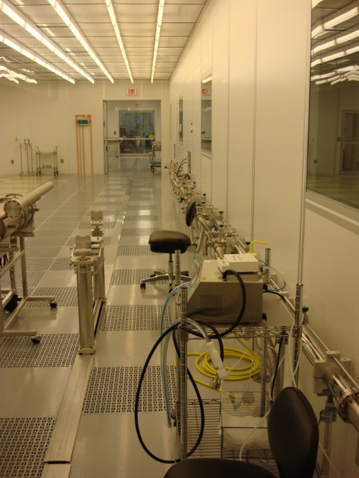
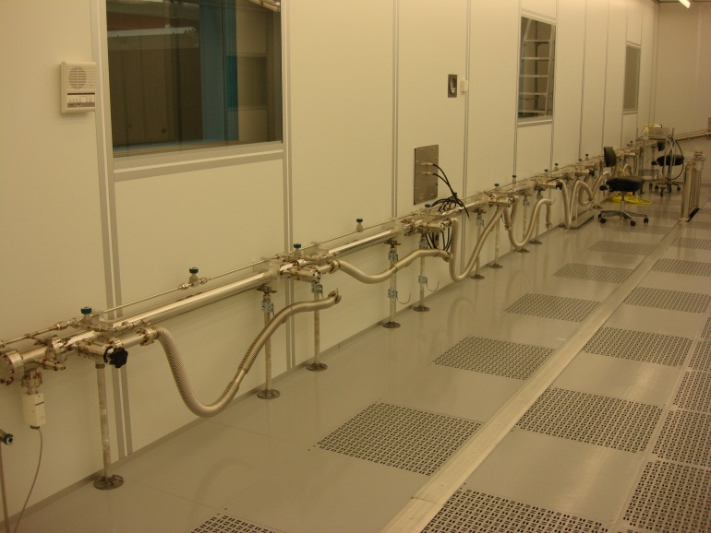
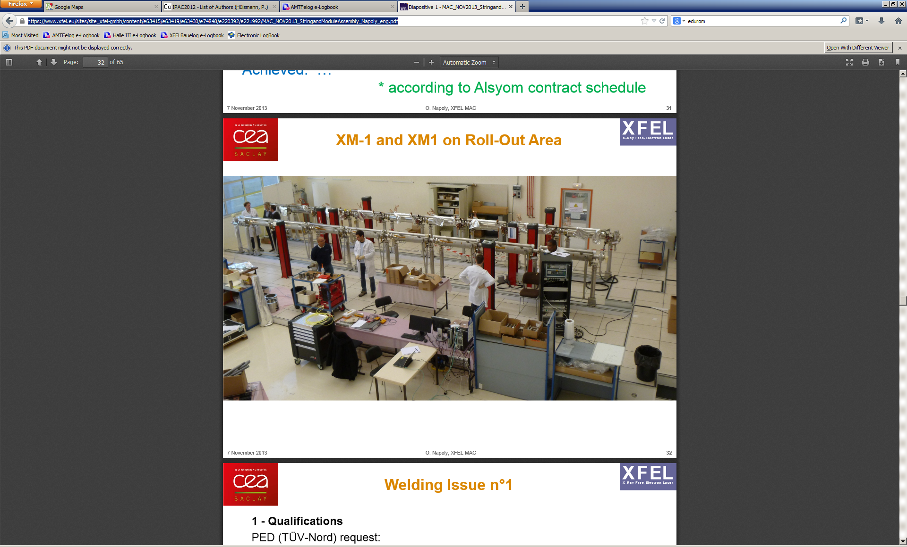
Cavity string assembly

Slide 16
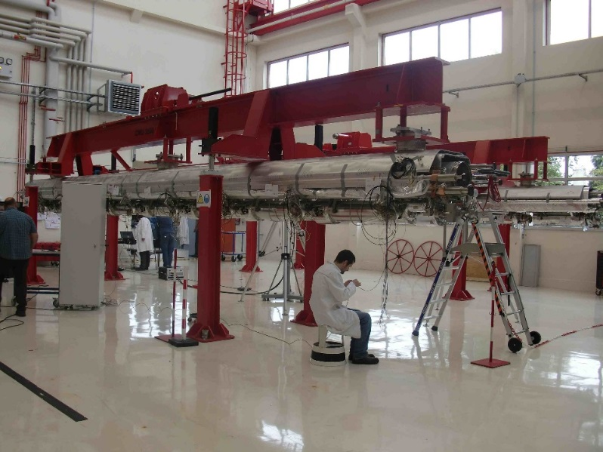
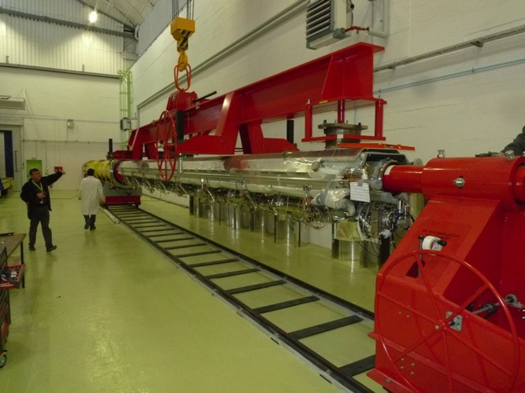
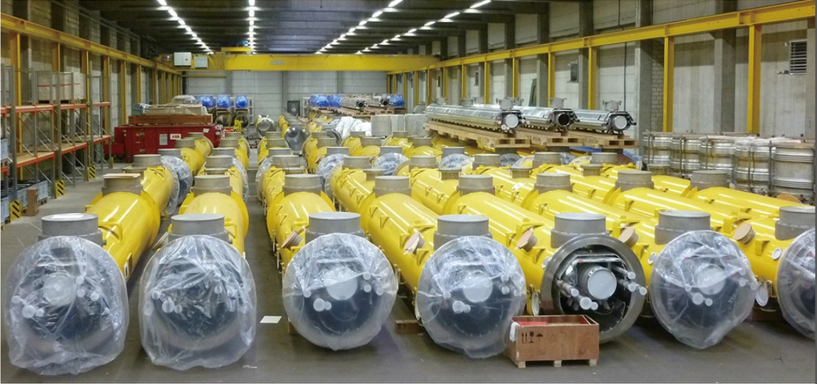
Cryomodule assembly
15x36

Slide 17
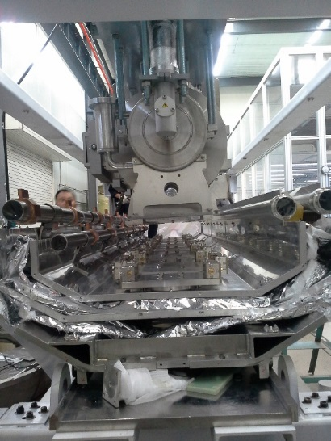
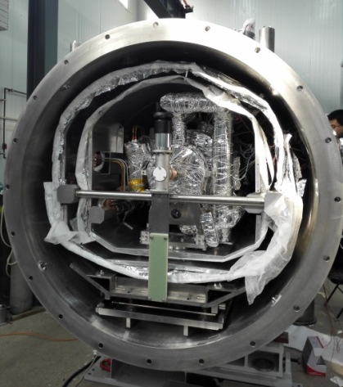
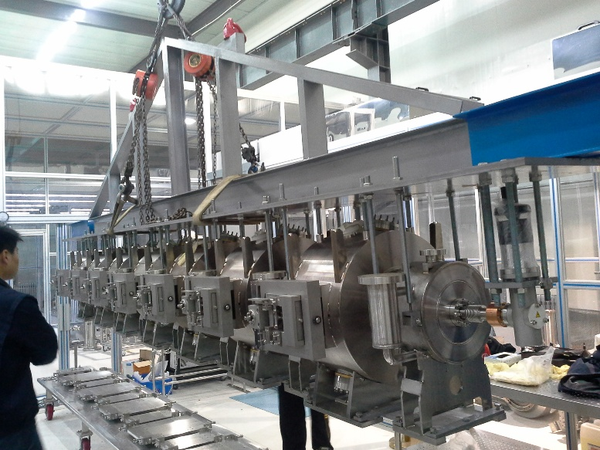
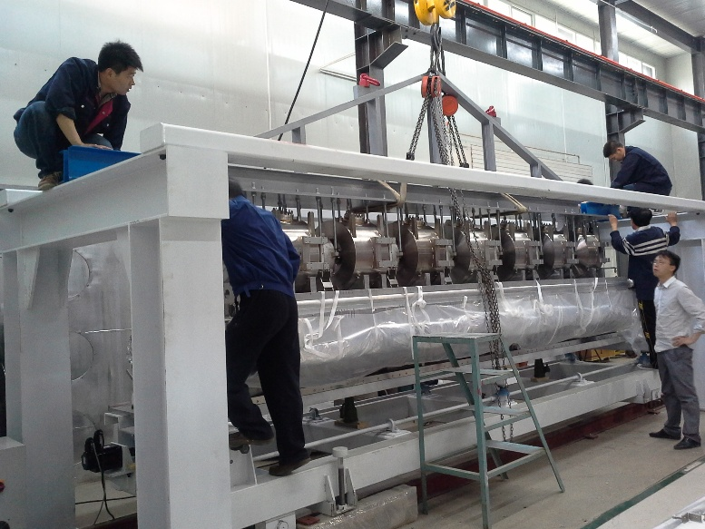
Cryomodule assembly
15x36

Slide 18
thanks！

