Slide 1
SRF Cavity Vertical Test System for PAPS
Zhenghui MI
On behalf of the VT group of PAPS-RF
Accelerator Centre, IHEP
2017/07/14

Slide 2
Vertical Cavity Test Facility
Requirements:
Test cavities bare or with He vessel: 166.6 MHz QWR cavity；325 MHz Spoke cavity；500 MHz single-cell cavity；650MHz single-cell cavity，2-cell cavities，5-cell cavities；1.3GHz single-cell cavity and 9-cell cavities；
RF power up to 300W
Measure Q0 vs E, Q0 vs T, radiation (FE)
Cryoplant: 2500W 4K refrigerator, ＞100L/h liquefaction (2K), Heat load capacity for VT 100W@2K (500W@4.2K)

Slide 3
Design Tasks
  Civil Construction
  Cryostat
  Magnetic Shielding
  Radiation Shielding
  RF & DAQ System
  Insert (Cavity support)
  Vacuum System
  Quench location system
    T-Mapping
    Second sound

Slide 4
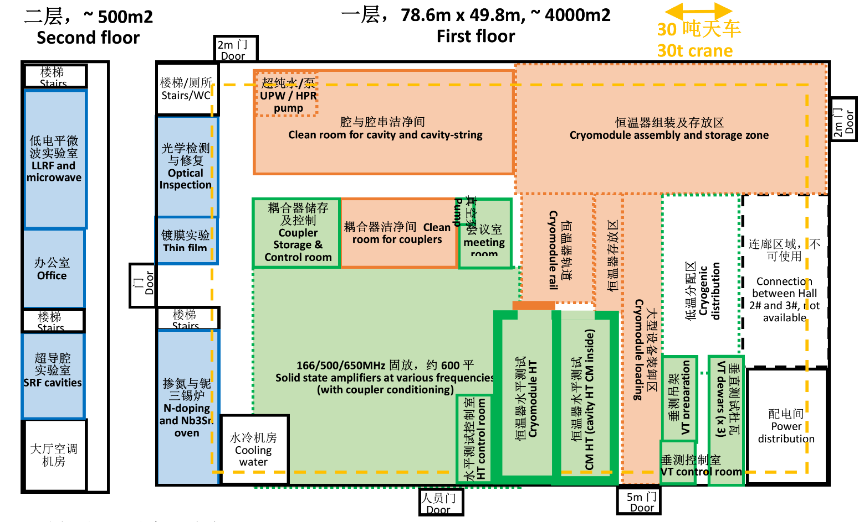
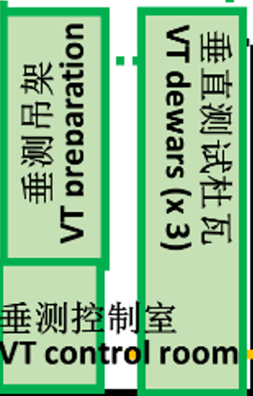
Civil Construction
VT area
North
South
130㎡
8m
15m
Vacuum oven
4m
1m
3m

Slide 5
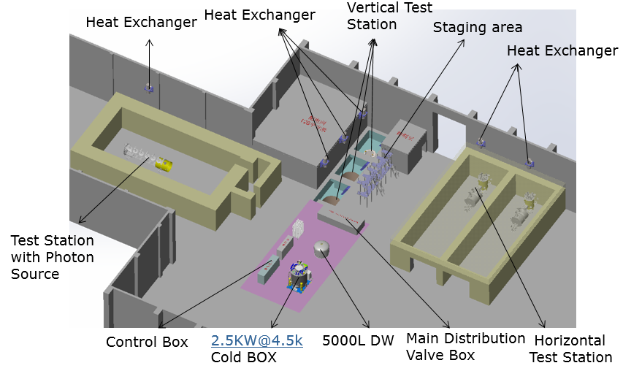
Civil Construction
  Three test pits (two large and one small)
  The crane:
  weight capacity: 30t ，10t
  Guard rails/fencing for personnel
  safety
1.5m
6.5m
2.5m/1.5m

Slide 6
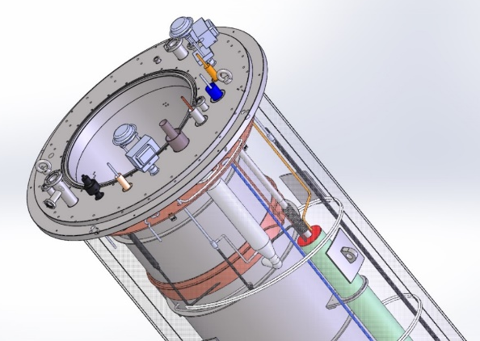
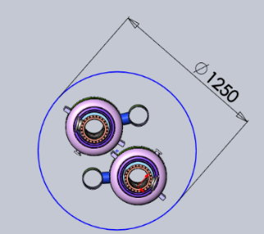
Cryostat
Requirements:
  Bath temperature : 1.5 – 4.5 K
  Bath pressure: 3.5 – 1000 Torr
  Fast cool down ＞ 2.4K/min
  Fast warm up: heater 1000W, the ability to pour liquid into each other
  Static heat load ：≤ 6W
  Deep and large enough for two 650 MHz 5-cell cavities( with He vessel)
  Ambient magnetic filed: ≤ 10 mG （With magnetic shielding）

Slide 7
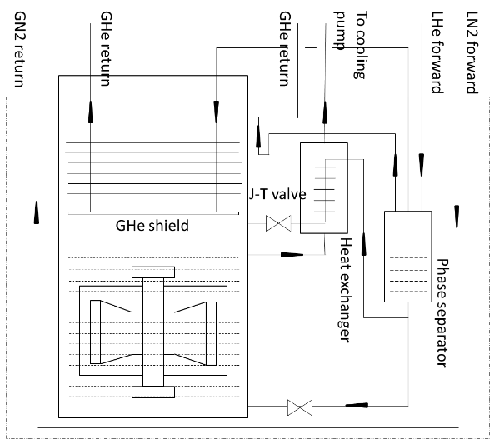
Cryostat
Specifications
  LHe Vessel : 5m deep, 1.25m ID (Two), 0.85m ID (One)
  Warm (300K) & Cold (2K) magnetic shields
  Internal heater 1000W
  Temperature sensor to monitor bath temperature
  LHe level probes (2m +1m)
  80K thermal shields
  Bottom and top fill valves for LHe filling and topoff
The technical solution of vertical test cryostat we have used in the project of ADS inject-1. The test result show that the heat load of cryostat is about 3.5W at 2K.

Slide 8
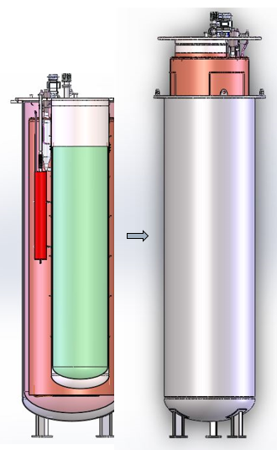
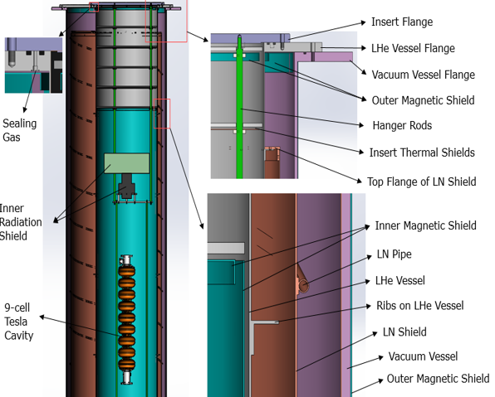
Cryostat
The volume of LHe level 2.5 m：
Large Dewar 3067L, small Dewar 1420L
The structure composition
Inner Φ850, thickness 3mm, depth 5243mm （316L）
Outer Φ1400, thickness 12mm, depth 6000mm (304)

Slide 9
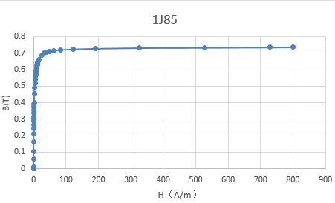
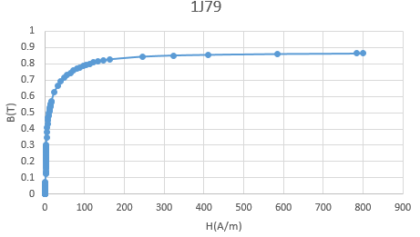
Magnetic Shielding
Surface resistance increases due to trapped magnetic flux
Earth’s magnetic field (~500 mG)
Two- layer design
  Outer RT cylindrical shield, attached to pressure vessel OD
  permalloy 1J85, thickness 1.5mm
  Inner 2K cylindrical shield, attached to helium vessel ID, with a cap
  permalloy 1J79, thickness 1.5mm
  Ambient magnetic filed ≤ 10 mG with significant safety margin
  Both “permanently” installed in/on cryostat to avoid damage

Slide 10
Magnetic Shielding
The structure composition (The big one)
UP end cap
bottom
The center axis
Deviation center axis 400mm

Slide 11
Magnetic Shielding
The structure composition (The small one)
UP end cap
bottom
The center axis
Deviation center axis 400mm

Slide 12
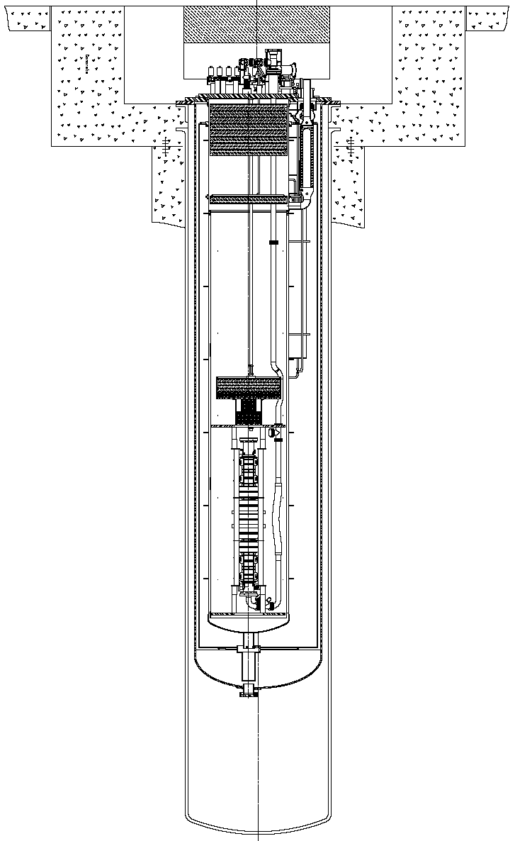
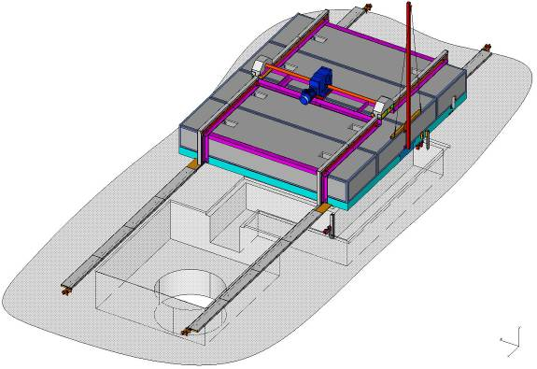
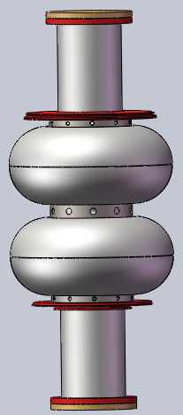
Radiation Shielding
Structure
Refer to Fermi lab's shielding cover scheme
Mast for power& signal cables
Drive chains
normal concrete
(thickness 0.5-1m)
Steel base plate
lead
Motor and gear drive
Hardened steel rails

Slide 13
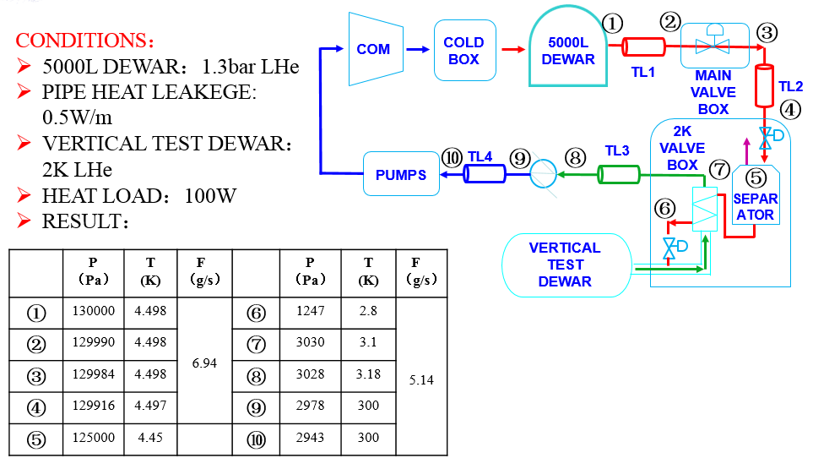
Flowchart for VT
2K Flowchart for VT

Slide 14
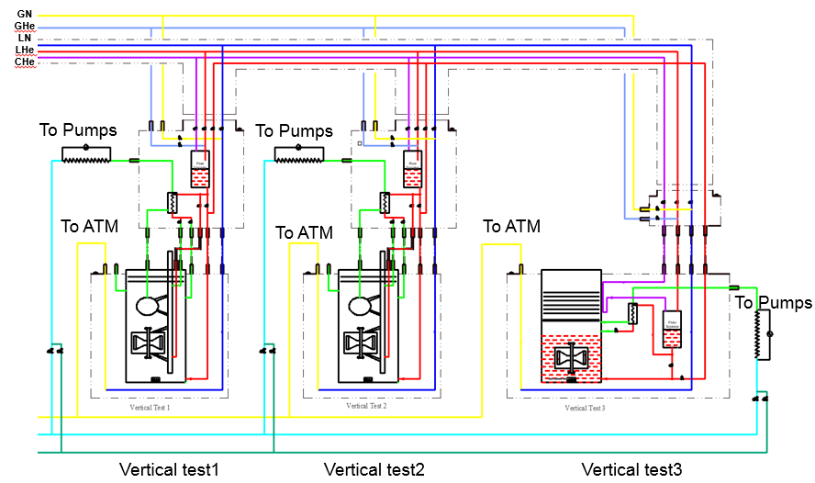
Cryogenic function flowchart for VT
Cryogenic system flowchart
Liquid Helium Transfer Lines
Between Three Dewar
Liquid Helium Injecting to
Helium Pool with Movably Connection
Liquid Helium Injecting to Vertical
Test Dewar with Stationary Connection
To pumps, 2K pipe

Slide 15
RF& DAQ System
Requirements:
  Provide stable RF power to the cavity, with control of amplitude
  relative phase, and frequency
  Measure incident, reflected, and transmitted power of the cavity (including transmitted power from HOM couplers if so equipped)
  Measure radiation produced from FE (field emission) or MP (multipacting)
  Provide automated data acquisition and control
  Calculate cavity performance parameters (E, Q₀) from power measurements and field decay time constant

Slide 16
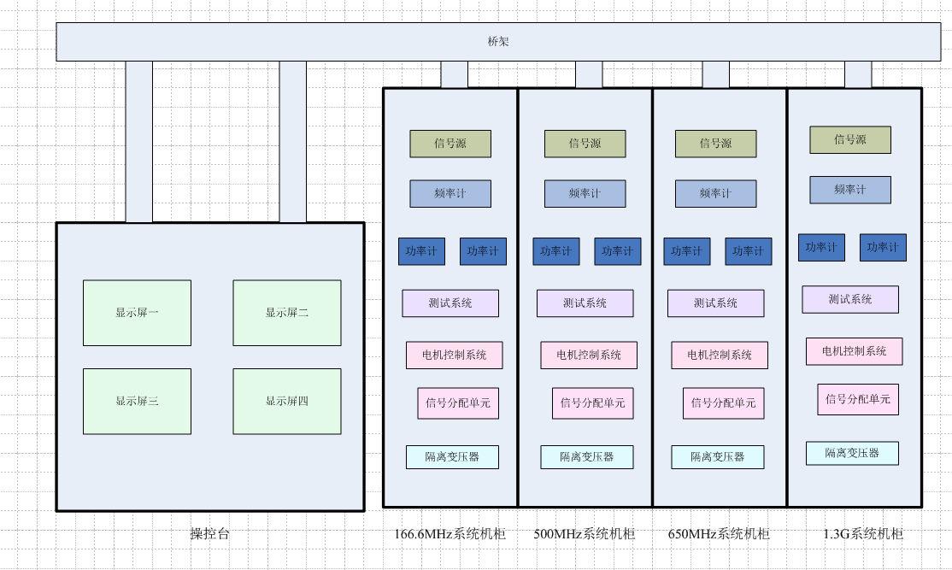
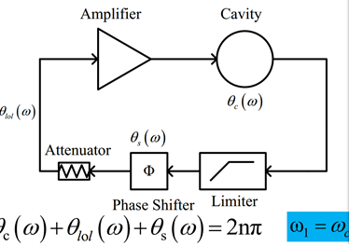
RF& DAQ System
Specifications -1:
  The self-excitation test system will
  be adopted
  RF test system for cavities with different frequency
  Functional areas to separate

Slide 17
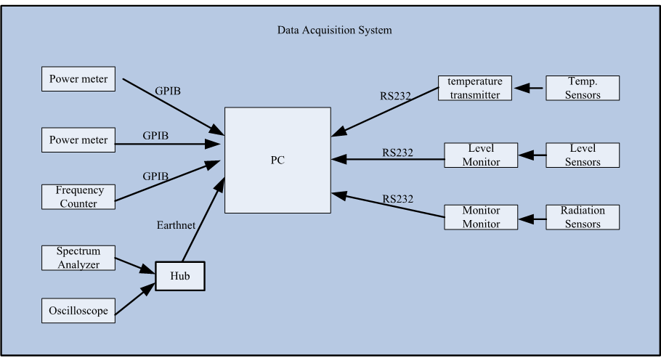
RF& DAQ System
Specifications -2:
  Power Supply & Measurement : SS amplifier
  Acquisition and Control :
    Automatic calculation of β
    Interactive cable calibration routine
    Continuous online display of E, Q₀, Rad, freq, P_{i}, and P_{r}
    RF output power control
    Phase control
    Display of cryogenic status (temps, Dewar pressure)
    Graphic display of Q0 vs E_{acc}
    Graphic display of Rad vs time, w/ Rad vs Eacc option
frequency | Max power
166.6MHz | 500W
325MHz | 500W
500MHz | 300W
650MHz | 300W
1.3GHz | 300W

Slide 18
RF& DAQ System
Specifications -3:
  Radiation / Interlocks
    Measurement and logging of radiation inside Dewar shield enclosure by DAQ system.
    High power RF enable interlocked w/ Personnel Safety System.
    Interlock system monitors both external-to-Dewar area monitor radiation signals and Dewar lid closure status, and displays status.
Radiation monitor
Shielding lid

Slide 19
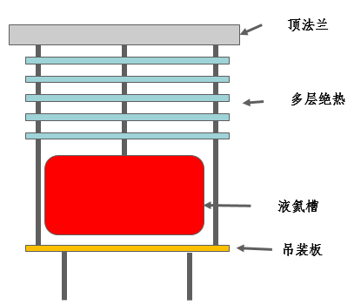
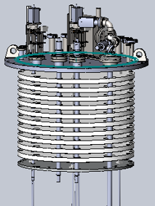
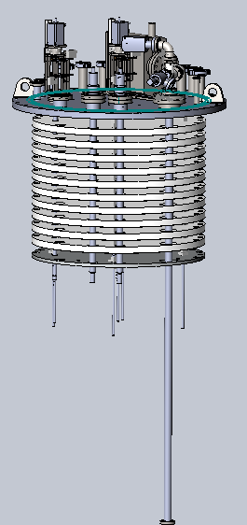
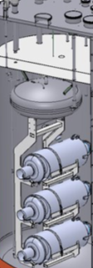
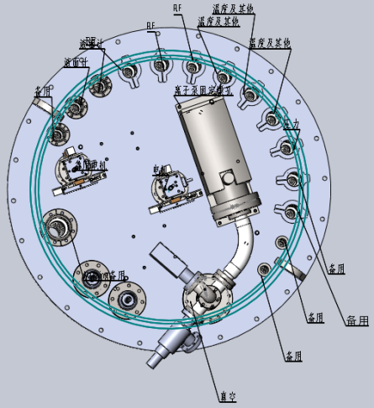

Dewar Insert
Specifications :
  Three Dewar Insert : two larger and one small
Thermal rad.
baffles
1.5m
Rad shielding
(Pb)
1m
He buffer
(~1000L)
2.5m
Large one
Small one
Top plate insert

Slide 20
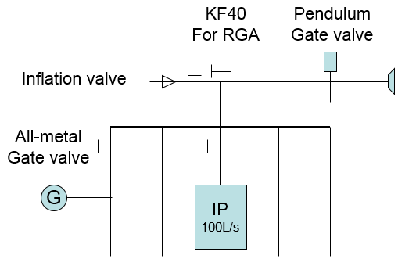
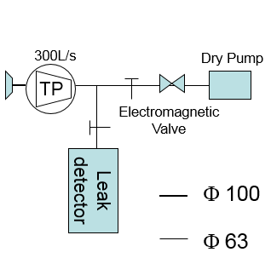
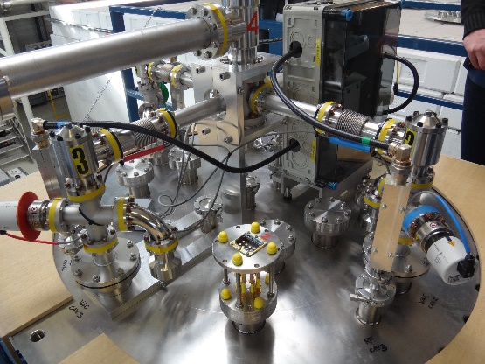
Vacuum system
Specifications :
  Three vertical inserts share a rough pumping unit and a leak detector
  Each vertical vacuum system consists of four separate test lines
  The pendulum gate valve and Electromagnetic valve are designed to prevent the Air regurgitation when power off.
  The limit vacuum of the system at warm temperature is better than 1e-3pa.
UHV for Vertical test
Refer to Desy VT system
Rough pump and Leak detector

Slide 21
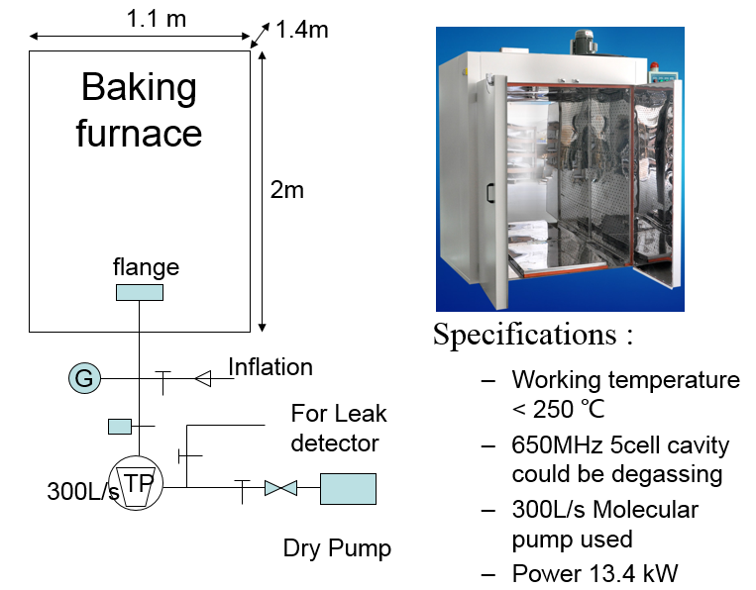
Baking furnace for cavity degassing

Slide 22
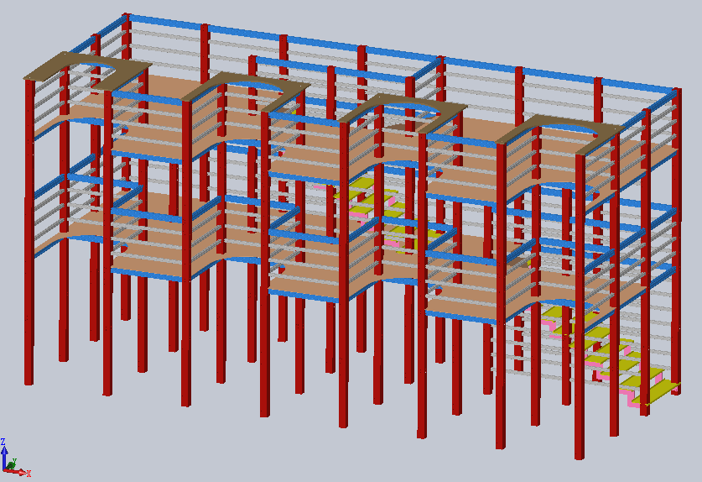
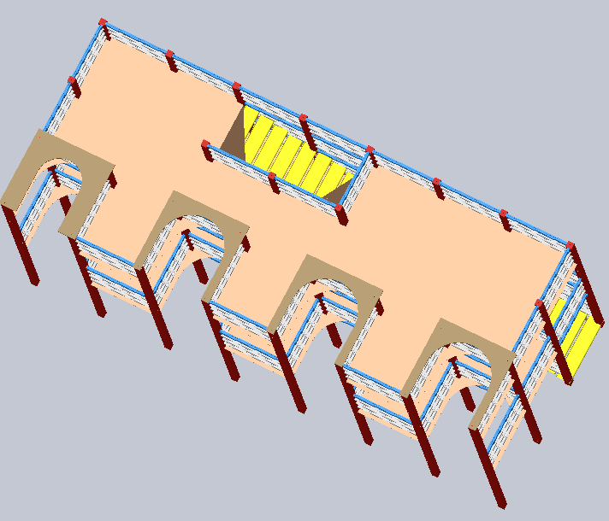
Staging Area
Specifications :
  Size : 4 m × 10 m × 5.2 m （2 + 2+ 1.2）
  Can be for four Inserts ：Three larger and
  One small
  Steel + Aluminum alloy
  Surrounded by plastic wrap
A “staging area” is used to store the inserts, and provide an appropriate environment for mounting and instrumenting a cavity before test.

Slide 23
Single VTS Throughput
Task | Duration (hours)
Cavities baking | 48
Cavity cooling to 300 K | 2
Mount cavities to insert | 1
Connect cables and TDR test | 1
Install insert in Dewar | 1
Perform Dewar leak check | 0.5
Helium replacement | 3
Cool down to 4K | 4
Fill @ 4K | 5
Pump to 2K | 2
RF Test at 2K | 5
Boil off LHe | 2
Warm up Dewar | 20
Remove insert | 1
Remove cavity from insert | 1
Total single test cycle duration | 46.5 + 50
200/Year（650MHz 5-cell cavity）, 400/Year（1.3GHz 9-cell cavity）

Slide 24
Quench localization
  Quench localization is a vital part of understanding cavity performance limitations – once we know where a cavity is quenching, we can look further to try and determine why it is quenching
  Two techniques will be used
    T- Mapping
    Second Sound

Slide 25
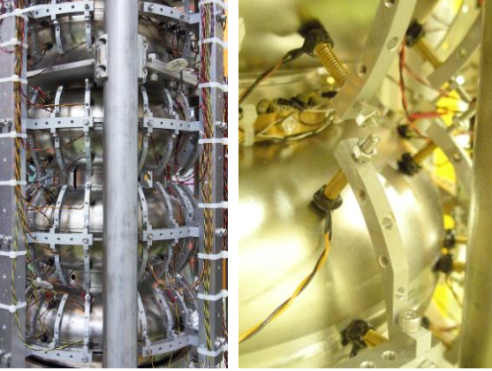
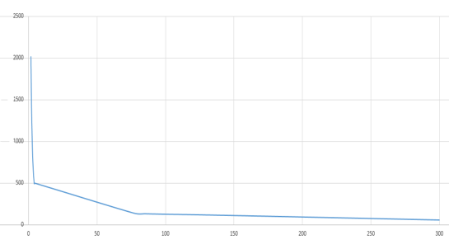
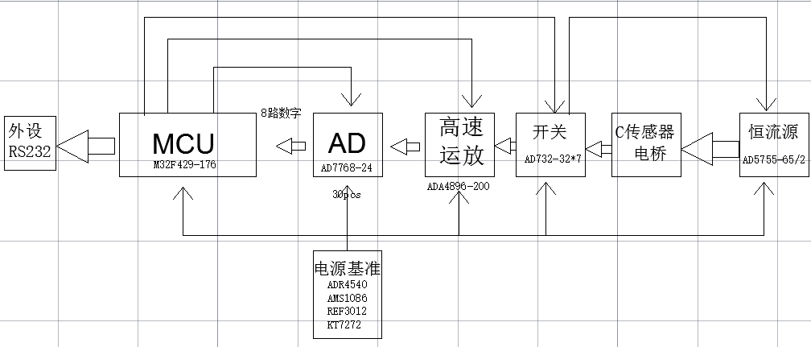
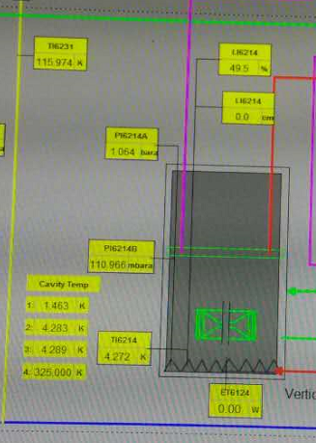
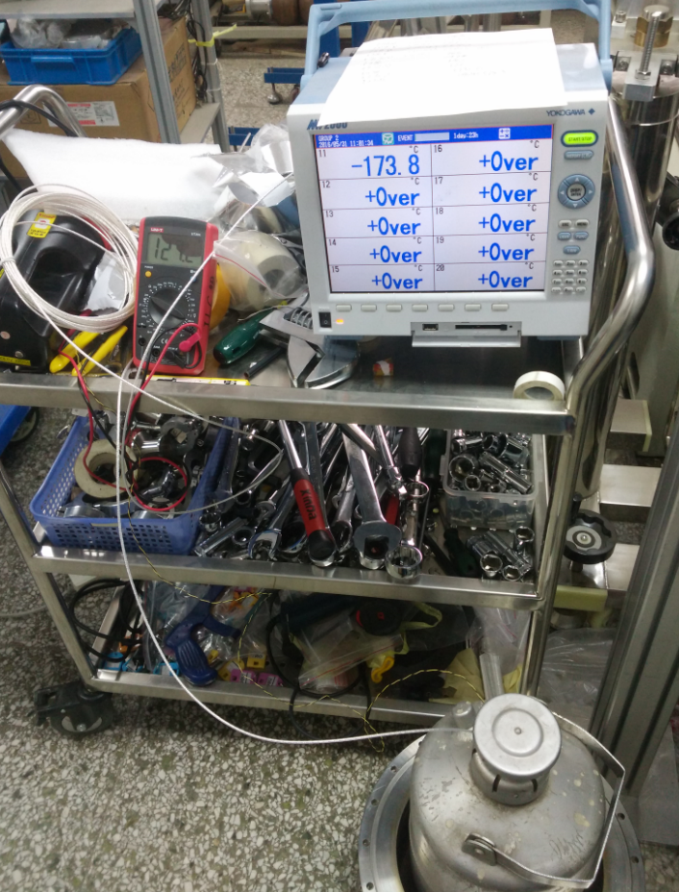
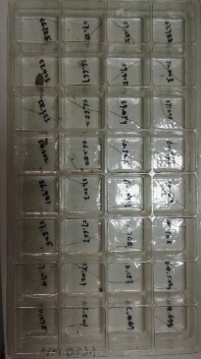
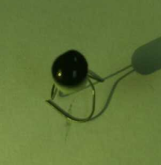
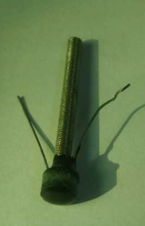
T-Mapping
  T- Mapping
    Consider KEK's design

Slide 26
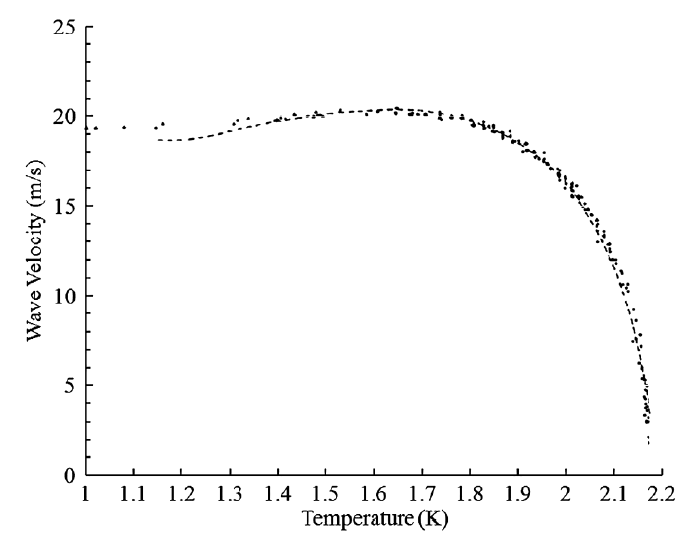
Second Sound
Principle:
  The speed of second sound in He-II is good to be used for position detection. It is about 17m/s at 2K.
  L= T × V

Slide 27
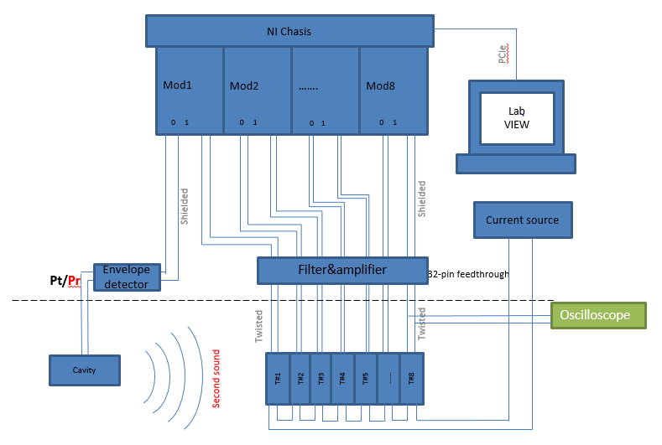
Circuits for one Dewar

Slide 28
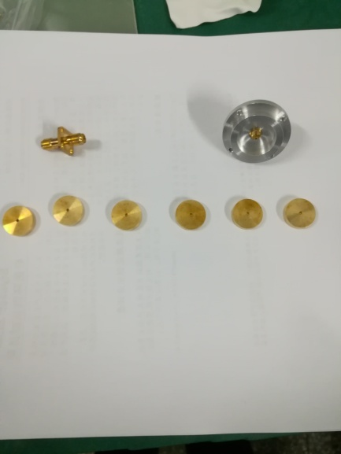
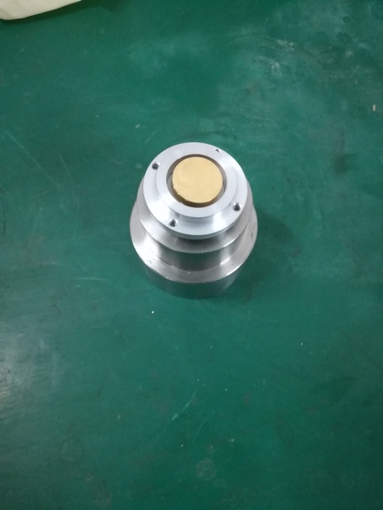
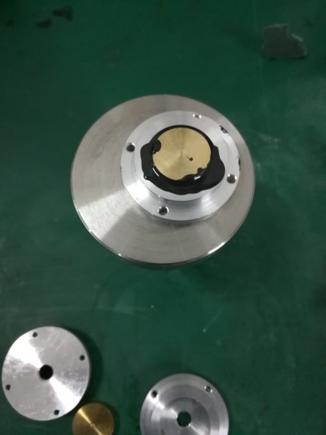
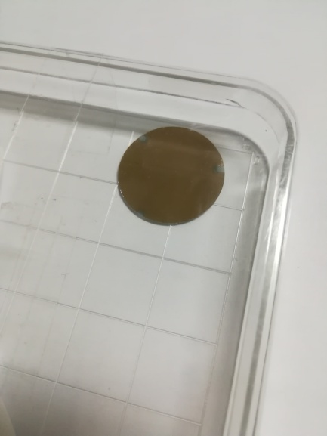
Testing conditions
Sensors
  Cernox bare chip：tested in 2K LHe with cavity and heater √
  Germanium bare chip： tested in 2K LHe with cavity and heater √
  Oscillating SuperLeak Transducers (OST): in fabrication

Slide 29
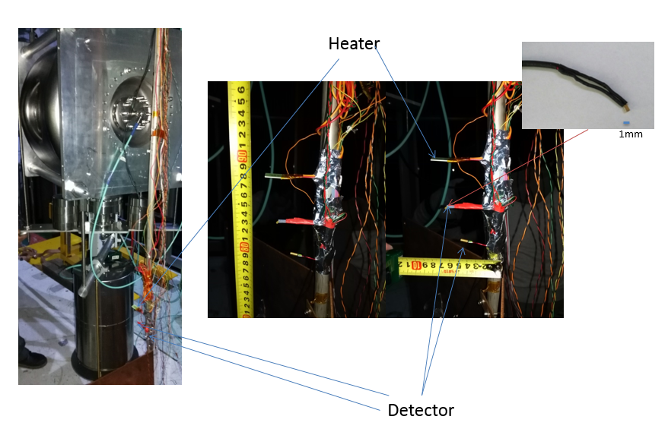
test

Slide 30
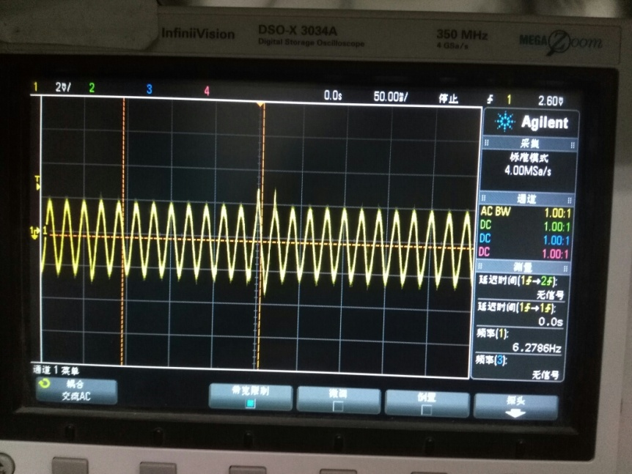
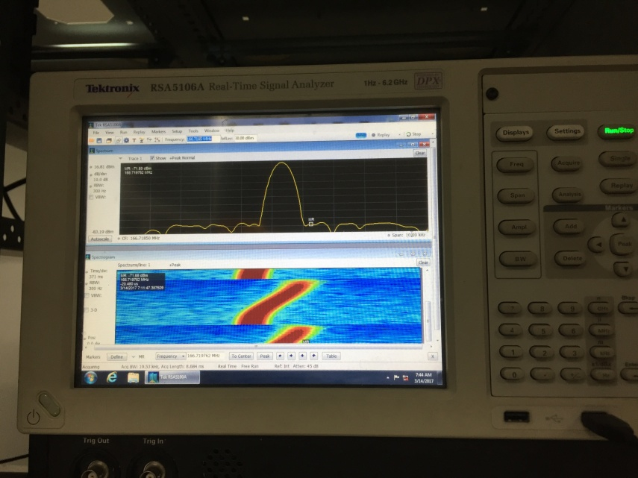
Testing results
Cavity Quench signal is found
Quench signal

Slide 31
Thanks !

