Slide 1

Platform of Advanced Photon Source Technology R&D
The power coupler test station
Tongming Huang (IHEP)
On behalf of the power coupler working group

Slide 2
Outline
Goal
General layout
Coupler life cycle
Test benches
Conditioning

Slide 3
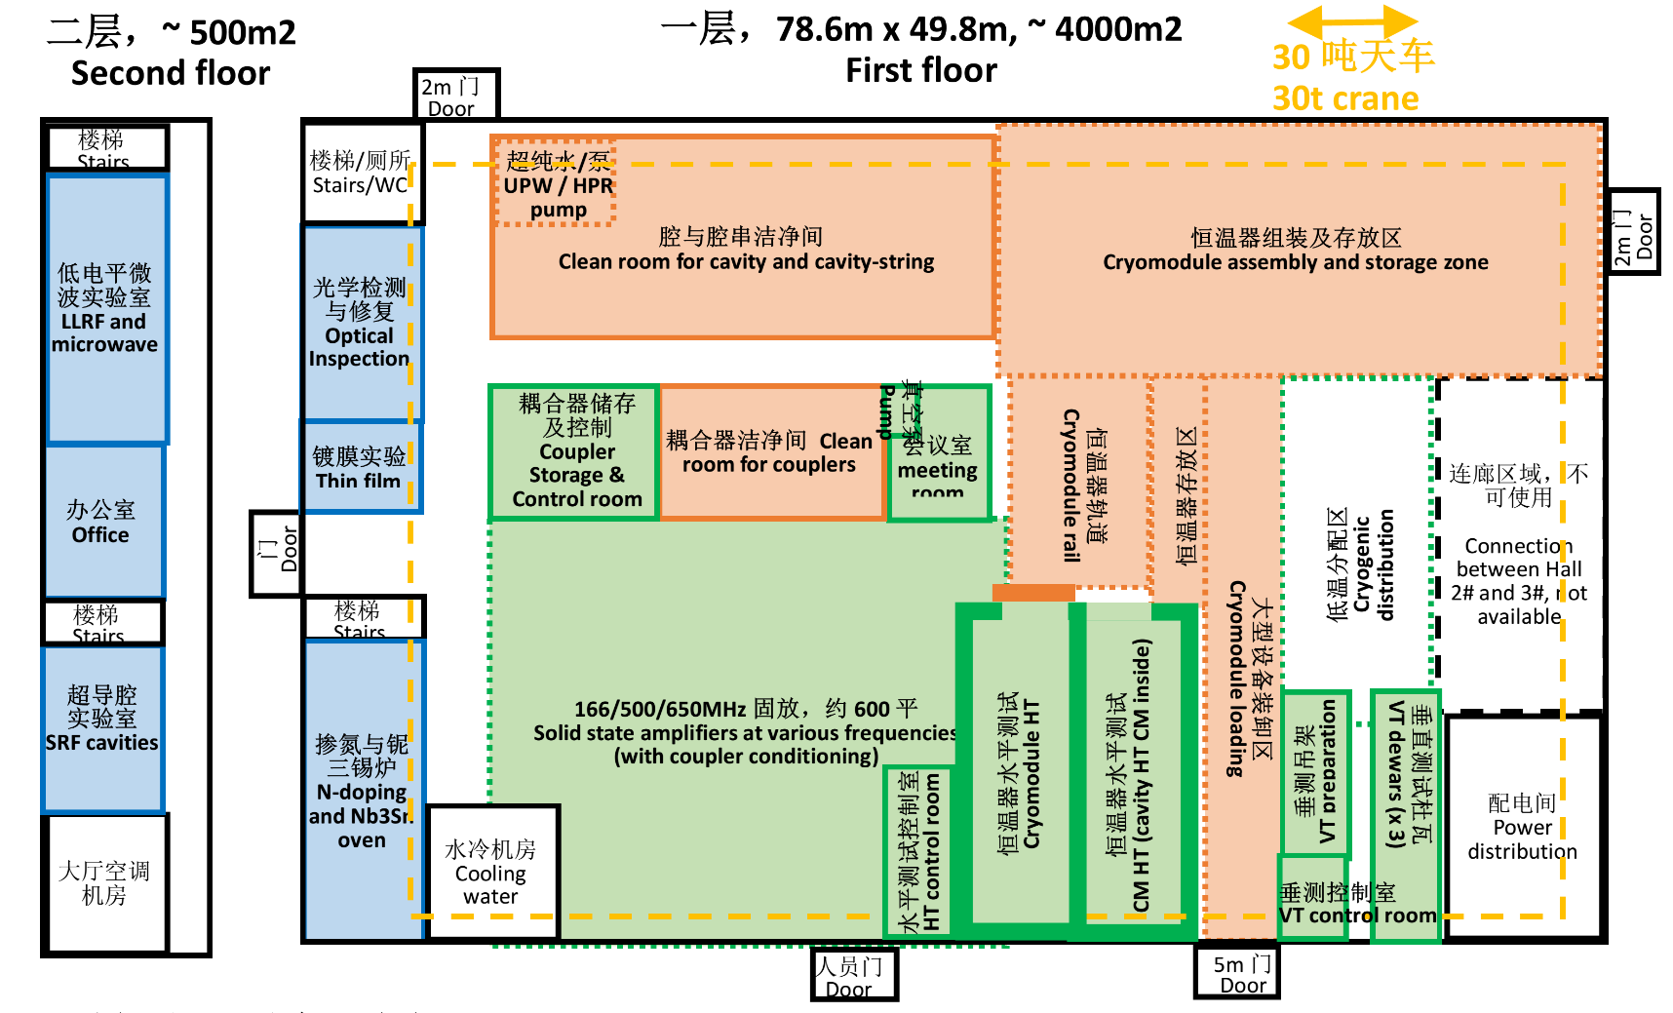
Location
PAPS-RF
Testing
Clean assembly
Cavity VT
Labs
Cavity HT
CM conditioning
Coupler conditioning
Post processing
Microwave & LLRF
SC materials
Cavity R&D

Slide 4
Goal
Our Goal is to build a large-scale high power coupler test stand, covering four frequencies of 166.6MHz, 500MHz, 650MHz and 1300MHz, focusing on the future projects, such as HEPS, CIADS, Shanghai light source, CEPC and so on.
Construction cycle: Two years.
Functions：
  Clean processing and assembly
  High power conditioning
Capability: 2~4 couplers per week
The power requirements
Frequency | Test power
166.6 MHz | 200 kW, CW
500 MHz | 100 kW, CW
650 MHz | 150 kW, CW*
1.3 GHz | 15 kW, CW
*: Upgradable for 400 kW, CW to meet the CEPC requirements if high power source is available

Slide 5
General layout
③ Within the conditioning room adding laminar flows ensure a clean room standard class 10 (ISO 4); the assembly, dismounting and packing will be processed in the class 10 clean room.
② Conditioning room guaranteeing an overall class 10000 clean room (ISO 7): clean, baking and conditioning area are foreseen inside the class 10000 conditioning room
①Reception, components leak check, buffer storage and LLRF control are to be processed in a general room.
①General room: 76 m^2 (L10.1*W7.55*H4 meter)
②Class 10000 room: 78 m^2 (L14.1 *W7.55*H4 meter)
③Class 10 room: 28 m^2 (L7.55*W3.725*H3 meter)

Slide 6
General layout
Equipment available in the cleaning room:
  Test benches;
  Ultra-sonic clean bath;
  Ultra-pure water rinsing bath;
  Baking oven;
  Vacuum pumping system: turbo pumps, ion pumps
  Helium leak detectors;
  Network analyzer;
  Packaging system;
  Tooling;
  Furniture.

Slide 7
⑪
Coupler life cycle

Slide 8
Reception
Status of delivery from company
Visual inspection:
  Ceramic and RF surface: no scratches, no contamination
  Copper plating quality
  Sealing surface
  For the hidden surfaces, special designed inspection bench with endoscope is needed.
Key dimensions confirmation
Sub-assemblies pre-installation
Coupler | Reception status
 | Window assembly | Doorknob & T-box | W/O test box
166.6 MHz | N2 filled storage | Bag package | Without
500 MHz | N2 filled storage | Bag package | Without
650 MHz | N2 filled storage | Bag package | Without
1.3 GHz warm part | N2 filled storage | Bag package | Without
1.3 GHz cold part | N2 filled storage | / | With
BEST
XFEL 1.3GHz coupler delivery status

Slide 9
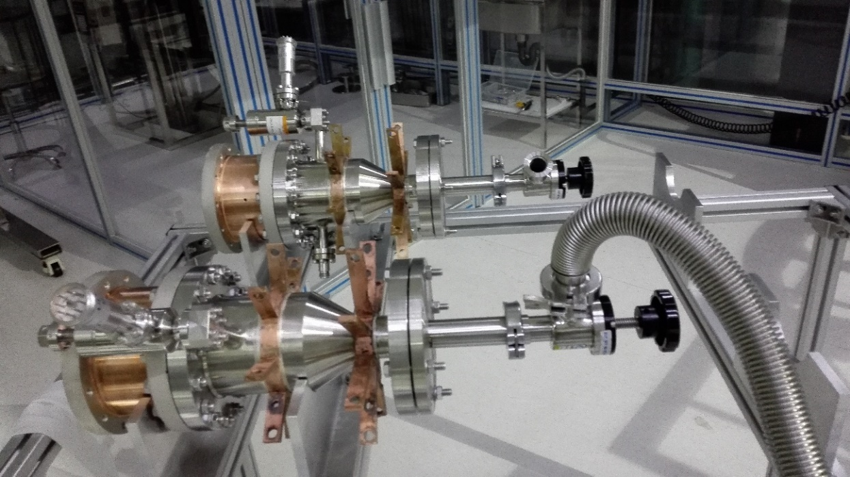
Leak check
Leak check after clean assembly

Slide 10
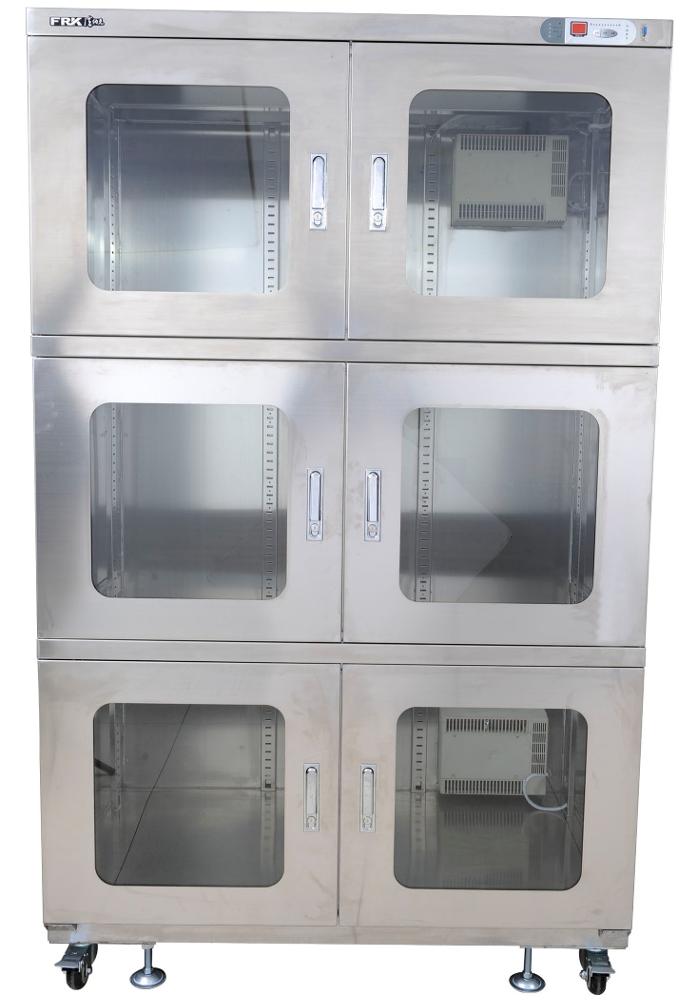
Buffer storage
The Nitrogen cabinet with dimensions of W1500*D800*H1980 (unit: mm) will be used for buffer storage

Slide 11
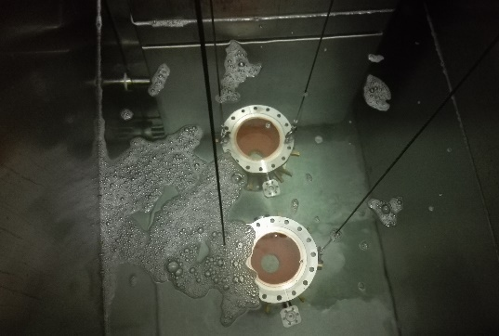
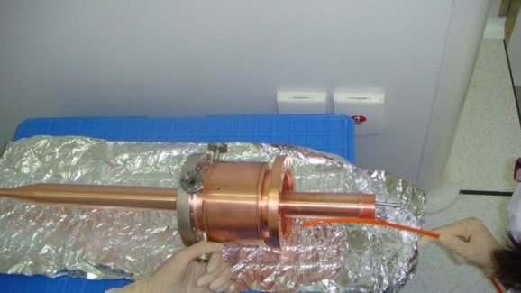
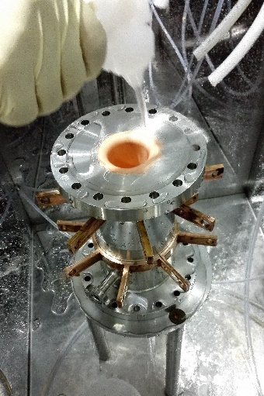
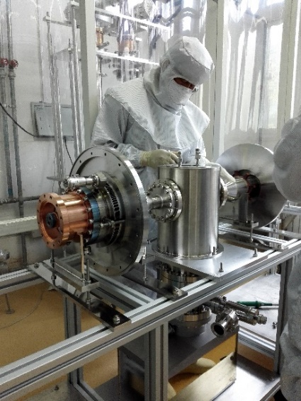
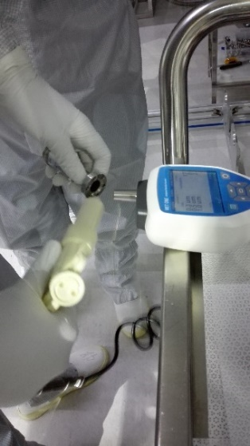
Preparation procedure before conditioning
Ultrasonic clean
Drying
Pure water rinsing
Clean assembling
Particles monitoring

Slide 12
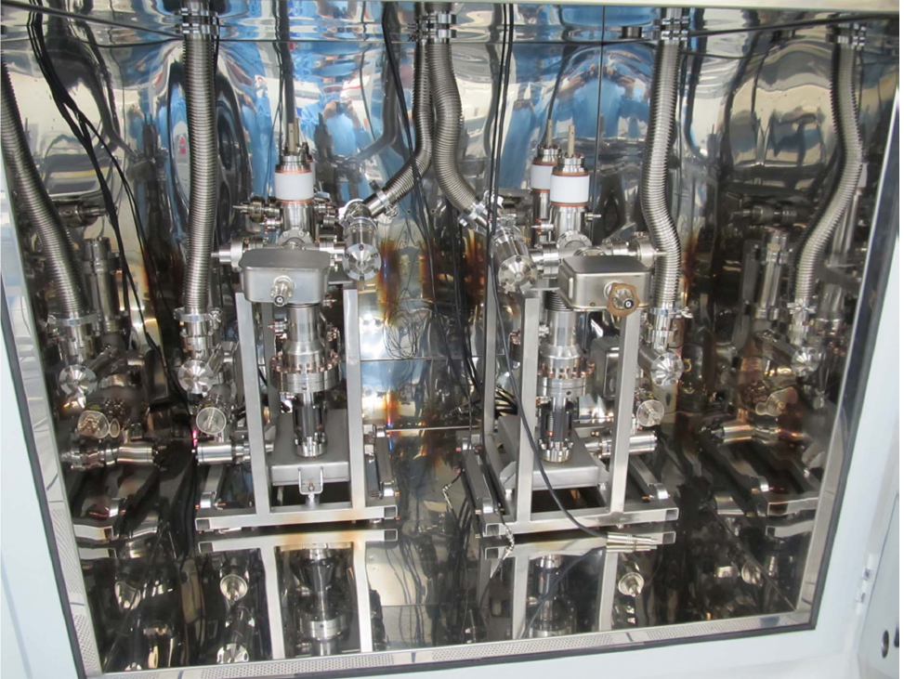
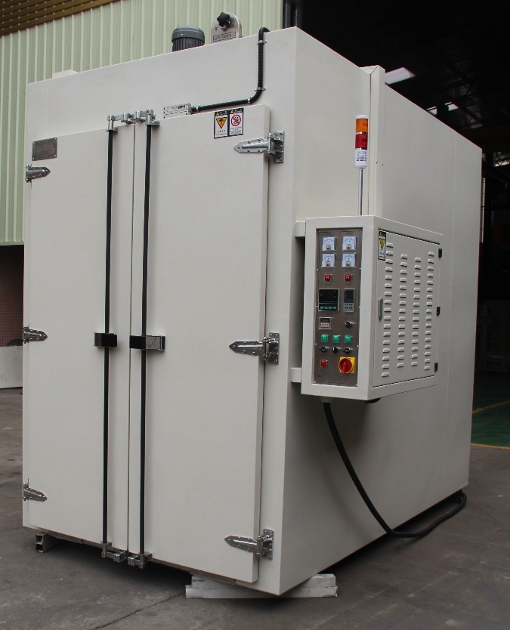
Baking
Baking can drastically reducing the conditioning time.
Baking time: 48 hours
Baking temperature: 120~150 ℃
A special baking oven will be adopted:
  Class 10000 clean requirements
  Easy operation
  With pumping interfaces for coupler-test bench evacuation
  Auto-control of temperature based on vacuum pressure
  Uniform temperature
  With Nitrogen gas filling pipes
The baking oven developed at LAL for XFEL FPC
The baking oven will be ordered

Slide 13
Parallel tests capability
Conditioning of 2~4 couplers per week is expected, so the parallel test must be assured.
Coupler | Parallel test
166.6 MHz | 1 pair
500 MHz | 1 pair
650 MHz | 2 pairs
1300 MHz | 2 pairs

Slide 14
Workflow of Parallel test
 | Run 1 (4couplers) |  |  |  | Run 2 (4 couplers)
 | R1-Pair 1 |  | R1-Pair 2 |  | R2-Pair 1 |  | R2-Pair 2
Day 1 | ① reception; ② component leak check
Day 2 | ③ S11 measurement; ④ component storage
Day 3 | ⑤ clean processing
Day 4 | ⑥ clean assembly; ⑦assembly leak check
Day 5 | ⑧ baking |  |  |  | ① reception; ② component leak check
Day 6 | ⑧ baking |  |  |  | ③ S11 measurement; ④ component storage
Day 7 | ⑨ conditioning |  |  |  | ⑤ clean processing
Day 8 | ⑨ conditioning |  |  |  | ⑥ clean assembly; ⑦ assembly leak check
Day 9 | ⑨ conditioning |  |  |  | ⑧ baking
Day 10 | ⑩ dismounting, packing |  |  | ⑪ Delivery | ⑧ baking
Day 11 |  |  |  |  | ⑨ conditioning
Day 12 |  |  |  |  | ⑨ conditioning
Day 13 |  |  |  |  | ⑨ conditioning
Day 14 |  |  |  |  | ⑩ dismounting, packing |  |  | ⑪ Delivery
Technical staff released from Run1!
Technical staff released from Run2!

Slide 15
Manpower consideration
 | Task | No. of persons
Scientist | In charge of acceptance In charge of the whole conditioning Special phenomena analysis | 1
Engineer | Reception; S11 measurement Clean assembly guide In charge of the Auto conditioning loop Log data tape-in | 3
Technical staff | Vacuum leak check Clean processing Clean assembly Baking Dismounting, packing and delivery | 6~8

Slide 16
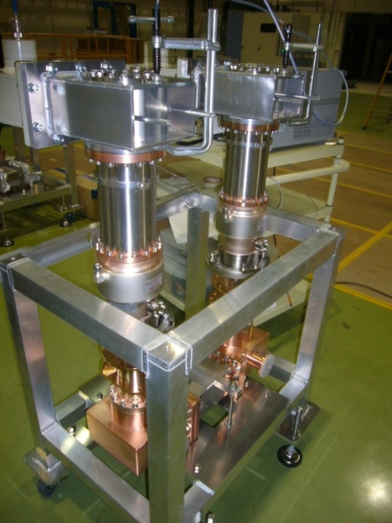
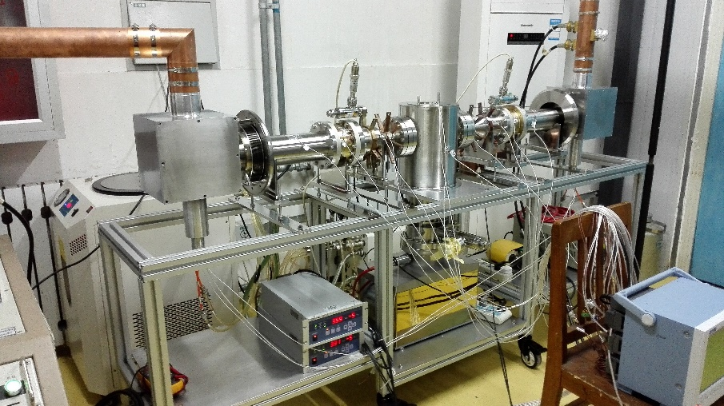
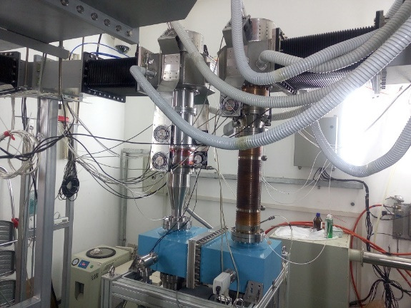
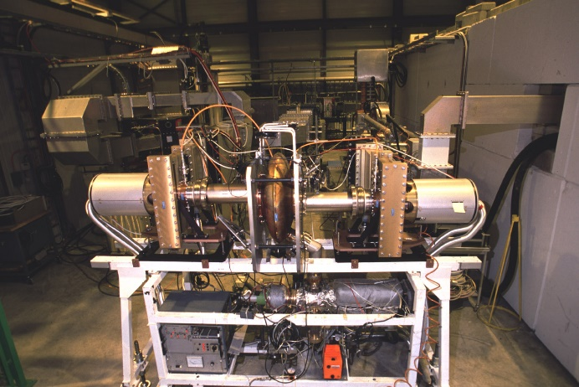
Test benches
For the room temperature high power test, two couplers are assembled back to back in a test bench usually.
Test bench design criteria:
  Good impedance matching: TW
  Easy installation
  Compact structure
  Easy evacuation
  Not overheating: cooling
325MHz test bench (IHEP CADS)
1300MHz test bench (KEK cERL)
500MHz test bench (IHEP BEPCII)
400MHz test bench (CERN LHC )

Slide 17
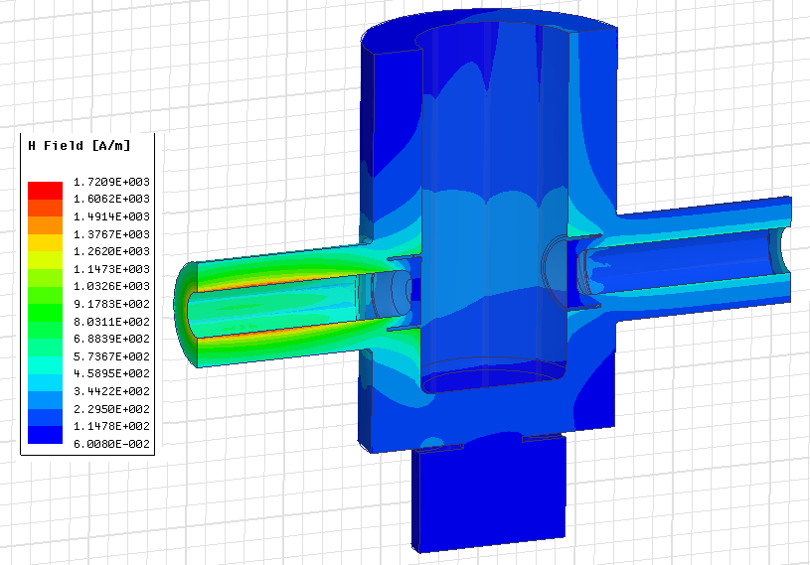
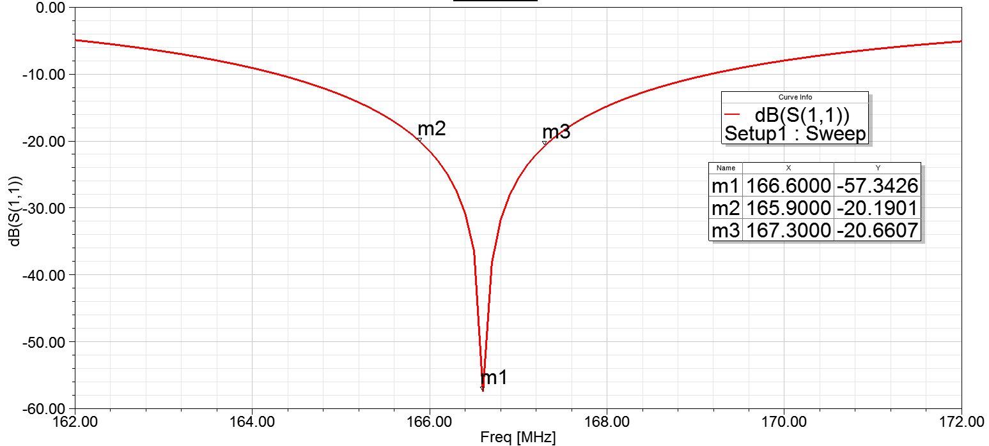
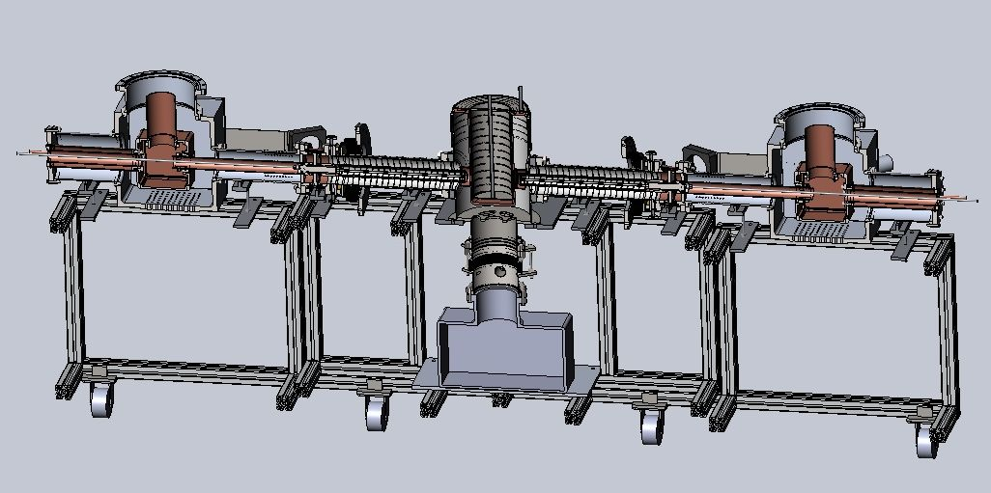
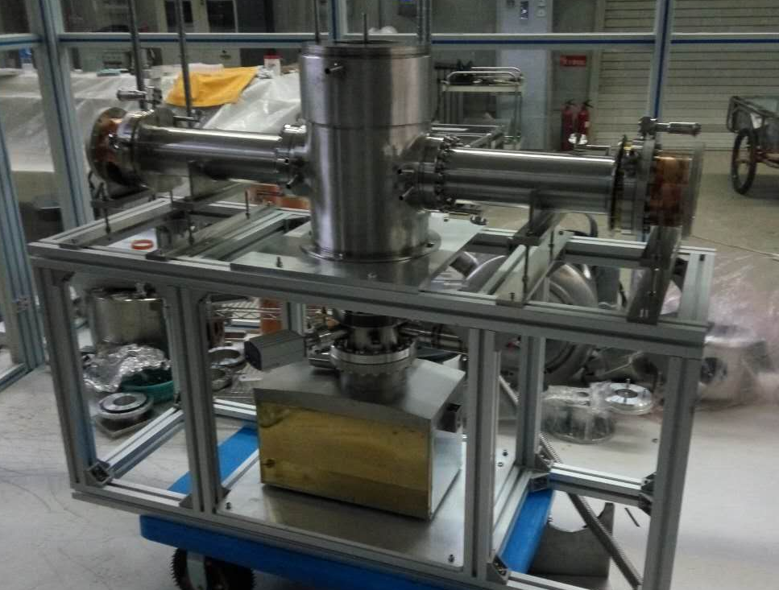
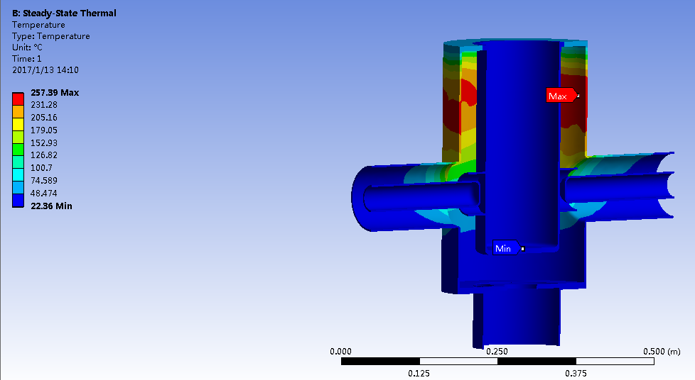
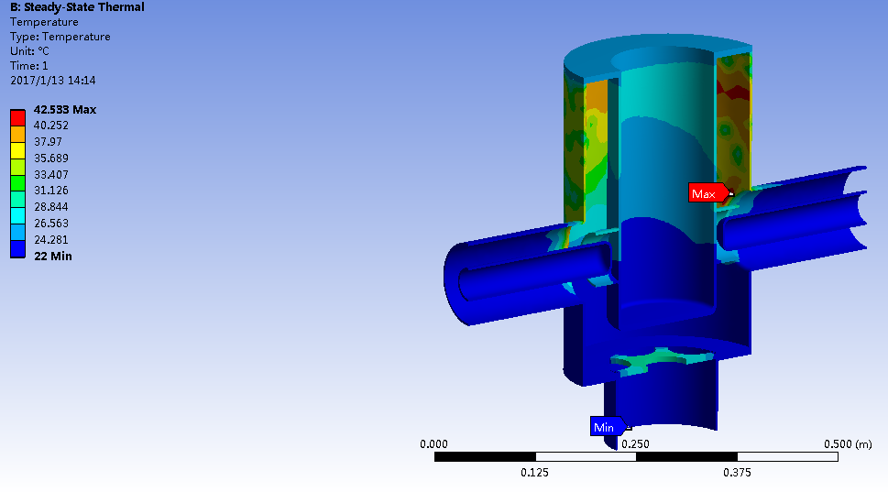
166.6 MHz test bench
A QWR resonant cavity are designed for the 166.6MHz coupler test bench.
Power capability: 300 kW; IC: OFHC, water cooling; OC: S.S + copper coating, water cooling
H-field at 300kW, TW
S11 vs Frequency: -57dB@ 166.6MHz
Temperature at 300kW,TW, OC no cooling: 257 ℃
Temperature at 300kW,TW, OC water cooling: 42 ℃
The test bench will be used in the HEPS-TF 166.6MHz coupler test in this month.

Slide 18
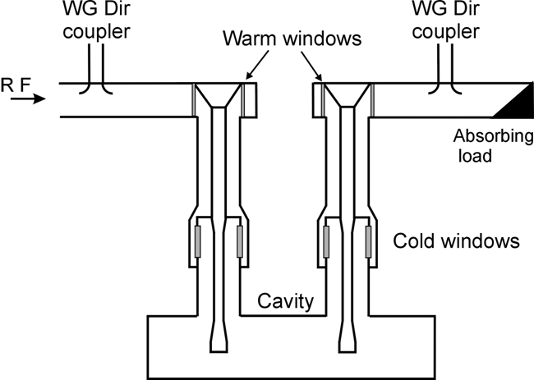
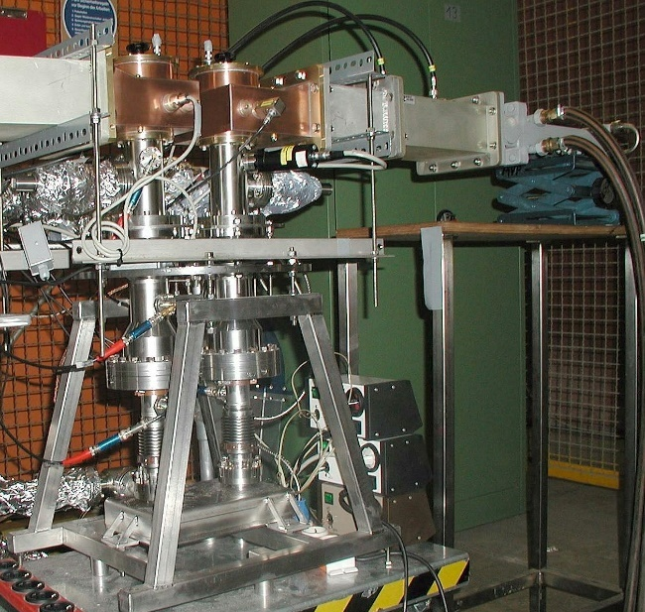
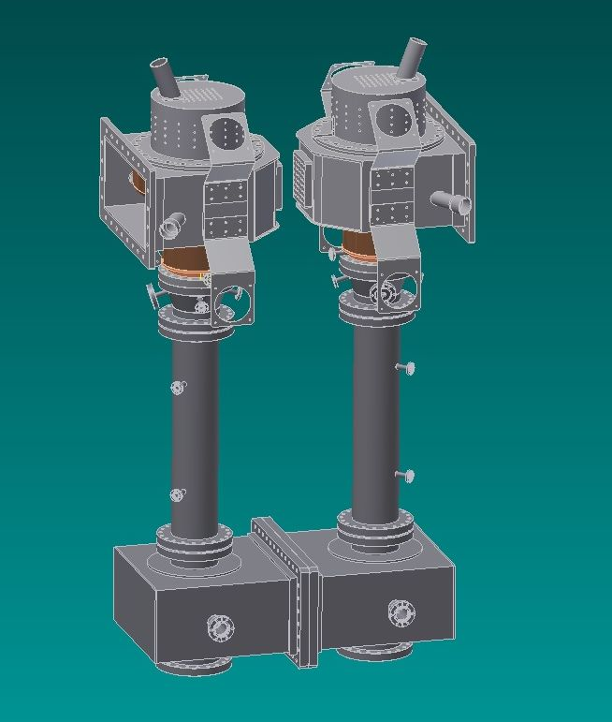
500/650/1300 MHz test benches
Waveguide box are adopted for the 500/650/1300 MHz test benches;
500/650 MHz test benches: WR1500 WG； S.S+ copper plating;
1.3GHz test bench: WR650 or half height WR650 WG ; S.S + copper plating or aluminum (final decision based on thermal and stress analysis)
Compromise: compact size VS power capability
WG box test bench
XFEL 1.3GHz coupler test bench
The designed 500MHz coupler test bench

Slide 19
Conditioning
Purposes:
  Acceptance test: RF, vacuum, thermal performance
  Pre-conditioning: save time; reliable operation.
High power test system:
  Power source
  Test stand
  Power distribution system: WG, circular, variable short circuit, dummy load
  Cooling system
  LLRF control system

Slide 20
High power conditioning system diagram

Slide 21
Power source systems
Solid state power sources will be selected instead of Klystron for all frequencies.
  Easy maintenance;
  High redundance rate of fault
The requirements
Frequency | Power source
166.6 MHz | Solid state power source, 200kW, CW
500 MHz | Solid state power source, 100kW, CW
650 MHz | Solid state power source, 150kW, CW
1300 MHz | Solid state power source, 15kW, CW

Slide 22
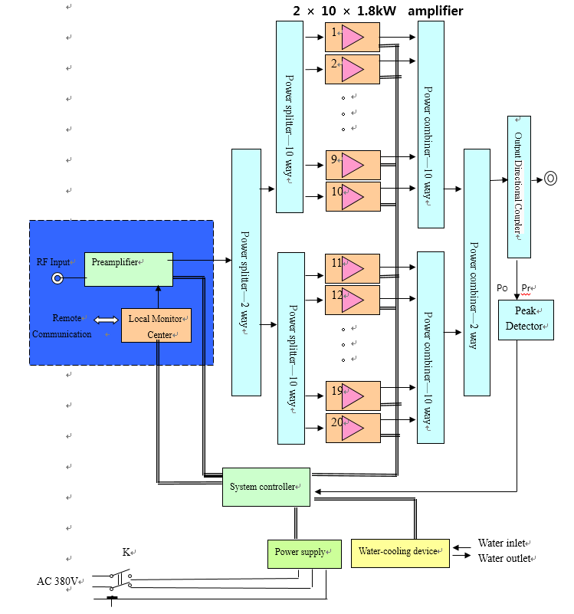
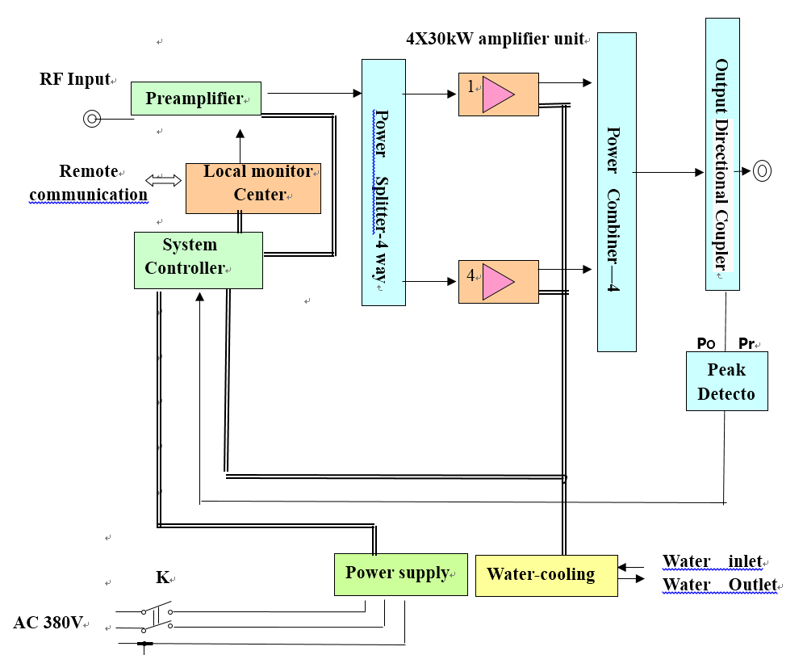
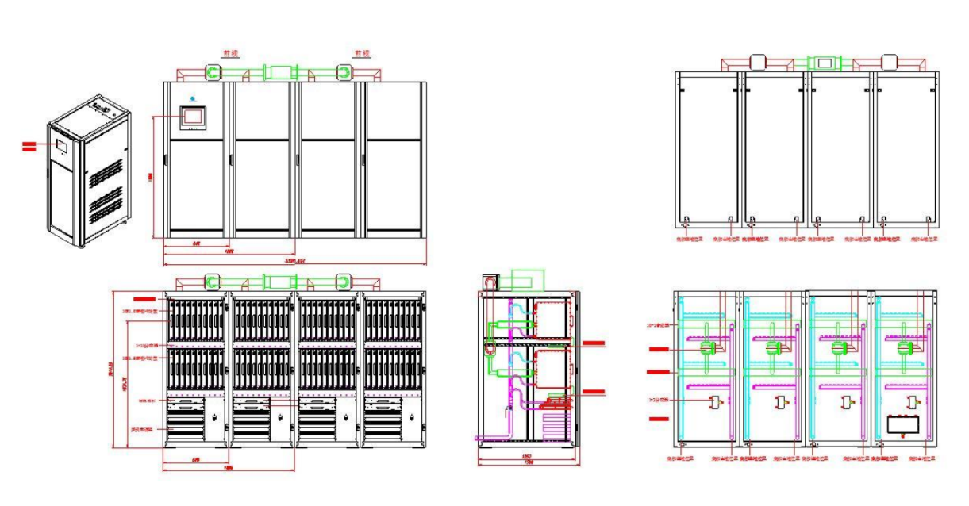
500MHz SSA
The general lay out: W 3390*D1300*H2200 (mm)
Unit block diagram: 30kW
(2*10*1.8 kW）
Whole block diagram: 4*30kW

Slide 23
Power distribution circuits
Equipment required:
  Waveguide: WR1500, WR650
  WG with direction coupler: pick up power
  Dummy load: TW conditioning
  Variable short circuit: SW conditioning
  Splitter: split RF power for parallel conditioning
  Circulator: protect the high power source; included or not based on the budget.
The requirements
Frequency | Wave guide | Variable short circuit | Dummy load
166.6 MHz | Coaxial , 9-3/16” | Half wave length; Satisfy the power requirements | 50kW, CW
500 MHz | WR1500 |  | 100kW, CW
650 MHz | WR1500 |  | 150kW, CW
1.3 GHz | WR650 |  | 15kW, CW

Slide 24
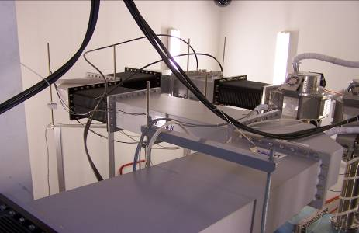
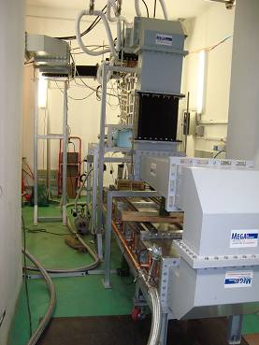
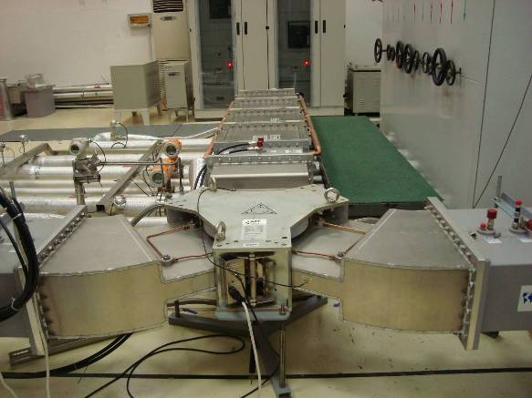
Power distribution circuits
500MHz WG(IHEP, BEPCII)
500MHz circulator(IHEP, BEPCII)
The WG distribution will be optimized based on the space:
  Tidy
  Compact
500MHz dummy load (IHEP, BEPCII)
1.3GHz WG(LAL,XFEL)

Slide 25
LLRF control
Function:
  Protect the coupler
  Auto conditioning operation
  Data acquisition and recording

Slide 26
Interlocks
Parameters | Interlock value
Vacuum | < 2E-4 Pa
Temperature | < 45℃ (window)
Cooling water flow | > 0.5 l/min
Cooling water pressure | >0.5 bar & <2.5 bar
Electrons | < 5 uA
Arc occurrence | 1 time; Response time: < 20us
The diagnostics of XFEL 1.3GHz coupler

Slide 27
Conditioning method description
Two methods:
  Short pulse (low DF, low power level) → CW, nominal power level;
  CW→ Pulse or CW + pulse→ CW, nominal power level
Method1
Method2

Slide 28
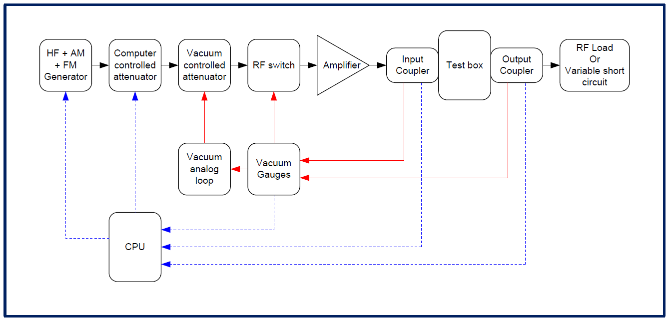
Auto-control system
An automatic control system which handles the conditioning procedure, all necessary diagnostics, monitoring and analysis systems will be applied.
CERN conditioning loop is one of the options.

Slide 29
Thank you for your attention!

