Slide 1




LHC Cryogenics Availability
& Helium Management during Run 2 (2015-2018)
8th International Workshop on Cryogenics Operation
4 – 7 June 2018
IHEP, CAS, Beijing, China
Laurent Delprat
On behalf of the cryogenic operation team
With contribution from K. Brodzinski and G. Ferlin

Slide 2
Introduction
Cryoplants reliability
Cryogenic system availability
Helium inventory management
Conclusion – Perspectives
OUTLOOK

Slide 3
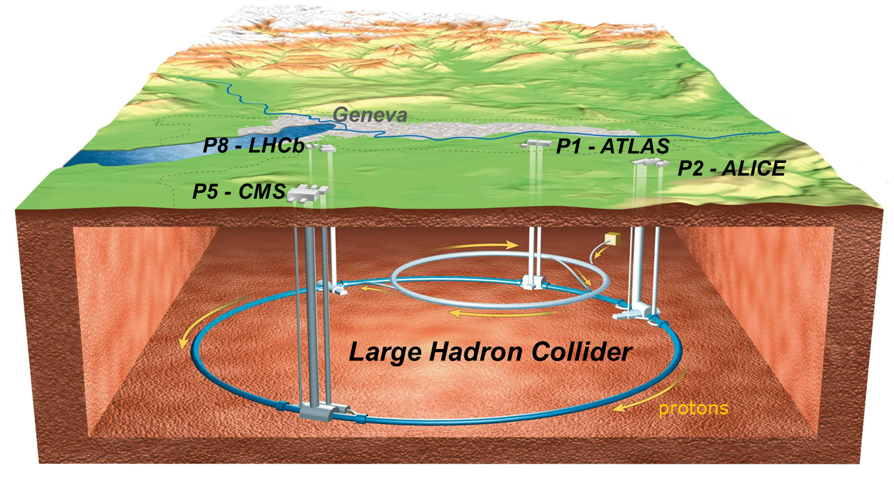
LHC Cryogenic System Architecture
HL
HL
B
P5
B
A
A
P4
P6
LL
A – upgraded ex-LEP cryo plant
B – new LHC cryogenic plant
LL
P3
LHC Cryogenics
P7
LL
LL – Low Load sector
HL – High Load sector
LL
circumference ➔ ~ 27 km,
constructed at ~ 100 m underground,
the accelerator ring inclination is 1.4 %
P2
P8
A
P18
A
P1
B
HL
HL
LHC cryogenics:
8 x 18 kW @ 4.5 K
1800 sc magnets
24 km & 20 kW @ 1.8 K
37 000 tons @ 1.9 K
130 tons of helium inventory
B
Compressor station
4.5 K refrigerator
Interconnection box
1.8 K pumping unit (cold compressor)
Notes:
Total for 8 sectors:
Compressors: 64
Turbines: 74
Cold Comp.: 28
Leads: 1’200
I/O signals: 60’000
PID loops: 4’000

Slide 4
LHC Cryogenics Operation Timeline
≈ 130 W / half-cell*
Beam-induced
heat load
≈ 10 W / half-cell*
13 TeV
Beam
Energy
8 TeV
7 TeV
RUN 1
LONG SHUT
DOWN
1
RUN 2
Time
2008
2009
2010
2011
2012
2013
2014
2015
2016
2017
2018
1st cooldown
Year End Technical Stops
TODAY
*half-cell: LHC cryogenic half-cell of 53 m housing (among others) one local beam-screen cooling loop
Notes:
B. Bradu, ICEC 26, estimation of 10 W/hc in Run 1 and 130 W/hc in Run 2.

Slide 5
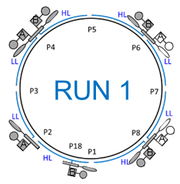
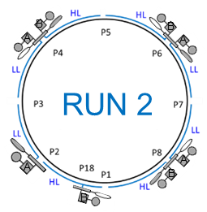
LHC Cryogenic System Configurations
Notes:
Idea: keep as many refrigerators as possible OFF, to minimize the number of running cryoplants and then maximize the global reliability and availability.
As well, increased beam-induced heat loads acts directly on the load seen by the 4.5 K refrigerators and not the 1.8 K ones. Remember that installed capacity can cover 160 W/hc, and we are no more at 10 W/hc but at 130 W/hc => less less margin!!!
BEWARE: at LHC Point 4, QURCB is running (and not QURCA), because of the sensitivity of RF cavities to pressure increase (around 1.4 bar). If we run QURCA, then there will be no temperature mixing between D return from QURCB (around 30 K) and D return from the cavity (around 12 K) => D return will be colder on that side (around 12 K instead 20 K).
On this “B side”, QSRB is at surface level => there is a 100 m hydrostatic column. At 12 K, gas is more dense, hence the raise in pressure in line D => as well in the RF cavity, which is very sensitive to that factor!
Instead of that, we run QURCB (to mix the “D returns” of the cavity and the QURC), because on the A side, there is no hydrostatic column, as QURA is in cavern.

Slide 6
LHC CRYOPLANTS RELIABILITY

Slide 7
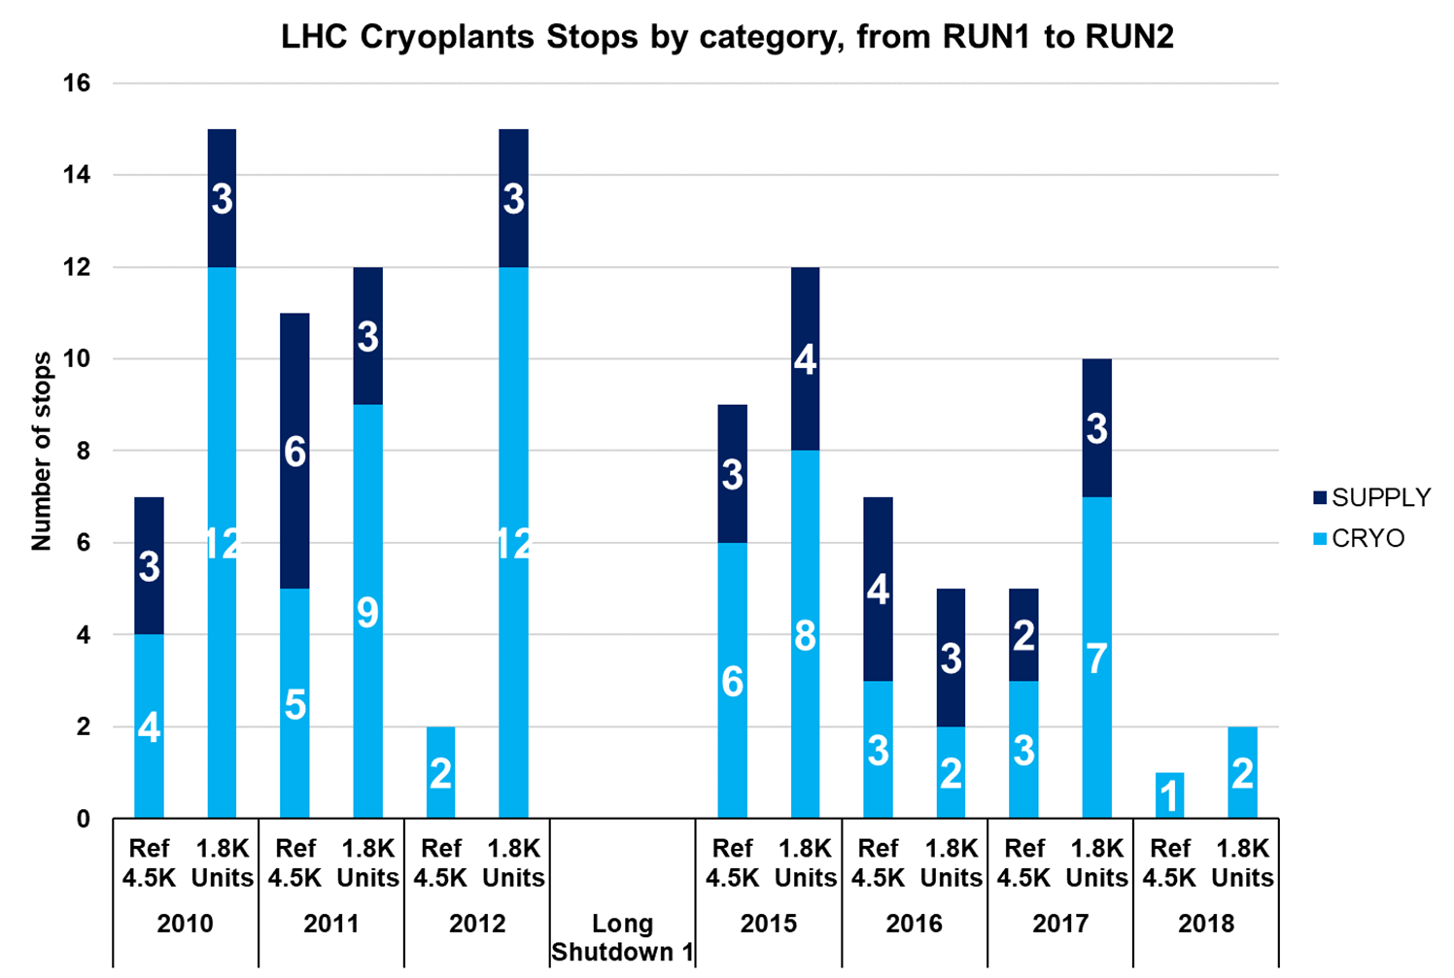
RUN 1
RUN 2
3.5 TeV to
4 TeV
6.5 TeV
Preliminary

Slide 8
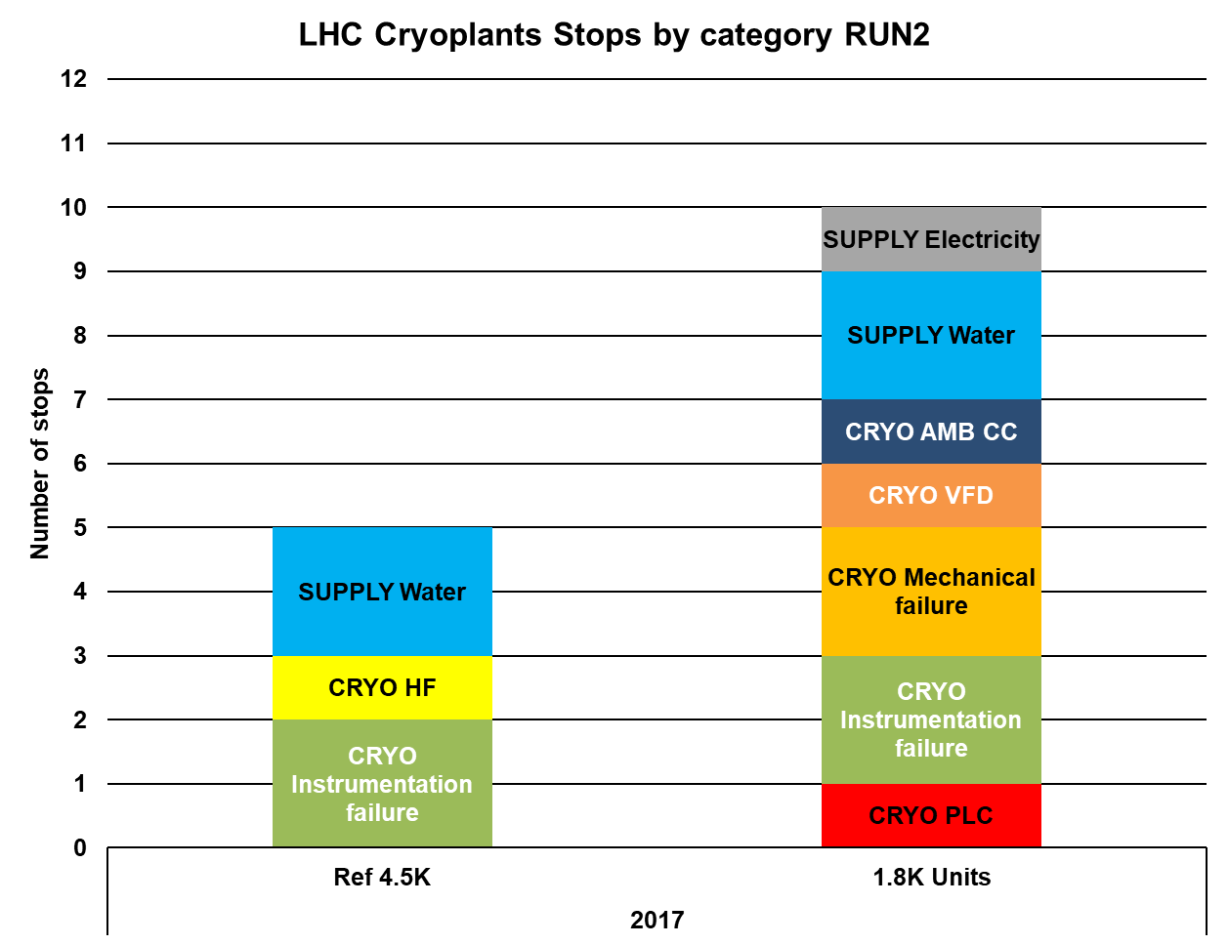
18 kV transformer in P8
Cooling water leakage in P4 cavern
Loss of water cooling towers in P8
Solved during Technical Stops
1 in P2
Solved during Technical Stops
Com card in P18
2 smooth cloggings of inlet filter P4
Stop & Go during operation
Oil / logic in P4
Solved during Technical Stops
Faulty electrical insulation on TT sensor in P2
Exchanged by new PLC 580 type
Solved during Technical Stops
Compressed air PT sensor in default in P4
1 in P8 (Schneider, non M580 type)

Slide 9
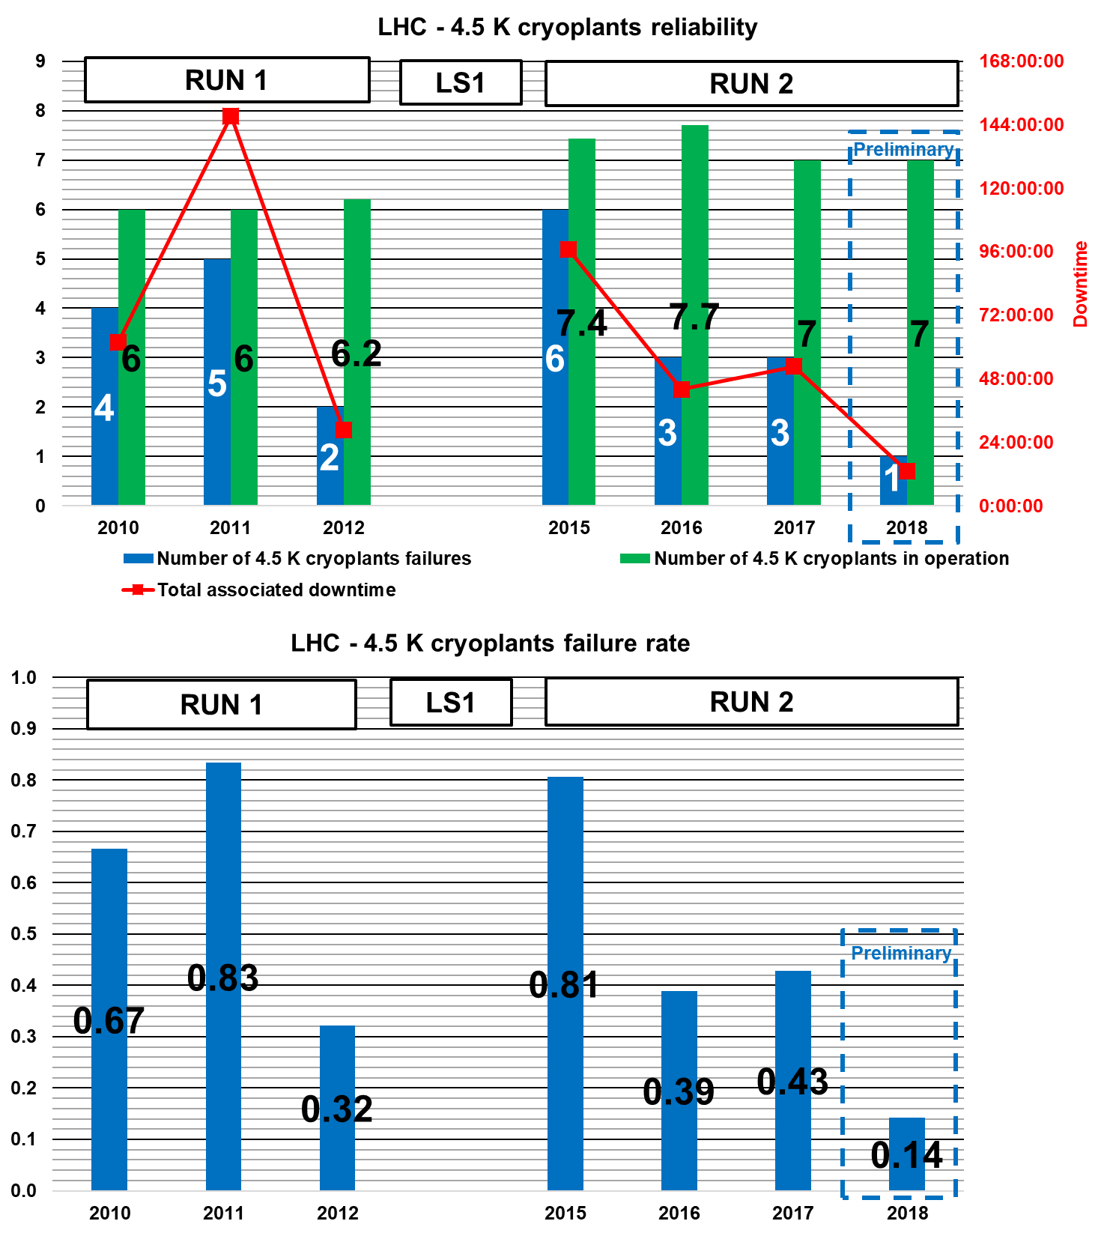
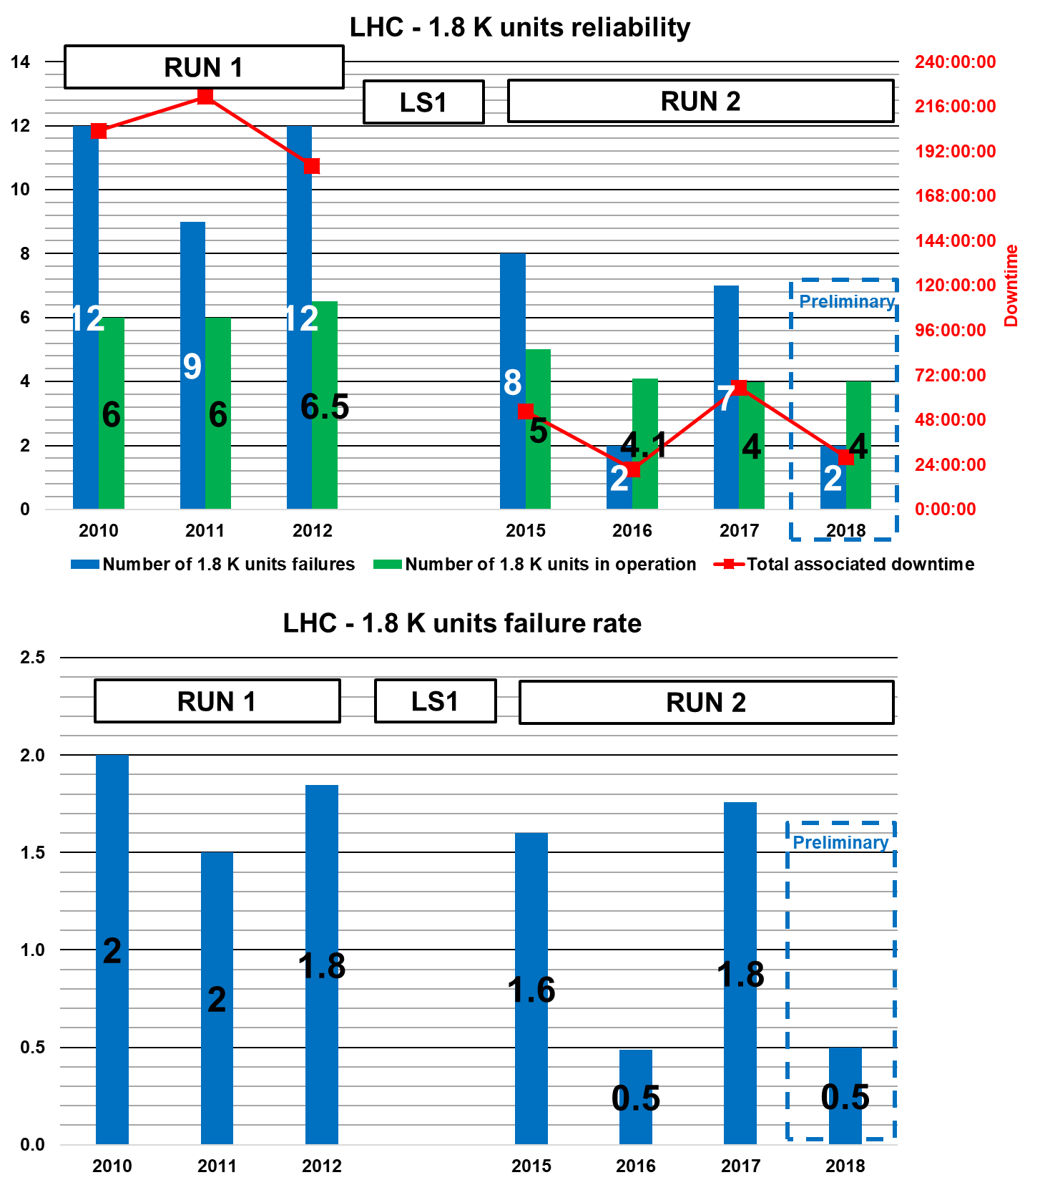
LHC Cryoplants Reliability

Slide 10
LHC CRYOGENIC SYSTEM AVAILABILITY

Slide 11
Due operation days of one refrigerator
15 days allocated for maintenance
365 days
M
118 days
LHC sectors cold standby and beam commissioning
232 days
LHC physics production
LHC Cryogenic Availability statistics are refering to this period
Based on Run 2 average values

Slide 12
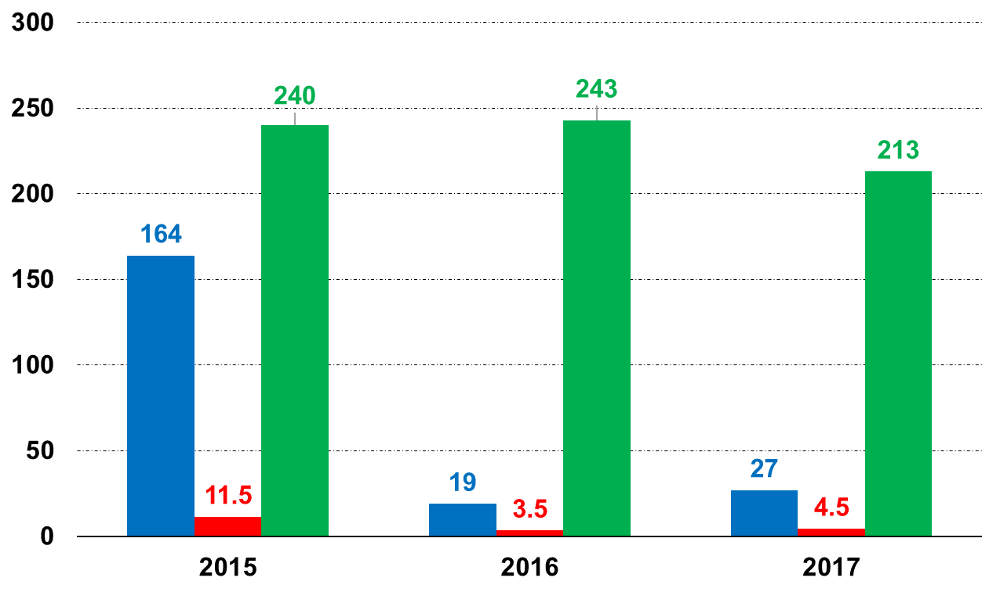
Run 2 CryoMaintain Downtime
Cryo losses duration (days)
Due operation time (days)
Cryo losses number
Average due operation time for Run 2:
5561 hours per year (⬄ 232 days)
One should act both on:
Most frequent losses
Most time consuming losses
Notes:
Comments: RUN 2 was dominated by increased beam energy and intensity. Electron cloud phenomenon pushed our refrigerators towards their limits, and for the first time the beam feedback had to be taken into account to operate LHC Cryogenics.
This is the very reason why 2015 served as learning curve, to allow for troubleshooting of CM losses related to increased beam-induced heat loads => let us see on next slide what were the main losses of RUN 2, by type and by duration.
One should also remember that LHC cryogenics deals with 64 CP, 74 TUs, 28 CCs, 1200 current leads, 60 000 I/O signals and 4000 PID loops!!!
Instrumentation – inventory for LHC tunnel : TTs ~10000, PTs ~700 PTs, LTs ~500, EHs ~2500 + different cryogenic valves (cold valves ~1400 + 1258 current leads warm valves)

Slide 13
Run 2 CryoMaintain Downtime Origins
Supercritical helium degradation
Electrical feedboxes helium level oscillations
Beam screen temperatures evolution
56 losses
58 losses
Most frequent losses
25 losses
66% of all losses
⬄ 139 out of 210 losses
70% of total cryo downtime
Most time consuming losses
⬄ 323 out of 460 hours
PLCs failures
Tunnel instrumentation
Cryoplants stops
53 hours
106 hours
164 hours
Notes:
Most frequent losses:
DFBs level oscillations: 44 losses in 2015, 8 losses in 2016, 6 in 2017
ScHe quality degradation due to partial failure of insulation vacuum in one 4.5 K refrigerator in LHC Point 8: 56 losses in 2015, 0 in 2016,
Beam screen temperatures evolution beyond thresholds: 25 losses in 2015, 0 in 2016, 0 in 2017
Most time consuming losses:
PLC failures (4 in 2015, 72h50min /// 2 in 2016, 27h46min /// 1 in 2017, 5h38min)
Cryoplants stops (not related to PLC failures): 72h29 in 2015, 21h31min in 2016, 70h24min in 2017 /// 26% of cryo downtime in 2015, 65% of cryo downtime in 2016, 75% in 2017
Tunnel instrumentation: 38h42min in 2015, 9h19 in 2016, 5h21min in 2017

Slide 14
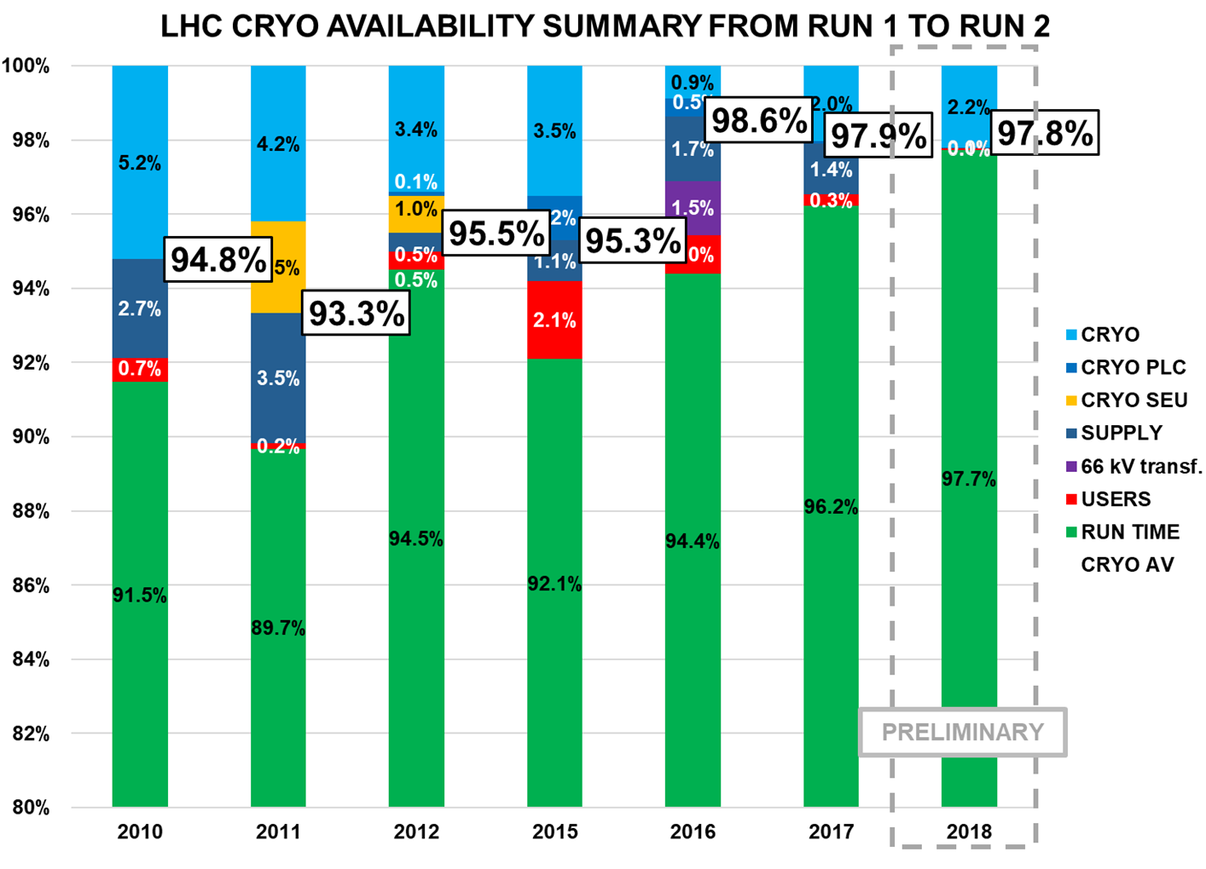
RUN 2
RUN 1

Slide 15
LHC HELIUM INVENTORY MANAGEMENT

Slide 16
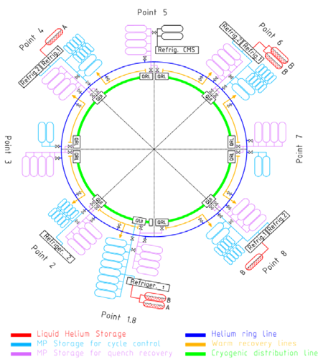
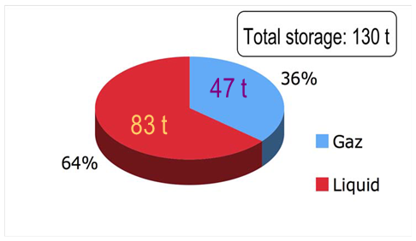
LHC helium inventory storage
Notes:
Storage:
36 tanks 75 m3
50 tanks 250 m3
8 LHe dewars 120 m3 / 15 tons
Circulating inventory: 40 tons
Beware: all tons are here metric tons!!!

Slide 17
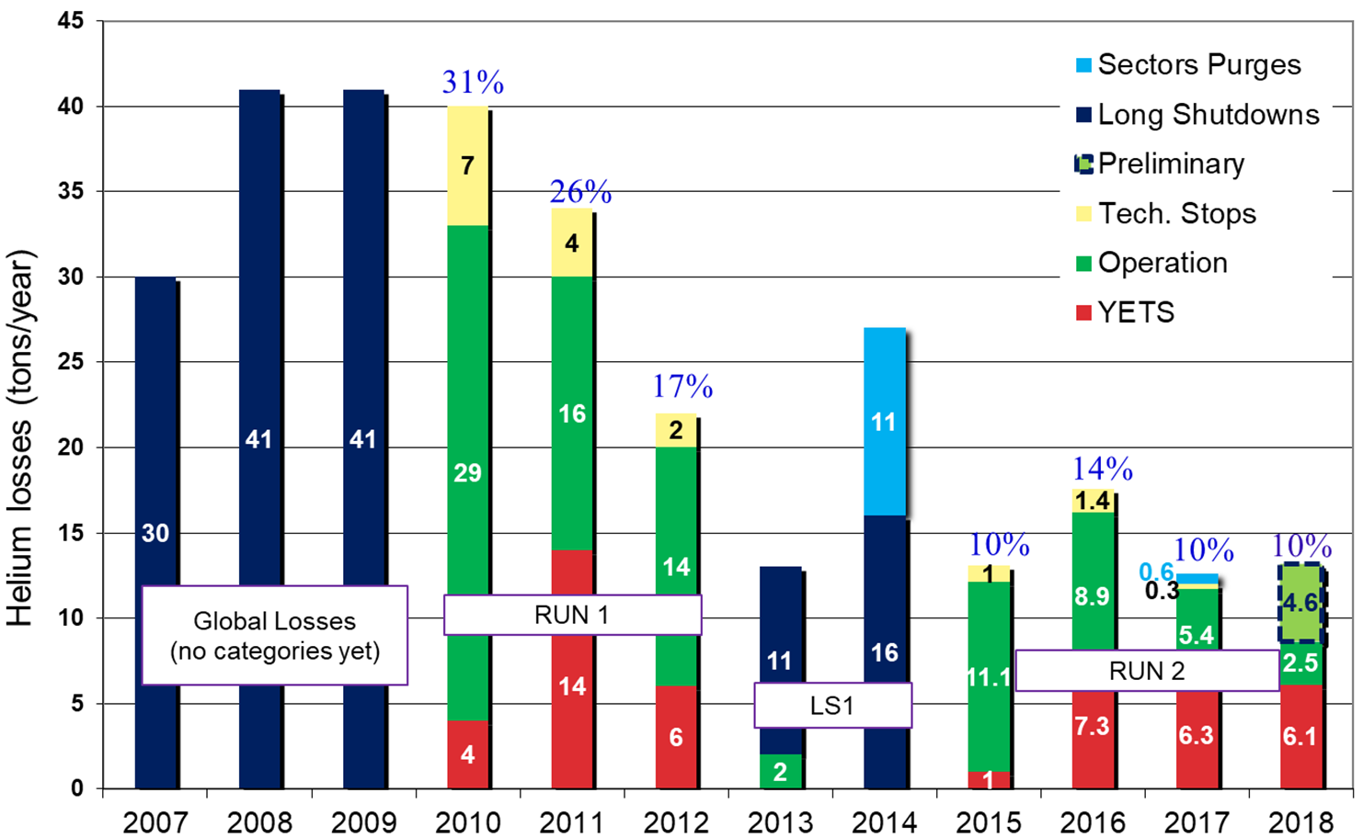
Helium consumptions and losses
Notes:
2012 : 1500 kg/month of helium recurrent losses
2015 : 987 kg/month of helium recurrent losses
2016 : 850 kg/month of helium recurrent losses
2017 : 550 kg/month of helium recurrent losses
2018 : 727 kg/month of helium recurrent losses for the time being

Slide 18
Our main goal: reduce our recurrent He losses and improve the precision of our balance.
How ?
- Reduce the number of running cryoplants
- Look for He losses in ventilation: surface installations checked regularly, tunnel installations to be done during next Technical Stop in June – in progress
- Systematic check of gaseous storage installations (as it is one of the major contributors to our recurrent losses)
- On-line follow-up accuracy checks – improvements
- Operational consumptions acounting: around 500 kg of He per year for the whole machine regarding adsorbers and dryers regenerations plus 500 kg for cryoplants conditioning – 1 t shall then be extracted from our recurrent losses
Main actions

Slide 19
Conclusion – Perspectives
Run 1 operation at lower than designed beam intensity gave cryogenic teams extensive experience with the complex LHC cryogenics system
Run 2 operation with increased beam-induced heat loads allowed for maintaining high level of availability while for the first time taking into account the beam feedback
Extensive follow-up of the downtime origins together with close discussions with technical services allow for proposing adequate mitigation solutions to encountered problems, thus improving hardware reliability and finally availability
Optimization of the cryogenic performance is still ongoing, with work to collect more detailed failure data and use data-mining analysis to use early-warning signals
Thank you for your attention!
Questions ?

Slide 20
SPARE SLIDES

Slide 21
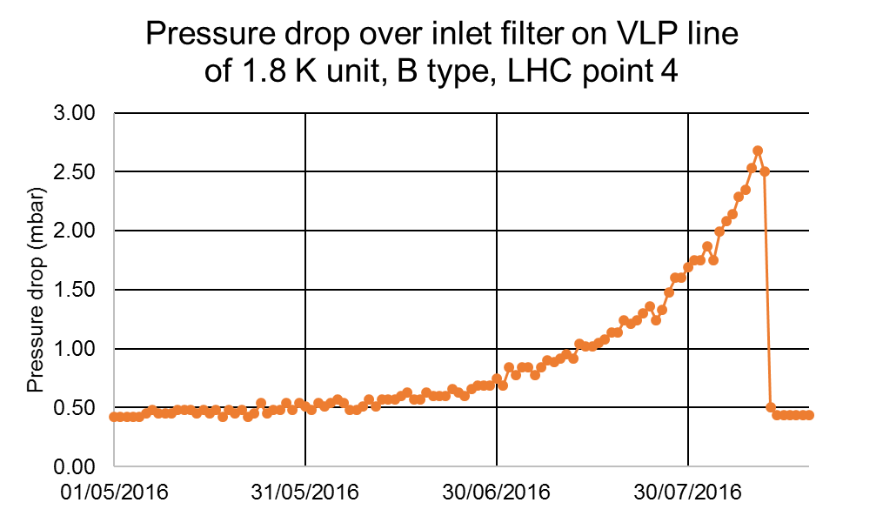
Run 2 main failures impacting availability
2015
2016
3 turbines failures on 4.5 K refrigerators
1 warm compressor failure on 4.5 K refrigerator
16 RFL valves failures
4 PLCs failures
1 major internal helium leak towards vacuum chamber on 4.5 K refrigerator
1 motor degradation on 4.5 K refrigerator
1 warm compressor degradation on 4.5 K refrigerator
1 smooth clogging of inlet filter on the VLP line of 1.8 K unit B type
2017
2018
1 moto-compressor degradation on 4.5 K refrigerator (major fault on 3.3 kV elec. cell)
1 flange leak on a 4.5 K refrigerator turbine
2 smooth cloggings of inlet filter on the VLP line of 1.8 K unit B type
1 warm compressor degradation on 4.5 K refrigerator (moto-compressor coupling)
1 smooth clogging of inlet filter on the VLP line of 1.8 K unit B type
Notes:
Systematic vibration measurements (1/month) allow for in advance detection of the problem to avoid serious damage and high repairs cost of affected machine
From June 2009 until now: 8 warm compressors had to be repaired (7 of firm “A”, and 1 from firm “B”)
RFL valves: needed for AL turbines to control axial profile of the shaft temperature. Three offers received, prototypes to be installed on the cold boxes during EYETS’16-17
P4: QURCB-4-PTD240 – from April’16 to August’16 – induced 1 Stop&Go – last time appeared during RUN1, once again during RUN2 since we are experiencing much longer periods of continous operation => followed

Slide 22
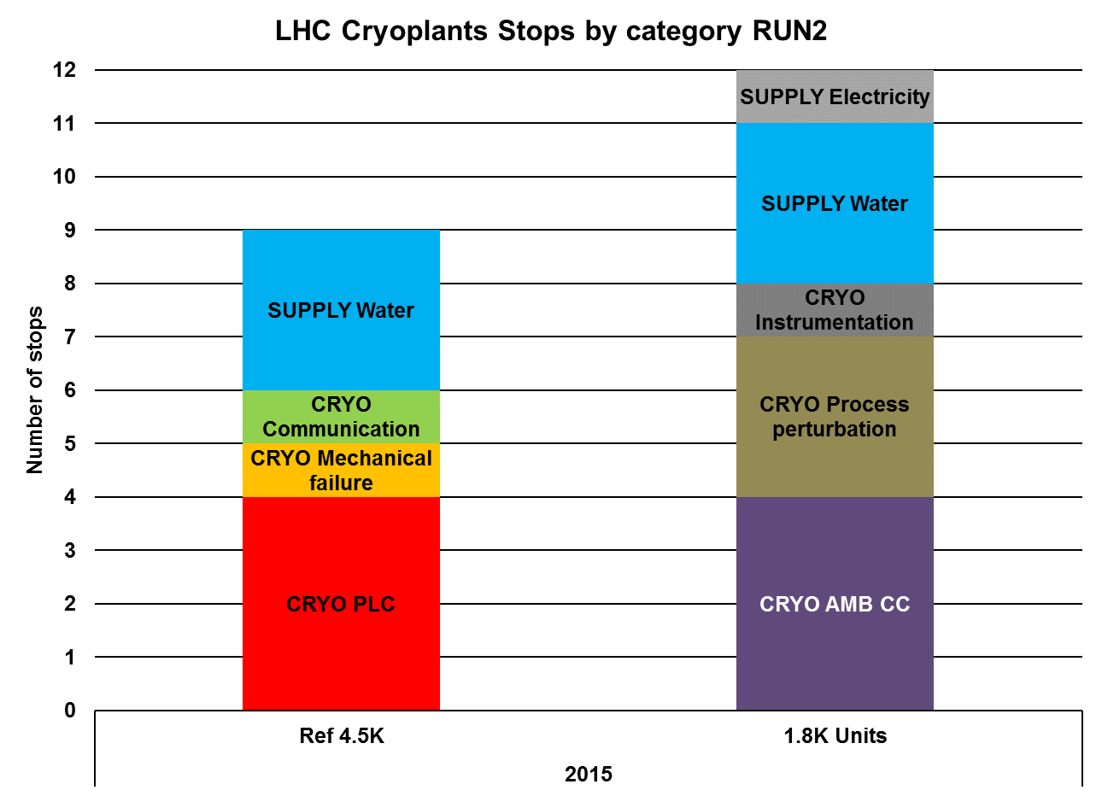
Electrical glitch
2 water losses in P18, 1 in P6
Repaired
P4 WCS instrumentation
Faulty cables between turbines and security PLC
Process perturbations on VLP pumping line
Repaired
Repaired
Leaky oil pump in P18
QURCA-2-CC1 electronics (*3)
+
QURCA-4-CC3 electronics (*1)
2 in P4, 1 in P18, 1 in P8
Solved during YETS’15 with new firmware
Consolidated during TS

Slide 23
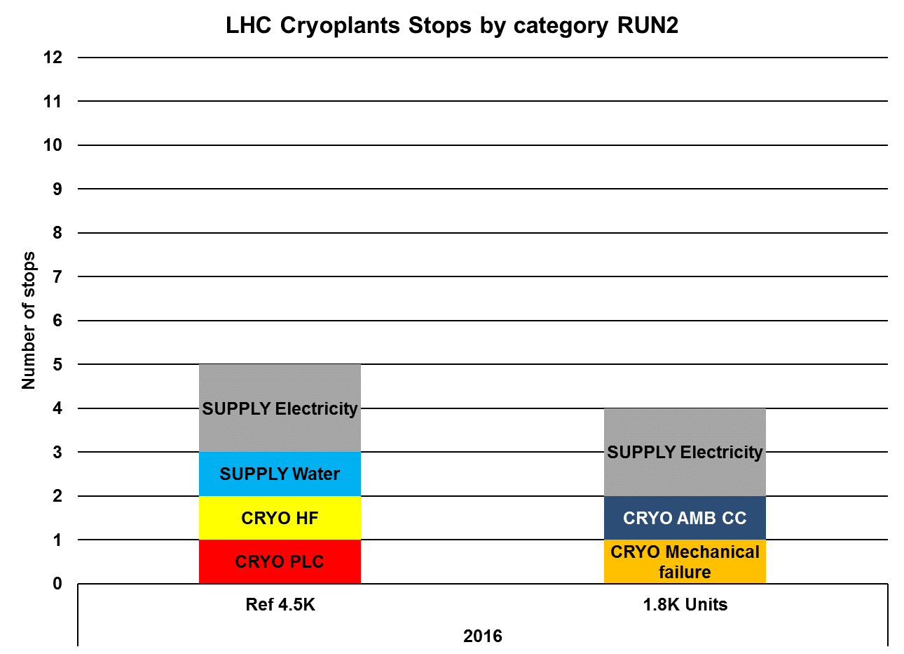
66 kV transformer in P8
Faulty relay causing 66 kV loss in P2
Water QSCA-8
Will be hardened during TS
LHCB-18 (oil)
QURCA-2-CC1 electronics
Unclogged + follow-up
LHCB-18 (QSRB-PLC)
LHCCA-2-WCSC2 cooling water circuit
Will be addressed by new PLC 580 type
Notes:
LHCB-18: detection of oil after 3rd coalescer (by lack of purge).
PLC: even with the new firmware, PLC has crashed once this year (remember that they are quite loaded with the cryo, and they are already 10 year old). They (PLC premium) will be all replaced by new 580 type from Siemens.

Slide 24
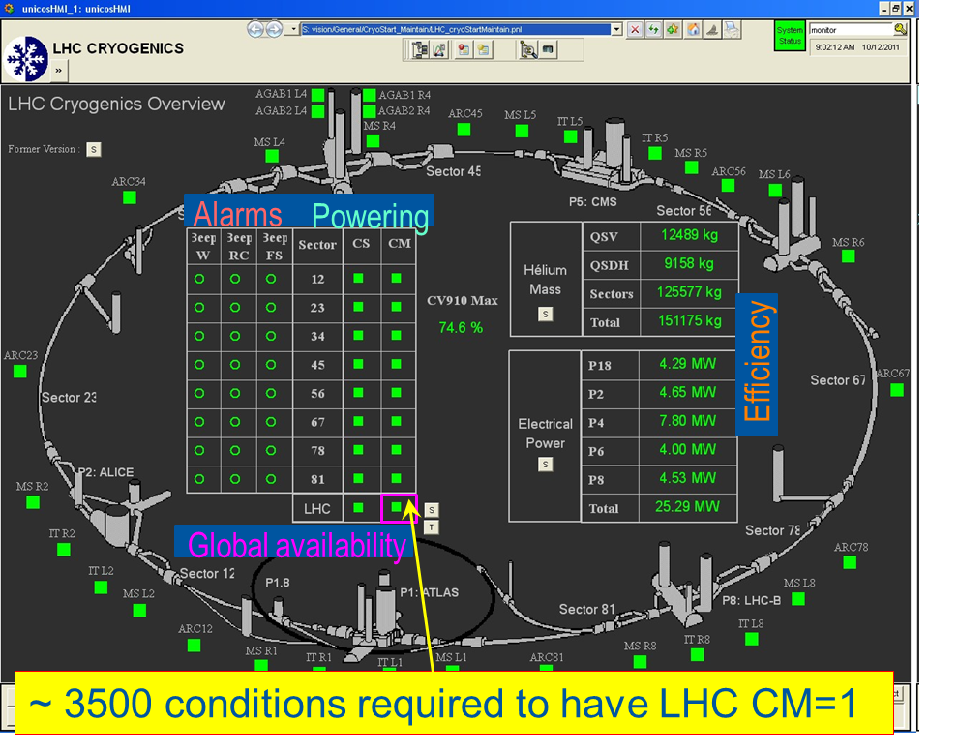
Cryogenic Conditions Definition
Set of cryogenic conditions:
to start powering (Cryo Start – CS)
to keep the magnets powered (Cryo Maintain – CM)…
… and in the end to allow for beams to circulate, and for physics production !
Notes:
Oral introduction of the slide: availability of cryogenics is compulsory for the beam to circulate and for the production of physics => we shall then define what is “Cryogenics Availability”.
What’s more, and not presented here, LHC Cryogenics is integrated in AFT_LHC (“Availability & Fault Tracking Tool of LHC) – refer to B. Todd presentation.

Slide 25
Example for magnet temperature
Set of cryogenic conditions:
to start powering (Cryo Start – CS)
to keep the magnets powered (Cryo Maintain – CM)
Availability impacted!
Magnet Temperature (K)
Loss of
cryo conditions
Diagnose,
Repair (if needed),
Restart
Cryo Maintain
2.15 K
Temperature drift
Temperature decrease
Cryo Start
2.05 K
Cryo conditions
back, towards nominal
Perturbation
Operation Temperature
1.90 K

Slide 26
Interface with the users
Quality of helium
Hardware / Production
Control modification
Instrumentation / Distribution
PID & SP of regulation loops
Example: loss of cooling water on a compressor station
Tests to validate wrt Tech. Resp.
Operation boundaries adaptation
Human Factor
LHe level
Temperature
Training
3 ways to lose availability:
Act directly on level or temperature
Recruitment
⬄ Quench
CRYO START = 1
CRYO MAINTAIN = 1
Act on one of the 4 root causes
⬄ Technical Services or Cryo Equipment
The context
Operational context (delayed injections, …)
⬄ Ask for delayed injection
Notes:
Le quench (les pertes Users) est une action externe qui vient mettre OFF la bulle « Level / Temperature »
Les pertes Technical Services viennent quant à elles couper les lignes du dessus entre la bulle « Level / Temperature » et les autres bulles « Hardware / Production », etc…

Slide 27
Availability losses categorization

Slide 28
Typical follow-up

Slide 29
2015 to 2017 Overall availability (Cryo Maintain)
2015
2016
2017
Notes:
2016: 130h of downtime for the weasel event in P8 !

Slide 30
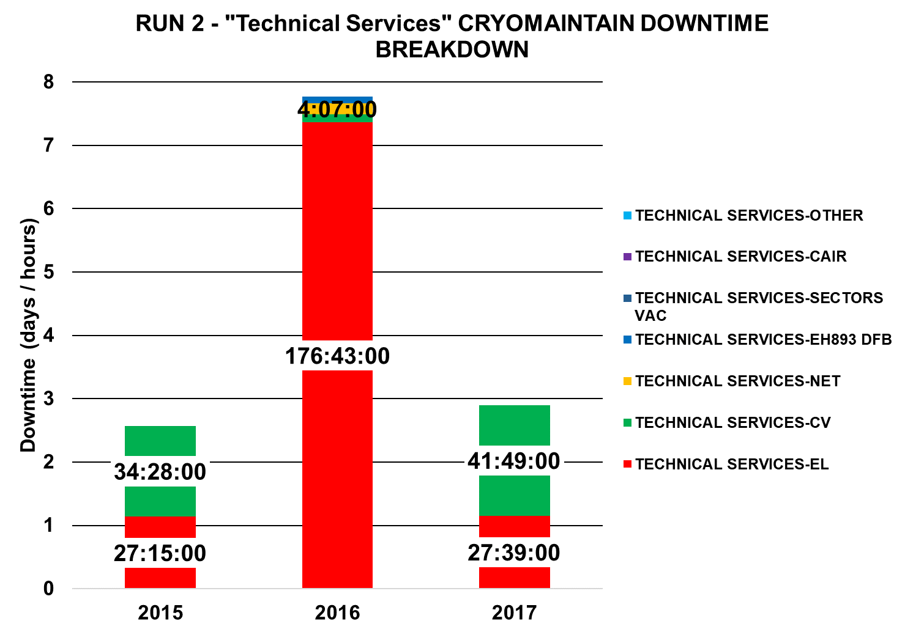

Slide 31
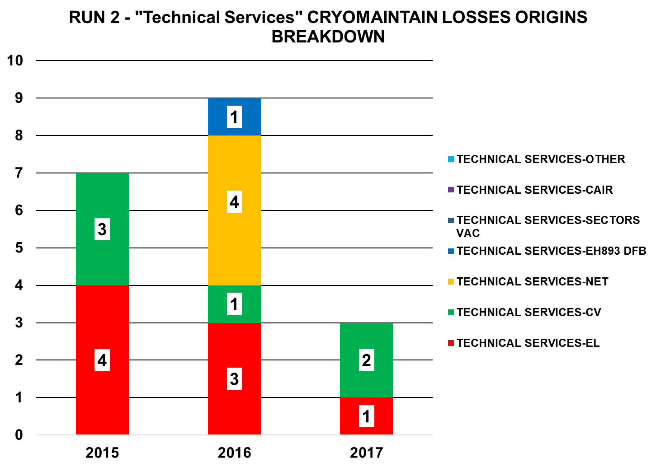

Slide 32
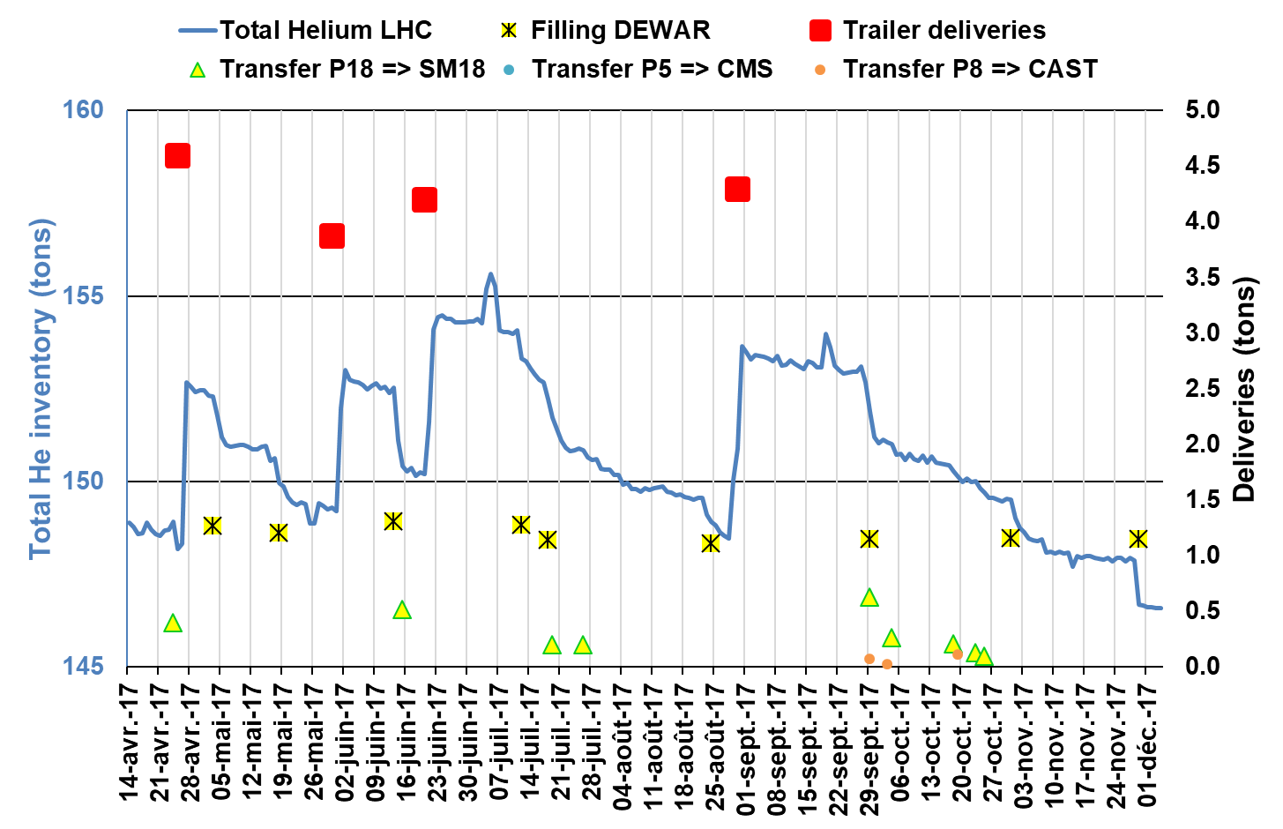
Typical helium inventory follow-up
Notes:
Identified accidental He losses
June 1st: 40 kg LHCA-6-TU7
June 2nd: 200 kg RF45 after QSCB-4 stop
June 12th: 200 kg QSCA-6-CP7 connection to HBL leaky
June 13th: 10 kg RF45 after QSRB-4 stop
July 16th: 350 kg SV LPA P2 after QSCA-2 stop on TT100 failure (electrical insulation problem)
August 2nd: 270 kg QSDH-1-18 (leak on liquid flexible pipe)
November 8th: 350 kg P8 (complete cooling water stop – EN-CV)

Slide 33
LHC helium inventory management
150 metric tons of helium
130 t
+
15 t
+
5 t
=
Operation Configuration
120 t in sectors
10 t in cryoplants + storage
Rotating stock
Strategic stock
≤ 83 t
+
47 t
+
External
=
Year End Configuration
LHe (6 dewars at 14 t each)
GHe (all 75 m³ and 250 m³ tanks at 18 bar abs)
≥ 20 tons (at least 5 LHe trucks)
Notes:
Operation configuration is oscillating between 145 tons and 155 tons, and more practically between 148 t and 154 t.

Slide 34
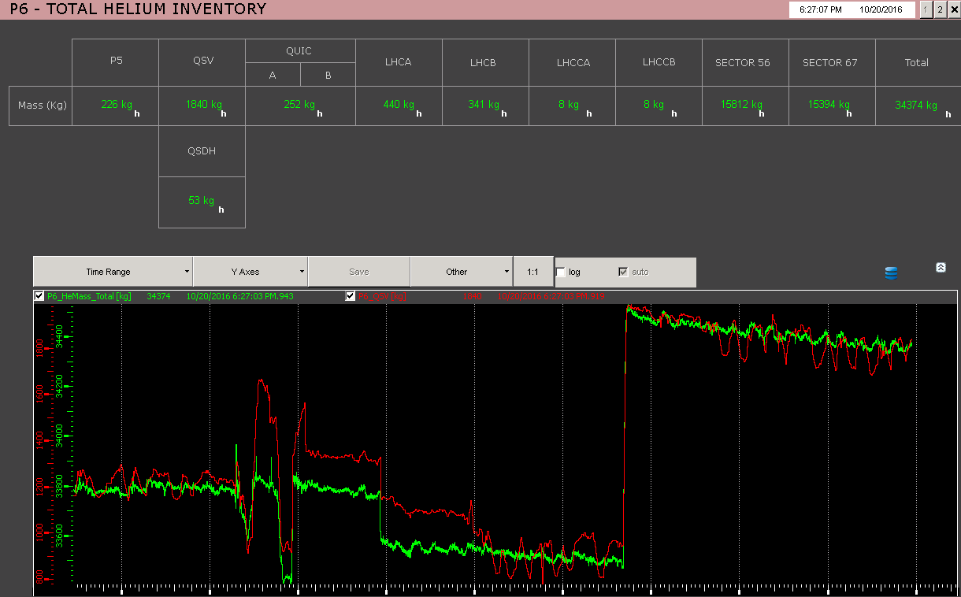
Real-time helium inventory
- Variables are created in the supervision system + logging in the central database for post-mortem treatment
- Principle of calculation:
Mass (kg) = volume (m³) * density (kg/m³)
- Accessible on the supervision system
Documentation
Calculated values from (P,T)
Notes:
Si T > = 20K : r = 48.14*P/T
Si T < 20 K : lecture de r dans tables (élaborées avec HePak) avec comme pas de tabulation 0.1 bar et 0.05 K (puis interpolation linéaire)
Si LT>1%, lecture r liq sat et r vap sat (tabulées de la même manière avec HePak)

