Slide 1

Day 3 – Session 6
“General cryogenic maintenance policy and recent update for CERN assets”
Frédéric Ferrand
CERN, Geneva, Switzerland
On behalf of CERN Cryogenics Group

Slide 2
Introduction
Definition of maintenance strategy for critical Assets
Maintenance Policy for cryogenic equipment at CERN
Work Organization an implementation of the strategy for Long Shut Down 2
Conclusion
OUTLOOK

Slide 3
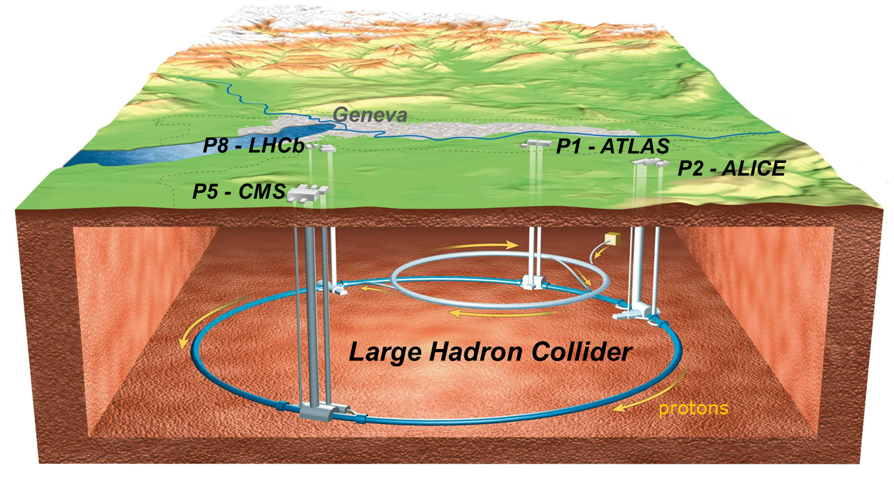
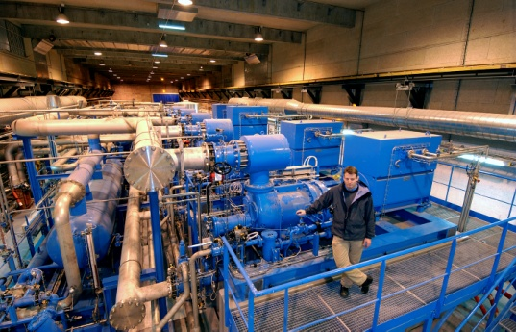
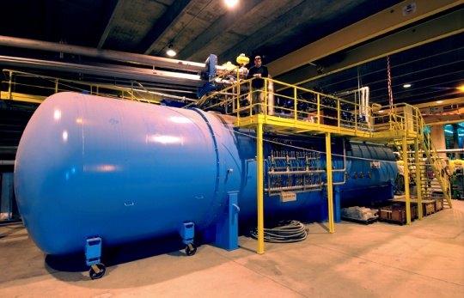
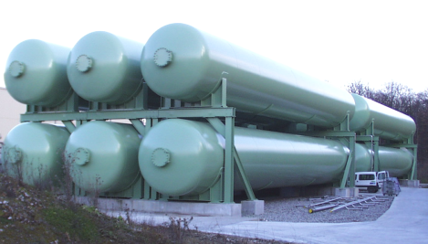
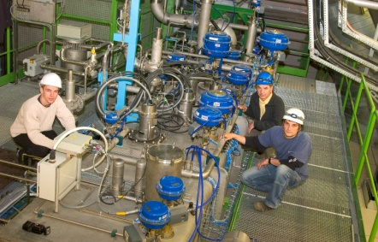
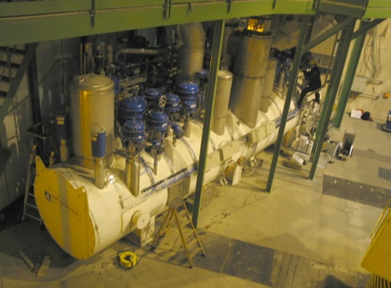
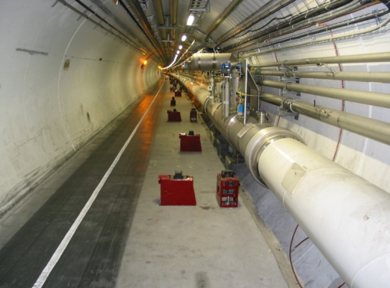
LHC Machine Cryogenics Architecture
SURFACE
Compressor Stations 4.5K Cold Boxes Liquid & Gas storages
B
B
A
P5
A
P4
P6
A – upgraded ex-LEP cryo plant
B – new LHC cryogenic plant
@CERN
@CERN
@CERN
P3
LHC Cryogenics
P7
UNDERGOUND
4.5K & 1.8K Cold Boxes Distribution Valve Boxes Distribution System
circumference ➔ ~ 27 km,
constructed at ~ 100 m underground,
the accelerator ring inclination is 1.4 %
P2
P8
A
P18
A
P1
B
LHC cryogenics:
8 x 18 kW @ 4.5 K
24 km & 20 kW @ 1.8 K
130 tons of helium inventory
B
@CERN
@CERN
@CERN
Compressor station
4.5 K refrigerator
Interconnection box
1.8 K pumping unit (cold compressor)
Notes:
Total for 8 sectors:
Compressors: 64
Turbines: 74
Cold Comp.: 28
Leads: 1’200
I/O signals: 60’000
PID loops: 4’000

Slide 4
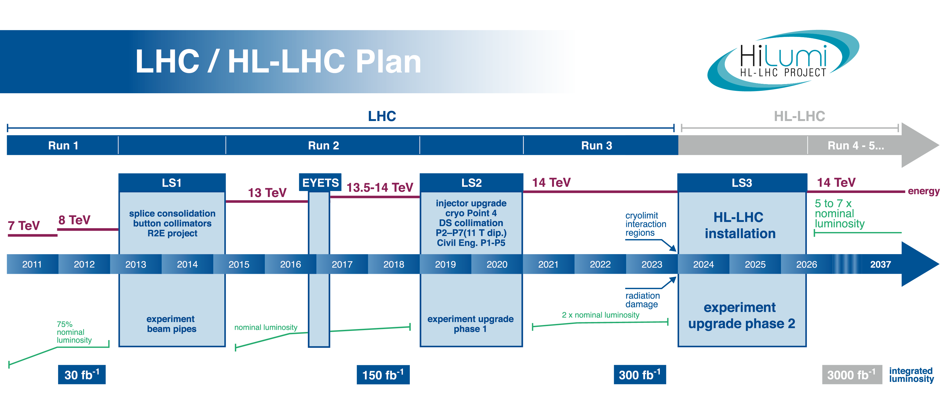
LHC Machine Cryogenics Maintenance Windows
CRYO ASSETS RUNNING HOURS ~40’000
CRYO ASSETS RUNNING HOURS ~32’000
YETS
YETS
YETS
YETS
EXTENDED YEAR END TECHNICAL SHUTDOWN
4 Weeks per cryoplant
LONG SHUTDOWN
50 Weeks per cryoplant
YEAR END TECHNICAL SHUTDOWN
2 Weeks per cryoplant
MAINTENANCE WINDOWS =
Notes:
B. Bradu, ICEC 26, estimation of 10 W/hc in Run 1 and 130 W/hc in Run 2.

Slide 5

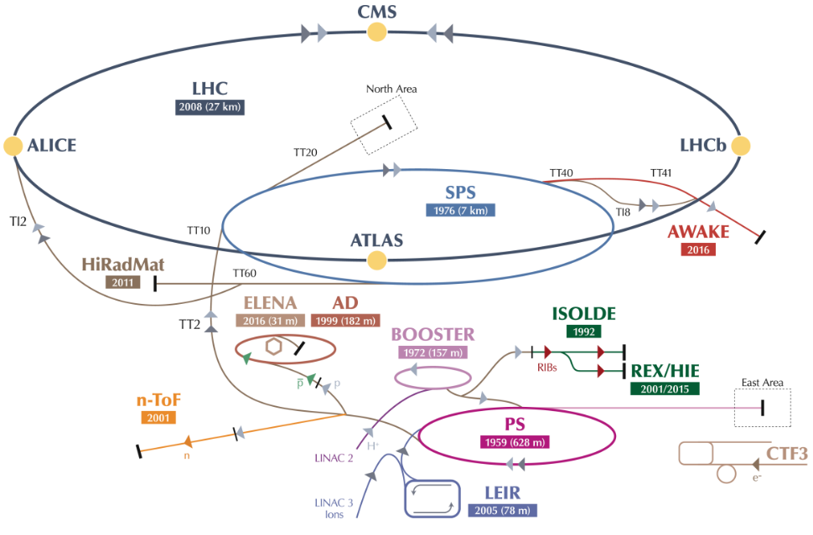
Cryogenic Test and Experimental Facilities
@CERN – CMS Detector
ACCELERATOR COMPLEX LHC EXPERIMENTS
ATLAS Cryogenics
CMS Cryogenics
TEST FACILITIES
SM18 Magnet Testing facility
West Area Testing facility
Cryo LAB 163
CENTRAL LIQUEFIER
Central Liquefier 165
Helium recovery center 243 - 253
ACCELERATOR COMPLEX BOOSTER & PS
NA61.1/NA61.2 NA62 HIE Isolde
ATLAS H8 CAST
CMS-RD5 COMPASS
ACCELERATOR COMPLEX SPS
BA4-COLDEX
BA6
18 cryoplants in addition to LHC Machine
Serving more than 20 key users
Tailor made Operation & Maintenance plan
Notes:
Total for 8 sectors:
Compressors: 64
Turbines: 74
Cold Comp.: 28
Leads: 1’200
I/O signals: 60’000
PID loops: 4’000

Slide 6
Cryogenic Test and Experimental Facilities
@CERN – CMS Detector
Operation & Maintenance
ACCELERATOR COMPLEX LHC EXPERIMENTS
ATLAS Cryogenics
CMS Cryogenics
TEST FACILITIES
SM18 Magnet Testing facility
West Area Testing facility
Cryo LAB 163
CENTRAL LIQUEFIER
Central Liquefier 165
Helium recovery center 243 - 253
ACCELERATOR COMPLEX BOOSTER & PS
NA61.1/NA61.2 NA62 HIE Isolde
ATLAS H8 CAST
CMS-RD5 COMPASS
ACCELERATOR COMPLEX SPS
BA4-COLDEX
BA6
Operation planning is a combination between LHC general planning and each experiment specific requirements
Usually 2 to 4 weeks maintenance window is allocated on standard year
CERN
& support contract
External Contractor
Result oriented contract
Tailor made planning for each installation according to user requirements
Usually 1 to 4 weeks maintenance per year
Notes:
Total for 8 sectors:
Compressors: 64
Turbines: 74
Cold Comp.: 28
Leads: 1’200
I/O signals: 60’000
PID loops: 4’000

Slide 7
Basic Functional Analysis of LHC cryogenics
Expanding
Turbines
MAIN CRITICAL
EQUIPMENTS
Compressors
Cold
Compressors
Notes:
Electrical glitchs: milliseconds
Water: minutes
Cryo: hours

Slide 8
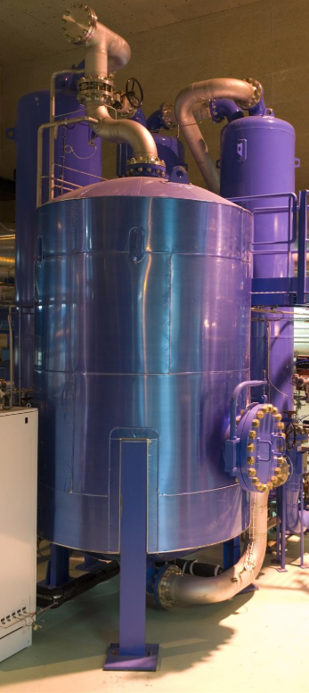
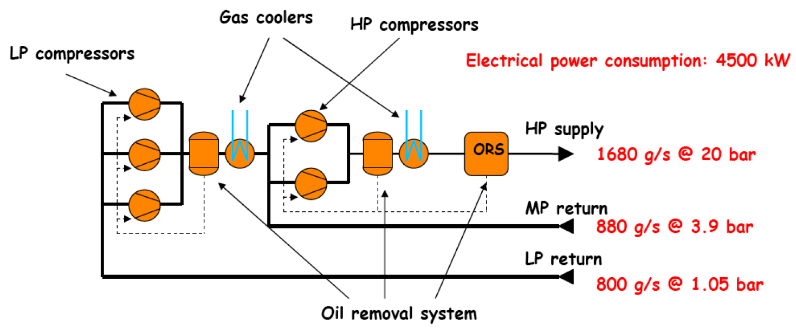
Compressor station & Oil Removal System
Courtesy of Serge Claudet Superconductivity and Cryogenics, 2011
@CERN
Notes:
B. Bradu, ICEC 26, estimation of 10 W/hc in Run 1 and 130 W/hc in Run 2.

Slide 9
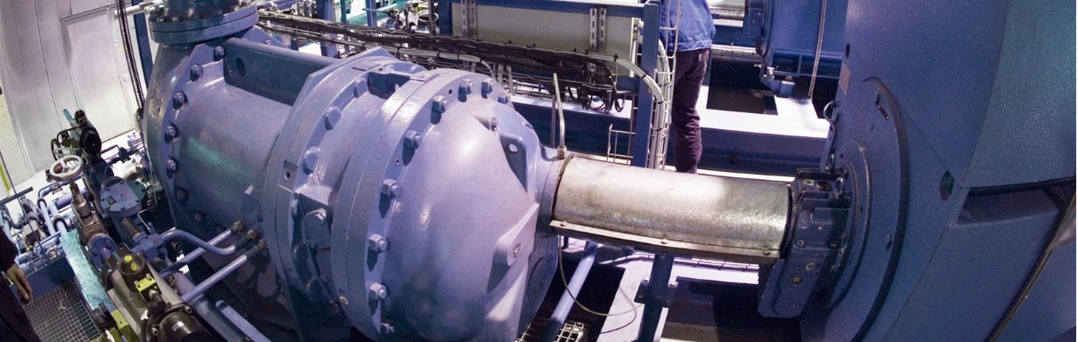
Compressor station & Oil Removal System
MAINTENANCE STRATEGY
Maintenance strategy includes
  major overhauling during Long Shutdown
  vibration analysis to anticipate complete breakdown for compressors and motors
  Oil Analysis for large capacity oil separator
设备维修策略
@CERN
Notes:
B. Bradu, ICEC 26, estimation of 10 W/hc in Run 1 and 130 W/hc in Run 2.

Slide 10
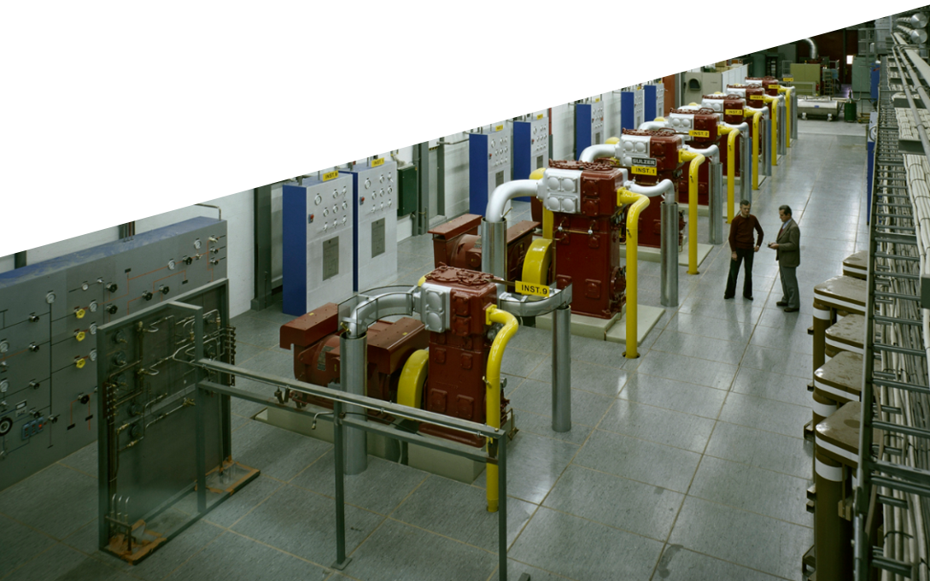
Compressor station & Oil Removal System
Critical spare parts LHC 4.5K:
  8 spares for 52 compressors in operation for LHC machine
  16% of the financial RAV
Critical spare parts LHC 1.8K:
  2 spares for 16 compressors in operation for LHC machine
  12.5% of the financial RAV
4.5K
_____
1.8K
Other compressors in Operation
Same approach applied to Motors not presented here
@CERN
@CERN – North Area Compressor 1979
Notes:
B. Bradu, ICEC 26, estimation of 10 W/hc in Run 1 and 130 W/hc in Run 2.

Slide 11
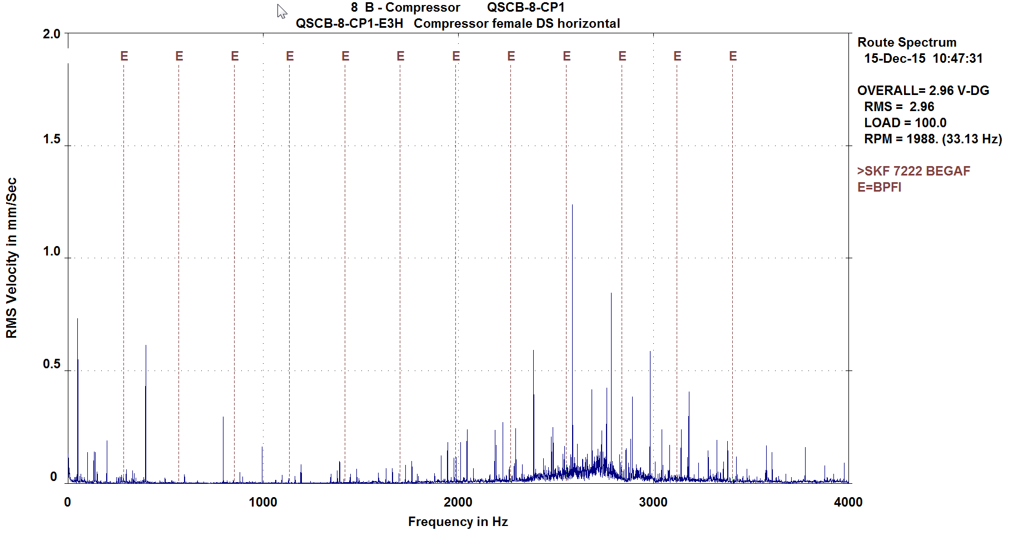
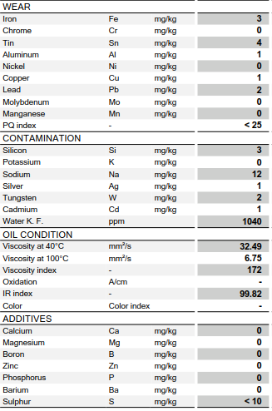
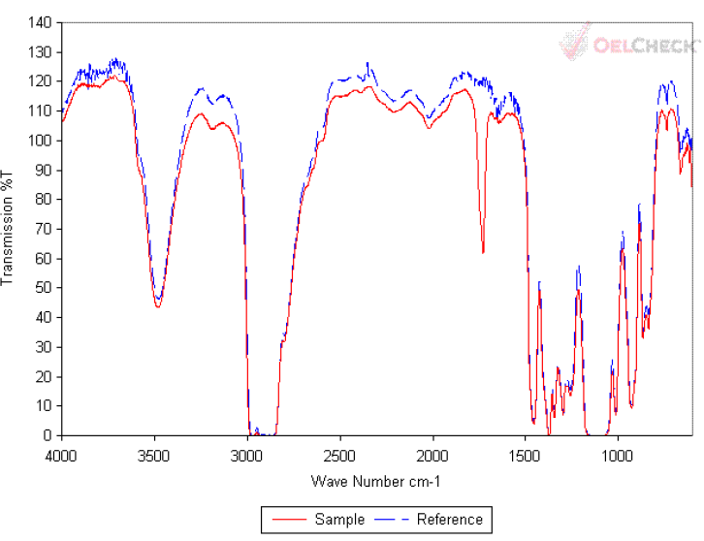
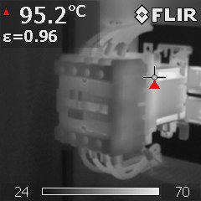
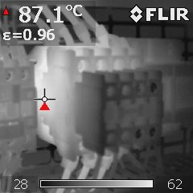
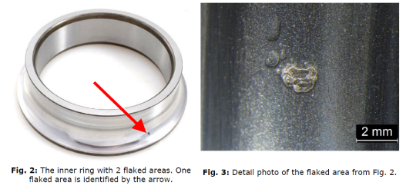
Compressor station & Oil Removal System
PREDICTIVE Maintenance program – Condition Based Monitoring
Checked Criteria
Vibration analysis Monthly Multiple : spectrum analysis
Oil analysis program Yearly Multiple : oxidation, particules
Electrical cabinets thermography Yearly Over heating temperature
Critical instrumentation checks 4-Yr Deviating value
PREVENTIVE Maintenance program
Oil pumps Revision 8’000(minor) & 24’000(major) running hours
Activated charcoal load replacement 24’000 running hours
Coalescing filters replacement None or 24’000 running hours
Screw compressor Major Overhauling 40’000 running hours
High Voltage Motors 30’000(bearings) & 40’000(sleeve bearings) running hours
Vacuum pumps revisions 8’000 to 40’000 running hours
Safety chain check Yearly
Safety valves test bench test 2-Yr, 4Yr, 5-Yr
Water Heat Exchangers chemical cleaning 4-Yr
Critical instrumentation & valves check 4-Yr
Courtesy of TE-CRG Mechanical Section
Notes:
B. Bradu, ICEC 26, estimation of 10 W/hc in Run 1 and 130 W/hc in Run 2.

Slide 12
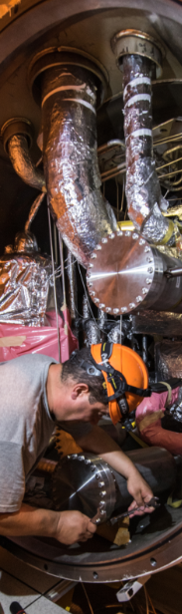

Cold Boxes
Process cycle & T-S diagram of LHC 18 kW @ 4.5 K cryoplant
LHCB P18 (AL)
Courtesy of
@CERN
@CERN
Notes:
B. Bradu, ICEC 26, estimation of 10 W/hc in Run 1 and 130 W/hc in Run 2.

Slide 13
Cold Boxes
MAINTENANCE STRATEGY
Turbine automation protection in the process
Service contract to reduce MTTR below 4 weeks and avoid buying spare for turbines above 80K
Critical spare parts LHC Machine:
  27 different types of turbines
  21 spares for 64 turbines in operation for LHC machine
  32% of the RAV
设备维修策略
@CERN
@CERN
Notes:
B. Bradu, ICEC 26, estimation of 10 W/hc in Run 1 and 130 W/hc in Run 2.

Slide 14
Cold Boxes
MAINTENANCE STRATEGY
Power Supply and electronic design change to improve reliability
Predictive maintenance with mechanical clearance and bearings check to validate service intervention on time
Critical spare parts LHC Machine:
  7 different types of Cold Compressors
  7 spares for 28 units in operation for LHC
  25% of the financial RAV
设备维修策略
@CERN
@CERN
Notes:
B. Bradu, ICEC 26, estimation of 10 W/hc in Run 1 and 130 W/hc in Run 2.

Slide 15
Cold Boxes
PREDICTIVE Maintenance program – Condition Based Monitoring
Checked Criteria
Electrical cabinets thermography Yearly Over heating temperature
Critical instrumentation checks 4-Yr Deviating value
Cold Compressors 4-Yr Mechanical cleareance
Heat exchangers 4-Yr Tightness test
Turbine filters Yearly Delta P
PREVENTIVE Maintenance program
Safety valves test bench or local test 2-Yr, 4Yr, 5-Yr
Safety chain check Yearly
Water Heat Exchangers chemical cleaning 4-Yr
Vacuum pumps revisions 8’000 to 24’000 running hours
Critical valves & instrumentation check 4-Yr
Turbine filters 4-Yr (when vacuum break required)
RUN to FAIL
Turbines
@CERN
@CERN
Notes:
B. Bradu, ICEC 26, estimation of 10 W/hc in Run 1 and 130 W/hc in Run 2.

Slide 16
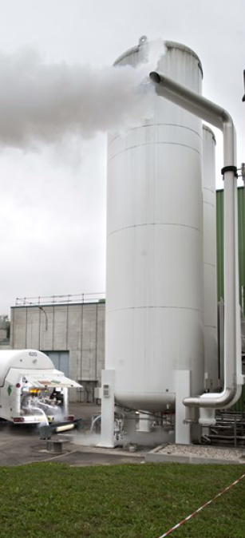
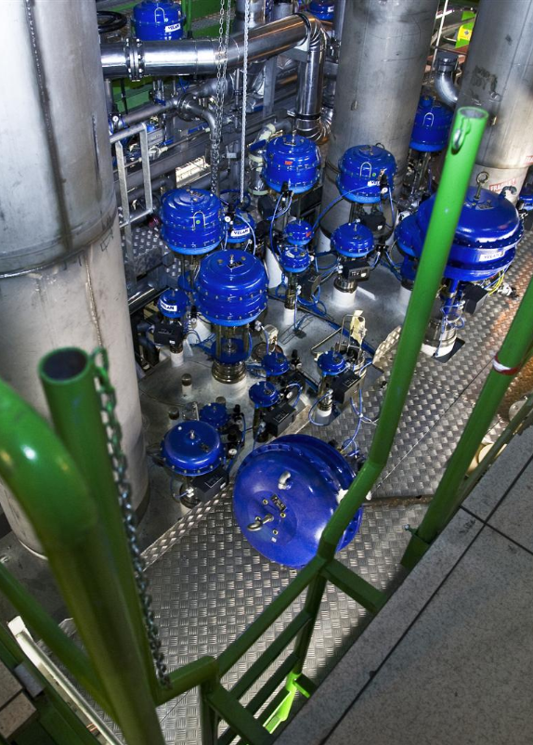
Storage, Distribution & Cryostat
PREDICTIVE Maintenance program – Condition Based Monitoring
Checked Criteria
Line integrity test during warm-up 4-Yr Pressure and vacuum tests
Critical instrumentation checks 4-Yr Deviating value
Critical valves check 4-Yr Leak tighness
Capacity legal pressure check 10-Yr Pressure test according to EU
PREVENTIVE Maintenance program
Safety valves 2-Yr, 4Yr, 5-Yr
Safety chain check Yearly
Vacuum pumps revisions 8’000 to 24’000 running hours
Critical valves check 4-Yr
Critical instrumentation check 1 to 4-Yr
@CERN – LHC Nitrogen tank during LHC pre cooling
@CERN
@CERN
@CERN – LHC Point 2 Distribution Valve Box
Notes:
B. Bradu, ICEC 26, estimation of 10 W/hc in Run 1 and 130 W/hc in Run 2.

Slide 17
Work Organization and LS2 implementation
CERN Cryogenics group
involvement in Maintenance
Industrial Partnership
Cryogenics Group
Operation
Methods and Logistics
Cryolab and Instrumentation
Mechanical and Engineering support
Control and Electrical Support
Maintenance support Team
Mechanical Maintenance Experts
Instrumentation Maintenance Experts
Electrical Maintenance Experts
Operation
Operation support or fully delegated
Mechanical Maintenance Team
Maintenance support Team
Coordination
Planning
CMMS
Spare parts
Field Mechanical Team
Field E&I Team
Notes:
B. Bradu, ICEC 26, estimation of 10 W/hc in Run 1 and 130 W/hc in Run 2.

Slide 18
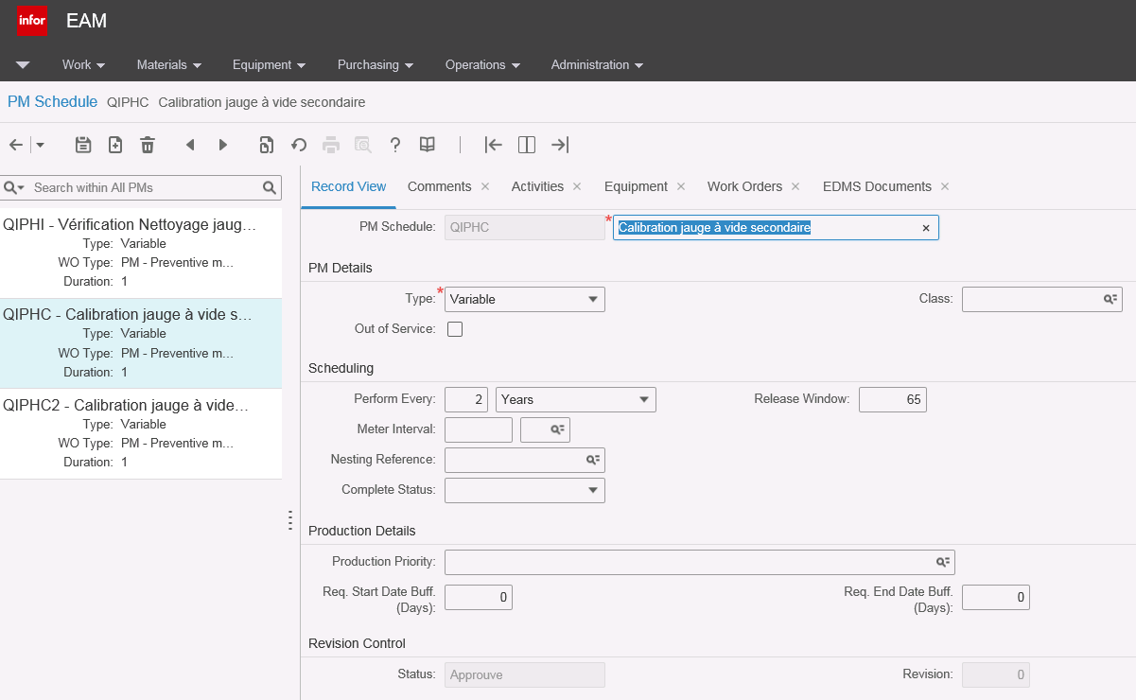

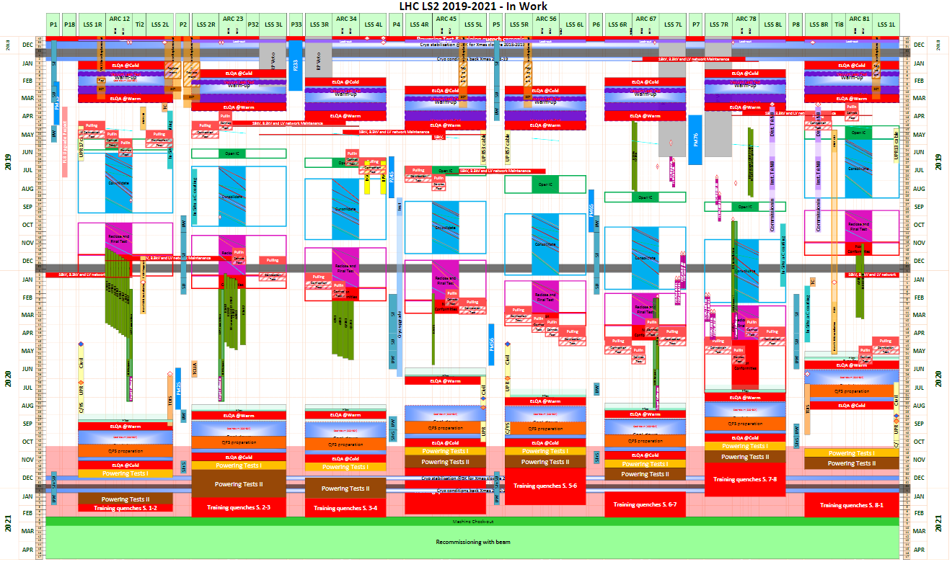
Work Organization and LS2 implementation
Computerized Maintenance Management System
All Maintenance Plans are review by:
  Maintenance experts by field
  Method & Logistic support section
  Contractor Maintenance Support team
Reference matrix is updated and shared with the team
Update of the of the CMMS is done by the contractor
Work Preparation and planning will follow in the coming months according to CERN requirement
Notes:
B. Bradu, ICEC 26, estimation of 10 W/hc in Run 1 and 130 W/hc in Run 2.

Slide 19
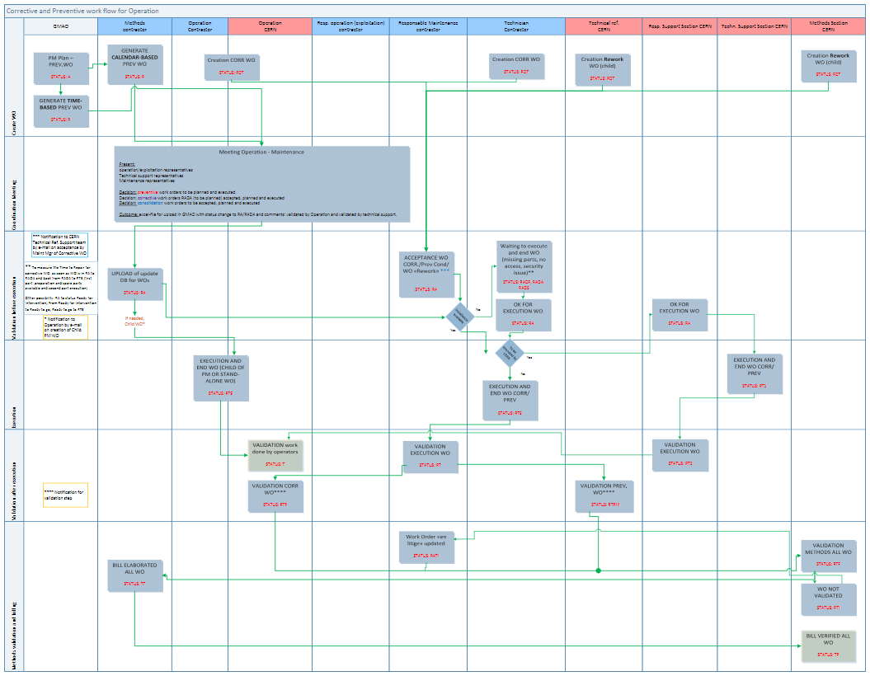
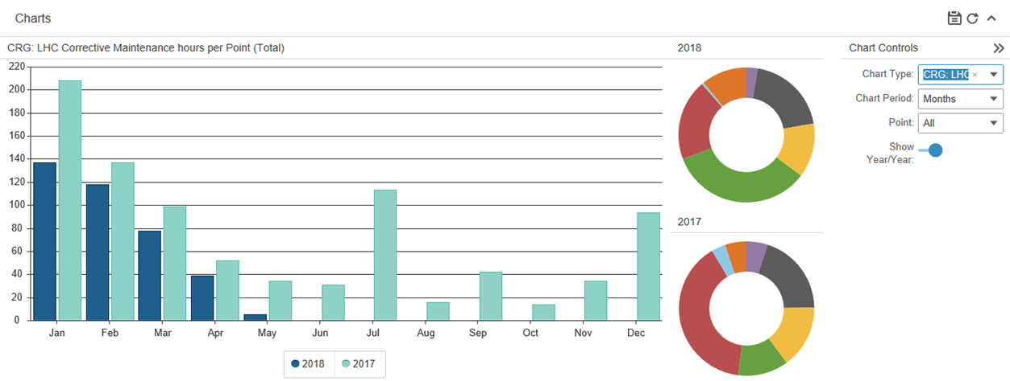
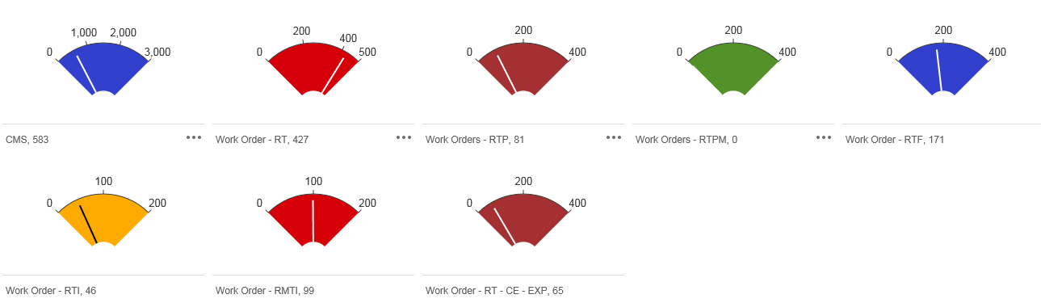
Work Organization and LS2 implementation
Computerized Maintenance Management System
Technical Stop 3-4d 30-80wo
YETS 2-3wk 1’000-1’200wo
Long Shutdown 1yr 3’000-4’000wo
Workflow is in place and each WO is check and validated by CERN technical expert in the field and quality controller
Notes:
B. Bradu, ICEC 26, estimation of 10 W/hc in Run 1 and 130 W/hc in Run 2.

Slide 20
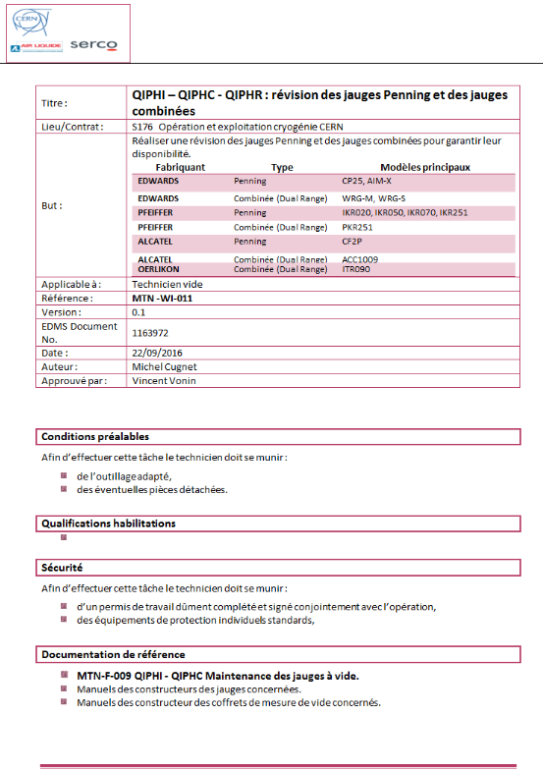
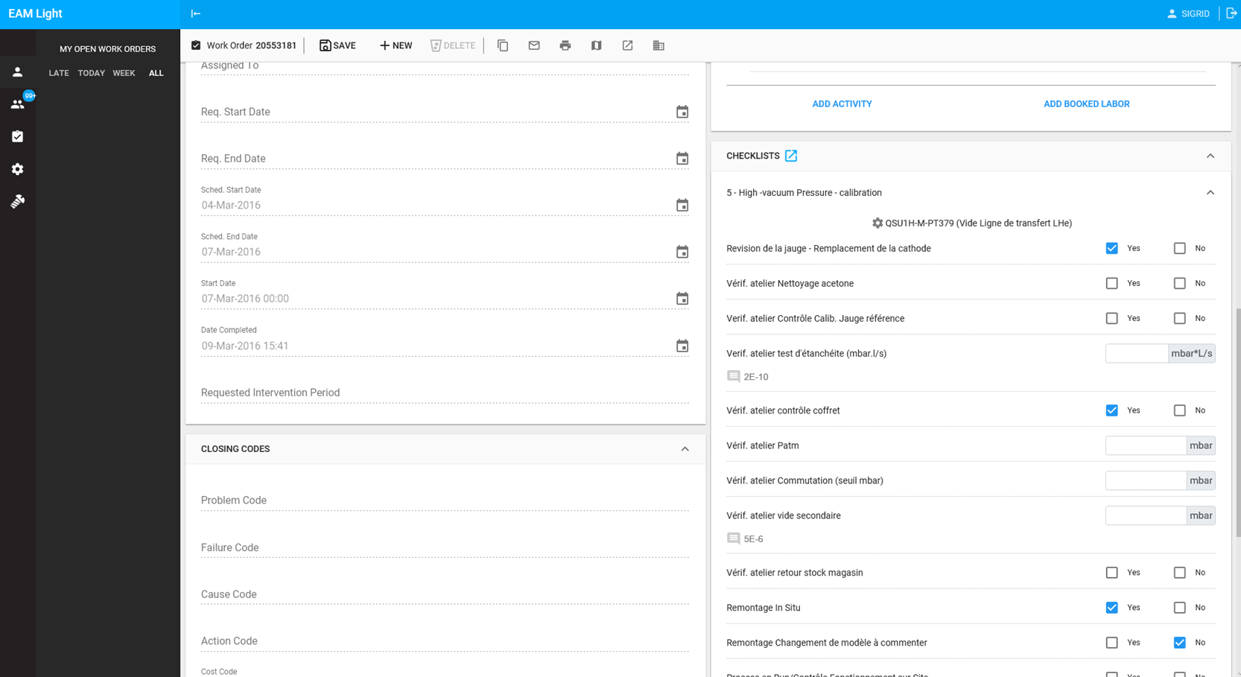
Work Organization and LS2 implementation
Work Instructions and Field Forms
All mechanical documents technical contents have been updated in the past year
We are testing electronic checklists and integrated calibration device
Notes:
B. Bradu, ICEC 26, estimation of 10 W/hc in Run 1 and 130 W/hc in Run 2.

Slide 21
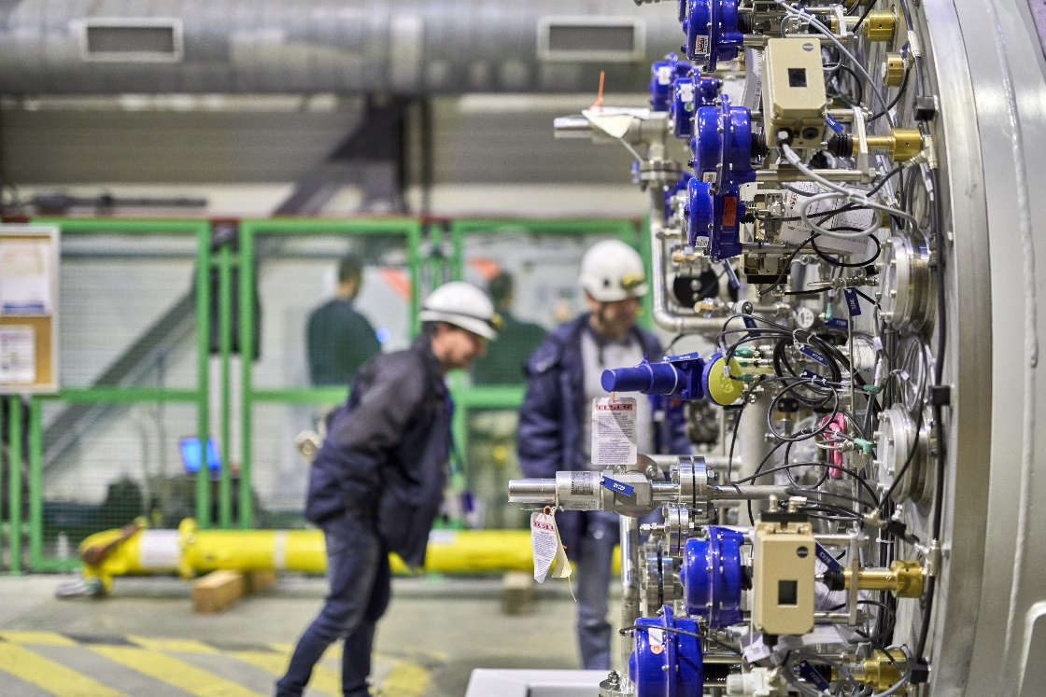
Conclusion
Conclusion
@CERN – BA6 Mobile Cold Box
设备维修策略
Maintenance Strategy
definition is very important and shall integrate :
  Identification of the Failure Modes
  Evolution of the expected pattern
  Criticality assessment of the Asset
  Evaluate technical and financial capability
  Ensure quality of the executed work
CMMS is also mandatory in order to TRACK and RECORD precisely maintenance events and analyze things correctly the situation
when facing the unexpected.
Notes:
BA6 Mobile Cold Box

Slide 23
设备维修策略
she bei wei hu ce lue
\ \ / \ \ \
Maintenance Strategy

