Slide 1
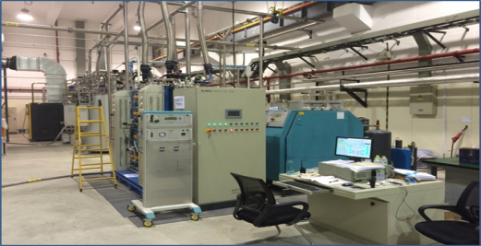
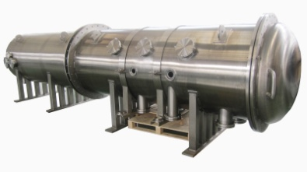
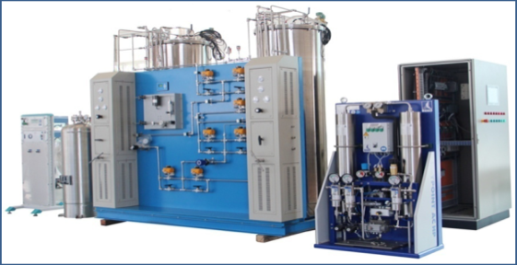
Application and Problem-solution of Helium Purifier
for Cryogenic System
Xuehua Zhang
VACREE TECHNOLOGIES CO., LTD

Slide 2
Contents
1
Helium Purifier Application in Cryogenic System
2
Helium Purifier Methods and Process Flow
3
Solution of Helium purifier in Cryogenic System
4
Problem Analysis and Discussion

Slide 3
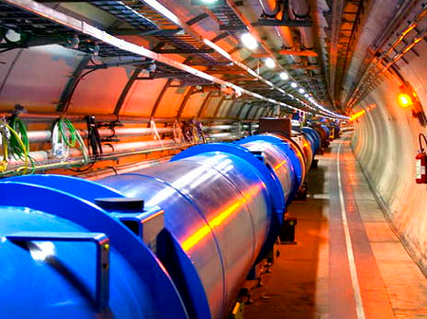
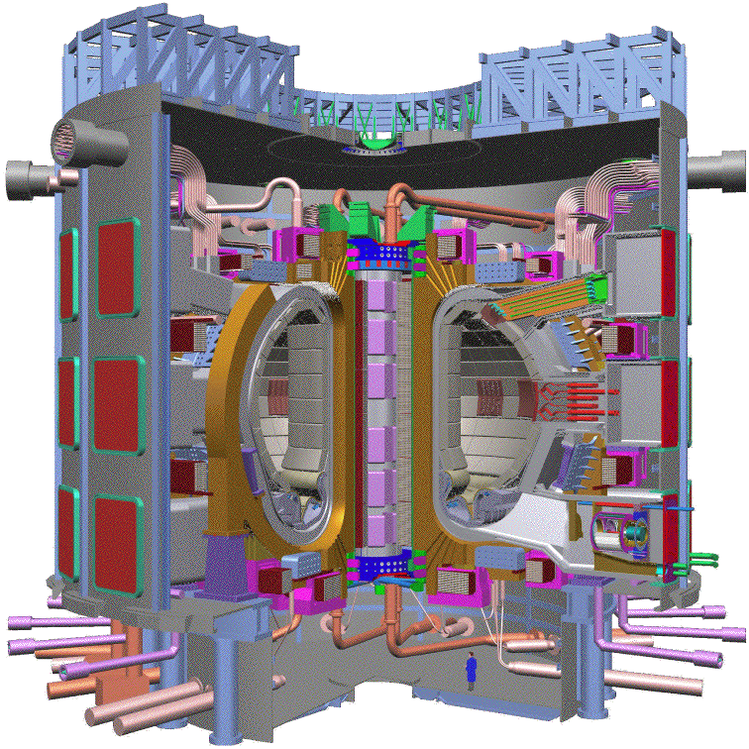
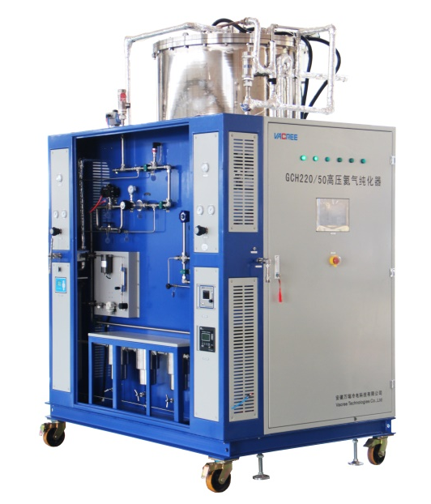
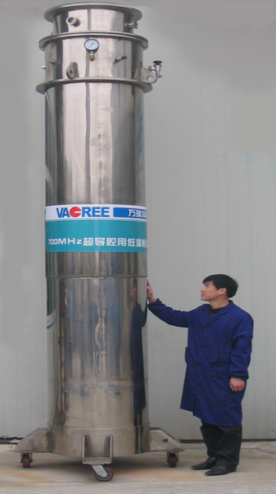
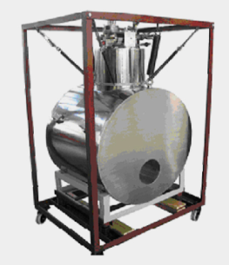
Application requirements
Particle Accelerator
Magnetic confinement fusion
Vertical Test Cryostat
Superconducting magnet
Helium purifier
Notes:
3
<click> Among others, there are four fundamental questions as Herbert Simon pointed out in his talk at Boulder in 1986: Matter, Universe, Life, and Mind.

Slide 4
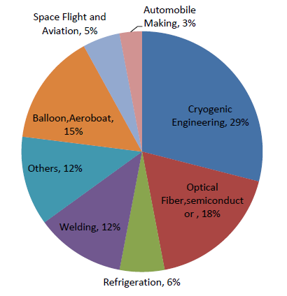
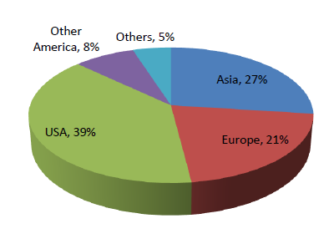
Application requirements
Main application fields of helium
Proportion of helium consumption worldwide
The annual use of helium in China is 2.42×10⁷ Nm³
So helium recovery and purification is necessary.

Slide 5
Contents
1
Helium Purifier Application in Cryogenic System
2
Helium Purifier Methods and Process Flow
3
Solution of Helium purifier in Cryogenic System
4
Problem Analysis and Discussion

Slide 6
Purification principle
Comparison of Helium Purification Methods
No | Item | High Pressure Cryo-condensation & adsorption | Membrane Separation | PSA | Freezing Adsorption
1 | Working Pressure bar | 100～150 | 8 | 8、16 | 8
2 | Technique | Technical maturity | Advanced | More advanced | More advanced
3 | Structure | Compact | Compact | Big Size | Compact
4 | He Compressor | Needed | Needed | Needed | Needed
5 | He Recovery | Gas Cyliner Filling | TBA | TBA | TBA
6 | Operation | Easy | Easy | Complex | Easy
7 | Automation | High | High | High | High
8 | LN2 | LN2 Storage Tank | Not Needed | Not Needed | Not Needed

Slide 7
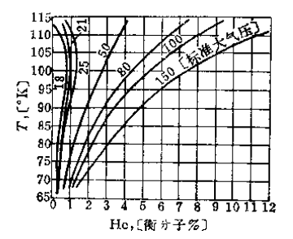
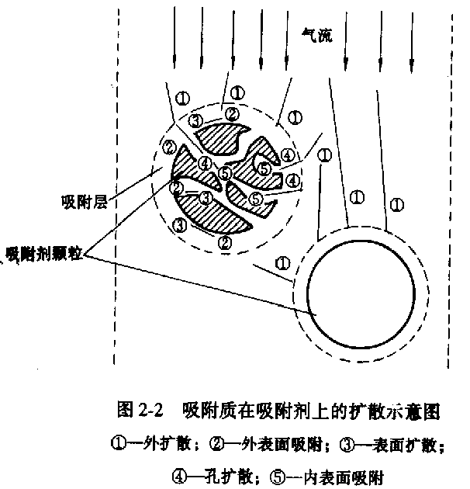
Cryogenic Purification
Cryogenic Liquefaction ( Freezing) & Separation
Principle: Taking LN₂ as cold source to cool raw gas to be lower than 77K, and pressurize the gas to HP ,The boil point of He is the lowest 4.2K,Other impurity gases are liquefied and separated out.
Features: Big capacity, High purity, Complex structure
Cryogenic Adsorption
Principle：Adsorption agent has very big specific surface area, which has excellent adsorption to impurity gases under cryogenic temperature
Features: Good adsorption, Regenerative, High purity gas processed.

Slide 8
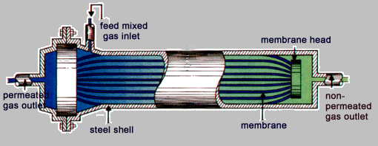
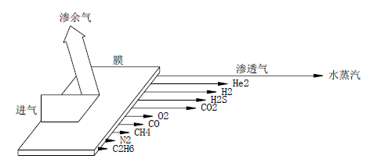
Gas membrane separation
Membrane Separation
Principle: Gases have different permeability across the membrane. It is easier for Helium to pass through the membrane
Permeability Coefficient：P=D×S
Separation Coefficient：α=P1/P2
Feature ：Small size, High-efficiency, Low energy-consumption, But the highest purity of helium is 99%
H2
e

Slide 9
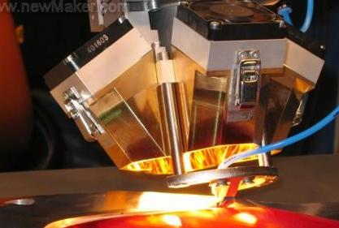
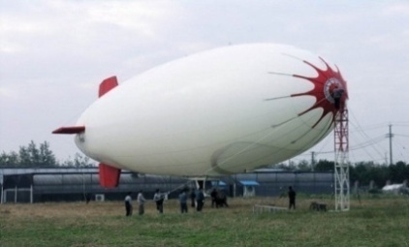
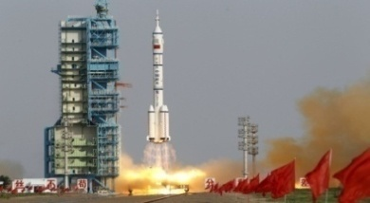
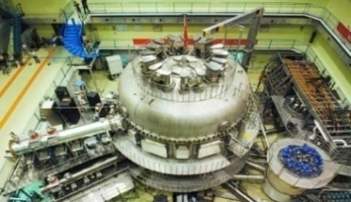
Purification principle
Principle diagram of helium recovery and purification
Adopt Two-stage Separation & Purification
≥10.0% Crude Helium
1st stage Purification
2nd stage Purification
Recycling
Cryogenic gas/ liquid Separation
Cryocooler Cryogenic Condensation
Recovery
Unit
User
Membrane Separation
LN2 HP/MP Cryogenic Adsorption Separation
≥99.0%
Helium
≥99.999%
Helium
Float, Optical Fiber Cooling, Leakage Detection, etc
Cryogenic SC, Protective gas of Optical Fiber, Cryogenic physics
fiber- optical factory
Semiconductor production
Metal arc welding
aerostat
Pipeline replacement
Cryogenic Engineering

Slide 10
Contents
1
Helium Purifier Application in Cryogenic System
2
Helium Purifier Methods and Process Flow
3
Solution of Helium purifier in Cryogenic System
4
Problem Analysis and Discussion

Slide 11
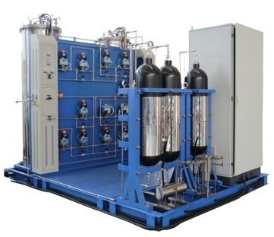
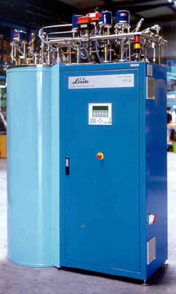
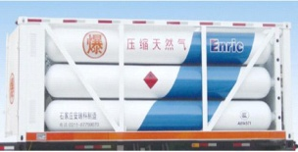
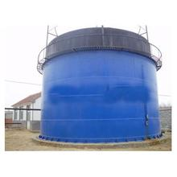
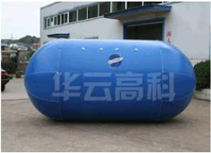
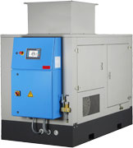
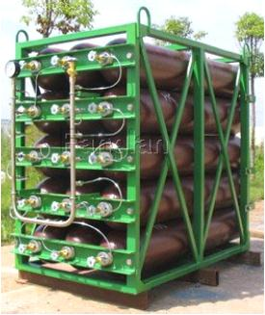
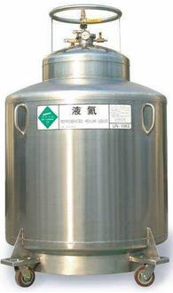
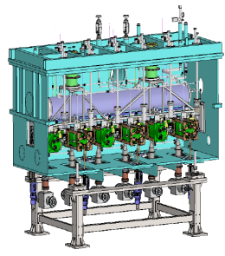
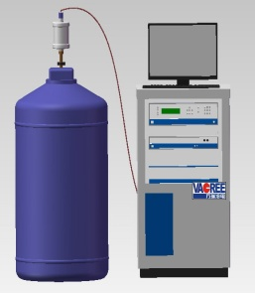
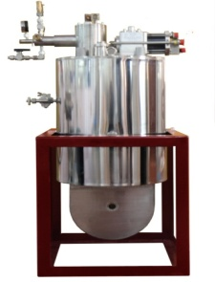
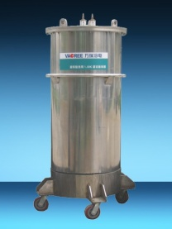
System Process Flow
Recovery & Storage
Purification & Liquefaction
End-User

Slide 12
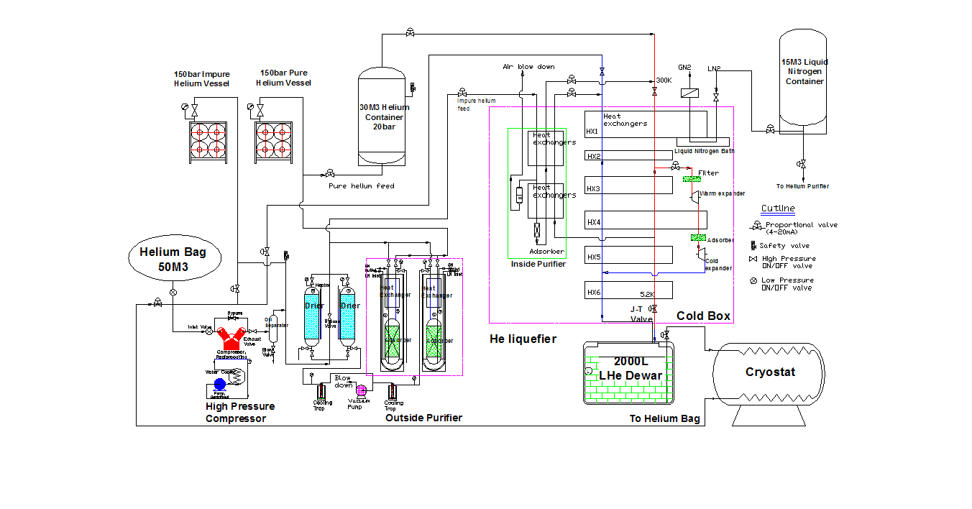
Flow diagram
双龙

Slide 13
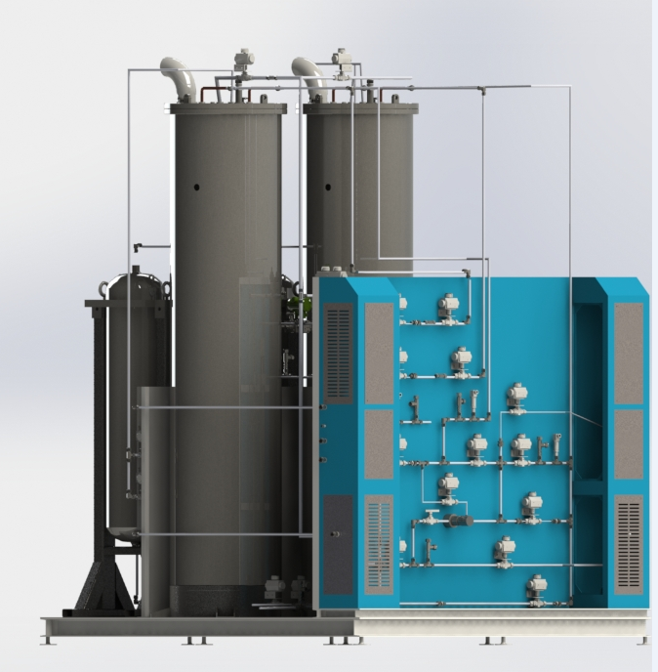
GCH Series High Helium Purifier
Typical helium purifier used in cryogenic engineering, He:95%→99.999%
Diagram
Specifications
Item | Unit | Index | Test Result | Remark
Medium |  | Helium | 95% He （Averaged） | Better
Capacity | Nm³/h | 20～100 | 100 | Compliance
Working Pressure | bar(g) | 100～200 | 120(Averaged) | Compliance
Pressure Loss | bar(g) | ≤2 | 1.8 (Averaged) | Better
Dim. | mm | 2240×2456×3100 （L×W×H） | 2240×2456×3100 （L×W×H） | Compliance
Outlet Impurity | ppm | ≤10 | 2.8PPm and above | Better
Saturation | h | 98% He，≥6.5 | 95% He，≥8 | Better
 |  | 99% He，≥12

Slide 14
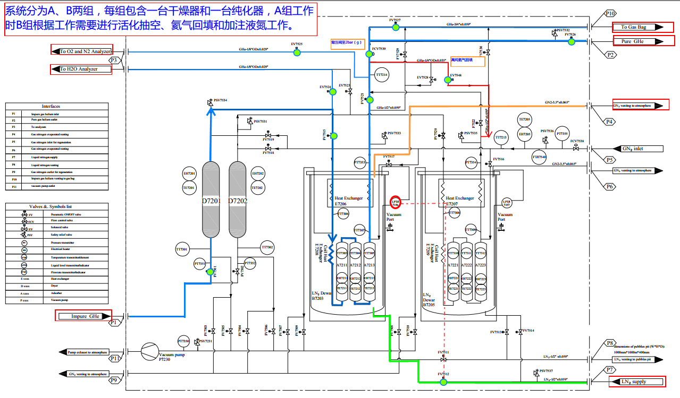
GCH Series High Helium Purifier
Process Flow Diagram
The system is divided into two groups，each containing a dryer and a purifier , one working and the other activating standby

Slide 15
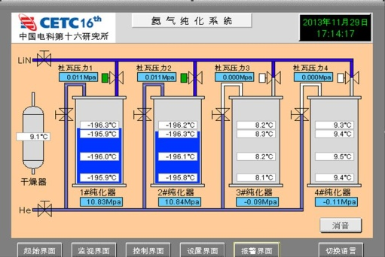
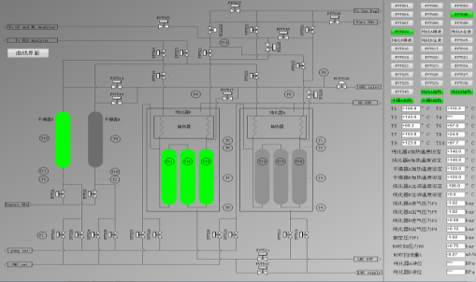
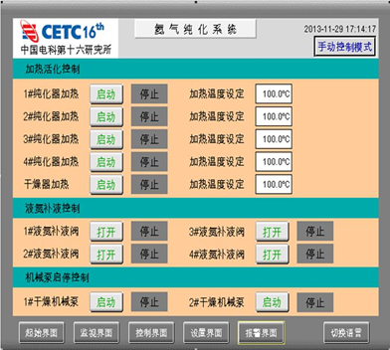
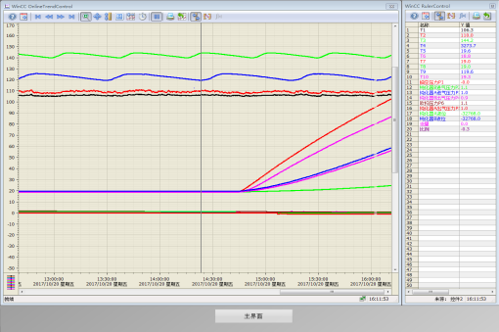
Control Logic
Control system
System Control
Functions
Data Display
Start-off Compressor
Tank pressure regulate
Inlet Pressure regulate
Start-off Solenoid valves
Helium flow control
Controller
Operation Status
CP Fault light
Differential pressure
Pressure points
Flow capacity points
Temperature
PLC
Valve operators, mechanical pumps ,etc
Pressure
Status of Components
Signal indicators，Alarm
Data Exchange
Touch Screen
Data display
The purifier is controlled by PLC to detect ,control,and store the data of T,P,F﹍
Data Storage
Curve Generation
Status Display
Equipment Control

Slide 16
GCH Series High Helium Purifier
Test graph of the system, including: Capacity/Pressure/Purity/Adsorption Volume
Ave. Capacity：80.354m³/h
PIN-POUT＜2bar
Ave. Differential Pressure：1.749bar(g)
Ave. Purity：96.287%
Adsorption Volume
∑ N2+O2+H2O＜5ppm
5N9: 80.354×（1-96.287%）×8=23.865m³（air）
5N9.5: 80.354×（1-96.287%）×6.5=19.393m³（air）
Requirement：80×0.02×6.5=10.4m³（air）

Slide 17
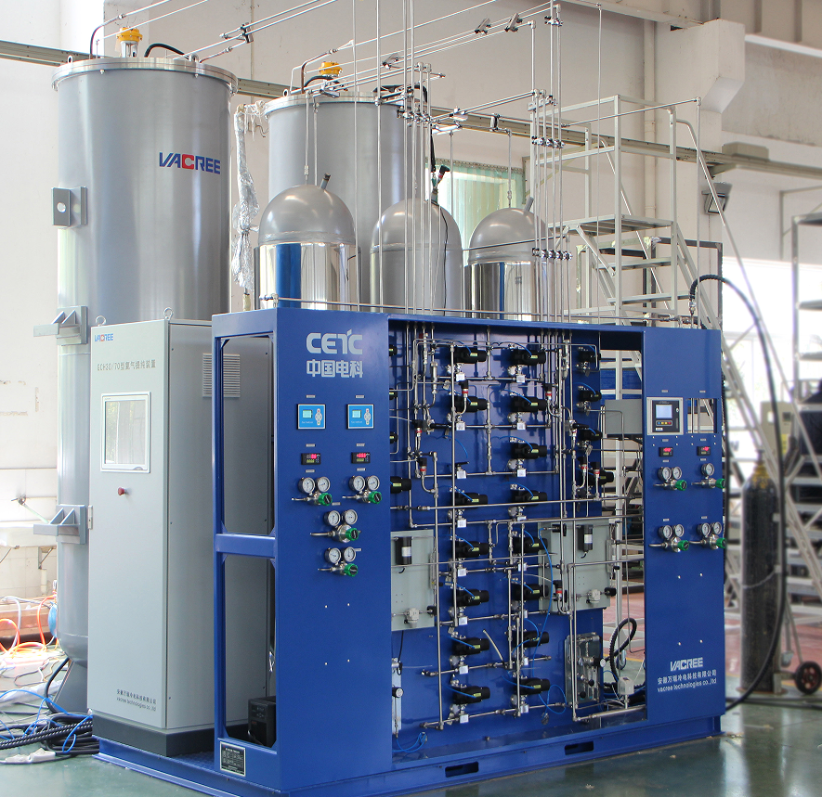
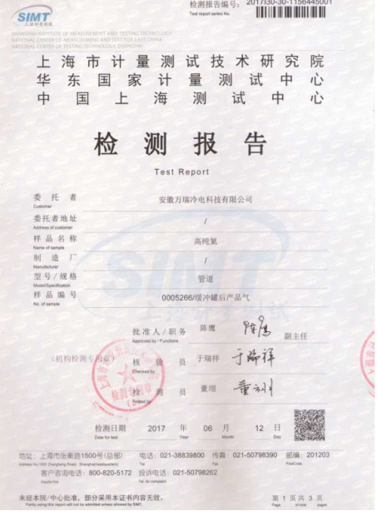
GCH Series High Helium Purifier
Product photo
Third party Test Report

Slide 18
Contents
1
Helium Purifier Application in Cryogenic System
2
Helium Purifier Methods and Process Flow
3
Solution of Helium purifier in Cryogenic System
4
Problem Analysis and Discussion

Slide 19
Application Reference
No | User | Specification | Year
1 | IMP,CAS | Capacity:100Nm3/h；Outlet Purity≥ 99.999% ；Working Pressure：16bar | 2012
2 | IHEP.CAS | Capacity:105Nm3/h；Outlet Purity≥99.9995% ；Working Pressure：150bar | 2013
3 | SINAP,CAS | Capacity:30Nm3/h；Outlet Purity ≥99.995%；Working Pressure：200bar | 2013
4 | CAEP | Capacity:20Nm3/h；Outlet Purity≥99.999% ；Working Pressure：150bar | 2013
5 | Chinese space | Capacity:60Nm3/h；Outlet Purity≥99.999% ；Working Pressure：250bar | 2014
6 | ASIPP,CAS | Capacity:80Nm3/h；Outlet Purity≥99.999% ；Working Pressure：19-30bar | 2015
7 | TIPC,CAS | Capacity：100Nm3 /h：Working Pressure：150bar；Outlet Purity≥99.999% | 2016
8 | Sumitomo Electric | Capacity：25Nm3 /h：Working Pressure：70bar；Inlet Purity 60%，Outlet Purity≥99.999% | 2016
9 | Air Liquide | Capacity:100Nm3 /h；Working Pressure：150bar；Outlet Purity≥99.999% | 2016
10 | Peking University | Capacity:60Nm3 /h；Working Pressure：150bar；Outlet Purity≥99.999% | 2016
Application of helium purifier in cryogenic engineering in China

Slide 20
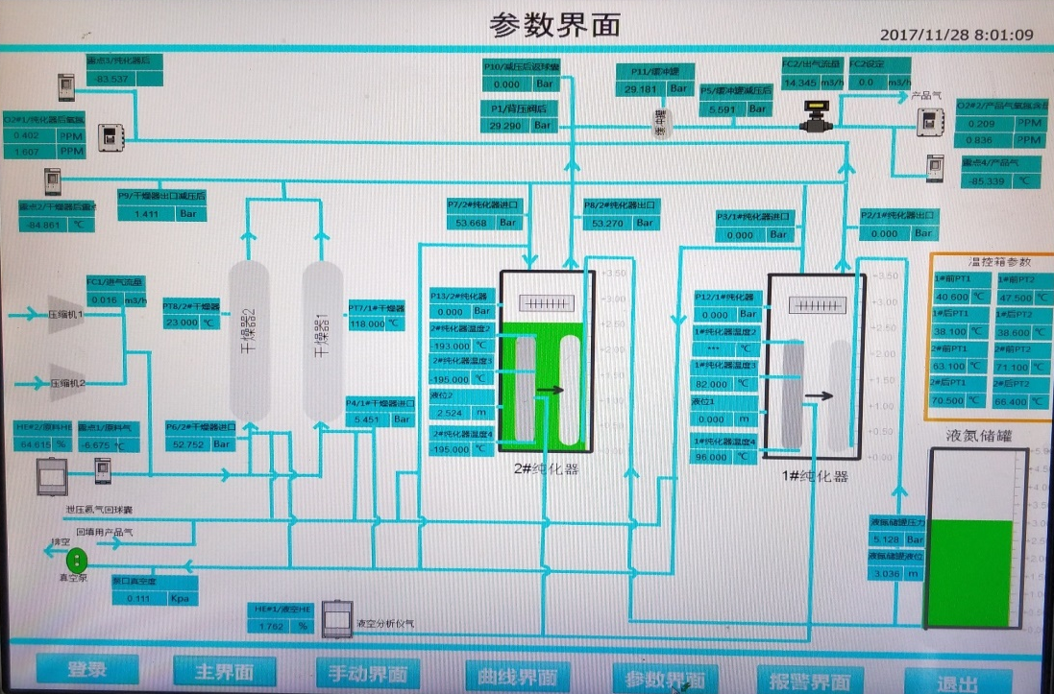
Problem-solution-1
We had some problems on the purifier during the operations.
Temp. Sensor Damaged
HT & LT
Shock
Select reliable or backup

Slide 21
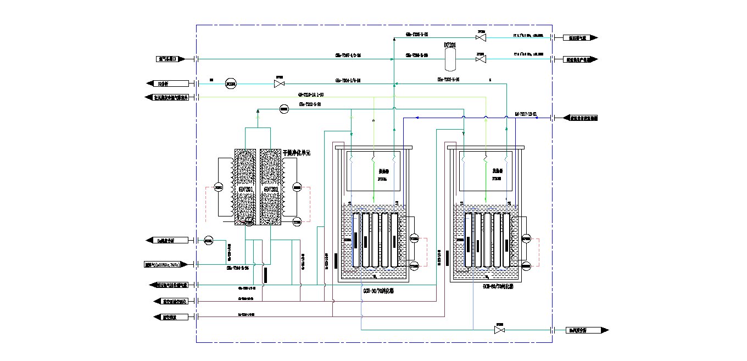
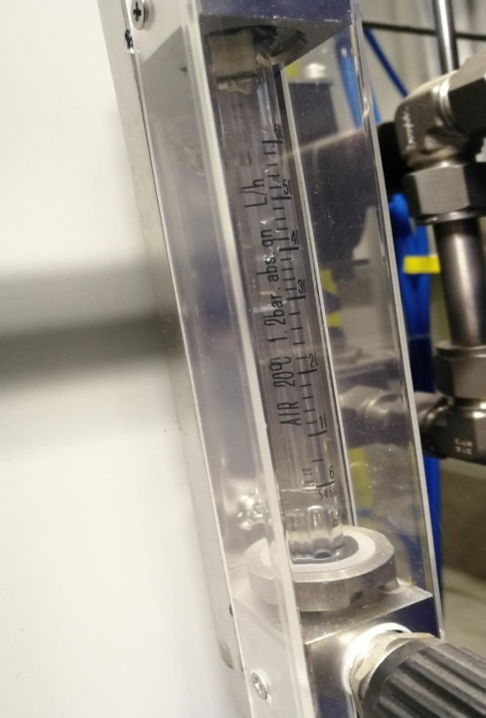
Problem-solution-2
Inlet Gas Analyzer damaged
Water inside
Analyzer was Installed After dryer
After solution
Dryer
Before solution

Slide 22
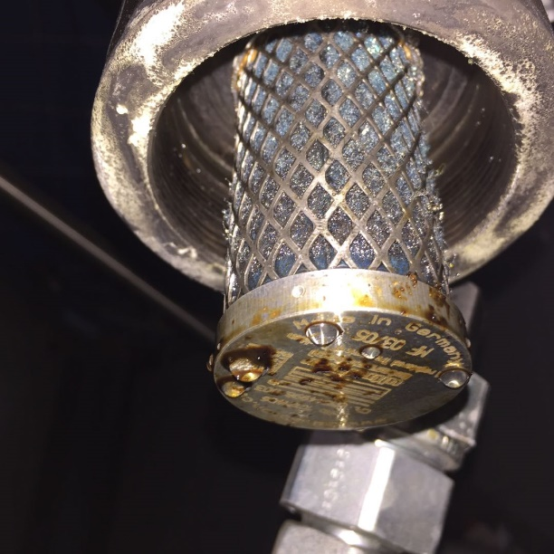
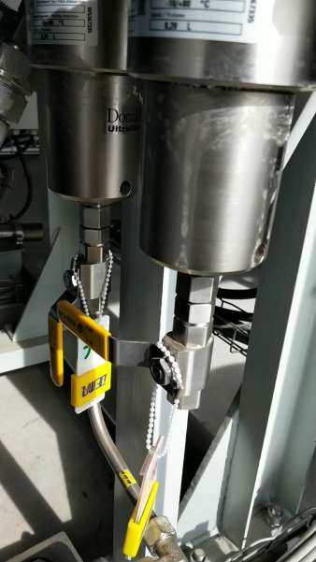
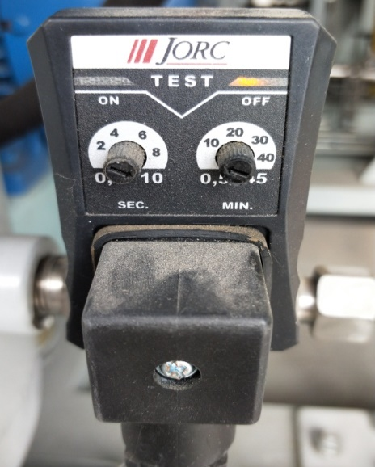
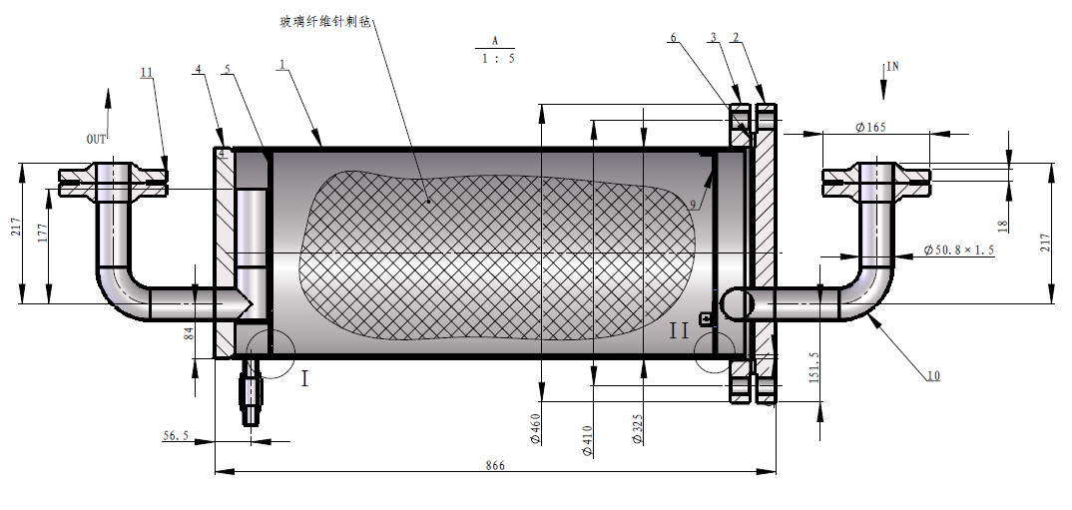
Problem-solution-3
Compressed He Contains
a lot of oil
The effect of oil-filter is not good
Add another oil-filter

Slide 23
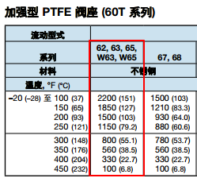
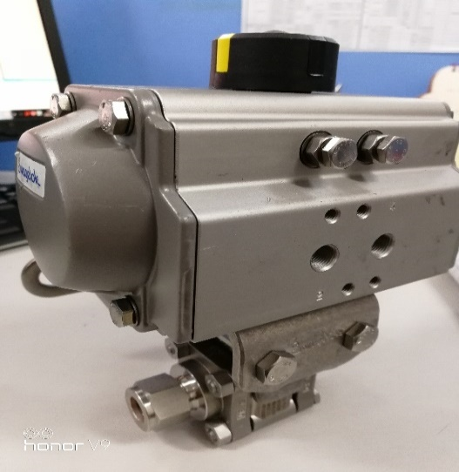
Problem-solution-4
Pneumatic Valve Leakage
Valve Disc/Stem
The valve cannot work at low temperature
Exchange LT valve

Slide 24
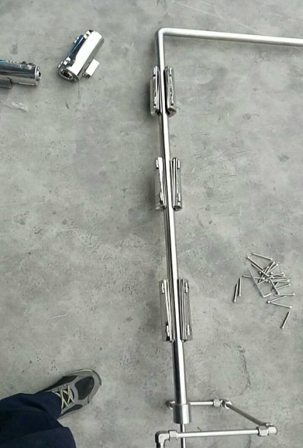
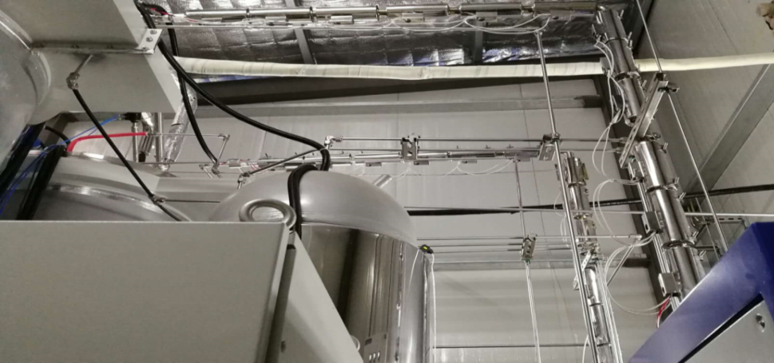
Problem-solution-5
The T of Heat exchanger outlet is low
The HE is in the cold LN2 of Dewar
Outlay Heat Exchanger added
Heater to be Added
303K
293K
170K
80K

Slide 25
Problem-solution-6
Purifier Blocked
Adsorption powder?
Valve leakage?
H₂O filtered not completely?
Inlet pressure
Outlet pressure
Solution: Reverse exhaust from vent or replacement of adsorption material

Slide 26
GCH Series High Helium Purifier
Model | GCH -20 | GCH -60 | GCH -100 | GCH - 200 | GCH - 300
System handling capacity | 20﻿﻿﻿﻿m³/Hr | 60﻿﻿m³/Hr | 100﻿﻿m³/Hr | 200﻿﻿m³/Hr | 300﻿﻿m³/Hr
Working pressure | 20~200 bar | 20~200 bar | 20~200 bar | 20~200 bar | 20~200 bar
Inlet helium purity | 50%~99% | 50%~99% | 50%~99% | 50%~99% | 50%~99%
Outlet helium purity | 99.999% | 99.999% | 99.999% | 99.999% | 99.999%
Through years of improvement and upgrading, We have
a series of standard products

Slide 27
Conclusion
1
Helium Purifier is extensively used in the cryogenics system
2
Helium Purification Methods: Membrane separation,cryogenic condensation and adsorption
3
The outlet Purity can be 99.999%
4
We should focus on key parts selection and process optimization

Slide 28
Welcome to VACREE booth for questions
Thanks for your attention!
Contact information
Company: Vacree Technologies Co., Ltd.
Add： No. 189 Haitang Road Hi-Tech Zone ,Hefei, China.
Website：www.vacree.com
Cellphone：13956079943
E-mail： Zhangxh@vacree.com

