Slide 1

Thermal behavior of the cryogenic system during quench protection tests of the superconducting magnet of a hybrid magnet
Junjie LI
High Magnetic Field Lab, CAS
18/6/5

Slide 2
Contents
1. About the CHMFL
2. The helium cryogenic system
3. Thermal behavior of cryogenic system
during quenching protection
4. Conclusion

Slide 3

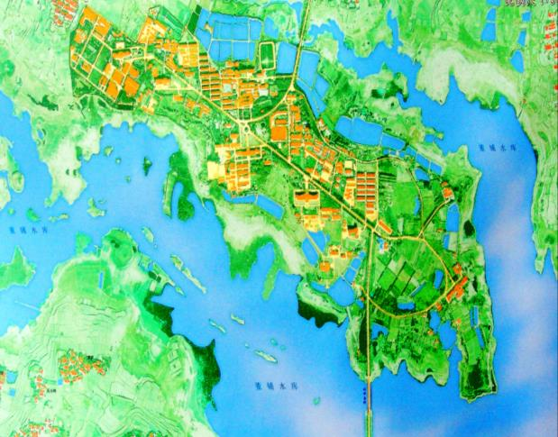
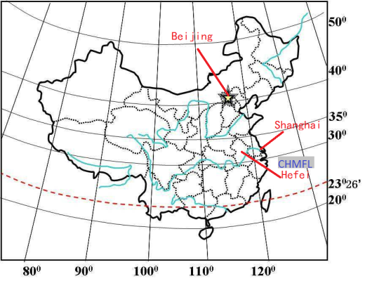
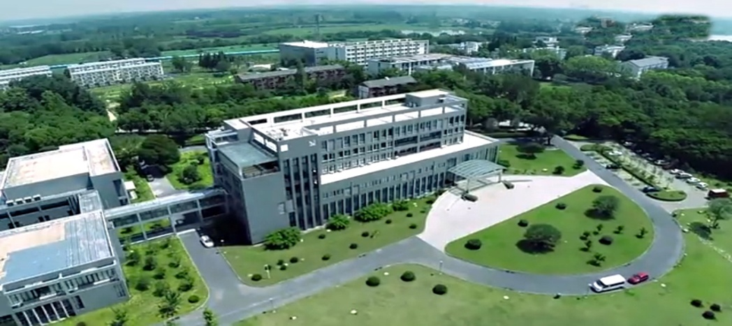

About the CHMFL
Nijmegen
the main missions of the Lab (from May 2008):
1）Develop series of high field magnets (hybrid magnets, superconducting magnets and water-cooled magnets)
Water-cooled magnets (resistant magnets) | WM1 | 38.5T@32mm
 | WM2 | 25T@50mm
 | WM3 | 20T@200mm
 | WM4 | 27.5T@32mm
 | WM5 | 35T@50mm
Superconducting magnets | SM1 | 8T@100mm
 | SM2 | 20T@50mm
 | SM3 | 18.8T@54mm
 | SM4 | 9.4T@400mm
Hybrid magnets | HM1 | 45T@32mm
Tsukuba
Tallahassee
Grenoble
Hefei
2）Research on physics, functional material, chemistry, life sciences and pharmacology in the extreme high magnetic field
TMS | Transport Measurement System @Closed Cycle Refrigerator
MPMS | Magnetic Property Measurement System
MOMS | Magneto-Optical Measurement System
SMA | STM-MFM-AFM Combo System
HPMS | High Pressure Measurement System
ULTES | Ultra Low Temperature Experiment System

Slide 4
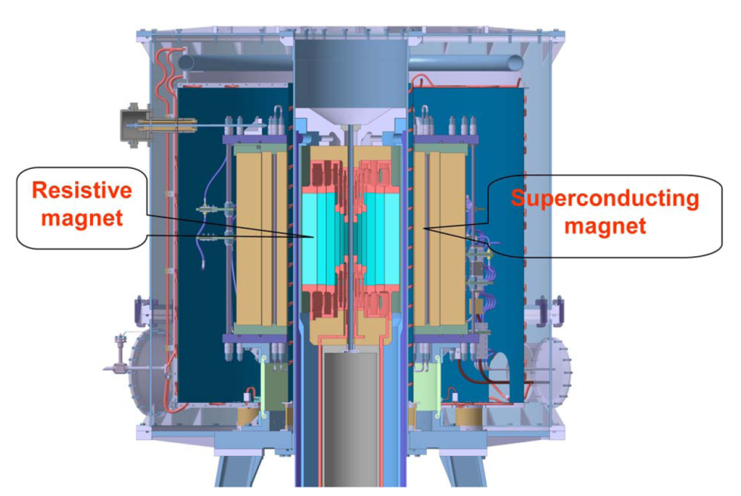
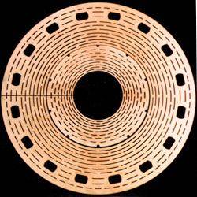
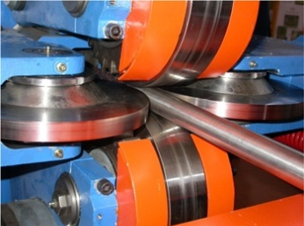
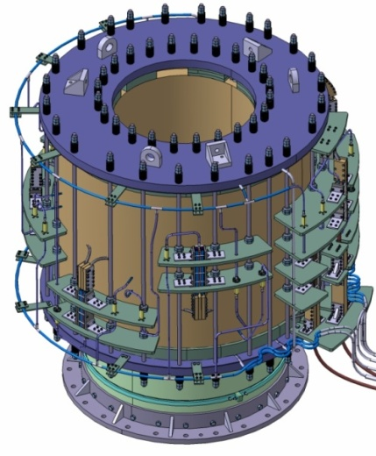
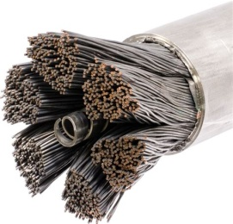
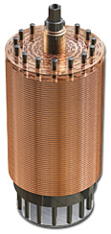
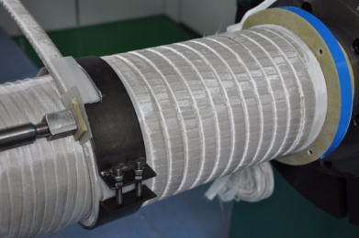

About the CHMFL
Hybrid Magnet
Combined system | Field | Operating temperature | conductors | Clear bore
Superconducting magnet (outsert) | 11T | 4.5 K | CICC | 800mm
Water-cooled magnet (insert) | 34T | Room temperature | Florida- Bitter Disc | 32mm
Superconducting coils are wound by multi-stage cable-in-conduit conductors (CICC) which are cooled by 4.5K supercritical helium @ 4.2 bar.
Cooling water
Helium
~30% void

Slide 5
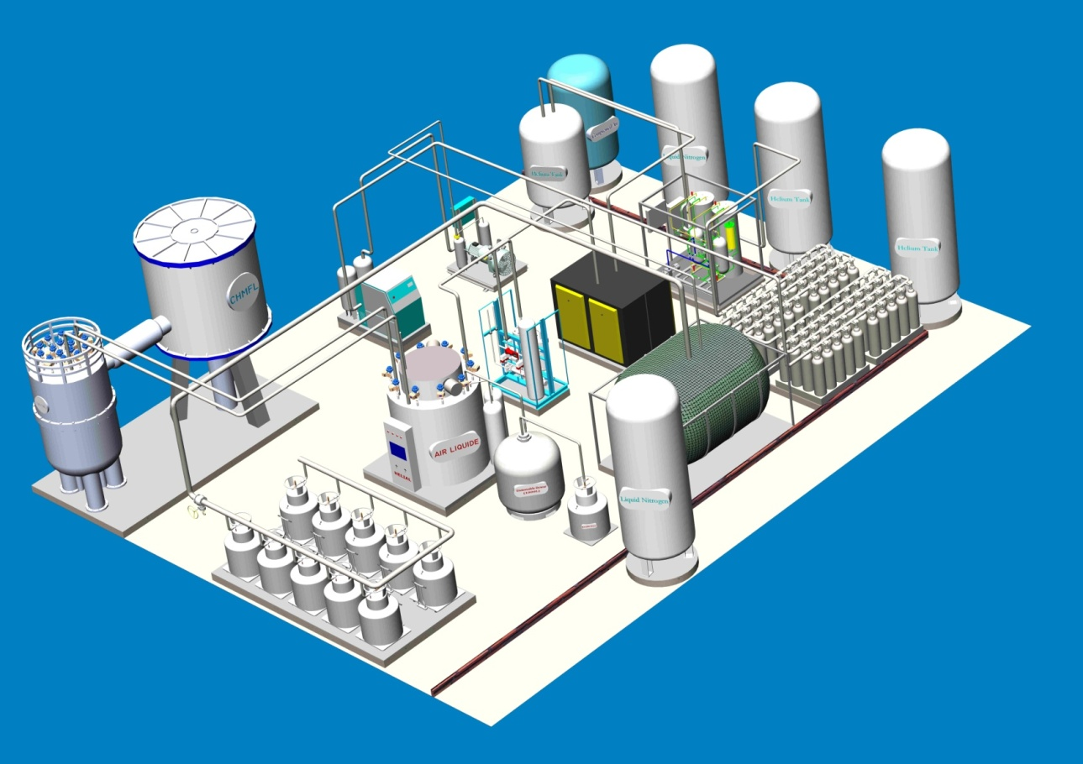

The helium cryogenic system
Requirement of cryogenics
Our team are in charge of the design, building, commissioning and operation of the helium cryogenic system with functions as follows:
Supply 4.5 K supercritical helium for the hybrid superconducting outsert .
(heat load : ~100W@4.5K)
Supply liquid helium for other superconducting magnets and cryogenic experimental facilities.
(50000 L/year)
Hybrid magnet
Helium refrigerator
Helium purifier
Recovery compressors
2,400
Million
Gasbag
Experimental building
Facility hall
Cryo-distribution box
Liquid helium station
The capacity of helium refrigerator is 360W @4.5 K.
Magnet workshop

Slide 6
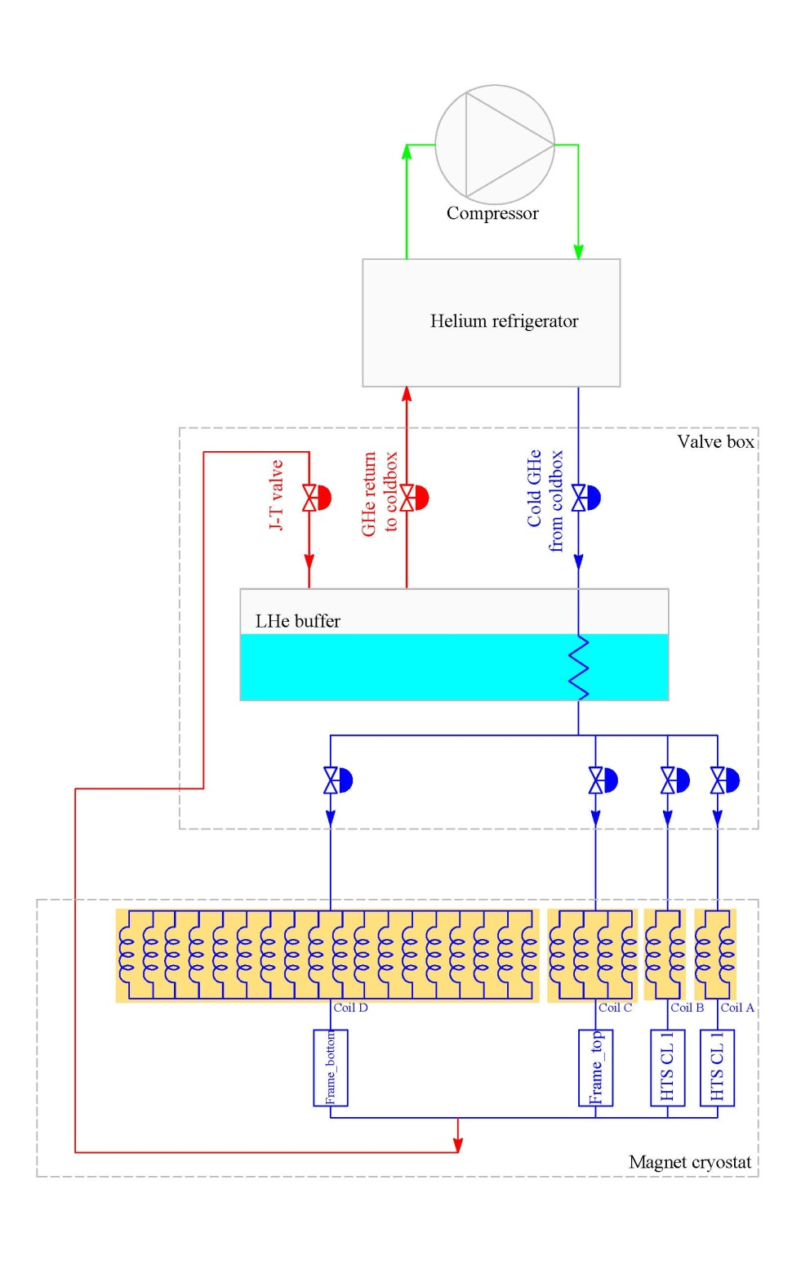
The helium cryogenic system
Cryogenic circuit for the superconducting magnet
4.5 K,1.25 bar
5.4 K, 3 bar
6.2 K,4.22 bar
26 cooling channels
4.45 K,1.25 bar
channels | length（m）
A-1 | 154.54
A-2 | 160.11
B-1 | 181.26
B-2 | 186.79
C-1 | 208.05
C-2 | 213.58
C-3 | 219.11
C-4 | 224.64
D1-18 | 182.32
4.5 K,4.2 bar
5.4 K,3 bar

Slide 7
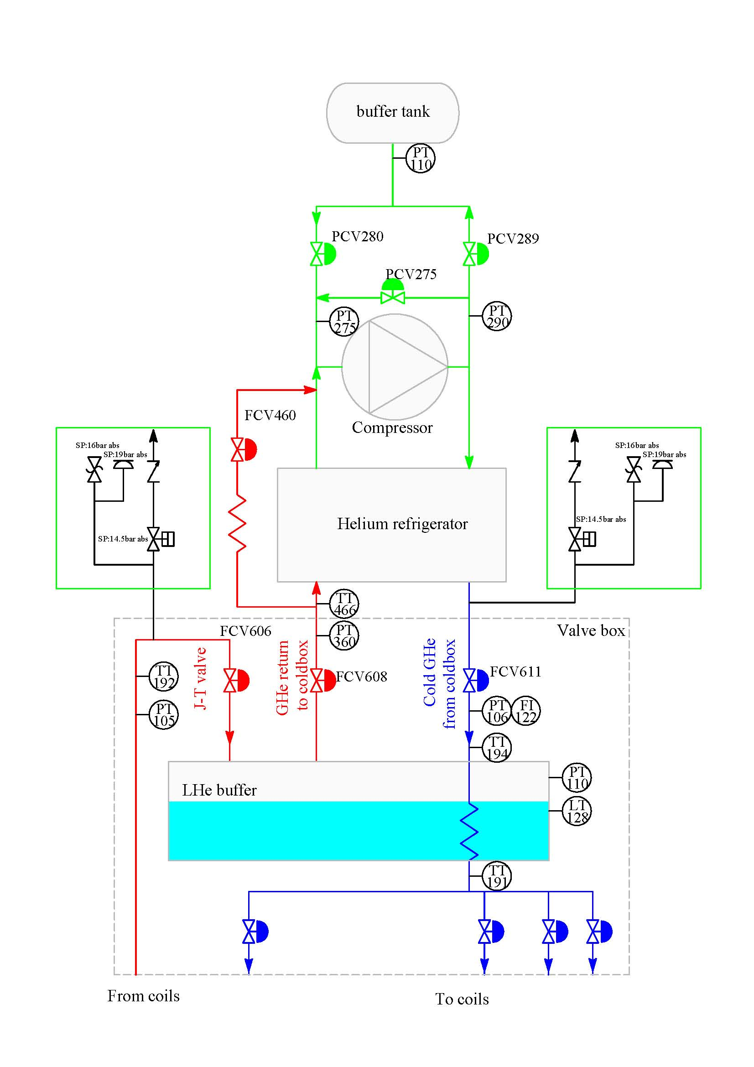
The helium cryogenic system
Cryogenic control and safety
object: LP
actuator: PCV275
measure: PT275
setpoint: 1.05 bar abs
object: HP
actuator: PCV280/289
measure: PT290
setpoint: 14.3 bar abs
object: Helium return
actuator: FCV460
measure: PT360
setpoint: 1.2 bar abs
object: LHe pressure
actuator: FCV608
measure: PT110
setpoint: 1.25 bar abs
object: JT valve
actuator: FCV606
measure: PT105
setpoint: 3 bar abs

Slide 8
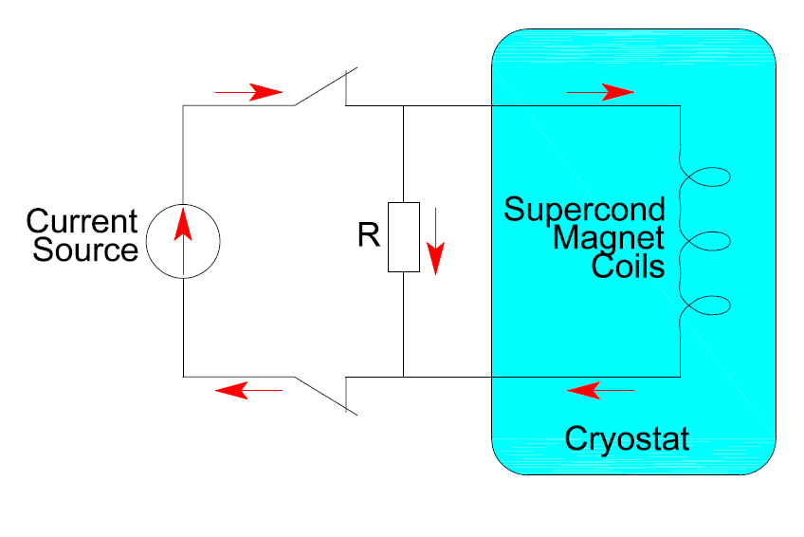
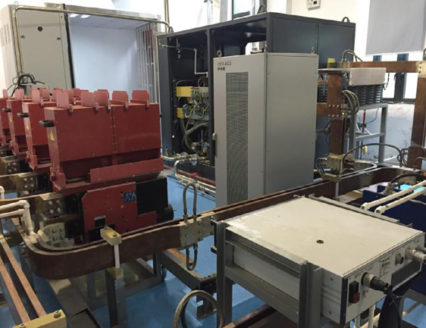
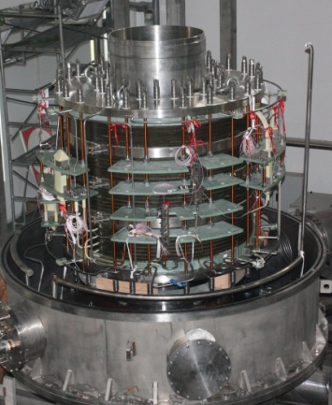
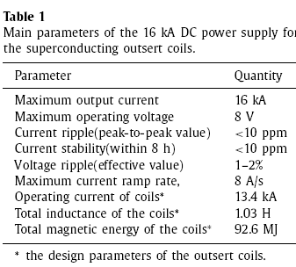
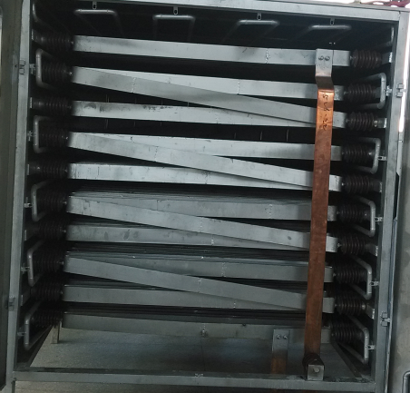
Thermal behavior during quenching protection
Configuration of the quenching protection
Energy dump resistor
Resistance: 0.284 Ω
Mass: ~1 ton
Limiting voltage: 4 kV

Slide 9
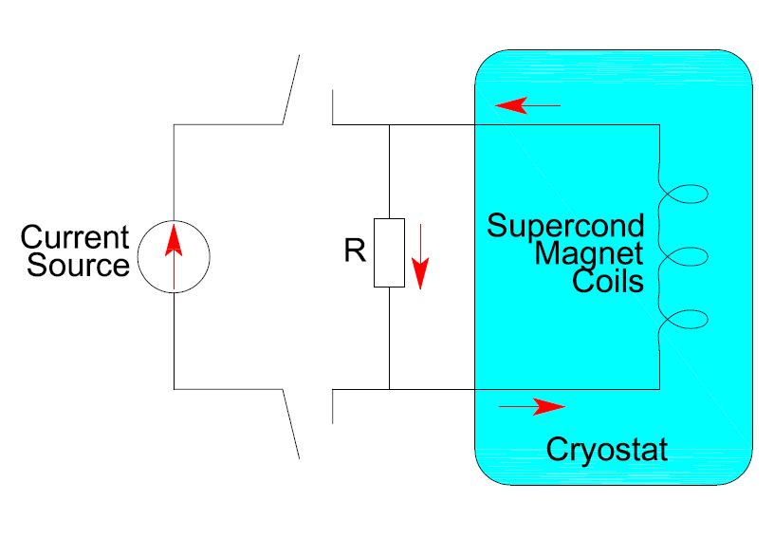
Thermal behavior during quenching protection
Process of the quenching protection
Current in the coils decreases exponentially, and reaches 36.8% of the operating current in 3.6s.
99.9% of the energy is transferred to the resistor outsides.
0.1% (~100kJ) of the energy heats the coils in the way of eddy current.

Slide 10
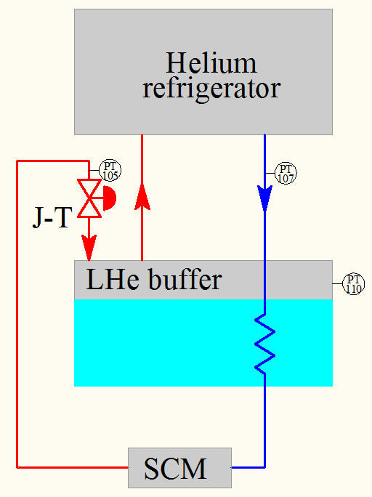
Thermal behavior during quenching protection
Pressure change of the cryo-distribution box
The inlet pressure increases from 4.2 bara to 12.7 bara and the outlet pressure increase from 3 bara to 10.7 bara in 30s.
The pressure of the LHe buffer increases from 1.26 bara to 1.42 bara in 2 minutes.
In the whole process, ~60 L liquid helium are evaporated.

Slide 11
Thermal behavior during quenching protection
Temperature change of the cryo-distribution box

Slide 12
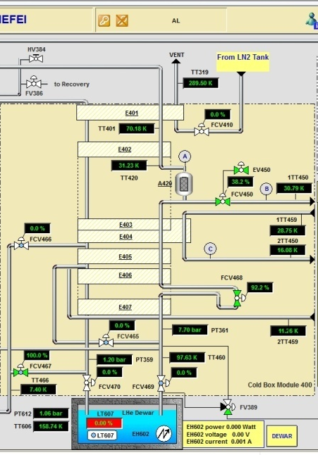
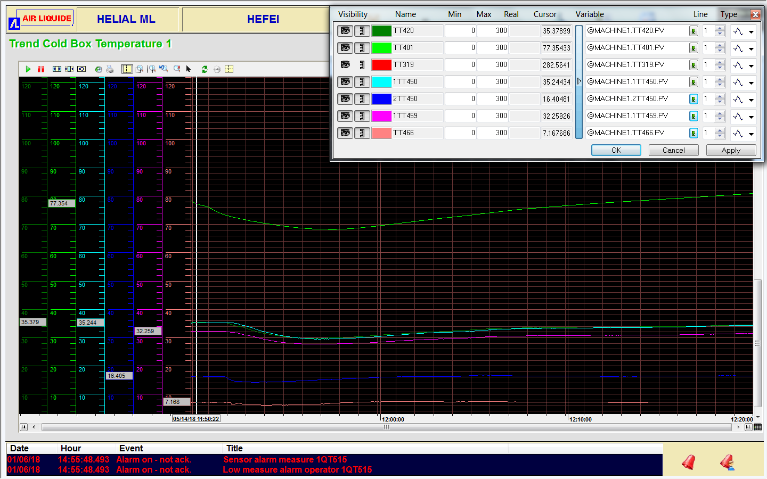
Thermal behavior during quenching protection
Situation of the coldbox

Slide 13
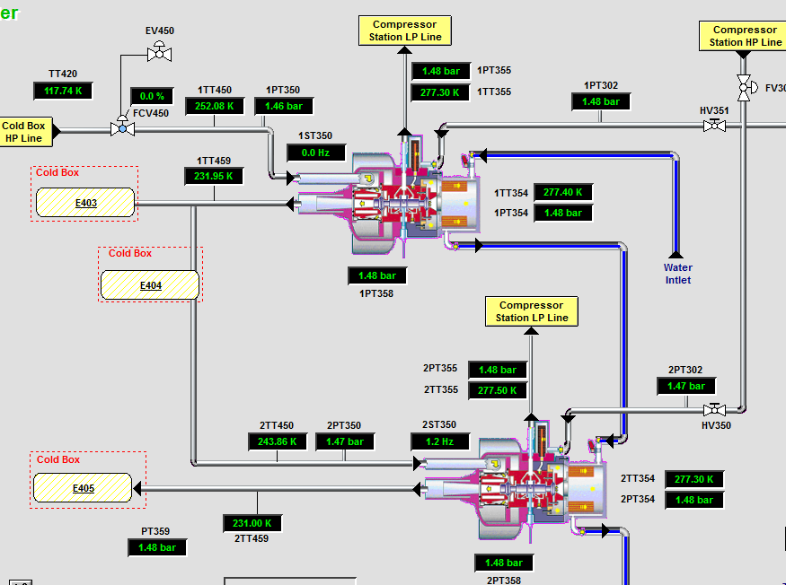
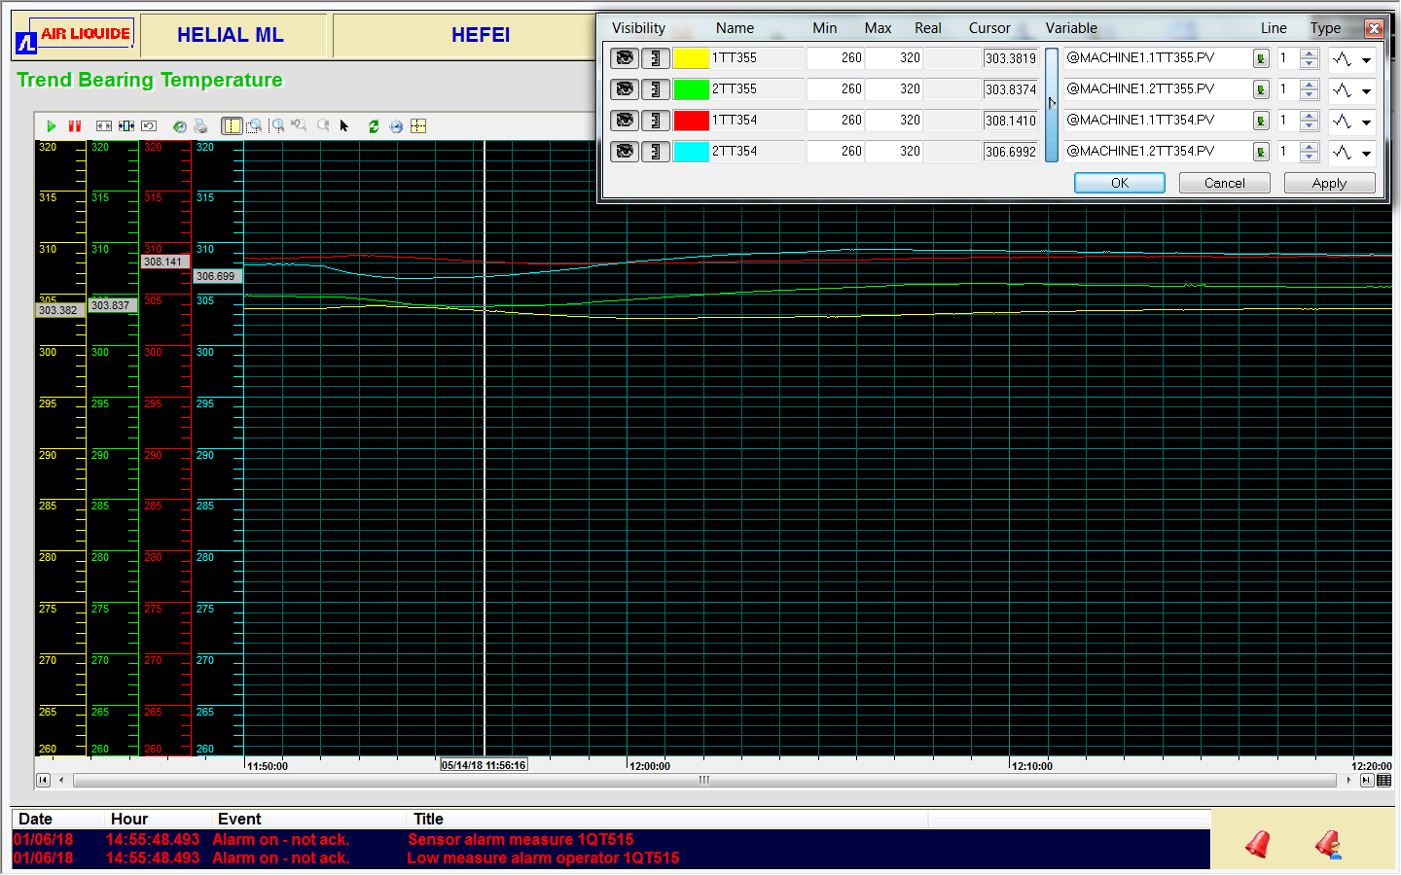
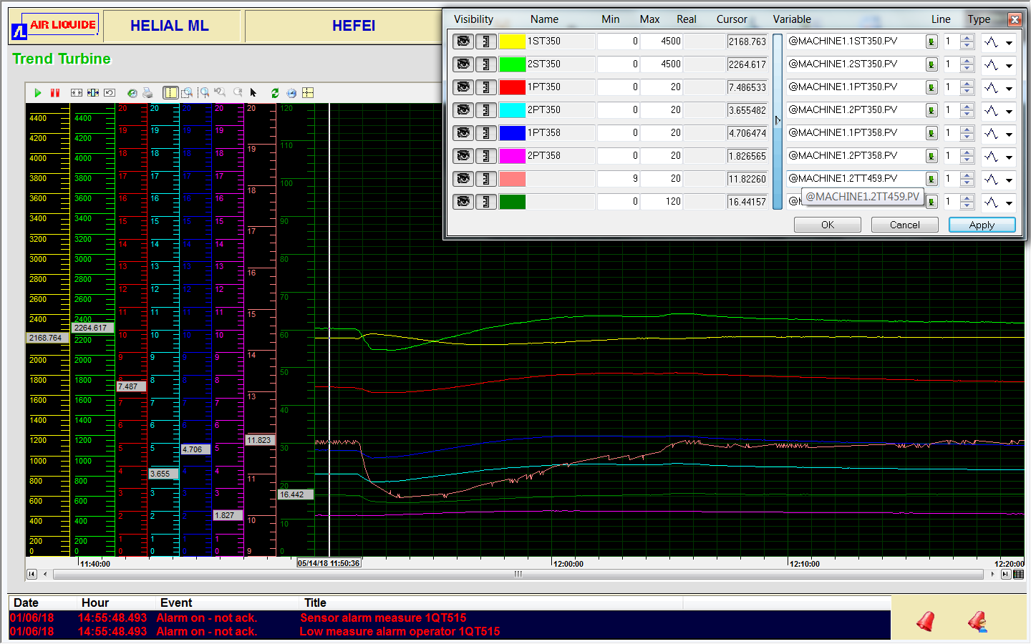
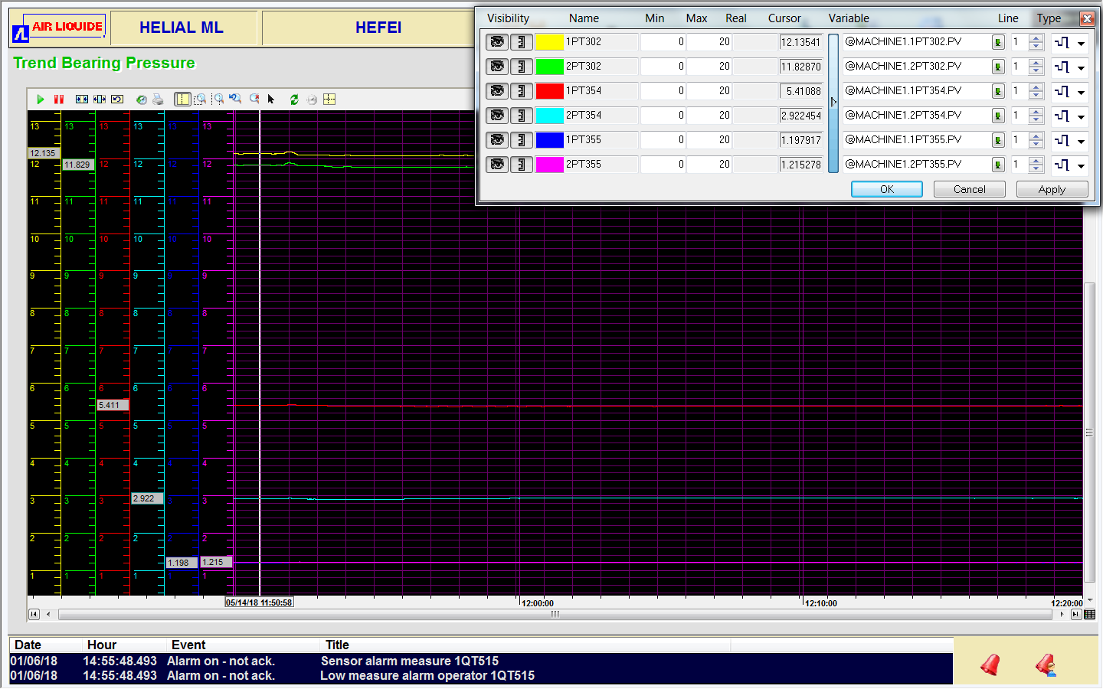
Thermal behavior during quenching protection
Situation of the turbine bearings
Situation of the turbines
T2 speed
T1 speed

Slide 14
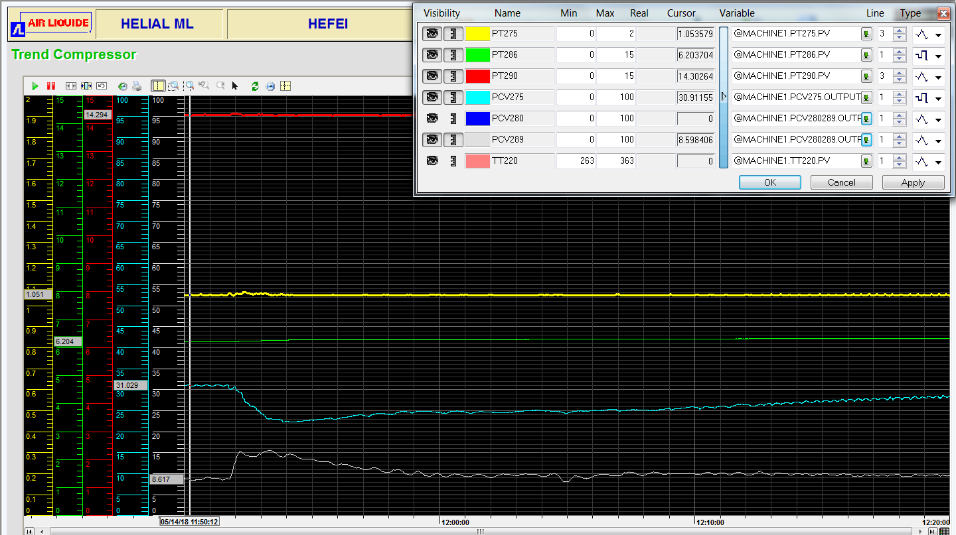
Thermal behavior during quenching protection
Situation of the compressor
HP/LP pressure
Buffer pressure (110m³）
Bypass valve
Unload valve

Slide 15
Conclusion
At CHMFL, construction of the helium cryogenic system which have the functions of liquid helium production and hybrid superconducting outsert cooling is finished.
At 4.5 K, the field of the hybrid superconducting outsert is increased to 11 T. Combined with the water-cooled magnet, 42.9 T magnetic field in a 32 mm clear bore is obtained.
During quenching protection of the superconducting coils with maximum operating current, the helium cryogenic system can response successfully.

Slide 16
THANKS FOR YOUR ATTENATION

