Slide 1
Cryogenic activities at IHEP
Shaopeng Li
On behalf of IHEP cryogenic team
Institute of High Energy Physics ( IHEP ), CAS, CHINA
The 18th International Workshop on Cryogenic Operation, Beijing, June 4-7, 2018

Slide 2
Outline
Brief introduction of cryogenic activities at IHEP
In operation
  BEPCII cryogenic system
  ADS Injector I cryogenic system
  CSNS cryogenic system
Under construction
  PAPS cryogenic system
  HEPS cryogenic system
Under planning
  CEPC cryogenic system
Summary

Slide 3
Brief introduction of cryogenic activities at IHEP
BEPCII cryogenic system is the first cryogenic system in IHEP, which was built from 2004 to 2007. So far, the superconducting cavity and superconducting magnet have been operating steadily for 10 years.
ADS injector I 2K cryogenic system was completed in 2015, providing 4K/2K vertical test of dozens of superconducting cavities and the operation of two cryomodules with beam.
CSNS cryogenic system is a 20K supercritical hydrogen system, which was completed and put into operation in 2017

Slide 4
Brief introduction of cryogenic activities at IHEP
PAPS cryogenic system is also a 2K cryogenic system, providing the R&D of various superconducting cavities. The system will be completed in 2020.
HEPS project will adopt five 166.6MHz single cell SC cavities and two 499.8MHz third harmonic SC cavities. The project will start at the end of 2018 and is scheduled to be completed in 2025.
CEPC cryogenic system is currently in the stage of conceptual design and the R&D of key equipment. It is expected the construction from 2022

Slide 5
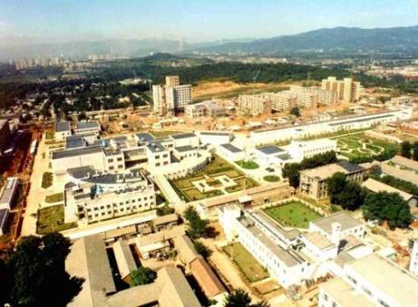
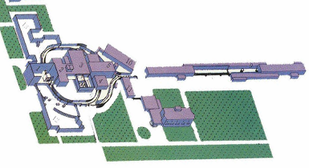
BEPC & BEPCII
Beijing Electron Positron Collider :
  Constructed: 1984-1988
  BESI: run from 1989-1998
  BESII: run from 1999-2004
Upgraded (BEPCII ):
  2004-2008
  BESIII: run from 2008

Slide 6
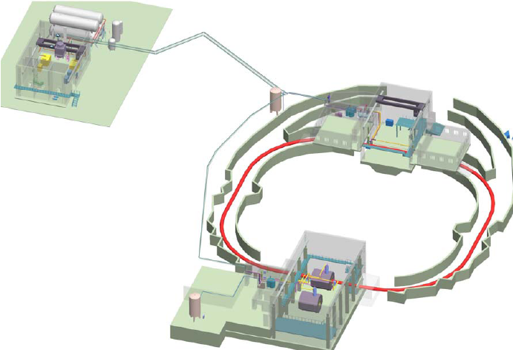
Layout of BEPCII cryogenic system
Tank farm
No.2 Refrigerator
Warm pipe
Cryogenic hall
1#SRFC
2#SRFC
BEPCII Storage Ring
No.1 Refrigerator
SSM&SIM SC magnets

Slide 7
Heat Loads of SC Cavity cryogenic system
SRF static heat load（W） |  | 2×30
Dynamic heat loads | RF loss（W） | 2×84
 | coupler（W） | 2×12
Common parts | Distribution valve box（W） | 20
 | Cryogenic transfer lines（W） | 24
 | Helium dewar and heaters（W） | 30
Margin 20% （W） |  | 65.2
Total（W） |  | 391.2W

Slide 8
Flowchart of SC cavity cryogenic system

Slide 9
Heat loads of SC magnet cryogenic system
Cryogenic devices | SCQ×2 | SSM
Cryostats for magnets | 15×2 | 25
Current leads | 0.3g/s×2 | 0.4g/s
Eddy current loss |  | 15
Valve boxes for magnets | 9×2 | 15
Cryogenic transfer lines | 35 | 23
1000L Dewar& Valve Box | 30
Subcooled heat exchanger | 20
Subtotal | 211+1g/s
Margin | 30%
Total | 274.3 W+1.3 g/s

Slide 10
Flowchart of SC magnet cryogenic system

Slide 11
Milestone of BEPCII cryogenic system
Nov. 2001 to May 2002 Conceptual design
Feb. 2003 to Feb. 2005 Engineering Design
Feb. 2003 to May 2005 Standard equipment procurement
Nov. 2004 to Aug. 2006 Non-standard equipment manufacture and
installation
May 2005 to Sept. 2005 Acceptance tests for two 500W@4.5K
refrigerators
May 2006 to Aug. 2006 Commissioning and Cryogenic test for SRFC cryogenic system
Nov. 2006 to now SRFC cryogenic system operation
Sept. 2006 to Dec. 2006 Modification for 1000L Dewar & Valve Box
Sept. 2006 to Apr. 2007 Modification for SCQA/B valve boxes and
current leads
May 2007 to Jun. 2007 SCQA/B & SSM cryogenic system
commissioning
Jun. 2007 to now SCQA/B & SSM cryogenic system operation

Slide 12
ADS Injector I Project
Injector II
Tasks of IMP
CW @ 1.5GeV / 10 mA
Injector I
Main Linac
Tasks of IHEP
Chinese ADS proton linear has two 0~10MeV injectors and one 10~1500MeV superconducting linac.
Injector I and Injector II were constructed by Institute of High Energy Physics (IHEP) and Institute of Modern Physics (IMP) respectively.

Slide 13
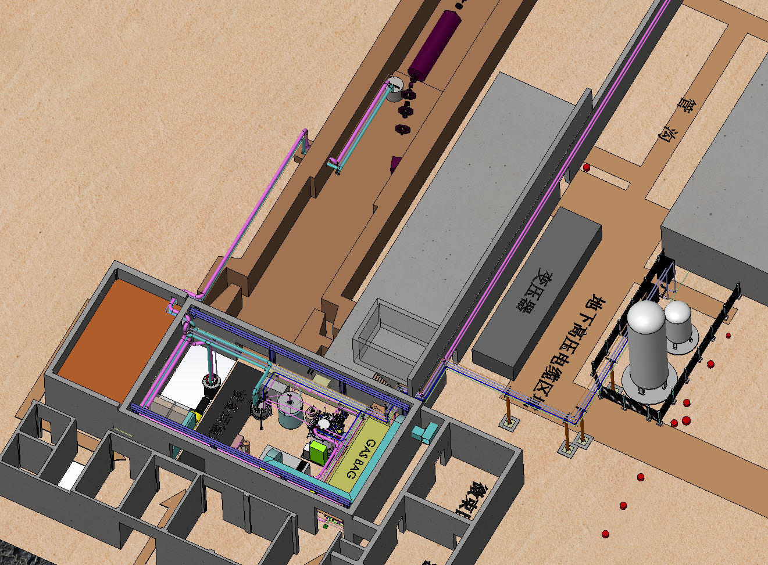
Layout of IHEP-ADS cryogenic system(Building1#）

Slide 14
Heat loads of ADS injector I cryogenic system
IHEP-ADS equipments | 80K热负荷 (W) | 4K热负荷 (W) | 2K热负荷 (W)
4.2K Distribution valve box |  | 26
4K cryogenic transferline |  | 30
2K Coldbox |  | 17 | 5
2K cryogenic transferline |  | 5 | 2
Operation Cryomodule (OCM) | 2×267 | 2×57.5 | 2×21
 | 534 | 193 | 49
Total (redundancy 50% ） | 801 | 289.5 | 73.5
equivalent to 4K |  | 657
IHEP-ADS equipments:
3000L dewar
4.2K Distribution valve box
2K coldbox
4K，2K cryogenic transferline
Operation Cryomodule (OCM)
Horizontal Cryomodule (HCM)
Vertical test dewar（DW）

Slide 15
Main parameters of refrigerator
Performance | Guaranteed Values | Expected Values
1. Refrigeration With LN2 | > 1000W@4,5K P_{dewar} = 1,3bar abs +/- 2 mbar | > 1050W@4,5K LN2 consumption =30 L/h
2. Liquefaction With LN2 | >284L/h | > 290L LN2 consumption =130 L/h
3. Refrigeration & Liquefaction With LN2 | >350W@4.5K&200L/h | >370W@4.5K&210L/h
4. Refrigeration Without LN2 | > 720W@4,5K Pdewar = 1,3bar,abs +/- 2 mbar | > 750W@4,5K
5. Liquefaction Without LN2 | >90L/h | > 95L/h
6. Refrigeration & Liquefaction Without LN2 | >250W@4.5K&70L/h | >275W@4.5K&70L/h

Slide 16
Milestone of ADS injectoer I cryogenic system
Project application from 2010
Preliminary design in 2011
Construction from 2012
Refrigerator commissioning in 2014
Commissioning of whole cryogenic system in 2015

Slide 17
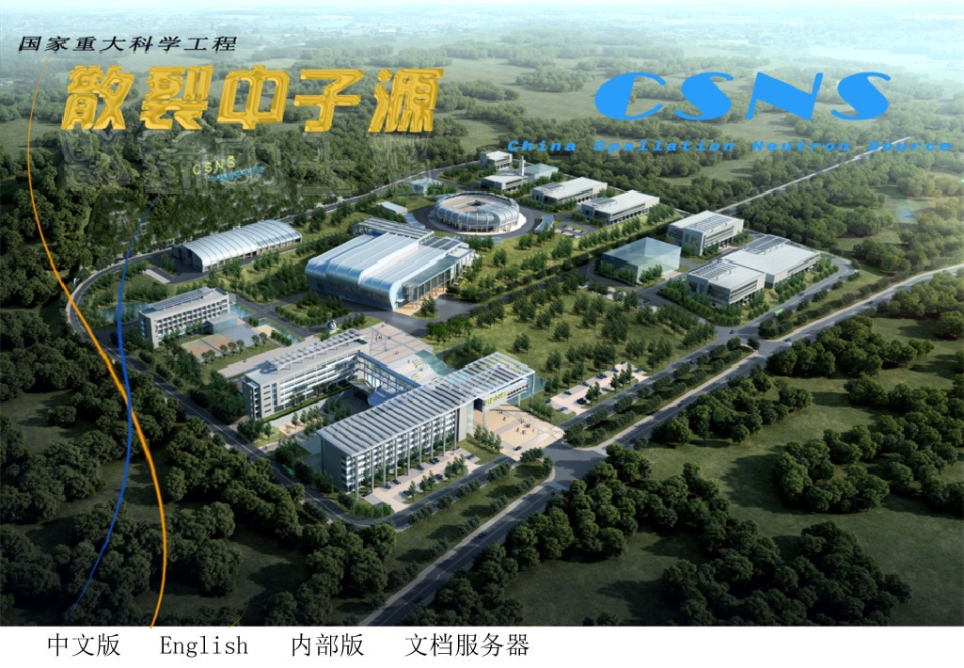
China spallation neutron source (CSNS) Project
CSNS construction site locates at Dongguan, Guangdong province.
It is about 85 km from Guangzhou and about 125 km from Hong Kong.

Slide 18
CSNS cryogenic system
Cryogenic system of China spallation neutron source (CSNS) provides 20K supercritical hydrogen for neutron moderators, and it is consist of helium refrigerator and hydrogen circulation system. The total hydrogen volume in hydrogen circulation is about 140 liters.
Design parameters of CSNS cryogenic system
Helium refrigerator | Flow rate | <110g/s | Hydrogen circulation system | Circulation temp. | 18-21.8K
 | Inlet temp. | >13.5K |  | Circulation pressure | 1.5±0.1MPa
 | Outlet temp. | <20.8K |  | Design pressure | 2.5MPa
 | Discharge pressure | <1.5MPa |  | Static heat load | 800W
 | Cooling power | 2200W@20K |  | Dynamic heat load | 700W

Slide 19
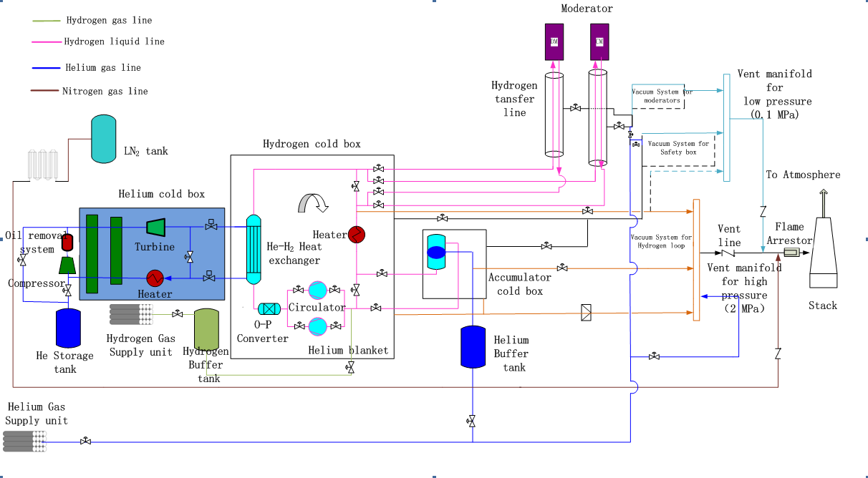
Flow chart of CSNS cryogenic system

Slide 20
Milestone of CSNS cryogenic system
October 20th, 2011, start construction of CSNS.
December 5th, 2012, sign contract for helium refrigerator.
November 18th, 2015, performance test of hydrogen cold box with 80K helium gas.
August 5th, 2016, tested refrigeration power is 2300W@20K, reached the acceptance target.
January 8th, 2017, start commissioning of CSNS cryogenic system.
April 12th, 2017, successful cooling down with 20 K helium gas.
May 5th, 2017, successful cooling down with 20 K hydrogen gas.
June 21st, 2017, joint commissioning with moderators.
December 11th, 2017, cryogenic system start operation till now.
February 14th, 2018, national test of cryogenic system

Slide 21
PAPS and HEPS Projects
Platform of Advanced Photon Source Technology R&D (PAPS) was officially launched in Feb. 2017.
The goal of the PAPS project is to provide a good foundation and condition for R&D, engineering testing and verification for the high energy photon source (HEPS) project to be completed on schedule and to achieve the expected design target.
The other goal of the PAPS project is able to produce and test 200 SC cavities and 20 EXFEL-like cryomodules every year.
The kick off of HEPS project is scheduled in November, 2018.

Slide 22
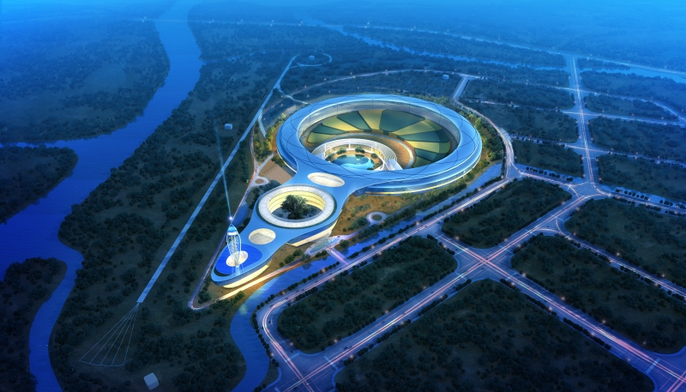
HEPS-High Energy Photon Source
It will be constructed from Dec 2018 to Jun 2025

Slide 23
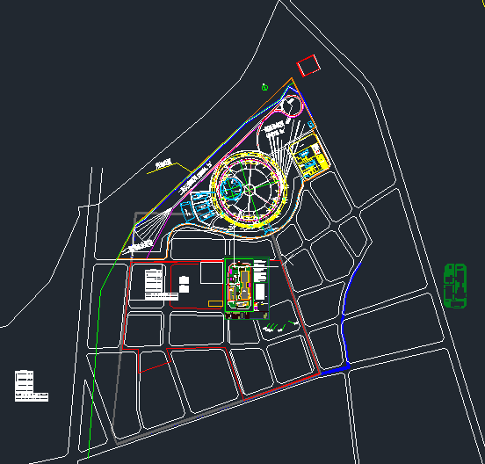
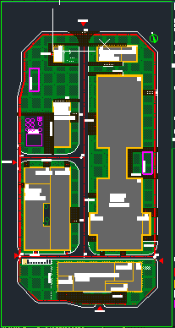
Construction site
Huairou district of Beijing
About 60Km from IHEP
SC lab.
HEPS
Cryogenic
PAPS

Slide 24
Construction goals of PAPS cryogenic system
Construct a 2.5KW@4.5K or 300W@2K cryogenic system with three vertical test stand, two horizontal test stand and a beam test stand of superconducting cavity.
Construct a impure helium recovery and purification system with the capacity of 210m3/h helium recovery and 100m3/h helium purification
Support the performance test of various type of superconducting cavity.

Slide 25
Flow chart of PAPS cryogenic system
Key equipment :
  Refrigerator/liquefier
  Helium Storage
  Transfer and distribution
  2K pump system
  2K JT heat exchanger
  Vertical test dewar
  Cryomodules
  LN2 system
  Recovery and purifaction system

Slide 26
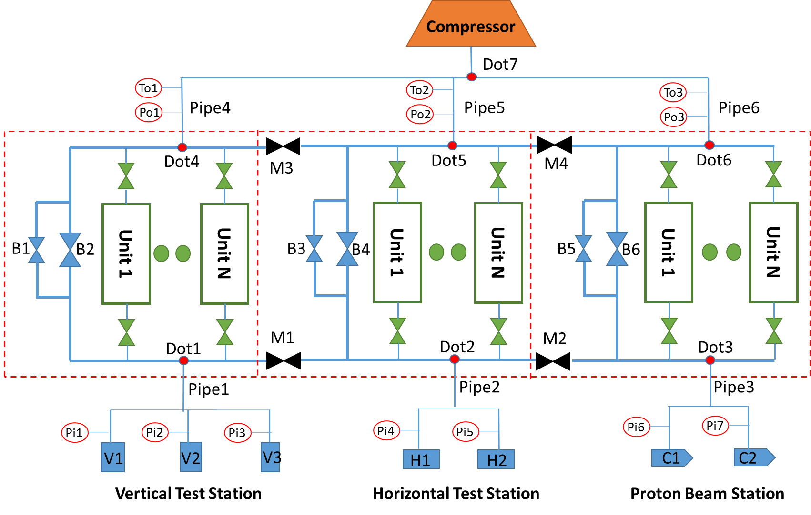
2K pumping system
Main parameters
Helium tank pressure | 3129 Pa
Pressure stability | +/-10 Pa
Max mass flow | 26.7 g/s
Total pumps system capacity | 19200 m³/h（300K,30mbar）
Pumps station inlet temperature | 300K
Pumps station outlet pressure | 1.2 Bar
Noise level | <80 dB@1m
Leakage rate | 1E-6 Pa·m³/s
Vibration size | <5mm/s
Function diagram
Separate control systems will be set up for each station. The control system is divided into manual and automatic modes, including two parts: local and remote.
When the pressure of station reach to 31mbar, the pressure fluctuation will be controlled within ± 10Pa .

Slide 27
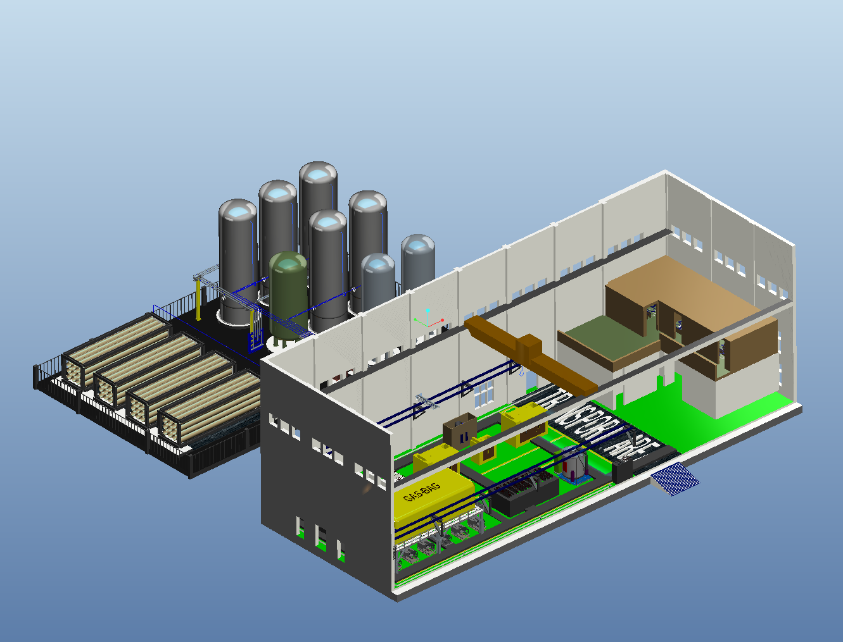
Layout of PAPS Cryogenic hall
5*100m3 medium pressure
Helium gas storage tanks
2*40m3 LN2
Storage Dewars
Control room
20000Nm3
High pressure
helium cylinders
Room temperature equipment
(Recycle screw compressor; Piston compressor; Helium purifier; Screw pump; Oil removal system)

Slide 28
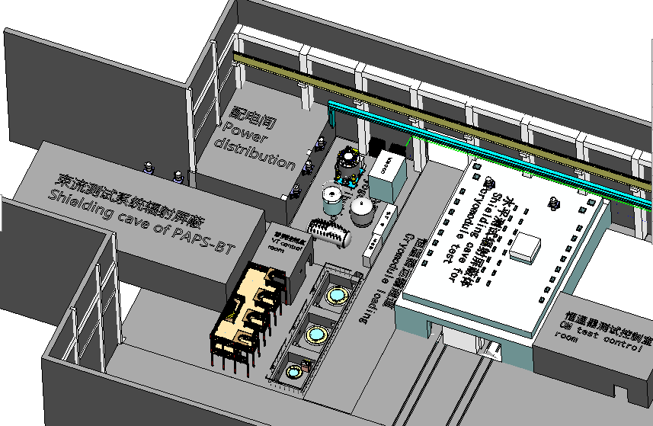
Layout of PAPS SC test stands
1KW@4.5k Cold BOX
2.5KW@4.5k Cold BOX
Heat Exchanger
5000L DW
3000L DW
Main Distribution Valve Box
Vertical Test Station

Slide 29
PAPS Time schedule
Feb. 2017 Project start
Aug. 2017 Preliminary design
Oct. 2018 Civil work
Aug. 2017 Contract of cryoplant
Jul. 2019 Pipe work
Jul. 2019 Commissioning of recovery and purification system
Aug. 2019 Commissioning of cryoplant
Sept. 2019 Commissioning with Vertical/Horizontal/Beam test stand
Dec. 2019 Cryogenic system operation
Jun. 2020 Project finish

Slide 30
Main components of HEPS cryogenic system
4.5K helium cryogenic system
used to cool down five166.6MHz and two 499.8MHz superconducting cavities, two another 499.8MHz will be added in the next phase;
Cooling capacity 2 KW@4.5K；
auxiliary system, impure helium gas recovery and purify
LN2 cryogenic system
Used to cool down several tens cryogenic devices, CPMU and monochromator.

Slide 31
Block diagram of HEPS cryogenic system
Recovery, purify and gas storage
Valve box 1#
166.6MHz cavity 1#
Valve box 2#
166.6MHz cavity 2#
R&D of Superconducting and cryogenic equipments
Valve box 3#
166.6MHz cavity 3#
Valve box 4#
166.6MHz cavity 4#
LHe Dewar
Main distribution valve box
Refrigerator
Valve box 5#
166.6MHz cavity 5#
Valve box 6#
499.8 MHz cavity 1#
Spare compressor
Valve box 7#
499.8 MHz cavity 2#

Slide 32
CEPC-SppC
A circular e+/e- collider as Higgs Factory has been studying at IHEP. The machine can be converted into a proton-proton collider for tens TeV high-energy frontier.
pp collider
SppC：50 – 90 TeV
CEPC：240 – 250GeV
e⁻e⁺ Higgs Factory

Slide 33
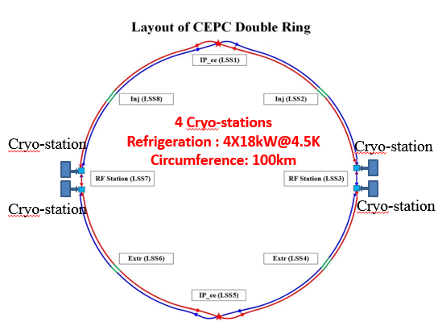
Layout of CEPC cryogenic system
Booster ring:
1.3 GHz 9-cell cavities, 96 cavities
12 cryomodules
3 cryomodules/each station
Temperature: 2K/31mbar
  Collider ring:
650MHz 2-cell cavities, 240 cavities
40 cryomodules
10 cryomodules/each station
Temperature: 2K/31mbar

Slide 34
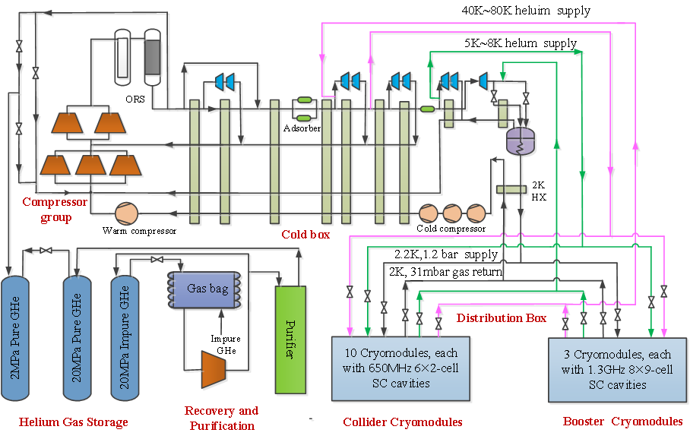
Flowchart of cryogenic system for one Cryo-station
Each Cryo-station mainly includes Compressor, Cold box, helium gas storage tanks, cryomudules and purification system.
The cryomodules have two shields, a 40K~80K shield and a 5K~8K shield.
A 2.2K, 1.2bar helium is supplied for the cryomodules and the 2K, 31mbar helium gas return to the cold box with the cold compressors.

Slide 35
Heat load of cryogenic system
Higgs Mode | Unit | Collider |  |  | Booster
 |  | 40-80K | 5-8K | 2K | 40-80K | 5-8K | 2K
Static heat load per cryomodule | W | 300 | 60 | 12 | 140 | 20 | 3
Cavity dynamic heat load per cryomodule | W | 300 | 60 | 153.59 | 140 | 10 | 13.98
Input coupler dynamic heat load per cryomodule | W | 20 | 12 | 2 | 40 | 3 | 0.4
HOM dynamic heat load per cryomodule | W | 60 | 40 | 6 | 2 | 1 | 1
Module dynamic heat load | W | 380 | 112 | 161.59 | 182 | 14 | 15.38
Connection boxes | W | 50 | 10 | 10 | 50 | 10 | 10
Cryomodule number |  | 40 |  |  | 12
Total heat load | kW | 29.20 | 7.28 | 7.34 | 4.46 | 0.53 | 0.34
Total mass flow | g/s | 139.93 | 227.15 | 346.58 | 21.39 | 16.47 | 16.07
Overall net cryogenic capacity multiplier |  | 1.54 | 1.54 | 1.54 | 1.54 | 1.54 | 1.54
4.5K equiv. heat load with multiplier | kW | 3.38 | 10.14 | 36.18 | 0.52 | 0.74 | 1.68
Total 4.5K equiv. heat load with multiplier | kW | 49.70 |  |  | 2.93
Total 4.5K equiv. heat load of booster and collider | kW | 52.63

Slide 36
CEPC Time Schedule

Slide 37
Summary
Since 2002, from the design of BEPCII cryogenic system, IHEP has accumulated 15 years of experience in the design, construction and operation of the cryogenic system.
A professional team of cryogenic engineering has been built, which supports the construction and development of large science engineering project at IHEP.

Slide 38
Thank you for your attentions!

