Slide 1
Cryogenics at the European Spallation Source
Challenges of parallel installation and commissioning activities
Philipp Arnold
Section Leader Cryogenics
www.europeanspallationsource.se
June 05, 2018

Slide 2
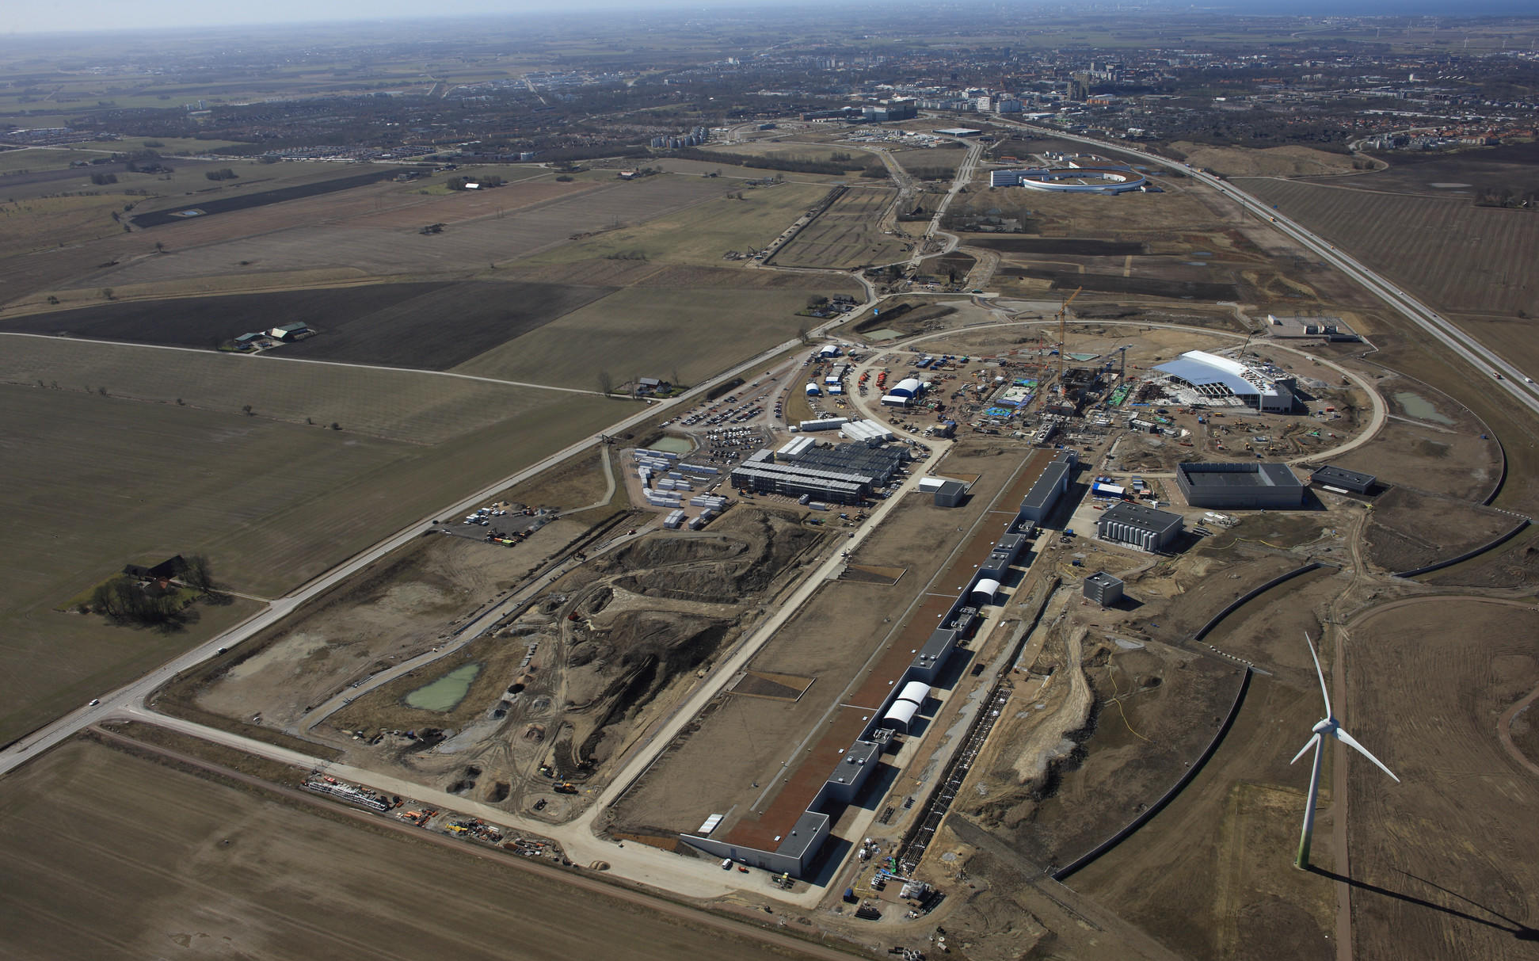
Aerial view May 2018
Coldbox Building G.02

Slide 3
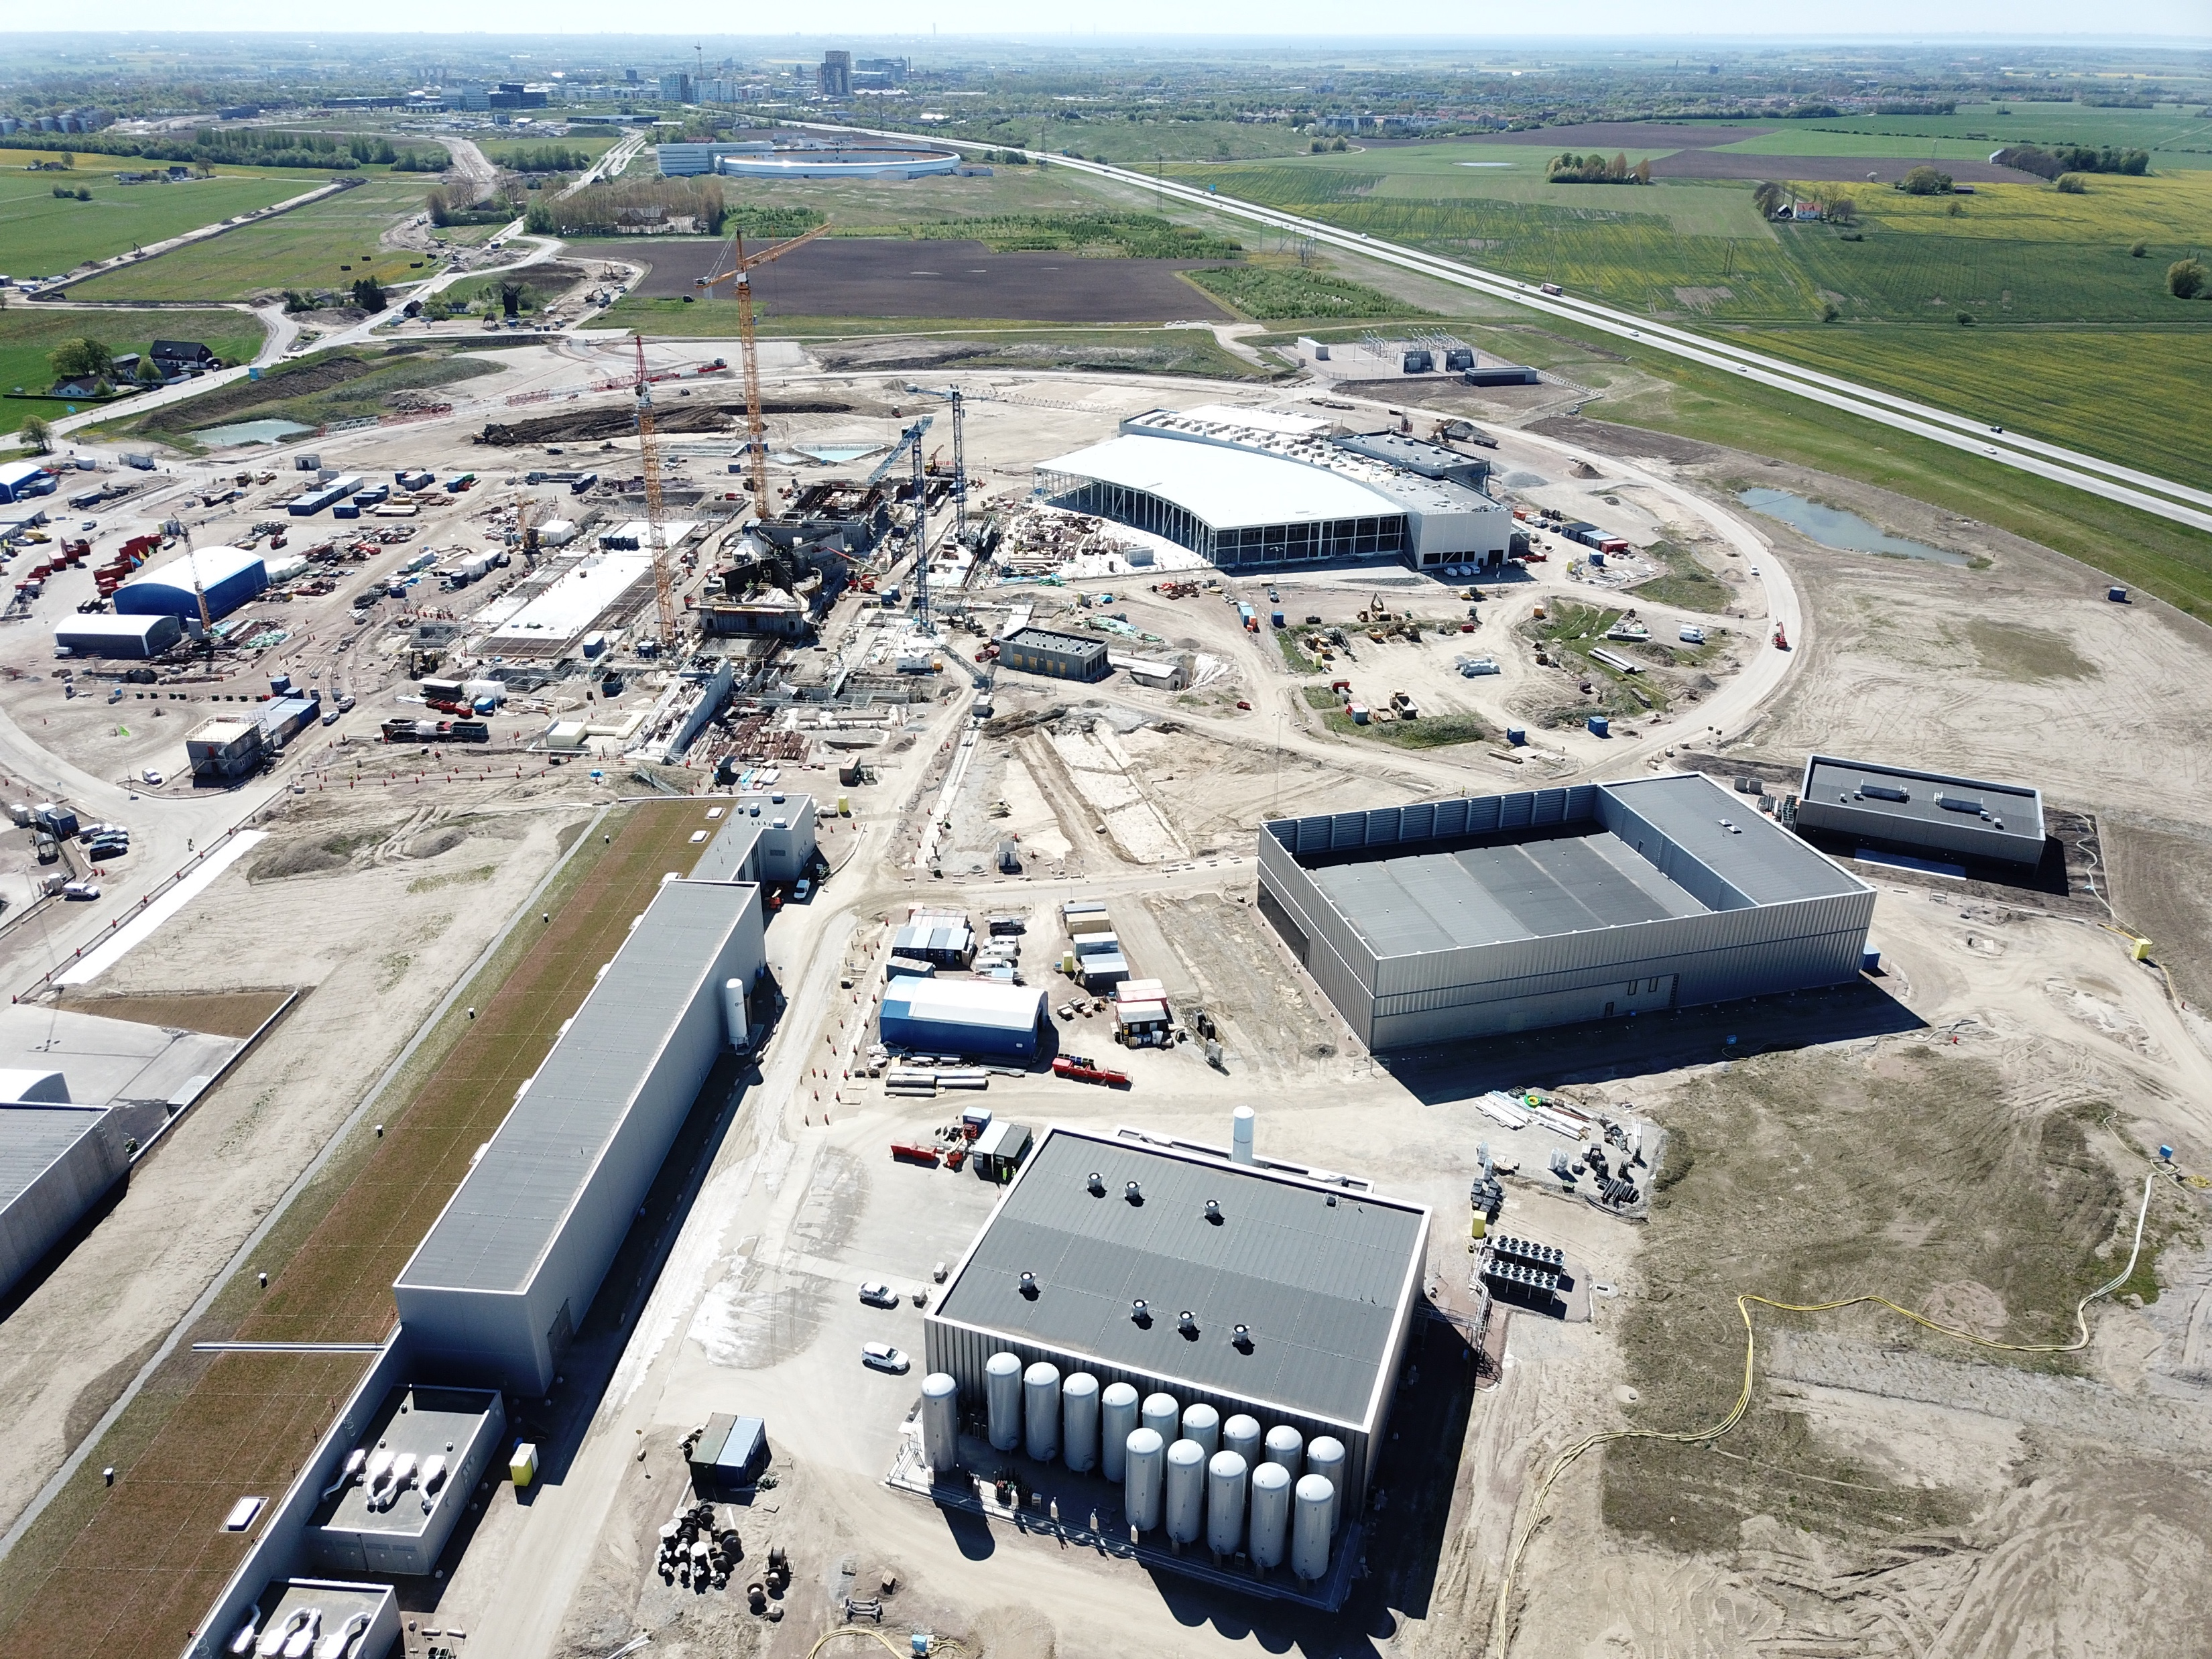
Cryo Buildings

Slide 4
Outline
Cryogenic system overview and status
How do we prepare installation activities
What happens in parallel commissioning
A practical tool to ensure workers safety
Outlook and conclusions

Slide 5
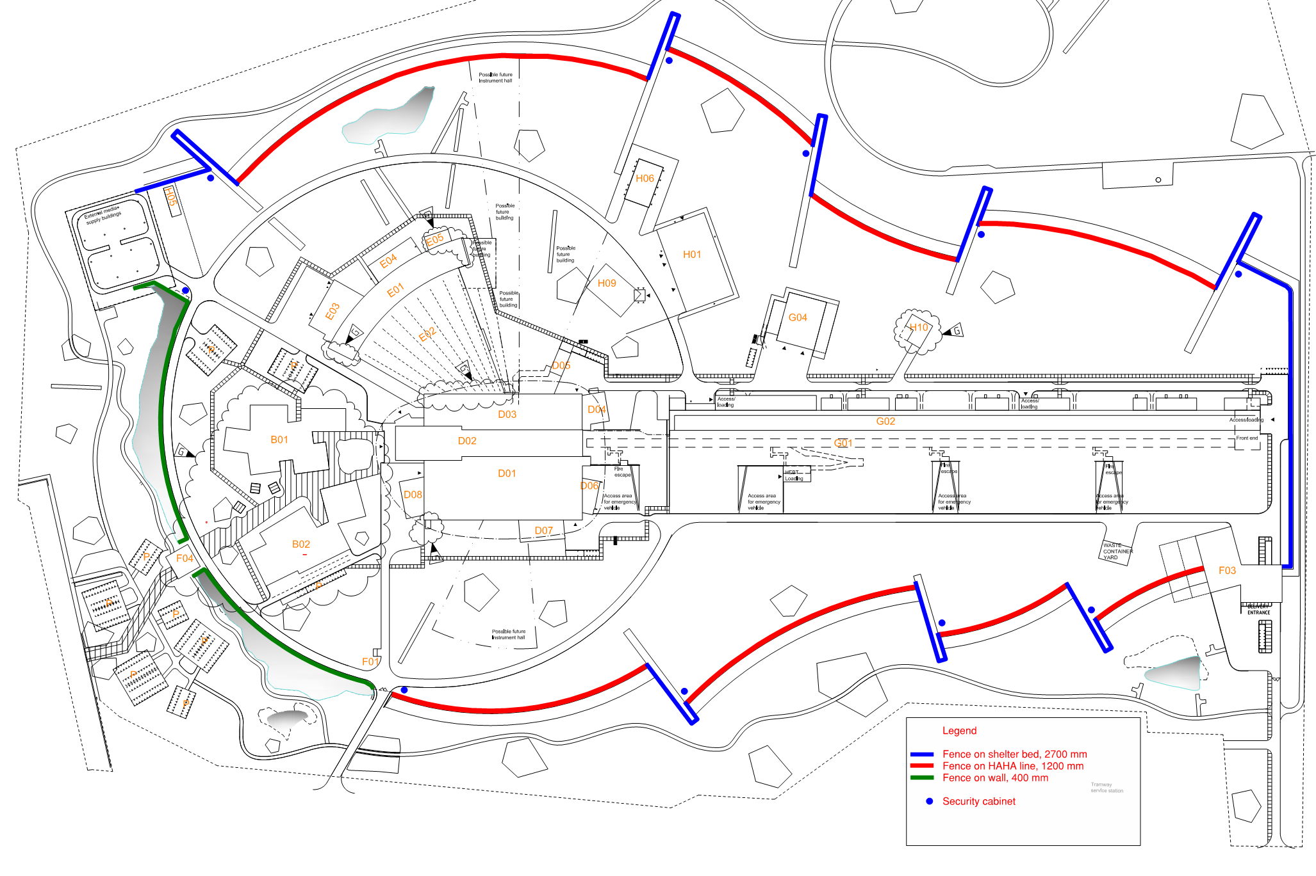
(1.2) Cryogenics at the site - overview
Cryogenic Moderator Room
Neutron Instrument Halls
Cryo Compressor Building
Coldbox Hall
Accelerator Tunnel
Cryomodule Teststand

Slide 6
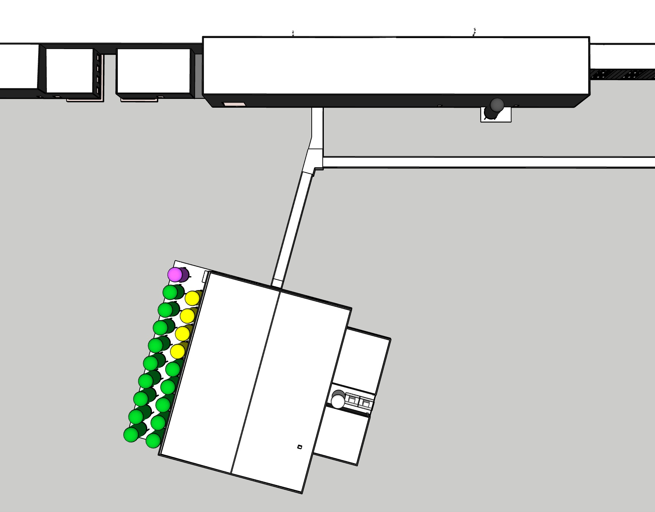
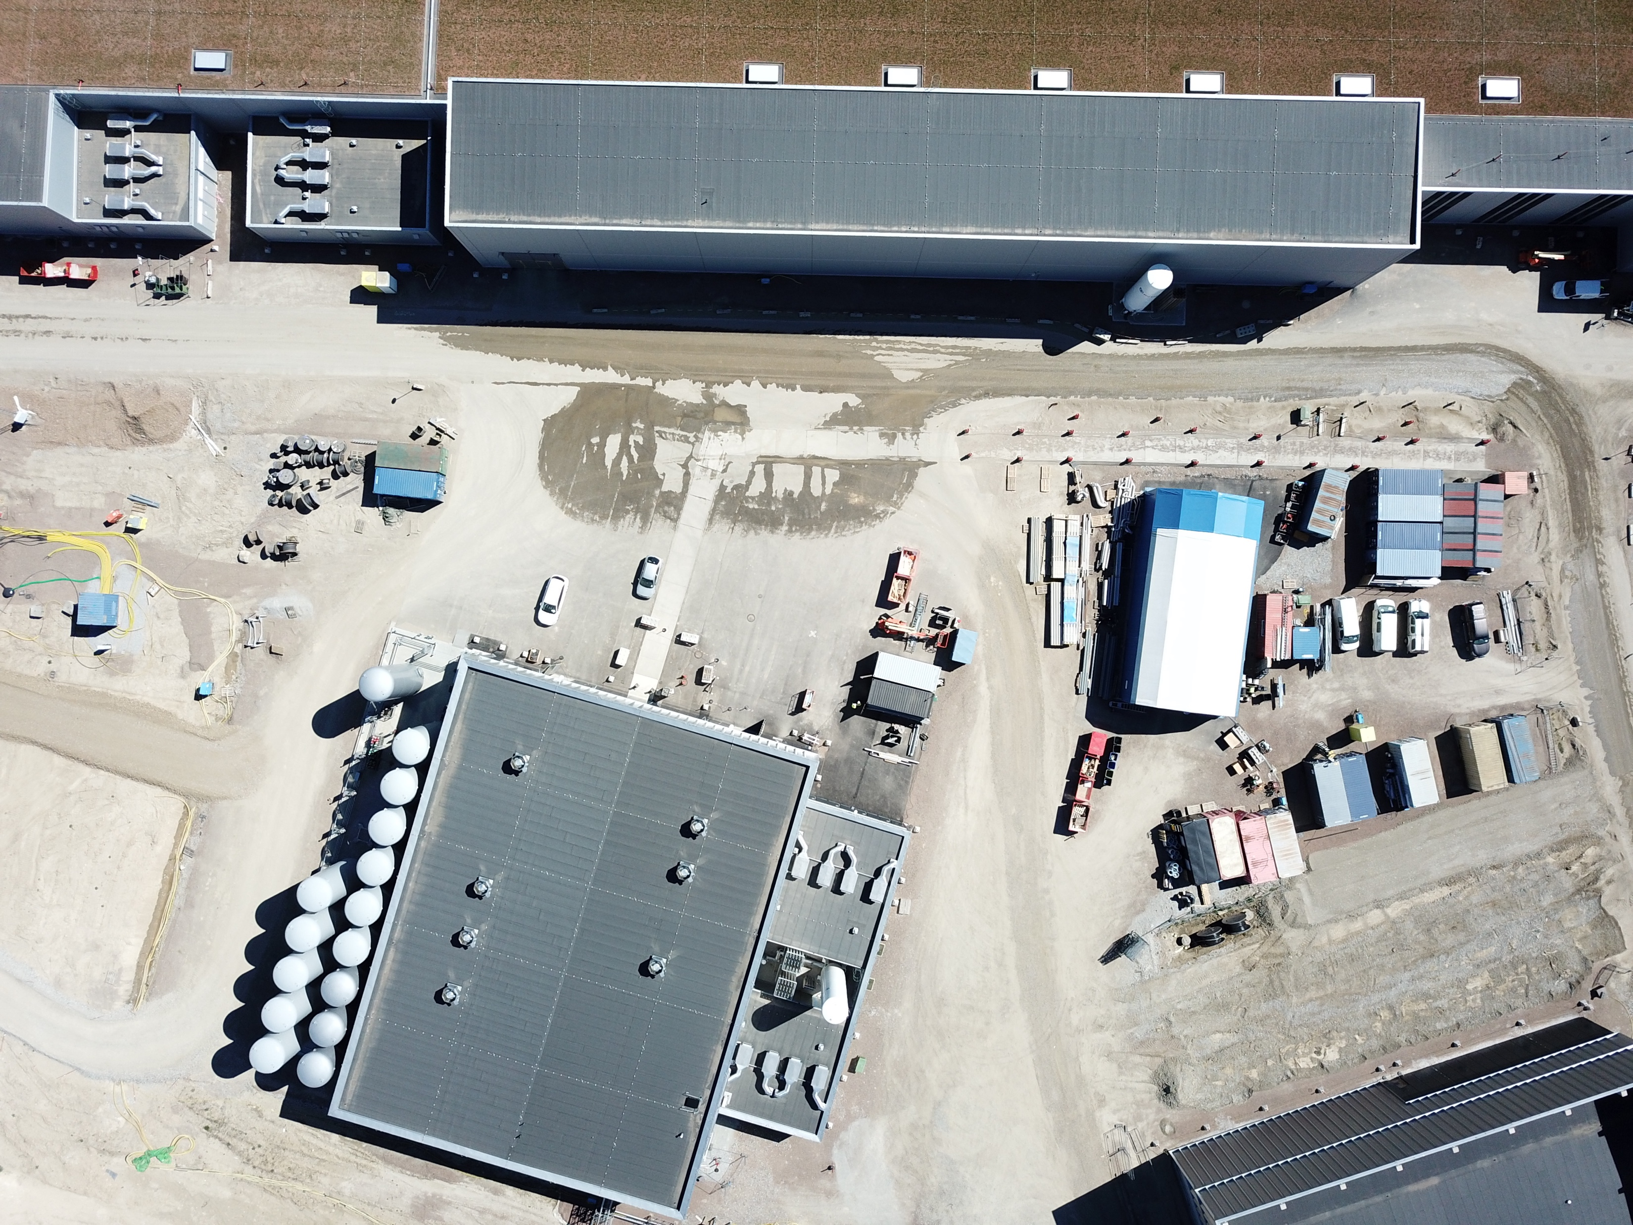
Cryo Buildings

Slide 7
(1.3) System overview – block diagram
Pure Helium
Gas Storage
Standalone Helium Purifier
Helium Recovery System
Target Moderator
Cryoplant
Accelerator
Cryoplant
20 m³ LHe Tank
5 m³
LHe Tank
Test & Instrument Cryoplant
Target Cryodistribution System
LHe Mobile Dewars
Test Stand Cryodistribution System
Cryodistribution System for Elliptical Linac
Cryodistribution System for
Spoke Linac
LN2 Storage Tanks
Hydrogen Circulation Box
Elliptical
Cryomodules
Spoke
Cryomodules
LN2 Mobile Dewars
Instruments & Experiments
Test Stand Lund 2
Hydrogen Moderator
Notes:
ACCP: 3kW @ 2K, 11kW @ 40K, 270 l/h Liquefaction → special plant, power consumption in MW range, big industrial compressors, sophisticated CC system
TICP: 76W @ 2K, 420W @ 40K, 6 l/h Liquefaction → plant well in the standard range
TMCP: 32kW @ 15-20K → very large again, some challenges but not terribly sophisticated process, compared to ACCP
Large and sophisticated cryo-distribution system for all plants and their consumers

Slide 8
(1.4) Master Schedule WP11 Cryogenics

Slide 9
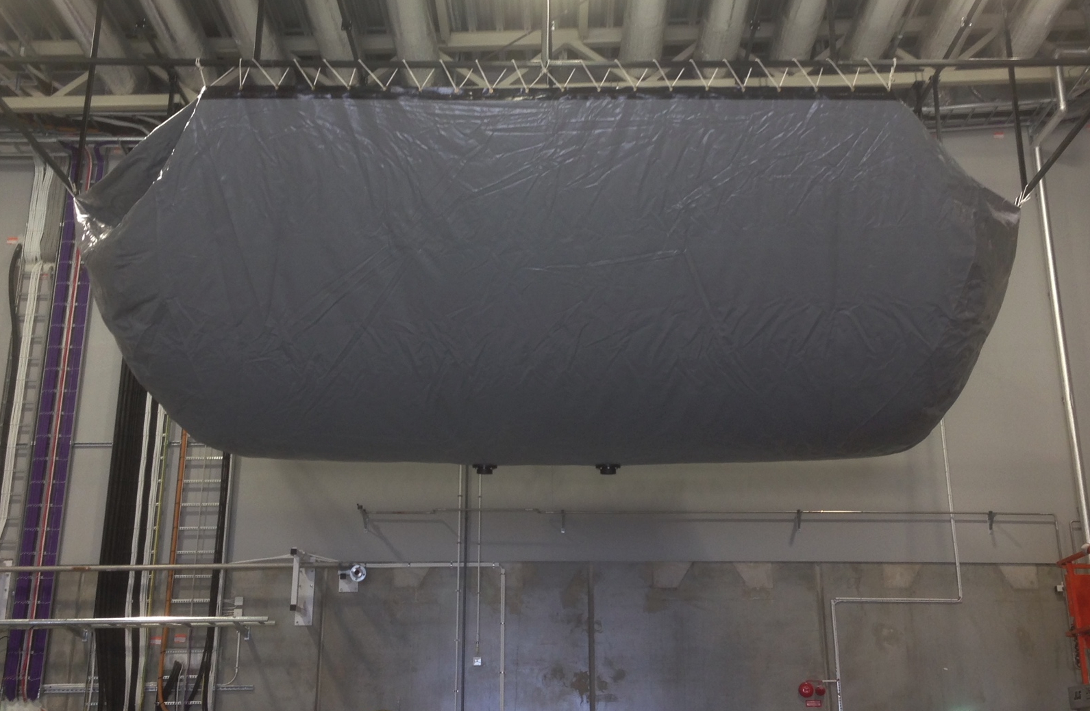
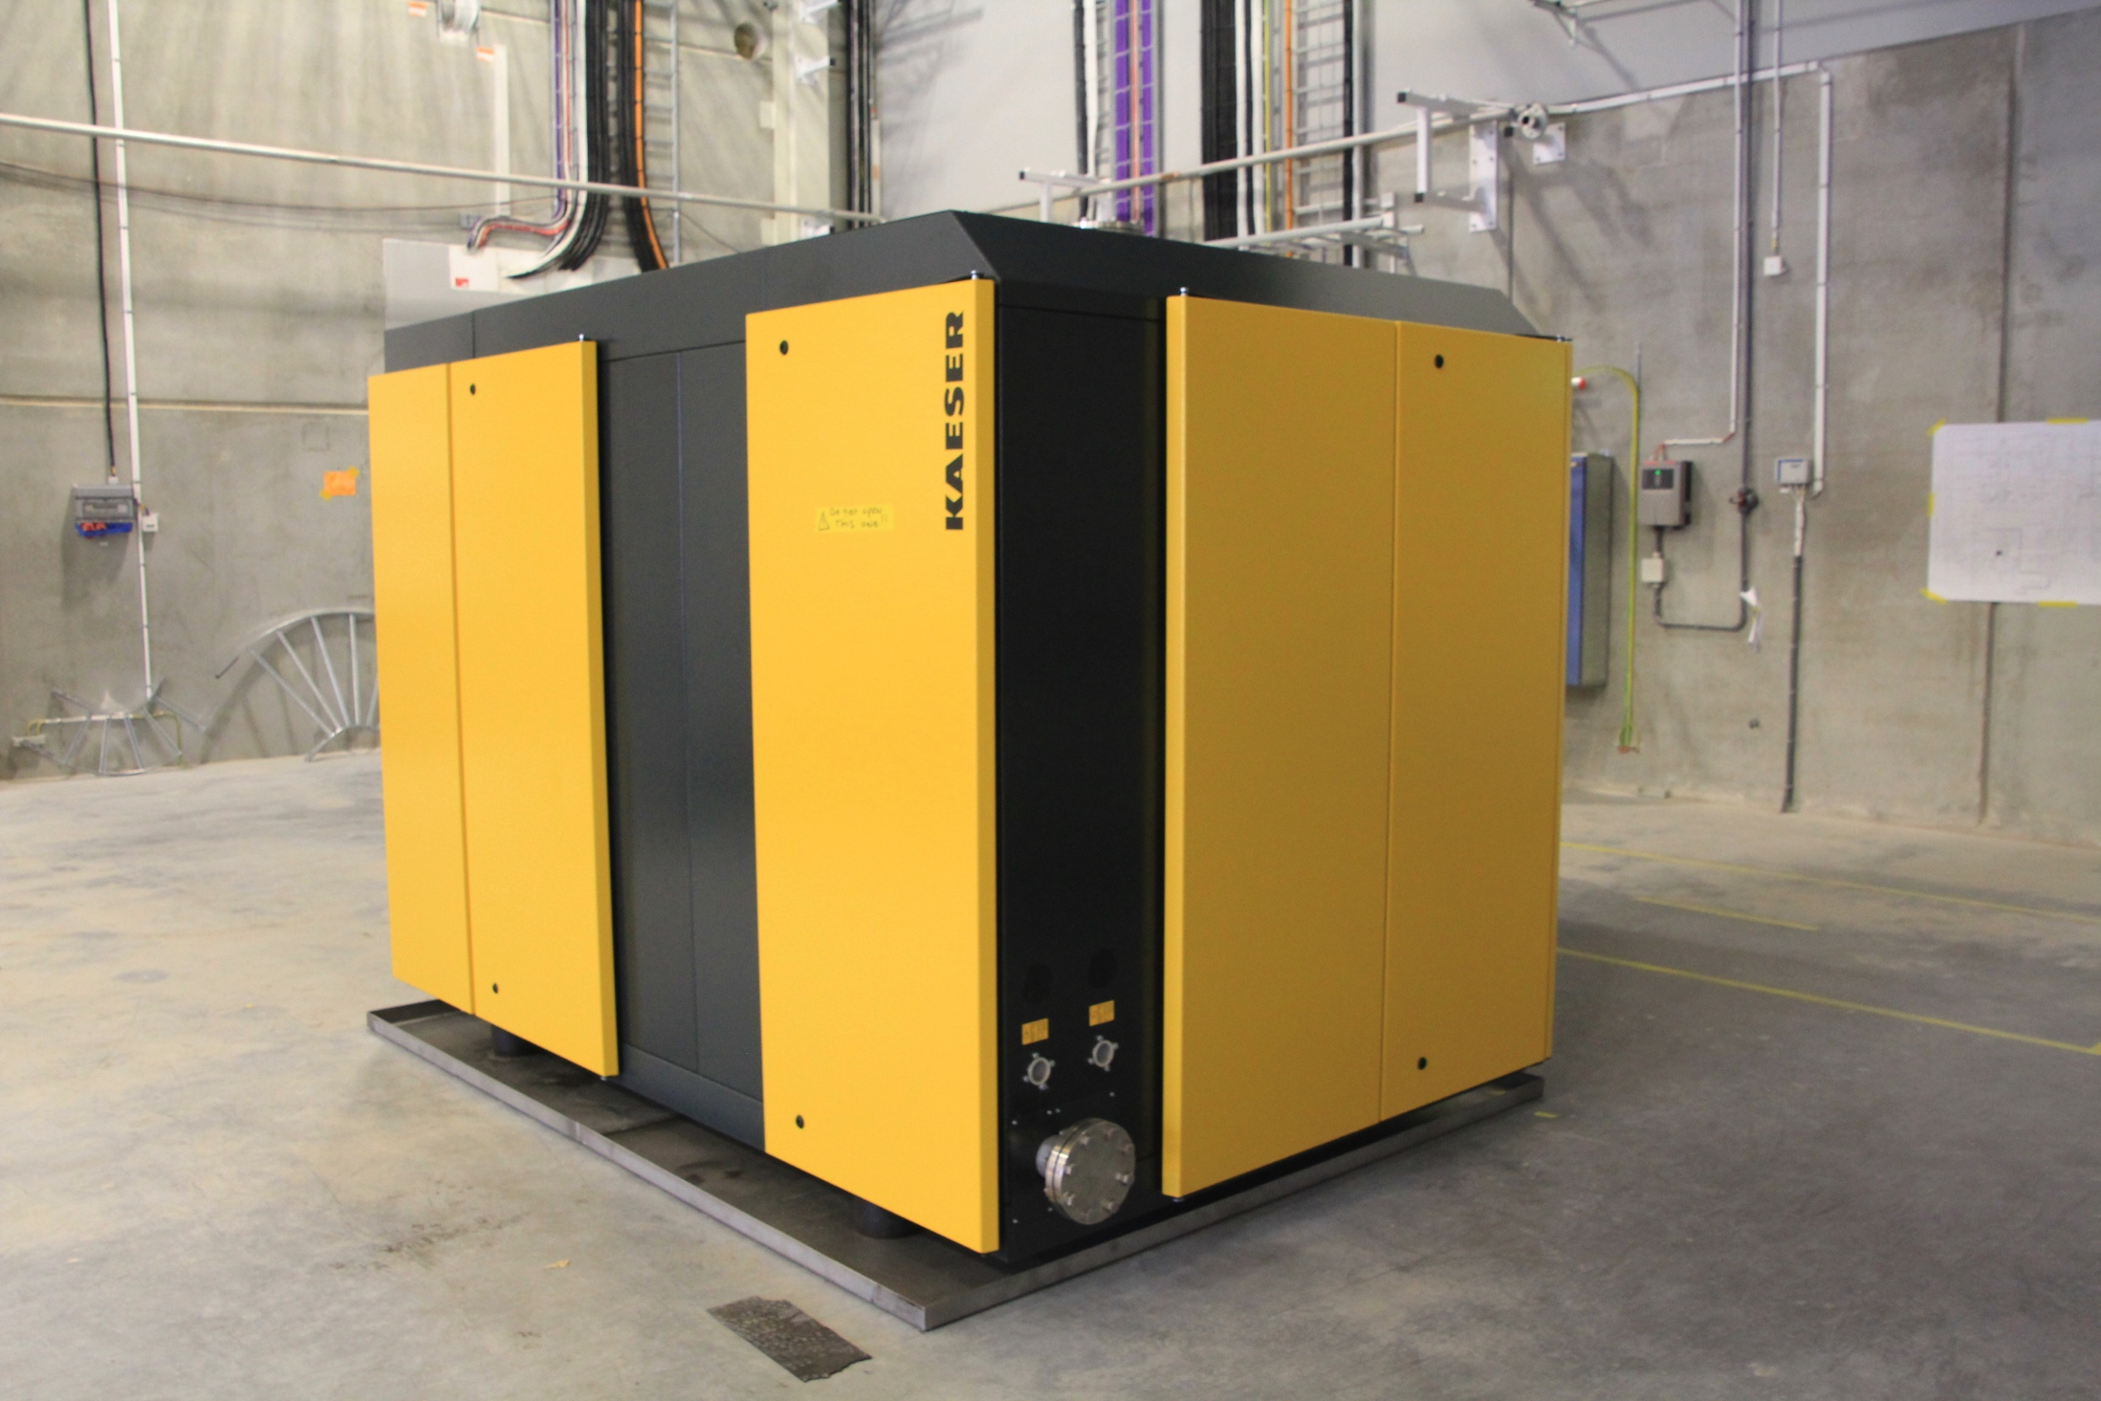
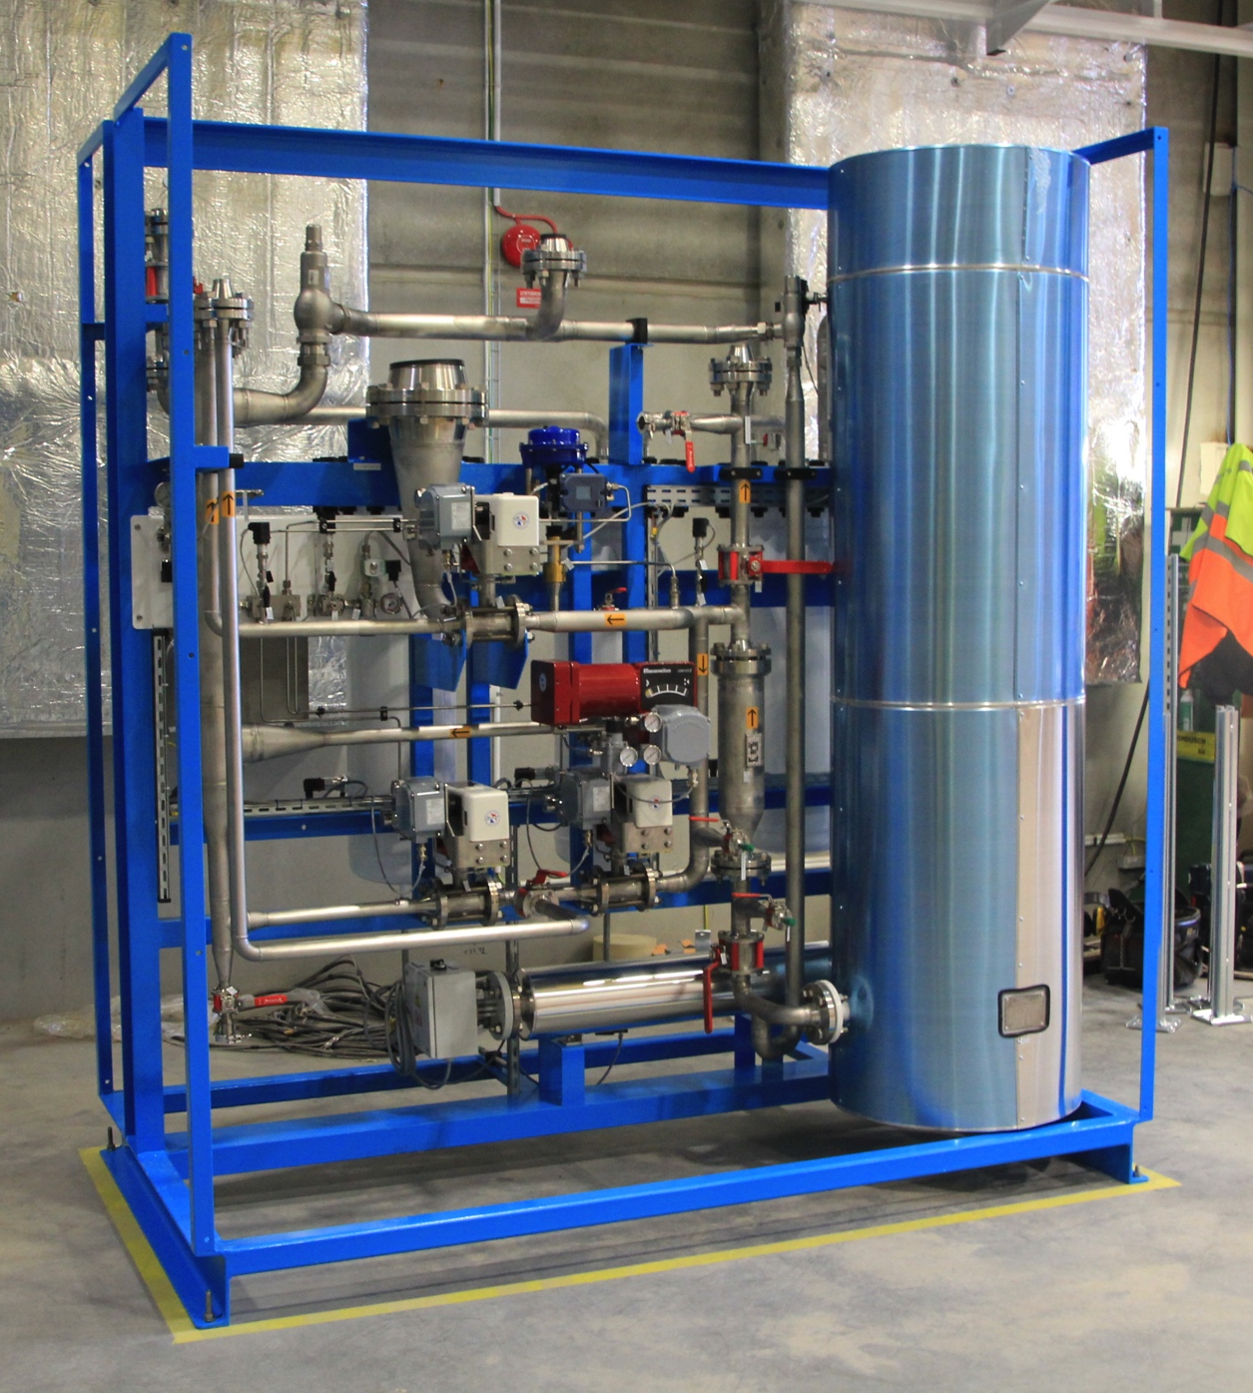
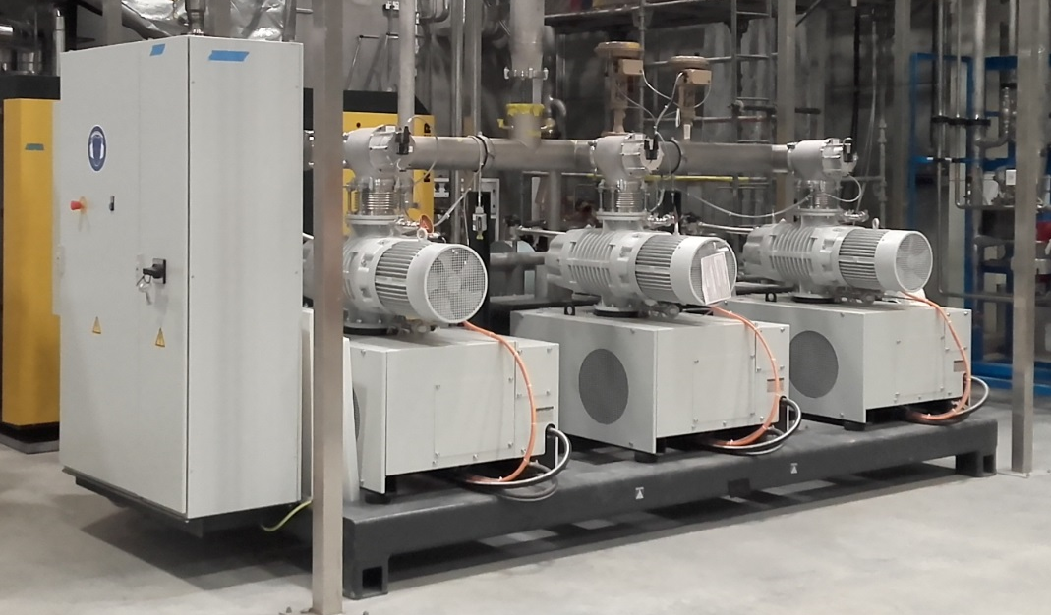
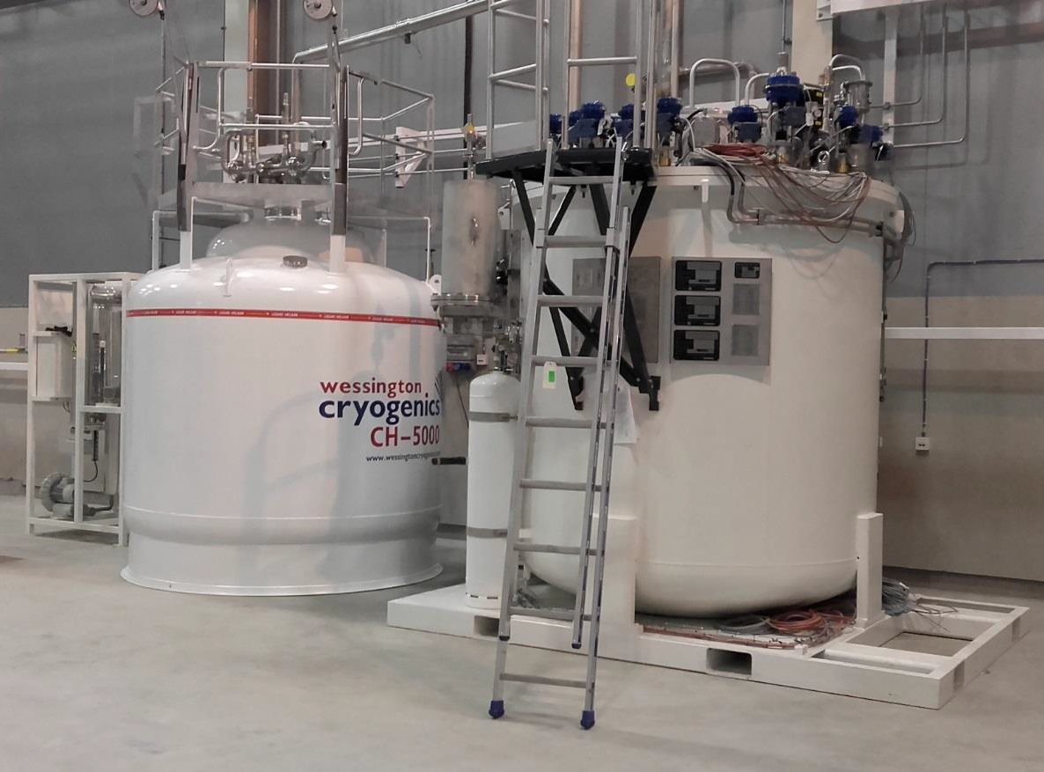
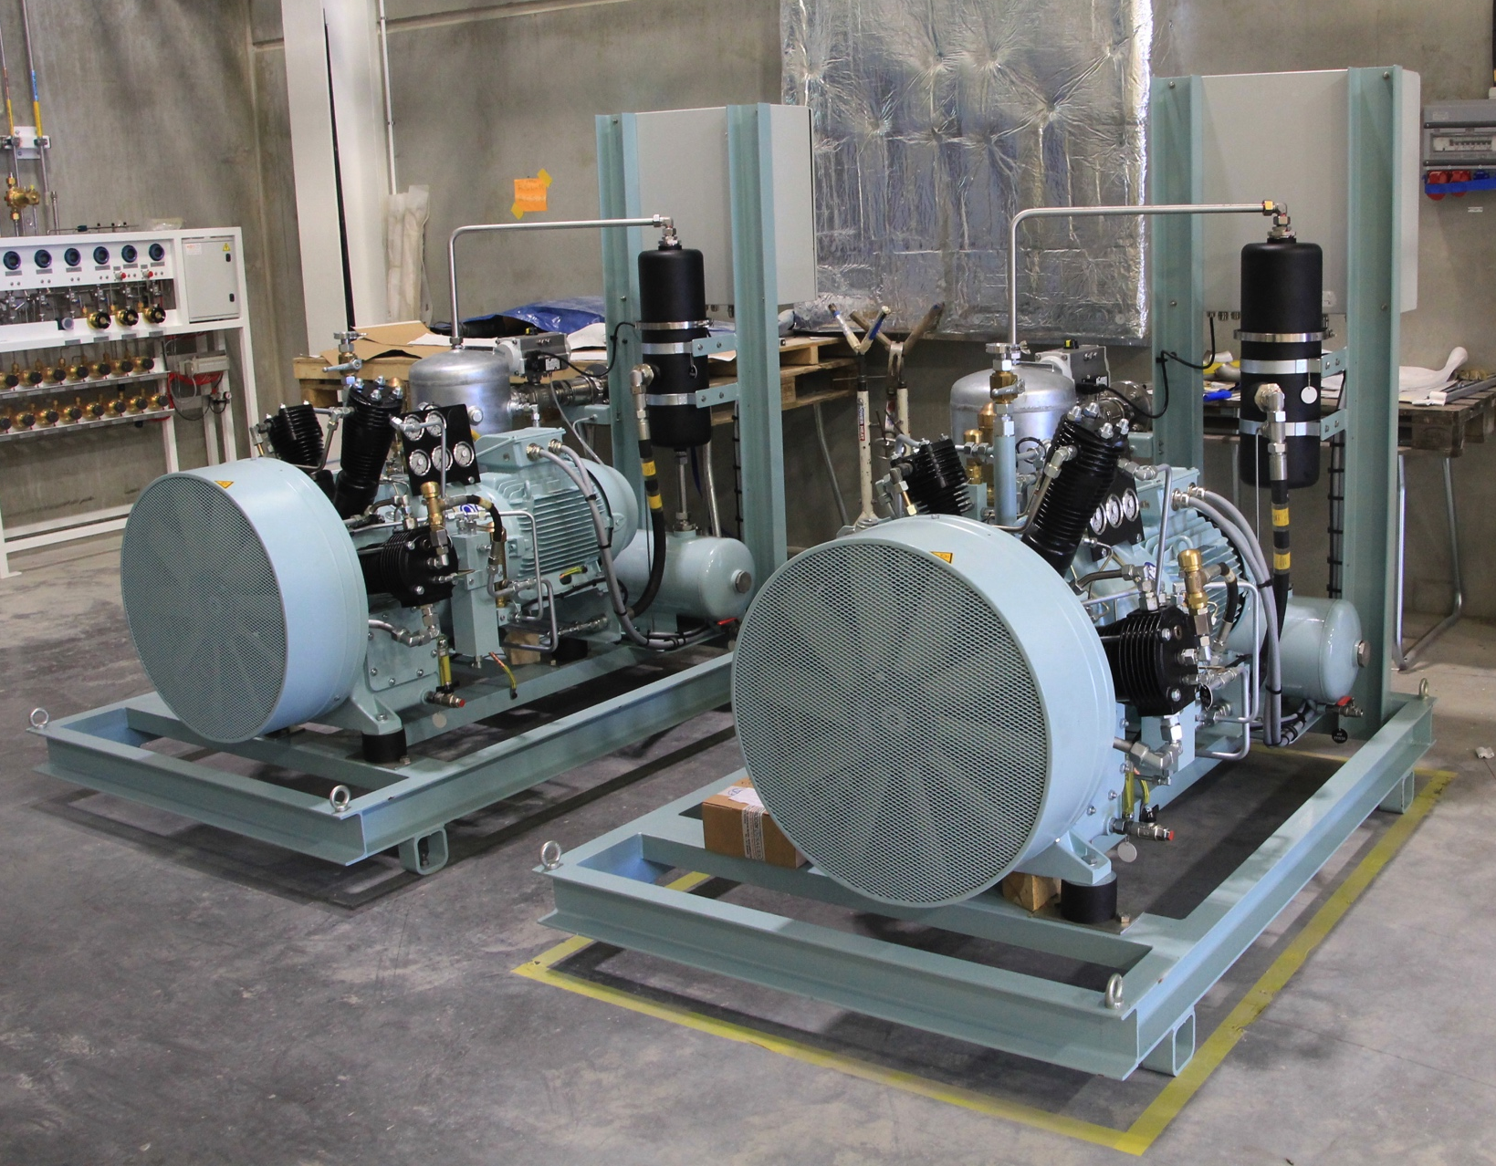
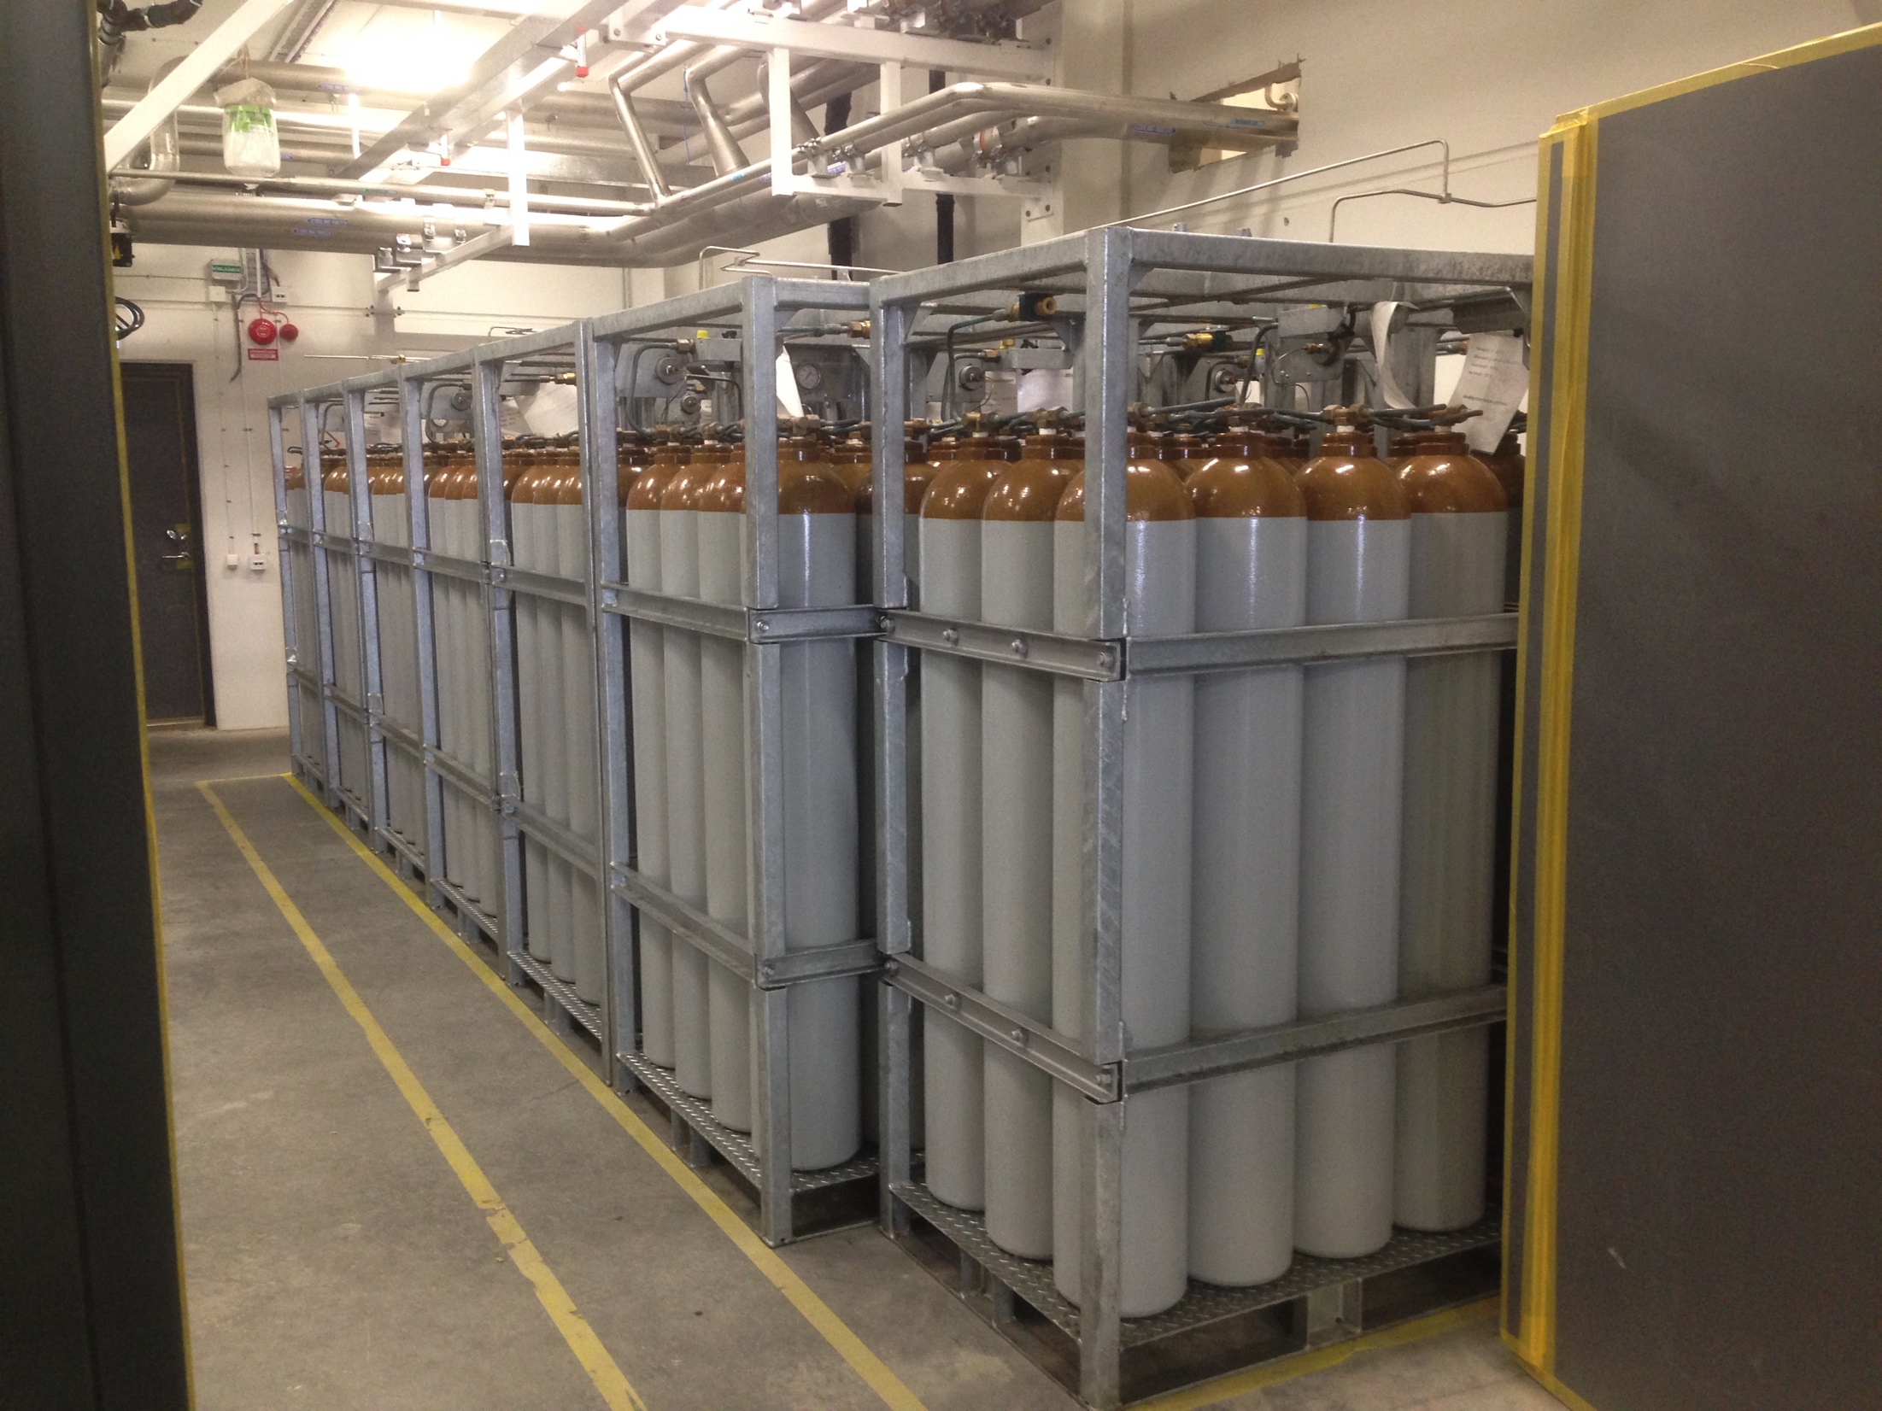
(1.5) Test and Instruments Cryoplant

Slide 10
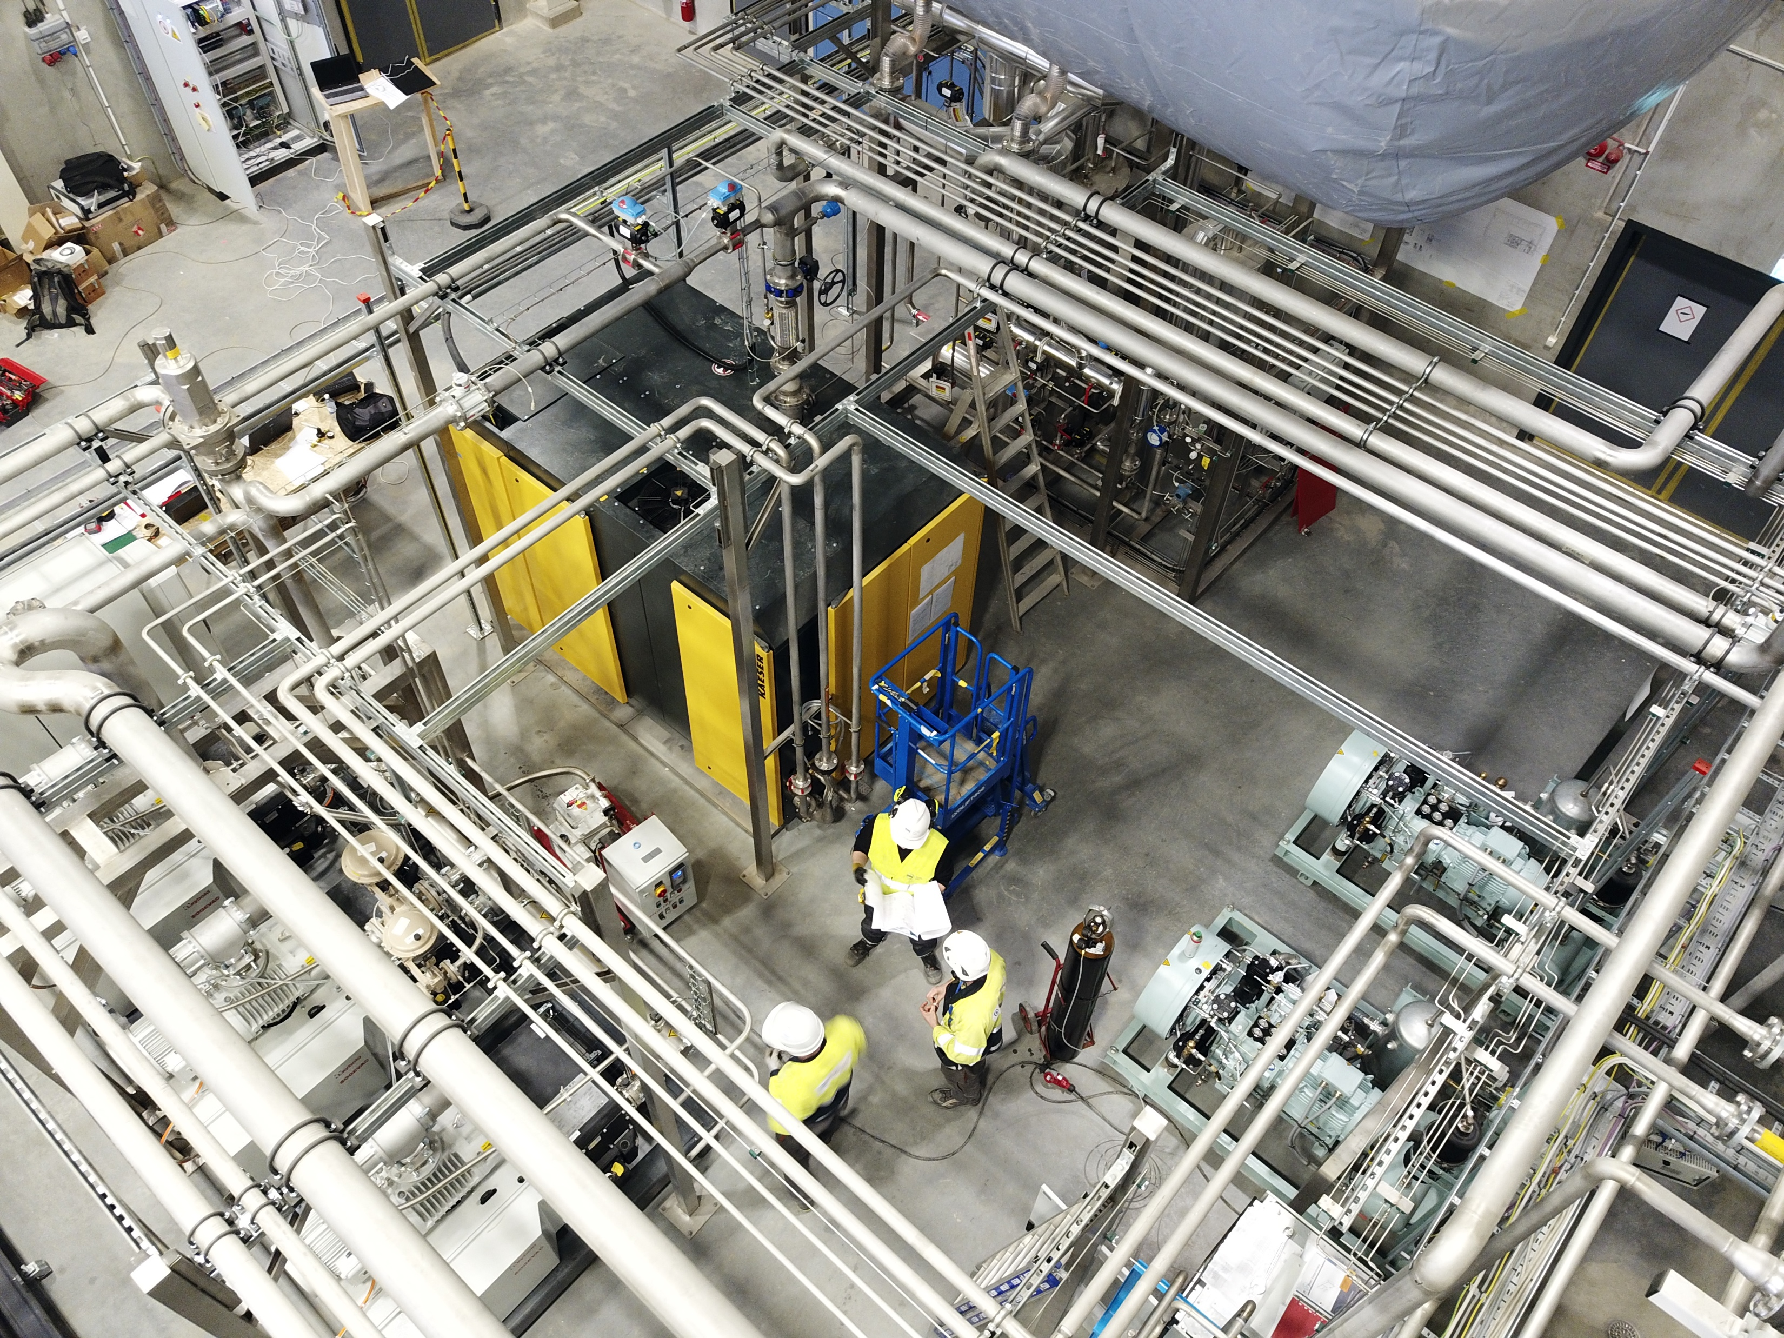
(1.5) Test and Instruments Cryoplant

Slide 11
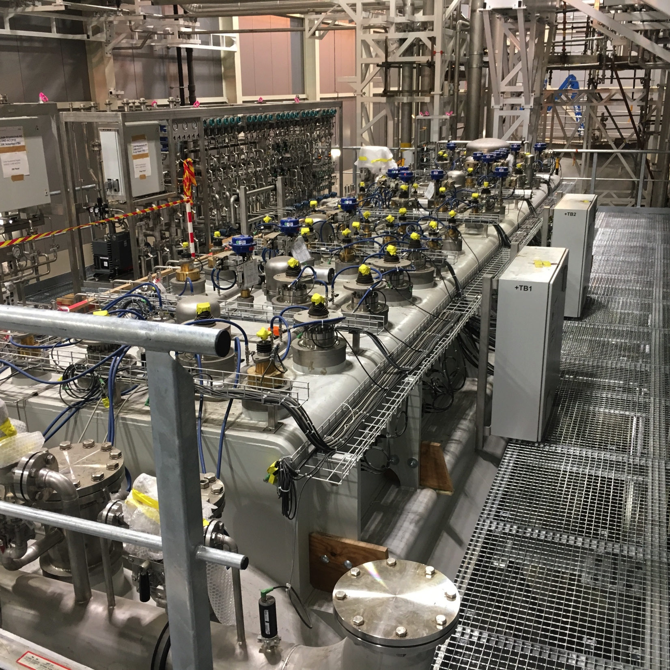
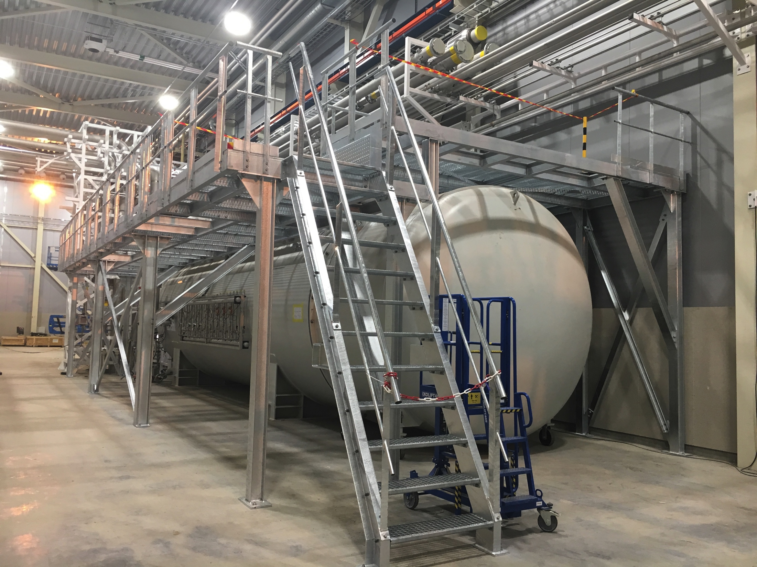
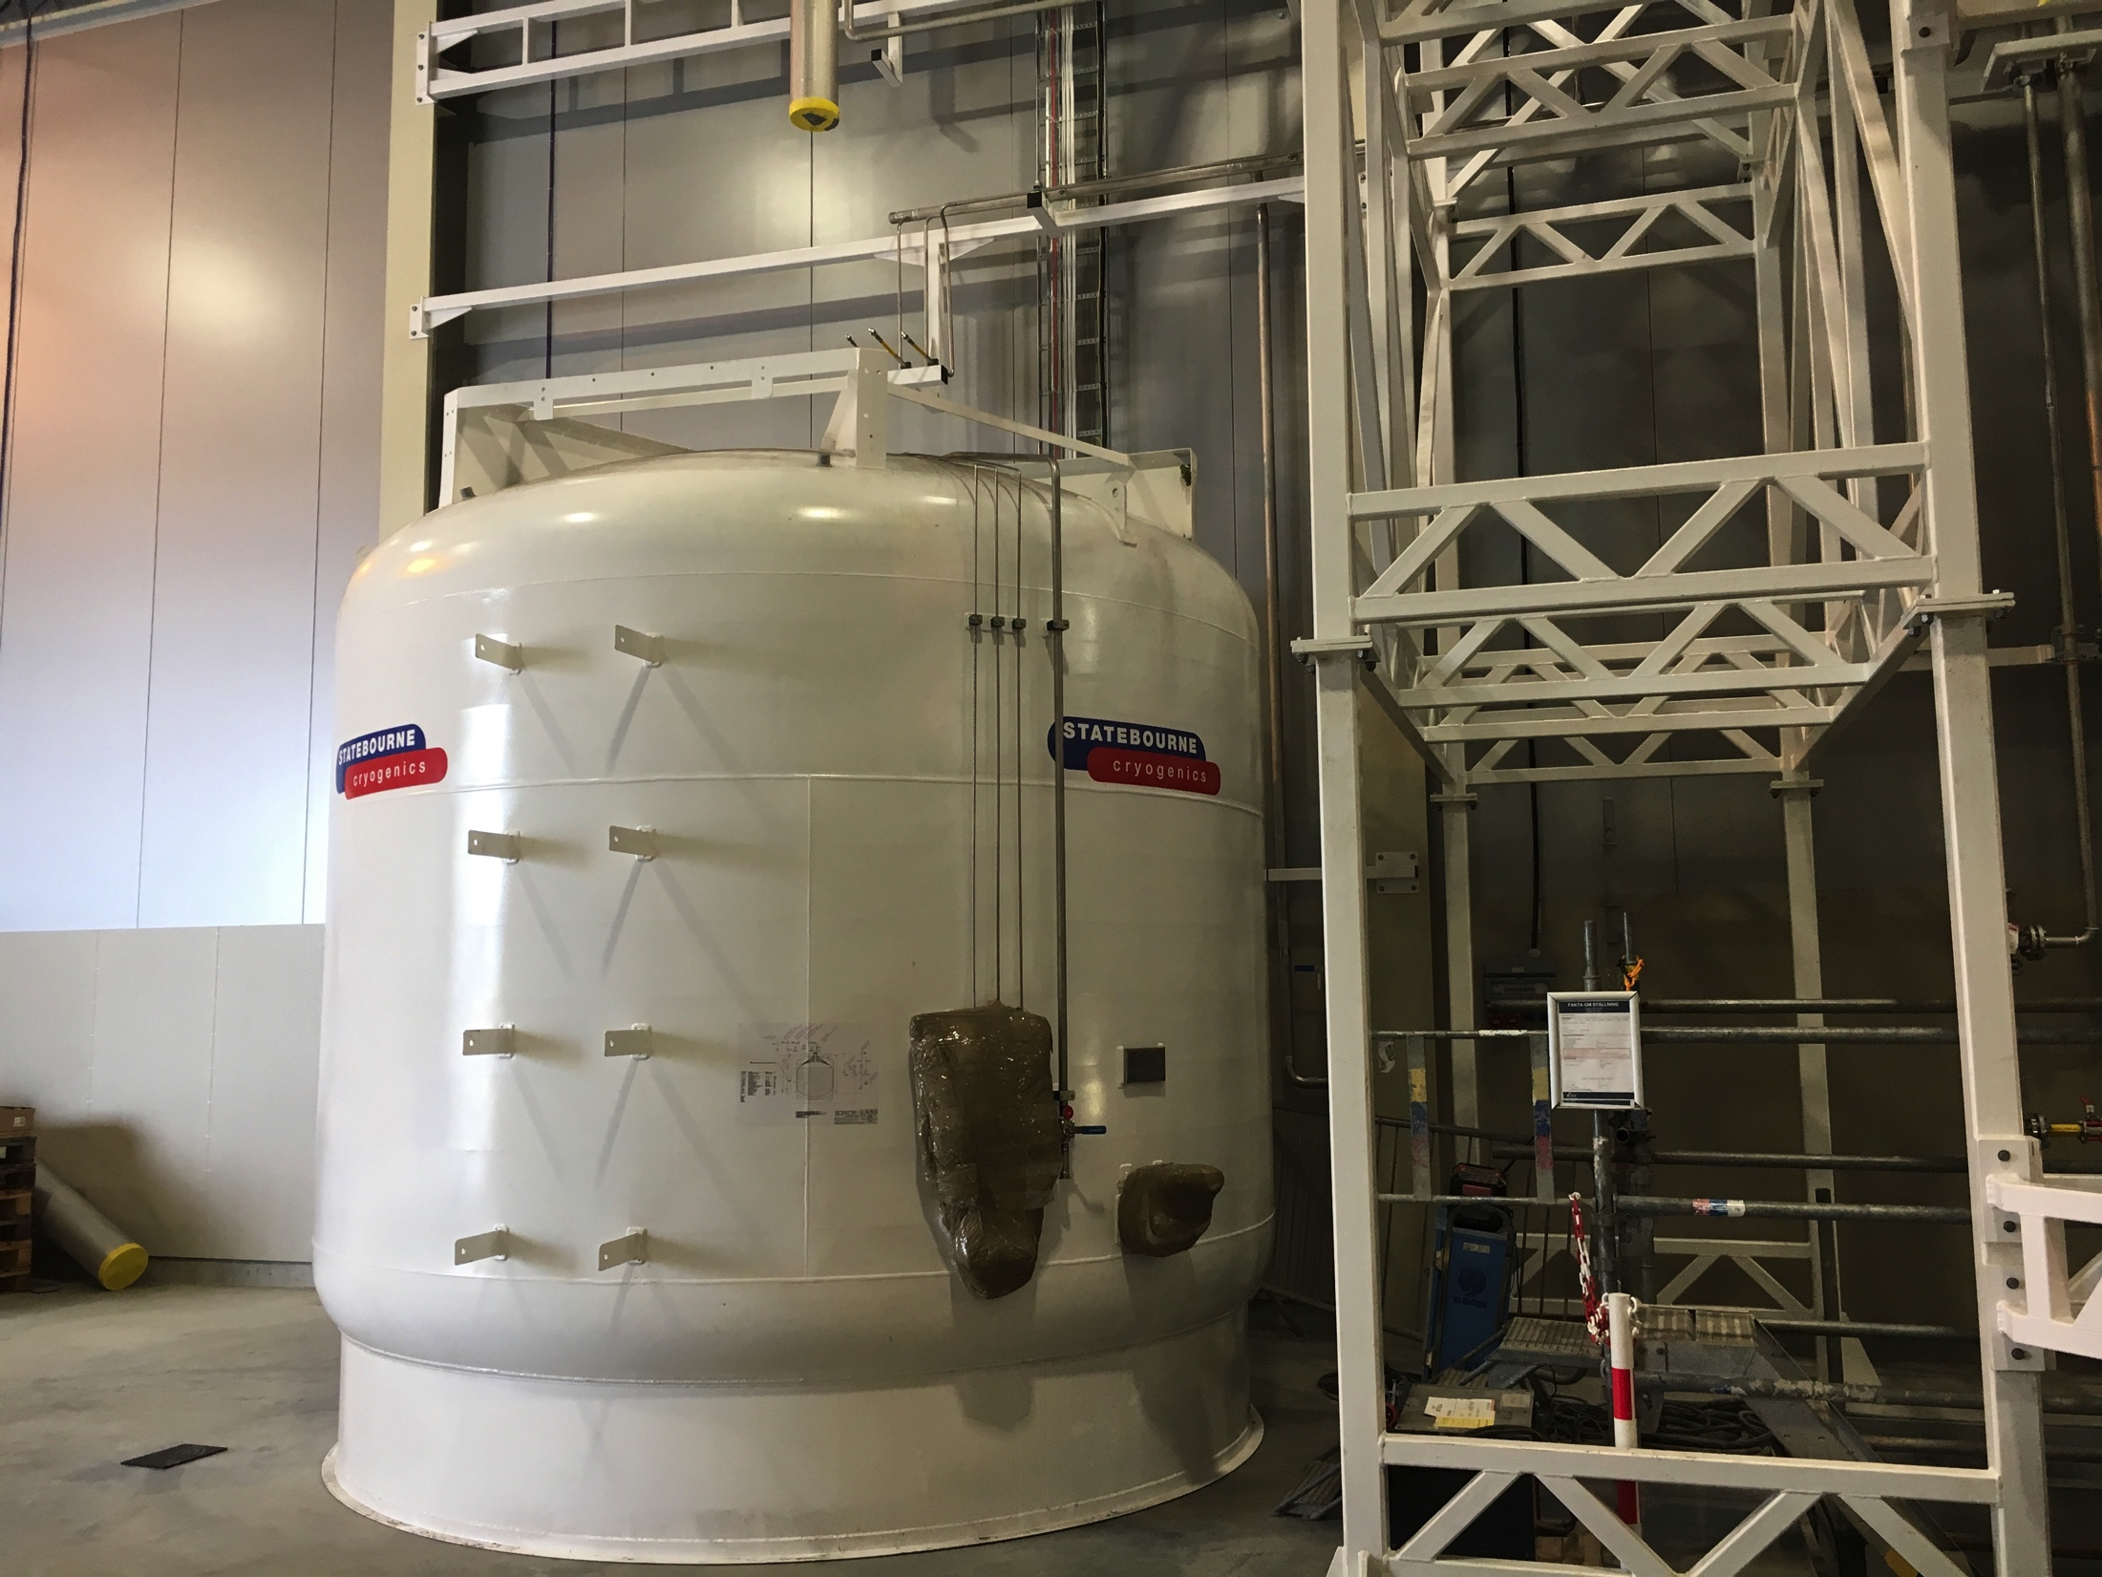
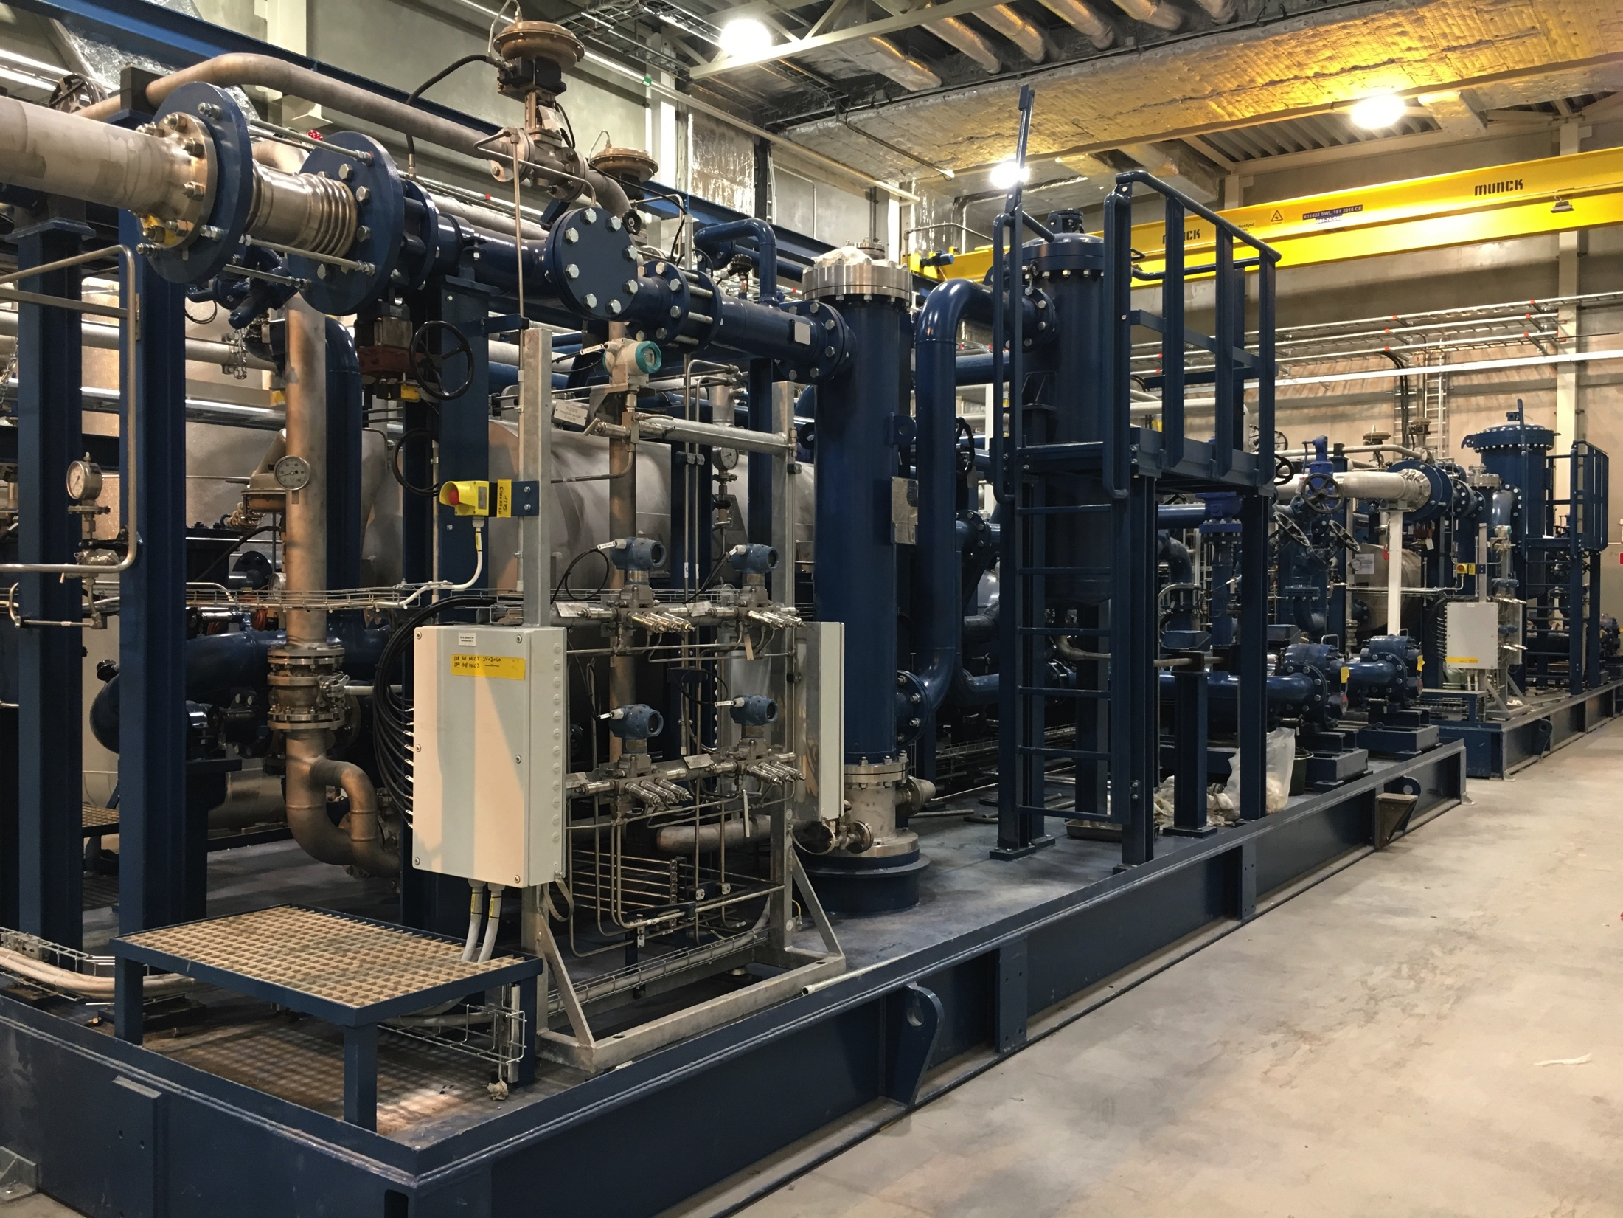
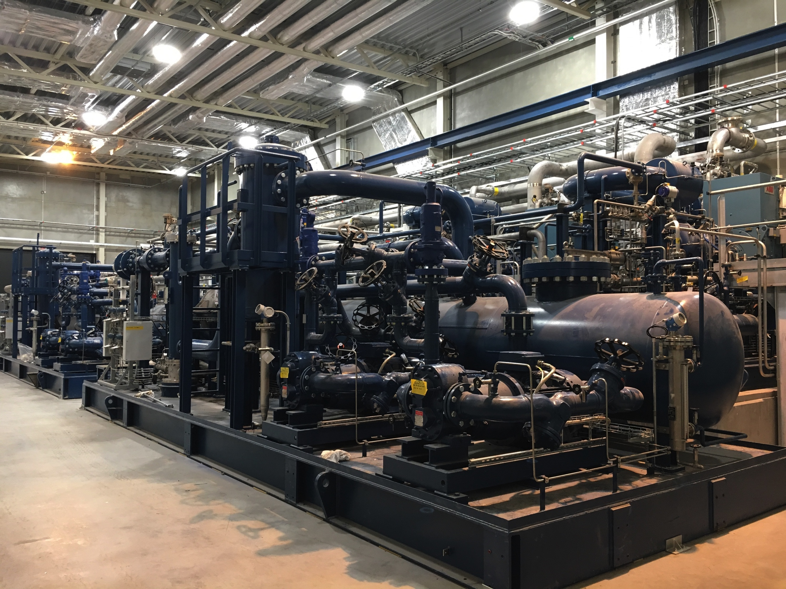
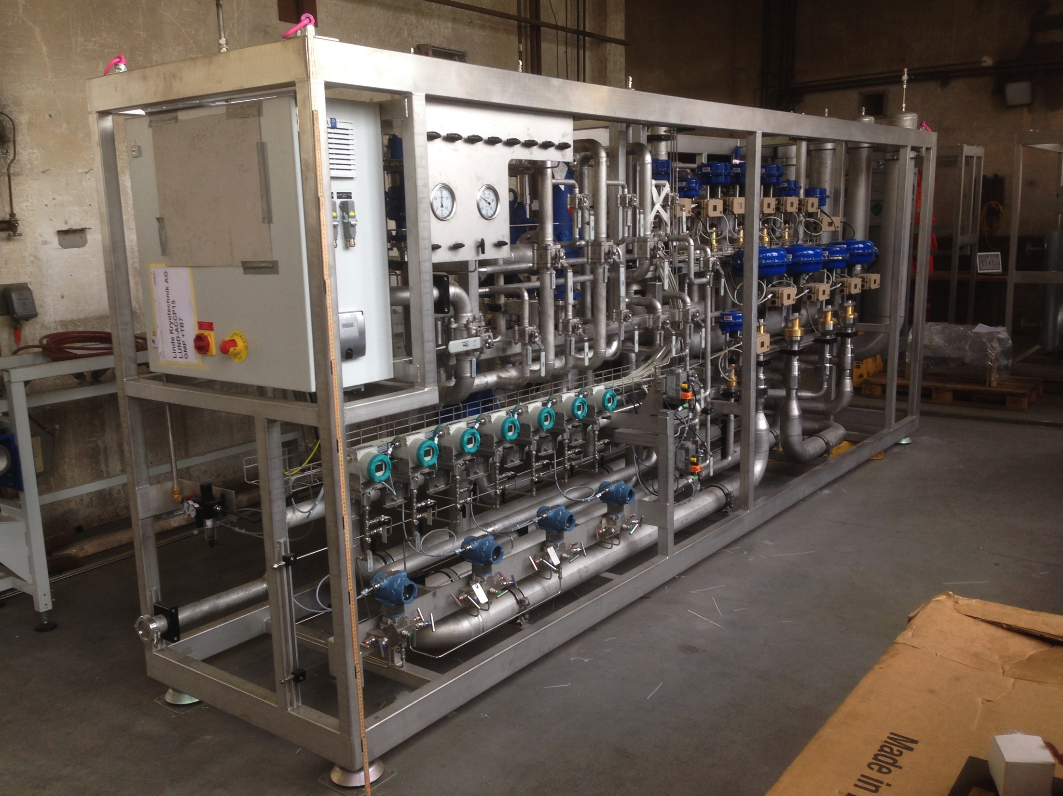
(1.6) Accelerator Cryoplant
REMINDER
June 6, 2018, 16.30 – 16.50:
Progress in the installation of the ESS Accelerator Cryoplant, Xilong Wang

Slide 12
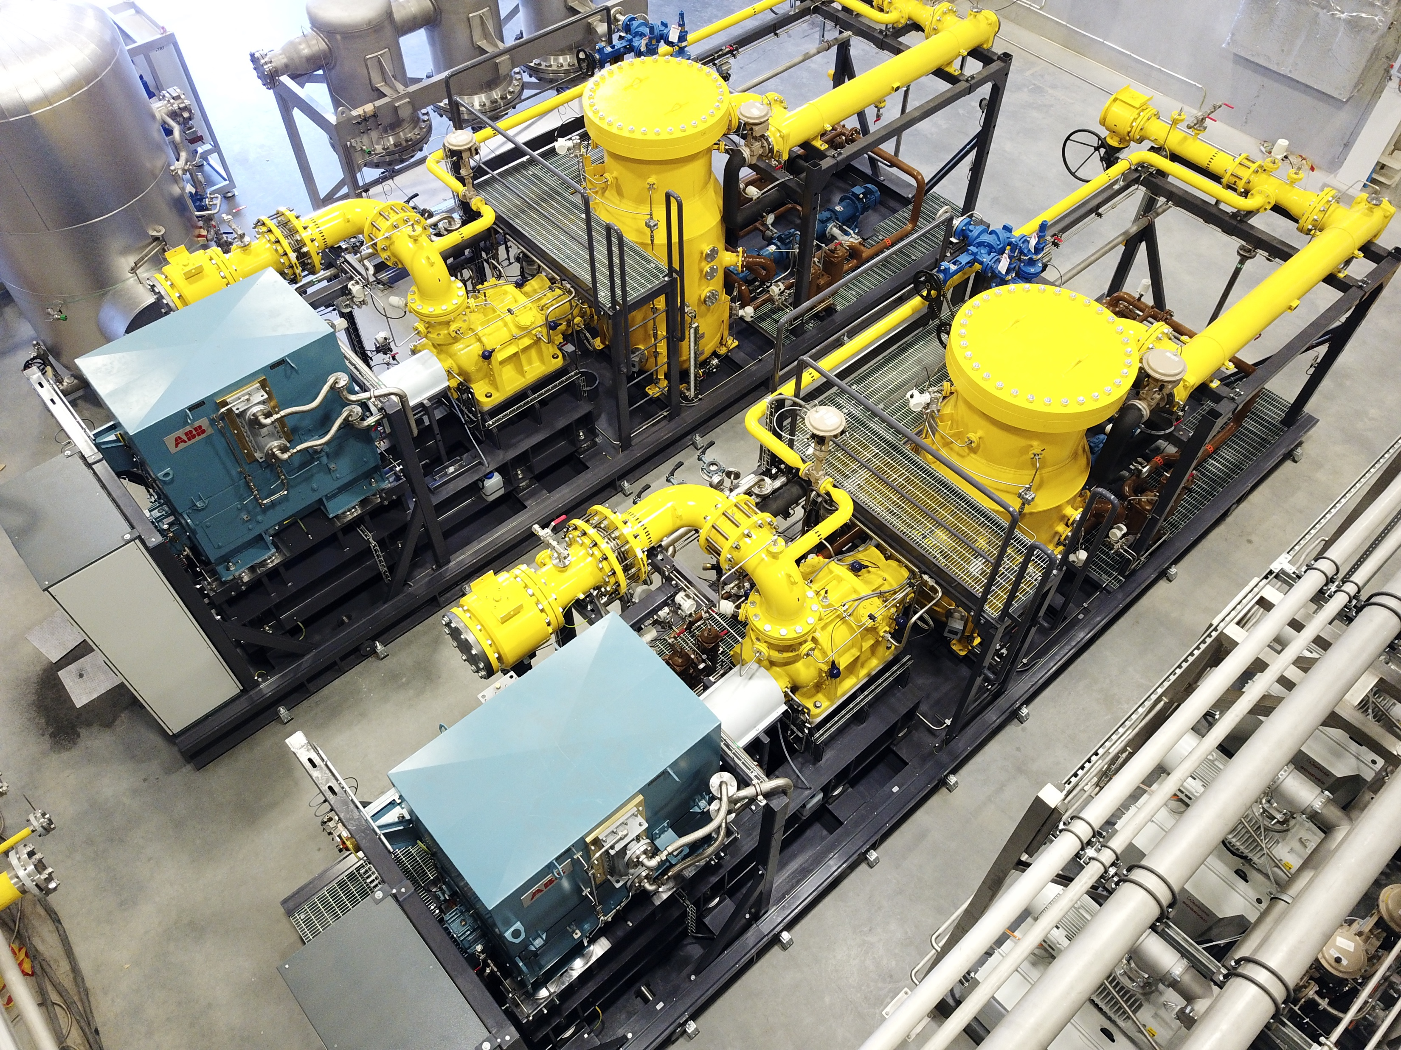
(1.7) Target Moderator Cryoplant

Slide 13
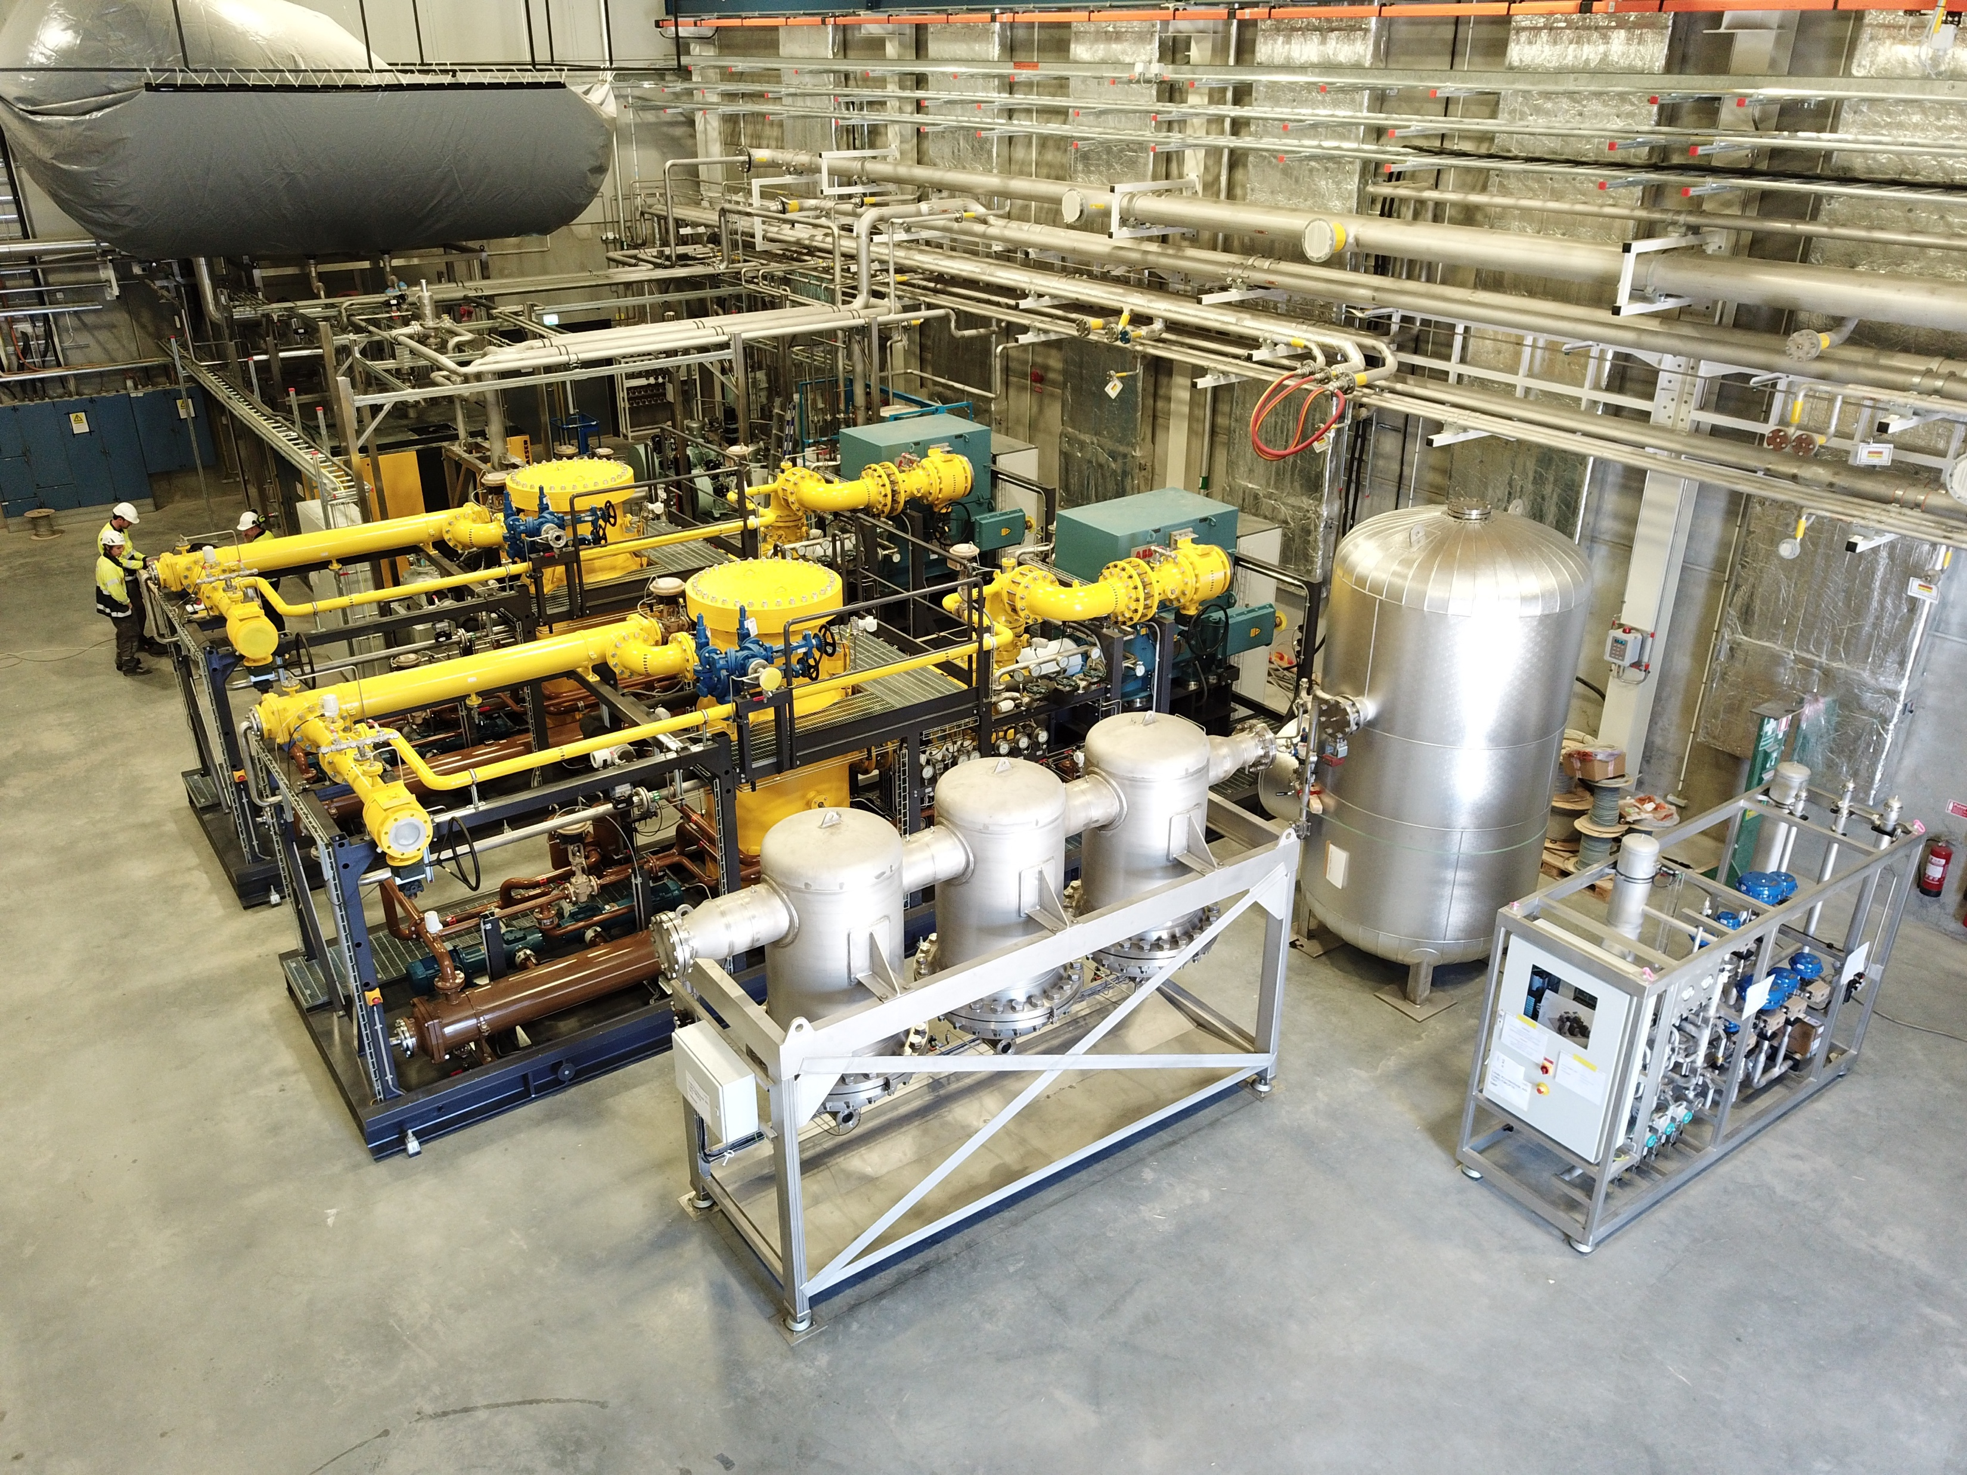
(1.7) Target Moderator Cryoplant

Slide 14
Outline
Cryogenic system overview and status
How do we prepare installation activities
What happens in parallel commissioning
A practical tool to ensure workers safety
Outlook and conclusions

Slide 15
(2.1) Installation preparation
Preparation of Installation Readiness Reviews for all bigger equipment packages / subsystems
Main document: Work and Safety Coordination Plan
Many appendices relating to safety rules, construction site rules, work orders etc.
Installation schedule, Transport and delivery plan
Manpower, tools, equipment, temporary storage planning
Safety training matrix
ESS safety awareness courses
Pre-work visit, ID06, PPE

Slide 16
(2.2) During installation
Update Area Hazard Analysis
Check Job Hazard Analysis / Method statements
Follow Inspection and Test Plan for installation
Weekly / daily work coordination meetings
Safety rounds
Building, site services, utilities coordination

Slide 17


(3) Pre-commissioning activities
Blow down of lines
Evacuation and pressure/purge cycles
Oil adsorber heating
Cold adsorber activiation header
Cooling water flushing
Valve check-out / instrument air
Helium filling
Etc.

Slide 18
Outline
Cryogenic system overview and status
How do we prepare installation activities
What happens in parallel commissioning
A practical tool to ensure workers safety
Outlook and conclusions

Slide 19
(4.1) Integrated P&ID

Slide 20
(4.1) P&IDs and derivates
Integrated P&ID of entire installation
Specific reduced P&IDs for common interfaces
  Cooling water
  Instrument air
  Nitrogen
  Helium buffer lines
  Safety relief headers and helium recovery
One special interface connecting ACCP and TICP LP
Attention to inside-skid interfaces

Slide 21

(4.2) Creating a database
Piping List
Interface List
Valve
List
Instrument List
…

Slide 22
(4.3) Defining energisation procedure
Operator
Procedure for pressurization of cryogenics sub-system(s)
Make a request online for pressurization [1]
Cryogenics Technician
Check with the affected sub-system owner(s) that the sub-system(s) can be pressurized (no on-going work)
Sub-system owners affected
Approval given to the CT to pressurize the sub-system(s)
Cryogenics Technician
Implementation of safety measures (e.g. marking, signposting, valve blocking, etc.)
Cryogenics Technician
Check that the sub-system(s) is(are) safe before pressurization
Cryogenics Technician
The sub-system(s) is(are) pressurized after final approval from the CT
Update of the cryogenic system database
Information sent to the requester and sub-system owner(s) that the system(s) is(are) pressurized

Slide 23
(4.3) Defining de-energisation procedure
Operator
Procedure for de-pressurization of cryogenics sub-system(s)
Make a request online for de-pressurization [1]
Job description
Sub-system(s) affected
Work duration
Information sent to the CT
Cryogenics Technician
CT informs the affected sub-system owner(s)
Sub-system owner(s) affected
Approval given to the CT to de-pressurize the sub-system(s)
Cryogenics Technician
The sub-system(s) is(are) ready to be de-pressurized
Cryogenics Technician
The sub-system(s) is(are) de-pressurized after final approval from the CT
Cryogenics Technician
Implementation of safety measures (e.g. marking, signposting, valve blocking, etc.)
Update of the cryogenics system database [2]
Information sent to the requester and sub-system owner(s) that the sub-system(s) is(are) de-pressurized

Slide 24
(4.4) Realisation of procedure
Defining roles
  Sub-system owners and deputies
  Requesters
  Gate keeper and deputy
Use Atlassian JIRA as database and request handling tool
Continuously train and remind partners to follow procedure REGLIGIOUSLY

Slide 25
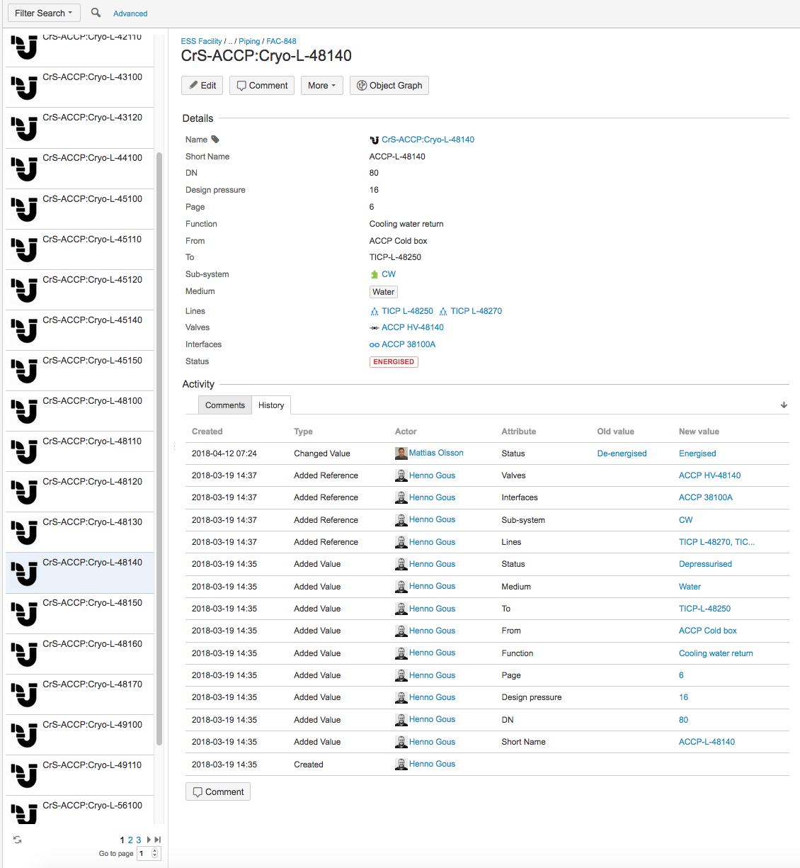
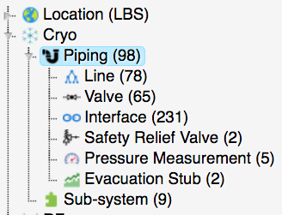
(4.5) Database of piping system

Slide 26
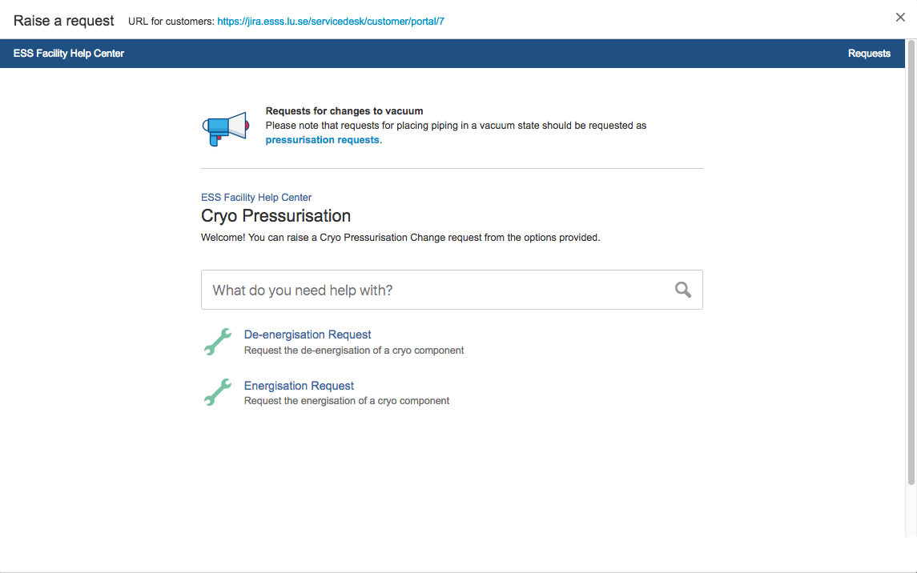
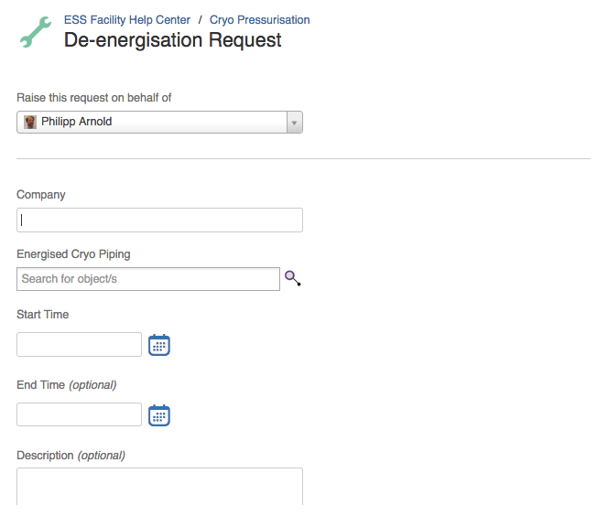
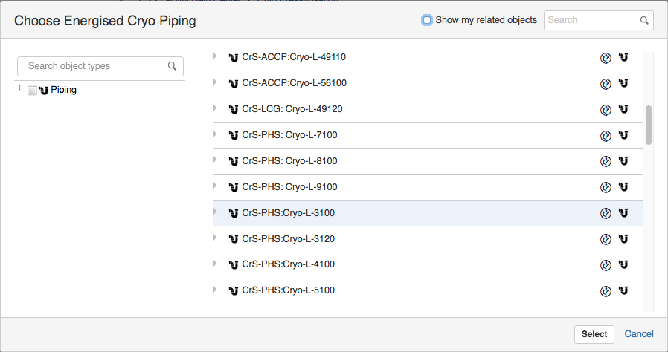
(4.6) Realisation de-energisation request
After request is finalised the gate keeper is informed by automatic email notification

Slide 27
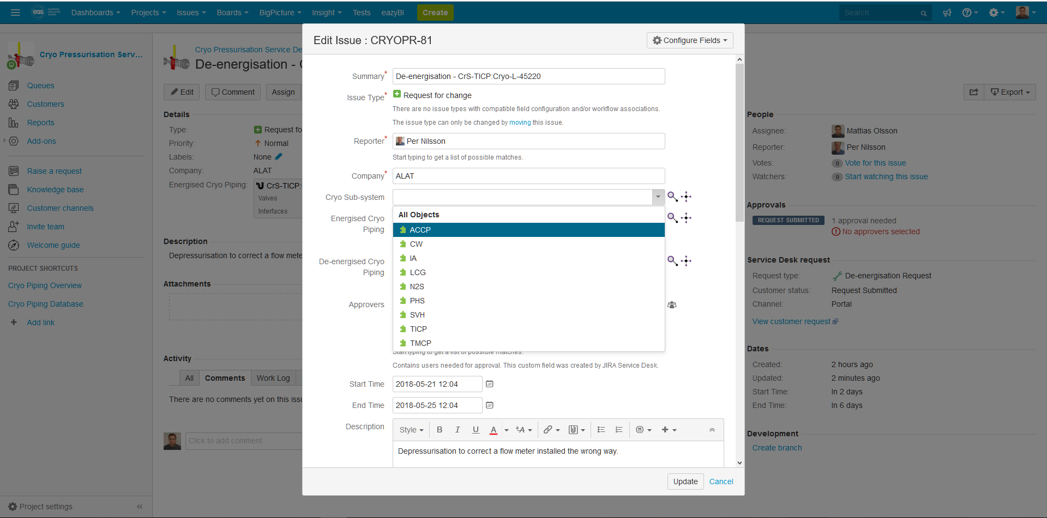
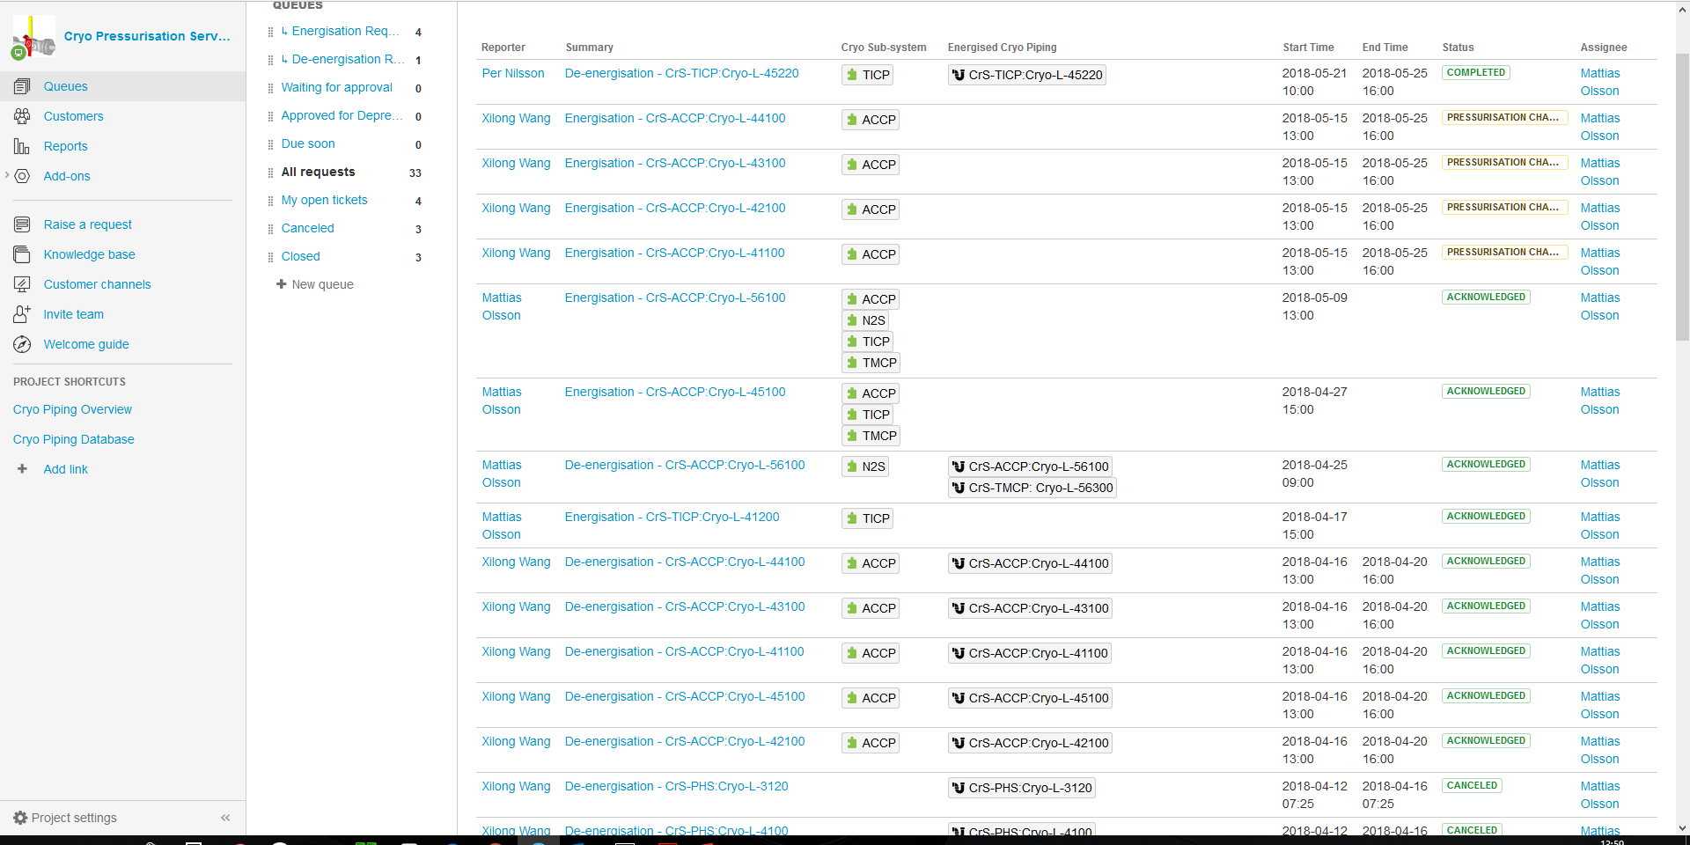
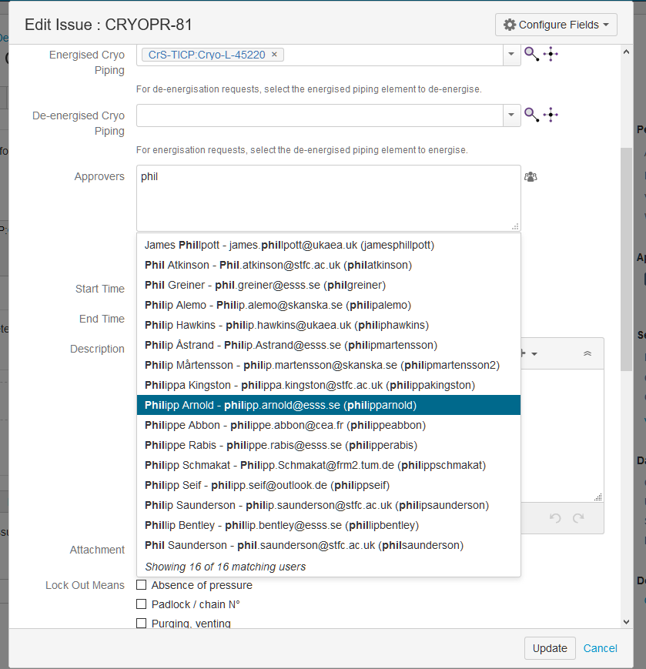
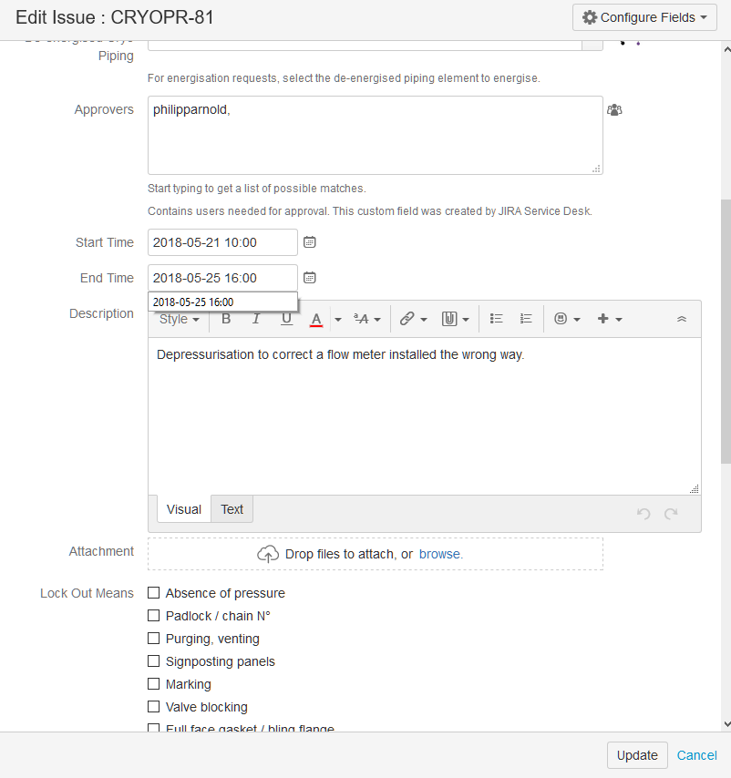
(4.7) Gate keeper adds details to request

Slide 28
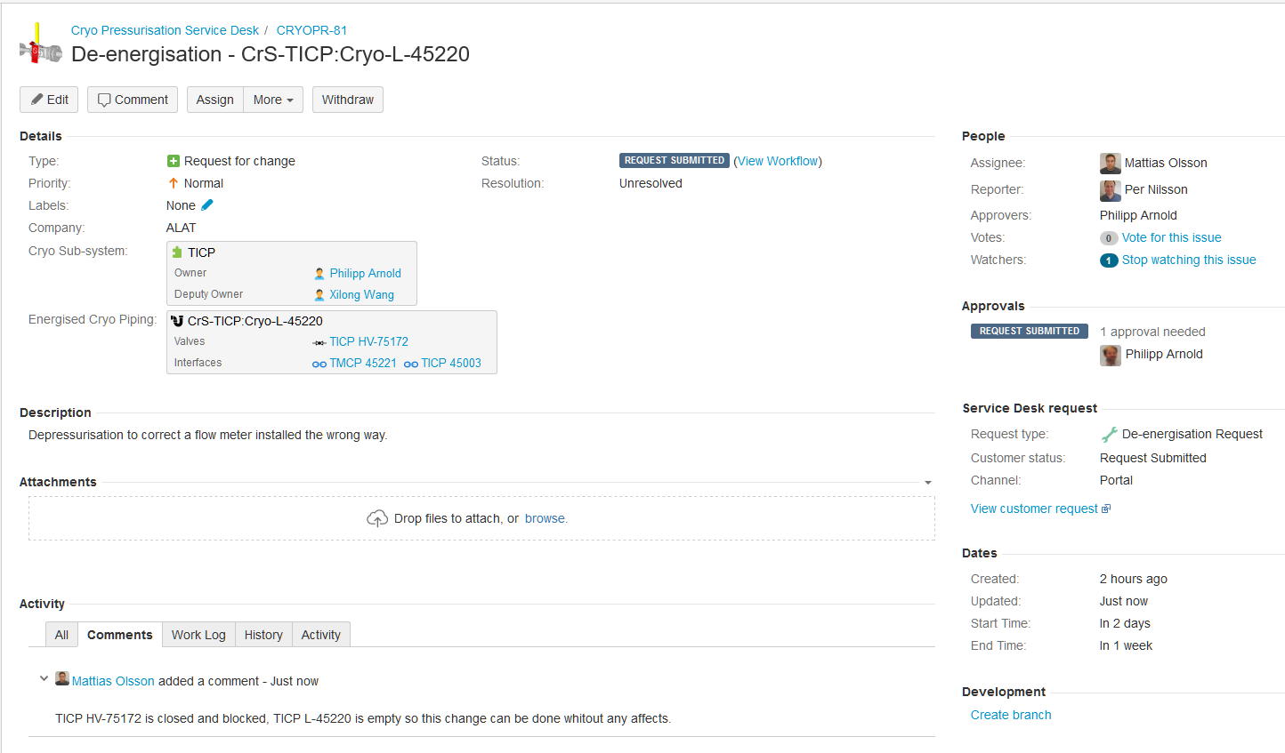
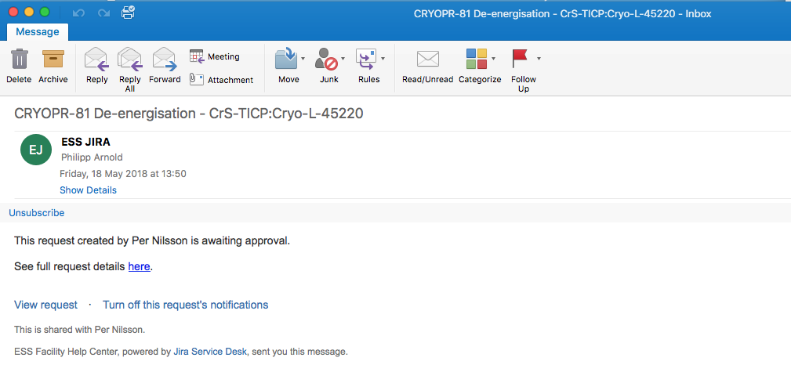
(4.8) Gate keeper informs approver(s)

Slide 29
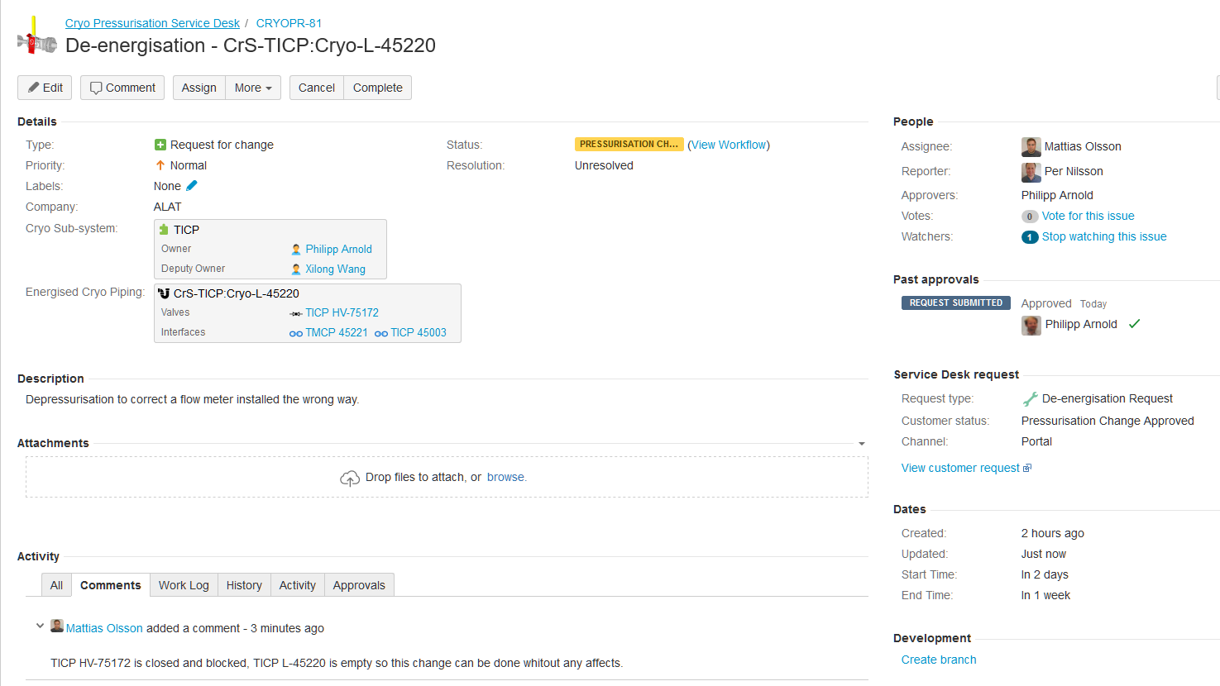
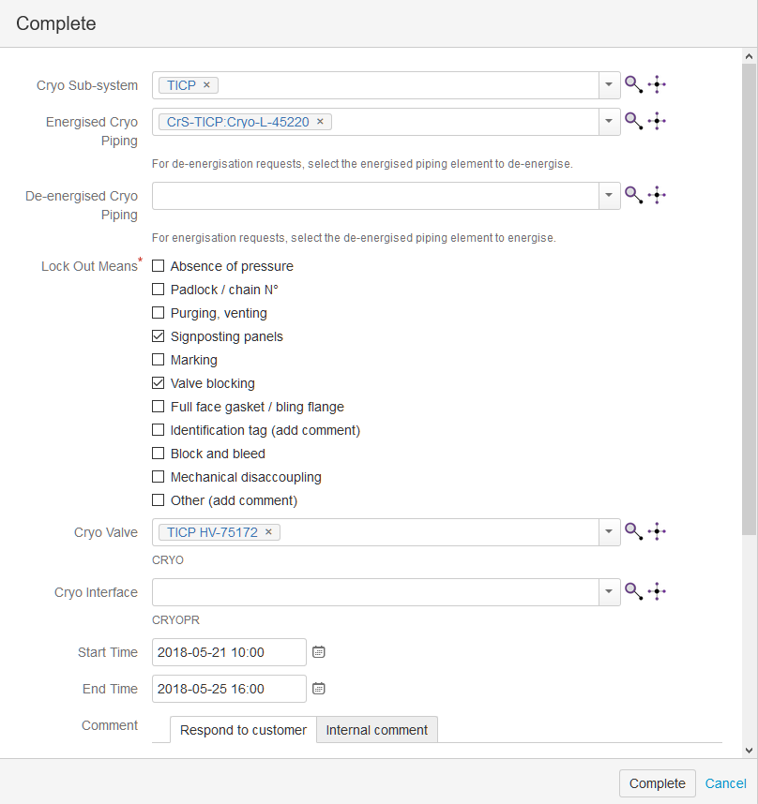
(4.9) Gate keeper prepares de- energisation

Slide 30
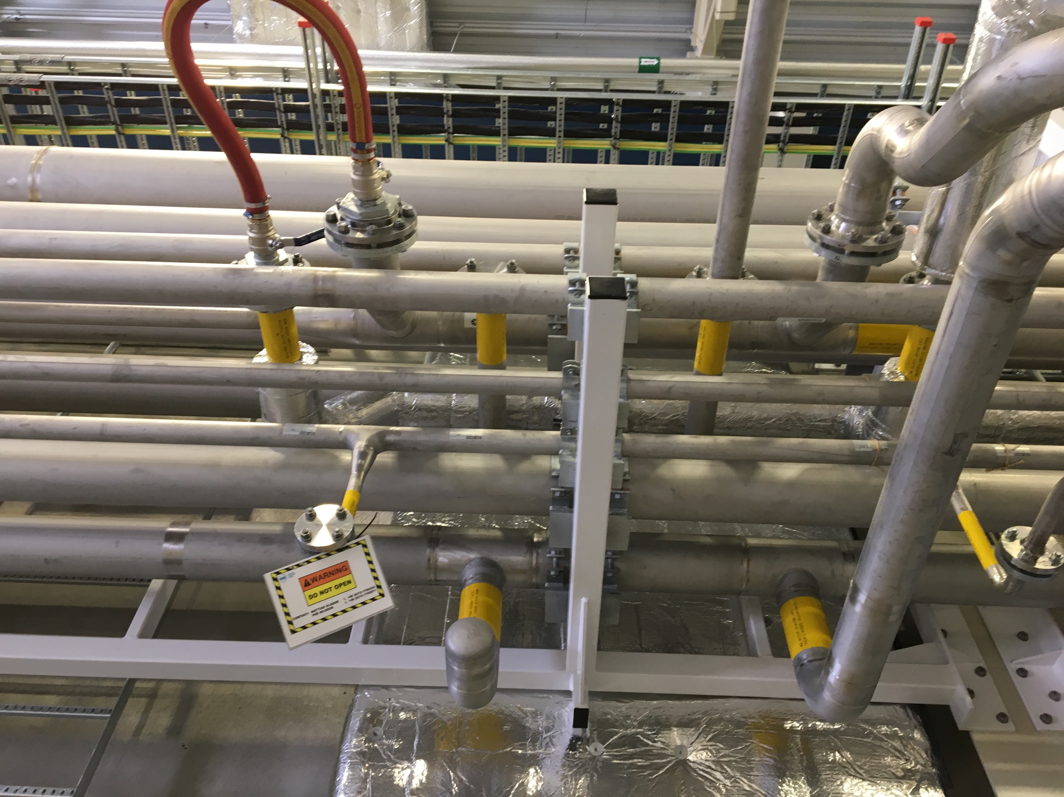
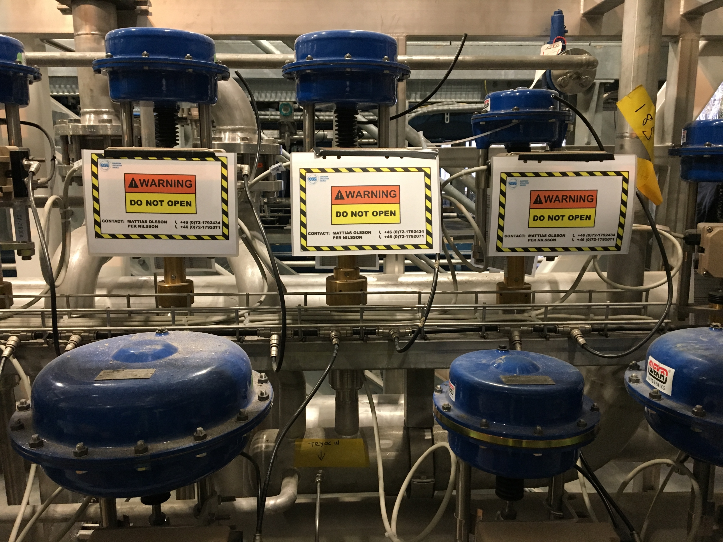
(4.9) Procedure in practice
Inform everybody involved
Mount warning signs
Block valves
Etc.

Slide 31
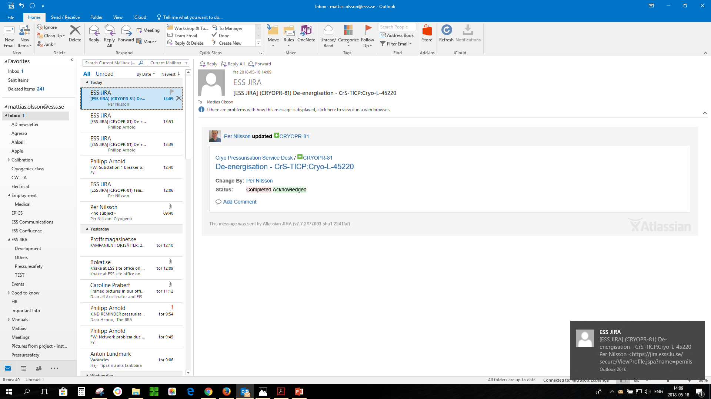
(4.10) De-energisation performed and acknowledged

Slide 32
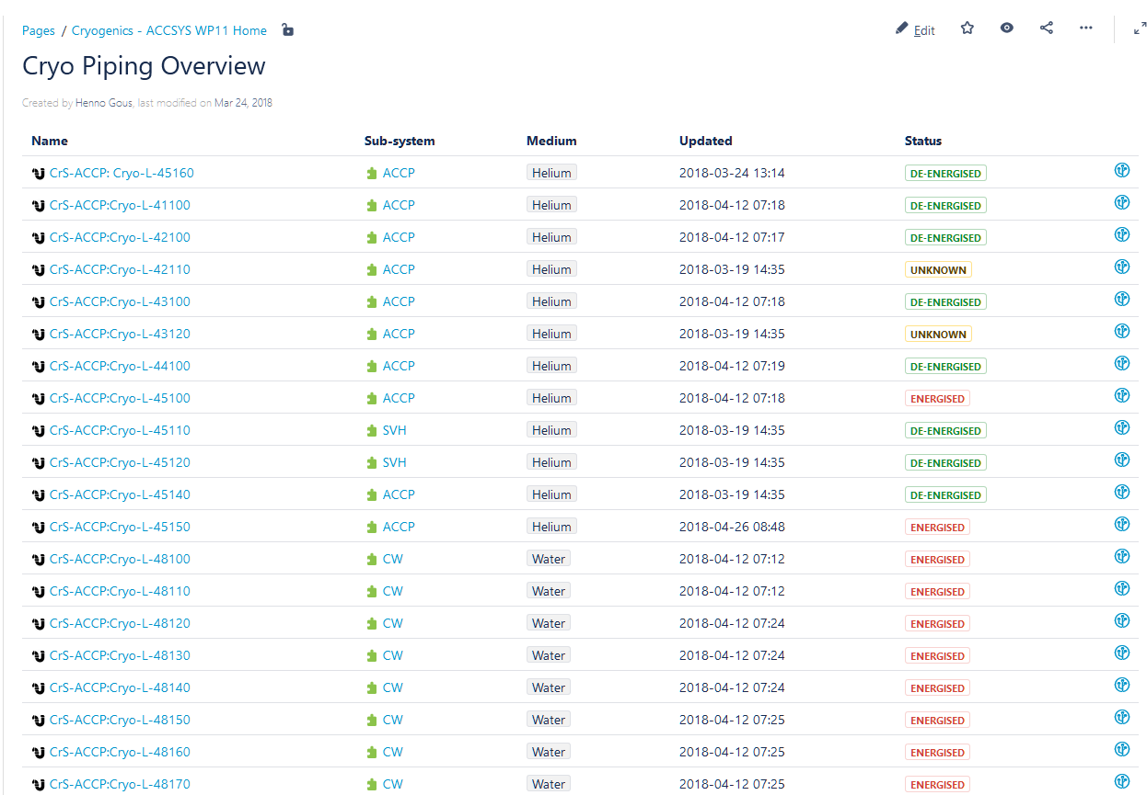
(4.11) Piping status overview

Slide 33
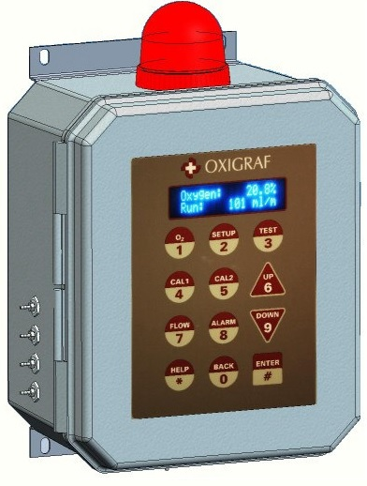
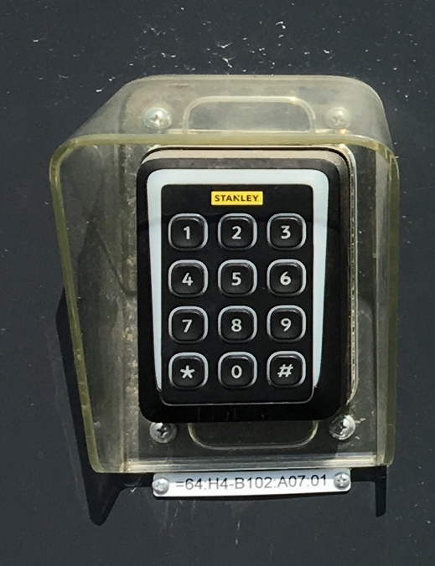
(4.12) ODH and access control
Access control by information
Personal ODH monitors
Permanent ODH monitors
Access control with card readers

Slide 34
Outline
Cryogenic system overview and status
How do we prepare installation activities
What happens in parallel commissioning
A practical tool to ensure workers safety
Outlook and conclusions

Slide 35
(5.1) What next
Include measurements, evacuation and purge points in database
Include circuits inside skids in database
Transform JIRA tool from documentation system to work order system
Use statistical tools offered by JIRA
Connect permanent ODH monitors to PPS and backed-up power
Intelligent card reader system

Slide 36

(5.2) Summary
Good progress on cryogenic systems installation at ESS
Managing parallel installation and (pre-) commissioning activities is challenging
Personal safety is absolute key
Entire team to be involved early in system interconnections and procedures
Questions?

